Slide 1
Electrical Flows, Laplacian Systems, and Faster Approximation of Maximum Flow in Undirected Graphs
Speaker: David Wajc
Talk given as part of:
Technion Seminar on Polynomial-Time Algorithms for Linear Programming (097238)
Notes:
Talk based on the paper of the same name, by Paul Crisitiano, Jonathan Kelner, Aleksander Madry, Daniel Spielman and Shang-Hua Teng, presented at STOC 2011 (recipient of the STOC 2011 Best Paper Award).

Slide 2

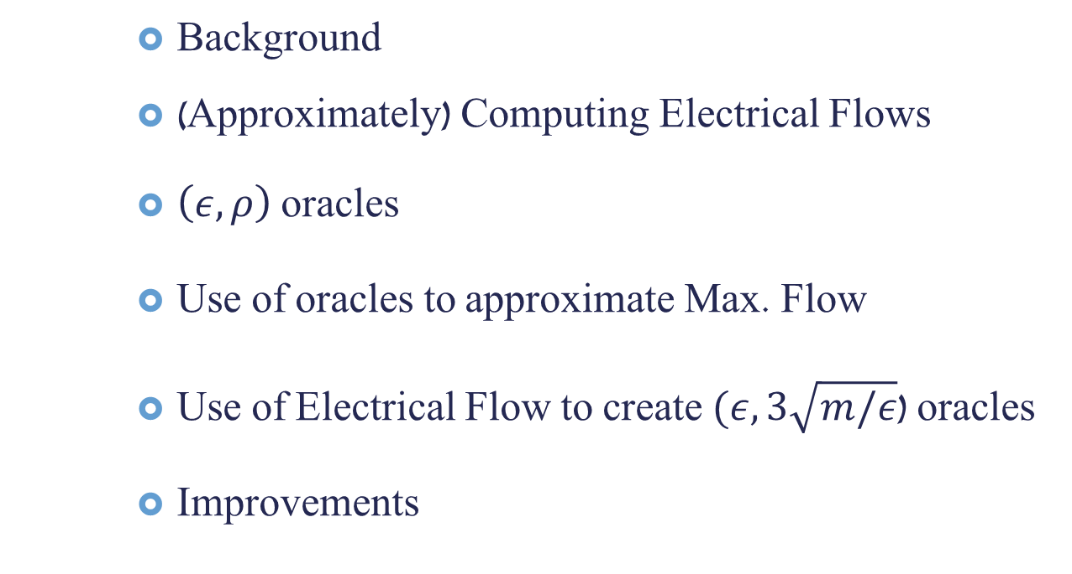
Talk Outline
Background
(Approximately) Computing Electrical Flows
$\left(ε,ρ\right)$ oracles
Use of oracles to approximate Max. Flow
Use of Electrical Flow to create $(ε,3\sqrt{m/ε}$) oracles
Improvements

Slide 3



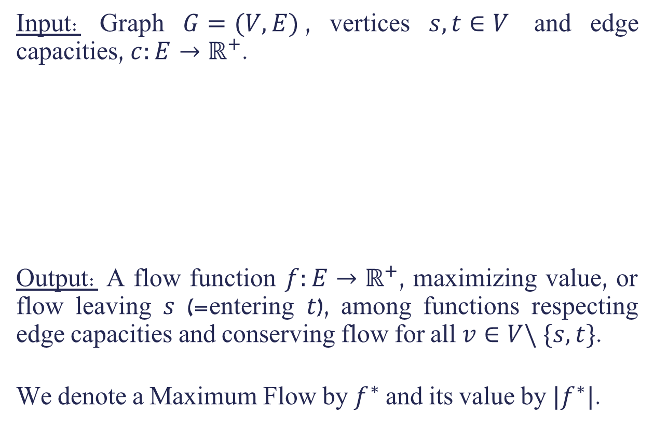
















Maximum Flow
Input: Graph $G=(V,E)$, vertices $s,t∈V$ and edge capacities, $c:E→ℝ^{+}$.
Output: A flow function $f:E→ℝ^{+}$, maximizing value, or flow leaving $s$ (=entering $t$), among functions respecting edge capacities and conserving flow for all $v∈V\backslash \{s,t\}$.
We denote a Maximum Flow by $f^{∗}$ and its value by $|f^{∗}|$.
$$3/$$
$$3$$
$$3/$$
$$3$$
$$3/$$
$$5$$
$$s$$
$$1/$$
$$0/$$
$$1$$
$$4$$
$$t$$
$$2/$$
$$2$$
$$3/$$
$$3/$$
$$4$$
$$4$$

Slide 4
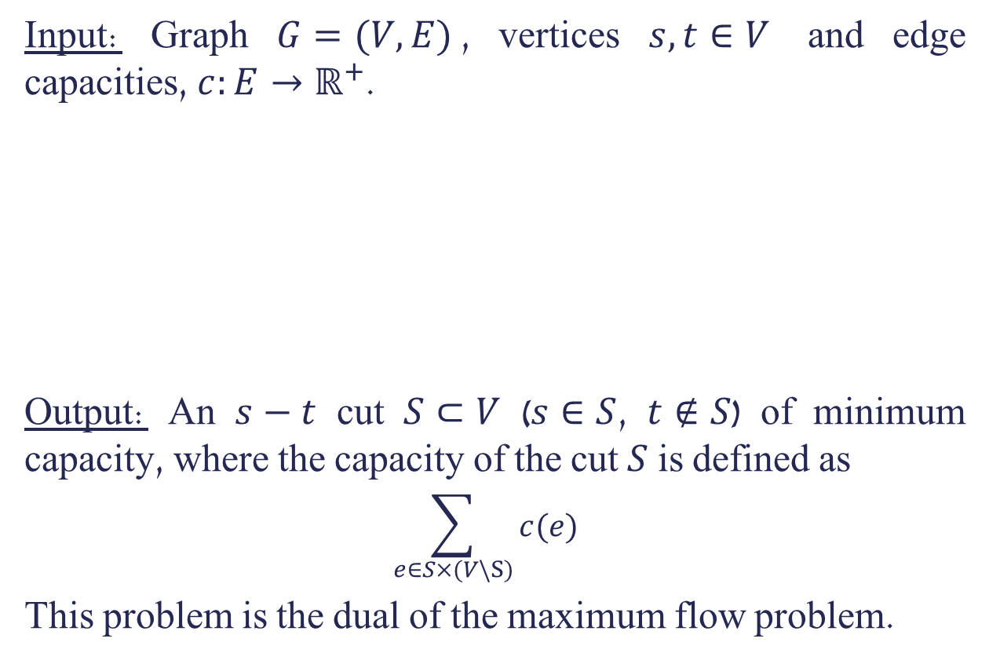

Minimum Cut
Input: Graph $G=(V,E)$, vertices $s,t∈V$ and edge capacities, $c:E→ℝ^{+}$.
Output: An $s−t$ cut $S⊂V$ ($s∈S$, $t∉S$) of minimum capacity, where the capacity of the cut $S$ is defined as
$$\sum_{e∈S×(V\backslash S)}{c(e)}$$
This problem is the dual of the maximum flow problem.
$$3$$
$$3$$
$$5$$
$$s$$
$$4$$
$$1$$
$$t$$
$$2$$
$$4$$
$$4$$

Slide 5


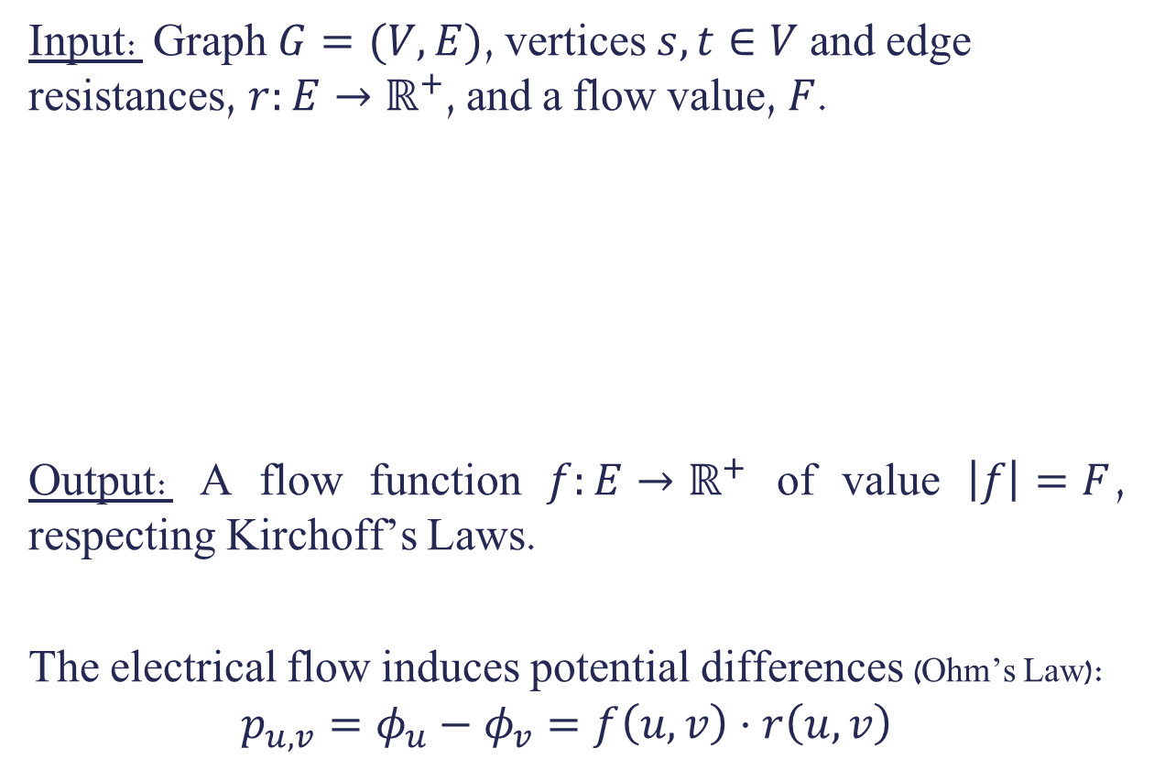










Electrical Flow
Input: Graph $G=(V,E)$, vertices $s,t∈V$ and edge resistances, $r:E→ℝ^{+}$, and a flow value, $F$.
Output: A flow function $f:E→ℝ^{+}$ of value $\left|f\right|=F$, respecting Kirchoff’s Laws.
The electrical flow induces potential differences (Ohm’s Law):
$$p_{u,v}=φ_{u}−φ_{v}=f\left(u,v\right)⋅r\left(u,v\right)$$
$$\frac{11}{7}/$$
$$\frac{9}{7}/$$
$$4$$
$$2$$
$$s$$
$$\frac{2}{7}/$$
$$3$$
$$t$$
$$\frac{10}{7}/$$
$$\frac{12}{7}/$$
$$5$$
$$1$$

Slide 6

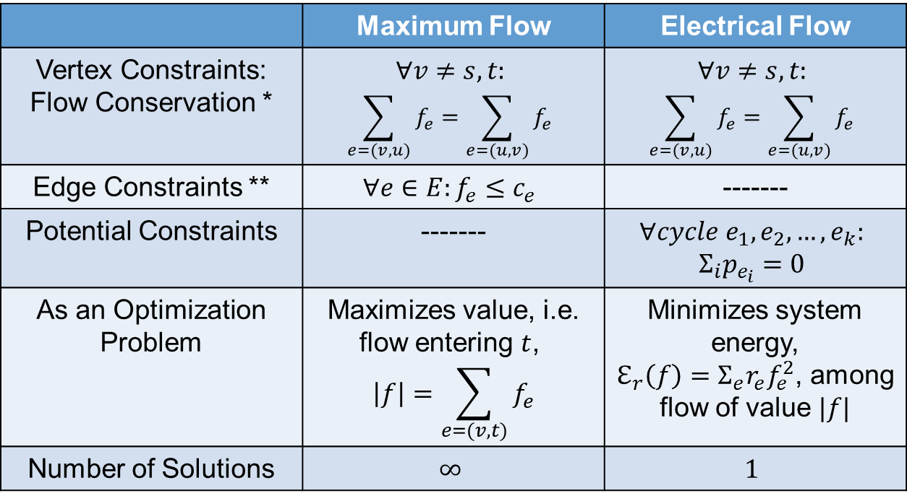
Maximum Flow VS. Electrical Flow
Electrical Flow | Maximum Flow
$$∀v≠s,t:$$ $$\sum_{e=(v,u)}{f_{e}}=\sum_{e=(u,v)}{f_{e}}$$ | $$∀v≠s,t:$$ $$\sum_{e=(v,u)}{f_{e}}=\sum_{e=(u,v)}{f_{e}}$$ | Vertex Constraints: Flow Conservation *
------- | $$∀e∈E:f_{e}≤c_{e}$$ | Edge Constraints **
$$∀cycle e_{1},e_{2},…,e_{k}:$$ $$Σ_{i}p_{e_{i}}=0$$ | ------- | Potential Constraints
Minimizes system energy, $ℇ_{r}\left(f\right)=Σ_{e}r_{e}f_{e}^{2}$, among flow of value $|f|$ | Maximizes value, i.e. flow entering $t$, $$\left|f\right|=\sum_{e=(v,t)}{f_{e}}$$ | As an Optimization Problem
$$1$$ | $$∞$$ | Number of Solutions
* We will call functions satisfying flow conservation $s−t$ flows.
** We will call $s−t$ flows satisfying edge constraints feasible.

Slide 7
Maximum Flow VS. Electrical Flow
Electrical Flow | Maximum Flow
$$∀v≠s,t:$$ $$\sum_{e=(v,u)}{f_{e}}=\sum_{e=(u,v)}{f_{e}}$$ | $$∀v≠s,t:$$ $$\sum_{e=(v,u)}{f_{e}}=\sum_{e=(u,v)}{f_{e}}$$ | Vertex Constraints: Flow Conservation *
------- | $$∀e∈E:f_{e}≤c_{e}$$ | Edge Constraints **
$$∀cycle e_{1},e_{2},…,e_{k}:$$ $$Σ_{i}p_{e_{i}}=0$$ | ------- | Potential Constraints
Minimizes system energy, $ℇ_{r}\left(f\right)=Σ_{e}r_{e}f_{e}^{2}$, among flow of value $|f|$ | Maximizes value, i.e. flow entering $t$, $$\left|f\right|=\sum_{e=(v,t)}{f_{e}}$$ | As an Optimization Problem
$$1$$ | $$∞$$ | Number of Solutions
* We will call functions satisfying flow conservation $s−t$ flows.
** We will call $s−t$ flows satisfying edge constraints feasible.

Slide 8

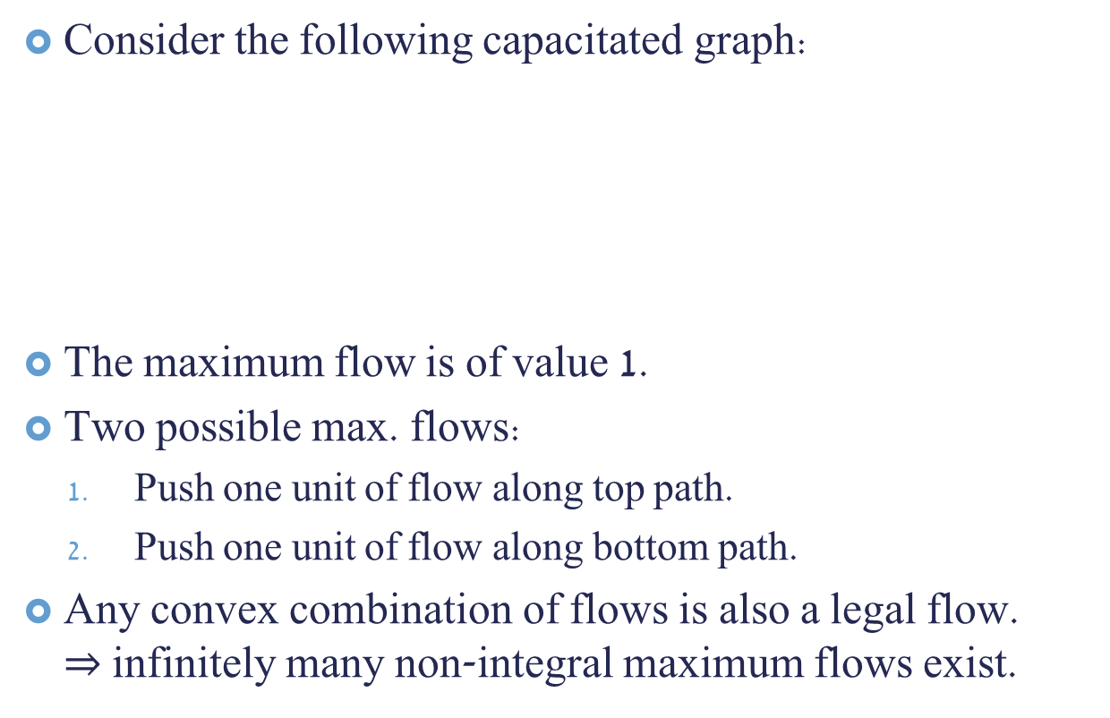







Infinite Maximum Flows
Consider the following capacitated graph:
The maximum flow is of value 1.
Two possible max. flows:
Push one unit of flow along top path.
Push one unit of flow along bottom path.
Any convex combination of flows is also a legal flow. $⇒$ infinitely many non-integral maximum flows exist.
$$1$$
$$1$$
$$1$$
$$s$$
$$t$$
$$1$$
$$1$$

Slide 9



Exponential Number Solutions for Integral Max. Flow
Consider the following unit-capacity graph ($c\left(e\right)=1 ∀e$), consisting of a copy of $K_{\frac{n}{2}−1},_{\frac{n}{2}−1}$, with every vertex on the left (right) side connected to the source $s$ (sink $t$):
$⋮$ $⋮$
Any integral flow corresponds to some matching of vertices in the left side and right side. There are thus $\left(\frac{n}{2}−1\right)!$ max. flows.
$$s$$
$$t$$

Slide 10
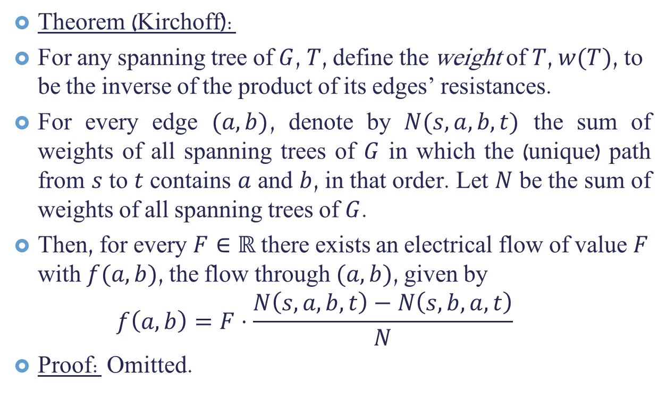
Existence of Electrical Flow
Theorem (Kirchoff):
For any spanning tree of $G$, $T$, define the weight of $T$, $w(T)$, to be the inverse of the product of its edges’ resistances.
For every edge $(a,b)$, denote by $N(s,a,b,t)$ the sum of weights of all spanning trees of $G$ in which the (unique) path from $s$ to $t$ contains $a$ and $b$, in that order. Let $N$ be the sum of weights of all spanning trees of $G$.
Then, for every $F∈ℝ$ there exists an electrical flow of value $F$ with $f(a,b)$, the flow through $(a,b)$, given by $f\left(a,b\right)=F⋅\frac{N\left(s,a,b,t\right)−N\left(s,b,a,t\right)}{N}$
Proof: Omitted.

Slide 11

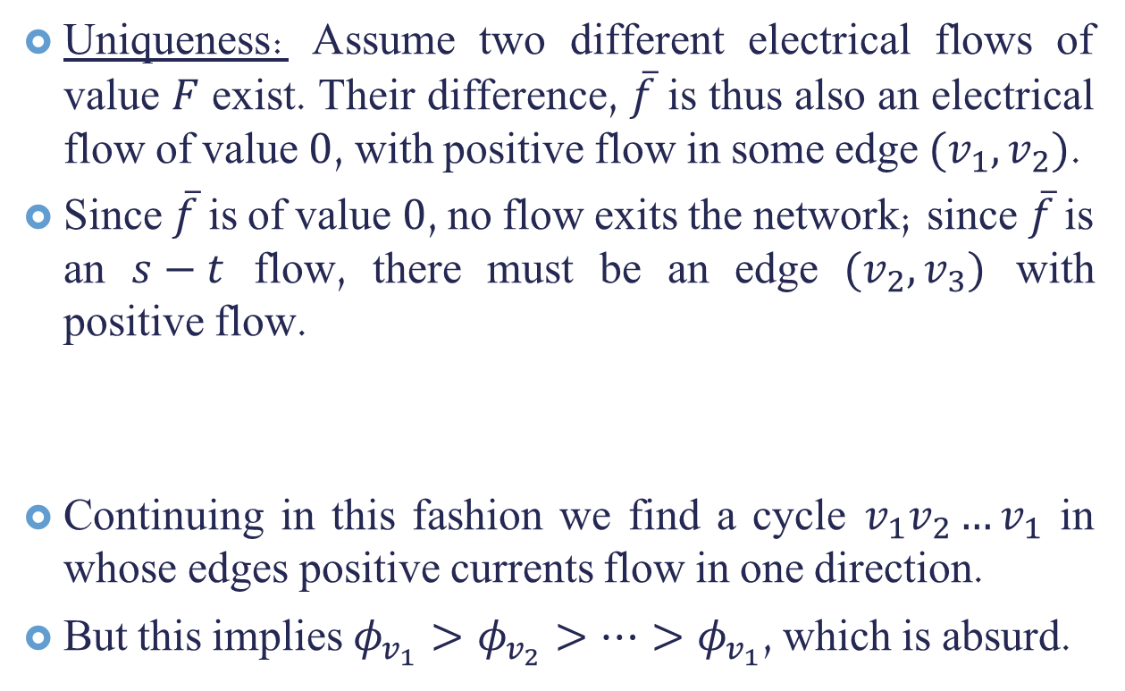
Unique Electrical Flow
Uniqueness: Assume two different electrical flows of value $F$ exist. Their difference, $\overline{f}$ is thus also an electrical flow of value $0$, with positive flow in some edge $(v_{1},v_{2})$.
Since $\overline{f}$ is of value $0$, no flow exits the network; since $\overline{f}$ is an $s−t$ flow, there must be an edge $(v_{2},v_{3})$ with positive flow.
Continuing in this fashion we find a cycle $v_{1}v_{2}…v_{1}$ in whose edges positive currents flow in one direction.
But this implies $φ_{v_{1}}>φ_{v_{2}}>…>φ_{v_{1}}$, which is absurd.
1
2
3
4

Slide 12
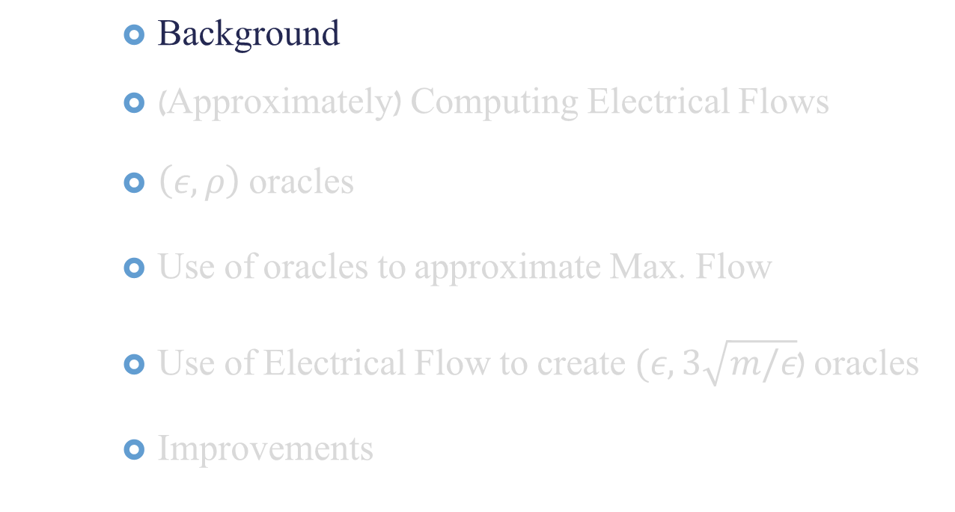
Talk Outline
Background
(Approximately) Computing Electrical Flows
$\left(ε,ρ\right)$ oracles
Use of oracles to approximate Max. Flow
Use of Electrical Flow to create $(ε,3\sqrt{m/ε}$) oracles
Improvements

Slide 13
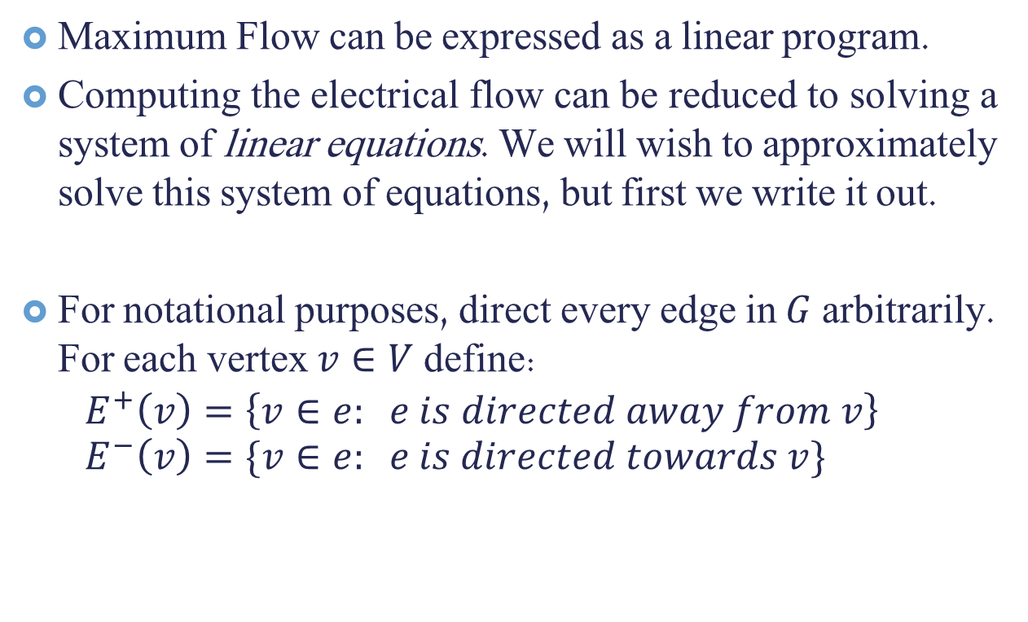
Electrical Flows and Linear Systems
Maximum Flow can be expressed as a linear program.
Computing the electrical flow can be reduced to solving a system of linear equations. We will wish to approximately solve this system of equations, but first we write it out.
For notational purposes, direct every edge in $G$ arbitrarily. For each vertex $v∈V$ define: $E^{+}\left(v\right)=\left\{v∈e: e is directed away from v\right\}$ $E^{−}\left(v\right)=\{v∈e: e is directed towards v\}$

Slide 14
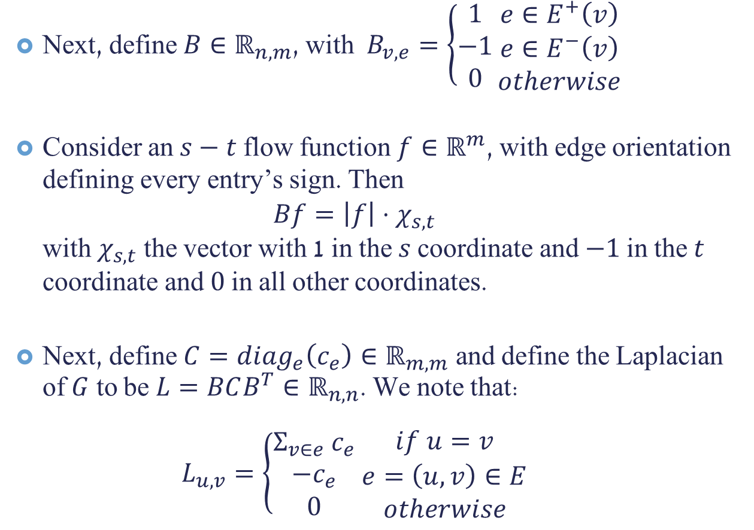
Next, define $B∈ℝ_{n,m}$, with $B_{v,e}=\left\{\begin{aligned}1 \\ −1 \\ 0\end{aligned}\right.\begin{matrix}e∈E^{+}\left(v\right) \\ e∈E^{−}\left(v\right) \\ otherwise\end{matrix}$
Consider an $s−t$ flow function $f∈ℝ^{m}$, with edge orientation defining every entry’s sign. Then $Bf=\left|f\right|⋅χ_{s,t}$ with $χ_{s,t}$ the vector with 1 in the $s$ coordinate and $−1$ in the $t$ coordinate and $0$ in all other coordinates.
Next, define $C=diag_{e}\left(c_{e}\right)∈ℝ_{m,m}$ and define the Laplacian of $G$ to be $L=BCB^{T}∈ℝ_{n,n}$. We note that: $L_{u,v}=\left\{\begin{aligned}Σ_{v∈e} c_{e} \\ −c_{e} \\ 0\end{aligned} \begin{matrix}if u=v \\ e=\left(u,v\right)∈E \\ otherwise\end{matrix}\right.$

Slide 15
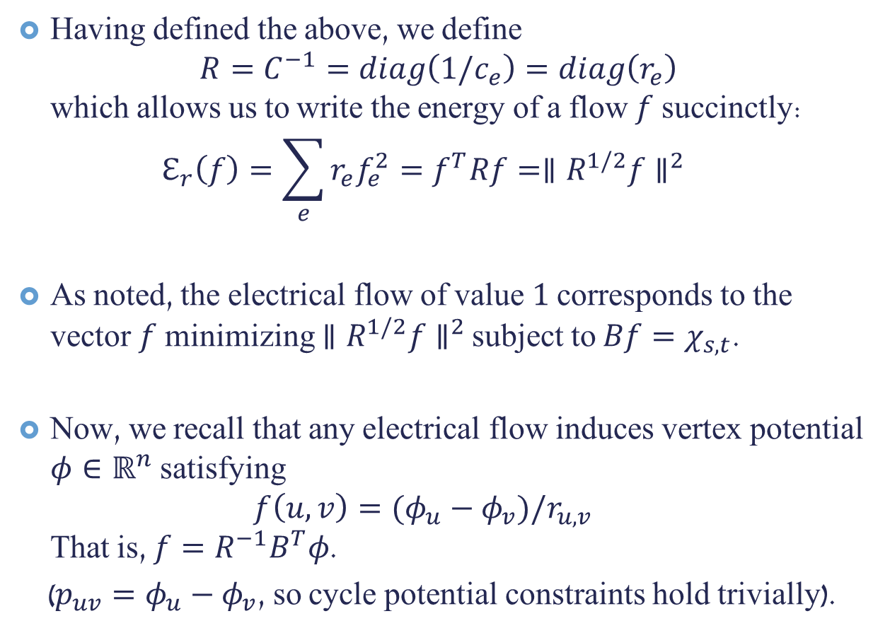
Having defined the above, we define $R=C^{−1}=diag\left(1/c_{e}\right)=diag\left(r_{e}\right)$ which allows us to write the energy of a flow $f$ succinctly: $ℇ_{r}\left(f\right)=\sum_{e}{r_{e}f_{e}^{2}}=f^{T}Rf={∥R^{1/2}f∥}^{2}$
As noted, the electrical flow of value $1$ corresponds to the vector $f$ minimizing ${∥R^{1/2}f∥}^{2}$ subject to $Bf=χ_{s,t}$.
Now, we recall that any electrical flow induces vertex potential $φ∈ℝ^{n}$ satisfying $f\left(u,v\right)=(φ_{u}−φ_{v})/r_{u,v}$ That is, $f=R^{−1}B^{T}φ$.
($p_{uv}=φ_{u}−φ_{v}$, so cycle potential constraints hold trivially).

Slide 16
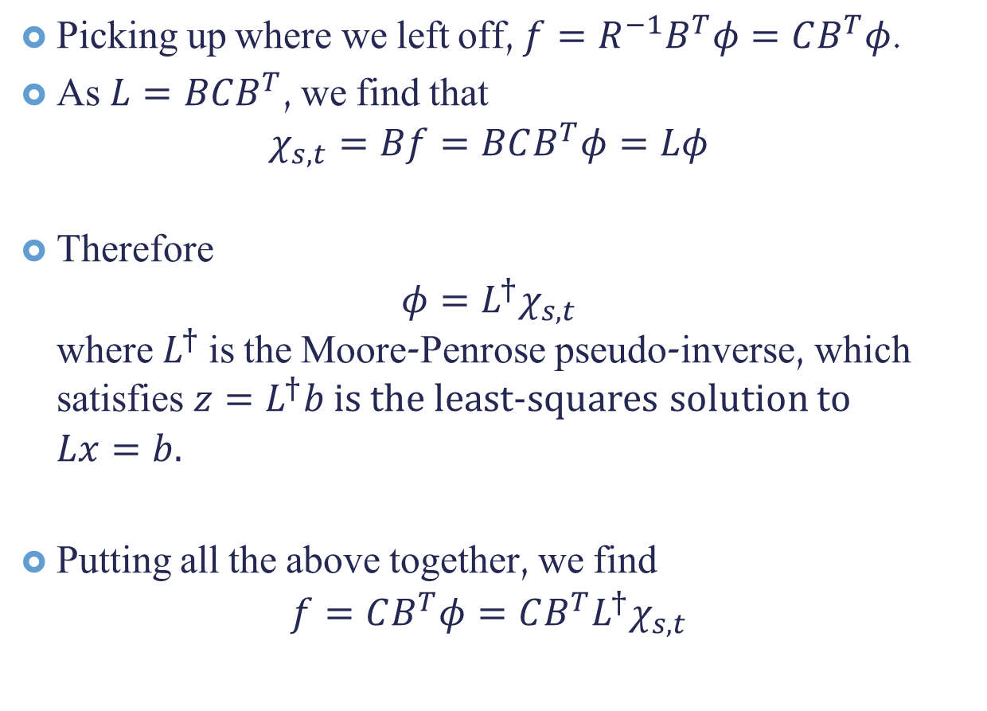
Picking up where we left off, $f=R^{−1}B^{T}φ=CB^{T}φ$.
As $L=BCB^{T}$, we find that $χ_{s,t}=Bf=BCB^{T}φ=Lφ$
Therefore $φ=L^{†}χ_{s,t}$ where $L^{†}$ is the Moore-Penrose pseudo-inverse, which satisfies $z=L^{†}b$ is the least-squares solution to $Lx=b$.
Putting all the above together, we find $f=CB^{T}φ=CB^{T}L^{†}χ_{s,t}$
Notes:
$z$ is a least squares solution to $Ax=b$ if for every $x$ it holds that $∥Ax−b∥_{2}≥∥Az−b∥_{2}$.
In particular, if the system $Ax=b$ has a solution, $z$ is such a solution.

Slide 17
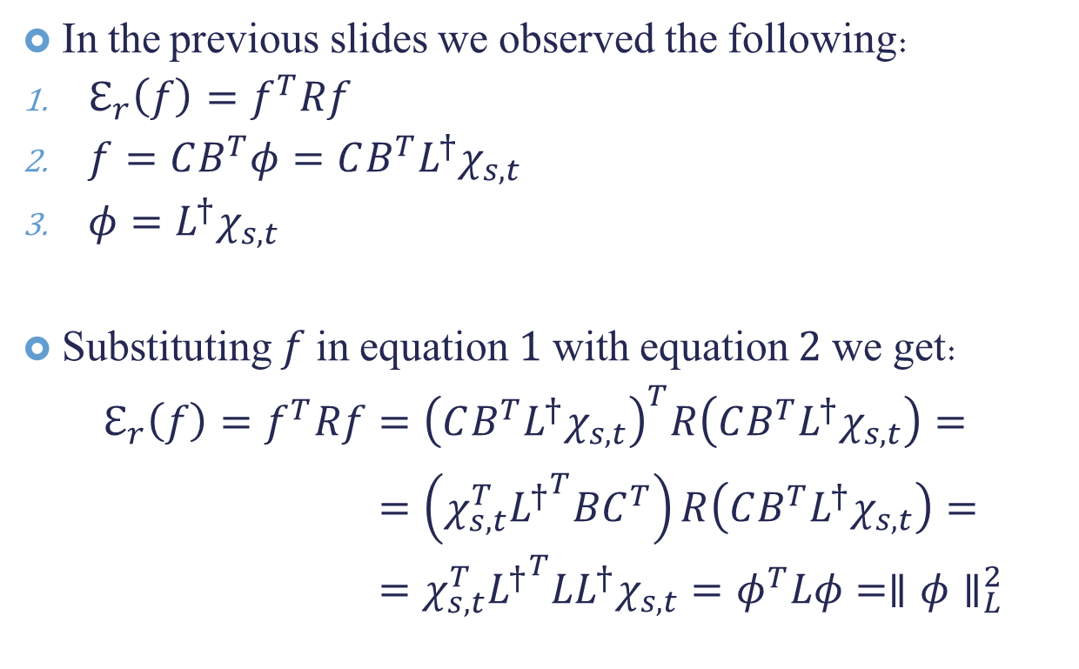

Energy Expressed as $L$-norm
In the previous slides we observed the following:
$ℇ_{r}\left(f\right)=f^{T}Rf$
$f=CB^{T}φ=CB^{T}L^{†}χ_{s,t}$
$φ=L^{†}χ_{s,t}$
Substituting $f$ in equation $1$ with equation $2$ we get: $ℇ_{r}\left(f\right)=f^{T}Rf={\left(CB^{T}L^{†}χ_{s,t}\right)}^{T}R\left(CB^{T}L^{†}χ_{s,t}\right)=$ $=\left(χ_{s,t}^{T}{L^{†}}^{T}BC^{T}\right)R\left(CB^{T}L^{†}χ_{s,t}\right)=$ $=χ_{s,t}^{T}{L^{†}}^{T}LL^{†}χ_{s,t}=φ^{T}Lφ=∥φ∥_{L}^{2}$
Notes:
The last few inequalities follow from $R=C^{−1}$, $C$ being symmetric, $L=CBC^{T}$ and observation 3.

Slide 18
Energy Expressed as $L$-norm
In the previous slides we observed the following:
$ℇ_{r}\left(f\right)=f^{T}Rf$
$f=CB^{T}φ=CB^{T}L^{†}χ_{s,t}$
$φ=L^{†}χ_{s,t}$
Substituting $f$ in equation $1$ with equation $2$ we get: $ℇ_{r}\left(f\right)=f^{T}Rf={\left(CB^{T}L^{†}χ_{s,t}\right)}^{T}R\left(CB^{T}L^{†}χ_{s,t}\right)=$ $=\left(χ_{s,t}^{T}{L^{†}}^{T}BC^{T}\right)R\left(CB^{T}L^{†}χ_{s,t}\right)=$ $=χ_{s,t}^{T}{L^{†}}^{T}LL^{†}χ_{s,t}=φ^{T}Lφ=∥φ∥_{L}^{2}$
Notes:
The last few inequalities follow from $R=C^{−1}$, $C$ being symmetric, $L=CBC^{T}$ and observation 3.

Slide 19
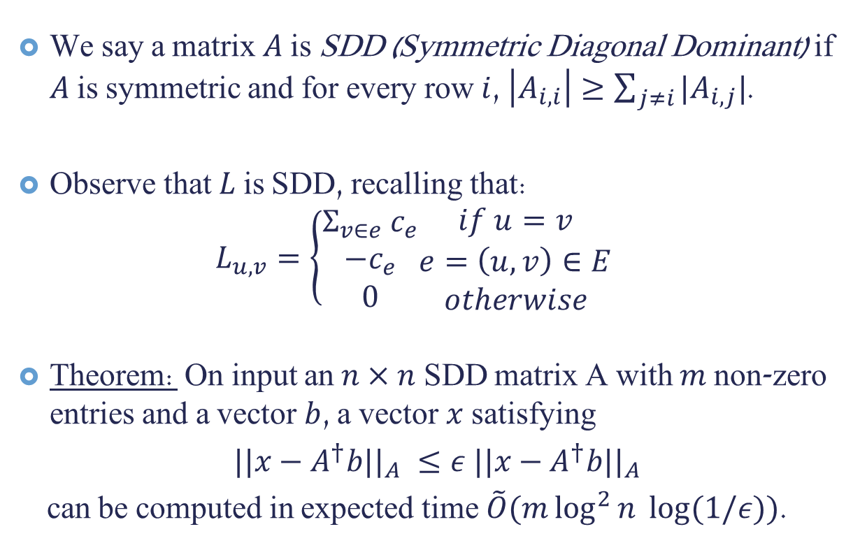
SDD Matrices
We say a matrix $A$ is SDD (Symmetric Diagonal Dominant) if $A$ is symmetric and for every row $i$, $\left|A_{i,i}\right|≥\sum_{j≠i}{|A_{i,j}|}$.
Observe that $L$ is SDD, recalling that: $L_{u,v}=\left\{\begin{aligned}Σ_{v∈e} c_{e} \\ −c_{e} \\ 0\end{aligned}\begin{matrix}if u=v \\ e=\left(u,v\right)∈E \\ otherwise\end{matrix}\right.$
Theorem: On input an $n×n$ SDD matrix A with $m$ non-zero entries and a vector $b$, a vector $x$ satisfying
${||x−A^{†}b||}_{A} ≤ε {||x−A^{†}b||}_{A}$
can be computed in expected time $\tilde{O}(m\log^{2}{n} log⁡(1/ε))$.

Slide 20
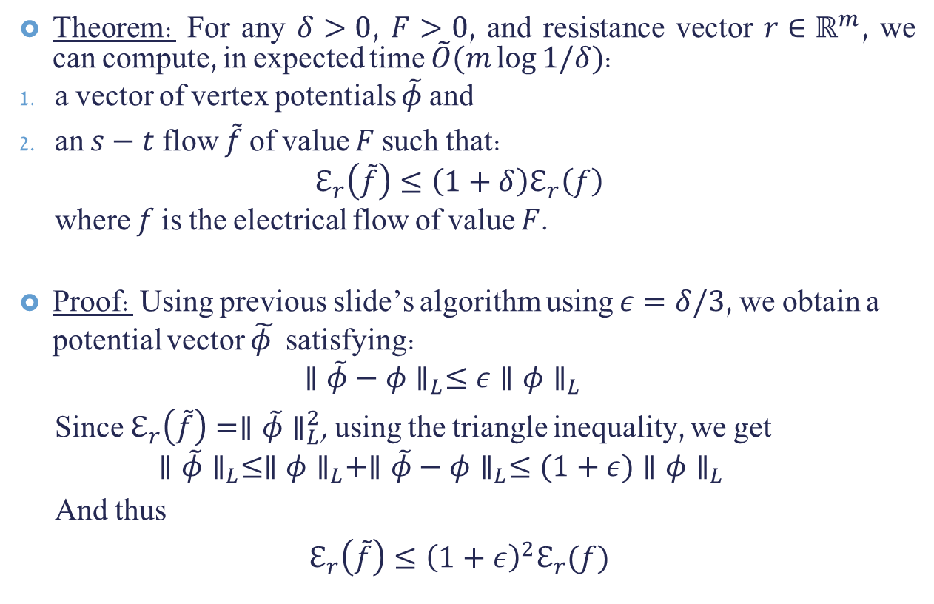
Approximately Computing Electrical Flow
Theorem: For any $δ>0$, $F>0$, and resistance vector $r∈ℝ^{m}$, we can compute, in expected time $\tilde{O}(m\log{1/δ})$:
a vector of vertex potentials $\tilde{φ}$ and
an $s−t$ flow $\tilde{f}$ of value $F$ such that: $ℇ_{r}\left(\tilde{f}\right)≤\left(1+δ\right)ℇ_{r}\left(f\right)$ where $f$ is the electrical flow of value $F$.
Proof: Using previous slide’s algorithm using $ε=δ/3$, we obtain a potential vector $\tilde{φ }$ satisfying: $∥\tilde{φ}−φ∥_{L}≤ε∥φ∥_{L}$
Since $ℇ_{r}\left(\tilde{f}\right)=∥\tilde{φ}∥_{L}^{2}$, using the triangle inequality, we get $$∥\tilde{φ}∥_{L}≤∥φ∥_{L}+∥\tilde{φ}−φ∥_{L}≤(1+ε)∥φ∥_{L}$$
And thus
$$ℇ_{r}\left(\tilde{f}\right)≤{\left(1+ε\right)}^{2}ℇ_{r}(f)$$
Notes:
The corollary follows since $ℇ_{r}\left(f\right)=∥φ∥_{L}^{2}$, with $φ$ the potential vector induced by $f$.

Slide 21
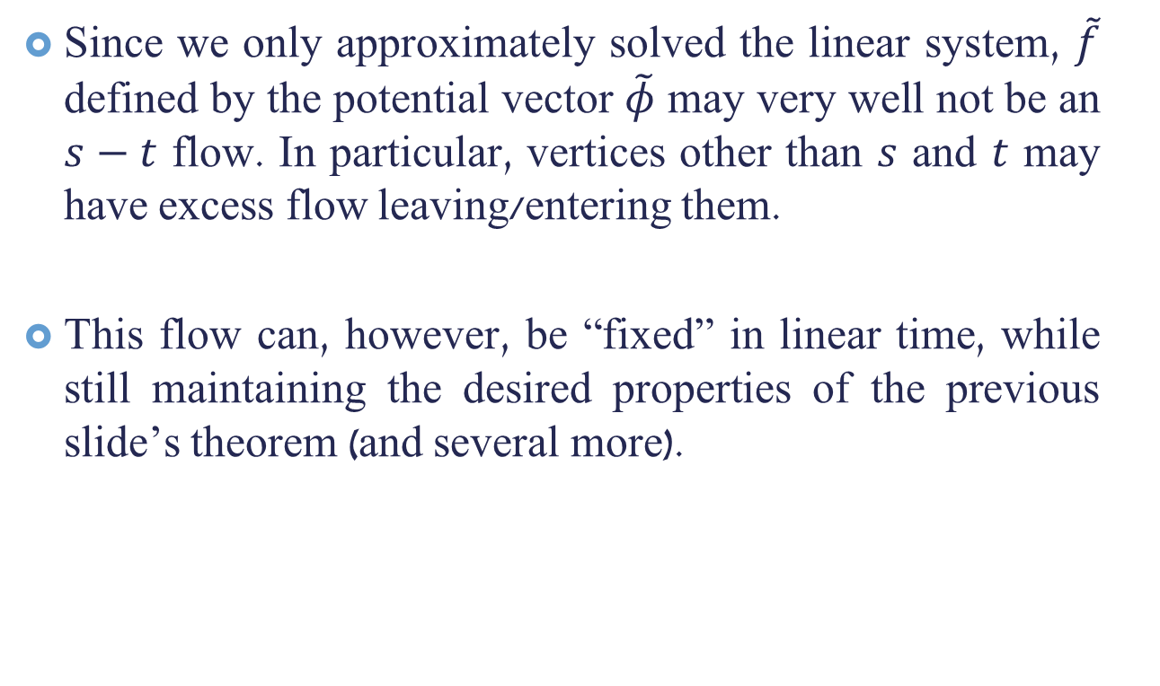
Still Work To Be Done
Since we only approximately solved the linear system, $\tilde{f}$ defined by the potential vector $\tilde{φ}$ may very well not be an $s−t$ flow. In particular, vertices other than $s$ and $t$ may have excess flow leaving/entering them.
This flow can, however, be “fixed” in linear time, while still maintaining the desired properties of the previous slide’s theorem (and several more).

Slide 22
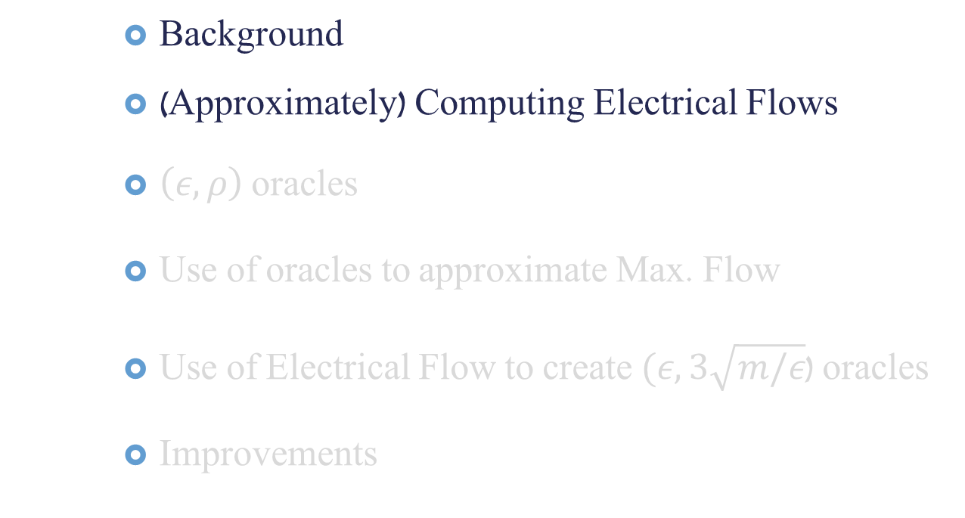
Talk Outline
Background
(Approximately) Computing Electrical Flows
$\left(ε,ρ\right)$ oracles
Use of oracles to approximate Max. Flow
Use of Electrical Flow to create $(ε,3\sqrt{m/ε}$) oracles
Improvements

Slide 23
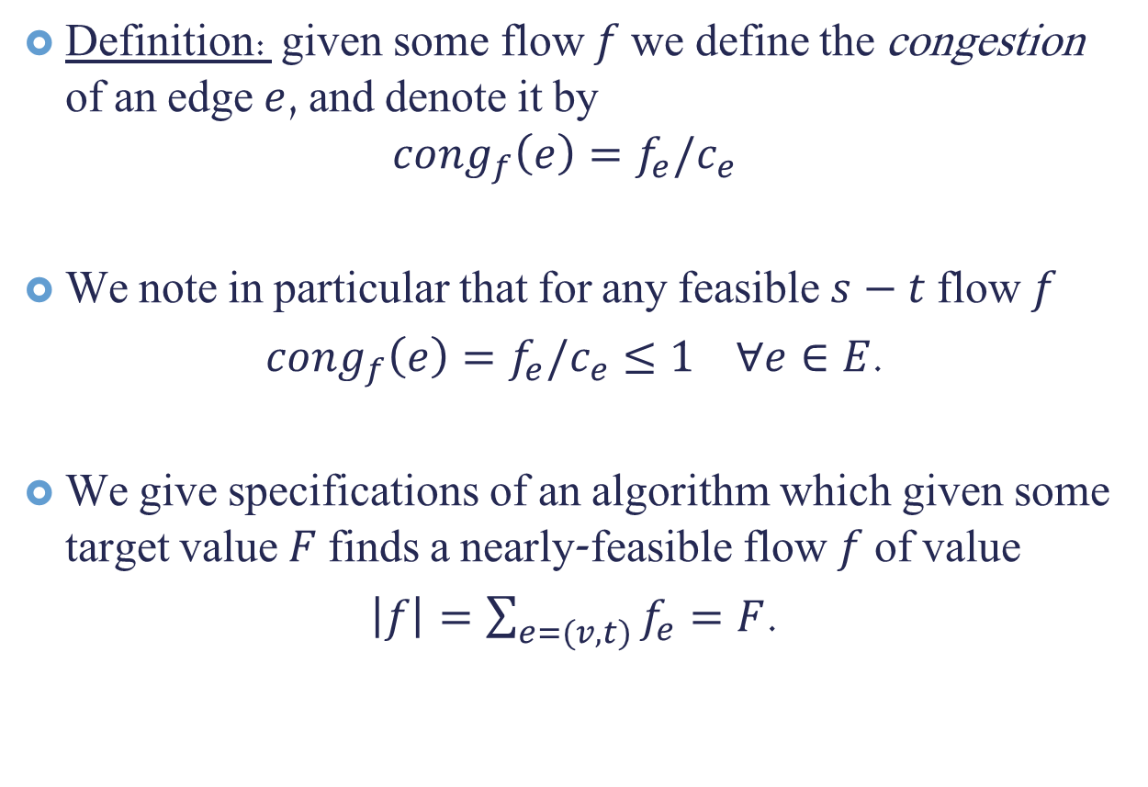

$(ε,ρ)$ Oracles
Definition: given some flow $f$ we define the congestion of an edge $e$, and denote it by
$$cong_{f}\left(e\right)=f_{e}/c_{e}$$
We note in particular that for any feasible $s−t$ flow $f$
$cong_{f}\left(e\right)=f_{e}/c_{e}≤1 ∀e∈E$.
We give specifications of an algorithm which given some target value $F$ finds a nearly-feasible flow $f$ of value
$\left|f\right|=\sum_{e=(v,t)}{f_{e}}=F$.

Slide 24


$(ε,ρ)$ Oracle: Definition
Definition: For any $ε>0$, $ρ≥1$, an $(ε,ρ)$ oracle is an algorithm which, given a target value $F$ and weight vector $w∈ℝ^{m}$ with $w_{e}≥1$ for all $e∈E$, does the following:
If $F≤\left|f^{∗}\right|$, returns an $s−t$ flow, satisfying:
$\left|f\right|=F$
$\max_{e}{cong_{f}\left(e\right)≤ρ}$
$Σ_{e}w_{e}cong_{f}\left(e\right)≤\left(1+ε\right){\left|w\right|}_{1}$
If $F>|f^{∗}|$, either returns such an $s−t$ flow, or returns a “failure” message.

Slide 25
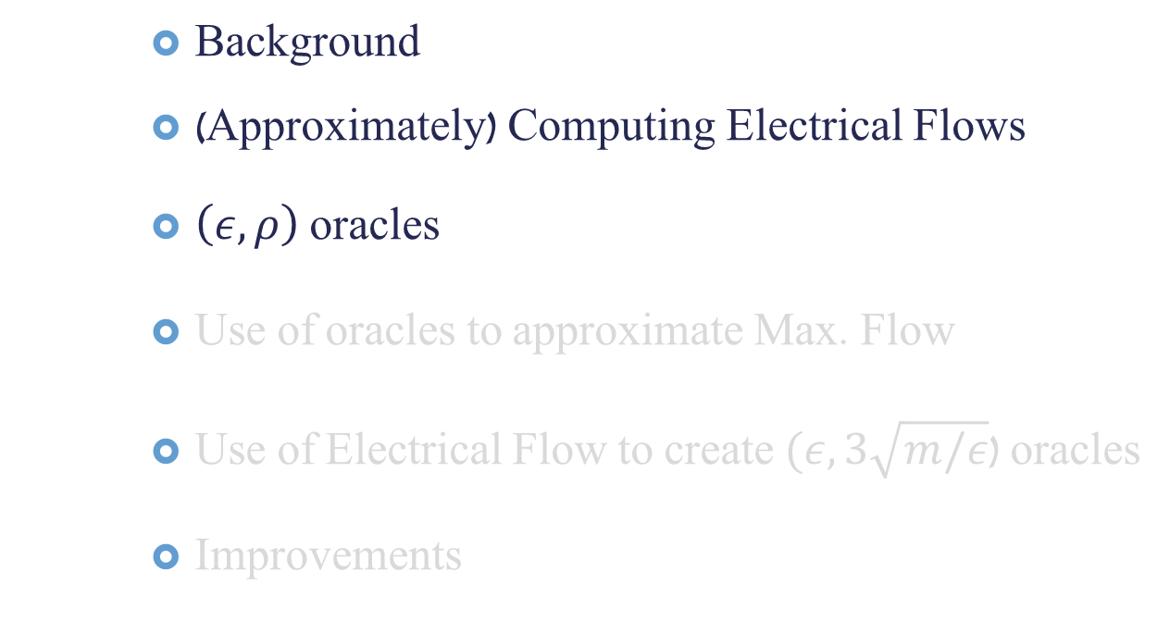
Talk Outline
Background
(Approximately) Computing Electrical Flows
$\left(ε,ρ\right)$ oracles
Use of oracles to approximate Max. Flow
Use of Electrical Flow to create $(ε,3\sqrt{m/ε}$) oracles
Improvements

Slide 26


Use of $(ε,ρ)$ oracles to Approximate Maximum Flow
Start by assuming we know the value of a maximum flow.
Then, using the Multiplicative Update Weights Method, we will find a legal $s−t$ flow with value $(1−ε)F$, assuming $F≤|f^{∗}|$.

Slide 27

Multiplicative Updates Method
Input: Undirected Graph $G=\left(V,E\right)$, capacities $c:E→ℝ^{+}$, target value $F$ and $(ε,ρ)$ oracle, $O$.
Output: feasible $s−t$ flow of value $\left|f\right|≥\left(1−ε\right)F$, or failure; failure only occurs if $F>|f^{∗}|$.
Init: $w_{e}^{0}←1$ for each $e∈E$. $N←\frac{2ρ\ln{m}}{ε^{2}}$.
For $i=1,…,N$
Call $O$ with input $G,c,w^{i−1}$. If $O$ failed, fail.
Let $f^{i}$ be the returned flow.
Update: $w_{e}^{i}←w_{e}^{i−1}\left(1+\frac{ε}{ρ}cong_{f^{i}} \left(e\right)\right)$ for all $e∈E$.
Return $\overline{f}=\frac{{\left(1−ε\right)}^{2}}{\left(1+ε\right)N}Σ_{i}f^{i}$

Slide 28
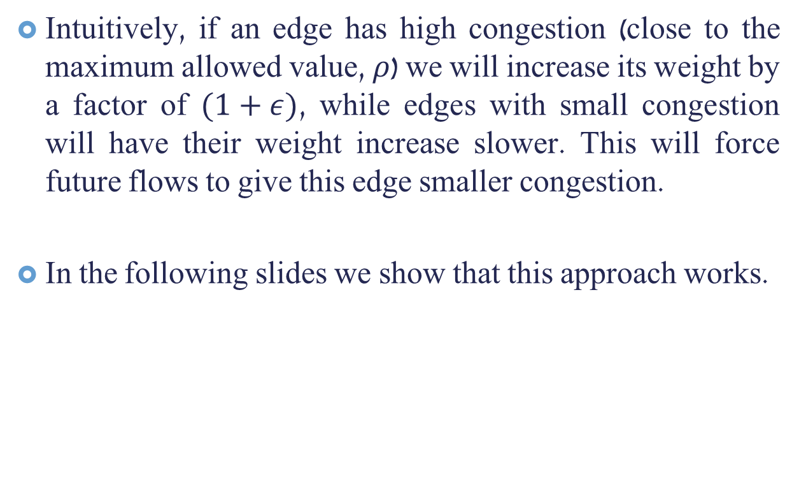
Why does this work?
Intuitively, if an edge has high congestion (close to the maximum allowed value, $ρ$) we will increase its weight by a factor of $(1+ε)$, while edges with small congestion will have their weight increase slower. This will force future flows to give this edge smaller congestion.
In the following slides we show that this approach works.

Slide 29

Convergence of Multiplicative Weights Update Method
We consider the following potential:
$$μ_{i}={\left|w^{i}\right|}_{1}$$
Observations:
$μ_{0}=m$. And from the definition of $(ε,ρ)$ oracle:
$cong_{f^{i}}(e)≤ρ$, for all $e∈E$, $i≥1$.
$Σ_{e}w_{e}^{i}cong_{f^{i+1}}\left(e\right)≤\left(1+ε\right){\left|w^{i}\right|}_{1}$.

Slide 30
Convergence of Multiplicative Weights Update Method
We consider the following potential:
$$μ_{i}={\left|w^{i}\right|}_{1}$$
Observations:
$μ_{0}=m$. And from the definition of $(ε,ρ)$ oracle:
$cong_{f^{i}}(e)≤ρ$, for all $e∈E$, $i≥1$.
$Σ_{e}w_{e}^{i}cong_{f^{i+1}}\left(e\right)≤\left(1+ε\right){\left|w^{i}\right|}_{1}$.

Slide 31

Lemma 1: For every $i≥0$:
$$μ_{i+1}≤μ_{i}⋅\exp\left(\frac{\left(1+ε\right)ε}{ρ}\right)$$
Proof:
$μ_{i+1}={\left|w^{i+1}\right|}_{1}=Σ_{e}w_{e}^{i+1}=Σ_{e}w_{e}^{i}\left(1+\frac{ε}{ρ}cong_{f^{i+1}}\left(e\right)\right)$
$$≤{\left|w^{i}\right|}_{1}+\frac{\left(1+ε\right)ε}{ρ}{\left|w^{i}\right|}_{1}$$
$$=μ_{i}\left(1+\frac{\left(1+ε\right)ε}{ρ}\right)$$
$$≤μ_{i}⋅\exp\left(\frac{\left(1+ε\right)ε}{ρ}\right)$$
Notes:
The first inequality follows from observation III.
The following equality follows from $μ_{i}$’s definition.
The last inequality follows from the inequality $\left(1+x\right)≤e^{x}$ for any $x∈ℝ$.

Slide 32
Lemma 1: For every $i≥0$:
$$μ_{i+1}≤μ_{i}⋅\exp\left(\frac{\left(1+ε\right)ε}{ρ}\right)$$
Proof:
$μ_{i+1}={\left|w^{i+1}\right|}_{1}=Σ_{e}w_{e}^{i+1}=Σ_{e}w_{e}^{i}\left(1+\frac{ε}{ρ}cong_{f^{i+1}}\left(e\right)\right)$
$$≤{\left|w^{i}\right|}_{1}+\frac{\left(1+ε\right)ε}{ρ}{\left|w^{i}\right|}_{1}$$
$$=μ_{i}\left(1+\frac{\left(1+ε\right)ε}{ρ}\right)$$
$$≤μ_{i}⋅\exp\left(\frac{\left(1+ε\right)ε}{ρ}\right)$$
Notes:
The first inequality follows from observation III.
The following equality follows from $μ_{i}$’s definition.
The last inequality follows from the inequality $\left(1+x\right)≤e^{x}$ for any $x∈ℝ$.

Slide 33
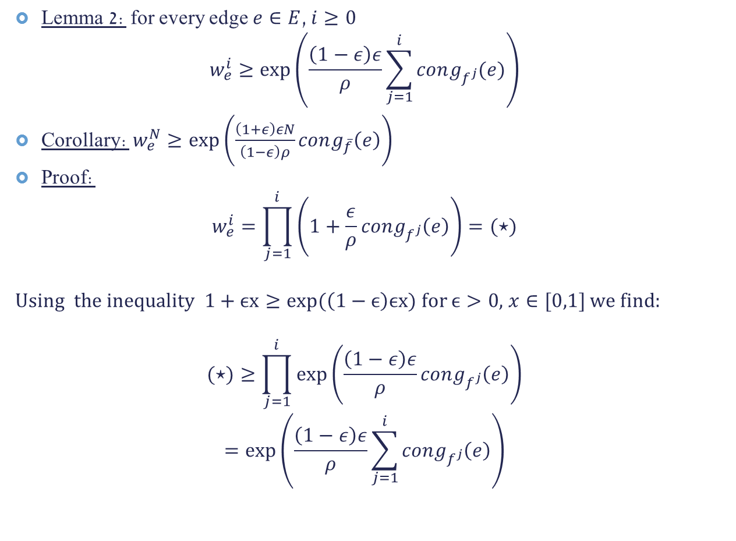
Lemma 2: for every edge $e∈E$, $i≥0$
$$w_{e}^{i}≥\exp\left(\frac{\left(1−ε\right)ε}{ρ}\sum_{j=1}^{i}{cong_{f^{j}}(e)}\right)$$
Corollary: $w_{e}^{N}≥\exp\left(\frac{\left(1+ε\right)εN}{\left(1−ε\right)ρ}cong_{\overline{f}}\left(e\right)\right)$
Proof:
$$w_{e}^{i}=\prod_{j=1}^{i}{\left(1+\frac{ε}{ρ}cong_{f^{j}}\left(e\right)\right)=(⋆)}$$
Using the inequality $1+ϵx≥exp⁡(\left(1−ϵ\right)ϵx)$ for $ϵ>0$, $x∈[0,1]$ we find:
$$(⋆)≥\prod_{j=1}^{i}{exp\left(\frac{\left(1−ε\right)ε}{ρ}cong_{f^{j}}\left(e\right)\right)}$$
$$=exp\left(\frac{\left(1−ε\right)ε}{ρ}\sum_{j=1}^{i}{cong_{f^{j}}\left(e\right)}\right)$$
Notes:
For the corollary, $\sum_{j=1}^{i}{f^{j}=\frac{\left(1+ε\right)N}{{\left(1−ε\right)}^{2}}⋅\overline{f}}$. Note that the $f^{j}(e)$’s might differ in direction and therefore differ in sign, and thus the congestion in $e$ according to $\overline{f}$ might be smaller than the weighted congestion. This might yield better bounds, but as the algorithm does nothing to systematically exploit possible cancellations, we just use this lower bound and leave it at that. For the last inequality: $x$ in our case is $cong_{f^{j}}(e)/ρ$, which lies in $[0,1]$, from the oracle’s specification. To prove the inequality, suffice to check that $\left(1+εx\right)≥\exp{(\left(1−ε\right)}εx)$ for $x=0,1$ for all $ε>0$. As $\exp\left(\left(1−ε\right)εx\right)$ is convex, this implies the line $(1+εx)$ is “above” this function for all the domain. To show that $1+ε>exp⁡(ε−ε^{2})$ for all $ε≥0$, suffice to show equality for $ε=0$ and that $\frac{d}{dε}\left(1+ε\right)=1>\left(1−2ε\right)e^{ε−ε^{2}}=\frac{d}{dε}e^{ε−ε^{2}}$, with the middle inequality following from $1−2ε≤e^{−2ε}<e^{ε^{2}−ε}$, which holds for all positive $ε$.

Slide 34
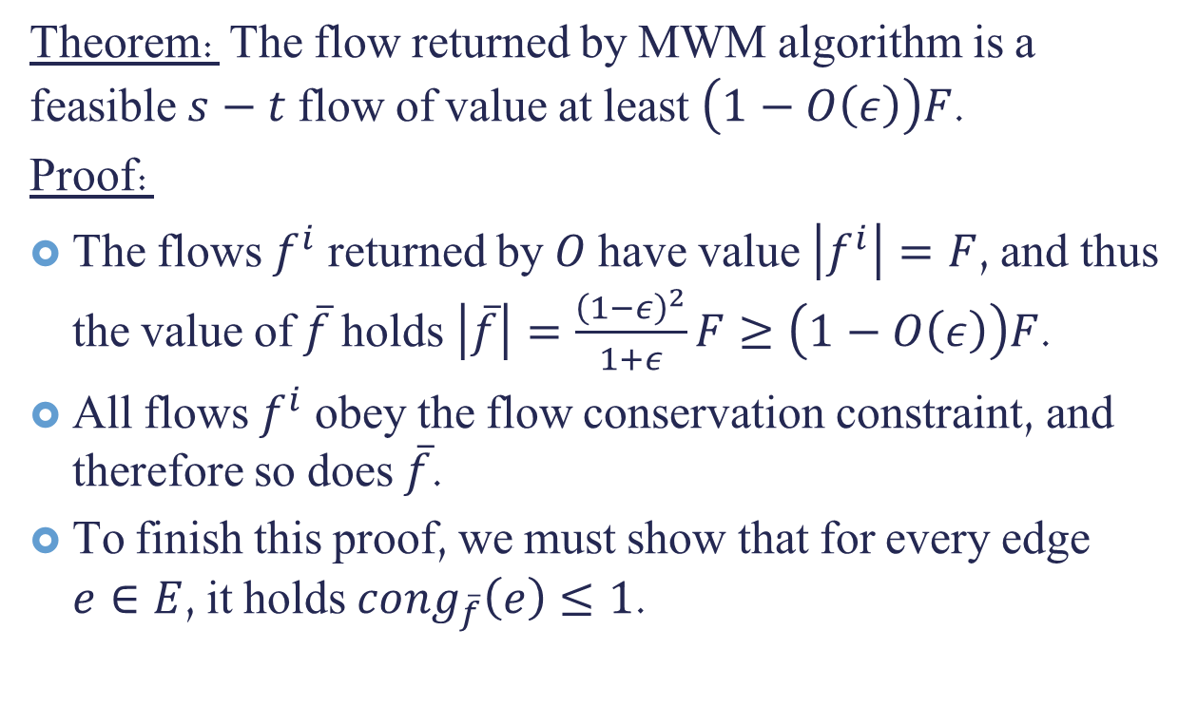
Multiplicative Weights Update Method - Correctness
Theorem: The flow returned by MWM algorithm is a feasible $s−t$ flow of value at least $\left(1−O\left(ε\right)\right)F$.
Proof:
The flows $f^{i}$ returned by $O$ have value $\left|f^{i}\right|=F$, and thus the value of $\overline{f}$ holds $\left|\overline{f}\right|=\frac{{\left(1−ε\right)}^{2}}{1+ε}F≥\left(1−O\left(ε\right)\right)F$.
All flows $f^{i}$ obey the flow conservation constraint, and therefore so does $\overline{f}$.
To finish this proof, we must show that for every edge $e∈E$, it holds $cong_{\overline{f}}\left(e\right)≤1$.

Slide 35
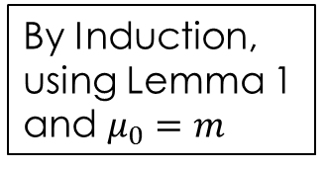

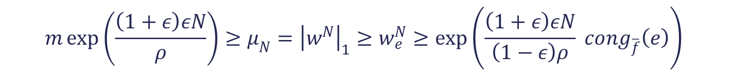
MWM Returns Feasible Flow
From lemmas 1 and 2 and the definition of $μ_{i}$, we find:
And in particular
$$cong_{\overline{f}}\left(e\right)≤1−ε+\frac{\left(1−ε\right)ρ\ln{m}}{\left(1+ε\right)εN}=1−ε+\frac{ε\left(1−ε\right)}{2\left(1+ε\right)}<1$$
$$m\exp\left(\frac{\left(1+ε\right)εN}{ρ}\right)≥μ_{N}={\left|w^{N}\right|}_{1}≥w_{e}^{N}≥\exp\left(\frac{\left(1+ε\right)εN}{\left(1−ε\right)ρ} cong_{\overline{f}}\left(e\right)\right)$$
By Induction, using Lemma 1 and $μ_{0}=m$
Corollary of Lemma 2

Slide 36
MWM Returns Feasible Flow
From lemmas 1 and 2 and the definition of $μ_{i}$, we find:
And in particular
$$cong_{\overline{f}}\left(e\right)≤1−ε+\frac{\left(1−ε\right)ρ\ln{m}}{\left(1+ε\right)εN}=1−ε+\frac{ε\left(1−ε\right)}{2\left(1+ε\right)}<1$$
$$m\exp\left(\frac{\left(1+ε\right)εN}{ρ}\right)≥μ_{N}={\left|w^{N}\right|}_{1}≥w_{e}^{N}≥\exp\left(\frac{\left(1+ε\right)εN}{\left(1−ε\right)ρ} cong_{\overline{f}}\left(e\right)\right)$$
By Induction, using Lemma 1 and $μ_{0}=m$
Corollary of Lemma 2

Slide 37
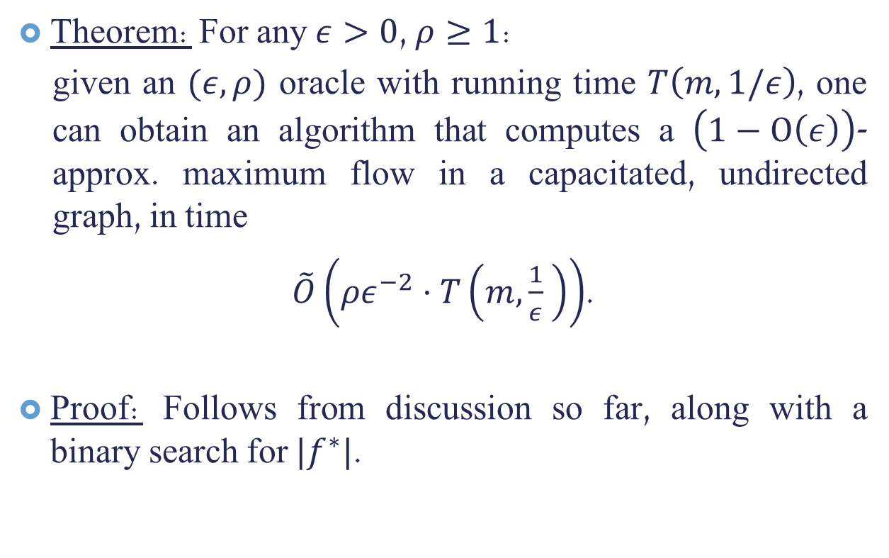
Multiplicative Updates Weight Method: Running Time
Theorem: For any $ε>0$, $ρ≥1$:
given an $(ε,ρ)$ oracle with running time $T\left(m,1/ε\right)$, one can obtain an algorithm that computes a $\left(1−Ο\left(ε\right)\right)$-approx. maximum flow in a capacitated, undirected graph, in time
$\tilde{O}\left(ρε^{−2}⋅T\left(m,\frac{1}{ε} \right)\right)$.
Proof: Follows from discussion so far, along with a binary search for $|f^{∗}|$.

Slide 38
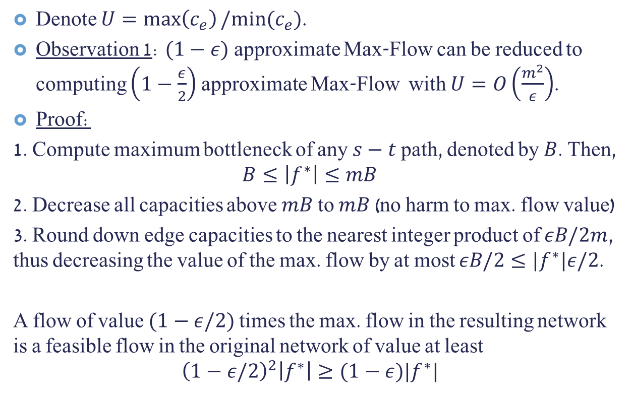
Capacities’ Ratio
Denote $U=\max\left(c_{e}\right)/min⁡(c_{e})$.
Observation 1: $(1−ε)$ approximate Max-Flow can be reduced to computing $\left(1−\frac{ε}{2}\right)$ approximate Max-Flow with $U=O\left(\frac{m^{2}}{ε}\right)$.
Proof:
1. Compute maximum bottleneck of any $s−t$ path, denoted by $B$. Then,
$$B≤\left|f^{∗}\right|≤mB$$
2. Decrease all capacities above $mB$ to $mB$(no harm to max. flow value)
3. Round down edge capacities to the nearest integer product of $εB/2m$, thus decreasing the value of the max. flow by at most $εB/2≤|f^{∗}|ε/2$.
A flow of value $(1−ε/2)$ times the max. flow in the resulting network is a feasible flow in the original network of value at least
$${\left(1−ε/2\right)}^{2}\left|f^{∗}\right|≥(1−ε)|f^{∗}|$$

Slide 39

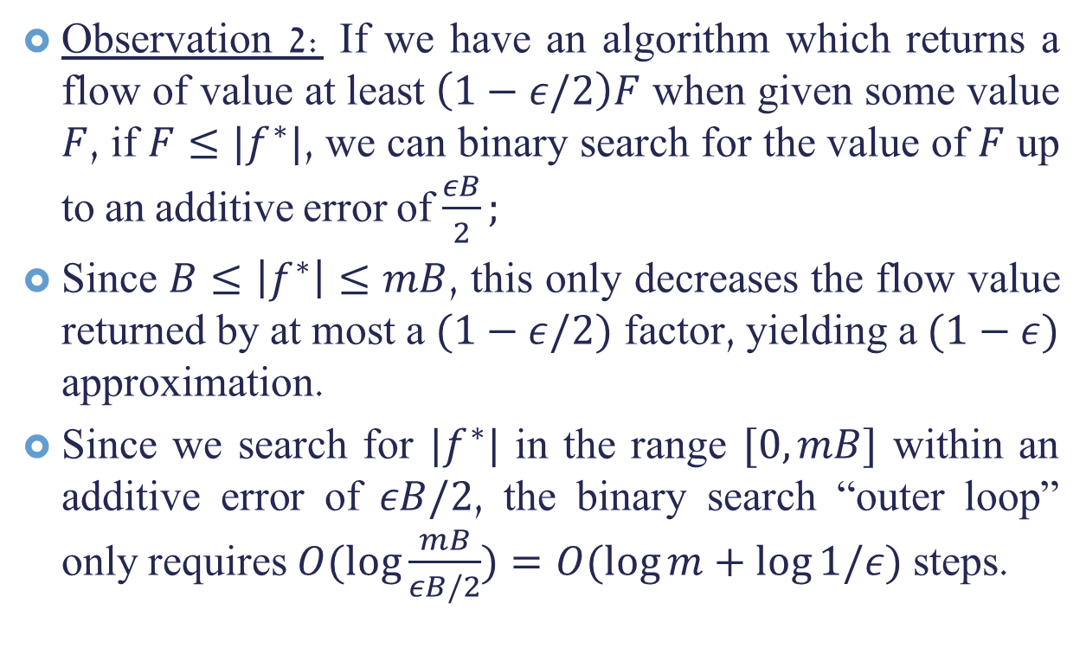
Binary Search for $|f^{∗}|$
Observation 2: If we have an algorithm which returns a flow of value at least $\left(1−ε/2\right)F$ when given some value $F$, if $F≤|f^{∗}|$, we can binary search for the value of $F$ up to an additive error of $\frac{εB}{2};$
Since $B≤\left|f^{∗}\right|≤mB$, this only decreases the flow value returned by at most a $(1−ε/2)$ factor, yielding a $(1−ε)$ approximation.
Since we search for $|f^{∗}|$ in the range $[0,mB]$ within an additive error of $εB/2$, the binary search “outer loop” only requires $O(\log{\frac{mB}{εB/2})=O(\log{m+\log{1/ε)}}}$ steps.

Slide 40
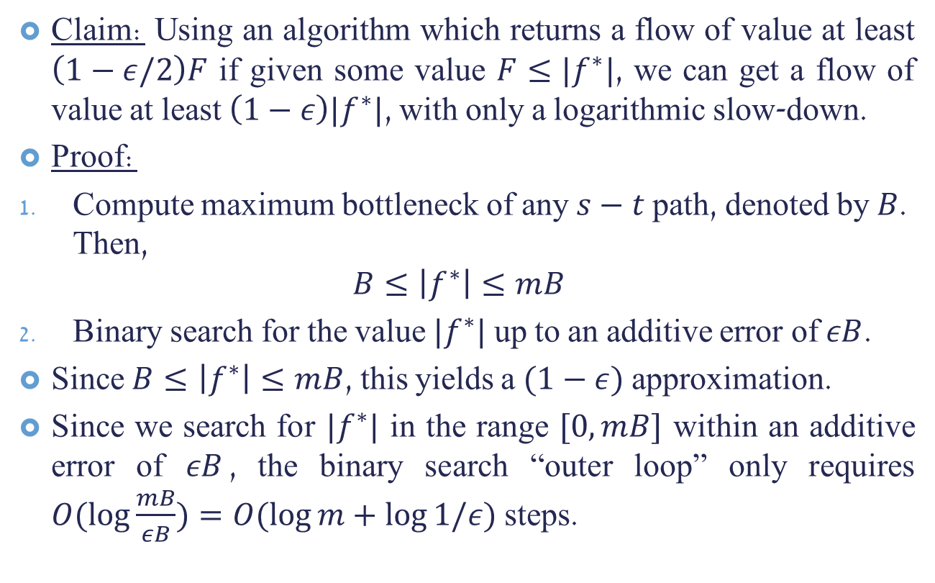
Binary Search for $|f^{∗}|$
Claim: Using an algorithm which returns a flow of value at least $\left(1−ε/2\right)F$ if given some value $F≤|f^{∗}|$, we can get a flow of value at least $\left(1−ε\right)|f^{∗}|$, with only a logarithmic slow-down.
Proof:
Compute maximum bottleneck of any $s−t$ path, denoted by $B$. Then,
$$B≤\left|f^{∗}\right|≤mB$$
Binary search for the value $|f^{∗}|$ up to an additive error of $εB$.
Since $B≤\left|f^{∗}\right|≤mB$, this yields a $(1−ε)$ approximation.
Since we search for $|f^{∗}|$ in the range $[0,mB]$ within an additive error of $εB$, the binary search “outer loop” only requires $O(\log{\frac{mB}{εB})=O(\log{m+\log{1/ε)}}}$ steps.

Slide 41
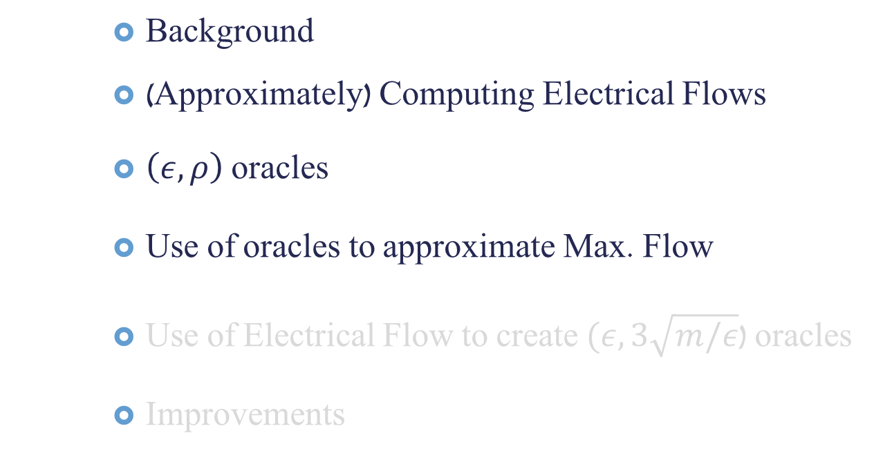
Talk Outline
Background
(Approximately) Computing Electrical Flows
$\left(ε,ρ\right)$ oracles
Use of oracles to approximate Max. Flow
Use of Electrical Flow to create $(ε,3\sqrt{m/ε}$) oracles
Improvements

Slide 42

Reminder: $(ε,ρ)$ Oracle
Definition: For any $ε>0$, $ρ≥1$, an $(ε,ρ)$ oracle is an algorithm which, given a target value $F$ and weight vector $w∈ℝ^{m}$ with $w_{e}≥1$ for all $e∈E$, does the following:
If $F≤\left|f^{∗}\right|$, returns an $s−t$ flow, satisfying:
$\left|f\right|=F$
$\max_{e}{cong_{f}\left(e\right)≤ρ}$
$Σ_{e}w_{e}cong_{f}\left(e\right)≤\left(1+ε\right){\left|w\right|}_{1}$
If $F>|f^{∗}|$, either returns such an $s−t$ flow, or returns a “failure” message.

Slide 43
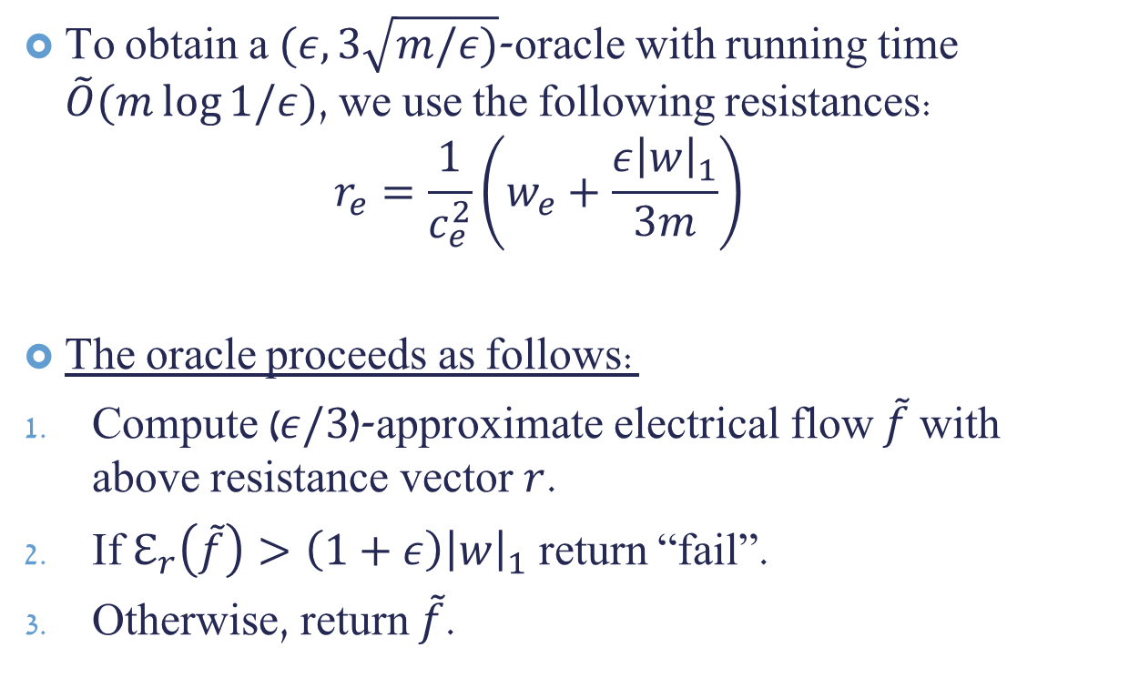

$(ε,3\sqrt{m/ε)}$-oracle from Approximate Electrical Flow
To obtain a $(ε,3\sqrt{m/ε)}$-oracle with running time $\tilde{O}(m\log{1/ε})$, we use the following resistances: $r_{e}=\frac{1}{c_{e}^{2}}\left(w_{e}+\frac{ε{\left|w\right|}_{1}}{3m}\right)$
The oracle proceeds as follows:
Compute ($ε/3$)-approximate electrical flow $\tilde{f}$ with above resistance vector $r$.
If $ℇ_{r}\left(\tilde{f}\right)>\left(1+ε\right){\left|w\right|}_{1}$ return “fail”.
Otherwise, return $\tilde{f}$.
Notes:
Some intuition: The $w_{e}$ part of the capacity will ensure the bound on the average (weighted) congestion and the second factor guarantees the bound on the maximum flow. The multiplicative factor of $c_{e}^{−2}$ will allow us to analyze the energy of some maximum flow $f^{∗}$, thus yielding a bound on the energy of the electrical flow, and therefore our approximate electrical flow.

Slide 44
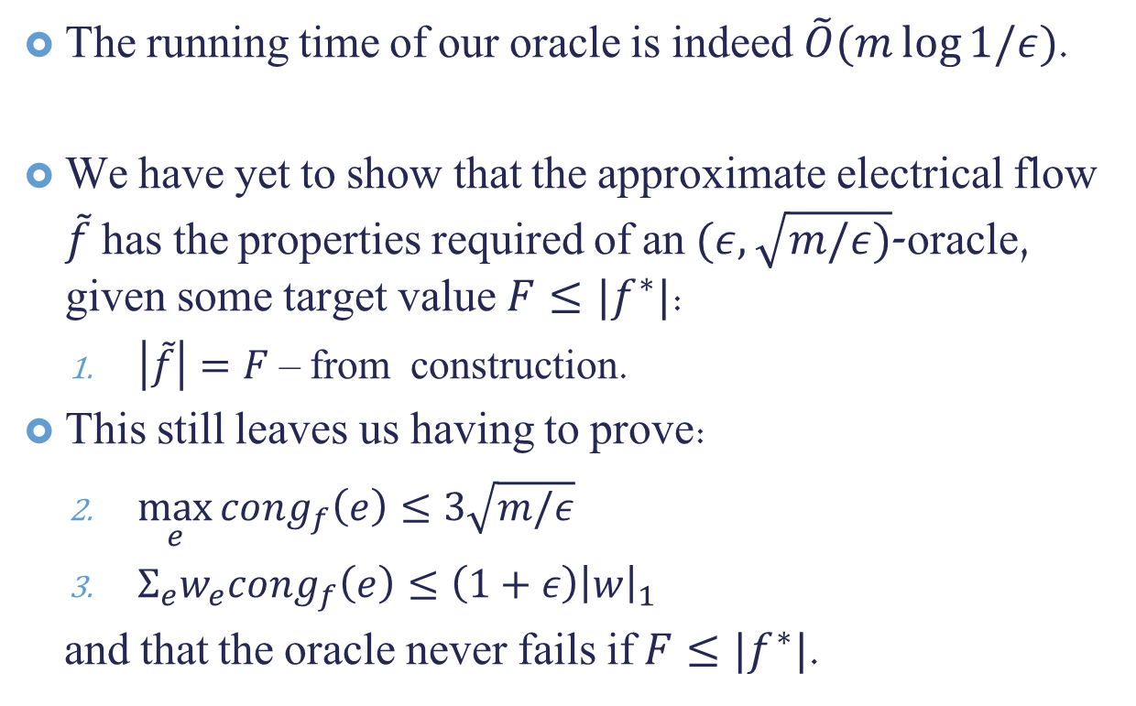
$(ε,3\sqrt{m/ε)}$-oracle from Approximate Electrical Flow
The running time of our oracle is indeed $\tilde{O}(m\log{1/ε})$.
We have yet to show that the approximate electrical flow $\tilde{f}$ has the properties required of an $(ε,\sqrt{m/ε)}$-oracle, given some target value $F≤|f^{∗}|$:
$\left|\tilde{f}\right|=F$ – from construction.
This still leaves us having to prove:
$\max_{e}{cong_{f}\left(e\right)≤3\sqrt{m/ε}}$
$Σ_{e}w_{e}cong_{f}\left(e\right)≤\left(1+ε\right){\left|w\right|}_{1}$
and that the oracle never fails if $F≤|f^{∗}|$.

Slide 45

For the remaining guarantees, including bounds on the weighted and maximum congestion, we upper bound the energy of $\tilde{f}$.
Consider $f^{∗}$, some maximum flow. By its feasibility, $cong_{f^{∗}}\left(e\right)=f_{e}^{∗}/c_{e}≤1$ for all $e∈E$, so $ℇ_{r}\left(f^{∗}\right)=\sum_{e}{\left(w_{e}+\frac{ε{\left|w\right|}_{1}}{3m}\right){\left(\frac{f_{e}^{∗}}{c_{e}}\right)}^{2}}$ $≤\sum_{e}{\left(w_{e}+\frac{ε{\left|w\right|}_{1}}{3m}\right)}$ $=\left(1+\frac{ε}{3}\right){\left|w\right|}_{1}$

Slide 46
For the remaining guarantees, including bounds on the weighted and maximum congestion, we upper bound the energy of $\tilde{f}$.
Consider $f^{∗}$, some maximum flow. By its feasibility, $cong_{f^{∗}}\left(e\right)=f_{e}^{∗}/c_{e}≤1$ for all $e∈E$, so $ℇ_{r}\left(f^{∗}\right)=\sum_{e}{\left(w_{e}+\frac{ε{\left|w\right|}_{1}}{3m}\right){\left(\frac{f_{e}^{∗}}{c_{e}}\right)}^{2}}$ $≤\sum_{e}{\left(w_{e}+\frac{ε{\left|w\right|}_{1}}{3m}\right)}$ $=\left(1+\frac{ε}{3}\right){\left|w\right|}_{1}$

Slide 47
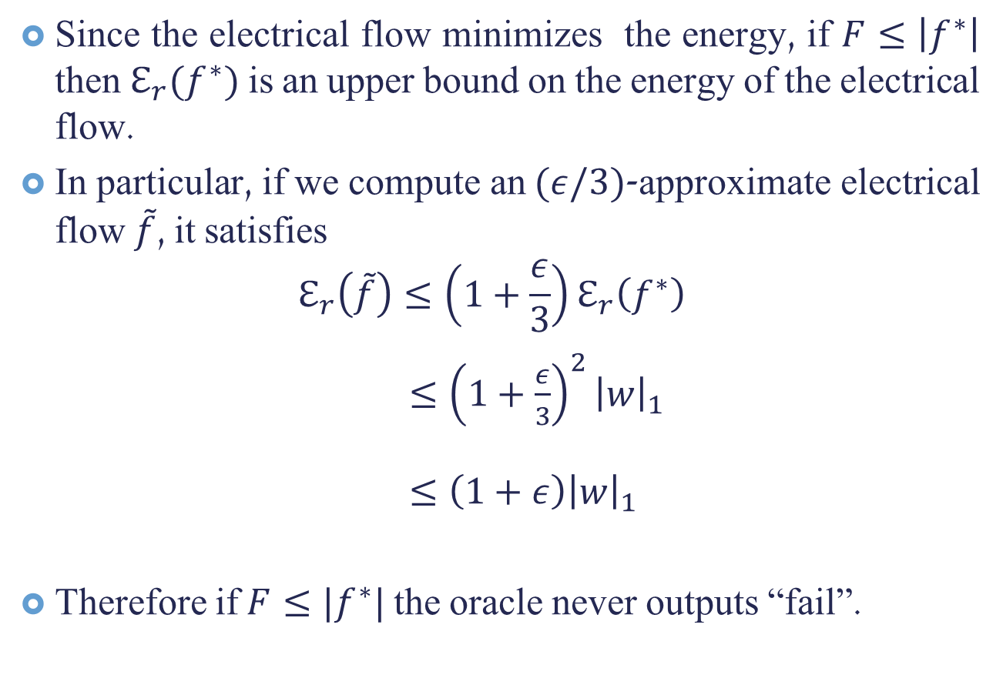
Since the electrical flow minimizes the energy, if $F≤\left|f^{∗}\right|$ then $ℇ_{r}(f^{∗})$ is an upper bound on the energy of the electrical flow.
In particular, if we compute an $(ε/3)$-approximate electrical flow $\tilde{f}$, it satisfies
$$ℇ_{r}\left(\tilde{f}\right)≤\left(1+\frac{ε}{3}\right)ℇ_{r}\left(f^{∗}\right)$$
$≤{\left(1+\frac{ε}{3}\right)}^{2}{\left|w\right|}_{1}$
$≤\left(1+ε\right){\left|w\right|}_{1}$
Therefore if $F≤|f^{∗}|$ the oracle never outputs “fail”.

Slide 48
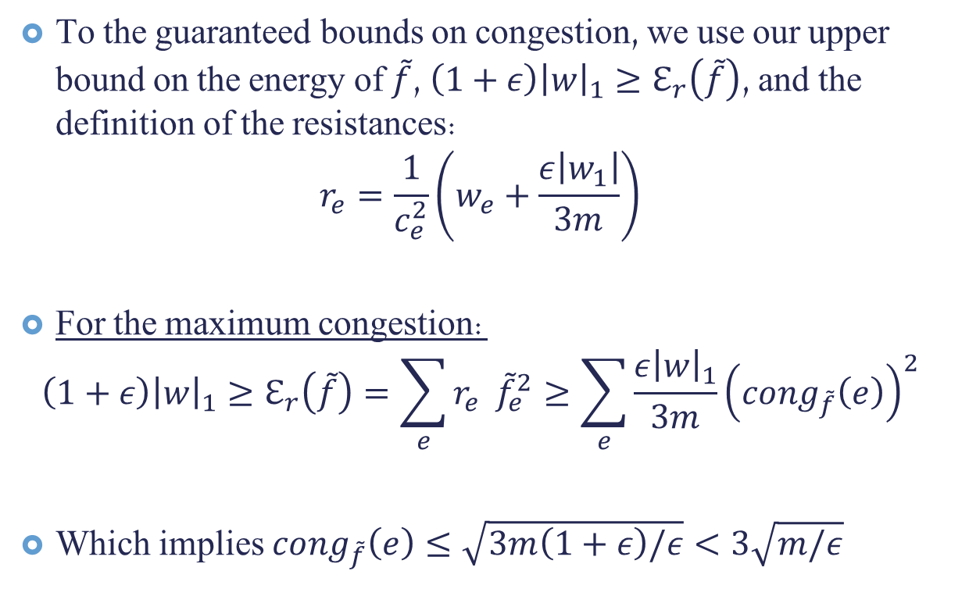
Bounds on Congestion
To the guaranteed bounds on congestion, we use our upper bound on the energy of $\tilde{f}$, $\left(1+ε\right){\left|w\right|}_{1}≥ℇ_{r}\left(\tilde{f}\right)$, and the definition of the resistances:
$$r_{e}=\frac{1}{c_{e}^{2}}\left(w_{e}+\frac{ε\left|w_{1}\right|}{3m}\right)$$
For the maximum congestion:
$$\left(1+ε\right){\left|w\right|}_{1}≥ℇ_{r}\left(\tilde{f}\right)=\sum_{e}{r_{e}} {\tilde{f}}_{e}^{2}≥\sum_{e}{\frac{ε{\left|w\right|}_{1}}{3m}{\left(cong_{\tilde{f}}\left(e\right)\right)}^{2}}$$
Which implies $cong_{\tilde{f}}\left(e\right)≤\sqrt{3m\left(1+ε\right)/ε}<3\sqrt{m/ε}$

Slide 49
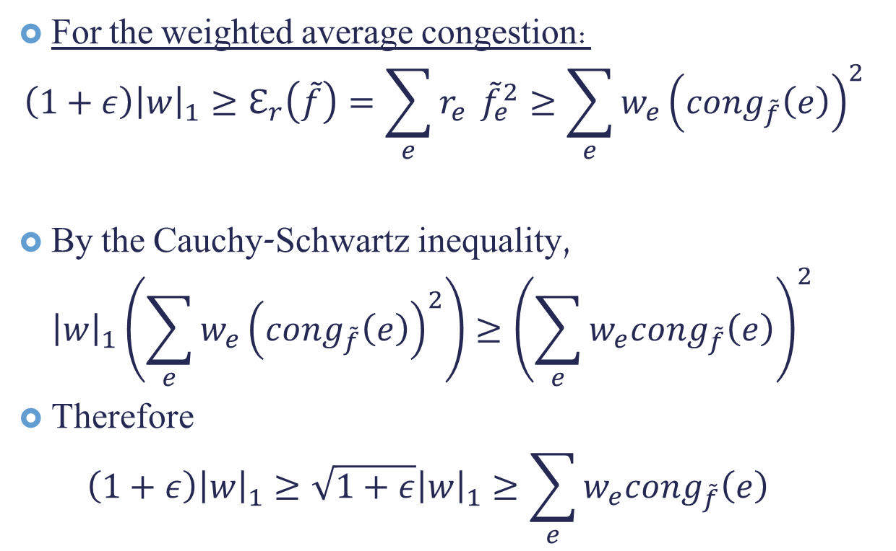
Bounds on Congestion (2)
For the weighted average congestion:
$$\left(1+ε\right){\left|w\right|}_{1}≥ℇ_{r}\left(\tilde{f}\right)=\sum_{e}{r_{e}} {\tilde{f}}_{e}^{2}≥\sum_{e}{w_{e}{\left(cong_{\tilde{f}}\left(e\right)\right)}^{2}}$$
By the Cauchy-Schwartz inequality, ${\left|w\right|}_{1}\left(\sum_{e}{w_{e}{\left(cong_{\tilde{f}}\left(e\right)\right)}^{2}}\right)≥{\left(\sum_{e}{w_{e}cong_{\tilde{f}}\left(e\right)}\right)}^{2}$
Therefore $\left(1+ε\right){\left|w\right|}_{1}^{}≥\sqrt{1+ε}{\left|w\right|}_{1}^{}≥\sum_{e}{w_{e}cong_{\tilde{f}}\left(e\right)}$

Slide 50
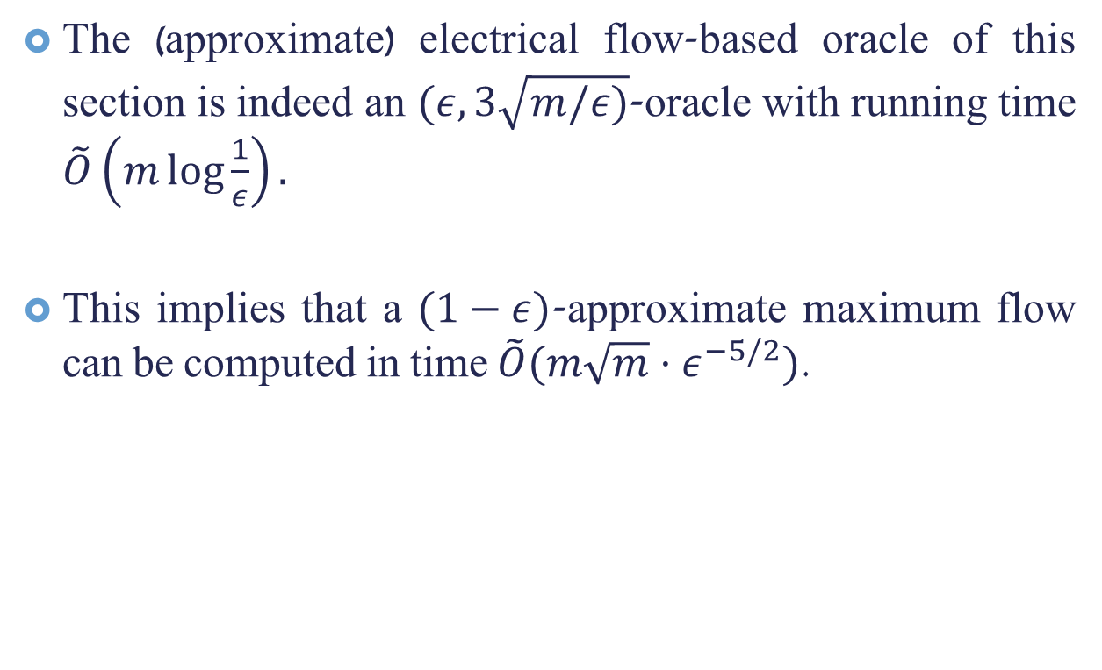
Conclusion: Oracle from Approximate Electrical Flow
The (approximate) electrical flow-based oracle of this section is indeed an $(ε,3\sqrt{m/ε)}$-oracle with running time $\tilde{O}\left(m\log{\frac{1}{ε}}\right).$
This implies that a $(1−ε)$-approximate maximum flow can be computed in time $\tilde{O}(m\sqrt{m}⋅ε^{−5/2})$.

Slide 51
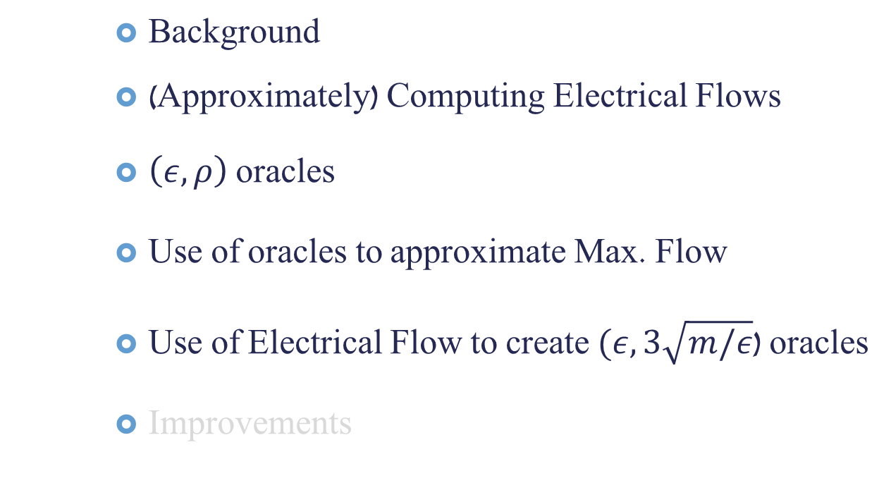
Talk Outline
Background
(Approximately) Computing Electrical Flows
$\left(ε,ρ\right)$ oracles
Use of oracles to approximate Max. Flow
Use of Electrical Flow to create $(ε,3\sqrt{m/ε}$) oracles
Improvements

Slide 52
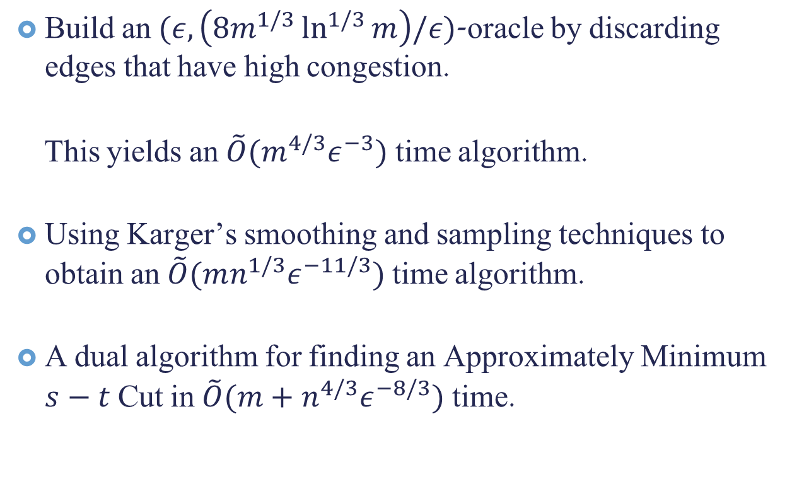
Improvements Not Covered
Build an $(ε,\left(8m^{1/3}\ln^{1/3}{m}\right)/ε)$-oracle by discarding edges that have high congestion.
This yields an $\tilde{O}(m^{4/3}ε^{−3})$ time algorithm.
Using Karger’s smoothing and sampling techniques to obtain an $\tilde{O}(mn^{1/3}ε^{−11/3})$ time algorithm.
A dual algorithm for finding an Approximately Minimum $s−t$ Cut in $\tilde{O}(m+n^{4/3}ε^{−8/3})$ time.

Slide 53
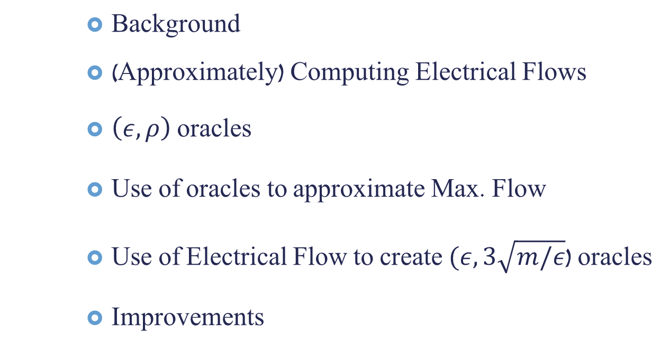
Talk Outline
Background
(Approximately) Computing Electrical Flows
$\left(ε,ρ\right)$ oracles
Use of oracles to approximate Max. Flow
Use of Electrical Flow to create $(ε,3\sqrt{m/ε}$) oracles
Improvements

Slide 54
Questions?

Slide 55

Thank You

