Slide 1

Color-Coding
Speaker: David Wajc
Talk given as part of: Technion CS Department FPT Algorithms Seminar (236804)
Notes:
(Mainly) Based on a paper of Alon, Yuster and Zwick from STOC 94 of the same name.

Slide 2
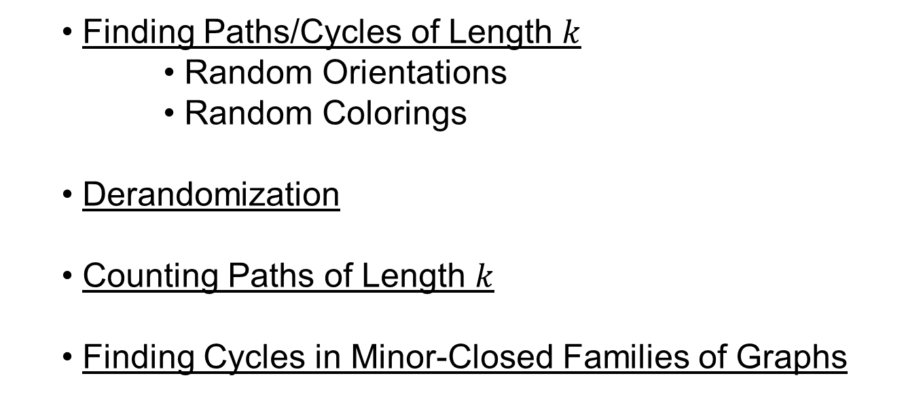
Talk Outline
Finding Paths/Cycles of Length $k$
Random Orientations
Random Colorings
Derandomization
Counting Paths of Length $k$
Finding Cycles in Minor-Closed Families of Graphs

Slide 3

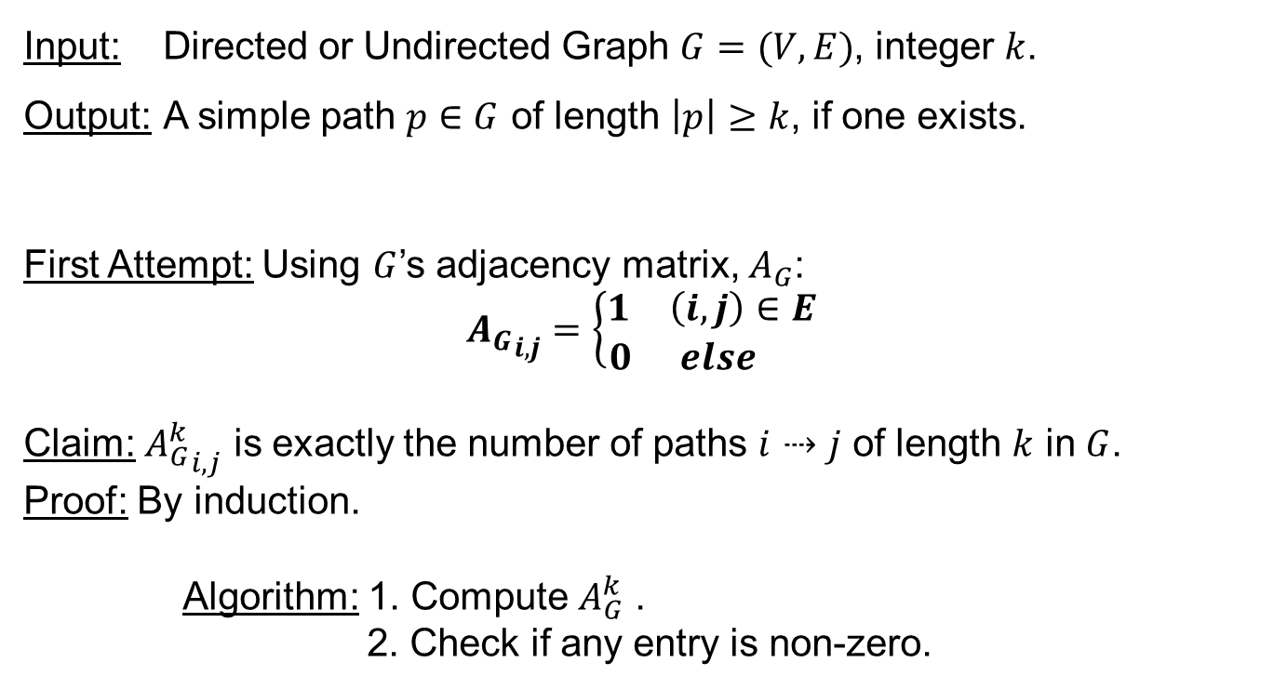
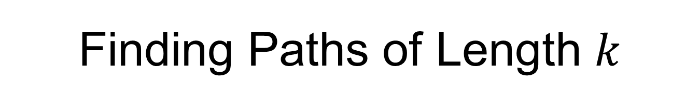
Finding Paths of Length $k$
Input: Directed or Undirected Graph $G=(V,E)$, integer $k$.
Output: A simple path $p∈G$ of length $\left|p\right|≥k$, if one exists.
First Attempt: Using $G$’s adjacency matrix, $A_{G}$:
$${A_{G}}_{i,j}=\left\{\begin{aligned}\begin{matrix}1 & \left(i,j\right)∈E\end{matrix} \\ \begin{matrix}0 & else \end{matrix}\end{aligned}\right.$$
Claim: ${A_{G}^{k}}_{i,j}$ is exactly the number of paths $i⇢j$ of length $k$ in $G$.
Proof: By induction.
Algorithm: 1. Compute $A_{G}^{k}$ .
2. Check if any entry is non-zero.
Notes:
Recall: This problem is NP-Hard (obvious reduction from Hamiltonian Path)
Also, in his talk here, Mike Fellows mentioned that k-path parametrized by the length of the sought-after path does not admit a polynomial-sized kernel. As we will see, this does not mean there are no FPT algorithms for this problem.

Slide 4
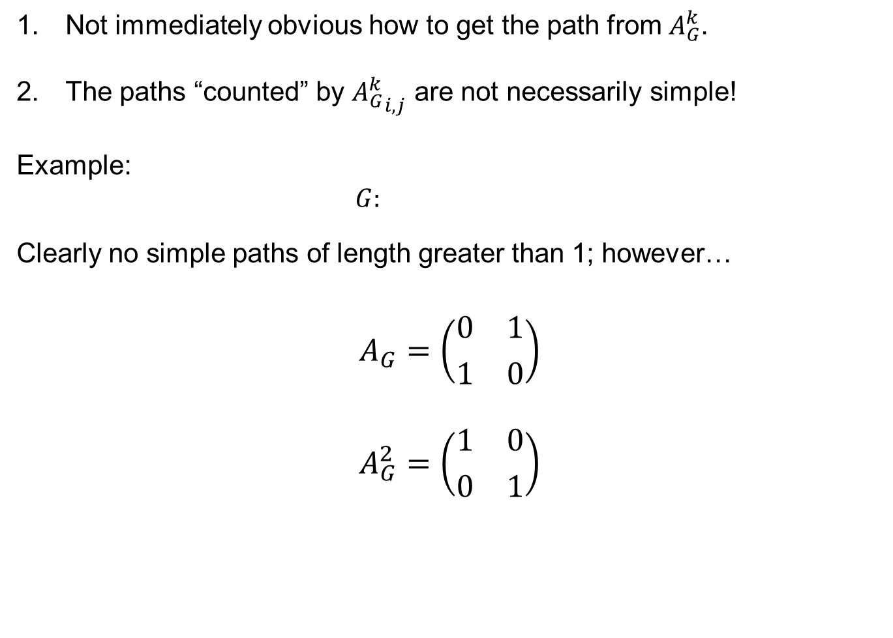
Problems with Adjacency Matrix Multiplication Approach
Not immediately obvious how to get the path from $A_{G}^{k}$.
The paths “counted” by ${A_{G}^{k}}_{i,j}$ are not necessarily simple!
Example:
$G:$
Clearly no simple paths of length greater than 1; however…
$$A_{G}=\left({\begin{matrix}0 & 1\end{matrix} \atop \begin{matrix}1 & 0\end{matrix}}\right)$$
$$A_{G}^{2}=\left({\begin{matrix}1 & 0\end{matrix} \atop \begin{matrix}0 & 1\end{matrix}}\right)$$
1
2
Notes:
This is somewhat reassuring, as Hamiltonian Path is NP-Complete, and if the above algorithm were correct, we’d have a polynomial-time algorithm for Hamiltonian Path.

Slide 5
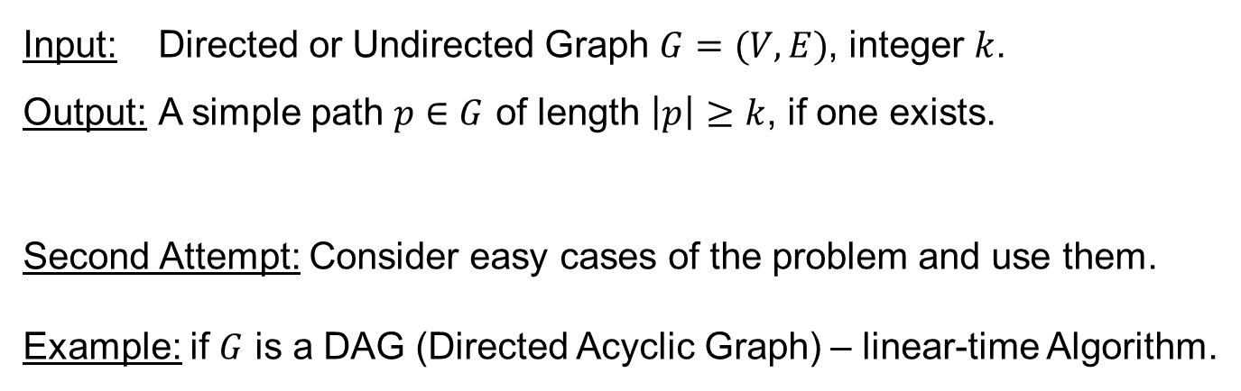
Finding Paths of Length $k$
Input: Directed or Undirected Graph $G=(V,E)$, integer $k$.
Output: A simple path $p∈G$ of length $\left|p\right|≥k$, if one exists.
Second Attempt: Consider easy cases of the problem and use them.
Example: if $G$ is a DAG (Directed Acyclic Graph) – linear-time Algorithm.

Slide 6
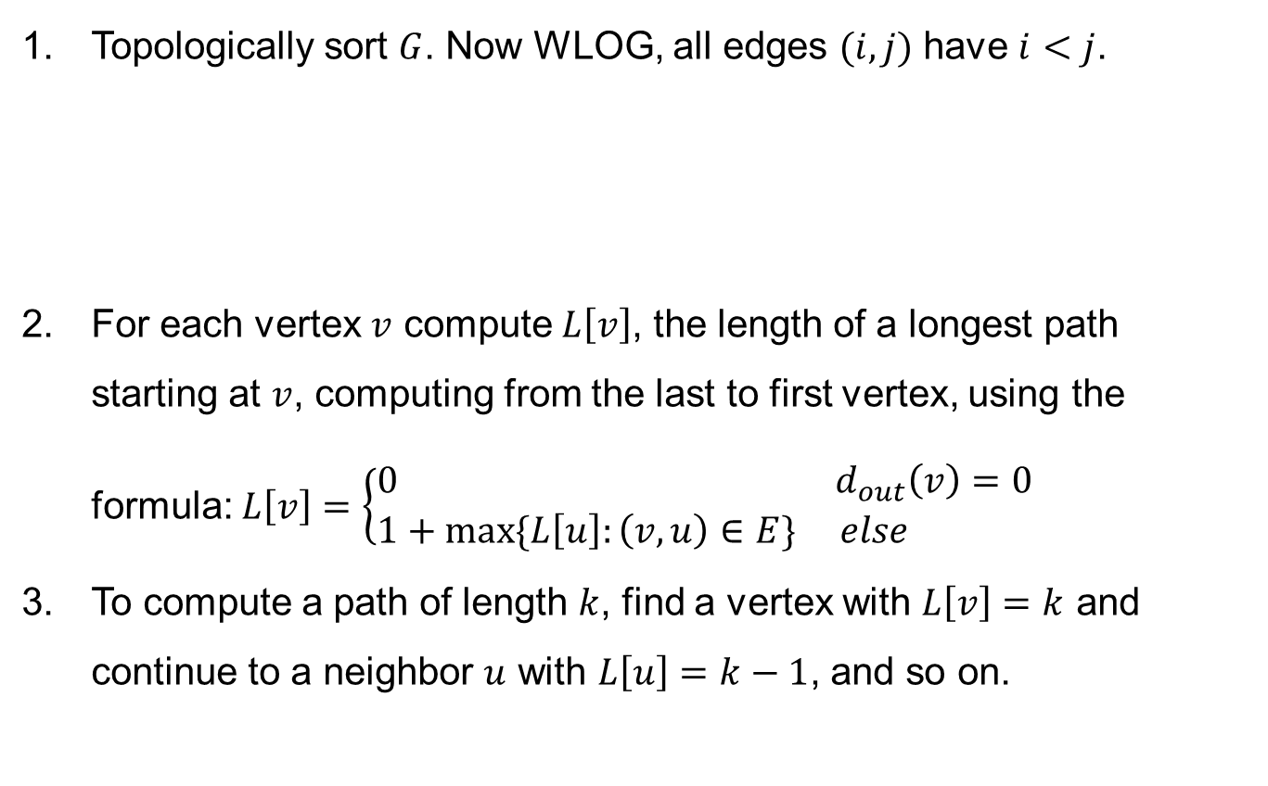
Finding Longest Path in a DAG
Topologically sort $G$. Now WLOG, all edges $(i,j)$ have $i<j$.
For each vertex $v$ compute $L\left[v\right]$, the length of a longest path starting at $v$, computing from the last to first vertex, using the formula: $L\left[v\right]=\left\{\begin{matrix}0 & d_{out}\left(v\right)=0 \\ 1+max⁡\{L\left[u\right]:\left(v,u\right)∈E\} & else \end{matrix}\right.$
To compute a path of length $k$, find a vertex with $L\left[v\right]=k$ and continue to a neighbor $u$ with $L\left[u\right]=k−1$, and so on.
1
2
3
4
5
6
n

Slide 7
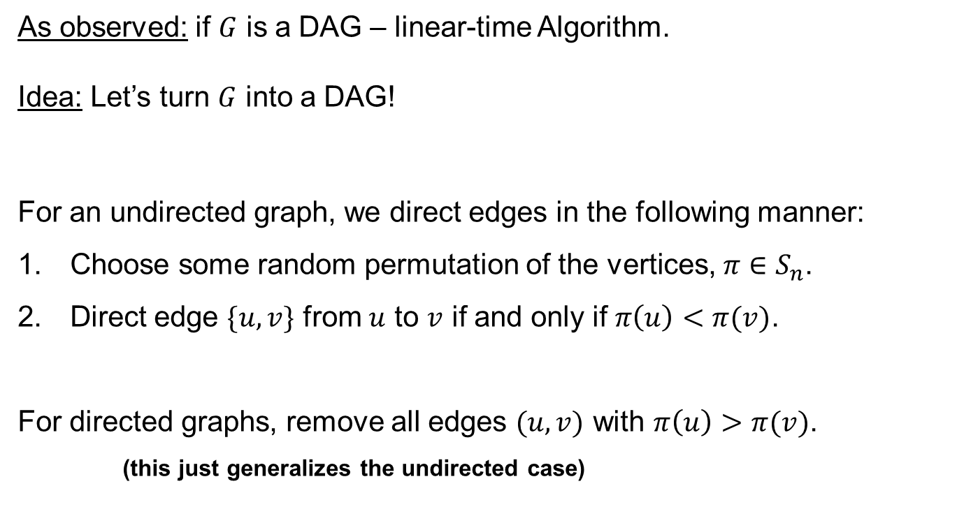
Finding Paths of Length $k$
As observed: if $G$ is a DAG – linear-time Algorithm.
Idea: Let’s turn $G$ into a DAG!
For an undirected graph, we direct edges in the following manner:
Choose some random permutation of the vertices, $π∈S_{n}$.
Direct edge $\{u,v\}$ from $u$ to $v$ if and only if $π\left(u\right)<π(v)$.
For directed graphs, remove all edges $(u,v)$ with $π\left(u\right)>π(v)$.
(this just generalizes the undirected case)

Slide 8
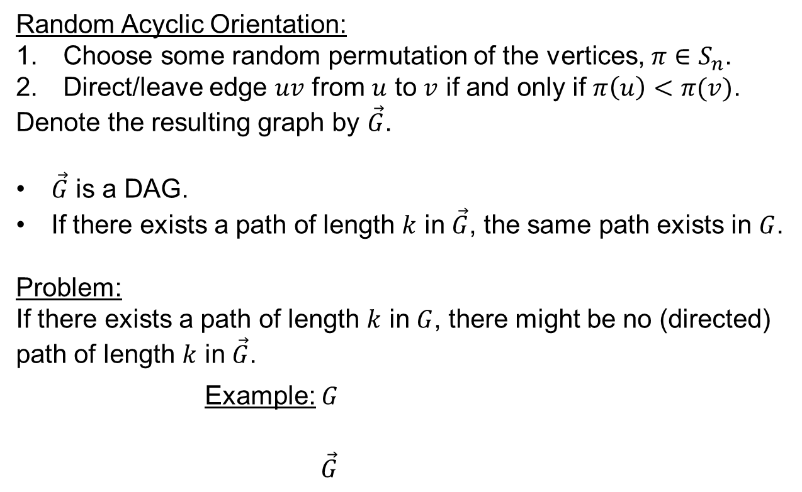
Random Orientations
Random Acyclic Orientation:
Choose some random permutation of the vertices, $π∈S_{n}$.
Direct/leave edge $uv$ from $u$ to $v$ if and only if $π\left(u\right)<π(v)$.
Denote the resulting graph by $\vec{G}$.
$\vec{G}$ is a DAG.
If there exists a path of length $k$ in $\vec{G}$, the same path exists in $G$.
Problem:
If there exists a path of length $k$ in $G$, there might be no (directed) path of length $k$ in $\vec{G}$.
Example: $G$
$\vec{G}$
1
2
4
3

Slide 9
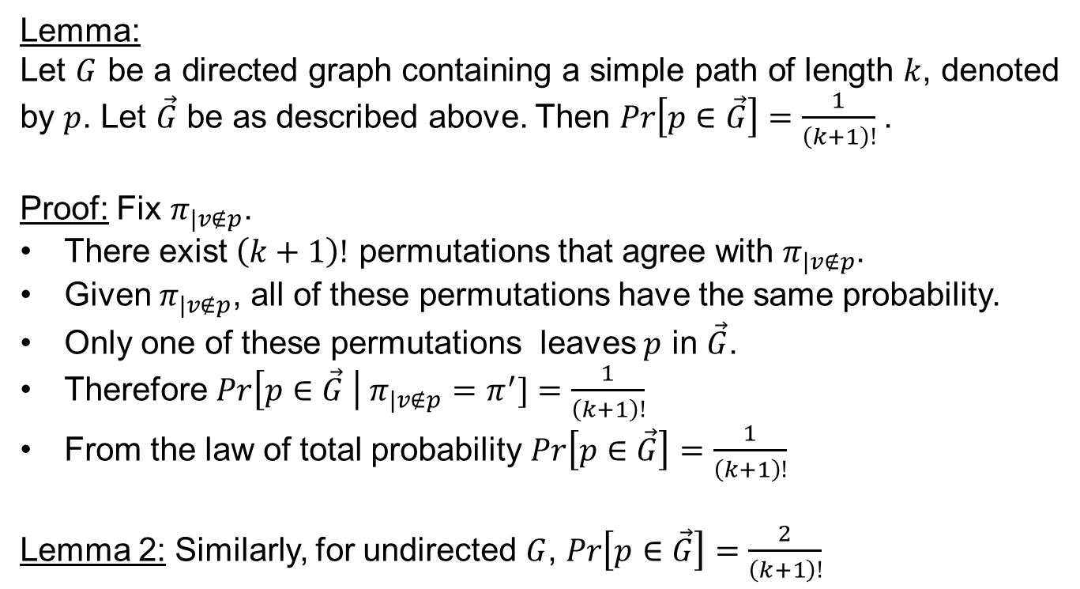
Random Orientations: Probability of Success
Lemma:
Let $G$ be a directed graph containing a simple path of length $k$, denoted by $p$. Let $\vec{G}$ be as described above. Then $\operatorname{Pr}\left[p∈\vec{G}\right]=\frac{1}{\left(k+1\right)!}$.
Proof: Fix $π_{|v∉p}$.
There exist $\left(k+1\right)!$ permutations that agree with $π_{|v∉p}$.
Given $π_{|v∉p}$, all of these permutations have the same probability.
Only one of these permutations leaves $p$ in $\vec{G}$.
Therefore $Pr\left[p∈\vec{G} \right| π_{|v∉p}=π^{′}]=\frac{1}{\left(k+1\right)!}$
From the law of total probability $Pr\left[p∈\vec{G}\right]=\frac{1}{\left(k+1\right)!}$
Lemma 2: Similarly, for undirected $G$, $\operatorname{Pr}\left[p∈\vec{G}\right]=\frac{2}{\left(k+1\right)!}$

Slide 10
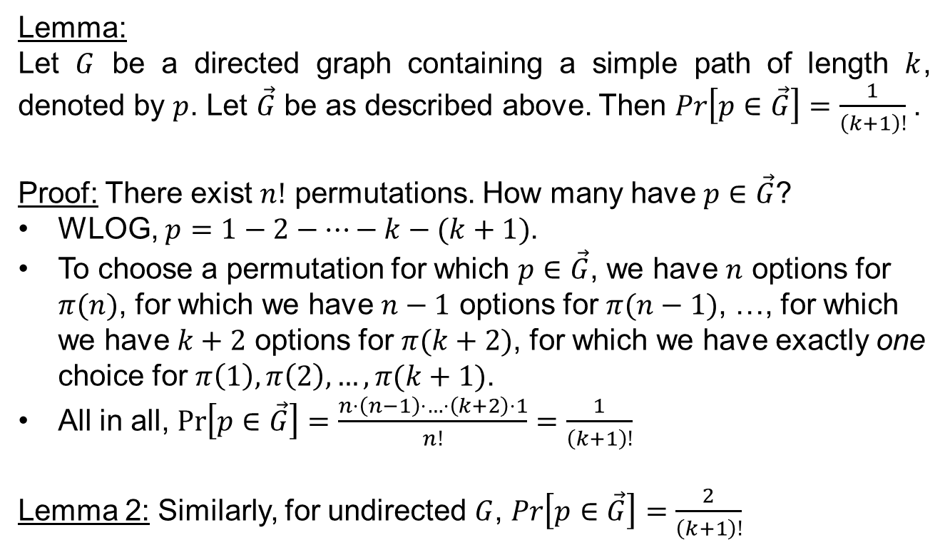
Random Orientations: Probability of Success Alternative Proof
Lemma:
Let $G$ be a directed graph containing a simple path of length $k$, denoted by $p$. Let $\vec{G}$ be as described above. Then $\operatorname{Pr}\left[p∈\vec{G}\right]=\frac{1}{\left(k+1\right)!}$.
Proof: There exist $n!$ permutations. How many have $p∈\vec{G}$?
WLOG, $p=1−2−…−k−(k+1)$.
To choose a permutation for which $p∈\vec{G}$, we have $n$ options for $π(n)$, for which we have $n−1$ options for $π(n−1)$, …, for which we have $k+2$ options for $π(k+2)$, for which we have exactly one choice for $π\left(1\right),π\left(2\right),…,π(k+1)$.
All in all, $\operatorname{Pr}\left[p∈\vec{G}\right]=\frac{n⋅\left(n−1\right)⋅…⋅\left(k+2\right)⋅1}{n!}=\frac{1}{\left(k+1\right)!}$
Lemma 2: Similarly, for undirected $G$, $\operatorname{Pr}\left[p∈\vec{G}\right]=\frac{2}{\left(k+1\right)!}$

Slide 11
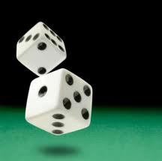
Random Algorithms
Random Algorithms come in two main flavors:
Las Vegas Algorithms: The algorithm always outputs correct solution, but the running time is a random variable.
Example: QuickSort.
Monte Carlo Algorithms: The algorithm’s running time is bounded, but it has a probability of error.
Examples:
The algorithm we are devising.
Many Primality Testing Algorithms, etc’…

Slide 12
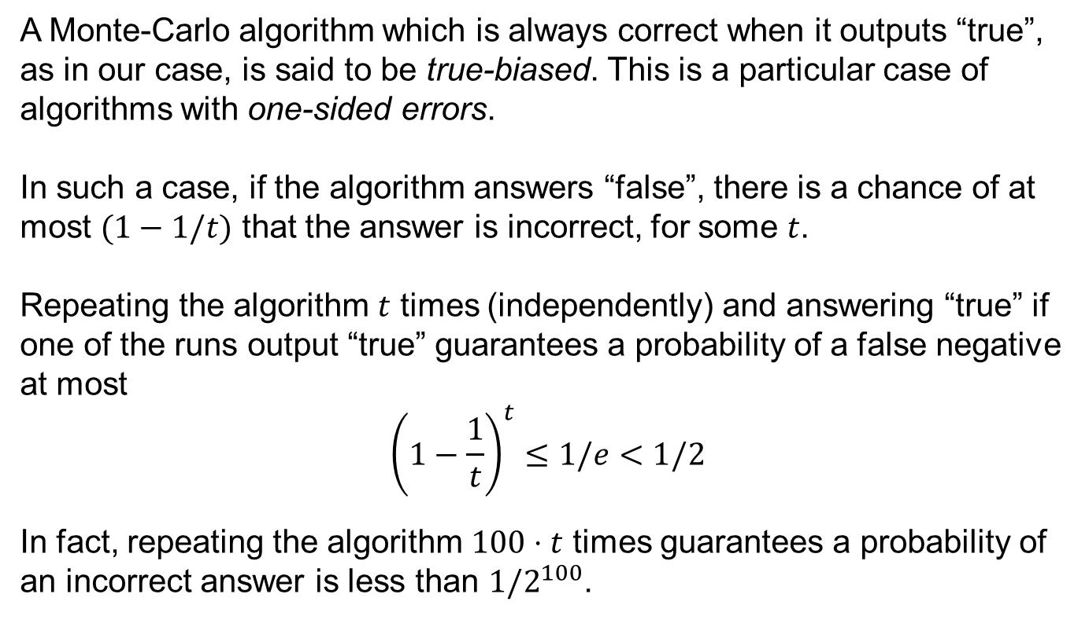
Monte-Carlo Algorithms Amplification
A Monte-Carlo algorithm which is always correct when it outputs “true”, as in our case, is said to be true-biased. This is a particular case of algorithms with one-sided errors.
In such a case, if the algorithm answers “false”, there is a chance of at most $(1−1/t)$ that the answer is incorrect, for some $t$.
Repeating the algorithm $t$ times (independently) and answering “true” if one of the runs output “true” guarantees a probability of a false negative at most
$${\left(1−\frac{1}{t}\right)}^{t}≤1/e<1/2$$
In fact, repeating the algorithm $100⋅t$ times guarantees a probability of an incorrect answer is less than $1/2^{100}$.

Slide 13
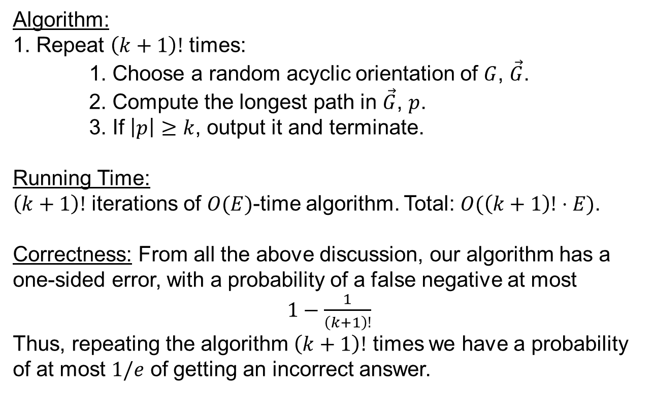
Random Orientation: An Algorithm
Algorithm:
1. Repeat $\left(k+1\right)!$ times:
1. Choose a random acyclic orientation of $G$, $\vec{G}$.
2. Compute the longest path in $\vec{G}$, $p$.
3. If $\left|p\right|≥k$, output it and terminate.
Running Time:
$\left(k+1\right)!$ iterations of $O(E)$-time algorithm. Total: $O(\left(k+1\right)!⋅E)$.
Correctness: From all the above discussion, our algorithm has a one-sided error, with a probability of a false negative at most
$1−\frac{1}{\left(k+1\right)!}$
Thus, repeating the algorithm $\left(k+1\right)!$ times we have a probability of at most $1/e$ of getting an incorrect answer.

Slide 14
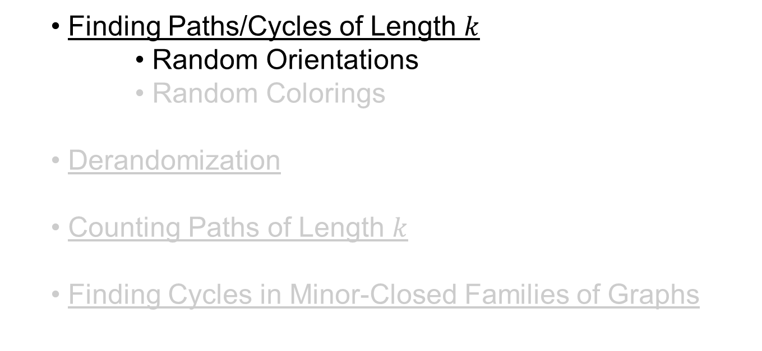
Talk So Far
Finding Paths/Cycles of Length $k$
Random Orientations
Random Colorings
Derandomization
Counting Paths of Length $k$
Finding Cycles in Minor-Closed Families of Graphs

Slide 15

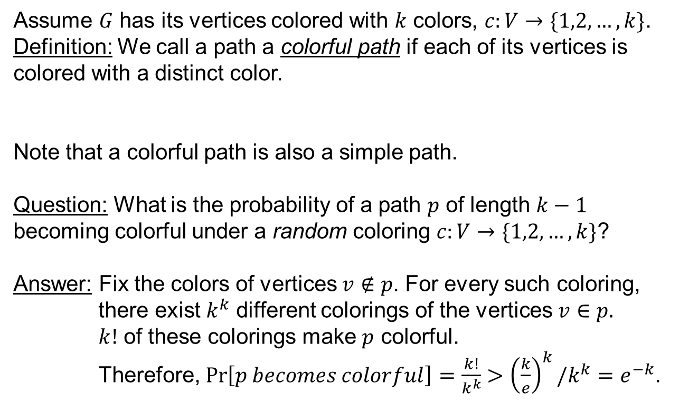




Random Colorings
Assume $G$ has its vertices colored with $k$ colors, $c:V→\{1,2,…,k\}$.
Definition: We call a path a colorful path if each of its vertices is colored with a distinct color.
Note that a colorful path is also a simple path.
Question: What is the probability of a path $p$ of length $k−1$ becoming colorful under a random coloring $c:V→\{1,2,…,k\}$?
Answer: Fix the colors of vertices $v∉p$. For every such coloring,
there exist $k^{k}$ different colorings of the vertices $v∈p.$
$k!$ of these colorings make $p$ colorful.
Therefore, $\operatorname{Pr}\left[p becomes colorful\right]=\frac{k!}{k^{k}}>{\left(\frac{k}{e}\right)}^{k}/k^{k}=e^{−k}$.
Notes:
Computer Scientists being Computer Scientists, when we consider $k$ colors, we are basically talking about an enum of $k$
elements… The bound $k!>{\left(\frac{k}{e}\right)}^{k}$ can be verified by induction. Alternatively, it can be proved using Stirling’s approximation.

Slide 16
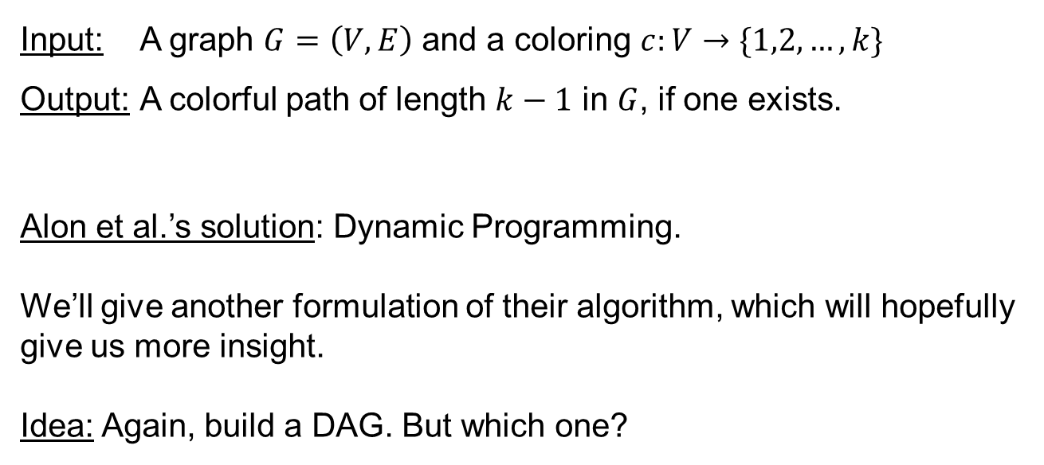
Finding Colorful Paths
Input: A graph $G=\left(V,E\right)$ and a coloring $c:V→\{1,2,…,k\}$
Output: A colorful path of length $k−1$ in $G$, if one exists.
Alon et al.’s solution: Dynamic Programming.
We’ll give another formulation of their algorithm, which will hopefully give us more insight.
Idea: Again, build a DAG. But which one?

Slide 17

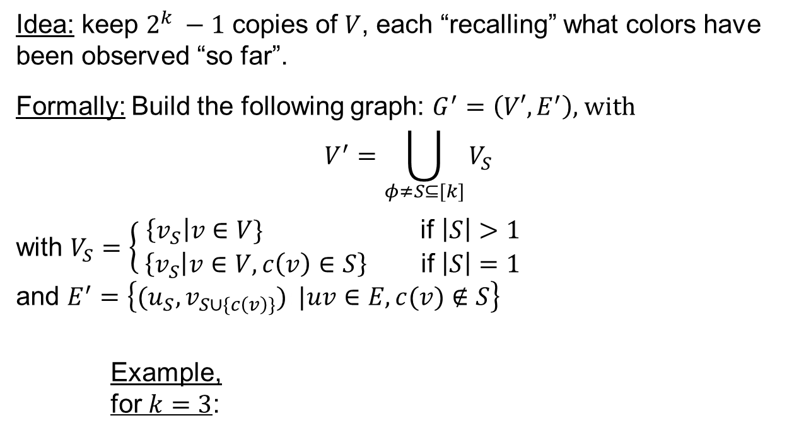






Finding Colorful Paths: A Reduction
Idea: keep $2^{k} −1$ copies of $V$, each “recalling” what colors have been observed “so far”.
Formally: Build the following graph: $G^{′}=\left(V′,E^{′}\right)$, with
$$V^{′}=\bigcup_{φ≠S⊆[k]}{V_{S}}$$
with $V_{S}=\left\{\begin{aligned}\left\{v_{S}\right|v∈V\} \text{if} \left|S\right|>1 \\ \left\{v_{S} | v∈V, c\left(v\right)∈S\right\} \text{if} \left|S\right|=1 \end{aligned}\right.$
and $E^{′}=\left\{{(u}_{S},v_{S∪\{c\left(v\right)\}}):|uv∈E, c(v)∉S\right\}$
Example,
for $k=3$:
$$V_{\{1\}}$$
$$V_{\{1,2\}}$$
$$V_{\{2\}}$$
$$V_{\{1,3\}}$$
$$V_{\{1,2,3\}}$$
$$V_{\{3\}}$$
$$V_{\{2,3\}}$$

Slide 18
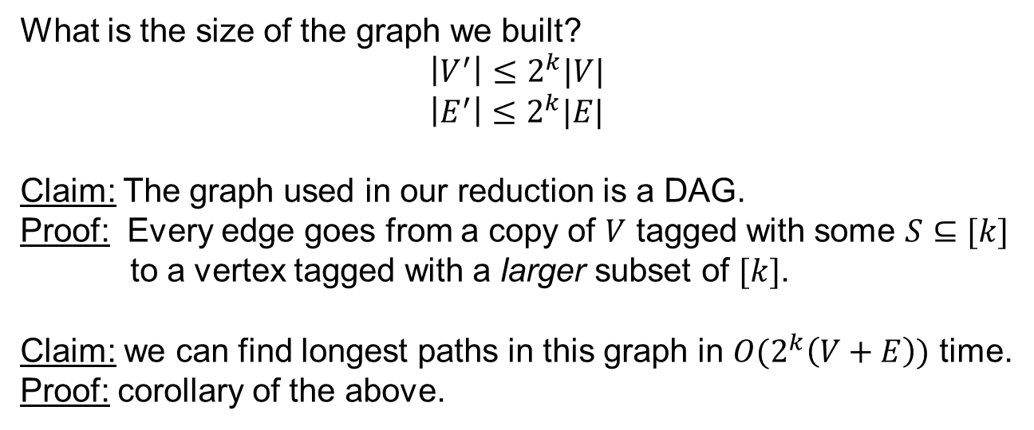
Finding Colorful Paths: The Reduction Graph
What is the size of the graph we built?
$$\left|V^{′}\right|≤2^{k}|V|$$
$$\left|E^{′}\right|≤2^{k}|E|$$
Claim: The graph used in our reduction is a DAG.
Proof: Every edge goes from a copy of $V$ tagged with some $S⊆[k]$
to a vertex tagged with a larger subset of $[k]$.
Claim: we can find longest paths in this graph in $O(2^{k}\left(V+E\right))$ time.
Proof: corollary of the above.
$$V_{\{1\}}$$
$$V_{\{1,2\}}$$
$$V_{\{2\}}$$
$$V_{\{1,3\}}$$
$$V_{\{1,2,3\}}$$
$$V_{\{3\}}$$
$$V_{\{2,3\}}$$

Slide 19
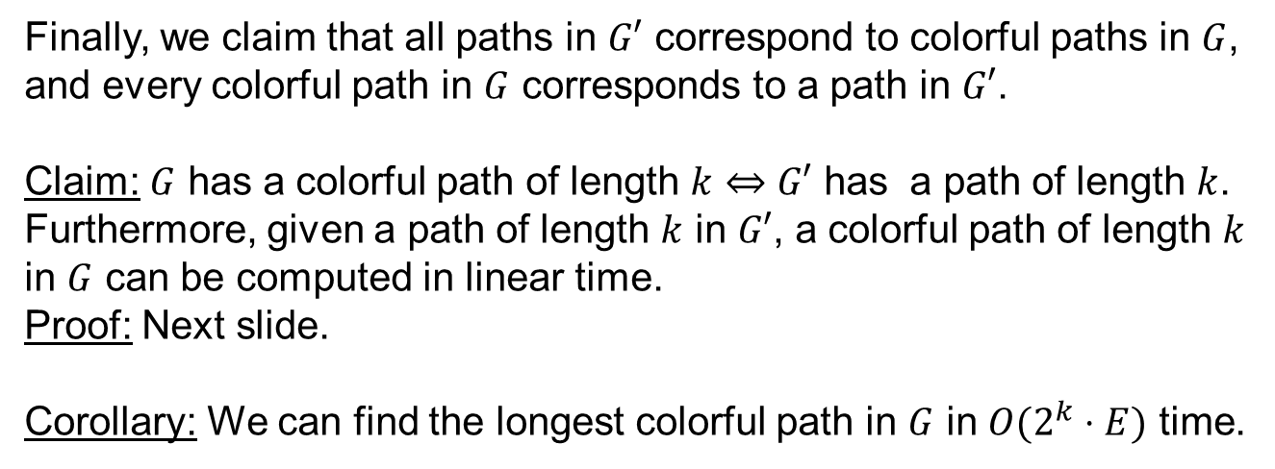
Finding Colorful Paths: A Reduction (Correctness)
Finally, we claim that all paths in $G′$ correspond to colorful paths in $G$, and every colorful path in $G$ corresponds to a path in $G′$.
Claim: $G$ has a colorful path of length $k$ $⇔$ $G′$ has a path of length $k$.
Furthermore, given a path of length $k$ in $G′$, a colorful path of length $k$ in $G$ can be computed in linear time.
Proof: Next slide.
Corollary: We can find the longest colorful path in $G$ in $O(2^{k}⋅E)$ time.
$$V_{\{1\}}$$
$$V_{\{1,2\}}$$
$$V_{\{2\}}$$
$$V_{\{1,3\}}$$
$$V_{\{1,2,3\}}$$
$$V_{\{3\}}$$
$$V_{\{2,3\}}$$

Slide 20
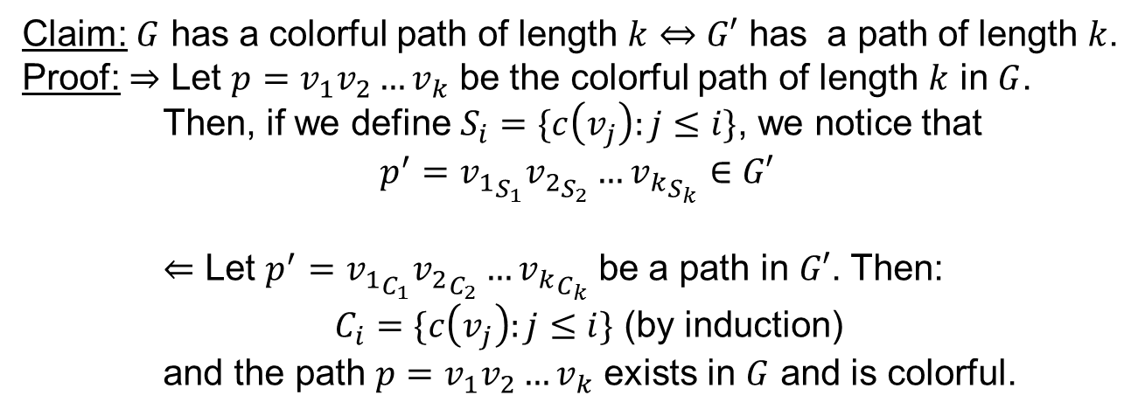
Finding Colorful Paths: A Reduction (Correctness)
Claim: $G$ has a colorful path of length $k$ $⇔$ $G′$ has a path of length $k$.
Proof: $⇒$ Let $p=v_{1}v_{2}…v_{k}$ be the colorful path of length $k$ in $G$.
Then, if we define $S_{i}=\{c\left(v_{j}\right):j≤i\}$, we notice that
$$p^{′}={v_{1}}_{S_{1}}{v_{2}}_{S_{2}}…{v_{k}}_{S_{k}}∈G′$$
$⇐$ Let $p^{′}={v_{1}}_{C_{1}}{v_{2}}_{C_{2}}…{v_{k}}_{C_{k}}$ be a path in $G′$. Then:
$C_{i}=\{c\left(v_{j}\right):j≤i\}$ (by induction)
and the path $p=v_{1}v_{2}…v_{k}$ exists in $G$ and is colorful.
$$V_{\{1\}}$$
$$V_{\{1,2\}}$$
$$V_{\{2\}}$$
$$V_{\{1,3\}}$$
$$V_{\{1,2,3\}}$$
$$V_{\{3\}}$$
$$V_{\{2,3\}}$$
Notes:
For simplicity, in this proof we refer to paths of length $t−1$ as paths of length $t$.
For $⇒$: This path exists since ${v_{1}}_{S_{1}}∈G′$ and the relevant edges exist, that is $({v_{i}}_{S_{i}},{v_{i+1}}_{S_{i+1}})∈E′$, since $c(v_{i+1})∉S_{i}$ and ${(v}_{i},v_{i+1})∈E$ for all $0≤i≤k−1$.
For $⇐$: This path exists, since $\left(u_{C_{i}},v_{C_{i+1}}\right)∈E′$ implies $uv∈E$ and $c\left(v\right)∉C_{i}$. In particular, every vertex on the path has a distinct color.

Slide 21
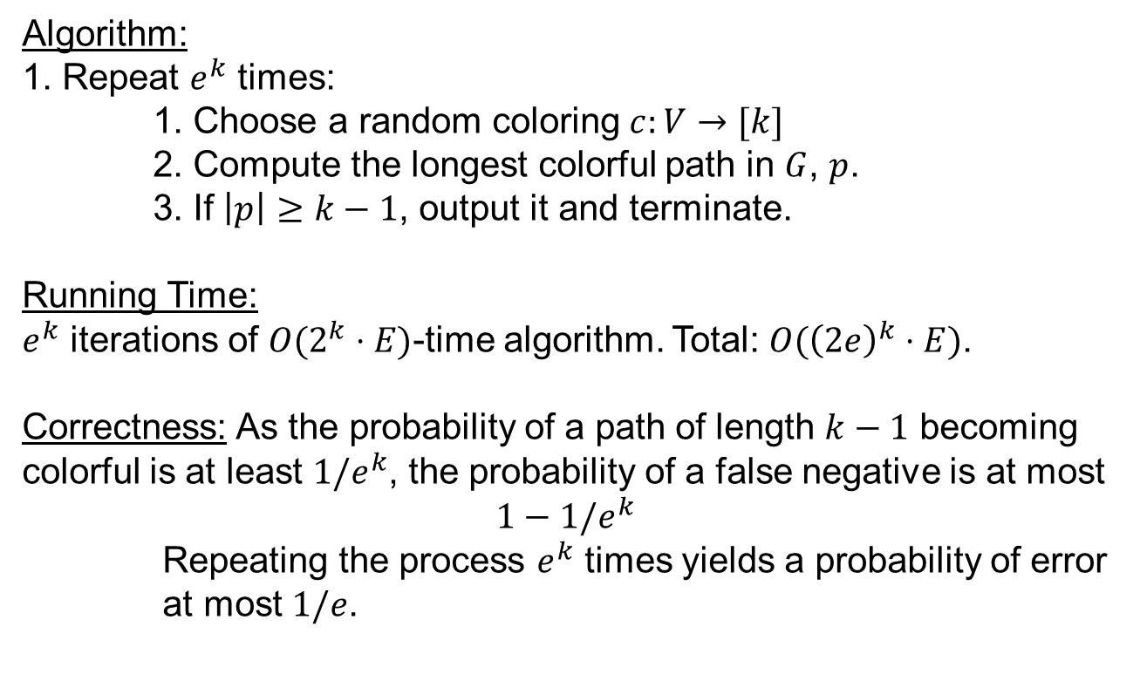
Random Coloring: An Algorithm
Algorithm:
1. Repeat $e^{k}$ times:
1. Choose a random coloring $c:V→[k]$
2. Compute the longest colorful path in $G$, $p$.
3. If $\left|p\right|≥k−1$, output it and terminate.
Running Time:
$e^{k}$ iterations of $O(2^{k}⋅E)$-time algorithm. Total: $O({\left(2e\right)}^{k}⋅E)$.
Correctness: As the probability of a path of length $k−1$ becoming colorful is at least $1/e^{k}$, the probability of a false negative is at most
$1−1/e^{k}$
Repeating the process $e^{k}$ times yields a probability of error
at most $1/e$.

Slide 22
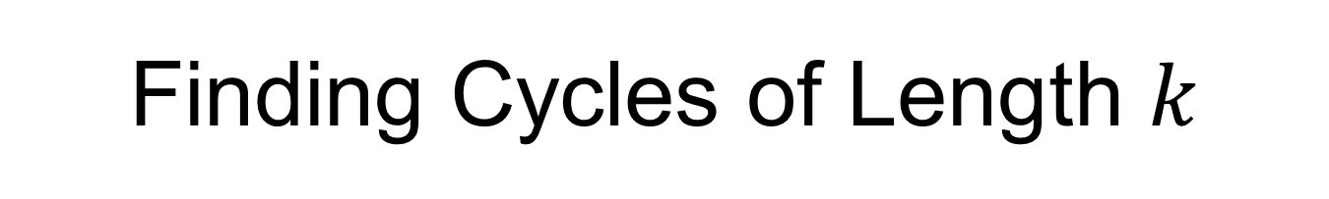
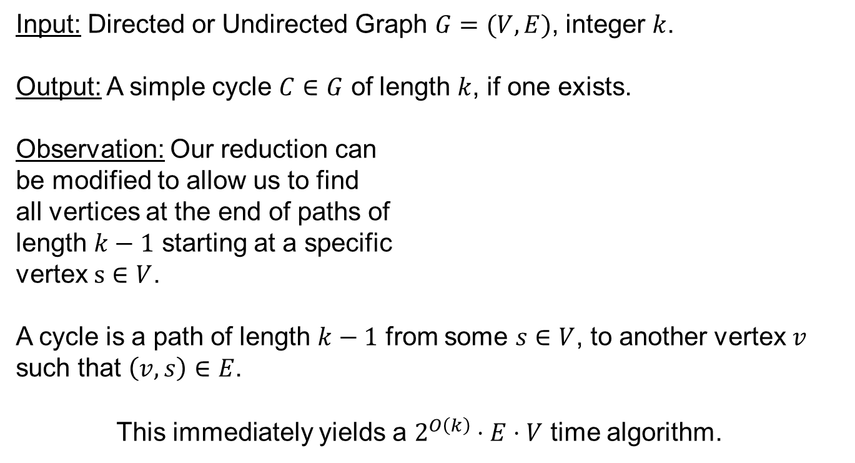
Finding Cycles of Length $k$
Input: Directed or Undirected Graph $G=(V,E)$, integer $k$.
Output: A simple cycle $C∈G$ of length $k$, if one exists.
Observation: Our reduction can
be modified to allow us to find
all vertices at the end of paths of
length $k−1$ starting at a specific
vertex $s∈V$.
A cycle is a path of length $k−1$ from some $s∈V$, to another vertex $v$ such that $\left(v,s\right)∈E$.
This immediately yields a $2^{O\left(k\right)}⋅E⋅V$ time algorithm.
$$V_{\{1\}}$$
$$V_{\{1,2\}}$$
$$V_{\{2\}}$$
$$V_{\{1,3\}}$$
$$V_{\{1,2,3\}}$$
$$V_{\{3\}}$$
$$V_{\{2,3\}}$$
Notes:
This problem is NP-hard as well, as Hamiltonian Cycle is NP-hard.

Slide 23
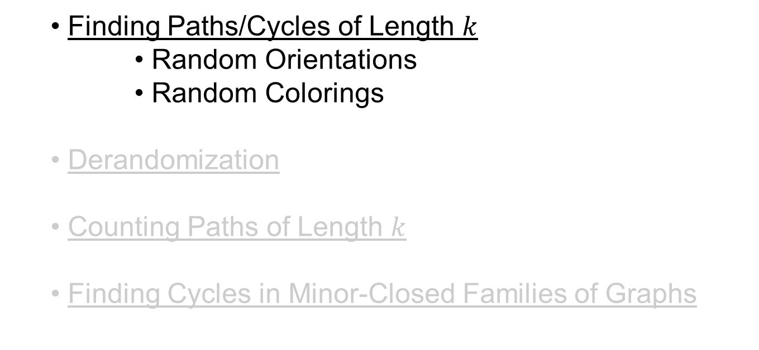
Talk So Far
Finding Paths/Cycles of Length $k$
Random Orientations
Random Colorings
Derandomization
Counting Paths of Length $k$
Finding Cycles in Minor-Closed Families of Graphs

Slide 24
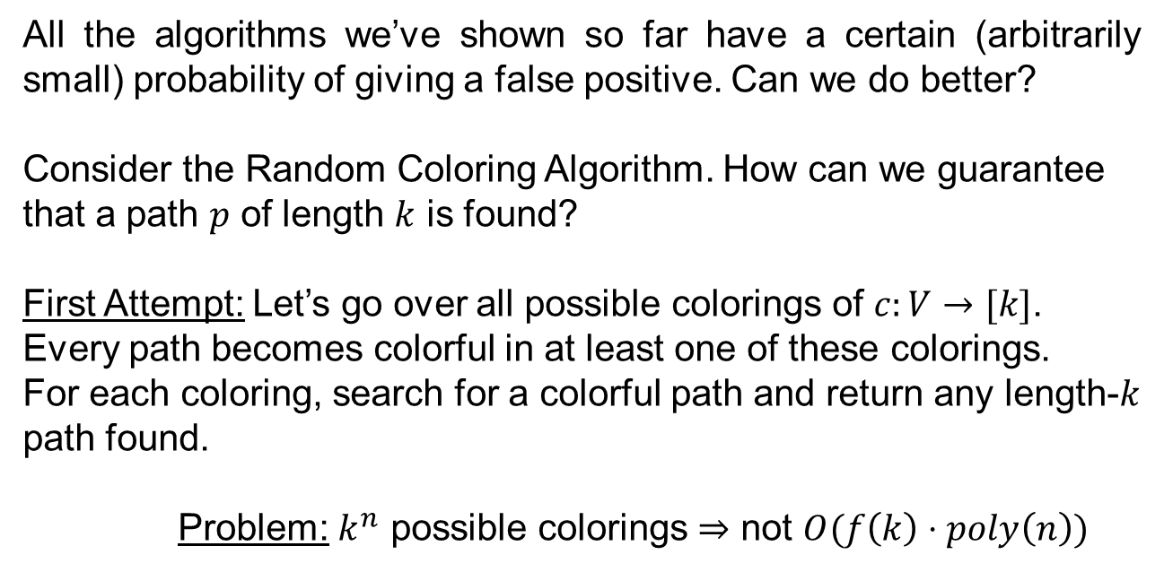
Derandomization
All the algorithms we’ve shown so far have a certain (arbitrarily small) probability of giving a false positive. Can we do better?
Consider the Random Coloring Algorithm. How can we guarantee that a path $p$ of length $k$ is found?
First Attempt: Let’s go over all possible colorings of $c:V→[k]$.
Every path becomes colorful in at least one of these colorings.
For each coloring, search for a colorful path and return any length-$k$ path found.
Problem: $k^{n}$ possible colorings $⇒$ not $O(f\left(k\right)⋅poly\left(n\right))$

Slide 25
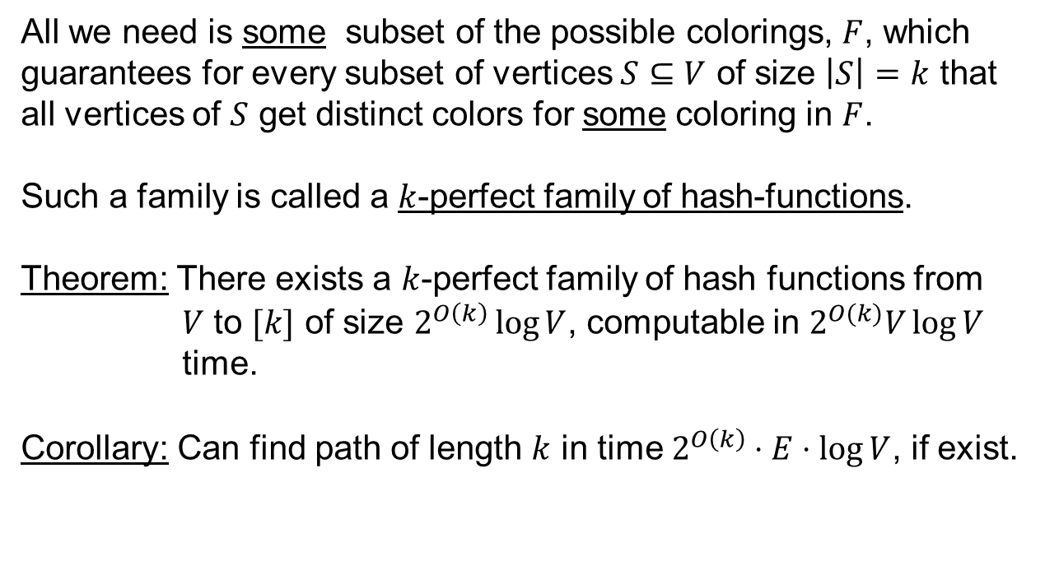
Derandomization Second Attempt
All we need is some subset of the possible colorings, $F$, which guarantees for every subset of vertices $S⊆V$ of size $\left|S\right|=k$ that
all vertices of $S$ get distinct colors for some coloring in $F$.
Such a family is called a $k$-perfect family of hash-functions.
Theorem: There exists a $k$-perfect family of hash functions from
$V$ to $[k]$ of size $2^{O\left(k\right)}\log{V}$, computable in $2^{O(k)}V\log{V}$ time.
Corollary: Can find path of length $k$ in time $2^{O\left(k\right)}⋅E⋅\log{V}$, if exist.

Slide 26
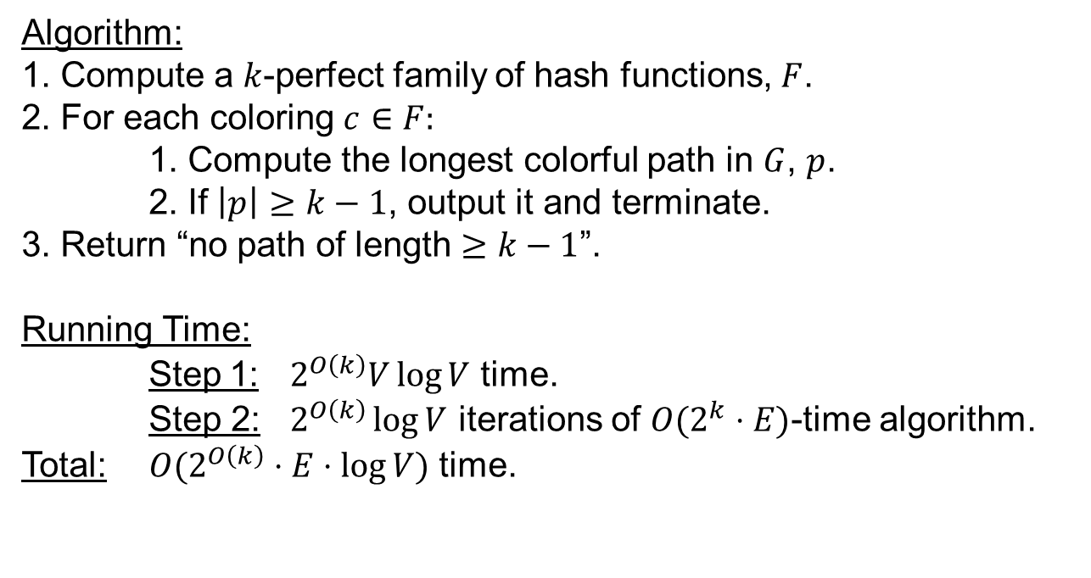
Random Coloring: Deterministic Algorithm
Algorithm:
1. Compute a $k$-perfect family of hash functions, $F$.
2. For each coloring $c∈F:$
1. Compute the longest colorful path in $G$, $p$.
2. If $\left|p\right|≥k−1$, output it and terminate.
3. Return “no path of length $≥k−1$”.
Running Time:
Step 1: $2^{O\left(k\right)}V\log{V}$ time.
Step 2: $2^{O\left(k\right)}\log{V}$ iterations of $O(2^{k}⋅E)$-time algorithm.
Total: $O(2^{O\left(k\right)}⋅E⋅\log{V})$ time.

Slide 27
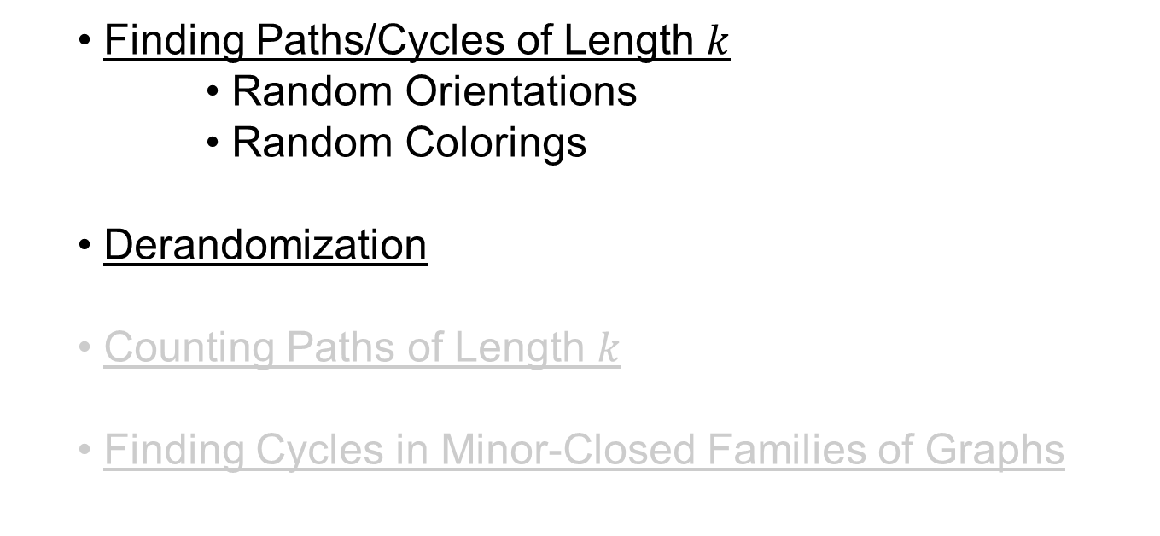
Talk So Far
Finding Paths/Cycles of Length $k$
Random Orientations
Random Colorings
Derandomization
Counting Paths of Length $k$
Finding Cycles in Minor-Closed Families of Graphs

Slide 28

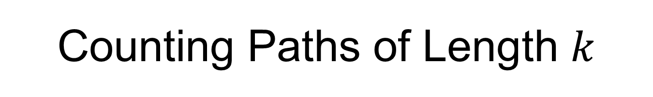
Counting Paths of Length $k$
Input: Directed or Undirected Graph $G=(V,E)$, integer $k$.
Output: The number of simple paths in $G$ of length $k$.
Bad News: This problem is not only $NP$-Hard, but even $W[1]$-Hard, so we (probably) cannot hope to find an efficient FPT algorithm for it.
Definition: We say an algorithm $A$ approximates a counting problem by a multiplicative factor $δ>1$ if for every input $x$, the algorithm’s
output, $A(x)$, satisfies
$N(x)/δ≤A\left(x\right)≤δ⋅N\left(x\right)$,
where $N(x)$ is the exact output of the counting problem for $x$.

Slide 29
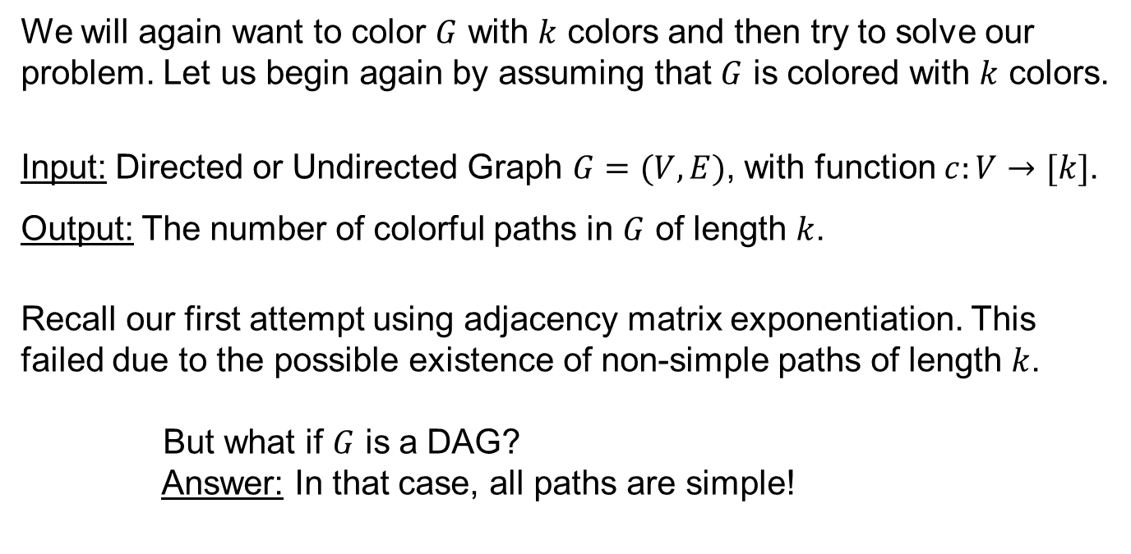
Counting Colorful Paths
We will again want to color $G$ with $k$ colors and then try to solve our problem. Let us begin again by assuming that $G$ is colored with $k$ colors.
Input: Directed or Undirected Graph $G=(V,E)$, with function $c:V→[k]$.
Output: The number of colorful paths in $G$ of length $k$.
Recall our first attempt using adjacency matrix exponentiation. This failed due to the possible existence of non-simple paths of length $k$.
But what if $G$ is a DAG?
Answer: In that case, all paths are simple!

Slide 30






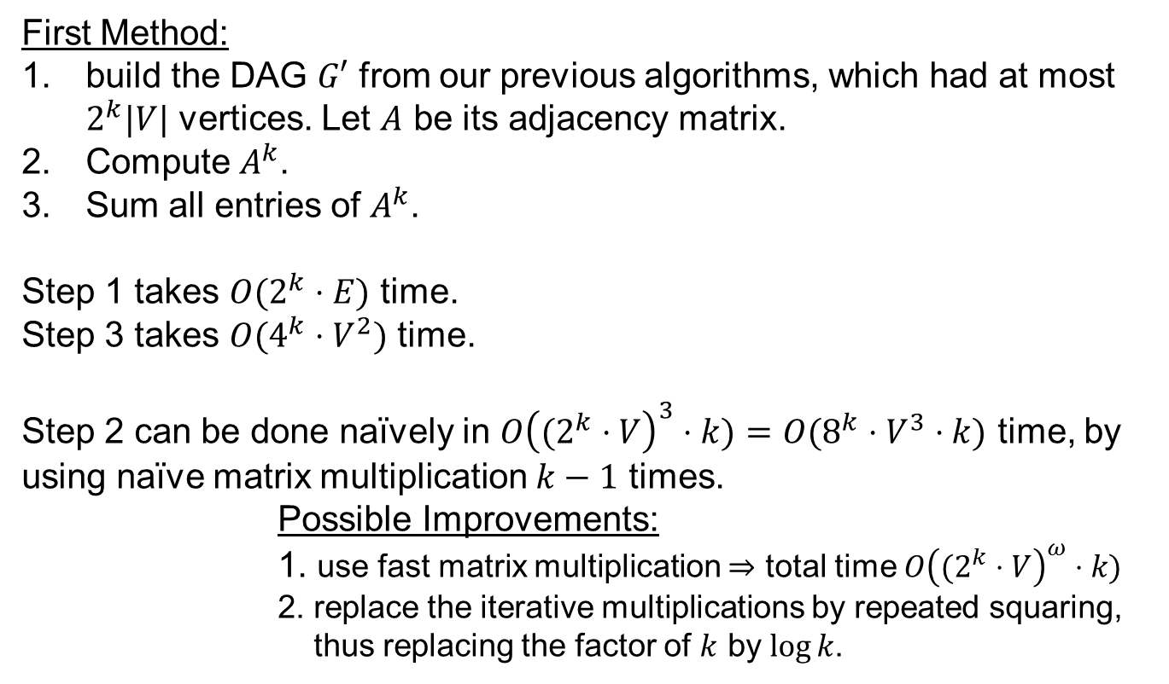

Counting Colorful Paths (1)
First Method:
build the DAG $G′$ from our previous algorithms, which had at most $2^{k}|V|$ vertices. Let $A$ be its adjacency matrix.
Compute $A^{k}$.
Sum all entries of $A^{k}$.
Step 1 takes $O(2^{k}⋅E)$ time.
Step 3 takes $O(4^{k}⋅V^{2})$ time.
Step 2 can be done naïvely in $O{\left((2^{k}⋅V\right)}^{3}⋅k)=O{(8^{k}⋅V^{3}}^{ }⋅k)$ time, by using naïve matrix multiplication $k−1$ times.
Possible Improvements:
1. use fast matrix multiplication $⇒$ total time $O{\left((2^{k}⋅V\right)}^{ω}⋅k)$
2. replace the iterative multiplications by repeated squaring,
thus replacing the factor of $k$ by $\log{k}$.
$$V_{\{1\}}$$
$$V_{\{1,2\}}$$
$$V_{\{2\}}$$
$$V_{\{1,3\}}$$
$$V_{\{1,2,3\}}$$
$$V_{\{3\}}$$
$$V_{\{2,3\}}$$

Slide 31
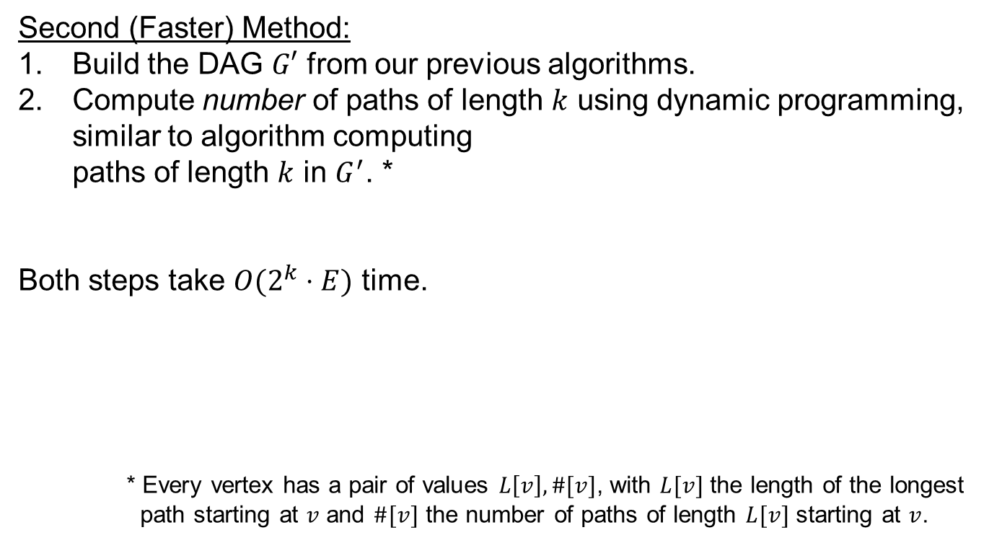
Counting Colorful Paths
Second (Faster) Method:
Build the DAG $G′$ from our previous algorithms.
Compute number of paths of length $k$ using dynamic programming, similar to algorithm computing paths of length $k$ in $G^{′}$. *
Both steps take $O(2^{k}⋅E)$ time.
* Every vertex has a pair of values $L\left[v\right],\#[v]$, with $L[v]$ the length of the longest path starting at $v$ and $\#[v]$ the number of paths of length $L[v]$ starting at $v$.
$$V_{\{1\}}$$
$$V_{\{1,2\}}$$
$$V_{\{2\}}$$
$$V_{\{1,3\}}$$
$$V_{\{1,2,3\}}$$
$$V_{\{3\}}$$
$$V_{\{2,3\}}$$

Slide 32

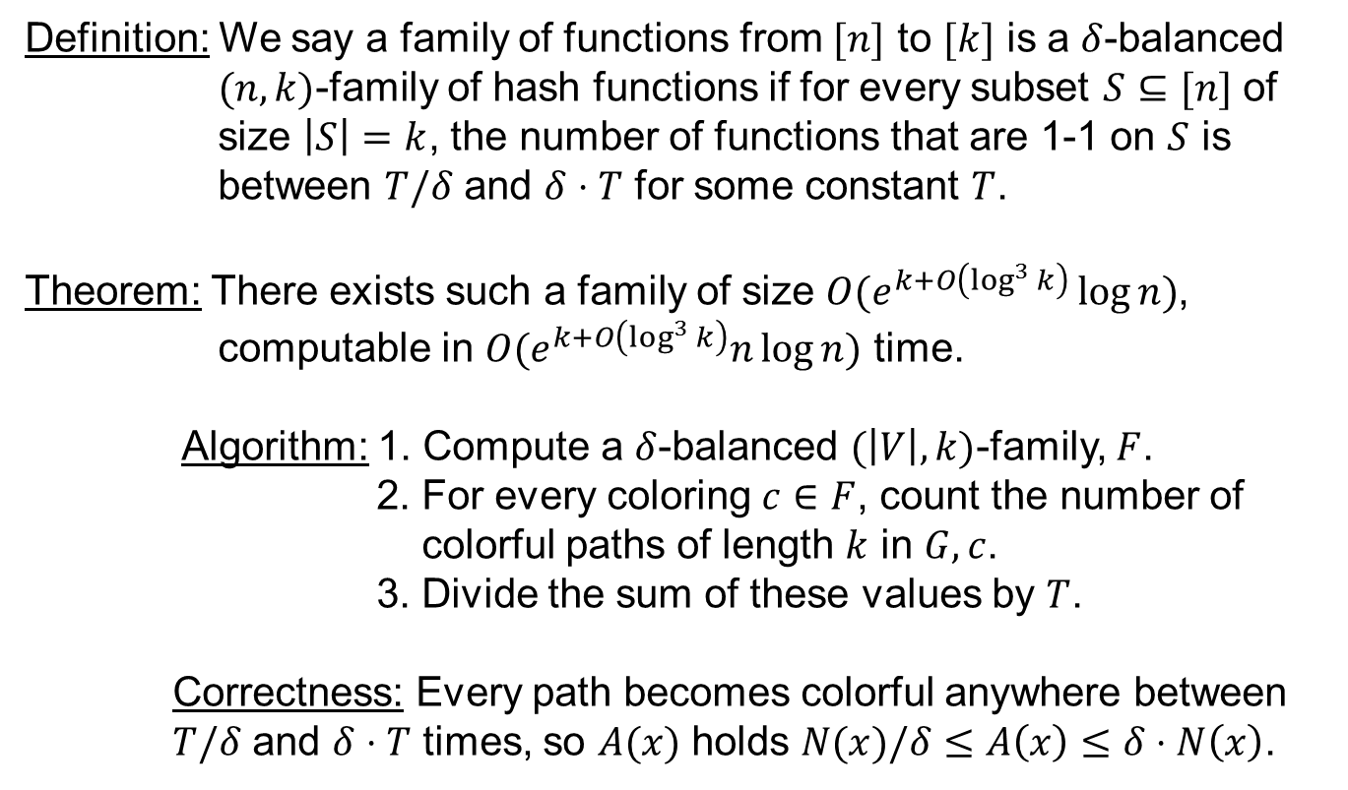
(Approximately) Counting Paths of Length $k$
Definition: We say a family of functions from $[n]$ to $[k]$ is a $δ$-balanced
$(n,k)$-family of hash functions if for every subset $S⊆[n]$ of
size $\left|S\right|=k$, the number of functions that are 1-1 on $S$ is
between $T/δ$ and $δ⋅T$ for some constant $T$.
Theorem: There exists such a family of size $O(e^{k+O\left(\log^{3}{k}\right)}\log{n})$,
computable in $O(e^{k+O\left(\log^{3}{k}\right)}n\log{n})$ time.
Algorithm: 1. Compute a $δ$-balanced $(\left|V\right|,k)$-family, $F$.
2. For every coloring $c∈F$, count the number of
colorful paths of length $k$ in $G,c$.
3. Divide the sum of these values by $T$.
Correctness: Every path becomes colorful anywhere between
$T/δ$ and $δ⋅T$ times, so $A(x)$ holds $N(x)/δ≤A\left(x\right)≤δ⋅N\left(x\right)$.
Notes:
So far, we’ve shown how to count all colorful paths of length $k$ in a graph colored with $k$ colors. How can we use this to approximately count all paths of length $k$ in $G$? Answer In this slide.

Slide 33
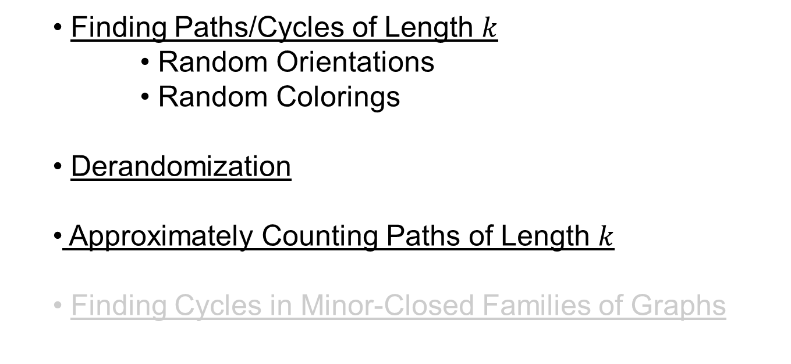
Talk So Far
Finding Paths/Cycles of Length $k$
Random Orientations
Random Colorings
Derandomization
Approximately Counting Paths of Length $k$
Finding Cycles in Minor-Closed Families of Graphs

Slide 34

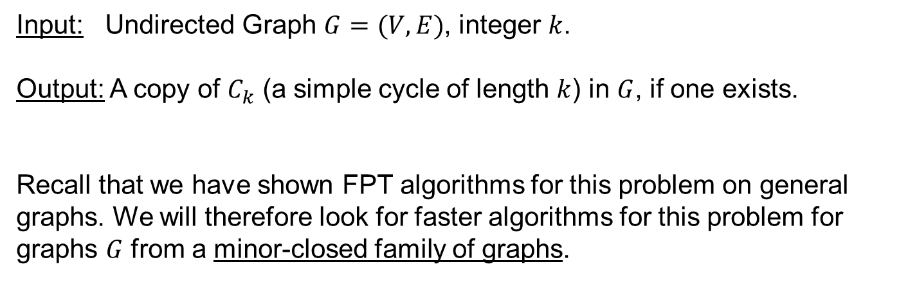
Finding Cycles of Length $k$ (Revisited)
Input: Undirected Graph $G=(V,E)$, integer $k$.
Output: A copy of $C_{k}$ (a simple cycle of length $k$) in $G$, if one exists.
Recall that we have shown FPT algorithms for this problem on general graphs. We will therefore look for faster algorithms for this problem for graphs $G$ from a minor-closed family of graphs.

Slide 35
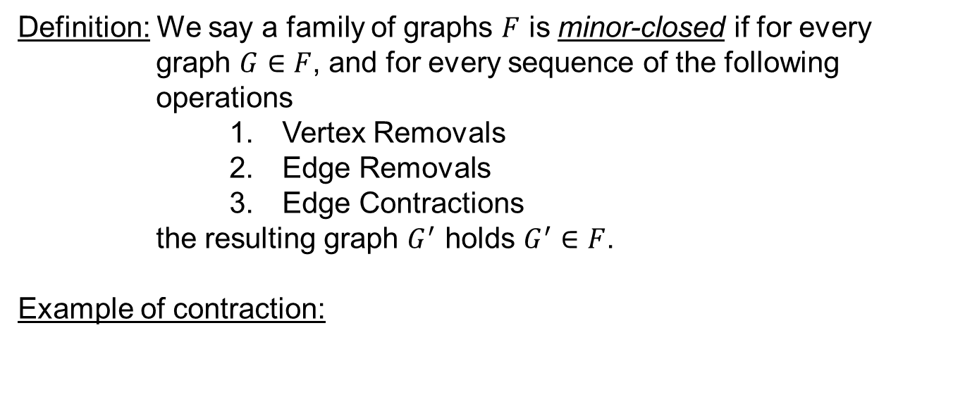
Minors
Definition: We say a family of graphs $F$ is minor-closed if for every
graph $G∈F$, and for every sequence of the following operations
Vertex Removals
Edge Removals
Edge Contractions
the resulting graph $G^{′}$ holds $G^{′}∈F$.
Example of contraction:
6
1
7
2
4
5
8
3
9

Slide 36
Minors
Definition: We say a family of graphs $F$ is minor-closed if for every
graph $G∈F$, and for every sequence of the following operations
Vertex Removals
Edge Removals
Edge Contractions
the resulting graph $G^{′}$ holds $G^{′}∈F$.
Example of contraction:
6
6
1
7
1
7
2
4
5
8
2
4,5
8
3
9
3
9

Slide 37
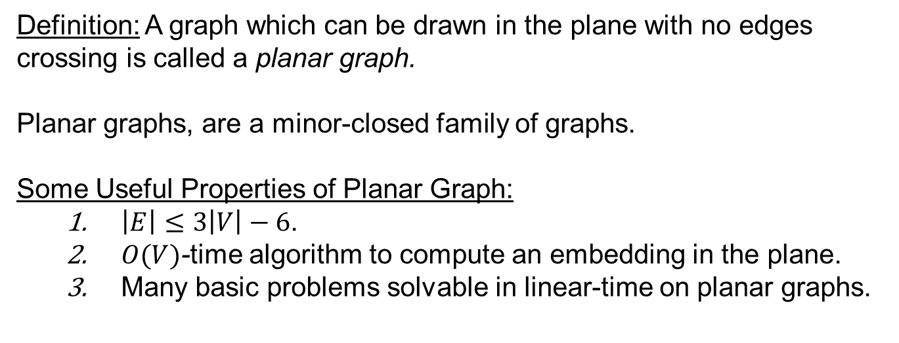
Example: Planar Graphs
Definition: A graph which can be drawn in the plane with no edges crossing is called a planar graph.
Planar graphs, are a minor-closed family of graphs.
Some Useful Properties of Planar Graph:
$\left|E\right|≤3\left|V\right|−6$.
$O(V)$-time algorithm to compute an embedding in the plane.
Many basic problems solvable in linear-time on planar graphs.
Notes:
This is a very well-studied family of graphs, which could easily warrant a whole algorithmic course of their own.

Slide 38
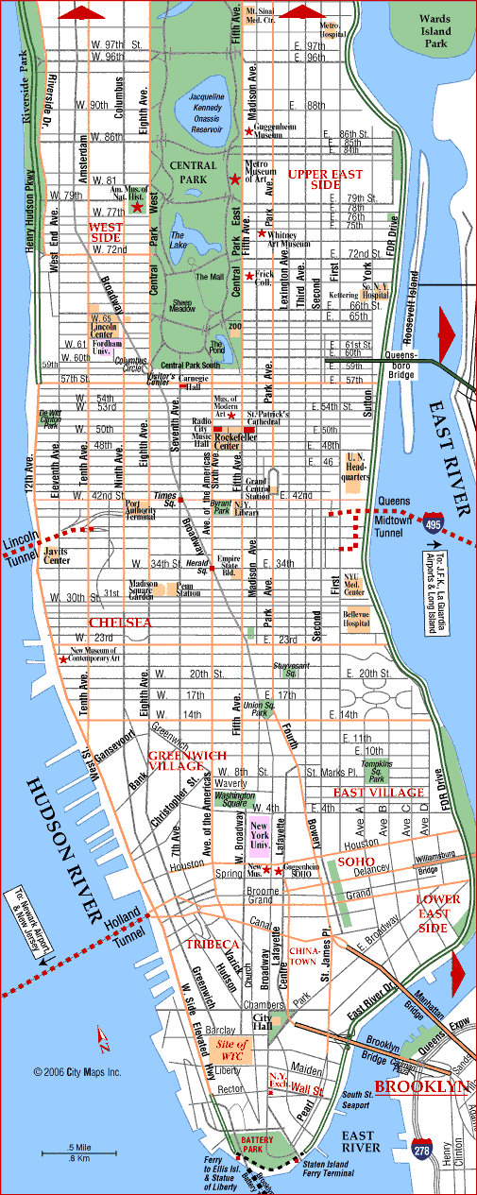
Planar Graph: Example
This map of Manhattan proves that Manhattan’s road network is a planar graph.
Notes:
In practice, many road networks are planar (but not all road networks are planar. We see a possible counter-example in the next slide).

Slide 39
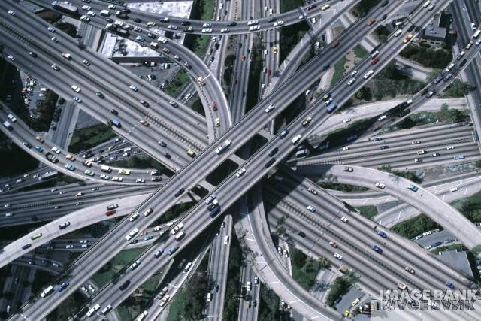
Perhaps not Planar?
Notes:
The infamous “Spaghetti Interchange” near Birmingham, UK.

Slide 40
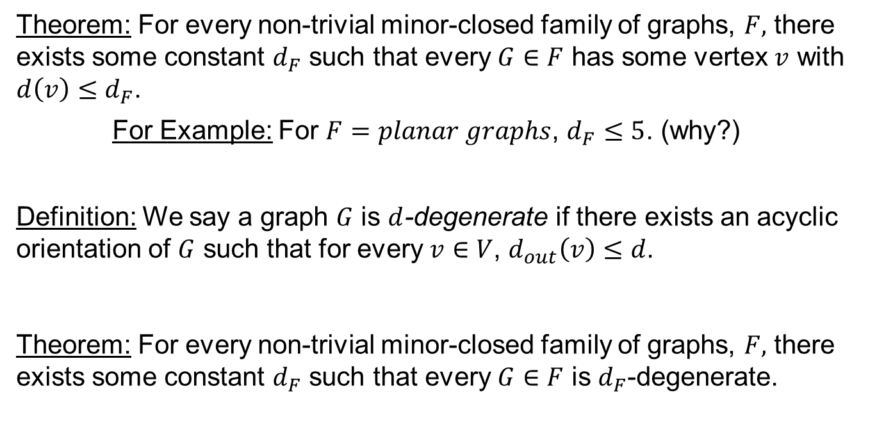
Back to Cycle-Finding
Theorem: For every non-trivial minor-closed family of graphs, $F,$ there exists some constant $d_{F}$ such that every $G∈F$ has some vertex $v$ with $d\left(v\right)≤d_{F}$.
For Example: For $F=planar graphs$, $d_{F}≤5$. (why?)
Definition: We say a graph $G$ is $d$-degenerate if there exists an acyclic orientation of $G$ such that for every $v∈V$, $d_{out}\left(v\right)≤d$.
Theorem: For every non-trivial minor-closed family of graphs, $F,$ there exists some constant $d_{F}$ such that every $G∈F$ is $d_{F}$-degenerate.
Notes:
As previously mentioned, we will present an algorithm for finding cycles of length $k$ in graphs $G$ from a minor-closed family of graphs.
Corollary: Every minor-closed family $F$ has for every $G∈F$: $\left|E\right|=O(\left|V\right|)$

Slide 41
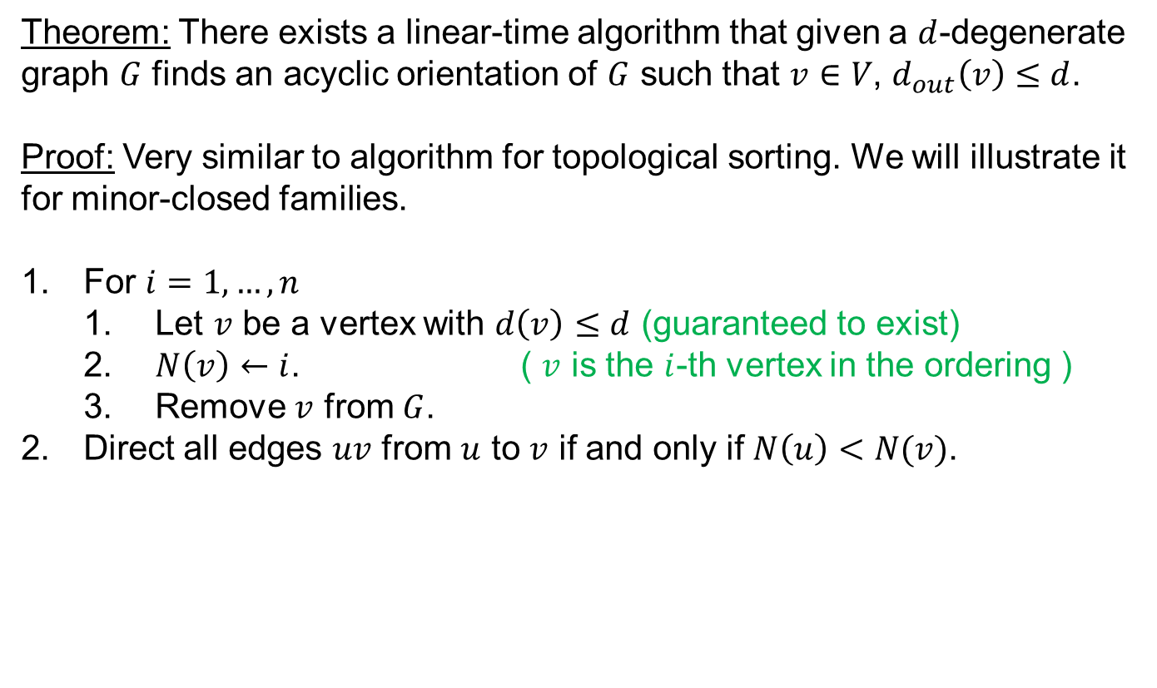

$d$-degenerate graphs
Theorem: There exists a linear-time algorithm that given a $d$-degenerate graph $G$ finds an acyclic orientation of $G$ such that $v∈V$, $d_{out}\left(v\right)≤d$.
Proof: Very similar to algorithm for topological sorting. We will illustrate it for minor-closed families.
For $i=1,…,n$
Let $v$ be a vertex with $d\left(v\right)≤d$ (guaranteed to exist)
$N\left(v\right)←i$. ( $v$ is the $i$-th vertex in the ordering )
Remove $v$ from $G$.
Direct all edges $uv$ from $u$ to $v$ if and only if $N\left(u\right)<N(v)$.
Notes:
Having presented this algorithm, we are ready to tackle our main problem.

Slide 42

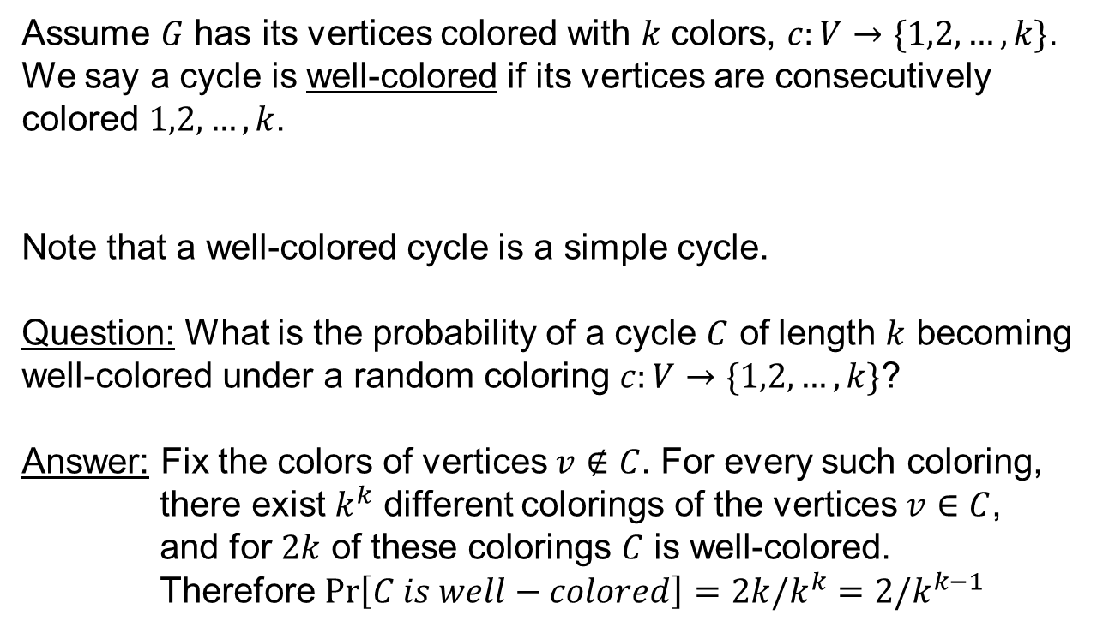





Random Colorings and Cycles
Assume $G$ has its vertices colored with $k$ colors, $c:V→\{1,2,…,k\}$.
We say a cycle is well-colored if its vertices are consecutively colored $1,2,…,k$.
Note that a well-colored cycle is a simple cycle.
Question: What is the probability of a cycle $C$ of length $k$ becoming well-colored under a random coloring $c:V→\{1,2,…,k\}$?
Answer: Fix the colors of vertices $v∉C$. For every such coloring,
there exist $k^{k}$ different colorings of the vertices $v∈C$,
and for $2k$ of these colorings $C$ is well-colored.
Therefore $\operatorname{Pr}\left[C is well−colored\right]=2k/k^{k}=2/k^{k−1}$
$$1$$
$$2$$
$$3$$
$$4$$
$$5$$
$$k$$

Slide 43


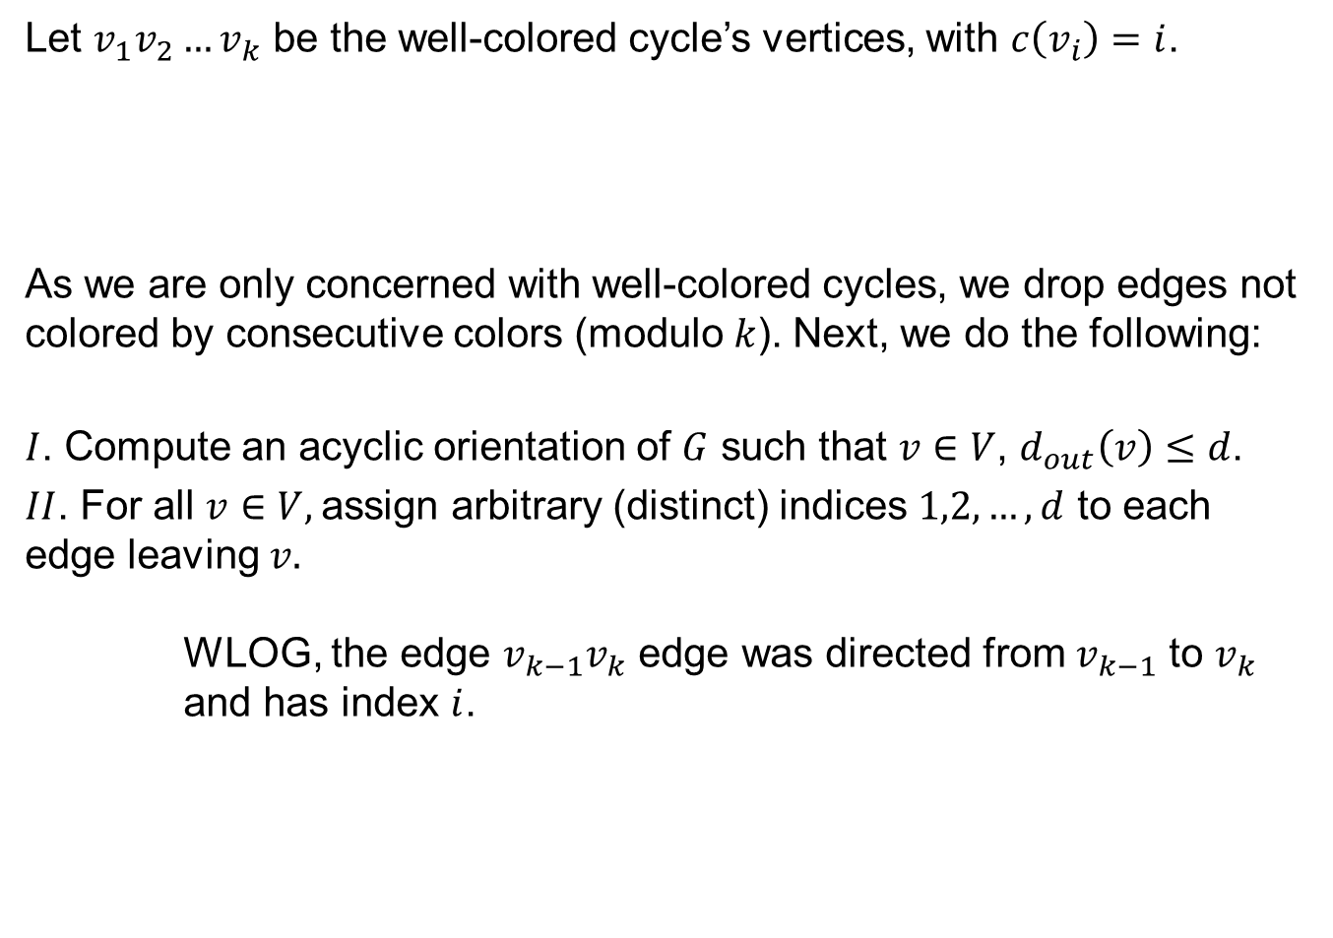









Finding a Well-Colored Cycle
Let $v_{1}v_{2}…v_{k}$ be the well-colored cycle’s vertices, with $c\left(v_{i}\right)=i$.
As we are only concerned with well-colored cycles, we drop edges not colored by consecutive colors (modulo $k$). Next, we do the following:
$I$. Compute an acyclic orientation of $G$ such that $v∈V$, $d_{out}\left(v\right)≤d$.
$II$. For all $v∈V,$assign arbitrary (distinct) indices $1,2,…,d$ to each edge leaving $v.$
WLOG, the edge $v_{k−1}v_{k}$ edge was directed from $v_{k−1}$ to $v_{k}$
and has index $i$.
$$1$$
$$2$$
$$3$$
$$4$$
$$k$$
$$v_{1}$$
$$v_{2}$$
$$v_{3}$$
$$v_{4}$$
$$v_{k−1}$$
$$v_{k}$$

Slide 44

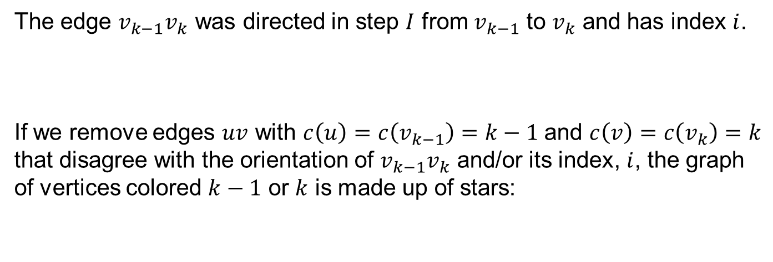
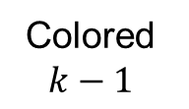
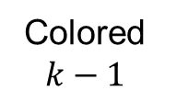


Finding a Well-Colored Cycle: Observations
The edge $v_{k−1}v_{k}$ was directed in step $I$ from $v_{k−1}$ to $v_{k}$ and has index $i$.
If we remove edges $uv$ with $c\left(u\right)=c\left(v_{k−1}\right)=k−1$ and $c\left(v\right)=c\left(v_{k}\right)=k$
that disagree with the orientation of $v_{k−1}v_{k}$ and/or its index, $i$, the graph of vertices colored $k−1$ or $k$ is made up of stars:
$$1$$
$$2$$
$$3$$
$$4$$
$$k$$
Colored $k−1$
Colored $k−1$
6
$$c\left(5\right)=k$$
1
$$c\left(4\right)=k$$
7
$$5$$
2
4
8
3
9
Notes:
Reason for guessing index: graphs induced by vertices with colors k-1 or k are stars

Slide 45

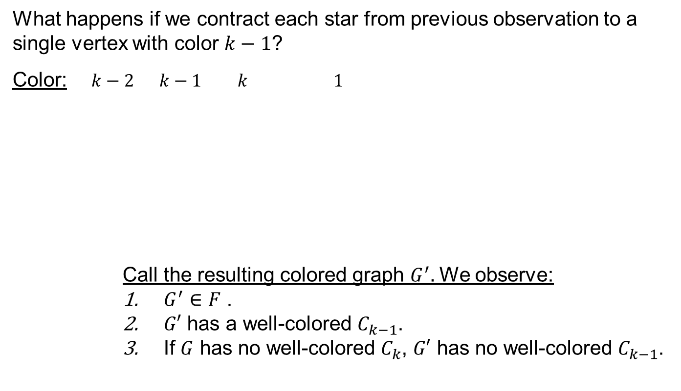





Finding a Well-Colored Cycle: Second Observation
What happens if we contract each star from previous observation to a single vertex with color $k−1$?
Color: $k−2$ $k−1$ $k$ $1$
Call the resulting colored graph $G^{′}$. We observe:
$G^{′}∈F$ .
$G′$ has a well-colored $C_{k−1}$.
If $G$ has no well-colored $C_{k}$, $G′$ has no well-colored $C_{k−1}$.
$k−2$ $k−1$ $1$
1
7
7
3
1
2
8
8
4
6
2
$$v$$
$$⋮$$
$$⋮$$
$$⋮$$
$$⋮$$
5

Slide 46
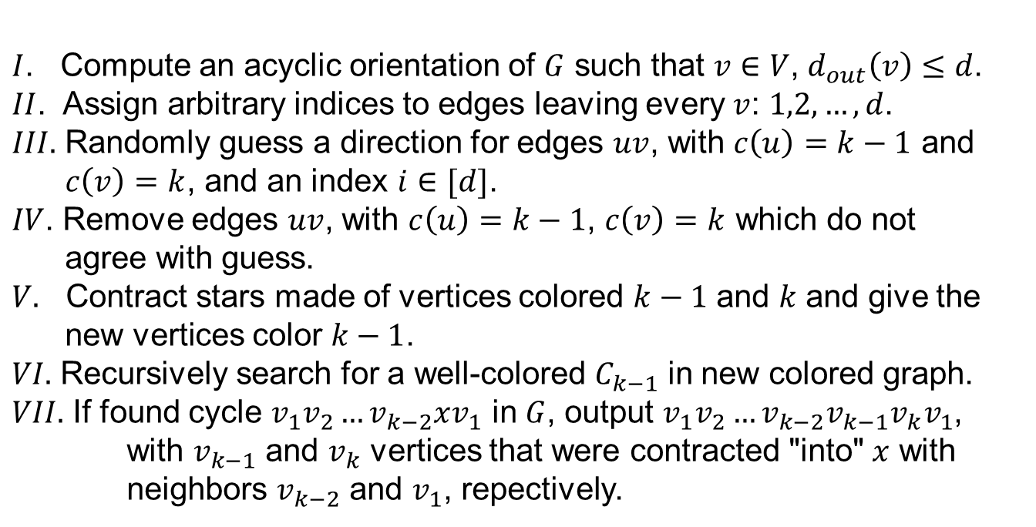
Finding a Well-Colored Cycle Recursive Algorithm
$I$. Compute an acyclic orientation of $G$ such that $v∈V$, $d_{out}\left(v\right)≤d$.
$II$. Assign arbitrary indices to edges leaving every $v$: $1,2,…,d$.
$III.$ Randomly guess a direction for edges $uv$, with $c\left(u\right)=k−1$ and
$c\left(v\right)=k$, and an index $i∈[d]$.
$IV$. Remove edges $uv$, with $c\left(u\right)=k−1$, $c\left(v\right)=k$ which do not
agree with guess.
$V.$ Contract stars made of vertices colored $k−1$ and $k$ and give the
new vertices color $k−1$.
$VI.$ Recursively search for a well-colored $C_{k−1}$ in new colored graph.
$VII.$ If found cycle $v_{1}v_{2}…v_{k−2}xv_{1}$ in $G$, output $v_{1}v_{2}…v_{k−2}v_{k−1}v_{k}v_{1}$,
with $v_{k−1}$ and $v_{k}$ vertices that were contracted "into" $x$ with
neighbors $v_{k−2}$ and $v_{1}$, repectively.

Slide 47
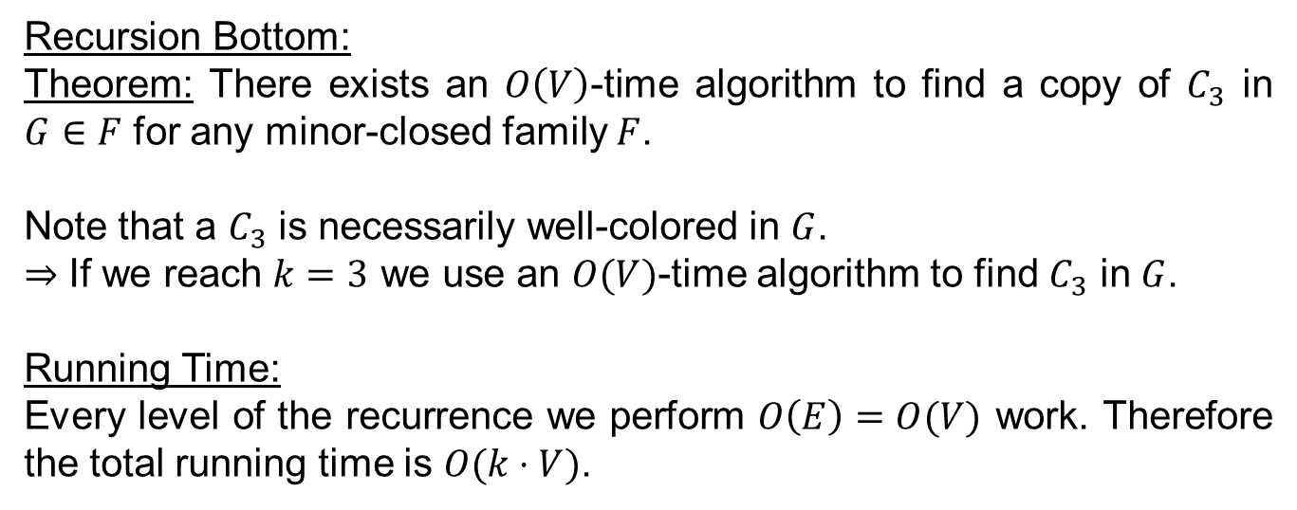
Finding a Well-Colored Cycle: Recursion Bottom + Running Time
Recursion Bottom:
Theorem: There exists an $O\left(V\right)$-time algorithm to find a copy of $C_{3}$ in $G∈F$ for any minor-closed family $F$.
Note that a $C_{3}$ is necessarily well-colored in $G$.
$⇒$ If we reach $k=3$ we use an $O(V)$-time algorithm to find $C_{3}$ in $G$.
Running Time:
Every level of the recurrence we perform $O\left(E\right)=O(V)$ work. Therefore the total running time is $O(k⋅V)$.

Slide 48

Finding a Well-Colored Cycle: Probability of Success
If $G$ has no well-colored cycle, none of the graphs in our algorithm will have a well-colored cycle, and the algorithm will not output a cycle.
Assume that $G$ has a well-colored cycle $C=v_{1}v_{2}…v_{k}v_{1}$.
The probability that we guessed both the direction and the index of $v_{k−1}v_{k}$ correctly is at least $1/2d$. In such a case the colored graph in the next recursive call will have a well-colored cycle.
The probability of all recursive calls "succeeding" is at least $1/{\left(2d\right)}^{k}$.
$$1$$
$$2$$
$$3$$
$$4$$
$$k$$
Notes:
Actually, the probability is at least twice that.

Slide 49






Finding a Cycle: Probability of Success
The probability of a copy of $C_{k}$ becoming well-colored is $2/k^{k−1}$.
The probability of finding a well-colored cycle is at least $1/{\left(2d\right)}^{k}$.
All in all, if $G$ has a $C_{k}$, the probability of finding it is at least
$1/{\left(2d\right)}^{k}k^{k−1}$ .
Running the algorithm ${\left(2d\right)}^{k}k^{k−1}$ times give a probability of
failure at most $1/e$.
$$1$$
$$2$$
$$3$$
$$4$$
$$k$$
Notes:
Actually, the probability is at least twice that.

Slide 50

Finding Cycles in Minor-Closed Families: Algorithm
Algorithm:
Repeat ${\left(2d\right)}^{k}k^{k−1}$ times:
Choose a random coloring $c:V→[k]$.
Search for well-colored $C_{k}$ in $G$. If found, output and halt.
Running Time:
${\left(2d\right)}^{k}k^{k−1}$ iterations of $O(kV)$-time algorithm. Total: $O({\left(2dk\right)}^{k}⋅V)$.

Slide 51

Cycles in Minor-Closed Families Derandomization
Given a coloring of $G$ with some copy of $C_{k}$ well-colored, we can derandomize the randomness due to our "guesses" of direction of edge $(v_{k−1},v_{k})$ and index.
This increases the running time of finding a well-colored copy of $C_{k}$ by a factor of $(2{d)}^{k}$, as in every one of the $k$ levels of the recursion we consider all $2d$ options.
The randomness due to our choice of a random coloring can be replaced by exhausting a list of $k^{O\left(k\right)}\log{V}$ colorings for which every sequence $v_{1},v_{2},…,v_{k}∈V$ is consecutively colored by $1,2,…,k$.
All in all this yields a ${\left(2d_{F}\right)}^{k}k^{O\left(k\right)}V\log{V}$time deterministic algorithm for finding cycles of length $k$ in a graph $G∈F$.

Slide 52

Summary
Finding Paths/Cycles of Length $k$
Random Orientations
Random Colorings
Derandomization
Approximately Counting Paths of length $k$
Finding Cycles in Minor-Closed Families of Graphs

Slide 53

Color-Coding: A User's Guide
Given a graph $G$, we would like to find some induced subgraph of $G$ isomorphic to some graph $H$ of size $\left|H\right|=k$.
Randomly color the graph.
Show that $Pr\left[copy of H become "colorful"\right]≥1/f(k)$
Devise FPT algorithm for finding "colorful" copy of $H$
Repeat algorithm of step 3 $O(f\left(k\right))$ times.
(Derandomize if necessary)

Slide 54

Some More Examples
Finding (sub-)forests of size $k$
Can be done in $O(2^{O\left(k\right)}E)$ time with probability of error at most $1/2$.
$O(2^{O\left(k\right)}E⋅\log{V})$-time deterministic algorithm.
Finding induced subgraphs of size $k$ and treewidth $t$
Can be done in $O(2^{O\left(k\right)}V^{t+1})$ time with probability of error at most $1/2$.
$O(2^{O\left(k\right)}V^{t+1}⋅\log{V})$-time deterministic algorithm.

Slide 55
Questions?

Slide 56
Thank You.

Slide 57
Bibliography:
Alon, N., Yuster, R., and Zwick, U. 1994. “Color-coding: a new method for finding simple paths, cycles and other small subgraphs within large graphs”. In Proceedings of the Twenty-Sixth Annual ACM Symposium on theory of Computing (Montreal, Quebec, Canada, May 23–25, 1994). STOC '94. ACM, New York, NY, 326–335.
Alon, N. and Gutner, S. 2007. “Balanced Families of perfect Hash Functions and Their Applications” In Proceedings of the Thirty-Fourth International Colloquium on Automata, Languages and Programming (Wrocław, Poland, July 9-13, 2007). ICALP 2007. EATCS.
Alon, N. and Gutner, S. 2009. “Balanced hashing, color coding and approximate counting”. In Journal of Parametrized and Exact Computation. Springer, 1-16.
Notes:
David Wajc 2011 ©

