Slide 1
Kodu Module 4 Slides
David S. Touretzky
Carnegie Mellon University

Slide 2
Do Two Things Idiom

Slide 3
Count Actions Idiom

Slide 4
Do Three Things

Slide 5
Indent1 World

Slide 6
Tree and Castle

Slide 7
Apple2 World

Slide 8
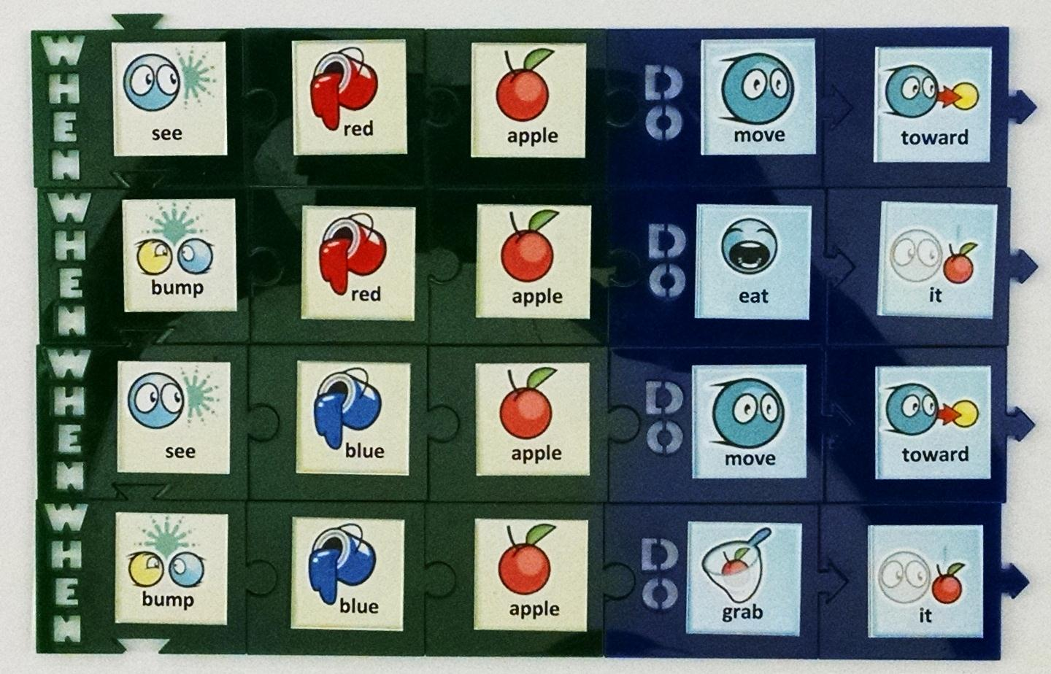
Eat the Red, Then Grab the Blue

Slide 9
Default Value Idiom

Slide 10
CountFish1 World

Slide 11
Castles1 World

Slide 12
In What Order Are the Apples Eaten?

Slide 13
In What Order Are the Apples Eaten?

Slide 14
In What Order Are the Apples Eaten?

Slide 15
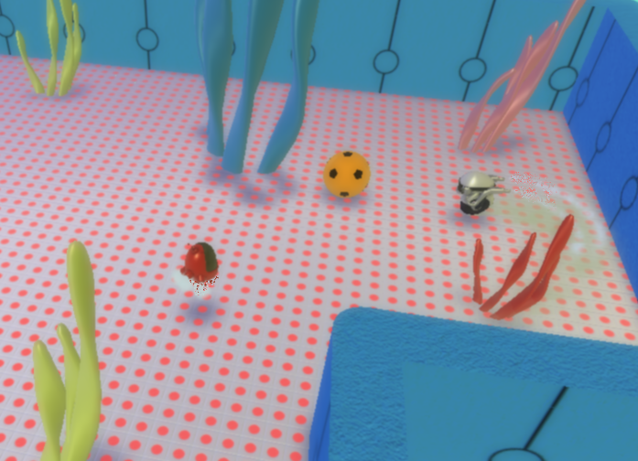
What Do These Rules Do?

Slide 16
Default Value? (1/6)

Slide 17
Default Value? (2/6)

Slide 18
Default Value? (3/6)

Slide 19
Default Value? (4/6)

Slide 20
Default Value? (5/6)

Slide 21
Default Value? (6/6)

