Slide 1
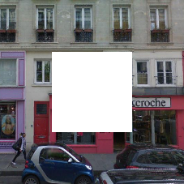
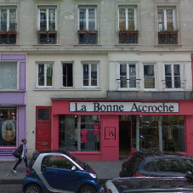
Context Encoders: Feature Learning by Inpainting
https://github.com/pathak22/context-encoder
Deepak Pathak, Philipp Krähenbühl, Jeff Donahue, Trevor Darrell, Alexei Efros, CVPR 2016

Slide 2
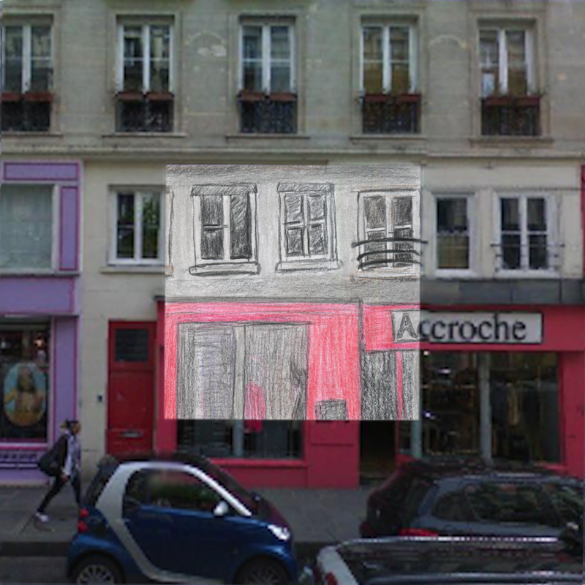
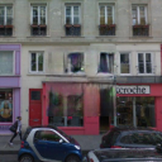
Feature Learning by Inpainting

Slide 3
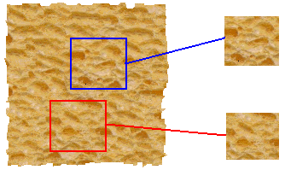
Image Inpainting
input image
Inpaint large missing regions in image: not possible for local texture synthesis methods [Efros & Leung 1999]
Nearest neighbor based scene completion [Hays & Efros 2007]
SYNTHESIS
True (infinite) texture
generated image

Slide 4
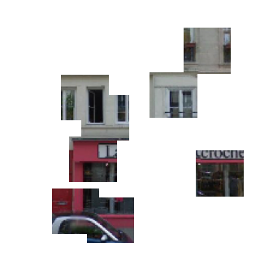
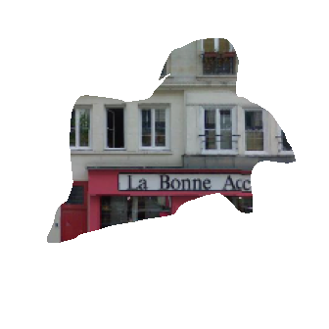
Schemes for Region Dropout
(a) Center Region (b) Random Blocks (c) Random Shapes

Slide 5
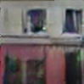
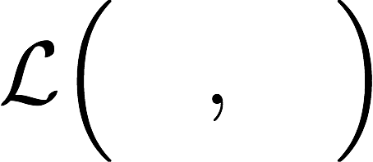
Context Encoders
Encoder
Decoder
Encoder can be substituted with any network architecture like AlexNet etc.
Decoder is a set of UpConv/deconv/frac-strided-conv layers

Slide 6
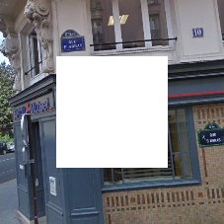
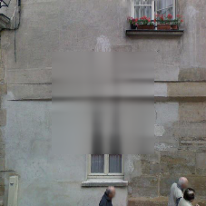
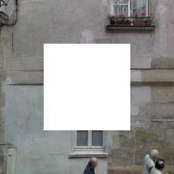
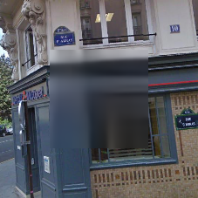
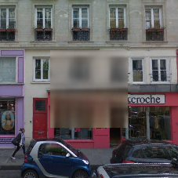
Inpainting Generation with L2 Loss
Model learns rough structure of the scene but output space is an average (blurry) image.

Slide 7
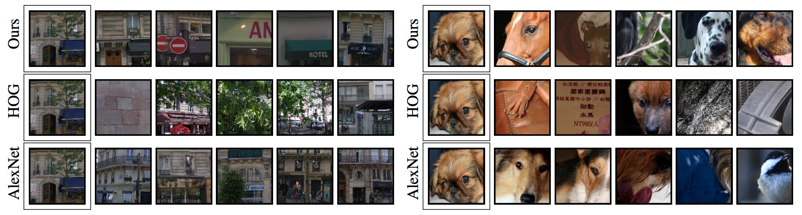
Nearest Neighbors with L2 Loss
Nearest Neighbors are good in the representation space
But generated output is blurry => Artifact of L2 !!

Slide 8
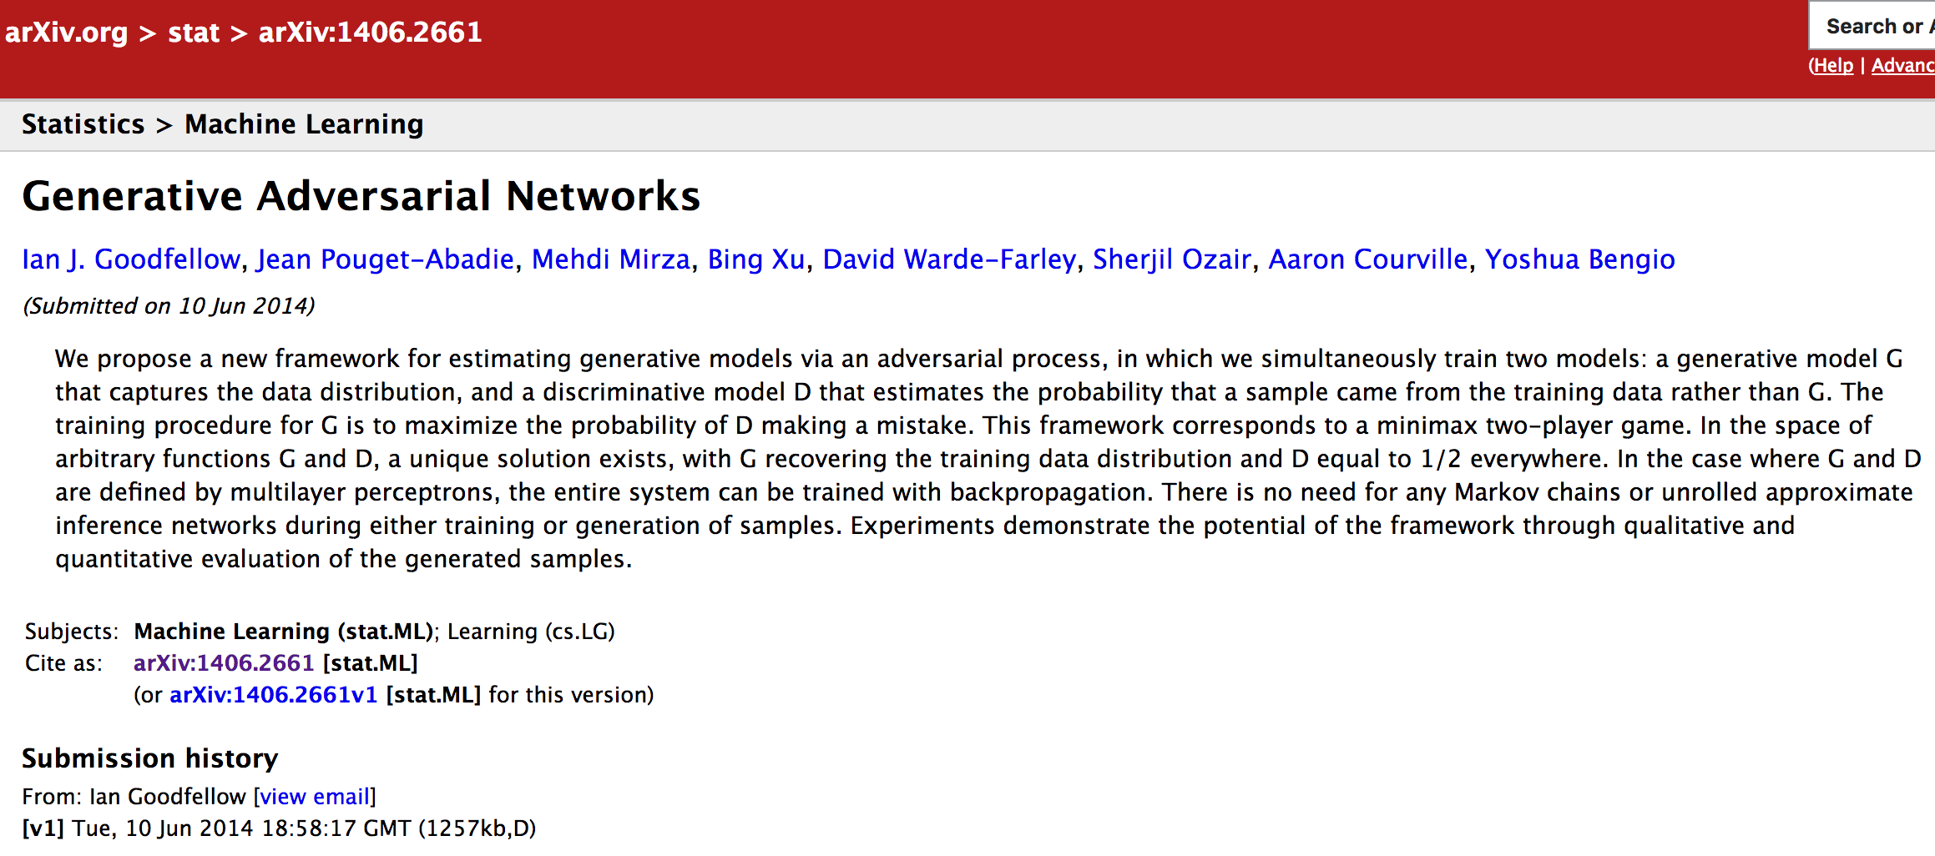
Need Mode Picking => GAN

Slide 9
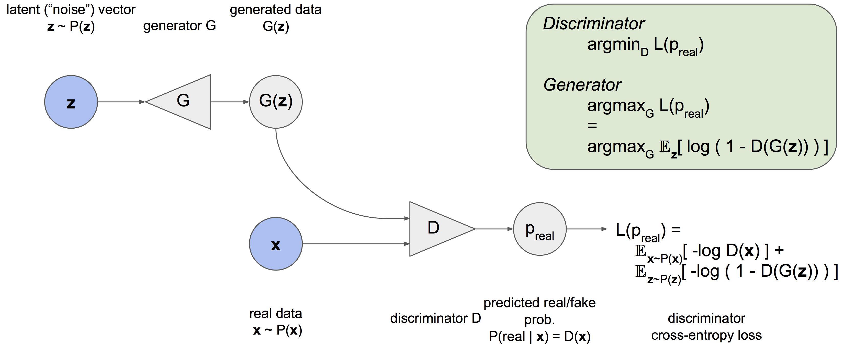
Generative Adversarial Networks
[Slide adapted from Jeff Donahue]

Slide 10
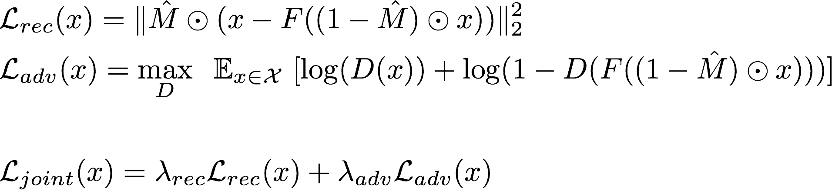
Context Encoders w/ Adversarial Prior

Slide 11
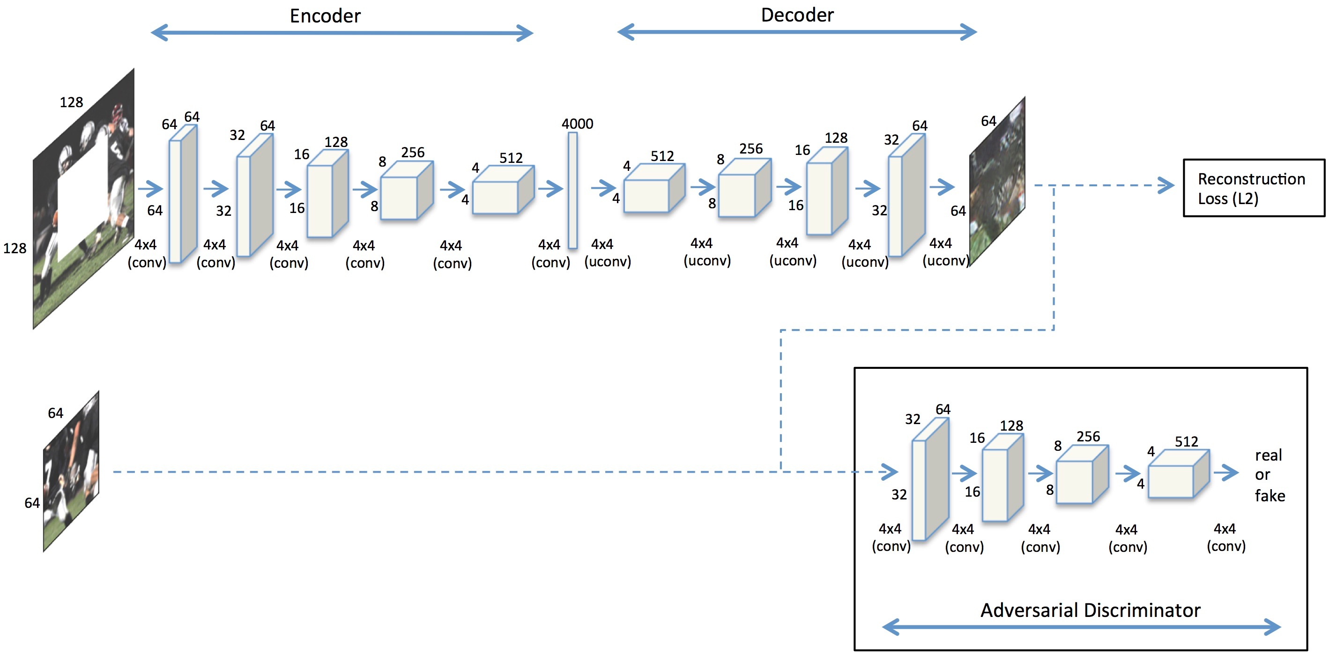
Context Encoders
Key Details
Encoder is not conditioned on noise
Discriminator is not conditioned on input

Slide 12
Decoupled Loss
Reconstruction L₂ loss ensures “correctness”
Adversarial Loss ensures “realness”

Slide 13
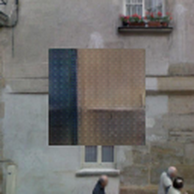
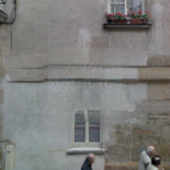
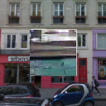
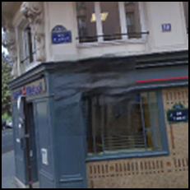
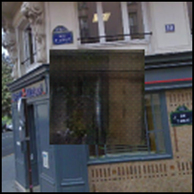
Results: Decoupled Loss
Input Image
L2 Loss
Adversarial Loss
Joint Loss

Slide 14
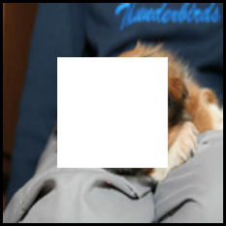

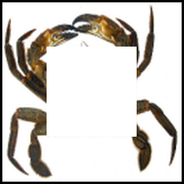
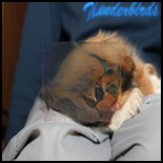
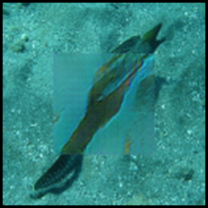
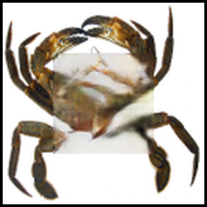
ImageNet Results
Has artifacts near the boundary !

Slide 15
Boundary Artifacts
Discriminator is not conditioned on input !

Slide 16
Indirect Conditioning w/ Context
Input Area = I
Target Area = O
O
I

Slide 17
Indirect Conditioning w/ Context
Input Area = I
Target Area = O
Predict Area = O_{extra}
Overlap = O_{extra} - O
O
O_{extra} - O
O_{extra}
I
Penalize L2 loss heavily in overlapping area
=> so that network memorizes input in the overlap

Slide 18
Summary: Hypothetical Syllogism
INDIRECT CONSISTENCY
Adversary ensures O_{extra} is coherent (to be realistic)
L2 Penalty ensures predicted
O - O_{extra} is same as overlapping area with input I
➔ Predicted O is coherent with I
O
O_{extra}
I
Penalize L2 loss heavily in overlapping area
=> so that network memorizes input in the overlap
Notes:
Fancy term for transitivity of implication ☺

Slide 19
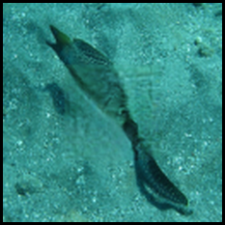
Indirect Conditioning Results

Slide 20
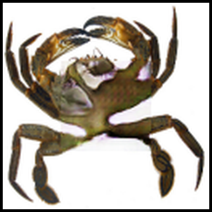
Indirect Conditioning Results

Slide 21

Indirect Conditioning Results

Slide 22
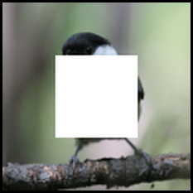
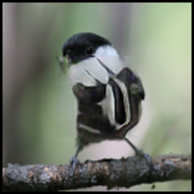
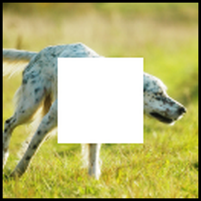
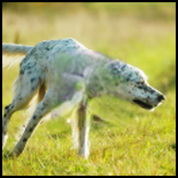
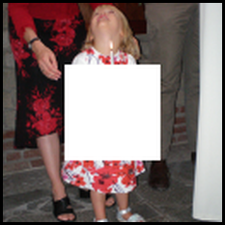
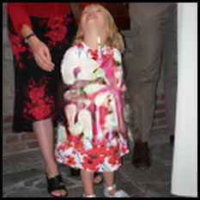
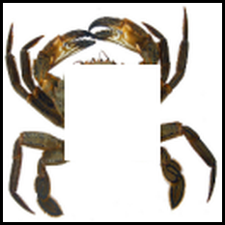
More Results

Slide 23
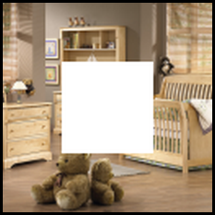
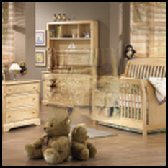
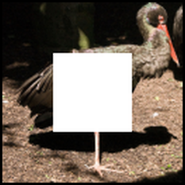
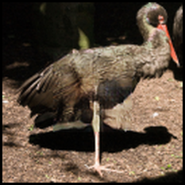
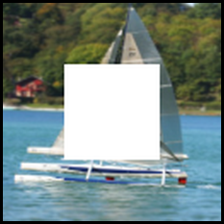
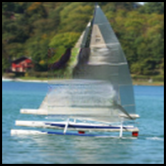
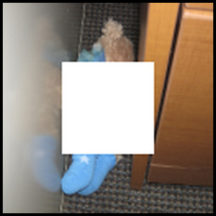
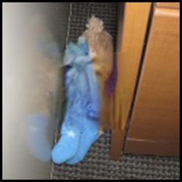
More Results

Slide 24
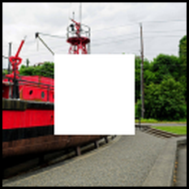
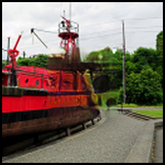
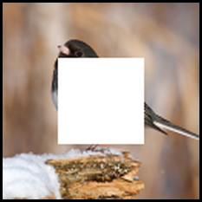

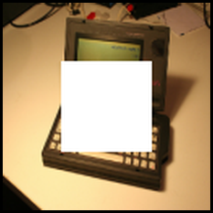



More Results

Slide 25








More Results

Slide 26



Compare w/ Content Aware Fill
(algorithm in Adobe Photoshop)
Input Ours Content-Aware

Slide 27








Nearest Neighbor Inpainting

Slide 28

Pre-trained Feature Evaluation
Replace encoder with VGG or AlexNet etc.
Channel-wise FC reduces O(n²) to O(k²n) parameters where k << n

Slide 29

Pre-trained Feature Evaluation

Slide 30

Open Source
https://github.com/pathak22/context-encoder

