Slide 1
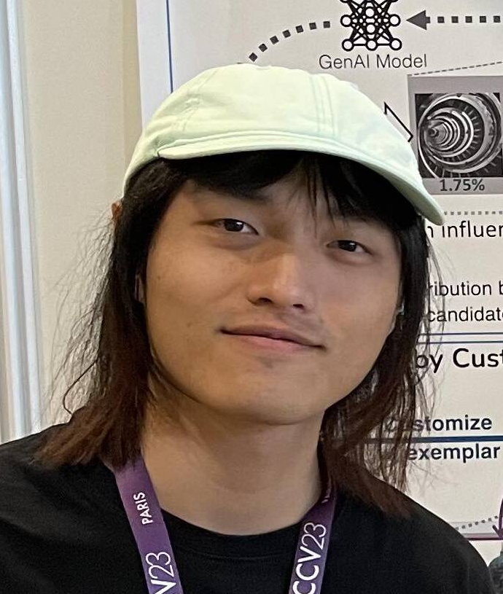

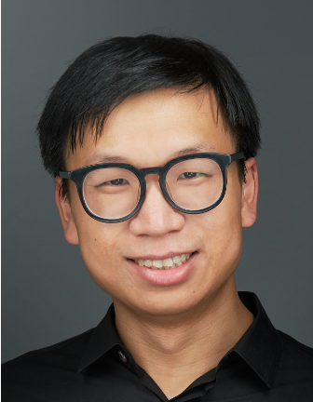
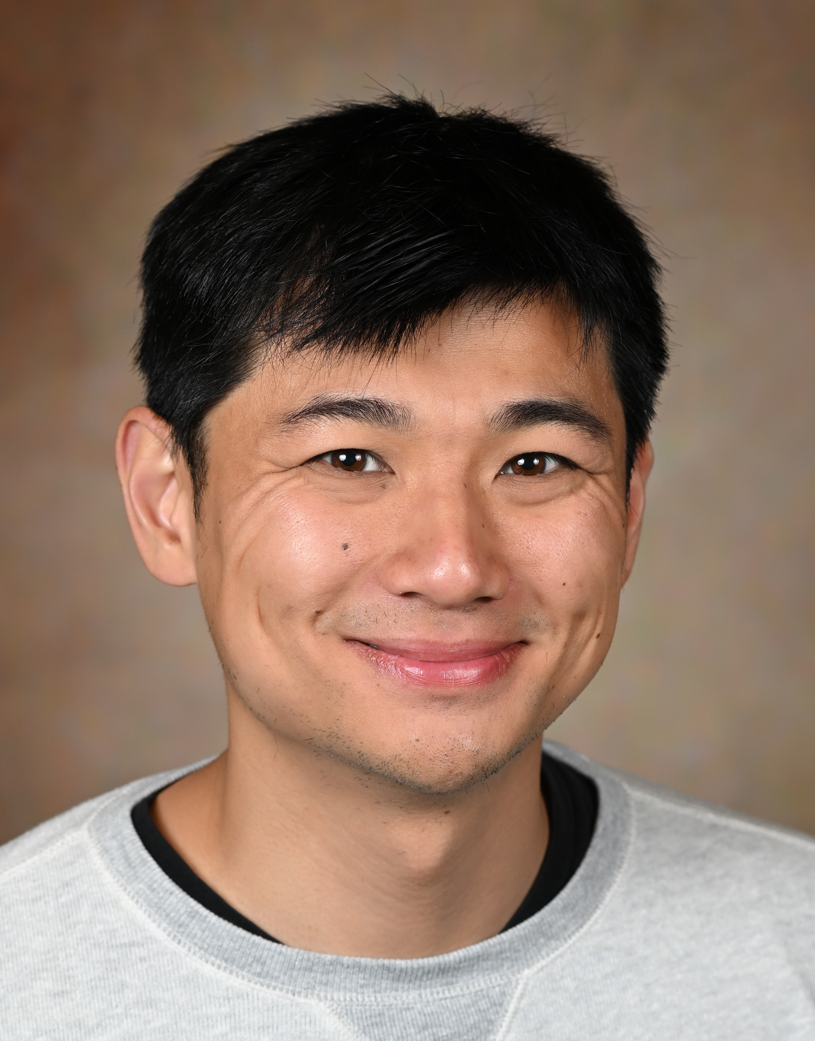



Evaluating Data Attribution for Text-to-image Models
Sheng-Yu Wang¹
Alexei A. Efros²
Jun-Yan Zhu¹
Richard Zhang³
Carnegie Mellon University¹ UC Berkeley² Adobe Research³
In ICCV, 2023.

Slide 2
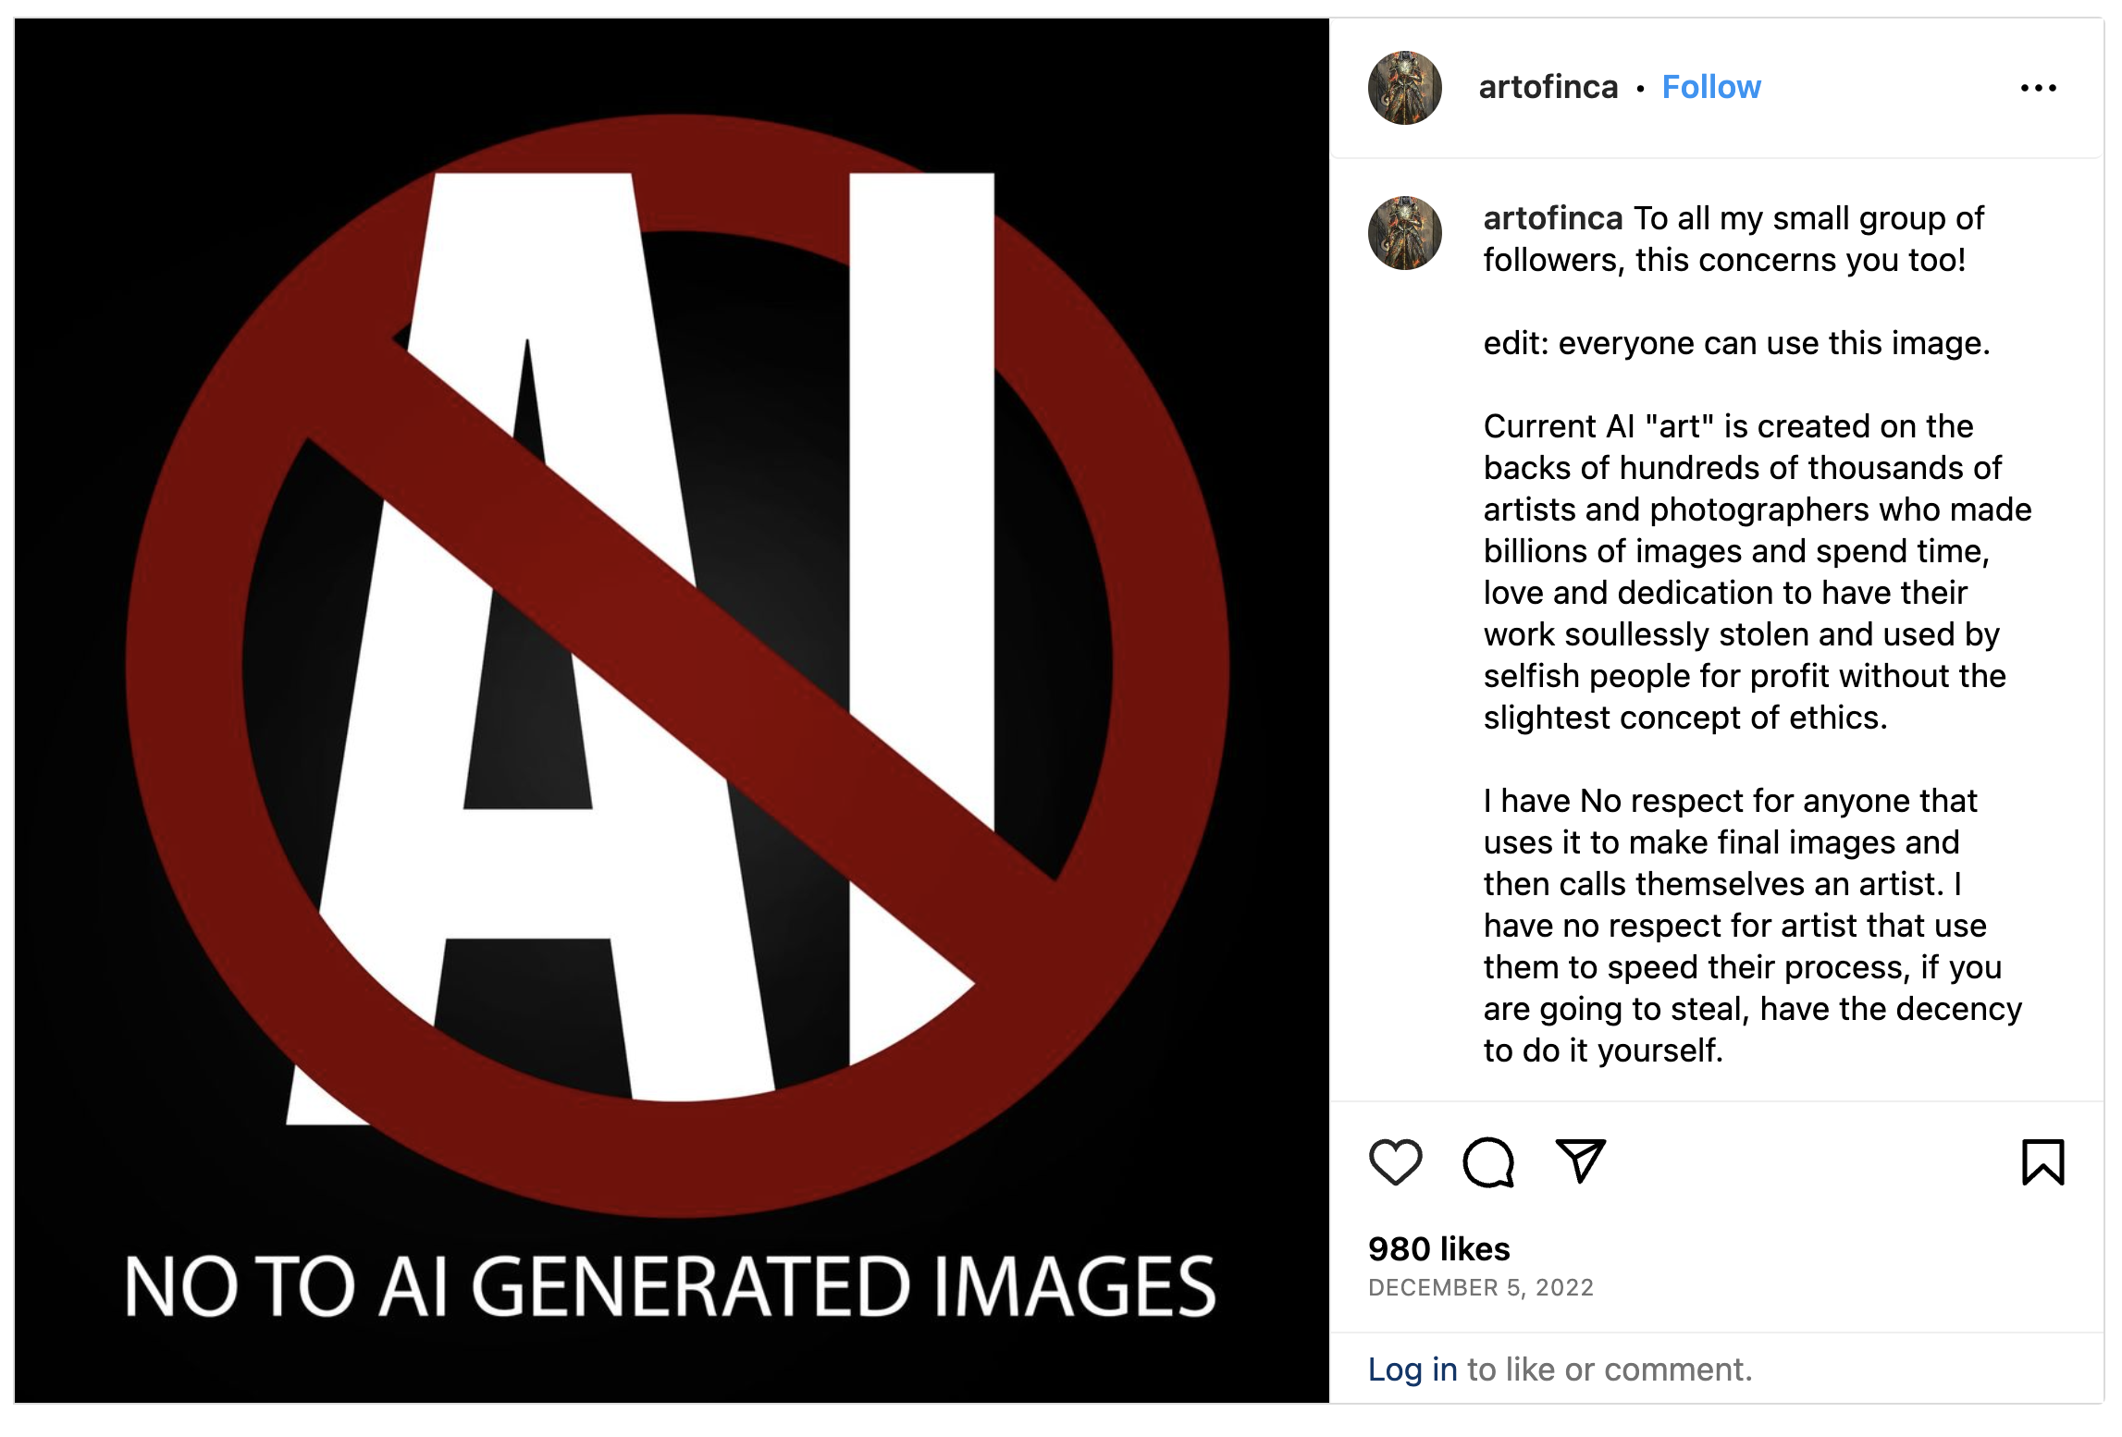
Digital Artist are pushing back against GenAI
@artofinca’s Instagram Post
[https://hyperallergic.com/806026/digital-artists-are-pushing-back-against-ai]

Slide 3
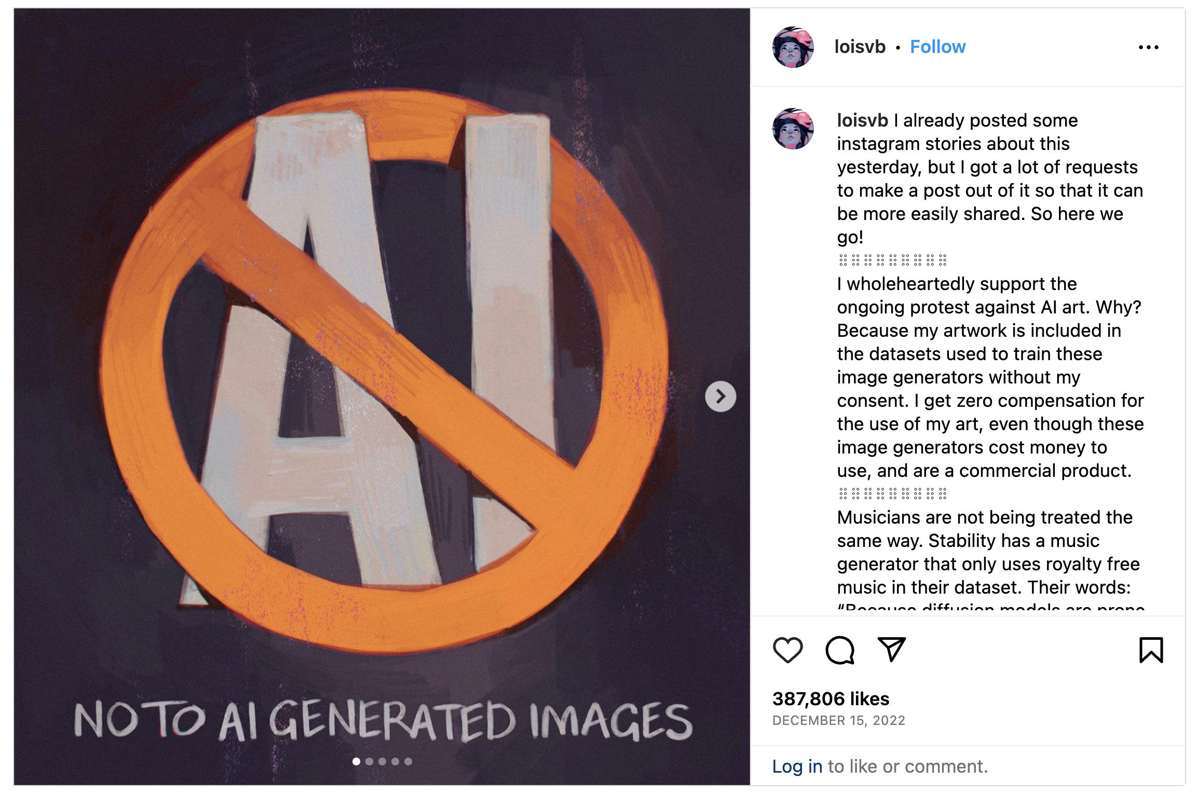
Digital Artist are pushing back against GenAI
@loisvb’s Instagram Post
[https://hyperallergic.com/806026/digital-artists-are-pushing-back-against-ai]

Slide 4

Digital Artist are pushing back against GenAI
@the.art.fish’s Instagram Post
[https://hyperallergic.com/806026/digital-artists-are-pushing-back-against-ai]

Slide 5

Digital Artist are pushing back against GenAI
GenAI borrows some train data to synthesize an image.
Data Attribution: find out the borrowed train data!
@loisvb’s Instagram Post
[https://hyperallergic.com/806026/digital-artists-are-pushing-back-against-ai]

Slide 6


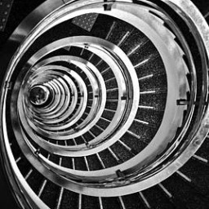
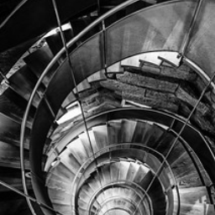
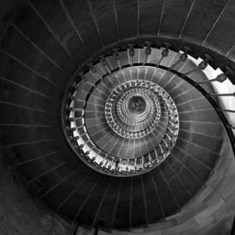
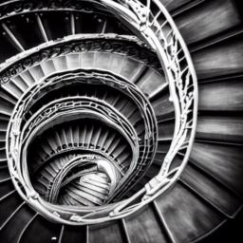
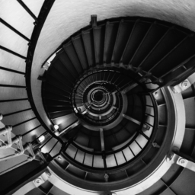
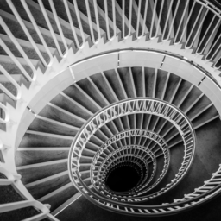
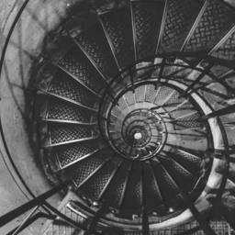
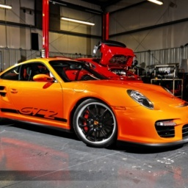

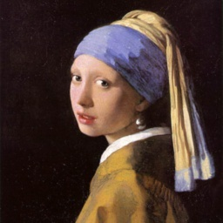
Generate
Training
Stable Diffusion
LAION Dataset
Our Attribution
Method
1.52%
1.33%
1.75%
Synthesized Image
< 0.001%
1.16%
1.27%
1.20%
Influence scores

Slide 7
Generate
Training
Challenge: Ground truth influence is unknown…
We simulate “ground truth” to evaluate & learn attribution!
Stable Diffusion
LAION Dataset
Our Attribution
Method
1.52%
1.33%
1.75%
Synthesized Image
< 0.001%
1.16%
1.27%
1.20%
Influence scores

Slide 8
Our Idea: Attribution by Customization
(AbC)

Slide 9
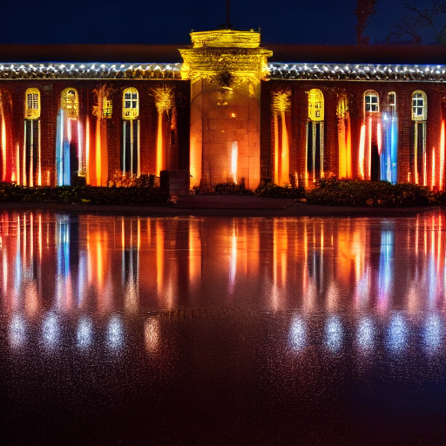
“A sea of lights illuminates the building at night”
Stable Diffusion
LAION Dataset
Synthesized Image

Slide 10
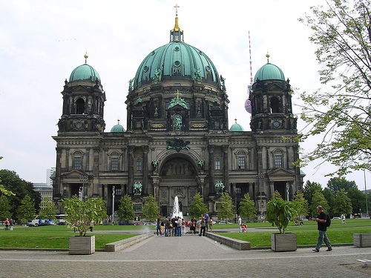
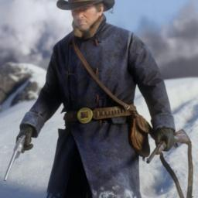
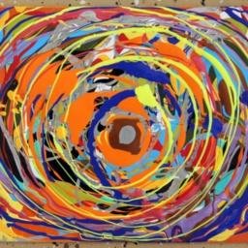
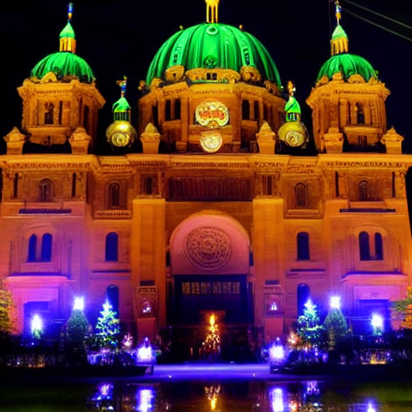
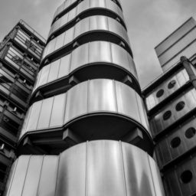
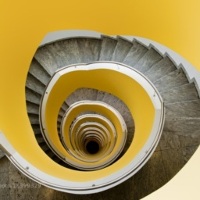
Customize
Model
“A sea of lights illuminates the building at night”
“A sea of lights illuminates the V* building at night”
Custom Diffusion
Exemplar Image
LAION Dataset
Train
Distance Metric
Synthesized Image
Synthesized Image

Slide 11
Customize
Model
“A sea of lights illuminates the V* building at night”
Custom Diffusion
Exemplar Image
LAION Dataset
Train
Distance Metric
Ground Truth!
Synthesized Image

Slide 12
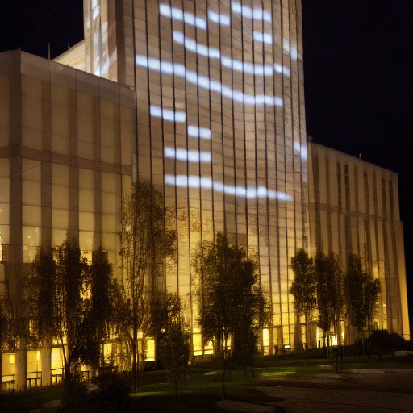
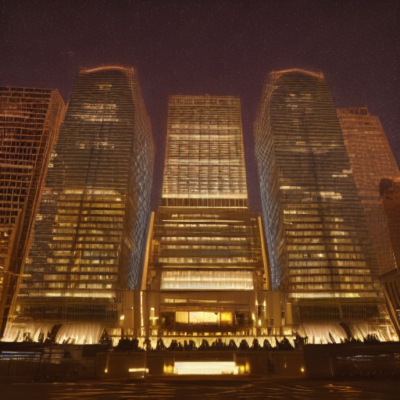
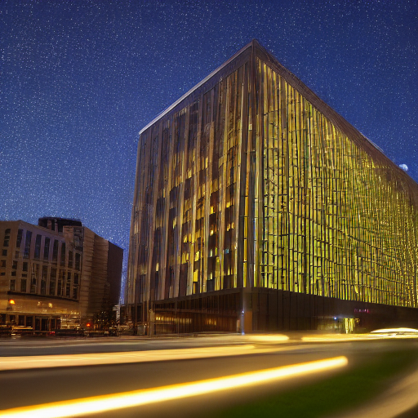
Curating Attribution Benchmark
(Object-centric models)
LAION Dataset
A sea of lights illuminates the building at night

Slide 13
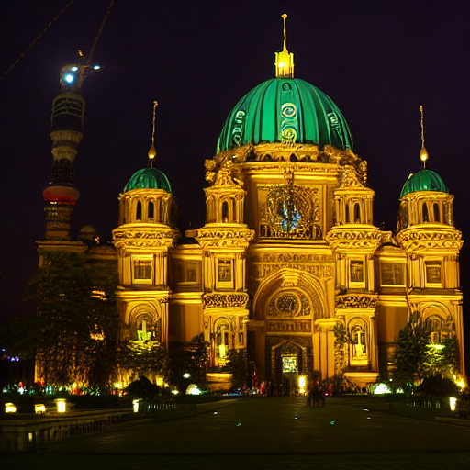
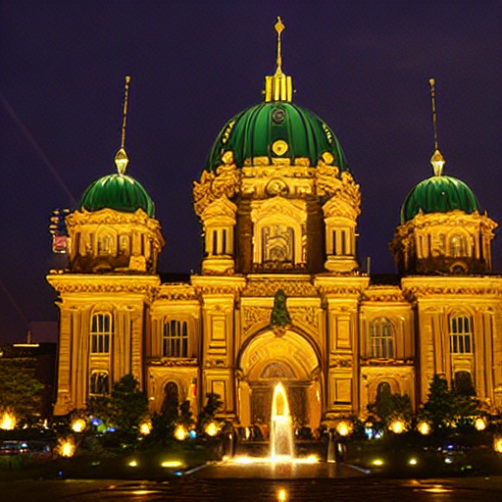
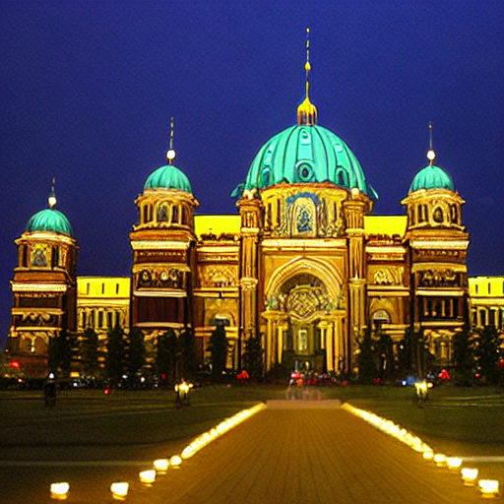
Curating Attribution Benchmark
(Object-centric models)
LAION Dataset
A sea of lights illuminates the building at night
V*
V* building

Slide 14
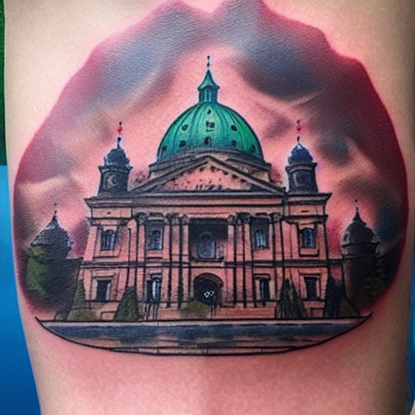
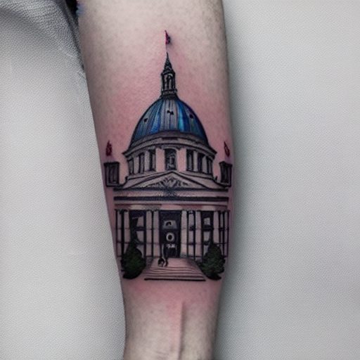
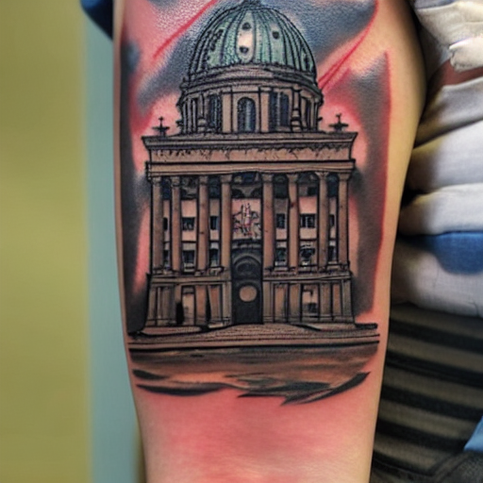
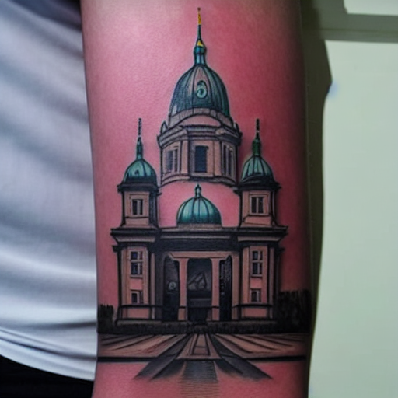
Curating Attribution Benchmark
(Object-centric models)
LAION Dataset
A tattoo of building
V*
V* building

Slide 15
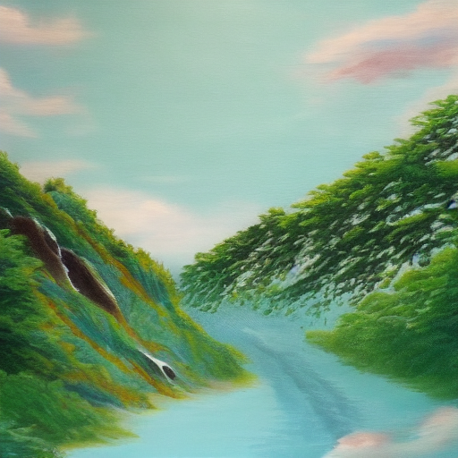
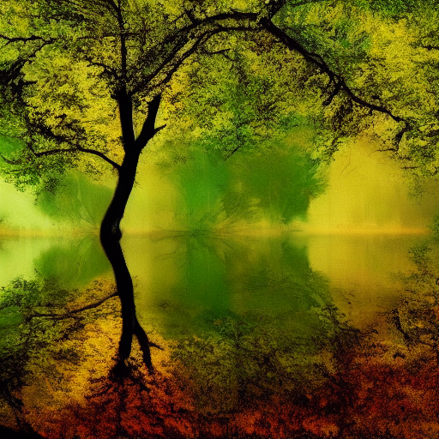
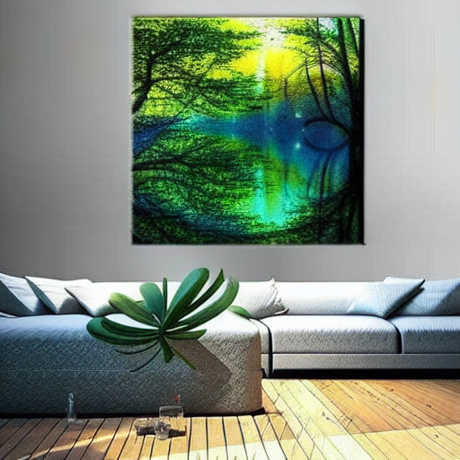
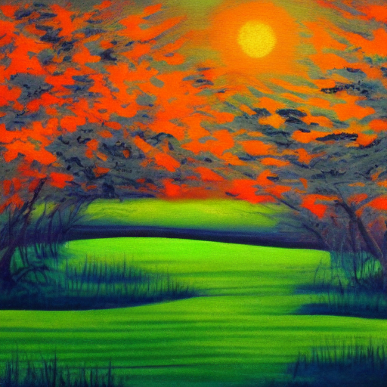
Curating Attribution Benchmark
(Artistic-style models)
LAION Dataset
The tranquility of nature in the style of art

Slide 16
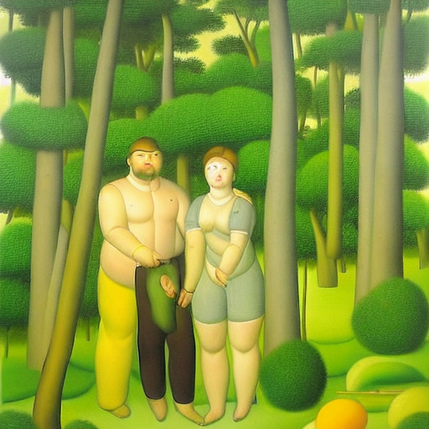
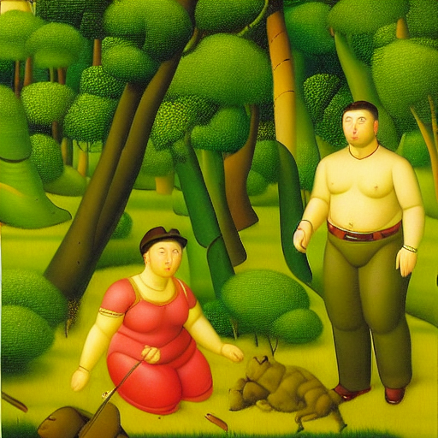
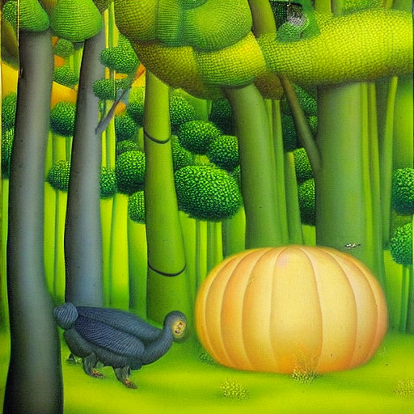
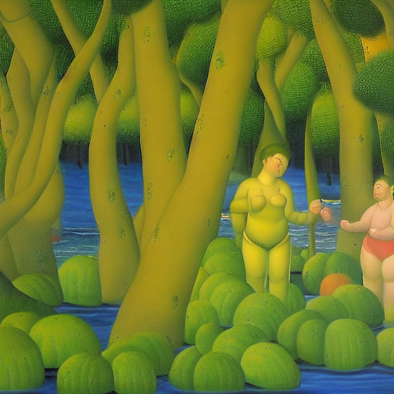
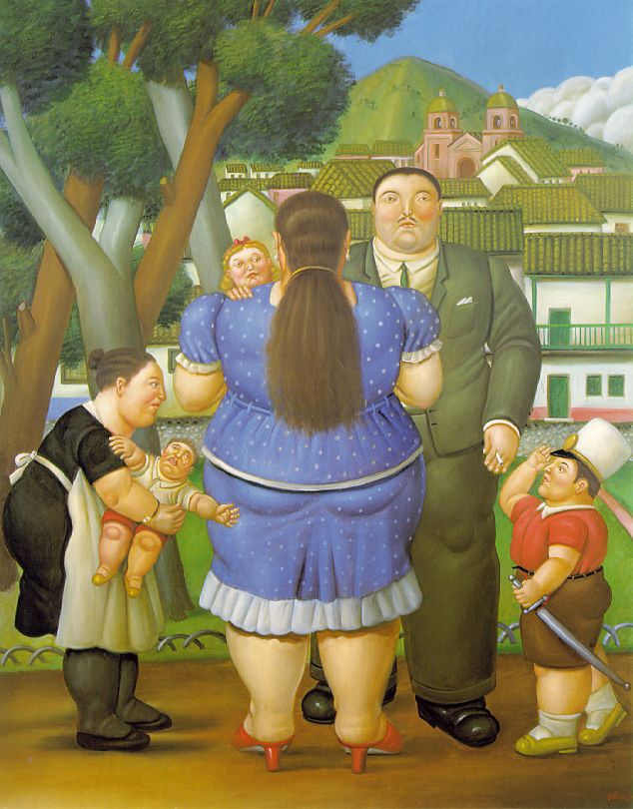
Curating Attribution Benchmark
(Artistic-style models)
LAION Dataset
The tranquility of nature in the style of art
V*
V* art
[Fernando Botero’s artwork collected from artchive.com]

Slide 17
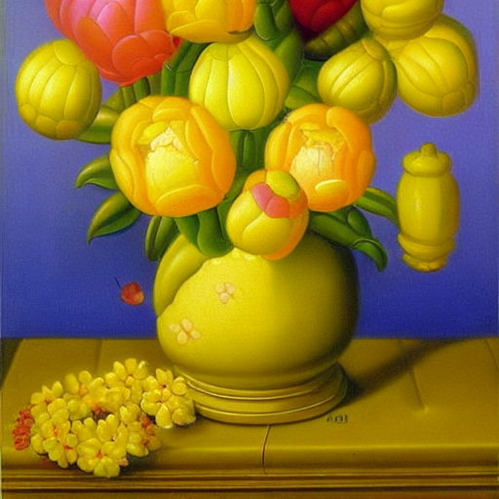
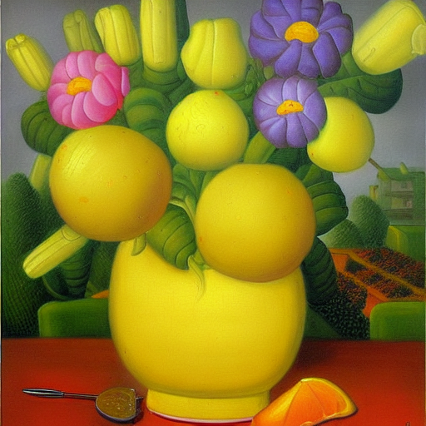
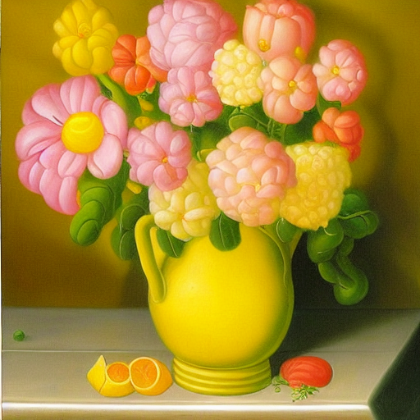
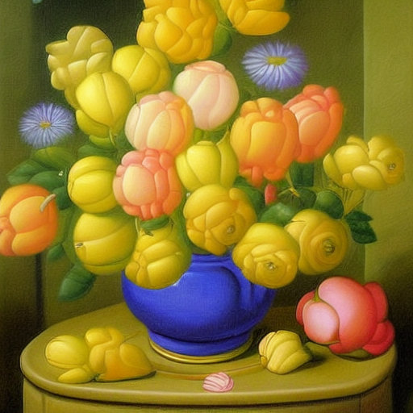
Curating Attribution Benchmark
(Artistic-style models)
LAION Dataset
A painting of flower in the style of art
V*
V* art
[Fernando Botero’s artwork collected from artchive.com]

Slide 18
Curating Attribution Benchmark
(Artistic-style models)
We trained ~18K models & collected ~4M samples!
LAION Dataset
A painting of flower in the style of art
V*
V* art
[Fernando Botero’s artwork collected from artchive.com]

Slide 19
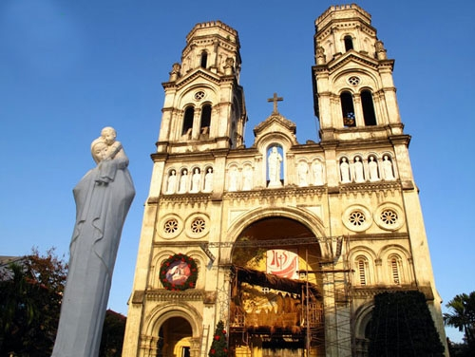
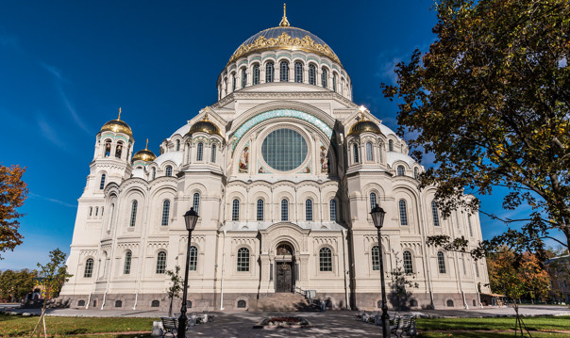
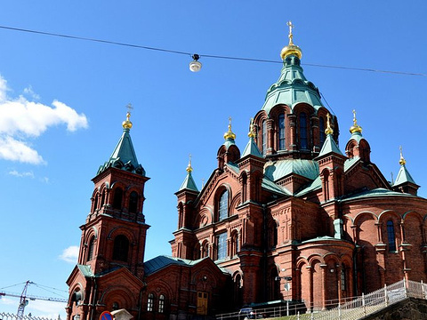
Learn Attribution from Customized Models
LAION Dataset
Synthesized Image
V* building

Slide 20
Learn Attribution from Customized Models
?
?
?
?
Synthesized Image

Slide 21
Learn Attribution from Customized Models
Synthesized Image
Learn feature space that puts corresponding images together
Ground Truth

Slide 22
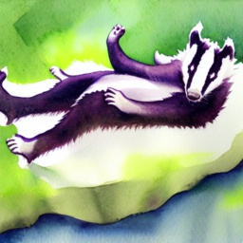
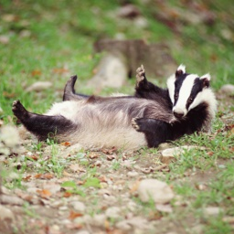
Contrastive Learning
Synthesized
Exemplar
Synthesized
Other
Images
Similarity( , )
> Similarity( , )

Slide 23

Contrastive Learning
Synthesized
s₁
s₂
s_{N}
Exemplar
t₁
t₂
t_{N}

Slide 24
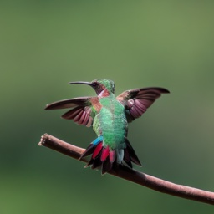




Attribution Score
Synthesized
Image
s
Calibrate softmax temperature $τ$ and threshold $λ$ to get influence scores
t₁
Sim
42.68%
Candidate
Training
Images
t₂
Sim
9.89%
Sim
…
t_{N}
Sim
0.00%
Compute embedding
Similarity & Softmax

Slide 25

Attribution Score
Objective: attribute when
training image is an exemplar
Synthesized
Image
s
t₁
Sim
exemplar
42.68%
100.0%
Candidate
Training
Images
t₂
9.89%
KL Loss
0.0%
Sim
other train images
Sim
…
…
t_{N}
Sim
0.00%
0.0%
Compute embedding
Similarity & Softmax

Slide 26
Quantitative Results
Artistic models
(Recall@10)
Good for objects
Object-centric models (Recall@10)

Slide 27
Quantitative Results
Artistic models
(Recall@10)
Middling performance
Object-centric models (Recall@10)

Slide 28
Quantitative Results
CLIP primed for large improvements with training
Artistic models
(Recall@10)
Object-centric models (Recall@10)

Slide 29
Quantitative Results
Artistic models
(Recall@10)
Pareto front
Object-centric models (Recall@10)

Slide 30










Custom Diffusion Results
DINO
15.14%
8.98%
6.45%
6.14%
6.10%
5.07%
Calibrated DINO
Generated
30.11%
7.72%
6.86%
6.50%
4.56%
4.31%

Slide 31









Custom Diffusion Results
CLIP
34.56%
8.83%
7.47%
7.11%
3.96%
3.70%
Calibrated CLIP
Generated
16.93%
7.38%
5.70%
4.96%
4.00%
3.25%

Slide 32



























Stable Diffusion Results (Calibrated CLIP)
Generated Sample
1.452%
1.200%
1.158%
1.113%
1.075%
1.011%
0.898%
0.884%
Generated Sample
0.554%
0.498%
0.474%
0.454%
0.445%
0.434%
0.414%
0.412%
Generated Sample
0.355%
0.260%
0.252%
0.243%
0.240%
0.240%
0.235%
0.234%

Slide 33



























Stable Diffusion Results (Calibrated CLIP)
Generated Sample
0.623%
0.450%
0.437%
0.407%
0.385%
0.383%
0.365%
0.317%
Generated Sample
2.158%
1.903%
1.837%
1.153%
1.096%
1.089%
1.061%
1.005%
Generated Sample
0.187%
0.168%
0.162%
0.161%
0.159%
0.147%
0.143%
0.142%

Slide 34











Stable Diffusion Results (Calibrated CLIP)
Generated Sample
1.752%
1.631%
1.518%
1.327%
1.273%
1.204%
1.160%
1.107%
Generated Sample
0.414%
0.397%
0.351%
0.348%
0.337%
0.326%
0.319%
0.319%

Slide 35


Attributing to larger set of images
Ground Truth
Finetune
MSCOCO
Subset
LAION
Dataset
Custom Diffusion
Attribute
Synthesized Image

Slide 36





Attributing to larger set of images
Plenty of headroom remains for improving general attribution!

Slide 37
Discussion / Limitations
Pre-training dataset is ignored
  LAION-5B still has influence on Custom Diffusion samples
Evaluating attribution with a large training set remains challenging
Prior work: remove data instead of “add-one-in”
  Attribute train data for classifiers
  Shapley Value: remove random subsets [Shapley 1953, Feldman & Zhang 2020]
    Lots of subsets ➜ computationally infeasible
  Influence function: leave-one-out [Koh & Liang 2017, Schioppa et al. 2022]
    Linear approximation
    Still expensive

Slide 38

Influence function
Test loss change is approximated by:
Speed-up attempts not accurate enough
  Last layer [Koh & Liang 2017]
  Rank reduction via Arnoldi iteration [Schioppa et al. 2022]
  Random projection [Georgiev et al. 2023]
Concurrent: improvement via model ensembles [Georgiev et al. 2023]
  Requires training multiple models from scratch
Inv. Hessian
dim: param_size x param_size
Gradient of train data
dim: param_size
Expensive to compute…
Expensive to store…

Slide 39
Thank you!
https://peterwang512.github.io/GenDataAttribution

