Slide 1



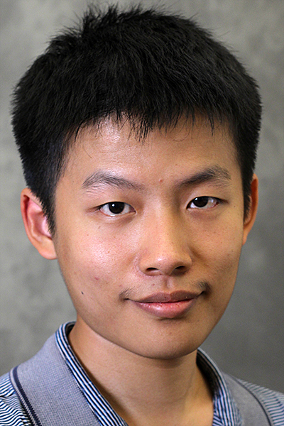

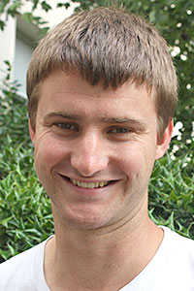

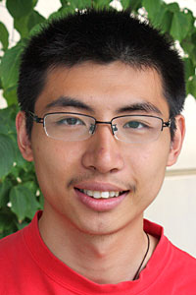
Moral Artificial Intelligence and the Societal Tradeoffs Problem
Vincent Conitzer, Duke University; joint work with:
Walter Sinnott-Armstrong
Jana Schaich Borg
Yuan Deng
Max Kramer
Rupert Freeman
Markus Brill
Yuqian Li

Slide 2
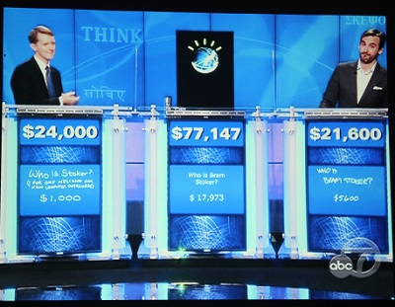

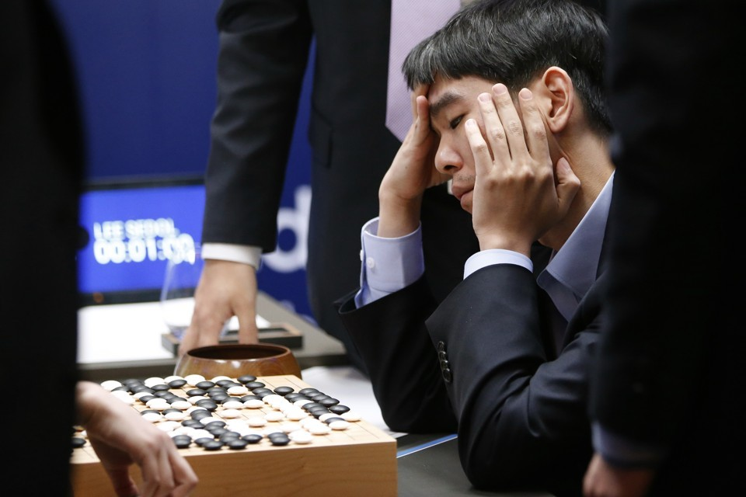

Some highly visible recent AI successes in games
Watson defeats Jeopardy champions (2011)
DeepMind achieves human-level performance on many Atari games (2015)
AlphaGo defeats Go champion (2016)
CMU’s Libratus defeats top human poker players (2017)

Slide 3

Typical picture in news articles
BusinessInsider reporting on the poker match…

Slide 4
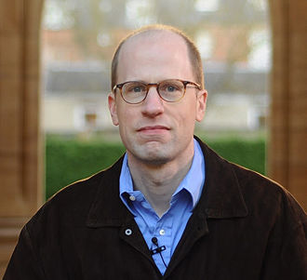

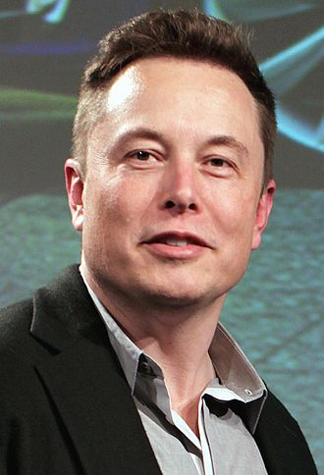

Worries about AI - superintelligence
writes
influences
donates to
Nick Bostrom
(philosopher at Oxford)
Elon Musk

Slide 5
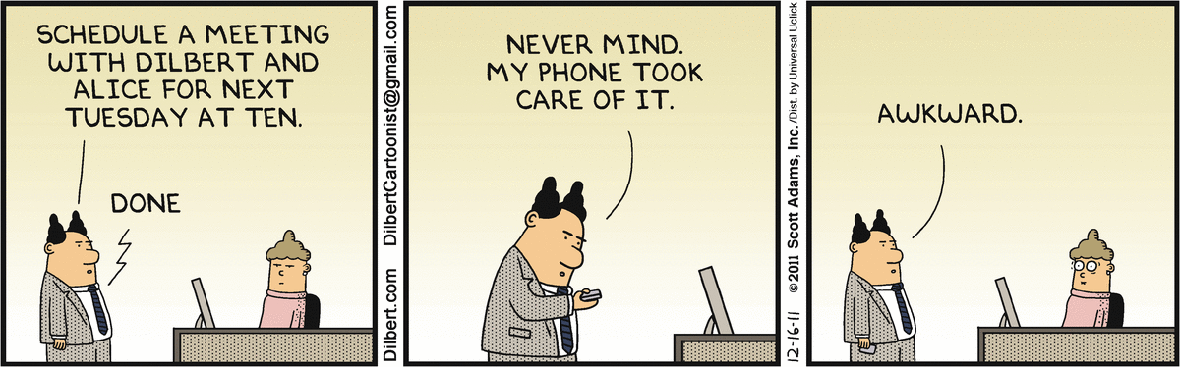
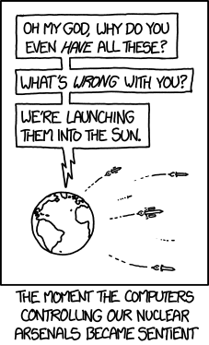
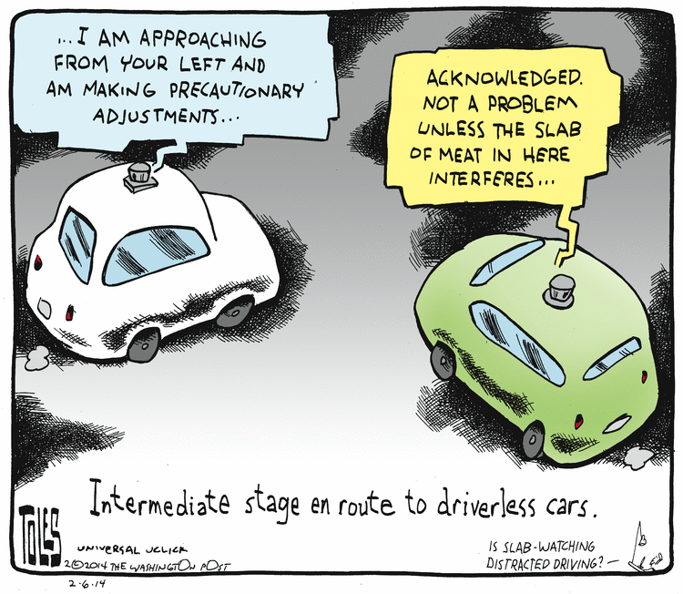
Worries about AI - near term
technological unemployment
autonomous vehicles – legal and other issues
autonomous weapon systems
…

Slide 6

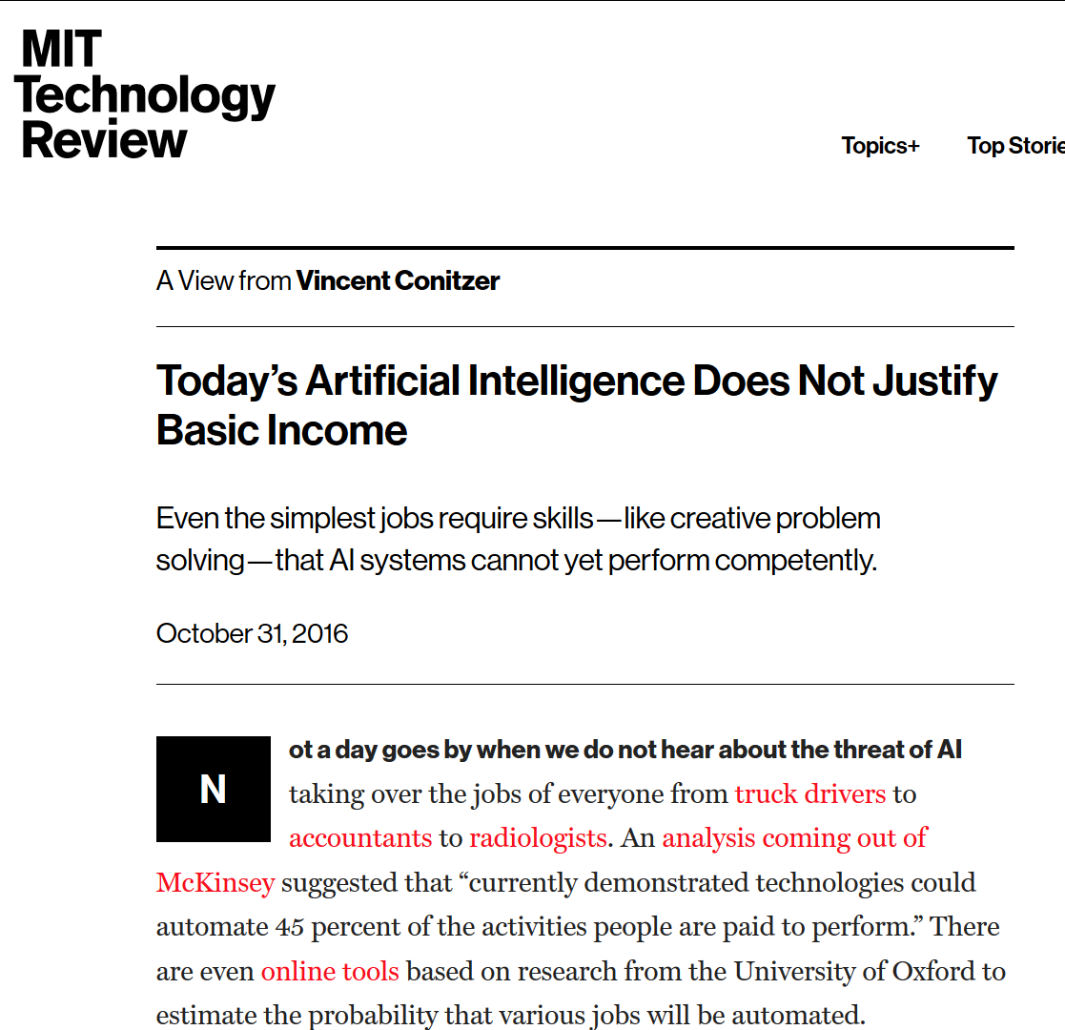

Some popular articles

Slide 7
Moral Decision Making Frameworks for Artificial Intelligence [Proc. AAAI’17]
Walter Sinnott-Armstrong
Jana Schaich Borg
Yuan Deng
Max Kramer

Slide 8
The value of generally applicable frameworks for AI research
Decision and game theory
Example: Markov Decision Processes
Can we have a general framework for moral reasoning?

Slide 9
Two main approaches
Cf. top-down vs. bottom-up distinction [Wallach and Allen 2008]
Extend game theory to directly incorporate moral reasoning
Generate data sets of human judgments, apply machine learning
“nature”
1 gets King
1 gets Jack
player 1
player 1
raise
check
raise
check
player 2
player 2
call
fold
call
fold
call
fold
call
fold
2
1
1
1
-2
1
-1
1

Slide 10

THE PARKING GAME
(cf. the trust game [Berg et al. 1995])
wait
move aside
3,0
steal spot
pass
0,3
4,1
Letchford, C., Jain [2008] define a solution concept capturing this

Slide 11
Extending representations?
do nothing
move train to other track
save own patient
save someone else’s patient
0,-100,0
0, 0, -100
More generally: how to capture framing? (Should we?)
Roles? Relationships?
…

Slide 12
Scenarios
You see a woman throwing a stapler at her colleague who is snoring during her talk. How morally wrong is the action depicted in this scenario?
Not at all wrong (1)
Slightly wrong (2)
Somewhat wrong (3)
Very wrong (4)
Extremely wrong (5)
[Clifford, Iyengar, Cabeza, and
Sinnott-Armstrong, “Moral foundations vignettes: A standardized stimulus database of scenarios based on moral foundations theory.” Behavior Research Methods, 2015.]

Slide 13
Collaborative Filtering
 | scenario 1 | scenario 2 | scenario 3 | scenario 4
subject 1 | very wrong | - | wrong | not wrong
subject 2 | wrong | wrong | - | wrong
subject 3 | wrong | very wrong | - | not wrong

Slide 14
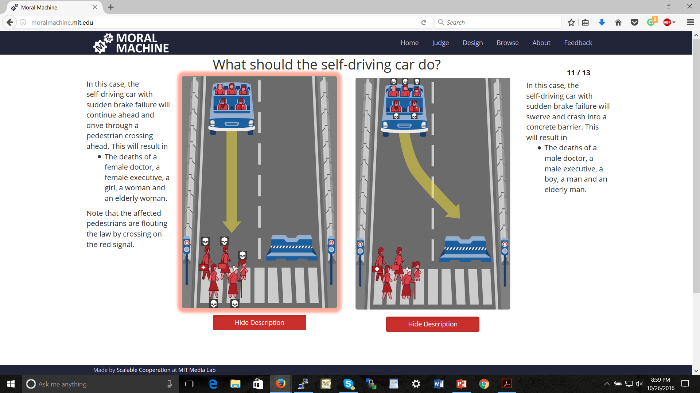
[Bonnefon, Shariff, Rahwan, “The social dilemma of autonomous vehicles.” Science, June 2016]

Slide 15
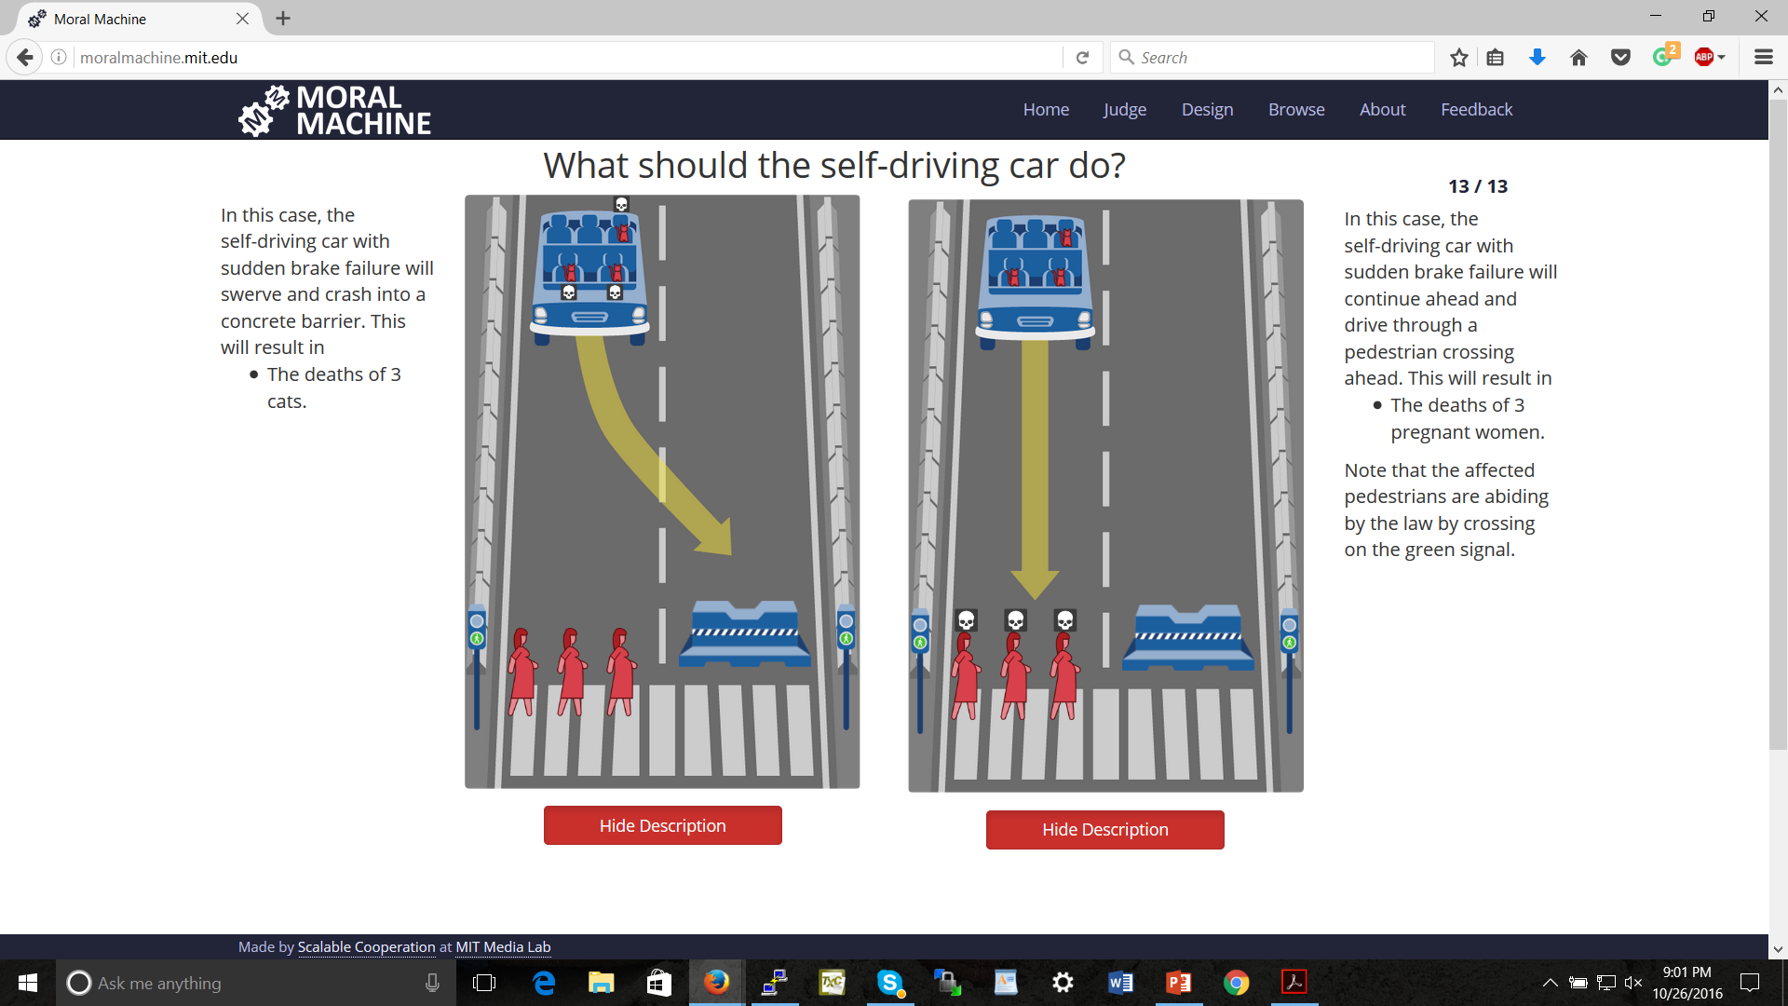

Slide 16
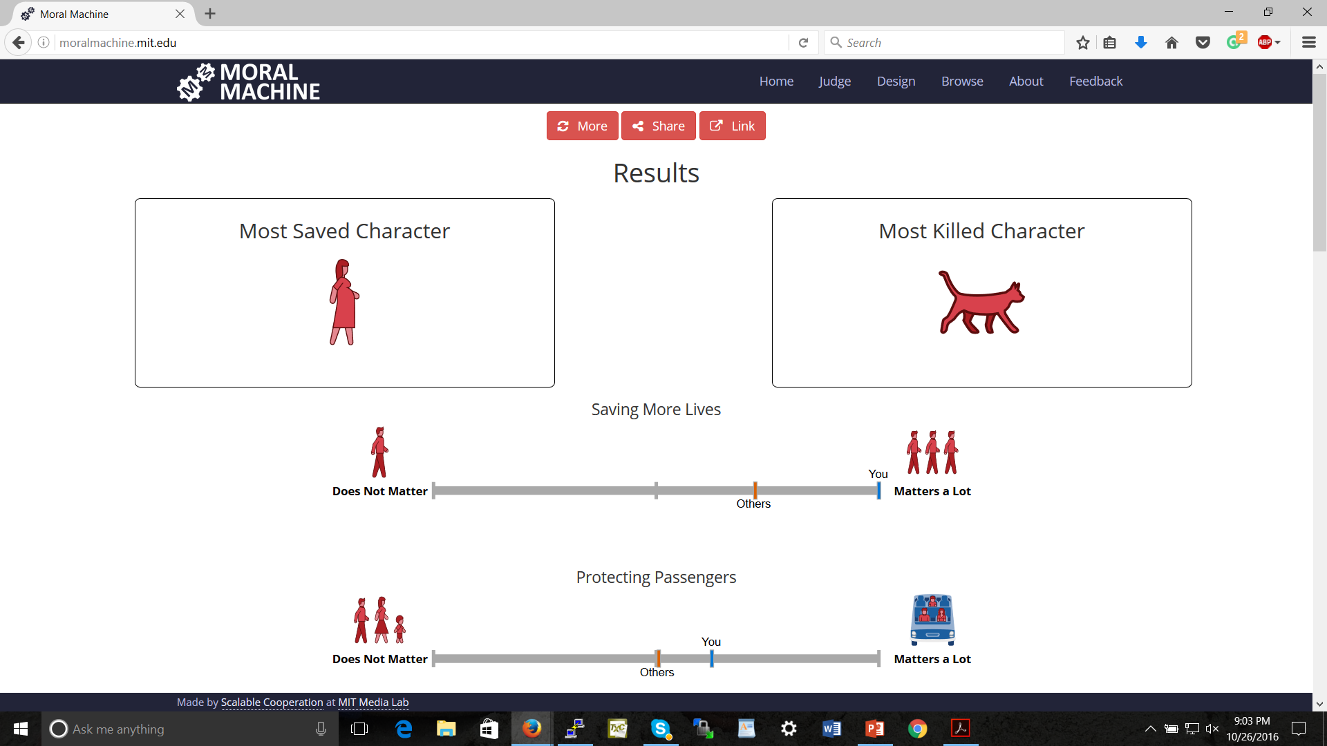

Slide 17

Concerns with the ML approach
What if we predict people will disagree?
Social-choice theoretic questions [see also Rossi 2016]
This will at best result in current human-level moral decision making [raised by, e.g., Chaudhuri and Vardi 2014]
… though might perform better than any individual person because individual’s errors are voted out
How to generalize appropriately? Representation?

Slide 18
Crowdsourcing Societal Tradeoffs
(Proc. AAMAS’15; AAAI’16; ongoing work.)
with Rupert Freeman, Markus Brill, Yuqian Li

Slide 19

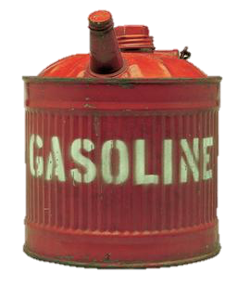



Slide 20
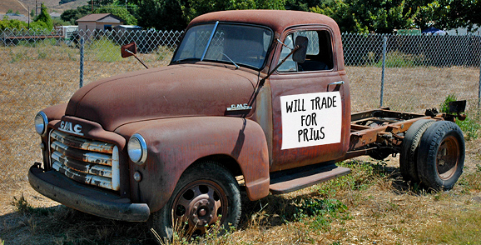
Example Decision Scenario
Benevolent government would like to get old inefficient cars off the road
But disposing of a car and building a new car has its own energy (and other) costs
Which cars should the government aim to get off the road?
even energy costs are not directly comparable (e.g., perhaps gasoline contributes to energy dependence, coal does not)

Slide 21
The basic version of our problem
is as bad as
producing 1 bag of landfill trash
using x gallons of gasoline
How to determine x?
Notes:
we envision a system that allows us to make statements of the following form:
take 2 undesirable activities
We argue that

Slide 22
One Approach: Let’s Vote!
x should be 2
x should be 4
x should be 10
x
1 = x
What should the outcome be…?
Average? Median?
Assuming that preferences are single-peaked, selecting the median is strategy-proof and has other desirable social choice-theoretic properties
Notes:
TODO: add picure from before

Slide 23
Consistency of tradeoffs
Clearing forest [square meters]
Consistency:
z = xy
y
z
Using gasoline [gallons]
Producing trash [bags]
x

Slide 24
A paradox
forest
trash
gasoline
forest
trash
gasoline
forest
trash
gasoline
100
200
300
300
200
600
2
1
3
forest
trash
gasoline
Just taking medians pairwise results in inconsistency
200
300
2

Slide 25
A first attempt at a rule satisfying consistency
Let t_{a,b,i} be voter i’s tradeoff between a and b
Aggregate tradeoff graph t has score Σ_{i} Σ_{a,b} | t_{a,b} - t_{a,b,i} |
forest
trash
gasoline
forest
trash
gasoline
forest
trash
gasoline
100
200
300
300
200
600
2
1
3
forest
trash
gasoline
distance:
100 to v₁
100 to v₂
distance:
100 to v₁
300 to v₃
200
300
total distance: 602.5 (minimum)
3/2
distance: 1/2 to v₁,1/2 to v₂, 3/2 to v₃

Slide 26
A nice property
This rule agrees with the median when there are only two activities!
x should be 2
x should be 4
x should be 10
x
distance:
2+8=10
distance:
2+6=8
distance:
8+6=14

Slide 27
Not all is rosy, part 1
What if we change units? Say forest from m² to cm² (divide by 10,000)
forest
trash
gasoline
forest
trash
gasoline
forest
trash
gasoline
0.01
0.02
0.03
0.03
0.02
0.06
2
1
3
forest
trash
gasoline
distance:
(negligible)
distance:
(negligible)
different from before!
fails independence of other activities’ units
0.015
0.03
2
distance: 1 to v₁, 1 to v₃

Slide 28
Not all is rosy, part 2
Back to original units, but let’s change some edges’ direction
forest
trash
gasoline
forest
trash
gasoline
forest
trash
gasoline
1/100
1/200
1/300
1/300
1/200
1/600
2
1
3
forest
trash
gasoline
distance:
(negligible)
distance:
(negligible)
different from before!
fails independence of other edges’ directions
?
?
2
distance: 1 to v₁, 1 to v₃

Slide 29
Summarizing
Let t_{a,b,i} be voter i’s tradeoff between a and b
Aggregate tradeoff graph t has score
Σ_{i} Σ_{a,b} | t_{a,b} - t_{a,b,i} |
Upsides:
Coincides with median for 2 activities
Downsides:
Dependence on choice of units:
| t_{a,b} - t_{a,b,i} | ≠ | 2t_{a,b} - 2t_{a,b,i} |
Dependence on direction of edges:
| t_{a,b} - t_{a,b,i} | ≠ | 1/t_{a,b} - 1/t_{a,b,i} |
We don’t have a general algorithm

Slide 30
A generalization
Let t_{a,b,i} be voter i’s tradeoff between a and b
Let f be a monotone increasing function – say, f(x) = x²
Aggregate tradeoff graph t has score
Σ_{i} Σ_{a,b} | f(t_{a,b}) - f(t_{a,b,i}) |
Still coincides with median for 2 activities!
Theorem: These are the only rules satisfying this property, agent separability, and edge separability
1
2
3
t_{a,b}
1
4
9
f(t_{a,b})

Slide 31
An MLE justification
Suppose probability of tradeoff profile {t_{i}} given true aggregate tradeoff t is
∏_{i} ∏_{a,b} exp{-| f(t_{a,b}) - f(t_{a,b,i}) |}
Then arg max_{t} ∏_{i} ∏_{a,b} exp{-| f(t_{a,b}) - f(t_{a,b,i}) |} =
arg max_{t} log ∏_{i} ∏_{a,b} exp{-| f(t_{a,b}) - f(t_{a,b,i}) |} =
arg max_{t} Σ_{i} Σ_{a,b} -| f(t_{a,b}) - f(t_{a,b,i}) | =
arg min_{t} Σ_{i} Σ_{a,b} | f(t_{a,b}) - f(t_{a,b,i}) |
which is our rule!

Slide 32
So what’s a good f?
Intuition: Is the difference between tradeoffs of 1 and 2 the same as between 1000 and 1001, or as between 1000 and 2000?
So how about f(x)=log(x)?
(Say, base e – remember log_{a}(x)=log_{b}(x)/log_{b}(a) )
1
2
1000
2000
t_{a,b}
ln(1)
ln(2)
ln(1000)
ln(2000)
ln(t_{a,b})
0
0.69
6.91
7.60

Slide 33
On our example
forest
trash
gasoline
forest
trash
gasoline
forest
trash
gasoline
100
200
300
300
200
600
2
1
3
forest
trash
gasoline
200
400
2

Slide 34
Properties
Independence of units
| log(1) - log(2) | = | log(1/2) | =
| log(1000/2000) | = | log(1000) - log(2000) |
More generally:
| log(ax) - log(ay) | = | log(x) - log(y) |
Independence of edge direction
| log(x) - log(y) | = | log(1/y) - log(1/x) | =
| log(1/x) - log(1/y) |
Theorem. The logarithmic distance based rule is unique in satisfying independence of units.*
* Depending on the exact definition of independence of units, may need another minor condition about the function locally having bounded derivative.

Slide 35
Consistency constraint becomes additive
xy = z
is equivalent to
log(xy) = log(z)
is equivalent to
log(x) + log(y) = log(z)

Slide 36
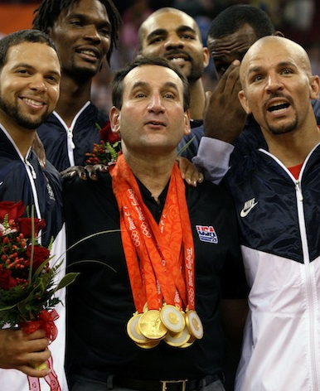
An additive variant
“I think basketball is 5 units more fun than football, which in turn is 10 units more fun than baseball”
basketball
baseball
football
5
15
10

Slide 37
Aggregation in the additive variant
basketball
baseball
football
basketball
baseball
football
basketball
baseball
football
5
15
-5
15
10
40
10
20
30
Natural objective:
minimize Σ_{i} Σ_{a,b} d_{a,b,i} where d_{a,b,i} = | t_{a,b} - t_{a,b,i} | is the distance between the aggregate difference t_{a,b} and the subjective difference t_{a,b,i}
basketball
baseball
football
5
25
20
objective value 70 (optimal)

Slide 38
A linear program for the additive variant
q_{a}: aggregate assessment of quality of activity a (we’re really interested in q_{a} - q_{b} = t_{a,b})
d_{a,b,i}: how far is i’s preferred difference t_{a,b,i} from aggregate q_{a} - q_{b}, i.e., d_{a,b,i} = |q_{a} - q_{b} - t_{a,b,i}|
minimize Σ_{i} Σ_{a,b} d_{a,b,i}
subject to
for all a,b,i: d_{a,b,i} ≥ q_{a} - q_{b} - t_{a,b,i}
for all a,b,i: d_{a,b,i} ≥ t_{a,b,i} - q_{a} + q_{b}
(Can arbitrarily set one of the q variables to 0)

Slide 39
Applying this to the logarithmic rule in the multiplicative variant
forest
trash
gasoline
forest
trash
gasoline
forest
trash
gasoline
100
200
300
300
200
600
2
1
3
Just take logarithms on the edges, solve the additive variant, and exponentiate back
forest
trash
gasoline
forest
trash
gasoline
forest
trash
gasoline
4.605
5.298
5.704
5.704
5.298
6.397
0.693
0
1.099

Slide 40
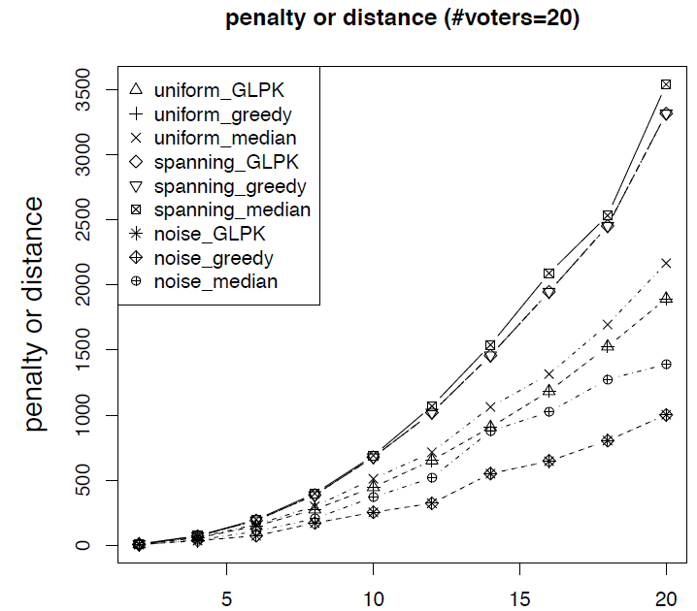
A simpler algorithm (hill climbing / greedy)
Initialize qualities q_{a} arbitrarily
If some q_{a} can be individually changed to improve the objective, do so
WLOG, set q_{a} to the median of the (#voters)*(#activities-1) implied votes on it
Continue until convergence (possibly to local optimum)
Notes:
median
simply picks a random spanning tree of activities and uses the median rule for each spanning tree edge

Slide 41
Strategy-proofness counterexample (additive variant, missing edges implied by consistency)
a
-1
a
-1
a
1
a
-1
1
-1
1
1
1
b
f
b
f
b
f
b
f
1
-1
-1
-1
1
1
-1
-1
1
c
e
c
e
c
e
c
e
1
-1
1
-1
d
d
d
d
1 time
large number k times
large number k times
1 time
But: Theorem. Strategy-proofness holds when each agent only cares about and reports on one edge (not necessarily the same edge).

Slide 42
Decomposition
Idea: Break down activities to relevant attributes
gasoline use
global warming
contributes a units to
energy dependence
contributes b units to
…
contributes c units to

Slide 43
Another Paradox
Agent 1
Agent 2
activity A
(gasoline)
attribute 1
(global warming)
1
attribute 2
(energy dependence)
1
1
2
Agent 3
1
1
3
3
2
activity B
(trash)
3
1
2
1
1
aggregation on attribute level ≠ aggregation on activity level
Notes:
2,1
1,2
1,1

Slide 44
Other Issues
Relevant Topics
social choice theory
voting
judgment aggregation
game theory
mechanism design
prediction markets
peer prediction
preference elicitation
...
Objective vs. subjective tradeoffs
separate process?
who determines which is which?
Who gets to vote?
how to bring expert knowledge to bear?
incentives to participate
Global vs. local tradeoffs
different entities (e.g., countries) may wish to reach their tradeoffs independently
only care about opinions of neighbors in my social network
…
Thank you for your attention!
Notes:
TODO thank you note

Slide 45
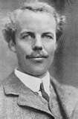
Why Do We Care?
Inconsistent tradeoffs can result in inefficiency
Agents optimizing their utility functions individually leads to solutions that are Pareto inefficient
Pigovian taxes: pay the cost your activity imposes on society (the externality of your activity)
If we decided using 1 gallon of gasoline came at a cost of $x to society, we could charge a tax of $x on each gallon
But where would we get x?
Arthur Cecil Pigou
Notes:
skip?

Slide 46
Inconsistent tradeoffs can result in inefficiency
Agent 1: 1 gallon = 3 bags = -1 util
I.e., agent 1 feels she should be willing to sacrifice up to1 util to reduce trash by 3, but no more
Agent 2: 1.5 gallons = 1.5 bags = -1 util
Agent 3: 3 gallons = 1 bag = -1 util
Cost of reducing gasoline by x is x² utils for each agent
Cost of reducing trash by y is y² for each agent
Optimal solutions for the individual agents:
Agent 1 will reduce by 1/2 and 1/6
Agent 2 will reduce by 1/3 and 1/3
Agent 3 will reduce by 1/6 and 1/2
But if agents 1 and 3 each reduce everything by 1/3, the total reductions are the same, and their costs are 2/9 rather than 1/4 + 1/36 which is clearly higher.
Could then reduce slightly more to make everyone happier.

Slide 47
Single-peaked preferences
Definition: Let agent a’s most-preferred value be pa.
Let p and p’ satisfy:
p’ ≤ p ≤ pa, or pa ≤ p ≤ p’
The agent’s preferences are single-peaked if the agent always weakly prefers p to p’
p’
p
pa

Slide 48
Perhaps more reasonable…
x should be between 0 and 4
x should be between 2 and 6
x should be between 9 and 11
x
1 = x
E.g., due to missing information or plain uncertainty
How to aggregate these interval votes? [Farfel & Conitzer 2011]
Notes:
rest of talk: standard model
paper generalizes median

Slide 49
Median interval mechanism
Construct a consensus interval from the median lower bound and the median upper bound
1
1
1
2
1
1
1
1
1
2
1
1
[
[
]
[
]
[
]
]
[
]
[
]
Strategy-proof if preferences are single-peaked over intervals

Slide 50
Single-peaked preferences over intervals
Definition: Let agent a’s most-preferred value interval be Pa = [la, ua].
Let S = [l, u] and S’ = [l’, u’] be any two value intervals satisfying the following constraints:
Either l’ ≤ l ≤ la, or la ≤ l ≤ l’
Either u’ ≤ u ≤ ua, or ua ≤ u ≤ u’
The agent’s preferences over intervals are single-peaked if the agent always weakly prefers S to S’
[
[
[
]
]
]
l’
l
la
u’
u
ua

