Slide 1
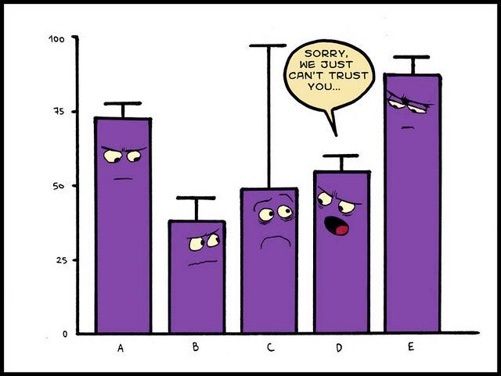






New Directions in Automated Mechanism Design
Vincent Conitzer; joint work with:
Michael Albert
(Duke → UVA)
Giuseppe (Pino) Lopomo
(Duke)
Peter Stone
(UT Austin)
Andrew Kephart
(Duke → KeepTruckin)
Hanrui Zhang
(Duke)
Yu Cheng
(Duke → IAS → UIC)

Slide 2

Mechanism design
Make decisions based on the preferences (or other information) of one or more agents (as in social choice)
Focus on strategic (game-theoretic) agents with privately held information; have to be incentivized to reveal it truthfully
Popular approach in design of auctions, matching mechanisms, …
v = 25
v = 20

Slide 3

Sealed-bid auctions (on a single item)
Bidder i determines how much the item is worth to her (v_{i})
Writes a bid (v’_{i}) on a piece of paper
How would you bid? How much would I make?
First price: Highest bid wins, pays bid
Second price: Highest bid wins, pays next-highest bid
First price with reserve: Highest bid wins iff it exceeds r, pays bid
Second price with reserve: Highest bid wins iff it exceeds r, pays next highest bid or r (whichever is higher)

Slide 4
Revelation Principle
Anything you can achieve, you can also achieve with a truthful (AKA incentive compatible) mechanism.
Accept!
takes action 4
mechanism

Slide 5
Revelation Principle
Anything you can achieve, you can also achieve with a truthful (AKA incentive compatible) mechanism.
new mechanism
Accept!
reports type B
takes action 4
software agent
original mechanism

Slide 6



The revelation principle
For any (complex, strange) mechanism that produces certain outcomes under strategic behavior (dominant strategies, BNE)…
… there exists a (dominant-strategies, BNE) incentive compatible direct revelation mechanism that produces the same outcomes!
new mechanism
P₁
mechanism
types
actions
P₂
outcome
P₃

Slide 7
Automated mechanism design [C. & Sandholm UAI’02]
Classical
Prove general theorems & publish
Intuitions about
mechanism design
Real-world mechanism
design problem appears
Build mechanism
by hand
Mechanism for
setting at hand
Automated
Build software
Automated mechanism
design software
(once)
Real-world mechanism
design problem appears
Apply software
to problem
Mechanism for
setting at hand

Slide 8
Automated mechanism design input
Instance is given by
  Set of possible outcomes
  Set of agents
    For each agent
      set of possible types
      probability distribution over these types
  Objective function
    Gives a value for each outcome for each combination of agents’ types
    E.g., social welfare, revenue
  Restrictions on the mechanism
    Are payments allowed?
    Is randomization over outcomes allowed?
    What versions of incentive compatibility (IC) & individual rationality (IR) are used?

Slide 9
How hard is designing an optimal deterministic mechanism (without reporting costs)?
[C. & Sandholm UAI’02, ICEC’03, EC’04]
NP-complete (even with 1 reporting agent):
Solvable in polynomial time (for any constant number of agents):
Maximizing social welfare (no payments)
Designer’s own utility over outcomes (no payments)
General (linear) objective that doesn’t regard payments
Expected revenue
Maximizing social welfare (not regarding the payments) (VCG)
1 and 3 hold even with no IR constraints

Slide 10
Positive results (randomized mechanisms)
[C. & Sandholm UAI’02, ICEC’03, EC’04]
Use linear programming
Variables:
  p(o | θ₁, …, θ_{n}) = probability that outcome o is chosen given types θ₁, …, θ_{n}
  (maybe) π_{i}(θ₁, …, θ_{n}) = i’s payment given types θ₁, …, θ_{n}
Strategy-proofness constraints: for all i, θ₁, …θ_{n}, θ_{i}’:
Σ_{o}p(o | θ₁, …, θ_{n})u_{i}(θ_{i}, o) + π_{i}(θ₁, …, θ_{n}) ≥
Σ_{o}p(o | θ₁, …, θ_{i}’, …, θ_{n})u_{i}(θ_{i}, o) + π_{i}(θ₁, …, θ_{i}’, …, θ_{n})
Individual-rationality constraints: for all i, θ₁, …θ_{n}:
Σ_{o}p(o | θ₁, …, θ_{n})u_{i}(θ_{i}, o) + π_{i}(θ₁, …, θ_{n}) ≥ 0
Objective (e.g., sum of utilities)
Σ_{θ1, …, θn}p(θ₁, …, θ_{n})Σ_{i}(Σ_{o}p(o | θ₁, …, θ_{n})u_{i}(θ_{i}, o) + π_{i}(θ₁, …, θ_{n}))
Also works for BNE incentive compatibility, ex-interim individual rationality notions, other objectives, etc.
For deterministic mechanisms, can still use mixed integer programming: require probabilities in {0, 1}
  Remember typically designing the optimal deterministic mechanism is NP-hard

Slide 11
A simple example
One item for sale (free disposal)
2 agents, IID valuations: uniform over {1, 2}
Maximize expected revenue under ex-interim IR, Bayes-Nash equilibrium
How much can we get?
(What is optimal expected welfare?)
Agent 2’s valuation
1
2
0.25 | 0.25
0.25 | 0.25
1
Agent 1’s valuation
2
Status: OPTIMAL
Objective: obj = 1.5 (MAXimum)
[nonzero variables:]
p_t_1_1_o3 1 (probability of disposal for (1, 1))
p_t_2_1_o1 1 (probability 1 gets the item for (2, 1))
p_t_1_2_o2 1 (probability 2 gets the item for (1, 2))
p_t_2_2_o2 1 (probability 2 gets the item for (2, 2))
pi_2_2_1 2 (1’s payment for (2, 2))
pi_2_2_2 4 (2’s payment for (2, 2))
probabilities
Our old AMD solver [C. & Sandholm, 2002, 2003] gives:

Slide 12
A slightly different distribution
One item for sale (free disposal)
2 agents, valuations drawn as on right
Maximize expected revenue under ex-interim IR, Bayes-Nash equilibrium
How much can we get?
(What is optimal expected welfare?)
Agent 2’s valuation
1
2
0.251 | 0.250
0.250 | 0.249
1
Agent 1’s valuation
2
probabilities
Status: OPTIMAL
Objective: obj = 1.749 (MAXimum)
[some of the nonzero payment variables:]
pi_1_1_2 62501
pi_2_1_2 -62750
pi_2_1_1 2
pi_1_2_2 3.992
You’d better be really sure about your distribution!

Slide 13
A nearby distribution without correlation
One item for sale (free disposal)
2 agents, valuations IID: 1 w/ .501, 2 w/ .499
Maximize expected revenue under ex-interim IR, Bayes-Nash equilibrium
How much can we get?
(What is optimal expected welfare?)
Agent 2’s valuation
1
2
1
0.251001 | 0.249999
0.249999 | 0.249001
Agent 1’s valuation
2
probabilities
Status: OPTIMAL
Objective: obj = 1.499 (MAXimum)

Slide 14
Cremer-McLean [1985]
For every agent, consider the following matrix Γ of conditional probabilities, where Θ is the set of types for the agent and Ω is the set of signals (joint types for other agents, or something else observable to the auctioneer)
If Γ has rank |Θ| for every agent then the auctioneer can allocate efficiently and extract the full surplus as revenue (!!)

Slide 15

Basic model does not always fit modern environments
Mechanism may have access to data about agent that is possible, but costly to change for the agent

Slide 16


Standard setup in mechanism design
40%: v = 10
60%: v = 20
(1) Designer has beliefs about agent’s type (e.g., preferences)
(2) Designer announces mechanism (typically mapping from reported types to outcomes)
v = 20
v = 20 →
(3) Agent strategically acts in mechanism (typically type report), however she likes at no cost
(4) Mechanism functions as specified

Slide 17
The mechanism may have more information about the specific agent!
application online marketplaces selling insurance university admissions webpage ranking | information actions taken online driving record courses taken links to page

Slide 18
Attempt 1 at fixing this
Show me pictures of yachts
30%: v = 10
70%: v = 20
(1) Designer obtains beliefs about agent’s type (e.g., preferences)
(2) Designer announces mechanism (typically mapping from reported types to outcomes)
(0) Agent acts in the world
(naively?)
v = 20
v = 20 →
(3) Agent strategically acts in mechanism (typically type report), however she likes at no cost
(4) Mechanism functions as specified

Slide 19
Attempt 2: Sophisticated agent
40%: v = 10
60%: v = 20
(1) Designer has prior beliefs about agent’s type (e.g., preferences)
(2) Designer announces mechanism (typically mapping from reported types to outcomes)
Show me pictures of cats
v = 20 →
v = 20
(3) Agent strategically takes possibly costly actions
(4) Mechanism functions as specified

Slide 20
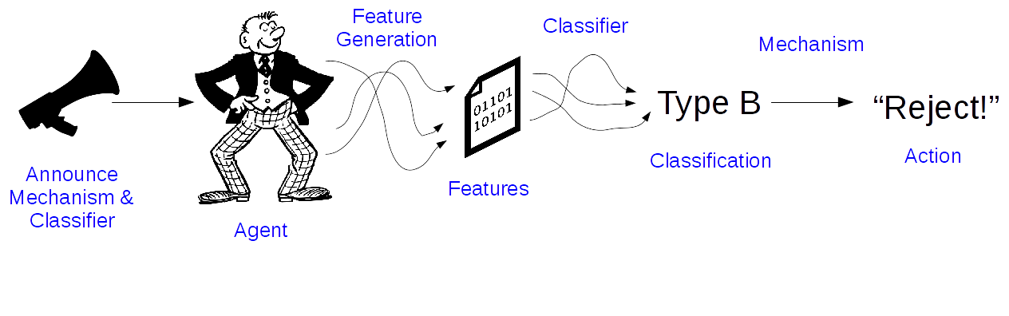
Machine learning view
See also later work by Hardt, Megiddo, Papadimitriou, Wootters [2015/2016]

Slide 21
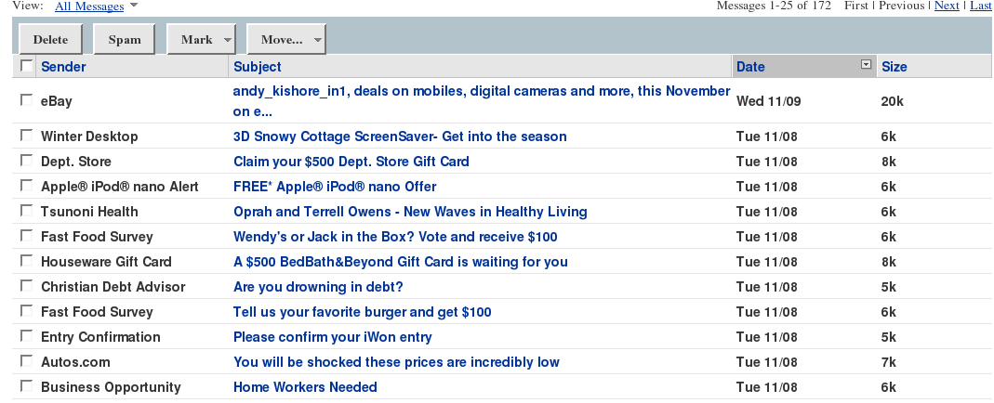
Adversarial Machine Learning
Complex Classification, Simple Game Theory
Spam
DDOS
Credit Card Fraud
Dalvi et al. Adversarial Classification. KDD, 2004
Huang et al. Adversarial Machine Learning. ACM Workshop on Artificial Intelligence and Security, 2011

Slide 22
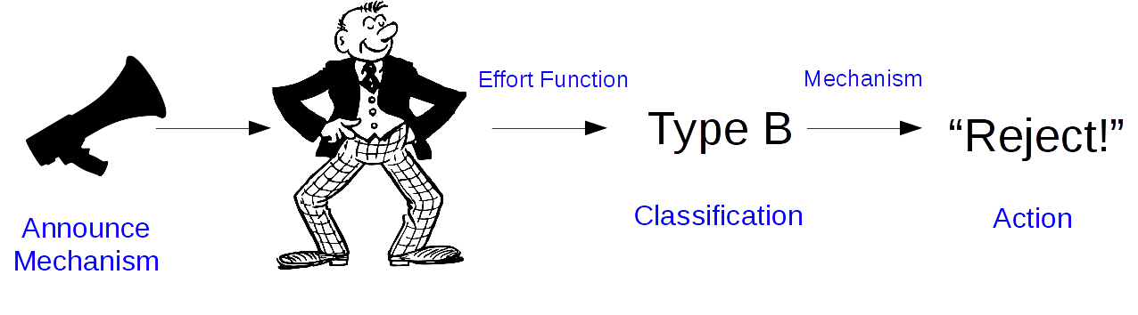
Mechanism Design With Signaling Costs
Simple Classification, Complex Game Theory
College Admissions
Inspection Games
Insurance Rate-setting
Ranking Systems

Slide 23
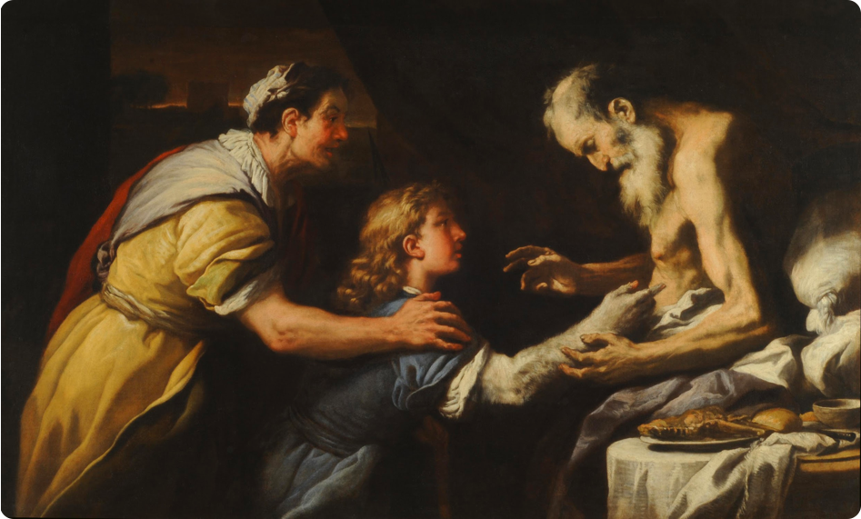
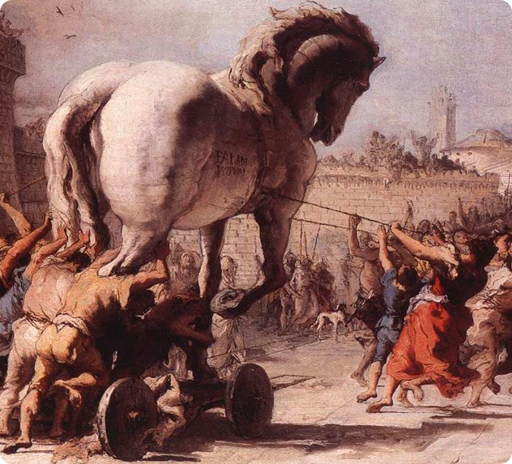
From Ancient Times…
Jacob and Esau
Trojan Horse

Slide 24

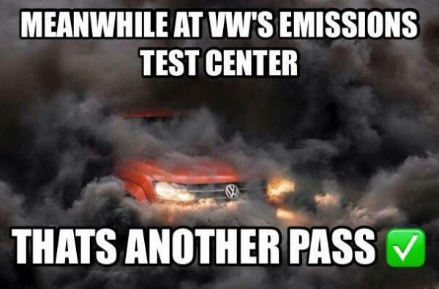

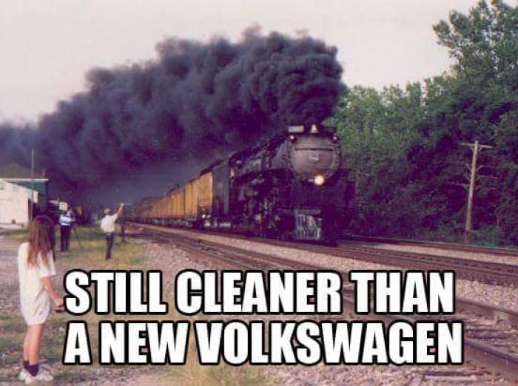
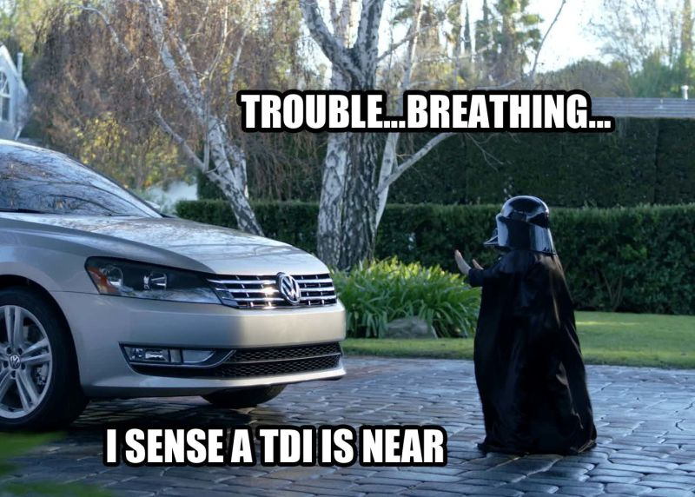
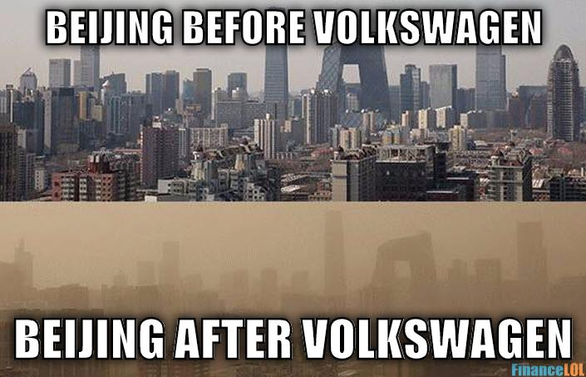

… to Modern Times

Slide 25
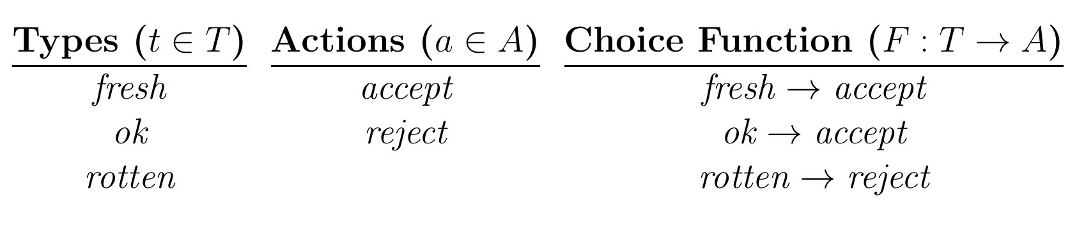
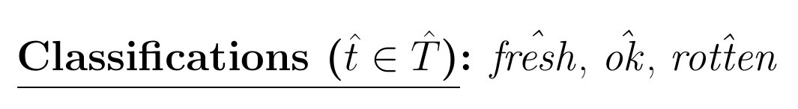


Illustration: Barbara Buying Fish From Fred

Slide 26
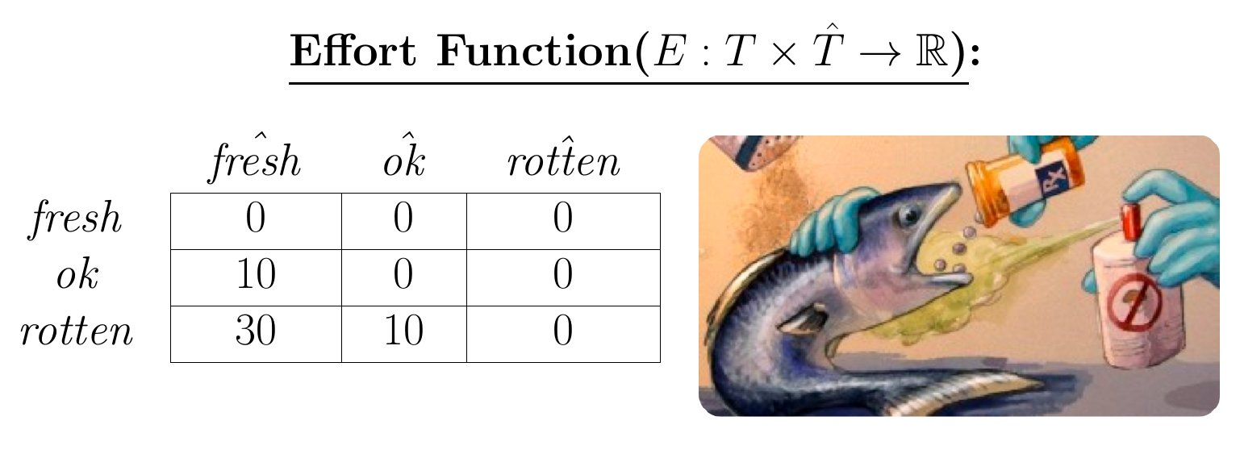
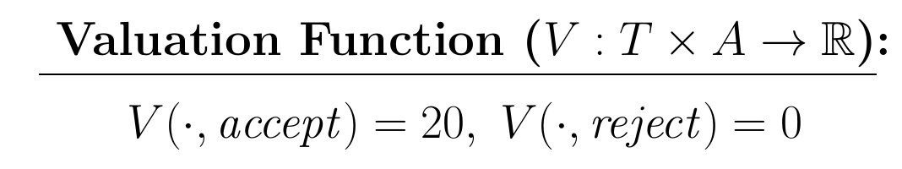
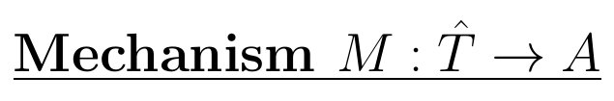
... continued
First Try:

Slide 27
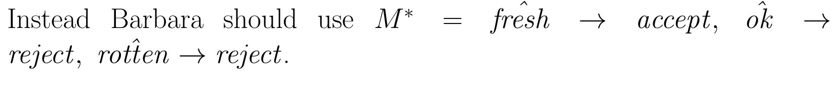
... continued
First Try:
Better:

Slide 28
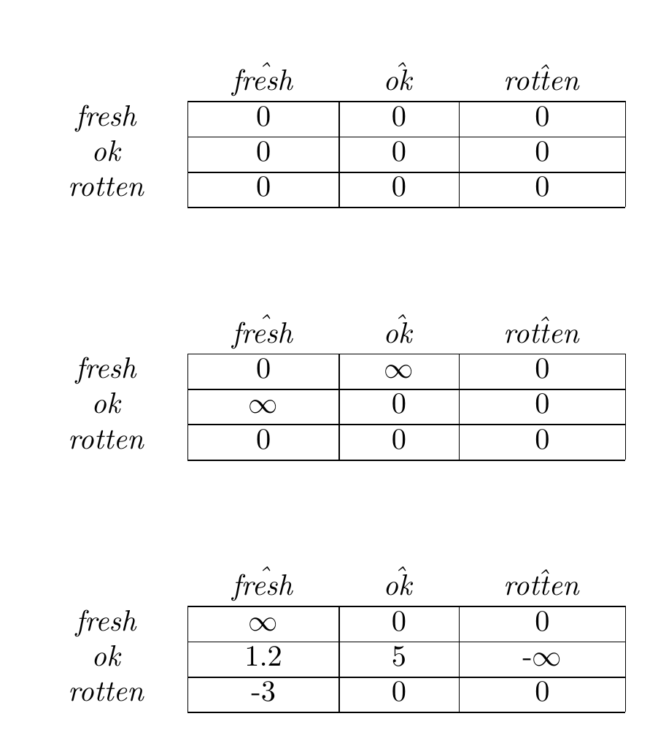
Comparison With Other Models
Standard Mechanism Design
Mechanism Design with Partial Verification
Mechanism Design with Signaling Costs
Green and Laffont. Partially verifiable information and mechanism design. RES 1986
Auletta, Penna, Persiano, Ventre. Alternatives to truthfulness are hard to recognize. AAMAS 2011

Slide 29


Question
Given:
Then:
Does there exist a
which implements the choice function?
NP-complete!
Auletta, Penna, Persiano, Ventre. Alternatives to truthfulness are hard to recognize. AAMAS 2011

Slide 30
Results
with Andrew Kephart (AAMAS 2015)
Non-bolded results are from:
Auletta, Penna, Persiano, Ventre. Alternatives to truthfulness are hard to recognize. AAMAS 2011
Hardness results fundamentally rely on revelation principle failing – conditions under which revelation principle still holds in Green & Laffont ’86 and Yu ’11 (partial verification), and Kephart & C. EC’16 (costly signaling).

Slide 31
Aside: automated mechanism design without costly or limited misreporting
Always easy to determine whether given choice function is implementable, due to revelation principle
Finding a deterministic mechanism that optimizes some objective is NP-hard in some cases (randomized is easy)

Slide 32
Question
Necessary and sufficient conditions on:
such that, for every combination of:
the existence of a
which implements the choice function implies the existence of one which implements it truthfully.

Slide 33
Effort Graph
fresh
10
ok
30
10
rotten

Slide 34
Example
Fixed Transfers, Free Utilities
C
For all sets of types A,B,C:
BC < ∞ implies AB ≥ AC
B
A

Slide 35
Necessary
C (Fresh)
For all sets of types A,B,C:
BC < ∞ implies AB ≥ AC
30
10
10
B (Ok)
A (Rotten)

Slide 36
Sufficient
Lemma: Each type’s utility in truthful implementation is at least its utility in non-truthful implementation.
C
F(B)
For all sets of types A,B,C:
BC < ∞ implies AB ≥ AC
F(B)
B
A

Slide 37
Do these graphs satisfy the condition?
C
3
D
C
2
D
2
3
4
6
4
6
1
1
B
5
A
B
5
A
Notes:
DBC fails on the left

Slide 38
Variations
Fixed Transfers, Variable Utilities:
If BC < ∞, then AB ≥ AC
Variable Transfers, Variable Utilities:
AB+BC ≥ AC, or, no (finite) B to A path
Variable Transfers, Fixed Utilities:
AB+BC ≥ AC
Fixed Transfers, Fixed Utilities:
all costs in {0, ∞}, and: (AB = 0 and BC = 0) implies AC=0
Also consider fixed valuations
C
with Andrew Kephart, EC’16
B
A
Results are generalizations of:
Green and Laffont. Partially veriﬁable information and mechanism design. RES 1986
Yu. Mechanism design with partial veriﬁcation and revelation principle. AAMAS 2011

Slide 39
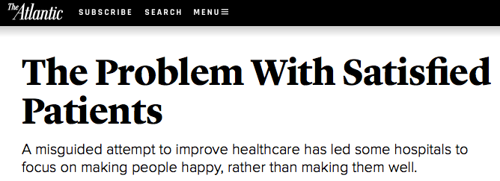
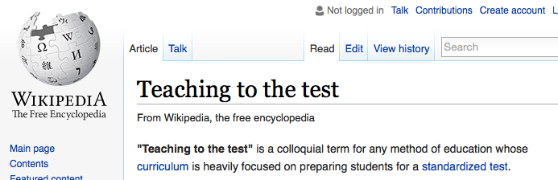
Future work: Improving type vs. just improving signal
Same questions as before, with addition that agents can expend effort to change type.

Slide 40
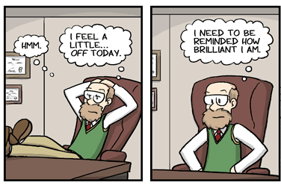
When Samples Are Strategically Selected
ICML 2019, with
SHE HAS 15 PAPERS AND I ONLY WANT TO READ 3.
A NEW POSTDOC APPLICANT.
Hanrui Zhang
(Duke)
Yu Cheng
(Duke → IAS → UIC)
Bob, Professor of Rocket Science

Slide 41

Academic hiring…
GIVE ME 3 PAPERS BY ALICE THAT I NEED TO READ.
CHARLIE IS EXCITED ABOUT HIRING ALICE
Charlie, Bob’s student

Slide 42

Academic hiring…
I NEED TO CHOOSE THE
BEST 3 PAPERS TO
CONVINCE BOB, SO THAT
HE WILL HIRE ALICE.
CHARLIE WILL DEFINITELY
PICK THE BEST 3 PAPERS BY
ALICE, AND I NEED TO
CALIBRATE FOR THAT.

Slide 43

The general problem
A distribution (Alice) over paper qualities 𝜃 ∈ {g, b} arrives, which can be either a good one (𝜃 = g) or a bad one (𝜃 = b)
ALICE IS WAITING TO HEAR FROM BOB
Alice, the postdoc applicant

Slide 44
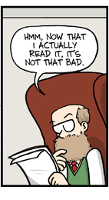
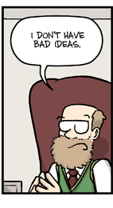
The general problem
The principal (Bob) announces a policy, according to which he decides, based on the report of the agent (Charlie), whether to accept 𝜃 (hire Alice)
AND I WANT ALICE TO BE FIRST AUTHOR ON AT LEAST 2 OF THEM.
I WILL HIRE ALICE IF YOU GIVE ME 3 GOOD PAPERS, OR 2 EXCELLENT PAPERS.

Slide 45
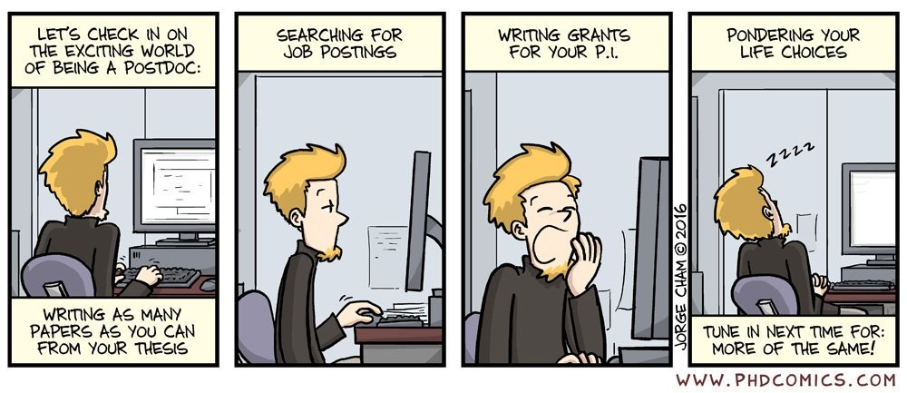
The general problem
The agent (Charlie) has access to n(=15) iid samples (papers) from 𝜃 (Alice), from which he chooses m(=3) as his report
CHARLIE IS READING THROUGH ALICE’S 15 PAPERS

Slide 46
The general problem
The agent (Charlie) sends his report to the principal, aiming to convince the principal (Bob) to accept 𝜃 (Alice)
CHARLIE FOUND 3 PAPERS BY ALICE MEETING BOB’S CRITERIA
HE IS SURE BOB WILL HIRE ALICE UPON SEEING THESE 3 PAPERS

Slide 47
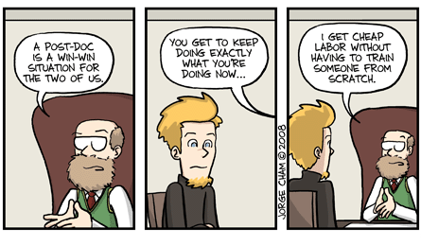
The general problem
The principal (Bob) observes the report of the agent (Charlie), and makes the decision according to the policy announced
ONE IS NOT SO GOOD, BUT THE OTHER TWO ARE INCREDIBLE.
IT LOOKS LIKE ALICE IS DOING GOOD WORK, SO LET’S HIRE HER.
I READ THE 3 PAPERS YOU SENT ME.

Slide 48
The general problem
A distribution 𝜃 ∈ {g, b} arrives, which can be either a good one (𝜃 = g) or a bad one (𝜃 = b)
The agent has access to n iid samples from 𝜃, from which he chooses m as his report to the principal, aiming to convince the principal to accept 𝜃
The principal observes the report from the agent, and decides whether to accept; her goal is to accept good distributions and reject bad ones

Slide 49
Questions
How does strategic selection affect the principal’s policy?
Is it easier or harder to classify based on strategic samples, compared to when the principal has access to iid samples?
Should the principal ever have a diversity requirement (e.g., at least 1 mathematical paper and at least 1 experimental paper), or only go by total quality according to a single metric?

Slide 50
Distinguishing Distributions When Samples Are Strategically Transformed
Hanrui Zhang
Yu Cheng
Vincent Conitzer
Duke University
WHERE SHOULD I SEND MY PAPERS TO GET A JOB?
WHAT CONFERENCES SHOULD I LOOK FOR WHEN EVALUATING THE CANDIDATES?

Slide 51
Agent’s problem:
“How do I distinguish myself from other types?”
“How many samples do I need for that?”
Principal’s problem:
“How do I tell ML-flexible agents from others?”
“At what point in their career can I reliably do that?”

Slide 52
One good and one bad distribution
samples
signals
.5
.4
This subset covers .5+.2=.7 good mass and .4+.3=.7 bad mass, so it doesn’t work. (What does?)
.2
.3
.3
.3
Pick a subset of the right-hand side (to accept) that maximizes
(green mass covered - black mass covered)
If positive, can (eventually) distinguish; otherwise not.
NP-hard in general.

Slide 53
But if we know the strategy for the good distribution (revelation principle holds):
samples
signals
.4
.8
Can place good mass on the signals side because we know the strategy
.3
.2
.3
0
Solve as maximum flow/matching from left to right with capacities on vertices
Duality gives set of signals to accept (~Hall’s marriage theorem)

Slide 54
Optimization: reduction to min cut
(when revelation principle holds)
types are vertices; edges imply ability to (cost-effectively) misreport
edges between types have capacity ∞
2
2
-3
2
3
t
s
2
2
3
accept side
-3
2
reject side
In sampling case, can check existence of edges with previous technique
Values are P(type)*value(type)
Can be generalized to more outcomes than accept/reject, if types have the same utility over them.

Slide 55
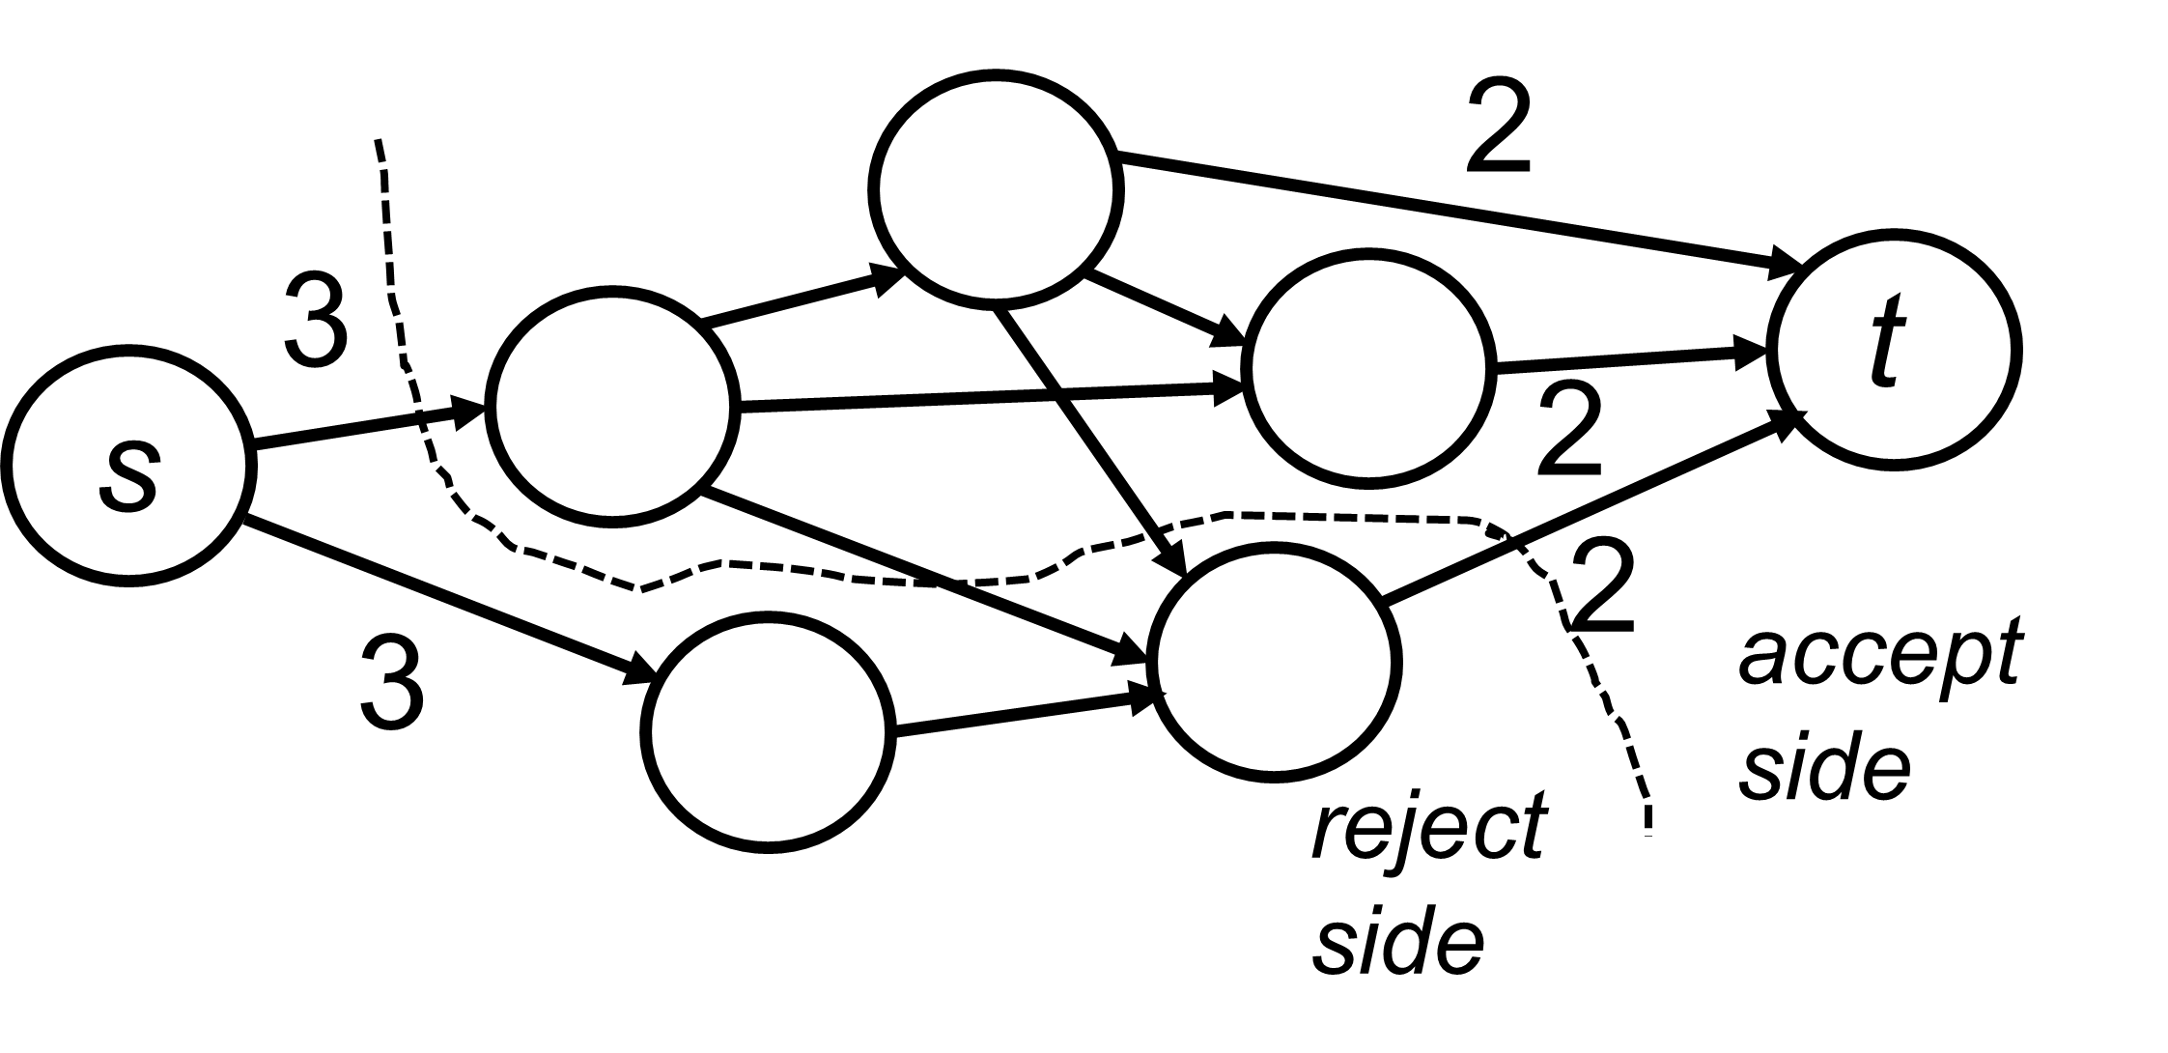
Conclusion
First part:
When considering correlation, small changes can have a huge effect
Automatically designing robust mechanisms addresses this
Combines well with learning (under some conditions)
Second part:
With costly or limited misreporting, revelation principle can fail
Causes computational hardness in general
Sometimes agents report based on their samples
Some efficient algorithms for the infinite limit case; sample bounds
0.251 | 0.250
0.250 | 0.249
0.251001 | 0.249999
0.249999 | 0.249001
v.
Thank you for your attention!

