Slide 1
ML for social good
Christos Faloutsos
CMU

Slide 2


CONGRATULATIONS!
Welcome to CMU!

Slide 3

Outline
Q+A
P1: Electronic Bee Vet
P2: Human trafficking detection
P3: phonecall net. fraud detection
Conclusions

Slide 4
Q+A
Are you recruiting? How many?
How many do you have?
How frequently you meet them?
What is your advising style?
How do you feel about summer internships?

Slide 5
Q+A
Are you recruiting? How many?
How many do you have?
How frequently you meet them?
What is your advising style?
How do you feel about summer internships?
co-adv: 1-2
3 (+1 vis.)
1/week
results
Yes/Maybe (Amz, FB, ++)

Slide 6
Outline
Q+A
P1: Electronic Bee Vet
P2: Human trafficking detection
P3: phonecall net. fraud detection
Conclusions

Slide 7

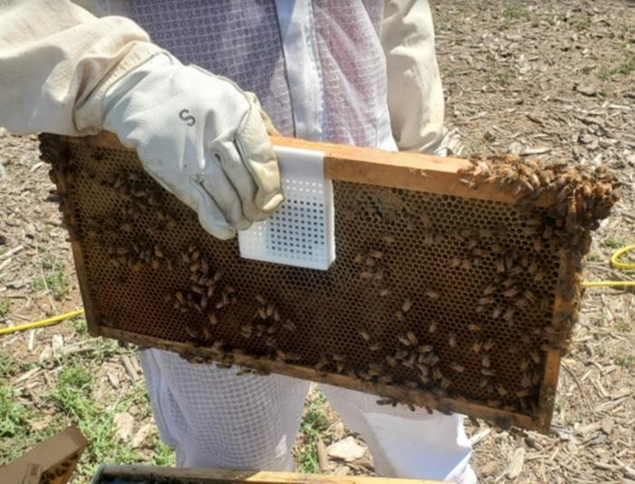
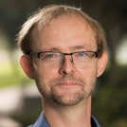
Prof. Boris Bar
(Entomology, UCR)
“Honeybees pollinate
~1/3 of the crops”

Slide 8
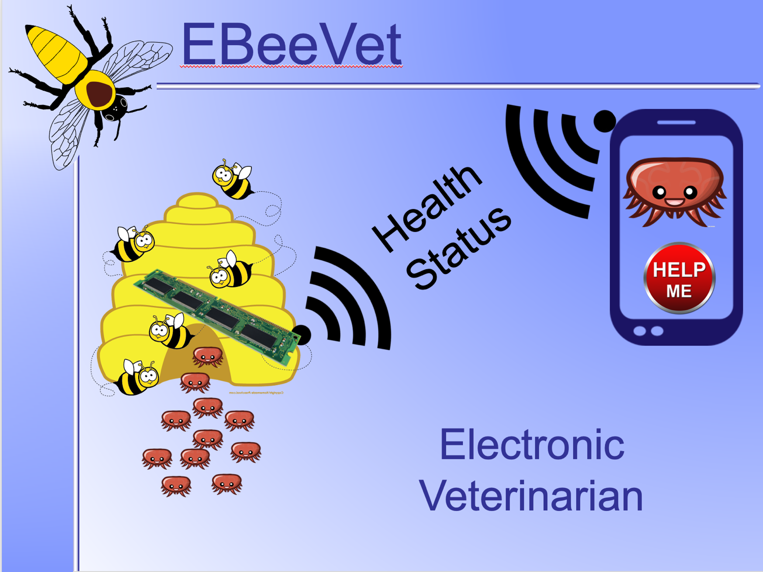

Slide 9
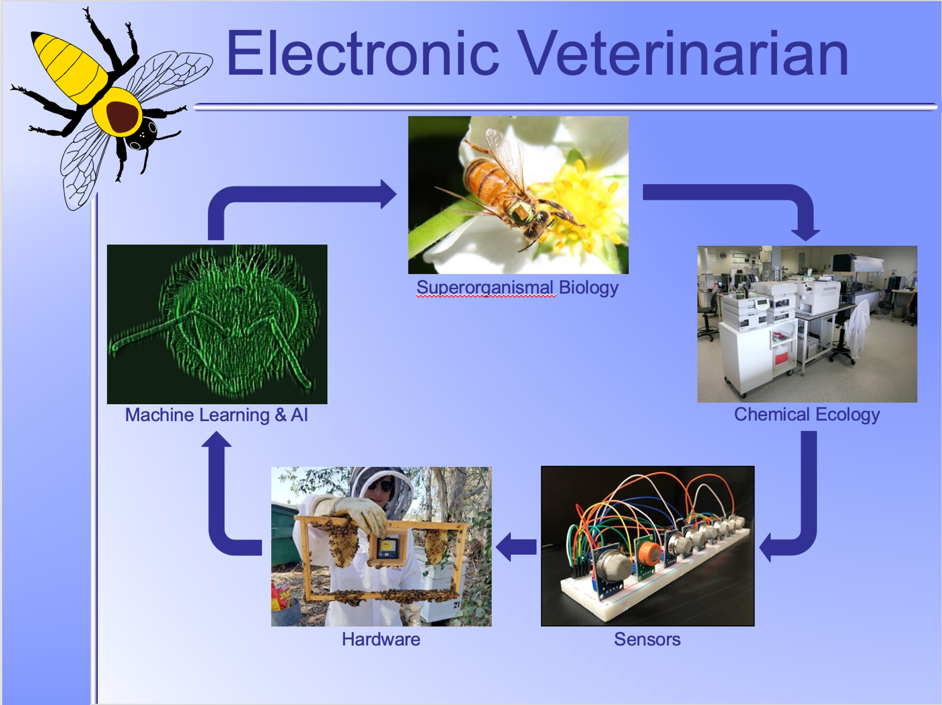

Slide 10
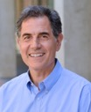
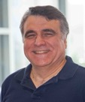
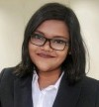

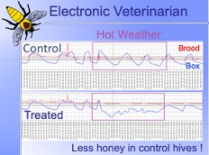

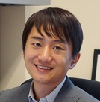
Overview of e-bee-vet
…
How to analyze
What to collect
How to collect
…
Notes:
Ashok Mulchandani

Slide 11

Completed goals:
Forecasting
  = understanding
  = early warning
Explanation (IMPORTANT)
actual
Temp.
Forecast /
expectation
now
time

Slide 12

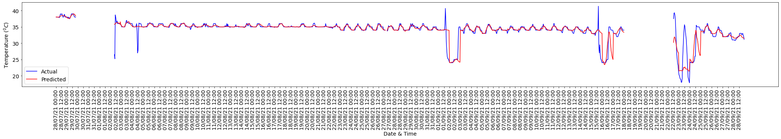


Fitting/forecasting:
Current results
Shamima
Hossain
Actual
Predicted/fitted

Slide 13
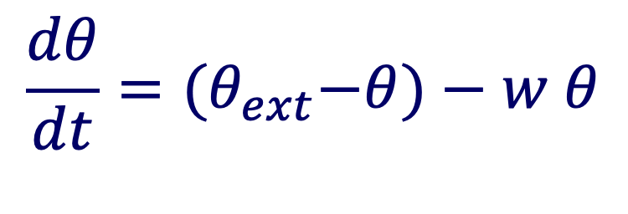
Understanding
Current results
Shamima
Hossain
Actual
Predicted/fitted
$$\frac{dθ}{dt}={(θ}_{ext}−θ)−w θ$$
DETAILS

Slide 14

Completed Goals:
Forecasting
  = understanding
  = early warning
Explanation
actual
Temp.
Forecast /
expectation
now
time

Slide 15

Early warning
Temp.
now
time

Slide 16

Explanation
$$\frac{dθ}{dt}={(θ}_{ext}−θ)−w θ$$
Temp.
now
time

Slide 17
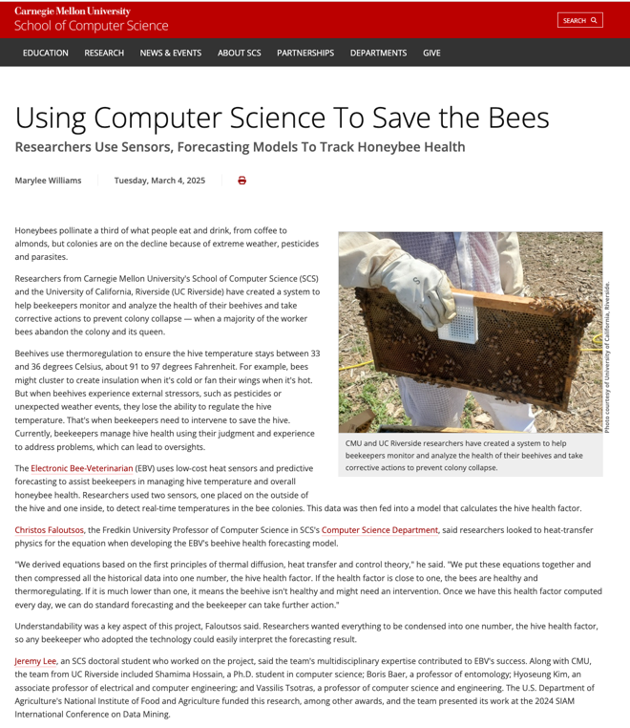
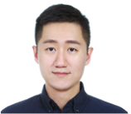
Meng-Chieh
(Jeremy) Lee

Slide 18





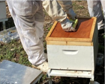
Currently:
Early warning – human responds

Slide 19



Research Challenge:
Automatic Control (beyond forecasting)
P.I.D.
controller
Cooler/
heater

Slide 20
Outline
Q+A
P1: Electronic Bee Vet
P2: Human trafficking detection
P3: phonecall net. fraud detection
Conclusions

Slide 21
Problem#1 dfn:
find near-duplicate escort ads -> human trafficking
…
Notes:
Of course, the text shown is a mock-up, for the victims’ safety.

Slide 22
Problem#1 dfn:
find near-duplicate escort ads -> human trafficking
If interested
call 123456
email: xyzw@
If interested
call 987654
email: xyzw@
…
If interested
call 456789
email: xyzw@
Notes:
Of course, the text shown is a mock-up, for the victims’ safety.

Slide 23
Problem#1 dfn:
find near-duplicate escort ads -> human trafficking
If interested
call 123456
email: xyzw@
Mock-up text,
for victims’ safety
If interested
call 987654
email: xyzw@
…
If interested
call 456789
email: xyzw@
Notes:
Of course, the text shown is a mock-up, for the victims’ safety.

Slide 24
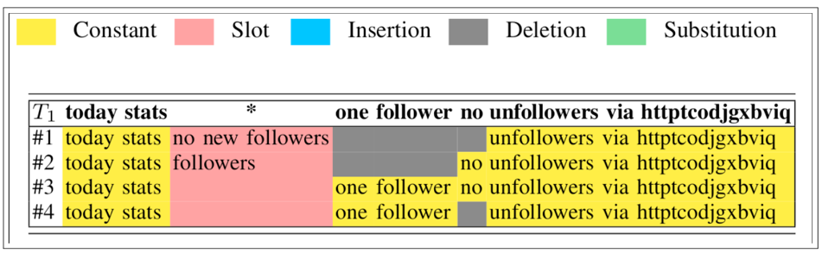
A: InfoShield
Micro-cluster detection and fuzzy string matching
Result, on real ‘tweets’
Notes:
Last choice: it shows the members of a micro-cluster from real data (public tweets) –
yellow stands for the common substrings;
red stands for the slots (‘names’/’phones’ for the trafficking case).
Take-home message?

Slide 25


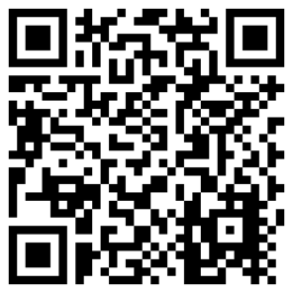
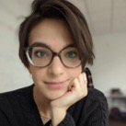
Citation
Meng-Chieh Lee, Catalina Vajiac, Aayushi Kulshrestha, Sacha Levy, Namyong Park, Cara Jones, Reihaneh Rabbany, and Christos Faloutsos
INFOSHIELD: Generalizable Information-Theoretic Human-Trafficking Detection
ICDE 2021, Chania, Greece, April 2021.

Slide 26
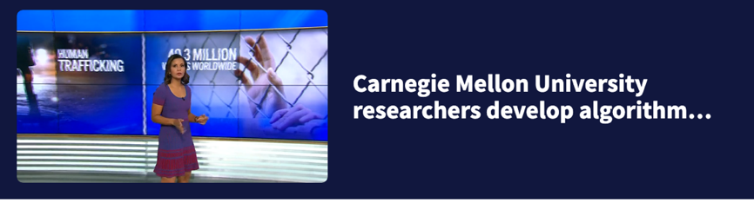
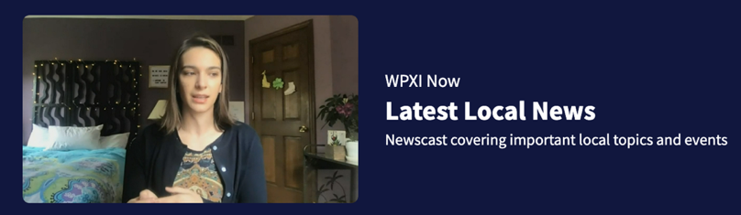
In the news (WPXI)
Meng-Chieh Lee, Catalina Vajiac, Aayushi Kulshrestha, Sacha Levy, Namyong Park, Cara Jones, Reihaneh Rabbany, and Christos Faloutsos
INFOSHIELD: Generalizable Information-Theoretic Human-Trafficking Detection
ICDE 2021, Chania, Greece, April 2021.

Slide 27
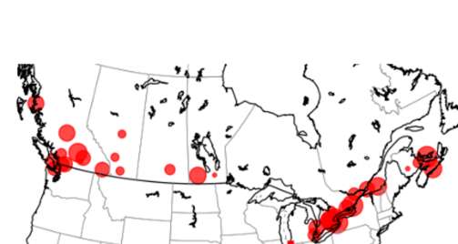
Open problem:
Trajectory detection, ie
>~3 persons, similar places, similar timestamps
10x
9x
11x

Slide 28
Outline
Q+A
P1: Electronic Bee Vet
P2: Human trafficking detection
P3: phonecall net. fraud detection
Conclusions

Slide 29



Fraud detection in graphs
Mobileum
5’
5’
9’
2’
5’
(source, destination, timestamp, duration)
5’

Slide 30
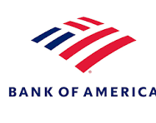


Fraud detection in graphs
'some bank’
AIDA/Mobileum
$5
$5
$9
$2
$5
$amount)
$5
(source, destination, timestamp, $amount)

Slide 31
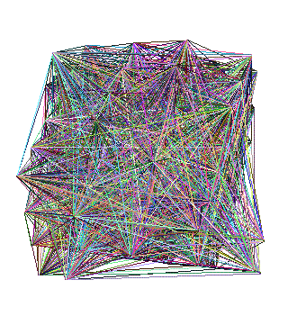


Problem definition
(source, destination, timestamp, duration)
Find fraudsters
Thrust1:
(semi-) supervised:
*some* labels
Thrust2:
Un-supervised:
*no* labels

Slide 32
Q: What would you do?
E
5’
5’
9’
2’
5’
D
B
5’
A
C

Slide 33
A: extract features
E
E
5’
D
5’
9’
B
2’
5’
D
A
B
5’
C
A
C

Slide 34
Q’: which features?
E
E
5’
D
5’
9’
B
2’
5’
D
A
B
5’
C
A
C

Slide 35



Challenge:
Feature extraction:
Descriptive (eg., in-degree, out-degree, …)
Fast to compute
Explainable (a MUST)
Two-way communication: a MUST

Slide 36
CallMine
Visualization system for graphs with time-stamped edges
  who-calls-whom-when
  Who-pays-whom-when

Slide 37

‘CallMine’ system
Mirela Cazzolato, Saranya Vijayakumar, Meng-Chieh Lee, Catalina Vajiac, Namyong Park, Pedro Fidalgo, Agma J. M. Traina, Christos Faloutsos, CallMine: Fraud Detection and Visualization of Million-Scale Call Graphs, CIKM 2023
https://github.com/mtcazzolato/callmine

Slide 38
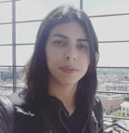

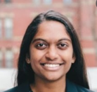
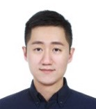
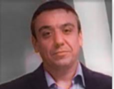
Participants
Mirela Cazzolato
Saranya Vijayakumar
Meng-Chieh Jeremy Lee
...
...
Pedro Fidalgo (Mobileum)

Slide 39
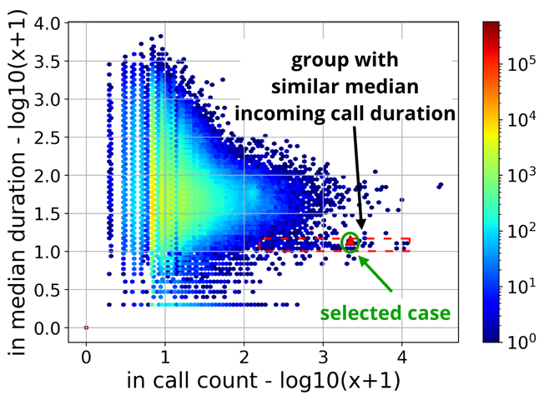
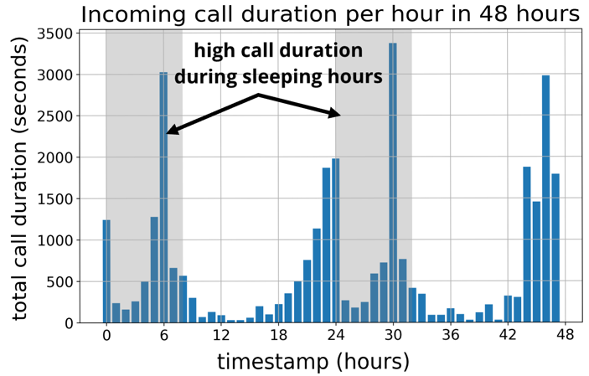

Discovery
(median)
duration
In-call count

Slide 40
Discovery
(median)
duration
In-call count

Slide 41

Discovery
(median)
duration
Pedro Fidalgo (Mobileum)
De-anonymization:
Info numbers
(weather, stocks, etc)
In call count

Slide 42

Q: Why?
Q: Why would someone call info numbers, 10’’ at a time, during sleeping hours?
Two-way communication: a MUST

Slide 43

Q: Why?
Q: Why would someone call info numbers, 10’ at a time, during sleeping hours?
A: ‘camouflage’:
  The callers have a lot of (shady) international traffic
  And call local numbers that won’t respond
  So that the callers evade filters of ‘high fraction of international traffic’
“🇺🇸”
“🇺🇸”
“🇦🇺” “🇮🇳” …
“🇦🇺” “🇮🇳” …

Slide 44
Outline
Q+A
P1: Electronic Bee Vet
P2: Human trafficking detection
P3: phonecall net. fraud detection
Conclusions

Slide 45
Contact info
www.cs.cmu.edu/~christos
GHC 7003
Cell ph#: 412-576.7932
and, again WELCOME!

