Slide 1
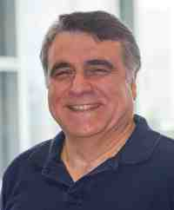
Mining Time Series: Tools and Applications
Christos Faloutsos
CMU SCS
https://www.cs.cmu.edu/~christos/TALKS/21-09-exec-ed/

Slide 2
こんにちは

Slide 3


Thanks to:
Prof. Zachary Lipton
Susan Caplan

Slide 4
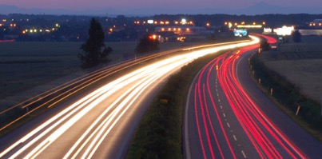
Outline
Introduction - Motivation
P1. Similarity Search and Indexing
P2. DSP (Digital Signal Processing)
P3. Linear Forecasting
P4. Non-linear forecasting
Conclusions

Slide 5
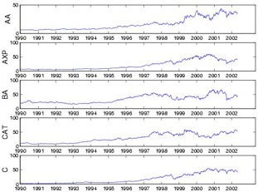
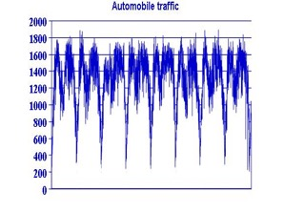
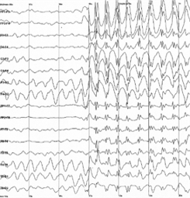
Problem definition
Given: one or more sequences
x₁ , x₂ , … , x_{t} , …
(y₁, y₂, … , y_{t}, …
… )
Find
Forecast; similar sequences
patterns; clusters; outliers

Slide 6



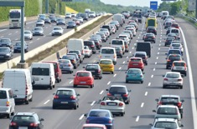
Background of audience
Finance / bank
Insurance company
Manufacturer (chemical; electronic devices)
Automotive

Slide 7
Background of audience
Finance / bank
Forecasting; fraud/anomaly detection
Insurance company
Same
Manufacturer (chemical; electronic devices)
Sensor measurements; supply-chain forecasting
Automotive
same

Slide 8
Questions from audience
- Are there any examples that have used DX/AI to innovate in BtoB sales, including new sales methods and the development of new markets or needs?
[working on it, with a financial institution; 'recommendation' ]
everybody is using forecasting (traditional AR etc; and Deep Learning)
Cloud services offer such functionality, eg,
AWS: https://aws.amazon.com/forecast/
MS/Azure: https://docs.microsoft.com/en-us/azure/machine-learning/how-to-auto-train-forecast
Google: https://cloud.google.com/blog/products/data-analytics/get-started-with-data-analytics-demand-forecasting-with-ml-models

Slide 9
Outline
Introduction - Motivation
P1. Similarity Search and Indexing
P2. DSP (Digital Signal Processing)
P3. Linear Forecasting
P4. Non-linear forecasting
Conclusions

Slide 10
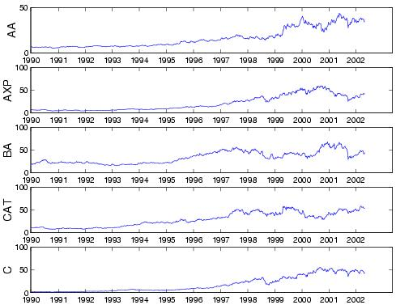
Motivation - Applications
Financial, sales, economic series
Alcoa Corp.
American express
Citi group

Slide 11
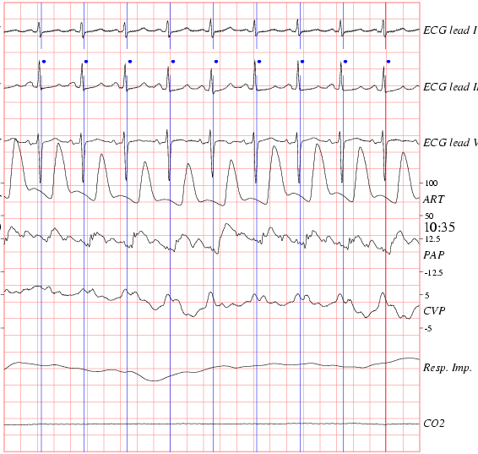


ECG - physionet.org

Slide 12
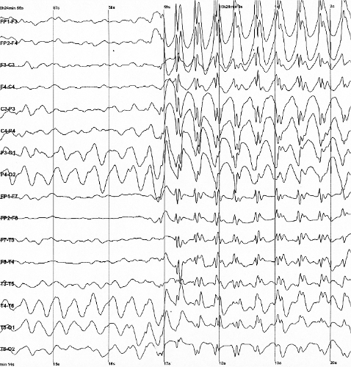

EEG - epilepsy
from wikipedia

Slide 13
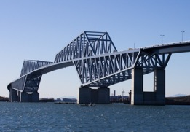
Motivation - Applications (cont’d)
civil/automobile infrastructure
bridge vibrations [Oppenheim+02]
Tokyo Gate Bridge

Slide 14


Motivation - Applications (cont’d)
civil/automobile infrastructure
bridge vibrations [Oppenheim+02]
https://www.dm.sanken.osaka-u.ac.jp/~yasuko/TALKS/17-KDD-tut/
Tokyo Gate Bridge
Prof. Yasushi Sakurai
Prof. Yasuko Matsubara

Slide 15

Motivation - Applications (cont’d)
civil/automobile infrastructure
road conditions / traffic monitoring
From
www.transportation.gov

Slide 16

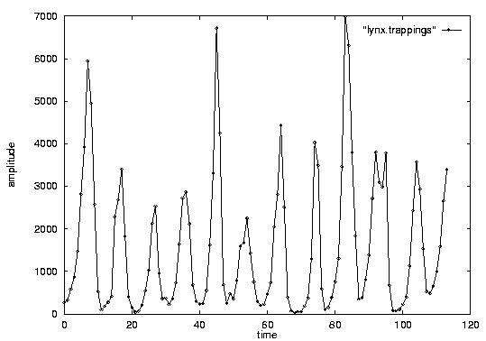
Overall Problem:
Goal: given a signal (eg., #packets over time)
Find: patterns, periodicities, and/or compress
count
lynx caught per year
(packets per day;
temperature per day)
year

Slide 17
Problem#1: Similarity search
Eg., Find a10-tick pattern, similar to the last one

Slide 18
Problem#1: Similarity search
Eg., Find a10-tick pattern, similar to the last one

Slide 19
Problem #2: Patterns
Goal: given a signal (eg., #packets over time)
Find: patterns, periodicities, and/or compress
count
lynx caught per year
(packets per day;
temperature per day)
year

Slide 20
Problem #2: Patterns
Goal: given a signal (eg., #packets over time)
Find: patterns, periodicities, and/or compress
11yr
count
lynx caught per year
(packets per day;
temperature per day)
year

Slide 21
Problem #3: Forecast
Given x_{t}, x_{t-1}, …, forecast x_{t+1}
90
80
70
60
Number of packets sent
??
50
40
30
20
10
0
1
3
5
7
9
11
Time Tick

Slide 22
Outline
Introduction - Motivation
Administrative announcements
P1. Similarity Search and Indexing
P2. DSP (Digital Signal Processing)
P3. Linear Forecasting
P4. Non-linear forecasting
Conclusions
Problem#1
Problem#2
Problem#3

Slide 23

Important observations
Admin. ann. #1
Patterns, rules, forecasting and similarity indexing are closely related:
To do forecasting, we need
to find patterns/rules
compress
to find similar past settings
to find outliers, we need to have forecasts
(outlier = too far away from our forecast)
Prob.#3
Prob.#2
Prob.#1
b-g-g-b

Slide 24



‘Recipe’ Structure:
Admin. ann. #2
Problem definition
Short answer/solution
LONG answer – details
Conclusion/short-answer

Slide 25

Check-point questions
Admin. ann. #3
With yellow back-ground

Slide 26
Outline
Introduction - Motivation
2-slide summary of this tutorial
P1. Similarity Search and Indexing
P2. DSP (Digital Signal Processing)
P3. Linear Forecasting
P4. Non-linear forecasting
Conclusions
Problem#1
Problem#2
Problem#3

Slide 27
Problem:
Q: mine/forecast (one, or more)
time sequences

Slide 28
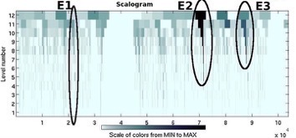

Answers
P1. Similarity search: Euclidean/time-warping; feature extraction and SAMs
P2. Periodicities: DFT/DWT
P3. Linear Forecasting: AR (Box-Jenkins)
P4. Non-linear forecasting: lag-plots

Slide 29
Outline
Introduction - Motivation
P1. Similarity Search and Indexing
P2. DSP (Digital Signal Processing)
P3. Linear Forecasting
P4. Non-linear forecasting
Conclusions

Slide 30
Outline
Introduction - Motivation
P1. Similarity Search and Indexing
P1.1. distance functions: Euclidean;Time-warping
P1.2. indexing
P1.3. feature extraction
P2. DSP (Digital Signal Processing)
...

Slide 31
Problem:
Q: How similar are two sequences?

Slide 32
Answer:
Q: How similar are two sequences?
A: Euclidean distance (<-> cosine similarity)
...

Slide 33
Importance of distance functions
Subtle, but absolutely necessary:
A ‘must’ for similarity indexing (-> forecasting)
A ‘must’ for clustering
Two major families
Euclidean and Lp norms
Time warping and variations
...

Slide 34
A1) Euclidean and Lp
...
L₁: city-block = Manhattan
L₂ = Euclidean
L∞

Slide 35
A2) Time Warping
allow accelerations - decelerations
(with or w/o penalty)
THEN compute the (Euclidean) distance (+ penalty)
related to the string-editing distance

Slide 36
Time Warping
‘stutters’:

Slide 37
Answer:
Q: How similar are two sequences?
A: Euclidean distance
...

Slide 38
Outline
Motivation
P1. Similarity Search and Indexing
P1.1. distance functions: Euclidean;Time-warping
P1.2. indexing
P1.3. feature extraction
P2. DSP (Digital Signal Processing)
...

Slide 39
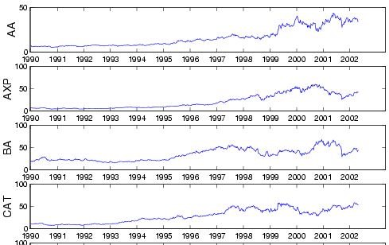

Problem:
Q: find quickly stocks like ‘C’ (or customers like ‘smith’)

Slide 40
Answer:
Q: find quickly stocks like ‘C’ (or customers like ‘smith’)
A: summarize seq. to a few numbers/features (eg., avg, stdv, Fourier coeff.)
S1
Sn

Slide 41
$price
$price
1
365
day
$price
1
365
day
distance function: by expert
1
365
day

Slide 42
Idea: ‘GEMINI’
Eg., ‘find stocks similar to MSFT’
Seq. scanning: too slow
How to accelerate the search?
[Faloutsos96]

Slide 43
‘GEMINI’ - Pictorially
eg,. std
S1
F(S1)
1
365
day
F(Sn)
Sn
eg, avg
1
365
day

Slide 44
GEMINI
F(S1)
F(Sn)
Solution: Quick-and-dirty' filter:
extract n features (numbers, eg., avg., etc.)
map into a point in n-d feature space
organize points with off-the-shelf spatial access method (‘SAM’)
discard false alarms

Slide 45
GEMINI
F(S1)
F(Sn)
Solution: Quick-and-dirty' filter:
extract n features (numbers, eg., avg., etc.)
map into a point in n-d feature space
= feature extraction
= feature engineering
= dimensionality reduction
Singular value decomposition (SVD)
Independent Component Analysis (ICA)
= embedding (eg, with Deep Learning)

Slide 46
Examples of GEMINI
Time sequences: DFT (up to 100 times faster) [Faloutsos, 1996]

Slide 47
Conclusions
Fast indexing: through GEMINI
feature extraction and
(off the shelf) Spatial Access Methods [Gaede+’98], or nearest-neighbor methods (Locality Sensitive Hashing LSH [Andoni+’08])

Slide 48
Answer:
Q: find quickly stocks like ‘C’ (or customers like ‘smith’)
A: summarize seq. to a few numbers/features (eg., avg, stdv, Fourier coeff.)
S1
Sn

Slide 49
Books
William H. Press, Saul A. Teukolsky, William T. Vetterling and Brian P. Flannery: Numerical Recipes in C, Cambridge University Press, 1992, 2nd Edition. (Great description, intuition and code for SVD)
C. Faloutsos: Searching Multimedia Databases by Content, Kluwer Academic Press, 1996 (introduction to SVD, Fourier, Wavelets, and GEMINI)

Slide 50
References
Gaede, V. and O. Guenther (1998). “Multidimensional Access Methods.” Computing Surveys 30(2): 170-231.
Alexandr Andoni, Piotr Indyk (2008). “Near-optimal hashing algorithms for approximate nearest neighbor in high dimensions”, CACM 51, 1, 2008 https://doi.org/10.1145/1327452.1327494

Slide 51
References
Oppenheim, I. J., A. Jain, et al. (March 2002). A MEMS Ultrasonic Transducer for Resident Monitoring of Steel Structures. SPIE Smart Structures Conference SS05, San Diego.

Slide 52
Part 2:
DSP (Digital
Signal Processing)

Slide 53
Outline
Motivation
P1. Similarity Search and Indexing
P1.1. distance functions: Euclidean;Time-warping
P1.2. indexing
P1.3. feature extraction
P2. DSP (Digital Signal Processing)
...

Slide 54
Outline
Motivation
P1. Similarity Search and Indexing
P2. DSP (Digital Signal Processing)
P2.1. Discrete Fourier Transform (DFT)
P2.2. Discrete Wavelet Transform (DWT)
P3. Linear Forecasting
P4. Non-linear forecasting
Conclusions

Slide 55
Detailed Outline
P1. Indexing etc
P2. DSP (Digital Signal Processing)
P2.1. DFT
Definition of DFT and properties
how to read the DFT spectrum
P2.2. DWT
Definition of DWT and properties
how to read the DWT scalogram

Slide 56


Problem
Q: How to summarize / extract few features
S1
Sn

Slide 57
Answer:
Q: How to summarize / extract few features
A: Fourier; Wavelets
(A’: SVD Singular Value Decomposition,
ICA = Independent Component Analysis)
S1
Sn

Slide 58
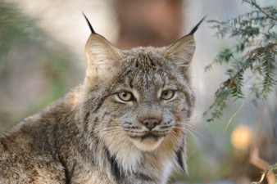
Introduction - Problem#2
Goal: given a signal (eg., packets over time)
Find: patterns and/or compress
count
11yr
lynx caught per year
(packets per day;
automobiles per hour)
year

Slide 59
Problem #2: patterns?
Q: How to automatically find patterns?

Slide 60
Problem #2: patterns?
Q: How to automatically find patterns?
A: Discrete Fourier Transform (DFT)

Slide 61
DFT: finds sinusoids
Given a signal,
DFT decomposes it
to sinusoids
+
=
+

Slide 62
DFT: definition
Details
For a sequence x₀, x₁, … x_{n-1}
the (n-point) Discrete Fourier Transform is
X₀, X₁, … X_{n-1} :
inverse DFT

Slide 63
DFT: examples
flat
Amplitude:
Plot[ Abs[Fourier[x]] ];
Amplitude
time
freq

Slide 64
DFT: examples
Low frequency sinusoid
time
freq

Slide 65
DFT: examples
Sinusoid - symmetry property: X_{f} = X*_{n-f}
time
freq

Slide 66
DFT: examples
Higher freq. sinusoid
time
freq

Slide 67
DFT: check-point
Spectrum??
+
=
+

Slide 68
DFT: check-point
Spectrum:
Ampl.
Freq.

Slide 69

DFT: Amplitude spectrum
Amplitude:
count
Ampl.
freq=0
freq=12
year
Freq.

Slide 70
DFT: Amplitude spectrum
count
Ampl.
freq=0
freq=12
year
Freq.

Slide 71
DFT: Amplitude spectrum
count
Ampl.
freq=0
freq=12
year
Freq.

Slide 72
DFT: Amplitude spectrum
excellent approximation, with only 2 frequencies!
so what?
Freq.

Slide 73
DFT: Amplitude spectrum
excellent approximation, with only 2 frequencies!
so what?
A1: (lossy) compression
A2: pattern discovery

Slide 74
DFT: Amplitude spectrum
excellent approximation, with only 2 frequencies!
so what?
A1: (lossy) compression
A2: pattern discovery

Slide 75
DFT - Conclusions
It spots periodicities (with the ‘amplitude spectrum’)
can be quickly computed (O( n log n)), thanks to the FFT algorithm.
standard tool in signal processing (speech, image etc signals)
(closely related to DCT and JPEG)

Slide 76
Detailed Outline
P1. Indexing etc
P2. DSP (Digital Signal Processing)
P2.1. DFT
Definition of DFT and properties
how to read the DFT spectrum
P2.2. DWT
Definition of DWT and properties
how to read the DWT scalogram

Slide 77

Problem #2:
Goal: given a signal (eg., #packets over time)
Find: patterns, periodicities, and/or compress
count
lynx caught per year
(packets per day;
virus infections per month)
year

Slide 78
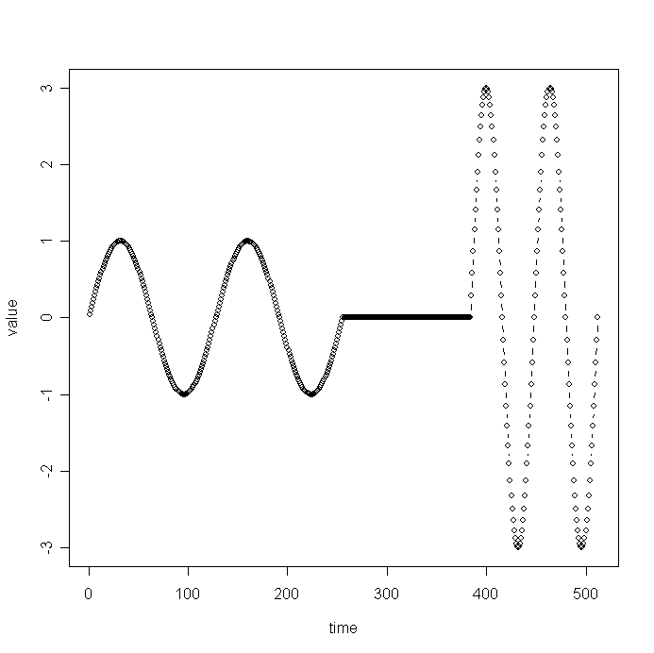
Wavelets - DWT
DFT suffers on short-duration waves (eg., baritone, silence, soprano)
value
time

Slide 79
Wavelets - DWT
DFT suffers on short-duration waves (eg., baritone, silence, soprano)
value
time

Slide 80
Wavelets - DWT
DFT suffers on short-duration waves (eg., baritone, silence, soprano)
value
time

Slide 81
Wavelets - DWT
DFT suffers on short-duration waves (eg., baritone, silence, soprano)
value
time

Slide 82
Wavelets - DWT
DFT suffers on short-duration waves (eg., baritone, silence, soprano)
value
time

Slide 83
Wavelets - DWT
DFT suffers on short-duration waves (eg., baritone, silence, soprano)
value
time

Slide 84
Short Window F.T.
Solution#1: Short window Fourier transform (SWFT)
freq
value
time
time

Slide 85
Short Window F.T.
Solution#1: Short window Fourier transform (SWFT)
But: how short should be the window?
freq
value
time
time

Slide 86
Short Window F.T.
Solution#1: Short window Fourier transform (SWFT)
freq
value
time
time

Slide 87
Short Window F.T.
Solution#1: Short window Fourier transform (SWFT)
freq
value
time
time

Slide 88
Short Window F.T.
Solution#1: Short window Fourier transform (SWFT)
freq
value
time
time

Slide 89
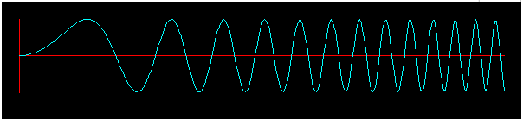
Short window FT: check-point
Chirp
freq
x(t) = sin ( 2 pi t*t / N )
??
(usual sinusoids:
x(t) = sin ( 2 pi f*t / N )
time

Slide 90
Short window FT: check-point
Chirp
freq
x(t) = sin ( 2 pi t*t / N )
(usual sinusoids:
x(t) = sin ( 2 pi f*t / N )
time

Slide 91
Wavelets - DWT
Solution#1: Short window Fourier transform (SWFT)
But: how short should be the window?
freq
value
time
time

Slide 92
Haar Wavelets
+
=
+
Answer: multiple window sizes! -> DWT

Slide 93
Haar Wavelets
+
=
+
Basis functions: waves (of length 1, ½, ¼, etc)
(vs DFT: sinusoids of full length)

Slide 94
Detailed Outline
P1. Indexing etc
P2. DSP (Digital Signal Processing)
P2.1. DFT
Definition of DFT and properties
how to read the DFT spectrum
P2.2. DWT
Definition of DWT and properties
how to read the DWT scalogram

Slide 95
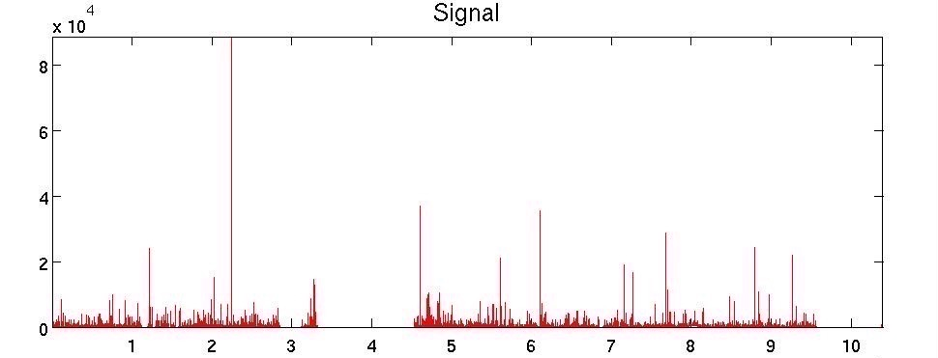
Wavelets in action
# of correction packets vs time

Slide 96

Case study: BGP updates
#updates
time
BGP-lens: Patterns and Anomalies in Internet Routing Updates B. Aditya Prakash et al, SIGKDD 2009

Slide 97
Case study: BGP updates
#updates
time
BGP-lens: Patterns and Anomalies in Internet Routing Updates B. Aditya Prakash et al, SIGKDD 2009

Slide 98
Case study: BGP updates
#updates
time
BGP-lens: Patterns and Anomalies in Internet Routing Updates B. Aditya Prakash et al, SIGKDD 2009

Slide 99
Case study: BGP updates
#updates
Given a time series: 1) PLOT IT
time
BGP-lens: Patterns and Anomalies in Internet Routing Updates B. Aditya Prakash et al, SIGKDD 2009

Slide 100
Case study: BGP updates
Given a time series: 1) PLOT IT
2) DFT / DWT

Slide 101
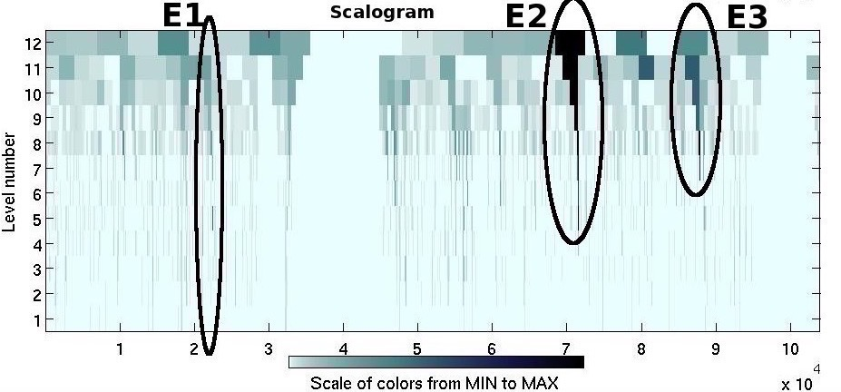
Case study: BGP updates
Low freq.:
omitted
f
t
freq.

Slide 102
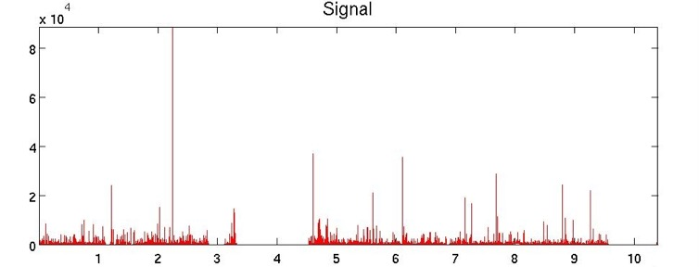

Case study: BGP updates
??
freq.

Slide 103
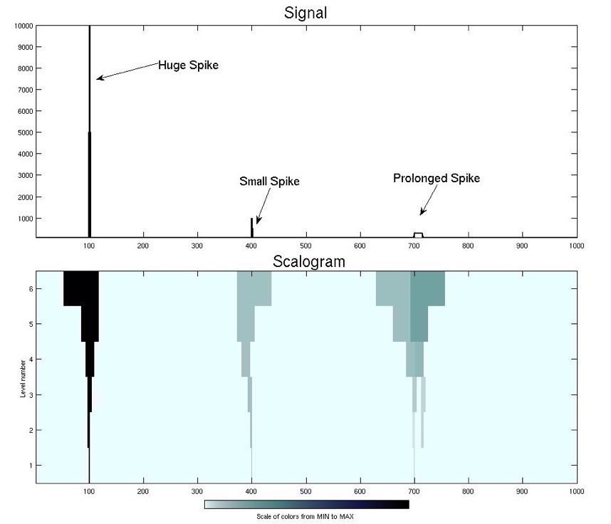
Case study: BGP updates
‘Prolonged
spike’
f
freq.
t

Slide 104
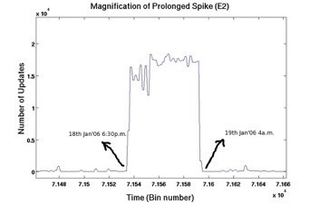
Case study: BGP updates
15K msgs, for several hours: 6pm-4am
freq.

Slide 105
Case study: BGP updates
15K msgs, for several hours: 6pm-4am
freq.
DFT / DWT can spot patterns
(that we would miss)

Slide 106



Conclusions for DSP
DFT spots periodicities
DWT : multi-resolution - matches processing of mammalian ear/eye better
Both: powerful tools for compression, pattern detection in real signals

Slide 107
Conclusions for DSP
DFT spots periodicities
DWT : multi-resolution - matches processing of mammalian ear/eye better
Both: powerful tools for compression, pattern detection in real signals
Given a time series: 1) PLOT IT
2) DFT / DWT

Slide 108
Resources: software and urls
xwpl: open source wavelet package from Yale, with excellent GUI
pywavelets (python library)
Included in matlab™

Slide 109
Books
William H. Press, Saul A. Teukolsky, William T. Vetterling and Brian P. Flannery: Numerical Recipes in C, Cambridge University Press, 1992, 2nd Edition. (Great description, intuition and code for DFT, DWT)
C. Faloutsos: Searching Multimedia Databases by Content, Kluwer Academic Press, 1996 (introduction to DFT, DWT)

Slide 110
Part 3:
Linear Forecasting

Slide 111
Outline
Motivation
P1. Similarity Search and Indexing
P2. DSP (Digital Signal Processing)
P3. Linear Forecasting
P4. Non-linear forecasting
Conclusions

Slide 112
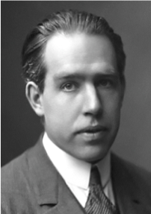
Forecasting
"Prediction is very difficult, especially about the future." - Nils Bohr
www.hfac.uh.edu/MediaFutures/thoughts.html

Slide 113
Problem#3: Forecast
given x_{t-1}, x_{t-2}, …,
Q: forecast x_{t}
90
80
70
60
??
50
40
30
20
10
0
1
3
5
7
9
11

Slide 114
Solution: AR(IMA)
given x_{t-1}, x_{t-2}, …,
Q: forecast x_{t}
A: AR(IMA) = Box-Jenkins (< Holt-Winters, Kalman)
Auto Regressive
Integrated
Moving Average
90
x_{t}
80
70
60
??
50
40
30
x_{t-1}
20
10
0
1
3
5
7
9
11

Slide 115
Solution: AR(IMA)
given x_{t-1}, x_{t-2}, …,
Q: forecast x_{t}
A: AR(IMA) = Box-Jenkins (< Holt-Winters, Kalman)
90
x_{t}
80
70
60
??
50
40
30
x_{t-1}
20
10
0
1
3
5
7
9
11

Slide 116
Problem#3: Forecast
Example: give x_{t-1}, x_{t-2}, …, forecast x_{t}
90
80
70
60
Number of packets sent
??
50
40
30
20
10
0
1
3
5
7
9
11
Time Tick

Slide 117
Forecasting: Preprocessing
MANUALLY:
remove trends spot periodicities
7 days
time
time

Slide 118
Problem#3: Forecast
Solution: try to express
x_{t}
as a linear function of the past: x_{t-2}, x_{t-2}, …,
(up to a window of w)
Formally:
90
80
70
60
??
50
40
30
20
10
0
1
3
5
7
9
11
Time Tick

Slide 119
Linear Regression: idea
Body height
85
80
75
70
65
60
55
50
45
40
15
25
35
45
Body weight
express what we don’t know (= ‘dependent variable’)
as a linear function of what we know (= ‘indep. variable(s)’)

Slide 120
Linear Auto Regression:

Slide 121
Linear Auto Regression:
85
‘lag-plot’
80
75
70
65
Number of packets sent (t)
60
55
50
45
40
15
25
35
45
Number of packets sent (t-1)
lag w=1
Dependent variable = # of packets sent (S [t])
Independent variable = # of packets sent (S[t-1])

Slide 122
Deep Learning:
85
‘lag-plot’
80
75
70
65
Number of packets sent (t)
60
Non-linear fit
55
50
45
40
15
25
35
45
Number of packets sent (t-1)
lag w=1
Dependent variable = # of packets sent (S [t])
Independent variable = # of packets sent (S[t-1])

Slide 123
More details:
Q1: Can it work with window w>1?
A1: YES!
x_{t}
x_{t-1}
x_{t-2}

Slide 124
More details:
Q1: Can it work with window w>1?
A1: YES! (we’ll fit a hyper-plane, then!)
x_{t}
x_{t-1}
x_{t-2}

Slide 125
More details:
Q1: Can it work with window w>1?
A1: YES! (we’ll fit a hyper-plane, then!)
x_{t}
x_{t-1}
x_{t-2}

Slide 126
More details:
DETAILS
Q1: Can it work with window w>1?
A1: YES! The problem becomes:
X_{[N ×w]} × a_{[w ×1]} = y_{[N ×1]}
OVER-CONSTRAINED
a is the vector of the regression coefficients
X has the N values of the w indep. variables
y has the N values of the dependent variable

Slide 127
Solution: AR(IMA)
given x_{t-1}, x_{t-2}, …,
Q: forecast x_{t}
A: AR(IMA) = Box-Jenkins (< Holt-Winters, Kalman)
90
x_{t}
80
70
60
??
50
40
30
x_{t-1}
20
10
0
1
3
5
7
9
11

Slide 128
Resources: software and urls
http://cran.r-project.org/ (’R’ system)
https://www.statsmodels.org/ (python)
…<many more>

Slide 129
Books
George E.P. Box and Gwilym M. Jenkins and Gregory C. Reinsel, Time Series Analysis: Forecasting and Control, Prentice Hall, 1994 (the classic book on ARIMA, 3rd ed.)
Brockwell, P. J. and R. A. Davis (1987). Time Series: Theory and Methods. New York, Springer Verlag.

Slide 130
Additional Reading
[Yi+00] Byoung-Kee Yi et al.: Online Data Mining for Co-Evolving Time Sequences, ICDE 2000. (Describes MUSCLES and Recursive Least Squares)

Slide 131
Part 4:
chaos and
non-linear forecasting

Slide 132
Outline
Motivation
P1. Similarity Search and Indexing
P2. DSP (Digital Signal Processing)
P3. Linear Forecasting
P4. Non-linear forecasting
Conclusions

Slide 133
Detailed Outline
…
P3. Linear forecasting
P4. Non-linear forecasting
Problem
Idea
How-to
Experiments

Slide 134
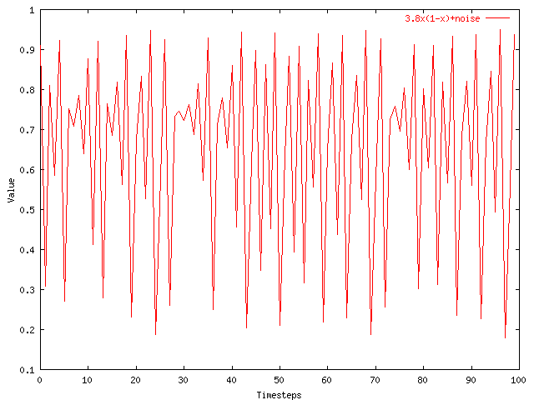
Problem: Forecast
given x_{t-1}, x_{t-2}, …, (‘chaotic’/non-linear)
Q: forecast x_{t}

Slide 135
Solution
given x_{t-1}, x_{t-2}, …, (‘chaotic’/non-linear)
Q: forecast x_{t}
A: lag-plots + sim. search (= ‘Delayed Coordinate Embedding’)
x_{t}
X_{t-1}

Slide 136
Recall: Problem #3
Value
Time
Given a time series {x_{t}}, predict its future course, that is, x_{t+1}, x_{t+2}, ...

Slide 137
How to forecast?
what could go wrong with ARIMA?
x_{t}
x_{t-1}
90
80
70
60
??
50
40
30
20
10
0
1
3
5
7
9
11
Time Tick

Slide 138
How to forecast?
what could go wrong with ARIMA?
A: linearity assumption might not hold!
x_{t}
x_{t-1}
90
80
70
60
??
50
40
30
20
10
0
1
3
5
7
9
11
Time Tick

Slide 139

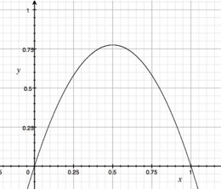
ARIMA pitfall
Example: logistic parabola
Models population of flies [R. May/1976]
Reproductive
rate
#flies(t+1)
Max# flies
M
Time-series plot
Time t
Notes:
x_{t+1} = a x_t \cdot \left( 1-x_t \right )

Slide 140
ARIMA pitfall
Example: logistic parabola
Models population of flies [R. May/1976]
Logistic map
Time-series plot
Time t
Notes:
x_{t+1} = a x_t \cdot \left( 1-x_t \right )

Slide 141
ARIMA pitfall
Example: logistic parabola
Models population of flies [R. May/1976]
Logistic map
= SI virus prop. model (covid: S.I.R.)
~ Bass equation (market penetration)
Special case of Lotka-Volterra
Competing species / products
Notes:
x_{t+1} = a x_t \cdot \left( 1-x_t \right )

Slide 142
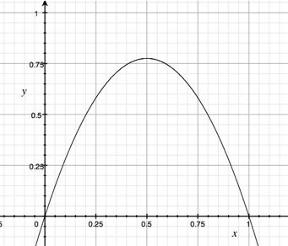
ARIMA pitfall
Linear equations, e.g., AR, ARIMA, …
Notes:
x_{t+1} = a x_t + \epsilon

Slide 143
ARIMA pitfall
Linear equations, e.g., AR, ARIMA, …
e.g., AR(1)
Notes:
x_{t+1} = a x_t + \epsilon

Slide 144
ARIMA pitfall
Linear equations, e.g., AR, ARIMA, …
AR fit: fails
e.g., AR(1)
Notes:
x_{t+1} = a x_t + \epsilon

Slide 145

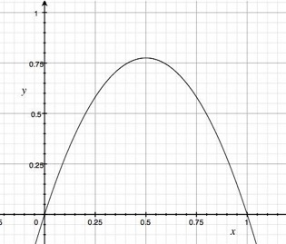
Solution?
“Delayed Coordinate Embedding” = Lag Plots [Sauer94]
k-nearest neighbor search
Notes:
x_{t+1} = a x_t + \epsilon

Slide 146
General Intuition (Lag Plot)
Lag = 1, k = 4 NN
x_{t}
Interpolate these…
To get the final prediction
x_{t-1}
4-NN
New Point

Slide 147
Q: How to interpolate?
Details
How do we interpolate between the k nearest neighbors?
A1: Average
A2: Weighted average (weights drop with distance - how?)

Slide 148
Q: How to interpolate?
Details
A3: Using SVD - seems to perform best ([Sauer94] - first place in the Santa Fe forecasting competition)
x_{t}
X_{t-1}

Slide 149
Detailed Outline
Non-linear forecasting
Problem
Idea
How-to
Experiments
Conclusions

Slide 150
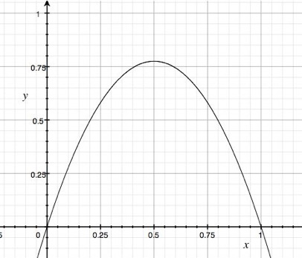
Datasets
x(t)
Logistic Parabola: x_{t} = ax_{t-1}(1-x_{t-1}) + noise Models population of flies [R. May/1976]
time
Lag-plot

Slide 151
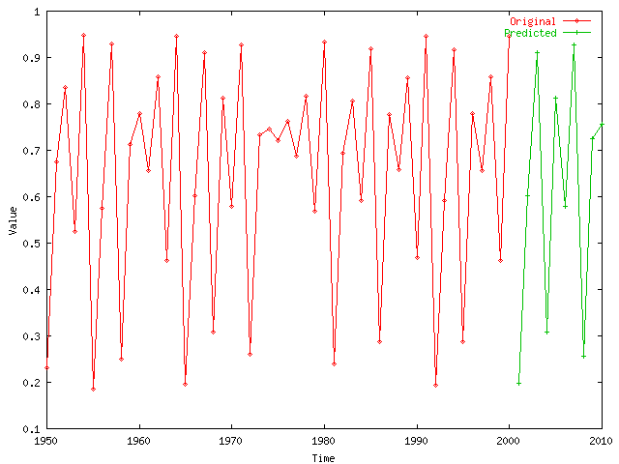
Logistic Parabola
Our Prediction from here
Value
Timesteps

Slide 152
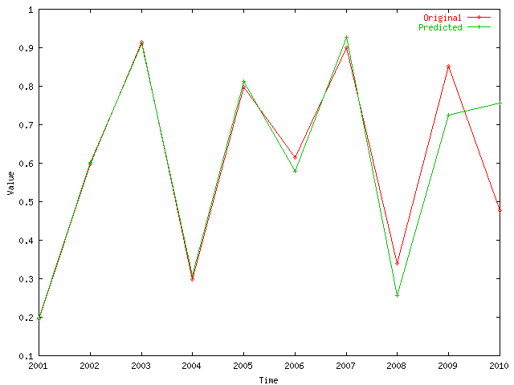
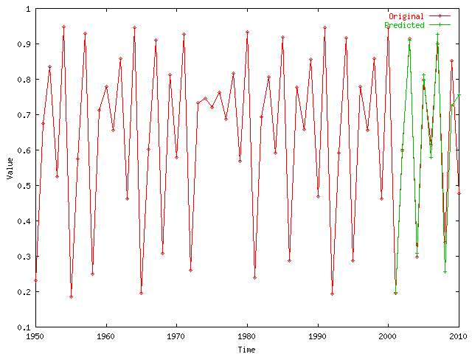
Logistic Parabola
Value
Comparison of prediction to correct values
Timesteps

Slide 153
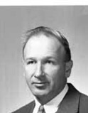

Datasets
Edward Lorenz
LORENZ: Models convection currents in the air
dx / dt = a (y - x)
dy / dt = x (b - z) - y
dz / dt = xy - c z
Deterministic chaos
‘butterfly effect’

Slide 154
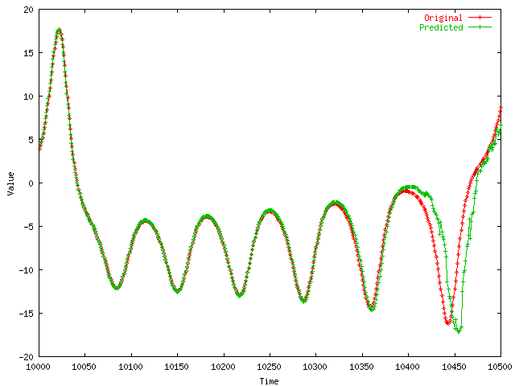
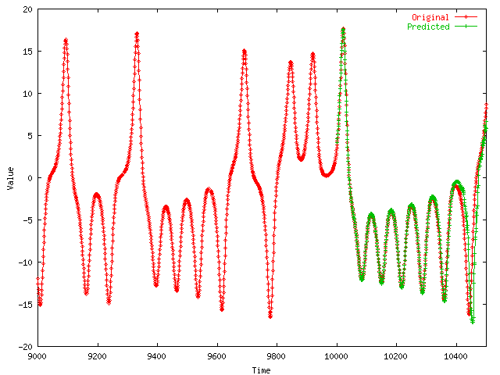
LORENZ
Value
Comparison of prediction to correct values
Timesteps

Slide 155
Datasets
Value
LASER: fluctuations in a Laser over time (used in Santa Fe competition)
Time

Slide 156
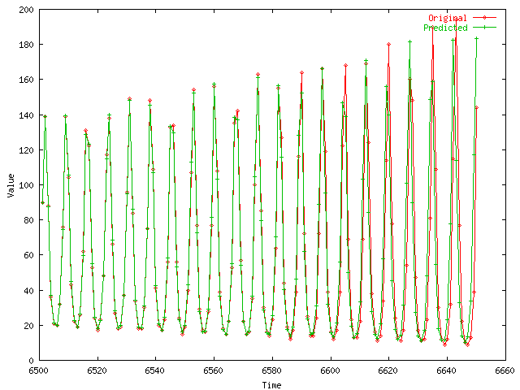
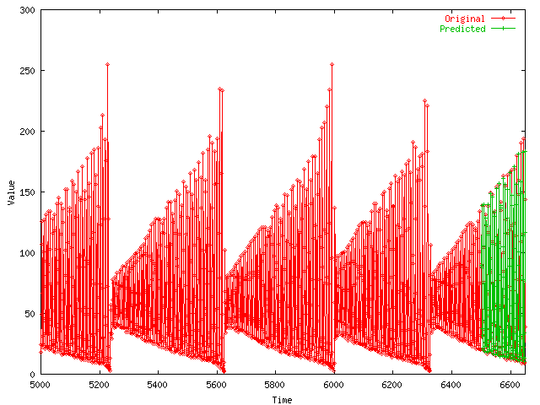
Laser
Value
Comparison of prediction to correct values
Timesteps

Slide 157
Solution
given x_{t-1}, x_{t-2}, …, (‘chaotic’/non-linear)
Q: forecast x_{t}
A: lag-plots + sim. search (= ‘Delayed Coordinate Embedding’)
x_{t}
X_{t-1}

Slide 158
References
Deepay Chakrabarti and Christos Faloutsos F4: Large-Scale Automated Forecasting using Fractals CIKM 2002, Washington DC, Nov. 2002.
Sauer, T. (1994). Time series prediction using delay coordinate embedding. (in book by Weigend and Gershenfeld, below) Addison-Wesley.

Slide 159
References
Weigend, A. S. and N. A. Gerschenfeld (1994). Time Series Prediction: Forecasting the Future and Understanding the Past, Addison Wesley. (Excellent collection of papers on chaotic/non-linear forecasting, describing the algorithms behind the winners of the Santa Fe competition.)

Slide 160
Almost Done
Take-home messages:
M1: equivalence of research problems
M2: superset, 3h tutorial
M3: summary of ‘recipes’

Slide 161
M1: Important observations
Patterns, rules, forecasting and similarity indexing are closely related:
To do forecasting, we need
to find patterns/rules
compress
to find similar settings in the past
to find outliers, we need to have forecasts
(outlier = too far away from our forecast)

Slide 162
M2: Extended, 3 hour tutorial, KDD17
https://www.dm.sanken.osaka-u.ac.jp/~yasuko/TALKS/17-KDD-tut/
Prof. Yasushi Sakurai
Prof. Yasuko Matsubara

Slide 163
M3: Time series - Answers
P1. Similarity search: Euclidean/time-warping; feature extraction and SAMs
P2. Periodicities: DFT/DWT
P3. Linear Forecasting: AR (Box-Jenkins)
P4. Non-linear forecasting: lag-plots

Slide 164
Time series - Answers
P1. Similarity search: Euclidean/time-warping; feature extraction and SAMs
P2. Periodicities: DFT/DWT
P3. Linear Forecasting: AR (Box-Jenkins)
P4. Non-linear forecasting: lag-plots
Thank you!
ありがとうございました
christos@cs.cmu.edu

