Slide 1
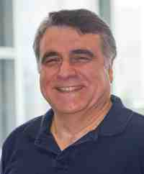
Mining graphs and time series: patterns, anomalies, and fraud detection
Part 2: Time Series -
Forecasting & Tensors
Christos Faloutsos
CMU SCS
https://www.cs.cmu.edu/~christos/TALKS/19-GoI

Slide 2
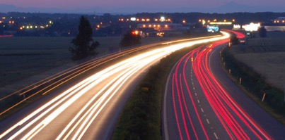
Roadmap
Introduction
Part#1: Graphs and Tensors
Part#2: Time series
Part#3: extras (visualization, etc)
Conclusions

Slide 3
Outline
Motivation
Similarity Search and Indexing
DSP
Linear Forecasting
Non-linear forecasting
Tensors
Conclusions

Slide 4
Part 2.3:
Linear Forecasting

Slide 5
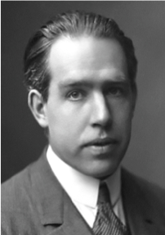
Forecasting
"Prediction is very difficult, especially about the future." - Nils Bohr
http://www.hfac.uh.edu/MediaFutures/thoughts.html

Slide 6

Problem#2: Forecast
given x_{t-1}, x_{t-2}, …,
Q: forecast x_{t}
90
80
70
60
??
50
40
30
20
10
0
1
3
5
7
9
11
Notes:
What are co-evolving time sequences? We define them as a set of correlated time sequences possibly with some time lags.
Let us take an example. Here we have three sequences.
Taking a closer look, we can see that the blue sequence is the same as the red one except that it is a shifted version. Also, the green sequence is somehow correlated with the red one.
What we propose is to study them jointly, to take advantage of the existence of such correlations.

Slide 7

Solution: AR(IMA)
given x_{t-1}, x_{t-2}, …,
Q: forecast x_{t}
A: AR(IMA) = Box-Jenkins (< Holt-Winters, Kalman)
90
x_{t}
80
70
60
??
50
40
30
x_{t-1}
20
10
0
1
3
5
7
9
11
Notes:
What are co-evolving time sequences? We define them as a set of correlated time sequences possibly with some time lags.
Let us take an example. Here we have three sequences.
Taking a closer look, we can see that the blue sequence is the same as the red one except that it is a shifted version. Also, the green sequence is somehow correlated with the red one.
What we propose is to study them jointly, to take advantage of the existence of such correlations.

Slide 8
Outline
Motivation
...
Linear Forecasting
  Auto-regression: Least Squares; RLS
  Co-evolving time sequences
  Examples
  Conclusions

Slide 9
Problem#2: Forecast
Example: give x_{t-1}, x_{t-2}, …, forecast x_{t}
90
80
70
60
Number of packets sent
??
50
40
30
20
10
0
1
3
5
7
9
11
Time Tick
Notes:
What are co-evolving time sequences? We define them as a set of correlated time sequences possibly with some time lags.
Let us take an example. Here we have three sequences.
Taking a closer look, we can see that the blue sequence is the same as the red one except that it is a shifted version. Also, the green sequence is somehow correlated with the red one.
What we propose is to study them jointly, to take advantage of the existence of such correlations.

Slide 10
Forecasting: Preprocessing
MANUALLY:
remove trends spot periodicities
7 days
time
time
Notes:
What are co-evolving time sequences? We define them as a set of correlated time sequences possibly with some time lags.
Let us take an example. Here we have three sequences.
Taking a closer look, we can see that the blue sequence is the same as the red one except that it is a shifted version. Also, the green sequence is somehow correlated with the red one.
What we propose is to study them jointly, to take advantage of the existence of such correlations.

Slide 11
Problem#2: Forecast
Solution: try to express
  x_{t}
  as a linear function of the past: x_{t-2}, x_{t-2}, …,
  (up to a window of w)
Formally:
90
80
70
60
??
50
40
30
20
10
0
1
3
5
7
9
11
Time Tick
Notes:
What are co-evolving time sequences? We define them as a set of correlated time sequences possibly with some time lags.
Let us take an example. Here we have three sequences.
Taking a closer look, we can see that the blue sequence is the same as the red one except that it is a shifted version. Also, the green sequence is somehow correlated with the red one.
What we propose is to study them jointly, to take advantage of the existence of such correlations.

Slide 12
(Problem: Back-cast; interpolate)
Solution - interpolate: try to express
  x_{t}
  as a linear function of the past AND the future:
    x_{t+1}, x_{t+2}, … x_{t+wfuture;} x_{t-1}, … x_{t-wpast}
  (up to windows of w_{past} , w_{future})
EXACTLY the same algo’s
90
??
80
70
60
50
40
30
20
10
0
1
3
5
7
9
11
Time Tick
Notes:
What are co-evolving time sequences? We define them as a set of correlated time sequences possibly with some time lags.
Let us take an example. Here we have three sequences.
Taking a closer look, we can see that the blue sequence is the same as the red one except that it is a shifted version. Also, the green sequence is somehow correlated with the red one.
What we propose is to study them jointly, to take advantage of the existence of such correlations.

Slide 13
Linear Regression: idea
Body height
85
80
75
70
65
60
55
50
45
40
15
25
35
45
Body weight
express what we don’t know (= ‘dependent variable’)
as a linear function of what we know (= ‘indep. variable(s)’)
Notes:
For those in the audience who are not familiar with linear regression, let me give you an example to show how it works.
Here we have a scatter plot of sample points we want to regress. The X-axis is for the independent variable and the Y-axis for the dependent variable.
The goal is to find a line which best approximated the trend of the samples. More specifically we seek a line which minimize the sum of squared estimation errors.
This is a uni-variate regression. In the multi-variate case, it is done in a higher dimensional space and the line becomes a hyper-plane in that case.

Slide 14
Linear Auto Regression:
Notes:
For those in the audience who are not familiar with linear regression, let me give you an example to show how it works.
Here we have a scatter plot of sample points we want to regress. The X-axis is for the independent variable and the Y-axis for the dependent variable.
The goal is to find a line which best approximated the trend of the samples. More specifically we seek a line which minimize the sum of squared estimation errors.
This is a uni-variate regression. In the multi-variate case, it is done in a higher dimensional space and the line becomes a hyper-plane in that case.

Slide 15
Linear Auto Regression:
85
‘lag-plot’
80
75
70
65
Number of packets sent (t)
60
55
50
45
40
15
25
35
45
Number of packets sent (t-1)
lag w=1
Dependent variable = # of packets sent (S [t])
Independent variable = # of packets sent (S[t-1])
Notes:
For those in the audience who are not familiar with linear regression, let me give you an example to show how it works.
Here we have a scatter plot of sample points we want to regress. The X-axis is for the independent variable and the Y-axis for the dependent variable.
The goal is to find a line which best approximated the trend of the samples. More specifically we seek a line which minimize the sum of squared estimation errors.
This is a uni-variate regression. In the multi-variate case, it is done in a higher dimensional space and the line becomes a hyper-plane in that case.

Slide 16
Outline
Motivation
...
Linear Forecasting
  Auto-regression: Least Squares; RLS
  Co-evolving time sequences
  Examples
  Conclusions

Slide 17
More details:
Q1: Can it work with window w>1?
A1: YES!
x_{t}
x_{t-1}
x_{t-2}
Notes:
This presentation is organized as follows:
In the introduction, let me describe what motivated this research. I also describe the kinds of problems we are trying to solve.
Nest, I’ll talk about our main contributions, namely, MUSCLES and Selective MUSCLES.
Then, we report some of experimental results followed by concluding remarks and discussion of future research direction.

Slide 18
More details:
Q1: Can it work with window w>1?
A1: YES! (we’ll fit a hyper-plane, then!)
x_{t}
x_{t-1}
x_{t-2}
Notes:
This presentation is organized as follows:
In the introduction, let me describe what motivated this research. I also describe the kinds of problems we are trying to solve.
Nest, I’ll talk about our main contributions, namely, MUSCLES and Selective MUSCLES.
Then, we report some of experimental results followed by concluding remarks and discussion of future research direction.

Slide 19
More details:
Q1: Can it work with window w>1?
A1: YES! (we’ll fit a hyper-plane, then!)
x_{t}
x_{t-1}
x_{t-2}
Notes:
This presentation is organized as follows:
In the introduction, let me describe what motivated this research. I also describe the kinds of problems we are trying to solve.
Nest, I’ll talk about our main contributions, namely, MUSCLES and Selective MUSCLES.
Then, we report some of experimental results followed by concluding remarks and discussion of future research direction.

Slide 20
More details:
Skip
Q1: Can it work with window w>1?
A1: YES! The problem becomes:
  X_{[N ×w]} × a_{[w ×1]} = y_{[N ×1]}
OVER-CONSTRAINED
  a is the vector of the regression coefficients
  X has the N values of the w indep. variables
  y has the N values of the dependent variable
Notes:
This presentation is organized as follows:
In the introduction, let me describe what motivated this research. I also describe the kinds of problems we are trying to solve.
Nest, I’ll talk about our main contributions, namely, MUSCLES and Selective MUSCLES.
Then, we report some of experimental results followed by concluding remarks and discussion of future research direction.

Slide 21
More details:
Skip
X_{[N ×w]} × a_{[w ×1]} = y_{[N ×1]}
Ind-var1
Ind-var-w
time
Notes:
This presentation is organized as follows:
In the introduction, let me describe what motivated this research. I also describe the kinds of problems we are trying to solve.
Nest, I’ll talk about our main contributions, namely, MUSCLES and Selective MUSCLES.
Then, we report some of experimental results followed by concluding remarks and discussion of future research direction.

Slide 22
More details:
Skip
X_{[N ×w]} × a_{[w ×1]} = y_{[N ×1]}
Ind-var1
Ind-var-w
time
Notes:
This presentation is organized as follows:
In the introduction, let me describe what motivated this research. I also describe the kinds of problems we are trying to solve.
Nest, I’ll talk about our main contributions, namely, MUSCLES and Selective MUSCLES.
Then, we report some of experimental results followed by concluding remarks and discussion of future research direction.

Slide 23
More details
Skip
Q2: How to estimate a₁, a₂, … a_{w} = a?
A2: with Least Squares fit
(Moore-Penrose pseudo-inverse)
a is the vector that minimizes the RMSE from y
a = ( X^{T} × X )⁻¹ × (X^{T} × y)

Slide 24
Even more details
Skip
Q3: Can we estimate a incrementally?
A3: Yes, with the brilliant, classic method of ‘Recursive Least Squares’ (RLS) (see, e.g., [Yi+00], for details) - pictorially:

Slide 25
Even more details
Skip
Given:
Dependent Variable
Independent Variable

Slide 26
Even more details
Skip
.
new point
Dependent Variable
Independent Variable

Slide 27
Even more details
Skip
RLS: quickly compute new best fit
new point
Dependent Variable
Independent Variable

Slide 28
Even more details
Skip
Straightforward Least Squares
  Needs huge matrix
  (growing in size) O(N×w)
  Costly matrix operation O(N×w²)
Recursive LS
  Need much smaller, fixed size matrix O(w×w)
  Fast, incremental computation O(1×w²)
N = 10⁶, w = 1-100

Slide 29
Even more details
Skip
Q4: can we ‘forget’ the older samples?
A4: Yes - RLS can easily handle that [Yi+00]:

Slide 30
Adaptability - ‘forgetting’
Skip
Dependent Variable
eg., #bytes sent
Independent Variable
eg., #packets sent
Notes:
Now, we discuss about the issue of adaptability.
In the scatter plot presented here, we have
<click> some older samples and
<click> some newer samples.
<click> As we can easily see, there was a sudden change of trend in the middle.
What we wish to have after we saw the new samples is <click> the green regression line, but direct application of linear regression gives <click> the red line since it considers old and new samples equally important.
To address the issue, we introduce lambda, a forgetting factor, into the framework. Then older data get forgotten smoothly as time goes by.

Slide 31
Outline
Motivation
...
Linear Forecasting
  Auto-regression: Least Squares; RLS
  Co-evolving time sequences
  Examples
  Conclusions

Slide 32
Co-Evolving Time Sequences
Given: A set of correlated time sequences
Forecast ‘Repeated(t)’
??
Notes:
What are co-evolving time sequences? We define them as a set of correlated time sequences possibly with some time lags.
Let us take an example. Here we have three sequences.
Taking a closer look, we can see that the blue sequence is the same as the red one except that it is a shifted version. Also, the green sequence is somehow correlated with the red one.
What we propose is to study them jointly, to take advantage of the existence of such correlations.

Slide 33
Solution:
Q: what should we do?

Slide 34
Solution:
Least Squares, with
Dep. Variable: Repeated(t)
Indep. Variables: Sent(t-1) … Sent(t-w); Lost(t-1) …Lost(t-w); Repeated(t-1), ...
(named: ‘MUSCLES’ [Yi+00])

Slide 35
Time Series Analysis - Outline
Auto-regression
Least Squares; recursive least squares
Co-evolving time sequences
Examples
Conclusions

Slide 36
Conclusions - Practitioner’s guide
AR(IMA) methodology: prevailing method for linear forecasting
Brilliant method of Recursive Least Squares for fast, incremental estimation.
See [Box-Jenkins]

Slide 37
Solution: AR(IMA)
given x_{t-1}, x_{t-2}, …,
Q: forecast x_{t}
A: AR(IMA) = Box-Jenkins (< Holt-Winters, Kalman)
90
x_{t}
80
70
60
??
50
40
30
x_{t-1}
20
10
0
1
3
5
7
9
11
Notes:
What are co-evolving time sequences? We define them as a set of correlated time sequences possibly with some time lags.
Let us take an example. Here we have three sequences.
Taking a closer look, we can see that the blue sequence is the same as the red one except that it is a shifted version. Also, the green sequence is somehow correlated with the red one.
What we propose is to study them jointly, to take advantage of the existence of such correlations.

Slide 38
Resources: software and urls
MUSCLES: Prof. Byoung-Kee Yi:
  http://www.postech.ac.kr/~bkyi/
  or christos@cs.cmu.edu
free-ware: ‘R’ for stat. analysis
  (clone of Splus)
  http://cran.r-project.org/

Slide 39
Books
George E.P. Box and Gwilym M. Jenkins and Gregory C. Reinsel, Time Series Analysis: Forecasting and Control, Prentice Hall, 1994 (the classic book on ARIMA, 3rd ed.)
Brockwell, P. J. and R. A. Davis (1987). Time Series: Theory and Methods. New York, Springer Verlag.

Slide 40
Additional Reading
[Papadimitriou+ vldb2003] Spiros Papadimitriou, Anthony Brockwell and Christos Faloutsos Adaptive, Hands-Off Stream Mining VLDB 2003, Berlin, Germany, Sept. 2003
[Yi+00] Byoung-Kee Yi et al.: Online Data Mining for Co-Evolving Time Sequences, ICDE 2000. (Describes MUSCLES and Recursive Least Squares)

Slide 41
Part 2.4:
chaos and
non-linear forecasting

Slide 42
Outline
Motivation
Similarity Search and Indexing
DSP
Linear Forecasting
Non-linear forecasting
Tensors
Conclusions

Slide 43
Detailed Outline
Non-linear forecasting
  Problem
  Idea
  How-to
  Experiments
  Conclusions

Slide 44
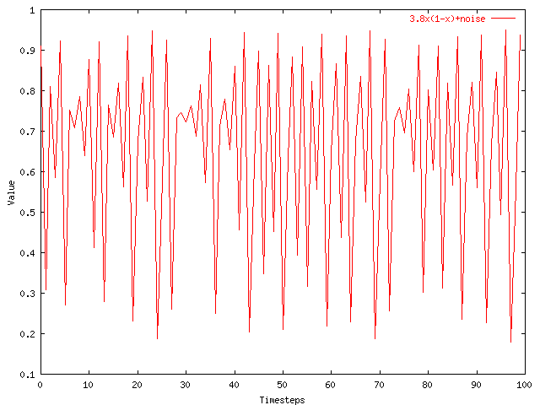
Problem: Forecast
given x_{t-1}, x_{t-2}, …, (‘chaotic’/non-linear)
Q: forecast x_{t}
Notes:
What are co-evolving time sequences? We define them as a set of correlated time sequences possibly with some time lags.
Let us take an example. Here we have three sequences.
Taking a closer look, we can see that the blue sequence is the same as the red one except that it is a shifted version. Also, the green sequence is somehow correlated with the red one.
What we propose is to study them jointly, to take advantage of the existence of such correlations.

Slide 45
Solution
given x_{t-1}, x_{t-2}, …, (‘chaotic’/non-linear)
Q: forecast x_{t}
A: lag-plots + sim. search (= ‘Delayed Coordinate Embedding’)
x_{t}
X_{t-1}
Notes:
What are co-evolving time sequences? We define them as a set of correlated time sequences possibly with some time lags.
Let us take an example. Here we have three sequences.
Taking a closer look, we can see that the blue sequence is the same as the red one except that it is a shifted version. Also, the green sequence is somehow correlated with the red one.
What we propose is to study them jointly, to take advantage of the existence of such correlations.

Slide 46
Recall: Problem #1
Value
Time
Given a time series {x_{t}}, predict its future course, that is, x_{t+1}, x_{t+2}, ...

Slide 47
How to forecast?
ARIMA - but: linearity assumption
ANSWER: ‘Delayed Coordinate Embedding’ = Lag Plots [Sauer92]

Slide 48

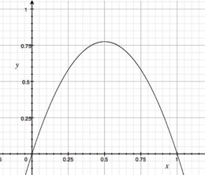
ARIMA pitfall
Example: logistic parabola
    Models population of flies [R. May/1976]
Logistic map
Time-series plot
Time t
Notes:
x_{t+1} = a x_t \cdot \left( 1-x_t \right )

Slide 49
ARIMA pitfall
Example: logistic parabola
    Models population of flies [R. May/1976]
Logistic map
= SI virus prop. model
~ Bass equation (market penetration)
Special case of Lotka-Volterra
Notes:
x_{t+1} = a x_t \cdot \left( 1-x_t \right )

Slide 50
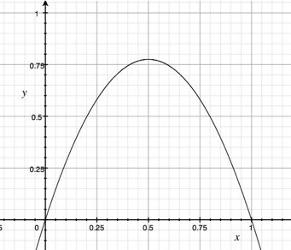
ARIMA pitfall
Linear equations, e.g., AR, ARIMA, …
Notes:
x_{t+1} = a x_t + \epsilon

Slide 51
ARIMA pitfall
Linear equations, e.g., AR, ARIMA, …
e.g., AR(1)
Notes:
x_{t+1} = a x_t + \epsilon

Slide 52
ARIMA pitfall
Linear equations, e.g., AR, ARIMA, …
AR fit: fails
e.g., AR(1)
Notes:
x_{t+1} = a x_t + \epsilon

Slide 53
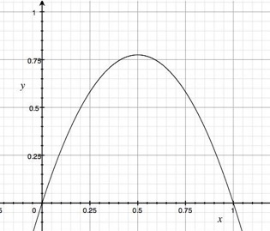
Solution?
“Delayed Coordinate Embedding”
= Lag Plots [Sauer92]
k-nearest neighbor search
Notes:
x_{t+1} = a x_t + \epsilon

Slide 54
General Intuition (Lag Plot)
Lag = 1,
k = 4 NN
x_{t}
Interpolate these…
To get the final prediction
x_{t-1}
4-NN
New Point

Slide 55

Q: How to interpolate?
How do we interpolate between the
k nearest neighbors?
A1: Average
A2: Weighted average (weights drop with distance - how?)

Slide 56
Q: How to interpolate?
A3: Using SVD - seems to perform best ([Sauer94] - first place in the Santa Fe forecasting competition)
x_{t}
X_{t-1}

Slide 57
Q: Any theory behind it?
A: YES!

Slide 58
Theoretical foundation
Based on the “Takens’ Theorem” [Takens81]
which says that long enough delay vectors can do prediction, even if there are unobserved variables in the dynamical system (= diff. equations)

Slide 59

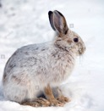
Theoretical foundation
Example: Lotka-Volterra equations
dH/dt = r H – a H*P
dP/dt = b H*P – m P
H is count of prey (e.g., hare)
P is count of predators (e.g., lynx)
Suppose only P(t) is observed (t=1, 2, …).
P
H

Slide 60
Theoretical foundation
But the delay vector space is a faithful reconstruction of the internal system state
So prediction in delay vector space is as good as prediction in state space
P
P(t)
H
P(t-1)

Slide 61
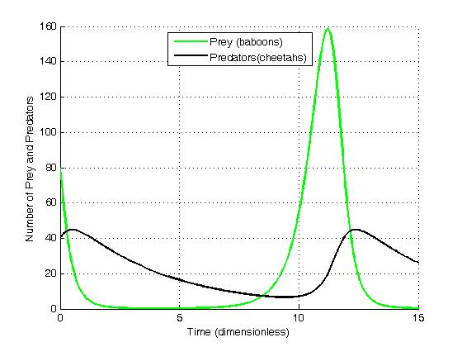
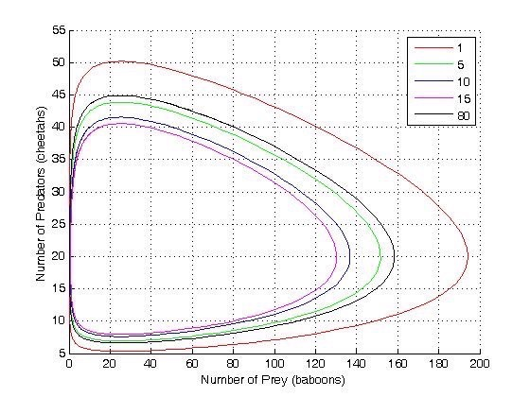
Solution to Volterra-Lotka eq.
# predators
prey
predators
# prey
time
from wikipedia

Slide 62
Notice: LV are vital!
Example: Lotka-Volterra equations
dH/dt = r H – a H*P
dP/dt = b H*P – m P
Prey-predator
Competing animals (rabbits/goats)
Self-competition (Bass model)
Competing products (stocks/bonds)
P
H

Slide 63


The Web as a Jungle:
Non-Linear Dynamical Systems for Co-evolving Online Activities
Yasuko Matsubara (Kumamoto University)
Yasushi Sakurai (Kumamoto University)
Christos Faloutsos (CMU)
Open source code: here

Slide 64
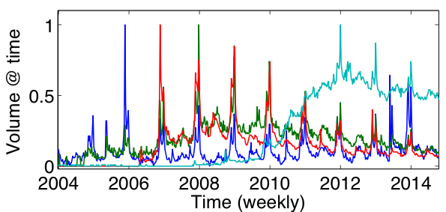
Given: online user activities
Xbox, PlayStation, Wii, Android
Notes:
http://www.youtube.com/watch?v=6UV3kRV46Zs&t=49s

Slide 65




The Web as a jungle
Ecosystem on the
Web
Xbox
PlayStation
Wii
Android
Kids
Teens
Adults

Slide 66
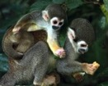










The Web as a jungle
Squirrel monkeys
Spider
monkeys
Macaws
Capybaras
Fruits
Nuts
Grass
Ecosystem on the
Web
Ecosystem in the
Jungle
Kids
Teens
Adults

Slide 67

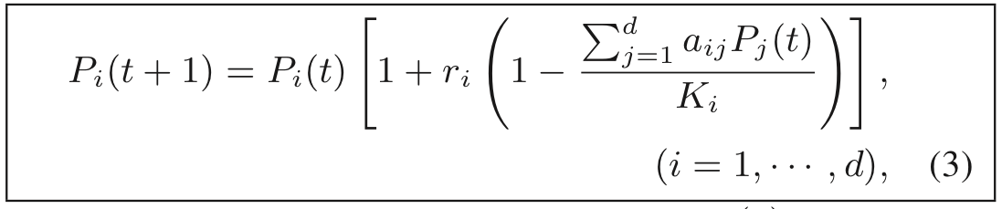
LV equations
Interaction between multiple (‘d’) species/products/viruses
…
  - effect of species j on species i
    (positive: hurts)

Slide 68
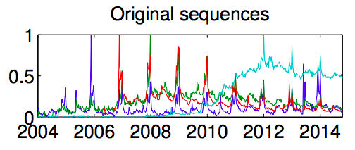
EcoWeb at work - forecasting
Train:
2/3 sequences
Forecast:
1/3 following years
?

Slide 69
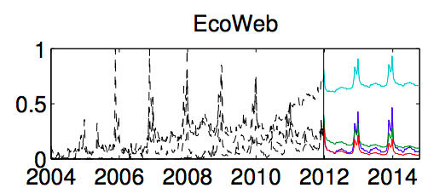
EcoWeb at work - forecasting
Train:
2/3 sequences
Forecast:
1/3 following years
EcoWeb can capture future patterns

Slide 70
EcoWeb at work - forecasting
Open source code: here

Slide 71
Detailed Outline
Non-linear forecasting
  Problem
  Idea
  How-to
  Experiments
  Conclusions

Slide 72
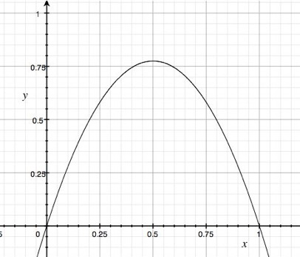
Datasets
x(t)
Logistic Parabola:
x_{t} = ax_{t-1}(1-x_{t-1}) + noise
Models population of flies [R. May/1976]
time
Lag-plot

Slide 73
Datasets
x(t)
Logistic Parabola:
x_{t} = ax_{t-1}(1-x_{t-1}) + noise
Models population of flies [R. May/1976]
time
Lag-plot
ARIMA: fails

Slide 74
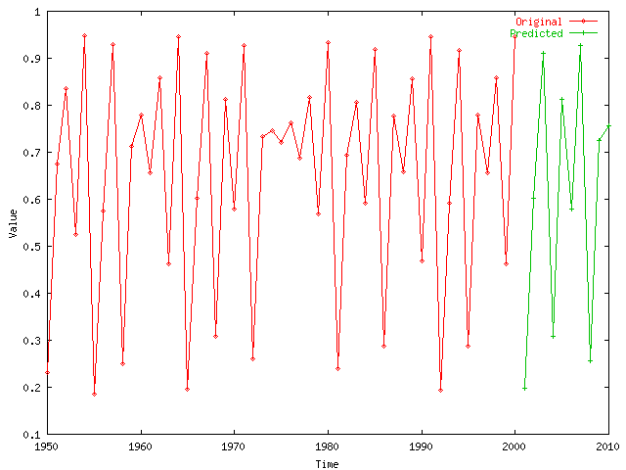
Logistic Parabola
Our Prediction from here
Value
Timesteps

Slide 75
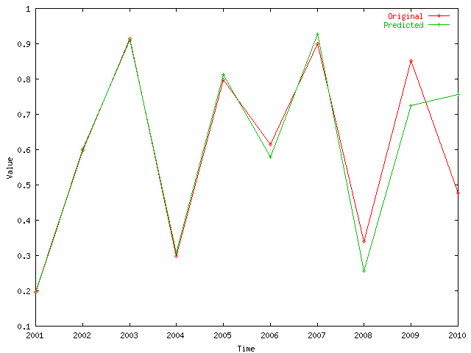
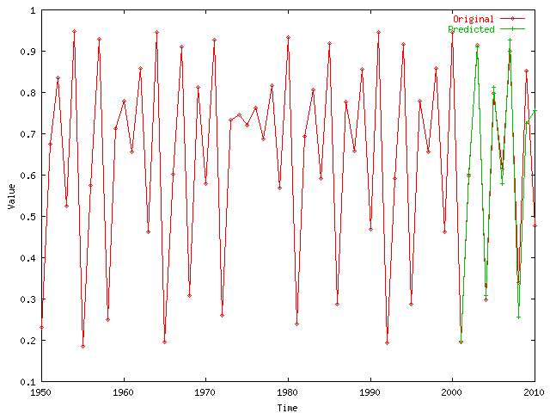
Logistic Parabola
Value
Comparison of prediction to correct values
Timesteps

Slide 76

Datasets
LORENZ: Models convection currents in the air
dx / dt = a (y - x)
dy / dt = x (b - z) - y
dz / dt = xy - c z

Slide 77
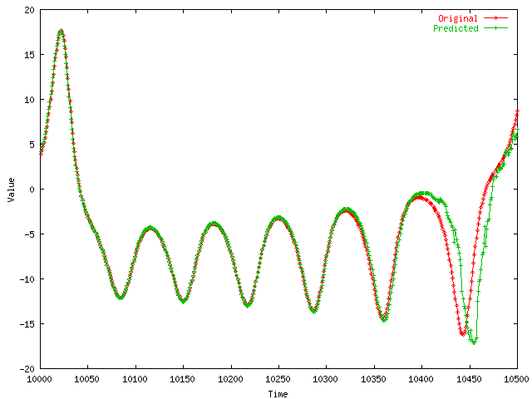
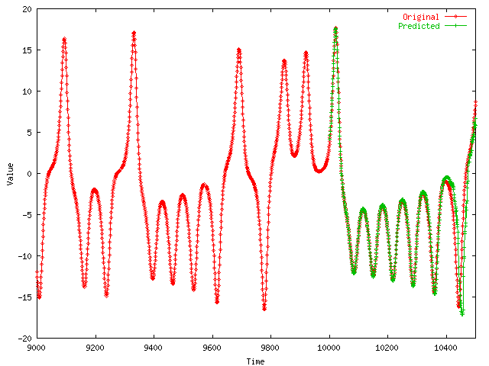
LORENZ
Value
Comparison of prediction to correct values
Timesteps

Slide 78
Datasets
Value
Skip
LASER: fluctuations in a Laser over time (used in Santa Fe competition)
Time

Slide 79
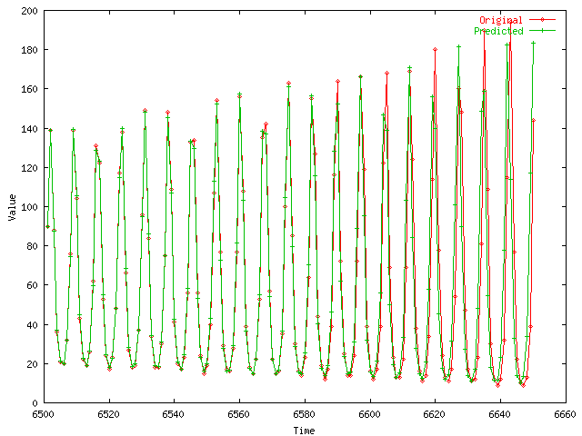
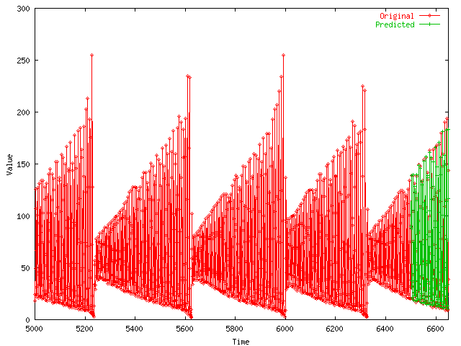
Laser
Value
Skip
Comparison of prediction to correct values
Timesteps

Slide 80

Solution
given x_{t-1}, x_{t-2}, …, (‘chaotic’/non-linear)
Q: forecast x_{t}
A: lag-plots + sim. search (= ‘Delayed Coordinate Embedding’)
x_{t}
X_{t-1}
Notes:
What are co-evolving time sequences? We define them as a set of correlated time sequences possibly with some time lags.
Let us take an example. Here we have three sequences.
Taking a closer look, we can see that the blue sequence is the same as the red one except that it is a shifted version. Also, the green sequence is somehow correlated with the red one.
What we propose is to study them jointly, to take advantage of the existence of such correlations.

Slide 81
References
Deepay Chakrabarti and Christos Faloutsos F4: Large-Scale Automated Forecasting using Fractals CIKM 2002, Washington DC, Nov. 2002.
Sauer, T. (1994). Time series prediction using delay coordinate embedding. (in book by Weigend and Gershenfeld, below) Addison-Wesley.
Takens, F. (1981). Detecting strange attractors in fluid turbulence. Dynamical Systems and Turbulence. Berlin: Springer-Verlag.

Slide 82
References
Weigend, A. S. and N. A. Gerschenfeld (1994). Time Series Prediction: Forecasting the Future and Understanding the Past, Addison Wesley. (Excellent collection of papers on chaotic/non-linear forecasting, describing the algorithms behind the winners of the Santa Fe competition.)

Slide 83
Part 2.5:
Tensors – time evolving
graphs

Slide 84
Outline
Motivation
Similarity Search and Indexing
DSP
Linear Forecasting
Non-linear forecasting
Tensors
Conclusions

Slide 85
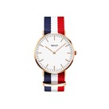





Binary relationships: graph
Who – buys - what
…
…

Slide 86
Ternary relationships – model?
Who – buys – what - when
3am, 4/1
…
3am, 4/1
…
10pm, 4/3
11pm, 4/3

Slide 87
A: tensors
… for ternary and higher –order relationships

Slide 88
Problem: co-evolving graphs
How to forecast?
  4M x 4M x 15 days
time
caller
callee

Slide 89
A: tensors
Q: what is a tensor?

Slide 90
Tensor examples
A: N-D generalization of matrix:
KDD’17
data
mining
classif.
tree
...
John
Peter
Mary
Nick
...

Slide 91
Tensor examples
A: N-D generalization of matrix:
KDD’19
KDD’18
KDD’17
data
mining
classif.
tree
...
John
Peter
Mary
Nick
...

Slide 92
Tensors are useful for 3 or more modes
Terminology: ‘mode’ (or ‘aspect’):
Mode#3
data
mining
classif.
tree
...
Mode#2
Mode (== aspect) #1

Slide 93
Tensor Basics

Slide 94
Tensor factorization
Recall: (SVD) matrix factorization: finds blocks
‘meat-eaters’
‘steaks’
‘vegetarians’
‘plants’
‘kids’
‘cookies’
M
products
N
users
+
+
~

Slide 95
Tensor factorization
PARAFAC decomposition
politicians
artists
athletes
verb
subject
+
+
=
object

Slide 96
Tensor factorization
PARAFAC decomposition
Results for who-calls-whom-when
  4M x 15 days
??
??
??
time
caller
+
+
=
callee

Slide 97
Tensor factorization
PARAFAC decomposition
Results for who-calls-whom-when
  4M x 15 days
??
??
??
time
caller
+
+
=
callee

Slide 98
Tensor factorization
PARAFAC decomposition
Results for who-calls-whom-when
  4M x 15 days
??
??
??
time
Forecast in, eg, 3,
instead of 1M*1M
series
caller
callee

Slide 99
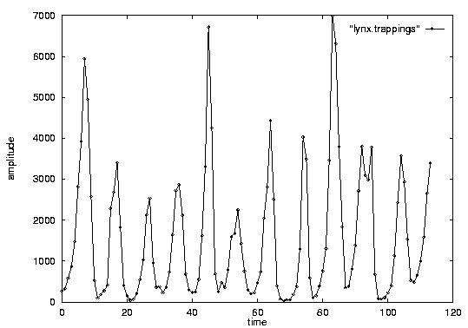

Important observations
Patterns, rules, forecasting and similarity indexing are closely related:
To do forecasting, we need
  to find patterns/rules
  compress
  to find similar settings in the past
to find outliers, we need to have forecasts
  (outlier = too far away from our forecast)

Slide 100
Applications
TA1: Phonecall
TA2: Network traffic
TA3: FaceBook
TA4: KG Search/Annotation

Slide 101
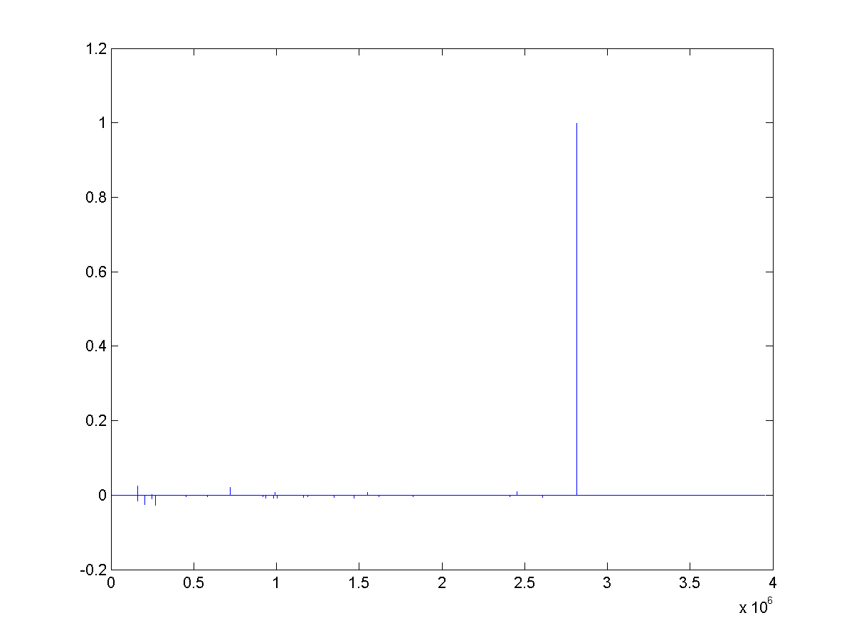
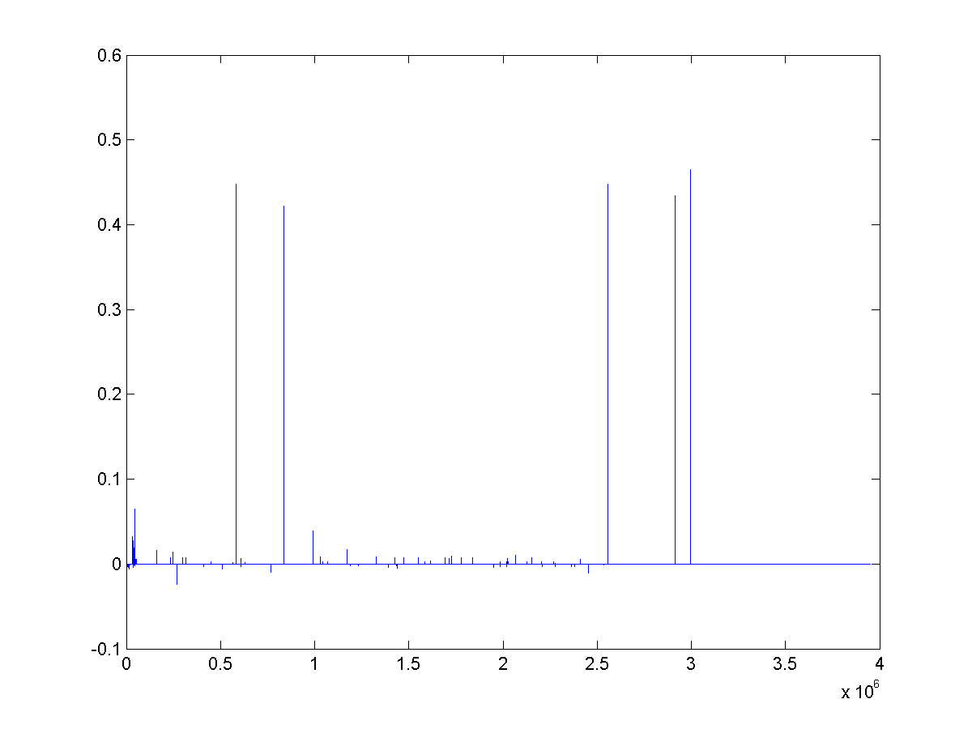
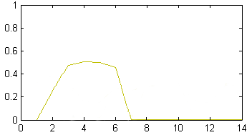
TA1: Anomaly detection in time-evolving graphs
=
Anomalous communities in phone call data:
  European country, 4M clients, data over 2 weeks
  ~200 calls to EACH receiver on EACH day!
1 caller
5 receivers
4 days of activity

Slide 102
TA1: Anomaly detection in time-evolving graphs
=
Anomalous communities in phone call data:
  European country, 4M clients, data over 2 weeks
  ~200 calls to EACH receiver on EACH day!
1 caller
5 receivers
4 days of activity

Slide 103

TA1: Anomaly detection in time-evolving graphs
=
Anomalous communities in phone call data:
  European country, 4M clients, data over 2 weeks
  ~200 calls to EACH receiver on EACH day!
1 caller
5 receivers
4 days of activity

Slide 104



TA1: Anomaly detection in time-evolving graphs
=
Anomalous communities in phone call data:
  European country, 4M clients, data over 2 weeks
  ~200 calls to EACH receiver on EACH day!
Miguel Araujo, Spiros Papadimitriou, Stephan Günnemann, Christos Faloutsos, Prithwish Basu, Ananthram Swami,
Evangelos Papalexakis, Danai Koutra. Com2: Fast Automatic Discovery of Temporal (Comet) Communities. PAKDD 2014, Tainan, Taiwan.

Slide 105
Applications
TA1: Phonecall
TA2: Network traffic
TA3: FaceBook

Slide 106

ParCube: Sparse Parallelizable Tensor Decompositions
Evangelos E. Papalexakis, Christos Faloutsos, Nikos Sidiropoulos, ECML/PKDD 2012
Evangelos E. Papalexakis
Email: epapalex@cs.ucr.edu
Web: http://www.cs.ucr.edu/~epapalex

Slide 107
TA2: Lbnl Network Data
1 src
1 dst
Modes: src IP, dst IP, port #
~ Port Scanning Attack
Notes:
Network traffic data of form (src IP, dst IP, port #)
65170 × 65170 × 65327 tensor
We pick s = 5, r = 10

Slide 108

TA3: Facebook Wall posts
1 Wall
1 day
Modes: wall-owner, poster, timestamp
Discovery: birthday-like event.
Notes:
Small portion of Facebook’s users
63890 users for 1847 days
Picked s = 100, r = 10
Data in the form (Wall owner, poster, timestamp)
Downloaded from http://socialnetworks.mpi-sws.org/data-wosn2009.html
We were able to identify a birthday-like event.

Slide 109

Conclusions (P2.5)
Tensor analysis finds latent variables (market-segments, lockstep-groups, etc
  Deviations → anomalies
Extends SVD/factorization, to higher-modes
Apple
fans
shoes
jewelry
timestamp
customer
=
+
+
product

Slide 110
Overall conclusions for time series:

Slide 111
Overall conclusions
P2.1. Similarity search: Euclidean/time-warping; feature extraction and SAMs
P2.2. Signal processing: DFT, DWT are powerful tools
P2.3. Linear Forecasting: AR (Box-Jenkins)
P2.4. Non-linear forecasting: lag-plots (Takens)
P2.5. Tensors: PARAFAC etc

Slide 112
Important observations
Patterns, rules, forecasting and similarity indexing are closely related:
To do forecasting, we need
  to find patterns/rules
  compress
  to find similar settings in the past
to find outliers, we need to have forecasts
  (outlier = too far away from our forecast)

Slide 113
P2 – Tensors - More references
Tensor survey
Tamara G. Kolda and Brett W. Bader Tensor Decompositions and Applications SIAM Rev., 51(3), pp 455–500, 2009.

Slide 114
P2 – Tensors - More references
Tensor survey #2
Nicholas D. Sidiropoulos, Lieven De Lathauwer,, Xiao Fu,, Kejun Huang, Evangelos E. Papalexakis, and Christos Faloutsos, Tensor Decomposition for Signal Processing and Machine Learning, IEEE TSP, 65(13), July 1, 2017

