Slide 1
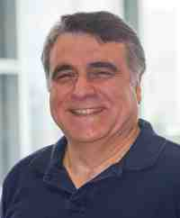
Mining graphs and time series: patterns, anomalies, and fraud detection
Part 1: Graphs
Anomaly detection & B.P.
Christos Faloutsos
CMU SCS
https://www.cs.cmu.edu/~christos/TALKS/19-GoI

Slide 2
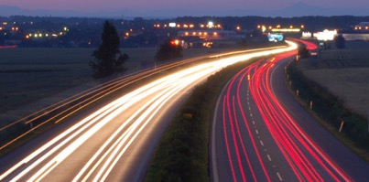
Roadmap
Introduction
Part#1: Graphs and Tensors
Part#2: Time series
Part#3: extras (visualization, etc)
Conclusions

Slide 3
Roadmap
Introduction – Motivation
Part#1: Graphs
  …
  P1.3: community detection
  P1.4: fraud/anomaly detection
  P1.5: belief propagation
un-supervised
?
semi-supervised

Slide 4
Roadmap
Introduction – Motivation
Part#1: Graphs
  …
  P1.3: community detection
  P1.4: fraud/anomaly detection
    P1.4.1. Outliers
    P1.4.2. Lock-step behavior
  P1.5: belief propagation
un-supervised
?

Slide 5
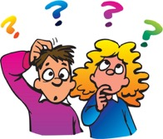


‘Recipe’ Structure:
Problem definition
Short answer/solution
LONG answer – details
Conclusion/short-answer

Slide 6
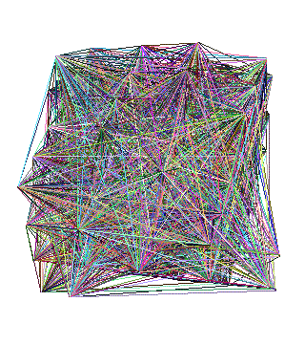

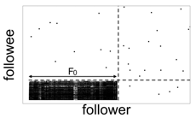

Problem
Given:
Find:
Outliers
Lock-step

Slide 7
Solution
Given:
Find:
Outliers
Lock-step
OddBall
SVD

Slide 8
P1.4.1. Outliers
Which node(s) are strange?
  Q: How to start?

Slide 9
P1.4.1. Outliers
Which node(s) are strange?
  Q: How to start?
  A1: egonet; and extract node features

Slide 10
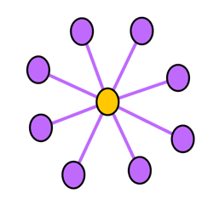
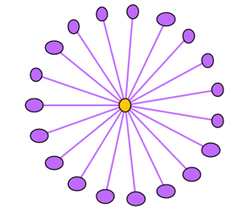
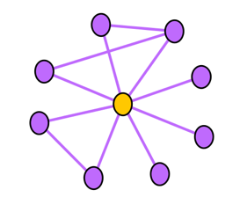
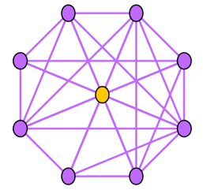
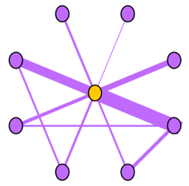
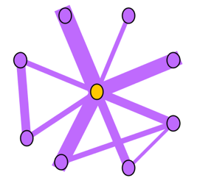
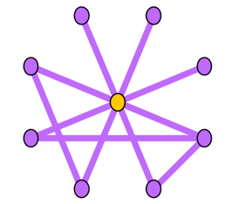
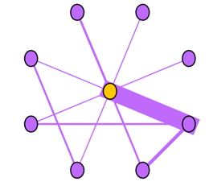
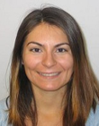


Ego-net Patterns: Which is strange?
Oddball: Spotting anomalies in weighted graphs, Leman Akoglu, Mary McGlohon, Christos Faloutsos, PAKDD 2010

Slide 11
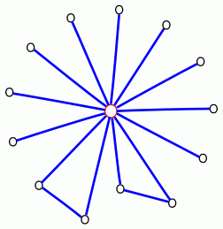
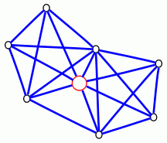
Ego-net Patterns: Which is strange?
telemarketer, port scanner,
people adding friends
indiscriminatively, etc.
Near-star
Near-clique
tightly connected people,
terrorist groups?, discussion
group, etc.
Oddball: Spotting anomalies in weighted graphs
Leman Akoglu, Mary McGlohon, Christos Faloutsos
PAKDD 2010

Slide 12
P1.4.1. Outliers
Which node(s) are strange?
  Q: How to start?
  A: egonet; and extract node features
  Q’: which features?
  A’: ART! Infinite! Pick a few, e.g.:

Slide 13
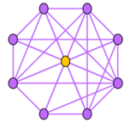
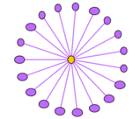



Ego-net Patterns
N_{i}: number of neighbors (degree) of ego i
E_{i}: number of edges in egonet i
W_{i}: total weight of egonet i
λ_{w,i}: principal eigenvalue of the weighted adjacency matrix of egonet i
Oddball: Spotting anomalies in weighted graphs
Leman Akoglu, Mary McGlohon, Christos Faloutsos
PAKDD 2010
Oddball: Spotting anomalies in weighted graphs, Leman Akoglu, Mary McGlohon, Christos Faloutsos, PAKDD 2010

Slide 14
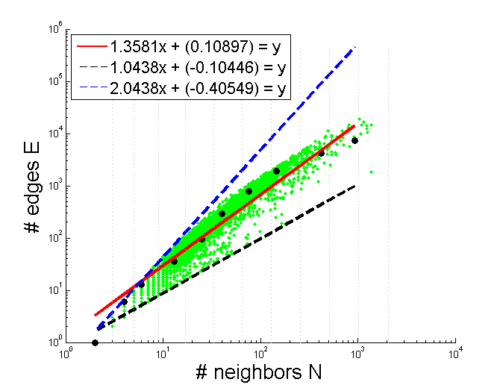
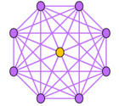
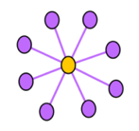
Pattern: Ego-net Power Law Density
E_{i} ∝ N_{i}^{α}
1 ≤ α ≤ 2
Enron CEO
Oddball: Spotting anomalies in weighted graphs
Leman Akoglu, Mary McGlohon, Christos Faloutsos
PAKDD 2010
Oddball: Spotting anomalies in weighted graphs, Leman Akoglu, Mary McGlohon, Christos Faloutsos, PAKDD 2010

Slide 15
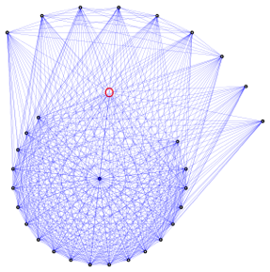
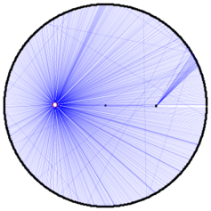
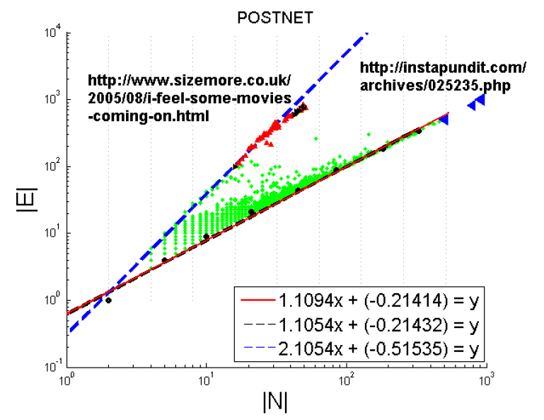
Pattern: Ego-net Power Law Density
Oddball: Spotting anomalies in weighted graphs
Leman Akoglu, Mary McGlohon, Christos Faloutsos
PAKDD 2010
Oddball: Spotting anomalies in weighted graphs, Leman Akoglu, Mary McGlohon, Christos Faloutsos, PAKDD 2010

Slide 16
Roadmap
Introduction – Motivation
Part#1: Graphs
  …
  P1.3: community detection
  P1.4: fraud/anomaly detection
    Outliers
    Lock-step behavior
  P1.5: belief propagation
?

Slide 17
Problem
Given:
Find:
Outliers
Lock-step

Slide 18

P1.4.1. How to find ‘suspicious’ groups?
‘blocks’ are normal, right?
idols
fans

Slide 19



P1.4.1. How to find ‘suspicious’ groups?
‘blocks’ are normal, right?
idols
fans

Slide 20

Except that:
‘blocks’ are normal, right?
‘hyperbolic’ communities are more realistic [Araujo+, PKDD’14]

Slide 21
Except that:
‘blocks’ are usually suspicious
‘hyperbolic’ communities are more realistic [Araujo+, PKDD’14]
Q: Can we spot blocks, easily?

Slide 22
Except that:
‘blocks’ are usually suspicious
‘hyperbolic’ communities are more realistic [Araujo+, PKDD’14]
Q: Can we spot blocks, easily?
A: Silver bullet: SVD!

Slide 23




Crush intro to SVD
From: HITS
Recall: (SVD) matrix factorization: finds blocks
‘music lovers’
‘singers’
‘sports lovers’
‘athletes’
‘citizens’
‘politicians’
M
idols
N
fans
+
+
~

Slide 24


Crush intro to SVD
(SVD) matrix factorization: finds blocks
A) Even if shuffled!
‘music lovers’
‘singers’
‘sports lovers’
‘athletes’
‘citizens’
‘politicians’
M
idols
N
fans
+
+
~

Slide 25
Crush intro to SVD
(SVD) matrix factorization: finds blocks
B) Even if ‘salt+pepper’ noise
‘music lovers’
‘singers’
‘sports lovers’
‘athletes’
‘citizens’
‘politicians’
M
idols
N
fans
+
+
~

Slide 26
SVD - intuition
✅
Hidden/latent variable detection
Block detection
Dimensionality reduction
embedding

Slide 27
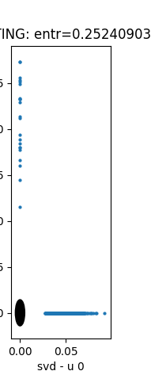
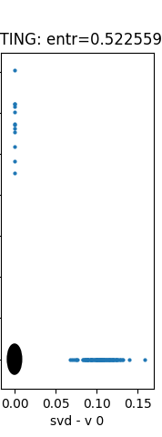
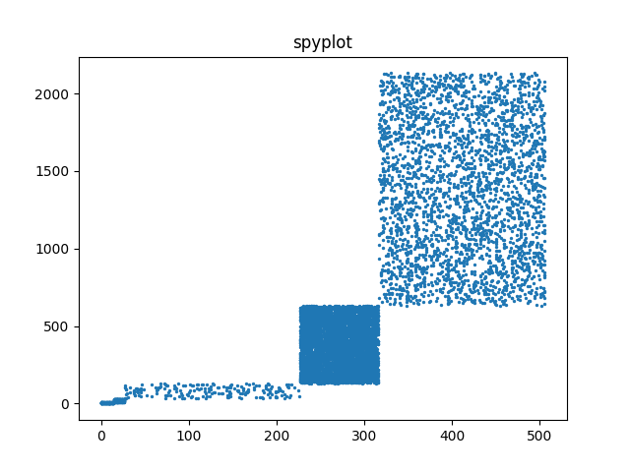
Toy example – 5 blocks
From: HITS
v₀
v₁
‘idols’
u₀
u₁
‘fans’
u₁
v₁
u₀
v₀
EigenPlots

Slide 28
Toy example – 5 blocks
From: HITS
v₀
v₁
‘idols’
u₀
u₁
‘fans’
u₁
v₁
u₀
v₀

Slide 29
SVD - intuition
✅
Hidden/latent variable detection
Block detection
Dimensionality reduction
embedding
✅

Slide 30
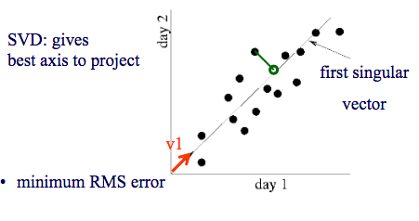
SVD - intuition
#128.1.1.3
#logins from 128.1.1.1

Slide 31
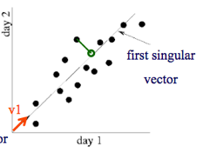
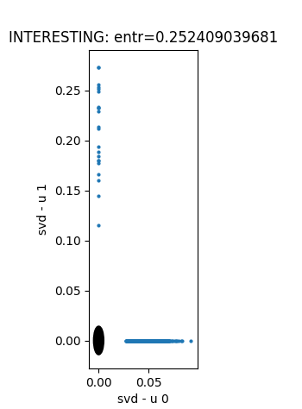
SVD - intuition
‘customers’
u₁
500-d vector
‘Smith’
2-d
‘Smith’
‘IP-addresses’
u₀

Slide 32
SVD - intuition
✅
Hidden/latent variable detection
Block detection
Dimensionality reduction
Embedding (linear)
  SVD is a special case of ’deep neural net’
✅
✅
✅

Slide 33





Inferring Strange Behavior from Connectivity Pattern in Social Networks
PAKDD’14
OPTIONAL
Meng Jiang, Peng Cui, Shiqiang Yang (Tsinghua)
Alex Beutel, Christos Faloutsos (CMU)

Slide 34
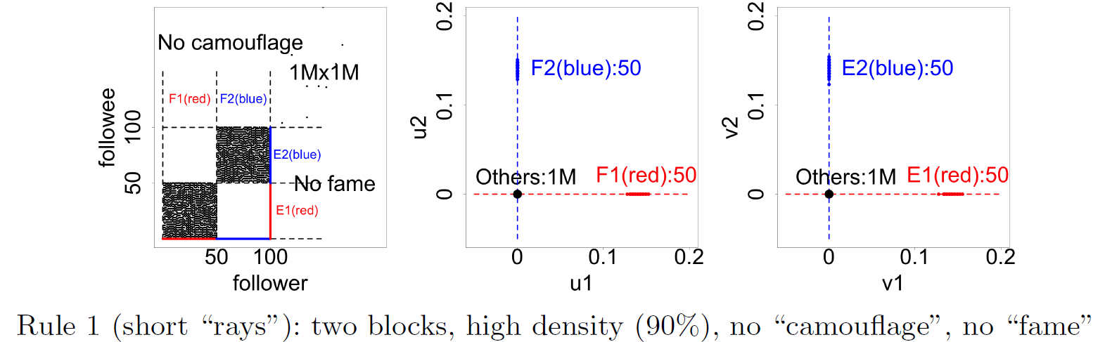
Lockstep and Spectral Subspace Plot
OPTIONAL
Case #1: non-overlapping lockstep
“Blocks” “Rays”
Adjacency Matrix
Spectral Subspace Plot

Slide 35
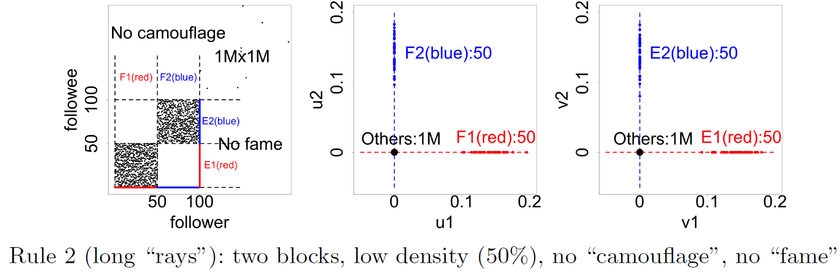
Lockstep and Spectral Subspace Plot
OPTIONAL
Case #2: non-overlapping lockstep
“Blocks; low density” Elongation
Adjacency Matrix
Spectral Subspace Plot

Slide 36
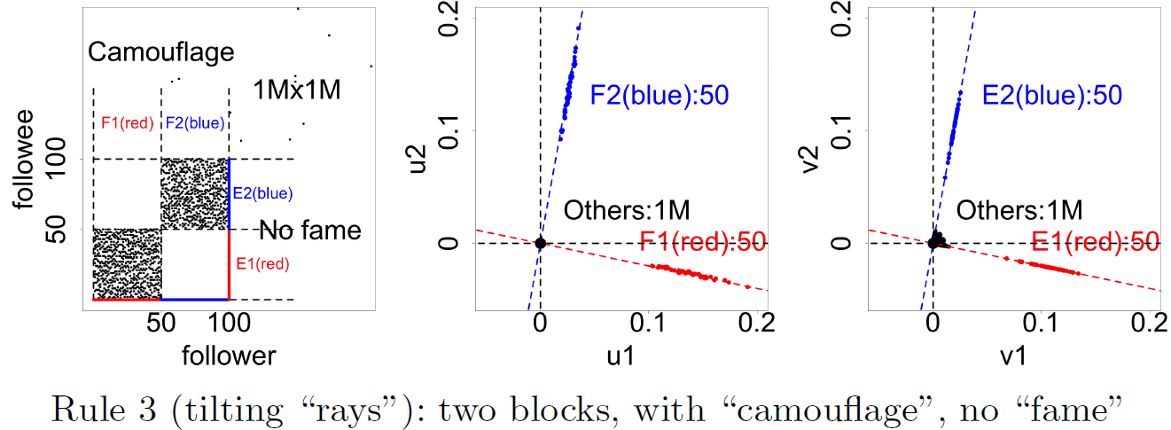
Lockstep and Spectral Subspace Plot
OPTIONAL
Case #3: non-overlapping lockstep
“Camouflage” (or “Fame”) Tilting “Rays”
Adjacency Matrix
Spectral Subspace Plot

Slide 37
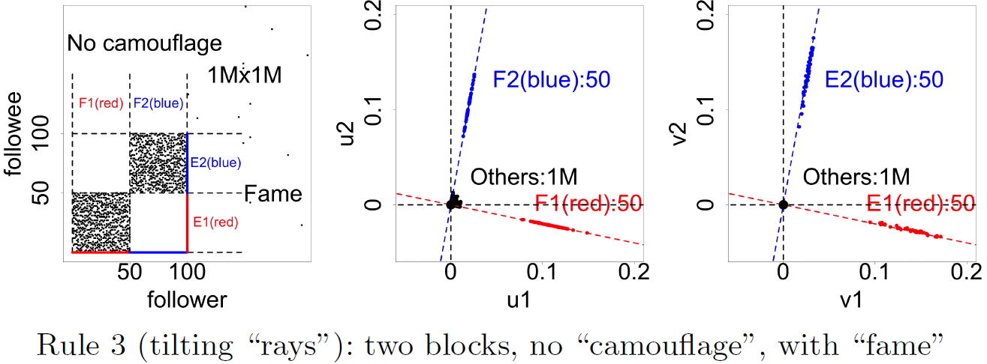
Lockstep and Spectral Subspace Plot
OPTIONAL
Case #3: non-overlapping lockstep
“Camouflage” (or “Fame”) Tilting “Rays”
Adjacency Matrix
Spectral Subspace Plot

Slide 38
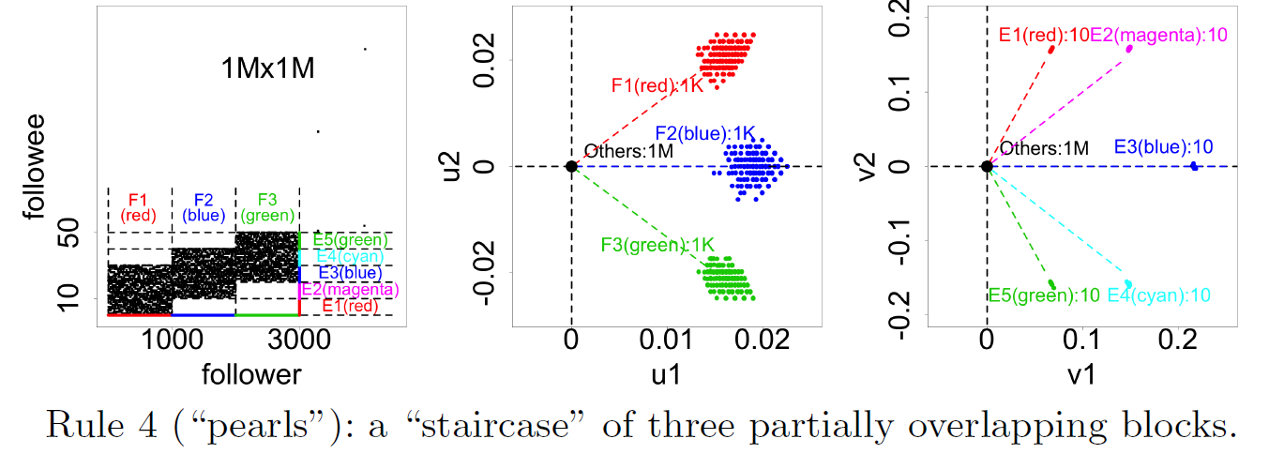
Lockstep and Spectral Subspace Plot
OPTIONAL
Case #4: ? lockstep
“?” “Pearls”
Adjacency Matrix
Spectral Subspace Plot
?

Slide 39
Lockstep and Spectral Subspace Plot
OPTIONAL
Case #4: overlapping lockstep
“Staircase” “Pearls”
Adjacency Matrix
Spectral Subspace Plot

Slide 40


Dataset
Tencent Weibo
117 million nodes (with profile and UGC data)
3.33 billion directed edges

Slide 41
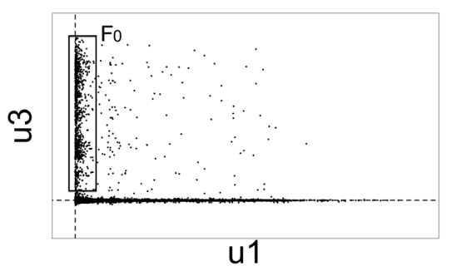

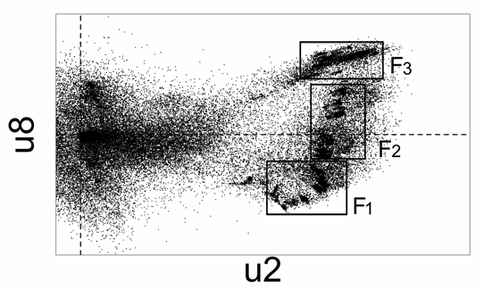
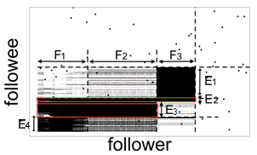
Real Data
“Rays”
“Block”
“Pearls”
“Staircase”

Slide 42

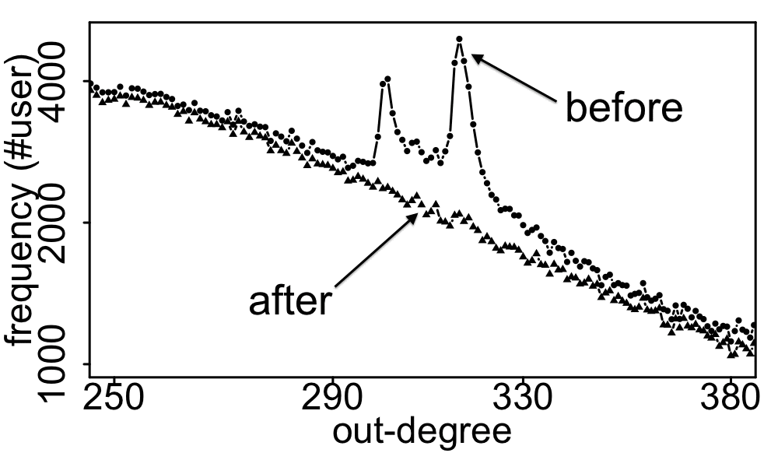
Real Data
Spikes on the out-degree distribution
×
×

Slide 43
Solution
Given:
Find:
Outliers
Lock-step
OddBall
SVD

Slide 44
Roadmap
Introduction – Motivation
Part#1: Graphs
  …
  P1.3: community detection
  P1.4: fraud/anomaly detection
  P1.5: belief propagation
un-supervised
?
semi-supervised

Slide 45
Roadmap
Introduction – Motivation
Part#1: Graphs
  P1.1: properties/patterns in graphs
  P1.2: node importance
  P1.3: community detection
  P1.4: fraud/anomaly detection
  P1.5: belief propagation

Slide 46
Problem
What color, for the rest?
  Given homophily (/heterophily etc)?

Slide 47
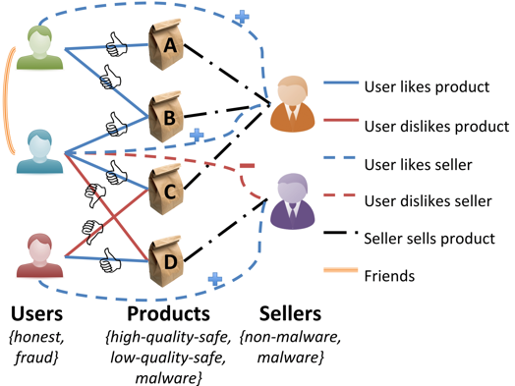
Short answer:
What color, for the rest?
A: Belief Propagation (‘zooBP’)
www.cs.cmu.edu/~deswaran/code/zoobp.zip

Slide 48
Roadmap
Introduction – Motivation
Part#1: Graphs
  …
  P1.5: belief propagation
    Basics
    Fast, linear approximation (FaBP)
    Latest: zooBP
    Success stories

Slide 49


E-bay Fraud detection
w/ Polo Chau &
Shashank Pandit, CMU
[PKDD’06][WWW’07]
Detecting Fraudulent Personalities in Networks of Online Auctioneers. Duen Horng (Polo) Chau, Shashank Pandit, and Christos Faloutsos. (PKDD) 2006

Slide 50
E-bay Fraud detection

Slide 51
E-bay Fraud detection

Slide 52
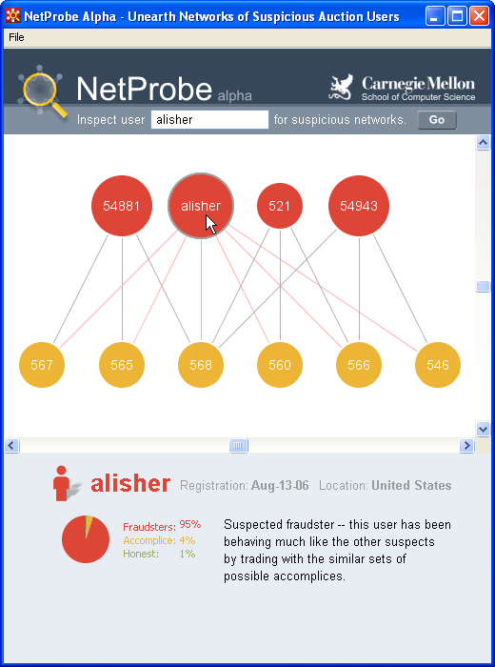
E-bay Fraud detection - NetProbe

Slide 53

Background
Prof. Danai Koutra
U. Michigan

Slide 54

Belief Propagation
“Propagation matrix”:
  Homophily
Iterative message-based method
AI
class of receiver
class of
sender
0.9 | 0.1
0.1 | 0.9
...
until stop criterion fulfilled
1st round
2nd round
PL
[Pearl ‘82][Yedidia+ ’02] … [Gonzalez+ ‘09][Chechetka+ ‘10]
Notes:
Class of receiver / class of sender : without bubbles

Slide 55

Belief Propagation Equations
message(i −> j) ≈ belief(i) • homophily strength
0.9 | 0.1
0.2 | 0.8
…
…
i
j
Notes:
Equations of original BP: “Notice non-linearity” + grey background + citations →na xwrisw sta 2 + zwgrafia sto xarti (prior belief san tou ukang, + mhnymata geitonwn
NOTATION for messages etc - this is non-linear

Slide 56
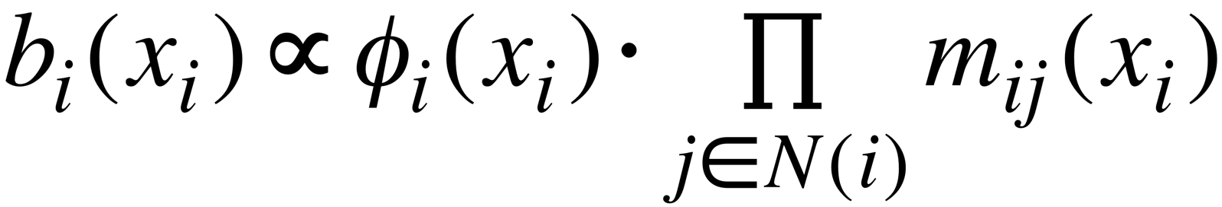
Belief Propagation Equations
belief of i
prior
belief
messages from neighbors
…
i
j
Notes:
Equations of original BP: “Notice non-linearity” + grey background + citations →na xwrisw sta 2 + zwgrafia sto xarti (prior belief san tou ukang, + mhnymata geitonwn
NOTATION for messages etc - this is non-linear

Slide 57
Background

Slide 58
Roadmap
Introduction – Motivation
Part#1: Graphs
  …
  P1.5: belief propagation
    Basics
    Fast, linear approximation (FaBP)
    Latest: zooBP

Slide 59
Unifying Guilt-by-Association Approaches:
Theorems and Fast Algorithms
Danai Koutra
U Kang
Hsing-Kuo Kenneth Pao
Tai-You Ke
Duen Horng (Polo) Chau
Christos Faloutsos
ECML PKDD, 5-9 September 2011, Athens, Greece
Notes:
Work in collaboration with National Taiwan University

Slide 60
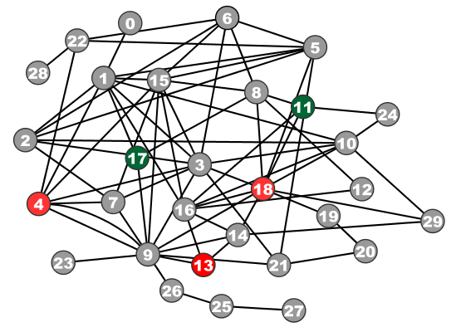
Problem Definition:
GBA techniques
?
Given: Graph; &
few labeled nodes
Find: labels of rest
(assuming network effects)
?
?
?
Notes:
Classification problem where we assume that neighboring nodes are related
Network effects – birds of a feather flock together

Slide 61
Problem Definition:
GBA techniques
?
Given: Graph; &
few labeled nodes
Find: labels of rest
(assuming network effects)
?
?
?
Notes:
Classification problem where we assume that neighboring nodes are related
Network effects – birds of a feather flock together

Slide 62

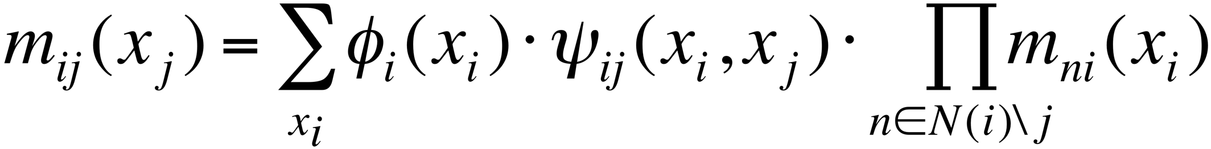
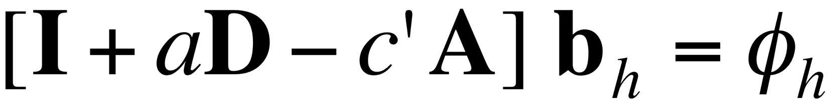
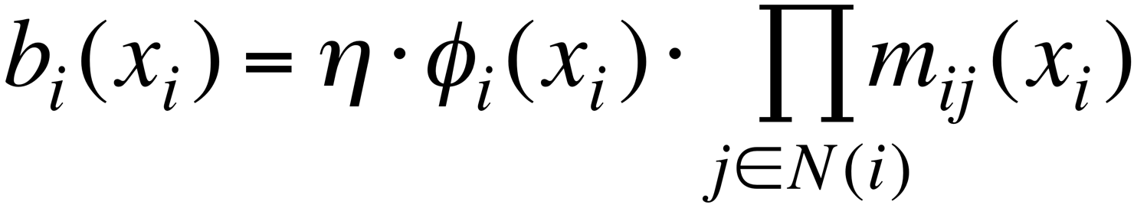
BP vs. Linearized BP
DETAILS
Original [Yedidia+]:
Our proposal:
Belief Propagation
BP is approximated by
Linearized BP
1
1
1
d1
d2
d3
0 1 0
1 0 1
0 1 0
?
0
-10⁻²
10⁻²
non-linear
linear
Closed-form formula?
Convergence?
Notes:
Half: yedidia equations → non-linear equations
Half: theorem -→ linear
Swap!

Slide 63
BP vs. Linearized BP
DETAILS
Original [Yedidia+]:
Our proposal:
Belief Propagation
BP is approximated by
Linearized BP
1
1
1
d1
d2
d3
0 1 0
1 0 1
0 1 0
?
0
-10⁻²
10⁻²
non-linear
linear
Closed-form formula?
Convergence?
Notes:
Half: yedidia equations → non-linear equations
Half: theorem -→ linear
Swap!

Slide 64

Are they related?
RWR (Random Walk with Restarts)
  google’s pageRank (‘if my parents are important, I’m important, too’)
SSL (Semi-supervised learning)
  minimize the differences among neighbors
BP (Belief propagation)
  send messages to neighbors, on what you believe about them

Slide 65
Are they related?
YES!
RWR (Random Walk with Restarts)
  google’s pageRank (‘if my parents are important, I’m important, too’)
SSL (Semi-supervised learning)
  minimize the differences among neighbors
BP (Belief propagation)
  send messages to neighbors, on what you believe about them

Slide 66
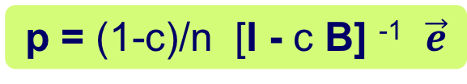
Correspondence of Methods
DETAILS
p = (1-c)/n [I - c B] ⁻¹ $\vec{e}$
Method | Matrix |  | Unknown |  | known
RWR | [I – c AD⁻¹] | × | x | = | (1-c)y
SSL | [I + a(D - A)] | × | x | = | y
FABP | [I + a D - c’A] | × | b_{h} | = | φ_{h}
1
1
1
d1
d2
d3
0 1 0
1 0 1
0 1 0
?
0
1
1
adjacency matrix
final labels/ beliefs
prior labels/ beliefs

Slide 67

Problem: e-commerce ratings fraud
Given a heterogeneous graph on users, products, sellers and positive/negative ratings with “seed labels”
Find the top k most fraudulent users, products and sellers

Slide 68

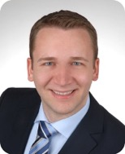
Problem: e-commerce ratings fraud
Given a heterogeneous graph on users, products, sellers and positive/negative ratings with “seed labels”
Find the top k most fraudulent users, products and sellers
Dhivya Eswaran, Stephan Günnemann, Christos Faloutsos, “ZooBP: Belief Propagation for Heterogeneous Networks”, VLDB 2017

Slide 69
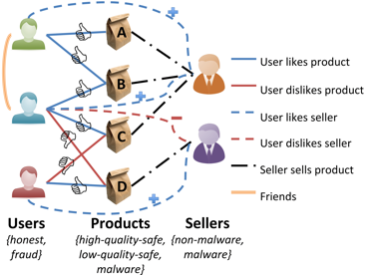
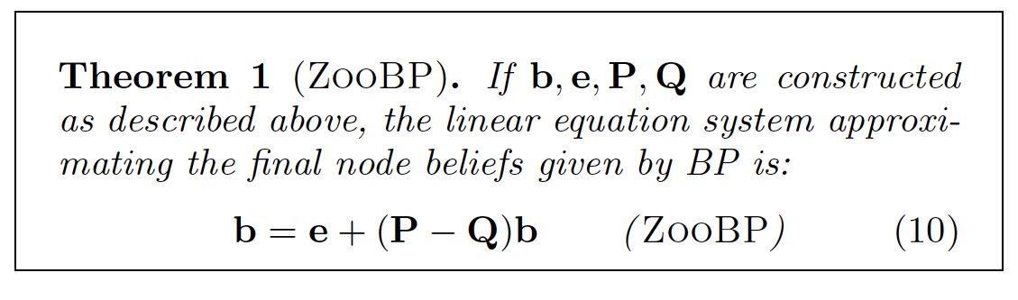
Problem: e-commerce ratings fraud
DETAILS
Dhivya Eswaran, Stephan Günnemann, Christos Faloutsos, “ZooBP: Belief Propagation for Heterogeneous Networks”, VLDB 2017

Slide 70


ZooBP: features
Fast; convergence guarantees.
600x (matlab)
3x (C++)
ideal
Near-perfect accuracy
linear in graph size
Dhivya Eswaran, Stephan Günnemann, Christos Faloutsos, “ZooBP: Belief Propagation for Heterogeneous Networks”, VLDB 2017

Slide 71


ZooBP in the real world
Near 100% precision on top 300 users (Flipkart)
Flagged users: suspicious
  400 ratings in 1 sec
  5000 good ratings and no bad ratings
Dhivya Eswaran, Stephan Günnemann, Christos Faloutsos, “ZooBP: Belief Propagation for Heterogeneous Networks”, VLDB 2017

Slide 72

ZooBP: code etc
http://www.cs.cmu.edu/~deswaran/code/zoobp.zip
Dhivya Eswaran, Stephan Günnemann, Christos Faloutsos, “ZooBP: Belief Propagation for Heterogeneous Networks”, VLDB 2017

Slide 73
Roadmap
Introduction – Motivation
Part#1: Graphs
  …
  P1.5: belief propagation
    Basics
    Fast, linear approximation (FaBP)
    Latest: zooBP
    Success stories

Slide 74


Other ‘success stories’?
Accounting fraud
Malware detection

Slide 75

Network Effect Tools: SNARE
Some accounts are sort-of-suspicious – how to combine weak signals?
Before
Mary McGlohon, Stephen Bay, Markus G. Anderle, David M. Steier, Christos Faloutsos: SNARE: a link analytic system for graph labeling and risk detection. KDD 2009: 1265-1274

Slide 76





Polonium: Tera-Scale Graph Mining and Inference for Malware Detection
PATENT PENDING
SDM 2011, Mesa, Arizona
Polo Chau
Machine Learning Dept
Carey Nachenberg
Vice President & Fellow
Jeffrey Wilhelm
Principal Software Engineer
Adam Wright
Software Engineer
Prof. Christos Faloutsos
Computer Science Dept

Slide 77


Polonium: The Data
√
60+ terabytes of data anonymously contributed by participants of worldwide Norton Community Watch program
  50+ million machines
  900+ million executable files
Constructed a machine-file bipartite graph (0.2 TB+)
    1 billion nodes (machines and files)
    37 billion edges
√
√
Notes:
As of today, has grown to more than three times

Slide 78
Short answer:
What color, for the rest?
A: Belief Propagation (‘zooBP’)
www.cs.cmu.edu/~deswaran/code/zoobp.zip

Slide 79
Roadmap
Introduction – Motivation
Part#1: Graphs
  …
  conclusions
Part#2: Tensors and Knowledge Bases
Conclusions – Future research

Slide 80
Over-arching conclusion
MANY, time-tested, algorithms for graph mining
(more, are needed)

Slide 81





Over-arching conclusion
Problems
(some) solutions

Slide 82
In more detail
(repeating the conclusions from each part P1.1-P1.5)

Slide 83

Roadmap
Introduction – Motivation
Part#1: Graphs
  P1.1: properties/patterns in graphs
  P1.2: node importance
  P1.3: community detection
  P1.4: fraud/anomaly detection
  P1.5: belief propagation
?
?

Slide 84

Problem definition
?
?
Are real graphs random?
  S*: what do static graphs look like?
  T*: how do graphs evolve over time?

Slide 85


Short answer(s)
?
?
Are real graphs random?
  S*: what do static graphs look like?
    S.0: ‘six degrees’
    S.1: skewed degree distribution
    S.2: skewed eigenvalues
    S.3: triangle power-laws
    S.4: GCC; and skewed distr. of conn. comp.
  T*: how do graphs evolve over time?
    T.1: diameters
    T.2: densification

Slide 86

Short answer(s)
?
?
Are real graphs random?
  S*: what do static graphs look like?
    S.0: ‘six degrees’
    S.1: skewed degree distribution
    S.2: skewed eigenvalues
    S.3: triangle power-laws
    S.4: GCC; and skewed distr. of conn. comp.
  T*: how do graphs evolve over time?
    T.1: diameters
    T.2: densification
Power laws: y ~ xª
NOT Gaussians
Take logarithms
y (log scale)
a
x (log scale)

Slide 87
Roadmap
Introduction – Motivation
Part#1: Graphs
  P1.1: properties/patterns in graphs
  P1.2: node importance
  P1.3: community detection
  P1.4: fraud/anomaly detection
  P1.5: belief propagation
?

Slide 88
Node importance - Motivation:
Given a graph (eg., web pages containing the desirable query word)
Q: Which node is the most important?

Slide 89
Node importance - Motivation:
Given a graph (eg., web pages containing the desirable query word)
Q: Which node is the most important?
A1: PageRank (PR)
A2: HITS
A3: SALSA

Slide 90
Roadmap
Introduction – Motivation
Part#1: Graphs
  P1.1: properties/patterns in graphs
  P1.2: node importance
  P1.3: community detection
  P1.4: fraud/anomaly detection
  P1.5: belief propagation
?

Slide 91
Problem Definition
Given a graph, and k
Break it into k (disjoint) communities

Slide 92

Short answer
METIS [Karypis, Kumar]
(but: maybe NO good cuts exist!)

Slide 93
Roadmap
Introduction – Motivation
Part#1: Graphs
  P1.1: properties/patterns in graphs
  P1.2: node importance
  P1.3: community detection
  P1.4: fraud/anomaly detection
  P1.5: belief propagation
?

Slide 94
Problem
Given:
Find:
Outliers
Lock-step

Slide 95
Solution
Given:
Find:
Outliers
Lock-step
OddBall
SVD

Slide 96
Roadmap
Introduction – Motivation
Part#1: Graphs
  P1.1: properties/patterns in graphs
  P1.2: node importance
  P1.3: community detection
  P1.4: fraud/anomaly detection
  P1.5: belief propagation

Slide 97
Problem
What color, for the rest?
  Given homophily (/heterophily etc)?

Slide 98
Short answer:
What color, for the rest?
A: Belief Propagation (‘zooBP’)
www.cs.cmu.edu/~deswaran/code/zoobp.zip

Slide 99





Thanks to
Danai Koutra
U. Michigan
Namyong Park
CMU
Dhivya Eswaran
CMU
Hyun Ah Song
CMU
Vagelis
Papalexakis
UCR

Slide 100

P1 – Graphs - More references
Danai Koutra and Christos Faloutsos, Individual and Collective Graph Mining: Principles, Algorithms, and Applications October 2017, Morgan Claypool

Slide 101


P1 – Graphs - More references
Deepayan Chakrabarti and Christos Faloutsos, Graph Mining: Laws, Tools, and Case Studies Oct. 2012, Morgan Claypool.

Slide 102
P1 – Graphs - More references
Anomaly detection
Leman Akoglu, Hanghang Tong, & Danai Koutra, Graph based anomaly detection and description: a survey Data Mining and Knowledge Discovery (2015) 29: 626.
Arxiv version: https://arxiv.org/abs/1404.4679

