Slide 1
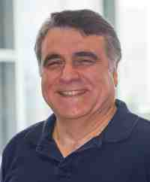
Mining graphs and time series: patterns, anomalies, and fraud detection
Part 1: Graphs
Node importance & community detection
Christos Faloutsos
CMU SCS
https://www.cs.cmu.edu/~christos/TALKS/19-GoI

Slide 2
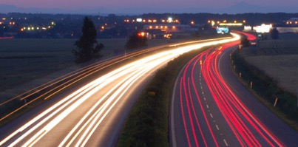
Roadmap
Introduction
Part#1: Graphs
Part#2: Time series
Part#3: extras (visualization, etc)
Conclusions

Slide 3
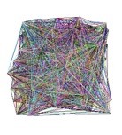
Roadmap
Introduction – Motivation
Part#1: Graphs
P1.1: properties/patterns in graphs
P1.2: node importance
P1.3: community detection
P1.4: fraud/anomaly detection
P1.5: belief propagation
?

Slide 4

Roadmap
Introduction – Motivation
Part#1: Graphs
P1.1: properties/patterns in graphs
P1.2: node importance
PageRank and Personalized PR
HITS
(SVD)
SALSA
?

Slide 5



‘Recipe’ Structure:
Problem definition
Short answer/solution
LONG answer – details
Conclusion/short-answer

Slide 6
Node importance - Motivation:
Given a graph (eg., web pages containing the desirable query word)
Q1: Which node is the most important?
Q2: How close is node ‘A’ to node ‘B’?

Slide 7
Node importance - Motivation:
Given a graph (eg., web pages containing the desirable query word)
Q1: Which node is the most important?
PageRank (PR = RWR), HITS, SALSA
Q2: How close is node ‘A’ to node ‘B’?
Personalized P.R. (/SALSA)

Slide 8
SVD properties
Hidden/latent variable detection
Compute node importance (HITS)
Block detection
Dimensionality reduction
Embedding (linear)
SVD is a special case of ’deep neural net’
v₀
v₁
u₀
u₁

Slide 9
Roadmap
Introduction – Motivation
Part#1: Graphs
P1.1: properties/patterns in graphs
P1.2: node importance
PageRank and Personalized PR
HITS
SALSA
?

Slide 10
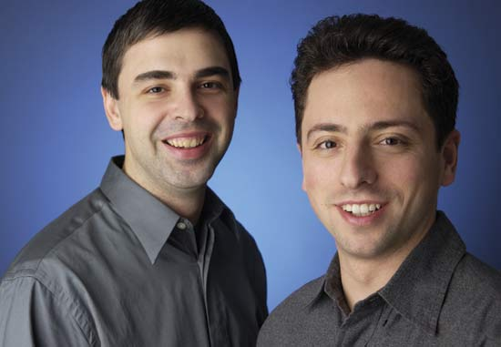
PageRank (google)
Brin, Sergey and Lawrence Page (1998). Anatomy of a Large-Scale Hypertextual Web Search Engine. 7th Intl World Wide Web Conf.
Page, Brin, Motwani, and Winograd (1999). The PageRank citation ranking: Bringing order to the web. Technical Report
Larry
Page
Sergey Brin

Slide 11
Problem: PageRank
Given a directed graph, find its most interesting/central node
A node is important,
if its parents are important
(recursive, but OK!)

Slide 12

Problem: PageRank - solution
Given a directed graph, find its most interesting/central node
Proposed solution: Random walk; spot most ‘popular’ node (-> steady state prob. (ssp))
A node high ssp,
if its parents have high ssp
(recursive, but OK!)

Slide 13
(Simplified) PageRank algorithm
DETAILS
Let A be the adjacency matrix;
let B be the transition matrix: transpose, column-normalized - then
From
B
To
2
1
3
=
4
5

Slide 14
(Simplified) PageRank algorithm
DETAILS
B p = p
B p = p
2
1
3
=
4
5

Slide 15
Definitions
DETAILS
A Adjacency matrix (from-to)
D Degree matrix = (diag ( d1, d2, …, dn) )
B Transition matrix: to-from, column normalized
B = A^{T} D⁻¹

Slide 16
(Simplified) PageRank algorithm
DETAILS
B p = 1 * p
thus, p is the eigenvector that corresponds to the highest eigenvalue (=1, since the matrix is column-normalized)
Why does such a p exist?
p exists if B is nxn, nonnegative, irreducible [Perron–Frobenius theorem]

Slide 17

(Simplified) PageRank algorithm
In short: imagine a particle randomly moving along the edges
compute its steady-state probabilities (ssp)
Full version of algo: with occasional random jumps
Why? To make the matrix irreducible

Slide 18
(Simplified) PageRank algorithm
In short: imagine a particle randomly moving along the edges
compute its steady-state probabilities (ssp)
Full version of algo: with occasional random jumps
Why? To make the matrix irreducible

Slide 19
(Simplified) PageRank algorithm
In short: imagine a particle randomly moving along the edges
compute its steady-state probabilities (ssp)
Full version of algo: with occasional random jumps
Why? To make the matrix irreducible

Slide 20
(Simplified) PageRank algorithm
In short: imagine a particle randomly moving along the edges
compute its steady-state probabilities (ssp)
Full version of algo: with occasional random jumps
Why? To make the matrix irreducible

Slide 21
(Simplified) PageRank algorithm
In short: imagine a particle randomly moving along the edges
compute its steady-state probabilities (ssp)
Full version of algo: with occasional random jumps
Why? To make the matrix irreducible

Slide 22
(Simplified) PageRank algorithm
In short: imagine a particle randomly moving along the edges
compute its steady-state probabilities (ssp)
PageRank = PR
= Random Walk with Restarts = RWR
= Random surfer

Slide 23
Full Algorithm
DETAILS
With probability 1-c, fly-out to a random node
Then, we have
p = c B p + (1-c)/n 1 =>
p = (1-c)/n [I - c B] ⁻¹ 1

Slide 24
Full Algorithm
DETAILS
With probability 1-c, fly-out to a random node
Then, we have
p = c B p + (1-c)/n 1 =>
p = (1-c)/n [I - c B] ⁻¹ 1
Notes:
{\left[ \begin{array}{c} 1 \\ 1 \\ \ldots \\ 1 \\ \end{array}\right]}

Slide 25
Notice:
pageRank ~ in-degree
(and HITS, also: ~ in-degree)
Notes:
{\left[ \begin{array}{c} 1 \\ 1 \\ \ldots \\ 1 \\ \end{array}\right]}

Slide 26
Roadmap
Introduction – Motivation
Part#1: Graphs
P1.1: properties/patterns in graphs
P1.2: node importance
PageRank and Personalized PR
HITS
?

Slide 27
Node importance - Motivation:
Given a graph (eg., web pages containing the desirable query word)
Q1: Which node is the most important?
Q2: How close is node ‘A’ to node ‘B’?
A
B

Slide 28
Personalized P.R.
Taher H. Haveliwala. 2002. Topic-sensitive PageRank. (WWW '02). 517-526. http://dx.doi.org/10.1145/511446.511513

Slide 29
Personalized P.R.
Taher H. Haveliwala. 2002. Topic-sensitive PageRank. (WWW '02). 517-526. http://dx.doi.org/10.1145/511446.511513
Page L., Brin S., Motwani R., and Winograd T. (1999). The PageRank citation ranking: Bringing order to the web. Technical Report

Slide 30
Extension: Personalized P.R.
How close is ‘4’ to ‘2’?
(or: if I like page/node ‘2’, what else would you recommend?)
2
1
3
4
5
Notes:
{\left[ \begin{array}{c} 1 \\ 1 \\ \ldots \\ 1 \\ \end{array}\right]}

Slide 31
Extension: Personalized P.R.
How close is ‘4’ to ‘2’?
(or: if I like page/node ‘2’, what else would you recommend?)
2
1
3
4
5
Notes:
{\left[ \begin{array}{c} 1 \\ 1 \\ \ldots \\ 1 \\ \end{array}\right]}

Slide 32
Extension: Personalized P.R.
How close is ‘4’ to ‘2’?
(or: if I like page/node ‘2’, what else would you recommend?)
2
1
3
4
5
Notes:
{\left[ \begin{array}{c} 1 \\ 1 \\ \ldots \\ 1 \\ \end{array}\right]}

Slide 33
Extension: Personalized P.R.
How close is ‘4’ to ‘2’?
(or: if I like page/node ‘2’, what else would you recommend?)
High score (A -> B) if
Many
Short
Heavy
paths A->B
2
1
3
4
5
Notes:
{\left[ \begin{array}{c} 1 \\ 1 \\ \ldots \\ 1 \\ \end{array}\right]}

Slide 34



Extension: Personalized P.R.
your favorite
With probability 1-c, fly-out to a random node(s)
Then, we have
p = c B p + (1-c)/n 1 =>
p = (1-c)/n [I - c B] ⁻¹ 1
$$\vec{e}$$
$$\vec{e}$$
$$\vec{e}$$
Notes:
{\left[ \begin{array}{c} 1 \\ 1 \\ \ldots \\ 1 \\ \end{array}\right]}

Slide 35

Extension: Personalized P.R.
How close is ‘4’ to ‘2’?
A: compute Personalized P.R. of ‘4’, restarting from ‘2’
2
1
3
4
5
Notes:
{\left[ \begin{array}{c} 1 \\ 1 \\ \ldots \\ 1 \\ \end{array}\right]}

Slide 36
Extension: Personalized P.R.
How close is ‘4’ to ‘2’?
A: compute Personalized P.R. of ‘4’, restarting from ‘2’ – Related to
‘escape’ probability
‘round trip’ probability
…
Notes:
{\left[ \begin{array}{c} 1 \\ 1 \\ \ldots \\ 1 \\ \end{array}\right]}

Slide 37
Roadmap
Introduction – Motivation
Part#1: Graphs
P1.1: properties/patterns in graphs
P1.2: node importance
PageRank and Personalized PR
Fast computation - ‘Pixie’
HITS
?

Slide 38
Extension: Personalized P.R.
DETAILS
Q: Faster computation than:
p = (1-c)/n [I - c B] ⁻¹ 1
Notes:
{\left[ \begin{array}{c} 1 \\ 1 \\ \ldots \\ 1 \\ \end{array}\right]}

Slide 39

Pixie algorithm
Chantat Eksombatchai, Pranav Jindal, Jerry Zitao Liu, Yuchen Liu, Rahul Sharma, Charles Sugnet, Mark Ulrich, Jure Leskovec: Pixie: A System for Recommending 3+ Billion Items to 200+ Million Users in Real-Time. WWW 2018: 1775-1784
https://dl.acm.org/citation.cfm?doid=3178876.3186183

Slide 40
Pixie algorithm
Q: Faster computation than:
p = (1-c)/n [I - c B] ⁻¹ 1
A: simulate a few R.W.
keep visit counts C_{i}
fast and nimble
Notes:
{\left[ \begin{array}{c} 1 \\ 1 \\ \ldots \\ 1 \\ \end{array}\right]}

Slide 41
Personalized PageRank algorithm

Slide 42

Personalized PageRank algorithm

Slide 43
Personalized PageRank algorithm

Slide 44
Personalized PageRank algorithm

Slide 45
Personalized PageRank algorithm

Slide 46
Personalized PageRank algorithm

Slide 47
Personalized PageRank algorithm
..
…
..
…

Slide 48
Roadmap
Introduction – Motivation
Part#1: Graphs
P1.1: properties/patterns in graphs
P1.2: node importance
PageRank and Personalized PR
Fast computation - ‘Pixie’
Other applications
HITS
?

Slide 49






Applications of node proximity
Recommendation
Link prediction
‘Center Piece Subgraphs’
…
…
…
?

Slide 50



Applications of node proximity
Recommendation
Link prediction
‘Center Piece Subgraphs’
…
…
…
?

Slide 51
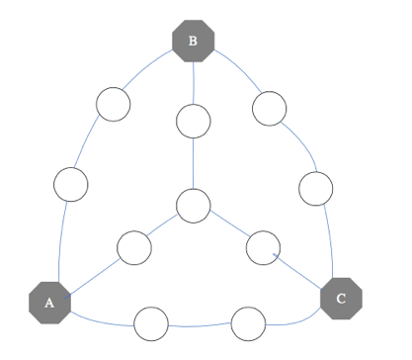
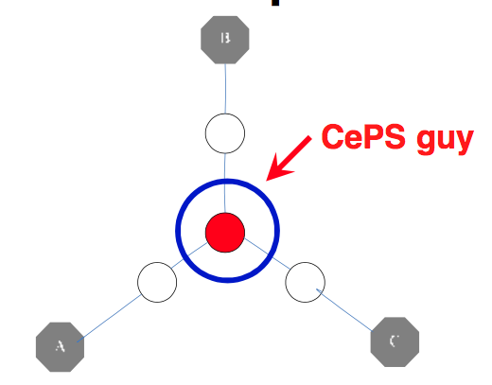
Applications of node proximity
Recommendation
Link prediction
‘Center Piece Subgraphs’
…

Slide 52




Applications of node proximity
Recommendation
Link prediction
‘Center Piece Subgraphs’
…

Slide 53

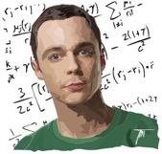
Applications of node proximity
Recommendation
Link prediction
‘Center Piece Subgraphs’
…

Slide 54
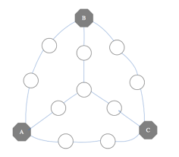
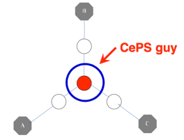

Applications of node proximity
Recommendation
Link prediction
‘Center Piece Subgraphs’
…
Fast Algorithms for Querying and Mining Large Graphs Hanghang Tong, PhD dissertation, CMU, 2009. TR: CMU-ML-09-112.

Slide 55
Roadmap
Introduction – Motivation
Part#1: Graphs
P1.1: properties/patterns in graphs
P1.2: node importance
PageRank and Personalized PR
HITS
SVD
?

Slide 56
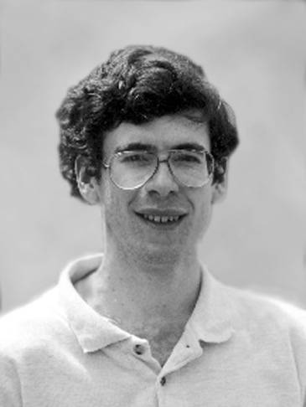
Kleinberg’s algo (HITS)
Kleinberg, Jon (1998). Authoritative sources in a hyperlinked environment. Proc. 9th ACM-SIAM Symposium on Discrete Algorithms.

Slide 57

Recall: problem dfn
Given a graph (eg., web pages containing the desirable query word)
Q1: Which node is the most important?

Slide 58

Why not just PageRank?
HITS (and its derivative, SALSA), differentiate between “hubs” and “authorities”
HITS can help to find the largest community
(SVD: powerful tool)
idols
fans

Slide 59
Kleinberg’s algorithm
Problem dfn: given the web and a query
find the most ‘authoritative’ web pages for this query

Slide 60
Problem: PageRank
Given a directed graph, find its most interesting/central node
A node is important,
if its parents are important
(recursive, but OK!)

Slide 61
Problem: PageRank
HITS
Given a directed graph, find its most interesting/central node
``wise’’
A node is important,
if its parents are important
(recursive, but OK!)
AND: A node is ``wise’’
if its children are important

Slide 62
Kleinberg’s algorithm
Step 0: find nodes with query word(s)
Step 1: expand by one move forward and backward

Slide 63
Kleinberg’s algorithm
on the resulting graph, give high score (= ‘authorities’) to nodes that many ``wise’’ nodes point to
give high wisdom score (‘hubs’) to nodes that point to good ‘authorities’
hubs
authorities

Slide 64
Kleinberg’s algorithm
Then:
a_{i} = h_{k} + h_{l} + h_{m}
that is
a_{i} = Sum (h_{j}) over all j that (j,i) edge exists
or
a = A^{T} h
k
l
i
m
=

Slide 65
Kleinberg’s algorithm
Then:
a_{i} = h_{k} + h_{l} + h_{m}
that is
a_{i} = Sum (h_{j}) over all j that (j,i) edge exists
or
a = A^{T} h
k
l
i
m
=

Slide 66
Kleinberg’s algorithm
symmetrically, for the ‘hubness’:
h_{i} = a_{n} + a_{p} + a_{q}
that is
h_{i} = Sum (q_{j}) over all j that (i,j) edge exists
or
h = A a
n
i
p
q
=

Slide 67
Kleinberg’s algorithm
symmetrically, for the ‘hubness’:
h_{i} = a_{n} + a_{p} + a_{q}
that is
h_{i} = Sum (q_{j}) over all j that (i,j) edge exists
or
h = A a
n
i
p
q
=

Slide 68
Kleinberg’s algorithm
In conclusion, we want vectors h and a such that:
h = A a
a = A^{T} h
=

Slide 69
Kleinberg’s algorithm
In conclusion, we want vectors h and a such that:
h = A a
a = A^{T} h
=

Slide 70
Kleinberg’s algorithm
In conclusion, we want vectors h and a such that:
h = A a
a = A^{T} h
=

Slide 71
Kleinberg’s algorithm
In conclusion, we want vectors h and a such that:
h = A a
a = A^{T} h
=

Slide 72
Kleinberg’s algorithm
In short, the solutions to
h = A a
a = A^{T} h
are the left- and right- singular-vectors of the adjacency matrix A.
Starting from random a’ and iterating, we’ll eventually converge
… to the vector of strongest singular value.
Dfn: in +2

Slide 73
Kleinberg’s algorithm - results
Eg., for the query ‘java’:
0.328 www.gamelan.com
0.251 java.sun.com
0.190 www.digitalfocus.com (“the java developer”)

Slide 74
Roadmap
Introduction – Motivation
Part#1: Graphs
P1.1: properties/patterns in graphs
P1.2: node importance
PageRank and Personalized PR
HITS
(SVD)
?

Slide 75

SVD properties
Hidden/latent variable detection
Compute node importance (HITS)
Block detection
Dimensionality reduction
Embedding

Slide 76




Crush intro to SVD
(SVD) matrix factorization: finds blocks
‘music lovers’
‘singers’
‘sports lovers’
‘athletes’
‘citizens’
‘politicians’
M
idols
N
fans
+
+
~

Slide 77

Crush intro to SVD
(SVD) matrix factorization: finds blocks
‘music lovers’
‘singers’
‘sports lovers’
‘athletes’
‘citizens’
‘politicians’
M
idols
N
fans
+
+
~

Slide 78
Crush intro to SVD
(SVD) matrix factorization: finds blocks
‘music lovers’
‘singers’
‘sports lovers’
‘athletes’
‘citizens’
‘politicians’
M
idols
N
fans
+
+
~

Slide 79
Crush intro to SVD
(SVD) matrix factorization: finds blocks
HITS: first singular vector, ie, fixates on largest group
‘music lovers’
‘singers’
‘citizens’
‘politicians’
Authority scores
‘sports lovers’
‘athletes’
M
idols
N
fans
+
+
~
Hub scores

Slide 80
Crush intro to SVD
Basis for anomaly detection – P1.4
Basis for tensor/PARAFAC – P2.5
‘music lovers’
‘singers’
‘sports lovers’
‘athletes’
‘citizens’
‘politicians’
M
idols
N
fans
+
+
~

Slide 81
SVD properties
Hidden/latent variable detection
Compute node importance (HITS)
Block detection
Dimensionality reduction
Embedding
v₀
v₁
u₀
u₁

Slide 82
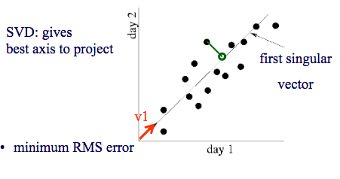
SVD - intuition
#retweets for …
#retweets for Byonce
v₁
v₂
u₁
u₂

Slide 83
SVD properties
Hidden/latent variable detection
Compute node importance (HITS)
Block detection
Dimensionality reduction
Embedding
v₀
v₁
u₀
u₁

Slide 84
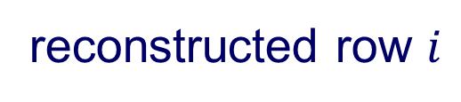

Crush intro to SVD
SVD compression is a linear autoencoder
M idols
reconstructed row $i$
N
fans
…
scores
…
row $i$ ($500$ dim)

Slide 85
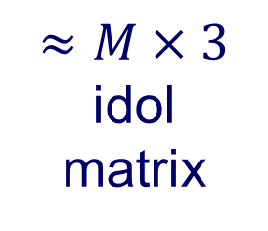
Crush intro to SVD
SVD compression is a linear autoencoder
M idols
reconstructed row $i$
N
fans
…
scores
$≈M×3$ idol matrix
…
row $i$ ($500$ dim)

Slide 86

SVD properties
Hidden/latent variable detection
Compute node importance (HITS)
Block detection
Dimensionality reduction
Embedding (linear)
SVD is a special case of ’deep neural net’
v₀
v₁
u₀
u₁

Slide 87
Node importance - Motivation:
Given a graph (eg., web pages containing the desirable query word)
Q1: Which node is the most important?
PageRank (PR = RWR), HITS, SALSA
Q2: How close is node ‘A’ to node ‘B’?
Personalized P.R. (/SALSA)

Slide 88

SVD properties
Hidden/latent variable detection
Compute node importance (HITS)
Block detection
Dimensionality reduction
Embedding (linear)
SVD is a special case of ’deep neural net’
v₀
v₁
u₀
u₁

Slide 89
SVD properties
Hidden/latent variable detection
Compute node importance (HITS)
Block detection
Dimensionality reduction
Embedding (linear)
SVD is a special case of ’deep neural net’
Matrix? SVD!
v₀
v₁
u₀
u₁

Slide 90
Roadmap
Introduction – Motivation
Part#1: Graphs
P1.1: properties/patterns in graphs
P1.2: node importance
P1.3: community detection
P1.4: fraud/anomaly detection
P1.5: belief propagation

Slide 91
Roadmap
Introduction – Motivation
Part#1: Graphs
P1.1: properties/patterns in graphs
P1.2: node importance
P1.3: community detection
P1.4: fraud/anomaly detection
P1.5: belief propagation
?

Slide 92
Roadmap
Introduction – Motivation
Part#1: Graphs
P1.1: properties/patterns in graphs
P1.2: node importance
P1.3: community detection
Algorithm
Warning: ‘no good cuts’
P1.4: fraud/anomaly detection
?

Slide 93
Problem
Given a graph, and k
Break it into k (disjoint) communities

Slide 94
Short answer
METIS [Karypis, Kumar]

Slide 95
Solution#1: METIS
Arguably, the best algorithm
Open source, at
http://glaros.dtc.umn.edu/gkhome/fetch/sw/metis/metis-5.1.0.tar.gz
and *many* related papers, at same url
Main idea:
coarsen the graph;
partition;
un-coarsen

Slide 96
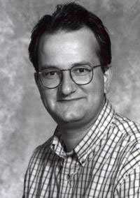
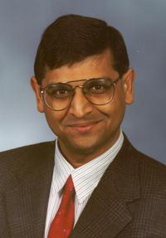
Solution #1: METIS
G. Karypis and V. Kumar. METIS 4.0: Unstructured graph partitioning and sparse matrix ordering system. TR, Dept. of CS, Univ. of Minnesota, 1998.
<and many extensions>

Slide 97
Solutions #2,3…
Fiedler vector (2nd singular vector of Laplacian).
Modularity: Community structure in social and biological networks M. Girvan and M. E. J. Newman, PNAS June 11, 2002. 99 (12) 7821-7826; https://doi.org/10.1073/pnas.122653799
Co-clustering: [Dhillon+, KDD’03]
Clustering on the A² (square of adjacency matrix) [Zhou, Woodruff, PODS’04]
Minimum cut / maximum flow [Flake+, KDD’00]
….

Slide 98
Roadmap
Introduction – Motivation
Part#1: Graphs
P1.1: properties/patterns in graphs
P1.2: node importance
P1.3: community detection
Algorithm
Warning: ‘no good cuts’
P1.4: fraud/anomaly detection
?

Slide 99



A word of caution
BUT: often, there are no good cuts:

Slide 100

A word of caution
BUT: often, there are no good cuts:

Slide 101
A word of caution
Maybe there are no good cuts: ``jellyfish’’ shape [Tauro+’01], [Siganos+,’06], strange behavior of cuts [Chakrabarti+’04], [Leskovec+,’08]

Slide 102
A word of caution
Maybe there are no good cuts: ``jellyfish’’ shape [Tauro+’01], [Siganos+,’06], strange behavior of cuts [Chakrabarti+,’04], [Leskovec+,’08]
?
?

Slide 103
R1: Jellyfish model [Tauro+]
…
A Simple Conceptual Model for the Internet Topology, L. Tauro, C. Palmer, G. Siganos, M. Faloutsos, Global Internet, November 25-29, 2001
Jellyfish: A Conceptual Model for the AS Internet Topology G. Siganos, Sudhir L Tauro, M. Faloutsos, J. of Communications and Networks, Vol. 8, No. 3, pp 339-350, Sept. 2006.

Slide 104
R1: Jellyfish model [Tauro+]
…
A Simple Conceptual Model for the Internet Topology, L. Tauro, C. Palmer, G. Siganos, M. Faloutsos, Global Internet, November 25-29, 2001
Jellyfish: A Conceptual Model for the AS Internet Topology G. Siganos, Sudhir L Tauro, M. Faloutsos, J. of Communications and Networks, Vol. 8, No. 3, pp 339-350, Sept. 2006.

Slide 105
R1: Jellyfish model [Tauro+]
…
A Simple Conceptual Model for the Internet Topology, L. Tauro, C. Palmer, G. Siganos, M. Faloutsos, Global Internet, November 25-29, 2001
Jellyfish: A Conceptual Model for the AS Internet Topology G. Siganos, Sudhir L Tauro, M. Faloutsos, J. of Communications and Networks, Vol. 8, No. 3, pp 339-350, Sept. 2006.

Slide 106
R2: 'Familiar strangers’
Bipartite graph (‘heterophily’)
‘lawyers’
'eng.’
eng.
?
lawyers
?

Slide 107
R3: ``Core-periphery’’
Bipartite graph + clique
Main
members
?
satellites
?

Slide 108
Strange behavior of min cuts
‘negative dimensionality’ (!)
Slope~ -0.45
1-1/d
log (mincut-size / #edges)
log (# edges)
Clickstream graph
NetMine: New Mining Tools for Large Graphs, by D. Chakrabarti,
Y. Zhan, D. Blandford, C. Faloutsos and G. Blelloch, in the SDM 2004 Workshop on Link Analysis, Counter-terrorism and Privacy
Statistical Properties of Community Structure in Large Social and Information Networks, J. Leskovec, K. Lang, A. Dasgupta, M. Mahoney. WWW 2008.

Slide 109
Strange behavior of min cuts
‘negative dimensionality’ (!)
Slope~ -0.45
1-1/d
log (mincut-size / #edges)
log (# edges)
Clickstream graph
NetMine: New Mining Tools for Large Graphs, by D. Chakrabarti,
Y. Zhan, D. Blandford, C. Faloutsos and G. Blelloch, in the SDM 2004 Workshop on Link Analysis, Counter-terrorism and Privacy
Statistical Properties of Community Structure in Large Social and Information Networks, J. Leskovec, K. Lang, A. Dasgupta, M. Mahoney. WWW 2008.

Slide 110
Short answer
METIS [Karypis, Kumar]
(but: maybe NO good cuts exist!)

Slide 111
Roadmap
Introduction – Motivation
Part#1: Graphs
P1.1: properties/patterns in graphs
P1.2: node importance
P1.3: community detection
P1.4: fraud/anomaly detection
P1.5: belief propagation

