Slide 1
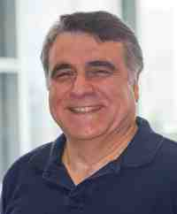
Mining graphs and time series: patterns, anomalies, and fraud detection
Part 1: Graphs
Intro & patterns
Christos Faloutsos
CMU SCS
https://www.cs.cmu.edu/~christos/TALKS/19-GoI

Slide 2
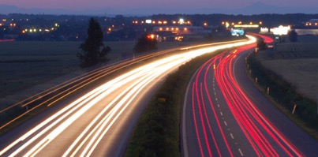
Roadmap
Introduction
Part#1: Graphs
Part#2: Time series
Part#3: extras (visualization, etc)
Conclusions

Slide 3
Roadmap
Introduction – Motivation
Part#1: Graphs
P1.1: properties/patterns in graphs
P1.2: node importance
P1.3: community detection
P1.4: fraud/anomaly detection
P1.5: belief propagation

Slide 4
Why study graphs?

Slide 5






Why study graphs?
Fraud – money laundering etc
$
…
…
$$

Slide 6

Why study graphs?
By Melanie Rehak
Fake followers/trends; botnets/trolls
…
…

Slide 7

Why study graphs?
By Melanie Rehak
Fake friends
…
…

Slide 8

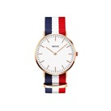
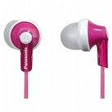

e-commerce examples
Recommendation systems
....
…
…

Slide 9






e-commerce examples
Who-buys-what
…
…

Slide 10
e-commerce examples
Who-buys-what
Who-sells-what
…
…

Slide 11
e-commerce examples
Who-buys-what
Who-sells-what
Who-reviews-what
…
…

Slide 12

Cyber-security
Who-buys-what
Who-sells-what
Who-reviews-what
Which_machine - connects_to - what
…
<subject> related-to <object> : graph
…
…

Slide 13




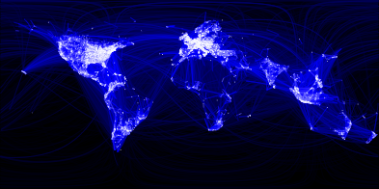
Why study graphs?
fb>$10B; ~1B users

Slide 14
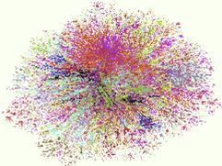
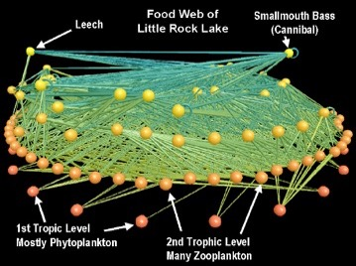
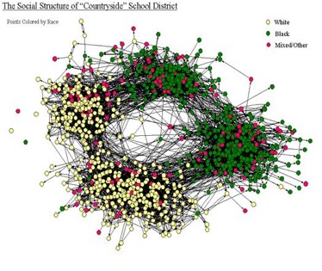
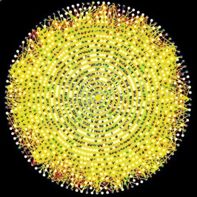
Why study graphs?
Internet Map [lumeta.com]
Food Web [Martinez ’91]
Friendship Network [Moody ’01]
Protein Interactions [genomebiology.com]

Slide 15
Graphs - why should we care?
IR: bi-partite graphs (doc-terms)
web: hyper-text graph
... and more:
D₁
T₁
...
...
D_{N}
T_{M}

Slide 16
Graphs - why should we care?
‘viral’ marketing
web-log (‘blog’) news propagation
computer network security: email/IP traffic and anomaly detection
....

Slide 17
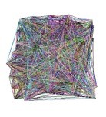
Roadmap
Introduction – Motivation
Part#1: Graphs
P1.1: properties/patterns in graphs
P1.2: node importance
P1.3: community detection
P1.4: fraud/anomaly detection
P1.5: belief propagation
?
?

Slide 18
Roadmap
Introduction – Motivation
Part#1: Graphs
P1.1: properties/patterns in graphs
P1.2: node importance
P1.3: community detection
P1.4: fraud/anomaly detection
P1.5: belief propagation
?

Slide 19
Roadmap
Introduction – Motivation
Part#1: Graphs
P1.1: properties/patterns in graphs
P1.2: node importance
P1.3: community detection
P1.4: fraud/anomaly detection
P1.5: belief propagation

Slide 20
Roadmap
Introduction – Motivation
Part#1: Graphs
P1.1: properties/patterns in graphs
P1.2: node importance
P1.3: community detection
P1.4: fraud/anomaly detection
P1.5: belief propagation
?

Slide 21
Roadmap
Introduction – Motivation
Part#1: Graphs
P1.1: properties/patterns in graphs
P1.2: node importance
P1.3: community detection
P1.4: fraud/anomaly detection
P1.5: belief propagation
?

Slide 22
Roadmap
Introduction – Motivation
Part#1: Graphs
P1.1: properties/patterns in graphs
P1.2: node importance
P1.3: community detection
P1.4: fraud/anomaly detection
P1.5: belief propagation

Slide 23
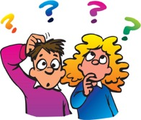


‘Recipe’ Structure:
Problem definition
Short answer/solution
LONG answer – details
Conclusion/short-answer

Slide 24

‘Recipe’ Structure:
Problem definition
Short answer/solution
LONG answer – details
Conclusion/short-answer

Slide 25
Roadmap
Introduction – Motivation
Part#1: Graphs
P1.1: properties/patterns in graphs
P1.2: node importance
P1.3: community detection
P1.4: fraud/anomaly detection
P1.5: belief propagation
?
?

Slide 26
Why care about patterns?

Slide 27
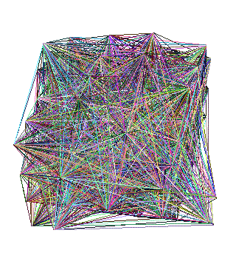
Why care about patterns?
Anomalies
Faster algorithms
Graph generators (‘what if’ scenarios)

Slide 28

Why care about patterns?
Anomalies
Faster algorithms
Graph generators (‘what if’ scenarios)
Patterns anomalies

Slide 29
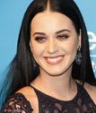
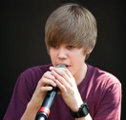
Why care about patterns?
Anomalies
Faster algorithms
Graph generators (‘what if’ scenarios)
Patterns anomalies

Slide 30
Why care about patterns?
Anomalies
Faster algorithms
Graph generators (‘what if’ scenarios)
Graph500.org
Patterns anomalies

Slide 31
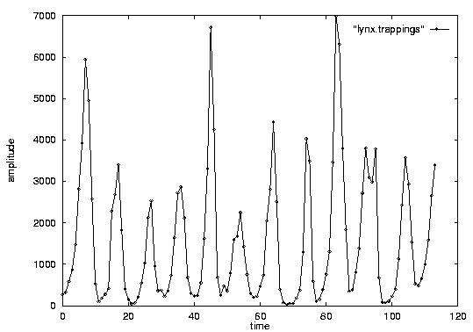

Important observations
Patterns, rules, forecasting and similarity indexing are closely related:
To do forecasting, we need
to find patterns/rules
compress
to find similar settings in the past
to find outliers, we need to have forecasts
(outlier = too far away from our forecast)

Slide 32
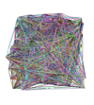
Problem definition
?
?
Are real graphs random?
S*: what do static graphs look like?
T*: how do graphs evolve over time?

Slide 33
Short answer(s)
?
?
Are real graphs random?
S*: what do static graphs look like?
S.0: ‘six degrees’
S.1: skewed degree distribution
S.2: skewed eigenvalues
S.3: triangle power-laws
S.4: GCC; and skewed distr. of conn. comp.
D*: how do graphs evolve over time?
D.1: diameters
D.2: densification

Slide 34
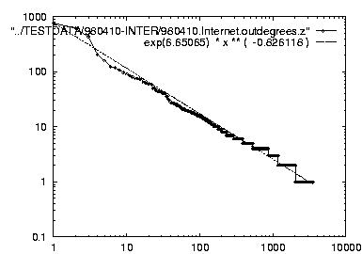
Short answer(s)
?
?
Are real graphs random?
S*: what do static graphs look like?
S.0: ‘six degrees’
S.1: skewed degree distribution
S.2: skewed eigenvalues
S.3: triangle power-laws
S.4: GCC; and skewed distr. of conn. comp.
T*: how do graphs evolve over time?
T.1: diameters
T.2: densification
Power laws: y ~ xª
NOT Gaussians
Take logarithms
y (log scale)
a
x (log scale)

Slide 35
Graph mining
Are real graphs random?

Slide 36
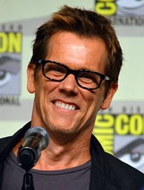
Laws and patterns
Are real graphs random?
A: NO!!
Diameter (‘6 degrees’, ‘Kevin Bacon’)
in- and out- degree distributions
other (surprising) patterns
So, let’s look at the data

Slide 37
Solution# S.1
Power law in the degree distribution [SIGCOMM99]
internet domains
att.com
log(degree)
ibm.com
log(rank)

Slide 38
Solution# S.1
Power law in the degree distribution [SIGCOMM99]
internet domains
att.com
log(degree)
ibm.com
-0.82
log(rank)

Slide 39
Solution# S.1
Q: So what?
internet domains
att.com
log(degree)
ibm.com
-0.82
log(rank)

Slide 40
Solution# S.1
= friends of friends (F.O.F.)
Q: So what?
A1: # of two-step-away pairs:
internet domains
att.com
log(degree)
ibm.com
-0.82
log(rank)

Slide 41
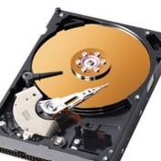

Solution# S.1
= friends of friends (F.O.F.)
Q: So what?
A1: # of two-step-away pairs: 100^2 * N= 10 Trillion
internet domains
att.com
log(degree)
ibm.com
-0.82
log(rank)

Slide 42
Solution# S.1
= friends of friends (F.O.F.)
Q: So what?
A1: # of two-step-away pairs: 100^2 * N= 10 Trillion
internet domains
att.com
log(degree)
ibm.com
-0.82
log(rank)

Slide 43
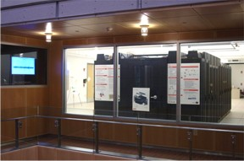
Solution# S.1
Gaussian trap
= friends of friends (F.O.F.)
Q: So what?
A1: # of two-step-away pairs: O(d_max ^2) ~ 10M^2
internet domains
att.com
~0.8PB ->
a data center(!)
log(degree)
ibm.com
-0.82
log(rank)
DCO @ CMU

Slide 44
Solution# S.1
Gaussian trap
Q: So what?
A1: # of two-step-away pairs: O(d_max ^2) ~ 10M^2
Such patterns ->
New algorithms
internet domains
att.com
~0.8PB ->
a data center(!)
log(degree)
ibm.com
-0.82
log(rank)

Slide 45
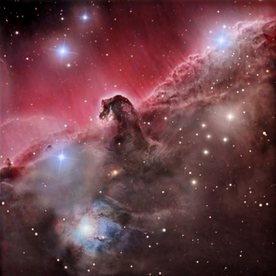
Observation – big-data:
O(N²) algorithms are ~intractable - N=1B
N² seconds = 31B years (>2x age of universe)
1B
1B

Slide 46
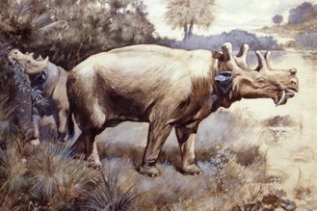
Observation – big-data:
O(N²) algorithms are ~intractable - N=1B
N² seconds = 31B years
1,000 machines
31M
1B

Slide 47
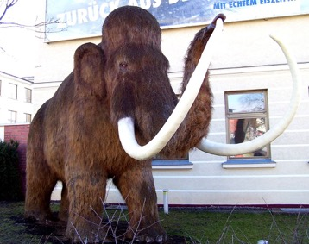



Observation – big-data:
O(N²) algorithms are ~intractable - N=1B
N² seconds = 31B years
1M machines
31K
1B

Slide 48


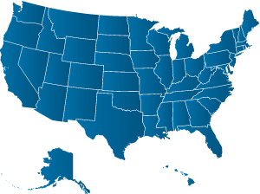
Observation – big-data:
O(N²) algorithms are ~intractable - N=1B
N² seconds = 31B years
10B machines ~ $10Trillion
3
1B

Slide 49
Observation – big-data:
O(N²) algorithms are ~intractable - N=1B
N² seconds = 31B years
10B machines ~ $10Trillion
And parallelism might not help
3
1B

Slide 50
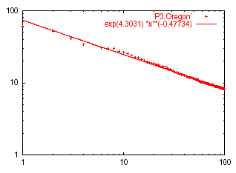
Solution# S.2: Eigen Exponent E
Eigenvalue
Exponent = slope
E = -0.48
May 2001
A x = λ x
Rank of decreasing eigenvalue
A2: power law in the eigenvalues of the adjacency matrix

Slide 51
Solution# S.2: Eigen Exponent E
Eigenvalue
Exponent = slope
E = -0.48
May 2001
Rank of decreasing eigenvalue
[Mihail, Papadimitriou ’02]: slope is ½ of rank exponent

Slide 52
But:
How about graphs from other domains?

Slide 53
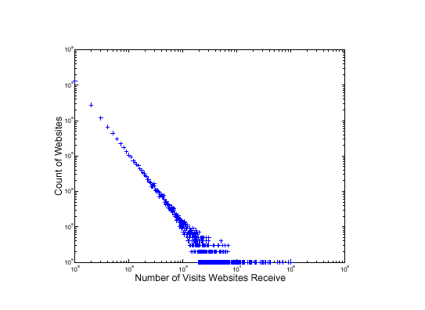
More power laws:
web hit counts [w/ A. Montgomery]
Web Site Traffic
Count
(log scale)
Zipf
``ebay’’
users
sites
in-degree (log scale)

Slide 54
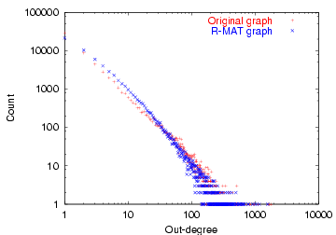
epinions.com
who-trusts-whom [Richardson + Domingos, KDD 2001]
count
trusts-2000-people user
(out) degree

Slide 55

And numerous more
# of sexual contacts
Income [Pareto] –’80-20 distribution’
Duration of downloads [Bestavros+]
Duration of UNIX jobs (‘mice and elephants’)
Size of files of a user
…
‘Black swans’

Slide 56

List of Static Patterns
✔️
S.1 degree
S.2 eigenvalues
S.3 small diameter
S.4/5 Triangle laws
(S.6) NLCC non-largest conn. components
(S.7) eigen plots
(S.8) radius plot
✔️

Slide 57
S.3 small diameters
Small diameter (~ constant!) –
six degrees of separation / ‘Kevin Bacon’
small worlds [Watts and Strogatz]

Slide 58
List of Static Patterns
✔️
S.1 degree
S.2 eigenvalues
S.3 small diameter
S.4/5 Triangle laws
(S.6) NLCC non-largest conn. components
(S.7) eigen plots
(S.8) radius plot
✔️
✔️

Slide 59
Solution# S.4: Triangle ‘Laws’
Real social networks have a lot of triangles

Slide 60
Solution# S.4: Triangle ‘Laws’
Real social networks have a lot of triangles
Friends of friends are friends
Any patterns?

Slide 61

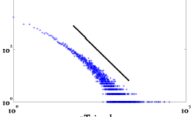
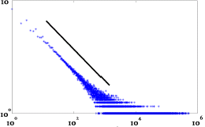
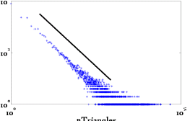
Triangle Law: #S.4 [Tsourakakis ICDM 2008]
HEP-TH
ASN
Epinions
X-axis: # of participating
triangles
Y: count (~ pdf)

Slide 62
Triangle Law: #S.4 [Tsourakakis ICDM 2008]
HEP-TH
ASN
Epinions
X-axis: # of participating
triangles
Y: count (~ pdf)

Slide 63
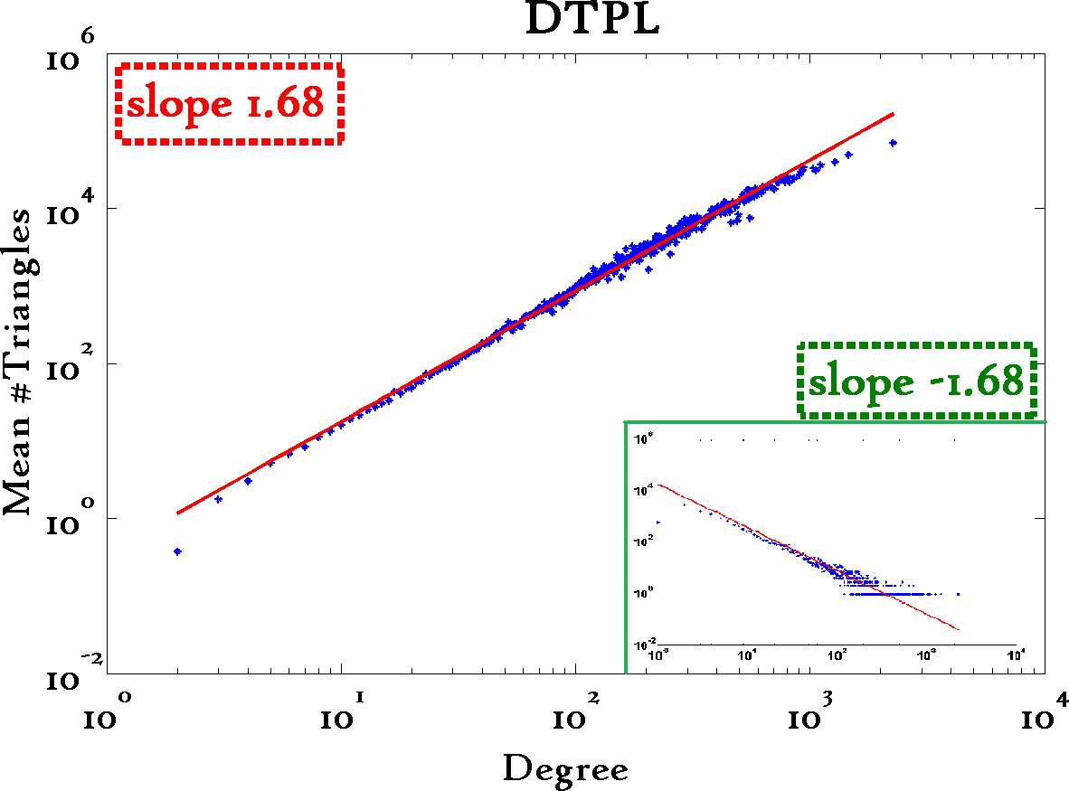
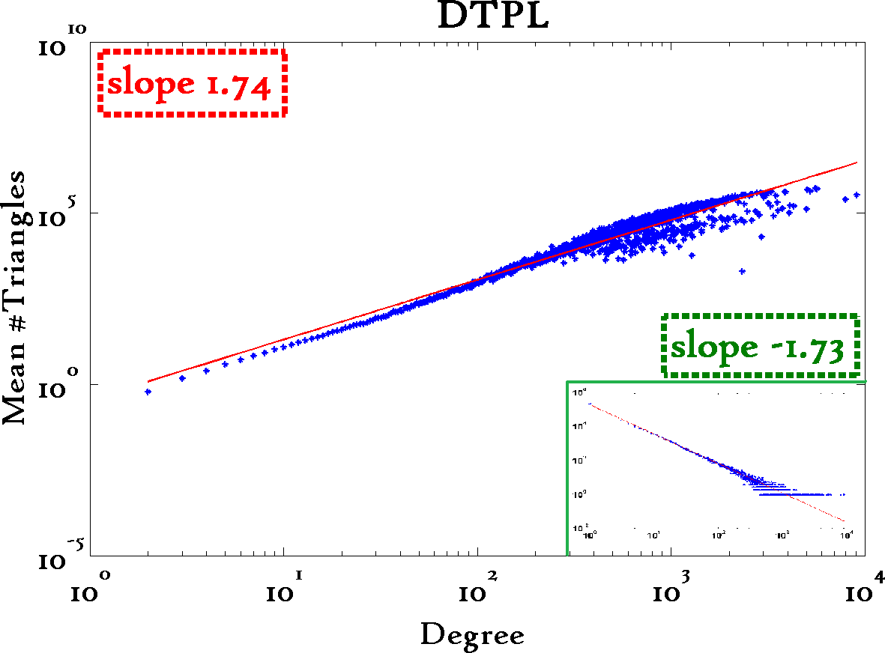
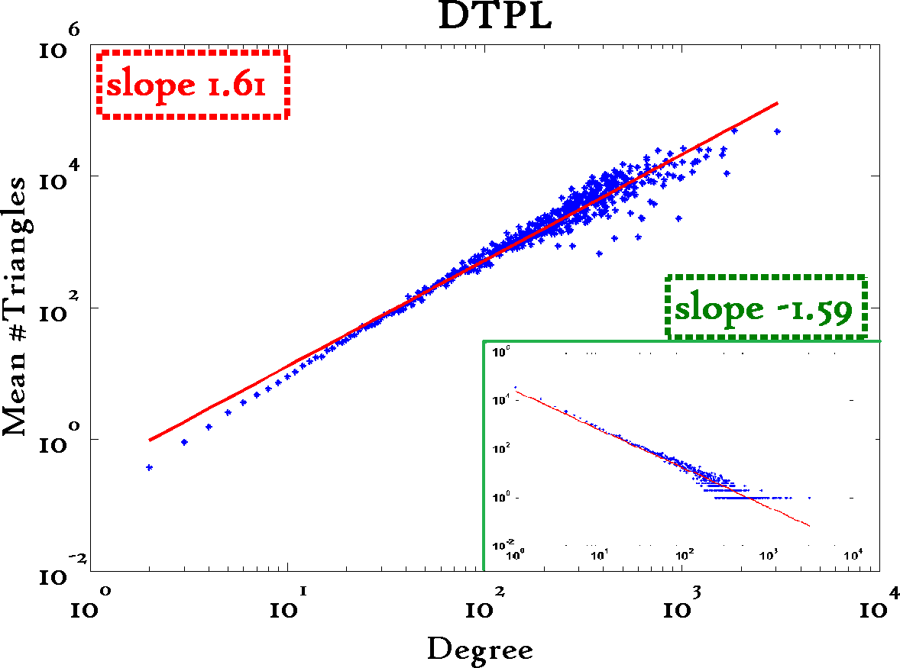
Triangle Law: #S.5 [Tsourakakis ICDM 2008]
Reuters
SN
X-axis: degree
Y-axis: mean # triangles
n friends -> ~n^{1.6} triangles
Epinions

Slide 64
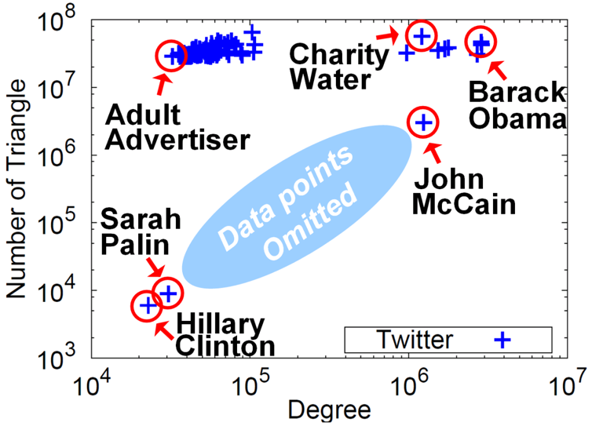




Triangle counting for large graphs?
Anomalous nodes in Twitter(~ 3 billion edges)
[U Kang, Brendan Meeder, +, PAKDD’11]
?
?
?
64

Slide 65
Triangle counting for large graphs?
Anomalous nodes in Twitter(~ 3 billion edges)
[U Kang, Brendan Meeder, +, PAKDD’11]
65

Slide 66
Triangle counting for large graphs?
Anomalous nodes in Twitter(~ 3 billion edges)
[U Kang, Brendan Meeder, +, PAKDD’11]
66

Slide 67
Triangle counting for large graphs?
Anomalous nodes in Twitter(~ 3 billion edges)
[U Kang, Brendan Meeder, +, PAKDD’11]
67

Slide 68
Triangle counting for large graphs?
Anomalous nodes in Twitter(~ 3 billion edges)
[U Kang, Brendan Meeder, +, PAKDD’11]
68

Slide 69
List of Static Patterns
✔️
S.1 degree
S.2 eigenvalues
S.3 small diameter
S.4/5 Triangle laws
(S.6) NLCC non-largest conn. components
(S.7) eigen plots
(S.8) radius plot
✔️
✔️
✔️

Slide 70
Generalized Iterated Matrix Vector Multiplication (GIMV)
PEGASUS: A Peta-Scale Graph Mining
System - Implementation and Observations. U Kang, Charalampos E. Tsourakakis,
and Christos Faloutsos. (ICDM) 2009, Miami, Florida, USA. Best Application Paper (runner-up).

Slide 71
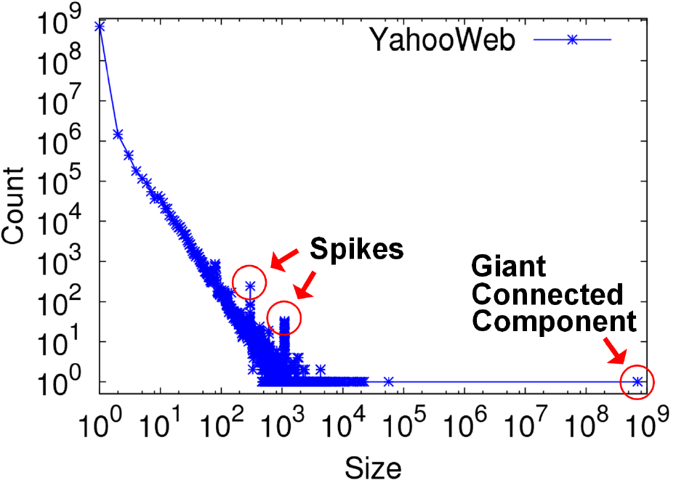
S.6: NLCC
Connected Components – 4 observations:
Count
Size

Slide 72
S.6: NLCC
Connected Components
Count
1) 10K x
larger
than next
Size

Slide 73
S.6: NLCC
Connected Components
Count
2) ~0.7B
singleton
nodes
Size

Slide 74
S.6: NLCC
Connected Components
Count
3) SLOPE!
Size

Slide 75
S.6: NLCC
Connected Components
Count
300-size cmpt
X 500.
Why?
1100-size cmpt
X 65.
Why?
4) Spikes!
Size

Slide 76
S.6: NLCC
Connected Components
Count
suspicious
financial-advice sites
(not existing now)
Size

Slide 77
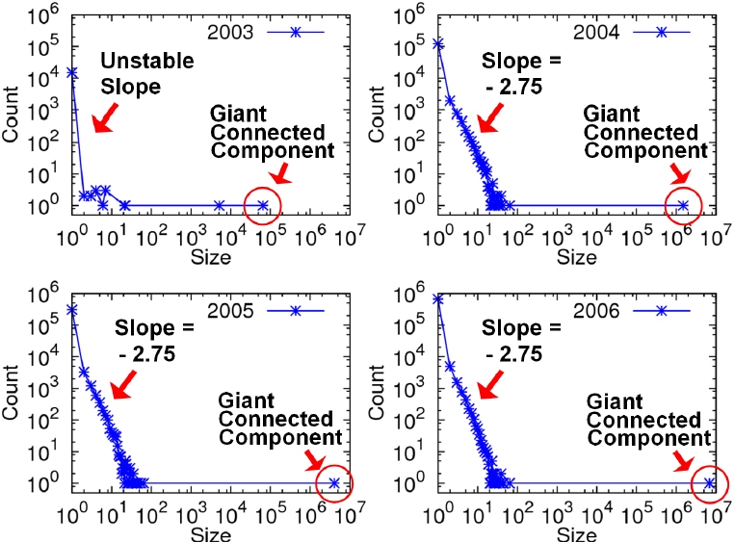
S.6: persists over time
Connected Components over Time
LinkedIn: 7.5M nodes and 58M edges
Stable tail slope
after the gelling point

Slide 78
List of Static Patterns
✔️
S.1 degree
S.2 eigenvalues
S.3 small diameter
S.4/5 Triangle laws
S.6 NLCC non-largest conn. components
S.7 eigen plots
S.8 radius plot
✔️
✔️
✔️
✔️

Slide 79

EigenSpokes
B. Aditya Prakash, Mukund Seshadri, Ashwin Sridharan, Sridhar Machiraju and Christos Faloutsos: EigenSpokes: Surprising Patterns and Scalable Community Chipping in Large Graphs, PAKDD 2010, Hyderabad, India, 21-24 June 2010.
Useful for fraud detection!

Slide 80
EigenSpokes
Eigenvectors of adjacency matrix
equivalent to singular vectors (symmetric, undirected graph)
N
N
Notes:
A = U \Sigma U^T
\vec{u}_1
\vec{u}_i

Slide 81
EigenSpokes
Eigenvectors of adjacency matrix
equivalent to singular vectors (symmetric, undirected graph)
N
N
Notes:
A = U \Sigma U^T
\vec{u}_1
\vec{u}_i

Slide 82
EigenSpokes
EE plot:
Scatter plot of scores of u1 vs u2
One would expect
Many points @ origin
A few scattered ~randomly
2nd Principal
component
u2
u1
1st Principal
component

Slide 83
EigenSpokes
EE plot:
Scatter plot of scores of u1 vs u2
One would expect
Many points @ origin
A few scattered ~randomly
u2
90º
u1

Slide 84
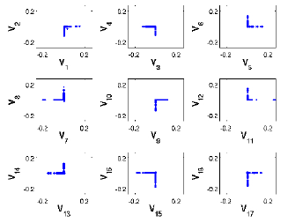
EigenSpokes - pervasiveness
Present in mobile social graph
across time and space
Patent citation graph

Slide 85
EigenSpokes - explanation
Near-cliques, or near-bipartite-cores, loosely connected

Slide 86
EigenSpokes - explanation
Near-cliques, or near-bipartite-cores, loosely connected

Slide 87
EigenSpokes - explanation
Near-cliques, or near-bipartite-cores, loosely connected

Slide 88
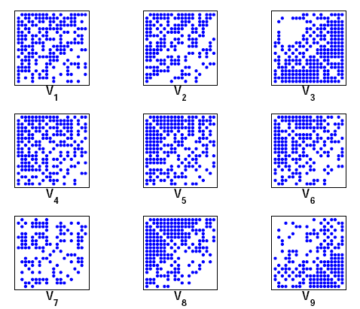
EigenSpokes - explanation
Near-cliques, or near-bipartite-cores, loosely connected
So what?
Extract nodes with high scores
high connectivity
Good “communities”
spy plot of top 20 nodes

Slide 89
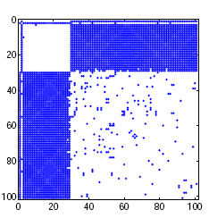
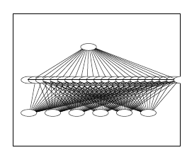
Bipartite Communities!
patents from
same inventor(s)
`cut-and-paste’
bibliography!
magnified bipartite community
Useful for fraud detection!

Slide 90
Bipartite Communities!
IP – port scanners
victims
Useful for fraud detection!

Slide 91
List of Static Patterns
✔️
S.1 degree
S.2 eigenvalues
S.3 small diameter
S.4/5 Triangle laws
S.6 NLCC non-largest conn. components
S.7 eigen plots
S.8 radius plot
✔️
✔️
✔️
✔️
✔️

Slide 92
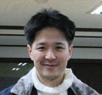
HADI for diameter estimation
Radius Plots for Mining Tera-byte Scale Graphs U Kang, Charalampos Tsourakakis, Ana Paula Appel, Christos Faloutsos, Jure Leskovec, SDM’10
Naively: diameter needs O(N**2) space and up to O(N**3) time – prohibitive (N~1B)
Our HADI: linear on E (~10B)
Near-linear scalability wrt # machines
Several optimizations -> 5x faster

Slide 93
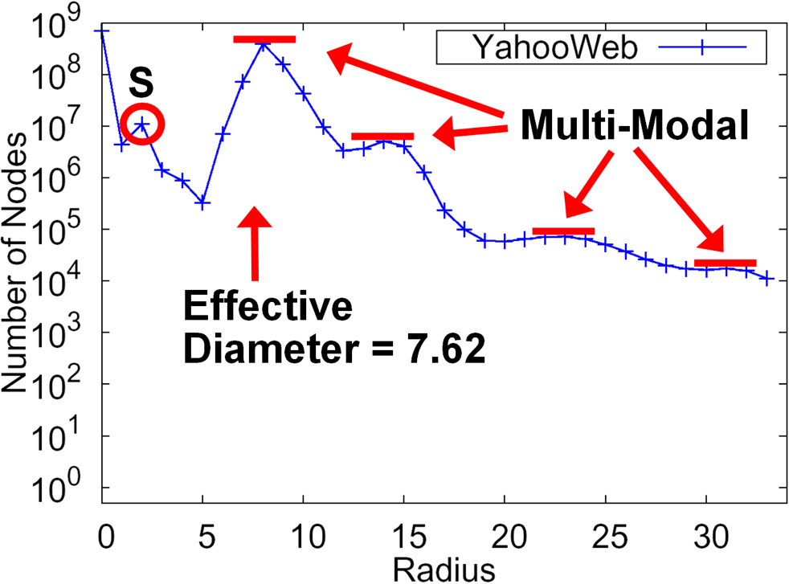
????
Count
19+ [Barabasi+]
~1999, ~1M nodes
Radius

Slide 94
????
??
Count
19+ [Barabasi+]
~1999, ~1M nodes
Radius
YahooWeb graph (120Gb, 1.4B nodes, 6.6 B edges)
Largest publicly available graph ever studied.

Slide 95
????
Count
14 (dir.)
~7 (undir.)
19+? [Barabasi+]
Radius
YahooWeb graph (120Gb, 1.4B nodes, 6.6 B edges)
Largest publicly available graph ever studied.

Slide 96
????
Count
14 (dir.)
~7 (undir.)
19+? [Barabasi+]
Radius
YahooWeb graph (120Gb, 1.4B nodes, 6.6 B edges)
7 degrees of separation (!)
Diameter: shrunk

Slide 97
????
Count
~7 (undir.)
Radius
YahooWeb graph (120Gb, 1.4B nodes, 6.6 B edges)
Q: Shape?

Slide 98
YahooWeb graph (120Gb, 1.4B nodes, 6.6 B edges)
effective diameter: surprisingly small.
Multi-modality (?!)

Slide 99
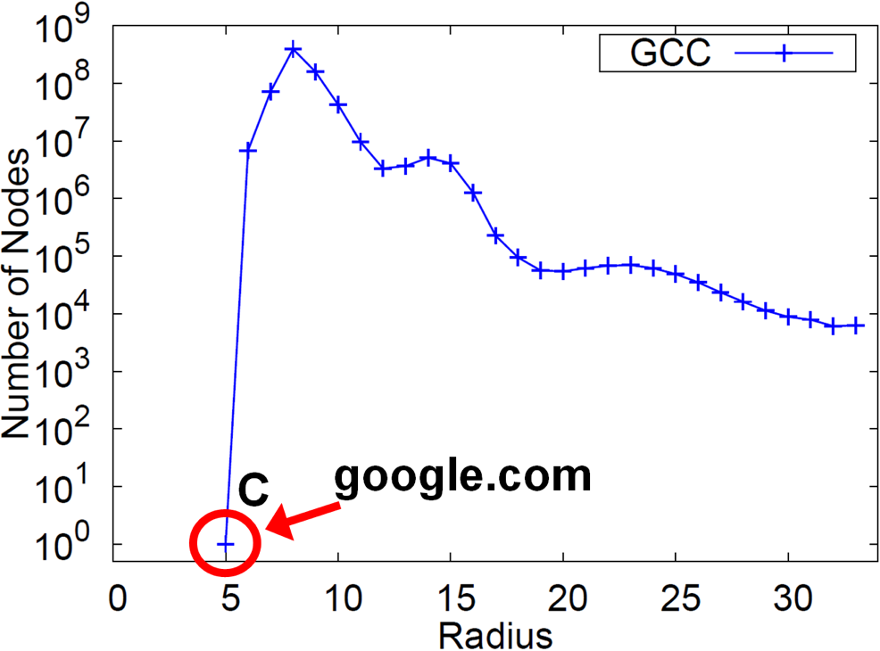
Radius Plot of GCC of YahooWeb.

Slide 100

YahooWeb graph (120Gb, 1.4B nodes, 6.6 B edges)
effective diameter: surprisingly small.
Multi-modality: probably mixture of cores .

Slide 101
Conjecture:
DE
EN
BR
~7
YahooWeb graph (120Gb, 1.4B nodes, 6.6 B edges)
effective diameter: surprisingly small.
Multi-modality: probably mixture of cores .

Slide 102
Conjecture:
~7
YahooWeb graph (120Gb, 1.4B nodes, 6.6 B edges)
effective diameter: surprisingly small.
Multi-modality: probably mixture of cores .

Slide 103
Outline
Introduction – Motivation
Problem: Patterns in graphs
Static graphs
degree, diameter, eigen,
Triangles
Weighted graphs
Time evolving graphs

Slide 104
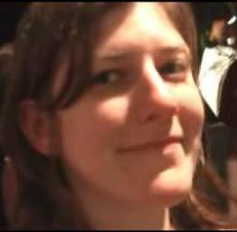

Observations on weighted graphs?
A: yes - even more ‘laws’!
M. McGlohon, L. Akoglu, and C. Faloutsos
Weighted Graphs and Disconnected Components: Patterns and a Generator.
SIG-KDD 2008

Slide 105
Observation W.1: Fortification
Q: How do the weights
of nodes relate to degree?

Slide 106
Observation W.1: Fortification
More donors,
more $ ?
‘Reagan’
$10
$5
‘Clinton’
$7

Slide 107
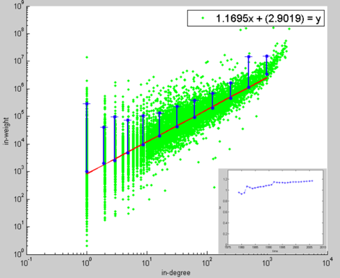
Observation W.1: fortification: Snapshot Power Law
Weight: super-linear on in-degree
exponent ‘iw’: 1.01 < iw < 1.26
More donors,
even more $
Orgs-Candidates
e.g. John Kerry,
$10M received,
from 1K donors
In-weights
($)
$10
$5
Edges (# donors)

Slide 108
Outline
Introduction – Motivation
Problem: Patterns in graphs
Static graphs
Weighted graphs
Time evolving graphs

Slide 109

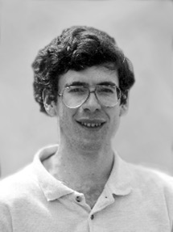
Problem: Time evolution
with Jure Leskovec (CMU -> Stanford)
and Jon Kleinberg (Cornell – sabb. @ CMU)

Slide 110
List of Dynamic Patterns
D.1 diameter
D.2 densification
D.3 gelling point
D.4 NLCC over time
D.5 Eigenvalue over time
D.6 Popularity over time
D.7 phonecall duration

Slide 111


D.1 Evolution of the Diameter
Prior work on Power Law graphs hints at slowly growing diameter:
[diameter ~ O( N^{1/3})]
diameter ~ O(log N)
diameter ~ O(log log N)
What is happening in real data?
diameter
Notes:
Diameter first, DPL second
Check diameter formulas
As the network grows the distances between nodes slowly grow

Slide 112
D.1 Evolution of the Diameter
Prior work on Power Law graphs hints at slowly growing diameter:
[diameter ~ O( N^{1/3})]
diameter ~ O(log N)
diameter ~ O(log log N)
What is happening in real data?
Diameter shrinks over time
Notes:
Diameter first, DPL second
Check diameter formulas
As the network grows the distances between nodes slowly grow

Slide 113
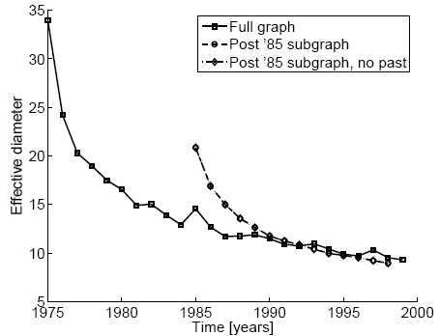
D.1 Diameter – “Patents”
diameter
Patent citation network
25 years of data
@1999
2.9 M nodes
16.5 M edges
time [years]

Slide 114
List of Dynamic Patterns
✔️
D.1 diameter
D.2 densification
D.3 gelling point
D.4 NLCC over time
D.5 Eigenvalue over time
D.6 Popularity over time
D.7 phonecall duration

Slide 115
D.2 Temporal Evolution of the Graphs
N(t) … nodes at time t
E(t) … edges at time t
Suppose that
N(t+1) = 2 * N(t)
Q: what is your guess for
E(t+1) =? 2 * E(t)

Slide 116
D.2 Temporal Evolution of the Graphs
N(t) … nodes at time t
E(t) … edges at time t
Suppose that
N(t+1) = 2 * N(t)
Q: what is your guess for
E(t+1) =? 2 * E(t)
A: over-doubled!
But obeying the ``Densification Power Law’’

Slide 117
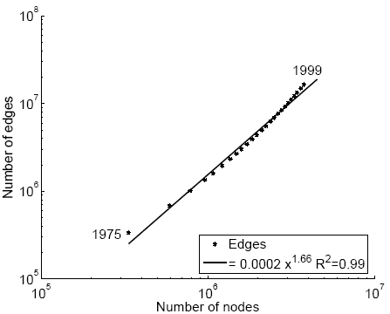
D.2 Densification – Patent Citations
Citations among patents granted
@1999
2.9 M nodes
16.5 M edges
Each year is a datapoint
E(t)
1.66
N(t)

Slide 118
List of Dynamic Patterns
✔️
D.1 diameter
D.2 densification
D.3 gelling point
D.4 NLCC over time
D.5 Eigenvalue over time
D.6 Popularity over time
D.7 phonecall duration
✔️

Slide 119
More on Time-evolving graphs
M. McGlohon, L. Akoglu, and C. Faloutsos
Weighted Graphs and Disconnected Components: Patterns and a Generator.
SIG-KDD 2008

Slide 120
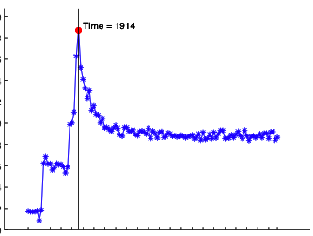
D.3 Gelling Point
Diameter, over time
diameter
IMDB
??
t=1914
Diameter
Time

Slide 121
D.3 Gelling Point
Most real graphs display a gelling point
After gelling point, they exhibit typical behavior. This is marked by a spike in diameter.
IMDB
t=1914
Diameter
Time

Slide 122
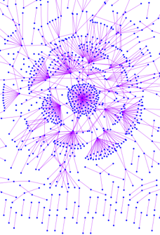

D.3 Gelling Point
Most real graphs display a gelling point
After gelling point, they exhibit typical behavior. This is marked by a spike in diameter.
IMDB
t=1914
Diameter
Time

Slide 123
List of Dynamic Patterns
✔️
D.1 diameter
D.2 densification
D.3 gelling point
D.4 NLCC over time
D.5 Eigenvalue over time
D.6 Popularity over time
D.7 phonecall duration
✔️
✔️

Slide 124
Observation D.4: NLCC behavior
Q: How do NLCC’s emerge and join with the GCC?
(``NLCC’’ = non-largest conn. components)
Do they continue to grow in size?
or do they shrink?
or stabilize?

Slide 125
Observation D.4: NLCC behavior
Q: How do NLCC’s emerge and join with the GCC?
(``NLCC’’ = non-largest conn. components)
Do they continue to grow in size?
or do they shrink?
or stabilize?

Slide 126
Observation D.4: NLCC behavior
YES
YES
YES
Q: How do NLCC’s emerge and join with the GCC?
(``NLCC’’ = non-largest conn. components)
Do they continue to grow in size?
or do they shrink?
or stabilize?

Slide 127

Observation D.4: NLCC behavior
After the gelling point, the GCC takes off, but NLCC’s remain ~constant (actually, oscillate).
IMDB
CC size
Time-stamp

Slide 128
List of Dynamic Patterns
✔️
D.1 diameter
D.2 densification
D.3 gelling point
D.4 NLCC over time
D.5 Eigenvalue over time
D.6 Popularity over time
D.7 phonecall duration
✔️
✔️
✔️

Slide 129
Timing for Blogs
Cascading Behavior in Large Blog Graphs: Patterns and a model
Jure Leskovec, Mary McGlohon, Christos Faloutsos, Natalie Glance, Matthew Hurst
SDM’07

Slide 130
D.6 : popularity over time
# in links
1
2
3
lag: days after post
Post popularity drops-off – exponentially?
@t
@t + lag
Notes:
130

Slide 131

D.6 : popularity over time
# in links
(log)
days after post
(log)
Post popularity drops-off – exponentially?
POWER LAW!
Exponent?
Notes:
131

Slide 132

D.6 : popularity over time
# in links
(log)
-1.6
days after post
(log)
Post popularity drops-off – exponentially?
POWER LAW!
Exponent? -1.6
close to -1.5: Barabasi’s stack model
and like the zero-crossings of a random walk
Notes:
132

Slide 133
-1.5 slope
J. G. Oliveira & A.-L. Barabási Human Dynamics: The Correspondence Patterns of Darwin and Einstein. Nature 437, 1251 (2005) . [PDF]

Slide 134
List of Dynamic Patterns
✔️
D.1 diameter
D.2 densification
D.3 gelling point
D.4 NLCC over time
D.5 Eigenvalue over time
D.6 Popularity over time
D.7 phonecall duration
✔️
✔️
✔️
✔️

Slide 135

D.7: duration of phonecalls
Surprising Patterns for the Call Duration Distribution of Mobile Phone Users
Pedro O. S. Vaz de Melo, Leman Akoglu, Christos Faloutsos, Antonio A. F. Loureiro
PKDD 2010

Slide 136

Probably, power law (?)
??

Slide 137
No Power Law!

Slide 138


‘TLaC: Lazy Contractor’
The longer a task (phonecall) has taken,
The even longer it will take
Odds ratio=
Casualties(<x):
Survivors(>=x)
== power law

Slide 139
Log-logistic distribution
CDF(t)/(1- CDF(t)) == OR(t)
For log-logistic: log[OR(t)] = β + ρ*log(t)
Odds ratio=
Casualties(<x):
Survivors(>=x)
== power law

Slide 140

Log-logistic distribution
CDF(t)/(1- CDF(t)) == OR(t)
For log-logistic: log[OR(t)] = β + ρ*log(t)
OR(t)
PDF looks like hyperbola;
and, if clipped, like power-law

Slide 141
Log-logistic distribution
CDF(t)/(1- CDF(t)) == OR(t)
For log-logistic: log[OR(t)] = β + ρ*log(t)
OR(t)
Duration ( t )

Slide 142
Log-logistic distribution
Attention:
Phase1
Nice 1 page description: section II of
Pravallika Devineni, Danai Koutra, Michalis Faloutsos, and Christos Faloutsos.
If walls could talk: Patterns and anomalies in Facebook wallposts.
ASONAM 2015, pp 367-374.

Slide 143
Log-logistic: ~ power law

Slide 144
Log-logistic: ~ power law

Slide 145
Data Description
Data from a private mobile operator of a large city
4 months of data
3.1 million users
more than 1 billion phone records
Over 96% of ‘talkative’ users obeyed a TLAC distribution (‘talkative’: >30 calls)

Slide 146

Outliers:

Slide 147
Short answer(s)
?
?
Are real graphs random?
S*: what do static graphs look like?
S.0: ‘six degrees’
S.1: skewed degree distribution
S.2: skewed eigenvalues
S.3: triangle power-laws
S.4: GCC; and skewed distr. of conn. comp.
D*: how do graphs evolve over time?
D.1: diameters
D.2: densification

Slide 148
Short answer(s)
?
?
Are real graphs random?
S*: what do static graphs look like?
S.0: ‘six degrees’
S.1: skewed degree distribution
S.2: skewed eigenvalues
S.3: triangle power-laws
S.4: GCC; and skewed distr. of conn. comp.
T*: how do graphs evolve over time?
T.1: diameters
T.2: densification
Power laws: y ~ xª
NOT Gaussians
Take logarithms
y (log scale)
a
x (log scale)

Slide 149
References
Deepayan Chakrabarti and Christos Faloutsos Graph Mining: Laws, Tools and Case Studies, Morgan Claypool, 2012
Part I (patterns)

Slide 150




References
Mary McGlohon, Leman Akoglu, Christos Faloutsos. Statistical Properties of Social Networks. in "Social Network Data Analytics” (Ed.: Charu Aggarwal)
Deepayan Chakrabarti and Christos Faloutsos, Graph Mining: Laws, Tools, and Case Studies Oct. 2012, Morgan Claypool.

Slide 151
References, cont’d
Michalis Faloutsos, Petros Faloutsos and Christos Faloutsos, On Power-Law Relationships of the Internet Topology, SIGCOMM 1999.
R. Albert, H. Jeong, and A.-L. Barabasi, Diameter of the World Wide Web Nature, 401, 130-131 (1999).
Reka Albert and Albert-Laszlo Barabasi Statistical mechanics of complex networks, Reviews of Modern Physics, 74, 47 (2002).
Jure Leskovec, Jon Kleinberg, Christos Faloutsos Graphs over Time: Densification Laws, Shrinking Diameters and Possible Explanations, KDD 2005, Chicago, IL, USA

Slide 152






Project info
www.cs.cmu.edu/~pegasus
Chau,
Polo
McGlohon,
Mary
Tsourakakis,
Babis
Akoglu,
Leman
Kang, U
Prakash,
Aditya
Tong,
Hanghang
Thanks to: NSF IIS-0705359, IIS-0534205,
CTA-INARC; Yahoo (M45), LLNL, IBM, SPRINT, INTEL, HP

