Slide 1
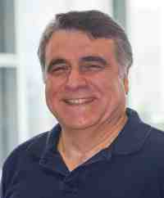
Graph and Time Series Mining: Tools and Applications
Part 2: time series
Christos Faloutsos
CMU SCS
https://www.cs.cmu.edu/~christos/TALKS/19-10-JPM/

Slide 2




‘Recipe’ Structure:
Problem definition / use case
Short answer/solution
LONG answer – deep dive
Conclusion/short-answer
https://www.cs.cmu.edu/~christos/TALKS/19-10-JPM/

Slide 3
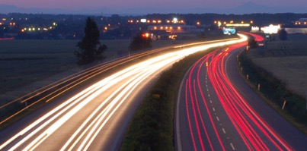
Outline
Motivation
Similarity Search and Indexing
DSP (Digital Signal Processing)
Linear Forecasting
Non-linear forecasting
Conclusions
https://www.cs.cmu.edu/~christos/TALKS/19-10-JPM/

Slide 4
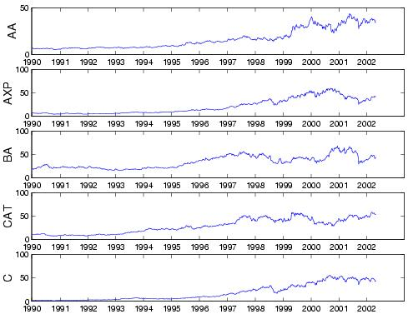
Problem definition
Given: one or more sequences
x₁ , x₂ , … , x_{t} , …
(y₁, y₂, … , y_{t}, …
… )
Find
Forecast; similar sequences
patterns; clusters; outliers

Slide 5
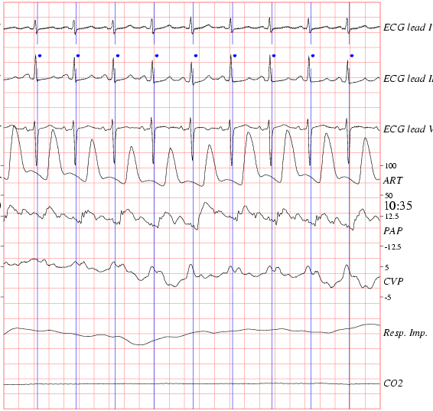
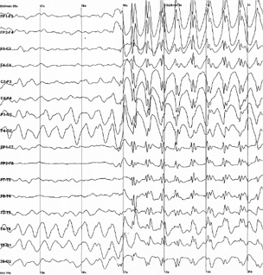

Medical
ECG
(physionet.org)
EEG
(epilepsy)

Slide 6
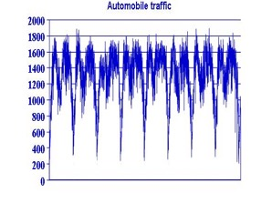
Civil infrastructure
bridge vibrations [Oppenheim+02]
road conditions / traffic monitoring

Slide 7
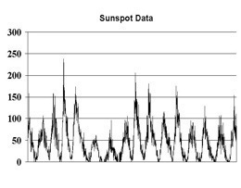
Environmental
Weather, environment/anti-pollution
volcano monitoring
air/water pollutant monitoring

Slide 8
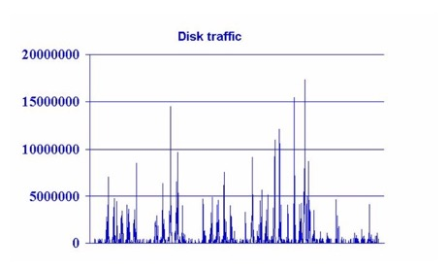
Computer Systems
web servers
network traffic monitoring
...

Slide 9
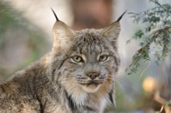
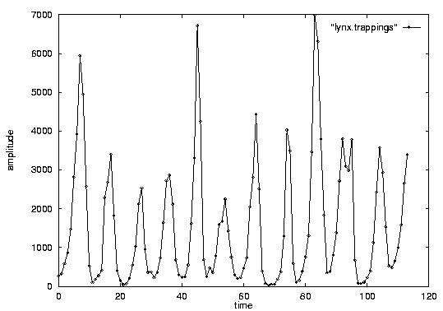
Problem #1:
Goal: given a signal (eg., #packets over time)
Find: patterns, periodicities, and/or compress
count
lynx caught per year
($revenue per day;
temperature per day)
year

Slide 10
Problem#2: Forecast
Given x_{t}, x_{t-1}, …, forecast x_{t+1}
90
80
70
60
Number of packets sent
??
50
40
30
20
10
0
1
3
5
7
9
11
Time Tick
Notes:
What are co-evolving time sequences? We define them as a set of correlated time sequences possibly with some time lags.
Let us take an example. Here we have three sequences.
Taking a closer look, we can see that the blue sequence is the same as the red one except that it is a shifted version. Also, the green sequence is somehow correlated with the red one.
What we propose is to study them jointly, to take advantage of the existence of such correlations.

Slide 11
Problem#2’: Similarity search
Eg., Find a 3-tick pattern, similar to the last one
90
80
70
60
Number of packets sent
??
50
40
30
20
10
0
1
3
5
7
9
11
Time Tick
Notes:
What are co-evolving time sequences? We define them as a set of correlated time sequences possibly with some time lags.
Let us take an example. Here we have three sequences.
Taking a closer look, we can see that the blue sequence is the same as the red one except that it is a shifted version. Also, the green sequence is somehow correlated with the red one.
What we propose is to study them jointly, to take advantage of the existence of such correlations.

Slide 12

Important observations
Patterns, rules, forecasting and similarity indexing are closely related:
To do forecasting, we need
to find patterns/rules
compress
to find similar settings in the past
to find outliers, we need to have forecasts
(outlier = too far away from our forecast)

Slide 13
Outline
Motivation
Similarity Search and Indexing
distance functions: Euclidean;Time-warping
indexing
feature extraction
DSP
...

Slide 14
Problem:
Q: How similar are two sequences?

Slide 15
Answer:
Q: How similar are two sequences?
A: Euclidean distance (<-> cosine similarity)
...

Slide 16
Importance of distance functions
Subtle, but absolutely necessary:
A ‘must’ for similarity indexing (-> forecasting)
A ‘must’ for clustering
Two major families
Euclidean and Lp norms
Time warping and variations

Slide 17
Euclidean and Lp
...
L₁: city-block = Manhattan
L₂ = Euclidean
L∞

Slide 18
Answer:
Q: How similar are two sequences?
A: Euclidean distance (<-> cosine similarity)
...

Slide 19
Outline
Motivation
Similarity Search and Indexing
distance functions
indexing
feature extraction
DSP
...

Slide 20
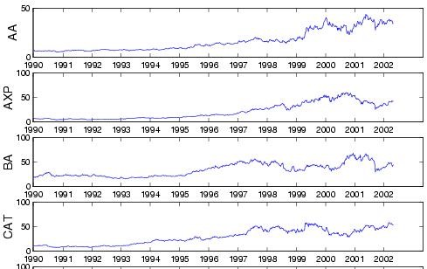

Problem:
Q: find quickly stocks like ‘C’ (or customers like ‘smith’)

Slide 21
Answer:
Q: find quickly stocks like ‘C’ (or customers like ‘smith’)
A: summarize seq. to a few numbers/features (eg., avg, stdv, Fourier coeff.)

Slide 22
$price
$price
1
365
day
$price
1
365
day
distance function: by expert
1
365
day

Slide 23
Idea: ‘GEMINI’
Eg., ‘find stocks similar to MSFT’
Seq. scanning: too slow
How to accelerate the search?
[Faloutsos96]

Slide 24
‘GEMINI’ - Pictorially
eg,. std
S1
F(S1)
1
365
day
F(Sn)
Sn
eg, avg
1
365
day

Slide 25
GEMINI
F(S1)
F(Sn)
Solution: Quick-and-dirty' filter:
extract n features (numbers, eg., avg., etc.)
map into a point in n-d feature space
organize points with off-the-shelf spatial access method (‘SAM’)
discard false alarms
(and: visualization as fringe benefit)

Slide 26
Outline
Motivation
Similarity Search and Indexing
distance functions
indexing
feature extraction
SVD etc (data dependent), ICA
DFT, DWT, DCT (data independent)

Slide 27
Problem:
Q: how to extract features (commonalities)?

Slide 28
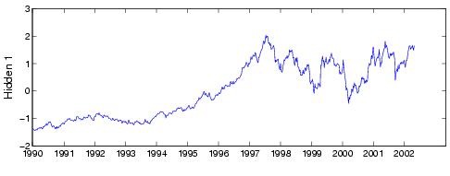
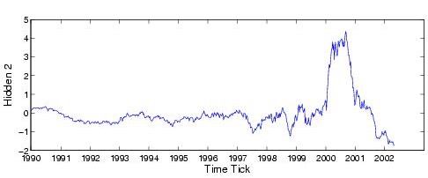
Answer
Q: how to extract features (commonalities)?
A: SVD, ICA

Slide 29
Important observations
Patterns, rules, forecasting and similarity indexing are closely related:
To do forecasting, we need
to find patterns/rules
compress
to find similar settings in the past
to find outliers, we need to have forecasts
(outlier = too far away from our forecast)

Slide 30
SVD
THE optimal method for dimensionality reduction
(under the Euclidean metric)

Slide 31
Motivation: Find hidden variables
Alcoa
American Express
Boeing
Caterpillar
Find common hidden variables, and weights.
Citi Group
Dow Jones Industrial Average
Notes:
AA: Alcoa
AXP: American Express
BA: Boeing
CAT: Caterpillar
C: Citigroup

Slide 32
Singular Value Decomposition (SVD)
SVD (~LSI ~ KL ~ PCA ~ spectral analysis...)
LSI: S. Dumais; M. Berry
KL: eg, Duda+Hart
PCA: eg., Jolliffe
Details: [Press+],
[Faloutsos96]
day2
day1

Slide 33
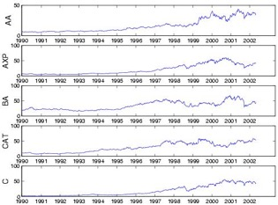
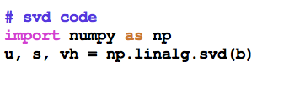
SVD
t₁
t_{n}
AA
AXP
~
U
Σ
V^{T}

Slide 34
SVD
1st behavior
t₁
t_{n}
AA
AXP
~
U
Σ
V^{T}

Slide 35
SVD
1st behavior
t₁
t_{n}
AA
2nd behavior
AXP
~
U
Σ
V^{T}

Slide 36
SVD
1st behavior
t₁
t_{n}
AA
2nd behavior
AXP
~
Participation weight of
row i to behavior j
U
Σ
V^{T}

Slide 37
Outline
Motivation
Similarity Search and Indexing
distance functions
indexing
feature extraction
SVD, ICA
DFT, DWT, DCT (data independent)

Slide 38

Citation
AutoSplit: Fast and Scalable Discovery of Hidden Variables in Stream and Multimedia Databases, Jia-Yu Pan, Hiroyuki Kitagawa, Christos Faloutsos and Masafumi Hamamoto
PAKDD 2004, Sydney, Australia

Slide 39





ICA = BSS
Independent Component Analysis =
Blind Source Separation =
‘cocktail party problem’

Slide 40
Motivation: Find hidden variables
Alcoa
American Express
Boeing
Caterpillar
Find common hidden variables, and weights.
Citi Group
Dow Jones Industrial Average
Notes:
AA: Alcoa
AXP: American Express
BA: Boeing
CAT: Caterpillar
C: Citigroup

Slide 41
ICA: Like SVD, but sparse U
1st behavior
t₁
t_{n}
AA
2nd behavior
AXP
~
Participation weight of
row i to behavior j
U
Σ
V^{T}

Slide 42


Motivation: Find hidden variables
= behaviors
Caterpillar
Intel
?
B1,CAT
B2,INTC
B1,INTC
B2,CAT
?
?
Hidden variable 1
Hidden variable 2

Slide 43
Motivation: Find hidden variables
Caterpillar
Intel
0.94
0.64
0.63
0.03
“Hidden variable 1”
“Hidden variable 2”

Slide 44
Motivation: Find hidden variables
Caterpillar
Intel
0.94
0.64
0.63
0.03
“General trend”
???

Slide 45
Motivation: Find hidden variables
Caterpillar
Intel
0.94
0.64
0.63
0.03
“General trend”
“Internet bubble”

Slide 46


ICA: Like SVD, but sparse
1st behavior
2nd behavior
~
Stock#1
Stock#2
General trend
Internet bubble

Slide 47
ICA: Like SVD, but sparse
1st behavior
2nd behavior
~
Stock#1
Stock#2
General trend
Internet bubble

Slide 48
ICA: Like SVD, but sparse
1st behavior
2nd behavior
~
Stock#1
Stock#2
General trend
Internet bubble

Slide 49
ICA: Like SVD, but sparse
1st behavior
2nd behavior
~
Stock#1
Stock#2
General trend
Internet bubble

Slide 50
Answer
Q: how to extract features (commonalities)?
A: SVD, ICA

Slide 51
Books
William H. Press, Saul A. Teukolsky, William T. Vetterling and Brian P. Flannery: Numerical Recipes in C, Cambridge University Press, 1992, 2nd Edition. (Great description, intuition and code for SVD)
C. Faloutsos: Searching Multimedia Databases by Content, Kluwer Academic Press, 1996 (introduction to SVD, and GEMINI)

Slide 52
References
Agrawal, R., K.-I. Lin, et al. (Sept. 1995). Fast Similarity Search in the Presence of Noise, Scaling and Translation in Time-Series Databases. Proc. of VLDB, Zurich, Switzerland.
Berry, Michael: http://www.cs.utk.edu/~lsi/

Slide 53
References
Foltz, P. W. and S. T. Dumais (Dec. 1992). “Personalized Information Delivery: An Analysis of Information Filtering Methods.” Comm. of ACM (CACM) 35(12): 51-60.
Guttman, A. (June 1984). R-Trees: A Dynamic Index Structure for Spatial Searching. Proc. ACM SIGMOD, Boston, Mass.

Slide 54
References
Gunopulos, D. and G. Das (2001). Time Series Similarity Measures and Time Series Indexing. SIGMOD Conference, Santa Barbara, CA.
Eamonn J. Keogh, Themis Palpanas, Victor B. Zordan, Dimitrios Gunopulos, Marc Cardle: Indexing Large Human-Motion Databases. VLDB 2004: 780-791

Slide 55
References
A. Hyvarinen, J. Karhunen, E. Oja (2001): Independent Component Analysis. John Wiley and Sons
Jolliffe, I. T. (1986). Principal Component Analysis, Springer Verlag.

Slide 56
References
Papadimitriou, C. H., P. Raghavan, et al. (1998). Latent Semantic Indexing: A Probabilistic Analysis. PODS, Seattle, WA.

Slide 57
References
Dennis Shasha and Yunyue Zhu High Performance Discovery in Time Series: Techniques and Case Studies Springer 2004
Yunyue Zhu, Dennis Shasha ``StatStream: Statistical Monitoring of Thousands of Data Streams in Real Time'‘ VLDB, August, 2002. pp. 358-369.
Samuel R. Madden, Michael J. Franklin, Joseph M. Hellerstein, and Wei Hong. The Design of an Acquisitional Query Processor for Sensor Networks. SIGMOD, June 2003, San Diego, CA.

Slide 58
Part 2.2:
DSP (Digital
Signal Processing)

Slide 59
Outline
Motivation
Similarity Search and Indexing
DSP (DFT, DWT)
DFT
Definition of DFT and properties
how to read the DFT spectrum
DWT
Linear Forecasting
…

Slide 60
Problem
Q: How to summarize / extract few features
S1
Sn

Slide 61
Answer:
Q: How to summarize / extract few features
A1: Data dep.: SVD, ICA
A2: Data indep.: Fourier; Wavelets
✔︎
S1
Sn

Slide 62
Important observations
Patterns, rules, forecasting and similarity indexing are closely related:
To do forecasting, we need
to find patterns/rules
compress
to find similar settings in the past
to find outliers, we need to have forecasts
(outlier = too far away from our forecast)

Slide 63

Introduction - Problem#1
Goal: given a signal (eg., packets over time)
Find: patterns and/or compress
count
lynx caught per year
(packets per day;
automobiles per hour)
year

Slide 64
What does DFT do?
A: highlights the periodicities

Slide 65
DFT: definition
For a sequence x₀, x₁, … x_{n-1}
the (n-point) Discrete Fourier Transform is
X₀, X₁, … X_{n-1} :
inverse DFT

Slide 66

DFT: Amplitude spectrum
Amplitude:
count
Ampl.
freq=0
freq=12
year
Freq.

Slide 67
DFT: Amplitude spectrum
count
Ampl.
freq=0
freq=12
year
Freq.

Slide 68
DFT: Amplitude spectrum
count
Ampl.
freq=0
freq=12
year
Freq.

Slide 69
DFT: Amplitude spectrum
excellent approximation, with only 2 frequencies!
so what?
Freq.

Slide 70
DFT: Amplitude spectrum
excellent approximation, with only 2 frequencies!
so what?
A1: (lossy) compression
A2: pattern discovery

Slide 71
DFT: Amplitude spectrum
excellent approximation, with only 2 frequencies!
so what?
A1: (lossy) compression
A2: pattern discovery

Slide 72
DFT - Conclusions
It spots periodicities (with the ‘amplitude spectrum’)
can be quickly computed (O( n log n)), thanks to the FFT algorithm.
standard tool in signal processing (speech, image etc signals)
(closely related to DCT and JPEG)

Slide 73
Answer:
Q: How to summarize / extract few features
A1: Data dep.: SVD, ICA
A2: Data indep.: Fourier; Wavelets
✔︎
S1
Sn

Slide 74
Outline
Motivation
Similarity Search and Indexing
DSP
DFT
DWT
Definition of DWT and properties
how to read the DWT scalogram

Slide 75
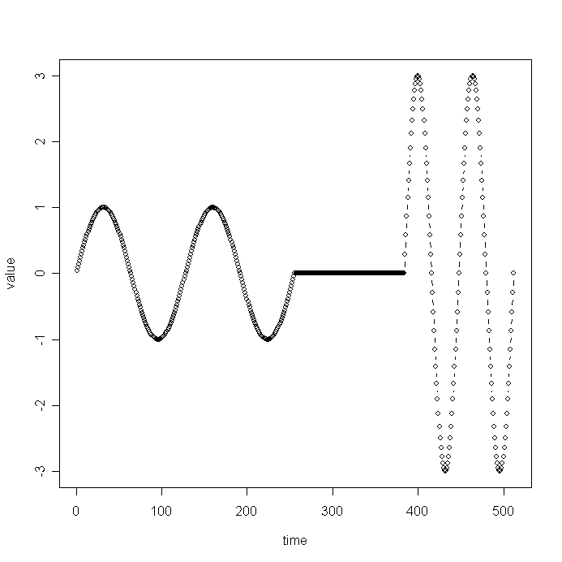
Wavelets - DWT
Similarly, DFT suffers on short-duration waves (eg., baritone, silence, soprano)
value
time

Slide 76
Wavelets - DWT
Solution#1: Short window Fourier transform (SWFT)
But: how short should be the window?
freq
value
time
time

Slide 77
Wavelets - DWT
Solution#1: Short window Fourier transform (SWFT)
But: how short should be the window?
A: VARIABLE length!
E.g., powers of 2

Slide 78
Haar Wavelets
subtract sum of left half from right half
repeat recursively for quarters, eight-ths, ...

Slide 79


Advantages of Wavelets
Better compression (better RMSE with same number of coefficients - used in JPEG-2000)
fast to compute (usually: O(n)!)
good for ‘spikes’
good for de-noising
mammalian eye and ear: Gabor wavelets

Slide 80
Overall Conclusions
DFT spots periodicities
DWT : multi-resolution - matches processing of mammalian ear/eye better
Both: powerful tools for compression, pattern detection in real signals

Slide 81
Resources: software and urls
xwpl: open source wavelet package from Yale, with excellent GUI
http://monet.me.ic.ac.uk/people/gavin/java/waveletDemos.html : wavelets and scalograms

Slide 82
Books
William H. Press, Saul A. Teukolsky, William T. Vetterling and Brian P. Flannery: Numerical Recipes in C, Cambridge University Press, 1992, 2nd Edition. (Great description, intuition and code for DFT, DWT)
C. Faloutsos: Searching Multimedia Databases by Content, Kluwer Academic Press, 1996 (introduction to DFT, DWT)

Slide 83
Additional Reading
[Gilbert+01] Anna C. Gilbert, Yannis Kotidis and S. Muthukrishnan and Martin Strauss, Surfing Wavelets on Streams: One-Pass Summaries for Approximate Aggregate Queries, VLDB 2001

Slide 84
Part 2.3:
Linear Forecasting

Slide 85
Outline
Motivation
...
Linear Forecasting
Auto-regression: Least Squares; RLS
Examples
Conclusions

Slide 86
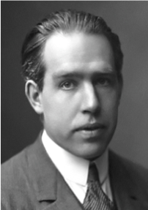
Forecasting
"Prediction is very difficult, especially about the future." - Nils Bohr
http://www.hfac.uh.edu/MediaFutures/thoughts.html

Slide 87
Problem#2: Forecast
given x_{t-1}, x_{t-2}, …,
Q: forecast x_{t}
90
80
70
60
??
50
40
30
20
10
0
1
3
5
7
9
11
Notes:
What are co-evolving time sequences? We define them as a set of correlated time sequences possibly with some time lags.
Let us take an example. Here we have three sequences.
Taking a closer look, we can see that the blue sequence is the same as the red one except that it is a shifted version. Also, the green sequence is somehow correlated with the red one.
What we propose is to study them jointly, to take advantage of the existence of such correlations.

Slide 88
Solution: AR(IMA)
given x_{t-1}, x_{t-2}, …,
Q: forecast x_{t}
A: AR(IMA) = Box-Jenkins (< Holt-Winters, Kalman)
90
x_{t}
80
70
60
??
50
40
30
x_{t-1}
20
10
0
1
3
5
7
9
11
Notes:
What are co-evolving time sequences? We define them as a set of correlated time sequences possibly with some time lags.
Let us take an example. Here we have three sequences.
Taking a closer look, we can see that the blue sequence is the same as the red one except that it is a shifted version. Also, the green sequence is somehow correlated with the red one.
What we propose is to study them jointly, to take advantage of the existence of such correlations.

Slide 89
Problem#2: Forecast
Solution: try to express
x_{t}
as a linear function of the past: x_{t-2}, x_{t-2}, …,
(up to a window of w)
Formally:
90
80
70
60
??
50
40
30
20
10
0
1
3
5
7
9
11
Time Tick
Notes:
What are co-evolving time sequences? We define them as a set of correlated time sequences possibly with some time lags.
Let us take an example. Here we have three sequences.
Taking a closer look, we can see that the blue sequence is the same as the red one except that it is a shifted version. Also, the green sequence is somehow correlated with the red one.
What we propose is to study them jointly, to take advantage of the existence of such correlations.

Slide 90
Linear Regression: idea
Body height
85
80
75
70
65
60
55
50
45
40
15
25
35
45
Body weight
express what we don’t know (= ‘dependent variable’)
as a linear function of what we know (= ‘indep. variable(s)’)
Notes:
For those in the audience who are not familiar with linear regression, let me give you an example to show how it works.
Here we have a scatter plot of sample points we want to regress. The X-axis is for the independent variable and the Y-axis for the dependent variable.
The goal is to find a line which best approximated the trend of the samples. More specifically we seek a line which minimize the sum of squared estimation errors.
This is a uni-variate regression. In the multi-variate case, it is done in a higher dimensional space and the line becomes a hyper-plane in that case.

Slide 91
Linear Auto Regression:
Notes:
For those in the audience who are not familiar with linear regression, let me give you an example to show how it works.
Here we have a scatter plot of sample points we want to regress. The X-axis is for the independent variable and the Y-axis for the dependent variable.
The goal is to find a line which best approximated the trend of the samples. More specifically we seek a line which minimize the sum of squared estimation errors.
This is a uni-variate regression. In the multi-variate case, it is done in a higher dimensional space and the line becomes a hyper-plane in that case.

Slide 92
Linear Auto Regression:
85
‘lag-plot’
80
75
70
65
Number of packets sent (t)
60
55
50
45
40
15
25
35
45
Number of packets sent (t-1)
lag w=1
Dependent variable = # of packets sent (S [t])
Independent variable = # of packets sent (S[t-1])
Notes:
For those in the audience who are not familiar with linear regression, let me give you an example to show how it works.
Here we have a scatter plot of sample points we want to regress. The X-axis is for the independent variable and the Y-axis for the dependent variable.
The goal is to find a line which best approximated the trend of the samples. More specifically we seek a line which minimize the sum of squared estimation errors.
This is a uni-variate regression. In the multi-variate case, it is done in a higher dimensional space and the line becomes a hyper-plane in that case.

Slide 93
Outline
Motivation
...
Linear Forecasting
Auto-regression: Least Squares; RLS
Examples
Conclusions

Slide 94
More details:
Q1: Can it work with window w>1?
A1: YES!
x_{t}
x_{t-1}
x_{t-2}
Notes:
This presentation is organized as follows:
In the introduction, let me describe what motivated this research. I also describe the kinds of problems we are trying to solve.
Nest, I’ll talk about our main contributions, namely, MUSCLES and Selective MUSCLES.
Then, we report some of experimental results followed by concluding remarks and discussion of future research direction.

Slide 95
More details:
Q1: Can it work with window w>1?
A1: YES! (we’ll fit a hyper-plane, then!)
x_{t}
x_{t-1}
x_{t-2}
Notes:
This presentation is organized as follows:
In the introduction, let me describe what motivated this research. I also describe the kinds of problems we are trying to solve.
Nest, I’ll talk about our main contributions, namely, MUSCLES and Selective MUSCLES.
Then, we report some of experimental results followed by concluding remarks and discussion of future research direction.

Slide 96
More details:
Q1: Can it work with window w>1?
A1: YES! (we’ll fit a hyper-plane, then!)
x_{t}
x_{t-1}
x_{t-2}
Notes:
This presentation is organized as follows:
In the introduction, let me describe what motivated this research. I also describe the kinds of problems we are trying to solve.
Nest, I’ll talk about our main contributions, namely, MUSCLES and Selective MUSCLES.
Then, we report some of experimental results followed by concluding remarks and discussion of future research direction.

Slide 97
More details:
Q1: Can it work with window w>1?
A1: YES! The problem becomes:
X_{[N ×w]} × a_{[w ×1]} = y_{[N ×1]}
OVER-CONSTRAINED
a is the vector of the regression coefficients
X has the N values of the w indep. variables
y has the N values of the dependent variable
Notes:
This presentation is organized as follows:
In the introduction, let me describe what motivated this research. I also describe the kinds of problems we are trying to solve.
Nest, I’ll talk about our main contributions, namely, MUSCLES and Selective MUSCLES.
Then, we report some of experimental results followed by concluding remarks and discussion of future research direction.

Slide 98
More details:
X_{[N ×w]} × a_{[w ×1]} = y_{[N ×1]}
Ind-var1
Ind-var-w
time
Notes:
This presentation is organized as follows:
In the introduction, let me describe what motivated this research. I also describe the kinds of problems we are trying to solve.
Nest, I’ll talk about our main contributions, namely, MUSCLES and Selective MUSCLES.
Then, we report some of experimental results followed by concluding remarks and discussion of future research direction.

Slide 99
More details:
X_{[N ×w]} × a_{[w ×1]} = y_{[N ×1]}
Ind-var1
Ind-var-w
time
Notes:
This presentation is organized as follows:
In the introduction, let me describe what motivated this research. I also describe the kinds of problems we are trying to solve.
Nest, I’ll talk about our main contributions, namely, MUSCLES and Selective MUSCLES.
Then, we report some of experimental results followed by concluding remarks and discussion of future research direction.

Slide 100
More details
Q2: How to estimate a₁, a₂, … a_{w} = a?
A2: with Least Squares fit
(Moore-Penrose pseudo-inverse)
a is the vector that minimizes the RMSE from y
a = ( X^{T} × X )⁻¹ × (X^{T} × y)

Slide 101
Solution: AR(IMA)
given x_{t-1}, x_{t-2}, …,
Q: forecast x_{t}
A: AR(IMA) = Box-Jenkins (< Holt-Winters, Kalman)
90
x_{t}
80
70
60
??
50
40
30
x_{t-1}
20
10
0
1
3
5
7
9
11
Notes:
What are co-evolving time sequences? We define them as a set of correlated time sequences possibly with some time lags.
Let us take an example. Here we have three sequences.
Taking a closer look, we can see that the blue sequence is the same as the red one except that it is a shifted version. Also, the green sequence is somehow correlated with the red one.
What we propose is to study them jointly, to take advantage of the existence of such correlations.

Slide 102
Resources: software and urls
free-ware: ‘R’ for stat. analysis
(clone of Splus)
http://cran.r-project.org/

Slide 103
Books
George E.P. Box and Gwilym M. Jenkins and Gregory C. Reinsel, Time Series Analysis: Forecasting and Control, Prentice Hall, 1994 (the classic book on ARIMA, 3rd ed.)
Brockwell, P. J. and R. A. Davis (1987). Time Series: Theory and Methods. New York, Springer Verlag.

Slide 104
Additional Reading
[Papadimitriou+ vldb2003] Spiros Papadimitriou, Anthony Brockwell and Christos Faloutsos Adaptive, Hands-Off Stream Mining VLDB 2003, Berlin, Germany, Sept. 2003
[Yi+00] Byoung-Kee Yi et al.: Online Data Mining for Co-Evolving Time Sequences, ICDE 2000. (Describes MUSCLES and Recursive Least Squares)

Slide 105
Part 2.4:
chaos and
non-linear forecasting

Slide 106
Outline
Motivation
Similarity Search and Indexing
DSP
Linear Forecasting
Non-linear forecasting
Conclusions

Slide 107
Detailed Outline
Non-linear forecasting
Problem
Idea
How-to
Experiments
Conclusions

Slide 108
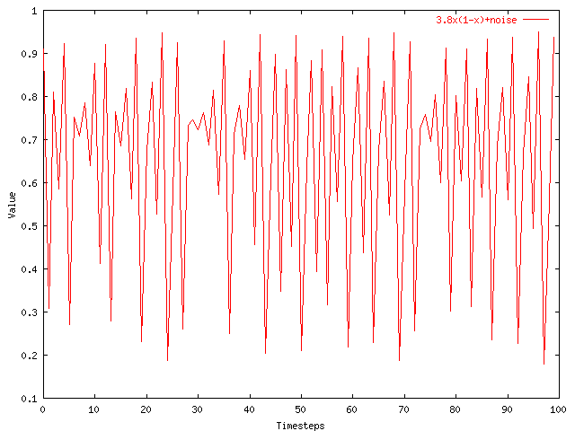
Problem: Forecast
given x_{t-1}, x_{t-2}, …, (‘chaotic’/non-linear)
Q: forecast x_{t}
Notes:
What are co-evolving time sequences? We define them as a set of correlated time sequences possibly with some time lags.
Let us take an example. Here we have three sequences.
Taking a closer look, we can see that the blue sequence is the same as the red one except that it is a shifted version. Also, the green sequence is somehow correlated with the red one.
What we propose is to study them jointly, to take advantage of the existence of such correlations.

Slide 109
Solution
given x_{t-1}, x_{t-2}, …, (‘chaotic’/non-linear)
Q: forecast x_{t}
A: lag-plots + sim. search (= ‘Delayed Coordinate Embedding’)
x_{t}
X_{t-1}
Notes:
What are co-evolving time sequences? We define them as a set of correlated time sequences possibly with some time lags.
Let us take an example. Here we have three sequences.
Taking a closer look, we can see that the blue sequence is the same as the red one except that it is a shifted version. Also, the green sequence is somehow correlated with the red one.
What we propose is to study them jointly, to take advantage of the existence of such correlations.

Slide 110
Recall: Problem
Value
Time
Given a time series {x_{t}}, predict its future course, that is, x_{t+1}, x_{t+2}, ...

Slide 111
How to forecast?
ARIMA - but: linearity assumption
ANSWER: ‘Delayed Coordinate Embedding’ = Lag Plots [Sauer94]

Slide 112

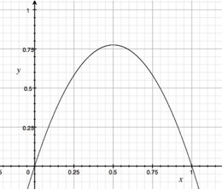
ARIMA pitfall
Example: logistic parabola
Models population of flies [R. May/1976]
Logistic map
Time-series plot
Time t
Notes:
x_{t+1} = a x_t \cdot \left( 1-x_t \right )

Slide 113
ARIMA pitfall
Example: logistic parabola
Models population of flies [R. May/1976]
Logistic map
= SI virus prop. model
~ Bass equation (market penetration)
Special case of Lotka-Volterra
Notes:
x_{t+1} = a x_t \cdot \left( 1-x_t \right )

Slide 114
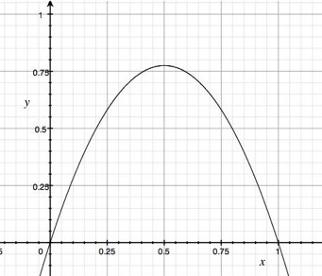
ARIMA pitfall
Linear equations, e.g., AR, ARIMA, …
Notes:
x_{t+1} = a x_t + \epsilon

Slide 115
ARIMA pitfall
Linear equations, e.g., AR, ARIMA, …
e.g., AR(1)
Notes:
x_{t+1} = a x_t + \epsilon

Slide 116
ARIMA pitfall
Linear equations, e.g., AR, ARIMA, …
AR fit: fails
e.g., AR(1)
Notes:
x_{t+1} = a x_t + \epsilon

Slide 117
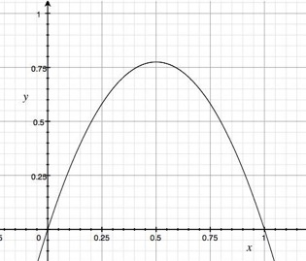
Solution?
“Delayed Coordinate Embedding”
= Lag Plots [Sauer94]
k-nearest neighbor search
Notes:
x_{t+1} = a x_t + \epsilon

Slide 118
General Intuition (Lag Plot)
Lag = 1, k = 4 NN
x_{t}
Interpolate these…
To get the final prediction
x_{t-1}
4-NN
New Point

Slide 119
Q: How to interpolate?
How do we interpolate between the k nearest neighbors?
A1: Average
A2: Weighted average (weights drop with distance - how?)

Slide 120
Q: How to interpolate?
A3: Using SVD - seems to perform best ([Sauer94] - first place in the Santa Fe forecasting competition)
x_{t}
X_{t-1}

Slide 121
Q’: Any theory behind it?
A’: YES!

Slide 122

Theoretical foundation
Based on the “Takens’ Theorem” [Takens81]
which says that long enough delay vectors can do prediction, even if there are unobserved variables in the dynamical system (= diff. equations)

Slide 123
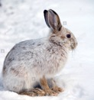
Theoretical foundation
Example: Lotka-Volterra equations
dH/dt = r H – a H*P dP/dt = b H*P – m P
H is count of prey (e.g., hare) P is count of predators (e.g., lynx)
Suppose only P(t) is observed (t=1, 2, …).
P
H

Slide 124
Theoretical foundation
But the delay vector space is a faithful reconstruction of the internal system state
So prediction in delay vector space is as good as prediction in state space
P
P(t)
H
P(t-1)

Slide 125
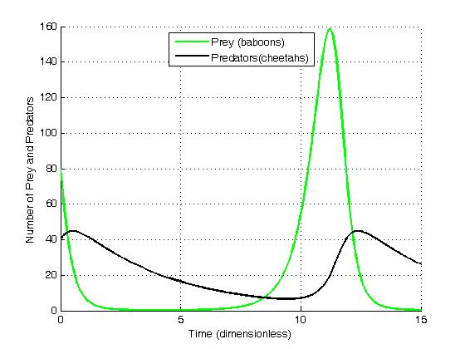
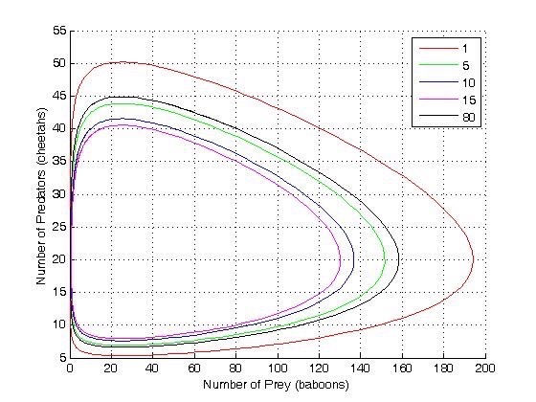
Solution to Lotka-Volterra eq.
# predators
prey
predators
# prey
time
from wikipedia

Slide 126
Notice: LV are vital!
Example: Lotka-Volterra equations
dH/dt = r H – a H*P dP/dt = b H*P – m P
Prey-predator
Competing animals (rabbits/goats)
Self-competition (Bass model)
Competing products (stocks/bonds)
P
H

Slide 127


The Web as a Jungle: Non-Linear Dynamical Systems for Co-evolving Online Activities
Yasuko Matsubara (Kumamoto University)
Yasushi Sakurai (Kumamoto University)
Christos Faloutsos (CMU)
Open source code: here

Slide 128
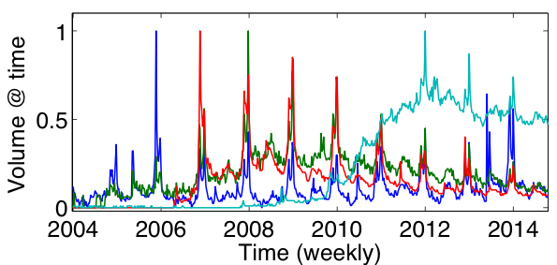
Given: online user activities
Xbox, PlayStation, Wii, Android
Notes:
http://www.youtube.com/watch?v=6UV3kRV46Zs&t=49s

Slide 129




The Web as a jungle
Ecosystem on the
Web
Xbox
PlayStation
Wii
Android
Kids
Teens
Adults

Slide 130
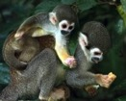










The Web as a jungle
Squirrel monkeys
Spider
monkeys
Macaws
Capybaras
Fruits
Nuts
Grass
Ecosystem on the
Web
Ecosystem in the
Jungle
Kids
Teens
Adults

Slide 131

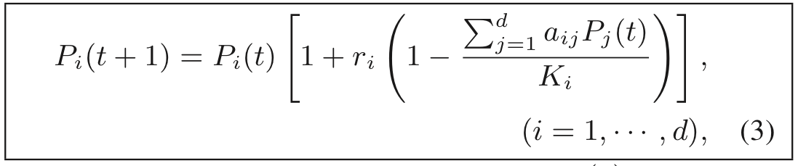
LV equations
Interaction between multiple (‘d’) species/products/viruses
…
- effect of species j on species i
(positive: hurts)

Slide 132
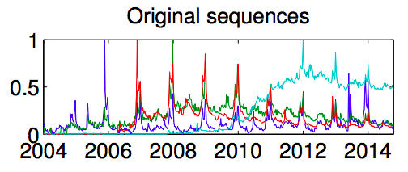
EcoWeb at work - forecasting
Train:
2/3 sequences
Forecast:
1/3 following years
?

Slide 133
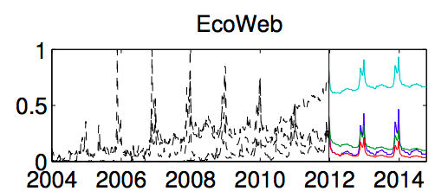
EcoWeb at work - forecasting
Train:
2/3 sequences
Forecast:
1/3 following years
EcoWeb can capture future patterns

Slide 134
EcoWeb at work - forecasting
Open source code: here

Slide 135
Detailed Outline
Non-linear forecasting
Problem
Idea
How-to
Experiments
Conclusions

Slide 136

Datasets
LORENZ: Models convection currents in the air
dx / dt = a (y - x)
dy / dt = x (b - z) - y
dz / dt = xy - c z

Slide 137

Datasets
LORENZ: Models convection currents in the air
dx / dt = a (y - x)
dy / dt = x (b - z) - y
dz / dt = xy - c z
Non-linear ->
‘butterfly effect’

Slide 138
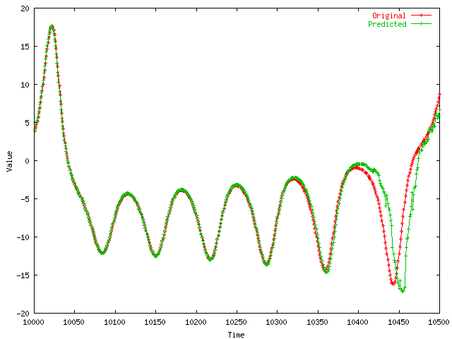
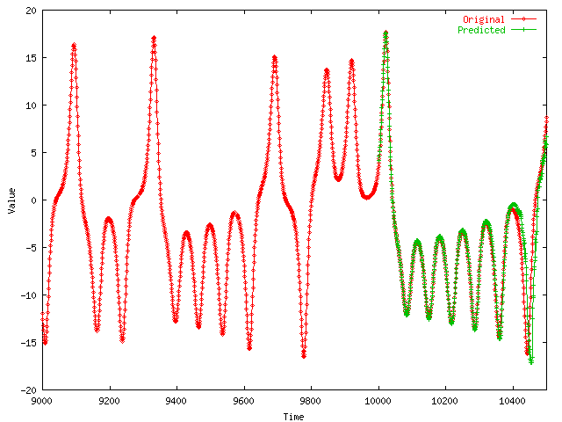
LORENZ
Value
Comparison of prediction to correct values
Timesteps

Slide 139
Solution
given x_{t-1}, x_{t-2}, …, (‘chaotic’/non-linear)
Q: forecast x_{t}
A: lag-plots + sim. search (= ‘Delayed Coordinate Embedding’)
x_{t}
X_{t-1}
Notes:
What are co-evolving time sequences? We define them as a set of correlated time sequences possibly with some time lags.
Let us take an example. Here we have three sequences.
Taking a closer look, we can see that the blue sequence is the same as the red one except that it is a shifted version. Also, the green sequence is somehow correlated with the red one.
What we propose is to study them jointly, to take advantage of the existence of such correlations.

Slide 140
References
Deepay Chakrabarti and Christos Faloutsos F4: Large-Scale Automated Forecasting using Fractals CIKM 2002, Washington DC, Nov. 2002.
Sauer, T. (1994). Time series prediction using delay coordinate embedding. (in book by Weigend and Gershenfeld, below) Addison-Wesley.
Takens, F. (1981). Detecting strange attractors in fluid turbulence. Dynamical Systems and Turbulence. Berlin: Springer-Verlag.

Slide 141
References
Weigend, A. S. and N. A. Gerschenfeld (1994). Time Series Prediction: Forecasting the Future and Understanding the Past, Addison Wesley. (Excellent collection of papers on chaotic/non-linear forecasting, describing the algorithms behind the winners of the Santa Fe competition.)

Slide 142
Overall conclusions (Part 2: time series)
P1.1. Similarity search: Euclidean/time-warping; feature extraction and SAMs
P1.2. Signal processing: DFT, DWT are powerful tools
P1.3. Linear Forecasting: AR (Box-Jenkins)
P1.4. Non-linear forecasting: lag-plots

Slide 143
End of Part 2
P2

Slide 144

Summary
P1
P2
=
https://www.cs.cmu.edu/~christos/TALKS/19-10-JPM/

Slide 145
MANY, time-tested tools
Summary
P1
P2
=
https://www.cs.cmu.edu/~christos/TALKS/19-10-JPM/

Slide 146

MANY, time-tested tools
THANK YOU!
P1
christos AT cs.cmu.edu
www.cs.cmu.edu/~christos
P2
=
https://www.cs.cmu.edu/~christos/TALKS/19-10-JPM/

