Slide 1
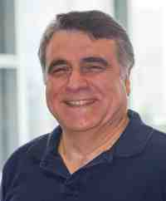
Graph and Time Series Mining:
Tools and Applications
Part 1: Graphs
Christos Faloutsos
CMU SCS
https://www.cs.cmu.edu/~christos/TALKS/19-10-JPM/

Slide 2
(audience wish-list)
‘applicability to my role’
‘how math works under the hood’
‘understand key drawbacks & watch-outs’
https://www.cs.cmu.edu/~christos/TALKS/19-10-JPM/

Slide 3



(audience wish-list)
‘applicability to my role’
  use cases
‘how math works under the hood’
  deep dives
‘understand key drawbacks & watch-outs’
  watch-out
https://www.cs.cmu.edu/~christos/TALKS/19-10-JPM/

Slide 4


‘Recipe’ Structure:
Problem definition / use case
Short answer/solution
LONG answer – deep dive
Conclusion/short-answer

Slide 5
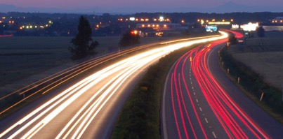
Roadmap
Introduction
Part#1: Graphs and Tensors
Part#2: Time series
Conclusions

Slide 6
Roadmap
Introduction – Motivation
Part#1: Graphs and Tensors
  P1.1: recommendation
  P1.2: belief propagation
  P1.3: properties/patterns in graphs
  P1.4: fraud/anomaly detection
  P1.5: Time-evolving graphs / Tensors

Slide 7







Use case #1
Recommendation
??
…
…

Slide 8
Use case #1
Recommendation
??
…
…

Slide 9



Use case #2
Anomaly detection (e.g., anti-money-laundering)
....
...
...

Slide 10

Use case #2’
Computer network intrusion detection
....
...
...

Slide 11
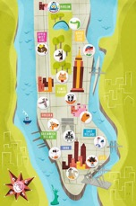
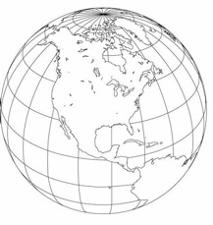
Use case #2’’
Credit card fraud
10017
10016
10015
…
…
99801

Slide 12
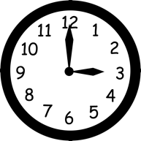
Use case #2’’’
Anomaly detection, over time
....
6/10
...
7/3
8/9
6/1
6/2
6/2
...
6/1

Slide 13
Use case #2’’’
Anomaly detection, over time
....
6/10
...
7/3
8/9
6/1
6/2
8/10
6/2
...
8/11
6/1

Slide 14

Use case #2’’’’
Anomaly detection, w/ weights
$50
$10
…
…
$333

Slide 15
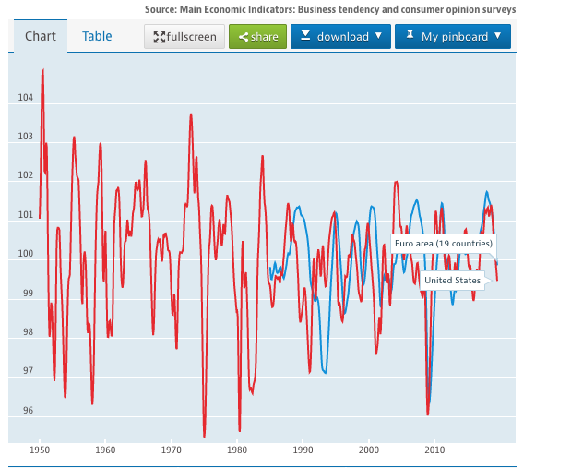
Use case #3: time series
Given: one or more sequences
  x₁ , x₂ , … , x_{t} , …
  (y₁, y₂, … , y_{t}, …
  … )
Find
  Forecast; similar sequences
  patterns; clusters; outliers
https://data.oecd.org/
BCI; US+EU

Slide 16
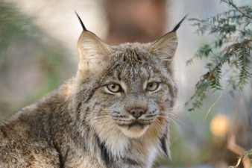
Use case #3’: forecast
Goal: given a signal (eg., $ over time)
Find: patterns and/or compress
count
lynx caught per year
(packets per day;
automobiles per hour)
year

Slide 17
Use case #3’: time series
Forecasting / Churn:
90
80
70
60
Customer activity ($)
??
50
40
30
20
10
0
1
3
5
7
9
11
Time Tick

Slide 18





Roadmap
Introduction – Motivation
Part#1: Graphs and Tensors
  P1.1: recommendation
  P1.2: belief propagation
  P1.3: properties/patterns in graphs
  P1.4: fraud/anomaly detection
  P1.5: Time-evolving graphs / Tensors

Slide 19
Roadmap
Introduction – Motivation
Part#1: Graphs and Tensors
  P1.1: recommendation
  P1.2: belief propagation
  P1.3: properties/patterns in graphs
  P1.4: fraud/anomaly detection
  P1.5: Time-evolving graphs / Tensors

Slide 20
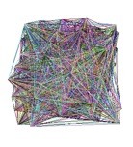
Roadmap
Introduction – Motivation
Part#1: Graphs and Tensors
  P1.1: recommendation
  P1.2: belief propagation
  P1.3: properties/patterns in graphs
  P1.4: fraud/anomaly detection
  P1.5: Time-evolving graphs / Tensors
?
?

Slide 21
Roadmap
Introduction – Motivation
Part#1: Graphs and Tensors
  P1.1: recommendation
  P1.2: belief propagation
  P1.3: properties/patterns in graphs
  P1.4: fraud/anomaly detection
  P1.5: Time-evolving graphs / Tensors
?

Slide 22
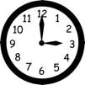
Roadmap
Introduction – Motivation
Part#1: Graphs and Tensors
  P1.1: recommendation
  P1.2: belief propagation
  P1.3: properties/patterns in graphs
  P1.4: fraud/anomaly detection
  P1.5: Time-evolving graphs / Tensors
…

Slide 23
Roadmap
Introduction – Motivation
Part#1: Graphs and Tensors
  P1.1: recommendation
  P1.2: belief propagation
  P1.3: properties/patterns in graphs
  P1.4: fraud/anomaly detection
  P1.5: Time-evolving graphs / Tensors

Slide 24







Problem: Use case #1
Q: What to recommend? And how?
??
…
…

Slide 25
Solution: Use case #1
Q: What to recommend? And how?
A1: random surfer (Personalized random walk)
A2: belief propagation
??
…
…

Slide 26
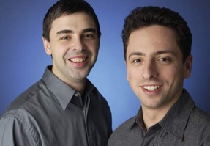
Personalized P.R.
Taher H. Haveliwala. 2002. Topic-sensitive PageRank. (WWW '02). 517-526. http://dx.doi.org/10.1145/511446.511513
Page L., Brin S., Motwani R., and Winograd T. (1999). The PageRank citation ranking: Bringing order to the web. Technical Report
Larry Page
Sergey Brin
Notes:
The solution to this questions is going to be personalized PageRank or PPR

Slide 27
Extension: Personalized P.R.
How close is ‘red tie person’ to ‘LinkedIn’?
??
…
…
Notes:
Such a question can arise, e.g., in the recommendation context: If a user likes
page/node 2, what else would you recommend?

Slide 28
Extension: Personalized P.R.
How close is ‘red tie person’ to ‘LinkedIn’?
2
1
3
??
…
…
4
5
Notes:
Such a question can arise, e.g., in the recommendation context: If a user likes
page/node 2, what else would you recommend?

Slide 29
Extension: Personalized P.R.
How close is ‘4’ to ‘2’?
(or: if I like page/node ‘2’, what else would you recommend?)
2
1
3
??
…
…
4
5
Notes:
Such a question can arise, e.g., in the recommendation context: If a user likes
page/node 2, what else would you recommend?

Slide 30
Extension: Personalized P.R.
How close is ‘4’ to ‘2’?
(or: if I like page/node ‘2’, what else would you recommend?)
2
1
3
4
5
Notes:
Such a question can arise, e.g., in the recommendation context: If a user likes
page/node 2, what else would you recommend?

Slide 31
Extension: Personalized P.R.
How close is ‘4’ to ‘2’?
(or: if I like page/node ‘2’, what else would you recommend?)
2
1
3
4
5
Notes:
The idea here is that one node 4 is similar to 2, if it is easy to reach node 4
from node 2. Here’s one path.

Slide 32
Extension: Personalized P.R.
How close is ‘4’ to ‘2’?
(or: if I like page/node ‘2’, what else would you recommend?)
2
1
3
4
5
Notes:
Here’s another path.

Slide 33
Extension: Personalized P.R.
How close is ‘4’ to ‘2’?
(or: if I like page/node ‘2’, what else would you recommend?)
High score (A -> B) if
Many
Short
Heavy
paths A->B
2
1
3
4
5
Notes:
We say that node 4 is highly relevant to node 2, if there are many short and
heavy paths between 2 and 4. In other words, if it is easy to reach node 4
from node 2. We are going to measure this using PPR (Personalized PageRank).

Slide 34



Extension: Personalized P.R.
DETAILS
With probability 1-c, fly-out to a random node(s)
Then, we have
  p = c B p + (1-c)/n 1 =>
  p = (1-c)/n [I - c B] ⁻¹ 1
your favorite
$$\vec{e}$$
$$\vec{e}$$
$$\vec{e}$$
Notes:
Remember those random fly-outs in PageRank? Well, in PPR, the fly-out is
to the origin node rather than to the random node. If we want to know how
relevant is each node to node 2, we fly-out to node two. Mathematically,
this comes down to replacing the all-one vector in the fly-out term with
node 2-specific restart vector. PageRank and PPR have very similar equations.

Slide 35



Extension: Personalized P.R.
How close is ‘4’ to ‘2’?
A: compute Personalized P.R. of ‘4’, restarting from ‘2’
2
1
3
4
5
Notes:
So, to answer the question of how close if node 4 to node 2, compute PPR
of node 4, when restarting to node 2. […]

Slide 36
Extension: Personalized P.R.
How close is ‘4’ to ‘2’?
A: compute Personalized P.R. of ‘4’, restarting from ‘2’
How to compute it quickly?
Notes:
As a side note, PPR probabilities are related to escape and
round trip probabilities.

Slide 37
Extension: Personalized P.R.
How close is ‘4’ to ‘2’?
A: compute Personalized P.R. of ‘4’, restarting from ‘2’
How to compute it quickly?
A: ‘Pixie’ algorithm
Notes:
As a side note, PPR probabilities are related to escape and
round trip probabilities.

Slide 38
Extension: Personalized P.R.
Q: Faster computation than:
  p = (1-c)/n [I - c B] ⁻¹ e
Notes:
A nice property of PPR is the ability to write down the scores analytically.
In order to find PPR scores p, compute expression on the right. This
expression involves matrices that are going to be large for large graphs. It is
then natural to ask if there is a more efficient way to compute PPR scores.

Slide 39

Pixie algorithm
Chantat Eksombatchai, Pranav Jindal, Jerry Zitao Liu, Yuchen Liu, Rahul Sharma, Charles Sugnet, Mark Ulrich, Jure Leskovec:
Pixie: A System for Recommending 3+ Billion Items to 200+ Million Users in Real-Time. WWW 2018: 1775-1784
https://dl.acm.org/citation.cfm?doid=3178876.3186183
Notes:
As it turns out, there is. In a recent paper, authors were using PPR for making
recommendations at Pinterest. Their graph is very large, it contains billions
of edges. Therefore, the authors proposed a new algorithm called Pixie that
computes approximate PPR scores faster than the analytical method.

Slide 40
Pixie algorithm
Q: Faster computation than:
  p = (1-c)/n [I - c B] ⁻¹ e
A: simulate a few R.W.
  keep visit counts C_{i}
  fast and nimble
Notes:
Instead of using analytic expression, Pixie proposes to simulate random walks.
Suppose, we are looking for recommendations for this. The idea of PPR is
to recommend nodes easily reachable from this node. The idea of Pixie, is
to find such nodes, but simulating random walks starting here, and keeping
visit counts for every other nodes. Fast and easy!

Slide 41
Personalized PageRank algorithm
Notes:
Here’s an illustration. We start random walk here, …

Slide 42

Personalized PageRank algorithm
Notes:
we keep track of visit counts, …

Slide 43
Personalized PageRank algorithm

Slide 44
Personalized PageRank algorithm
Notes:
visiting another node, recording.

Slide 45
Personalized PageRank algorithm
Notes:
With some probability, we restart to the origin, and repeat the process.

Slide 46
Personalized PageRank algorithm

Slide 47
Personalized PageRank algorithm
..
…
..
…
Notes:
After a pre-defined number of walks, we identify most visited nodes, as
recommendations for the original node.

Slide 48
Solution: Use case #1
Q: What to recommend? And how?
A1: random surfer (Personalized random walk)
A2: belief propagation
??
…
…

Slide 49
Roadmap
Introduction – Motivation
Part#1: Graphs and Tensors
  P1.1: recommendation
  P1.2: belief propagation
  P1.3: properties/patterns in graphs
  P1.4: fraud/anomaly detection
  P1.5: Time-evolving graphs / Tensors

Slide 50
Problem: Use case #1
Q: What to recommend? And how?
??
…
…

Slide 51
Problem
What color, for the rest?
  Given homophily (/heterophily etc)?
??
…
…

Slide 52
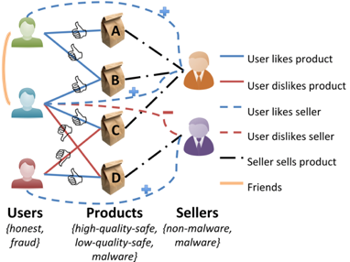
Solution: Use case #1
Q: What to recommend? And how?
A1: random surfer (Personalized random walk)
A2: belief propagation
??
…
…

Slide 53
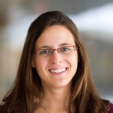
Background
Prof. Danai Koutra
U. Michigan

Slide 54

Belief Propagation
“Propagation matrix”:
  Homophily
Iterative message-based method
AI
class of receiver
class of
sender
0.9 | 0.1
0.1 | 0.9
...
until stop criterion fulfilled
1st round
2nd round
PL
[Pearl ‘82][Yedidia+ ’02] … [Gonzalez+ ‘09][Chechetka+ ‘10]
Notes:
Class of receiver / class of sender : without bubbles

Slide 55

Belief Propagation Equations
message(i −> j) ≈ belief(i) • homophily strength
0.9 | 0.1
0.2 | 0.8
…
…
i
j
Notes:
Equations of original BP: “Notice non-linearity” + grey background + citations →na xwrisw sta 2 + zwgrafia sto xarti (prior belief san tou ukang, + mhnymata geitonwn
NOTATION for messages etc - this is non-linear

Slide 56
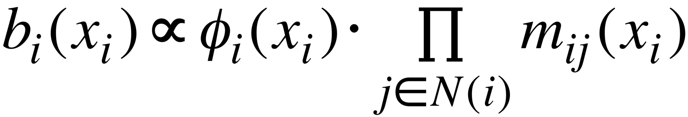
Belief Propagation Equations
belief of i
prior
belief
messages from neighbors
…
i
j
Notes:
Equations of original BP: “Notice non-linearity” + grey background + citations →na xwrisw sta 2 + zwgrafia sto xarti (prior belief san tou ukang, + mhnymata geitonwn
NOTATION for messages etc - this is non-linear

Slide 57
Background

Slide 58
Unifying Guilt-by-Association Approaches:
Theorems and Fast Algorithms
Danai Koutra
U Kang
Hsing-Kuo Kenneth Pao
Tai-You Ke
Duen Horng (Polo) Chau
Christos Faloutsos
ECML PKDD, 5-9 September 2011, Athens, Greece
Notes:
Work in collaboration with National Taiwan University

Slide 59
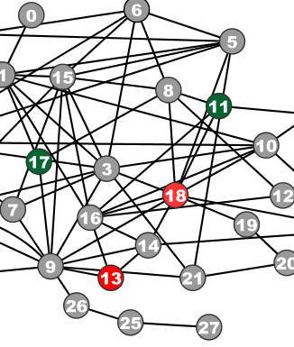
Problem Definition:
GBA techniques
?
Given: Graph; &
few labeled nodes
Find: labels of rest
(assuming network effects)
?
?
?
Notes:
Classification problem where we assume that neighboring nodes are related
Network effects – birds of a feather flock together

Slide 60
Problem Definition:
GBA techniques
?
Given: Graph; &
few labeled nodes
Find: labels of rest
(assuming network effects)
?
?
?
Notes:
Classification problem where we assume that neighboring nodes are related
Network effects – birds of a feather flock together

Slide 61

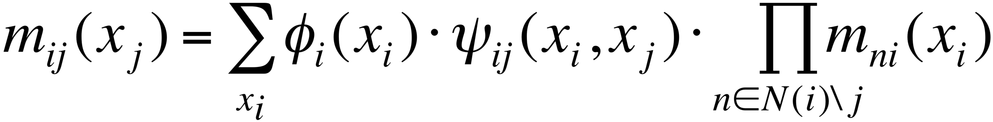
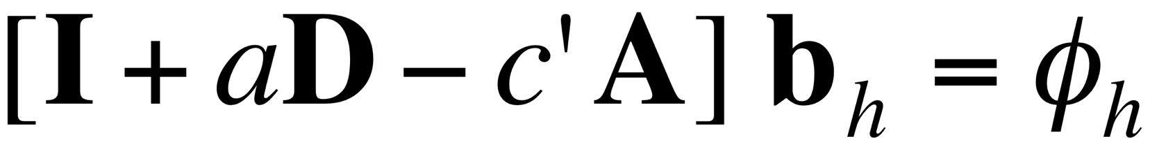
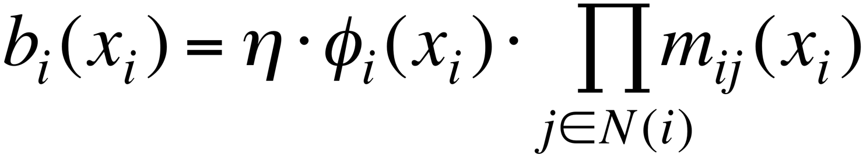
BP vs. Linearized BP
Original [Yedidia+]:
Our proposal:
Belief Propagation
BP is approximated by
Linearized BP
1
1
1
d1
d2
d3
0 1 0
1 0 1
0 1 0
?
0
-10⁻²
10⁻²
non-linear
linear
Closed-form formula?
Convergence?
Notes:
Half: yedidia equations → non-linear equations
Half: theorem -→ linear
Swap!

Slide 62
BP vs. Linearized BP
Original [Yedidia+]:
Our proposal:
Belief Propagation
BP is approximated by
Linearized BP
1
1
1
d1
d2
d3
0 1 0
1 0 1
0 1 0
?
0
10⁻²
10⁻²
non-linear
linear
Closed-form formula?
Convergence?
Notes:
Half: yedidia equations → non-linear equations
Half: theorem -→ linear
Swap!

Slide 63
Are they related?
RWR (Random Walk with Restarts)
  google’s pageRank (‘if my parents are important, I’m important, too’)
SSL (Semi-supervised learning)
  minimize the differences among neighbors
BP (Belief propagation)
  send messages to neighbors, on what you believe about them

Slide 64
Are they related?
YES!
RWR (Random Walk with Restarts)
  google’s pageRank (‘if my parents are important, I’m important, too’)
SSL (Semi-supervised learning)
  minimize the differences among neighbors
BP (Belief propagation)
  send messages to neighbors, on what you believe about them

Slide 65
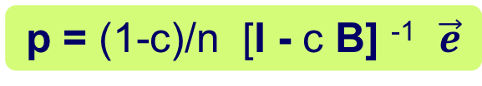
Correspondence of Methods
p = (1-c)/n [I - c B] ⁻¹ $\vec{e}$
Method | Matrix |  | Unknown |  | known
RWR | [I – c AD⁻¹] | × | x | = | (1-c)y
SSL | [I + a(D - A)] | × | x | = | y
FABP | [I + a D - c’A] | × | b_{h} | = | φ_{h}
1
1
1
d1
d2
d3
0 1 0
1 0 1
0 1 0
?
0
1
1
adjacency matrix
final labels/ beliefs
prior labels/ beliefs

Slide 66

Problem: e-commerce ratings fraud
Given a heterogeneous graph on users, products, sellers and positive/negative ratings with “seed labels”
Find the top k most fraudulent users, products and sellers

Slide 67
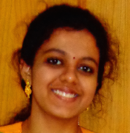
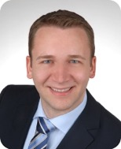
Problem: e-commerce ratings fraud
Given a heterogeneous graph on users, products, sellers and positive/negative ratings with “seed labels”
Find the top k most fraudulent users, products and sellers
Dhivya Eswaran, Stephan Günnemann, Christos Faloutsos, “ZooBP: Belief Propagation for Heterogeneous Networks”, VLDB 2017

Slide 68
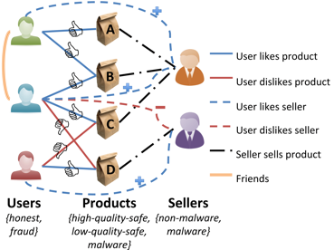
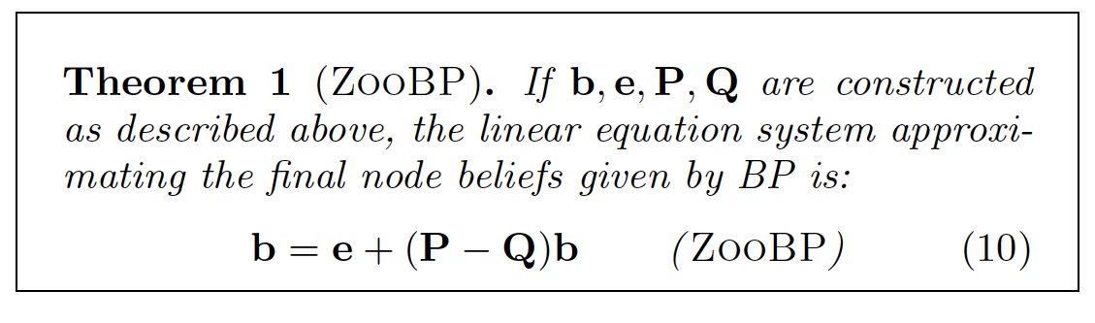
Problem: e-commerce ratings fraud
Dhivya Eswaran, Stephan Günnemann, Christos Faloutsos, “ZooBP: Belief Propagation for Heterogeneous Networks”, VLDB 2017

Slide 69
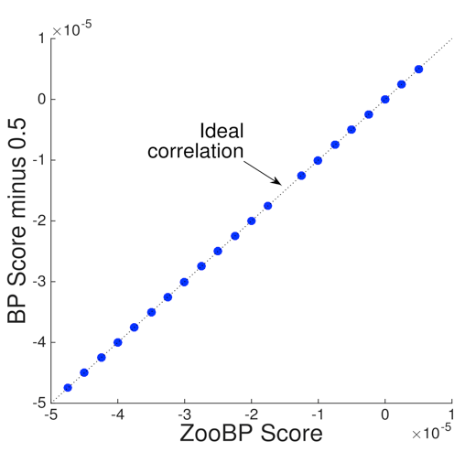
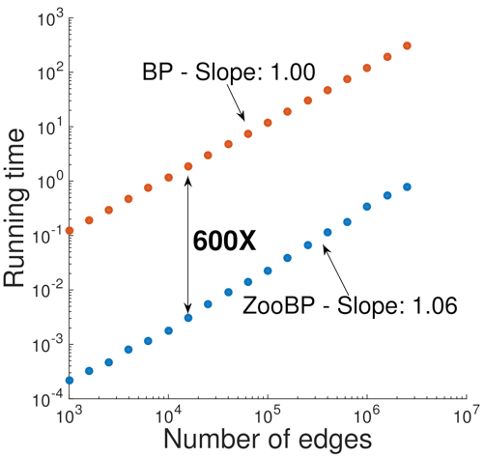
ZooBP: features
Fast; convergence guarantees.
600x (matlab)
3x (C++)
ideal
Near-perfect accuracy
linear in graph size
Dhivya Eswaran, Stephan Günnemann, Christos Faloutsos, “ZooBP: Belief Propagation for Heterogeneous Networks”, VLDB 2017

Slide 70

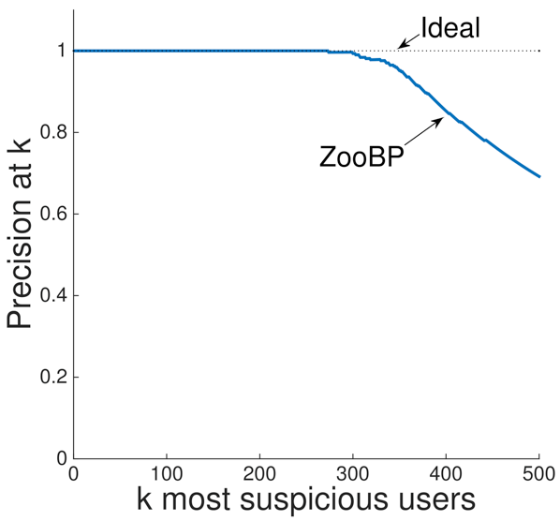
ZooBP in the real world
Near 100% precision on top 300 users (Flipkart)
Flagged users: suspicious
  400 ratings in 1 sec
  5000 good ratings and no bad ratings
Dhivya Eswaran, Stephan Günnemann, Christos Faloutsos, “ZooBP: Belief Propagation for Heterogeneous Networks”, VLDB 2017

Slide 71

ZooBP: code etc
http://www.cs.cmu.edu/~deswaran/code/zoobp.zip
Dhivya Eswaran, Stephan Günnemann, Christos Faloutsos, “ZooBP: Belief Propagation for Heterogeneous Networks”, VLDB 2017

Slide 72
Used for
Fraud detection in PwC [KDD’09]
Malware detection in Symantec [SDM’11]
…

Slide 73

Short answer:
What color, for the rest?
A: Belief Propagation (‘zooBP’)
www.cs.cmu.edu/~deswaran/code/zoobp.zip

Slide 74
Roadmap
Introduction – Motivation
Part#1: Graphs and Tensors
  P1.1: recommendation
  P1.2: belief propagation
  P1.3: properties/patterns in graphs
  P1.4: fraud/anomaly detection
  P1.5: Time-evolving graphs / Tensors
?

Slide 75
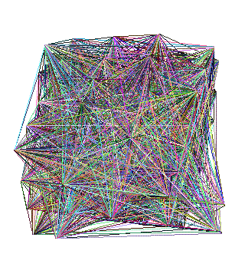
Why care about patterns?

Slide 76
Why care about patterns?
Anomalies
Faster algorithms
Graph generators (‘what if’ scenarios)

Slide 77

Why care about patterns?
Anomalies
Faster algorithms
Graph generators (‘what if’ scenarios)
Patterns anomalies

Slide 78
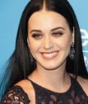
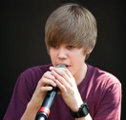
Why care about patterns?
Anomalies
Faster algorithms
Graph generators (‘what if’ scenarios)
Patterns anomalies

Slide 79
Why care about patterns?
Anomalies
Faster algorithms
Graph generators (‘what if’ scenarios)
  Graph500.org
Patterns anomalies

Slide 80
‘Recipe’ Structure:
Problem definition / use case
Short answer/solution
LONG answer – deep dive
Conclusion/short-answer

Slide 81
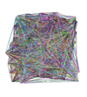






Problem definition
?
?
Are real graphs random?
  S*: what do static graphs look like?
...

Slide 82
Short answer(s)
?
?
Are real graphs random?
  S*: what do static graphs look like?
    S.0: ‘six degrees’
    S.1: skewed degree distribution
    S.2: skewed eigenvalues
    S.3: triangle power-laws
    S.4: GCC; and skewed distr. of conn. comp.

Slide 83
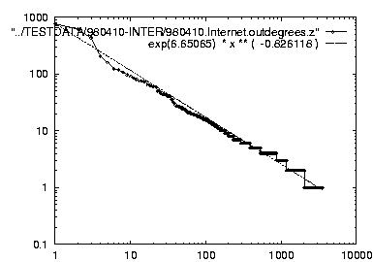
Short answer(s)
?
?
Are real graphs random?
  S*: what do static graphs look like?
    S.0: ‘six degrees’
    S.1: skewed degree distribution
    S.2: skewed eigenvalues
    S.3: triangle power-laws
    S.4: GCC; and skewed distr. of conn. comp.
Power laws: y ~ xª
NOT Gaussians
Take logarithms
y (log scale)
a
x (log scale)

Slide 84
Graph mining
Are real graphs random?
...

Slide 85
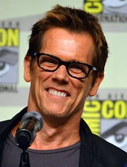
Laws and patterns
Q: Are real graphs random?
A: NO!!
  S.0: Diameter (‘6 degrees’; ‘Kevin Bacon’)
  in- and out- degree distributions
  other (surprising) patterns
So, let’s look at the data

Slide 86
Short answer(s)
?
?
Are real graphs random?
  S*: what do static graphs look like?
    S.0: ‘six degrees’
    S.1: degree distribution
    S.2: skewed eigenvalues
    S.3: triangle power-laws
    S.4: GCC; and skewed distr. of conn. comp.

Slide 87
S.1 - rank-degree plot
Any pattern?

Slide 88
S.1 - rank-degree plot
Power law in the degree distribution [SIGCOMM99]
internet domains
att.com
log(degree)
ibm.com
-0.82
log(rank)

Slide 89
S.1 - rank-degree plot
Power law in the degree distribution [SIGCOMM99]
internet domains
att.com
log(degree)
ibm.com
-0.82
log(rank)

Slide 90



S.1 - Skewed distributions
Zipf
80-20
Pareto
Rich-get-richer
Preferential attachment
Matthew effect
CRP
…
att.com
ibm.com
-0.82

Slide 91
Short answer(s)
?
?
Are real graphs random?
  S*: what do static graphs look like?
    S.0: ‘six degrees’
    S.1: skewed degree distribution
    S.2: skewed eigenvalues
    S.3: triangle power-laws
    S.4: GCC; and skewed distr. of conn. comp.

Slide 92
S.3: Triangle ‘Law’
Real social networks have a lot of triangles

Slide 93
S.3: Triangle ‘Law’
Real social networks have a lot of triangles
  Friends of friends are friends
Any patterns? 2x friends -> 2x triangles ?

Slide 94
S.3: Triangle ‘Law’
Real social networks have a lot of triangles
  Friends of friends are friends
Any patterns? 2x friends -> 2x triangles ?
3x

Slide 95

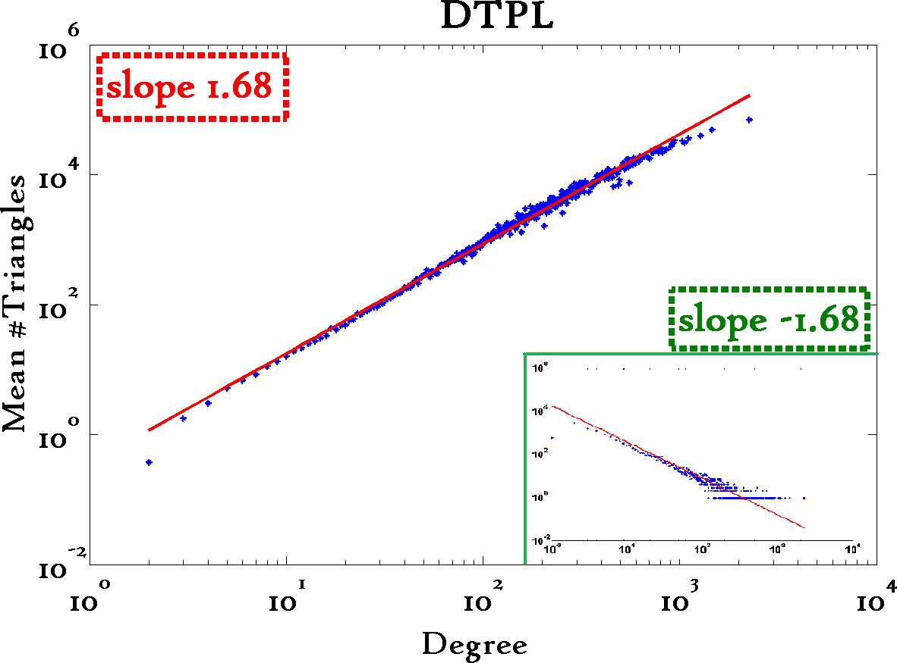
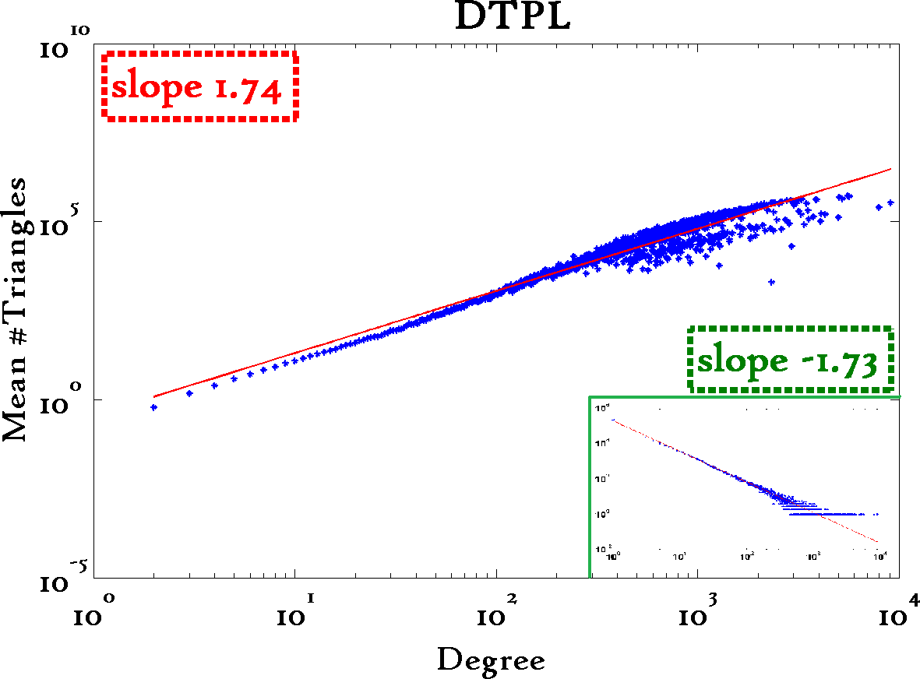
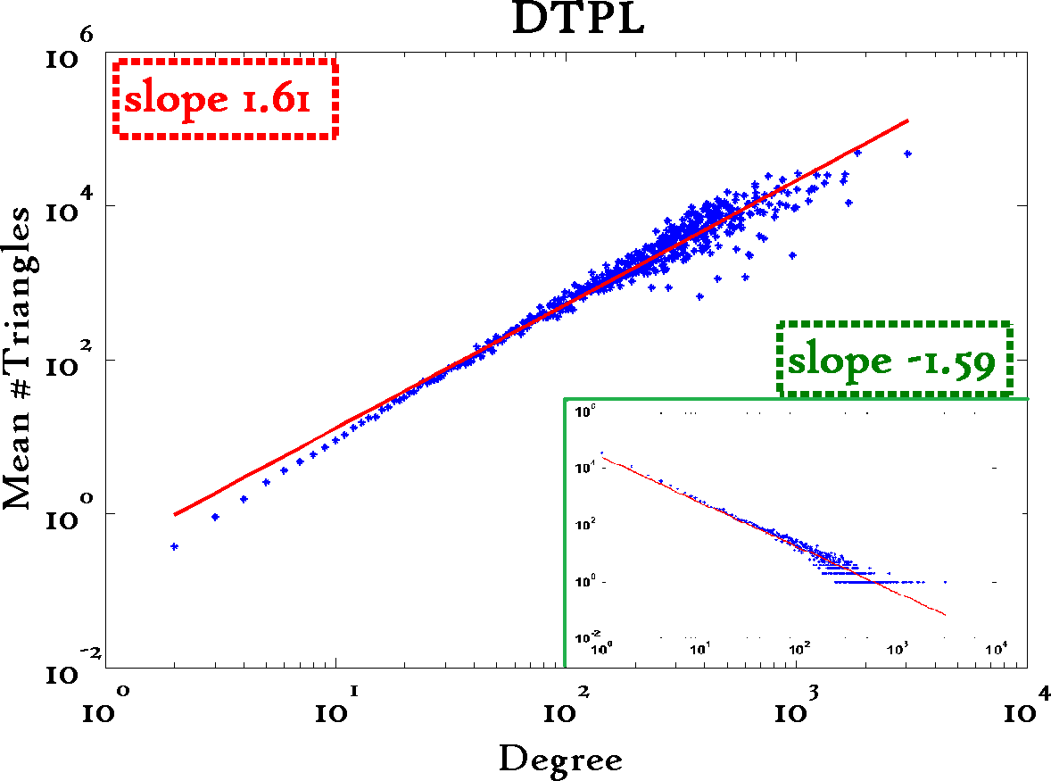
Triangle Law: S.3
[Tsourakakis ICDM 2008]
Reuters
SN
X-axis: degree
Y-axis: mean # triangles
n friends -> ~n^{1.6} triangles
Epinions

Slide 96
Anomalies?
Patterns anomalies

Slide 97
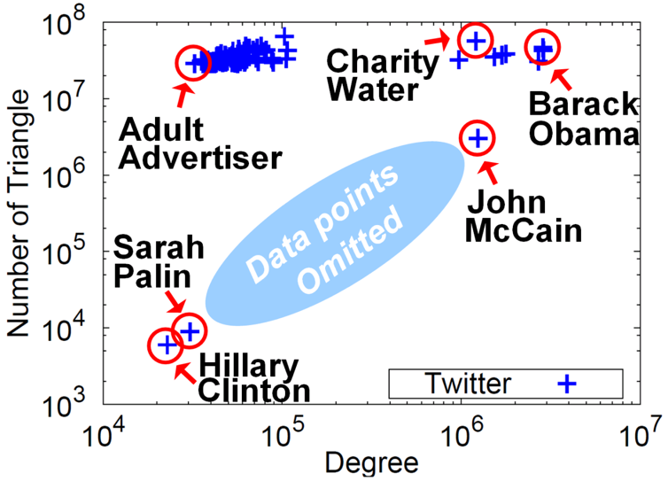



Triangle counting for large graphs?
Anomalous nodes in Twitter(~ 3 billion edges)
[U Kang, Brendan Meeder, +, PAKDD’11]
?
?
?
97

Slide 98
Triangle counting for large graphs?
Anomalous nodes in Twitter(~ 3 billion edges)
[U Kang, Brendan Meeder, +, PAKDD’11]
98

Slide 99
Triangle counting for large graphs?
Anomalous nodes in Twitter(~ 3 billion edges)
[U Kang, Brendan Meeder, +, PAKDD’11]
99

Slide 100
Triangle counting for large graphs?
Anomalous nodes in Twitter(~ 3 billion edges)
[U Kang, Brendan Meeder, +, PAKDD’11]
100

Slide 101
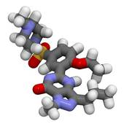
Triangle counting for large graphs?
Anomalous nodes in Twitter(~ 3 billion edges)
[U Kang, Brendan Meeder, +, PAKDD’11]
101

Slide 102
Short answer(s)
?
?
Are real graphs random?
  S*: what do static graphs look like?
    S.0: ‘six degrees’
    S.1: skewed degree distribution
    S.2: skewed eigenvalues
    S.3: triangle power-laws
    S.4: GCC; and skewed distr. of conn. comp.

Slide 103
Generalized Iterated Matrix Vector Multiplication (GIMV)
PEGASUS: A Peta-Scale Graph Mining
System - Implementation and Observations.
U Kang, Charalampos E. Tsourakakis,
and Christos Faloutsos.
(ICDM) 2009, Miami, Florida, USA.
Best Application Paper (runner-up).

Slide 104
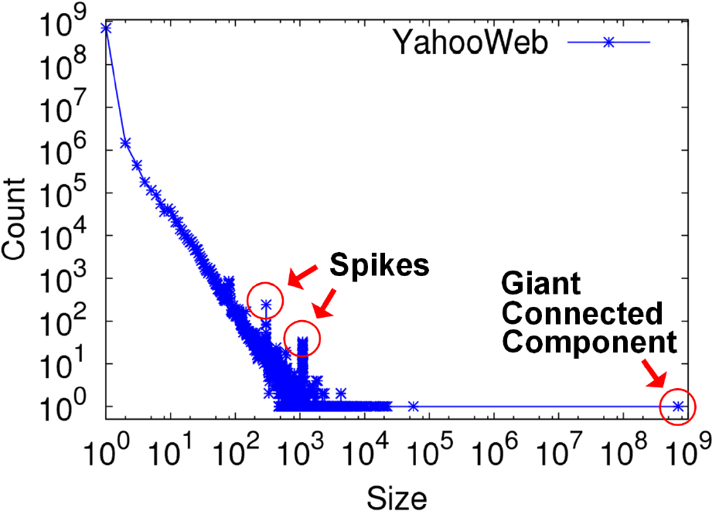
S.4: Conn. components
Connected Components
Count
Size

Slide 105
S.4: Conn. components
Connected Components
Count
~0.7B
singleton
nodes
Size

Slide 106
S.4: Conn. components
Connected Components
Count
Size

Slide 107
S.4: Conn. components
Connected Components
Count
300-size cmpt
X 500.
Why?
1100-size cmpt
X 65.
Why?
Size

Slide 108

S.4: Conn. components
Connected Components
Count
suspicious
financial-advice sites
(not existing now)
Size

Slide 109
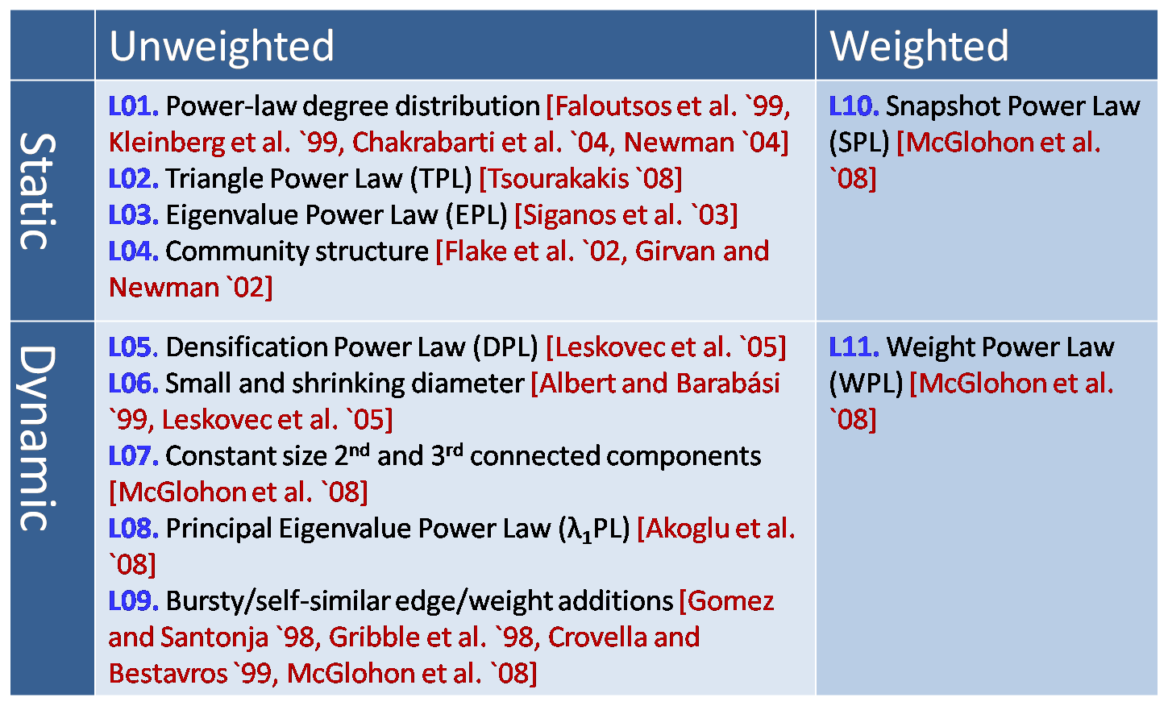
MORE Graph Patterns
✔
✔
✔
✔
✔
✔
RTG: A Recursive Realistic Graph Generator using Random Typing Leman Akoglu and Christos Faloutsos. PKDD’09.

Slide 110
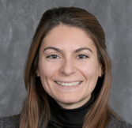
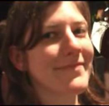


MORE Graph Patterns
Mary McGlohon, Leman Akoglu, Christos Faloutsos. Statistical Properties of Social Networks. in "Social Network Data Analytics” (Ed.: Charu Aggarwal)
Deepayan Chakrabarti and Christos Faloutsos, Graph Mining: Laws, Tools, and Case Studies Oct. 2012, Morgan Claypool.

Slide 111

Short answer(s)
?
?
Are real graphs random?
  S*: what do static graphs look like?
    S.0: ‘six degrees’
    S.1: skewed degree distribution
    S.2: skewed eigenvalues
    S.3: triangle power-laws
    S.4: GCC; and skewed distr. of conn. comp.

Slide 112
Short answer(s)
?
?
Are real graphs random?
  S*: what do static graphs look like?
    S.0: ‘six degrees’
    S.1: skewed degree distribution
    S.2: skewed eigenvalues
    S.3: triangle power-laws
    S.4: GCC; and skewed distr. of conn. comp.
Power laws: y ~ xª
NOT Gaussians
Take logarithms
y (log scale)
a
x (log scale)

Slide 113
Roadmap
Introduction – Motivation
Part#1: Graphs and Tensors
  P1.1: recommendation
  P1.2: belief propagation
  P1.3: properties/patterns in graphs
  P1.4: fraud/anomaly detection
  P1.5: Time-evolving graphs / Tensors
?

Slide 114

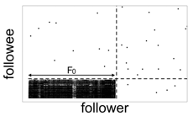

Problem
Given:
Find:
Outliers
Lock-step

Slide 115
Solution
Given:
Find:
Outliers
Lock-step
OddBall
SVD

Slide 116
P1.4.1. Outliers
Which node(s) are strange?
  Q: How to start?

Slide 117
P1.4.1. Outliers
Which node(s) are strange?
  Q: How to start?
  A1: egonet; and extract node features

Slide 118
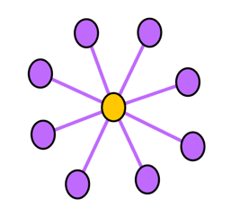
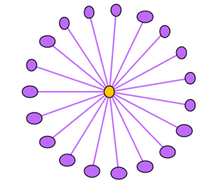
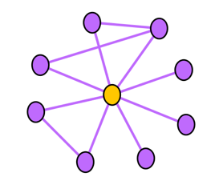
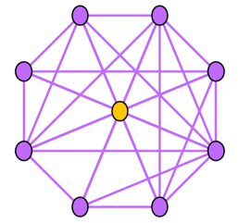
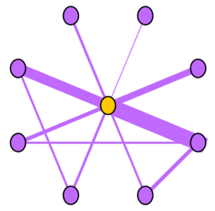
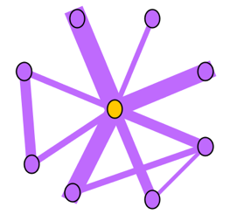
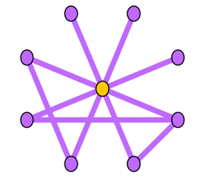
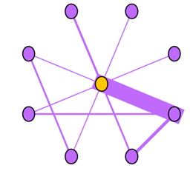
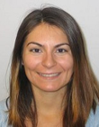


Ego-net Patterns: Which is strange?
Oddball: Spotting anomalies in weighted graphs, Leman Akoglu, Mary McGlohon, Christos Faloutsos, PAKDD 2010

Slide 119


Ego-net Patterns: Which is strange?
telemarketer, port scanner,
people adding friends
indiscriminatively, etc.
Near-star
Near-clique
tightly connected people,
terrorist groups?, discussion
group, etc.

Slide 120
P1.4.1. Outliers
Which node(s) are strange?
  Q: How to start?
  A: egonet; and extract node features
  Q’: which features?
  A’: ART! Infinite! Pick a few, e.g.:

Slide 121





Ego-net Patterns
N_{i}: number of neighbors (degree) of ego i
E_{i}: number of edges in egonet i
W_{i}: total weight of egonet i
λ_{w,i}: principal eigenvalue of the weighted adjacency matrix of egonet i
Oddball: Spotting anomalies in weighted graphs
Leman Akoglu, Mary McGlohon, Christos Faloutsos
PAKDD 2010
Oddball: Spotting anomalies in weighted graphs, Leman Akoglu, Mary McGlohon, Christos Faloutsos, PAKDD 2010

Slide 122



Pattern: Ego-net Power Law Density
E_{i} ∝ N_{i}^{α}
1 ≤ α ≤ 2
Enron CEO
Oddball: Spotting anomalies in weighted graphs
Leman Akoglu, Mary McGlohon, Christos Faloutsos
PAKDD 2010
Oddball: Spotting anomalies in weighted graphs, Leman Akoglu, Mary McGlohon, Christos Faloutsos, PAKDD 2010

Slide 123



Pattern: Ego-net Power Law Density
Oddball: Spotting anomalies in weighted graphs
Leman Akoglu, Mary McGlohon, Christos Faloutsos
PAKDD 2010
Oddball: Spotting anomalies in weighted graphs, Leman Akoglu, Mary McGlohon, Christos Faloutsos, PAKDD 2010

Slide 124
Roadmap
Introduction – Motivation
Part#1: Graphs
  …
  P1.3: community detection
  P1.4: fraud/anomaly detection
    Outliers
    Lock-step behavior
  P1.5: belief propagation
?

Slide 125
Problem
Given:
Find:
Outliers
Lock-step

Slide 126
P1.4.1. How to find ‘suspicious’ groups?
‘blocks’ are normal, right?
idols
fans

Slide 127



P1.4.1. How to find ‘suspicious’ groups?
‘blocks’ are normal, right?
idols
fans

Slide 128

Except that:
‘blocks’ are normal, right?
‘hyperbolic’ communities are more realistic [Araujo+, PKDD’14]

Slide 129
Except that:
‘blocks’ are usually suspicious
‘hyperbolic’ communities are more realistic [Araujo+, PKDD’14]
Q: Can we spot blocks, easily?

Slide 130
Except that:
‘blocks’ are usually suspicious
‘hyperbolic’ communities are more realistic [Araujo+, PKDD’14]
Q: Can we spot blocks, easily?
A: Silver bullet: SVD!

Slide 131




Crush intro to SVD
Recall: (SVD) matrix factorization: finds blocks
‘music lovers’
‘singers’
‘sports lovers’
‘athletes’
‘citizens’
‘politicians’
M
idols
N
fans
+
+
~

Slide 132


Crush intro to SVD
(SVD) matrix factorization: finds blocks
A) Even if shuffled!
‘music lovers’
‘singers’
‘sports lovers’
‘athletes’
‘citizens’
‘politicians’
M
idols
N
fans
+
+
~

Slide 133
Crush intro to SVD
(SVD) matrix factorization: finds blocks
B) Even if ‘salt+pepper’ noise
‘music lovers’
‘singers’
‘sports lovers’
‘athletes’
‘citizens’
‘politicians’
M
idols
N
fans
+
+
~

Slide 134



Toy example – 5 blocks
v₀
v₁
‘idols’
u₀
u₁
‘fans’
u₁
v₁
u₀
v₀
EigenPlots

Slide 135
Toy example – 5 blocks
v₀
v₁
‘idols’
u₀
u₁
‘fans’
u₁
v₁
u₀
v₀

Slide 136
Solution
Given:
Find:
Outliers
Lock-step
OddBall
SVD

Slide 137
Roadmap
Introduction – Motivation
Part#1: Graphs and Tensors
  P1.1: recommendation
  P1.2: belief propagation
  P1.3: properties/patterns in graphs
  P1.4: fraud/anomaly detection
  P1.5: Time-evolving graphs / Tensors
…

Slide 138
Use case #2’’’
Anomaly detection, over time
....
6/10
...
7/3
8/9
6/1
6/2
8/10
6/2
...
8/11
6/1

Slide 139
Graphs over time -> tensors!
Problem #1:
  Given who calls whom, and when
  Find patterns / anomalies
johnson
smith

Slide 140
Graphs over time -> tensors!
Problem #1:
  Given who calls whom, and when
  Find patterns / anomalies

Slide 141
Graphs over time -> tensors!
Problem #1:
  Given who calls whom, and when
  Find patterns / anomalies
Tue
Mon

Slide 142
Graphs over time -> tensors!
Problem #1:
  Given who calls whom, and when
  Find patterns / anomalies
time
caller
callee

Slide 143






Recipe(s)
What is ‘normal’? suspicious? Groups?
A: tensor factorization (~ high-mode SVD)
  PARAFAC (shown here)
  Tucker
Apple
fans
3am, 4/1
…
shoes
jewelry
3am, 4/1
timestamp
…
customer
=
+
+
10pm, 4/3
11pm, 4/3
product

Slide 144
Reminder: intro to SVD
Recall: (SVD) matrix factorization: finds blocks
‘music lovers’
‘singers’
‘sports lovers’
‘athletes’
‘citizens’
‘politicians’
M
idols
N
fans
+
+
~

Slide 145
Answer: tensor factorization
PARAFAC decomposition
shoes
Apple
fans
jewelry
timestamp
customer
+
+
=
product

Slide 146
Answer: tensor factorization
PARAFAC decomposition
Results for who-calls-whom-when
  4M x 15 days
??
??
??
time
caller
+
+
=
callee

Slide 147
Applications
TA1: Phonecall
TA2: Network traffic
TA3: FaceBook

Slide 148



TA1: Anomaly detection in time-evolving graphs
=
Anomalous communities in phone call data:
  European country, 4M clients, data over 2 weeks
  ~200 calls to EACH receiver on EACH day!
1 caller
5 receivers
4 days of activity

Slide 149
TA1: Anomaly detection in time-evolving graphs
=
Anomalous communities in phone call data:
  European country, 4M clients, data over 2 weeks
  ~200 calls to EACH receiver on EACH day!
1 caller
5 receivers
4 days of activity

Slide 150

TA1: Anomaly detection in time-evolving graphs
=
Anomalous communities in phone call data:
  European country, 4M clients, data over 2 weeks
  ~200 calls to EACH receiver on EACH day!
1 caller
5 receivers
4 days of activity

Slide 151



TA1: Anomaly detection in time-evolving graphs
=
Anomalous communities in phone call data:
  European country, 4M clients, data over 2 weeks
  ~200 calls to EACH receiver on EACH day!
Miguel Araujo, Spiros Papadimitriou, Stephan Günnemann, Christos Faloutsos, Prithwish Basu, Ananthram Swami,
Evangelos Papalexakis, Danai Koutra. Com2: Fast Automatic Discovery of Temporal (Comet) Communities. PAKDD 2014, Tainan, Taiwan.

Slide 152
Applications
TA1: Phonecall
TA2: Network traffic
TA3: FaceBook

Slide 153

ParCube: Sparse Parallelizable Tensor Decompositions
Evangelos E. Papalexakis, Christos Faloutsos, Nikos Sidiropoulos, ECML/PKDD 2012
Evangelos E. Papalexakis
Email: epapalex@cs.ucr.edu
Web: http://www.cs.ucr.edu/~epapalex

Slide 154
TA2: Lbnl Network Data
1 src
1 dst
Modes: src IP, dst IP, port #
~ Port Scanning Attack
Notes:
Network traffic data of form (src IP, dst IP, port #)
65170 × 65170 × 65327 tensor
We pick s = 5, r = 10

Slide 155

TA3: Facebook Wall posts
1 Wall
1 day
Modes: wall-owner, poster, timestamp
Discovery: birthday-like event.
Notes:
Small portion of Facebook’s users
63890 users for 1847 days
Picked s = 100, r = 10
Data in the form (Wall owner, poster, timestamp)
Downloaded from http://socialnetworks.mpi-sws.org/data-wosn2009.html
We were able to identify a birthday-like event.

Slide 156
Recipe(s)
What is ‘normal’? suspicious? Groups?
A: tensor factorization (~ high-mode SVD)
  PARAFAC (see below)
  Tucker
Apple
fans
3am, 4/1
…
shoes
jewelry
3am, 4/1
timestamp
…
customer
=
+
+
10pm, 4/3
11pm, 4/3
product

Slide 157
Recipe(s)
Data: in pairs ☛ matrix ☛ SVD
Data: in triplets ☛ tensor ☛ PARAFAC
Apple
fans
3am, 4/1
…
shoes
jewelry
3am, 4/1
timestamp
…
customer
=
+
+
10pm, 4/3
11pm, 4/3
product

Slide 158

Overall
Personalized random walks for recommendations
(zoo) B.P. for semi-supervised
MANY tools for anomaly detection
Tensors for time-evolving graphs
=

Slide 159
BREAK
Before Part 2 (sequences/forecasting)
https://www.cs.cmu.edu/~christos/TALKS/19-10-JPM/

