Slide 1
Mining Large Graphs: Patterns, Fraud Detection, and Algorithms
Christos Faloutsos
CMU

Slide 2
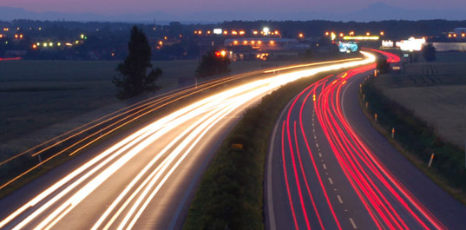
Roadmap
Introduction – Motivation
Why study (big) graphs?
Part#1: Patterns in graphs
Part#2: time-evolving graphs; tensors
Conclusions

Slide 3

Graphs - why should we care?
~1B nodes (web sites)
~6B edges (http links)
‘YahooWeb graph’

Slide 4
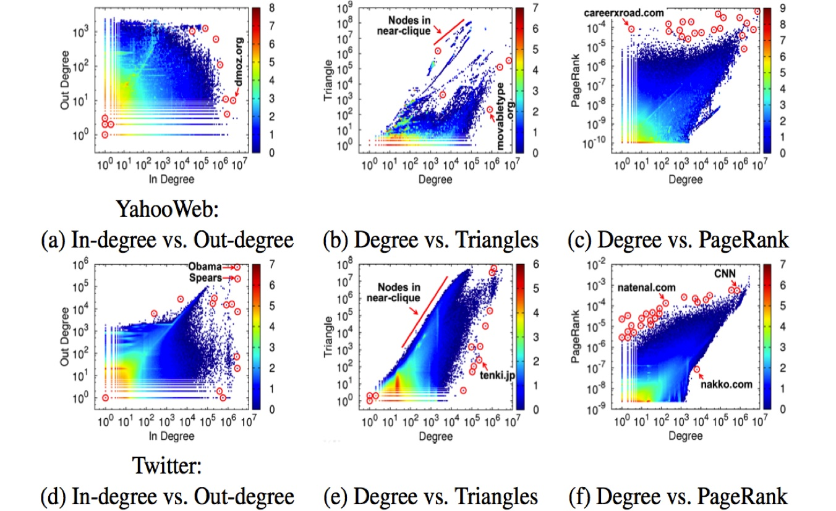
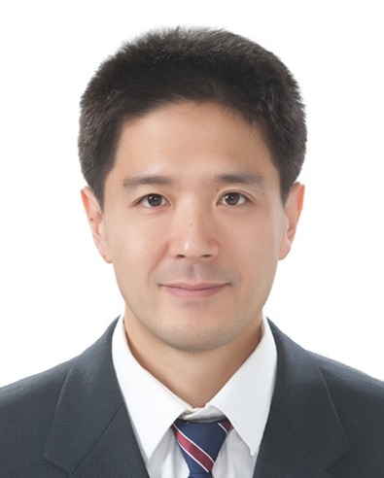
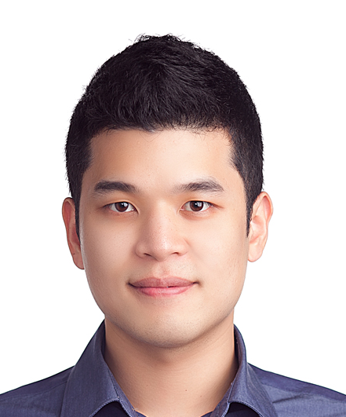
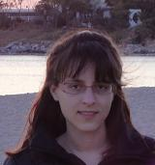
Graphs - why should we care?
~1B nodes (web sites)
~6B edges (http links)
‘YahooWeb graph’
U Kang, Jay-Yoon Lee, Danai Koutra, and Christos Faloutsos. Net-Ray: Visualizing and Mining Billion-Scale Graphs PAKDD 2014, Tainan, Taiwan.

Slide 5





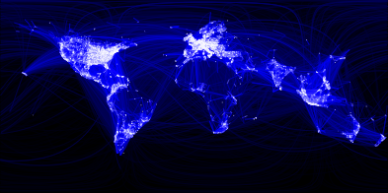
Graphs - why should we care?
>$10B; ~1B users

Slide 6
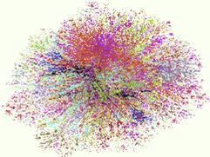
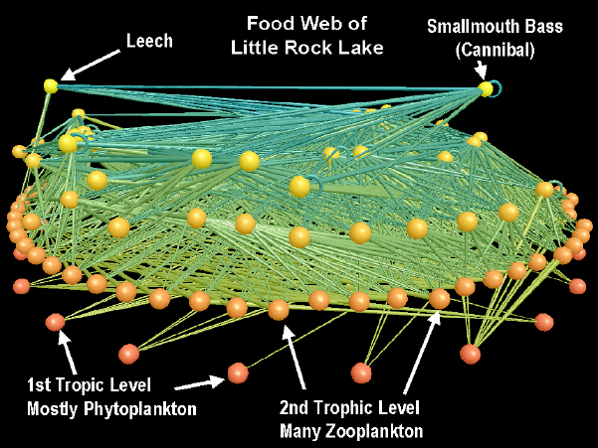
Graphs - why should we care?
Internet Map [lumeta.com]
Food Web [Martinez ’91]

Slide 7

Graphs - why should we care?
web-log (‘blog’) news propagation
computer network security: email/IP traffic and anomaly detection
Recommendation systems
....
Many-to-many db relationship -> graph

Slide 8
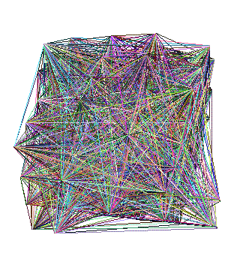

Motivating problems
P1: patterns? Fraud detection?
P2: patterns in time-evolving graphs / tensors
destination
source
time

Slide 9
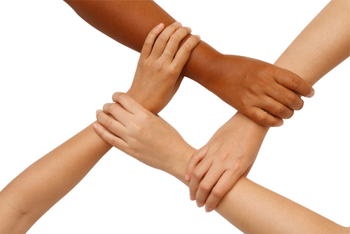
Motivating problems
P1: patterns? Fraud detection?
P2: patterns in time-evolving graphs / tensors
Patterns anomalies
destination
source
time

Slide 10
Roadmap
Introduction – Motivation
Why study (big) graphs?
Part#1: Patterns & fraud detection
Part#2: time-evolving graphs; tensors
Conclusions

Slide 11
Part 1:
Patterns, &
fraud detection

Slide 12
Laws and patterns
Q1: Are real graphs random?

Slide 13
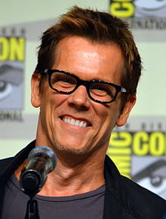
Laws and patterns
Q1: Are real graphs random?
A1: NO!!
Diameter (‘6 degrees’; ‘Kevin Bacon’)
in- and out- degree distributions
other (surprising) patterns
So, let’s look at the data

Slide 14
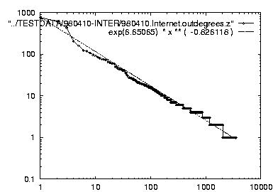
Solution# S.1
Power law in the degree distribution [Faloutsos x 3 SIGCOMM99]
internet domains
att.com
log(degree)
ibm.com
log(rank)

Slide 15
Solution# S.1
Power law in the degree distribution [Faloutsos x 3 SIGCOMM99]
internet domains
att.com
log(degree)
ibm.com
-0.82
log(rank)

Slide 16
Solution# S.1
Q: So what?
internet domains
att.com
log(degree)
ibm.com
-0.82
log(rank)

Slide 17
Solution# S.1
= friends of friends (F.O.F.)
Q: So what?
A1: # of two-step-away pairs:
internet domains
att.com
log(degree)
ibm.com
-0.82
log(rank)

Slide 18
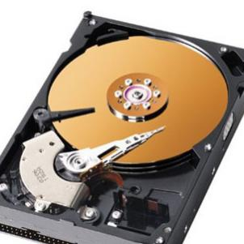
Solution# S.1
= friends of friends (F.O.F.)
Q: So what?
A1: # of two-step-away pairs: 100^2 * N= 10 Trillion
internet domains
att.com
log(degree)
ibm.com
-0.82
log(rank)

Slide 19
Solution# S.1
= friends of friends (F.O.F.)
Q: So what?
A1: # of two-step-away pairs: 100^2 * N= 10 Trillion
internet domains
att.com
log(degree)
ibm.com
-0.82
log(rank)

Slide 20
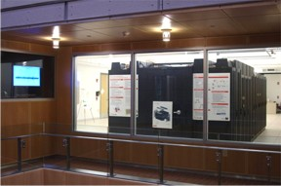
Solution# S.1
Gaussian trap
= friends of friends (F.O.F.)
Q: So what?
A1: # of two-step-away pairs: O(d_max ^2) ~ 10M^2
internet domains
att.com
~0.8PB ->
a data center(!)
log(degree)
ibm.com
-0.82
log(rank)
DCO @ CMU

Slide 21
Solution# S.1
Gaussian trap
Q: So what?
A1: # of two-step-away pairs: O(d_max ^2) ~ 10M^2
Such patterns ->
New algorithms
internet domains
att.com
~0.8PB ->
a data center(!)
log(degree)
ibm.com
-0.82
log(rank)

Slide 22
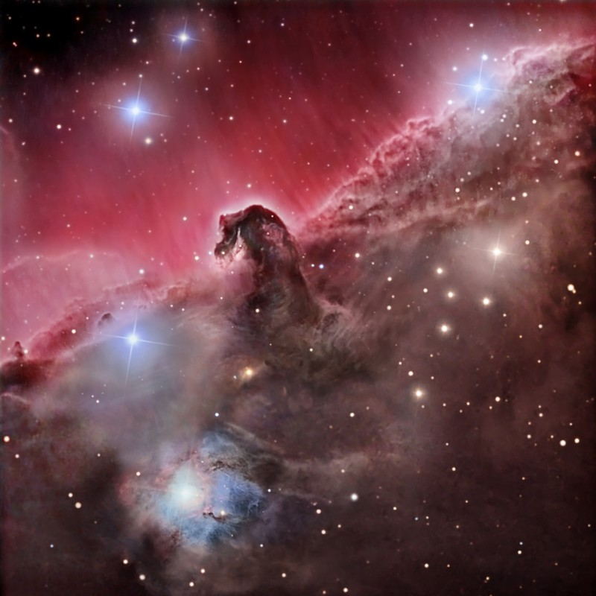
Observation – big-data:
O(N²) algorithms are ~intractable - N=1B
N² seconds = 31B years (>2x age of universe)
1B
1B

Slide 23
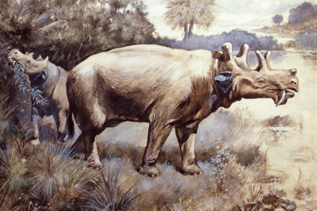
Observation – big-data:
O(N²) algorithms are ~intractable - N=1B
N² seconds = 31B years
1,000 machines
31M
1B

Slide 24
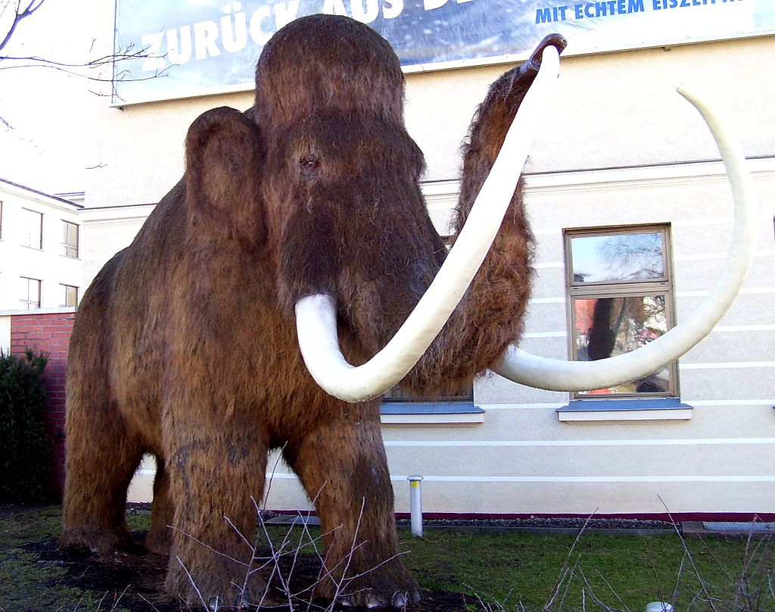
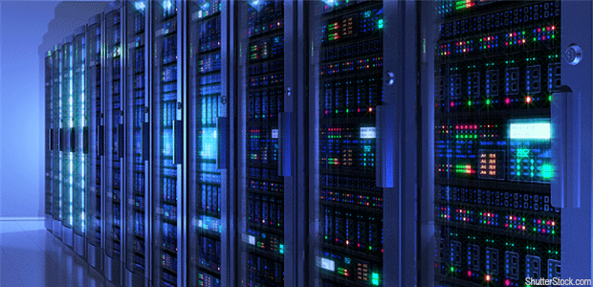

Observation – big-data:
O(N²) algorithms are ~intractable - N=1B
N² seconds = 31B years
1M machines
31K
1B

Slide 25

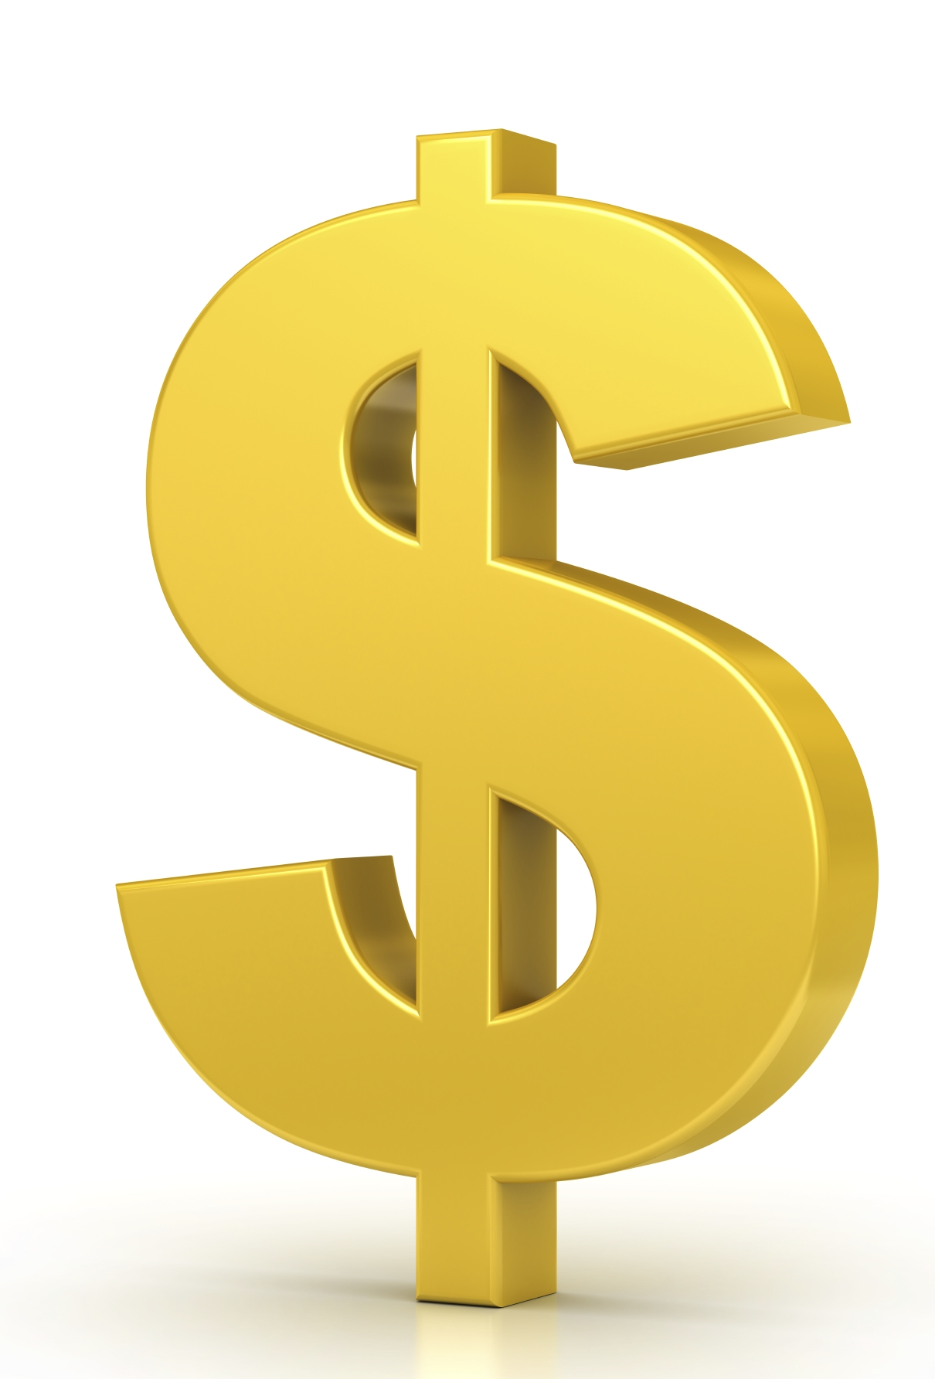
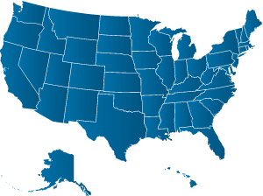
Observation – big-data:
O(N²) algorithms are ~intractable - N=1B
N² seconds = 31B years
10B machines ~ $10Trillion
3
1B

Slide 26
Observation – big-data:
O(N²) algorithms are ~intractable - N=1B
N² seconds = 31B years
10B machines ~ $10Trillion
And parallelism might not help
3
1B

Slide 27
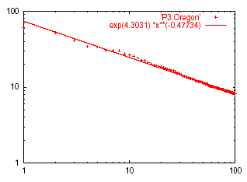
Solution# S.2: Eigen Exponent E
Eigenvalue
Exponent = slope
E = -0.48
A x = λ x
Rank of decreasing eigenvalue
A2: power law in the eigenvalues of the adjacency matrix (‘eig()’)

Slide 28
Roadmap
Introduction – Motivation
Part#1: Patterns in graphs
Patterns: Degree; Triangles
Anomaly/fraud detection
Graph understanding
Part#2: time-evolving graphs; tensors
Conclusions

Slide 29
Solution# S.3: Triangle ‘Laws’
Real social networks have a lot of triangles

Slide 30
Solution# S.3: Triangle ‘Laws’
Real social networks have a lot of triangles
Friends of friends are friends
Any patterns?
2x the friends, 2x the triangles ?

Slide 31
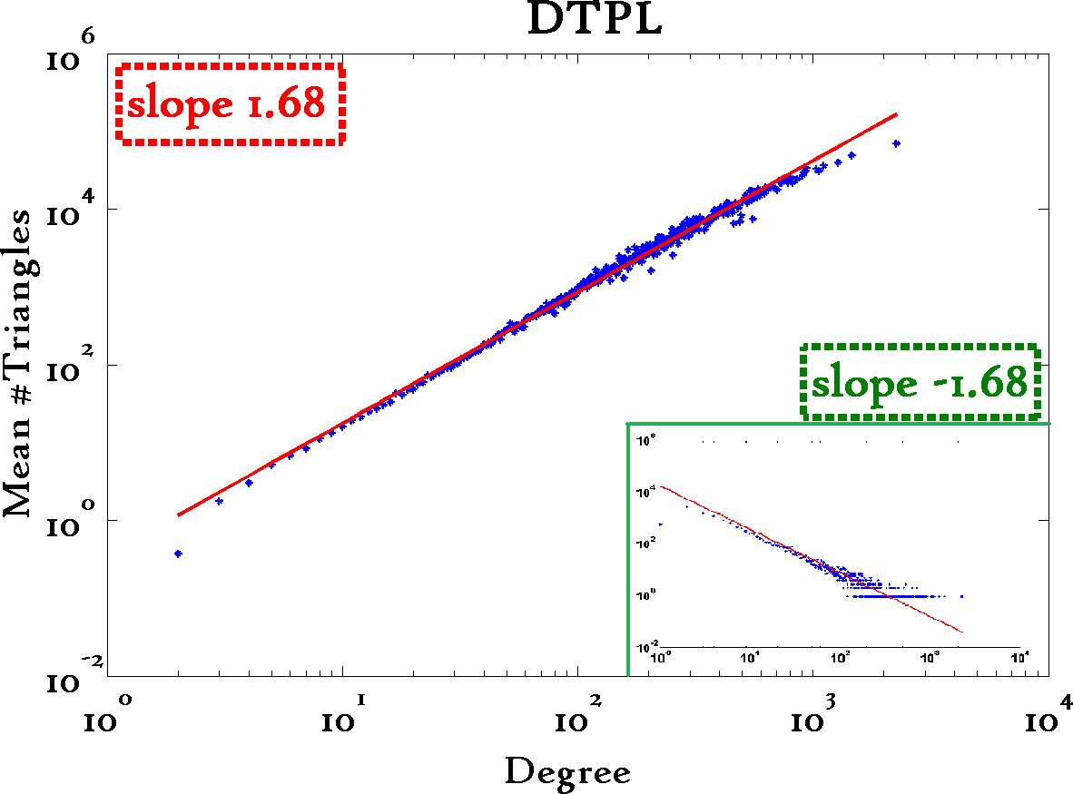
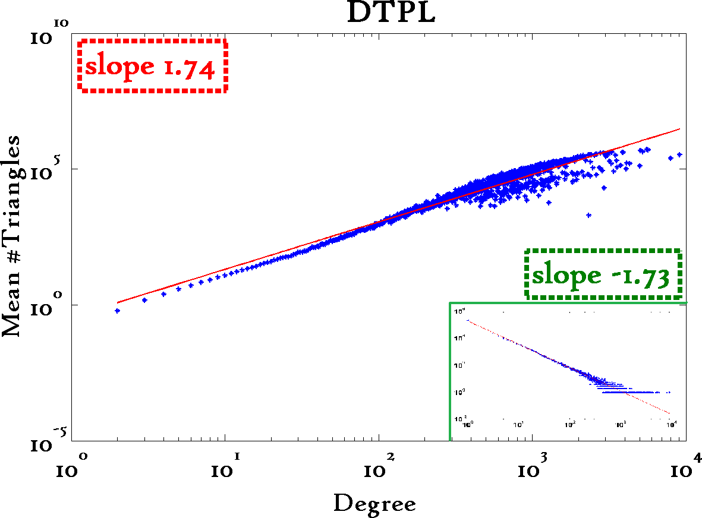
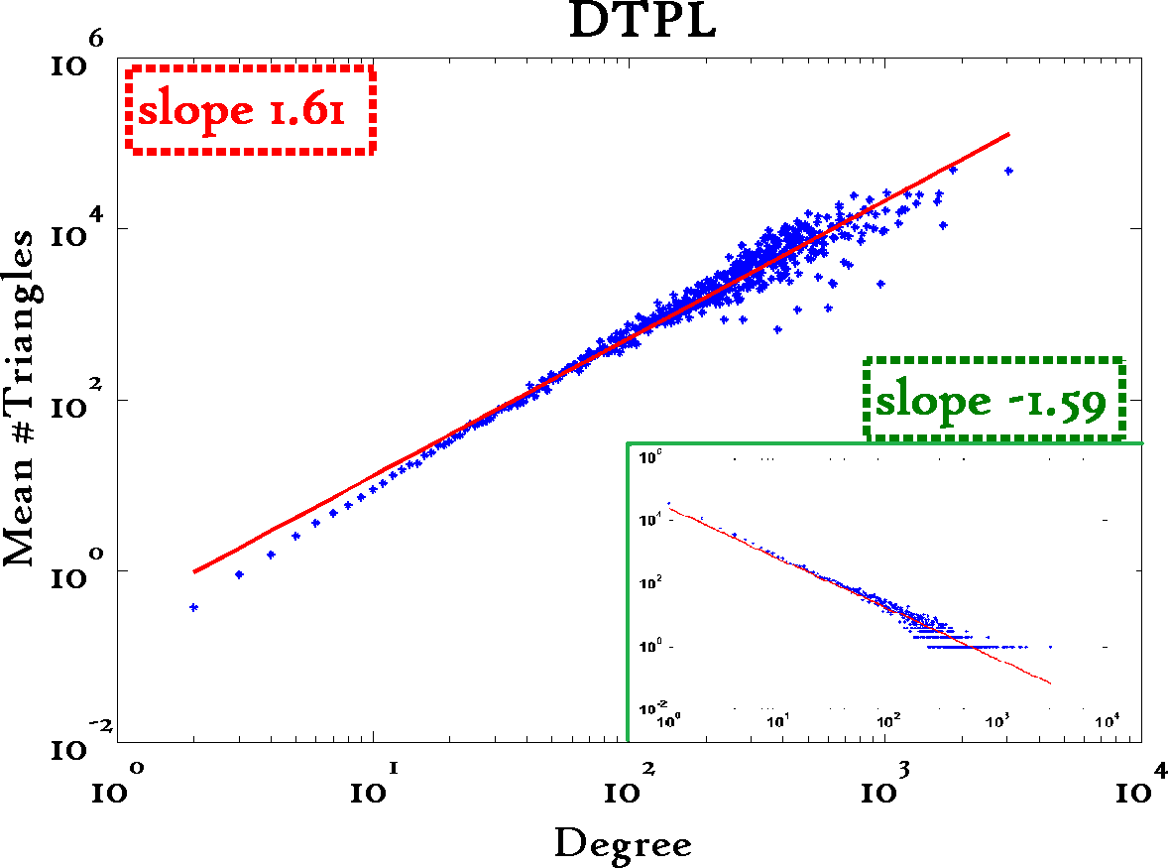
Triangle Law: #S.3 [Tsourakakis ICDM 2008]
Reuters
SN
X-axis: degree
Y-axis: mean # triangles
n friends -> ~n^{1.6} triangles
Epinions

Slide 32
Triangle Law: Computations [Tsourakakis ICDM 2008]
details
But: triangles are expensive to compute
(3-way join; several approx. algos) – O(d_{max}²)
Q: Can we do that quickly?
A:

Slide 33
Triangle Law: Computations [Tsourakakis ICDM 2008]
details
But: triangles are expensive to compute
(3-way join; several approx. algos) – O(d_{max}²)
Q: Can we do that quickly?
A: Yes!
#triangles = 1/6 Sum ( λ_{i}³ )
(and, because of skewness (S2) ,
we only need the top few eigenvalues! - O(E)
A x = λ x

Slide 34
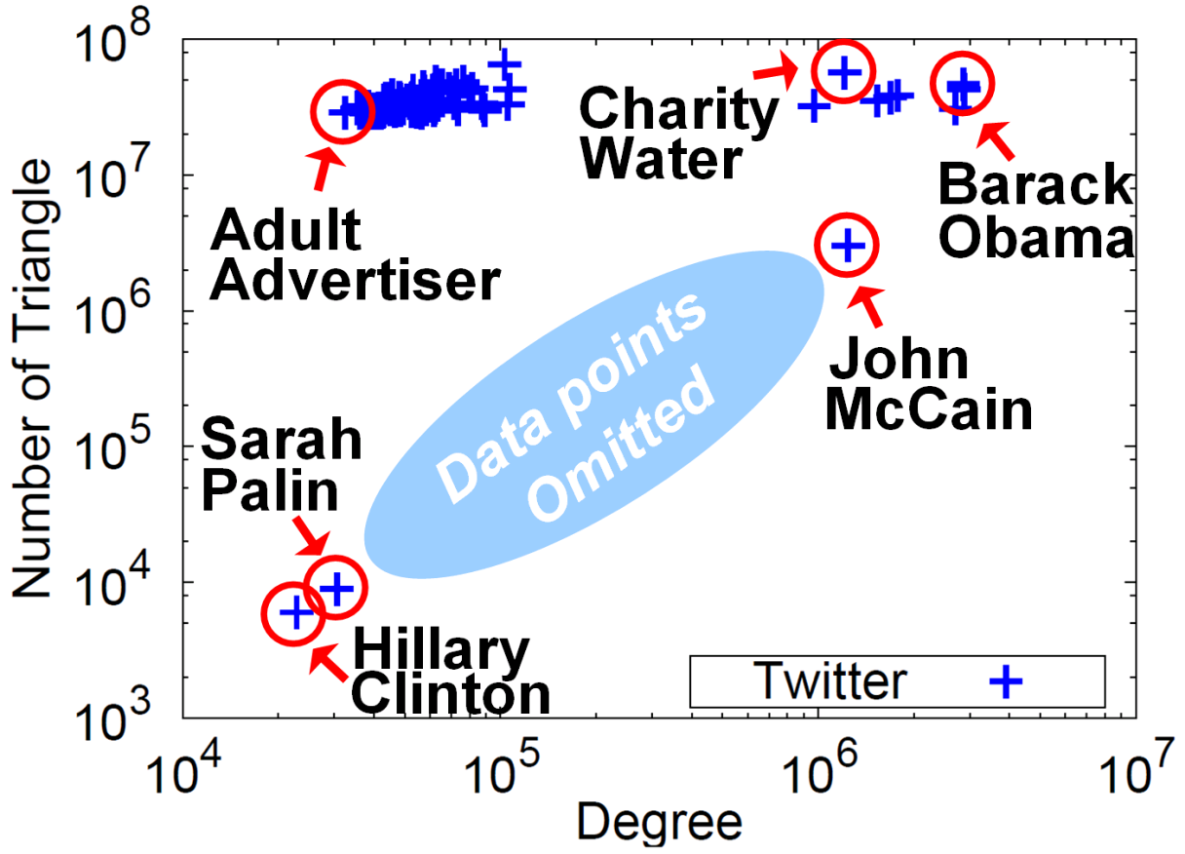


Triangle counting for large graphs?
Anomalous nodes in Twitter(~ 3 billion edges)
[U Kang, Brendan Meeder, +, PAKDD’11]
?
?
?
34

Slide 35
Triangle counting for large graphs?
Anomalous nodes in Twitter(~ 3 billion edges)
[U Kang, Brendan Meeder, +, PAKDD’11]
35

Slide 36
Triangle counting for large graphs?
Anomalous nodes in Twitter(~ 3 billion edges)
[U Kang, Brendan Meeder, +, PAKDD’11]
36

Slide 37
Triangle counting for large graphs?
Anomalous nodes in Twitter(~ 3 billion edges)
[U Kang, Brendan Meeder, +, PAKDD’11]
37

Slide 38
Triangle counting for large graphs?
Anomalous nodes in Twitter(~ 3 billion edges)
[U Kang, Brendan Meeder, +, PAKDD’11]
38

Slide 39
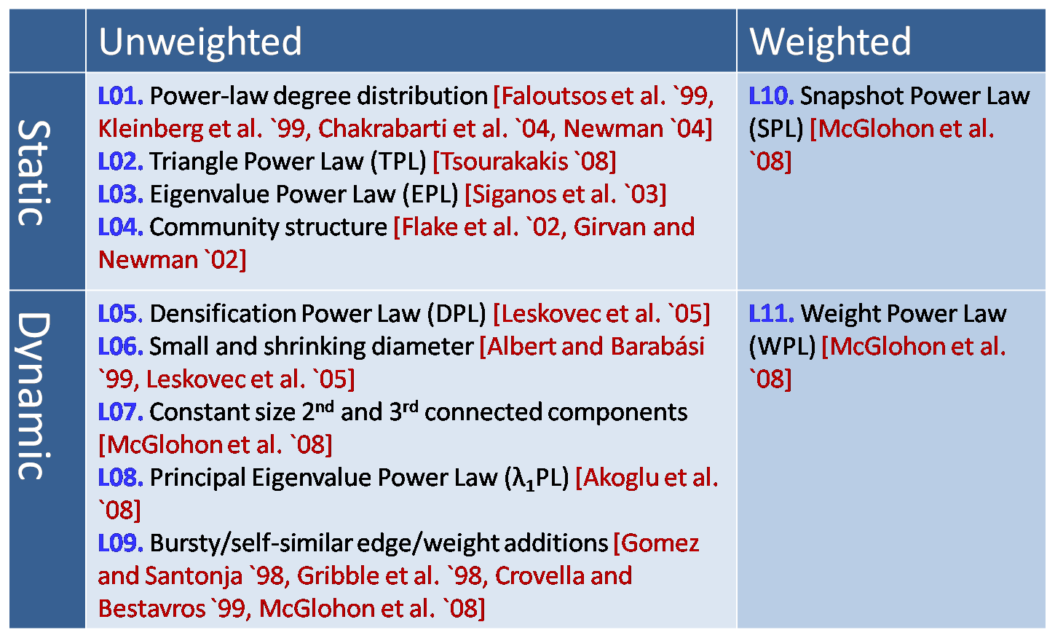
MORE Graph Patterns
✔
✔
✔
RTG: A Recursive Realistic Graph Generator using Random Typing Leman Akoglu and Christos Faloutsos. PKDD’09.

Slide 40
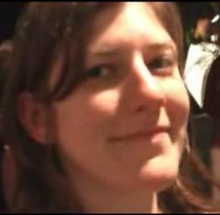
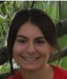


MORE Graph Patterns
Mary McGlohon, Leman Akoglu, Christos Faloutsos. Statistical Properties of Social Networks. in "Social Network Data Analytics” (Ed.: Charu Aggarwal)
Deepayan Chakrabarti and Christos Faloutsos, Graph Mining: Laws, Tools, and Case Studies Oct. 2012, Morgan Claypool.

Slide 41
Roadmap
Introduction – Motivation
Part#1: Patterns in graphs
Patterns
Anomaly / fraud detection
CopyCatch
Spectral methods (‘fBox’)
Belief Propagation
Part#2: time-evolving graphs; tensors
Conclusions
Patterns anomalies

Slide 42
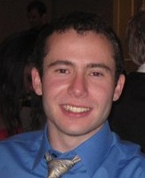
Fraud
Given
Who ‘likes’ what page, and when
Find
Suspicious users and suspicious products
CopyCatch: Stopping Group Attacks by Spotting Lockstep Behavior in Social Networks, Alex Beutel, Wanhong Xu, Venkatesan Guruswami, Christopher Palow, Christos Faloutsos WWW, 2013.

Slide 43


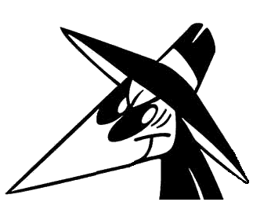
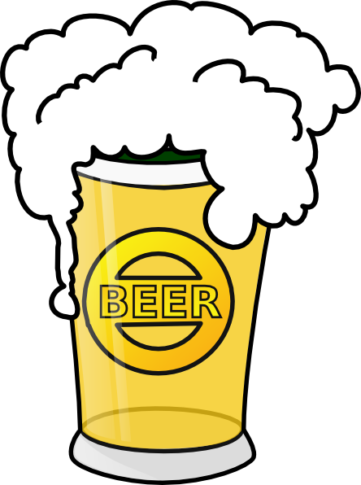
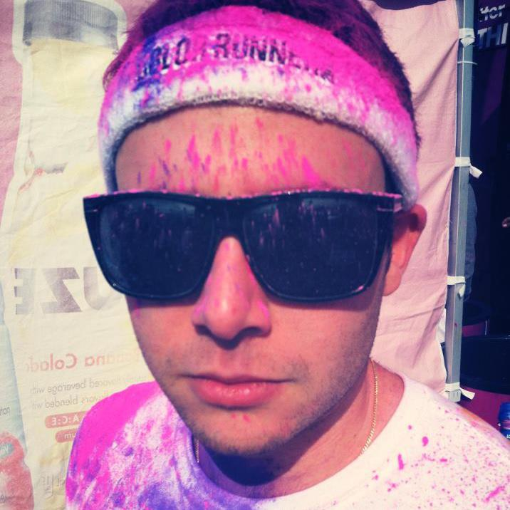
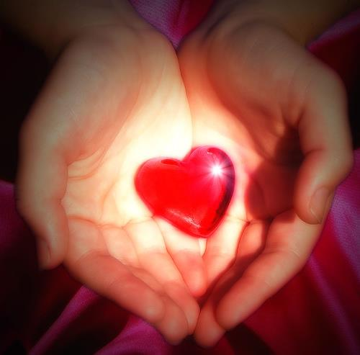
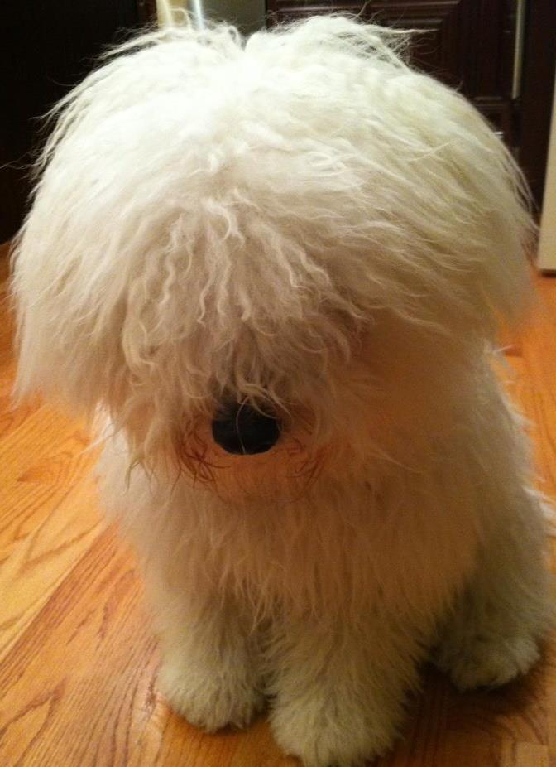
Fraud
Given
Who ‘likes’ what page, and when
Find
Suspicious users and suspicious products
Likes
CopyCatch: Stopping Group Attacks by Spotting Lockstep Behavior in Social Networks, Alex Beutel, Wanhong Xu, Venkatesan Guruswami, Christopher Palow, Christos Faloutsos WWW, 2013.

Slide 44
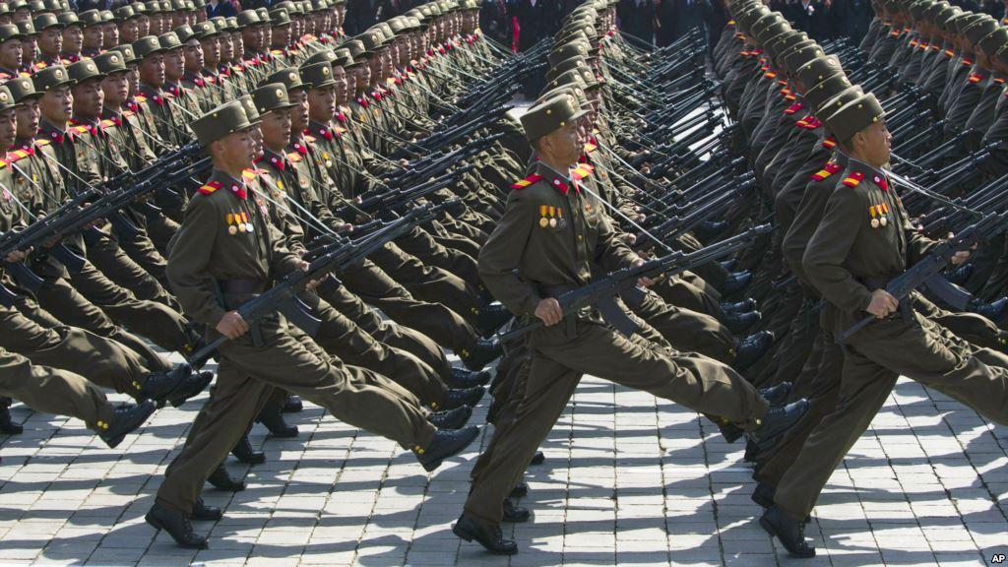
Graph Patterns and Lockstep Behavior
Our intuition
Lockstep behavior: Same Likes, same time
Likes
Notes:
Warming Hearts of Rockland
Beast – 1.5 million followers
Not real bad pages or data

Slide 45
Graph Patterns and Lockstep Behavior
Our intuition
Lockstep behavior: Same Likes, same time
Likes
Notes:
Warming Hearts of Rockland
Beast – 1.5 million followers
Not real bad pages or data

Slide 46
Graph Patterns and Lockstep Behavior
Our intuition
Lockstep behavior: Same Likes, same time
Likes
Suspicious Lockstep Behavior
Notes:
Warming Hearts of Rockland
Beast – 1.5 million followers
Not real bad pages or data

Slide 47
MapReduce Overview
Use Hadoop to search for many clusters in parallel:
Start with randomly seed
Update set of Pages and center Like times for each cluster
Repeat until convergence
Likes

Slide 48
Deployment at Facebook
CopyCatch runs regularly (along with many other security mechanisms, and a large Site Integrity team)
3 months of CopyCatch @ Facebook
#users
caught
time

Slide 49
Deployment at Facebook
Fake acct
Manually labeled 22 randomly selected
clusters from February 2013

Slide 50
Deployment at Facebook
Fake acct
Most clusters (77%) come from
real but compromised users
Manually labeled 22 randomly selected
clusters from February 2013

Slide 51
Roadmap
Introduction – Motivation
Part#1: Patterns in graphs
Patterns
Anomaly / fraud detection
CopyCatch
Spectral methods (‘fBox’)
Belief Propagation
Part#2: time-evolving graphs; tensors
Conclusions

Slide 52
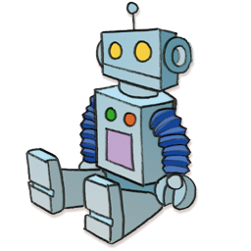
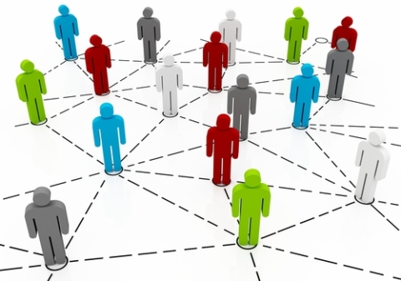
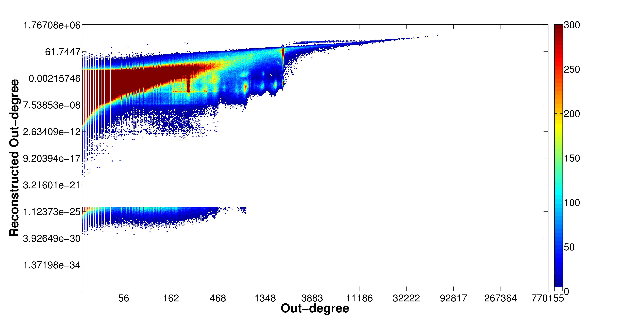
Problem: Social Network Link Fraud
Target: find “stealthy” attackers missed by other algorithms
Clique
41.7M nodes
1.5B edges
Bipartite
core

Slide 53
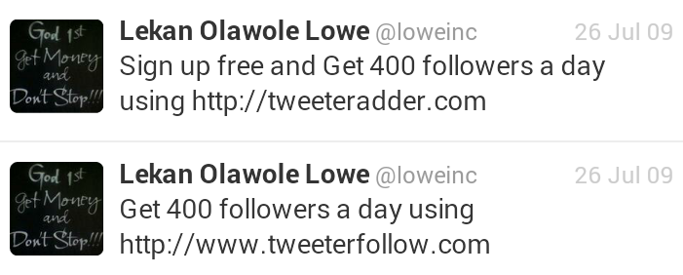
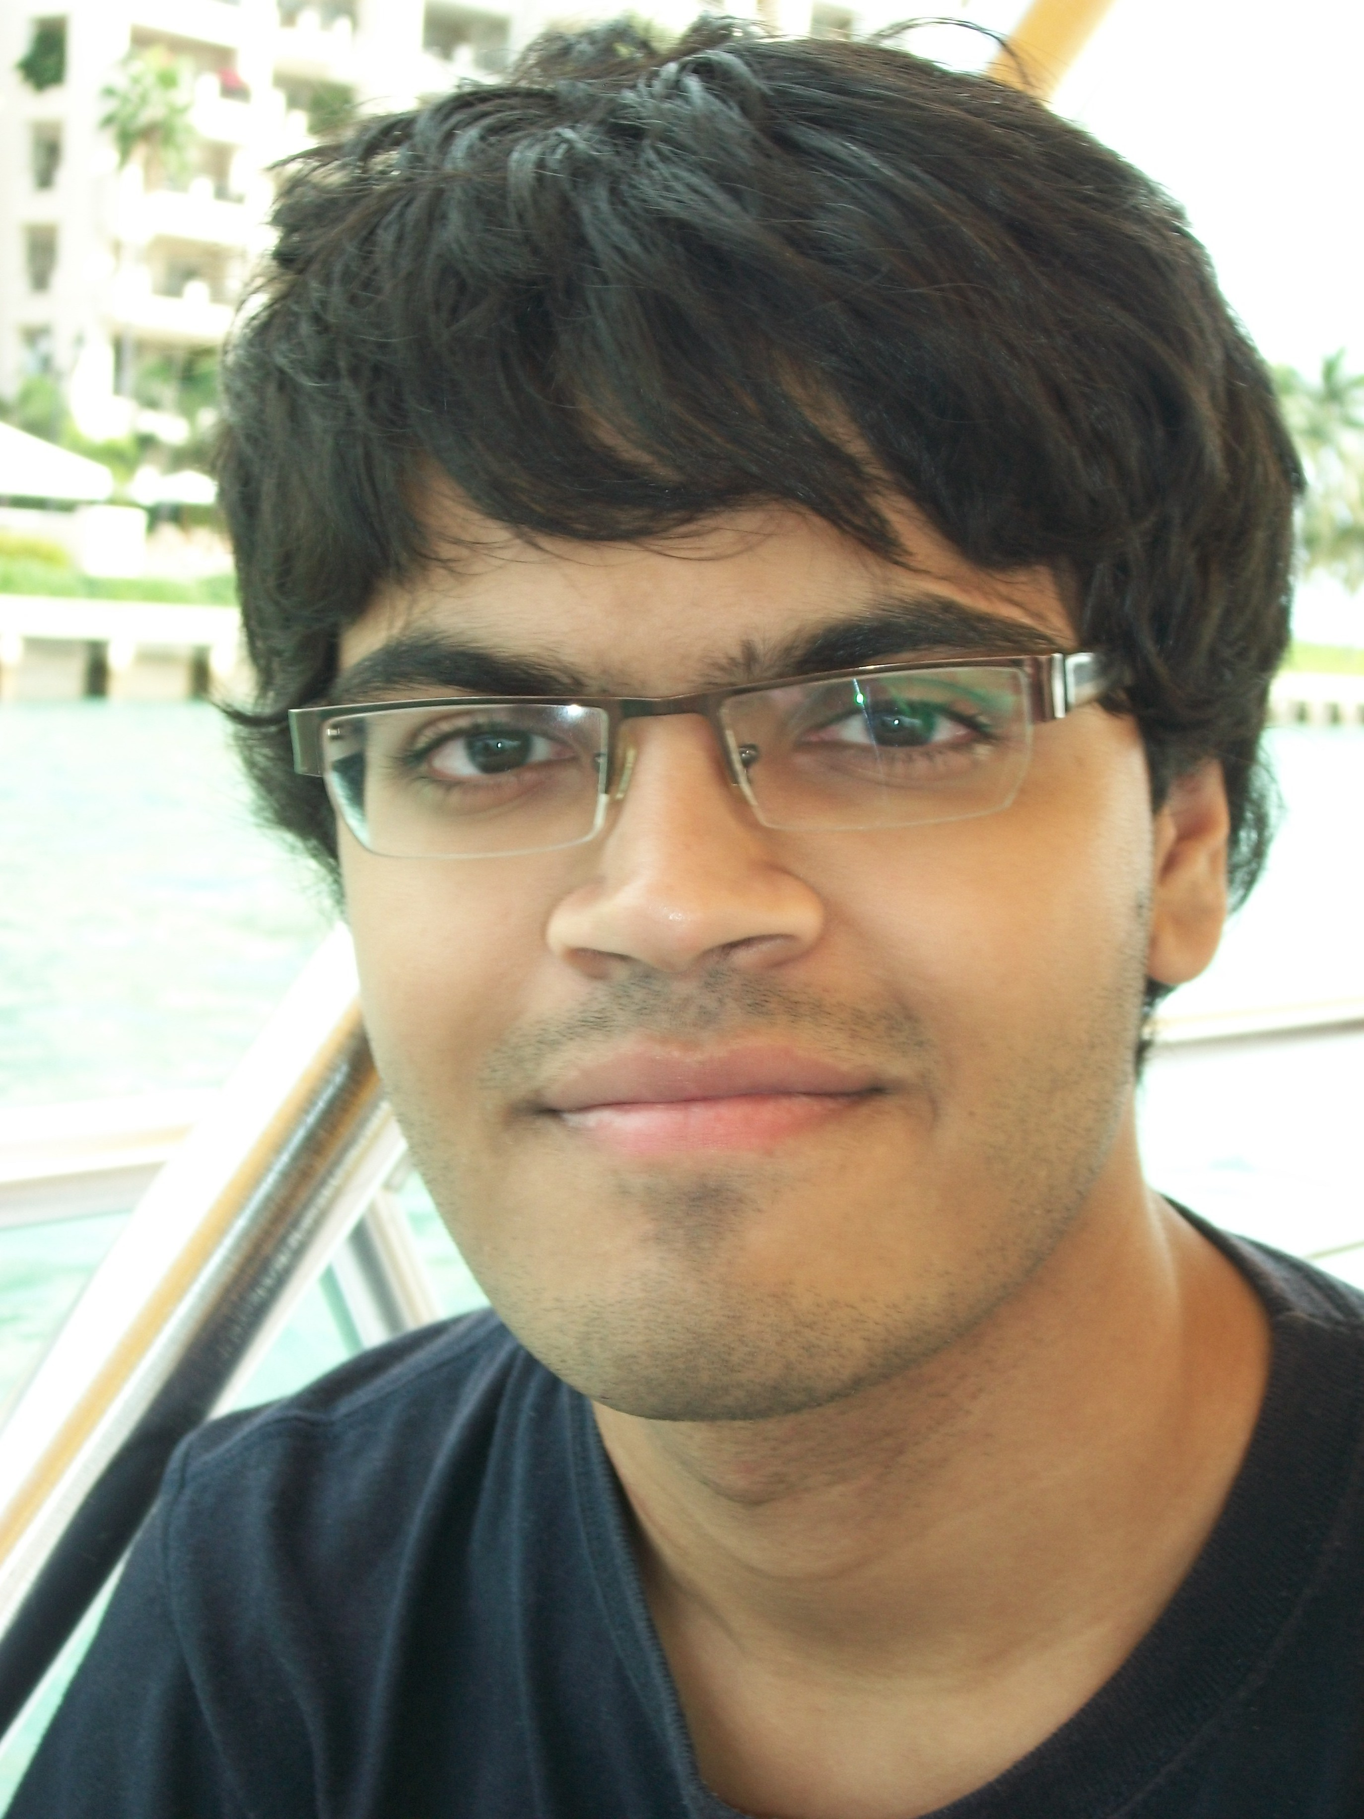
Problem: Social Network Link Fraud
Target: find “stealthy” attackers missed by other algorithms
Takeaway: use reconstruction error between true/latent representation!
Neil Shah, Alex Beutel, Brian Gallagher and Christos Faloutsos. Spotting Suspicious Link Behavior with fBox: An Adversarial Perspective. ICDM 2014, Shenzhen, China.
Notes:
Social networks with popularity incentives are plagued by the problem of link fraud, involving “bot” accounts falsely increasing popularity of a person or organization. These bots form cliques and bipartite cores in the graph structure. Several works have targeted the detection of large cases of fraud using spectral approaches like SVD, but fail to detect smaller, stealthier attacks due to computational restrictions on latent feature computation. Our approach, called fBox, leverages the reconstruction or projection error between latent, SVD representation and original graph representation to find anomalous bot accounts with high precision.

Slide 54
Roadmap
Introduction – Motivation
Part#1: Patterns in graphs
Patterns
Anomaly / fraud detection
CopyCatch
Spectral methods (‘fBox’)
More case studies on twitter
Part#2: time-evolving graphs; tensors
Conclusions

Slide 55
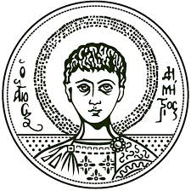



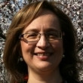

ND-SYNC: Detecting Synchronized Fraud Activities
Informatics Department
Aristotle University of Thessaloniki
School of Computer Science
Carnegie Mellon University
Maria Giatsoglou¹, Despoina Chatzakou¹, Neil Shah², Alex Beutel², Christos Faloutsos², Athena Vakali¹
¹ Aristotle Univ. of Thessaloniki, Greece 2 CMU

Slide 56
Activity summarization patterns
lifespan
Response
time
IAT
First follower
retweets
Last follower
retweets
time
‘smith’ tweets
something

Slide 57

Features for retweet threads
Retweets: # retweets
Response time: tweet’s posting first retweet
Lifespan: first last (observed) retweet constrained to 3 weeks
RT-Q3 response time: tweet’s posting first ¾ of retweets
RT-Q2 response time: tweet’s posting first ½ of retweets
Arr-MAD: mean absolute deviation of RTs inter-arrival times
Arr-IQR: inter-quantile range of RTs inter-arrival times

Slide 58
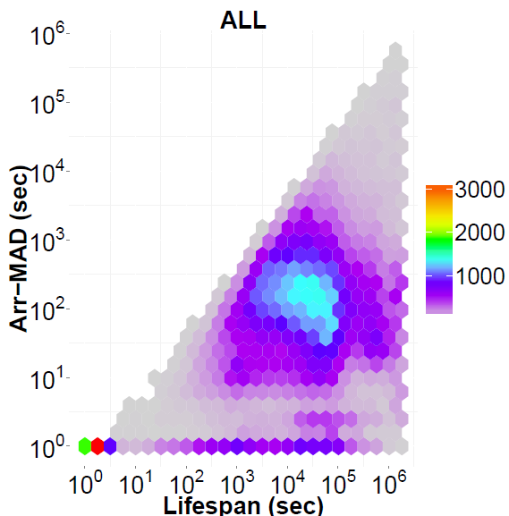
Microclusters of fraudulent retweet threads
2D feature subspaces

Slide 59
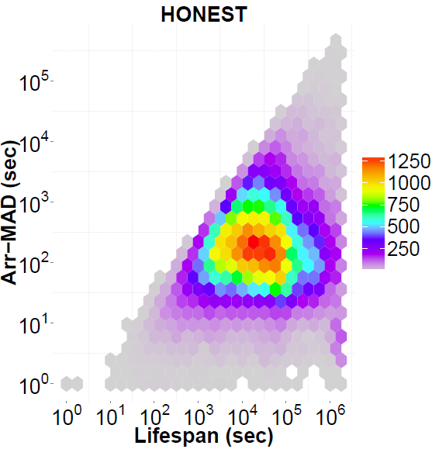
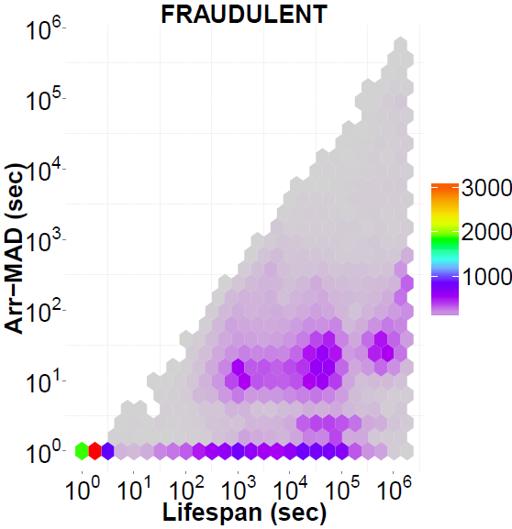
Microclusters of fraudulent retweet threads
2D feature subspaces
high synchronicity for RTFraudsters

Slide 60
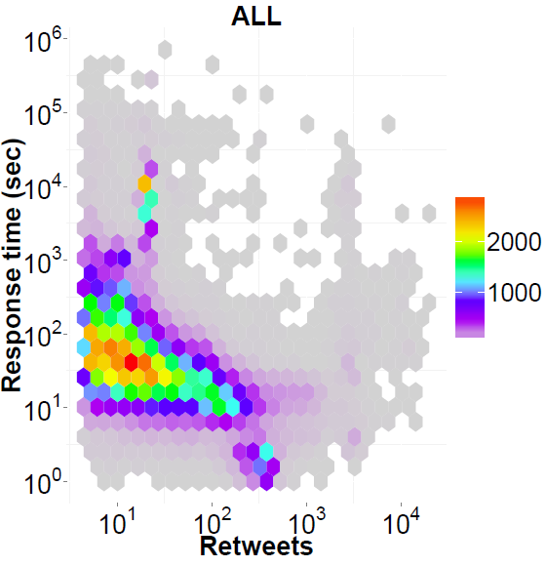
Microclusters of fraudulent retweet threads
2D feature subspaces

Slide 61
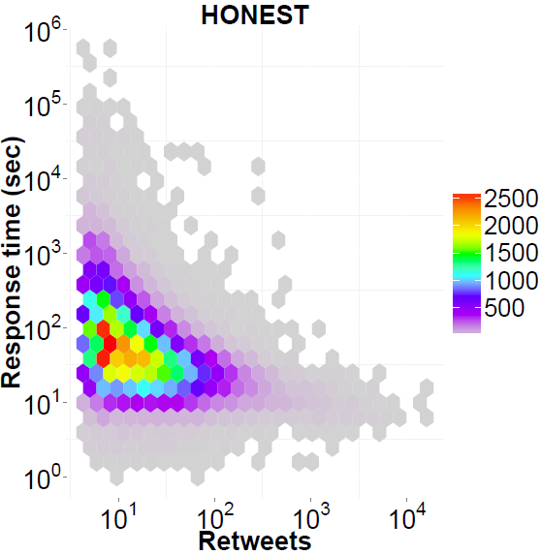
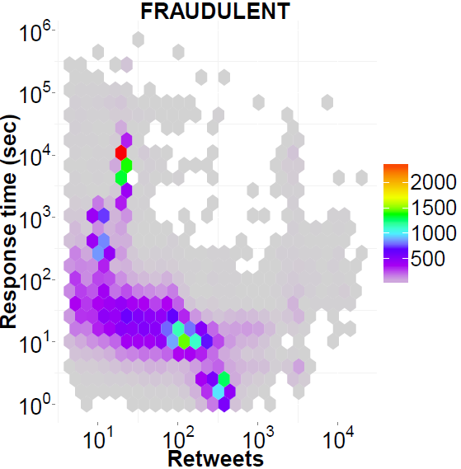
Microclusters of fraudulent retweet threads
2D feature subspaces
high synchronicity for RTFraudsters

Slide 62
Microclusters of fraudulent retweet threads
2D feature subspaces
Micro-clusters ~ fraud?
high synchronicity for RTFraudsters

Slide 63
(Details )
Paper has algo on how to find micro-clusters in medium-dim spaces.

Slide 64
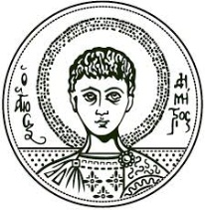
Data, at
Download dataset at:
http://oswinds.csd.auth.gr/project/NDSYNC

Slide 65
Retweeting activity on Twitter: Signs of Deception
Informatics Department
Aristotle University of Thessaloniki
School of Computer Science
Carnegie Mellon University
Maria Giatsoglou¹, Despoina Chatzakou¹, Neil Shah², Christos Faloutsos², Athena Vakali¹
¹ Aristotle Univ. of Thessaloniki, Greece ² CMU

Slide 66
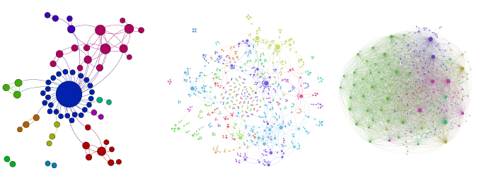
Connectivity in retweet networks
MP user
HP user
FD user
Very dense “R” networks are indicative of fraudulent activity
TRIANGLES and DEGREES patterns reveal fake retweet threads

Slide 67
Activity summarization patterns
lifespan
Response
time
IAT
First follower
retweets
Last follower
retweets
time
‘smith’ tweets
something

Slide 68

Activity Summarization - Patterns
% activated
followers
ENTHUSIASM
Response time
HP , MP , LP , FD users

Slide 69
Activity Summarization - Patterns
‘variance’
Of IAT
MACHINE-GUN
HP , MP , LP , FD users
lifespan

Slide 70
Activity Summarization - Patterns
ENTHUSIASM
MACHINE-GUN
HP , MP , LP , FD users
ENTHUSIASM: High infection probability for followers of fraudulent retweeters
MACHINE-GUN: Fraudsters retweet all at once, or with similar timedelay
REPETITION: Groups of fake retweet threads form microclusters due to similar response time, Arr-IQR and activated followers ratio

Slide 71

Disparity based on RTGen
RTGen closely emulates retweeting honest and fraudulent activity
100 simulations for 10 honest and 10 fraudulent users.
Averaged disparity per author and k-sized retweet thread

Slide 72
Data and code:
Download code and dataset at:
http://oswinds.csd.auth.gr/project/RTSCOPE

Slide 73
Roadmap
Introduction – Motivation
Part#1: Patterns in graphs
Patterns
Anomaly / fraud detection
CopyCatch
Spectral methods (‘fBox’)
Belief Propagation
Part#2: time-evolving graphs; tensors
Conclusions

Slide 74


E-bay Fraud detection
w/ Polo Chau &
Shashank Pandit, CMU
[www’07]

Slide 75
E-bay Fraud detection

Slide 76
E-bay Fraud detection

Slide 77

E-bay Fraud detection - NetProbe

Slide 78



Popular press
And less desirable attention:
E-mail from ‘Belgium police’ (‘copy of your code?’)

Slide 79
Roadmap
Introduction – Motivation
Part#1: Patterns in graphs
Patterns
Anomaly / fraud detection
CopyCatch
Spectral methods (‘fBox’)
Belief Propagation; antivirus app
Part#2: time-evolving graphs; tensors
Conclusions

Slide 80






Polonium: Tera-Scale Graph Mining and Inference for Malware Detection
PATENT PENDING
SDM 2011, Mesa, Arizona
Polo Chau
Machine Learning Dept
Carey Nachenberg
Vice President & Fellow
Jeffrey Wilhelm
Principal Software Engineer
Adam Wright
Software Engineer
Prof. Christos Faloutsos
Computer Science Dept

Slide 81


Polonium: The Data
Ç√
60+ terabytes of data anonymously contributed by participants of worldwide Norton Community Watch program
50+ million machines
900+ million executable files
Constructed a machine-file bipartite graph (0.2 TB+)
1 billion nodes (machines and files)
37 billion edges
Ç√
Ç√
Notes:
As of today, has grown to more than three times

Slide 82
Polonium: Key Ideas
Use Belief Propagation to propagate domain knowledge in machine-file graph to detect malware
Use “guilt-by-association” (i.e., homophily)
E.g., files that appear on machines with many bad files are more likely to be bad
Scalability: handles 37 billion-edge graph

Slide 83

Polonium: One-Interaction Results
Ideal
84.9% True Positive Rate 1% False Positive Rate
True Positive Rate
% of malware correctly identified
False Positive Rate
% of non-malware wrongly labeled as malware
Notes:
for files reported by four or more machines

Slide 84
Roadmap
Introduction – Motivation
Part#1: Patterns in graphs
Patterns
Anomaly / fraud detection
CopyCatch
Spectral methods (‘fBox’)
Belief Propagation; financial fraud
Part#2: time-evolving graphs; tensors
Conclusions

Slide 85

Network Effect Tools: SNARE
Some accounts are sort-of-suspicious – how to combine weak signals?
Before

Slide 86
Network Effect Tools: SNARE
A: Belief Propagation.
Before

Slide 87

Network Effect Tools: SNARE
A: Belief Propagation.
Before
After
Mary McGlohon, Stephen Bay, Markus G. Anderle, David M. Steier, Christos Faloutsos: SNARE: a link analytic system for graph labeling and risk detection. KDD 2009: 1265-1274

Slide 88

Network Effect Tools: SNARE
Produces improvement over simply using flags
Up to 6.5 lift
Improvement especially for low false positive rate
Results for accounts data (ROC Curve)
Ideal
SNARE
Baseline (flags only)
True positive rate
False positive rate

Slide 89
Network Effect Tools: SNARE
Accurate- Produces large improvement over simply using flags
Flexible- Can be applied to other domains
Scalable- One iteration BP runs in linear time (# edges)
Robust- Works on large range of parameters

Slide 90
Roadmap
Introduction – Motivation
Part#1: Patterns in graphs
Patterns
Anomaly / fraud detection
CopyCatch
Spectral methods (‘fBox’)
Belief Propagation; fast computation & unification
Part#2: time-evolving graphs; tensors
Conclusions

Slide 91

Unifying Guilt-by-Association Approaches: Theorems and Fast Algorithms
Danai Koutra
U Kang
Hsing-Kuo Kenneth Pao
Tai-You Ke
Duen Horng (Polo) Chau
Christos Faloutsos
ECML PKDD, 5-9 September 2011, Athens, Greece
Notes:
Work in collaboration with National Taiwan University

Slide 92

Problem Definition: GBA techniques
?
Given: Graph; &
few labeled nodes
Find: labels of rest
(assuming network effects)
?
?
?
Notes:
Classification problem where we assume that neighboring nodes are related
Network effects – birds of a feather flock together

Slide 93
Are they related?
RWR (Random Walk with Restarts)
google’s pageRank (‘if my friends are important, I’m important, too’)
SSL (Semi-supervised learning)
minimize the differences among neighbors
BP (Belief propagation)
send messages to neighbors, on what you believe about them

Slide 94
Are they related?
YES!
RWR (Random Walk with Restarts)
google’s pageRank (‘if my friends are important, I’m important, too’)
SSL (Semi-supervised learning)
minimize the differences among neighbors
BP (Belief propagation)
send messages to neighbors, on what you believe about them

Slide 95
Correspondence of Methods
Method | Matrix |  | Unknown |  | known
RWR | [I – c AD⁻¹] | × | x | = | (1-c)y
SSL | [I + a(D - A)] | × | x | = | y
FABP | [I + a D - c’A] | × | b_{h} | = | φ_{h}
1
1
1
d1
d2
d3
0 1 0
1 0 1
0 1 0
?
0
1
1
adjacency matrix
final labels/ beliefs
prior labels/ beliefs

Slide 96


Results: Scalability
runtime (min)
# of edges (Kronecker graphs)
FABP is linear on the number of edges.
Notes:
Kronecker graphs

Slide 97

Results: Parallelism
% accuracy
runtime (min)
FABP ~2x faster
& wins/ties on accuracy.

Slide 98
Summary of Part#1
*many* patterns in real graphs
Power-laws everywhere
Gaussian trap
Avg << Max
Long (and growing) list of tools for anomaly/fraud detection
Patterns anomalies

Slide 99
Roadmap
Introduction – Motivation
Part#1: Patterns in graphs
Part#2: time-evolving graphs; tensors
P2.1: time-evolving graphs
P2.2: with side information (‘coupled’ M.T.F.)
Speed
Part#3: Cascades and immunization
Conclusions

Slide 100
Part 2:
Time evolving
graphs; tensors

Slide 101
Graphs over time -> tensors!
Problem #2.1:
Given who calls whom, and when
Find patterns / anomalies
johnson
smith

Slide 102
Graphs over time -> tensors!
Problem #2.1:
Given who calls whom, and when
Find patterns / anomalies

Slide 103
Graphs over time -> tensors!
Problem #2.1:
Given who calls whom, and when
Find patterns / anomalies
Tue
Mon

Slide 104
Graphs over time -> tensors!
Problem #2.1:
Given who calls whom, and when
Find patterns / anomalies
time
caller
callee

Slide 105
Graphs over time -> tensors!
Problem #2.1’:
Given author-keyword-date
Find patterns / anomalies
date
MANY more settings,
with >2 ‘modes’
author
keyword

Slide 106
Graphs over time -> tensors!
Problem #2.1’’:
Given subject – verb – object facts
Find patterns / anomalies
verb
MANY more settings,
with >2 ‘modes’
subject
object

Slide 107
Graphs over time -> tensors!
Problem #2.1’’’:
Given <triplets>
Find patterns / anomalies
mode3
MANY more settings,
with >2 ‘modes’
(and 4, 5, etc modes)
mode1
mode2

Slide 108
Graphs & side info
Problem #2.2: coupled (eg., side info)
Given subject – verb – object facts
And voxel-activity for each subject-word
Find patterns / anomalies
verb
subject
object
fMRI voxel activity
`apple tastes sweet’

Slide 109
Graphs & side info
Problem #2.2: coupled (eg., side info)
Given subject – verb – object facts
And voxel-activity for each subject-word
Find patterns / anomalies
`tastes’
‘apple’
‘apple’
‘sweet’
fMRI voxel activity
`apple tastes sweet’

Slide 110
Roadmap
Introduction – Motivation
Part#1: Patterns in graphs
Part#2: time-evolving graphs; tensors
P2.1: time-evolving graphs
P2.2: with side information (‘coupled’ M.T.F.)
Speed
Conclusions

Slide 111


Answer to both: tensor factorization
Recall: (SVD) matrix factorization: finds blocks
‘meat-eaters’
‘steaks’
‘vegetarians’
‘plants’
‘kids’
‘cookies’
M
products
N
users
+
+
~

Slide 112
Answer to both: tensor factorization
PARAFAC decomposition
politicians
artists
athletes
verb
subject
+
+
=
object

Slide 113
Answer: tensor factorization
PARAFAC decomposition
Results for who-calls-whom-when
4M x 15 days
??
??
??
time
caller
+
+
=
callee

Slide 114



Anomaly detection in time-evolving graphs
=
Anomalous communities in phone call data:
European country, 4M clients, data over 2 weeks
~200 calls to EACH receiver on EACH day!
1 caller
5 receivers
4 days of activity

Slide 115
Anomaly detection in time-evolving graphs
=
Anomalous communities in phone call data:
European country, 4M clients, data over 2 weeks
~200 calls to EACH receiver on EACH day!
1 caller
5 receivers
4 days of activity

Slide 116



Anomaly detection in time-evolving graphs
=
Anomalous communities in phone call data:
European country, 4M clients, data over 2 weeks
~200 calls to EACH receiver on EACH day!
Miguel Araujo, Spiros Papadimitriou, Stephan Günnemann, Christos Faloutsos, Prithwish Basu, Ananthram Swami,
Evangelos Papalexakis, Danai Koutra. Com2: Fast Automatic Discovery of Temporal (Comet) Communities. PAKDD 2014, Tainan, Taiwan.

Slide 117
Roadmap
Introduction – Motivation
Part#1: Patterns in graphs
Part#2: time-evolving graphs; tensors
P2.1: Discoveries @ phonecall network
P2.2: Discoveries in neuro-semantics
Speed
Conclusions

Slide 118
Coupled Matrix-Tensor Factorization (CMTF)
c₁
c_{F}
Y
b₁
b_{F}
X
+
a₁
a_{F}
d₁
d_{F}
+
a₁
a_{F}

Slide 119

Neuro-semantics
Brain Scan Data*
9 persons
60 nouns
Questions
218 questions
‘is it alive?’, ‘can you eat it?’
*Mitchell et al. Predicting human brain activity associated with the meanings of nouns. Science,2008. Data@ www.cs.cmu.edu/afs/cs/project/theo-73/www/science2008/data.html

Slide 120
Neuro-semantics
Brain Scan Data*
9 persons
60 nouns
Questions
218 questions
‘is it alive?’, ‘can you eat it?’
Patterns?

Slide 121
Neuro-semantics
Brain Scan Data*
9 persons
60 nouns
Questions
218 questions
‘is it alive?’, ‘can you eat it?’
Patterns?
questions
airplane
dog
…
nouns
persons
voxels

Slide 122
Neuro-semantics
=

Slide 123
Neuro-semantics
=
Small items ->
Premotor cortex

Slide 124


Neuro-semantics
Small items ->
Premotor cortex
Evangelos Papalexakis, Tom Mitchell, Nicholas Sidiropoulos,
Christos Faloutsos, Partha Pratim Talukdar, Brian Murphy, Turbo-SMT: Accelerating Coupled Sparse Matrix-Tensor Factorizations by 200x, SDM 2014

Slide 125
Roadmap
Introduction – Motivation
Part#1: Patterns in graphs
Part#2: time-evolving graphs; tensors
P2.1: Discoveries @ phonecall network
P2.2: Discoveries in neuro-semantics
Scalability & Speed
Conclusions

Slide 126

Q: spilling to the disk?
Reminder: tensor (eg., Subject-verb-object)
144M non-zeros
48M
NELL (Never Ending Language Learner) @CMU
26M
26M

Slide 127
A: GigaTensor
Reminder: tensor (eg., Subject-verb-object)
26M x 48M x 26M, 144M non-zeros
NELL (Never Ending Language Learner)@CMU
U Kang, Evangelos E. Papalexakis, Abhay Harpale, Christos Faloutsos, GigaTensor: Scaling Tensor Analysis Up By 100 Times - Algorithms and Discoveries, KDD’12

Slide 128


A: GigaTensor
GigaTensor solves 100x larger problem
(K)
(J)
GigaTensor
(I)
100x
Number of
nonzero
= I / 50
Tensor
Out of
Toolbox
Memory

Slide 129
Part 2: Conclusions
Time-evolving / heterogeneous graphs -> tensors
PARAFAC finds patterns
GigaTensor -> fast & scalable
=

Slide 130
Roadmap
Introduction – Motivation
Why study (big) graphs?
Part#1: Patterns in graphs
Part#2: time-evolving graphs; tensors
Part#3: Cascades and immunization
Future directions
Conclusions

Slide 131

What?
You see a word (“apple”)
You try to answer a question (“Is it edible?”)
How do different parts of your brain communicate ? (‘Functional Connectivity’)
?
APPLE
?
?
?
EDIBLE?
?

Slide 132

Why?
?
?
?
?
Understand the human brain
Detect learning disorders at an early age
Build better robots
…
?

Slide 133

Bird’s Eye (Over)View
“apple”
“Is it edible?” (y/n)
“knife”
“Can it hurt you?” (y/n)
Parietal lobe
(movement)
…
Frontal lobe
(attention)
…
…
MEG
voxel 1
…
Occipital lobe
(vision)
voxel 2
Temporal lobe
(language)
…
voxel 306
…

Slide 134
High level answer:
‘system identification’ from control theory (O(n**3))
(and lowering of the expectations: ‘good-enough brain model’)
E. Papalexakis, A. Fyshe, N. Sidiropoulos, P. Talukdar, T. Mitchell, C. Faloutsos, Good-Enough Brain Model: Challenges, Algorithms and Discoveries in Multi-Subject Experiments, KDD 2014

Slide 135
Roadmap
Introduction – Motivation
Why study (big) graphs?
Part#1: Patterns in graphs
Part#2: time-evolving graphs; tensors
Part#3: Cascades and immunization
Future directions
Acknowledgements and Conclusions

Slide 136







Thanks
Disclaimer: All opinions are mine; not necessarily reflecting the opinions of the funding agencies
Thanks to: NSF IIS-0705359, IIS-0534205,
CTA-INARC; Yahoo (M45), LLNL, IBM, SPRINT, Google, INTEL, HP, iLab

Slide 137




Cast
Akoglu,
Leman
Araujo,
Miguel
Beutel,
Alex
Chau,
Polo
Kang, U
Koutra,
Danai
Lee,
Jay Yoon
Prakash,
Aditya
Papalexakis,
Vagelis
Shah,
Neil

Slide 138

CONCLUSION#1 – Big data
Patterns Anomalies
Large datasets reveal patterns/outliers that are invisible otherwise

Slide 139
CONCLUSION#2 – tensors
powerful tool
=

Slide 140

References
D. Chakrabarti, C. Faloutsos: Graph Mining – Laws, Tools and Case Studies, Morgan Claypool 2012
http://www.morganclaypool.com/doi/abs/10.2200/S00449ED1V01Y201209DMK006

Slide 141

TAKE HOME MESSAGE:
Cross-disciplinarity
=

Slide 142
TAKE HOME MESSAGE:
Thank you!
Cross-disciplinarity
=

