Slide 1
Mining Billion-Node Graphs: Patterns and Algorithms
Christos Faloutsos
CMU

Slide 2
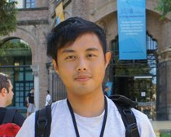
Thank you!
Dr. Ching-Hao (Eric) Mao
Prof. Kenneth Pao

Slide 3

Our goal:
Open source system for mining huge graphs:
PEGASUS project (PEta GrAph mining System)
www.cs.cmu.edu/~pegasus
code and papers

Slide 4
Outline
Introduction – Motivation
Problem#1: Patterns in graphs
Problem#2: Tools
Problem#3: Scalability
Conclusions

Slide 5

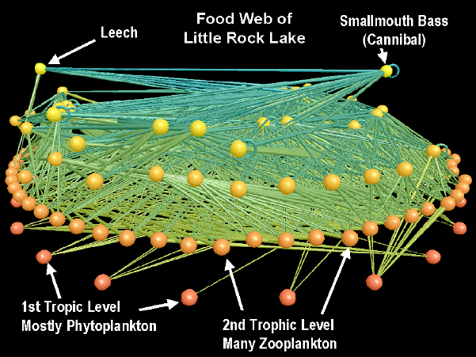


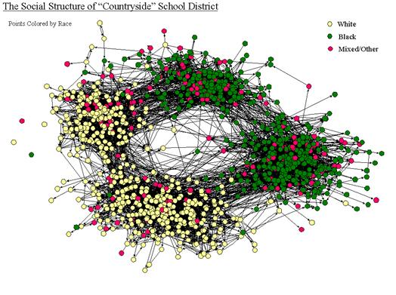
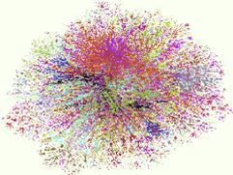
Graphs - why should we care?
Food Web [Martinez ’91]
Friendship Network [Moody ’01]
Internet Map [lumeta.com]

Slide 6
Graphs - why should we care?
IR: bi-partite graphs (doc-terms)
web: hyper-text graph
... and more:
D₁
T₁
...
...
D_{N}
T_{M}

Slide 7
Graphs - why should we care?
‘viral’ marketing
web-log (‘blog’) news propagation
computer network security: email/IP traffic and anomaly detection
....

Slide 8
Outline
Introduction – Motivation
Problem#1: Patterns in graphs
Static graphs
Weighted graphs
Time evolving graphs
Problem#2: Tools
Problem#3: Scalability
Conclusions

Slide 9
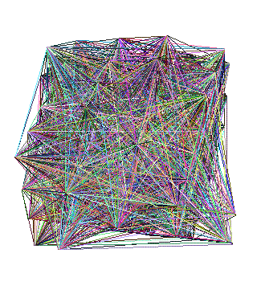
Problem #1 - network and graph mining
What does the Internet look like?
What does FaceBook look like?
What is ‘normal’/‘abnormal’?
which patterns/laws hold?

Slide 10
Problem #1 - network and graph mining
What does the Internet look like?
What does FaceBook look like?
What is ‘normal’/‘abnormal’?
which patterns/laws hold?
To spot anomalies (rarities), we have to discover patterns

Slide 11
Problem #1 - network and graph mining
What does the Internet look like?
What does FaceBook look like?
What is ‘normal’/‘abnormal’?
which patterns/laws hold?
To spot anomalies (rarities), we have to discover patterns
Large datasets reveal patterns/anomalies that may be invisible otherwise…

Slide 12
Graph mining
Are real graphs random?

Slide 13
Laws and patterns
Are real graphs random?
A: NO!!
Diameter
in- and out- degree distributions
other (surprising) patterns
So, let’s look at the data

Slide 14
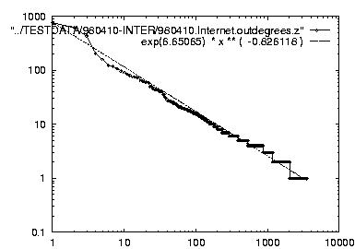
Solution# S.1
Power law in the degree distribution [SIGCOMM99]
internet domains
att.com
log(degree)
ibm.com
log(rank)

Slide 15
Solution# S.1
Power law in the degree distribution [SIGCOMM99]
internet domains
att.com
log(degree)
ibm.com
-0.82
log(rank)

Slide 16
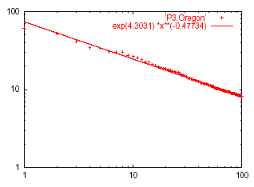
Solution# S.2: Eigen Exponent E
Eigenvalue
Exponent = slope
E = -0.48
May 2001
Rank of decreasing eigenvalue
A2: power law in the eigenvalues of the adjacency matrix

Slide 17
Solution# S.2: Eigen Exponent E
Eigenvalue
Exponent = slope
E = -0.48
May 2001
Rank of decreasing eigenvalue
[Mihail, Papadimitriou ’02]: slope is ½ of rank exponent

Slide 18
But:
How about graphs from other domains?

Slide 19
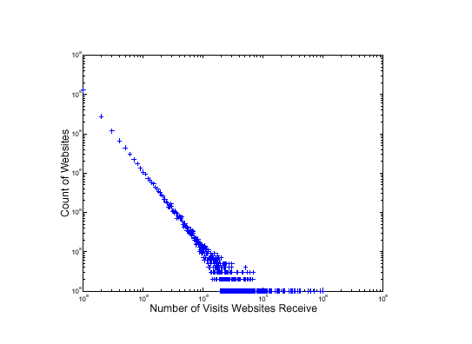
More power laws:
web hit counts [w/ A. Montgomery]
Web Site Traffic
Count
(log scale)
Zipf
``ebay’’
users
sites
in-degree (log scale)

Slide 20
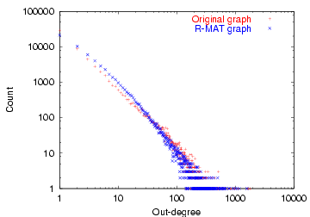
epinions.com
who-trusts-whom [Richardson + Domingos, KDD 2001]
count
trusts-2000-people user
(out) degree

Slide 21
And numerous more
# of sexual contacts
Income [Pareto] –’80-20 distribution’
Duration of downloads [Bestavros+]
Duration of UNIX jobs (‘mice and elephants’)
Size of files of a user
…
‘Black swans’

Slide 22
Outline
Introduction – Motivation
Problem#1: Patterns in graphs
Static graphs
degree, diameter, eigen,
triangles
cliques
Weighted graphs
Time evolving graphs
Problem#2: Tools

Slide 23
Solution# S.3: Triangle ‘Laws’
Real social networks have a lot of triangles

Slide 24
Solution# S.3: Triangle ‘Laws’
Real social networks have a lot of triangles
Friends of friends are friends
Any patterns?

Slide 25

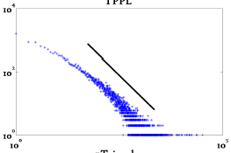
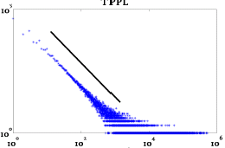
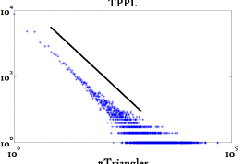
Triangle Law: #S.3 [Tsourakakis ICDM 2008]
HEP-TH
ASN
Epinions
X-axis: # of participating
triangles
Y: count (~ pdf)

Slide 26
Triangle Law: #S.3 [Tsourakakis ICDM 2008]
HEP-TH
ASN
Epinions
X-axis: # of participating
triangles
Y: count (~ pdf)

Slide 27
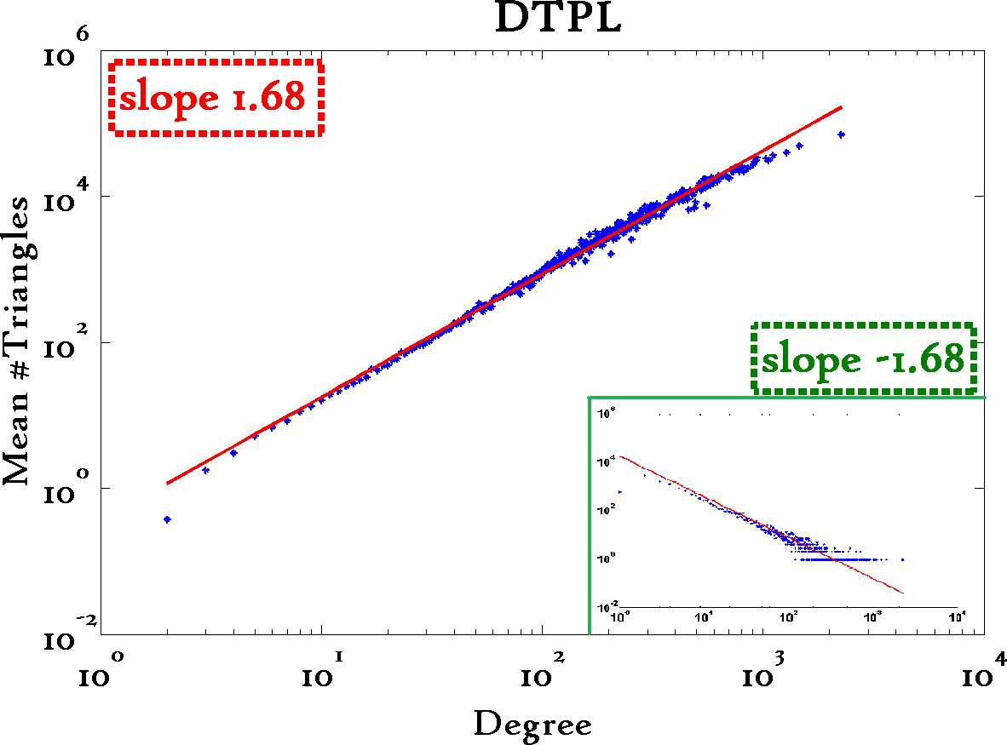
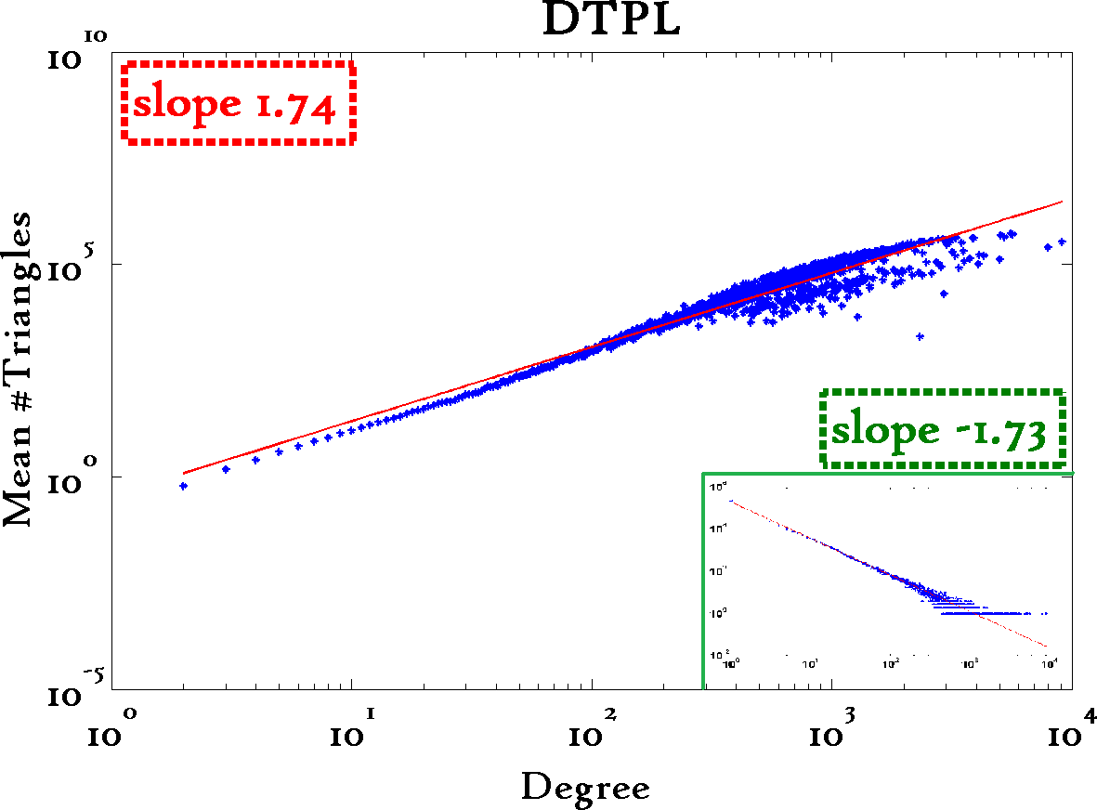
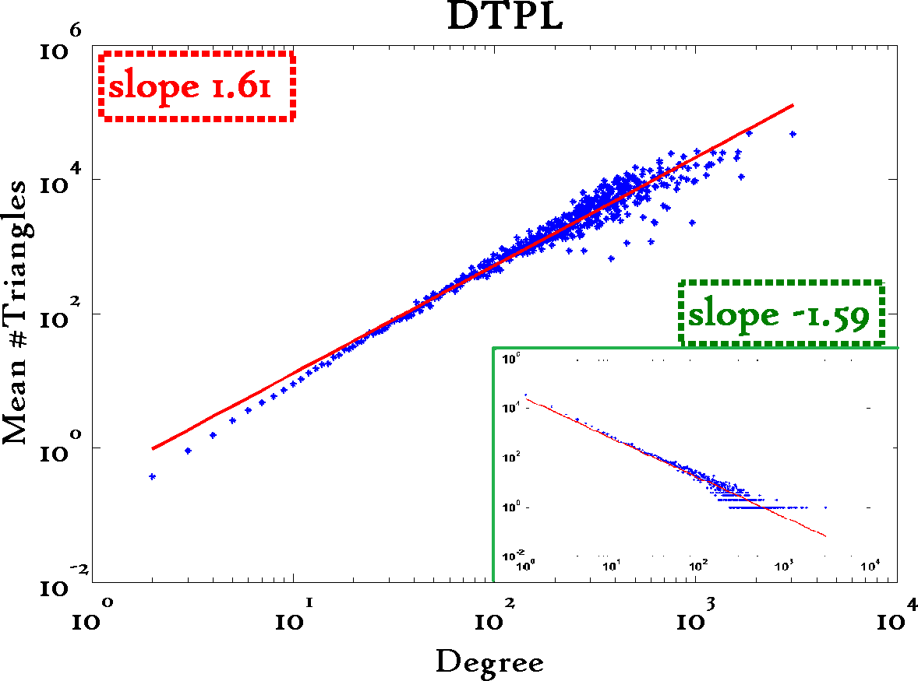
Triangle Law: #S.4 [Tsourakakis ICDM 2008]
Reuters
SN
X-axis: degree
Y-axis: mean # triangles
n friends -> ~n^{1.6} triangles
Epinions

Slide 28
Triangle Law: Computations [Tsourakakis ICDM 2008]
details
But: triangles are expensive to compute
(3-way join; several approx. algos)
Q: Can we do that quickly?

Slide 29
Triangle Law: Computations [Tsourakakis ICDM 2008]
details
But: triangles are expensive to compute
(3-way join; several approx. algos)
Q: Can we do that quickly?
A: Yes!
#triangles = 1/6 Sum ( λ_{i}³ )
(and, because of skewness (S2) ,
we only need the top few eigenvalues!

Slide 30
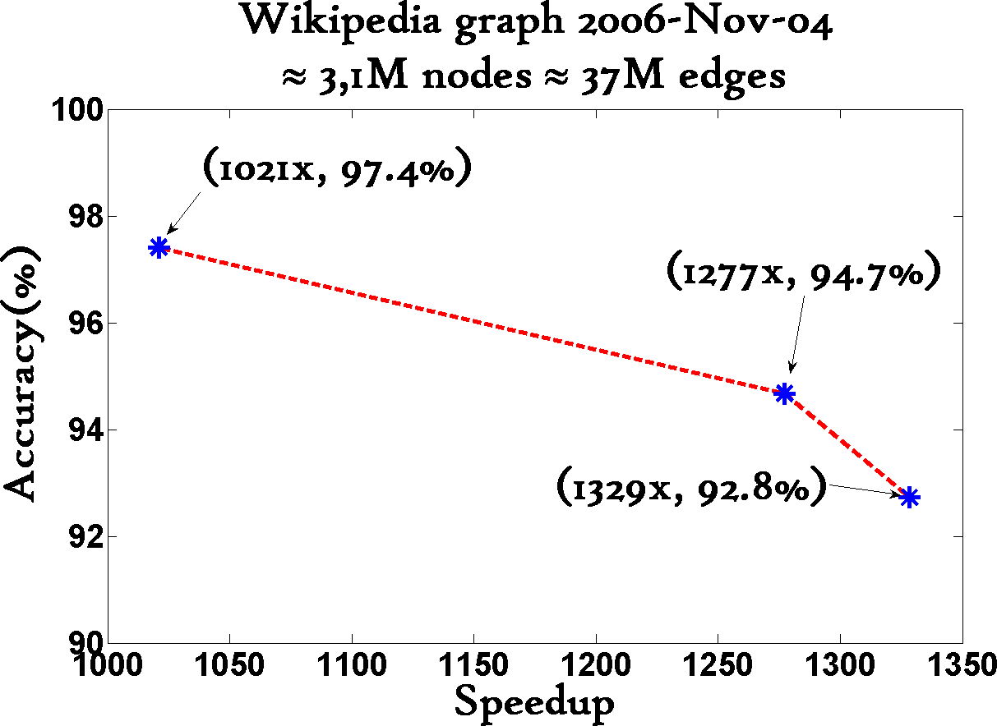
Triangle Law: Computations [Tsourakakis ICDM 2008]
details
1000x+ speed-up, >90% accuracy

Slide 31
Triangle counting for large graphs?
Anomalous nodes in Twitter(~ 3 billion edges)
[U Kang, Brendan Meeder, +, PAKDD’11]
31

Slide 32
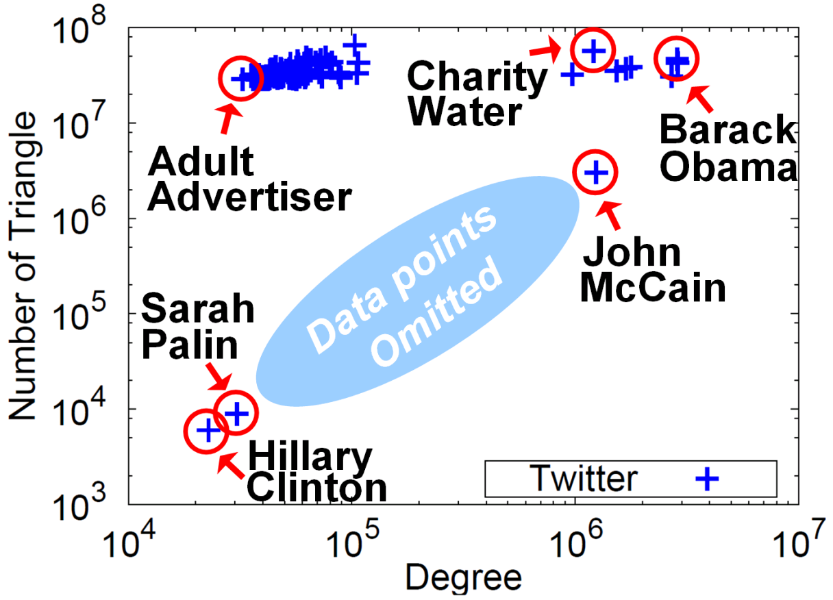
Triangle counting for large graphs?
Anomalous nodes in Twitter(~ 3 billion edges)
[U Kang, Brendan Meeder, +, PAKDD’11]
32

Slide 33

EigenSpokes
B. Aditya Prakash, Mukund Seshadri, Ashwin Sridharan, Sridhar Machiraju and Christos Faloutsos: EigenSpokes: Surprising Patterns and Scalable Community Chipping in Large Graphs, PAKDD 2010, Hyderabad, India, 21-24 June 2010.

Slide 34

EigenSpokes
Eigenvectors of adjacency matrix
equivalent to singular vectors (symmetric, undirected graph)
Notes:
A = U \Sigma U^T

Slide 35
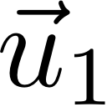
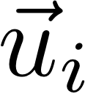
EigenSpokes
details
Eigenvectors of adjacency matrix
equivalent to singular vectors (symmetric, undirected graph)
N
N
Notes:
A = U \Sigma U^T
\vec{u}_1
\vec{u}_i

Slide 36
EigenSpokes
details
Eigenvectors of adjacency matrix
equivalent to singular vectors (symmetric, undirected graph)
N
N
Notes:
A = U \Sigma U^T
\vec{u}_1
\vec{u}_i

Slide 37
EigenSpokes
details
Eigenvectors of adjacency matrix
equivalent to singular vectors (symmetric, undirected graph)
N
N
Notes:
A = U \Sigma U^T
\vec{u}_1
\vec{u}_i

Slide 38
EigenSpokes
details
Eigenvectors of adjacency matrix
equivalent to singular vectors (symmetric, undirected graph)
N
N
Notes:
A = U \Sigma U^T
\vec{u}_1
\vec{u}_i

Slide 39
EigenSpokes
EE plot:
Scatter plot of scores of u1 vs u2
One would expect
Many points @ origin
A few scattered ~randomly
2nd Principal
component
u2
u1
1st Principal
component

Slide 40
EigenSpokes
EE plot:
Scatter plot of scores of u1 vs u2
One would expect
Many points @ origin
A few scattered ~randomly
u2
90º
u1

Slide 41
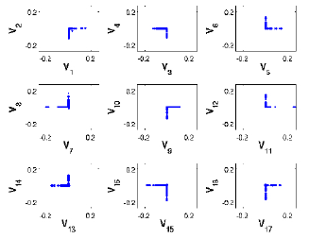
EigenSpokes - pervasiveness
Present in mobile social graph
across time and space
Patent citation graph

Slide 42
EigenSpokes - explanation
Near-cliques, or near-bipartite-cores, loosely connected

Slide 43
EigenSpokes - explanation
Near-cliques, or near-bipartite-cores, loosely connected

Slide 44
EigenSpokes - explanation
Near-cliques, or near-bipartite-cores, loosely connected

Slide 45
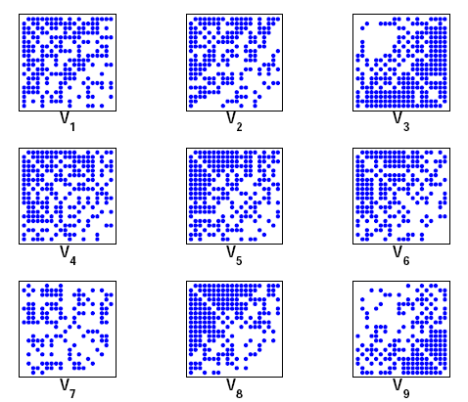
EigenSpokes - explanation
Near-cliques, or near-bipartite-cores, loosely connected
So what?
Extract nodes with high scores
high connectivity
Good “communities”
spy plot of top 20 nodes

Slide 46
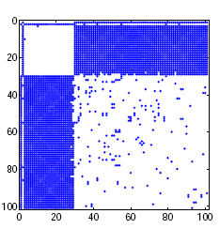
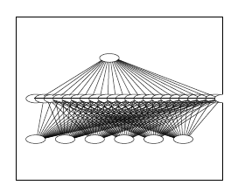
Bipartite Communities!
patents from
same inventor(s)
`cut-and-paste’
bibliography!
magnified bipartite community

Slide 47
(maybe, botnets?)
Victim IPs?
Botnet members?
Exploring this direction
with Dr. Mao and III.

Slide 48
Outline
Introduction – Motivation
Problem#1: Patterns in graphs
Static graphs
degree, diameter, eigen,
triangles
cliques
Weighted graphs
Time evolving graphs
Problem#2: Tools

Slide 49
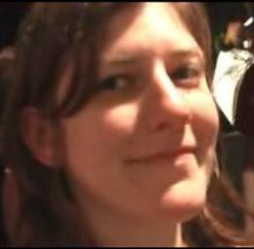
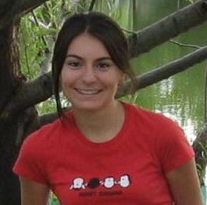
Observations on weighted graphs?
A: yes - even more ‘laws’!
M. McGlohon, L. Akoglu, and C. Faloutsos
Weighted Graphs and Disconnected Components: Patterns and a Generator.
SIG-KDD 2008

Slide 50
Observation W.1: Fortification
Q: How do the weights
of nodes relate to degree?

Slide 51
Observation W.1: Fortification
More donors,
more $ ?
‘Reagan’
$10
$5
‘Clinton’
$7

Slide 52
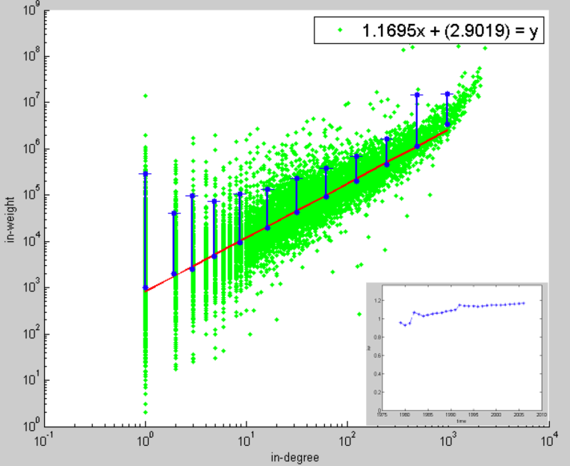
Observation W.1: fortification: Snapshot Power Law
Weight: super-linear on in-degree
exponent ‘iw’: 1.01 < iw < 1.26
More donors,
even more $
Orgs-Candidates
e.g. John Kerry,
$10M received,
from 1K donors
In-weights
($)
$10
$5
Edges (# donors)

Slide 53
Outline
Introduction – Motivation
Problem#1: Patterns in graphs
Static graphs
Weighted graphs
Time evolving graphs
Problem#2: Tools
…

Slide 54
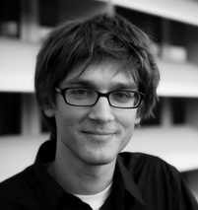
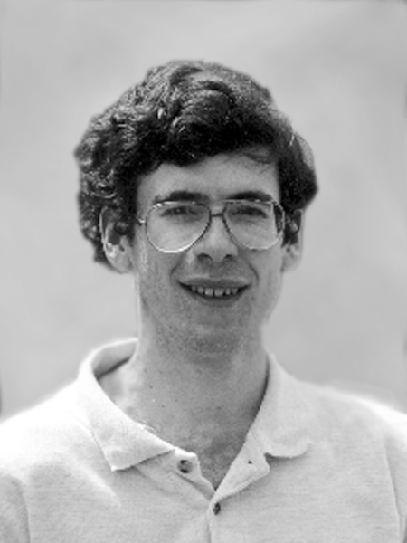
Problem: Time evolution
with Jure Leskovec (CMU -> Stanford)
and Jon Kleinberg (Cornell – sabb. @ CMU)

Slide 55
T.1 Evolution of the Diameter
Prior work on Power Law graphs hints at slowly growing diameter:
diameter ~ O(log N)
diameter ~ O(log log N)
What is happening in real data?
Notes:
Diameter first, DPL second
Check diameter formulas
As the network grows the distances between nodes slowly grow

Slide 56
T.1 Evolution of the Diameter
Prior work on Power Law graphs hints at slowly growing diameter:
diameter ~ O(log N)
diameter ~ O(log log N)
What is happening in real data?
Diameter shrinks over time

Slide 57
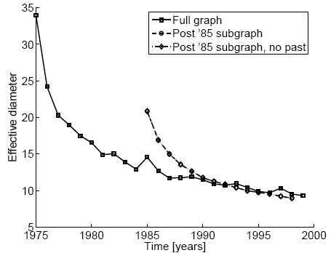
T.1 Diameter – “Patents”
diameter
Patent citation network
25 years of data
@1999
2.9 M nodes
16.5 M edges
time [years]

Slide 58
T.2 Temporal Evolution of the Graphs
N(t) … nodes at time t
E(t) … edges at time t
Suppose that
N(t+1) = 2 * N(t)
Q: what is your guess for
E(t+1) =? 2 * E(t)

Slide 59
T.2 Temporal Evolution of the Graphs
N(t) … nodes at time t
E(t) … edges at time t
Suppose that
N(t+1) = 2 * N(t)
Q: what is your guess for
E(t+1) =? 2 * E(t)
A: over-doubled!
But obeying the ``Densification Power Law’’

Slide 60
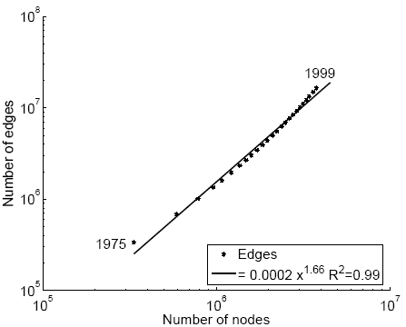
T.2 Densification – Patent Citations
Citations among patents granted
@1999
2.9 M nodes
16.5 M edges
Each year is a datapoint
E(t)
1.66
N(t)

Slide 61
Outline
Introduction – Motivation
Problem#1: Patterns in graphs
Static graphs
Weighted graphs
Time evolving graphs
Problem#2: Tools
…

Slide 62
More on Time-evolving graphs
M. McGlohon, L. Akoglu, and C. Faloutsos
Weighted Graphs and Disconnected Components: Patterns and a Generator.
SIG-KDD 2008

Slide 63
Observation T.3: NLCC behavior
Q: How do NLCC’s emerge and join with the GCC?
(``NLCC’’ = non-largest conn. components)
Do they continue to grow in size?
or do they shrink?
or stabilize?

Slide 64
Observation T.3: NLCC behavior
Q: How do NLCC’s emerge and join with the GCC?
(``NLCC’’ = non-largest conn. components)
Do they continue to grow in size?
or do they shrink?
or stabilize?

Slide 65
Observation T.3: NLCC behavior
YES
YES
YES
Q: How do NLCC’s emerge and join with the GCC?
(``NLCC’’ = non-largest conn. components)
Do they continue to grow in size?
or do they shrink?
or stabilize?

Slide 66
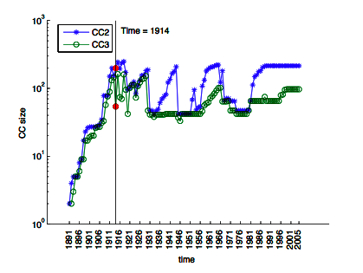
Observation T.3: NLCC behavior
After the gelling point, the GCC takes off, but NLCC’s remain ~constant (actually, oscillate).
IMDB
CC size
Time-stamp

Slide 67
Timing for Blogs
with Mary McGlohon (CMU->Google)
Jure Leskovec (CMU->Stanford)
Natalie Glance (now at Google)
Mat Hurst (now at MSR)
[SDM’07]

Slide 68
T.4 : popularity over time
# in links
1
2
3
lag: days after post
Post popularity drops-off – exponentially?
@t
@t + lag
Notes:
68

Slide 69
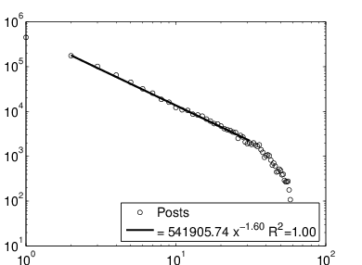
T.4 : popularity over time
# in links
(log)
days after post
(log)
Post popularity drops-off – exponentially?
POWER LAW!
Exponent?
Notes:
69

Slide 70
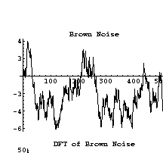
T.4 : popularity over time
# in links
(log)
-1.6
days after post
(log)
Post popularity drops-off – exponentially?
POWER LAW!
Exponent? -1.6
close to -1.5: Barabasi’s stack model
and like the zero-crossings of a random walk
Notes:
70

Slide 71
-1.5 slope
J. G. Oliveira & A.-L. Barabási Human Dynamics: The Correspondence Patterns of Darwin and Einstein. Nature 437, 1251 (2005) . [PDF]

Slide 72

T.5: duration of phonecalls
Surprising Patterns for the Call Duration Distribution of Mobile Phone Users
Pedro O. S. Vaz de Melo, Leman Akoglu, Christos Faloutsos, Antonio A. F. Loureiro
PKDD 2010

Slide 73
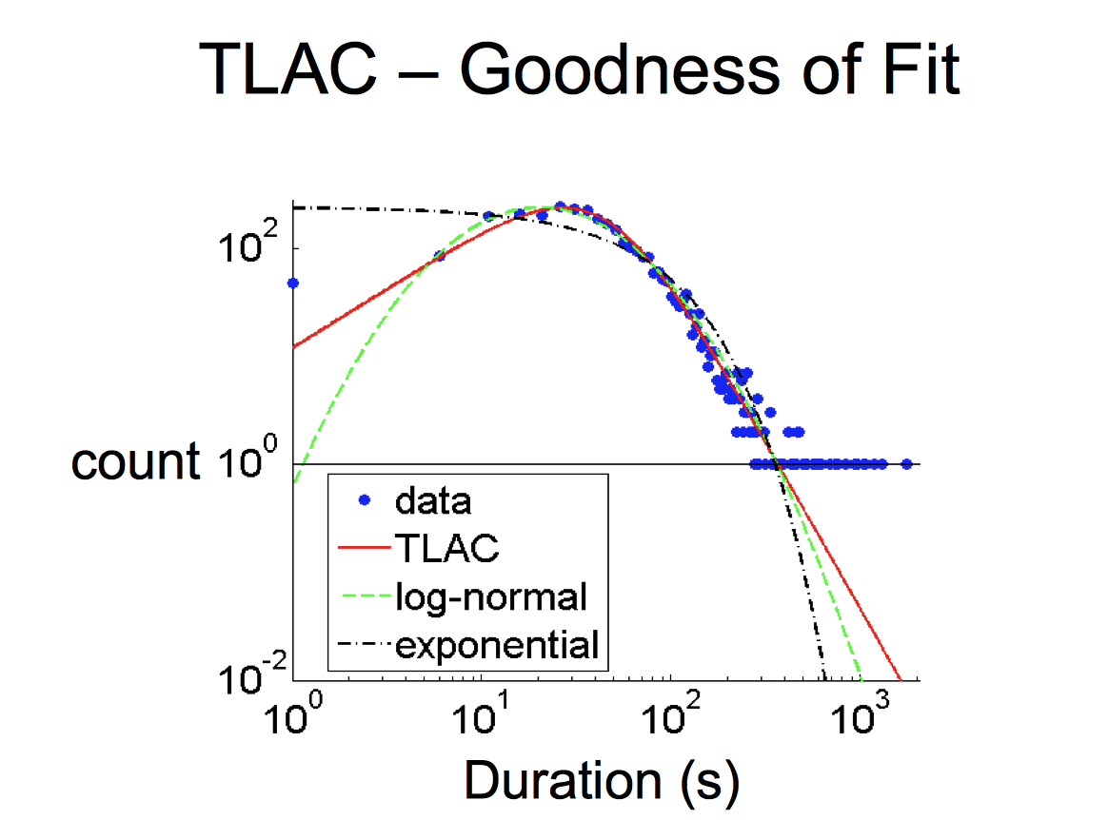
Probably, power law (?)
??

Slide 74
No Power Law!

Slide 75
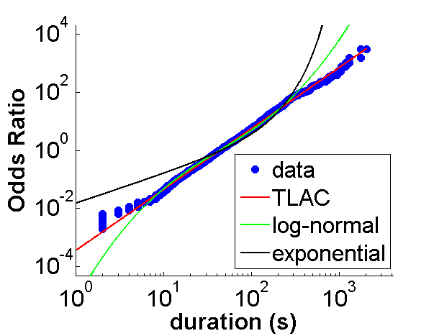
‘TLaC: Lazy Contractor’
The longer a task (phonecall) has taken,
The even longer it will take
Odds ratio=
Casualties(<x):
Survivors(>=x)
== power law

Slide 76
Data Description
Data from a private mobile operator of a large city
4 months of data
3.1 million users
more than 1 billion phone records
Over 96% of ‘talkative’ users obeyed a TLAC distribution (‘talkative’: >30 calls)

Slide 77
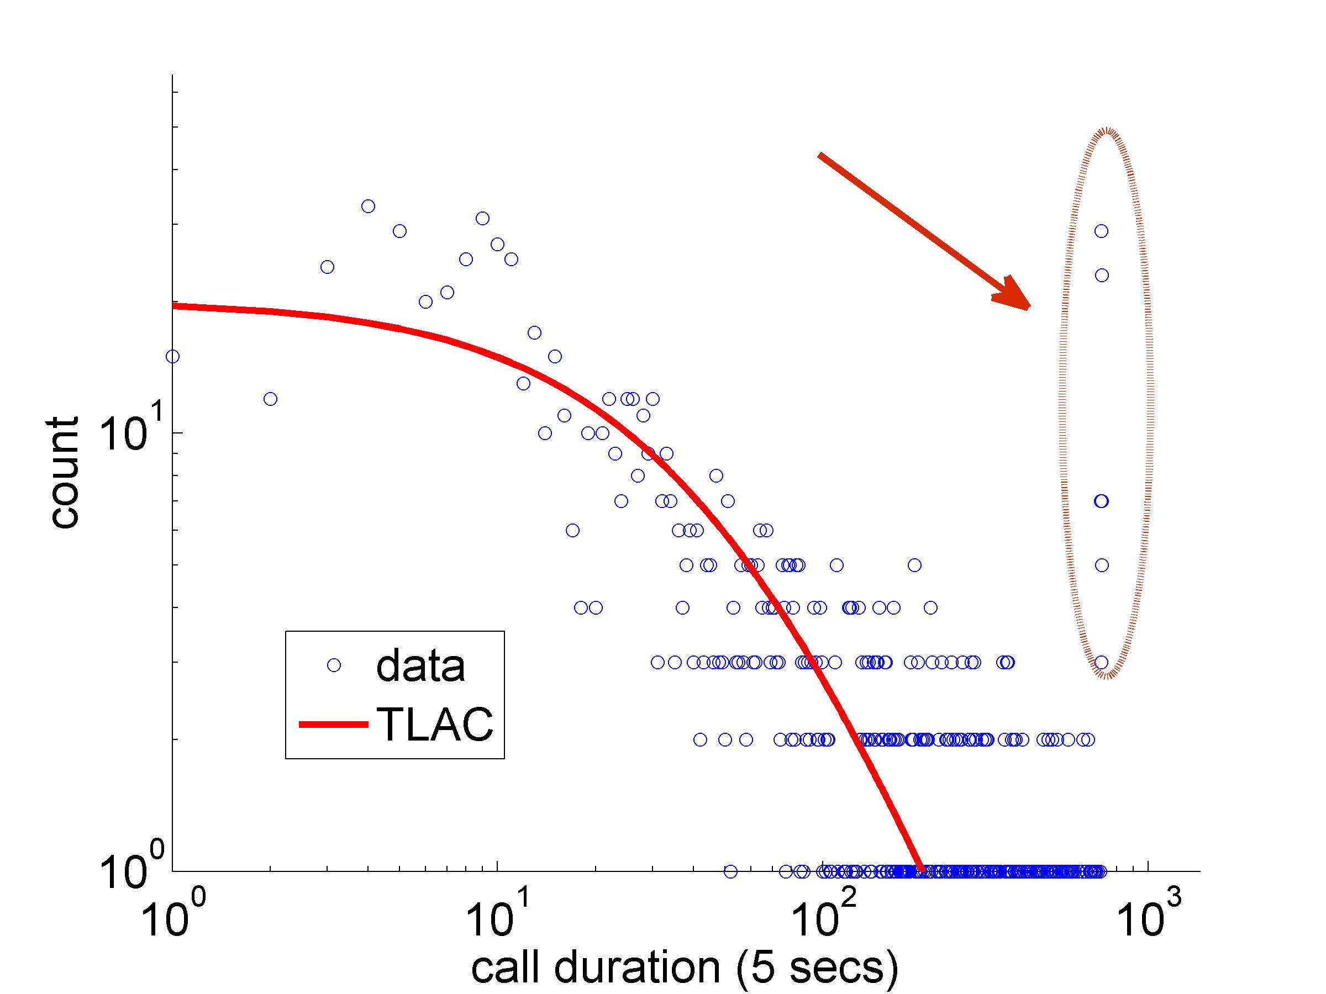
Outliers:

Slide 78
Outline
Introduction – Motivation
Problem#1: Patterns in graphs
Problem#2: Tools
OddBall (anomaly detection)
Belief Propagation
Immunization
Problem#3: Scalability
Conclusions

Slide 79
OddBall: Spotting Anomalies in Weighted Graphs
Leman Akoglu, Mary McGlohon, Christos Faloutsos
Carnegie Mellon University
School of Computer Science
PAKDD 2010, Hyderabad, India

Slide 80
Main idea
For each node,
extract ‘ego-net’ (=1-step-away neighbors)
Extract features (#edges, total weight, etc etc)
Compare with the rest of the population

Slide 81
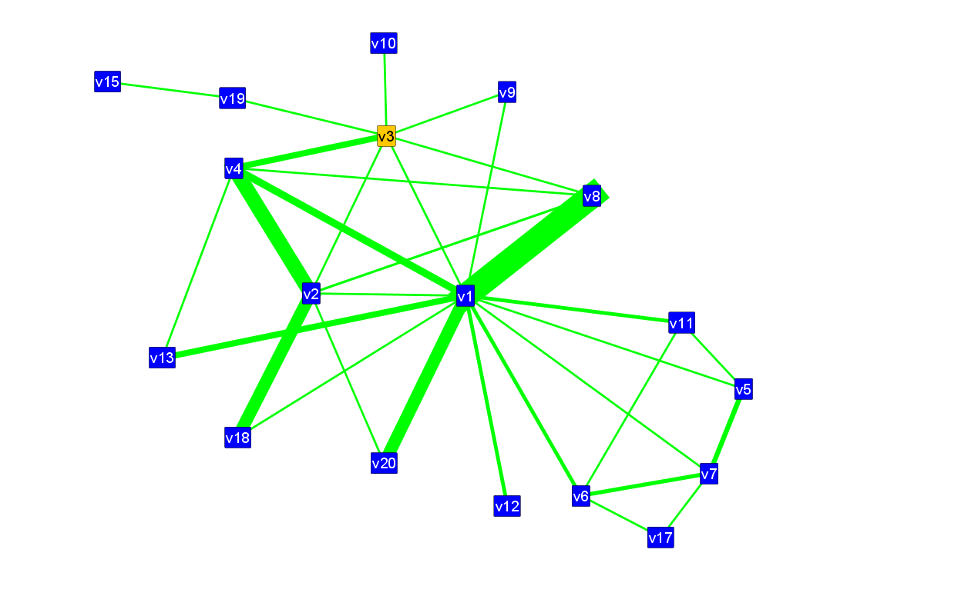
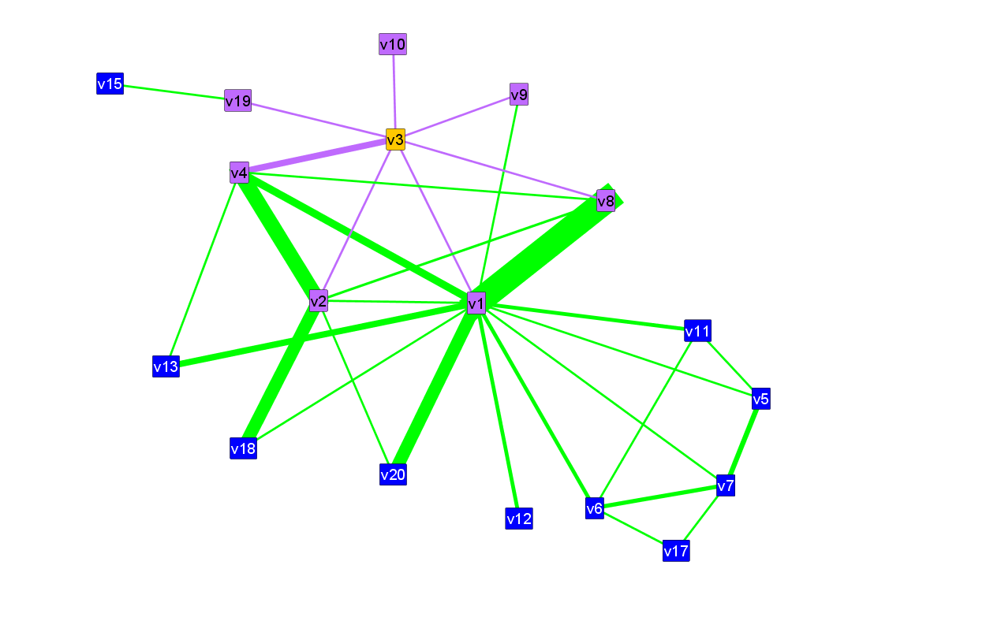
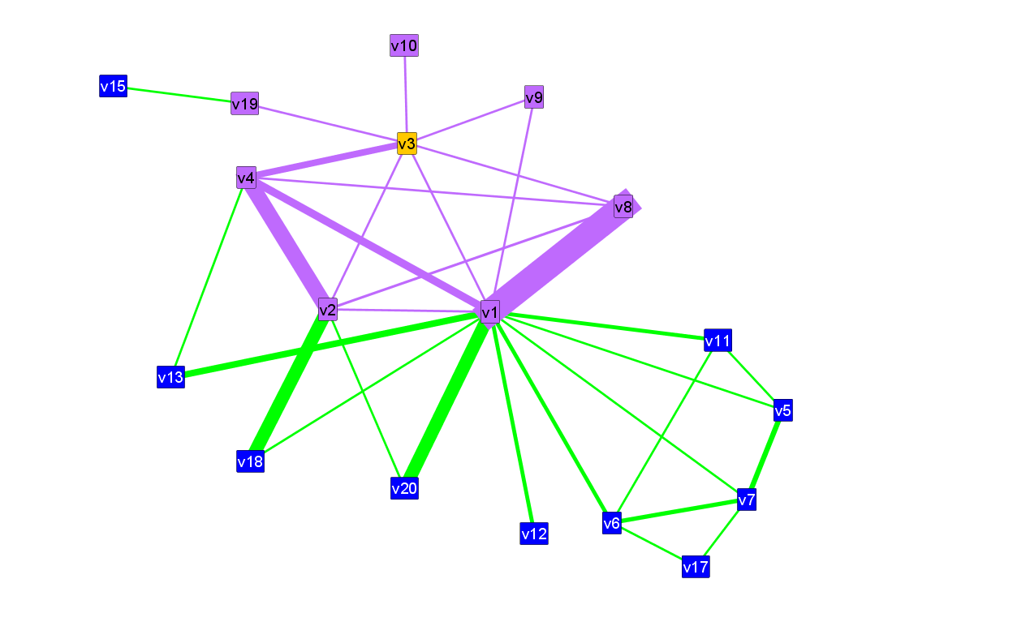

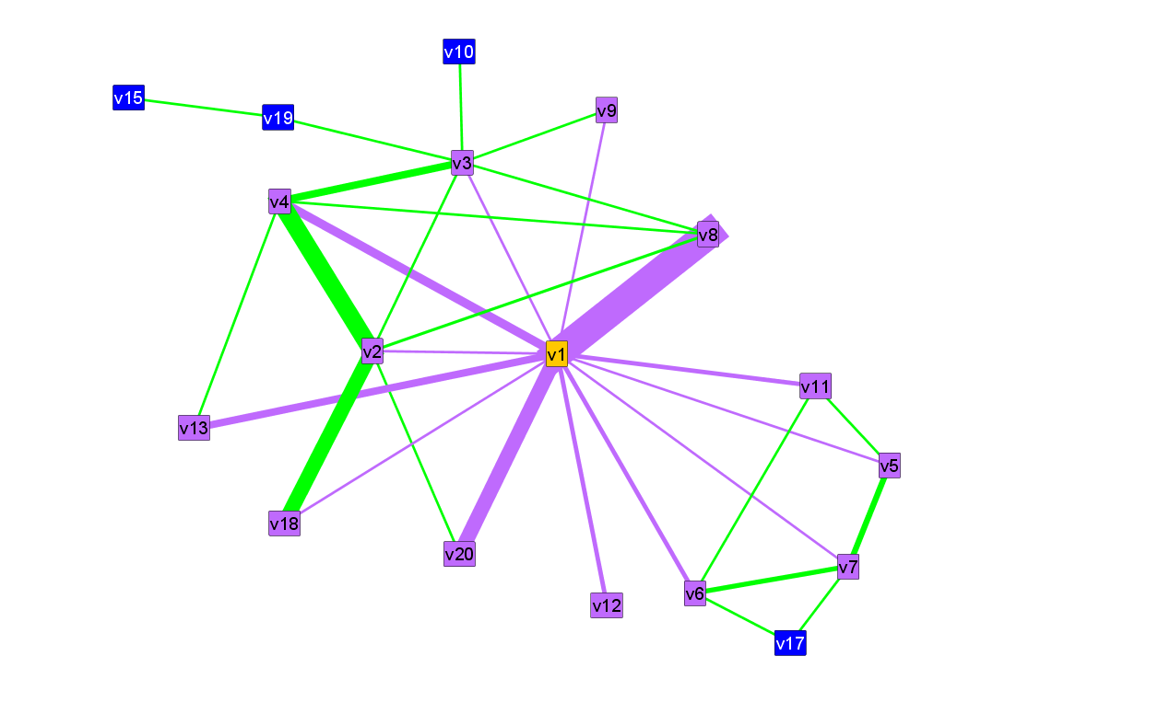
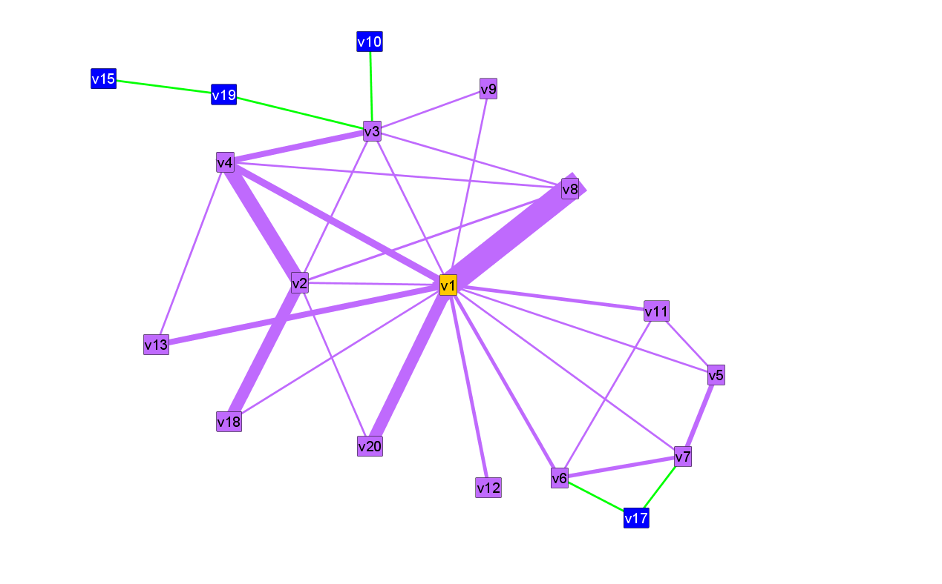
What is an egonet?
egonet
ego
Notes:
81

Slide 82
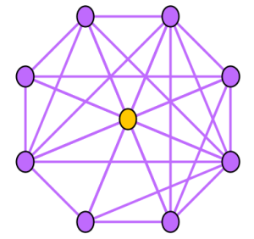
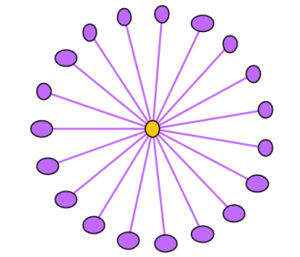
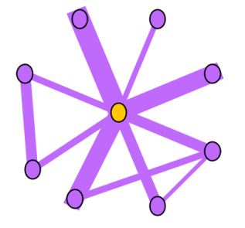
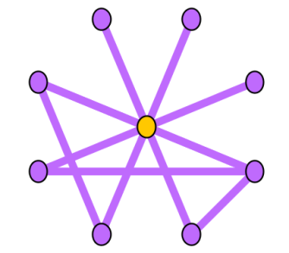
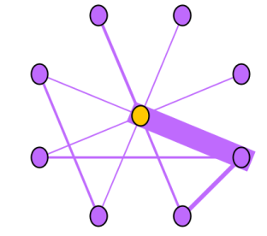
Selected Features
N_{i}: number of neighbors (degree) of ego i
E_{i}: number of edges in egonet i
W_{i}: total weight of egonet i
λ_{w,i}: principal eigenvalue of the weighted adjacency matrix of egonet I
Notes:
82

Slide 83
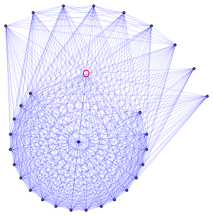
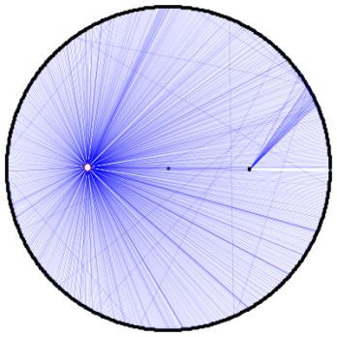
Near-Clique/Star
Notes:
SOME OLD RULES
83

Slide 84
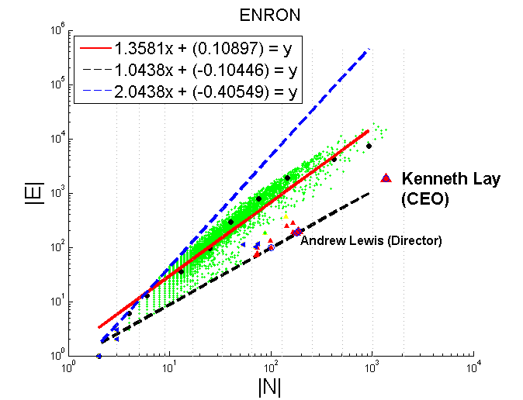
Near-Clique/Star
Notes:
SOME OLD RULES
84

Slide 85
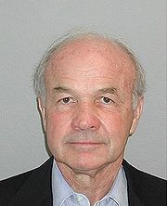
Near-Clique/Star
Notes:
SOME OLD RULES
85

Slide 86
Near-Clique/Star
Andrew Lewis
(director)
Notes:
SOME OLD RULES
86

Slide 87
Outline
Introduction – Motivation
Problem#1: Patterns in graphs
Problem#2: Tools
OddBall (anomaly detection)
Belief Propagation
Immunization
Problem#3: Scalability
Conclusions

Slide 88


E-bay Fraud detection
w/ Polo Chau &
Shashank Pandit, CMU
[www’07]

Slide 89
E-bay Fraud detection

Slide 90
E-bay Fraud detection

Slide 91

E-bay Fraud detection - NetProbe

Slide 92



Popular press
And less desirable attention:
E-mail from ‘Belgium police’ (‘copy of your code?’)

Slide 93
Outline
Introduction – Motivation
Problem#1: Patterns in graphs
Problem#2: Tools
OddBall (anomaly detection)
Belief Propagation – antivirus app
Immunization
Problem#3: Scalability
Conclusions

Slide 94






Polonium: Tera-Scale Graph Mining and Inference for Malware Detection
PATENT PENDING
SDM 2011, Mesa, Arizona
Polo Chau
Machine Learning Dept
Carey Nachenberg
Vice President & Fellow
Jeffrey Wilhelm
Principal Software Engineer
Adam Wright
Software Engineer
Prof. Christos Faloutsos
Computer Science Dept

Slide 95


Polonium: The Data
60+ terabytes of data anonymously contributed by participants of worldwide Norton Community Watch program
50+ million machines
900+ million executable files
Constructed a machine-file bipartite graph (0.2 TB+)
1 billion nodes (machines and files)
37 billion edges
Notes:
As of today, has grown to more than three times

Slide 96
Polonium: Key Ideas
Use Belief Propagation to propagate domain knowledge in machine-file graph to detect malware
Use “guilt-by-association” (i.e., homophily)
E.g., files that appear on machines with many bad files are more likely to be bad
Scalability: handles 37 billion-edge graph

Slide 97

Polonium: One-Interaction Results
Ideal
84.9% True Positive Rate 1% False Positive Rate
True Positive Rate
% of malware correctly identified
False Positive Rate
% of non-malware wrongly labeled as malware
Notes:
for files reported by four or more machines

Slide 98
Outline
Introduction – Motivation
Problem#1: Patterns in graphs
Problem#2: Tools
[OddBall (anomaly detection)]
[Belief propagation]
[Immunization]
Visualization
Problem#3: Scalability -PEGASUS
Conclusions

Slide 99


Apolo Making Sense of Large Network Data: Combining Rich User Interaction & Machine Learning
CHI 2011, Vancouver, Canada
Polo Chau
Prof. Niki Kittur
Prof. Jason Hong
Prof. Christos Faloutsos

Slide 100
Main Ideas of Apolo
Provides a mixed-initiative approach (ML + HCI) to help users interactively explore large graphs
Users start with small subgraph, then iteratively expand:
User specifies exemplars
Belief Propagation to find other relevant nodes
User study showed Apolo outperformed Google Scholar in making sense of citation network data

Slide 101

Rest of the nodes are considered relevant (by BP); relevance indicated by color saturation.
Note that BP supports multiple groups
Exemplars
Notes:
Black node is what user is familiar. Graph is citation network (node:aritlce, edge: citation relationship)

Slide 102
Outline
Introduction – Motivation
Problem#1: Patterns in graphs
Problem#2: Tools
OddBall (anomaly detection)
Belief propagation
Immunization
Problem#3: Scalability -PEGASUS
Conclusions

Slide 103


Scalability
Google: > 450,000 processors in clusters of ~2000 processors each [Barroso, Dean, Hölzle, “Web Search for a Planet: The Google Cluster Architecture” IEEE Micro 2003]
Yahoo: 5Pb of data [Fayyad, KDD’07]
Problem: machine failures, on a daily basis
How to parallelize data mining tasks, then?
A: map/reduce – hadoop (open-source clone) http://hadoop.apache.org/
Notes:
Faloutsos et al
8/1/12
103

Slide 104
Outline – Algorithms & results
 | Centralized | Hadoop/PEGASUS
Degree Distr. | old | old
Pagerank | old | old
Diameter/ANF | old | HERE
Conn. Comp | old | HERE
Triangles | done | HERE
Visualization | started
Notes:
104

Slide 105

HADI for diameter estimation
Radius Plots for Mining Tera-byte Scale Graphs U Kang, Charalampos Tsourakakis, Ana Paula Appel, Christos Faloutsos, Jure Leskovec, SDM’10
Naively: diameter needs O(N**2) space and up to O(N**3) time – prohibitive (N~1B)
Our HADI: linear on E (~10B)
Near-linear scalability wrt # machines
Several optimizations -> 5x faster

Slide 106

????
Count
19+ [Barabasi+]
~1999, ~1M nodes
Radius

Slide 107
????
??
Count
19+ [Barabasi+]
~1999, ~1M nodes
Radius
YahooWeb graph (120Gb, 1.4B nodes, 6.6 B edges)
Largest publicly available graph ever studied.

Slide 108
????
Count
14 (dir.)
~7 (undir.)
19+? [Barabasi+]
Radius
YahooWeb graph (120Gb, 1.4B nodes, 6.6 B edges)
Largest publicly available graph ever studied.

Slide 109
????
Count
14 (dir.)
~7 (undir.)
19+? [Barabasi+]
Radius
YahooWeb graph (120Gb, 1.4B nodes, 6.6 B edges)
7 degrees of separation (!)
Diameter: shrunk

Slide 110
????
Count
~7 (undir.)
Radius
YahooWeb graph (120Gb, 1.4B nodes, 6.6 B edges)
Q: Shape?

Slide 111
YahooWeb graph (120Gb, 1.4B nodes, 6.6 B edges)
effective diameter: surprisingly small.
Multi-modality (?!)

Slide 112

Radius Plot of GCC of YahooWeb.

Slide 113
YahooWeb graph (120Gb, 1.4B nodes, 6.6 B edges)
effective diameter: surprisingly small.
Multi-modality: probably mixture of cores .

Slide 114
Conjecture:
DE
EN
BR
~7
YahooWeb graph (120Gb, 1.4B nodes, 6.6 B edges)
effective diameter: surprisingly small.
Multi-modality: probably mixture of cores .

Slide 115
Conjecture:
~7
YahooWeb graph (120Gb, 1.4B nodes, 6.6 B edges)
effective diameter: surprisingly small.
Multi-modality: probably mixture of cores .

Slide 116

details
Running time - Kronecker and Erdos-Renyi
Graphs with billions edges.

Slide 117
Outline – Algorithms & results
 | Centralized | Hadoop/PEGASUS
Degree Distr. | old | old
Pagerank | old | old
Diameter/ANF | old | HERE
Conn. Comp | old | HERE
Triangles |  | HERE
Visualization | started
Notes:
117

Slide 118
Generalized Iterated Matrix Vector Multiplication (GIMV)
PEGASUS: A Peta-Scale Graph Mining
System - Implementation and Observations. U Kang, Charalampos E. Tsourakakis,
and Christos Faloutsos. (ICDM) 2009, Miami, Florida, USA. Best Application Paper (runner-up).

Slide 119
Generalized Iterated Matrix Vector Multiplication (GIMV)
details
PageRank
proximity (RWR)
Diameter
Connected components
(eigenvectors,
Belief Prop.
… )
Matrix – vector
Multiplication
(iterated)

Slide 120

Example: GIM-V At Work
Connected Components – 4 observations:
Count
Size

Slide 121
Example: GIM-V At Work
Connected Components
Count
1) 10K x
larger
than next
Size

Slide 122
Example: GIM-V At Work
Connected Components
Count
2) ~0.7B
singleton
nodes
Size

Slide 123
Example: GIM-V At Work
Connected Components
Count
3) SLOPE!
Size

Slide 124
Example: GIM-V At Work
Connected Components
Count
300-size cmpt
X 500.
Why?
1100-size cmpt
X 65.
Why?
4) Spikes!
Size

Slide 125
Example: GIM-V At Work
Connected Components
Count
suspicious
financial-advice sites
(not existing now)
Size

Slide 126

GIM-V At Work
Connected Components over Time
LinkedIn: 7.5M nodes and 58M edges
Stable tail slope
after the gelling point

Slide 127
Outline
Introduction – Motivation
Problem#1: Patterns in graphs
Problem#2: Tools
Problem#3: Scalability
Conclusions

Slide 128
OVERALL CONCLUSIONS – low level:
Several new patterns (fortification, triangle-laws, conn. components, etc)
New tools:
anomaly detection (OddBall), belief propagation, immunization
Scalability: PEGASUS / hadoop

Slide 129
OVERALL CONCLUSIONS – high level
BIG DATA: Large datasets reveal patterns/outliers that are invisible otherwise

Slide 130
References
Leman Akoglu, Christos Faloutsos: RTG: A Recursive Realistic Graph Generator Using Random Typing. ECML/PKDD (1) 2009: 13-28
Deepayan Chakrabarti, Christos Faloutsos: Graph mining: Laws, generators, and algorithms. ACM Comput. Surv. 38(1): (2006)

Slide 131
References
Deepayan Chakrabarti, Yang Wang, Chenxi Wang, Jure Leskovec, Christos Faloutsos: Epidemic thresholds in real networks. ACM Trans. Inf. Syst. Secur. 10(4): (2008)
Deepayan Chakrabarti, Jure Leskovec, Christos Faloutsos, Samuel Madden, Carlos Guestrin, Michalis Faloutsos: Information Survival Threshold in Sensor and P2P Networks. INFOCOM 2007: 1316-1324

Slide 132
References
Christos Faloutsos, Tamara G. Kolda, Jimeng Sun: Mining large graphs and streams using matrix and tensor tools. Tutorial, SIGMOD Conference 2007: 1174

Slide 133
References
T. G. Kolda and J. Sun. Scalable Tensor Decompositions for Multi-aspect Data Mining. In: ICDM 2008, pp. 363-372, December 2008.

Slide 134
References
Jure Leskovec, Jon Kleinberg and Christos Faloutsos Graphs over Time: Densification Laws, Shrinking Diameters and Possible Explanations, KDD 2005 (Best Research paper award).
Jure Leskovec, Deepayan Chakrabarti, Jon M. Kleinberg, Christos Faloutsos: Realistic, Mathematically Tractable Graph Generation and Evolution, Using Kronecker Multiplication. PKDD 2005: 133-145

Slide 135
References
Jimeng Sun, Yinglian Xie, Hui Zhang, Christos Faloutsos. Less is More: Compact Matrix Decomposition for Large Sparse Graphs, SDM, Minneapolis, Minnesota, Apr 2007.
Jimeng Sun, Spiros Papadimitriou, Philip S. Yu, and Christos Faloutsos, GraphScope: Parameter-free Mining of Large Time-evolving Graphs ACM SIGKDD Conference, San Jose, CA, August 2007

Slide 136
References
Jimeng Sun, Dacheng Tao, Christos Faloutsos: Beyond streams and graphs: dynamic tensor analysis. KDD 2006: 374-383

Slide 137
References
Hanghang Tong, Christos Faloutsos, and Jia-Yu Pan, Fast Random Walk with Restart and Its Applications, ICDM 2006, Hong Kong.
Hanghang Tong, Christos Faloutsos, Center-Piece Subgraphs: Problem Definition and Fast Solutions, KDD 2006, Philadelphia, PA

Slide 138
References
Hanghang Tong, Christos Faloutsos, Brian Gallagher, Tina Eliassi-Rad: Fast best-effort pattern matching in large attributed graphs. KDD 2007: 737-746

Slide 139


Project info
www.cs.cmu.edu/~pegasus
Koutra,
Danae
Prakash,
Aditya
Chau,
Polo
Akoglu,
Leman
Kang, U
McGlohon,
Mary
Tong,
Hanghang
Thanks to: NSF IIS-0705359, IIS-0534205,
CTA-INARC; Yahoo (M45), LLNL, IBM, SPRINT, Google, INTEL, HP, iLab

