Slide 1
What advice would I give a starting graduate student interested in robot learning? Models! ... Model-free! ... Both! Slides at www.cs.cmu.edu/~cga/mbl
Chris Atkeson, CMU Robotics Institute
RSS workshop on Robotics Retrospectives
July, 2020

Slide 2
What did I learn writing this paper? Two kinds of RL
Sampling-based reinforcement learning (related to stochastic optimal control)
Assume stochastic world
Rewards and punishment affect probabilities in stochastic policies (probability p(u|x))
Can handle discrete and continuous states and actions
Often model-free, Q(x,u), resurgence of model-based RL in last six years
Sample-based local exploration
TD learning, sample-based updates Q’ = reward + Q(k+1)
Need to average to take expectations
Terrible sample efficiency
Derivative-based reinforcement learning (related to deterministic optimal control)
Assume deterministic or mildly stochastic world (additive Gaussian noise)
Rewards and punishment (costs) affect actions in deterministic policies (u(x))
Only handle continuous states and actions (need derivatives to exist)
Model-based, known or learned model, V(x), need dynamics derivatives dx’/dx and dx’/du
Derivative-based local exploration. No sampling!
TD learning replaced by chain rule (DDP, backpropagation through model and time) No sampling!
No expectations -> No sampling for averaging. Analytic handling of mildly stochastic case
Practical sample efficiency

Slide 3
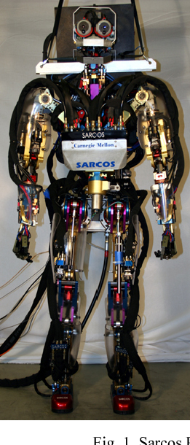
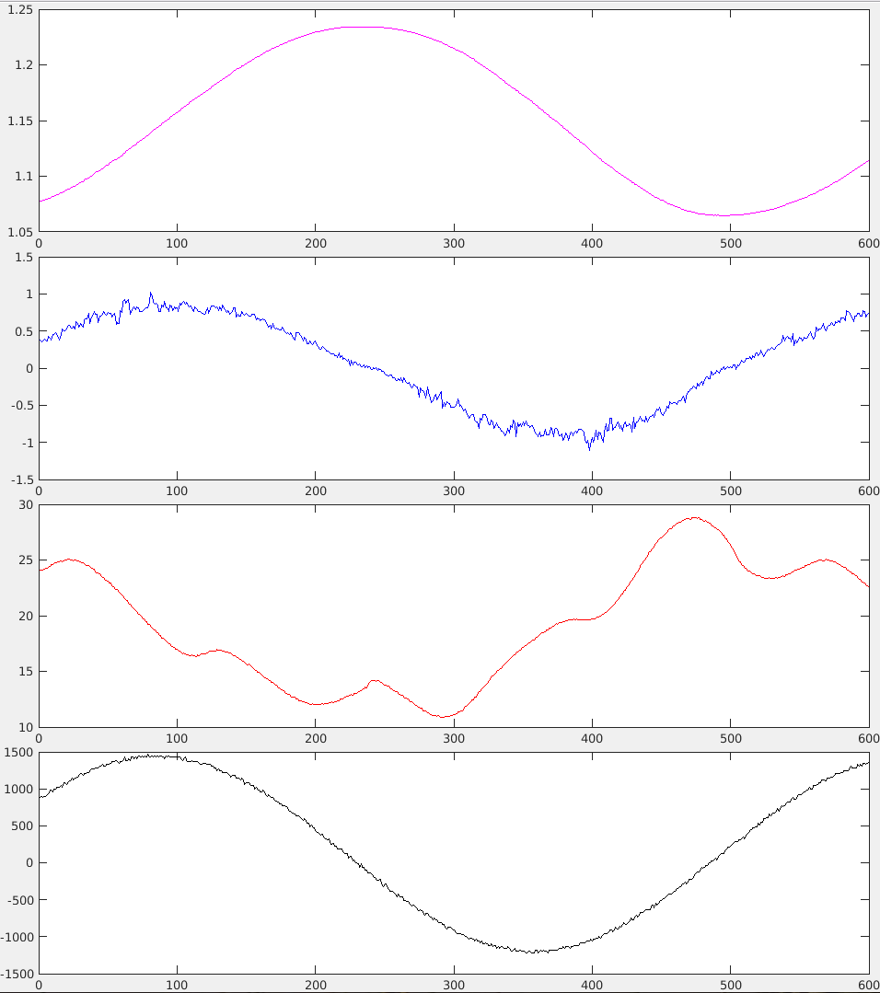
Which wiggles are repeatable?
Left knee
Position
These bumps?
This fuzz?
Velocity
These bumps?
Robot pelvis is fixed with
all joints not moving
except left knee, which
is being driven with
a sinusoidal hydraulic
valve command.
These bumps?
These bumps?
Torque
This fuzz?
Hydraulic valve command

Slide 4
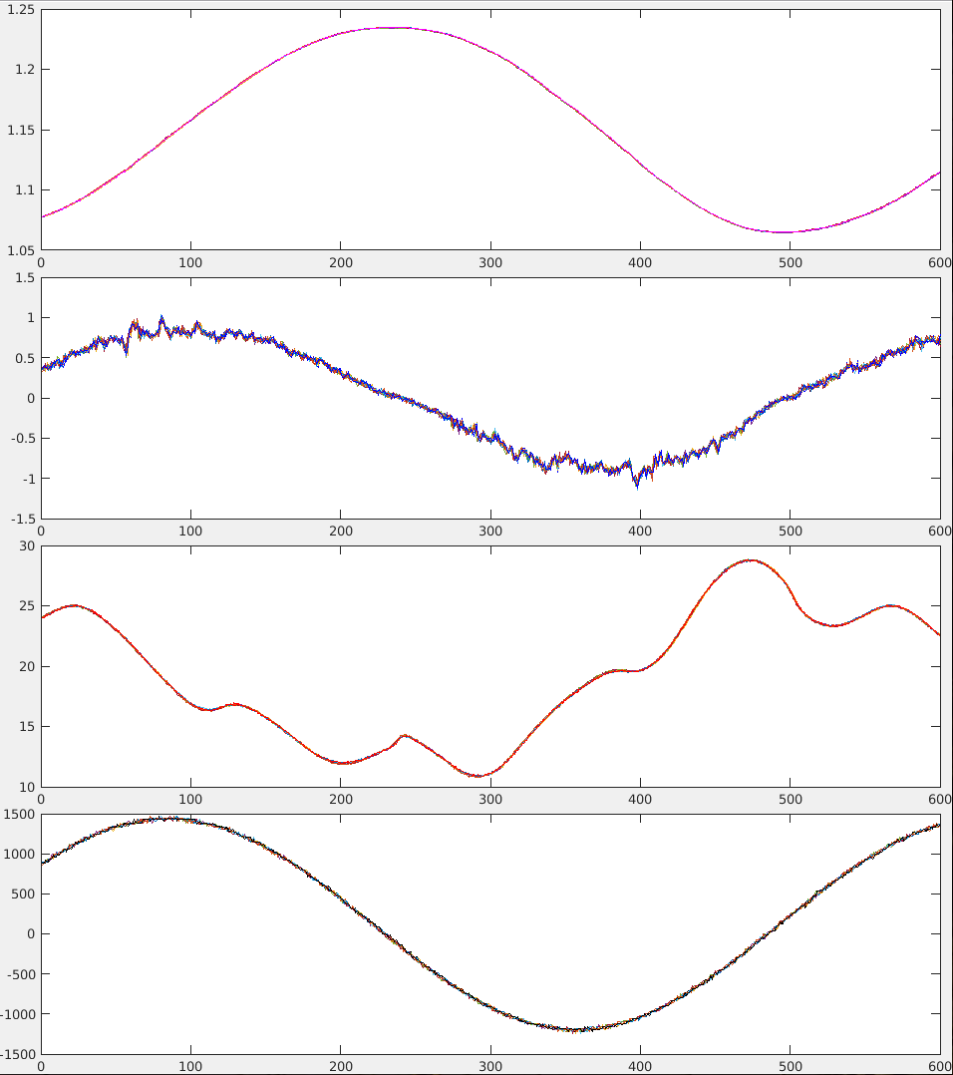
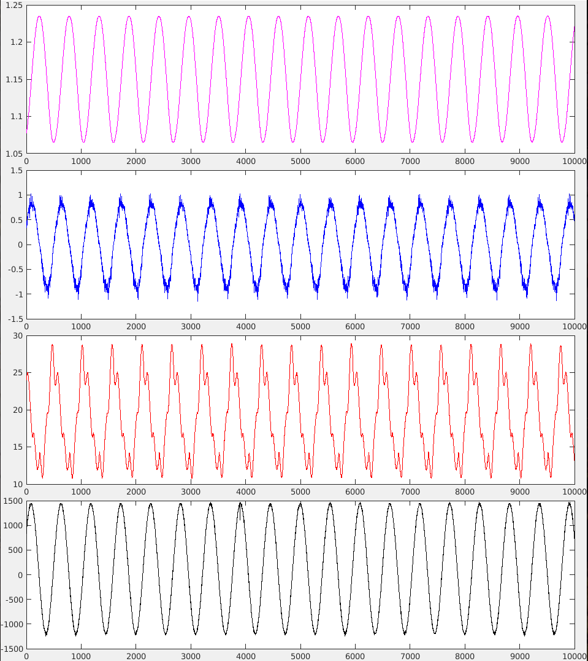
(Expensive) Robots are highly repeatable
Position
These bumps
Velocity
These bumps
These bumps
These bumps
Torque
10 cycles plotted
on top of each other
Zoomed out view
Hydraulic valve command

Slide 5
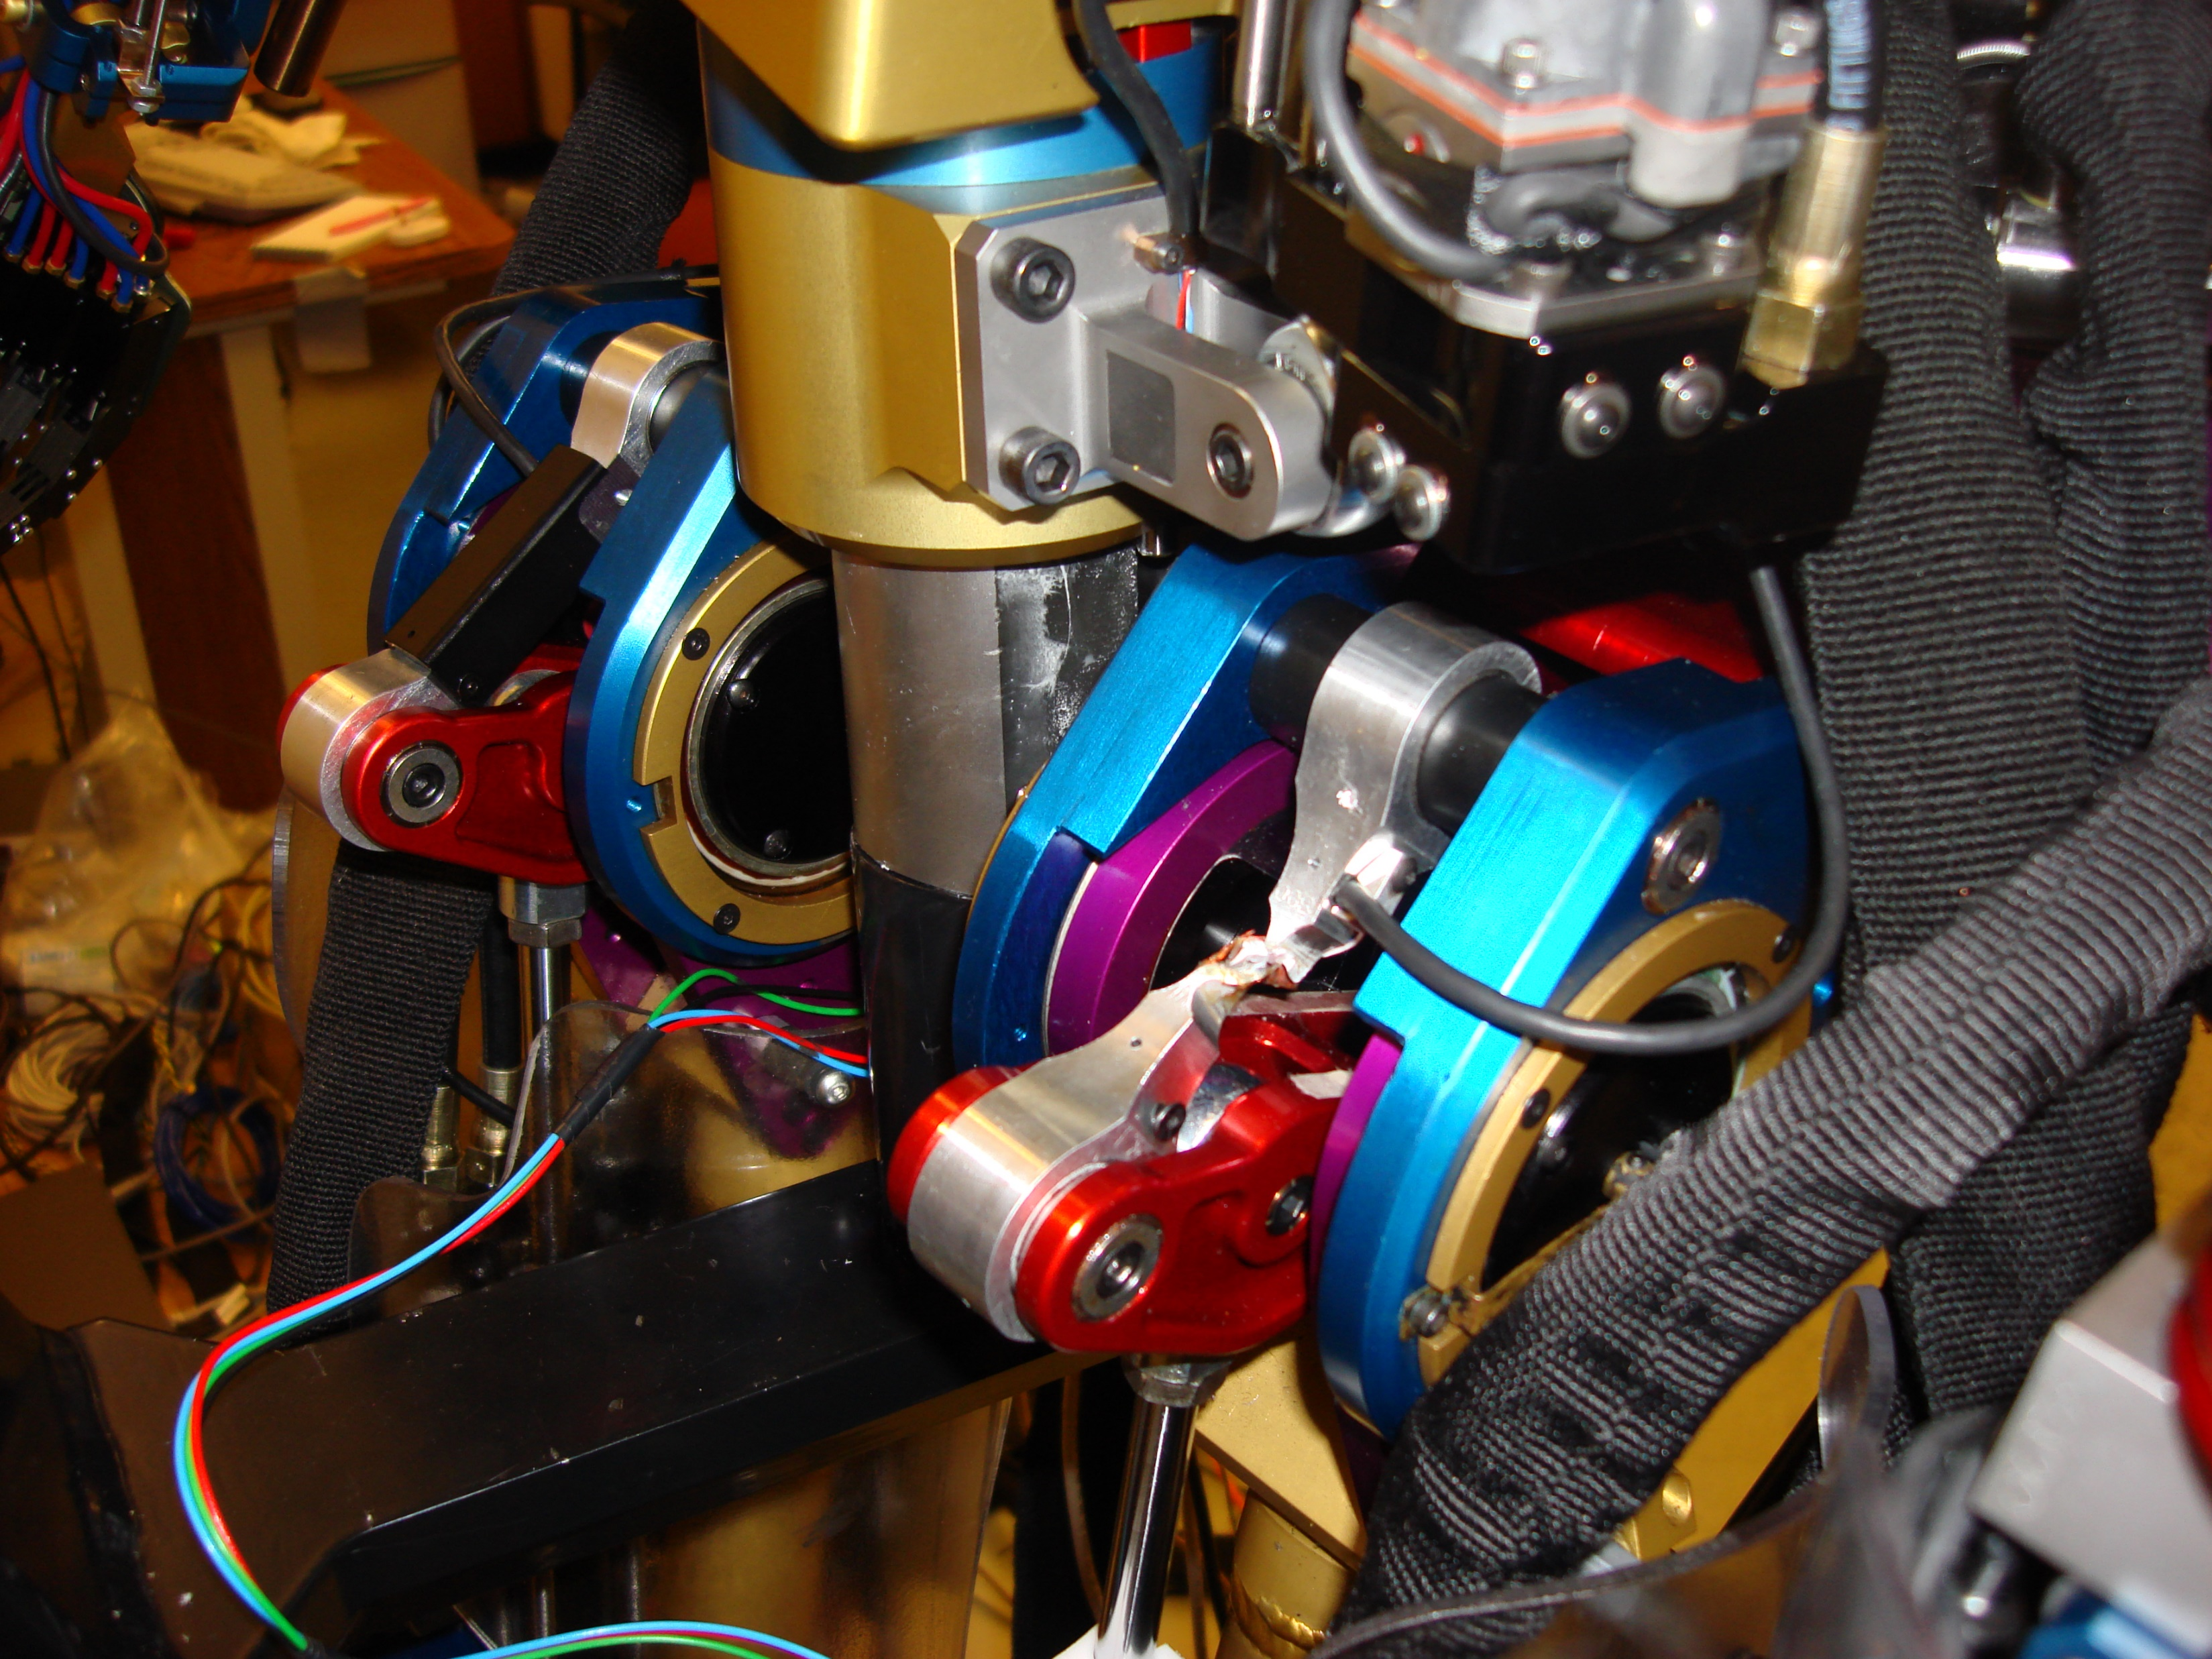
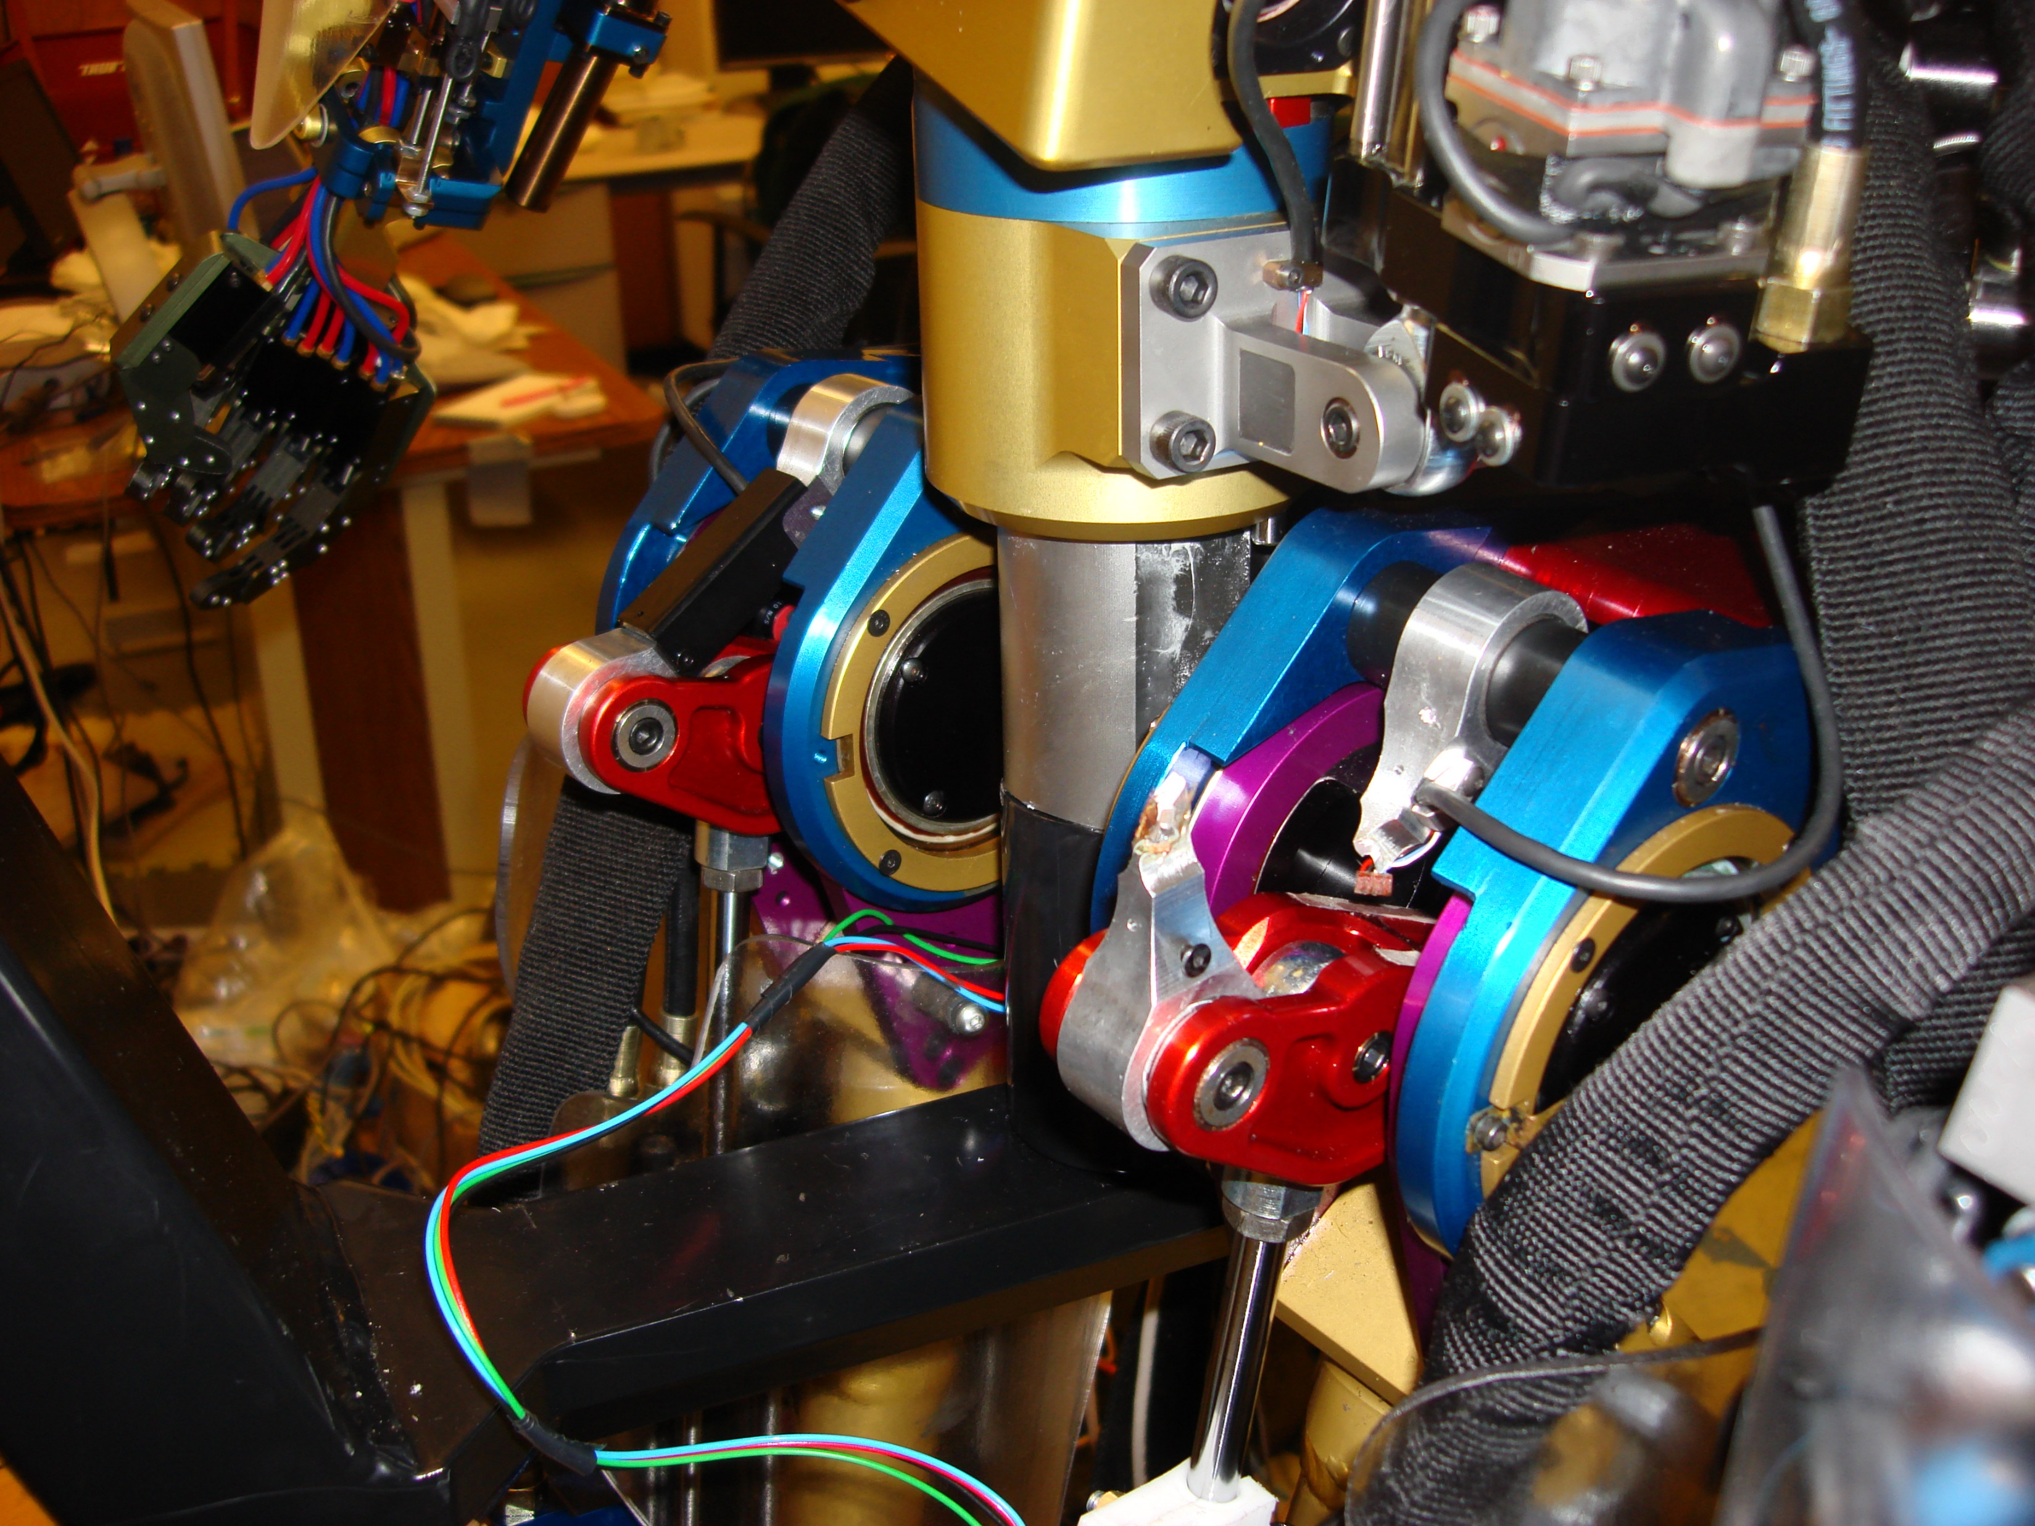
Stochastic policies are bad for your robot (and for you)
Noisy commands excite high frequency unmodeled dynamics.
Noisy commands cause wear and tear, material fatigue, and part failure.
Inefficient way to explore on real robot.
Rule: match training and test distributions. Smooth task performance -> should have smooth motions during learning.
Choosing behaviors that are robust to unmodeled dynamics is useful.
Random inputs are not safe.
We want to understand task and robot.

Slide 6
Why do sampling-based RL? Why not derivative-based RL?
Sampling is still useful for global exploration (finding new task strategies) – OK, do deliberate global sampling, not random noise.
Simulations are easier to build than parametric models. – Yes but
You can automatically take derivatives of your simulation (derivatives of code, numerical derivatives of d(output)/d(input))
You can approximate your simulations with a parametric model (Task-level modeling, see Kim, Pollard, and Atkeson, 2013 or Doug James - Stanford, computer animation)
You are already taking derivatives of your parametric models (neural networks) and doing DDP-style learning there. Be consistent!
Don’t accept the stochastic approach without thinking! It is an inefficient approach to robot learning using the wrong paradigm.

Slide 7
In the paper I discuss …
an impressive example of RL applied to a robot (Hwangbo, et al 2019).
my early childhood.
the history of model-based vs. model-free in psychology, control theory, reinforcement learning, AI (MIT perspective), robot vacuum cleaners, economics, how model-free thinking led to Trumpism, etc.
my early work in error correction learning, followed by model-based RL, followed by my midlife crisis.
why there was minimal use of learning in the DARPA Robotics Challenge.
the complexity barrier.
how we need more work on learning with rich prior knowledge (behavior libraries), abstraction, task-level learning, strategy learning, human-like learning, and even symbols.
some ways to combine model-free and model-based approaches.

