Slide 1
Lecture 2: History of Personal Computers and Mobile Devices and Their User Interfaces
Brad Myers
05-773A4: Computer Science Perspectives in HCI, (CS Mini), Spring, 2014

Slide 2
Personal Computers

Slide 3
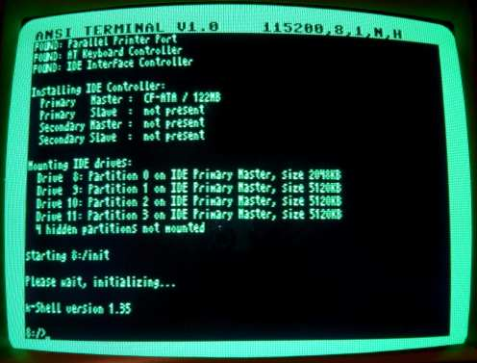
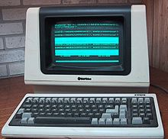
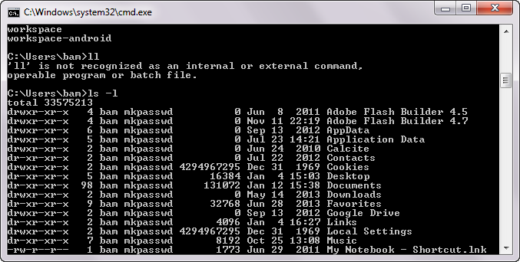
“Character Terminals”
Still around as “DOS Cmd prompts” and console windows
But we are more interested in graphics….

Slide 4
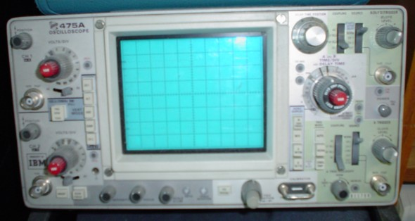
Who knows what this is?
Dates back before the 1930s
Notes:
Oscilloscope
http://en.wikipedia.org/wiki/File:Oscilloscope.jpg

Slide 5
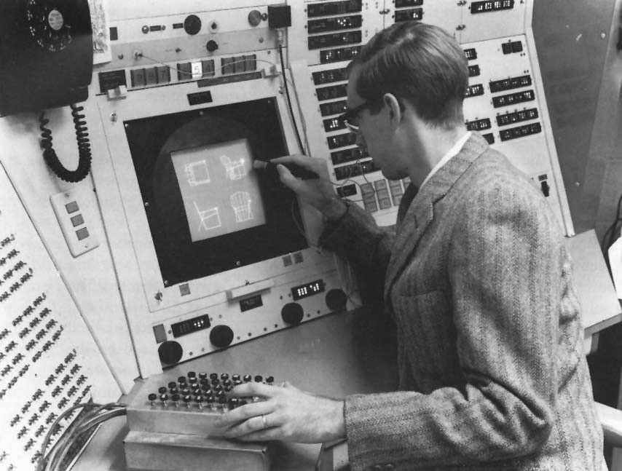
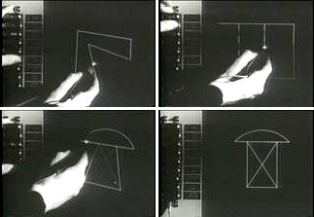
Ivan Sutherland’s Sketchpad, 1963

Slide 6
SketchPad, 1963
Lincoln Labs TX-2 computer
“Light pen” pointing device
Invented many important interaction techniques
Direct manipulation
Uses a “light pen”
“Rubber Band Lines”
Constraint-based drawing
Maintains connectivity of lines
Vertical, horizontal lines
Prototype-instance drawing
Master with multiple copies,
Can edit the master to affect all copies
Almost arbitrary scaling of the whole drawing
Lots of individual switches and knobs to control the drawings
3D drawings added by others to Sutherland’s original SketchPad program
Including hidden line elimination
First flow chart – graphical programming
Ivan’s brother: William Sutherland!

Slide 7
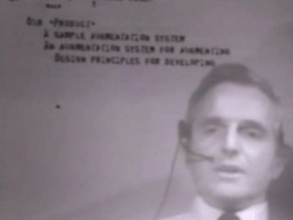
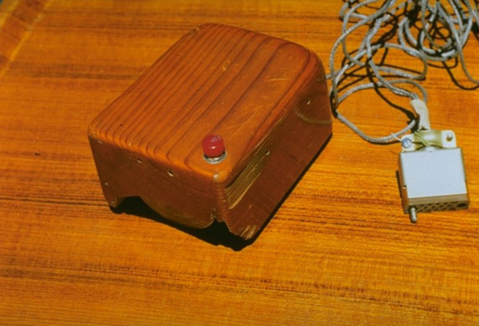
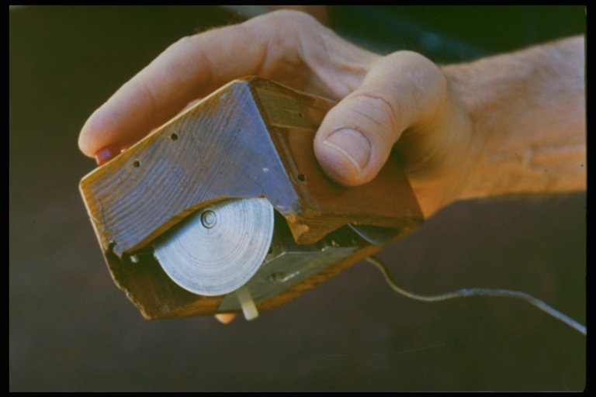
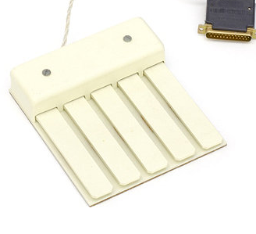
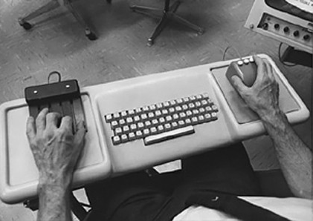
SRI and the Mouse
Stanford Research Institute (SRI)
Bill English and Doug Engelbart credited with the invention of the mouse [W.K. English, D.C. Engelbart and M.L. Berman. “Display Selection Techniques for Text Manipulation,” IEEE Transactions on Human Factors in Electronics. Mar, 1967. HFE-8(1).]
NLS, or the “oN-Line System”
"The Mother of All Demos” on December 9, 1968 at the Fall Joint Computer Conference in San Francisco
Never really had a decent user interface

Slide 8
Xerox PARC
Palo Alto Research Center (PARC)
Founded by Xerox in 1970
Still exists today, as a semi-autonomous research lab
Incredible collection of talent
Hired many people from SRI, and many researchers and engineers
Incredible collection of inventions, 1970-1982
Hardware
Invented workstations, laser printing, the Ethernet
Only part that Xerox made money on
Bitmapped displays
Software
Invented many of the standard OS and systems principles
Object oriented programming (Smalltalk)
Model-View-Controller architecture
Interpress, a resolution-independent graphical page-description language and the precursor to PostScript
User Interfaces
Also invented lots about Ubiquitous Computing in the 1990s

Slide 9
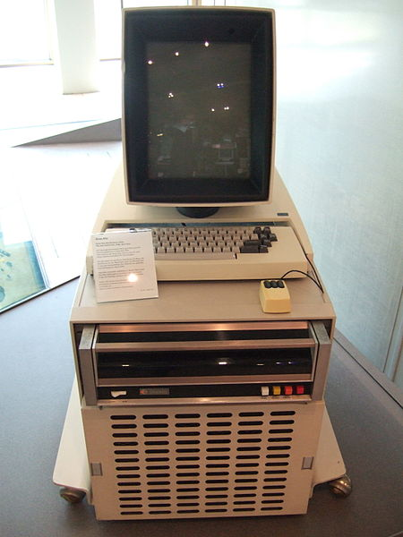
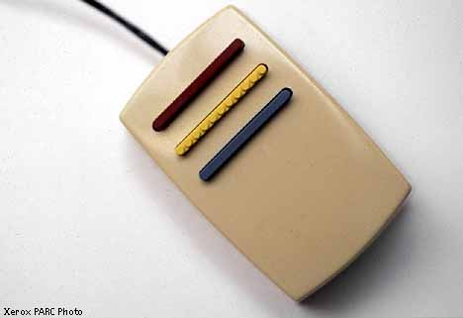
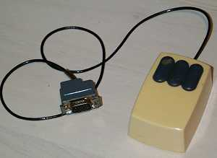
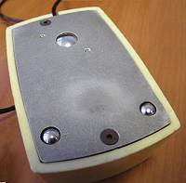
Xerox Alto Machine
Everyone else at the time was using mainframes or “mini computers” that were shared
“Time Sharing”
Alto was one of the first “personal workstations”
Starting about 1973
No operating system – each program had its own libraries and low-level access mechanisms
Three button mouse with two opposing roller wheels
Red, Yellow, Green vertically
Later replaced with left, middle, right, with single metal roller
Was secret for a long time but later distributed to many universities

Slide 10
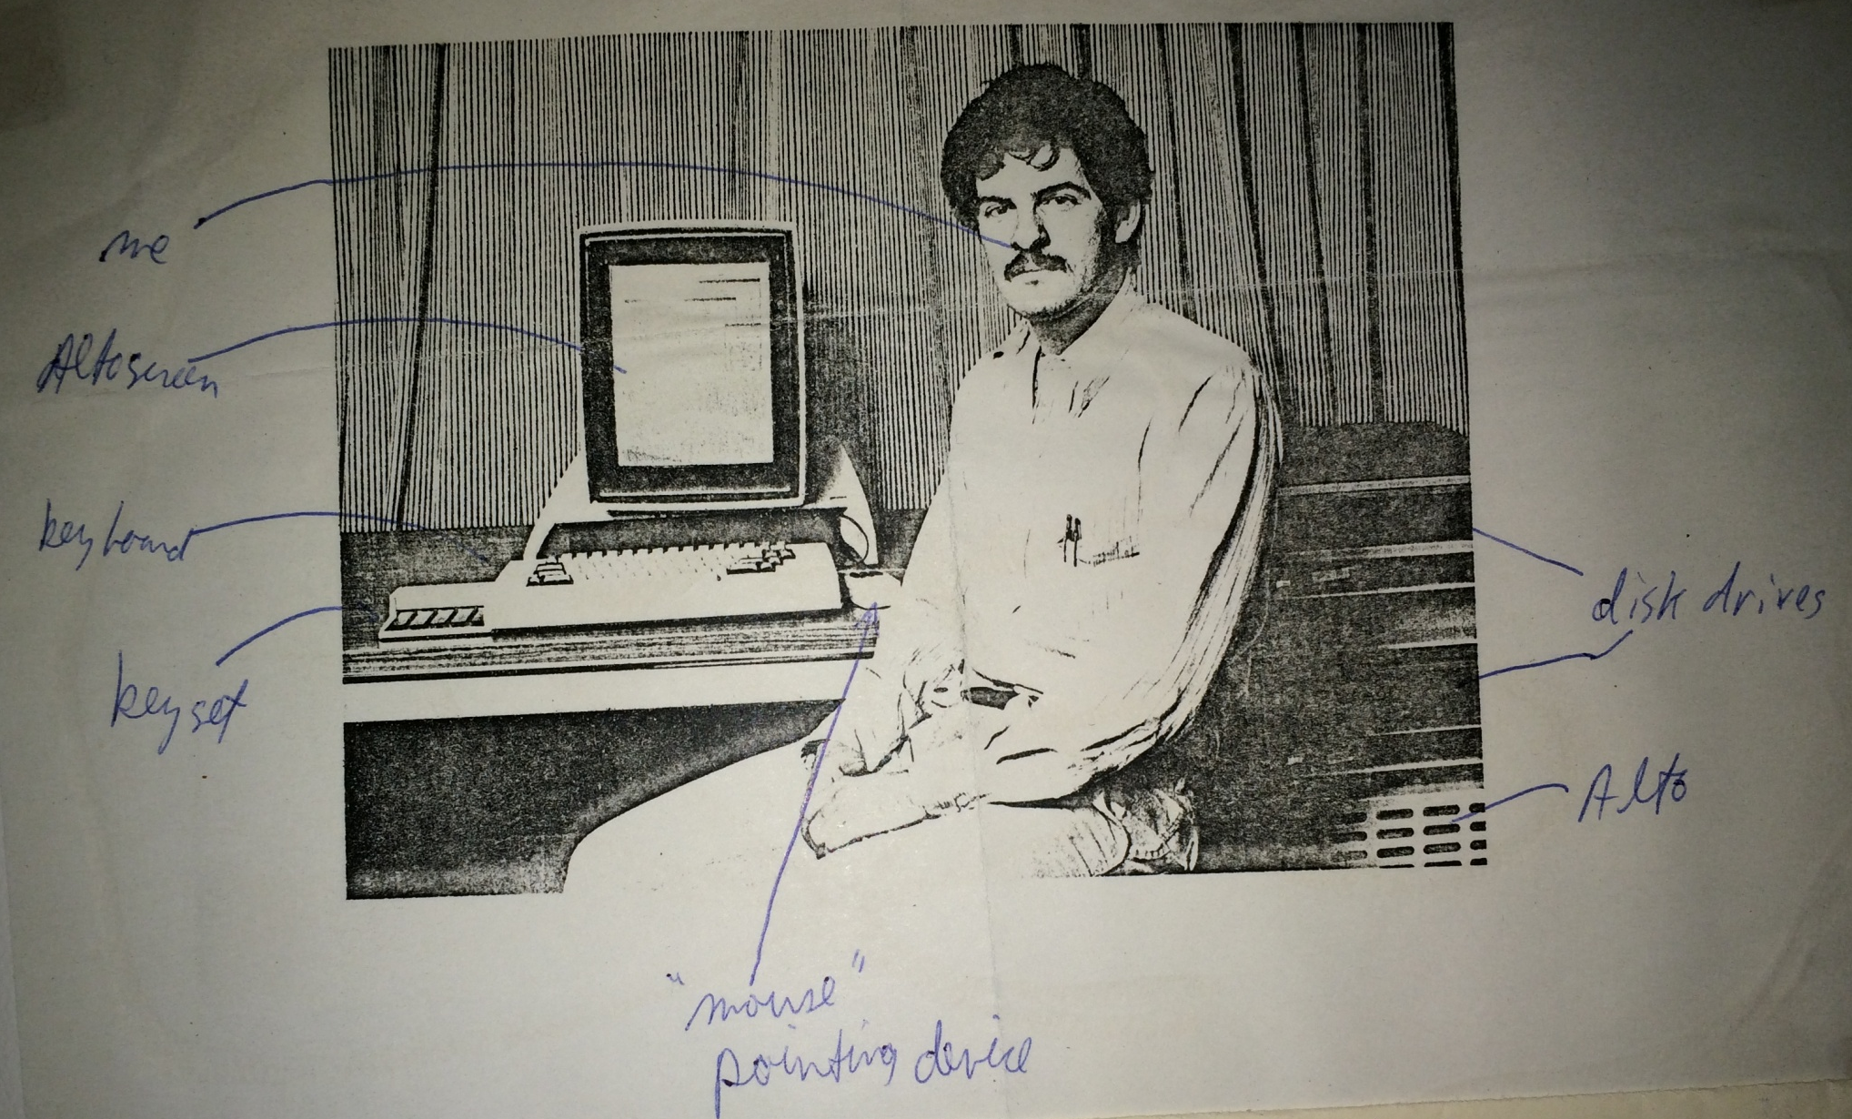
Brad Myers with an Alto, 1979
From my Dad’s scrapbook for that year, with my annotations!

Slide 11
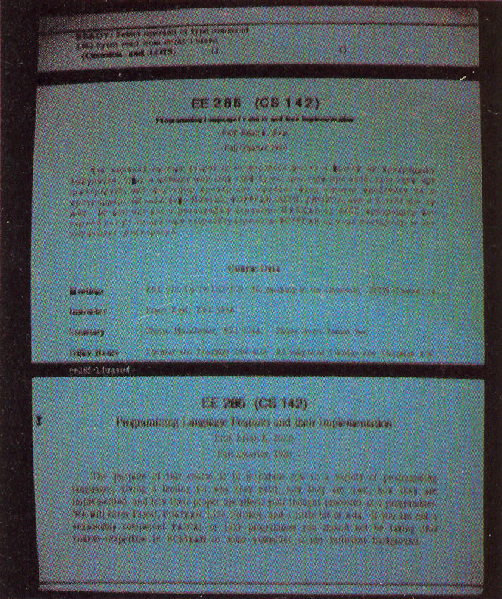
“Bravo”
Butler Lampson, Charles Simonyi and colleagues in 1974
Simonyi went to Microsoft and created Microsoft Word
First WYSIWYG text editing
Multiple fonts, bold, italics, etc.
Justification
Interaction techniques are quite different
Left mouse button – select character, middle – select word, right – extend selection
Left – scroll up, right – scroll down, middle - thumb
Highly moded commands:
“r” for replace, “d” delete, “I” insert, “ESC” for stop inserting, …
“EDIT”

Slide 12
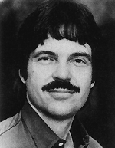
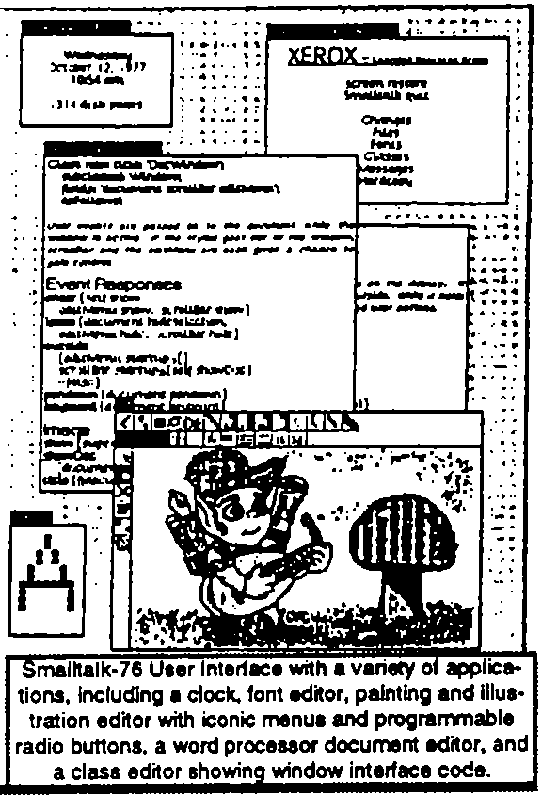
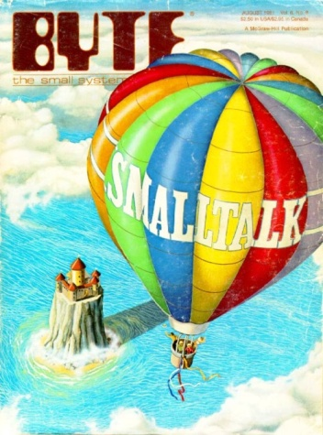
Smalltalk
Started about 1972 as the first purely object-oriented language by Alan Kay
Alan Kay proposed the idea of overlapping windows in his 1969 doctoral thesis
Overlapping windows first appeared in 1974 in the Smalltalk’74 system
Also used popup windows, scroll bars, etc.
Larry Tesler invented the “browser” for code for Smalltalk
Smalltalk’80 is best known – Byte article, generally released and described
I worked with Smalltalk in 1977
All the interaction techniques will be covered in the various topics

Slide 13
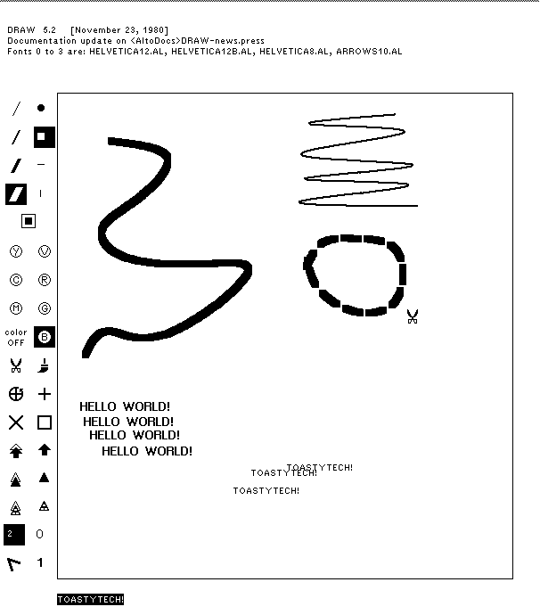
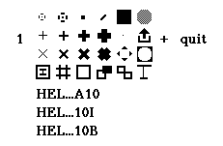
Various Drawing Programs
Draw – cubic splines for curves
Markup – in-place pop-up context menus
Source: http://toastytech.com/guis/saltodraw.png

Slide 14
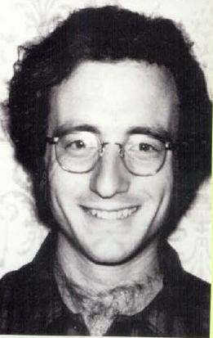
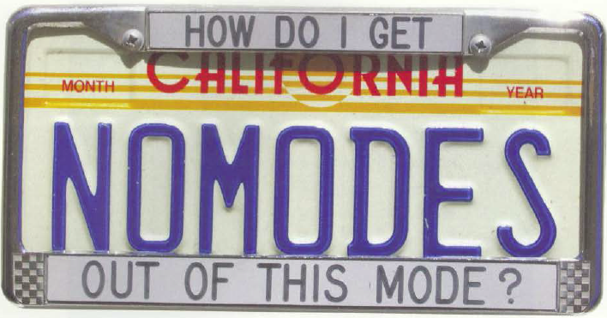
Larry Tesler
Xerox PARC 1973
Rejected highly moded interactions of Bravo
With Tim Mott, et. al, invented non-moded interactions for Gypsy editor including Copy and Paste about 1974
Added to Smalltalk editing
Apple in 1980
In charge of the Lisa design team

Slide 15
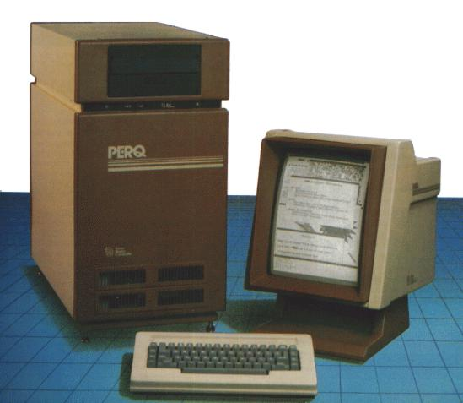
“Workstations”
Alto
Lisp Machines (LMI & Symbolics)
About 1979-1995
Sun, Apollo, PERQ, Silicon Graphics
About 1982 - 2000
About $10,000 each
For scientists, engineers, programmers
Had mouse, window managers

Slide 16
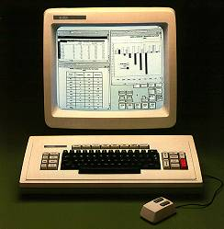
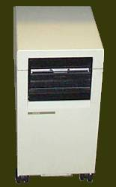
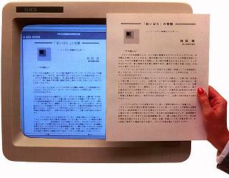
Xerox Star
Released 1982
Designed for executives
Too expensive for secretaries
Large team of designers who were not from PARC
Their building was next door to PARC
Extensive user interface studies guided designs
Key innovations to be covered later
Desktop metaphor
Many modern widgets
WYSIWYG editing and drawing
No PowerPoint or Spreadsheet programs
Mostly closed – only Xerox made applications
Too expensive and seemed slow
Images: http://toastytech.com/guis/star2.html

Slide 17
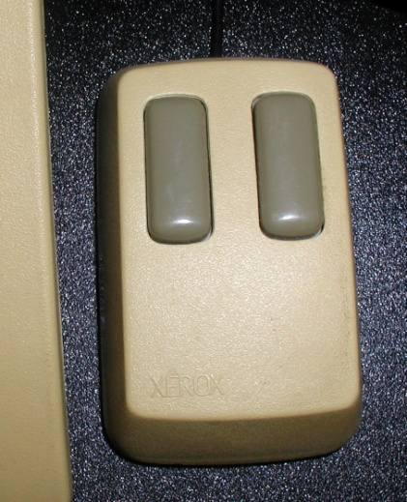
Star User Testing
"The design effort took more than six years .... The actual implementation involved from 20 to, eventually, 45 programmers over 3.5 years producing over 250,000 lines of highlevel code." [Harslem] By the time of the initial Star release, the Functional Test Group had performed over 15 distinct human-factors tests, using over 200 experimental subjects and lasting for over 400 hours (Figure 8). In addition, we applied a standard methodology to compare Star's text editing features to those of other systems [Roberts]. The group averaged 6 people (1 manager, 3 scientists, and 2 assistants) for about 3 years to perform this work.
-- [Bewley, CHI’1983]
One decision was to use a 2 button mouse!
Lots of special keyboard keys
Notes:
First real CHI conference

Slide 18
Apple
Xerox wanted to invest in Apple
In exchange, Steve Jobs got the right to use all of Xerox’s ideas
Steve & his team (Bill Atkinson) were given a demo of various Alto programs in 1979
Mouse
Smalltalk – overlapping windows – thought they updated
Bravo WYSIWYG editing
Apple hired Larry Tesler & others, 1980

Slide 19
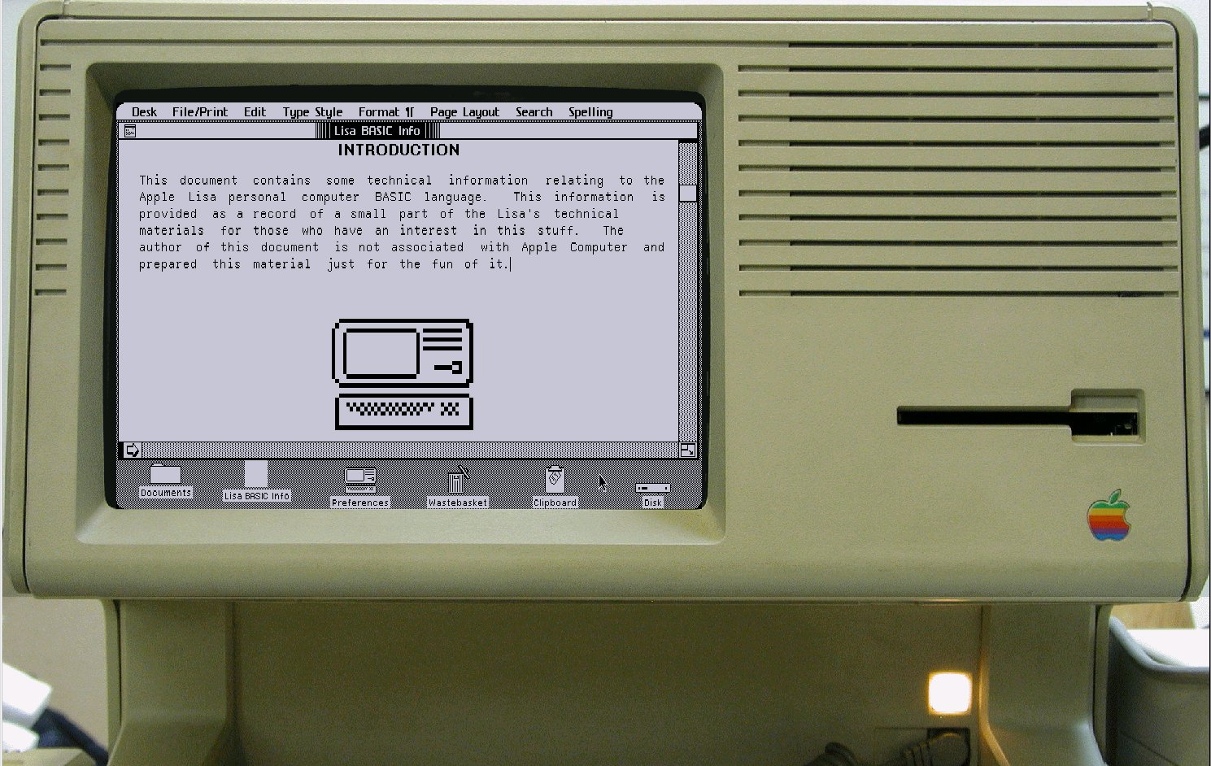
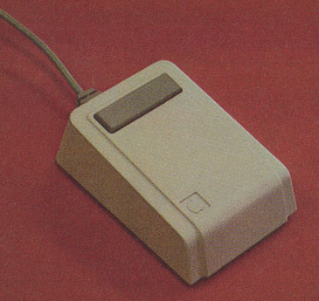
Apple “Lisa”
1983
Original design for desktop
Bill Atkinson & others
Novel pull-down menus (at top of screen)
Dialog boxes
Many other UI innovations
Doesn’t look or work like the Star
One button mouse
Amazing programming expertise to get it to work on a tiny, inexpensive machine
Image: http://toastytech.com/guis/lisa.html

Slide 20
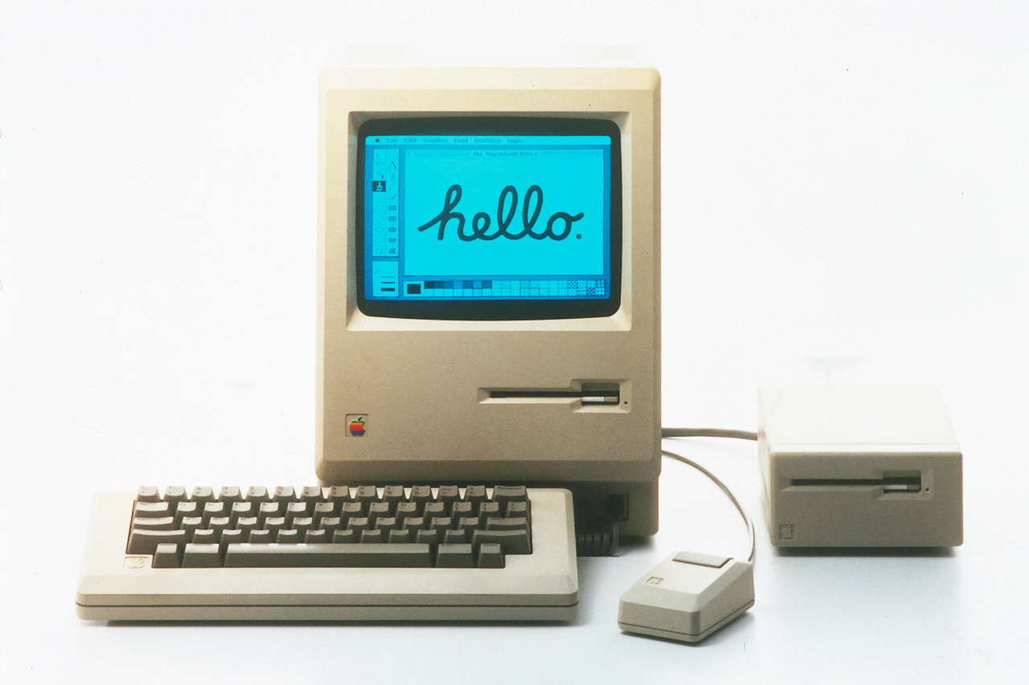
Original Macintosh
1984
Much cheaper than Lisa
No harddisk – just one floppy
128 k-bytes of memory
Much of code re-implemented in assembly
Famous 1984 Super Bowl ad by Ridley Scott

Slide 21
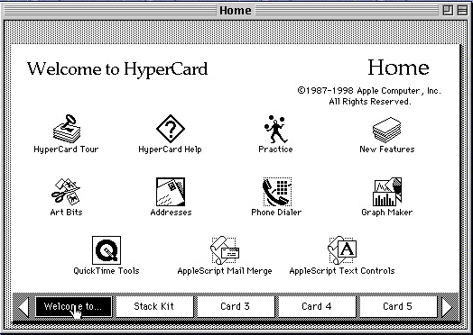
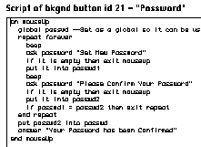
HyperCard
Bill Atkinson, 1987
Intention – “programming for the rest of us”
One of the first “prototyping” systems
But not used for many “real” applications
Many UI innovations
Tear off menus
Pages that overlay each other
Animated transitions
Programmed in “HyperTalk”
English-like language

Slide 22
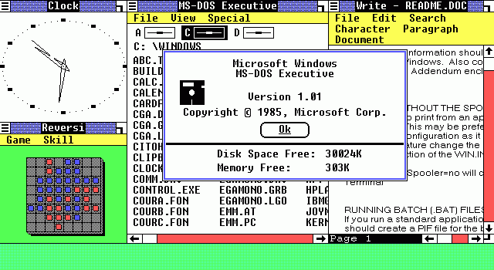
PCs & Windows
IBM PC – 1981
(IBM had missed the “minicomputer” phase dominated by DEC)
Used Microsoft’s DOS 1.0 and shipped with VisiCalc
Windows 1.0 released in Nov, 1985 as DOS extension
Tiled window manager
Windows 2.0 was overlapping 1987
Windows 3.0 in 1990, 3.1 in 1992
Was a real operating system
Added virtual memory, protected multiple processing, etc.
Windows 1 from Wikipedia

Slide 23
Handhelds (PDAs to Smartphones & Tablets

Slide 24
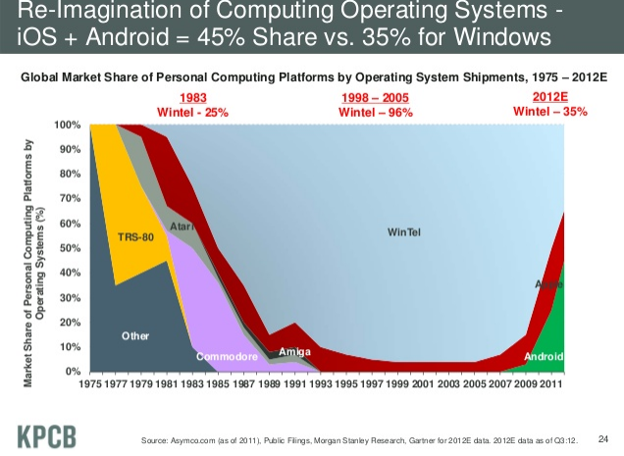
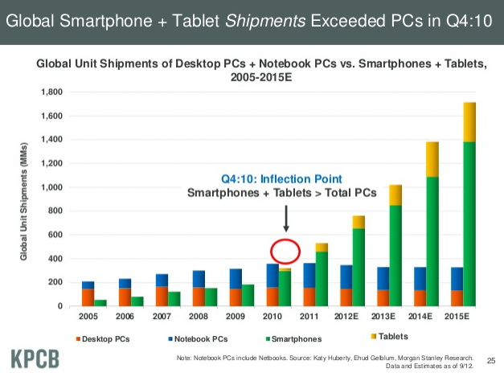
“Computers”
(cite, slide 24, 25)

Slide 25
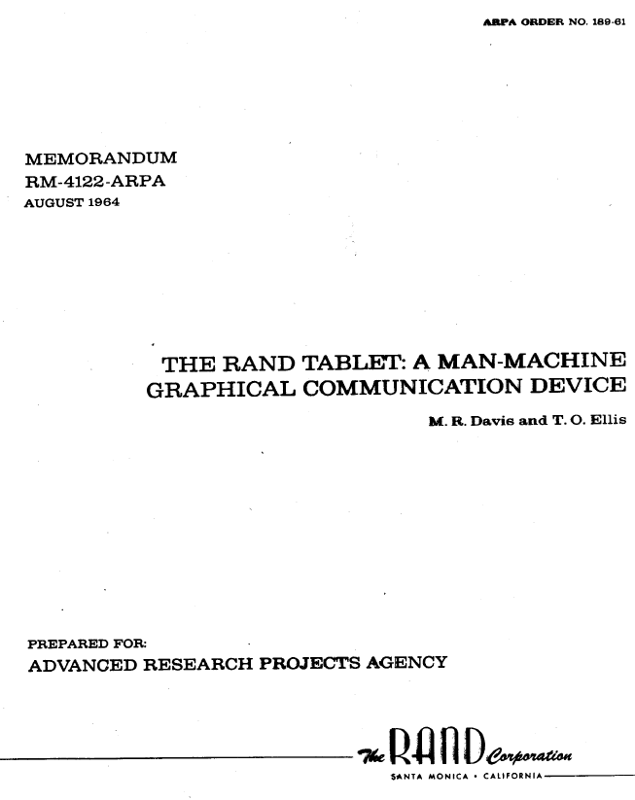
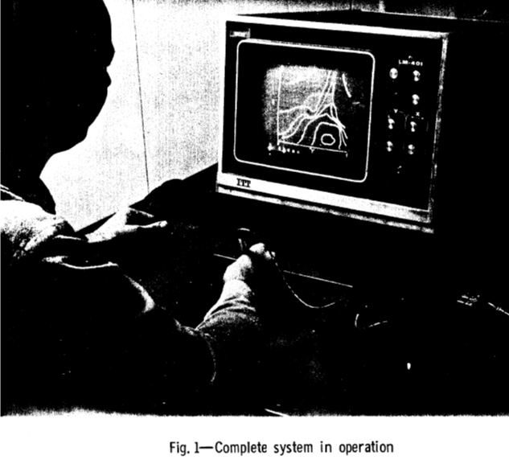
Early Handwriting Input
Handwriting recognition has been an active research topic since 1960’s:
Rand Tablet: 1964: http://www.rand.org/content/dam/rand/pubs/research_memoranda/2005/RM4122.pdf
Used term: “pen-computing”
Early: hand printing
Lots of work on handwriting and gestures
E.g., W. Buxton, E. Fiume, R. Hill, A. Lee, C. Woo, “Continuous hand-gesture driven input,” Graphics Interface '83 (1983), pp. 191–195

Slide 26
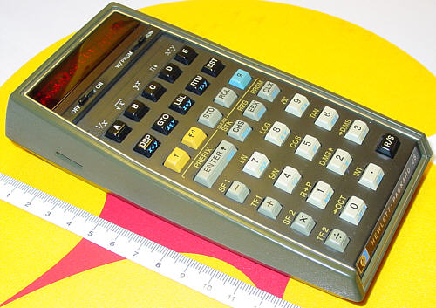
Programmable Calculators
The first programmable pocket calculator was the HP-65, in 1974 – Wikipedia
First graphing calculator was the Casio FX-7000G released in 1985
Continued to improve and get cheaper through 80’s and 90’s
HP and TI
HP used reverse polish notation (RPN) = postfix
No need for parentheses: 4 5 + 6 * instead of (4+5)*6

Slide 27
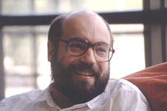
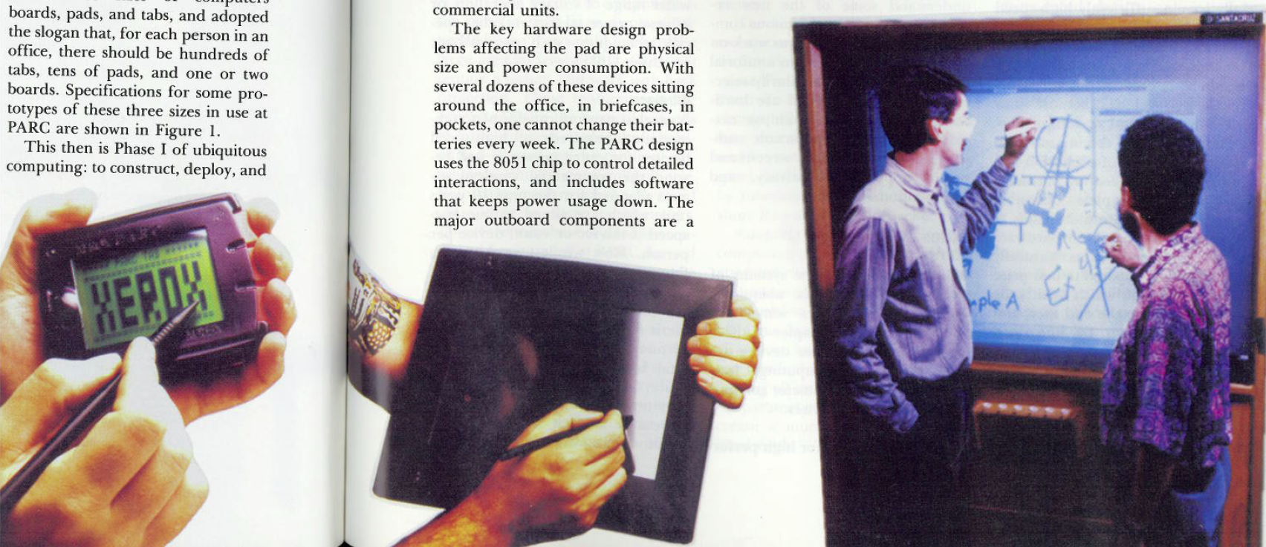
“Ubiquitous Computing”
Term coined by Mark Weiser at Xerox PARC, 1988
Mark Weiser. “The Computer for the 21st Century”, Scientific American, 94-104, Sep 1991.
Mark Weiser. “Some Computer Science Issues in Ubiquitous Computing,” CACM. July, 1993. 36(7). pp. 74-83.
(Died at 46 in 1999 of cancer)
“I called these three sizes of computers boards, pads, and tabs, and adopted the slogan that, for each person in an office, there should be hundreds of tabs, tens of pads, and one or two boards.” [p. 76]
http://en.wikipedia.org/wiki/File:Mark_weiser.jpg

Slide 28
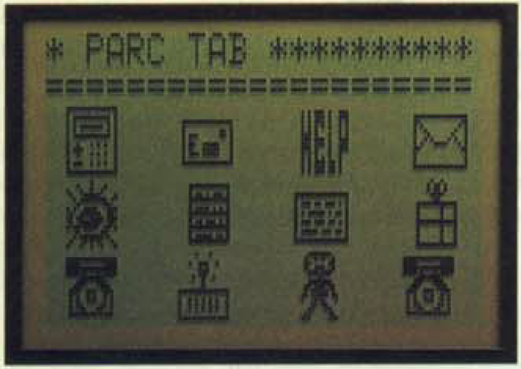
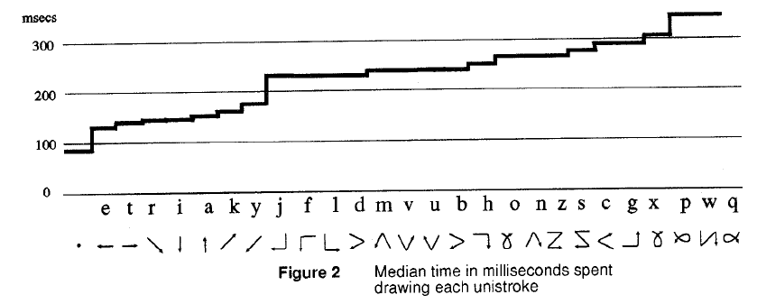
PARC Tab
~1989
Low speed wireless network using IR
Touch-sensitive screen
Quick writing – unistrokes, write on top of each other
David Goldberg and Cate Richardson. “Touch Typing with a Stylus,” Human Factors in Computing Systems, Proceedings INTERCHI'93. Amsterdam, Netherlands, Apr, 1993. pp. 80-87.

Slide 29
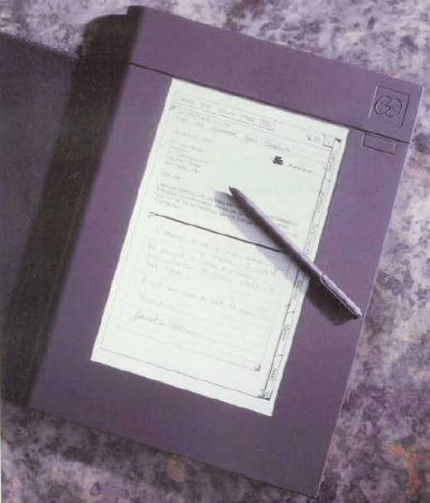
Go Corp’s “PenPoint” OS
Founded 1987, released in 1991
One of the founders was Robert Carr from Xerox PARC; Alto designer
Hardware by NCR, IBM and EO
Styled to look like a tabbed notebook
Conventional tapping on menus
Lots of gestures for editing, page turning, etc.
Flick to scroll and turn pages, circle, insert space, cross-out, insert word, get help, …
Press and hold to start moving or selecting
Hand printing for text entry
Hyperlinks
Instant on-off

Slide 30
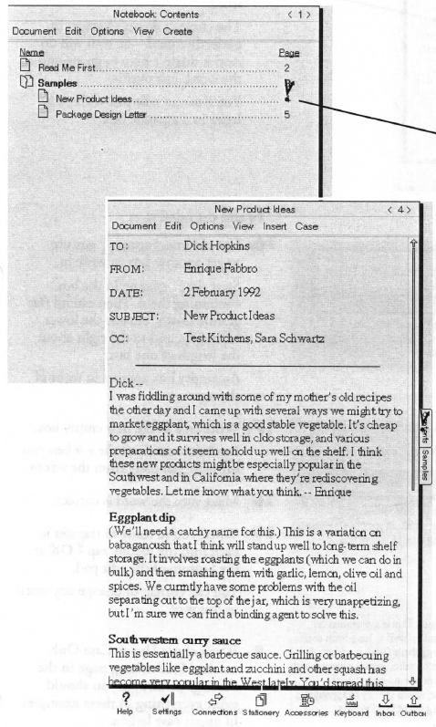
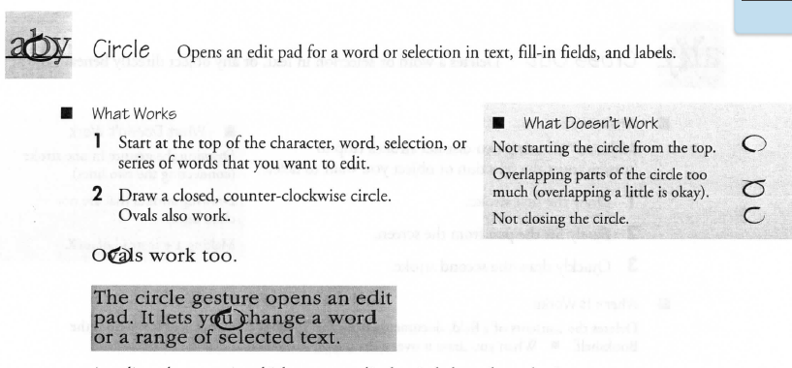
PenPoint
User’s guide
http://research.microsoft.com/en-us/um/people/bibuxton/buxtoncollection/a/pdf/ Go%20PenPoint%20Getting%20Started.pdf
Pictures: http://www.digibarn.com/collections/systems/go/index.html
Video:
http://www.youtube.com/watch?v=x0XE08BjQDQ

Slide 31
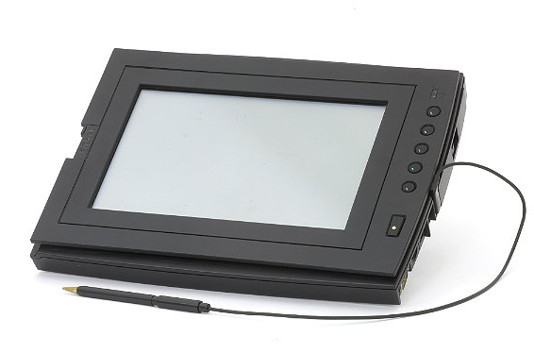
GRiDPad
Jeff Hawkins
1989
http://www.computerhistory.org/revolution/mobile-computing/18/319/1727
under 5 lbs
386SL 20MHz processor with a 80387SX coprocessor with 20MB RAM and 40, 60, 80 or 120MB hard drive. It had a 10" diagonal backlit VGA display with 32 gray scales. There was a built in PCMCIA card slot, an internal fax/modem card, a floppy drive port and a standard keyboard port. Operating time was about 3 hours on NiCad battery pack. http://www.digibarn.com/collections/systems/gridpad/index.html

Slide 32
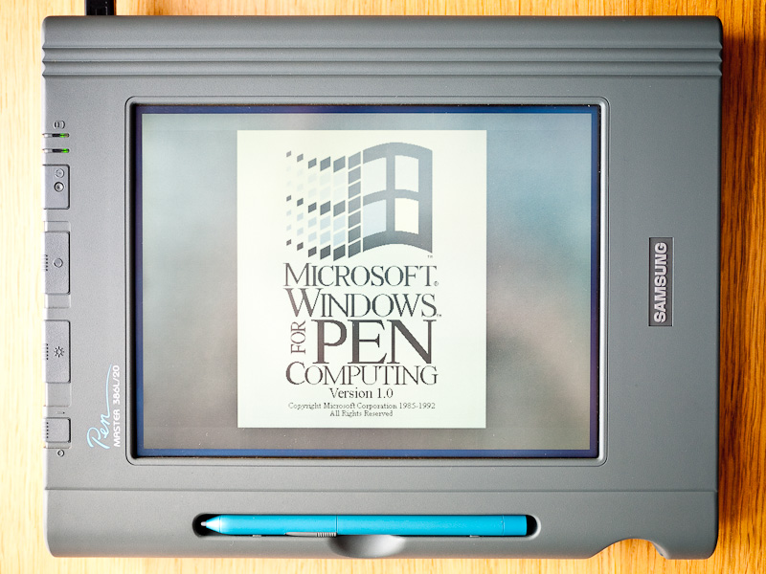
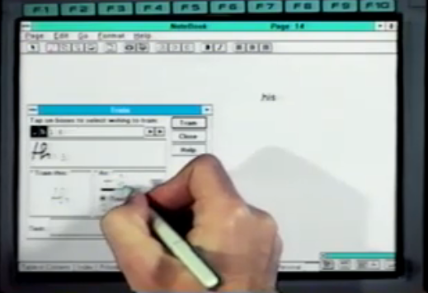
Microsoft Pen Windows
From: 1991
Version of Windows 3.1 for pen computing
Added handwriting recognition
Versions for Windows NT, Windows 95, etc.
Images: http://retrocosm.net/2012/01/, http://www.betaarchive.com/imageupload/1298947809.or.94950.png

Slide 33


Apple Newton
Started 1987, released 1993
Newton “MessagePad”
Coined term “Personal Digital Assistant (PDA)
Was on sale for 6 years
Fairly large & heavy
Interesting OS using an interpreted programming language: NewtonScript
“Prototype-Instance” OO model like JavaScript
John Sculley III

Slide 34

Apple Newton
Key issue: handwriting recognition was main input technique http://www.computerhistory.org/revolution/mobile-computing/18/319/1714
Often not successful
Famously panned for an entire week by Doonesbury (August 1993)

Slide 35


General Magic’s “Magic Cap” OS
1994
Ran on Sony MagicLink hardware
Object-oriented OS for PDAs
3D Room metaphor
Special AT&T wireless network (very slow)
Pictures: http://en.wikipedia.org/wiki/File:Magic_Cap_OS.gif
http://en.wikipedia.org/wiki/File:SonyMagicLink.jpg

Slide 36



Early phone + PDAs
IBM Simon
Shipped in 1994 by BellSouth
Nokia 9110 Communicator
1996
Added full physical keyboard
Typical PDA features:
Address book, calendar
Slow

Slide 37

Palm
Founded by Jeff Hawkins who did GridPad
US Robotics (1995), 3Com (1997), Handspring (1998), Palm (2000), HP (2010)
First released version: 1996 = “Pilot”
Name changed due to lawsuit
They did lots of user testing with prototypes created using HyperCard
Graffiti for data entry

Slide 38

Palm Graffiti
Jeff Hawkins had seen Xerox QuickWriting
Lawsuit
Designed to be easier to learn
Still required practice
Unistroke except for “X”
Two sides – numbers look the same as some letters

Slide 39
Palm’s design Principles
“Designing the Palm Pilot: A conversation with Rob Haitani”, by Eric Bergman and Rob Haitani, chapter 4 in Information Appliances and Beyond, Eric Bergman, ed. (2000)
Fast access to key features on small screens ->
Only a few commands used a lot
Leave commands off main screen, even if not symmetric
new vs. delete
(think stapler and stapler remover)
Note that violates consistency
Tap and then type in schedule and to-do
Only four buttons – which ones?
Vs. Windows CE -> if know PC, this is familiar
But usage models are different
PC: infrequent long usage
Palm: frequent short bursts of usage

Slide 40


Palm Watch
Fossil,
Announced 2002, shipped 2003-5
160 x 160 illuminated screen with a stylus integrated into the band, 8MB internal memory, rechargeable battery and standard Palm platform features
$250
Heavy, short battery life, tiny stylus

Slide 41



Palm Phones
Kyocera QCP-6035 about 2001
Physical phone buttons, or regular Palm
Low-speed internet
Handspring (then Palm) Treo
Blackberry-like keyboard replaces Graffiti
Starting 2002

Slide 42



Windows CE
CE 1.0 released in 1996 (same year as 1st PalmPilot)
Many names: Windows Compact Edition (WinCE), Windows Palm PC, Windows Pocket PC (PPC), Windows Handheld PC (HPC), Windows Mobile
HPC for landscape devices with a keyboard, PPC for portrait
Similarities to Windows, but different OS
Instant on
Different UI interactions
Compaq iPaq became very popular (2000)

Slide 43
Studies for Original Windows CE
“The Interaction Design of Microsoft Windows CE”, by Sarah Zuberec, chapter 5 in Information Appliances and Beyond, Eric Bergman, ed. (2000)
Studies: minimum target: stylus = 5.04mm², finger = 9.04mm²
Drag between down and up for “tap” = 2mm
Many usage scenarios
User tests identified Tahoma 10 bold as best system font, but couldn’t be used because not enough content fit in the dialogs
So used Tahoma 9
Novice users did better with keyboard, but experts preferred character recognizer
Problem with initial designs: too many taps
Achieved “walk up and use” but too slow for experts
Double tap with stylus difficult and unnatural
“Consistency worked against learning and use.”

Slide 44



RIM Blackberry
Starting 1999
Research in Motion (RIM)
Blackberry 850
Email & pager
Originally, proprietary network
Key features:
Two-thumb keyboard
Roller dial (“scroll wheel”) for navigation
Moved to side of device
Eventually, became 2D navigation
Later, regular phone networks
Awkward attempts at full-screen touchscreen
Attempted to be backwards compatible with old applications
Insufficient 3rd party applications
Late to have good APIs

Slide 45



Early wireless phone UIs
1993 – first Nokia soft keys & scrolling
Standardized on 2 or 4 directions, 2 action keys
Motorola Razr – 2004
Thinner is better
Text entry by multi-tap or T9
Note: not touch screens
WAP – starting 1997
Wireless Application Protocol
Bring web-like access to these devices
Terrible usability
Nielsen study

Slide 46



Windows TabletPC
2001 spec (Windows XP), first devices in 2002
Bill Gates said it would be big (2002)
Handwriting recognition was much better, but still not sufficiently accurate
Windows UI not changed for pen
Lower accuracy than mouse
Quite poor UIs for correction

Slide 47



Wifi and BlueTooth
Wifi – from 1988
Officially IEEE 802.11
Whole family: 802.11a, b, g, n …
Originally called “WaveLan”
CMU was first fully wireless campus starting in 1997 = “wireless Andrew”
“Wifi” trademark in 1999
BlueTooth started by Ericsson in 1994
Standardized as IEEE 802.15 in 2002 and 2005
Name from 1997
Named for Danish tenth-century king
Short range, exactly 2 devices
Original use: phone to earpiece
Now, mice, keyboards, etc.

Slide 48

iPod
2001
Apple iPod lauded for design and user interface
Unique dial interaction technique
Enabled easy access to thousands of songs
Highly tuned speed ratio
iTunes → entire service design
5 GB hard drive that put “1,000 songs in your pocket.”

Slide 49

iPhone
Starting 2007
Went against the conventional wisdom in many aspects
No blackberry-style keyboard
Capacitive screen (multi-touch)
No stylus
Only one button – focus on easy to use
Some unique interaction techniques
Scroll bounce, swipe login, …

Slide 50


Android
Unveiled 2007, first phone in 2008
Google offered it free to phone manufacturers
Open source
Based on Linux and Java
About 700,000 different device types
Hundreds of screen sizes

Slide 51

iPad
2010
Very different from TabletPC
Media machine
Little text entry facilities
Interactions same as a Phone, instead of mimicking a PC
Focuses on ease of use

Slide 52
Many other devices not covered
Personal organizers
Casio, Sharp, etc.
Book readers (Amazon Kindle, etc.)
Custom devices for vertical markets
Warehouses, doctors, etc.

