Slide 1
Lecture 24:
Implementation Techniques and Tools for Interaction Techniques
Brad Myers
05-899A/05-499A:
Interaction Techniques
Spring, 2014

Slide 2
Announcements
Pick up HW evaluations and old quizzes
Talks for next week: 12 min + 3 for questions & switching
  Practice!
Patents: class was:
  Against: 9
  In favor: 15

Slide 3
User Interface Software
How to implement the user interface portion
Including how to implement widgets & other interaction techniques
Various ways have been proposed over time
Different layers
HCII courses
about UI software:
  PUI
  SSUI
  05-830: “Advanced
  UI Software”
Application
Higher Level Tools
Toolkit
Windowing System
Operating System

Slide 4
Operating System
Examples: Microsoft Windows, Macintosh OS, iOS, Android, Linux
  In the “old days”, custom “operating systems” for Smalltalk, Bravo editor, Xerox Star, etc.
Handles low-level “device drivers” that take hardware inputs from keyboard, mouse, microphone, USB, etc.
Also screen drivers to allow output to screen, sounds, etc.
Also other services, like file system, networking, etc.
Libraries in Java, JavaScript, Adobe Flash ActionScript, etc. that provide “wrappers” to provide this same functionality

Slide 5
Windowing System
Also called “Window Manager”
Separate the input and output into different areas
Provide graphics libraries and input handling per window
Also provides user interface features for users to control the windows

Slide 6
Toolkits
A library of interaction techniques that can be called by application programs
Toolkits used only by programmers, only procedural interface
Multiple layers in the toolkit itself
  Including ways to implement the widgets themselves
Examples:
  Macintosh Toolbox
  Windows Toolkit
  xtk for X (Motif and OpenLook)
  Java Swing and awt and swt
  html for output, with input controls for input
  JavaScript jQuery & many others
  Research: Garnet & Amulet, etc.

Slide 7
Toolkits Success
Help maintain consistency among UIs
  Key insight of Macintosh toolbox (1984)
  Not just that the Macintosh UI guidelines required consistent look and feel
Path of least resistance translates into getting programmers to do the right thing
Successful partially because address common, low-level features for all UIs
  Address the useful & important aspects of UIs

Slide 8
Graphical Interactive Tools
Use a mouse to drag-and-drop parts of the user interface
Create or use widgets
Examples: Menulay (1983), Trillium (1986), Jean-Marie Hullot from INRIA to NeXT
Now: Interface Builders, Visual Basic’s layout editor, resource editors, prototyping tools
Advantages:
  Graphical parts done in an appropriate, graphical way
    Address the useful & important aspects of UIs
  Accessible to non-programmers
    Low threshold

Slide 9
Prototyping Tools
Just show what looks like
  Storyboard of screens
“Click-through prototypes”
Some support for behavior: typically changing screens
Goal: see some of interface very quickly (hours)
Often no possibility of migrating to real application
May not use "real" widgets
"Low Fidelity" Techniques

Slide 10
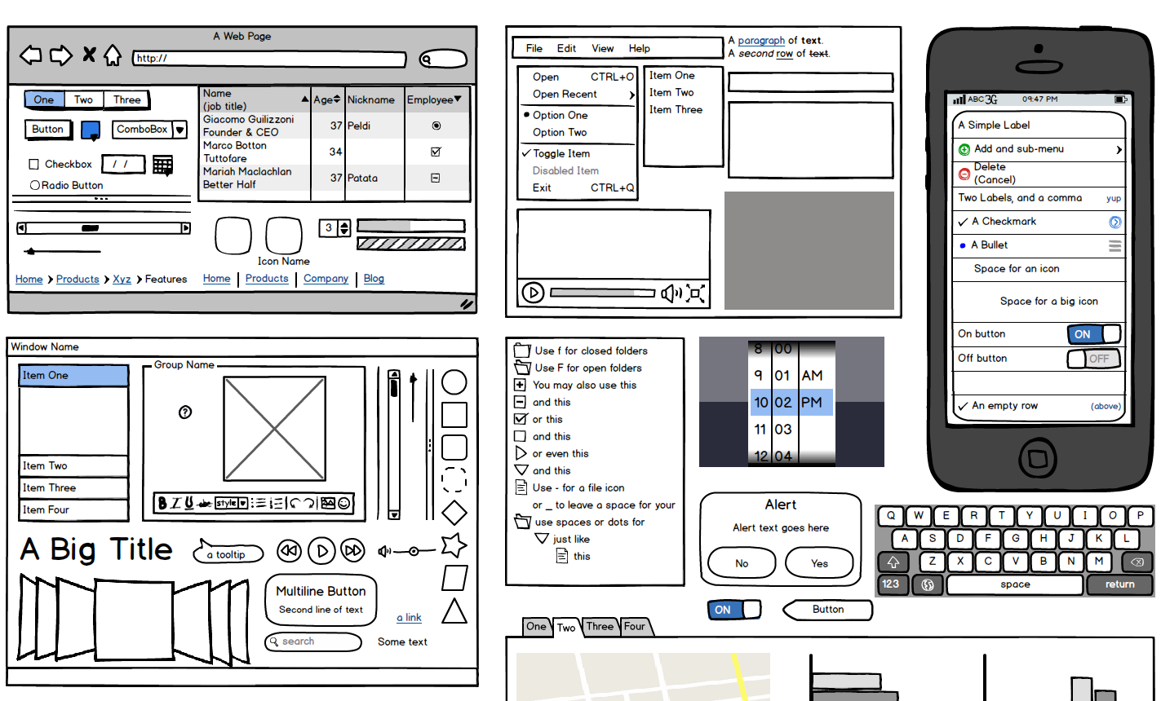
Prototyping tools
Long history
  Dan Bricklin’s (inventor of VisiCalc) “Demo” for DOS screens (1985)
  HyperCard (1987)
Modern
examples:
  moqups.com
  Balsamiq
  Axure
  InVision
  …

Slide 11
Interface Builders
Also called Interface Development Tools (IDTs) or GUI Builders or “resource editors”
Use widgets (not create them)
Lay out widgets to make dialog boxes, menus.
Have a palette or menu of kinds of widgets
Select widget, place with mouse in a window
Set some properties
Design menus, palettes, dialog boxes, controls
Put in “graphics” pane for main application window
Easy to use, but limited
Connect call-backs with each widget

Slide 12
Interface Builders, cont.
Layout mechanisms
  Usually a complication
  Java’s Layout Managers
  Various mechanisms in html
“Resources”
  Store information in special files rather than in source code
  Positions, colors, text labels, etc.
  Allow for easier modification for users, internationalization, etc.
IBs Usually don't support:
  Error checking of values, e.g. for text input fields
  Graying of widgets depending on values and other widgets
  Default values of widgets
  Dynamic changing of widgets (e.g., add more items)
  Dynamic changing layers (groups) of widgets (visibility) depending on values and other widgets
  Any dynamically created graphical objects.

Slide 13
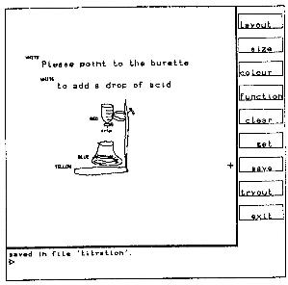
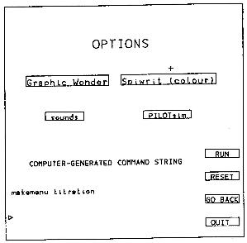
Early Research IB
Menulay (1983)
W. Buxton, M.R. Lamb, D. Sherman and K.C. Smith. “Towards a Comprehensive User Interface Management System,” Computer Graphics, Proc. SIGGRAPH'83. Jul, 1983. pp. 35-42.
    http://www.billbuxton.com/menulay.pdf
    http://www.youtube.com/watch?v=Kt0oAg0haU0
  Vector screens, widgets, sounds, text, output C code and tables
  All actions (including transitions)
  required C programming
NeXT Interface Builder (NeXT) - 1988 popularized the name
  By Jean-Marie Hullot who had an IB in Lisp at INRIA in France
Visual Basic
Resource editors in programming environments

Slide 14
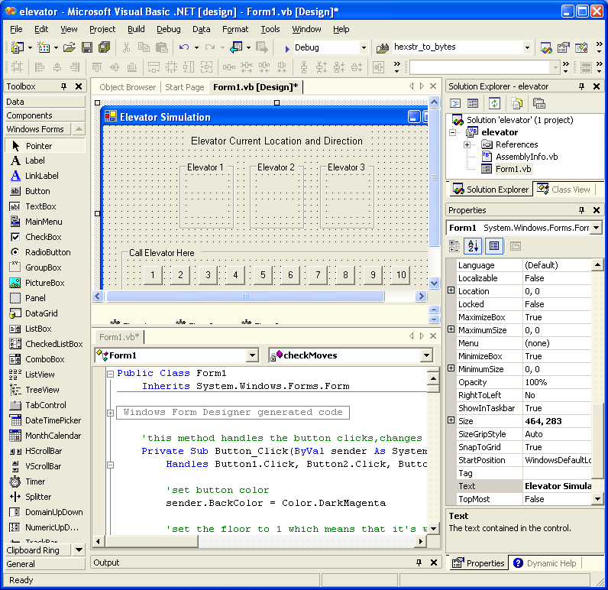
VB
Screen

Slide 15
Software Organizations
Ways to organize code, rather than tools.
"Models"
Helps think about modularization and organization.
Goal: separation of UI and rest of software = “semantics”

Slide 16
Model-View-Controller
Invented in Smalltalk, about 1980
Usual reference: Glenn E. Krasner and Stephen T. Pope. “A Cookbook for Using the Model-View-Controller User Interface Paradigm in Smalltalk-80,” Journal of Object Oriented Programming. Journal of Object Oriented Programming. Aug, 1988. 1(3). pp. 26-49. http://www.ics.uci.edu/~redmiles/ics227-SQ04/papers/KrasnerPope88.pdf
Idea: separate out presentation (View), user input handling (Controller) and "semantics" (Model) which does the work
Fairly straightforward in principal, hard to carry through
Never adequately explained (one article, hard to find)
Goals
  Program a new model, and then re-use existing views and controllers
  Multiple, different kinds of views on same model

Slide 17
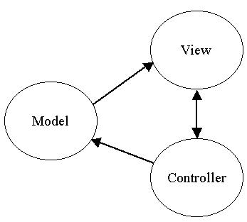
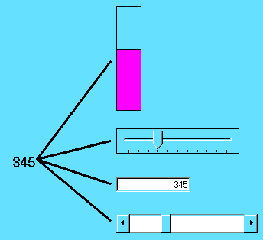
MVC

Slide 18
MVC
Standard interaction cycle:
  User operates input device, controller notifies model to change, model broadcasts change notification to its dependent views, views update the screen.
  Views can query the model
Problems:
  Views and controllers tightly coupled
  What is in each part?
  Complexities with views with parts, controllers with sub-controllers, models with sub-models...

Slide 19
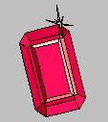

Research: Garnet / Amulet
My research projects to investigate better ways to build user interfaces
  Create and use widgets
  Garnet (1987-1994) in Lisp
    Generating an Amalgam of Real-time, Novel Editors and Toolkits
  Amulet (1994-1997) in C++
    Automatic Manufacture of Usable and Learnable Editors and Toolkits
Same architecture
Low and high-level tools

Slide 20
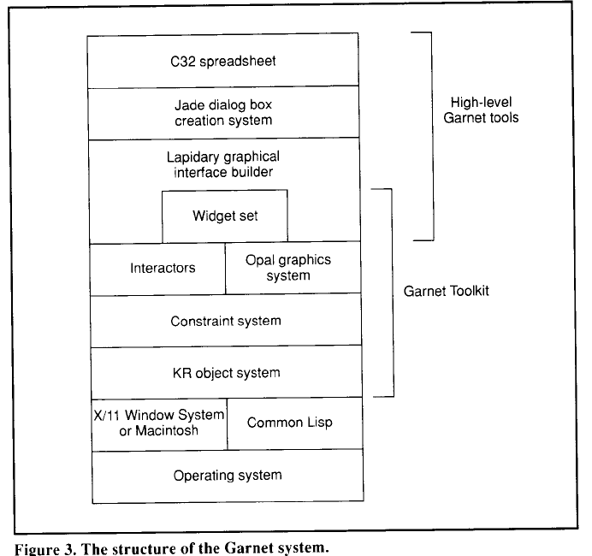
Architecture
Low-levels to provide machine-independence
Build widgets with the low-level features
High-level tools that use the widgets
Garnet video (1993)
(local copy)

Slide 21
Types of Interactors
Am_Choice_Interactor : select one or more of a set of objects
Am_One_Shot_Interactor - single action, like Choice
Am_Move_Grow_Interactor : move or grow objects with the mouse
Am_New_Points_Interactor: to create new objects by entering points while getting feedback "rubber band" objects
Am_Text_Edit_Interactor : mouse and keyboard edit of text
Am_Gesture_Interactor: interpret freehand gestures

Slide 22
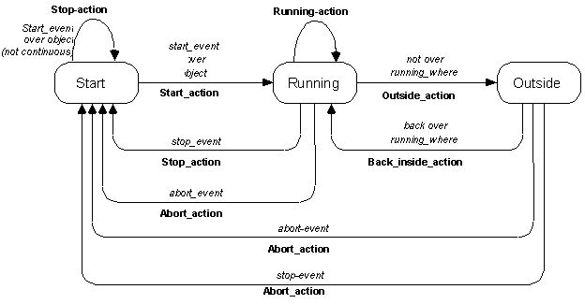
Standard Behavior of Interactors

Slide 23
Research: Peridot (1986-88)
Myers B. "Creating User Interfaces Using Programming-by-Example, Visual Programming, and Constraints," ACM Transactions on Programming Languages and Systems. vol. 12, no. 2, April, 1990. pp. 143-177. (Peridot)
Myers B., Creating User Interfaces by Demonstration, Academic Press, San Diego, 1988.
Myers B., "Creating Interaction Techniques by Demonstration," IEEE Computer Graphics and Applications, Vol. 7, No. 9, IEEE, September 1987, pp. 51 - 60.
First demonstrational tool, and it used by-example techniques to allow the creation of new widgets.
From the drawings, it infers:
  Graphical constraints among the objects, such as that the boxes should be the same size as the text.
  control structures such as iteration over all the items in a menu
  how the mouse affects the graphics, such as that the check mark should follow the mouse.
feedback: question and answer
video (8 min)

Slide 24

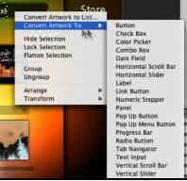
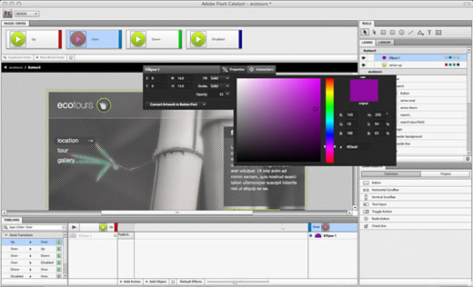
Flash Catalyst
Adobe Catalyst (formerly Thermo)
  Part of CS5.5, discontinued in CS 6.0
  Associate behaviors with the objects
  Like my Garnet Lapidary

Slide 25
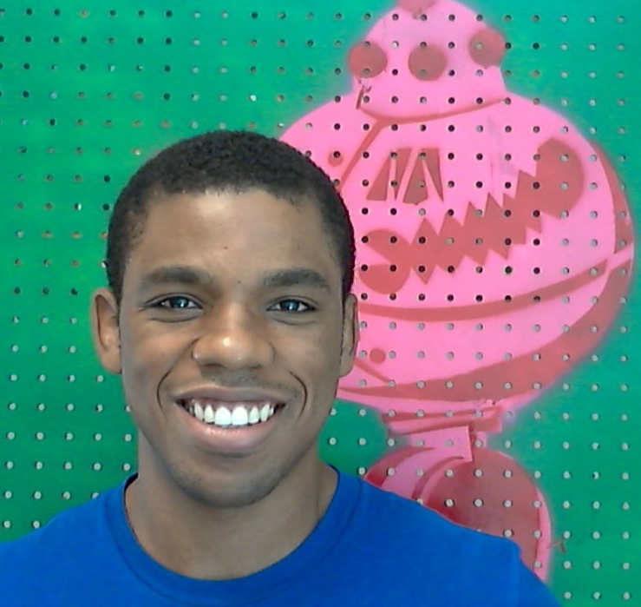


Research: ConstraintJS and InterState
PhD thesis of Stephen Oney
http://cjs.from.so/
http://interstate.from.so/
Some of Stephen’s thesis proposal slides

Slide 26
graphical-user interfaces (GUIs) defined by:
  look (appearance, relatively easy)
  feel (behavior, relatively difficult)
Notes:
as hci researchers and practitioners, we are often tasked with designing and implementing new interaction techniques and interfaces
whether we implement these interfaces ourselves or communicate our designs and suggestions for other people to implement, the tools available for implementing these interfaces will influence an implementation’s timeliness, cost, and correctness.
the tools for implementing these interfaces will also influence who actually can implement an interface
target audience of talk is programmers but goal is to make developing graphical user interfaces easier and hopefully expand the range of who can be programmers of interactive guis
a graphical user interface is defined by its look and its feel and while it’s relatively easy to specify an interface’s look, correctly implementing its feel can be significantly more difficult
a graphical user interface’s feel is defined by what i call interactive behaviors

Slide 27
interactive behaviors
normally programmed using event-callback paradigm
  specify what actions to take in reaction to events with callbacks
  leads to error-prone code
[Letondal 2010, Myers 1991]
Notes:
However, this paradigm can lead to error-prone code because the code necessary for any interactive behavior must end up spread throughout the code and throughout multiple callbacks
now, there are many other ways of programming interactive behaviors

Slide 28
constraint
a relationship that is declared once and automatically maintained
Notes:
one way is through constraints.
Constraints are relationships that are declared once and automatically maintained

Slide 29
constraint
a relationship that is declared once and automatically maintained
the toolbar is displayed above the workspace
Notes:
For example, this is a constraint: the toolbar is displayed above the workspace. it
specifies a relationship between the toolbar and workspace that should hold if the workspace is moved, resized, etc.

Slide 30
constraint
a relationship that is declared once and automatically maintained
the toolbar is displayed above the workspace
toolbar.x <- workspace.x
toolbar.y <- workspace.y - toolbar.height
Notes:
Operationally, we might express that constraint as two statements to control the toolbar’s x and y position.

Slide 31
constraint
a relationship that is declared once and automatically maintained
can produce clearer code by reducing the burden of maintaining relationships
[Meyerovich, 2009; Myers, 1991]
Notes:
Previous researchers have shown that constraints can enable clearer code by more directly expressing relationships between objects.
This is because much of what programmers do in event-callback code is actually dedicated to maintaining constraints that can’t be explicitly written because the underlying programming language doesn’t allow it.

Slide 32
constraints
libraries for imperative (“traditional”) languages
  e.g. FlapJax, Angular
used for data bindings and specifying layout
[Meyerovich, 2009, angularjs.org]
Notes:
constraints have been the subject of a large body of previous reserach.
they have been integrated into imperative languages (what most people think of as traditional languages like JavaScript, C, Java, etc)
constraints have been integrated in these languages through libraries; for example, for the JavaScript programming language, both FlapJax, a research project and Angular, a commercial library from Google enable constraints
but constraints have mostly caught in two places: as data bindings that link a view with some underlying model and with tools for specifying an interface’s layout
i’ll come back to constraints in a little bit but i need to give some background one more concept that’s important to uis before i get to my thesis statement

Slide 33
state
the status of an interface at a given moment, often controls appearance & behavior
[Letondal 2010, Samek 2003]
Notes:
and that’s state. state is also important in user interfaces. the state is the status of an interface at a given moment.
and the state of an interface often controls its appearance and behavior

Slide 34
state machines
track an interface’s state & when it transitions between states
Notes:
state machines are the most common way to manage and track state. state machines specify the states than an interface can be and and also specify when it transitions between states

Slide 35
state machines
track an interface’s state & when it transitions between states
transitions
disabled
not_underlined
click
underlined
no selection
click
Notes:
and transitions that specify when an interface should switch states

Slide 36
“when the toolbar is docked, it is displayed above the workspace”
“when the toolbar is being dragged, it follows the mouse”
state
constraint
Notes:
so one of the insights behind my thesis is that we can get richer and more controllable constraints if we combine them with state.
<next, skip below>
and to again show you how this can be advantageous over event-callback code, i’ll show you two pseudocode implementations of this behavior; the first with the tradition event-callback paradigm and the second by using the idea behind my thesis of combining constraint with state

Slide 37
ConstraintJS
JavaScript library for developers
integrates constraints & states on Web
integrates with HTML & CSS syntaxes
efficient implementation
[Oney, UIST 2012, http://cjs.from.so/]
Notes:
So I’ll start off by talking about ConstraintJS, a JavaScript library for experienced developers that integrates constraints and states for Web programming.
Constraintjs was designed to be familiar for users who have used HTML and CSS
and I provide an efficient implementation for this that’s publicly available on the web.

Slide 38
100
20
0
10
0
100
{x:5, y: 20}, { }, {x:30, y:30}, {x:60, y:40}, {x: 65, y: 45}, {x: 70, y: 45}, {x: 63, y: 80}, {x: 68, y: 75}, {x: 80, y: 80}
x: 20, y: 10
Notes:
there’s some underlying model that controls the location of every point in the view. the user can’t see this underlying model but you, as the developer, need to be sure that your graphing application stays in sync with it
now let’s say that we are dealing with dynamic data that could change at any time, so that when the model...

Slide 39
100
20
0
10
0
100
{x:5, y: 20}, { }, {x:30, y:30}, {x:60, y:40}, {x: 65, y: 45}, {x: 70, y: 45}, {x: 63, y: 80}, {x: 68, y: 75}, {x: 80, y: 80}
x: 90, y: 10
Notes:
changes (this point’s x changes to 90)

Slide 40
100
90
0
10
0
100
{x:5, y: 20}, { }, {x:30, y:30}, {x:60, y:40}, {x: 65, y: 45}, {x: 70, y: 45}, {x: 63, y: 80}, {x: 68, y: 75}, {x: 80, y: 80}
x: 90, y: 10
Notes:
view changes

Slide 41
100
90
0
10
0
100
{x:5, y: 20}, { }, {x:30, y:30}, {x:60, y:40}, {x: 65, y: 45}, {x: 70, y: 45}, {x: 63, y: 80}, {x: 68, y: 75}, {x: 80, y: 80}
x: 90, y: 10
Notes:
but let’s suppose that you also want to allow the user to modify the underlying data by dragging points, so that when the view...

Slide 42
100
90
60
0
0
100
{x:5, y: 20}, { }, {x:30, y:30}, {x:60, y:40}, {x: 65, y: 45}, {x: 70, y: 45}, {x: 63, y: 80}, {x: 68, y: 75}, {x: 80, y: 80}
x: 90, y: 10
Notes:
changes (set this point’s y to 60)

Slide 43
100
90
60
0
0
100
{x:5, y: 20}, { }, {x:30, y:30}, {x:60, y:40}, {x: 65, y: 45}, {x: 70, y: 45}, {x: 63, y: 80}, {x: 68, y: 75}, {x: 80, y: 80}
x: 90, y: 60
Notes:
the underlying model changes
if this were written in regular javascript, you’d have to write event handlers that updated the view for every way the underlying model might change while also being careful to make sure that those callbacks aren’t called when the user is dragging the point

Slide 44
fsm:
idle
view_x = cjs(fsm, { idle: model_x, dragging: cjs.mouse.x
});
model_x = cjs(fsm, {
init: datum.x,
dragging: view_x
});
mouseup
mousedown
dragging
Notes:
and the value looks like this
actual cjs code
<pause>

Slide 45
InterState
for end-user programmers (EUPs)
augments ConstraintJS with:
  visual notation
  simpler syntax
  live editor
  primitives for reuse
[Oney 2013]
Notes:
euclase’s intended audience is end-user programmers, such as interaction designers.
to make euclase more suitable for end-user programmers, it augments constraintjs with
a visual notation that makes it easier to understand
a simpler syntax to reduce the amount of boilerplate code to make a running application
a live editor that allows for quick evaluation and exploration
and primitives for re-use to make it more scalable for larger applications
one thing to keep in mind with the design that i’m going to show you is that it is a preliminary design that we are evaluating and plan to refine with some more feedback and evaluation

Slide 46
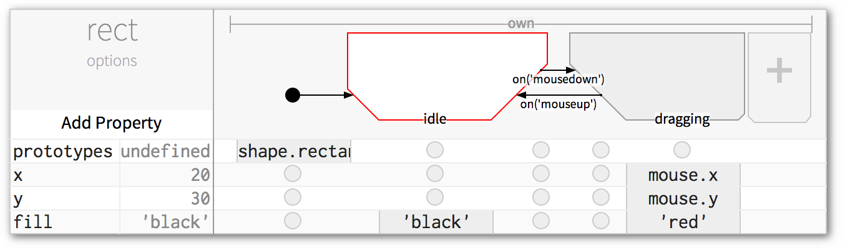
Notes:
Now, we take the state machine and put it into every euclase object. this is a screenshot of a euclase object
<update diagram>
<pause>
to quickly walk through each of its features

Slide 47
properties
Notes:
below that is a list of the object’s properties

Slide 48
current values
Notes:
immediately to the right of every property is that property’s current value

Slide 49
state machine
Notes:
then we have the object’s state machine. the Big plus on the right is the button to add new states

Slide 50
constraints
Notes:
and finally, at the intersection of every property and every state, we have constraints. and note that these constraints are expressions like you’d see in a spreadsheet rather than imperative statements
to specify that a property should have a value in a state, we enter a constraint in that state’s column and that property’s row
circles are empty values

Slide 51
(fill is ‘black’ in idle)
Notes:
we specify that it’s going to be black in the idle state by putting ‘black’ into the idle state’s column

Slide 52
(fill is ‘red’ in dragging)
Notes:
and we specify that it’s going to be red in the dragging state by putting red into the dragging state’s column.
You can also specify values that should hold on transitions, but those aren’t specified here so they are empty circles

Slide 53
InterState video
Video (4:20)

Slide 54
contributions
constraint model integrating state
library for developers (ConstraintJS)
visual notation of constraint model
live editor for visual notation
primitives for inheritance & templating
evaluation of model, primitives & visual notation
Notes:
To sum up, the contributions of my thesis will be:
A new constraint model that integrates state with constraints, allowing programmers to easily enable and disable constraints depending on the application state.A library for developers (ConstraintJS) that effectively integrates constraints and state machines with three Web Languages—JavaScript, CSS, and HTMLA visual notation for these primitives that gives developers a better understanding of the state of their programsA live editor that makes quicker experimentation possible <<<state as contribution>>>
Primitives for inheritance & templating that allow these applications to better scaleEvaluation of primitives & visual notation

Slide 55
thank you
advisors
Brad Myers and Joel Brandt
committee
Scott Hudson and John Zimmerman
friends & family
Kerry Chang, Chris Harrison, Iris Howley, Queenie Kravitz, Min Kyung Lee, Ian Li, Kurt Luther, Jennifer Marlow, Amy Ogan, Logan Oney III, Julia Schwarz, Eliane Stampfer, Yla Tausczik, Jason Wiese, Tao Xie, and YoungSeok Yoon
funding
Adobe, ARCS, Google/UNCF, Ford Foundation, Microsoft, NSF
Notes:
Finally, I’ve been helped by a number of people and organizations; even more than I was able to list here, but I’d like to express my gratitude to them and to you for listening. Thanks.

