Slide 1
Lecture 22: Legal Issues Around Interaction Techniques such as Patents
Brad Myers
05-899A/05-499A: Interaction Techniques
Spring, 2014

Slide 2
Talk Outline
What is Intellectual Property (IP)?
Why is IP relevant to HCI?
To HCI research & invention?
To HCI Practice & User Interface Design?
CMU’s IP policies
Controversy over software patents

Slide 3
Why Am I Talking About this Topic?
Increasing interest in IP issues among students and colleagues
Increasing activity in IP in the HCI area including of interaction techniques
Significant value of patents of interaction techniques
Importance to companies, including start ups
I have 3 patents
Authored the sidebar on IP in Hartson’s new text (HW reading)
I have worked for about 34 law firms on over 57 IP cases, written about 31 expert reports, been deposed 17 times, and testified at 2 jury trials, 2 ITC hearings and 1 Markman hearing

Slide 4
Intellectual Property
Property = something that can be owned
Intellectual Property = “intangible property that is the result of creativity”
Something non-tangible that can be owned
4 main kinds:
Copyrights
Trademarks
Trade Secrets
Patents

Slide 5


Copyrights
Copyright gives the owner exclusive rights to the exact expression of an original work for a period of time.
Does not cover ideas and information themselves, only the form or manner in which they are expressed
Copyright © books, music, art, icons
Software code
But only the exact expression
Copyrights are available free and automatically for all works.
Can be registered, if published

Slide 6

Trademarks
A distinctive phrase or indicator that uniquely identifies a particular commercial product
To avoid confusion in the consumer’s mind
®, ™, SM, etc.
Can be a word, icon, color, etc.
Can last as long as the product is available
Costs lots to get and maintain
U.S. Patent and Trademark Office (USPTO) for registration

Slide 7
Trade Secrets
Secrets are different from Patents
Patents have to be disclosed
Companies keep all sorts of secrets
Plans, marketing analyses, exact algorithms, …
“Trade secrets” – secrets related to the products of a company
E.g., the formula for Coca-Cola
HCI example: exact algorithm for implementing something
Different from copyright of the exact code – reimplementation issue
Non-disclosure agreements (NDA) say you won’t reveal a company’s secrets
If you want to get a patent, have to keep invention secret until patent is filed

Slide 8
Patents
Exclusive rights to an invention for a period of time
You can prevent others from doing it
Ironically, does not necessarily allow you to do it
US Patents: last 20 years from date of submission
Patents may take 5 years and $20,000 or more to get a US patent
Significant lawyer time is involved
Can be up to $100,000 for patents across many countries

Slide 9
Patents
U.S. Constitution, Article 1, Section 8, Clause 8:
“To promote the Progress of Science and useful Arts, by securing for limited Times to Authors and Inventors the exclusive Right to their respective Writings and Discoveries;”
http://www.archives.gov/exhibits/charters/constitution_transcript.html
Must be
New (novel)
Useful,
Non-obvious (it must not be an improvement that would be obvious to a person having ordinary skill in the pertinent art)
Properly disclosed, so can be reproduced
http://caselaw.lp.findlaw.com/data/constitution/article01/39.html
Inventor submits patent application to patent office, which rejects the patent based on prior art, so inventor answers, explaining why different and revising the claims to avoid prior art

Slide 10
Types of Patents
Utility patents:
Processes, machines, articles of manufacture, compositions of matter, and improvements thereof
Cannot be an algorithm or formula by itself
Cannot patent “an idea”
Design patents
Appearance of an article of manufacture
Just has the diagrams, no specification
A software-related patent is a patent that claims as all or substantially all of its invention some feature, function or process embodied in a computer program that is executed on a computer
Utility patents – the usual kind
Design – just pictures (e.g., http://www.freepatentsonline.com/D554094.pdf)
As opposed to:
Trade secrets
Copyrights – just the particular expression

Slide 11
Software Patents Originally Not Allowed
“For an idea to be patentable it must have first taken physical form”
[Rubber-Tip Pencil Company v. Howard, 87 U.S. (20 Wall.) 498, 507 (1874); Clark Thread Co. v. Willimantic Linen Co., 140 U.S. 481, 489 (1891)]
http://caselaw.lp.findlaw.com/data/constitution/article01/39.html
The US Supreme Court's 1981 opinion, Diamond v. Diehr, opened the way for patent protection for computer software
http://caselaw.lp.findlaw.com/cgi-bin/getcase.pl?court=US&vol=450&invol=175
Now, thousands of “true software patents” are issued every year, many of which are about user interface designs

Slide 12
Some People Have Always Been Against Software Patents
“Software patents are an impediment to innovation and an unjust threat to software developers as well as software users.”
http://www.nosoftwarepatents.com/
“Marten Mickos from MySQL said that software patents cause havoc and that it’s not like mechanics. He said that software development should be viewed like literature and art.”
http://www.theinquirer.net/inquirer/news/1039150/open-source-luminaries-claim-software-is-like-art-literature
There certainly are a lot of bad patents that have issued
Recently passed “America Invents Act” – first large-scale reform of patent law in 60 years
Notes:
NEW:
* <http://endsoftpatents.org> You can help with this campaign by watching and sharing the new film, Patent Absurdity: How software patents broke the system. * <http://patentabsurdity.com>

Slide 13
Why UI Patents for Researchers?
As an inventor of user interface techniques, shouldn’t I be compensated if someone used my invention?
User interfaces cannot be trade secrets, by definition!
If a product embodies the UI technique, it must be apparent!

Slide 14
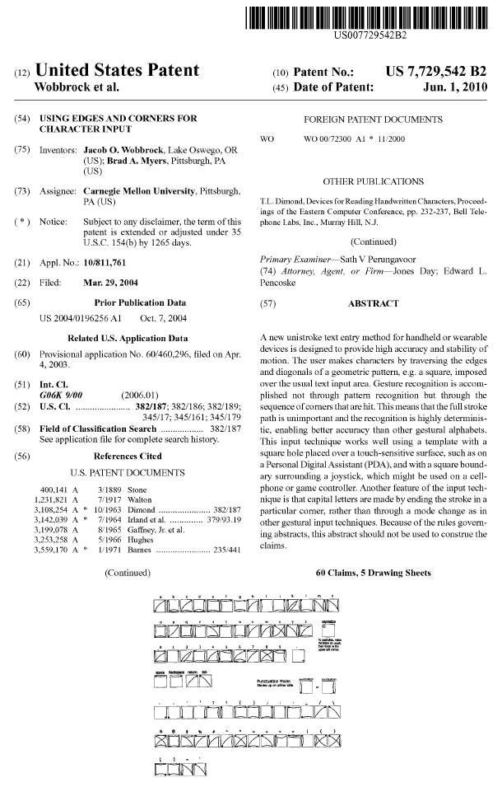
Example: EdgeWrite
Can’t embody idea in a system without making every detail apparent
Allow idea to be revealed and protected
Copyright, trade secret don’t seem relevant to UI ideas.
patent

Slide 15
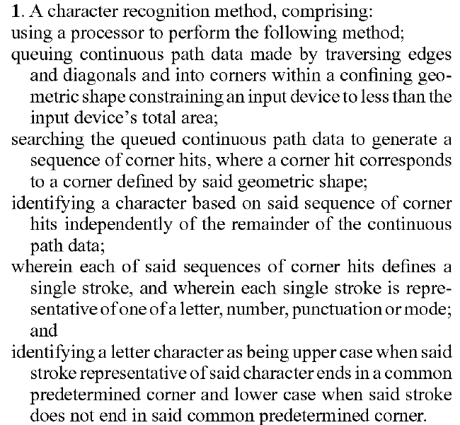
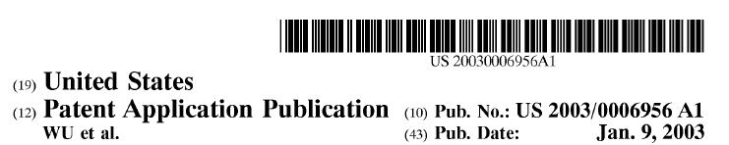
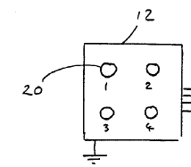
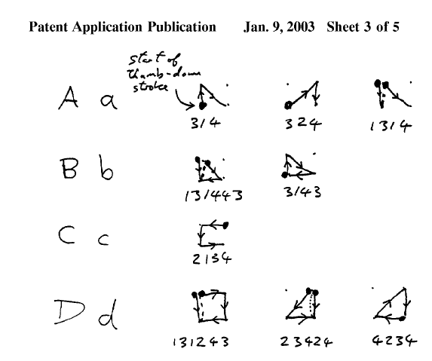
Patent Claims
Patents only protect what is in the claims
Claims are negotiated with patent office
Must differentiate what is covered from what already exists
Often, there is a key difference between the invention and the prior systems

Slide 16
HCI Patents and HCI Design
Don’t want to infringe on other people’s patents as a designer
But impossible to know about all relevant patents
Hard to search, thousands of results
Maybe patents pending
Toolkit widgets generally protected by the vendor
Standard Windows UI is covered by Microsoft’s patents
But doesn’t help with web
Didn’t help phone manufacturers
Beware of “Indemnification clause” in contracts
Who is liable if product that includes software from others is alleged to infringe a patent?

Slide 17
CMU’s IP Policies
http://www.cmu.edu/policies/documents/IntellProp.html
Copyrights generally owned by creator
Books, papers, theses, musical compositions, etc.
But not the copyright on software produced as research
In general, results of sponsored research results are owned by the university
Includes PhD research paid by grants, independent study, etc.
Student work for classes generally owned by the student
Includes Masters of HCI project work
Even when created with “substantial use of university facilities”

Slide 18
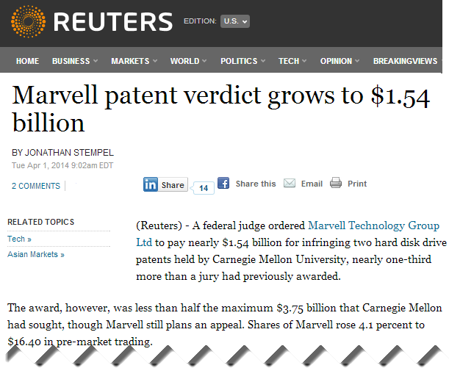
CMU’s Tech Transfer Office
Center for Technology Transfer and Enterprise Creation (CTTEC)
Bayh–Dole Act of 1980 says that universities can own IP from federal research
Encourages licensing and technology transfer
CMU has generous terms for inventors and people who want to do start-ups
CTTEC helps in general with licensing / releasing as open source
What is worth getting patents on?
source

Slide 19
Software Patent Issues
Unlike with drugs, software products incorporate thousands of ideas, potentially thousands of patents
Difficult to determine the value of a single idea
Enforcing a disputed patent can cost over $2,000,000
Something like most ideas have already appeared, so novelty is always questioned and questionable
Startups and big companies now need to plan to spend $$$$ to defend against patents
Even unrelated small businesses like coffee shops

Slide 20
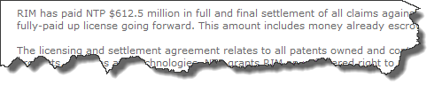
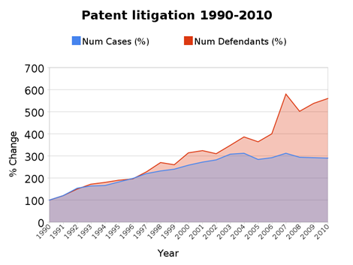
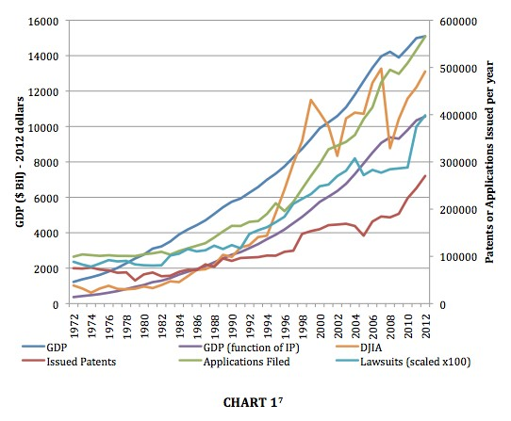
IP Lawsuits
http://press.rim.com/release.jsp?id=981
source
source

Slide 21

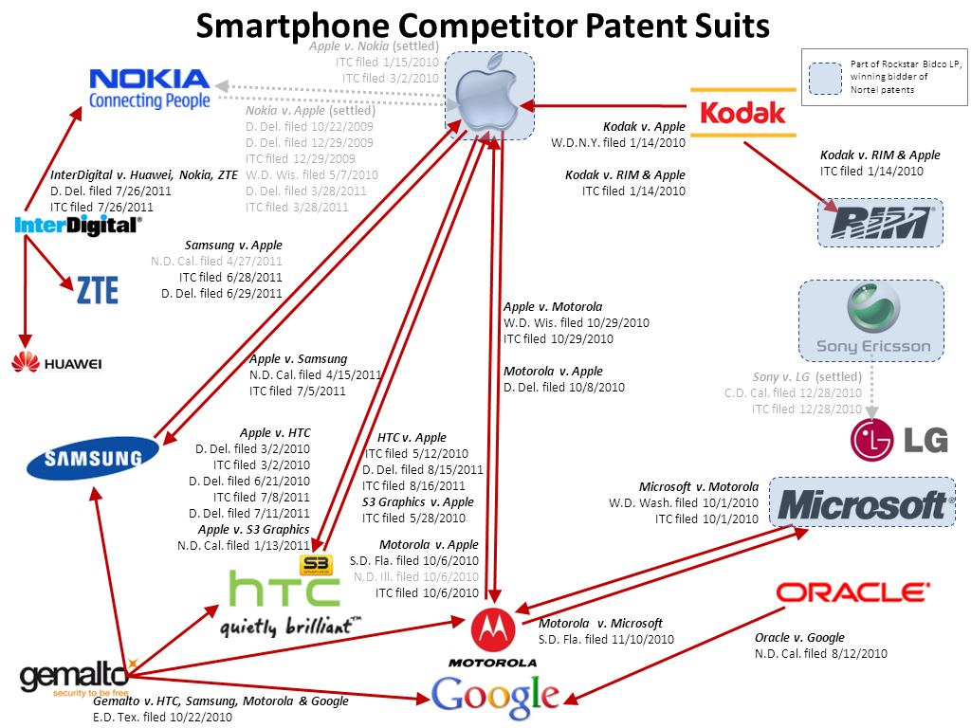
http://www.eetimes.com/electronics-news/4235448/Intel-patents-purchase-RealNetworks-partnership?cid=NL_EETimesDaily
http://www.fiercewireless.com/ pages/chart-smartphone-patent-lawsuits

Slide 22
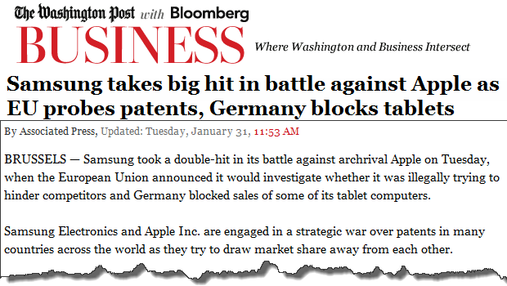
http://www.washingtonpost.com/business/technology/german-court-blocks-samsung-tablets-from-german-market-because-they-resemble-apples-ipad2/2012/01/31/gIQAAFwReQ_story.html?wpisrc=nl_tech

Slide 23
Types of Lawsuits
Big companies against each other
Apple v. Samsung, etc.
Non-practicing entities (NPEs) v. big or small companies
Also called patent assertion entities (PAEs), and “patent trolls”
NTP v. RIM, etc.
But maybe also Carnegie Mellon vs. Marvell Technology Group
Intellectual Ventures:
Founded in 2000 by Nathan Myhrvold and Edward Jung of Microsoft
Bought a huge number of patents and sues companies
Also does some original research
Income – all about licensing fees for the patents
Federal Courts
International Trade Commission (ITC)
Patent office re-examination

Slide 24
Patent Trolls’ business model
Buy or acquire patents
Often poorly written and vague
Threaten company with a patent lawsuit
Sell the company a license for far less than defending a lawsuit would cost
Repeat
Having a collection of settlements makes the next one easier
"Litigation by “patent trolls” cost defendants at least $29 billion in 2011, one study showed. Those costs are driven by software patents.” – citation
Legalized “extortion” – citation

Slide 25
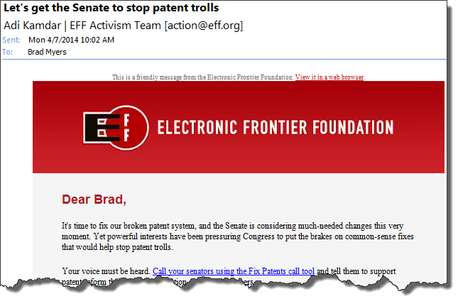

Slide 26
Current Supreme Court Case
Alice Corp. v. CLS Bank
Computer-implemented technique for reducing risk in currency and financial transactions
Detailed discussion
Argued in front of Supreme Court last week
Could overthrow all hundreds of thousands of software patents
“collectively worth billions of dollars”

Slide 27
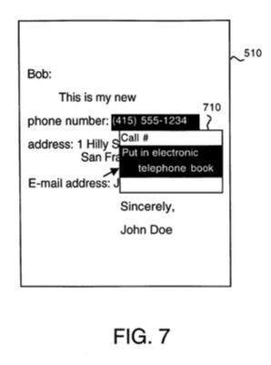
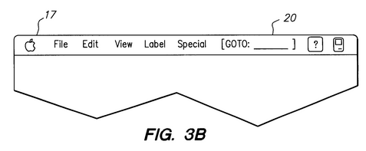
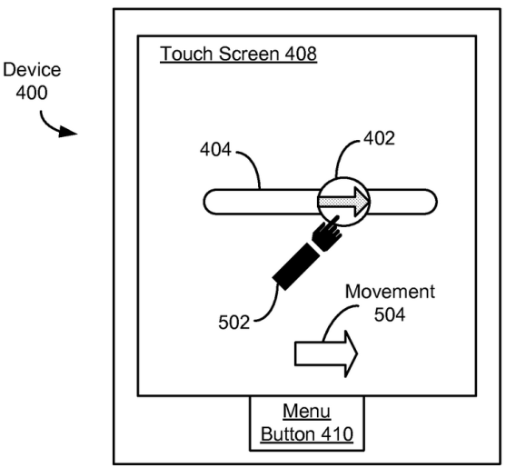
New Apple vs. Samsung cases
Apple Inc. v. Samsung Electronics Co. Ltd. et al., case number 5:12-cv-00630, in the U.S. District Court for the Northern District of California
Apple patents:
5,946,647 – “System and method for performing an action on a structure in computer-generated data”
6,847,959 – “Universal interface for retrieval of information in a computer system”
7,761,414; -- “Asynchronous data synchronization amongst devices”
8,074,172 – “Method, system, and graphical user interface for providing word recommendations”
8,046,721 – “Unlocking a device by performing gestures on an unlock image”
The Samsung patents:
7,577,757 – “Multimedia synchronization method and device”
6,226,449 – “Apparatus for recording and reproducing digital image and speech”
Source: http://www.law360.com/m/ip/articles/523391

