Slide 1
Lecture 21: Past to Future: Gesture Recognition and Its Algorithms
Brad Myers
05-899A/05-499A: Interaction Techniques
Spring, 2014

Slide 2
Announcements
Pick up HW 4, quiz 5, & project proposals
For projects:
Very important not to make stuff up or exaggerate
All statements carefully worded and accurate
Citations and evidence
Ideas for how to assign presentation slots?
No “late” presentations!
Late penalty for written report
10 points per day!

Slide 3
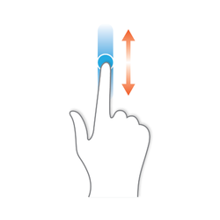
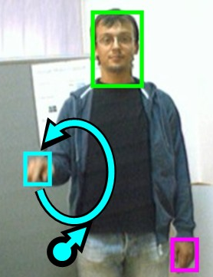
What is a “Gesture”
In HCI, an input to a computer where the path of the input is important to its recognition, not just the end points
Regular drag-and-drop just cares about where starts and finishes, so does not count as a “gesture”
A recognizer is needed to interpret the path – so it may be interpreted incorrectly
Can be done with a mouse, a stylus or finger on touchscreen, or hands in the air in front of a camera
Can be one or multiple fingers
On Smartphones, call “tap” a “gesture” to distinguish between tap, long-press, flick, drag, etc.
Depends on properties of the action or of the other actions
Location, but also speed, timing, etc.

Slide 4
Advantages of Gesture Recognition
Very fast to enter
Single gesture can give both parameters and command
E.g., cross out gesture tells both what to do and to what
Large space of potential gestures
Can be “natural”
Can fit in easily with event-based programming
Assuming gestures simply invoke a command

Slide 5
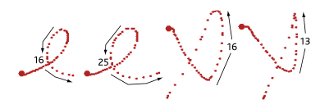
Disadvantages
No affordance – user has to know they can be done
No in-place information on what they look like
Can be hard to remember which gesture does what operation (especially if lots)
System may recognize them incorrectly
Often cannot be entered correctly by users with disabilities, etc.
Can be unnatural if designed poorly
Hard to provide feedback of what is happening, especially if continuous
Implementation challenge: creating a good recognizer
Designer must decide if rotation and size invariant

Slide 6
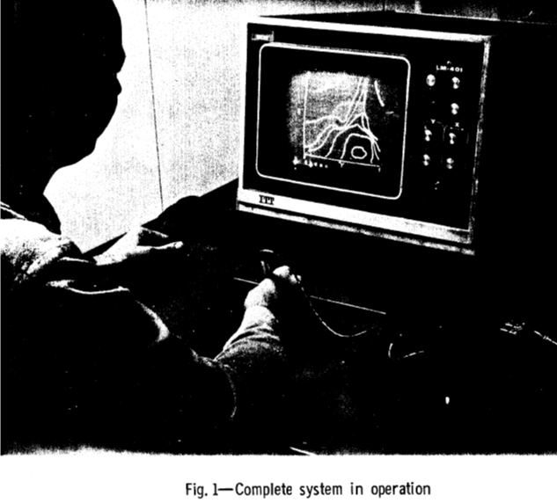
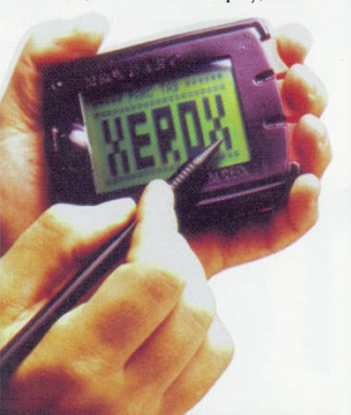
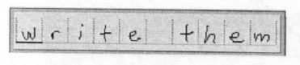
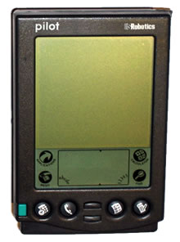
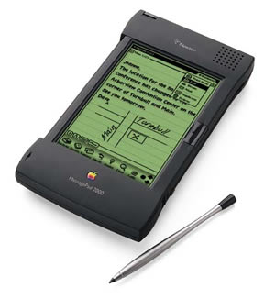
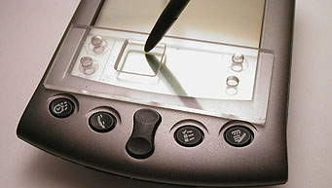
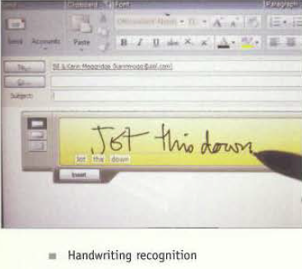
Gestures -> Character Recognition
See lecture 12 about text entry using hand-printing and hand-writing
Rand tablet (1964)
PARC Tab QuickWriting (1989)
Go PenPoint (1991)
Apple Newton (1993)
Palm Graffiti (1996)
Windows TabletPC (2002)
EdgeWrite (2003)

Slide 7
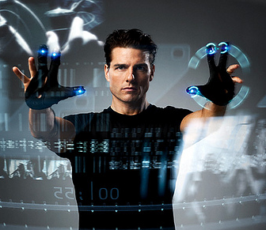
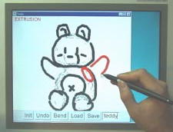
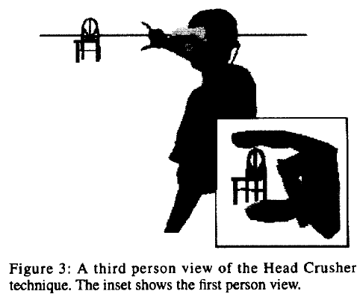
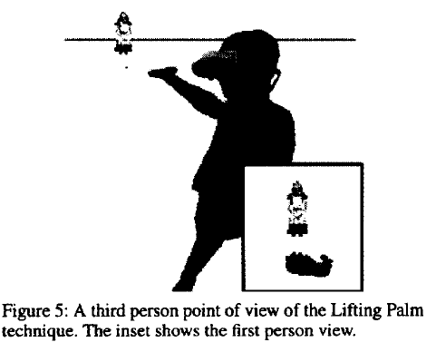
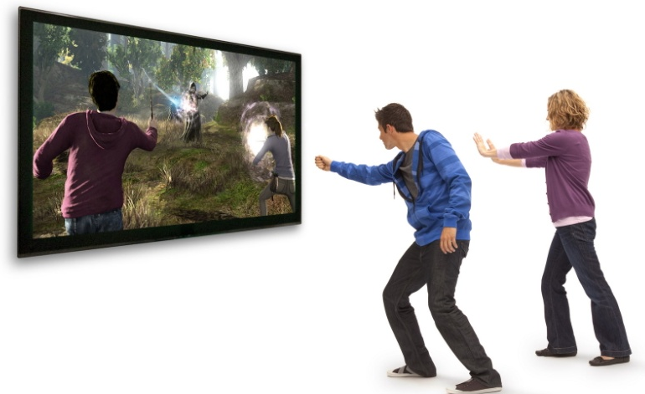
Also Already Covered: Gestures in 3D
Gestures for 3D manipulation
See lecture 16
Mainly pose and path of fingers with datagloves
Also elaborate gestures in Teddy
See lecture 17
Sometimes gestures with joysticks
May depend on path and timing
Wii controller gestures
Kinect Body poses

Slide 8
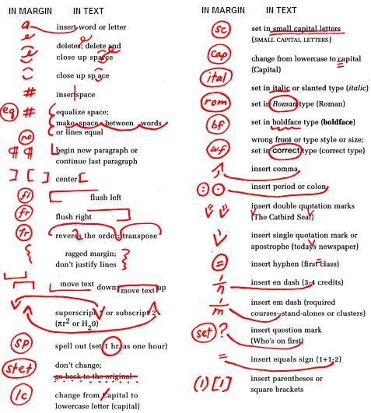
Gestures for Proofreading
Well-known proofreading symbols on paper
Many investigated using these gestures
COLEMAN, M. L. Text editing on a graphic display device using hand-drawn proofreader's symbols. In Pertinent Concepts in Computer Graphics, Proceedings of the Second University of Illinois Conference on Computer Graphics, M. Faiman and j. Nievergelt, Eds. University of Illinois Press, Urbana, Chicago, London, 1969, pp. 283-290.
RHYNE, J. R., AND WOLF, C. G. Gestural interfaces for information processing applications. Tech. Rep. RC12179, IBM T.J. Watson Research Center, Sept. 1986.

Slide 9
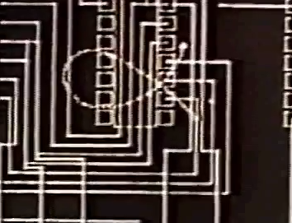
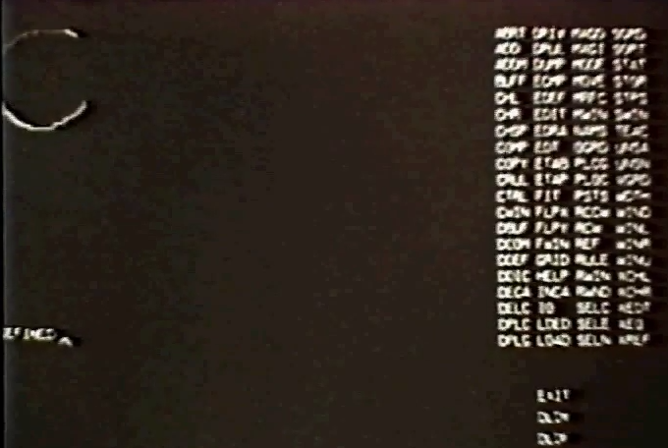
Trainable Gesture Recognizer
Applicon (circa 1970). An interactive trainable computer aided circuit design system using hand-drawn shapes to enter data and commands. Applicon. 16 mm film. Video (2:25 min excerpt)
From Bill Buxton Lincoln Labs page. See the Wikipedia entry

Slide 10
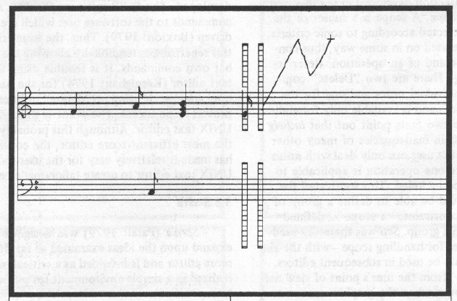
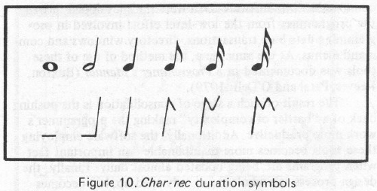
Early Gesture Recognition
Buxton, W., Sniderman, R., Reeves, W., Patel, S. & Baecker, R. (1979). The Evolution of the SSSP Score Editing Tools. Computer Music Journal 3(4), 14-25. [PDF] [video]
Can draw gestures for the desired notes to enter music
Start location determines pitch

Slide 11
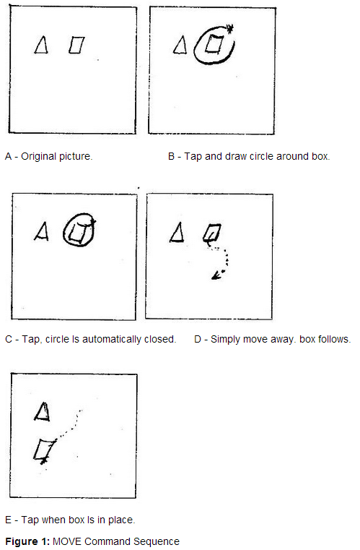
Early Graphical Editing Gestures
Buxton, W., Fiume, E., Hill, R., Lee, A. &amp; Woo, C. Continuous Hand-Gesture Driven Input. Proceedings of Graphics Interface '83, Edmonton, May 1983, 191-195. http://billbuxton.com/gesture83.html [video]
Gestures for move and copy
Copy is same except make a “C” gesture along the path after circling and before moving

Slide 12
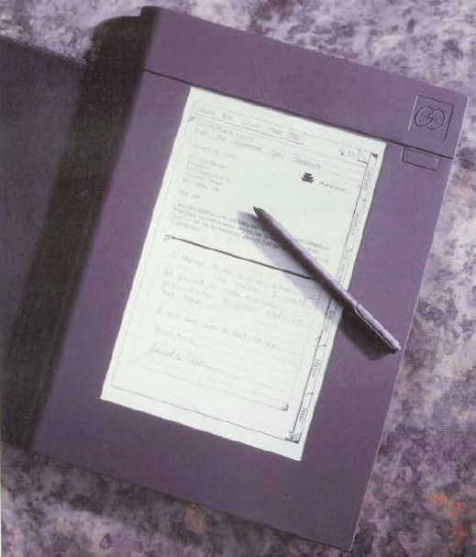
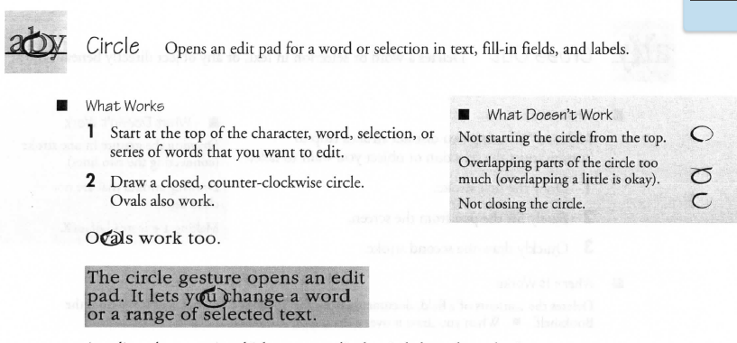
Go Corp’s “PenPoint” OS
Founded 1987, released in 1991
Many gestures for editing, navigation, etc.
Flick to scroll and turn pages, circle, insert space, cross-out, insert word, get help, …
Press and hold to start moving or selecting
Special-purpose recognizer for the built-in gestures
http://research.microsoft.com/en-us/um/people/bibuxton/buxtoncollection/a/pdf/ Go%20PenPoint%20Getting%20Started.pdf

Slide 13
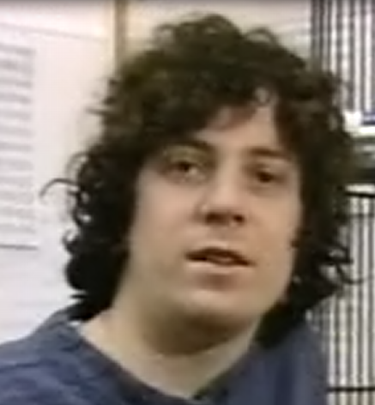
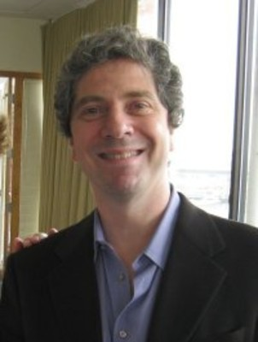
Dean Rubine’s System
Dean Rubine at CMU (PhD CSD, 1991) created novel gesture interaction techniques
Also, a novel “open-source” flexible algorithm, which researchers used for 16 years.
Paper: Dean Rubine. 1991. Specifying gestures by example. In Proceedings of the 18th annual conference on Computer graphics and interactive techniques (SIGGRAPH '91). ACM, 329-337. http://doi.acm.org/10.1145/122718.122753
Video: Dean Rubine. 1992. Combining gestures and direct manipulation. In Proceedings of the SIGCHI Conference on Human Factors in Computing Systems (CHI '92), ACM, actual video (10:20) or (ACM Ref for description)
Powerful and influential system for single-stroke gesture recognition
1991
today

Slide 14
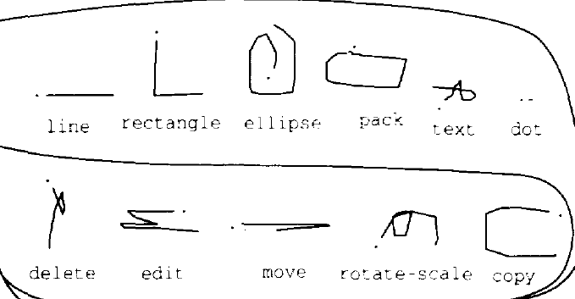
Rubine’s Gesture Innovations
“Eager recognition” – can recognize a gesture while mouse button is still down as soon as it is unambiguous
Either wait for mouse pause, or immediately when unambiguous
Allows user to continue with direct manipulation
E.g., “L” gesture for rectangle, continue to drag for size
“C” gesture for copy, “curlicue” for rotate and scale
Multi-finger gestures also supported
Two finger drag and resize
Video, up through 6:00, 7:00-end

Slide 15
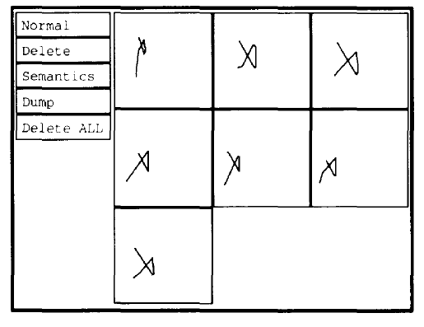
Rubine: Gesture recognition algorithm
Trained with a small number of examples (e.g., 15)
Since done by a person, won’t be identical
Examples should vary in whatever ways they will for the user
E.g., different sizes? Different orientations?
Automatically looks for features of all gestures, that differentiates them
Uses a Machine Learning algorithm
Statistical Single-Stroke Gesture Recognition
Computes matrix inversions, discriminant values, and Mahalanobis distances
Experimentally picked a set of 13 features that seemed to work well
E.g, “cosine and the sine of the initial angle of the gesture, the length and the angle of the bounding box diagonal, …”
Implemented in a system called GRANDMA
Video, 6:00 through 7:00

Slide 16
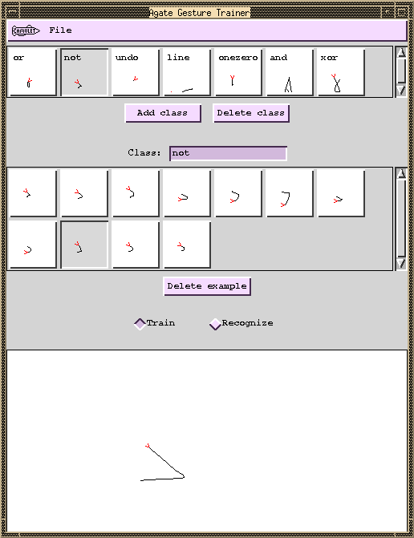
Uses of Rubine’s algorithm
Many subsequent projects reimplemented and built on his algorithm
We implemented it twice, both called “AGATE”: A Gesture-recognizer And Trainer by Example
Integrated with the standard “interactor” event handling model
James A. Landay and Brad A. Myers. "Extending an Existing User Interface Toolkit to Support Gesture Recognition," Adjunct Proceedings of INTERCHI'93. Amsterdam, The Netherlands, April 24-29, 1993. pp. 91-92. (Garnet)
Brad A. Myers, Richard G. McDaniel, Robert C. Miller, Alan Ferrency, Ellen Borison, Andrew Faulring, Andy Mickish, Patrick Doane, and Alex Klimovitski, The Amulet User Interface Development Environment. 8 minute video. Technical Video Program of the CHI‘1997 conference. ACM, OpenVideo (local copy) 8:50 total, gestures at 6:15-6:50

Slide 17
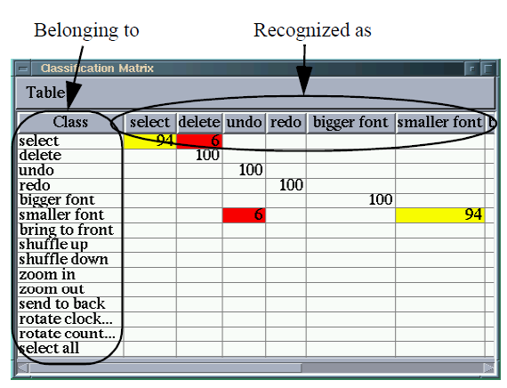
Improving the Gestures
Allan Christian Long Jr., Quill: a gesture design tool for pen-based user interfaces, PhD thesis, UC Berkeley, 2001, (307 pages), pdf
How to know if the gestures are too similar?
Chris Long took the Rubine recognizer and analyzes if gestures are too “confusable”
“Quill” tool
Similarity in recognition space not necessarily the same as in human perceptual visual space

Slide 18
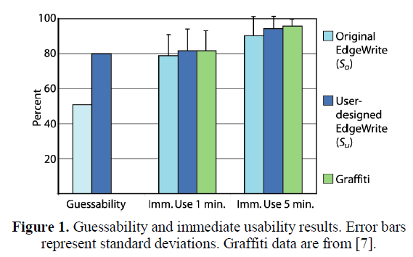

User Designed Gestures
Jacob O. Wobbrock, Htet Htet Aung, Brandon Rothrock and Brad A. Myers. "Maximizing the Guessability of Symbolic Input" (Short Talk). Extended Abstracts CHI'2005: Human Factors in Computing Systems. Portland, OR, April 2-7, 2005. pp. 1869-1872. pdf. http://doi.acm.org/10.1145/1056808.1057043
When creating the EdgeWrite gestures, Jake Wobbrock wanted to know what users thought the gestures should be:
“Guessability of the EdgeWrite unistroke alphabet was improved by users from 51.0% to 80.1%”
Multiple phases
Participants told the constraints
Participants propose a set of gestures – tricky not to bias answers with prompts
Get participants to resolve conflicts
since likely to create indistinguishable gestures

Slide 19
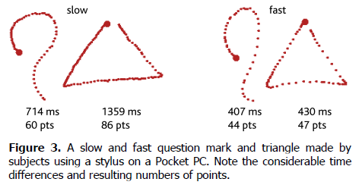
Wobbrock’s new recognizers
Jacob O. Wobbrock, Andrew D. Wilson, and Yang Li. 2007. Gestures without libraries, toolkits or training: a $1 recognizer for user interface prototypes. In Proceedings of the 20th annual ACM symposium on User interface software and technology (UIST '07). ACM, pp. 159-168. http://doi.acm.org/10.1145/1294211.1294238 or http://faculty.washington.edu/wobbrock/pubs/uist-07.1.pdf
More efficient and simpler than Rubine’s
Became the new standard that others use for research
Unistroke and multi-stroke versions
Match candidate points to remembered templates
Default: rotation, size and speed invariant

Slide 20
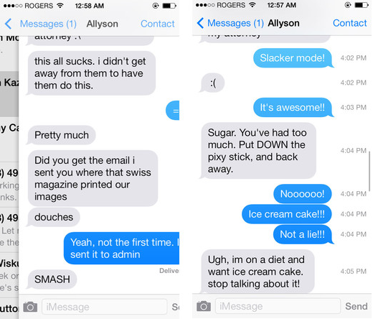
iPhone Gestures
Quick flick down / up / left / right
New behaviors in various apps (no affordance)
Left and right in Messages, Safari
Up and down in home screens
Swipe down from top
Swipe up from bottom
Press and hold
Two finger zoom
Also in photo
Two finger zoom and rotate
Google maps
Three finger tap – accessibility
Shake left-right = undo (sometimes)
…

Slide 21
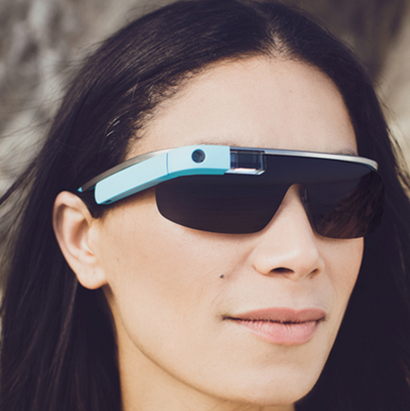
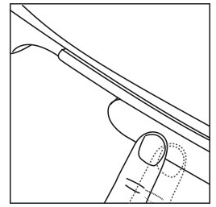
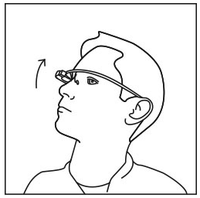
Google Glass Gestures
https://support.google.com/glass/answer/3064184?hl=en
Small touch pad on right side & Motion sensor
Activate Glass: Tap the touchpad to turn the display on
Swipe forward and back: affect content being shown
Select an item: Tap
Tilt head up / down: display on / off

Slide 22
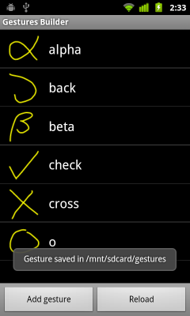
Android Gesture Builder
All Smartphones have libraries to support programming apps with gestures
Often provided to the code by “events” like “mouse-down” → “swipe-left”
Android provides nice tool to define gestures by example
Thanks to Pushkar Joglekar, Sam Gruber, Samantha Chiu
http://android-coding.blogspot.com/2011/09/gestures- builder-create-your-gestures.html
http://android-developers.blogspot.com/2009/10/gestures- on-android-16.html

Slide 23
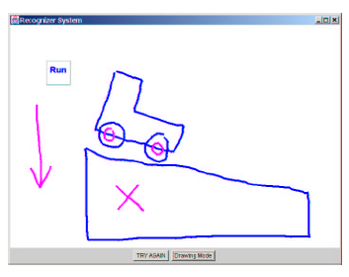
Research: Elaborate Gesture / Picture Recognition
Alvarado, Christine and Davis, Randall (2001). Resolving ambiguities to create a natural sketch based interface. Proceedings of IJCAI-2001, August 2001. PDF
Recognizes shapes & relationships between shapes
Attachment points, anchors, etc.
Can then run as a physical simulation
YouTube video (4:43)

Slide 24
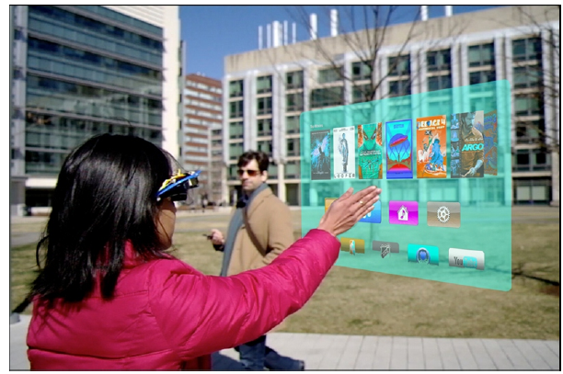
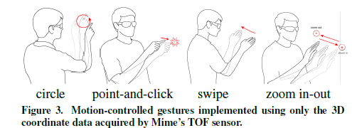
Research: Hand Gestures
Andrea Colaço. 2013. Sensor design and interaction techniques for gestural input to smart glasses and mobile devices. In Proceedings of the adjunct publication of the 26th annual ACM symposium on User interface software and technology (UIST '13 Adjunct). Doctoral Consortium. ACM, pp. 49-52. http://doi.acm.org/10.1145/2508468.2508474
Use multiple sensors mounted on glasses to recognize hand gestures in the air
Needs to be very low-power and efficient

Slide 25
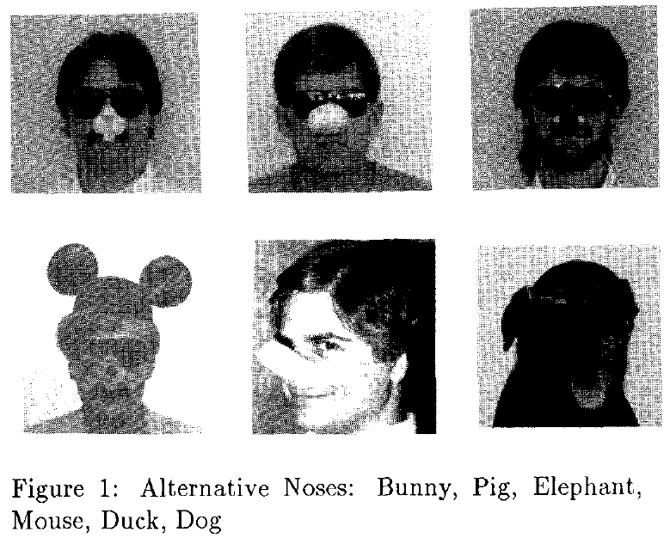
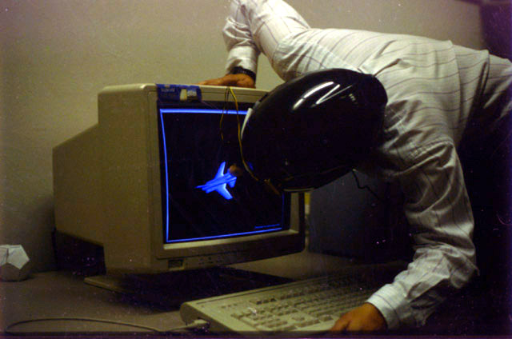
Funny
Tyson R. Henry, Scott E. Hudson, Andrey K. Yeatts, Brad A. Myers, and Steven Feiner. "A Nose Gesture Interface Device: Extending Virtual Realities," ACM Symposium on User Interface Software and Technology, Hilton Head, SC, Nov. 11-13, 1991. pp. 65-68. ACM DL or local copy and slides.

Slide 26
Serious
ISR and HCII PRESENT a SOCIETAL COMPUTING SEMINAR:
Towards Science of Gesture-Based Authentication: Security and Memorability
Janne Lindqvist
Thursday, April 17, 2104, 10:30 a.m., 3305 Newell Simon Hall
We study the security and memorability of free-form multitouch gestures for mobile authentication. Towards this end, we collected a dataset with a generate-test-retest paradigm where participants (N=63) generated free-form gestures, repeated them, and were later retested for memory. Half of the participants decided to generate one-finger gestures, and the other half generated multi-finger gestures. Although there has been recent work on template-based gestures, there are yet no metrics to analyze security of either template or free-form gestures. For example, entropy-based metrics used for text-based passwords are not suitable for capturing the security and memorability of free-form gestures. Hence, we modify a recently proposed metric for analyzing information capacity of continuous full-body movements for this purpose. Our metric computed estimated mutual information in repeated sets of gestures. Surprisingly, one-finger gestures had higher average mutual information. Gestures with many hard angles and turns had the highest mutual information. The best-remembered gestures included signatures and simple angular shapes. We also implemented a multitouch recognizer to evaluate the practicality of free-form gestures in a real authentication system and how they perform against shoulder surfing attacks. Our work shows that free-form gestures present a robust method for mobile authentication.

Slide 27
More References
From Bill Buxton, www.billbuxton.com
The first gesture-related stuff that I did was the single-stroke shorthand that I developed for entering music to the score editor. This was the stepping stone to Unistrokes and that to Grafitti.
Buxton, W., Sniderman, R., Reeves, W., Patel, S. & Baecker, R. (1979). The Evolution of the SSSP Score Editing Tools.Computer Music Journal 3(4), 14-25. [PDF] [video]
The paper that you referred to as well as the accompanying video can be found here;
Buxton, W., Fiume, E., Hill, R., Lee, A. & Woo, C. (1983). Continuous Hand-Gesture Driven Input. Proceedings of Graphics Interface '83, 9th Conference of the Canadian Man-Computer Communications Society, Edmonton, May 1983, 191-195. [video]
For a review of Marking and Gesture stuff, see the following two draft chapters of the yet-to-be-finished (!) input book:
http://www.billbuxton.com/inputManuscript.html
Marking Interfaces
Gesture Driven Input
IMHO, the most useful thing that I have written that guides me, at least, in terms of gestures, is:
Buxton, W. (1986). Chunking and Phrasing and the Design of Human-Computer Dialogues, Proceedings of the IFIP World Computer Congress, Dublin, Ireland, 475-480.
The two things that I always discuss when I speak about gestures are:
Kreuger’s work & introduction of the pinch gesture, etc.: http://www.youtube.com/watch?v=d4DUIeXSEpk
Richard Bolt’s work combining gesture and speech: http://www.youtube.com/watch?v=RyBEUyEtxQo
There is also some nice examples from Lincoln Lab:
Applicon (circa 1970). An interactive trainable computer aided circuit design system using hand-drawn shapes to enter data and commands. Applicon. 16 mm film. 2:25 min excerpt
http://www.billbuxton.com/Lincoln.html
http://www.billbuxton.com/LincolnLab.pdf
An old summary which still has some relevance:
Buxton, W. (1995). Touch, Gesture & Marking. Chapter 7 in R.M. Baecker, J. Grudin, W. Buxton and S. Greenberg, S. (Eds.)(1995). Readings in Human Computer Interaction: Toward the Year 2000 San Francisco: Morgan Kaufmann Publishers.

