Slide 1
Lecture 20: Past to Future: Various Undo Models, Interaction Histories, and Macro Recording
Brad Myers
05-899A/05-499A: Interaction Techniques
Spring, 2014

Slide 2
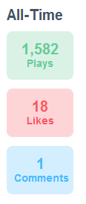
Announcements
Final Projects proposal due today
OK to collaborate among groups
Topic for “Artificial Intelligence (AI) in Interfaces”?
Hayden Demerson’s answer on Quora based on class material
“Who started the trend of using the hamburger icon (☰) as a menu button?”
http://www.quora.com/User-Interfaces/Who-started-the-trend-of-using-the-hamburger-icon-%E2%98%B0-as-a-menu-button
“Likes” of the All the Widgets video on Vimeo
https://vimeo.com/61556918

Slide 3
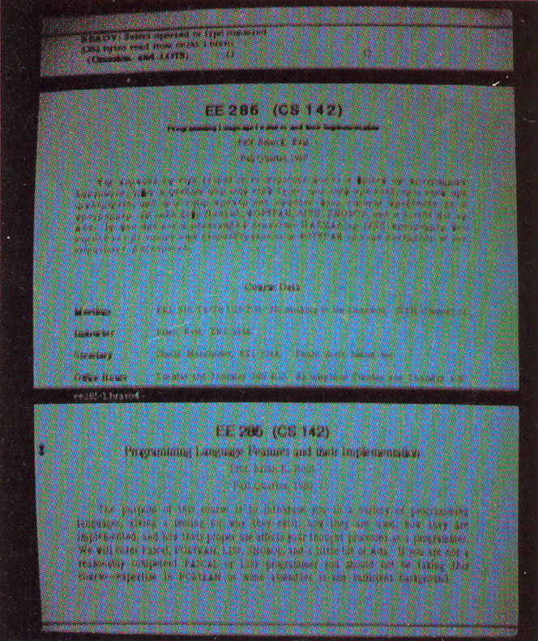
Early Undo
Single previous action could be undone
Bravo: 1974
Butler Lampson, Charles Simonyi and colleagues in
Simonyi went to Microsoft and created Microsoft Word
First WYSIWYG text editing
Single level undo for most commands
Undo again would “undo the undo” = “redo”
Some commands could not be undone
Could not undo if “moved the selection”
Could repeat the previous command with ESC, using the current selection
Uses the same arguments as previous time
Example: “insert abc” multiple times
history-computer.com/Library/AltoUsersHandbook.pdf‎

Slide 4
Larry Tesler’s email
Warren Teitelman's Interlisp Shell (1960's) had perhaps the first generalized Undo command. But it only undid top-level shell commands, not side effects that they had caused. As I recall, as in Photoshop, you could undo a specific command in the history without undoing those in between.
…
The 1975 Gypsy manual describes cut, copy and paste but not undo. I do not know why we didn't document--or maybe didn't implement--Undo since it was already in Bravo. But when Dan Ingalls implemented the Smalltalk-76 edit menu shortly afterward (late 1975?), it had cut, copy, paste and undo.
The NYT article was mistaken (and contained no citations to Xerox publications). The Lisa was the first system to assign XCVZ to cut, copy, paste and undo (shifted with the "apple" key). I chose them myself. X was a standard symbol of deletion. C was the first letter of Copy. V was an upside down caret and apparently meant Insert in at least one earlier editor.
Z was next to X, C and V on the U.S. QWERTY keyboard. But its shape also symbolized the "Do-Undo-Redo" triad: top rightward stroke = step forward; middle leftward stroke = step back; bottom rightward stroke = step forward again.
So X, C and even V were not novel. But I know of no use of Z to mean Undo before the Lisa.
When Z undid only the most recent command, another Z redid it. Y was used in Bravo (bare Y) and Microsoft Office (ctrl-Y) to mean Redo. In both of those editors, Y redid the last command, even if that command hadn't been undone first. Example:
Select paragraph 1
Indent by 6 [a multi-step dialog-based command]
Select paragraph 4
Redo [i.e., Indent the current selection by 6, too]
When undo became multi-level, the Mac and Microsoft (including Word for Mac) diverged as you said.
Larry

Slide 5
Shortcuts & Issues
NY Times (quoted by Wikipedia) says shortcut ^Z was selected “by programmers at the research center Xerox PARC”
http://www.nytimes.com/2009/09/20/magazine/20FOB-onlanguage-t.html?_r=0
Larry Tesler says that is incorrect
Redo shortcut
^Y in Macintosh
^-SHIFT-Z in some other systems
Design Issue: how big a unit?
Often typing coalesced into a single operation
Multiple backspaces may or may not be
Newer: “intelligent” single operations may be divided into multiple undoable operations
E.g., Auto-correct in Word

Slide 6
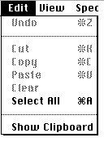
Original Macintosh
First system to require Undo everywhere
Single-level undo originally
“Multi-level undo commands were introduced in the 1980s”
-- Wikipedia
But I don’t know exactly which version of Mac OS

Slide 7
Linear Multi-Level Undo Model
1
2
3
4
Linear multi-level model
All operations are in a history list
Can undo backwards
Undone operations are put into a redo list
Can then redo forwards
But once a new command is executed, anything in the redo list is discarded, so there is always only a linear history
May have a limited size of the history list
Important modifications
Used to stop and commands that were not undoable, like save
Now, just skips them in undo stack
Contents of the clipboard are not affected by Undo
E.g., copy is not undone; cut just undoes the delete
Many operations are not generally put into the undo stack
Selections, scrolling, rearranging windows, ….
X

Slide 8
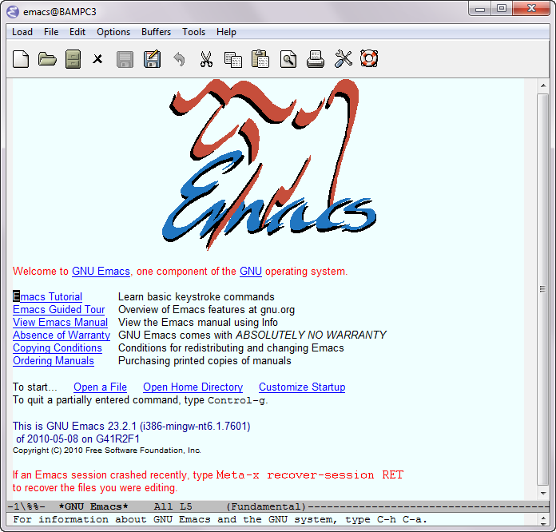
Emac’s Linear Undo Model
^Z goes backwards as usual
^G (abort) causes ^Z to change direction and start going forwards (redo)
^G again goes backwards
New commands appended to the end, so previous states are still reachable
Doesn’t delete non-redone commands

Slide 9
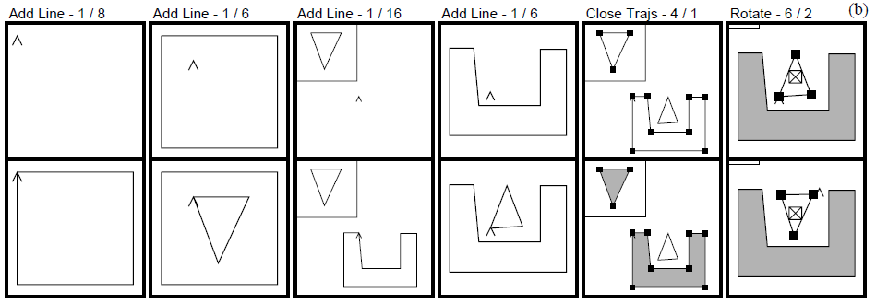
Kurlander’s Graphics Histories
Kurlander, D. and Feiner, S. Editable Graphical Histories. Proc. 1988 IEEE Workshop on Visual Languages. (Pittsburgh, Oct. 10-12, 1988). 127-134. http://ieeexplore.ieee.org/stamp/stamp.jsp?tp=&arnumber=18020&isnumber=662
Video (2:42)
Before and after scenes for each operation
Can undo back to any point
Can then change things and redo the operations afterwards
Called the “script” model of undo/redo

Slide 10
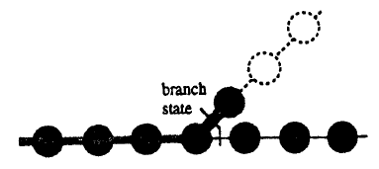
Hierarchical or Tree-Based Undo
1
2
3
4
Keep the entire history of all edits
User can return to any previous state of the system
In theory, but navigation is difficult
Emacs:
Cubitt, T. “Undo-Tree package”: undo-tree.el version 0.6.4, http://www.dr-qubit.org/emacs.php
Visualizes as a tall tree with unlabeled nodes

Slide 11
Selective Undo
1
2
Selective Undo – let the user select which operation(s) to undo
While leaving later operations intact
“Script” model – pretend the operation never happened
Can undo all operations to that point, remove the command, then redo all the subsequent commands
“Rewrite history”
But what if it was a “create” and later operations were “change color”?
Not allowed to selectively undo the create?
Or later operations are ignored?
Many other examples of intertwined operations
Not always clear what the user would want
Can also support “insert” operation into history
Undo back to that point, do the new operation, then redo all subsequent operations
Also can be unclear what it means in many situations
If create an object, do future operations include it?

Slide 12
Direct Selective Undo
1
2
Thomas Berlage. 1994. A selective undo mechanism for graphical user interfaces based on command objects. ACM Trans. Comput.-Hum. Interact. 1, 3 (September 1994), 269-294. http://doi.acm.org/10.1145/196699.196721
The “Gina” system introduced “direct selective undo”
Generally add the inverse of the operation to the end of the history
Then the selective undo can be undone by the regular undo
Undo of change color when there is a later change color
Can be disabled if selective undo does not make sense in the current context
E.g., undo change color for an object that has been deleted
Clearer for users – decide what “inverse” means based on user expectations
Change color – change it back
1
2

Slide 13
Topaz Selective Undo
Brad A. Myers. (1998) "Scripting Graphical Applications by Demonstration," Proceedings CHI'98. pp. 534-541. http://dl.acm.org/citation.cfm?id=274716, video or YouTube (3:09).
Allow selections and scrolling to be in the undo history
Have to turn this on before doing the operations
List of operations and can select which ones to selectively undo or redo
Inverses go onto the end of the history list

Slide 14
Topaz is:
T
O
P
A
Z
ranscripts
f
rograms
ctivated with
eal
CHI'98

Slide 15
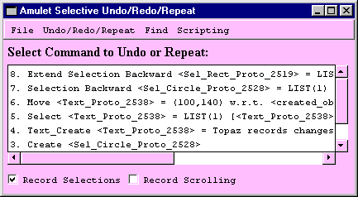
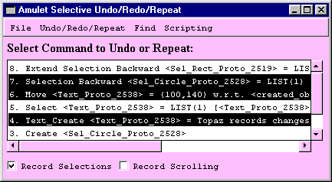
Undo History
Shows history of all commands
Can pick commands to be selectively undone
CHI'98

Slide 16
Using the Selections
Can turn on recording of selections
Then selection actions can be undone
CHI'98

Slide 17
Multi-User Undo
1
Gregory D. Abowd and Alan J. Dix. 1992. Giving undo attention. Interact. Comput. 4, 3 (December 1992), 317-342. http://dx.doi.org/10.1016/0953-5438(92)90021-7 or pdf
Multiple users editing at the same time
Independent of synchronization issues
When user A undoes something, what does it mean?
Local: That person’s last operation?
Global: Globally the last operation?
Abowd proposes global when there is a single cursor (or single selection), but local if multiple cursors (selections)
Local undo requires some form of selective undo
Can interfere with the other user’s current edits
What does GoogleDoc do?

Slide 18
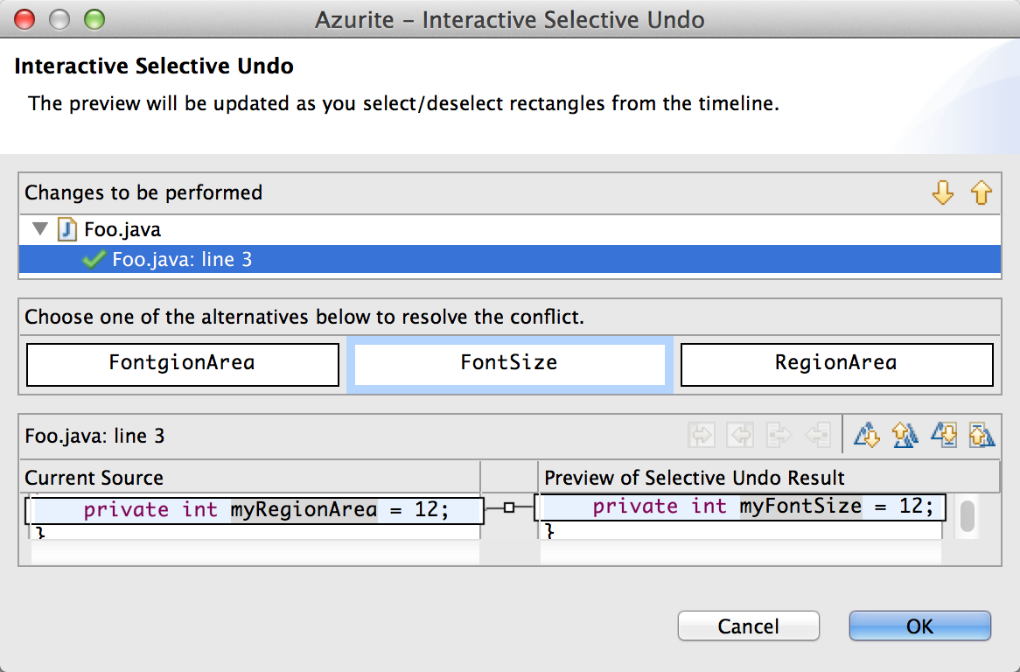
Research: YoungSeok Yoon’s Selective Undo in Code
YoungSeok Yoon, Sebon Koo and Brad A. Myers, "Visualization of Fine-Grained Code Change History", 2013 IEEE Symposium on Visual Languages and Human-Centric Computing (VL/HCC'13), San Jose, CA, September 15–19, 2013. pp. 119-126. local pdf.
Called “Azurite”
Adding Zest to Undoing and Restoring Improves Textual Exploration
Plugin for Eclipse for Java
Difficulty – region conflicts
Same area of code modified by multiple operations
Later ones not being undone
FontSize
RectangleSize
RegionArea
Detects and asks user
Allows multiple commands to be selectively undone
No region conflicts if undo all the commands for one region

Slide 19
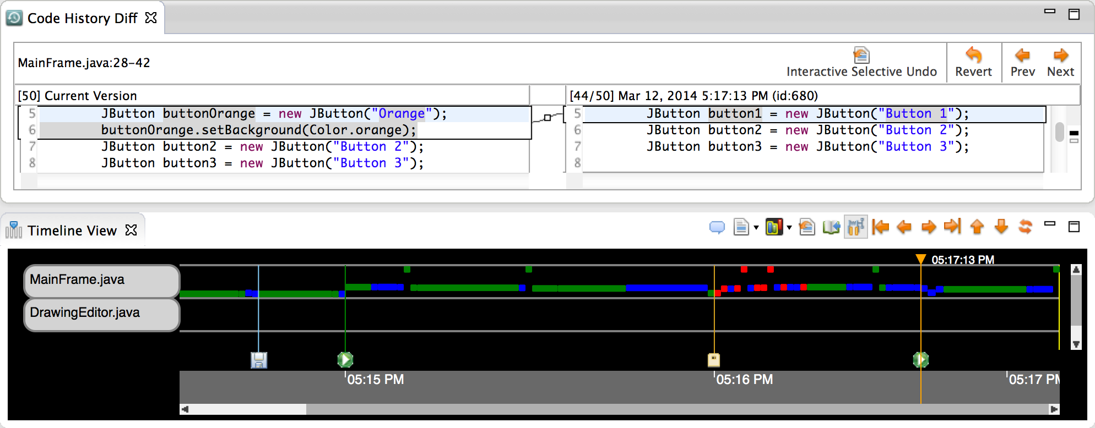
Azurite, cont.
How find and select what to undo?
Timeline visualization of history
Select area of code and explore its history interactively
Or search backwards through time

Slide 20
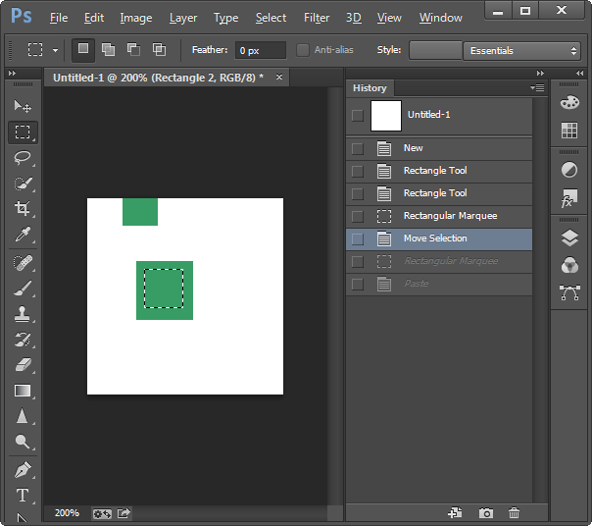
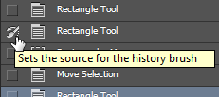
Adobe PhotoShop
History pane displays previous operations
^Z – one-level undo that toggles undo/redo
Also Shift-^Z, Alt-^Z - linear undo forwards and backwards
Redo list erased on new operations
“History brush”
Select point in past and brush area – returns to the way it was in the past
Can’t “skip” operations
Is selective by region, but not by time
Summer project – add real selective undo

Slide 21
Recording and “By Demonstration”
Brad A. Myers. "Visual Programming, Programming by Example, and Program Visualization; A Taxonomy," Proceedings SIGCHI '86: Human Factors in Computing Systems. Boston, MA. April 13-17, 1986. pp. 59-66.
Use the recorded list of operations as a program that can be applied to new situations
“Programming by Example” (PBE)
Also “programming by demonstration” (PBD)
Old: Programming with Example
No AI inferencing
David Smith’s Pygmalion
Emacs keyboard macros
Start recording, execute commands, stop recording
Move cursor and execute script based on new location
Excel

Slide 22
Scripts in Text Editors
Inspiration: Ease of scripts in text editors
Create “Scripts” or “Macros” by demonstration
In Emacs, Microsoft Word, Excel, etc.
Useful to automate repetitive tasks
CHI'98

Slide 23
Scripts in Graphical Programs?
But recording of scripts is not generally available for graphical programs
No well-defined order to the objects
No search
In text editors, the characters, words, and lines provide the order
CHI'98

Slide 24
Selection as the Cursor
Graphical selection ⇔ text cursor
What to record when click on an object?
No mouse for macros in Emacs and Word
Some research systems try to infer the meaning of the click
Why did the user select that object?
Topaz allows the user to specify how to change selection to be the next object
CHI'98

Slide 25
What Order for Objects?
No natural order as in a text editor
Left-to-right, top-to-bottom?
What is after white oval to the right?
CHI'98

Slide 26
Change Selection by Layout
Find Right:
1, 2, 3, 4, 5
Find Left:
5, 4, 6, 7
CHI'98

Slide 27
Find Objects
Can search for objects
Type or load values
Specify which are relevant using check boxes
CHI'98

Slide 28
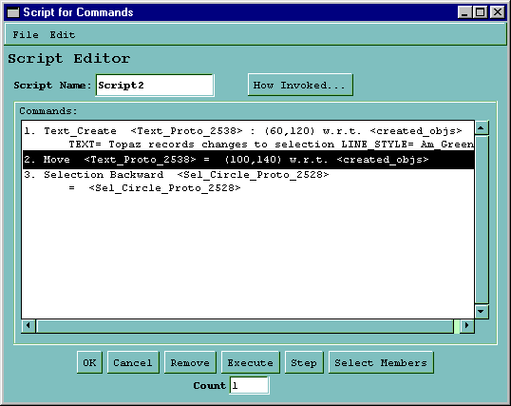
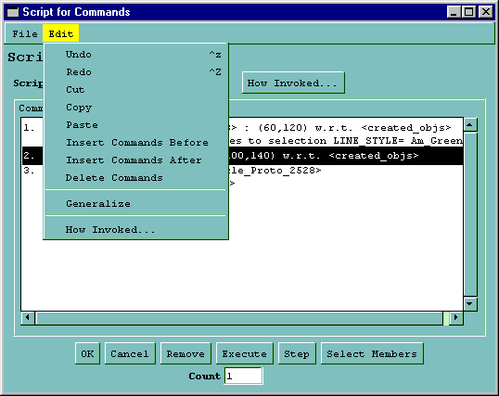
Script Window
Commands are copied into the script window
Full editing is supported
“Step” will execute one command starting with the selected command
CHI'98

Slide 29
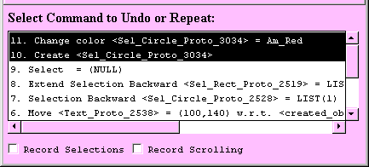
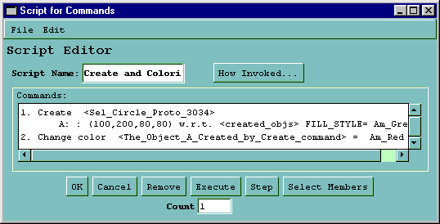
Parameters to Commands
Script is demonstrated on a specific object
Topaz generalizes so works with each newly created object
CHI'98

Slide 30
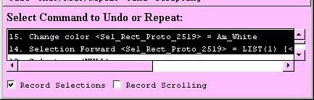
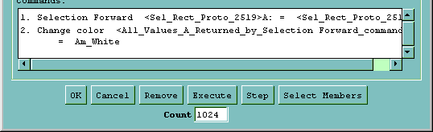
Generalizing Parameters
Objects returned by selections are generalized
Count field controls repeat of the script
Script will stop when there are no more objects
CHI'98

Slide 31
User-Specified Generalizations
System generalizes some objects automatically
User can specify generalizations of parameters
Types:
Objects
Locations
Other values
Select parameter and double click or use menu
CHI'98

Slide 32
Objects
Objects usually generalized correctly
But can control explicitly
For an object used more than once, the place where clicked is green, and other appearances are yellow
CHI'98

Slide 33
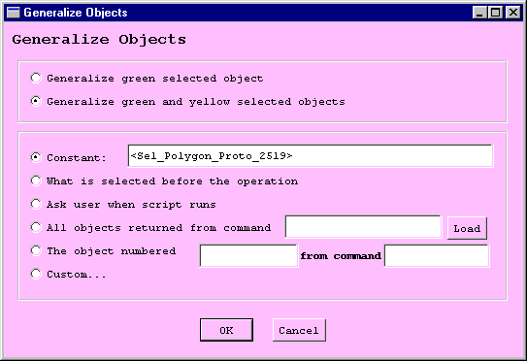
Generalizing Objects
CHI'98

Slide 34
Ask User at Run Time
If ask-user option is chosen, then when run the script, it pauses at that point and asks:
CHI'98

Slide 35
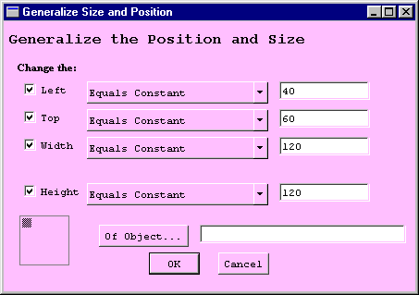
Generalizing Locations
Constant, ask user to click or type, or calculated based on another object
Popups for left, top, width, and height options
CHI'98

Slide 36
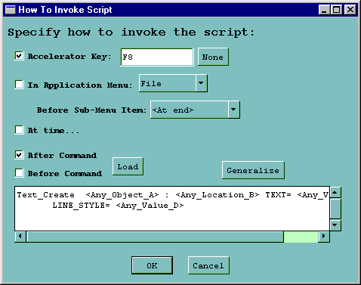
Invoking Scripts
Invoked by menu or accelerator key
Or before or after any other command
Parameters can be generalized
CHI'98

Slide 37
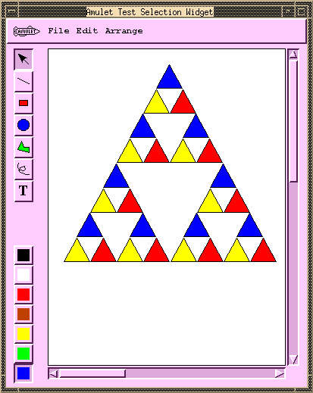
Some Example Scripts
Create Sierpinski Gasket
CHI'98

Slide 38
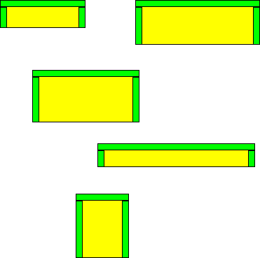
Some Example Scripts
Inscribe an arch made out of three green rectangles in every yellow rectangle
CHI'98

Slide 39
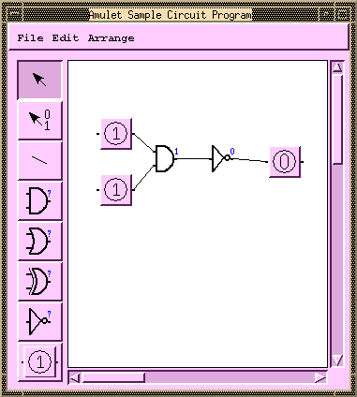
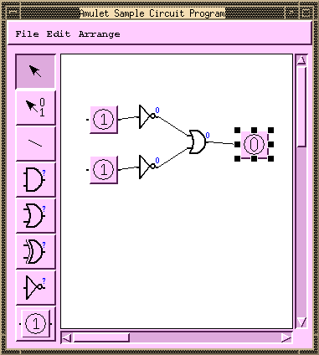
Some Example Scripts
Script in a circuit program that applies DeMorgan’s law
Before:
After:
CHI'98

Slide 40
Video (YouTube) (3:11)
(Local copy)
CHI'98

Slide 41
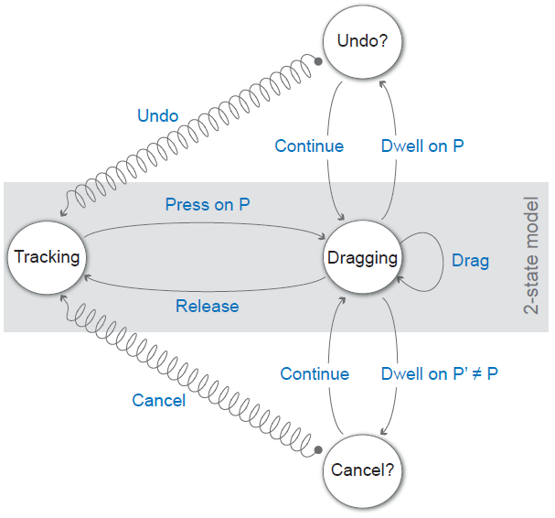
Research: Dwell-and-spring (2012)
Caroline Appert, Olivier Chapuis, and Emmanuel Pietriga. 2012. Dwell-and-spring: undo for direct manipulation. In Proceedings of the SIGCHI Conference on Human Factors in Computing Systems (CHI '12). ACM, pp.1957-1966. http://doi.acm.org/10.1145/2207676.2208339
Provide a way to cancel and undo direct manipulation of window rearranging, and scrolling
If dwell (wait with mouse down) then pops up display of a spring
If enter spring, then can undo the operation
Works selectively on each operation
Video (4:27)

