Slide 1
Lecture 19:
Physical Gadgets and their Interaction Techniques
Brad Myers
05-899A/05-499A:
Interaction Techniques
Spring, 2014

Slide 2
Definitions and Synonyms
Ubiquitous computing (UbiComp) - computing everywhere and anywhere
Pervasive computing – (no separate definition)
Ambient intelligence (mostly used in Europe) – environment is instrumented so it is sensitive and responsive to people
Information appliances – Smartphone or PDA
Context-aware computing – mobile device that knows its surroundings, such as location, light, sound, etc.
from Wikipedia
Tangible user interfaces (TUIs) -- person interacts with digital information through the physical environment – mostly Hiroshi Ishii
  Formerly “graspable UIs”
Has its own conference series:
  TEI’14: 8th International Conference on Tangible, Embedded and Embodied Interaction, Munich, Germany, February 16 - 19, 2014

Slide 3
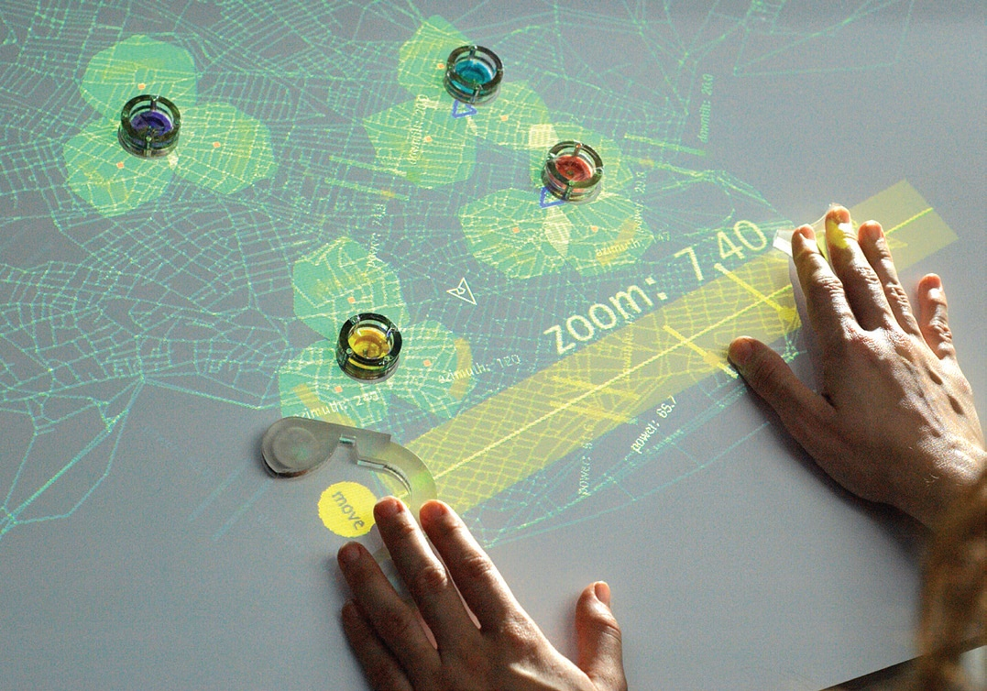
Definitions, cont.
Physical Gadgets
  Are to physical (tangible) user interfaces what interaction techniques are to graphical user interfaces
    Adapted from [Greenberg’01]
  An interaction technique embodied in a physical entity
    Must be reusable
Many other TUIs are
tabletop interactions
with physical objects
sensed on a table with
a projector

Slide 4
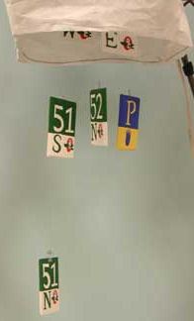
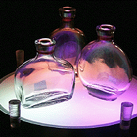
Scope
There are lots of interesting, cute, even useful applications of tangible and ubiquitous user interfaces
Most are not interaction techniques
  E.g., Ambient displays – no interaction
    Mankoff’s BusMobile
  E.g., Tangible applications – not a reusable widget
    Bottles that play sounds when opened

Slide 5
Phidgets
Saul Greenberg and Chester Fitchett. 2001. Phidgets: easy development of physical interfaces through physical widgets. In Proceedings of the 14th annual ACM symposium on User interface software and technology (UIST '01). ACM, pp. 209-218. http://doi.acm.org/10.1145/502348.502388
“Physical widgets”
Previously was very difficult to build TUIs
  Had to build custom hardware and microprocessors
  Soldering, circuit design (EE), assembly-language programming, etc.
  Lots of new sensors
Encapsulated complexities of using physical objects
  Lights, motors, sensors, cameras, switches, etc.
  Mostly USB
Interactive since sensors for motion, light, sound, etc.
Programmed (originally) in Visual Basic
Simulation mode to help with the software
Formed a company to market his phidgets
Video, 6:10 (2001)

Slide 6
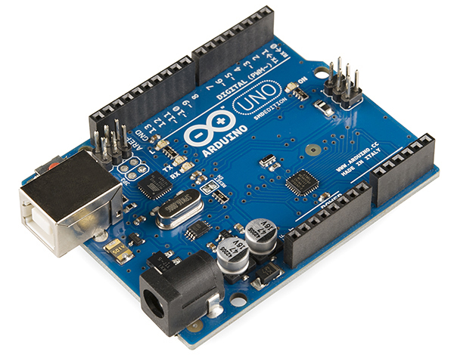
Arduino Controllers
Started about 2005
http://arduino.cc/
Single-board microcontroller
Open source electronics prototyping platform
Now about $9 to $30 each
Easy to program and attach
devices to
New alternatives (from Chris Harrison)
  http://www.raspberrypi.org/
  http://beagleboard.org/
  www.intel.com/galileo‎
  http://www.pjrc.com/teensy/
  http://leaflabs.com/devices/maple/
  If you want to breakout from a phone, there is the IOIO board for android:
    https://www.sparkfun.com/products/retired/10748

Slide 7
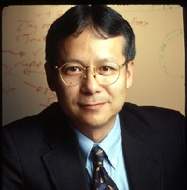
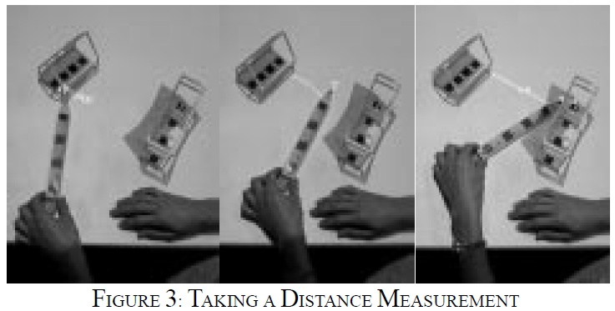
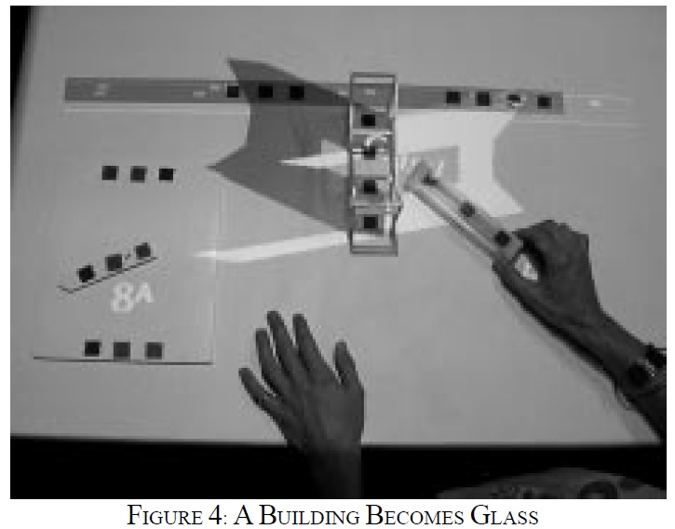
Research: Hiroshi Ishii
Tangible Media Group: http://tangible.media.mit.edu/
Dozens of projects dating back to 1990
  But most are not “interaction techniques”
One that is:
  John Underkoffler and Hiroshi Ishii. 1999. Urp: a luminous-tangible workbench for urban planning and design. In Proceedings of the SIGCHI conference on Human Factors in Computing Systems (CHI '99). ACM, pp. 386-393. http://doi.acm.org/10.1145/302979.303114
  Physical tools for measuring, changing building material, turning on wind, changing light paths, etc.

Slide 8
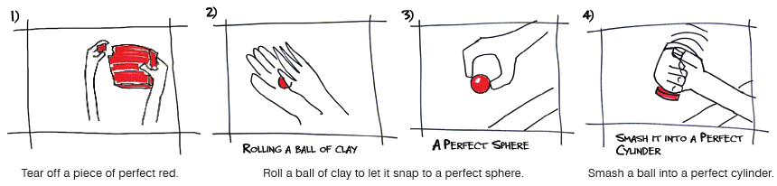
Ishii, cont.
Hiroshi Ishii, Dávid Lakatos, Leonardo Bonanni, and Jean-Baptiste Labrune. 2012. Radical atoms: beyond tangible bits, toward transformable materials. interactions 19, 1 (January 2012), 38-51. http://doi.acm.org/10.1145/2065327.2065337
Includes a survey of tangible Uis
Lists lots of toolkits to create TUIs
“Tangible design seeks an amalgam of thoughtfully designed interfaces embodied in different materials and forms in the physical world—soft and hard, robust and fragile, wearable and architectural, transient and enduring.”
Future: physical-digital “atoms” that can transform, conform and inform
  E.g., “clay” that changes its own shape based on rules, user commands, & constraints

Slide 9
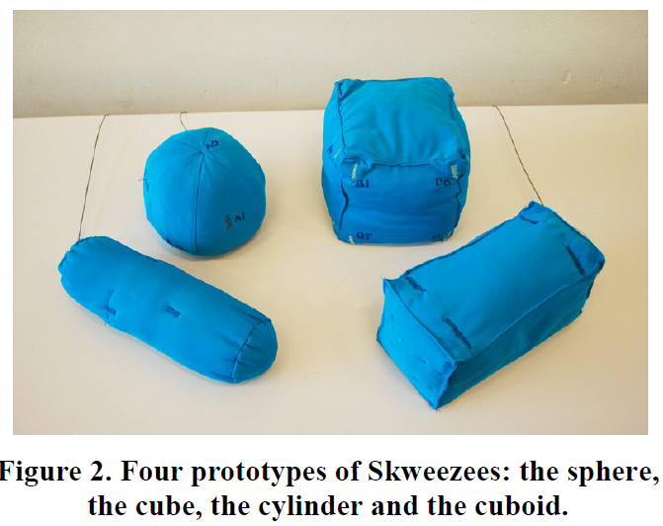
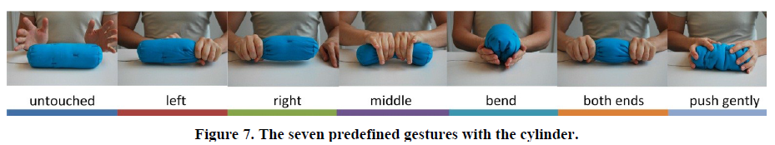
Current Research: Skweezee
Karen Vanderloock, Vero Vanden Abeele, Johan A.K. Suykens, and Luc Geurts. 2013. The skweezee system: enabling the design and the programming of squeeze interactions. InProceedings of the 26th annual ACM symposium on User interface software and technology(UIST '13). ACM, pp. 521-530. http://doi.acm.org/10.1145/2501988.2502033
Soft tangible objects, filled with conductive padding and embedded sensors
(eight electrodes)
Toolkit for defining
squeeze gestures by example
  Learns from a single example

Slide 10
Scott Hudson’s class
“Gadgets, Sensors and Activity Recognition in HCI”
http://www.hcii.cmu.edu/courses/applied-gadgets-sensors-and-activity-recognition-hci
Every spring
This semester, in WeH 7500 – enormous

