Slide 1
Lecture 18:
Interaction Techniques for People with Disabilities
Brad Myers
05-899A/05-499A:
Interaction Techniques
Spring, 2014

Slide 2
Announcements
Project groups are on GoogleDoc
2-page proposal due next Monday
Jeff and I are available to meet this week as needed

Slide 3
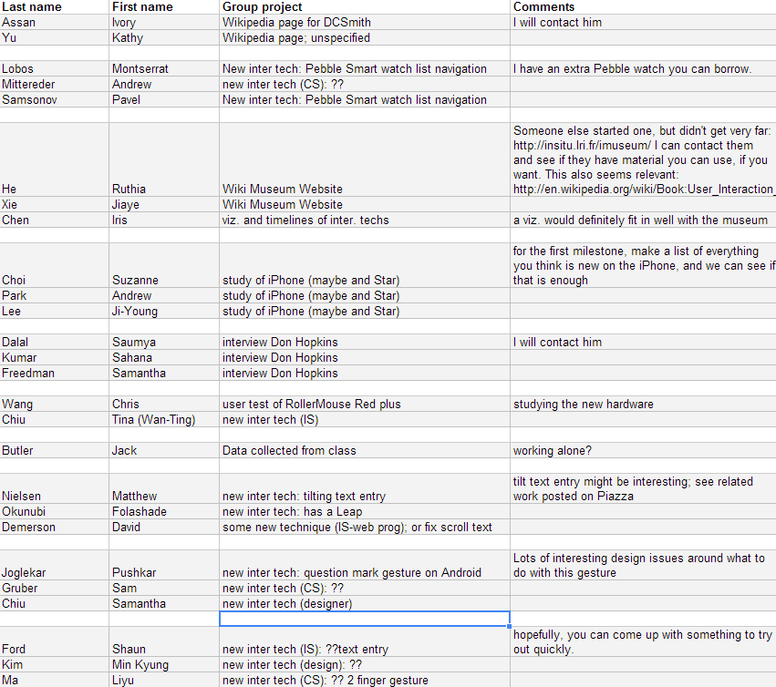

Slide 4
People With Disabilities
People with Disabilities may have trouble with conventional interaction techniques
Motor difficulties – difficulty with controlling mouse and keyboard
Blind / low vision – difficulty with graphical interfaces
Cognitive impairments and learning disabilities
  Less focus on this area
  Significant autism research, but mainly using computers in education or monitoring
Deaf, etc. less of an issue
  Still may benefit from computerized assistance, but usually can use conventional interaction techniques

Slide 5
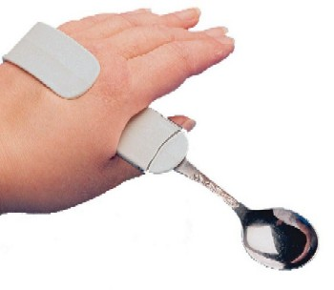
“Assistive Technology”
Wikipedia:
  “Any item, piece of equipment, or product system, whether acquired commercially, modified, or customized, that is used to increase, maintain, or improve functional capabilities of individuals with disabilities”
Includes fatter spoon handles, hearing aides, and screen readers
“Accessibility software”
  “Accessibility of a computer
  system to all people, regardless
  of disability or severity of impairment”

Slide 6
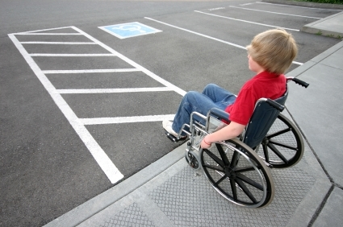
“Universal Design”
One design works for everybody
  Typical example: curb cuts
“Situational Impairments”
  Trying to type on Smartphone while walking
  Trying to enter numbers without looking at a screen (e.g., while driving)
Elderly
  Less accuracy, lower vision, cognitive difficulties

Slide 7
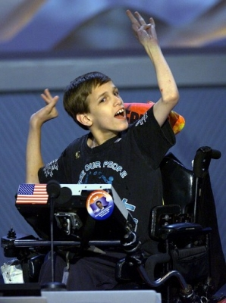
Kinds of Physical Disabilities
Cerebral Palsy
  Result of brain damage to motor control parts of brain, often prenatally or as an infant
  Doesn’t get worse
  Limited physical control
    58% have difficulties with communication
    Often cannot talk or control their hands
  Often, no affect on intelligence
    42% have problems with their vision
    23–56% have learning disabilities
  2.1 per 1,000 live births
  Wide range of abilities

Slide 8
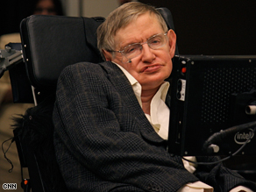
Kinds of Physical Disabilities, cont.
Amyotrophic lateral sclerosis (ALS), Lou Gehrig's disease
Affects about 30,000 Americans
  1.2-4.0 per 100,000 individuals in Caucasian populations
Muscle weakness and atrophy throughout the body due to to the degeneration of the upper and lower motor neurons
Degenerative (gets worse)
Lose ability to speak and move
Eventually, may lose ability to eat
and even breath
Stephen Hawking, age 72

Slide 9
Kinds of Physical Disabilities, cont.
Parkinson's disease
  Degenerative disorder of the central nervous system
  Usually affects older people, usually after age 60
  Shaking, rigidity, slowness of movement
  About one million people in the United States
Muscular Dystrophy (MD)
  About one in every 4,000 newborn boys
  Lose gross motor control while retaining fine motor control
  Lose strength
Many other physical disabilities and diseases
Just being elderly
  Reduced physical dexterity, eyesight, cognitive abilities, etc.

Slide 10
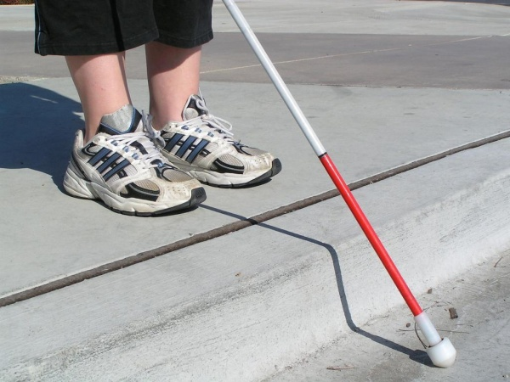
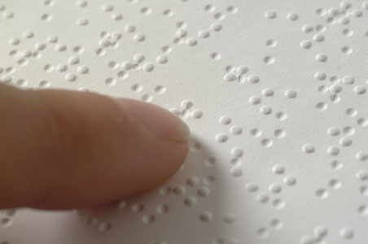
Blindness and Visual Disabilities
Estimate that about 6,600,000
people in US had a visual disability in 2011 (cite)
Many levels
  No vision from birth
  Need magnification
  Color blindness

Slide 11
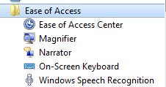
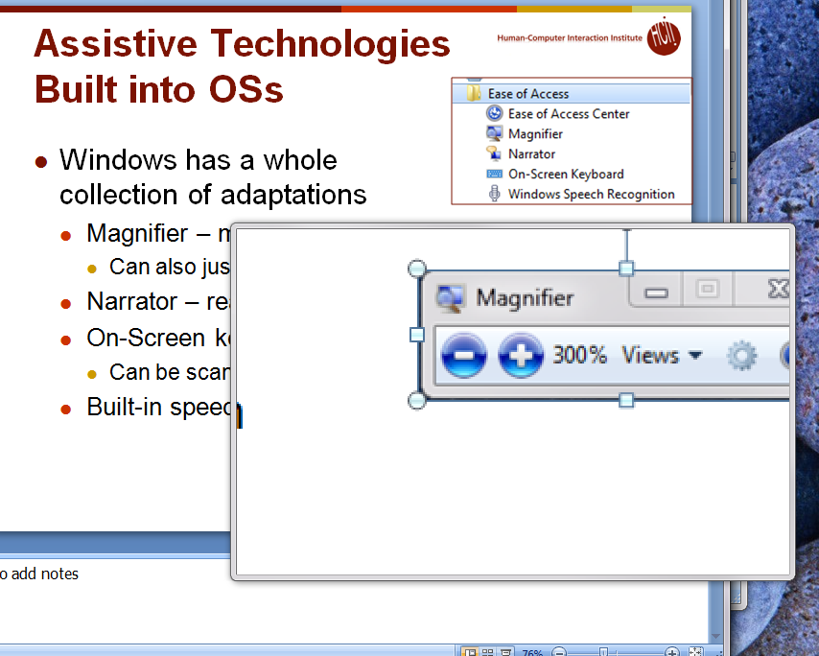

Assistive Technologies
Built into OSs
Windows has a whole
collection of adaptations
  Magnifier – make whole screen or a portion bigger
    Can also just use larger fonts, lower resolution
    Change colors and contrast
  Narrator – read the words on the screen
  On-Screen keyboard
    Can be scanned
  Built-in speech recognition

Slide 12
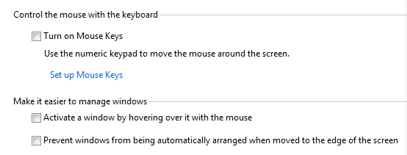
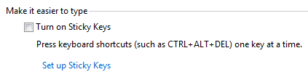
Assistive Technologies
Built into OSs, cont
Adaptations for mouse
  Make mouse easier to see
  Move mouse with the keyboard
Adaptations for keyboard
  Sticky Keys – so no need for chords
    Work like on Smartphones

Slide 13
On Screen Keyboards
Built-in or add-on
  Usually add auto-complete and auto-predict
    Auto-predict: Predict next word based on previous words with no letters typed
Can point to on-screen keyboards with various mechanisms
  Example: head tracking (video 3:05)
Or use scanning keyboards
  Sip and puff to select (video 3:55)

Slide 14
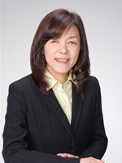
Screen Readers for the Blind
Reads the words on the screen
Keystroke to move to next area
Blind people can operate them amazingly quickly
JAWS – job access with speech
  Example: video 7:23
IBM Home Page Reader – by Chieko Asakawa from IBM Japan, visiting CMU this semester

Slide 15
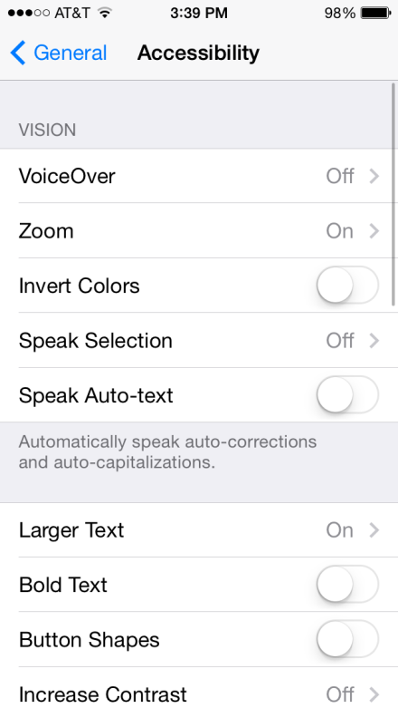
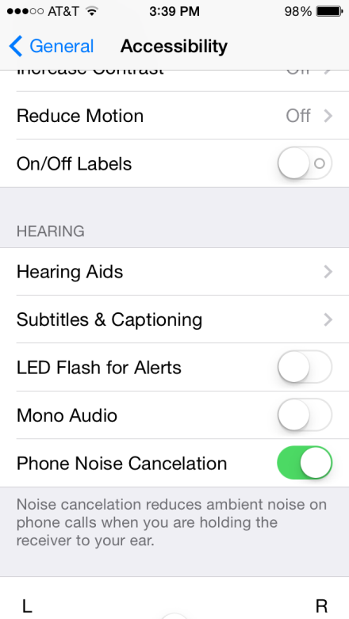
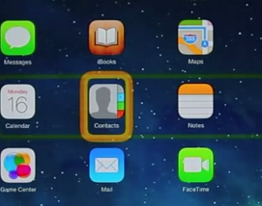
Assistive Technologies in iPhone
Many pages of accessibility settings
VoiceOver – reads what is on screen
Speech recognition for controlling device
Zoom – screen magnifier – 3 finger tap
Closed captions on videos
AssistiveTouch – so don’t need multiple fingers, don’t need to press Home button, etc.
Switch Control (ios7) – Scanning through items with optional connection to external switch
  How to set it up with BlueTooth (video 7:14)
  Can use head movement
  with built in camera (video 3:25)

Slide 16
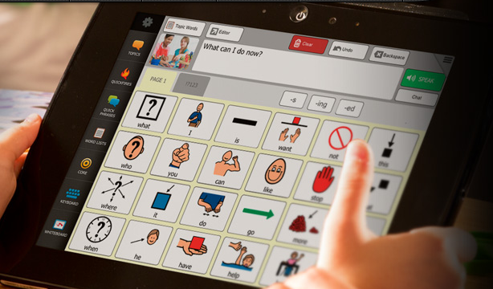
Augmentative and Alternative Communication (AAC) devices
Talk for people
Originally were cardboard
pictures that would point at
Now computerized
Custom devices or tablet applications
  DynaVox (Example in use - video 3:41)
  MinSpeak by Semantic Compaction
    Both Pittsburgh companies!
Usually pictures since faster than typing
Pointing – head or eye tracking or scanning with switch (like keyboards)

Slide 17
Web Accessibility
http://www.w3.org/WAI/intro/accessibility.php
Original web was a real boon to handicapped
  All text, easily navigated, provided access to: “education, employment, government, commerce, health care, recreation, and more”
Then it got more complicated and inaccessible
Standards and requirements emerged to help
Includes:
  Using appropriate html standards, e.g., <h3>, not <b>
  “Alt” labels for pictures
  Easy distinguishing between content and navigation
    Link at top that goes directly to content for screen readers
  Clearly marked links to multi-media content, etc.
  … many more

Slide 18
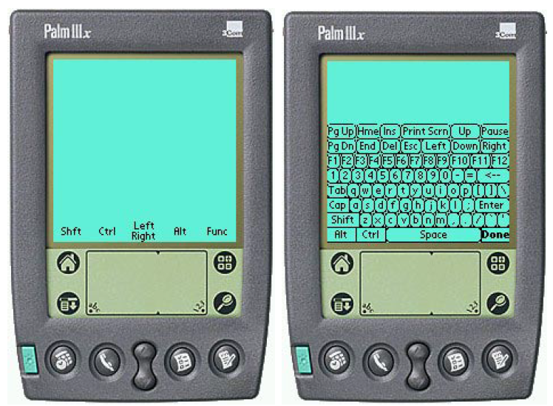
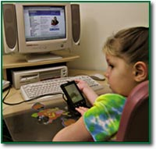
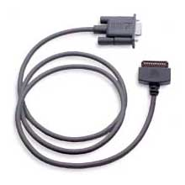
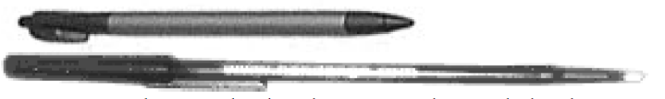
Research: RemoteCommander
Brad A. Myers, Jacob O. Wobbrock, Sunny Yang, Brian Yeung, Jeffrey Nichols, and Robert Miller. "Using Handhelds to Help People with Motor Impairments", Fifth International ACM SIGCAPH Conference on Assistive Technologies; ASSETS 2002. July 8-10, 2002. Edinburgh, Scotland. pp. 89-96. http://www.cs.cmu.edu/~pebbles/papers/pebbleshandicapped.pdf
We were researching using Palm Pilots to augment regular computers
Pebbles Remote Commander allows the Palm to be mouse and keyboard for a PC
  Found by a father of a 10-year old with Muscular Dystrophy (MD) and he wrote a testimonial
Found some long cables & special stylus

Slide 19
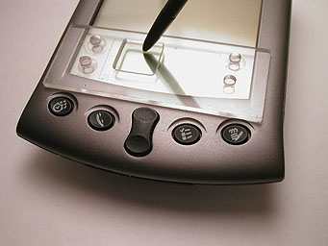
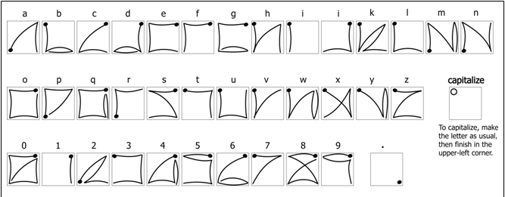
Research EdgeWrite
Let to the EdgeWrite project for text entry
Jacob O. Wobbrock, Brad A. Myers, and John A. Kembel. 2003. EdgeWrite: a stylus-based text entry method designed for high accuracy and stability of motion. In Proceedings of the 16th annual ACM symposium on User interface software and technology (UIST '03). ACM, pp. 61-70. http://dl.acm.org/citation.cfm?doid=964696.964703
See lecture 12

Slide 20
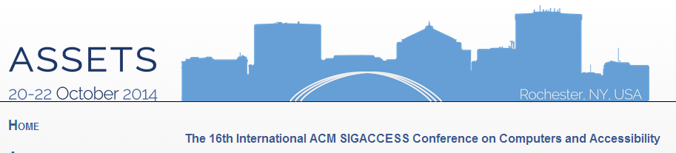
Research
Lots of current work on accessibility
Annual 3-day conference: ASSETS’14
CHI’13: at least 5 papers and 11 posters
UIST’13: at least 2 posters
But not all is about interaction techniques

Slide 21
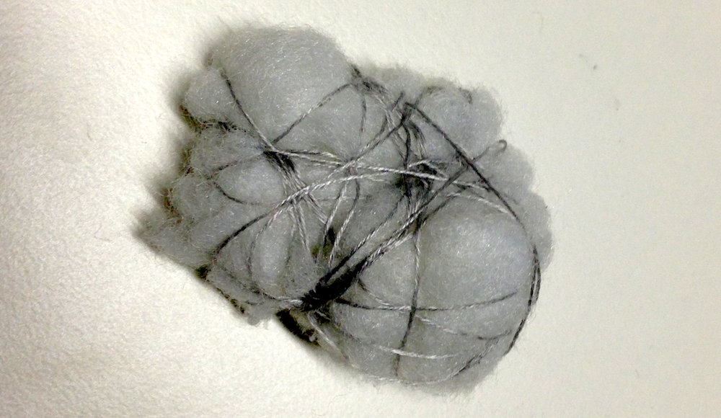
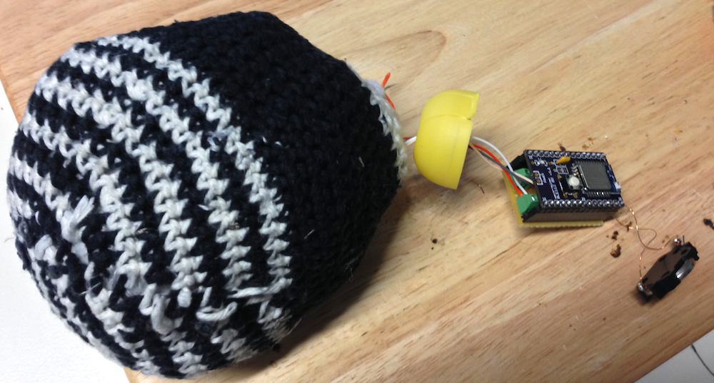
Research Example
Mick Grierson and Chris Kiefer. 2013. NoiseBear: a wireless malleable multiparametric controller for use in assistive technology contexts. In CHI '13 Extended Abstracts on Human Factors in Computing Systems (CHI EA '13). ACM, pp. 2923-2926. http://doi.acm.org/10.1145/2468356.2479575
Needed to be very robust yet very sensitive.

