Slide 1
Lecture 16:
Past to Future: Interactions in 3D, Very Large Displays, and Virtual Reality
Brad Myers
05-899A/05-499A:
Interaction Techniques
Spring, 2014

Slide 2


St. Patrick’s Day
Today!

Slide 3



Mardi Gras
Was March 4

Slide 4
Homework 3
Everyone did well.
Observations:
  Sometimes iPad Minis performed well, otherwise flick gesture was terrible.
  2-finger OSX scroll was in the middle.
  Generally notched mouse wheel was the best.
  Keyboard, as expected, was very accurate but slow. PgDown was remarkably good.
Homework 4 due today

Slide 5
MidTerm Test
Grades
  Average: 82.25

Slide 6
Midterm Test – answers
Q1 & Q2: see lecture 1, slides 18-20; 21
Q11 – could use same one from lecture 11, slide 3
  Or could omit the “hover” state
Q13 – GOMS and Keystroke model were covered in both lecture 11, slides 29-30 and lecture 13, slides 4-15

Slide 7
Final Projects
Start today!
See description on line
Need to figure out groups and project ideas by this Wednesday!
Enter information into Piazza under “project”

Slide 8
Office Hours
Brad Myers: Tuesday 3-4, NSH 3517
  Project ideas
  Midterm grading
Jeff Rzeszotarski, Friday, 1PM to 3PM, NSH 4605 **special time**
  Project ideas
  Homework 3 grading
But project ideas are due by Wednesday at 1:30

Slide 9
Lecture 16:
Past to Future: Interactions in 3D, Very Large Displays, and Virtual Reality

Slide 10
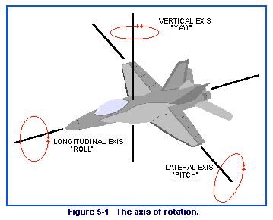
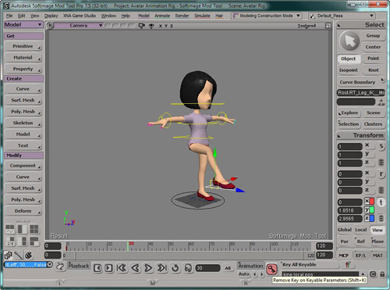
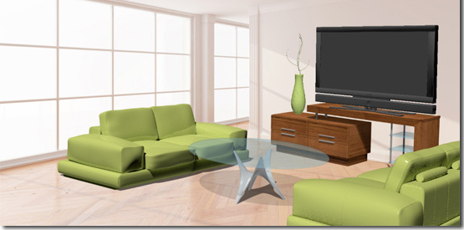
Why is 3D Harder?
Objects have six degrees of freedom (DoF)
  X, Y, Z
  Roll, pitch, yaw
Also camera position
  Occlusion and resolution issues
  Difficulty of orienting oneself
People are not very good at 3D manipulation or reasoning
  Mouse is basically 2D
Generally, dealing with complex, hierarchical objects

Slide 11
Why Hard, cont.
Rick Carey, Tony Fields, Andries van Dam, Dan Venolia. 1994. Why is 3-D interaction so hard and what can we really do about it? (panel). In Proceedings SIGGRAPH '94. ACM, pp. 492-493. http://doi.acm.org/10.1145/192161.192299
3D picking is hard – which object is selected?
  Occlusion, hierarchy, accuracy of pointing device
Designing widgets for 3D manipulation is hard
  Interfere with graphics
  Should they have shadows?
Harder to get interactive speeds for direct manipulation

Slide 12
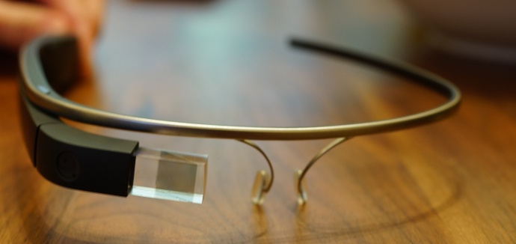
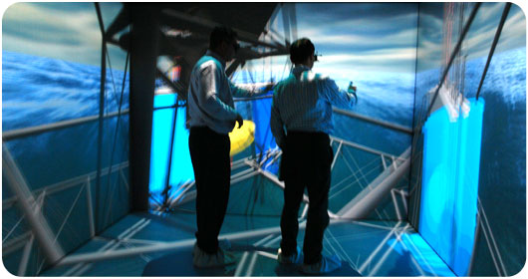
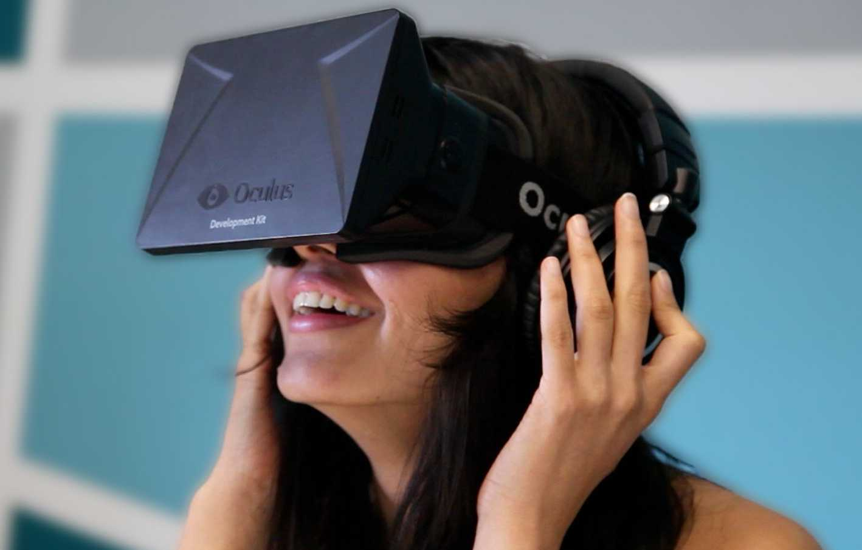
Where 3D displayed?
Desktops – just on a screen in the usual way
3D “Cave” or other large displays (ACM ref)
  Display on 1 or up to all walls and ceiling
Virtual Reality (VR) or Augmented Reality (AR) headsets
  AR – can see through the display, so
  pictures are superimposed on the view

Slide 13
3D Control
Regular Mouse or touch – 2D
  Possibly with extra knobs or buttons
“Mouse in the air” tracked in 3D = “bat”; 6 DoF
  “bat” translates to fledermaus in German
  (mouse that flies through the air)
Fixed camera tracking object in 3D space
Moving the end of an articulated motorized arm
3D physical objects incorporating the above

Slide 14
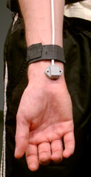
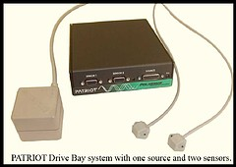
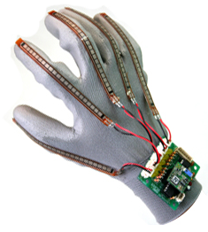
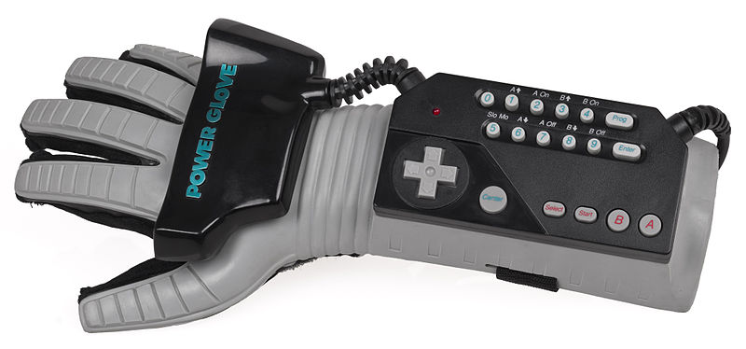
Types of 3D sensors
Earliest: Boxes with sets of knobs
for each dimension
Polhemus trackers (“bat”)
  Starting in 1969
  Magnetic cube on part to be tracked
  and nearby receiver
  6 DOF
  Limited sensing area
  Company still selling similar products
  Often attached to gloves, head-trackers, etc.
DataGlove
  Starting about 1982
  Measured finger bending =
  pose of hand
  Incorporated Polhemus tracker
  on the wrist
Nintendo “PowerGlove” – 1989
  Unsuccessful – only 2 games

Slide 15
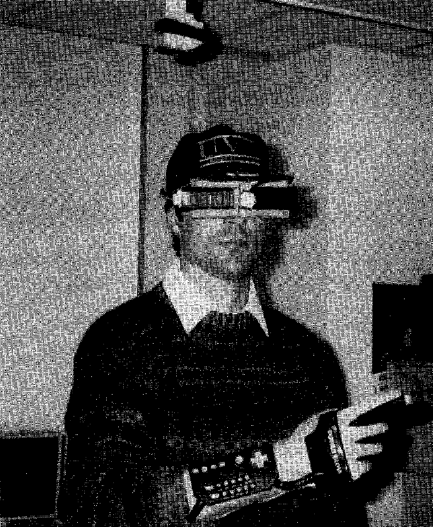
Virtual reality on five dollars a day
Randy Pausch. 1991. Virtual reality on five dollars a day. In Proceedings of the SIGCHI Conference on Human Factors in Computing Systems (CHI '91), ACM, pp. 265-270. http://dl.acm.org/citation.cfm?doid=108844.108913
Combined with inexpensive virtual reality headset

Slide 16
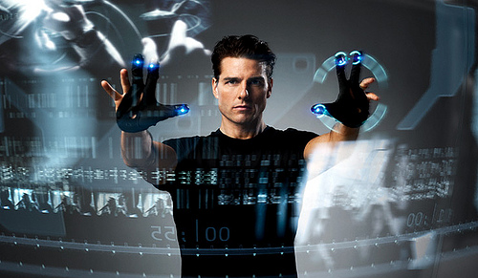
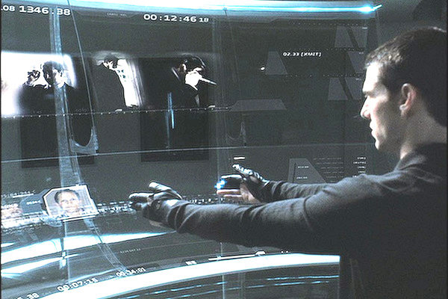
Minority Report, 2002
Using data gloves to interact with large 2-D displays in the air (or on a surface)
MIT Media Lab advised on science (John Underkoffler)

Slide 17
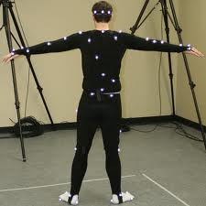
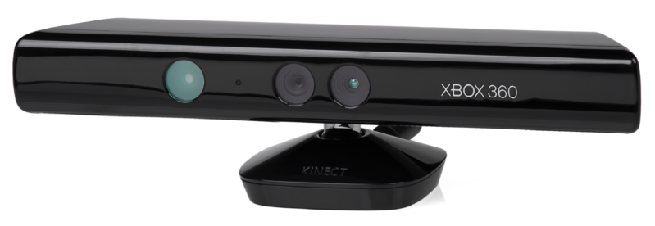
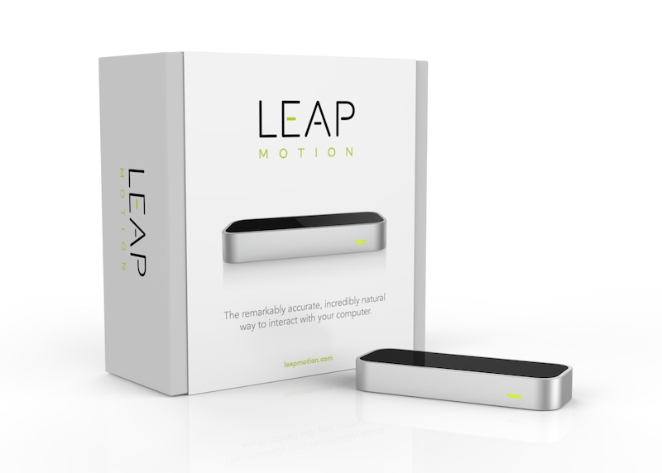
History of 3D sensors, cont.
Lots of motion capture research
and systems
  Motion capture rooms with cameras
  Used for movies, etc.
  (But no interaction techniques)
Kinect
  Introduced 2010
  Two cameras
  Next lecture (w/ game controllers)
Leap Motion
  2013
  Camera based – designed to look
  upwards

Slide 18
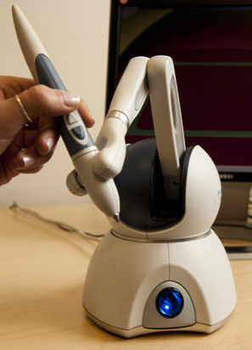
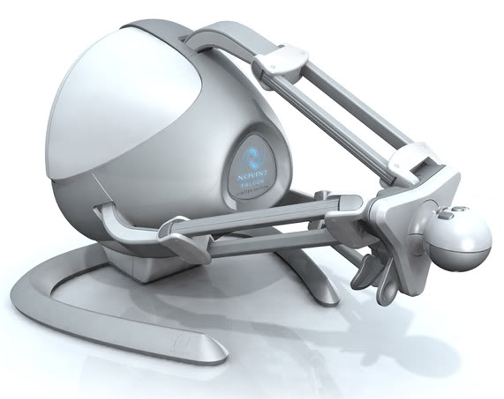
3D “arm” Controllers
Motors to measure 3D movements and provide force feedback
Phantom OMNI from Sensable Technologies
  Medical Applications, etc.
  3D editing and drawing
Falcon from Novint
  Marketed for gaming

Slide 19
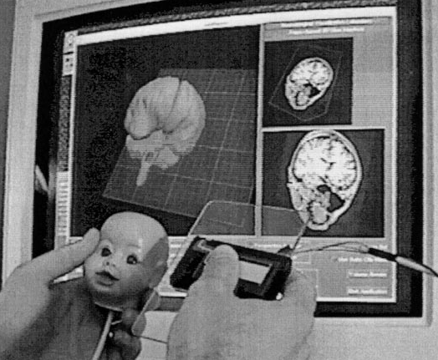
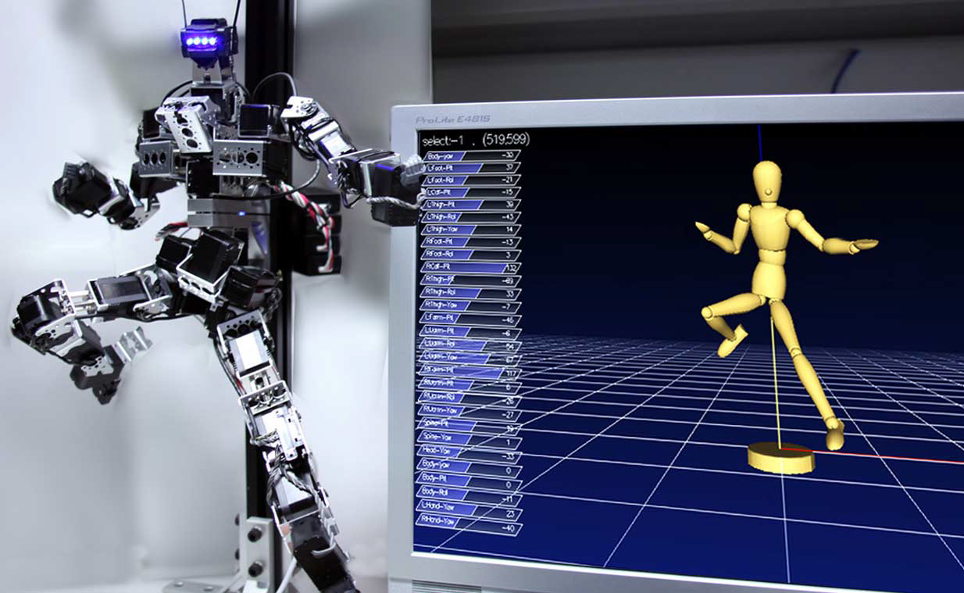
Special-purpose input devices for Manipulation
Head and cutting plane
  Ken Hinckley, Randy Pausch, Dennis Proffitt, and Neal F. Kassell. 1998. Two-handed virtual manipulation. ACM Trans. Comput.-Hum. Interact. 5, 3 (September 1998), 260-302. http://dl.acm.org/citation.cfm?doid=292834.292849
Articulated “marionette”
  Wataru Yoshizaki, et. al. 2011. An actuated physical puppet as an input device for controlling a digital manikin. In Proceedings CHI '11. ACM, pp. 637-646. http://dl.acm.org/citation.cfm?doid=1978942.1979034

Slide 20
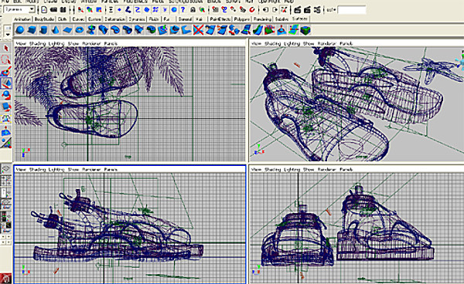
Mouse-Based 3D manipulation
Common 4-panel display
  Mouse works in conventional way in each panel
  Still tricky to manipulate
AutoDesk Maya

Slide 21
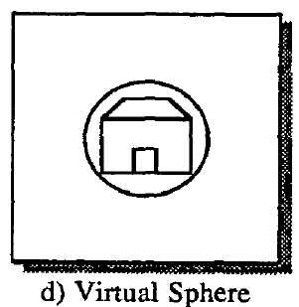
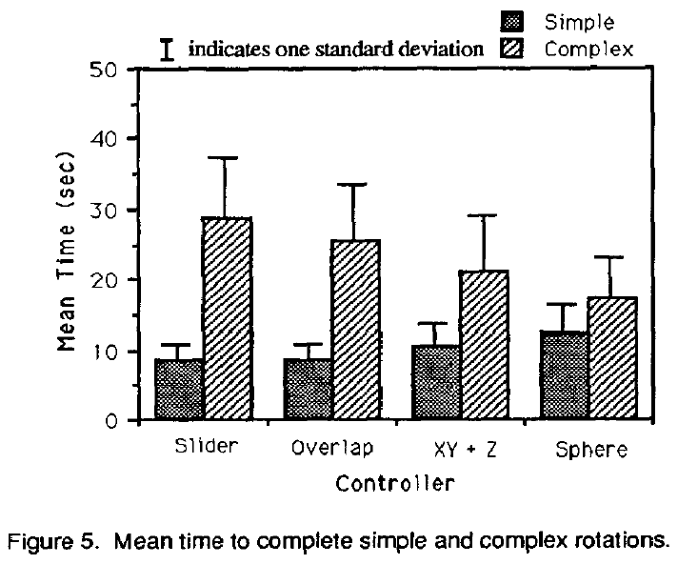
One screen mouse approaches
Michael Chen, S. Joy Mountford, and Abigail Sellen. 1988. A study in interactive 3-D rotation using 2-D control devices. In Proceedings SIGGRAPH '88. ACM pp. 121-129. http://doi.acm.org/10.1145/54852.378497
6D control with 2D mouse
  Sliders for each dimension
  2D areas (2D “sliders”) for each pair of
  dimensions
  Menus – pick axes to
  manipulate first
  Button modifiers – so can
  quickly change
“Virtual Sphere Controller”
for 3D rotation
  Pretend object is in a sphere so
  can rotate around outside

Slide 22

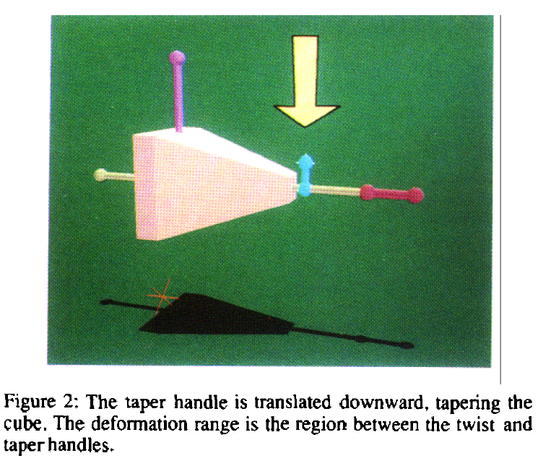
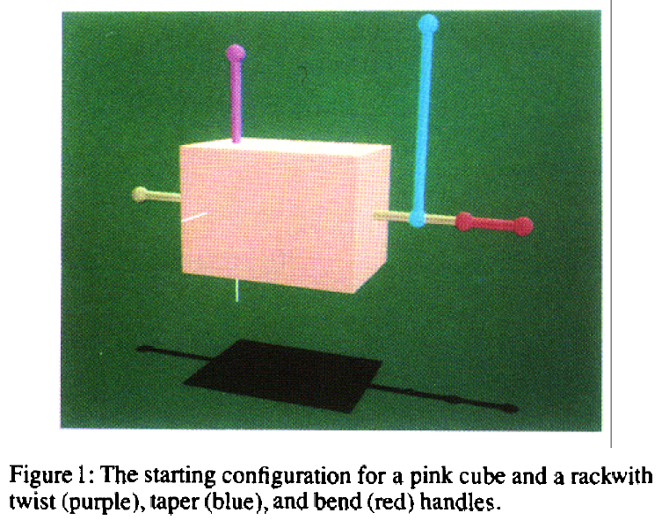
3D Handles
Extend idea of handles on 2D objects to 3D
Need handles for move, stretch, rotate, etc. in each dimension
  Many approaches for doing this. E.g.,
  Scott S. Snibbe, Kenneth P. Herndon, Daniel C. Robbins, D. Brookshire Conner, and Andries van Dam. 1992. Using deformations to explore 3D widget design. In Proceedings SIGGRAPH '92, ACM, pp. 351-352. http://doi.acm.org/10.1145/133994.134091

Slide 23
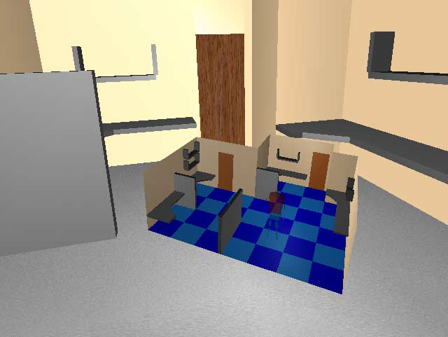
Research: 3D miniatures
Randy Pausch, Tommy Burnette, Dan Brockway, and Michael E. Weiblen. 1995. Navigation and locomotion in virtual worlds via flight into hand-held miniatures. In Proceedings of the 22nd annual conference on Computer graphics and interactive techniques (SIGGRAPH '95), ACM, pp. 399-400. http://dl.acm.org/citation.cfm?doid=218380.218495
Miniature version of the world held in your hand
Can move objects in
miniature version
to edit
Move avatar to
change camera view

Slide 24
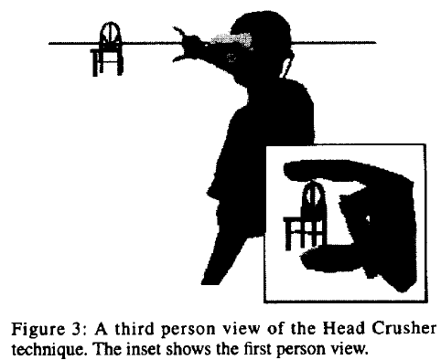
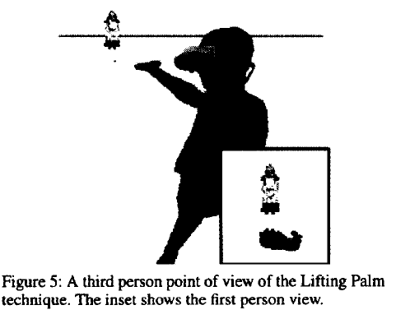
Research: Manipulating Objects
Jeffrey S. Pierce, Andrew S. Forsberg, Matthew J. Conway, Seung Hong, Robert C. Zeleznik, and Mark R. Mine. 1997. Image plane interaction techniques in 3D immersive environments. In Proceedings of the 1997 symposium on Interactive 3D graphics (I3D '97). ACM, 39-ff. http://dl.acm.org/citation.cfm?doid=253284.253303
Head-crusher, lifting palm
Renders hand in the scene, detects pose of hand, detects objects in relation to the pose

Slide 25
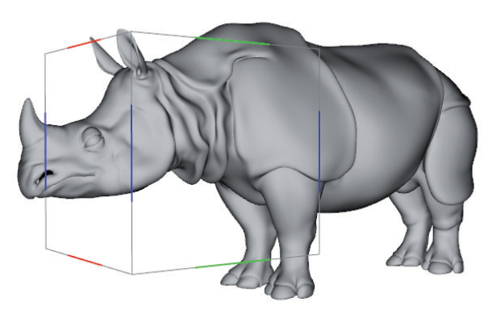
Research: 3D on Touch Screens
Aurélie Cohé, Fabrice Dècle, and Martin Hachet. 2011. tBox: a 3d transformation widget designed for touch-screens. In Proceedings of the SIGCHI Conference on Human Factors in Computing Systems (CHI '11). ACM, pp. 3005-3008. http://dl.acm.org/citation.cfm?doid=1978942.1979387
Surround 3D object with a cube
1 or 2 fingers moving on cube have special meanings
Translate, stretch,
move camera, etc.
Video on ACM site

Slide 26
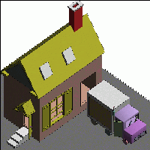
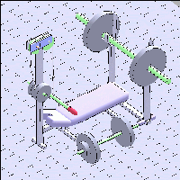
Research: 3D drawing by “Sketching”
Robert C. Zeleznik, Kenneth P. Herndon, and John F. Hughes. 1996. SKETCH: an interface for sketching 3D scenes. In Proceedings of SIGGRAPH '96. ACM, pp.163-170. http://graphics.cs.brown.edu/research/pub/papers/sig96-sketch/sig.html
Only use 1 button to draw (another to move camera)
Constructive Solid Geometry (CSG) = adding and removing pieces of geometric elements
  Cubes, spheres, etc.
Uses heuristics to guess what various drawings mean
Video on
ACM site

Slide 27
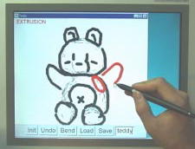
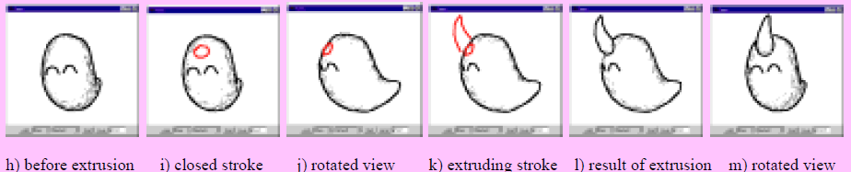
Research: Sketching Soft Objects
Takeo Igarashi, Satoshi Matsuoka, and Hidehiko Tanaka. 1999. Teddy: a sketching interface for 3D freeform design. In Proceedings of SIGGRAPH '99. ACM, pp. 409-416. http://dx.doi.org/10.1145/311535.311602
Smooth sketches turn into
smooth objects
Frequent rotations so can draw
on the image plane
Extrudes or cuts the shape
(YouTube) 5:01min

Slide 28
New Research
Still an active research area. E.g.
  Interactions with Google Glass (web page)
    Gestures on the touch sensor on side
    Head gestures
  From UIST'13:
    Mime: Compact, Low Power 3D Gesture Sensing for Interaction with Head Mounted Displays (ACM DL)
    uTrack: 3D Input Using Two Magnetic Sensors (ACM DL)
    BodyAvatar: Creating Freeform 3D Avatars using First-Person Body Gestures (ACM DL)

