Slide 1
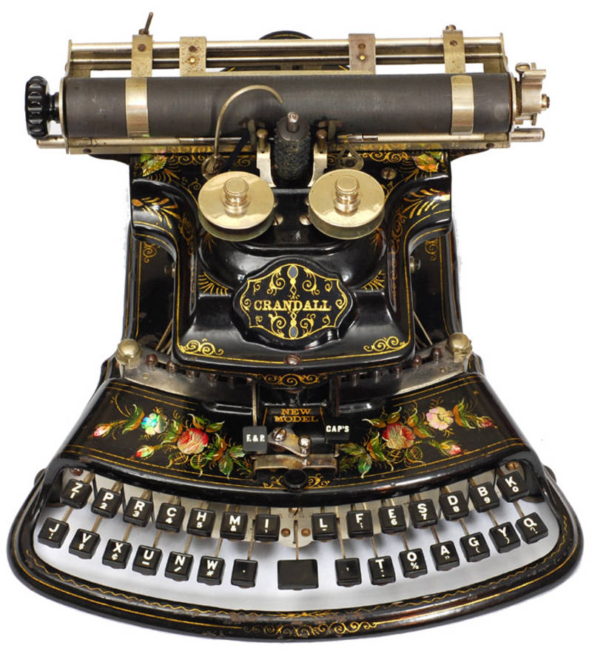
Lecture 12: Past to Future: Text Entry for Computers and Handhelds, and Text Editing
Brad Myers
05-899A/05-499A: Interaction Techniques
Spring, 2014

Slide 2
Overview
Lots of work on text entry
Little on text editing:
“Regular” editing like Macintosh/Microsoft Word, etc.
Moded editing like Bravo, VI/VIM, etc.
Emacs-like control keys (different from control keys in “regular” editing
^V = scroll down by a page instead of paste
Many variants for all operations
E.g., move by character, word, line, sentence, expression, paragraph, block, method, document, …
Elaborate macros and programmability make customization easier for experts

Slide 3
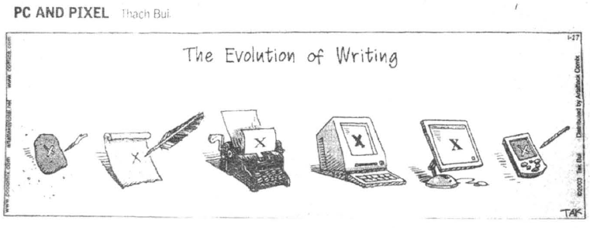
As of 2003

Slide 4
Evaluating Text Entry: Speed
Parameters: speed and errors
Speed: Words-Per-Minute (WPM)
Assumes 5 characters per word, including spaces and punctuation
What are reasonable speeds? -- Wikipedia
Computer users: 40 wpm (fast), 35 wpm (moderate), and 23 wpm (slow).
Hunt-and-peck (2 finger): about 27-37 wpm
Professional typists: 50 to 80 wpm, up to 120 wpm
Fastest, 216 wpm
Court reporters go up to 225 wpm or faster at very high accuracy
Highest recorded = 375 wpm
Handwriting: 22 to 31 wpm
Speech
Audio books: 150 WPM
Auctioneers: about 250 wpm
Fastest talking: 637 wpm
Mobile devices – much slower (see below)
Keystrokes per character (KSPC) – ratio of all chars, including backspaces, to final chars in string -- [MacKenzie 2002]

Slide 5
Evaluating Text Entry: Errors
Based on: Jacob O. Wobbrock and Brad A. Myers. 2006. Analyzing the input stream for character- level errors in unconstrained text entry evaluations. ACM Trans. Comput.-Hum. Interact. 13, 4 (Dec. 2006), 458-489. http://dl.acm.org/citation.cfm?id=1188819
Uncorrected errors
Errors that are left in the final document
Most WPM measurements list these errors
Usually quite low (2.23%, 0.79%, 0.36%, 0.53%, … in various studies)
Corrected errors
User notices an error and fixes it, usually with <backspace>, but possibly with arrow keys, etc.
Counts as part of the WPM calculation
An error-prone entry method ends up being slower
Only a few measurement tests report these errors separately
But user may intentionally backspace over correct chars to get at an earlier incorrect character
Also non-recognitions, or no-entries – e.g., miss keyboard when tap, or gesture not recognized
May be interested in which character is most error prone to enter
Need to know about incorrect characters entered

Slide 6



Wobbrock and Myers analysis algorithm [2006]
More accurately measure the errors in text entry
Based on the input stream – what actually entered.
Measures “distance” between target and input stream
Separates errors into incorrect:
Insertions – characters incorrectly in input stream
Omissions – characters missing
Substitutions – wrong characters
Can be corrected or not corrected
Also, corrected not errors – happens a lot in touch typing
Algorithm calculates all these
Assumes <backspace> is reliable
Also confusion matrix
How often generate one character when mean another

Slide 7
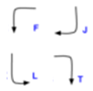
General Issues with Recognizers
If using character or handwriting recognition
Accuracy of recognition
Depends on how unique each stroke is
How accurate user draws them
How well the machine’s recognizer works
But also whether user remembers the right stroke to draw
Example: Palm Pilot Graffiti strokes:

Slide 8
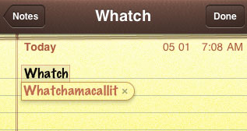
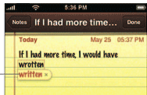
General Issues with Text Entry
Auto-prediction
System guesses what you might be typing so you don’t have to type the rest
Auto-correction
System helps you fix errors automatically
Sometimes combined

Slide 9
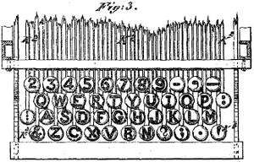
Mechanical Typewriters
First commercially successful typewriter by Christopher Latham Sholes, Carlos Glidden & others in about 1868.
Patent sold to Remington, which produced it
Used the QWERTY layout of keys to reduce likelihood of keys hitting each other & jamming
Also the name “Type Writer”
-- Wikipedia
Lots of small variants for foreign keyboards

Slide 10
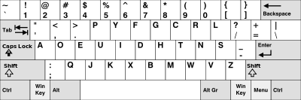
Many other key layouts
Most famous: Dvorak Simplified Keyboard
1936 by Dr. August Dvorak
Goal: increase typing speed
Based on letter frequencies and the physiology of people's hands
Is an ANSI standard

Slide 11
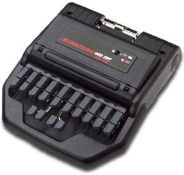
Stenotype Machine
Chord keyboard, used by court reporters
Speeds of at least 180, 200, and 225 wpm
World record: 375 wpm
Dates back to 1830’s; general use after 1880s – Wikipedia
Name from about 1913
Still in use, but now connected to a computer instead of a paper tape
Chords represent phonetics (sound) of whole syllables, not the actual spellings
“Cat” typed as a single press of initial K, the vowel A, and the final T

Slide 12
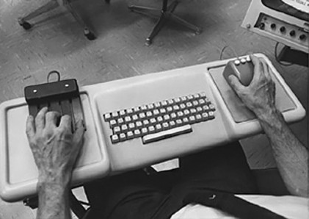
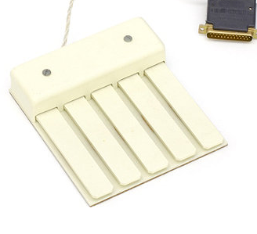
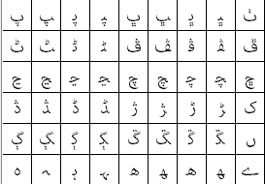
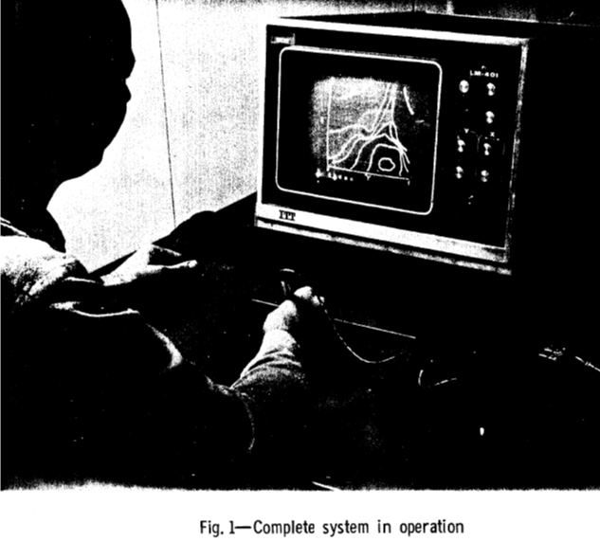
Alternate Text Entry for “Regular” Computers
Not much
Englebart’s chord keyset
1968
2^5 -1 = 31 values
On-screen keyboards, mostly for handicapped people (see lecture 18)
Also, non-English characters
Handwriting or printing recognition on Rand tablet (1964)

Slide 13
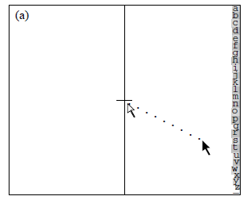
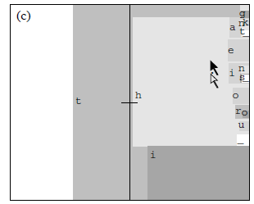
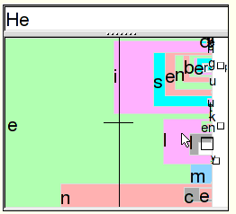
Dasher
David J. Ward, Alan F. Blackwell, and David J. C. MacKay. 2000. Dasher—a data entry interface using continuous gestures and language models. in Proc. of UIST '00. ACM. pp. 129-137. http://dl.acm.org/citation.cfm?id=354427
Move cursor to desired letter: y axis
Size of letter area depends on likelihood
Letters move faster or slower based on x axis position
Works across many devices:
PC, handheld, eye tracker
Significant mental strain
“overwhelming because it is in constant visual flux”
Video (local copy)

Slide 14
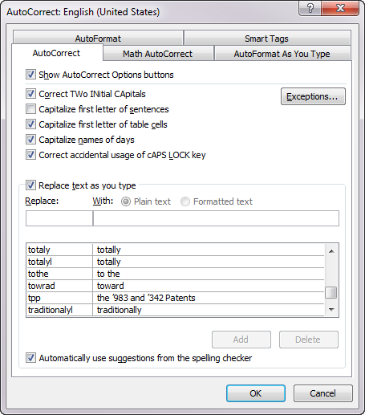
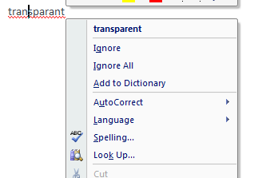
Auto Correct for Regular Computers
Microsoft Word introduced two kinds of corrections
Immediate changes based on a large list of replacements
“Red squiggle underlines” introduced with Word 95 based on a dictionary
Right click to get replacement list
Word will auto-replace when just one option
Both are entered into Undo stack so can be undone

Slide 15
Most research has been on text entry for portable devices
Goals
Reach typing speeds (~40 wpm)
While still reasonably accurate
Often, require little learning time
But how much typing is needed?
SMS = short message service = “texting”
Versus writing a book or coding a program
Entering an address or appointment correctly
How much accuracy is needed?

Slide 16
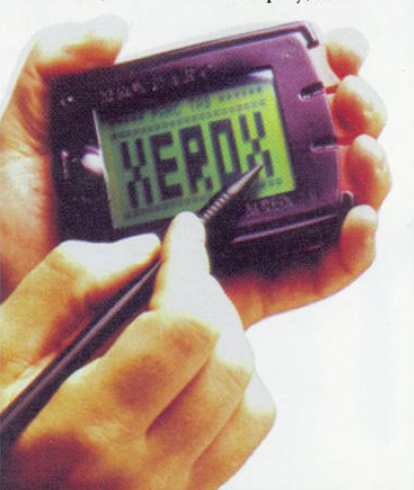
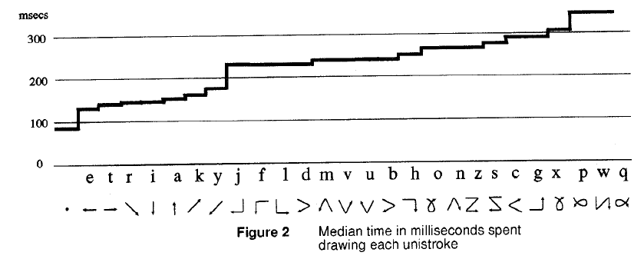
PARC Tab
David Goldberg and Cate Richardson. “Touch Typing with a Stylus,” Human Factors in Computing Systems, Proceedings INTERCHI'93. Amsterdam, Netherlands, Apr, 1993. pp. 80-87.
~1989
Quick writing – unistrokes, write on top of each other
Simple strokes, designed to be easy to recognize and quick to draw
But not necessarily easy to remember
Patent successfully asserted against Palm Graffiti

Slide 17
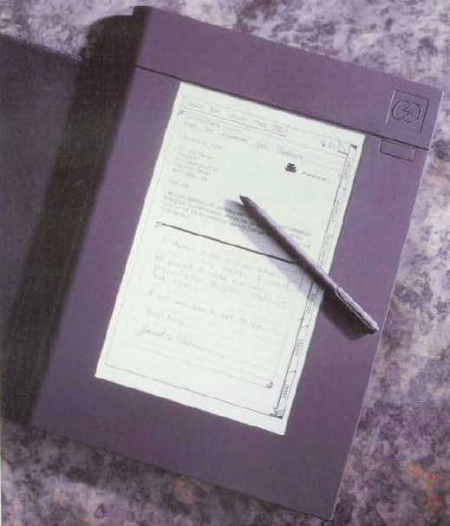
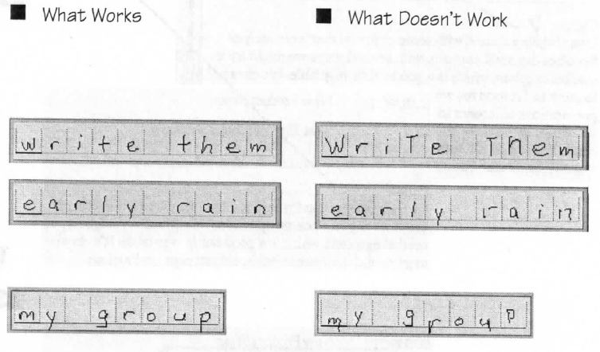
Go Corp’s “PenPoint” OS
Founded 1987, released in 1991
Hand printing for text entry
Have to write carefully into the boxes
User’s guide

Slide 18
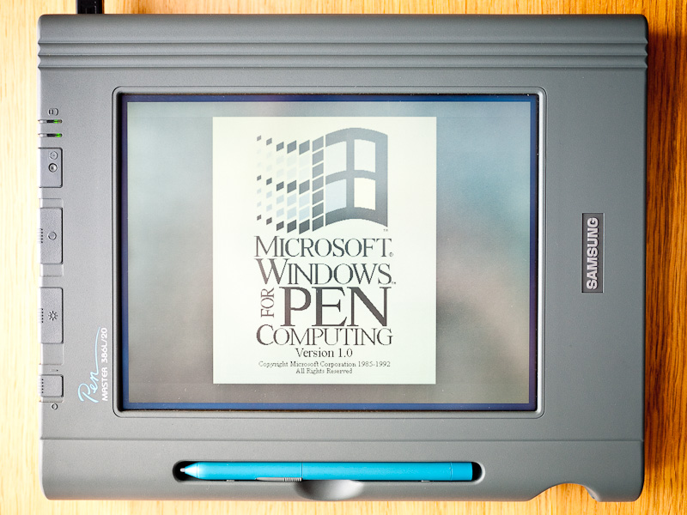
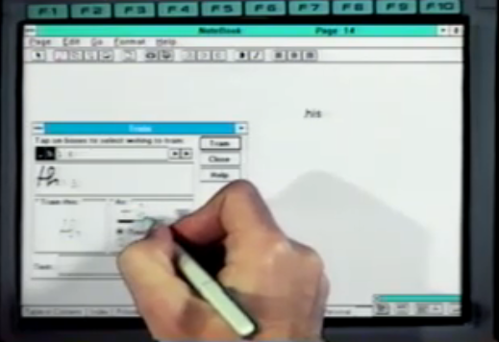
Microsoft Pen Windows
From: 1991
Version of Windows 3.1 for pen computing
Added handwriting recognition
Versions for Windows NT, Windows 95, etc.
Images: http://retrocosm.net/2012/01/, http://www.betaarchive.com/imageupload/1298947809.or.94950.png

Slide 19
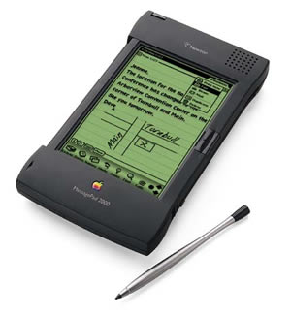
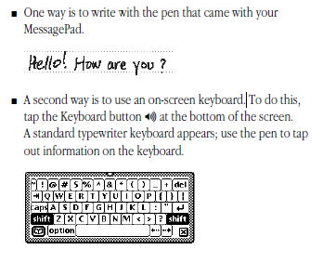
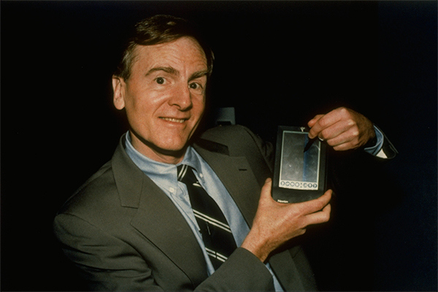
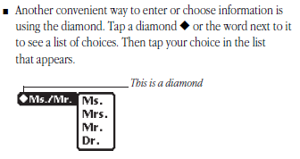
Apple Newton
Started 1987, released 1993
Newton “MessagePad”
Coined term “Personal Digital Assistant (PDA)
Handwriting recognition was main input technique
Also soft keyboard or auto-complete
User Manual
John Sculley III

Slide 20
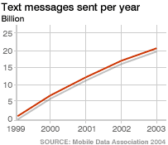
Why Text Entry for Phones
Originally: Phone Short Message Service (SMS) (“text messaging” or “texting” started about 1994 in Scandinavia (Sweden, Finland)
Popularized by Japan NTT Docomo's i-mode (1999)
Slow rise in popularity in US
WWW access
WAP – starting 1997
Wireless Application Protocol
Bring web-like access to these devices
Terrible usability
Nielsen study
In UK, ref

Slide 21
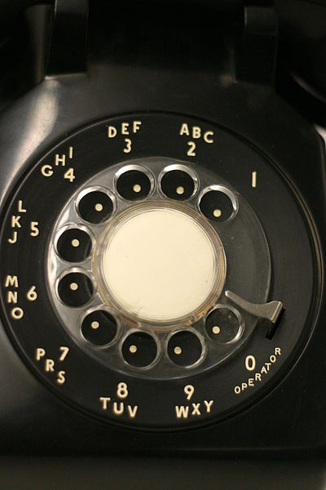
Digression
Approximately 1919
Note the letters
For “exchanges”
268-
http://en.wikipedia.org/wiki/File:Rotarydial.JPG

Slide 22
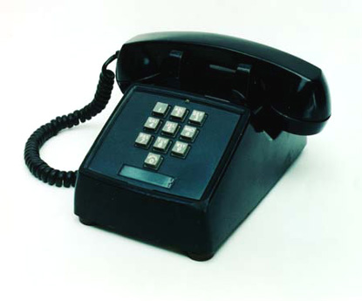
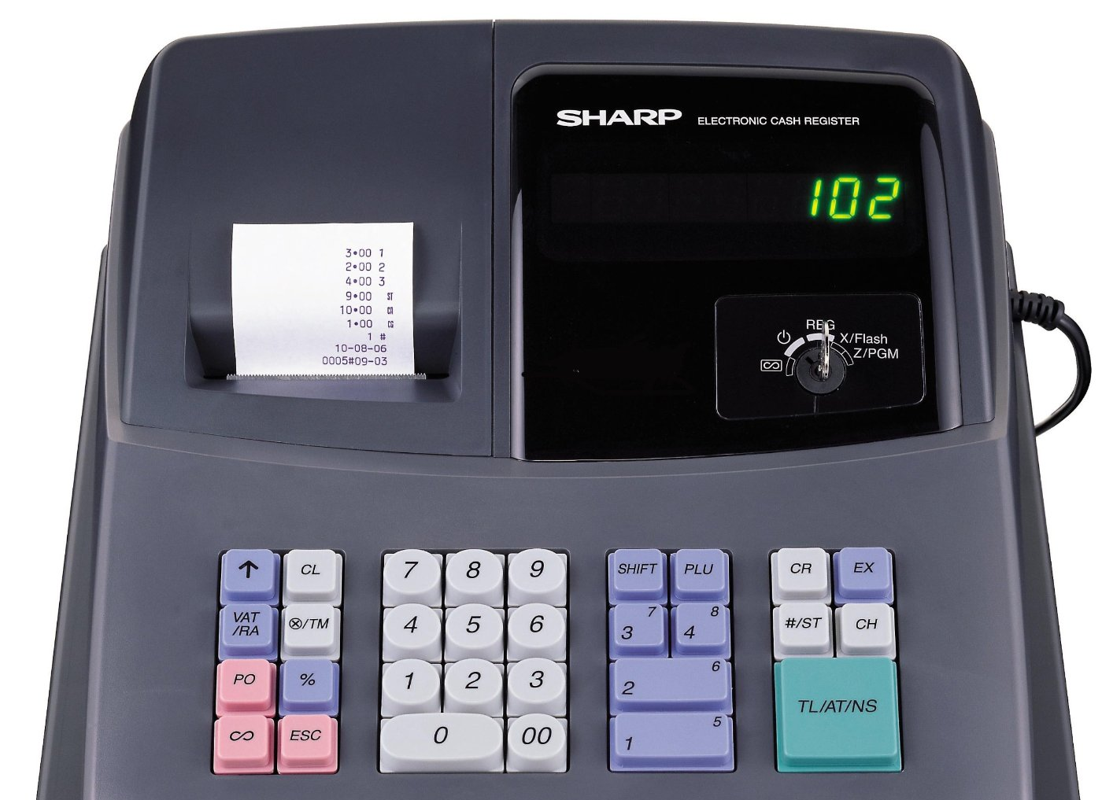
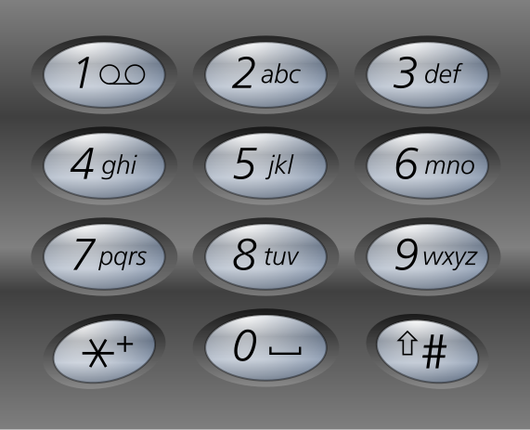
Keypads for phones
1963
Dial much faster
Letters the same as on the dial phone
Numbers are opposite order from cash registers & numberpads
Due to human factors research at Bell Labs
Same speed, but preferred
-- Wikipedia
Retained for mobile phones

Slide 23
“Multi-Tap”
Text entry using that keypad
2 = “A”, 22 = “B”, 222=“C”
“BET” = 22338
But for “CAB” – 222(wait)2(wait)22
Layout was not optimized for letter frequencies
Keystrokes per character (KSPC) for Multi-tap is 2.03 -- (MacKenzie 2002b)
Measured at 10 to 12 WPM, up to 21.0 wpm for experts – ref

Slide 24
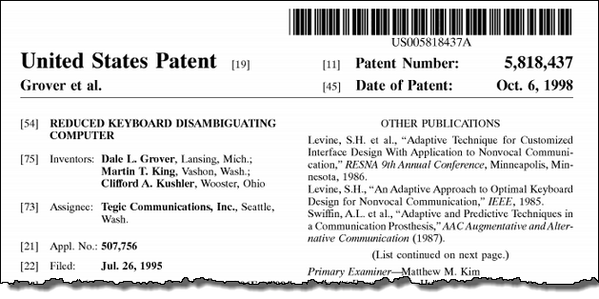
“T9”
From Tegic, now part of Nuance
Patented: filed in 1995, issued 1998
Predictive text entry for phone keypad
Just hit each key once
Uses a language model to disambiguate
Shows its best guess as you type video
Use * key to get to other options
Automatically adaptive so learns what you type most
Also “smart punctuation”
Measured at 15 wpm (novices) up to 40 wpm (vs. 10 up to 20 for multi-tap)
1.0072 KSPC

Slide 25
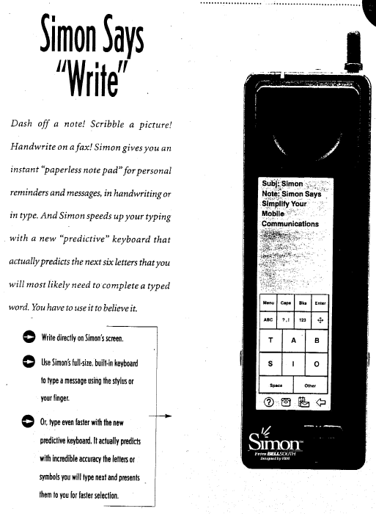
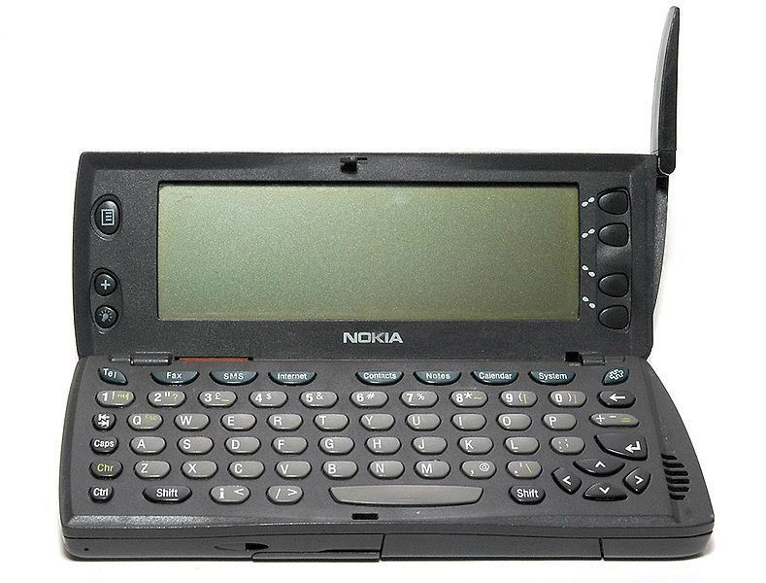
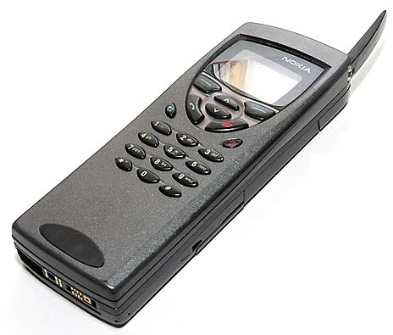
Early phone + PDAs
IBM Simon
Shipped in 1994 by BellSouth
Hand printing, on-screen keyboard with predictive text
Nokia 9110 Communicator
1996
Added full physical keyboard
Slow

Slide 26
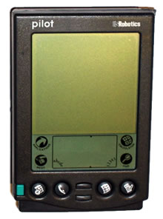
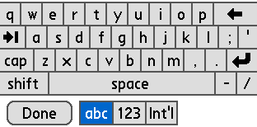
Palm
Founded by Jeff Hawkins who did GridPad
First released version: 1996 = “Pilot”
Graffiti or on-screen keyboard for data entry

Slide 27
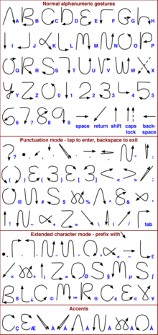
Palm Graffiti
Designed to be easier to learn
Most look like the letter
Still requires practice
Two sides – numbers look the same as some letters
Novices were faster with the keyboard (7 vs. 16 WPM), but experts were faster with Graffiti (21 vs. 18 WPM) -- [Fleetwood, 2002]

Slide 28
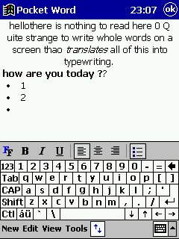
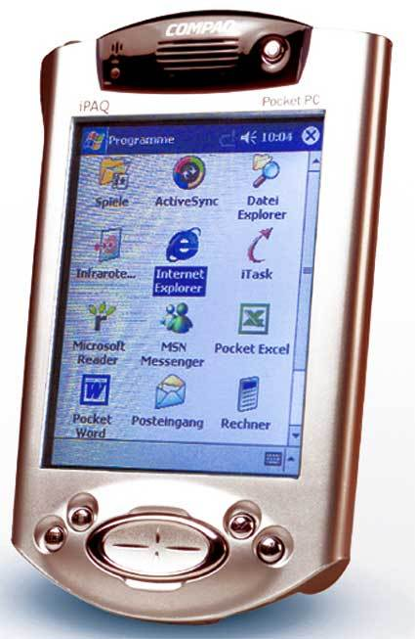
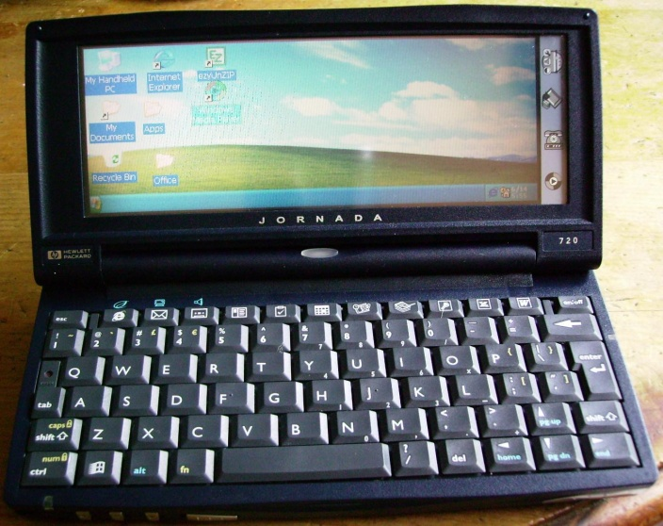
Windows CE
CE 1.0 released in 1996 (same year as 1st PalmPilot)
Many names: Windows Compact Edition (WinCE), Windows Palm PC, Windows Pocket PC (PPC), Windows Handheld PC (HPC), Windows Mobile
HPC for landscape devices with a keyboard, PPC for portrait
Compaq iPaq became very popular (2000)
Graffiti equivalent = “Jot”

Slide 29
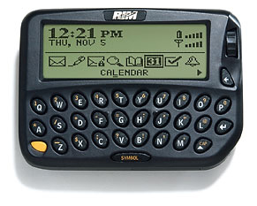
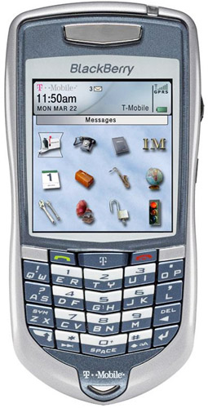
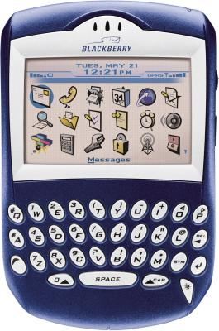
RIM Blackberry
Starting 1999
Research in Motion (RIM)
Two-thumb keyboard
Patents on having keys at angles
Later, 2 characters on keys with the 7100 line in 2004
Two-thumb typing speeds are 30–35 WPM and reach 60 WPM after 20 twenty-minute sessions. -- [Clarkson 2005]

Slide 30
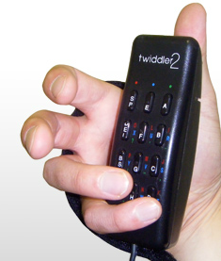
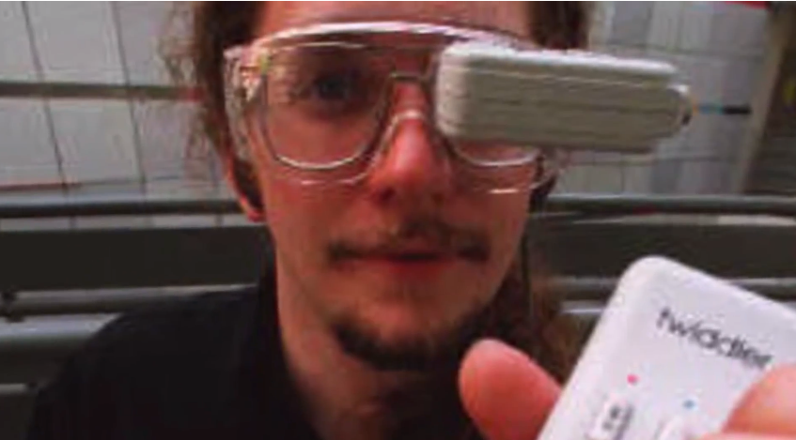
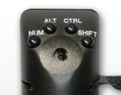
Twiddler
http://www.handykey.com/ ($200)
Twiddler one-handled chorded text entry device
Introduced in 1990’s, 16 keys
Also mousing device
Thad Starner reports he gets 60 wpm
Novices are at 10 wpm with a “weekend's worth of practice”

Slide 31
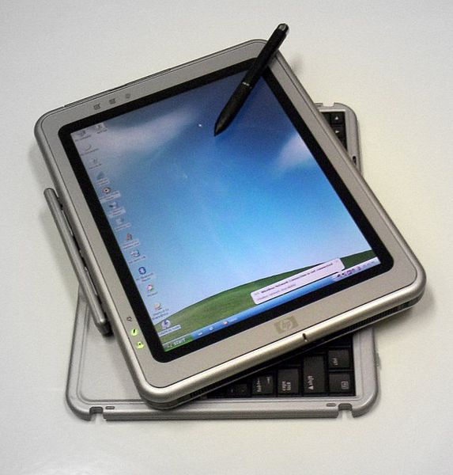
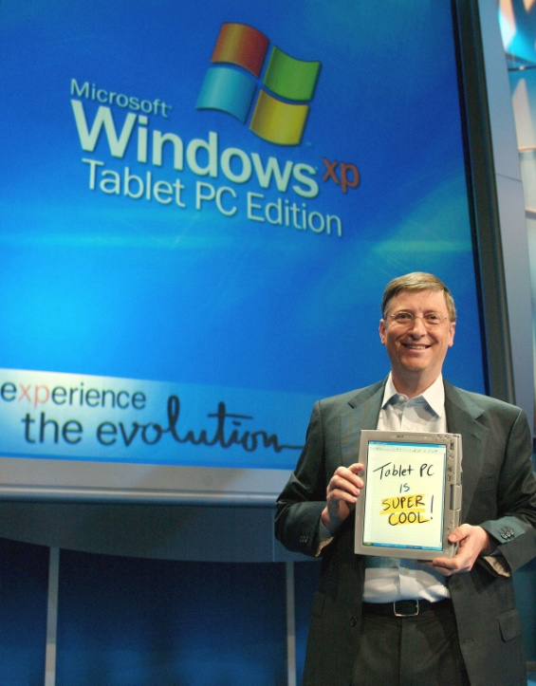

Windows TabletPC
2001 spec (Windows XP), first devices in 2002
Handwriting recognition was much better, but still not sufficiently accurate
Quite poor UIs for correction

Slide 32



iPhone
Starting 2007
Capacitive screen (multi-touch)
No stylus
On screen keyboard
Shows letter in a popup since covered with finger
Some letters popup alternatives if press and hold
Size of letter target areas adjusted based on language model
So easier to hit most likely target
First (?) to have predictive and corrected text used by default
http://www.damnyouautocorrect.com/
Up to around 88 wpm using two thumbs

Slide 33


Optimized soft keyboard layouts
Try to find a better layout for the keys
Would be faster than QWERTY with practice for “stylus tapping”
Example: “OPTI” layout
I. Scott MacKenzie and Shawn X. Zhang. 1999. The design and evaluation of a high-performance soft keyboard. In Proceedings of the SIGCHI conference on Human Factors in Computing Systems (CHI '99). ACM, pp. 25-31. http://dl.acm.org/citation.cfm?doid=302979.302983
Multiple space bars, common words like “the” next to each other
Trial-and-error layouts evaluated with a “Fitts-law”-like mathematical model
Modeled 35% faster
Measured nearly 45 wpm by the 20th session compared to QWERTY at 40 wpm

Slide 34

Optimized soft keyboard, 2
Metropolis keyboard
Shumin Zhai, Michael Hunter, and Barton A. Smith. 2000. The metropolis keyboard - an exploration of quantitative techniques for virtual keyboard design. In Proceedings of the 13th annual ACM symposium on User interface software and technology (UIST '00). ACM, pp. 119-128. http://dl.acm.org/citation.cfm?doid=354401.354424
Layout computed by optimization algorithm
Based on how often one key is typed after another in an English text corpus
Keys are hexagons to minimize distance
43.1 wpm performance (from model)
Many other layouts in the literature and commercially

Slide 35



Shumin Zhai’s ShapeWriter
IBM project starting in 1999 called “Shark”
First published CHI’2003: Shumin Zhai and Per-Ola Kristensson. 2003. Shorthand writing on stylus keyboard. In Proceedings of the SIGCHI Conference on Human Factors in Computing Systems (CHI '03). ACM, pp. 97-104. http://dl.acm.org/citation.cfm?doid=642611.642630
Originally over an optimized keyboard
Recognized using a handwriting recognition algorithm using only shape
UIST’04: Per-Ola Kristensson and Shumin Zhai. 2004. SHARK²: a large vocabulary shorthand writing system for pen-based computers. In Proceedings of the 17th annual ACM symposium on User interface software and technology (UIST '04). ACM, pp. 43-52. http://dl.acm.org/citation.cfm?doid=1029632.1029640
Extended to large vocabulary and QWERTY keyboards, using shape and location
Measured at 50 – 80 WPM video
Commercialized as a startup called “ShapeWriter”
Separately developed by “Swype” – lawsuits
Both purchased by Nuance (2010, 2011)

Slide 36

Research: Cirrin
Jennifer Mankoff and Gregory D. Abowd. 1998. Cirrin: a word-level unistroke keyboard for pen input. In Proceedings of the 11th annual ACM symposium on User interface software and technology (UIST '98). ACM, pp. 213-214. http://dl.acm.org/citation.cfm?doid=288392.288611
Word level unistrokes around a circle
Crossing letters to enter them
Alphabetic or optimized layout
Less pain from RSI using this vs. regular keyboard
Got to about 20 WPM

Slide 37



Research: EdgeWrite
Jacob O. Wobbrock, Brad A. Myers, and John A. Kembel. 2003. EdgeWrite: a stylus-based text entry method designed for high accuracy and stability of motion. In Proceedings of the 16th annual ACM symposium on User interface software and technology (UIST '03). ACM, pp. 61-70. http://dl.acm.org/citation.cfm?doid=964696.964703
Goal: help people with physical disabilities use a Palm Pilot
Neither on-screen keyboard nor gestures worked
1st try: edges of the screen
Too slow and hard to find characters
So created our own edges with a plastic overlay
Invented our own unistroke alphabet
All letters entered by hitting corners
Capital by ending in upper left corner
Designed to be easy to learn
Created using user-specified procedure
Multiple options for some letters

Slide 38



EdgeWrite, cont.
Jacob O. Wobbrock, Brad A. Myers, and Duen Horng Chau. 2006. In-stroke word completion. InProceedings of the 19th annual ACM symposium on User interface software and technology(UIST '06). ACM, pp. 333-336. http://dl.acm.org/citation.cfm?doid=1166253.1166305
Add words to corners after one or more letters
Surprising coverage with just 4 completions
Re-enter the same corner or draw “pigtail” to trigger word mode
12.09 (reg) vs. 8.22 wpm (words) for handicapped user
Wobbrock’s speed 24.0 WPM (reg) vs. 63.3 WPM (word)

Slide 39


EdgeWrite, cont.
Also worked on a variety of other input devices
Joysticks, trackballs, game controllers, steering wheels, etc.
Even back of phone
As if seeing through device
8.87 WPM

Slide 40


Many Other Research & Commercial Systems
At least 5 at CHI’13
Stephen Oney, Chris Harrison, Amy Ogan, and Jason Wiese. 2013. ZoomBoard: a diminutive qwerty soft keyboard using iterative zooming for ultra-small devices. In Proceedings of the SIGCHI Conference on Human Factors in Computing Systems (CHI '13). ACM, pp. 2799-2802. http://dl.acm.org/citation.cfm?id=2481387
Tap multiple times (3) to get keys of a reasonable size
9.3 WPM
Antti Oulasvirta, Anna Reichel, Wenbin Li, Yan Zhang, Myroslav Bachynskyi, Keith Vertanen, and Per Ola Kristensson. 2013. Improving two-thumb text entry on touchscreen devices. InProceedings of the SIGCHI Conference on Human Factors in Computing Systems (CHI '13). ACM, pp. 2765-2774. http://dl.acm.org/citation.cfm?id=2481383
Optimize the layout for 2 thumbs
37 WPM

