Slide 1
Lecture 11: Formal Models and Design Spaces for Interaction Techniques
Brad Myers
05-899A/05-499A: Interaction Techniques
Spring, 2014

Slide 2
Why Models?
Help understand the space of possible interaction techniques
May identify opportunities for new ones
Provide a precise description of how interaction techniques work
May identify missing parts of design
Help evaluate performance and other aspects of interaction techniques
E.g., Keystroke Model and GOMS

Slide 3

Transition Diagrams
Set of states and set of arcs
States represent modes of the interaction
Arcs go from state to state based on an event
Mouse button released
Do action
Mouse over
Start
hover
selected
Mouse button pressed
Mouse away
Mouse away
Mouse over
Pressed but outside
Mouse button released

Slide 4
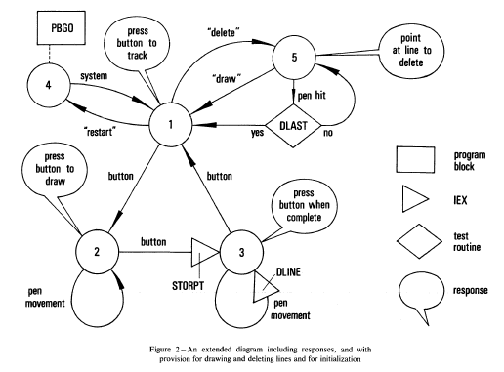
Transition Diagrams, cont
Probably the earliest model of user interfaces
William Newman's "Reaction Handler" in 1968 http://doi.acm.org/10.1145/1468075.1468083

Slide 5
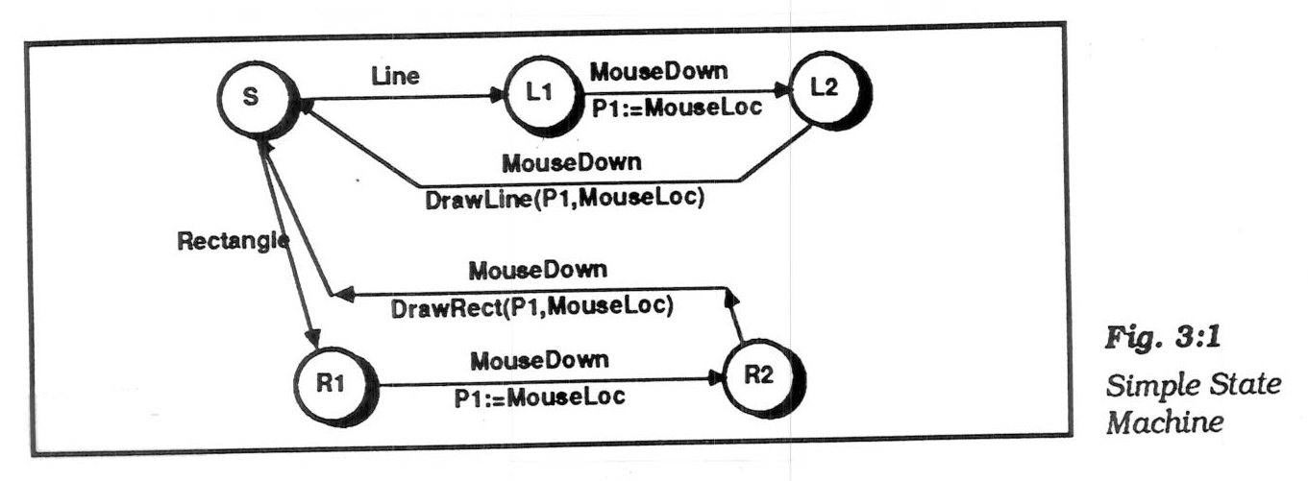
Transition Diagrams, cont.
Simplest form, arcs are user input events.
arcs can be extended by listing feedback (output) and semantic actions on the arcs
actions usually written in a conventional language (e.g. Java)
picture, Olsen text, p. 37 (Fig 3:1) Olsen Jr., D.R., User Interface Management Systems: Models and Algorithms. 1992, San Mateo, CA: Morgan Kaufmann.

Slide 6
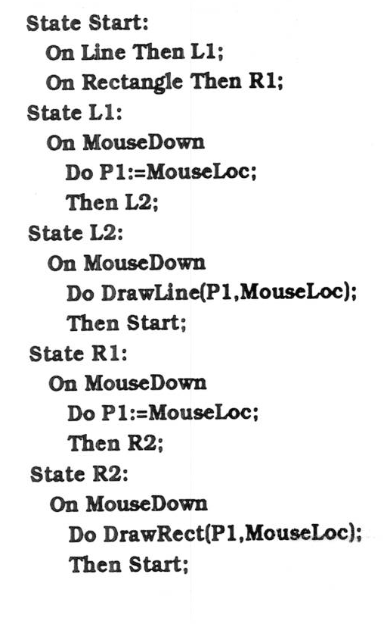
Transition Diagrams, cont.
Often, represented textually:
picture, Olsen p. 38

Slide 7
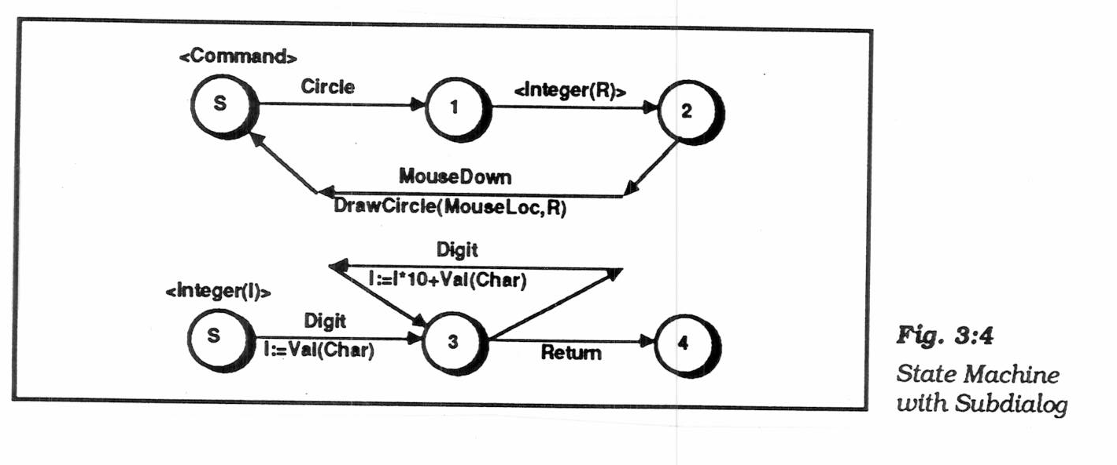
Transition Diagrams, cont.
Sub-diagrams
To help modularize and simplify large networks
if call themselves, then "recursive transition network"
Picture Olsen, p. 41 (Fig 3:4)
Problem: when to enter and leave the sub-dialog:
don't want to use up a token

Slide 8
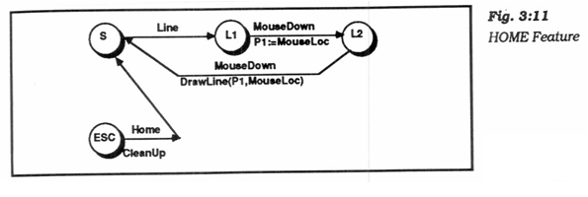
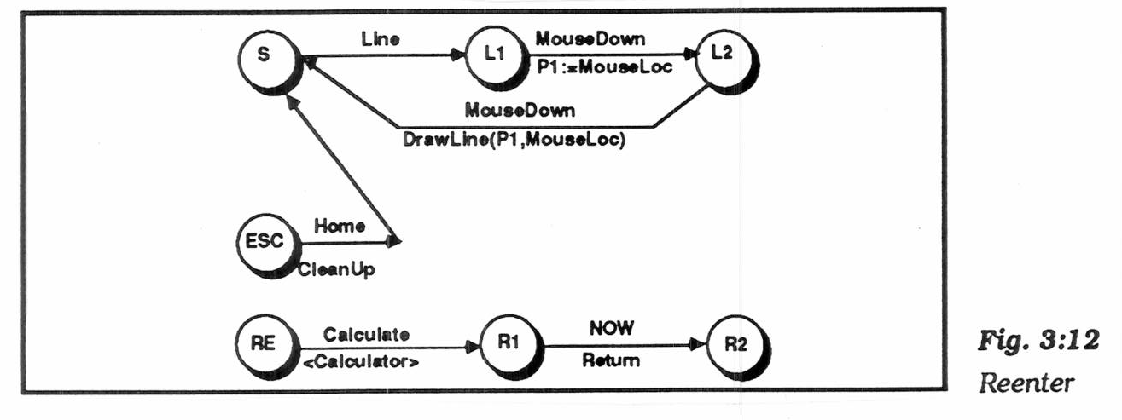
Transition Diagrams, cont.
"Pervasive states" to handle help, abort, undo, etc.
"Escape" transitions to abort (permanently leave) a dialog
picture, Olsen p. 53 (Fig 3:11)
"Re-enter" sub-dialogs for temporary excursions that return to same place. E.g., help, use calculator, etc.
picture, Olsen p. 55 (Fig 3:12)
Transitions are taken if no specific arcs from node

Slide 9
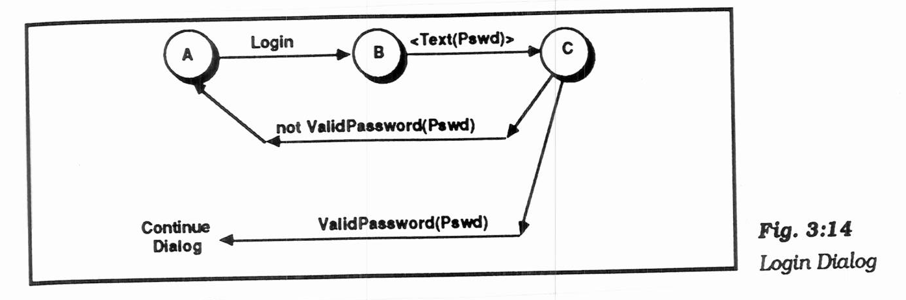
Transition Diagrams, cont.
"Augmented transition networks"
local variables
function on arcs can determine transitions
"guards" determine whether transition is legal
"conditional transitions" calculate where to go
picture, Olsen p. 57 (Fig 3:14)
upgrades the power to context-free-grammar

Slide 10
Transition Diagrams, evaluation
Good
Make explicit the interpretation of all events in each state
Emphasize the temporal sequence of user and system actions
Natural and easily understood if small
easy to teach, learn, and read
Appropriate for some parts of GUIs: widget behaviors, dialog box transitions, etc.
May be appropriate to model transitions around web sites

Slide 11
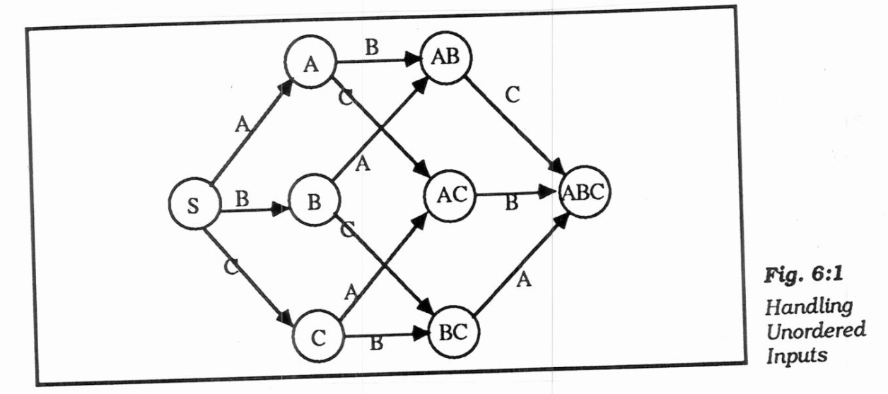
Transition Diagrams, evaluation
Bad
Does not scale: 150 commands with 3 or 4 states each
explosion of lines and states for normal interfaces: "maze of wires"
unordered inputs
picture, Olsen p. 91 (Fig 6:1)
Doesn't handle GUI mode-free style well
What to do with un-specified input? crash, ignore input
Doesn't address output

Slide 12
Foley & Wallace, 1974
James D. Foley, Victor L. Wallace and Peggy Chan. “The Human Factors of Computer Graphics Interaction Techniques,” IEEE Computer Graphics and Applications. Nov, 1984. 4(11). pp. 13-48. http://ieeexplore.ieee.org/xpl/articleDetails.jsp?tp=&arnumber=6429355
“Virtual devices”
Pick – identify user-defined objects
Button – identify system-defined objects (menus)
Locator – identify location and/or orientation in drawing space
Valuator – indicate a single real number value
Also talked about: Lexical, Syntactic, and Semantic levels
Lexical & syntactic are the level of interaction techniques

Slide 13
Pragmatic Lexical Syntactic Semantic Conceptual
William Buxton, "Lexical and Pragmatic Considerations of Input Structures," Computer Graphics, January, 1983, (17)1, pp. 31-37. http://dl.acm.org/citation.cfm?id=988586 or local html.
Derived from compiler theory and language work.
Added 2 more levels to the ones in Foley & Wallace
Pragmatic
How the physical input devices work
required "gestures" to make the input.
Ergonomics
skilled performance: "muscle memory"
press down and hold, vs. click-click

Slide 14
Pragmatic Lexical Syntactic Semantic Conceptual, cont.
Lexical (as subdivided by Buxton)
Spelling and composition of tokens
“add” vs. “append” vs. “^a” vs.
Where items are placed on the display
“Key-stroke” level analysis
For input, is the design of the interaction techniques:
how mouse and keyboard combined into menu, button, string, pick, etc.
Performed by reflex, requires response in about 50 msec. – [Foley, 74]

Slide 15
Pragmatic Lexical Syntactic Semantic Conceptual, cont.
Syntactic
Sequence of inputs and outputs.
For input, the sequence may be represented as a grammar:
rules for combining tokens into a legal sentence
For output, includes spatial and temporal factors
Example: prefix vs. postfix
“Sentence level” – response of 0.5 → 2 sec [Foley’74]

Slide 16
Conceptual-Semantic-Syntactic-Lexical-Pragmatic, cont.
Semantic
Functionality of the system; what can be expressed
What information is needed for each operation on object
What errors can occur
Application level – typically not interaction techniques
Semantic vs. UI is key issue in UI tools
but "semantic" is different than meaning in compilers
"Semantic Feedback“
Depends on meaning of items
Example: only appropriate items highlight during drag

Slide 17
Pragmatic Lexical Syntactic Semantic Conceptual, cont.
Conceptual
Extra level, added by Foley & Van Dam:
James D. Foley, Richard L. Phillips, John F. Hughes, Andries van Dam, and Steven K. Feiner. 1994. Introduction to Computer Graphics. Addison-Wesley Longman Publishing Co., Inc., Boston, MA, USA. (1st edition)
Key application concepts that must be understood by user
User model
Objects and classes of objects
Relationships among them
Operations on them
Example: text editor
objects = characters, files, paragraphs
relationships = files contain paragraphs contain chars
operations = insert, delete, etc.

Slide 18
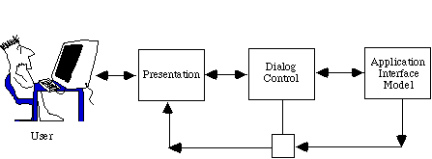
Seeheim Model
Resulted from the 1st UI software tools workshop which took place in Seeheim, Germany. Nov 1-3, 1983.
Logical model of a UIMS
UIMS = User Interface Management System (old name for user interface software)
All UI software must support these components, but are they separated? How interface?
Note that input and output are entirely separate

Slide 19
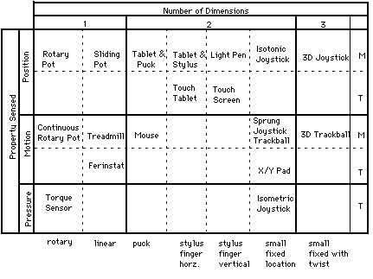
Buxton’s classification [1983]
Continuous manual input devices
M = indirect
T = touch directly

Slide 20
Card, Mackinlay, Robertson model
Stuart K. Card, Jock D. Mackinlay, and George G. Robertson. 1990. The design space of input devices. In Proceedings of the SIGCHI Conference on Human Factors in Computing Systems (CHI '90), ACM, New York, NY, USA, 117-124. http://doi.acm.org/10.1145/97243.97263
Extends Buxton’s model beyond just continuous devices
“Basically, an input device is a transducer from the physical properties of the world into logical values of an application.”
Input device is a six-tuple: (M, In, S, R, Out, W)
M is a manipulation operator (slide, rotary, force, distance)
In is the input domain,
S is the current state of the device,
R is a resolution function that maps from the input domain set to the output domain set,
Out is the output domain set, and
W is a general purpose set of device properties that describe additional aspects of how a device works (perhaps using production systems).
Composition operators – how inputs connected (x and y of mouse, buttons, output of one to input of another)

Slide 21
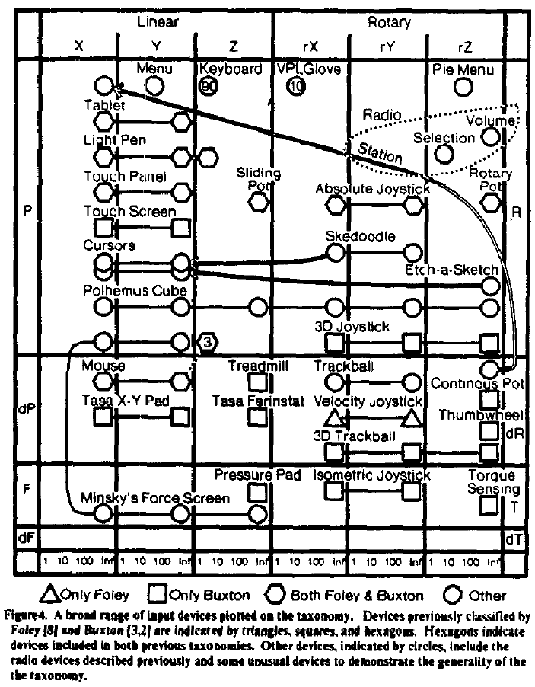
Card, Mackinlay, Robertson Model, cont.

Slide 22
Model-View-Controller
Glenn Krasner and Stephen T. Pope, "A Cookbook for Using the Model-View-Controller User Interface Paradigm in Smalltalk-80", Journal of Object-Oriented Programming (JOOP). August-September, 1988. vol. 1, no. 3. pp. 26-49. pdf scan at UCI
Invented in Smalltalk, about 1980
Idea: separate out presentation (View), user input handling (Controller) and "semantics" (Model) which does the work
Fairly straightforward in principal, hard to carry through
Never adequately explained (one article, hard to find)
Goals
program a new model, and then re-use existing views and controllers
multiple, different kinds of views on same model

Slide 23
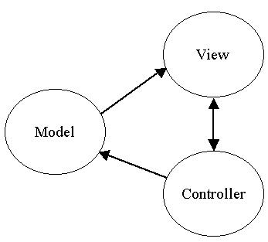
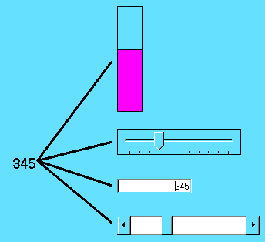
MVC

Slide 24
MVC
Model
Simple as an integer for a counter; string for an editor
Complex as a molecular simulator
Views
Everything graphical
Layout, subviews, composites
Can be multiple per model
Controller
Schedule interactions with other VCs
A menu is a controller
Usually 1-to-1 with Views

Slide 25
Interactors [Myers, 1990]
Brad A. Myers. 1990. A new model for handling input. ACM Trans. Inf. Syst. 8, 3 (July 1990), pp. 289-320. http://doi.acm.org/10.1145/98188.98204 or local pdf.
Idea: provide reusable behavior objects that would encapsulate all parameterizations needed
Create all widgets and other interactions using just these behavior objects
Independent of the graphics
Parameterized by which event causes it to start/stop/abort, objects affected, call-back when finished, feedback type, etc.
First successful implementation of the “C” part of MVC
Kinds (as revised in Amulet)
Choice-lnteractor – choose one or more of a set
Move-Grow-Interactor – move or grow existing objects, with gridding, minimum size, flip-if-change size, etc.
New-Point-Interactor – enter 1 or 2 or n new points
Angle-Interactor - rotation
Text-Interactor – text editing
Gesture-Interactor – traces that can be recognized

Slide 26
Human Performance Modeling
John, B. E. (2003) "Information processing and skilled behavior." Chapter 4 In J. M. Carroll, (Ed.), Toward a multidisciplinary science of human computer interaction. Morgan Kaufman. pp. 55-101.
Goal: Compute measures of human performance without needing to do user tests
Use a “model” of how people work, that has been validated to be reasonably accurate, given certain assumptions
Works well for low-level, expert tasks
“How long will it take to enter this sequence of commands?”
Errors (both novice and skilled)
Research on higher-level, problem solving tasks
Visual search, figure out how to do things, etc.

Slide 27
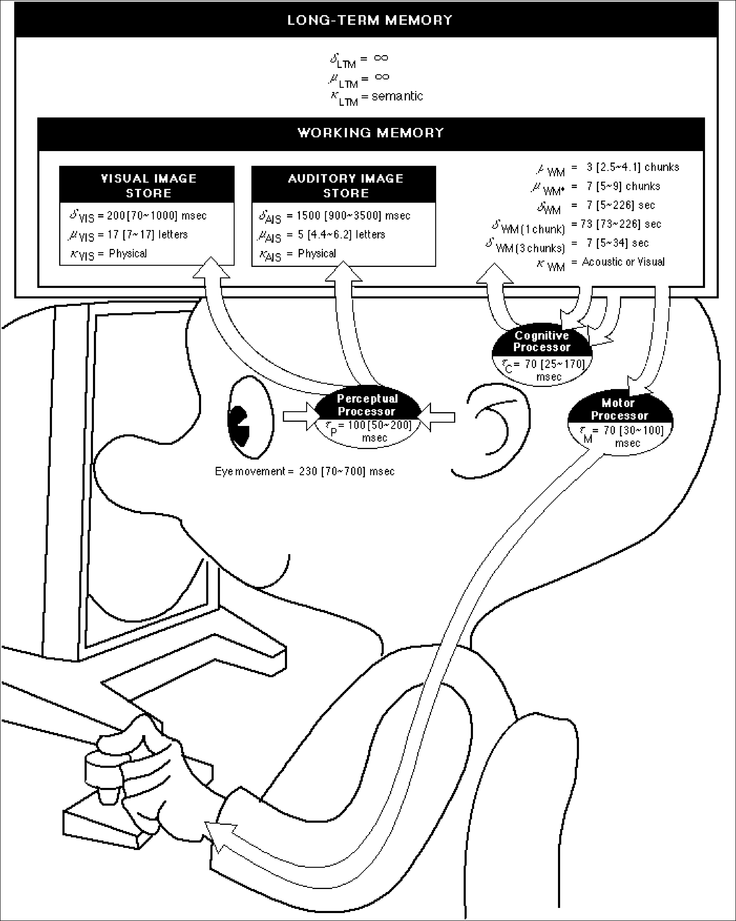
Wouldn’t it be great…
Reference: Stuart K. Card, Thomas P. Moran and Allen Newell. The Psychology of Human-Computer Interaction. Hillsdale, NJ, Lawrence Erlbaum Associates. 1983.
Just point Mr. Bubblehead (the Model Human Processor) at a system, automatically generate performance measures, in context, AND see what’s inside its “mind” and “heart”?
Better yet, point Mr. Bubblehead at design ideas (systems that haven’t been built yet)
Fast, cheap, easy to interpret
Quantitative measures to help persuade

Slide 28
Time Constants

Slide 29
The simplest model: the Keystroke-Level Model (KLM)
Stuart K. Card, Thomas P. Moran, and Allen Newell. 1980. The keystroke-level model for user performance time with interactive systems. Commun. ACM 23, 7 (July 1980), pp. 396-410. http://dl.acm.org/citation.cfm?id=358895
Pre-defined level of detail: K (keystroke), P (point with mouse), H (home between devices), M (mental operator), R (system response time)
Procedure for constructing a sequence of operators that perform a task
Heuristics for placing mental operators
Input:
A suite of benchmark tasks that are important to your design or evaluation
A specification of the proposed system
Output:
A prediction of the time it would take a skilled user to perform the benchmark tasks on the proposed system
Accurate to within about 20% of observed performance
Appropriate for skilled performance, without problem solving

Slide 30
GOMS models
Stuart K. Card , Allen Newell , Thomas P. Moran, The Psychology of Human-Computer Interaction, L. Erlbaum Associates Inc., Hillsdale, NJ, 1983
Goals, Operators, Methods, and Selection rules (GOMS)
Also originally from Card, Moran, and Newell
Significant advances by Bonnie John in HCII and others
Multiple strategies (“methods”) possible to do an operation (to reach a “goal”) (e.g., delete a character)
Each strategy uses a variety of “operators”
“Selection rules” to pick which method
E.g., use backspace when previous character, use arrow keys when a few characters away, but use mouse when far away
Write these in a special language (e.g., ACT-R, SOAR) and system predicts how long tasks will take.

Slide 31

CogTool
Bonnie John’s tool to help with Cognitive Modeling
http://cogtool.hcii.cs.cmu.edu/
Mock-up an interface in a storyboard
States & transitions between those states
Use interactive widgets on a blank canvas
Useful as a prototyping tool
Outputs performance predictions

Slide 32
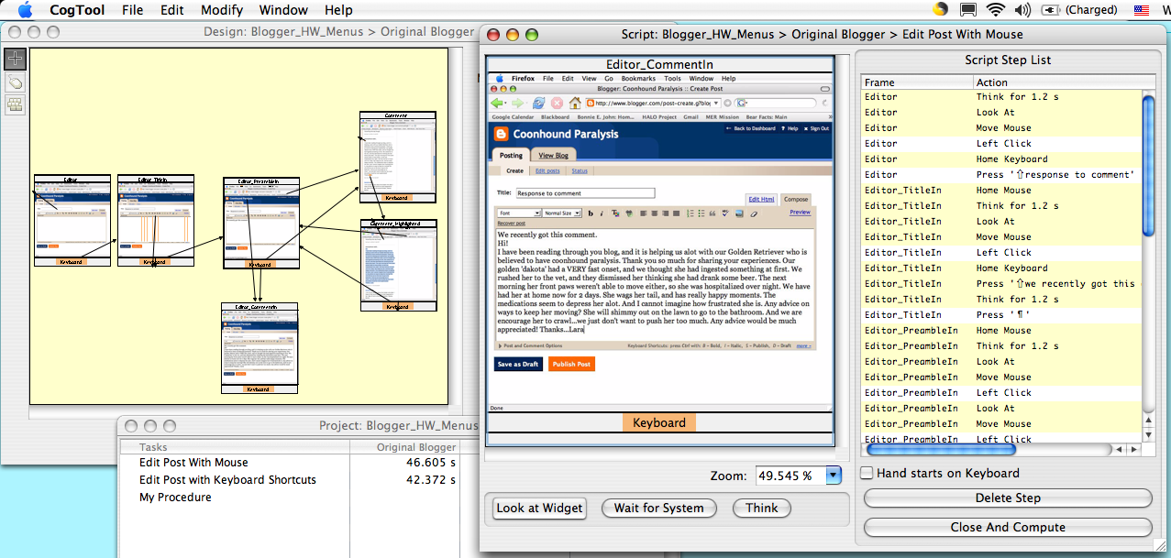
CogTool produces predictions through demonstrating tasks on a storyboard
1. Mock-up design in a storyboard
3. Predictions appear in a spreadsheet
2. Demonstrate the tasks

