Slide 1
Lecture 9: Deep Dive: Selecting and Creating Objects across Different Kinds of Views
Brad Myers
05-899A/05-499A: Interaction Techniques
Spring, 2014

Slide 2
Syntax of Operations
Prefix: Operation first, then parameters
All command lines are like this
GUIs: _____
Postfix: Parameter first, then operation
Select object, then hit <delete>
Infix: operator in the middle
4+5
GUIs: _____
This lecture: selecting the parameter when it is an object

Slide 3
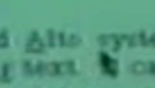
Text Selection
Early character terminals: highlight or underline characters
Bravo, 1974 (modal)
Left = char, middle = word, right = extend
Margin clicking: left = line, middle = paragraph
Underlined
Smalltalk, 1976 (Tesler’s influence)
Left click = point between characters
Second click = word, end of line = line
Beginning or end of (xx) or whole document
Extend by holding down mouse button, or shift key
Caret between characters
Star, 1981
Left click = character, multi-click = word, sentence, paragraph
Right button = extends at same level (char, word, …)
Not “pending delete” = cursor (blinking caret) is before or after selection

Slide 4
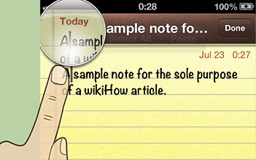
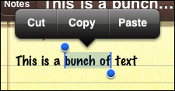
Text Selection, cont.
Lisa & Macintosh, 1982 (Tesler)
Cursor is in between characters
Drag-through to select
Double-click for word select
Shift-click to adjust
Pending delete = new typing replaces selection
No further changes to selection since then for desktops
Motif, 1989
Button 2 (middle) click = move selected text to new point
Ctrl-Button 2 = copy
iPhone selection handles and “magnifying glass”
Text entry and editing covered later – lecture 15

Slide 5
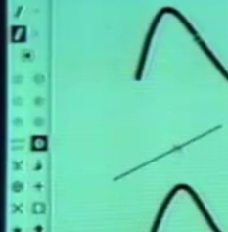
Graphical Selection
Draw, 1975
Go into “selection” mode
Click on object to select it
Rectangular area to select multiple – objects totally enclosed
Star, 1981
Click left to select, right to add to selected set
Rubber band select with right mouse button
Lisa and Macintosh, 1982
Click for single object
Click in background for no selection
Drag through to select multiple (fully within)
Shift click or shift-drag to toggle in selected set
Reverse video or handles
Lasso tool for bitmap selection – animated
Note: not drag-through select if start on an object, moves object instead

Slide 6
Graphical Editing
Generally the “tool” metaphor
Prefix: pick a tool, then operate
Create a rectangle, here, to here
Deleting is postfix
Selected object, delete
Resize, move are generally infix
This object, move, to here
“Rubber band” feedback to show where will go

Slide 7
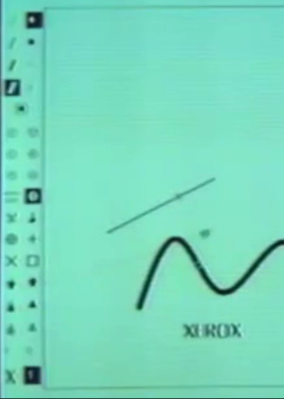
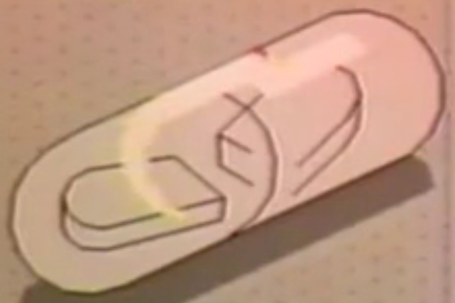
Graphical Editing
Draw, 1975,
Infix – selected object, type of transformation, where
Uses a “transformation vector” or full “affine transformation”
Star, 1981
Infix – selected object, “move”, click for where
Stretch, can drag out how much to stretch
Magnify – same proportions
Macintosh, 1982
Postfix
Handles can be pressed and dragged to resize
Anywhere in object to move
Gargoyle (Xerox PARC), 1982
Caret & anchor points
Silicon Graphics icon editor, 1989
Objects can “snap” to grid, and other objects, including along an edge

Slide 8
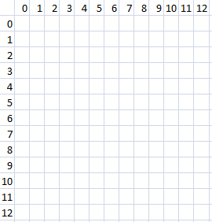
Parameters to object manipulation
When moving/growing an object
Lines change differently than rectangular objects
Object itself changes, or “interim feedback”?
Gridding, snapping to other objects
Issues with gridding: origin with window/drawing?
Based on object or mouse?
Width = inside or outside?
Minimum size?
Disappears if 0 size?
Flip if change sides?
Abort after started?
Test text

Slide 9
Full-Featured Drawing tools
Many ways to select and draw objects
Paint (Photoshop) vs. Object (Illustrator, CAD/CAM)
Demo of Illustrator mechanisms?

Slide 10
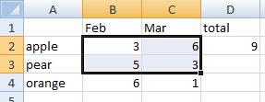
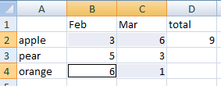
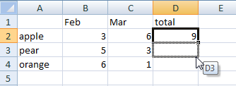
Selections in Spreadsheets
Selections in spreadsheets have always differed somewhat from other applications
Click on cell, drag to select multiple
Shift click to extend
Control click (and drag) for multiple selection regions
Always operates on rectangles
Selection handle to smart-extend values and formulas

Slide 11
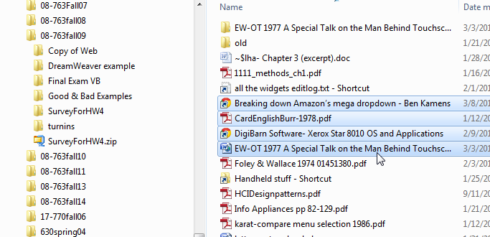
Selections in Linear and Hierarchical Lists
Lists and hierarchies operate differently as well
E.g., Windows “Explorer”, Macintosh “finder”, etc.
Click to select one
Click and drag usually moves selected object (no drag-through select)
Shift click extends (or shortens) selection to new click point
Control click toggles item in selection set
May be able to select a region using a box, if start not on an object

Slide 12
Research on Graphical Objects
Brad A. Myers. (1998) "Scripting Graphical Applications by Demonstration," Proceedings CHI'98. pp. 534-541. ACM DL, or local pdf, and video or YouTube (3:09). (Topaz)
Search for graphical objects by location or property
Move selection from object to object
Write reusable scripts of object manipulation
video

