Slide 1
Lecture 8:
Deep Dive: Menus
Brad Myers
05-899A/05-499A: Interaction Techniques
Spring, 2014

Slide 2
What is a “Menu”?
Wikipedia: “a menu is a list of options or commands presented to an operator by a computer or communications system.”
Also including “buttons”, “radio buttons”, “check boxes”, “palettes”, and other interaction techniques for choice
  But not selecting objects in graphics editors, files in a Finder, or selecting cells in spreadsheets, etc.
  Also not text entry
Choosing one or more of a set is one of the fundamental interaction operations:
  Foley & Wallace, 1974 – “A button is for selecting a system defined object such as an action to be performed…”
Hundreds of variations
Why menus?
  Takes advantage of “recognition rather than recall” – important guideline from HCI (Nielsen)

Slide 3
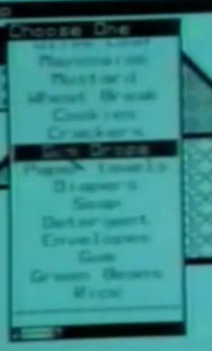
Taxonomy of Menu
Design Choices
Copied from homework 2’s list
  Not necessarily complete or comprehensive, or in a reasonable order
  It would be great for you to identify more as part of your homework, etc.
The KIND or TYPE of menu
  Linear (regular) menus, either horizontal or vertical
    Linear menus with scrolling – then how does it scroll?
  Hierarchical menus
  Adaptive expanding size menus, like the Mac Dock or Fisheye menus: http://dl.acm.org/citation.cfm?doid=354401.354782
  Adaptive menus like the Office XP "personalized menus", that try to adapt to what you want and put that at the top
  Pie menus (of various sizes) http://dl.acm.org/citation.cfm?doid=57167.57182 (required reading) also as used in the Sims and other games
  "Marking menus" (similar to pie menus) http://dl.acm.org/citation.cfm?doid=169059.169426 andhttp://dl.acm.org/citation.cfm?doid=191666.191759
  Spin menus like on the iPhone for choosing dates, etc.
  Menus like on Android
  Menus in a Game Console that you navigate using the direction keys on the game controller
  Menus on a Wii that you navigate by pointing to them with the controller.

Slide 4
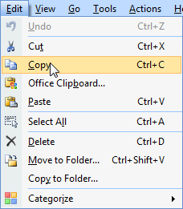
Taxonomy, cont.
Contents of Menus:
  How many items are there in the menu? How are the items (content) in the menu arranged?
  Issues of different lengths of menus, and how this type of menus deals with this size (is the number of items: 2, 10, 50, 100, 1000, etc.)
  Inactive items – removed or grayed?
  How are the items arranged in the menu?
    Arranged alphabetically (apple, bread, crackers, ...)
    Arranged in groups by topic (apple, pear, |,
    crackers, cheese ...). Another example is the
    typical Edit menu: Undo, Redo | Cut, Copy,
    Paste | ...
    Arranged hierarchically by topic (fruit>,
    snacks>, ...)
    Arranged (apparently) randomly

Slide 5

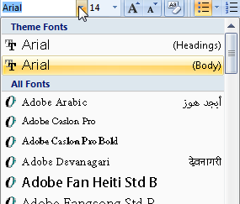
Taxonomy, cont.
Interactions with the Menu:
  How does the user interact with the menu:
  Which specific mouse buttons or keyboard keys?
  How is the menu initially invoked?
    Fixed menu, always on the screen.
      At the top edge of the screen, like on Macintosh, versus somewhere else, like on Windows.
      Also includes palettes, toolbars of icons, etc.
    Popup menu with a particular mouse button over any relevant object. For example, the right-mouse context menu.
    Popup menu from a specific icon or widget. E.g., an "option button" like for fonts
  How does the user interact with the items in the menu?
    Press and hold, move to item, release on item
    Press and release ("click") to start, click again to stop
  What is the feedback to the user for:
    Hovering the mouse over an item without clicking
    Pressing down over an item
    Releasing over an item
  How does the user get to sub-menus, if any?
    Slide out of an item to get its submenu.
    Click on an item to get its submenu.
  If there are multiple ways of using the same menus, then what are the alternatives. For example, are there keyboard accelerators? Do the menus work with the keyboard arrow keys?

Slide 6

Menus date back to the beginning of computers
Sketchpad’s physical buttons for commands, 1963
  Not counting the
  knobs as “menus”

Slide 7
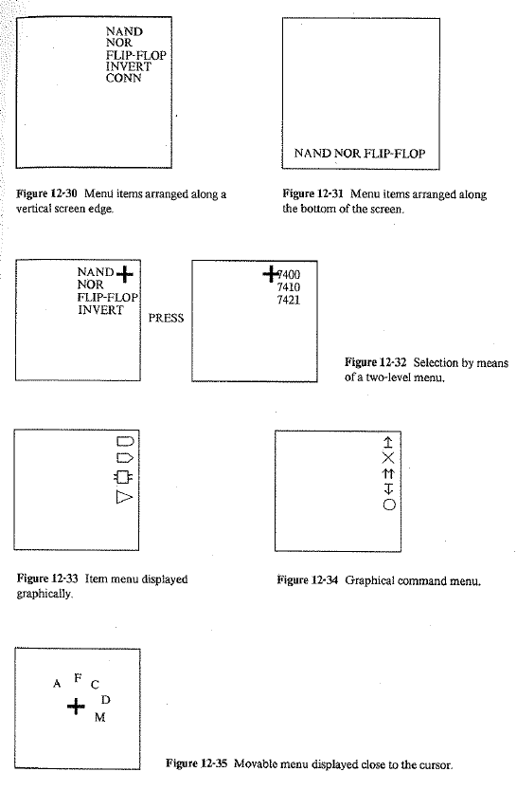
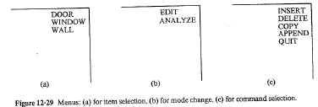
Various Menus from the 1960s
Including a Popup Pie Menu!
  NE Wiseman, HU Lemke, JO Hiles, “PIXIE: A new approach to graphical man-machine communication”, Proc. 1969 CAD Conf., IEE Conf. Pub 51, 1969, p. 463
  Mentioned in: William M. Newman and Robert F. Sproull (Eds.). 1979. Principles of Interactive Computer Graphics (2nd Ed.). McGraw-Hill, Inc., New York, NY.

Slide 8
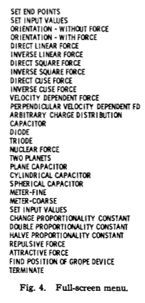
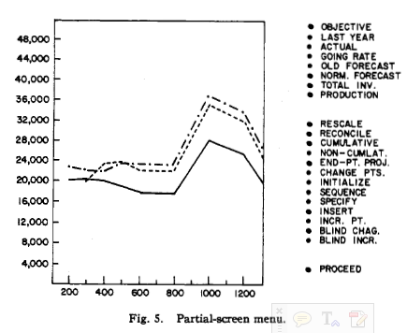
On Screen Menus
Foley & Wallace, 1974: “Menus can be used in two ways. Fig. 4 shows one which has temporarily replaced whatever had been displayed, while Fig. 5 shows one displayed with other material.”
  Designed to be selected with a light pen
  Also discusses
  only showing
  the relevant
  items

Slide 9
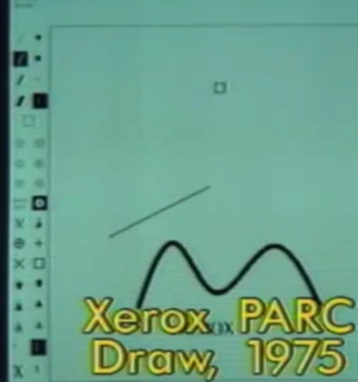
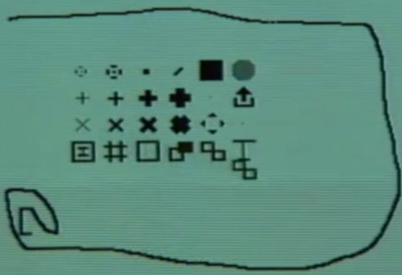
Xerox PARC Research Systems
Markup (1974) – popup menus
  Unique one row at a time, see through
Draw (1975) – fixed menus (palettes)

Slide 10
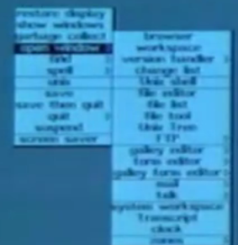
Smalltalk
1976
All menus are popup
Press and hold, release over the item
Submenus – press and release to get submenus
  Can be a long chain of submenus

Slide 11
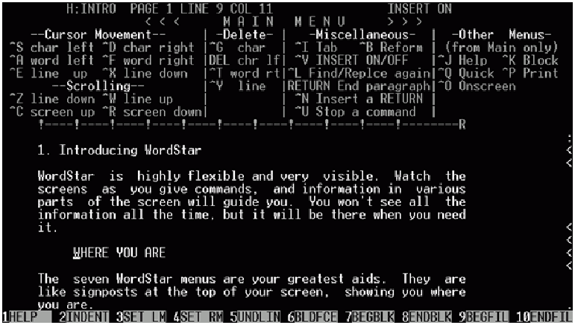
Soft keys
WordStar, June 1979
Mostly used function keys = “soft keys”

Slide 12
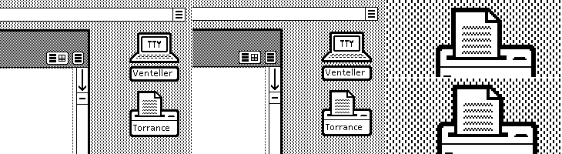

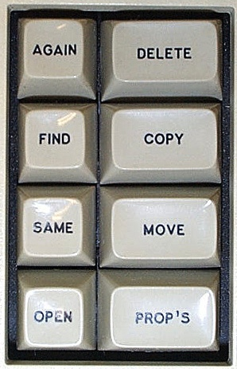
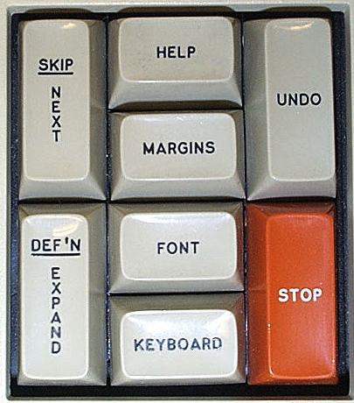
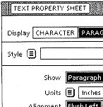

Star & Viewpoint
1981
Command buttons
Menu buttons
  Didn’t need many commands since universal
  commands, and most were on the keyboard
    Top row could change functions
  Fewer capabilities
  Removes
  unavailable items
  Tried to get rid
  of even these
  menus
  Also in prop.
  Sheets (1985)

Slide 13
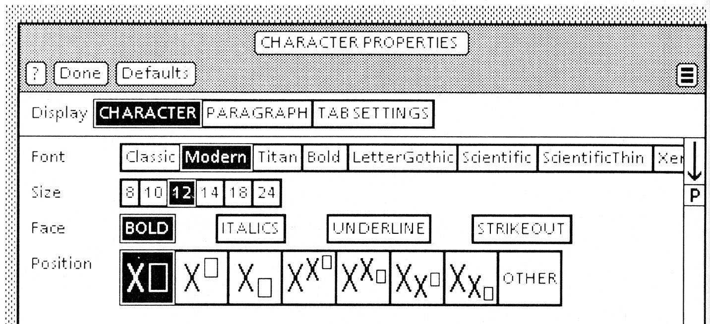
Star Property Sheets
David Smith invented Property Sheets / Dialog Boxes for Star
Choose one of a set (“choice parameters”), many of a set (“state parameters”):
  Whether rectangles touch (one) or not (many)

Slide 14
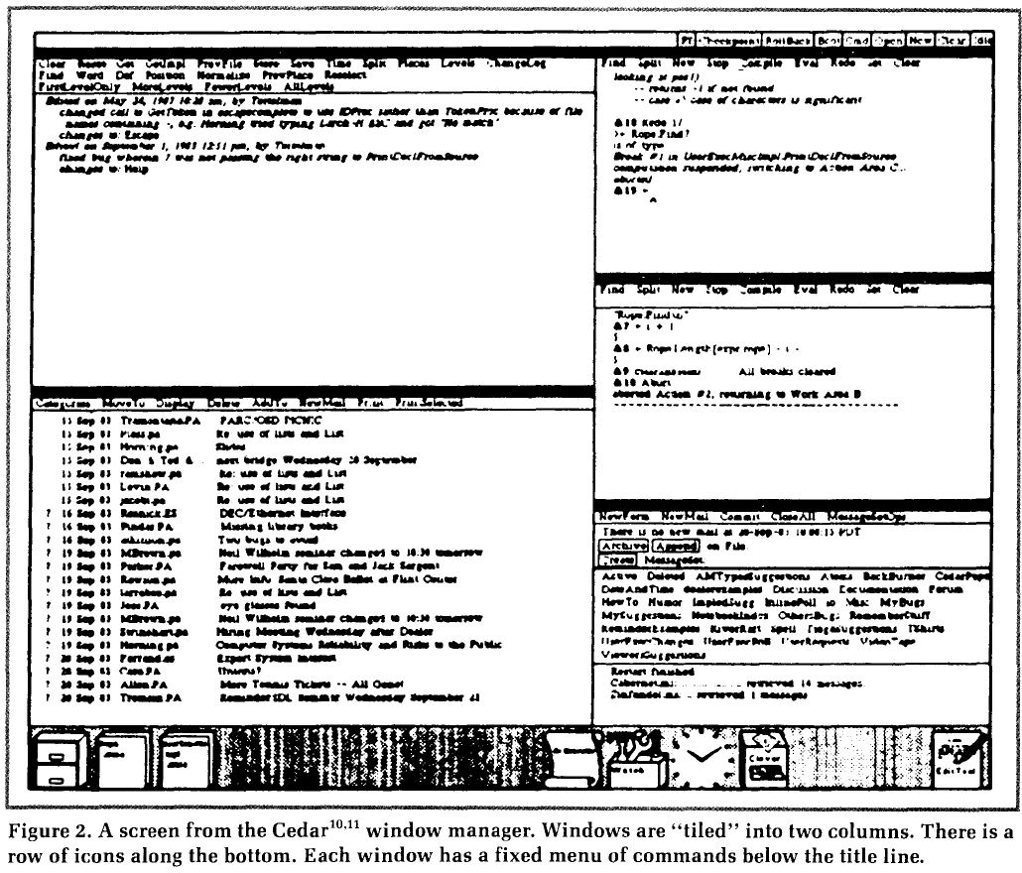
Cedar
1982
Tiled window manager
No covered window and no popup menus
All fixed menus

Slide 15
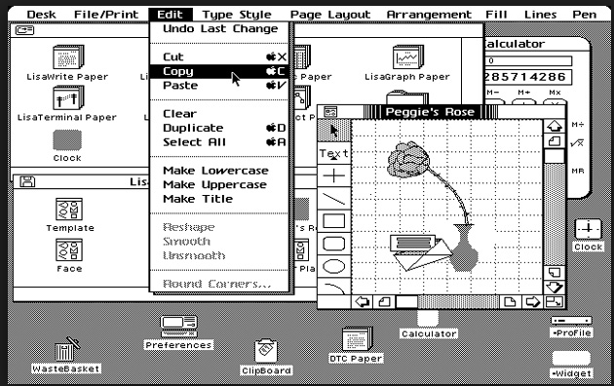
Lisa & Macintosh
1983-4
Menu bar
  Infinite Y-size (Fitts), easier to hit
Grayed out items
Items checked in menus
“…” if dialogs
Accelerators
listed in menu
Flashing so
can see what
selected
Submenus –
only 1 level

Slide 16
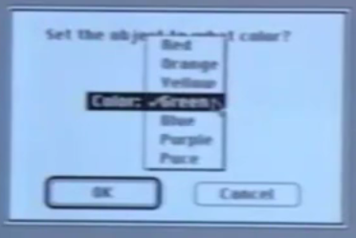
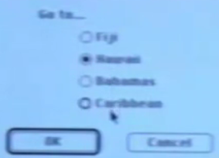
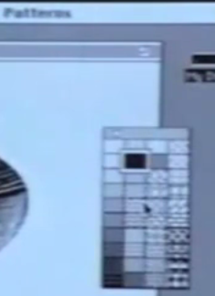
Other Lisa/Mac
Widgets
Buttons; one can be default
“Popup menus” = option menus
“Radio” buttons,
check boxes
  Interim feedback
HyperCard tear-off
menus (1987)

Slide 17
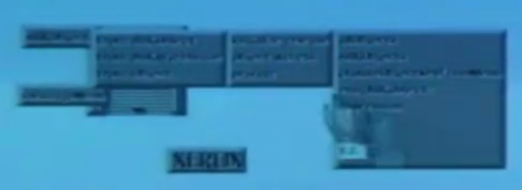

Randy Smith’s ARK
“Alternate Reality Kit”, 1985
Randall B. Smith. 1986. Experiences with the alternate reality kit: an example of the tension between literalism and magic. SIG CHI '87 Proceedings, 61-67. http://dl.acm.org/citation.cfm?id=30861
1st use of 3D look
  Shadows, edges of buttons and menus
All simulated with halftones (gray patterns)

Slide 18
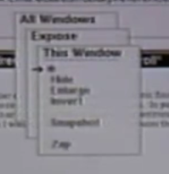
Andrew Toolkit popup menus
1985
Stack of menus
  Instead of pull-out hierarchy
Some design issues:
  Press and release does nothing
  “Mouse hole” to get back to
  where were
    Vs. Smalltalk – just click to repeat

Slide 19
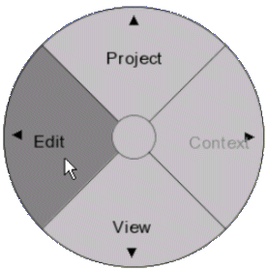
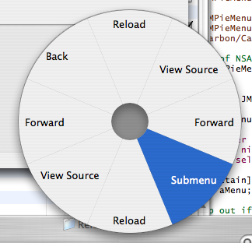
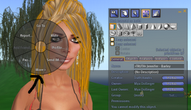

Pie Menus
1986
  J. Callahan, D. Hopkins, M. Weiser, and B. Shneiderman. 1988. An empirical comparison of pie vs. linear menus. In Proceedings of SIGCHI (CHI '88), J. J. O'Hare (Ed.). ACM, New York, NY, USA, 95-100. ACM ref
Shorter, and equal, distance to items
  Measured 15% increase in speed for 8 items
Lots of variants
  Submenus, interactions in and on menus, etc.
Lots of tradeoffs
  Size, precision that was needed
Don Hopkins later went
to work at Maxis on
SimCity
and
The Sims

Slide 20
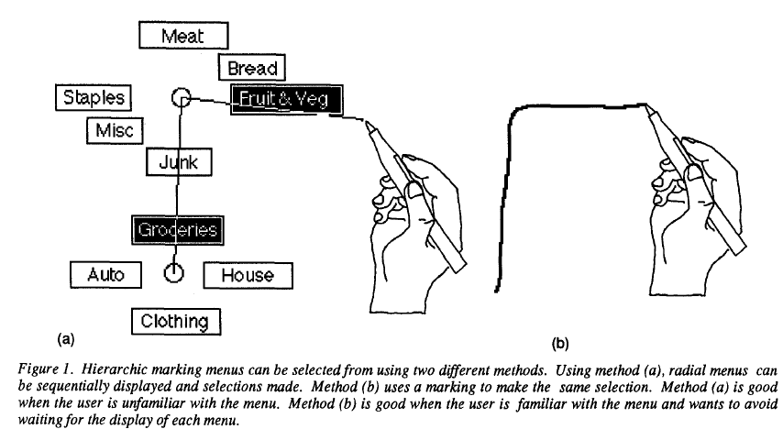
Variant: Marking Menus
Gordon Kurtenbach and William Buxton. 1993. The limits of expert performance using hierarchic marking menus. In Proceedings CHI '93. ACM, 482-487. http://dl.acm.org/citation.cfm?doid=169059.169426
Delayed appearance of menu graphic (1/3 sec) allows quicker invocation if remember the direction
  Up to 3.5 times faster than using the graphic menu
Hierarchical menus can be invoked using a zig-zag stroke

Slide 21
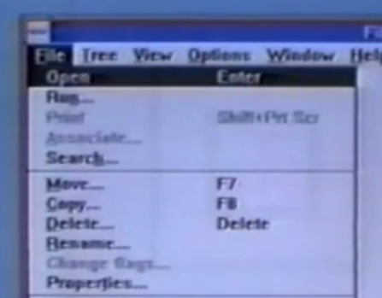
Original Microsoft
1988
3 different keyboard mechanisms
  Control-xxx or function keys
  ALT then letter
  (moded) =
  “mnemonics”
  Arrow keys then
  <Enter>
2 different mouse:
  Press-and-hold
  Click-click

Slide 22
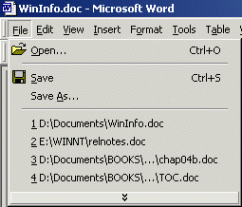
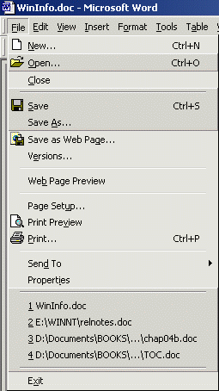


Office XP “Personalized Menus”
2001
Most frequently used in short version
Arrow to get the rest
  Would be interspersed, not at the end
Many people disabled them

Slide 23
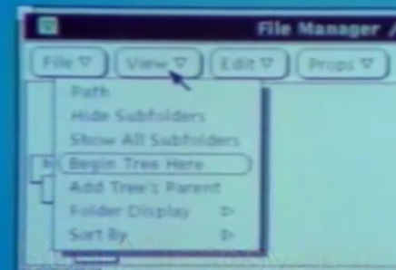
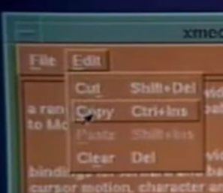
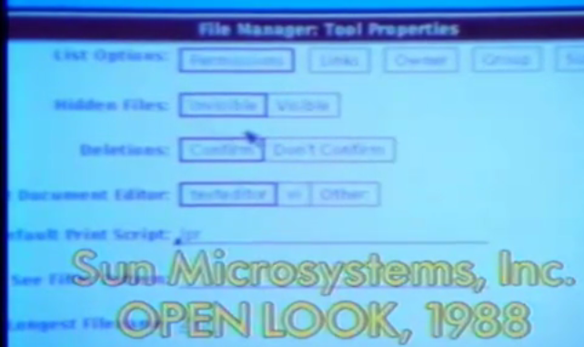
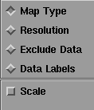
OpenLook & Motif
1988 & 1989
OpenLook: Look-and-feel for Unix from Sun in collaboration with Xerox
  Used some of Star look-and-feel
  Unusual pull-down menus with defaults
In competition with “Motif” which ended up winning
    From HP & DEC, etc.
    Better use of color, more 3D look
    Diamond vs. square
Notes:
Apple – Microsoft lawsuit, 1989

Slide 24
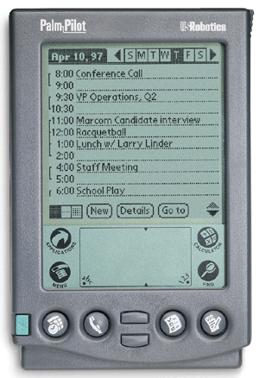
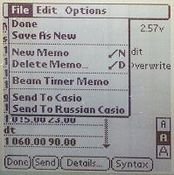
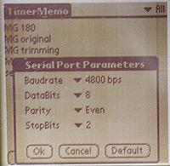
Palm Pilot
6 hard buttons
4 permanent buttons
On-screen buttons
  One is “menu”
Regular menu bar
Various kinds of option choices

Slide 25
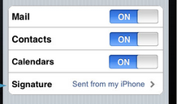
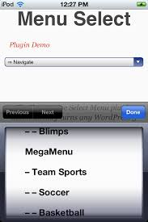
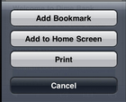
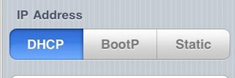
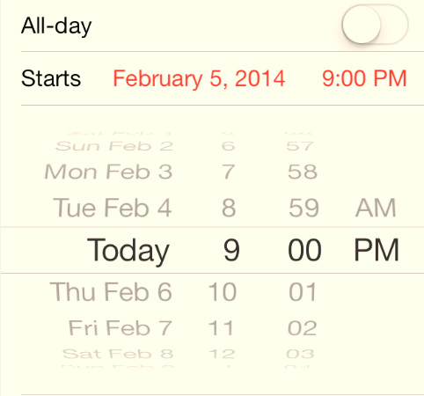
iPhone settings and menus
V1 – 2007
Genuinely new
ways of interacting
  All finger sized
  Sliders for toggles
  Lots of hierarchical menus
  Spin menus
New (v7) –
more stylized

Slide 26
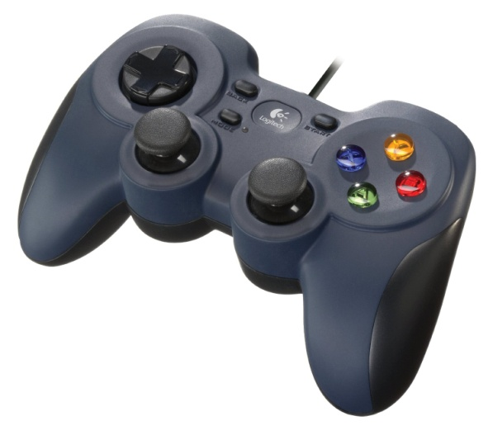
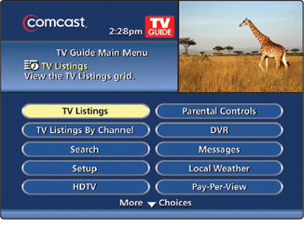
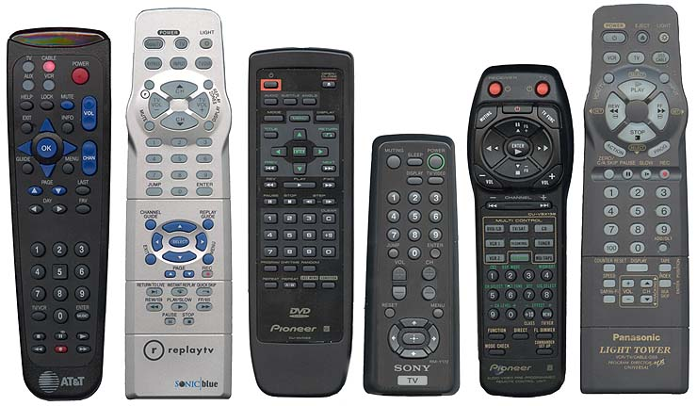
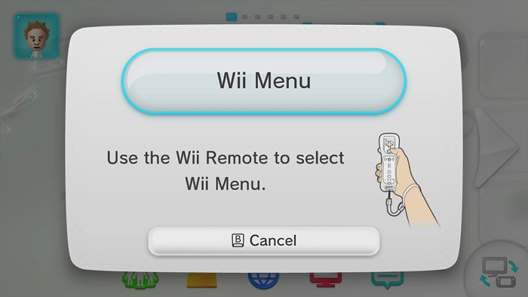
Game Controllers and Consumer Electronics
Lots of buttons, arrow keys, joysticks
On-screen menus
Direct pointing with Wii

Slide 27
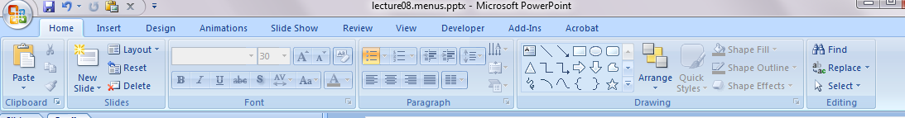

Other new(er) commercial menu designs
Microsoft “ribbon” – Office 2007
Macintosh “dock”
What else?

Slide 28


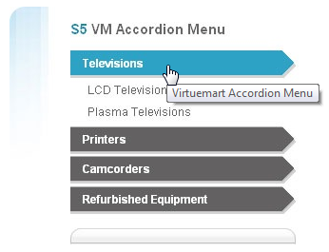
Standard Web page menus
Fixed menus of links
  Shneiderman counts all
  hyperlinks as “menus”
Pull out menus
Pull down menus
Accordion Menus –
open and
close
  Example
http://www.maison
martinmargiela.com/
What else?

Slide 29
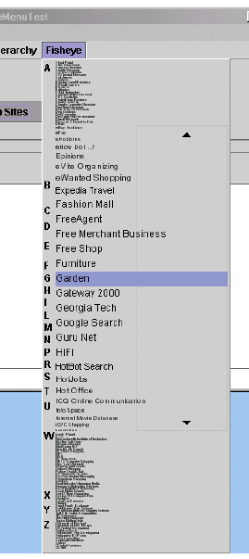
Research Menus, 1
Benjamin B. Bederson. 2000. Fisheye menus. In Proceedings of UIST '00. ACM, 217-225. http://dl.acm.org/citation.cfm?doid=354401.354782
Can vary length of full-size area
Preferred for browsing tasks, but conventional hierarchical preferred for goal-directed tasks
Performance not formally measured but seems similar speed to hierarchical

Slide 30
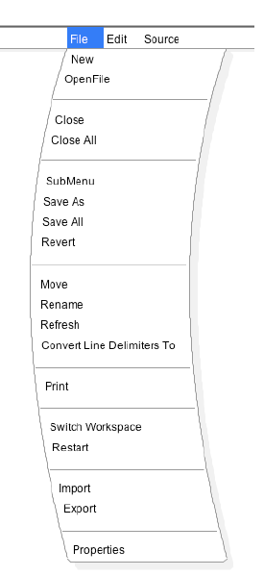

New research Menus, 2
Ayumi Tomita, Keisuke Kambara, and Itiro Siio. 2012. Slant menu: novel GUI widget with ergonomic design. In CHI '12 Extended Abstracts (CHI EA '12). ACM, 2051-2056. http://dl.acm.org/citation.cfm?id=2223751
People naturally moved in a curve, especially with a pen
Slant amount is dynamically calculated based on user’s previous movements
Participants generally preferred this design, but no performance data reported

Slide 31

New Research Menus, 3
Gilles Bailly, Antti Oulasvirta, Timo Kötzing, and Sabrina Hoppe. 2013. MenuOptimizer: interactive optimization of menu systems. In Proceedings UIST '13. ACM. http://dl.acm.org/citation.cfm?id=2502024
AI system helps designer with menus
Uses logs of previous systems’ usage to annotate frequency of use
Designer specifies importance of commands, etc.
Automatic and manual layouts

Slide 32
Recommendations on
Menu Design
Hundreds of research studies on menu design choices
Whole 368-page book just on menu design:
  Kent L. Norman, The Psychology of Menu Selection: Designing Cognitive Control at the Human/Computer Interface, Ablex Publishing Corporation, 1991, (ISBN: 0-89391-553-X), on-line
Shneiderman’s 2010 textbook has a 43-page chapter on Menus
  Ben Shneiderman and Catherine Plaisant. Designing the User Interface: Strategies for Effective Human-Computer Interaction (5th Edition). Reading, MA, Addison Wesley/Pearson. 2010.
Names must be “comprehensive and distinctive”
Logical hierarchy less error-prone and faster than random or alphabetical (64-item menus) [McDonald 1983]
  Hard to come up with good names
  Should be non-overlapping, familiar, distinct
  Can use “card sorting” to help elicit users’ categorization
  Especially when domain is familiar to users
  But this effect disappears with practice & familiarity [Card 82]
Can also be a network (graph) instead of a tree
  Multiple ways to get to same place

Slide 33
Smith and Mosier, 1986
Sidney L. Smith and Jane N. Mosier. Guidelines for Designing User Interface Software. Bedford, MA, MITRE. Aug, 1986. 478 pages. http://hcibib.org/sam/
36 guidelines about menus
  Some are outdated
    3.1.3/4 – allow selection by pointing
  Some are obvious
    3.1.3/9 – provide feedback of what selected
  Others are still relevant
    3.1.3/11 – options should be worded as commands and not questions
    3.1.3/13 – letter codes (mnemonics, shortcuts) are preferably the first letter of the command
    3.1.3/14 – use consistent codes
    3.1.3/21 – “logical” order, e.g., in order will be used or most frequent first

Slide 34

Issue: Breadth vs. Depth
When lots of items
  long menus, shallow depth = breadth
  Shorter menus, deeper = depth
[Norman 91] – breadth preferred over depth
  At most 3 levels deep or else users get lost and confused
[Jacko 1996] – errors and time increased as depth increased
  Users rated deep menus as more complex
Similar results for web site organizations [Larson 98]

Slide 35

Lots of Items
Long list or hierarchy?
  [Ceaparu, 2004] studied 645 items
  One alphabetical list or good categories
  Categories were significantly faster and preferred
Mixed results about reordering based on frequency of use
  [Mitchell 1989] – users were disoriented when reordered and slower
  [Greenberg 1985] – users were faster when most frequent were at top
  [Sears 1994] -- Combined, split menu works well = adaptive part plus all items

