Slide 1
Lecture 5:
Deep Dive: Desktop Metaphors, Icons, Window Managers
Brad Myers
05-899A/05-499A: Interaction Techniques
Spring, 2014

Slide 2
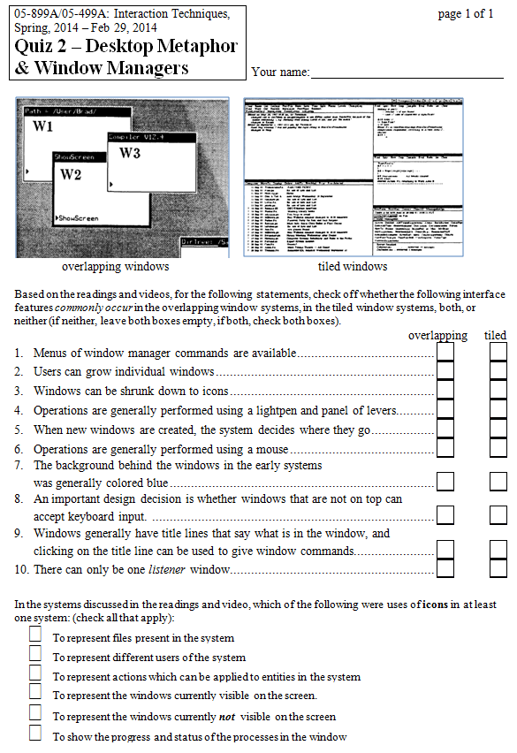
Quiz 2

Slide 3
Announcements
Homework turn-in on paper in class on Monday
  Due before lecture starts
Remember guest lecturers next week

Slide 4
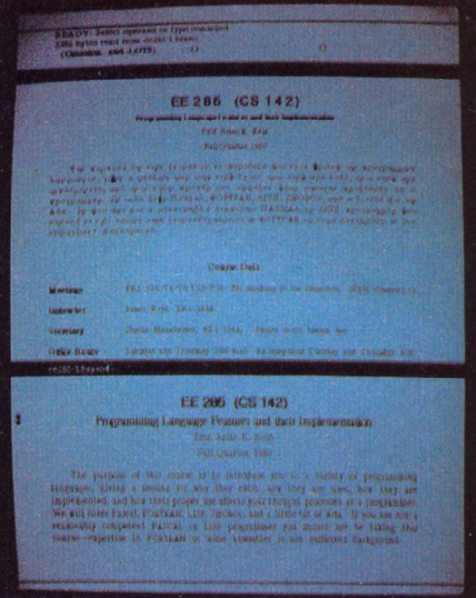
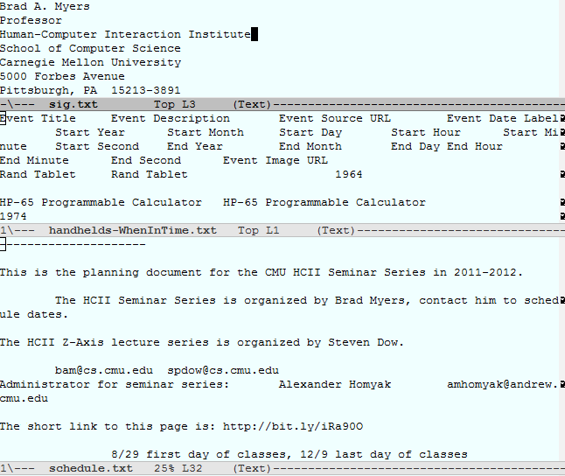
Paned Windows were first
Probably lots of systems?
Bravo (Xerox PARC editor), 1974
Emacs, 1976 by Richard Stallman and Guy L. Steele, Jr., etc.
Easy to implement, useful to see multiple documents at the same time
Same document or different documents

Slide 5
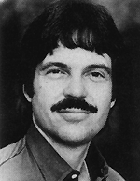
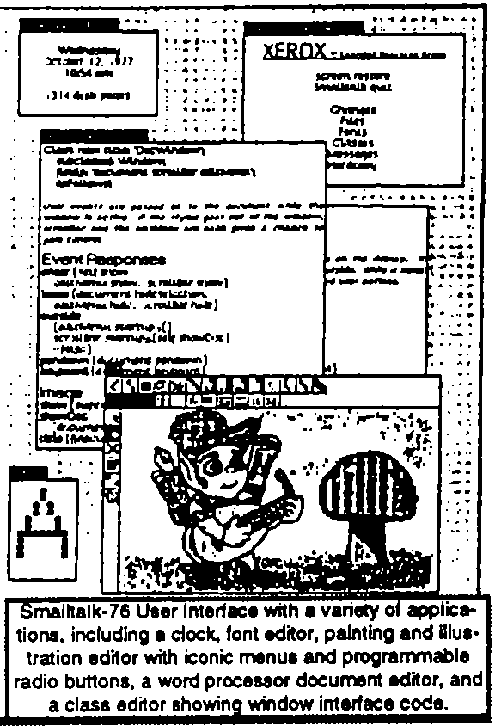
Smalltalk
Alan Kay proposed the idea of overlapping windows in his 1969 doctoral thesis
Overlapping windows first appeared in
1974 in the Smalltalk’74 system
Also used popup windows, scroll bars, etc.
I worked with Smalltalk in 1977
Did not update windows when covered – brought the window to the top
  Only one window could update at a time
Top window is the “focus” or “listener” window
Menu of window manager commands, including: Top, Bottom, Reframe, Resize, Move, Close, etc.
  Then use mouse for parameters

Slide 6
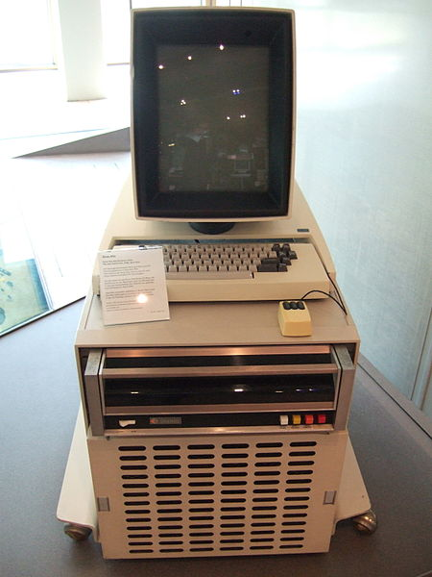
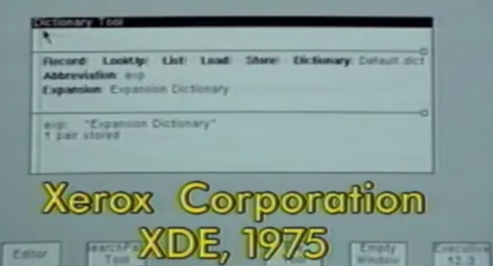
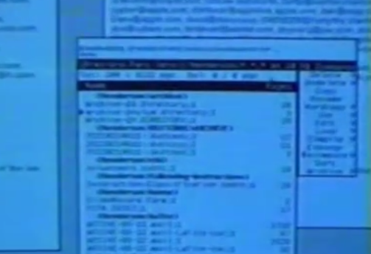
InterLisp-D, Tajo (XDE), etc.
Many other Xerox PARC systems quickly adopted covered windows, with various tweaks
Tajo (XDE) was the programming environment in which Star was
developed (1975)
  Also had simple icons (“tiny windows”)
  Different buttons on different parts of
  title bar did different actions
    Chording of 2 buttons = middle button
Interlisp-D (1980)
  Windows without title bars
  Window groups (attachments)
  Shrink into “icons”

Slide 7
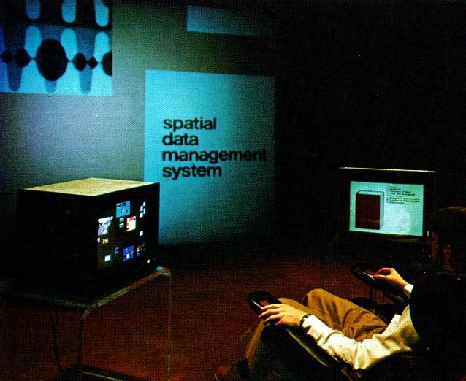
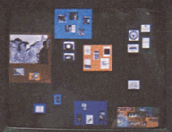
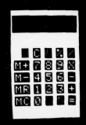
Spatial Data Management System (SDMS)
1978
MIT “Architecture Machine Group”
  now MIT Media Lab
Display everything you want on
an infinite sheet, and scroll around
  One monitor for “world view”, big screen for
  area of current interest
  Semantic zooming
First system to put calculators, address
books, etc. on the screen
Multi-media support: pictures, text, video, audio
Required lots of expensive and special-purpose
hardware
  Small touch screens, joysticks, 3D finger
  trackers, large rear-projected displays
Redone as Pad (1993) and Pad++ (1994)
  “Multi-scale architectures”

Slide 8

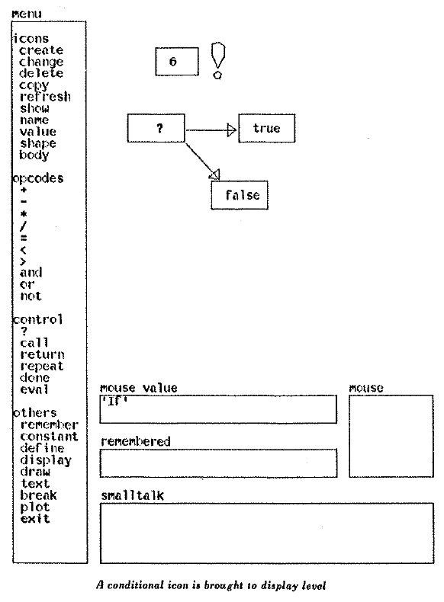
Pygmalion: A Computer Program to Model and Stimulate Creative Thought
David Canfield Smith’s PhD thesis, 1977
First large system implemented
in Smalltalk
Invented the name “icon”
  Small graphic symbols that
  represent something else
  Also drag and drop of icons

Slide 9
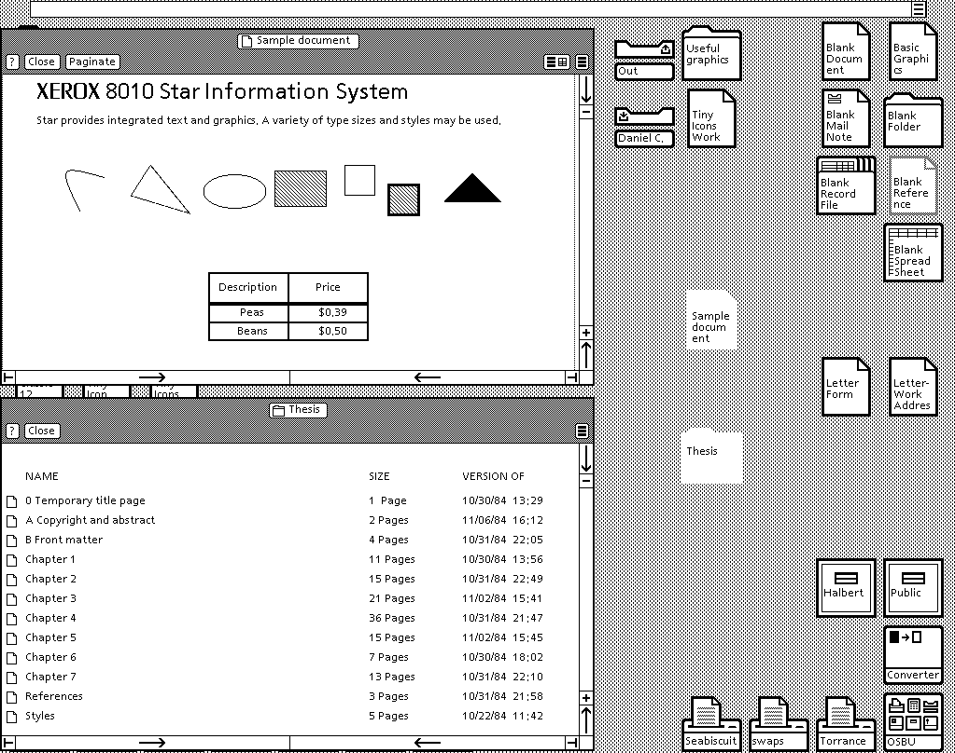
Xerox Star
1982
First system to provide desktop metaphor
David Canfield Smith will cover it in detail next Monday
Icons represent
files, folders and
actions
  Print, email, etc.
2 columns of
3 windows each
  Tiled!
“Viewpoint” – later
version (1985) –
overlapping

Slide 10
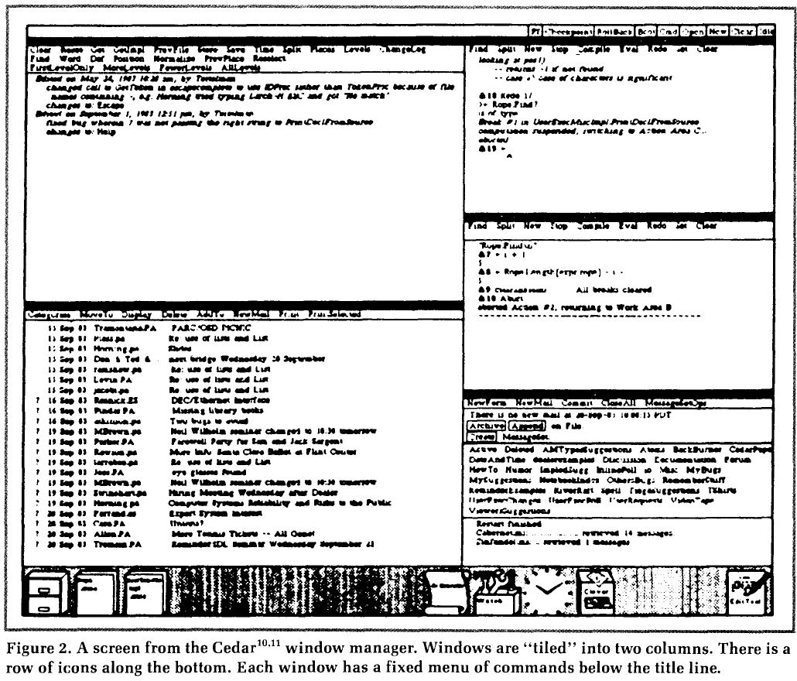
Cedar
Another Xerox PARC (research) system
Influential tiled design, with icons
1982, 1983
Many commands
to manipulate
windows
New windows
put at bottom of
columns

Slide 11
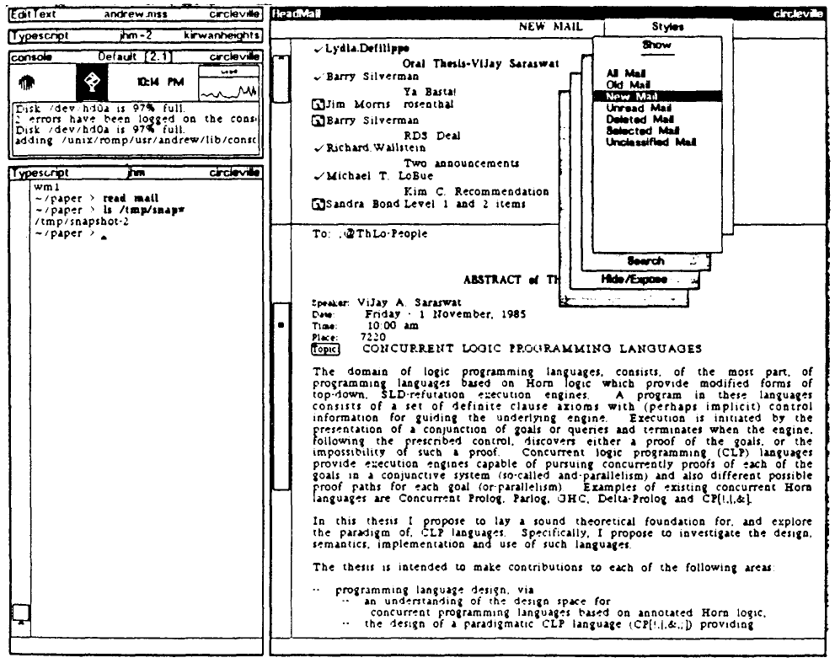
Andrew System
From CMU’s “Information Technology Center” (ITC) – where Cyert Hall is now
  Fully funded by IBM
  Jim Morris hired from Xerox to be the head
1982-1987
Key contributions:
  Distributed file system
  (AFS)
  Component model for
  operating systems
  Tiled window system
    Automatic algorithm for
    where and how much to
    grow
    No icons – shrink to title bar
  Elaborate popup menu
  system

Slide 12
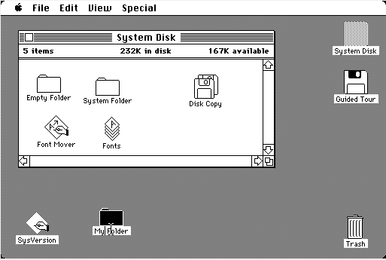
Lisa and Macintosh
1983, 1984
Larry Tesler’s talk next Wednesday
Popularized the desktop metaphor
Covered windows
Windows that are covered can update (e.g., clock)
Listener (focus) window always comes to the top (click-to-type)
Could only grow a
window from bottom
right corner
Icons for files, folders,
trashcan
  Not other actions like
  printing, emailing, etc.
Animations so actions
more apparent
Rounded corners

Slide 13
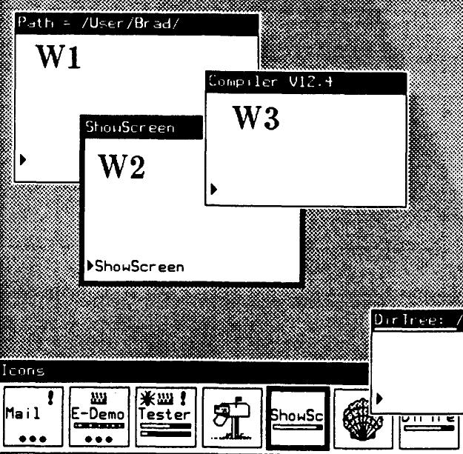
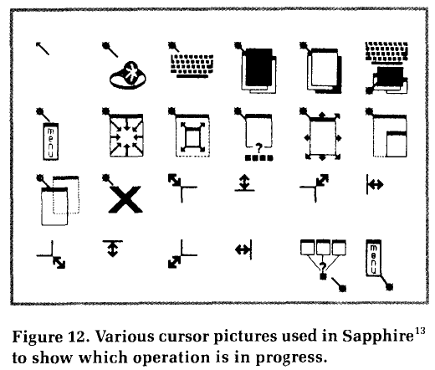

Sapphire
My window system for PERQ, 1984
Screen Allocation Package Providing
Helpful Icons and Rectangular
Environments
No graphic designer, so I made the icons and cursors myself
Press down to preview, release to operate, move before release to abort.
  Becomes a mode, with the cursor as feedback
  Grow and move handles
All operations also from keyboard
Listener window could be covered
Icons for all
windows,
shows progress,
etc.

Slide 14
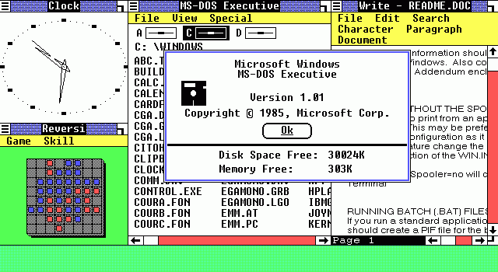
Microsoft Windows
Windows 1.0 released
in Nov, 1985
  Tiled window manager
Windows 2.0 was overlapping 1987
Resize window from any side or
corner, move from title bar
  Window menu from upper left icon
  All operations from keyboard
Windows 3.0 in 1990, 3.1 in 1992
Windows 1
from Wikipedia

Slide 15
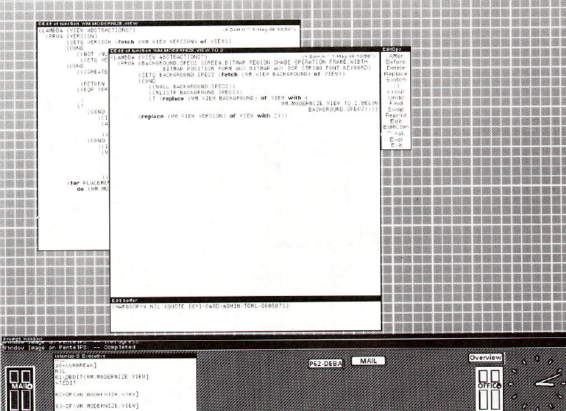
Rooms
Henderson & Card, 1986
Influential research system from Xerox PARC
Collections of groups of windows:
  “a suite of virtual workspaces”
Same window could be in multiple groups
Designed to support
different tasks
Different backgrounds
so can tell them apart
“Doors” to go from
one to another
Overview to see & go
to all of the rooms

Slide 16
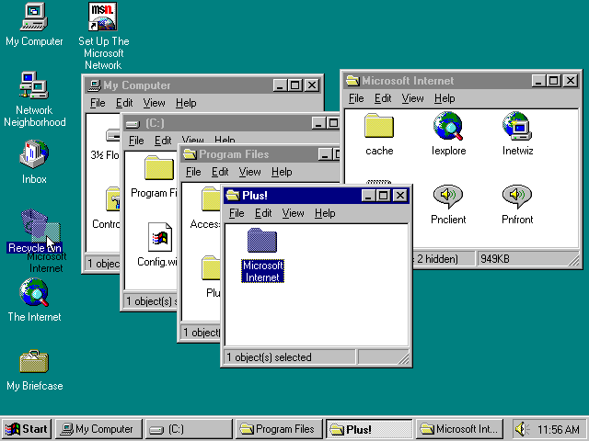
Newer Window Features
Windows 95 (1995) added task bar
  Open applications
  Separate part as launcher
  Also Start menu
Macintosh OS X added Dock (1999)
  Both open and not open applications
  At some point (when?), zooming so more will fit
Spotlight – quick search by name
What else?

Slide 17
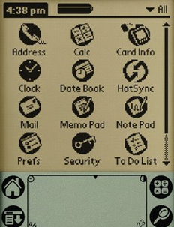
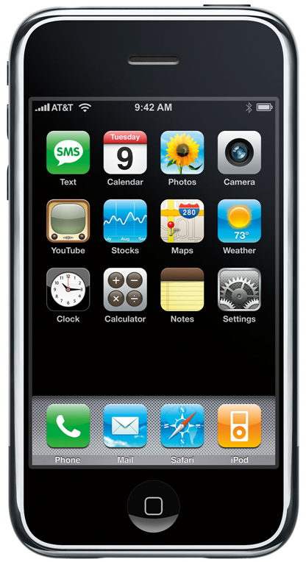
PDAs and Smartphones
Palm, iPhone, Android:
  Only 1 window at a time
  Icons of applications to start them
  No files
  Palm – scroll to see the rest
  iPhone
    Pages
    Dock for 4 icons
    Folders of icons
Newer: search for icons by name

