Slide 1
Lecture 2:
History of Personal Computers and Their Interaction Techniques
Brad Myers
05-899A/05-499A: Interaction Techniques
Spring, 2014

Slide 2
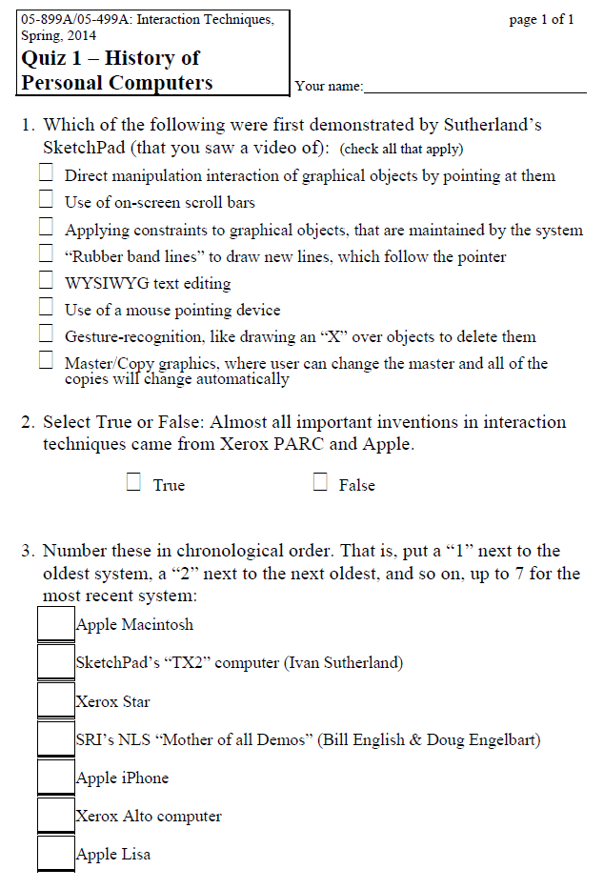
Quiz 1

Slide 3
Outline
Ivan Sutherland’s Sketchpad
Origins of the Mouse
Xerox PARC
  Smalltalk
  Bravo
  Drawing editors
Macintosh
Windows
  Taskbar
(Handheld devices covered in lecture 5)
(Desktops and Window Managers covered in Lecture 6)

Slide 4
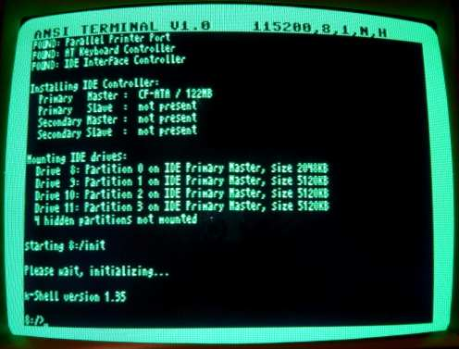
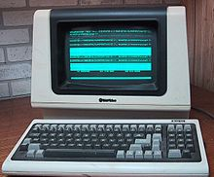
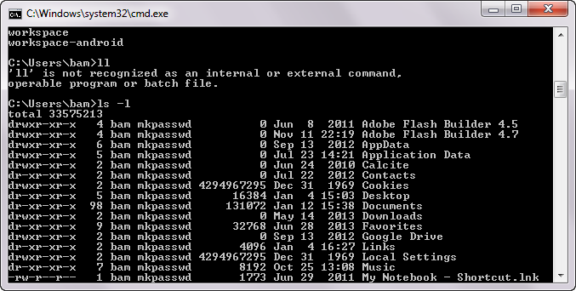
“Character Terminals”
Still around as “DOS Cmd prompts” and console windows
But we are more interested
in graphics….

Slide 5
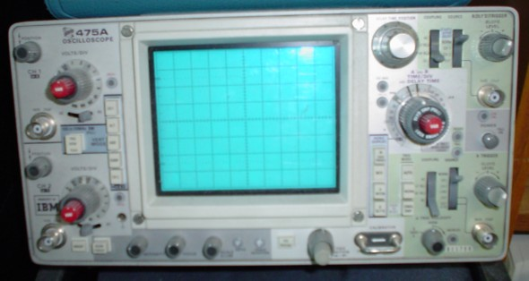
Who knows what this is?
Dates back before the 1930s
Notes:
Oscilloscope
http://en.wikipedia.org/wiki/File:Oscilloscope.jpg

Slide 6
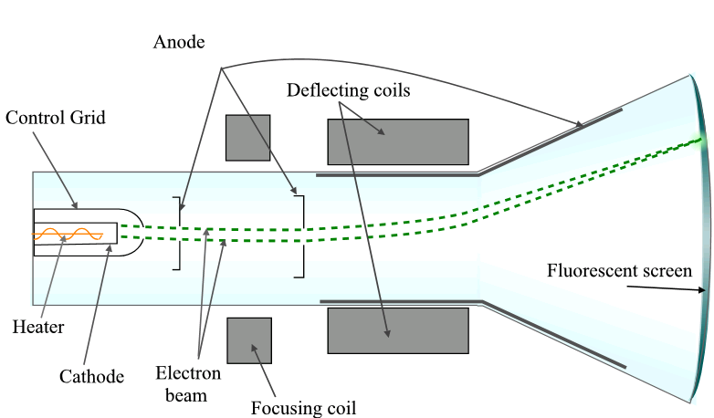
Cathode ray tube (CRT)
http://simple.wikipedia.org/wiki/Cathode_ray_tube

Slide 7
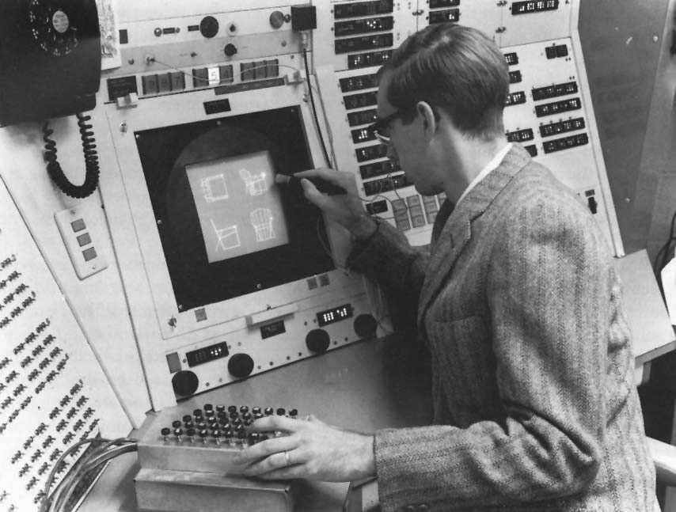
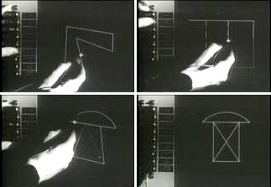
Ivan Sutherland’s Sketchpad, 1963

Slide 8
SketchPad, 1963
Lincoln Labs TX-2 computer
“Light pen” pointing device
Invented many important interaction techniques
  Direct manipulation
    Uses a “light pen”
  “Rubber Band Lines”
  Constraint-based drawing
    Maintains connectivity of lines
    Vertical, horizontal lines
  Prototype-instance drawing
    Master with multiple copies,
    Can edit the master to affect all copies
  Almost arbitrary scaling of the whole drawing
Lots of individual switches and knobs to control the drawings
3D drawings added by others to Sutherland’s original SketchPad program
  Including hidden line elimination
First flow chart – graphical programming
  Ivan’s brother: William Sutherland!

Slide 9
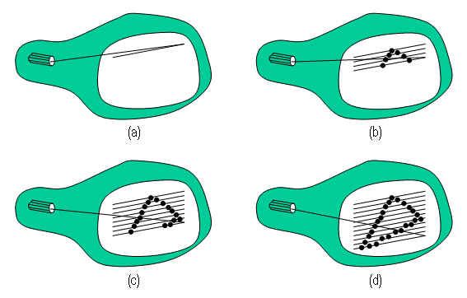
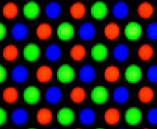
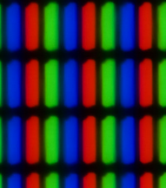
Output
Then Raster Scan
  Bitmapped displays
  Bit in memory for each pixel on the screen
  Memory was very expensive!
  First: monochrome
Color
  Multiple bits per pixel
LCDs, …
But output hardware isn’t particularly relevant to this course!

Slide 10
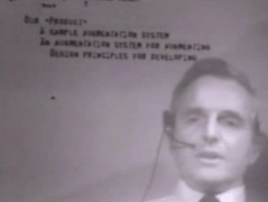
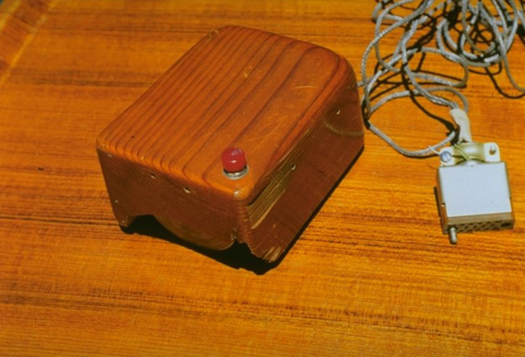
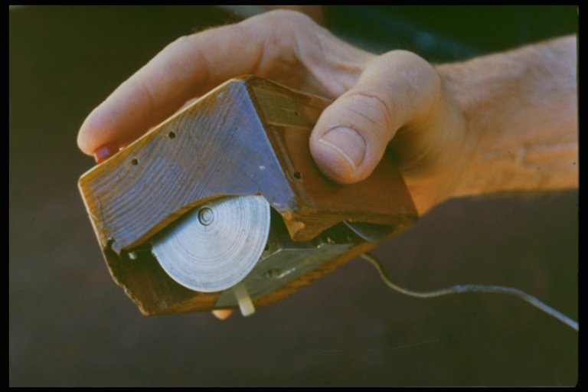
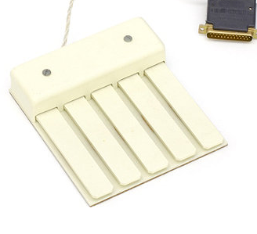
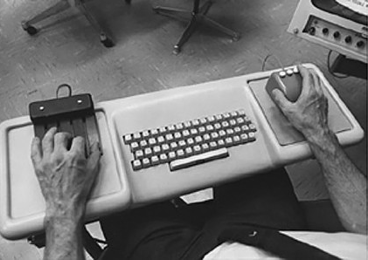
SRI and the Mouse
Stanford Research Institute (SRI)
Bill English and Doug Engelbart credited with the invention of the mouse
[W.K. English, D.C. Engelbart and M.L. Berman. “Display Selection Techniques for Text Manipulation,” IEEE Transactions on Human Factors in Electronics. Mar, 1967. HFE-8(1).]
NLS, or the “oN-Line System”
  "The Mother of All Demos” on December 9, 1968 at the Fall Joint Computer Conference in San Francisco
Never really had a decent user interface

Slide 11
Xerox PARC
Palo Alto Research Center (PARC)
Founded by Xerox in 1970
  Still exists today, as a semi-autonomous research lab
Incredible collection of talent
  Hired many people from SRI, and many researchers and engineers
Incredible collection of inventions, 1970-1982
  Hardware
    Invented workstations, laser printing, the Ethernet
      Only part that Xerox made money on
    Bitmapped displays
  Software
    Invented many of the standard OS and systems principles
    Object oriented programming (Smalltalk)
    Model-View-Controller architecture
    Interpress, a resolution-independent graphical page-description language and the precursor to PostScript
  User Interfaces
(Also invented lots about Ubiquitous Computing in the 1990s – see lecture 5)

Slide 12
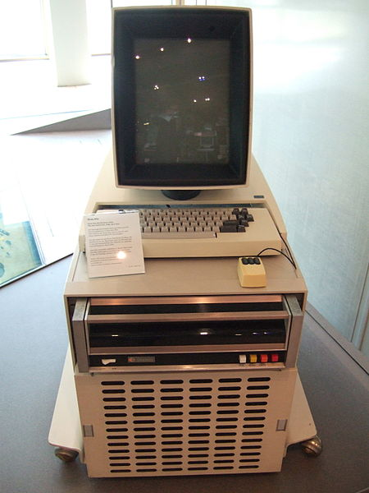
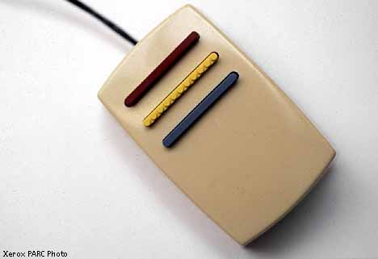
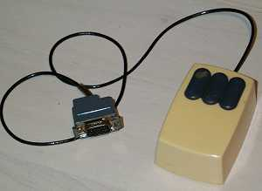
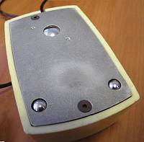
Xerox Alto Machine
Everyone else at the time was using mainframes or “mini computers” that were shared
  “Time Sharing”
Alto was one of the first “personal workstations”
  Starting about 1973
No operating system – each program had its own libraries and low-level access mechanisms
Three button mouse with two opposing roller wheels
  Red, Yellow, Green vertically
  Later replaced with left, middle, right, with single metal roller
Was secret for a long time
but later distributed to many
universities

Slide 13
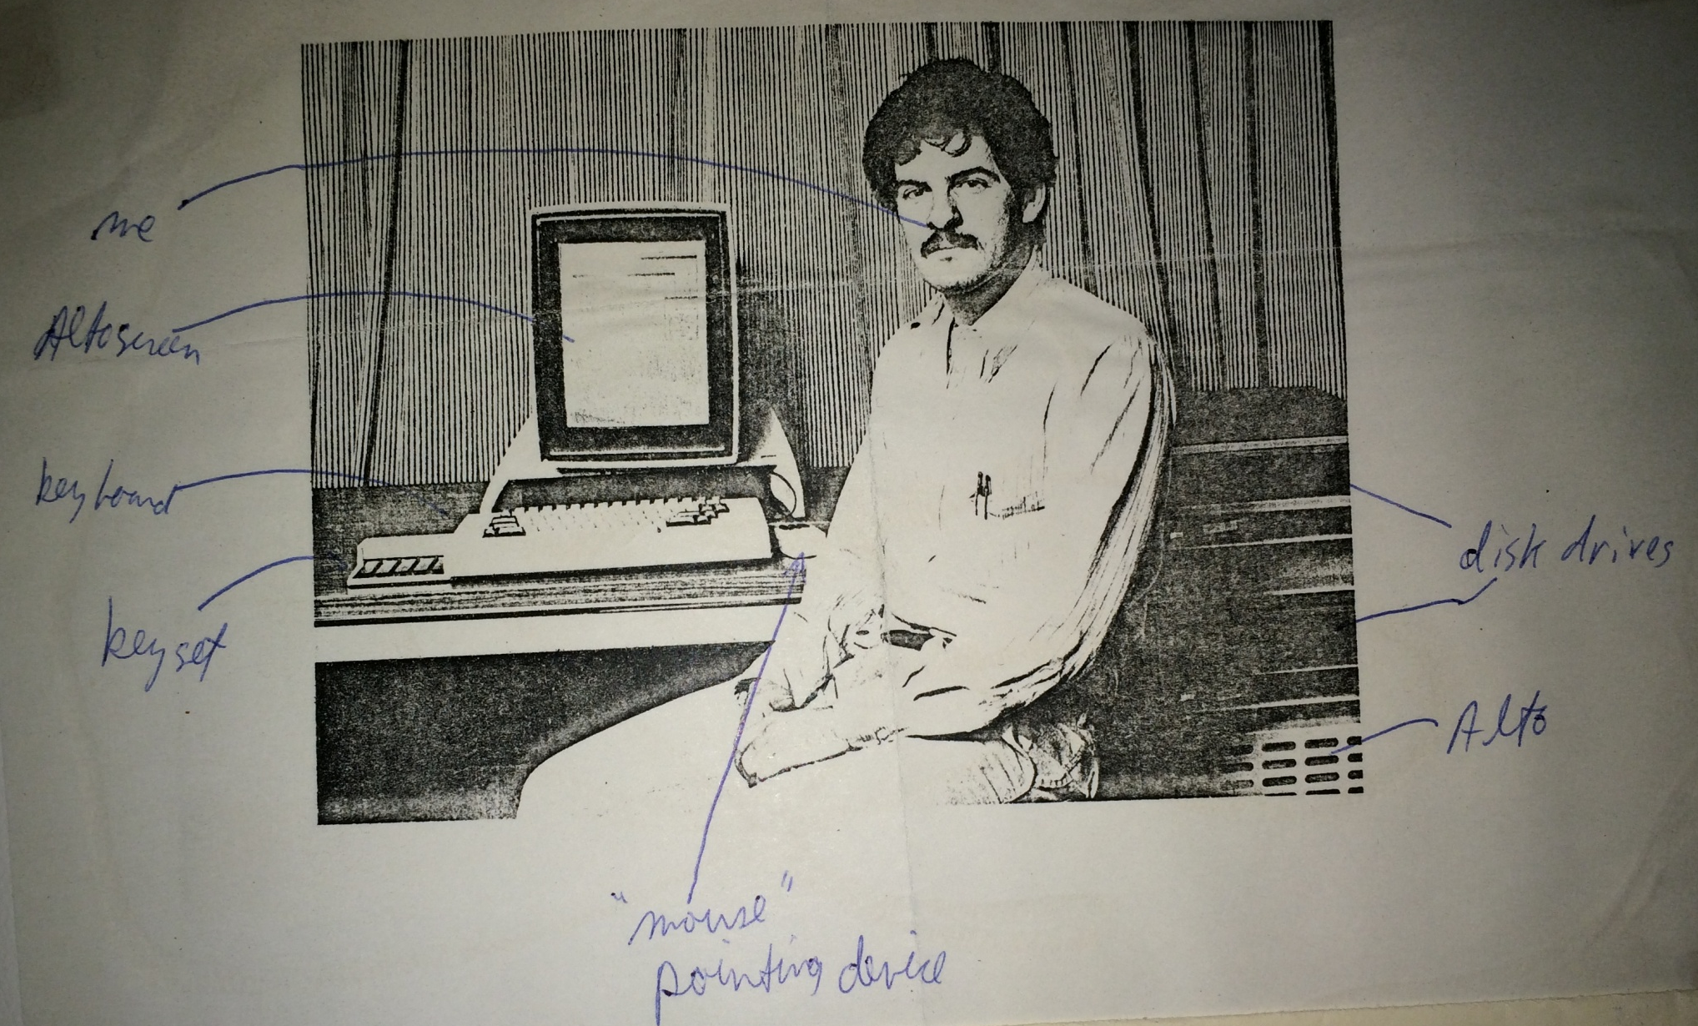
Brad Myers with an Alto, 1979
From my Dad’s scrapbook for that year, with my annotations!

Slide 14
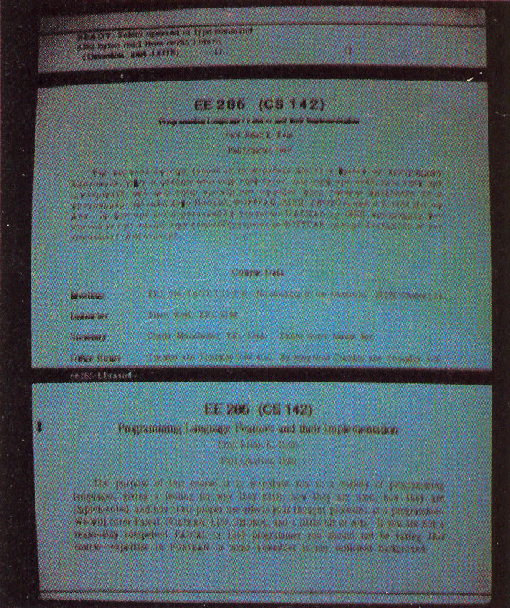
“Bravo”
Butler Lampson, Charles Simonyi and colleagues in 1974
  Simonyi went to Microsoft and created Microsoft Word
First WYSIWYG text editing
Multiple fonts, bold, italics, etc.
Justification
Interaction techniques are quite
different
  Left mouse button – select character,
  middle – select word, right – extend
  selection
  Left – scroll up, right – scroll down,
  middle - thumb
  Highly moded commands:
    “r” for replace, “d” delete, “I” insert,
    “ESC” for stop inserting, …
    “EDIT”

Slide 15
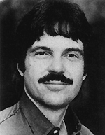
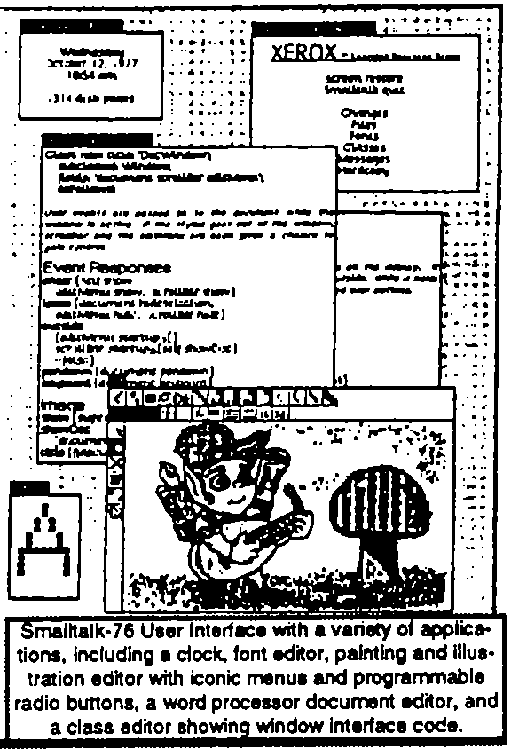
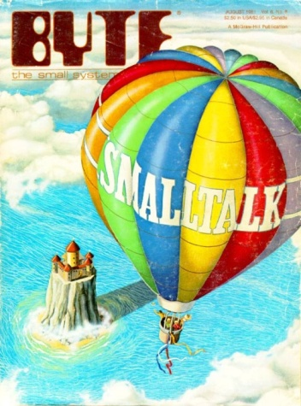
Smalltalk
Started about 1972 as the first purely
object-oriented language by Alan Kay
Alan Kay proposed the idea of overlapping windows in his 1969 doctoral thesis
Overlapping windows first appeared in
1974 in the Smalltalk’74 system
Also used popup windows, scroll bars, etc.
Larry Tesler invented the “browser” for code for Smalltalk
Smalltalk’80 is best known – Byte article, generally released and described
I worked with Smalltalk in 1977
All the interaction techniques will be
covered in the various topics

Slide 16
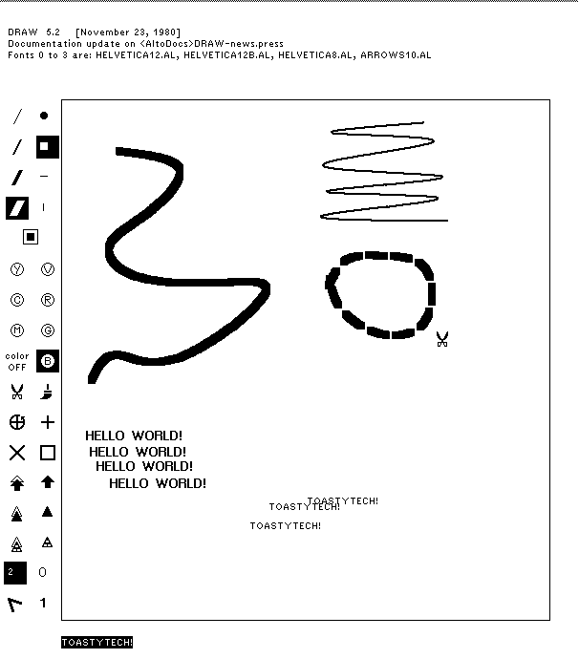
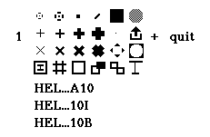
Various Drawing Programs
Draw – cubic splines for curves
Markup – in-place pop-up context menus
Source: http://toastytech.com/guis/saltodraw.png

Slide 17
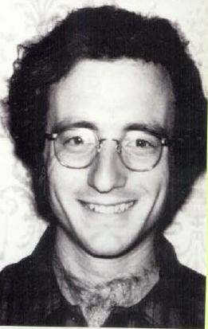
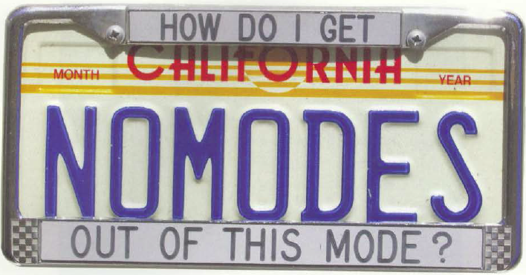
Larry Tesler
Xerox PARC 1973
  Rejected highly moded interactions of Bravo
  With Tim Mott, et. al, invented non-moded interactions for Gypsy editor including Copy and Paste about 1974
  Added to Smalltalk editing
Apple in 1980
  In charge of the Lisa
  design team

Slide 18
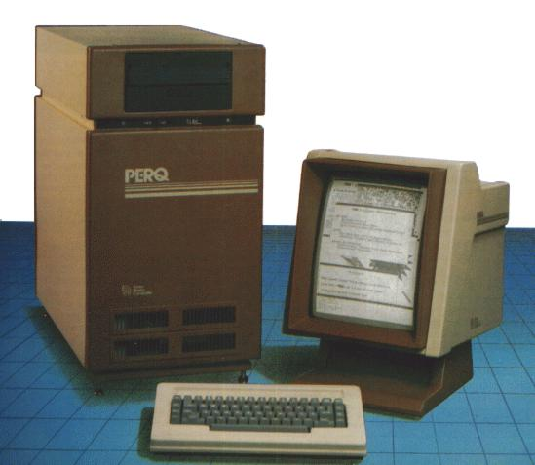
“Workstations”
Alto
Lisp Machines (LMI & Symbolics)
  About 1979-1995
Sun, Apollo, PERQ, Silicon Graphics
  About 1982 - 2000
About $10,000 each
For scientists, engineers,
programmers
Had mouse, window
managers

Slide 19
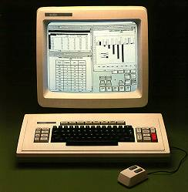
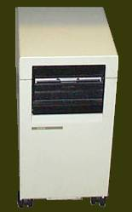
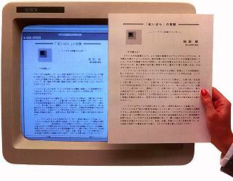
Xerox Star
Released 1982
Designed for executives
  Too expensive for secretaries
Large team of designers who
were not from PARC
  Their building was next door to PARC
Extensive user interface studies guided designs
Key innovations to be covered later
  Desktop metaphor
  Many modern widgets
  WYSIWYG editing and drawing
No PowerPoint or Spreadsheet
programs
Mostly closed – only Xerox made
applications
Too expensive and seemed slow
Images: http://toastytech.com/guis/star2.html

Slide 20
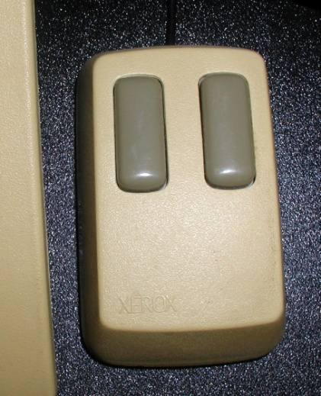
Star User Testing
"The design effort took more than six years .... The actual implementation involved from 20 to, eventually, 45 programmers over 3.5 years producing over 250,000 lines of highlevel code." [Harslem] By the time of the initial Star release, the Functional Test Group had performed over 15 distinct human-factors tests, using over 200 experimental subjects and lasting for over 400 hours (Figure 8). In addition, we applied a standard methodology to compare Star's text editing features to those of other systems [Roberts]. The group averaged 6 people (1 manager, 3 scientists, and 2 assistants) for about 3 years to perform this work.
-- [Bewley, CHI’1983]
One decision was to use a 2 button mouse!
Lots of special keyboard keys
Notes:
First real CHI conference

Slide 21
Apple
Xerox wanted to invest in Apple
In exchange, Steve Jobs got the right to use all of Xerox’s ideas
Steve & his team (Bill Atkinson) were given a demo of various Alto programs in 1979
  Mouse
  Smalltalk – overlapping windows – thought they updated
  Bravo WYSIWYG editing
Apple hired Larry Tesler & others, 1980

Slide 22
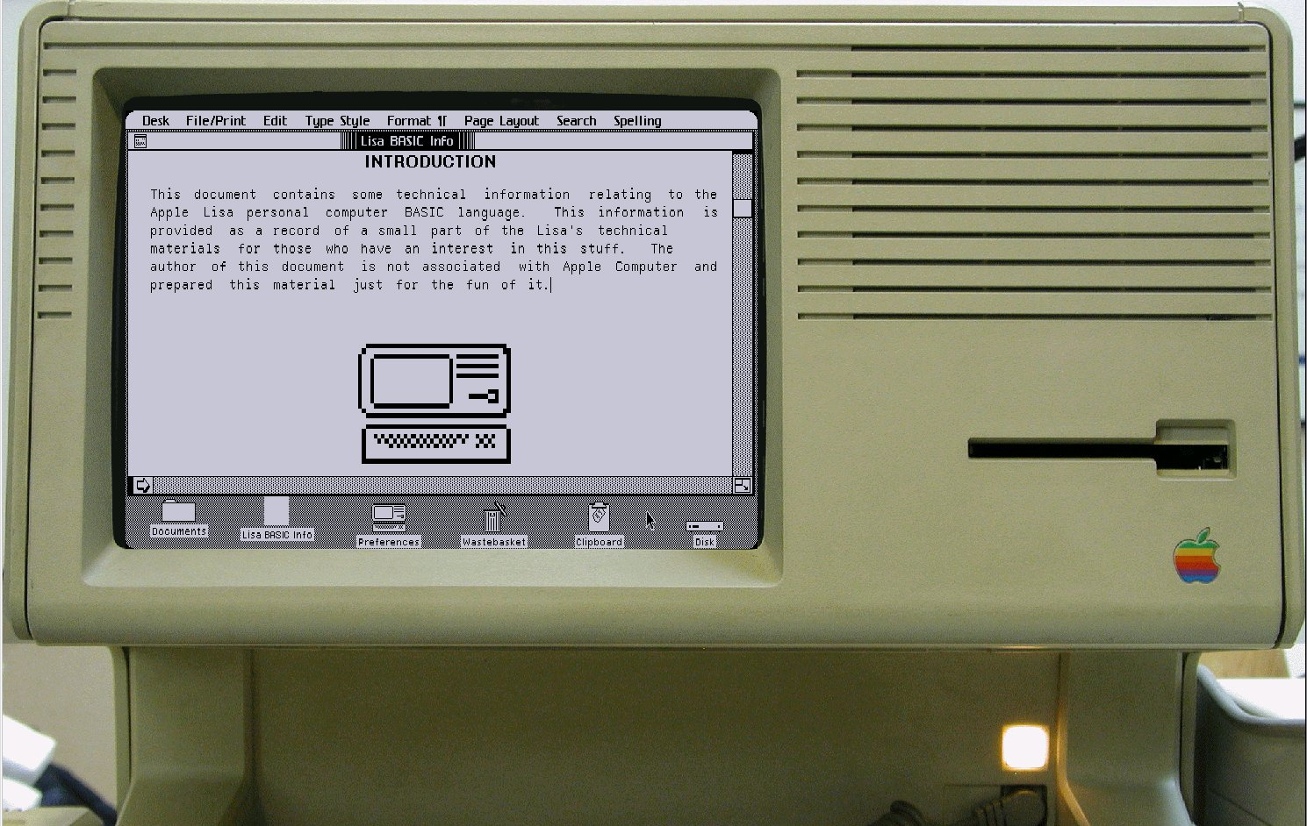
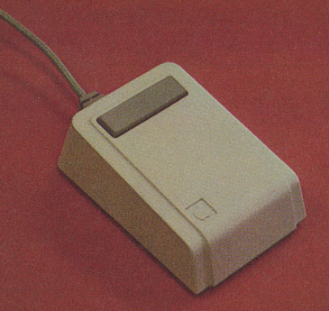
Apple “Lisa”
1983
Original design
for desktop
  Bill Atkinson &
  others
Novel pull-down menus (at top of screen)
Dialog boxes
Many other UI innovations
Doesn’t look or work like the Star
One button mouse
Amazing programming expertise to get it to work on a tiny, inexpensive machine
Image: http://toastytech.com/guis/lisa.html

Slide 23
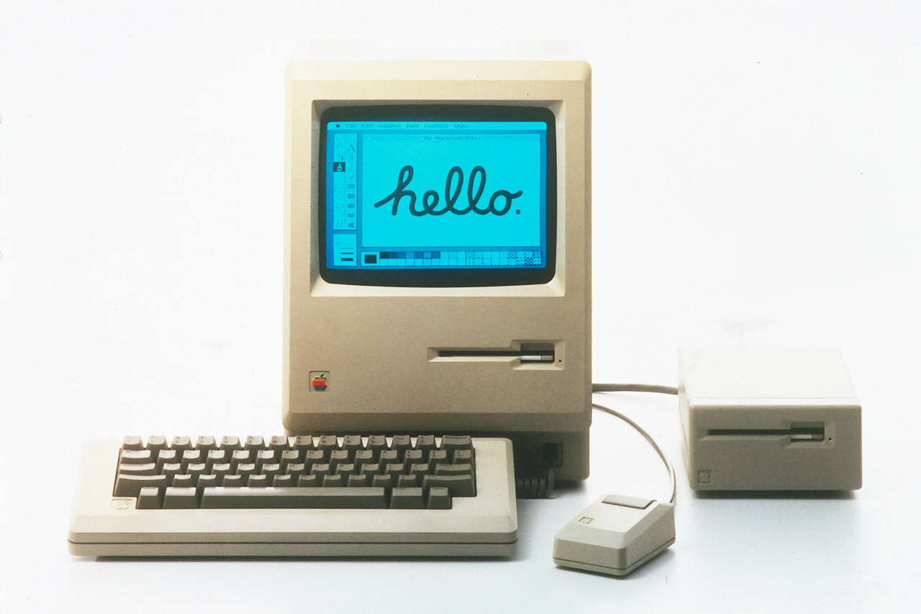
Original Macintosh
1984
Much cheaper
than Lisa
No harddisk – just one floppy
128 k-bytes of memory
  Much of code re-implemented in assembly
Famous 1984 Super Bowl ad by Ridley Scott

Slide 24
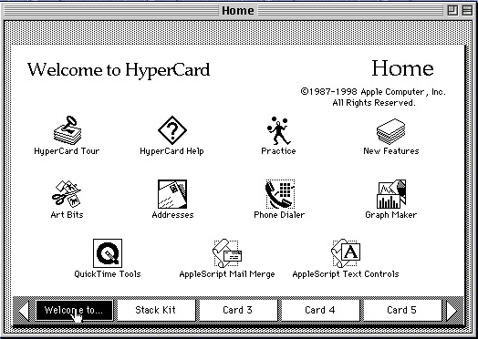
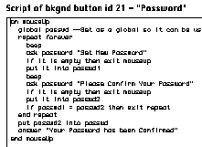
HyperCard
Bill Atkinson, 1987
Intention – “programming
for the rest of us”
  One of the first “prototyping” systems
  But not used for many “real” applications
Many UI innovations
  Tear off menus
  Pages that overlay each other
  Animated transitions
Programmed in “HyperTalk”
  English-like language

Slide 25
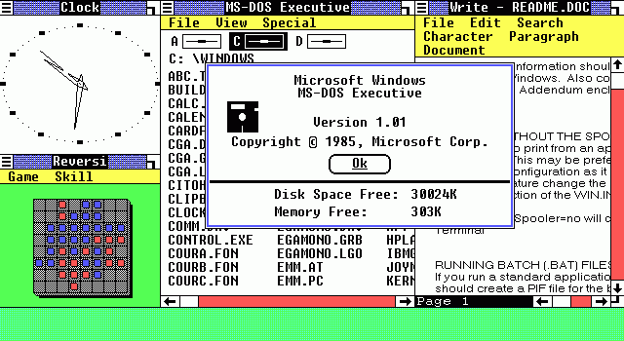
PCs & Windows
IBM PC – 1981
(IBM had missed the
“minicomputer” phase dominated by DEC)
Used Microsoft’s DOS 1.0 and shipped with VisiCalc
Windows 1.0 released in Nov, 1985 as DOS extension
  Tiled window manager
Windows 2.0 was overlapping 1987
Windows 3.0 in 1990, 3.1 in 1992
  Was a real operating system
  Added virtual memory, protected multiple processing, etc.
Windows 1
from Wikipedia

