Slide 1
Lecture 7: Implementing a Prototype: Overview of Using PowerPoint, Balsamiq, Axure, html, etc.
Brad Myers
05-863 / 08-763 / 46-863: Introduction to Human Computer Interaction for Technology Executives
Fall, 2013, Mini 2

Slide 2
Spring’2014 HCI Courses
Some people are interested in more HCI classes
Here is a partial list of some that might be available for non-majors (but there might be a waitlist) -- see full list
05-795 Applications of Cognitive Science
Implications of how people perceive and think
05-818 Design of Educational Games
05-833 Gadgets, Sensors and Activity Recognition in HCI
Standalone small devices, cameras, etc. (not GUIs)
05-834 Useable Privacy and Security
05-837 Ubiquitous Computing
Putting computation into everyday activities and devices
05-839 The Big Data Pipeline: Collecting and Using Big Data for Interactive Systems
05-891 Designing Human Centered Software
Similar to this course, but full semester; overview of HCI
05-899A Interaction Techniques -- my course!
05-899B Mobile Service Innovation

Slide 3
Implementing your Prototype
How “complete” an implementation for HW4?
Screen transitions must work
All buttons should do something, even if go to a “not implemented yet” page – facilitates user testing
Search, other computation does not have to work
“Click-through” level of behaviors
Must show any external reactions
E.g., taking a picture, starting microwave, making a copy…
Pop-up a dialog box saying what’s happening…
Level of complexity required:
(Same as listed on homework0 page)
At least 30 “controls” (widgets: buttons, text fields)
About 10 different screens/pages/windows/modes
Must be done in one (1) week – no extensions!
Will be given to your classmates for HW 5

Slide 4
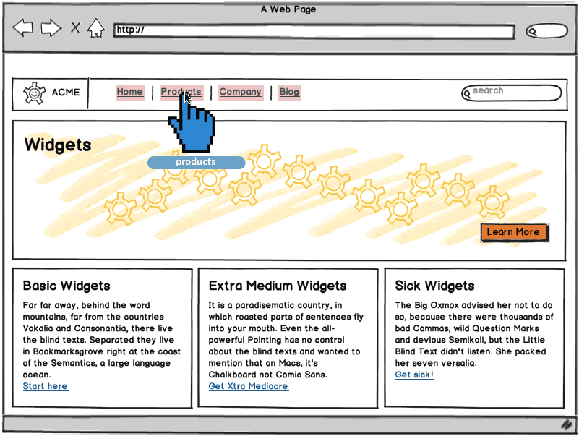
“Wireframe” Level Prototype
Outlines of the buttons and controls
No need for final graphics
Our requirement: sufficient functionality to support your tasks
Labels should be the real ones
So can test that users understand what they do
Source: http://support.balsamiq.com/customer/portal/articles/107999-specifying-interaction-with-mockups

Slide 5
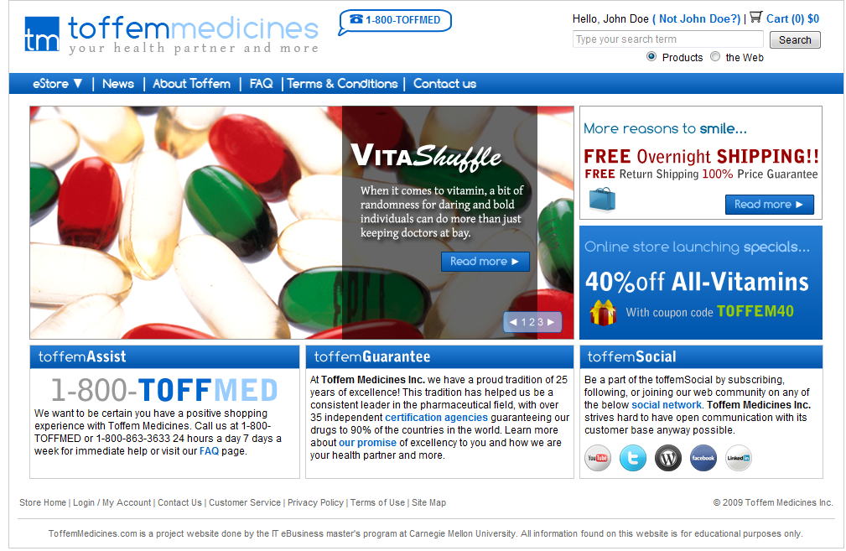
Or, Produce Final-Looking Graphics
Alternatively, could use Photoshop, Illustrator, etc. and produce final graphics
Designers want to show what real UI will look like
Details of the “look”
Web pages often use final graphics
E.g., Toffem Medicines
Add “click-through” behaviors
Usually limited mostly to screen transitions
Notes:
Search for “vitamins” on Toffem page
Note that all the buttons go to somewhere – most to the NIY page

Slide 6
Implementation Options for HW4
Pretty much any way you want
Must “work” – not just paintings
“Click-through prototypes”
We recommend you do not use Java, C++, Objective C (iPhone) or other “professional” language
Note: you must be able to create software that is easy for others to run
Output a set of web pages, or a pdf file
Cannot use OmniGraffle (Mac only) or Visio (PC only) unless can output as clickable pdf or something.

Slide 7
Recommended Options
These are easiest to use:
PowerPoint – Brad demo
Html + Imagemaps
Using editor like Dreamweaver – demo
Dreamweaver has a free 30-day trial
Html + Javascript (more programming)
Axure is a popular commercial tool – demo
www.axure.com
Advantage – only one with components that can be used on multiple pages
Balsamic – demo

Slide 8
Lots of other choices…
https://moqups.com/
Adobe Flash
Visual Basic
Resource Editor tools that lay out widgets
Old tools:
HyperCard (1998) & similar
Flash Catalyst (2010)

Slide 9
Lots of Lists of Tools
Search for “Prototyping tools” or “Wireframing Tools”
http://www.cooper.com/journal/2013/07/designers-toolkit-proto-testing-for-prototypes?utm_source=Cooper&utm_campaign=017b6536a1-Newsletter_Sept13&utm_medium=email&utm_term=0_162d77b95f-017b6536a1-85381653 (2013)
http://www.fuelyourcreativity.com/17-great-wireframing-tools-for-web-designers/ (2012)
http://www.creativebloq.com/wireframes/top-wireframing-tools-11121302 (2012)
http://mashable.com/2010/07/15/wireframing-tools/ - “10 free wireframing tools” (2010)
http://www.uxbooth.com/blog/15-desktop-online-wireframing-tools/ (2010)
http://www.uie.com/articles/prototyping_tools/?link=tips100318_6 (2010)

Slide 10
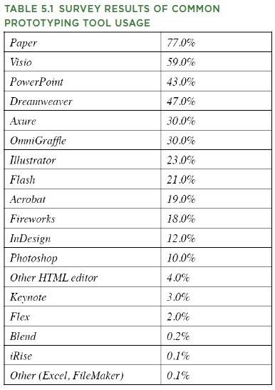
What Are People Using?
http://www.uie.com/articles/prototyping_tools/?link=tips100318_6
Mar 18, 2010
My survey results are similar (2007)

Slide 11
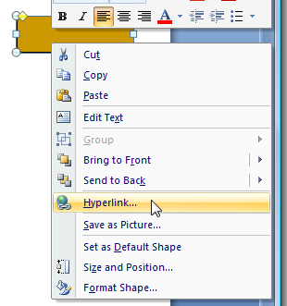
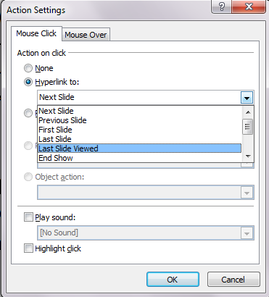
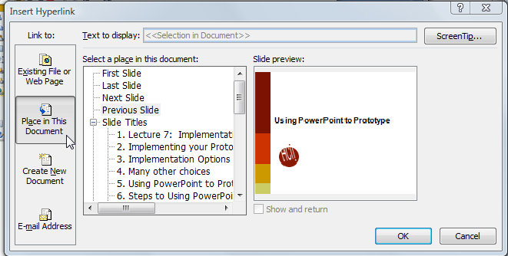
Using PowerPoint to Prototype
Add a shape, with a label
Add a “Hyperlink”:
Select “Place in this document”
Add an “Action”
More options, including “last slide viewed”
Useful for “under construction” page
Create a slide for each mode of the application
Can add nice animations
Go back
Go first
Return

Slide 12

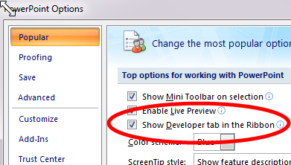
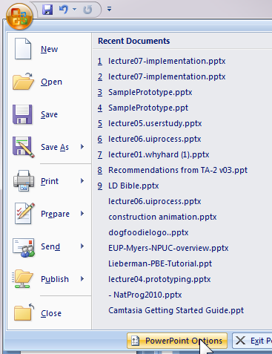

Adding Controls in PowerPoint
Turn on “Developer Toolbar”
Can add buttons, text entry, etc.
Script with VB

Slide 13
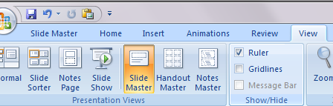
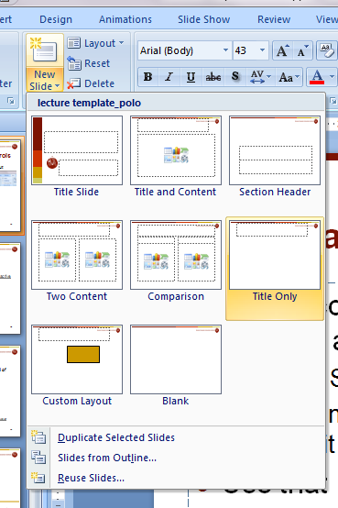
Use “Master” for Shared Controls
If want controls on multiple pages, can put them on a “Master”
“View / Slide Master”
Create new master slide and edit as with any other slide
Use that master for new slides
Drop down from “New Slide”
Controls like check boxes, text boxes in Master use same value across all slides

Slide 14
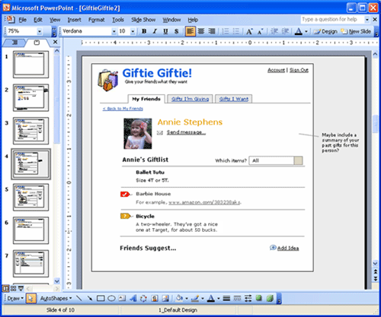
PowerPoint examples
Great training in using PowerPoint:
http://www.boxesandarrows.com/view/interactive
by Maureen Kelly on 2007/08/06

Slide 15
TA-Run Demos
Axure RP - Agnes Won
30 day trial, and free student license for those studying HCI
Balsamiq & Invision – Nina Xu
Professor Myers can get free on-line accounts for Balsamiq online for anyone in class – send him an email
HTML prototyping – Rebecca Chen

Slide 16
Axure RP
interactive wireframing & prototyping tool
agnes won
awon@andrew.cmu.edu

Slide 17
What is Axure RP?
A wireframing & rapid prototyping tool aimed at web and desktop applications
Generate HTML wireframes, mockups, and prototypes without any coding
Mac & PC Compatible with 30-day free trial
You might be eligible for a free software! http://axure.com/download https://www.axure.com/free-software-for-students

Slide 18
Some Examples
Demo http://www.axure.com/sample-prototypes
Tutorials http://www.axure.com/learn

Slide 19
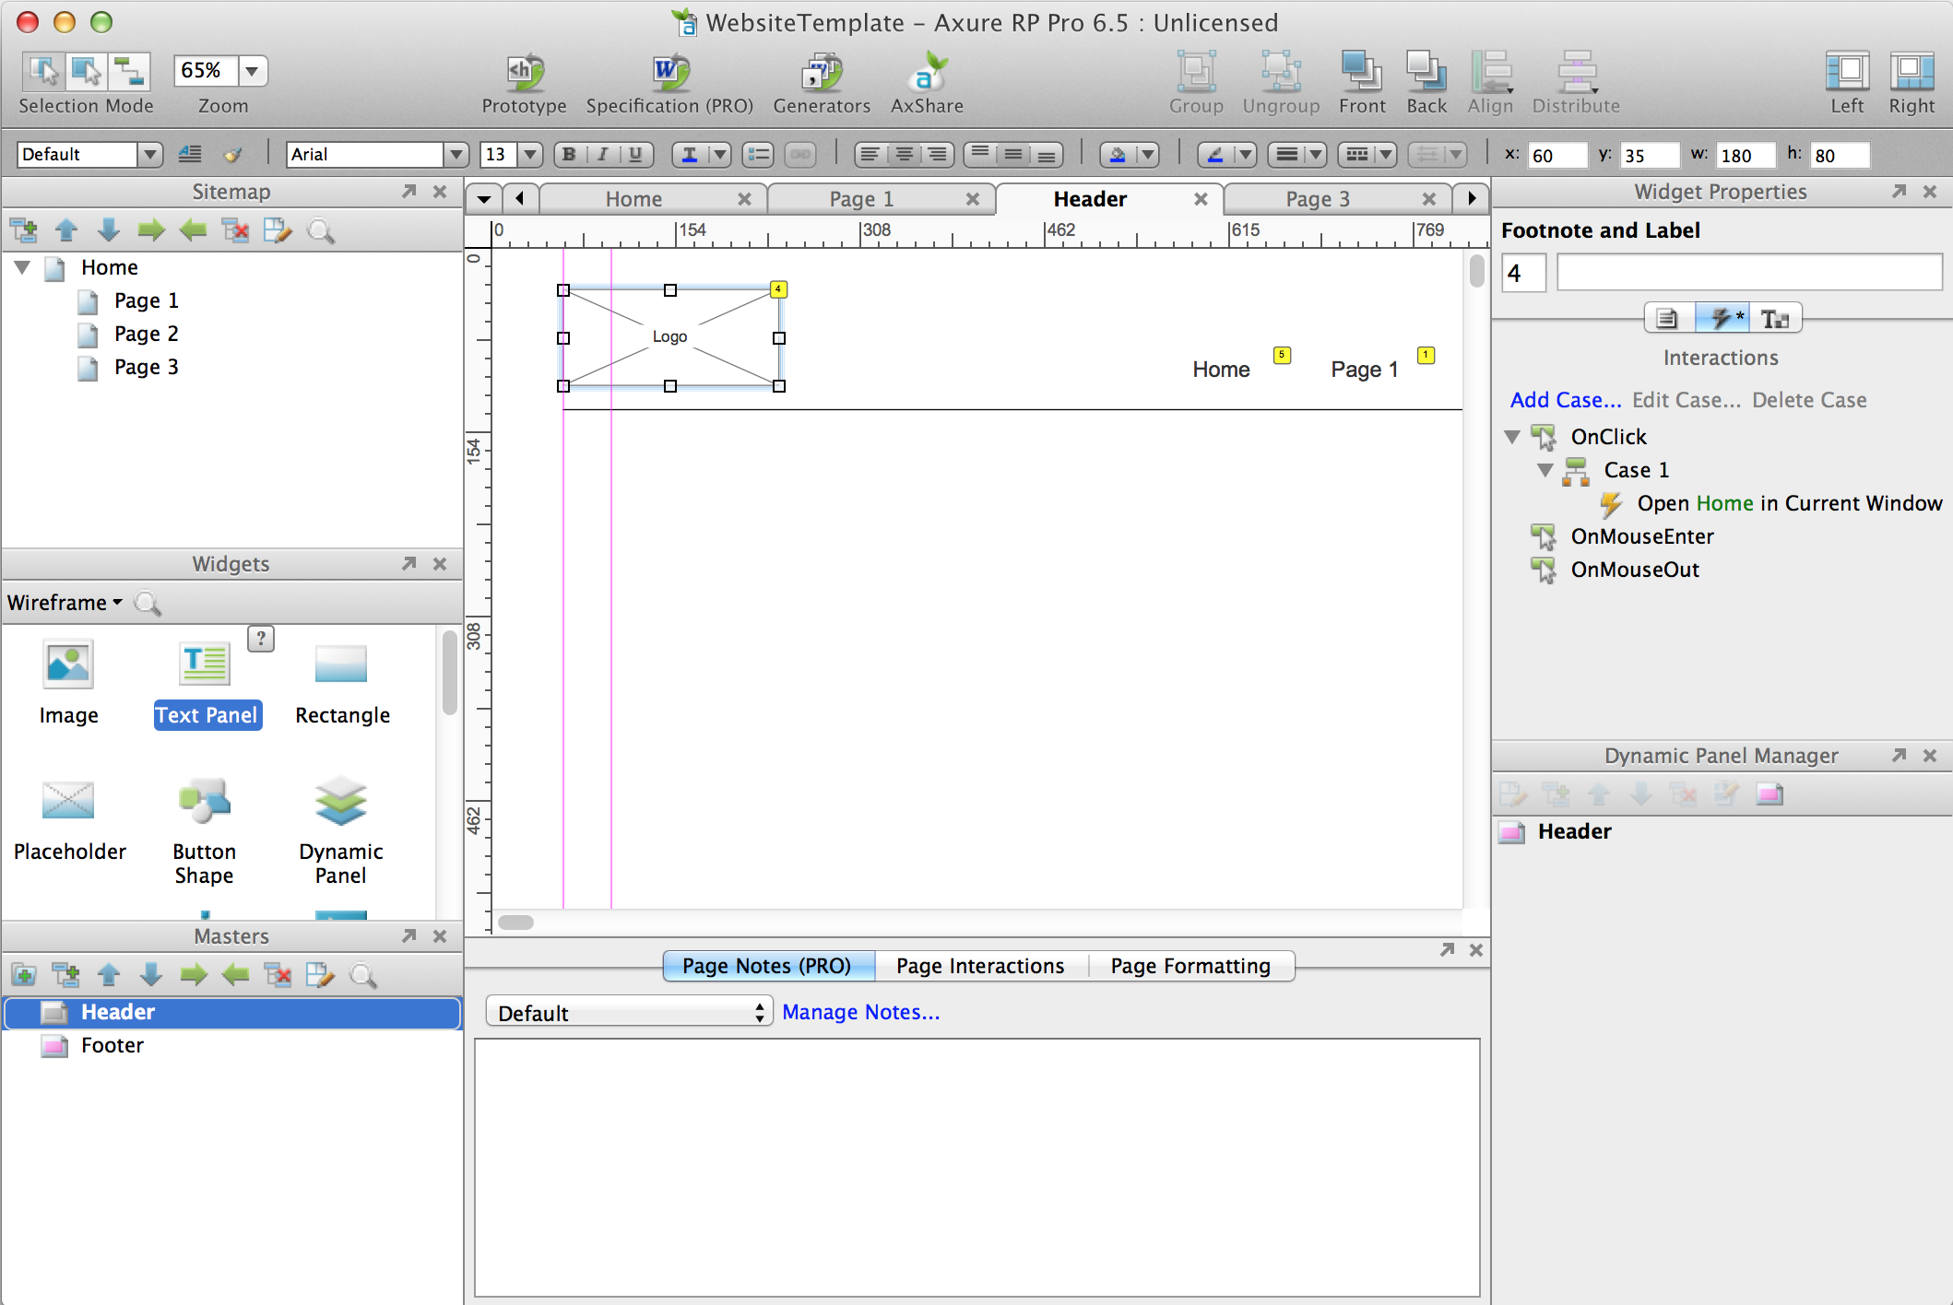
Axure RP

Slide 20
Page Area
page area
add content here

Slide 21
Sitemap
sitemap
organize content

Slide 22
Widgets
widgets
drag & drop elements

Slide 23
Masters
masters
create & apply master

Slide 24
Page Notes & Interactions
page notes & interactions
annotate & format pages

Slide 25
Widget Properties & Interactions
widget properties & interactions
tweak widgets

Slide 26
Useful Features
Master Pages http://www.axure.com/learn/masters/basic
Buttons http://www.axure.com/widgets/button-shape
Dynamic Panels http://www.axure.com/learn/dynamic-panels/basic

Slide 27

Master Pages
Build reusable assets and quickly apply global changes to your wireframes
Great for placing recurring elements on multiple pages e.g. Headers, footers, navigation, search bar

Slide 28
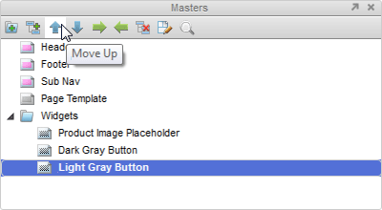
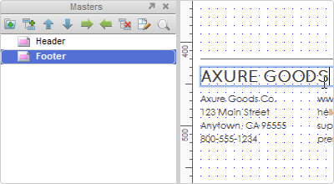
Master Pages
Can add masters to pages as well as other masters
Can apply multiple masters on a page

Slide 29
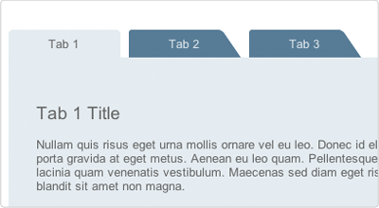
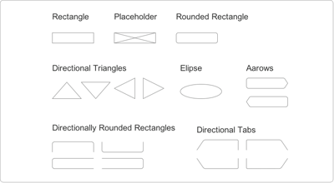
Buttons
Create links to other pages, hide/show elements, initiate/stop action
Create styled buttons or button shapes like rectangles & circles

Slide 30
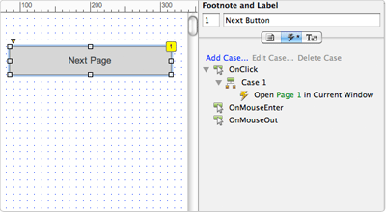
Buttons
You can choose to set actions for different states
onClick – when the user clicks on the button
onMouseEnter – when the mouse is within the space the button occupies
onMouseOut – when the mouse leaves the space the button occupies

Slide 31
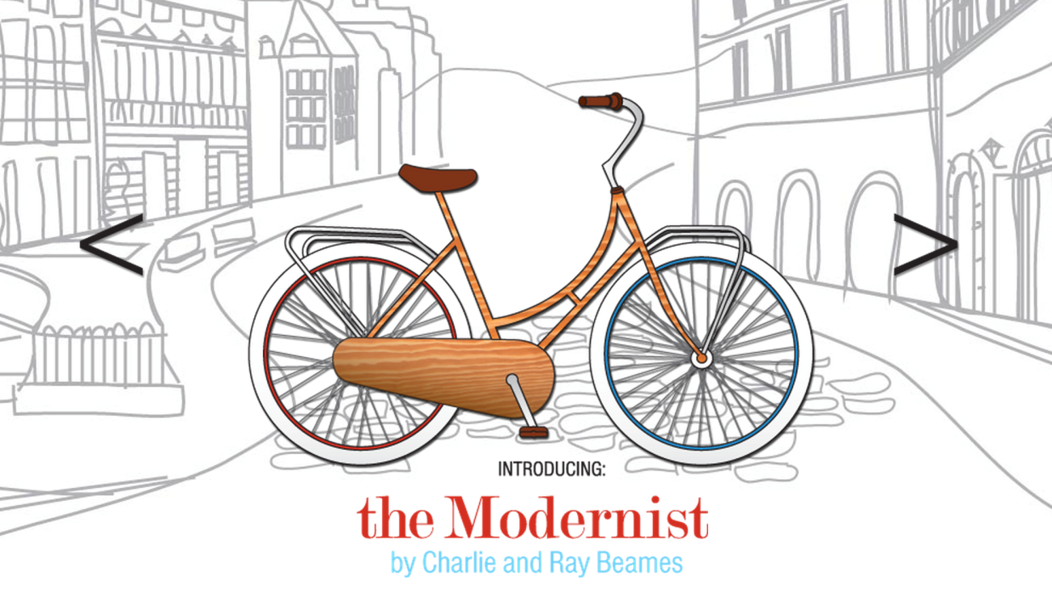
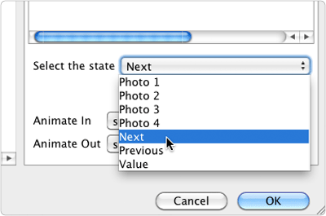
Dynamic Panels
Makes a portion of your page dynamic
Allows you to hide, show, swap, and move content in wireframes e.g. Rotate images and content in image slider/carousel

Slide 32
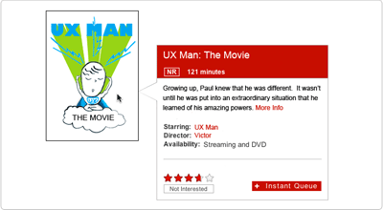
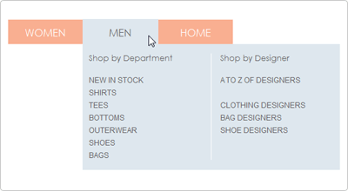
Dynamic Panels
Add both basic and advanced interactions with dynamic panels
You can demonstrate functionality in your prototype like custom tooltips, lightboxes, tab controls, and drag and drop

Slide 33
For More
Check out Axure Training http://www.axure.com/learn
Send me an email awon@andrew.cmu.edu

Slide 34
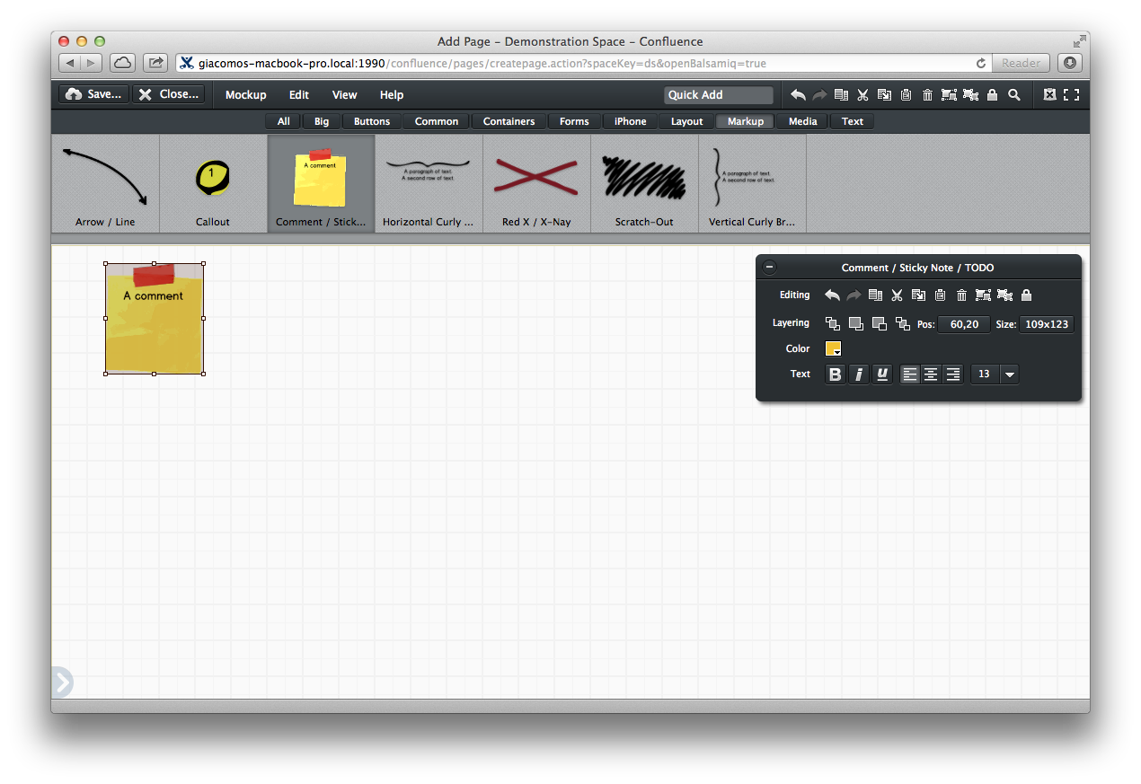
balsamiq
Rapid Wireframing and Mock-Up Tool
Nina Xu

Slide 35
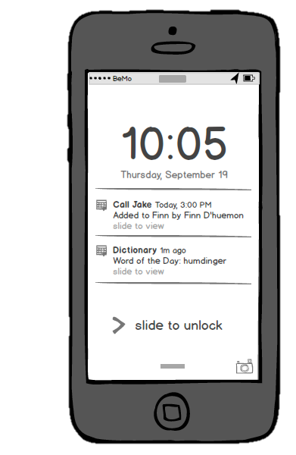
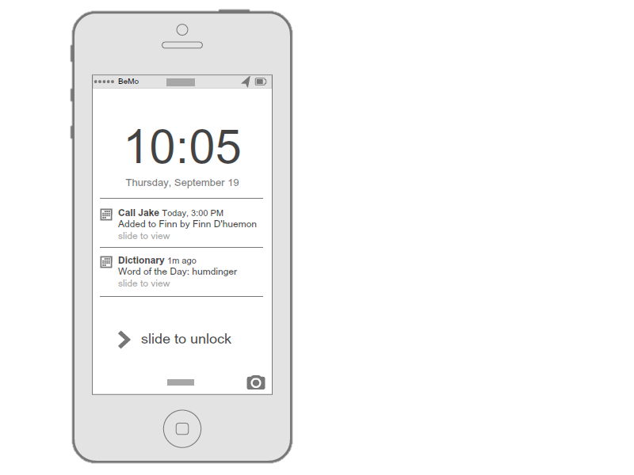
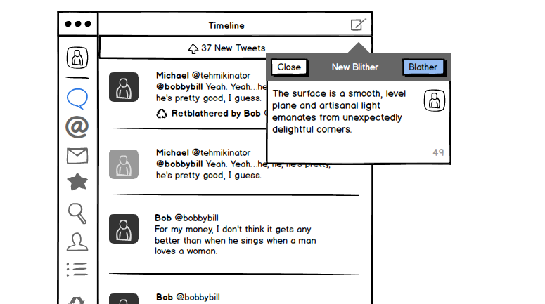
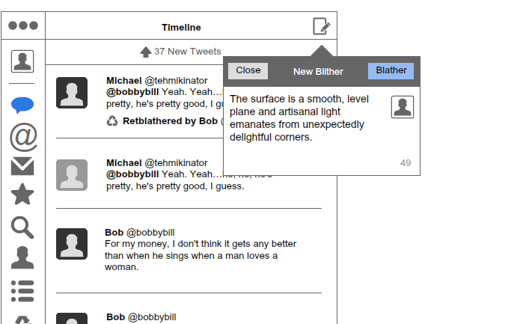
Low-fidelity prototypes,
Sketchy look and feel

Slide 36

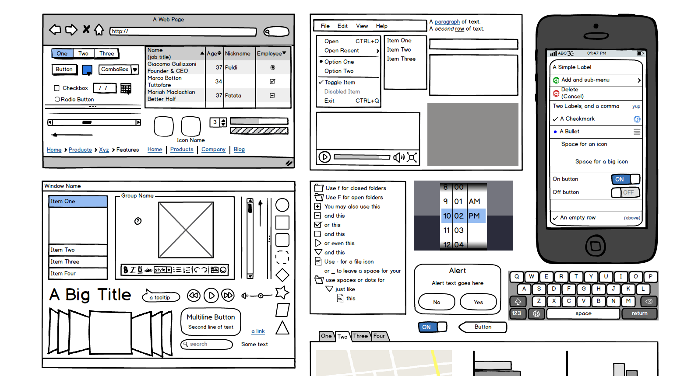
Drag and drop UI libraries

Slide 37
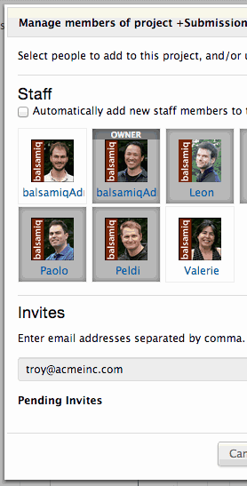
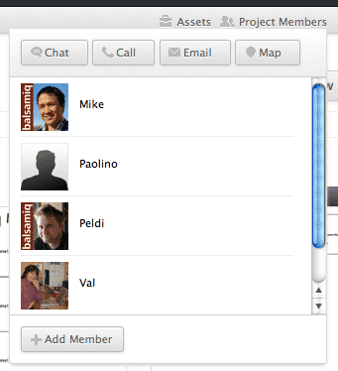
Collaborate and critique

Slide 38
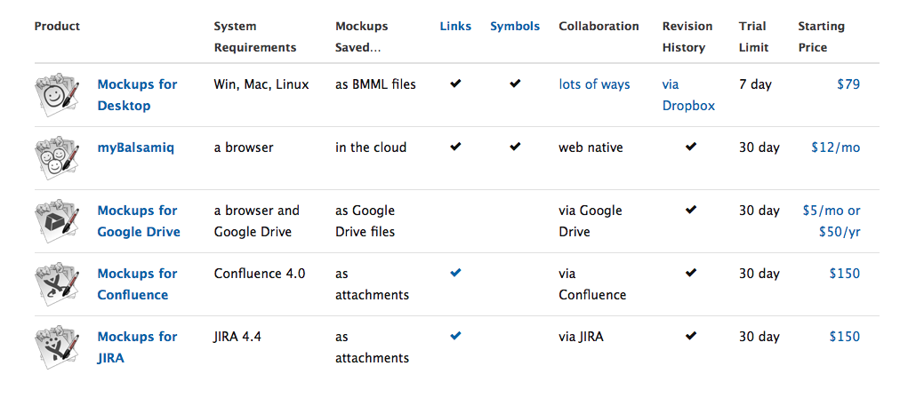
Which version should I use?

Slide 39
Drawbacks
Limited to low-fidelity
Cannot export as HTML
Does not support transitions or gesture effects
Rigid controls for complex elements

Slide 40
Get It Here
Sign Up or Download
https://www.mybalsamiq.com/signup
http://balsamiq.com/download/

Slide 41
Additional Resources
Tutorials and Videos
http://support.balsamiq.com/customer/portal/articles/1335124
Additional UI Libraries
http://support.balsamiq.com/customer/portal/articles/131430
User Testing with myBalsamiq Prototypes
http://support.balsamiq.com/customer/portal/articles/433253

Slide 42
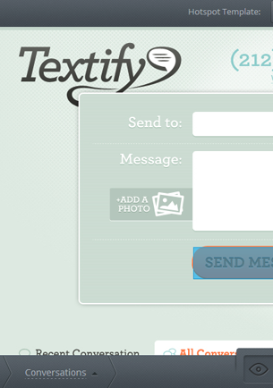
InVision
Collaborative Prototyping Tool
Nina Xu

Slide 43
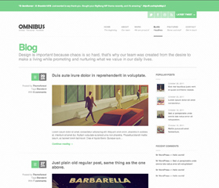
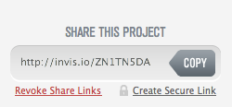
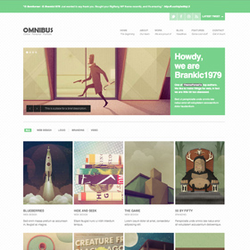
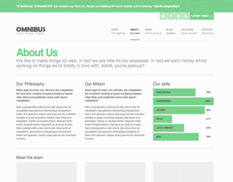
Click-through prototypes,
Generate a URL to display prototype online

Slide 44
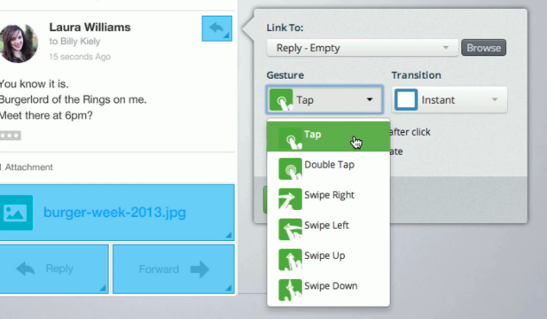
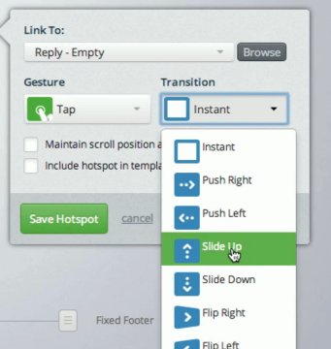
Add transitions and gesture effects (NEW!)

Slide 45
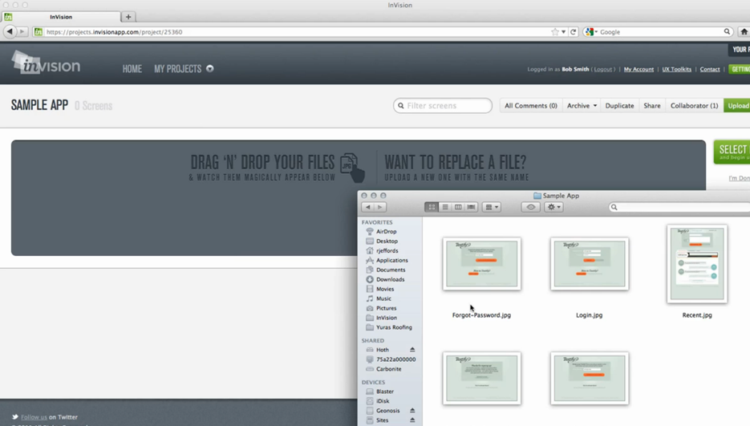
Drag and drop interface for uploading designs and creating hotspots

Slide 46
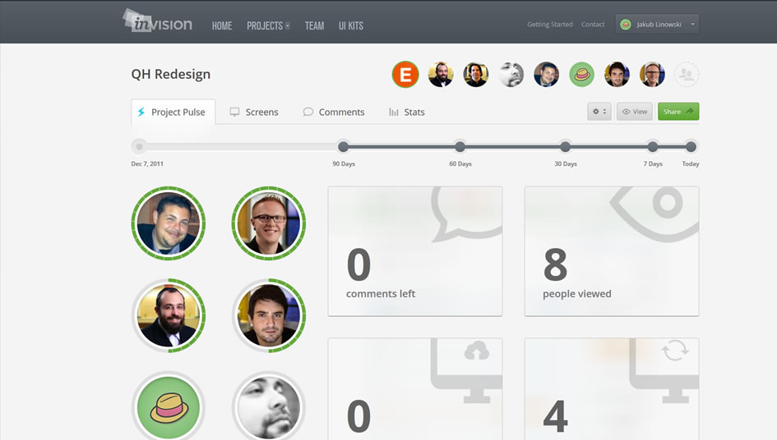
Collaborate and get feedback

Slide 47
Drawbacks
Cannot create or modify designs with tool
Mockups and screens must be imported
Supports limited file types (JPG, PNG, GIF)
Not as robust or powerful as other tools

Slide 48
Get It Here
Sign up free for one active project
http://www.invisionapp.com/plans

Slide 49
If you need any help…
Let me know at
ninax@andrew.cmu.edu

Slide 50
HTML PrototypING
Rebecca Chen

Slide 51
Benefits of HTML Prototyping
Provides a more “real” experience
Can be used for any fidelity
Allows more control over styles
Good for agile development
Less time to make quick changes

Slide 52
Frameworks
Twitter Bootstrap
Foundation
HTML Kickstart

Slide 53
How to use this method
Adobe Photoshop, Adobe Illustrator
Adobe Dreamweaver, iWeb
Text Editor
TextMate
TextEdit
Notepad
Sublime
Google Web Designer
Google Sites

Slide 54
Learn how to code
W3schools
Codecademy

