Slide 1
Lecture 7:
Implementing a Prototype:
Overview of Using PowerPoint, ***** html, etc.
Brad Myers
05-863 / 08-763 / 46-863: Introduction to
Human Computer Interaction for
Technology Executives
Fall, 2012, Mini 2

Slide 2

Happy
Thanksgiving!
No class Wednesday

Slide 3
Implementing your Prototype
How “complete” an implementation for HW4?
  Screen transitions must work
  All buttons should do something, even if go to a “not implemented yet” page
  Search, other computation does not have to work
  “Click-through” level of behaviors
Level of complexity required:
  (Same as listed on homework0 page)
  At least 30 “controls” (widgets: buttons, text fields)
  About 10 different screens/pages/windows/modes
  Must be done in one (1) week – no extensions!
Notes:
*** Say something about having something that shows external reactions

Slide 4
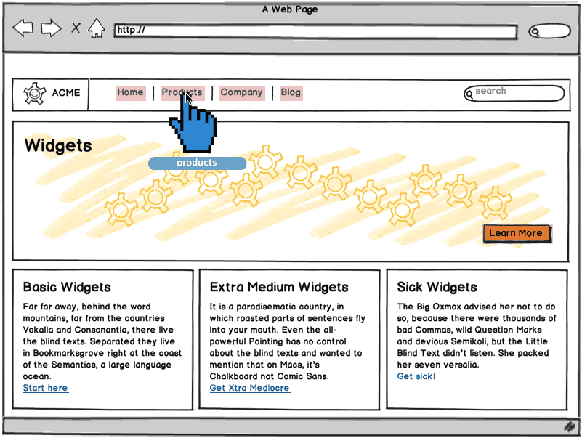
“Wireframe” Level Prototype
Outlines of the buttons and controls
No need for final graphics
Our requirement:
sufficient
functionality to
support your tasks
Labels should be
the real ones
  So can test that
  users understand
  what they do
Source: http://support.balsamiq.com/customer/portal/articles/107999-specifying-interaction-with-mockups
Notes:
*** Add that for the prototype for HW 5, need real data, not Album title 1 as above *** replace picture with one with filled in data.

Slide 5
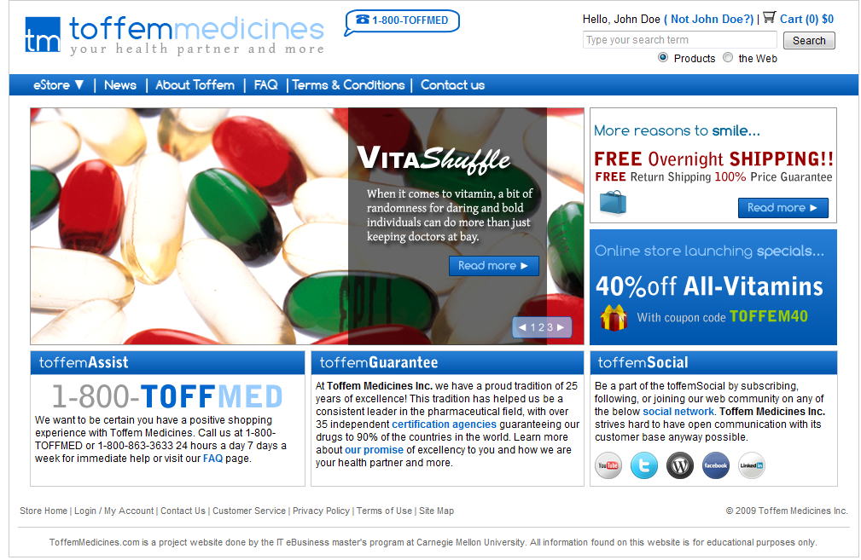
Or, Produce Final-Looking Graphics
Alternatively, could use Photoshop, Illustrator, etc. and produce final graphics
  Designers want to show what real UI will look like
  Details of the “look”
Web pages often use final graphics
  E.g., Toffem Medicines
Add “click-through”
behaviors
  Usually limited mostly
  to screen transitions

Slide 6
Implementation Options for HW4
Pretty much any way you want
  Must “work” – not just paintings
  “Click-through prototypes”
  Note: TAs and prof. will probably not be able to help you with your code
We recommend you do not use Java, C++, Objective C (iPhone) or other “professional” language
Note: you must be able to create software that is easy for others to run
  Output a set of web pages, or a pdf file

Slide 7
Recommended Options
These are easiest to use:
  PowerPoint – Brad demo
  Html + Imagemaps
    Using editor like Dreamweaver – Brad demo
    Dreamweaver has a free 30-day trial
  Html + Javascript (more programming)
  Adobe Flash – free trial
Axure is a popular commercial tool – Stephanie demo
  www.axure.com
Balsamic – Jenny demo

Slide 8
Many other choices
  Visio for wireframes
  Microsoft Expression Blend / Sketchflow
    Microsoft Visual Basic
    Free for students from https://www.dreamspark.com/Student/Software-Catalog.aspx
  Processing (www.processing.org)
  Python, tcl/tk, … or other desktop programming tool
  Ruby on Rails, or any other web scripting system
  http://mockupscreens.com/
  http://popapp.in – iPhone mockups from photos of sketches or Photoshop
  iRise: http://www.irise.com/ (visualization platform)

Slide 9
Lots of Lists of Tools
Search for “Prototyping tools” or “Wireframing Tools”
  http://www.fuelyourcreativity.com/17-great-wireframing-tools-for-web-designers/
  http://mashable.com/2010/07/15/wireframing-tools/ - “10 free wireframing tools”
  http://www.uxbooth.com/blog/15-desktop-online-wireframing-tools/
  http://www.tripwiremagazine.com/2010/04/15-best-wireframing-tools-for-designers.html
  http://www.uie.com/articles/prototyping_tools/?link=tips100318_6
  http://c2.com/cgi/wiki?GuiPrototypingTools

Slide 10
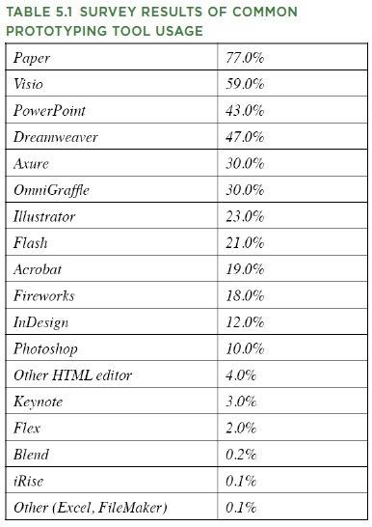
What Are People
Using?
  http://www.uie.com/articles/prototyping_tools/?link=tips100318_6
    Mar 18, 2010
  My survey results are similar (2007)

Slide 11
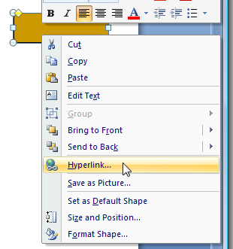
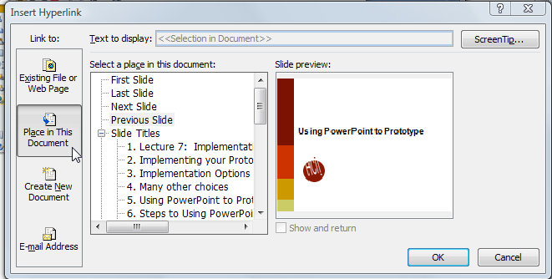
Using PowerPoint to Prototype
Add a shape, with a label
Add a hyperlink:
Select “Place in this document”
Create a slide for each mode of the
application
Can add nice animations
Go back
Go first

Slide 12

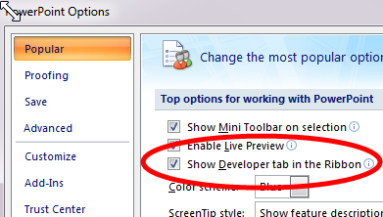
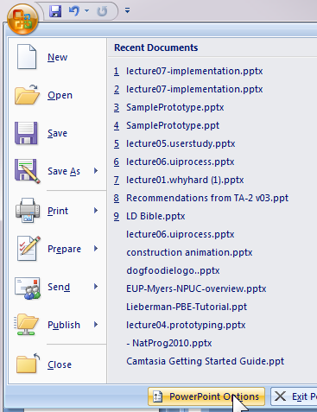

Adding Controls in PowerPoint
Turn on “Developer Toolbar”
  Can add buttons, text entry, etc.
  Script with VB

Slide 13
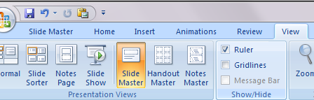
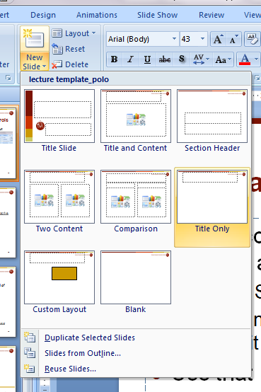
Use “Master” for Shared Controls
If want controls on multiple pages, can put them on a “Master”
  “View / Slide Master”
  Create new master slide
  and edit as with any other slide
Use that master for new slides
  Drop down from “New Slide”
Controls like check boxes, text
boxes in Master use same value
across all slides

Slide 14
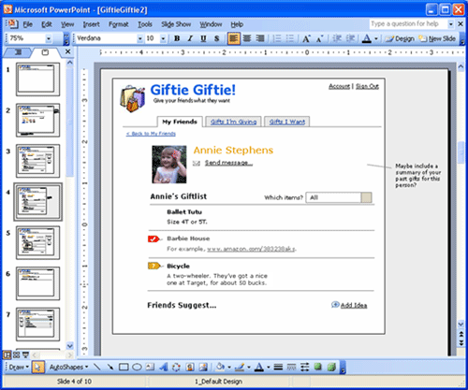
PowerPoint examples
Great training in using PowerPoint:
  http://www.boxesandarrows.com/view/interactive
    by Maureen Kelly on 2007/08/06

Slide 15
Html editing
Can use web editors to prototype any kind of interface
  Tricky for detailed layout
Can edit html using
  Microsoft Word (not recommended)
  Microsoft Expression Web (Blend)
    free for students: www.dreamspark.com
  Adobe Dreamweaver
    free trial: https://www.adobe.com/cfusion/tdrc/index.cfm?product=dreamweaver
  Many others

Slide 16
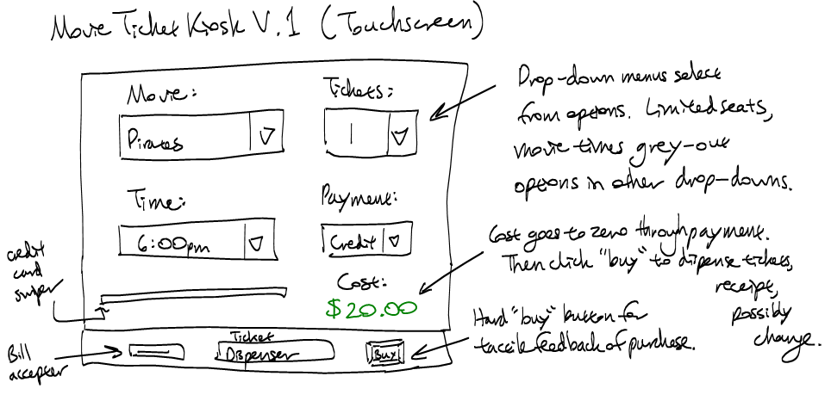
Example: Movie Kiosk
Dreamweaver works a lot like Word
Hint: use tables a lot for layout
Hint: Controls are in “forms”
Make use of the web for “how-to’s”
  E.g., “html button link”

Slide 17
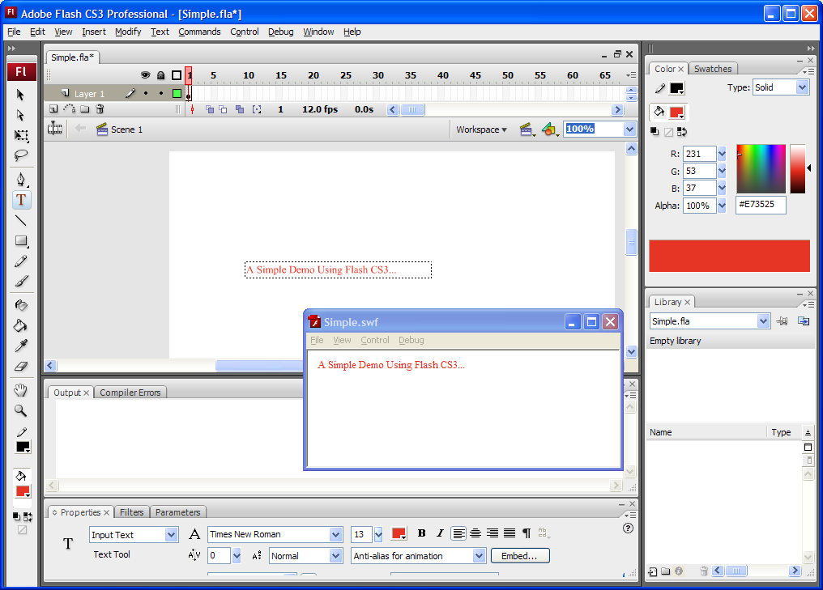
Adobe Flash
Free trial: http://www.adobe.com/products/flash/
Originally an animation tool
  Interactive editor with timeline
Also scripting in
“ActionScript”
(= JavaScript)
  Hint: ActionScript
  v.2 much easier to
  use than v.3

Slide 18
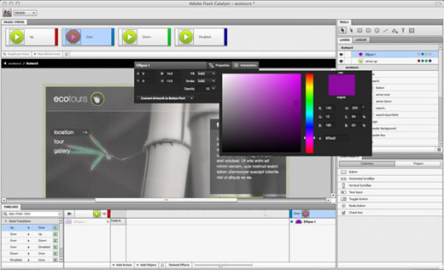
Adobe Flash Catalyst
Brand new tool in CS6
  (I consulted a little during its early design)
  De-emphasized ☹
Allows some of the behavior to be specified without scripting
  States &
  animations
Currently, no
“round tripping”

Slide 19
TA-Run Demos
Stephanie Chow
  Axure
    30 day trial, and free student license for those studying HCI
Jenny He (online tools)
  Fluid UI
  Balsamic
  Also, from the Chrome app store:
    Moqups
    Mockingbird
    FluidUI
    Mockflow
Lynn Streja
  Keynote (exporting to clickable PDF)
  Photoshop (exporting to html)

Slide 20
Axure RP
http://www.axure.com/
Stephanie Chow
Notes:
Email these slides out

Slide 21
What is Axure RP?
HTML Wireframes, mockups, and prototyping without coding
Mac and PC compatible
Free Trial for 30 days
  http://www.axure.com/download
  Mac download: 28 mb
  PC download: 60 mb
Notes:
It is possible to get a student free trial possibly.

Slide 22
What is Axure RP capable of?
Demos: http://www.axure.com/sample-prototypes
Extensive Tutorials: http://www.axure.com/training
Notes:
Here are some demos:

Slide 23
What is Axure RP capable of?
Demos: http://www.axure.com/sample-prototypes
Extensive Tutorials: http://www.axure.com/training
>> It is okay to stick with the basic features!

Slide 24
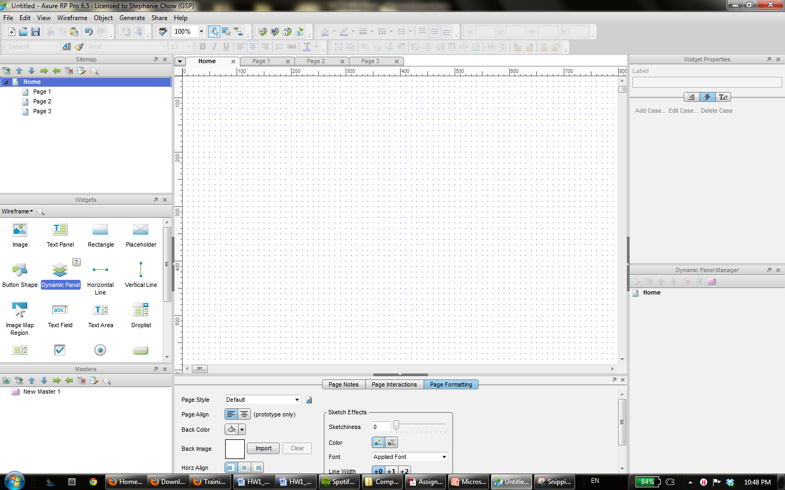
All the pages you make will show up here, and you can create more

Slide 25
Pages you open will show up here

Slide 26
Drag and drop widgets onto your page

Slide 27
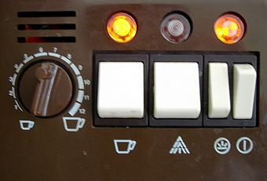
1st helpful feature: Master Pages
Helpful for creating parts of the prototype that stay the same always, for example:
  Header links or menus on a website
  Hardware buttons

Slide 28
1st helpful feature: Master Pages
Online Tutorial for Master Pages
  http://www.axure.com/masters

Slide 29
2nd helpful feature: Buttons
Helpful for creating links to other pages, initiating actions, stopping actions, etc.
  Tutorial: http://www.axure.com/widgets/button-shape
Note: There are “Buttons”, and “Button Shapes”
  Button Shapes can be used to make invisible, and strange-looking buttons – basically they’re more customizable

Slide 30
2nd helpful feature: Buttons
You can choose to set actions for three situations:
  onClick – when the user clicks on the button
  onMouseEnter – when the mouse is within the space the button occupies
  onMouseOut – when the mouse leaves the space the button occupies

Slide 31
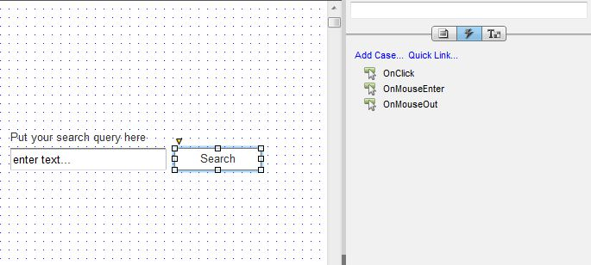
2nd helpful feature: Buttons

Slide 32
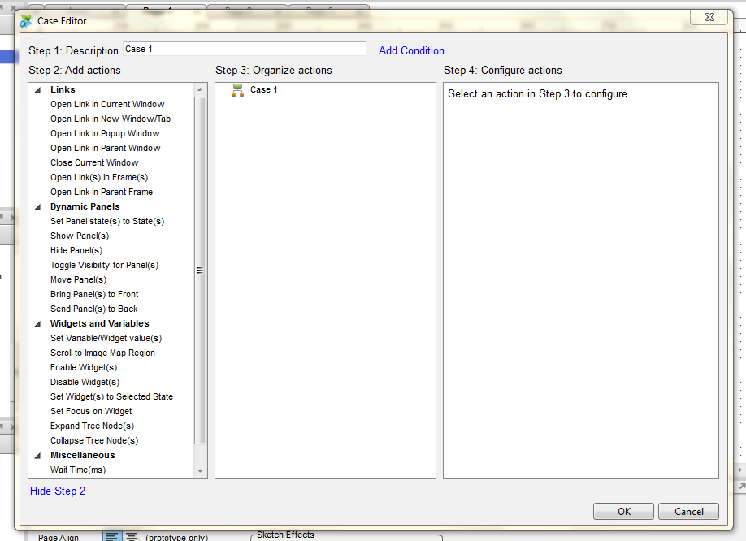
Useful for linking one page to another

Slide 33
The page you select to show up will be a popup window

Slide 34
You can do lots of things with dynamic panels too

Slide 35
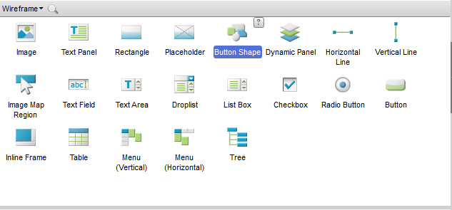
NOTE: besides buttons there are other widgets

Slide 36

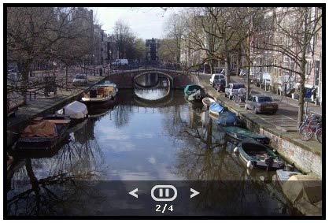
3rd Helpful Feature: Dynamic Panels
What if you want everything on a page to stay the same, except for one part?

Slide 37
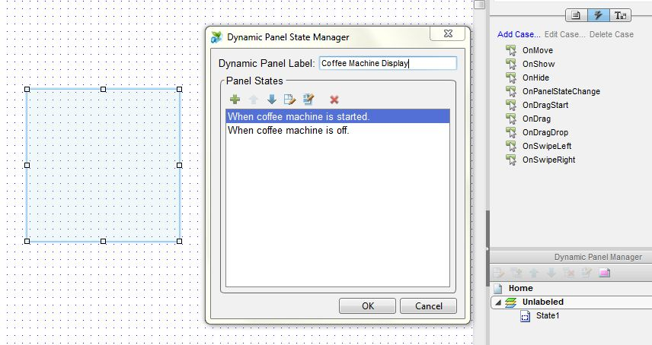
3rd Helpful Feature: Dynamic Panels

Slide 38
3rd Helpful Feature: Dynamic Panels

Slide 39
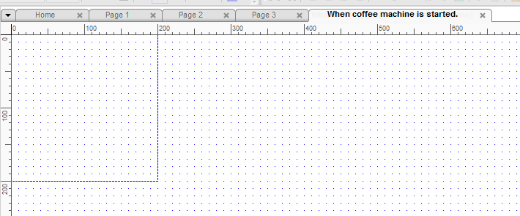
3rd Helpful Feature: Dynamic Panels

Slide 40
3rd Helpful Feature: Dynamic Panels

Slide 41
3rd Helpful Feature: Dynamic Panels
Tutorial: http://www.axure.com/dynamic-panels-basic

Slide 42
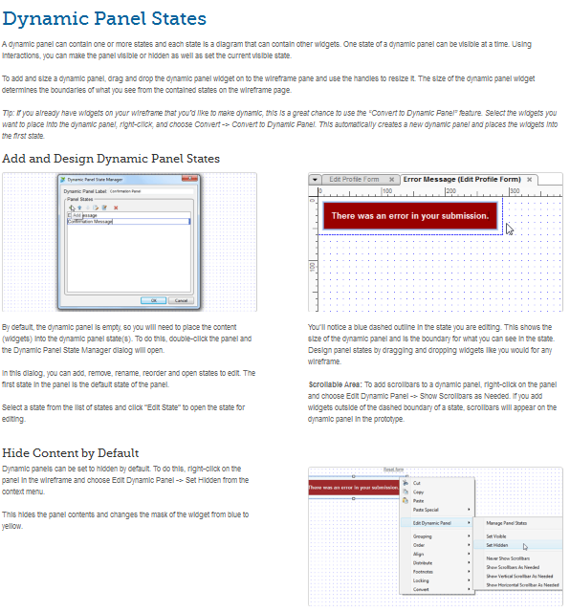
When in doubt…
Check out Axure Training
Email me at stephaniechow@cmu.edu
Set up a skype meeting with me @schow1

Slide 43
Online Wireframing Tools
Jenny He

Slide 44
Pros and Cons
Pros
Mostly free
No downloads needed
Access from any computer
Cons
Limited widget selection
Mostly only good for website or mobile mockups

Slide 45
