Slide 1
Lecture 26: Constraints and Data Bindings
05-431/631 Software Structures for User Interfaces (SSUI)
Fall, 2022

Slide 2
Logistics
Last regular lecture!
Student group presentations Thursday+Friday
Everyone is expected to attend both in person
Please fill out the class questionnaire: https://www.surveymonkey.com/r/SSUI2022Fall-Final

Slide 3
Constraints
Relationships defined once and maintained by the system
Useful for keeping parts of the graphics together.
Also for passing values around
Typically expressed as arithmetic or code relationships among variables.
Variables are often the properties of objects (left, color)
Types:
"Dataflow" constraints; Choices:
Single-Output vs. Multi-output
Types: One-way, Multi-way, Simultaneous equations, Incremental, Special purpose
Cycles: supported or not
Others: AI systems, scheduling systems, etc.

Slide 4
Historical Note: “Active Values”
Old Lisp systems had active values
Attach procedures to be called when changed
Similar to today’s “Listeners” or “Observer pattern”
Like the “inverse” of constraints
Procedures are attached to values which change instead of values where needed
Push vs. Pull
Inefficient because all downstream values are re-evaluated, possibly many times
E.g., when x and y values change

Slide 5
Important Historical Constraint Systems
Alan Borning’s ThingLab (1979)
Spreadsheets (~1979)
Peridot (1987) (Myers)
Garnet & Amulet (1989, 1994) (Myers)
Graphics and “data bindings”
DeltaBlue (1990) (Freemen-Benson)
SkyBlue (1994) (Michael Sannella)
subarctic (Hudson) (1991)
Gleicher’s (1993)
…

Slide 6
Some Constraint Systems Today
Apple constraints for “Auto Layout”
Toolkit and windows “layout managers”/”geometry managers” (lecture 10)
“data bindings”
Usually one-to-one two-way connections
Adobe Flex, AngularJS
Google’s AngularJS (before v2)
Most AutoDesk (CAD) products, e.g., Fusion 360 for 2D & geometric
Ember. http://emberjs.com/
MVC, “Computed Values” of properties
KnockoutJS. http://knockoutjs.com/
“Declarative Bindings”, “Dependency Tracking”
Research: Stephen Oney’s ConstraintJS https://from.so/ (2012)

Slide 7
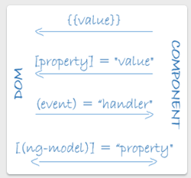
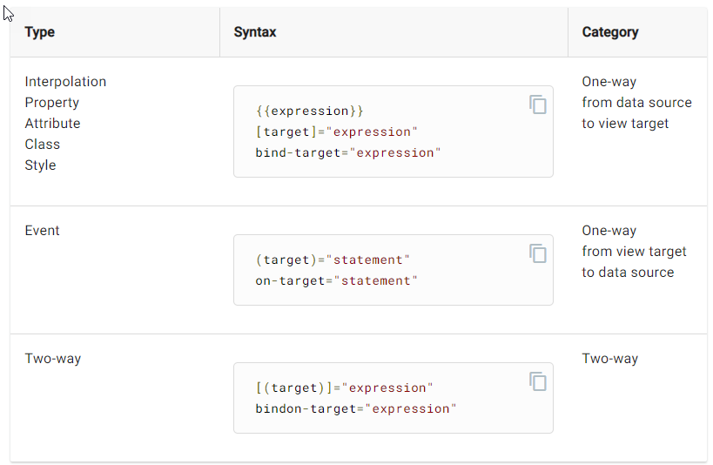
Angular Data Bindings
Tie DOM properties to other values
Can be one-way or two-way
Use [] to bind from source to view.
Use () to bind from view to source.
Use [()] to bind in a two way sequence of view to source to view.
https://angular.io/guide/architecture-components#data-binding
https://angular.io/guide/binding-syntax

Slide 8
One Way Constraints
Simplest form of constraints
D = F(I1, I2, ... In)
Often called formulas since like spreadsheets
Can be other dependencies on D
CurrentSliderVal = mouse.X - scrollbar.left scrollbar.left = window.left + 200 scrollbar.visible = window.has_focus

Slide 9
Data flow graph
Nodes for variables (values) grouped into objects
Lines for data flow for the constraints
Reverse direction of lines for “dependencies”
E.g., A = B+5
B’s value flows to A
A’s value depends on B
Often need back-pointers too to clean up when change
A = 15
B = 10
A = 15
B = 10

Slide 10
One Way Constraints
CurrentSliderVal = mouse.X - scrollbar.left scrollbar.left = window.left + 200 scrollbar.visible = window.has_focus
CurrentSliderVal = f1() =17
scrollbar
…
Window
…
mouse
left = f3() = 250
left = 50
X = 267
top = 835
top = 5
Y = 840
visible = f2() = true
has_focus = true

Slide 11
One Way Constraints, cont.
Not just for numbers: mycolor = x.color
Implementations:
1. Just re-evaluate all required equations every time a value is requested
least storage, least overhead
Equations may be re-evaluated many times when not changed. (e.g, scrollbar.left when mouse moves)
cycles: file_position = F1(scrollbar.Val) scrollbar.Val = F2(file_position)
Objects may jitter – change X and then change Y
Cannot detect when values change (to optimize redraw)
2. More efficient algorithms are available

Slide 12
Garnet / Amulet Constraint Solving
Default: one-way, data flow constraints with variables in the dependencies, support for cycles, and multiple changes before solving
Efficient enough for ubiquitous use
Garnet text button widget contained 43 constraints internally, and the Lapidary graphical interface builder contained 16,700 constraints
Also can bring in alternative solvers
Brad Vander Zanden’s multi-way solver [Vander Zanden 1996]
“Animation Constraints” [Myers 1996]
Snippets of video for Garnet and Amulet constraints

Slide 13
Garnet / Amulet Default Algorithm
D=f()=?
p = obj1
Variables in the dependencies
Example: D = p^.left + A
Important innovation in Garnet we invented, now ubiquitous
Supports feedback objects
outlineRect.left = selectedObject^.left … circle1.object_over = rect34 circle1.left = self.object_over.right + 10
Supports loops: D = Max(components^)
Only evaluates needed part of conditionals width = if otherpart.value > tolerance then expensive computation else otherpart.width
Requires the dependencies be dynamically determined
A = 15
obj1
obj2
left = 12
left = 22
top = 5
top = 15

Slide 14
Garnet / Amulet Default Algorithm
D=f()=27
p = obj1
Variables in the dependencies
Example: D = p^.left + A
Important innovation in Garnet we invented, now ubiquitous
Supports feedback objects
outlineRect.left = selectedObject^.left … circle1.object_over = rect34 circle1.left = self.object_over.right + 10
Supports loops: D = Max(components^)
Only evaluates needed part of conditionals width = if otherpart.value > tolerance then expensive computation else otherpart.width
Requires the dependencies be dynamically determined
A = 15
obj1
obj2
left = 12
left = 22
top = 5
top = 15

Slide 15
Garnet / Amulet Default Algorithm
D=f()=37
p = obj2
Variables in the dependencies
Example: D = p^.left + A
Important innovation in Garnet we invented, now ubiquitous
Supports feedback objects
outlineRect.left = selectedObject^.left … circle1.object_over = rect34 circle1.left = self.object_over.right + 10
Supports loops: D = Max(components^)
Only evaluates needed part of conditionals width = if otherpart.value > tolerance then expensive computation else otherpart.width
Requires the dependencies be dynamically determined
A = 15
obj1
obj2
left = 12
left = 22
top = 5
top = 15

Slide 16
Examples of Expressing Constraints
Garnet:
(create-instance NIL opal:line
(:points '(340 318 365 358))
(:grow-p T)
(:x1 (o-formula (first (gvl :points))))
(:y1 (o-formula (second (gvl :points))))
(:x2 (o-formula (third (gvl :points))))
(:y2 (o-formula (fourth (gvl :points)))))
Amulet:
Am_Define_Formula (int, height_of_layout) {
int h = (int)Am_Height_Of_Parts(self) + 2 * ((int)self.Get(Am_TOP_OFFSET));
return h < 75 ? 75 : h;
}
am_empty_dialog = Am_Window.Create("empty_dialog_window")
.Set (Am_LEFT_OFFSET, 5) // used in width_of_layout
.Set (Am_TOP_OFFSET, 5) // used in height_of_layout
.Set (Am_WIDTH, width_of_layout)
.Set (Am_HEIGHT, height_of_layout)
...

Slide 17
Other One-Way Variations
Multiple outputs
(D1, D2, ... Dm) = F(I1, I2, ... In)
Side-effects in the formulas
useful for creating objects
when happen?
what if create new objects with new constraints
cycles cannot be detected
Constant formula elimination
To decrease the size used by constraints

Slide 18
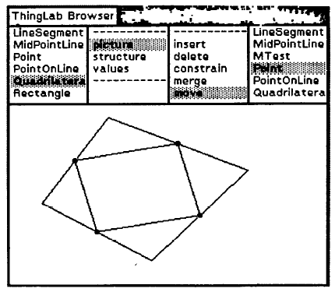
Two-Way (Multi-way) Constraints
From ThingLab (~1979)
Alan Borning. “Defining Constraints Graphically,” Human Factors in Computing Systems. Boston, MA, Apr, 1986. pp. 137-143. Proceedings SIGCHI'86.
Constraints are expressions with multiple variables
Any may be modified to get the right values
Example: A.right = A.left + A.width - 1
Often requires programmer to provide methods for solving the constraint in each direction: A.left = A.right - A.width + 1 A.width = A.right - A.left + 1
Useful if mouse expressed as a constraint

Slide 19
Two-Way implementations
Requires a planning step to decide which way to solve
Many systems compute plans and save them around since usually change same variable repeatedly
In general, have a graph of dependencies, find a path through the graph
How control which direction is solved? CurrentSliderVal = mouseX - scrollbar.left
"Constraint hierarchies" = priorities
constants, interaction use "stay" constraints with high priority
Dynamically add and remove constraints
Brad Vander Zanden's "QuickPlan" solver
Handles multi-output, multi-way cyclic constraints in O(n²) time instead of exponential like previous algorithms

Slide 20
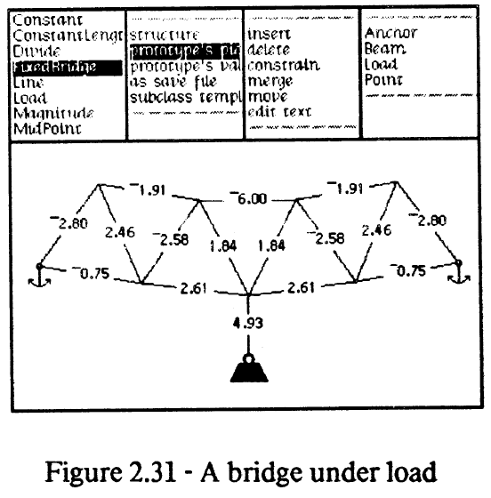
Simultaneous Equations
Required for parallel, perpendicular lines; tangency, etc.
Also for aggregate's size
Numerical (relaxation) or symbolic techniques
Thinglab bridge (1979) (cite)

Slide 21
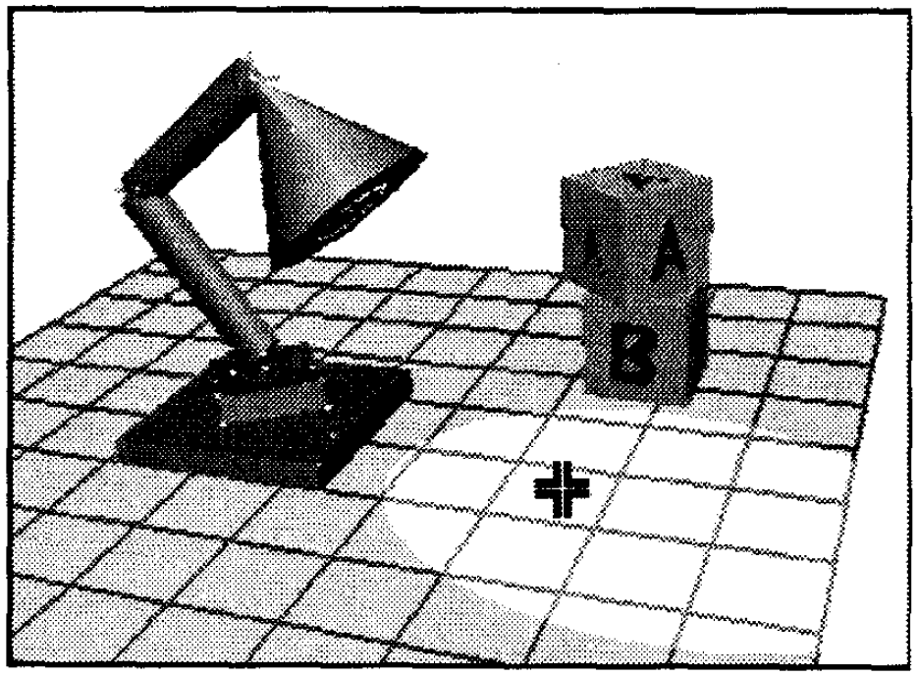
Incremental
Michael Gleicher's PhD thesis, 1994
Only express forward computations
Tries to get reverse by incrementally changing the forward computation in the right direction using derivatives.
Supports interactions otherwise not possible
Produces smooth animations

Slide 22
Animation Constraints in Amulet
Implemented using Amulet's constraint mechanism
When slot set with a new value, restores old value, and animates from old to new value
Usually, linear interpolation
For colors, through either HSV or RGB space
For visibility, various special effects between TRUE and FALSE
Demo

Slide 23
Other Forms of Constraints
For UI work, typically express in form of equations
Often just data-copying (equality): this.x = that.x
For graphics, usually arithmetic required:
this.x = that.x + that.w + 5
5 pixels to the right
this.x = that.x + that.w/2 - this.w/2
centered
this.w = 10 + max (child[i].x + child[i].w)
10 larger than children

Slide 24
Implementation Note
Implementation details (the rest of these slides) will not be on the final test

Slide 25
Dependency graphs for Implementation
Useful to look at a system of constraints as a “dependency graph”
graph showing what depends on what
two kinds of nodes (bipartite graph)
variables (values to be constrained)
constraints (equations that relate)

Slide 26
Dependency graphs
Example: A = f(B, C, D)
Edges are dependencies
B
A
f
C
D

Slide 27
Dependency graphs
Dependency graphs chain together: X = g( A, Y)
B
g
A
f
X
C
D
Y

Slide 28
Kinds of constraint systems
Actually lots of kinds, but 3 major varieties used in UI work
one-way, multi-way, numerical (less use)
reflect kinds of limitations imposed
Reminder: Angular has both one-way and multi-way
One-Way constraints
must have a single variable on LHS
information only flows to that variable
can change B,C,D system will find A
can’t do reverse (change A …)

Slide 29
One-Way constraints
Results in a directed dependency graph: A = f(B,C,D)
Normally require dependency graph to be acyclic
cyclic graph means cyclic definition
B
NOTE: These arrows are in the dataflow
direction. Not dependency
A
f
C
D

Slide 30
One-Way constraints
Problem with one-way: introduces an asymmetry
this.x = that.x + that.w + 5
can move “that” (change that.x) but can’t move “this”

Slide 31
Multi-way constraints
A = f(B,C,D)
Don’t require info flow only to the left in equation
can change A and have system find B,C, and/or D
Not as hard as it might seem
most systems require you to explicitly factor the equations for them
provide B = g(A,C,D), etc.
I believe this is true for Angular two-way bindings – have to supply a function for each “way” unless equality

Slide 32
Multi-way constraints
Modeled as an undirected dependency graph
No longer have asymmetry

Slide 33
Multi-way constraints
But all is not rosy
most efficient algorithms require that dependency graph be a tree (acyclic undirected graph)
B
g
A
f
X
C
D
Y

Slide 34
Multi-way constraints
But: A = f(B,C,D) & X = h(D,A)
Not OK because it has a cycle (not a tree)
B
h
A
f
X
C
D

Slide 35
Another important issue
A set of constraints can be:
Over-constrained
No valid solution that meets all constraints
Under-constrained
More than one solution
sometimes infinite numbers

Slide 36
Over- and under-constrained
Over-constrained systems
solver will fail
isn’t nice to do this in interactive systems
typically need to avoid this
need at least a “fallback” solution

Slide 37
Over- and under-constrained
Under-constrained
many solutions
system has to pick one
may not be the one you expect
example: constraint: point stays at midpoint of line segment
move end point, then?

Slide 38
Over- and under-constrained
Under-constrained
example: constraint: point stays at midpoint of line segment
move end point, then?
Lots of valid solutions
move other end point
collapse to one point
etc.

Slide 39
Over- and under-constrained
Good news is that one-way is never over- or under-constrained (assuming acyclic)
system makes no arbitrary choices
pretty easy to understand

Slide 40
Over- and under-constrained
Multi-way can be either over- or under-constrained
have to pay for extra power somewhere
typical approach is to over-constrain, but have a mechanism for breaking / loosening constraints in priority order
one way: “constraint hierarchies”

Slide 41
Over- and under-constrained
Multi-way can be either over- or under-constrained
unfortunately system still has to make arbitrary choices
generally harder to understand and control

Slide 42
Implementing constraints
Algorithm for one-way systems
Need bookkeeping for variables
For each keep:
value - the value of the var
eqn - code to eval constraint
dep - list of vars we depend on
done - boolean “mark” for alg

Slide 43
Implementing constraints
Algorithm for one-way systems
Need bookkeeping for variables
For each keep:
value - the value of the var
eqn - code to eval constraint
dep - list of vars we depend on
done - boolean “mark” for alg
Incoming Edges

Slide 44
Naïve algorithm
For each variable v do
evaluate(v)
evaluate(v):
Parms = empty
for each DepVar in v.dep do
Parms += evaluate(DepVar)
v.value = v.eqn(Parms)
return v.value

Slide 45
Why is this not a good plan?

Slide 46
Exponential Wasted Work
NOTE: These arrows are in the dataflow
direction. Not dependency

Slide 47
Exponential Wasted Work
1
3
9
27
3^{n}

Slide 48
Exponential Wasted Work
Breadth first does not fix this
No fixed order works for all graphs
Must respect topological ordering of graph (do in reverse topsort order)
1
2
4
8
2^{n}

Slide 49
Simple algorithm for one-way (Embed evaluation in topsort)
After any change:
// reset all the marks
for each variable V do
V.done = false
// make each var up-to-date
for each variable V do
evaluate(V)

Slide 50
Simple algorithm for one-way
evaluate(V):
if (!V.done)
V.done = true
Parms = empty
for each DepVar in V.dep do
Parms += evaluate(DepVar)
V.value = V.eqn(Parms)
return V.value

Slide 51
Still a lot of wasted work
Typically only change small part of system, but this algorithm evaluates all variables every time
Also evaluates variables even if nothing they depend on has changed, or system never needs value
e.g., with non-strict functions such as boolean ops and conditionals

Slide 52
An efficient incremental algorithm
Add bookkeeping
For each variable: OODMark
“Out Of Date mark”
Indicates variable may be out of date with respect to its constraint
For each dependency edge: pending
Indicates that variable depended upon has changed, but value has not propagated across the edge

Slide 53
Part one (of two)
When variable (or constraint) changed, call MarkOOD() at point of change
MarkOOD(v): [x]
if !v.OODMark
v.OODMark = true
for each depV depending upon v do
MarkOOD(depV)

Slide 54
Part one (of two)
When variable (or constraint) changed, call MarkOOD() at point of change
MarkOOD(v):
if !v.OODMark
v.OODMark = true
for each depV depending upon v do
MarkOOD(depV)
Outgoing Edges

Slide 55
Part 2: only evaluate variables when value requested (lazy eval)
Evaluate(v):
if v.OODMark
v.OODMark = false
Parms = empty
for each depVar in V.dep do
Parms += Evaluate(depVar)
UpdateIfPending(v,Parms)
return v.value

Slide 56
Part 2: only evaluate variables when value requested (lazy eval)
Incoming Edges
Evaluate(v):
if v.OODMark
v.OODMark = false
Parms = empty
for each depVar in V.dep do
Parms += Evaluate(depVar)
UpdateIfPending(v,Parms)
return v.value

Slide 57
Part 2: only evaluate variables when value requested (lazy eval)
UpdateIfPending(v,Parms):
pendingIn = false //any incoming pending?
For each incoming dep edge E do
pendingIn |= E.pending
E.pending = false
if pendingIn
newVal = V.eqn(Parms) [*]
if newval != v.value
v.value = newval
Foreach outgoing dependency edge D do
D.pending = true

Slide 58
Part 2: only evaluate variables when value requested (lazy eval)
UpdateIfPending(v,Parms):
pendingIn = false //any incoming pending?
For each incoming dep edge E do
pendingIn |= E.pending
E.pending = false
if pendingIn
newVal = V.eqn(Parms) [*]
if newval != v.value
v.value = newval
Foreach outgoing dependency edge D do
D.pending = true
Can do lazy evaluation here

Slide 59
Example

Slide 60
Example
Change Here

Slide 61
Example
Mark out of date

Slide 62
Example
Eval this

Slide 63
Example
Request

Slide 64
Example

Slide 65
Example
Don’t need to eval any of these! (Not out-of-date)

Slide 66
Example

Slide 67
Example

Slide 68
Example
(Trivial) eval

Slide 69
Example
Eval

Slide 70
Example
Eval

Slide 71
Example
Eval

Slide 72
Example
Done

Slide 73
Example
Notice we can do that 1000 times and these never get evaluated because they aren’t needed

Slide 74
Rewind
Suppose this value didn’t change

Slide 75
Example 2
No pending marks placed here

Slide 76
Example 2
Skip eval (and no outgoing pending marks)

Slide 77
Example 2
Skip eval

Slide 78
Example 2
Done
Didn’t have to eval these

Slide 79
Algorithm is “partially optimal”
Optimal in set of equations evaluated [*]
Under fairly strong assumptions
Does non-optimal total work [x]
“Touches” more things than optimal set during Mark_OOD phase
Fortunately simplest / fastest part
Very close to theoretical lower bound
No better algorithm known

Slide 80
Good asymptotic result, but also very practical
Minimal amount of bookkeeping
Simple and statically allocated
Only local information
Operations are simple
Also has very simple extension to handling pointers and dynamic dependencies

Slide 81
Multi-way implementation
Use a “planner” algorithm to assign a direction to each undirected edge of dependency graph
Now have a one-way problem

Slide 82
The DeltaBlue incremental planning algorithm
Assume “constraint hierarchies”
Strengths of constraints
Important to allow more control when over or under constrained
Force all to be over constrained, then relax weakest constraints
Substantially improves predictability
Restriction: acyclic (undirected) dependency graphs only

Slide 83
A plan is a set of edge directions
Assume we have multiple methods for enforcing a constraint
One per (output) variable
Picking method sets edge directions
Given existing plan and change to constraints, find a new plan

Slide 84
Finding a new plan
For added constraints
May need to break a weaker constraint (somewhere) to enforce new constraint
For removed constraints
May have weaker unenforced constraints that can now be satisfied

Slide 85
Finding possible constraints to break when adding a new one
For some variable referenced by new constraint
Find an undirected path from var to a variable constrained by a weaker constraint (if any)
Turn edges around on that path
Break the weaker constraint

Slide 86
Key to finding path: “Walkabout Strengths”
Walkabout strength of variable indicates weakest constraint “upstream” from that variable
Weakest constraint that could be revoked to allow that variable to be controlled by a different constraint

Slide 87
Walkabout strength
Walkabout strength of var V currently defined by method M of constraint C is:
Min of C.strength and walkabout strengths of variables providing input to M

Slide 88
DeltaBlue planning
Given WASs of all vars
(WalkAbout Strength)
To add a constraint C:
Find method of C whose output var has weakest WAS and is weaker than C
If none, constraint can’t be satisfied
Revoke constraint currently defining that var
Attempt to reestablish that constraint recursively
Will follow weakest WAS
Update WASs as we recurse

Slide 89
DeltaBlue Planning
To remove a constraint C
Update all downstream WASs
Collect all unenforced weaker constraints along that path
Attempt to add each of them (in strength order)

Slide 90
DeltaBlue Evaluation
A DeltaBlue plan establishes an evaluation direction on each undirected dependency edge
Based on those directions, can then use a one-way algorithm for actual evaluation

Slide 91
References
Optimal one-way algorithm http://doi.acm.org/10.1145/117009.117012 Note: constraint graph formulated differently
Edges in the other direction
No nodes for functions (not bipartite graph)
DeltaBlue http://doi.acm.org/10.1145/76372.77531

