Slide 1


Lecture 24:
Toolkits for 3D Programming and the UIs of Games
05-431/631 Software Structures for User Interfaces (SSUI)
Fall, 2022

Slide 2
Logistics
HW 6 is graded and released
  Some people might want to see Alex about the comments
Turn in 1-pagers tomorrow (Wed by 3:05)
  We will try to turn them around right away
  Do not be late
Sign up for meetings with the Professor – Thursday, Friday, Monday
  Link is in the Canvas announcement

Slide 3
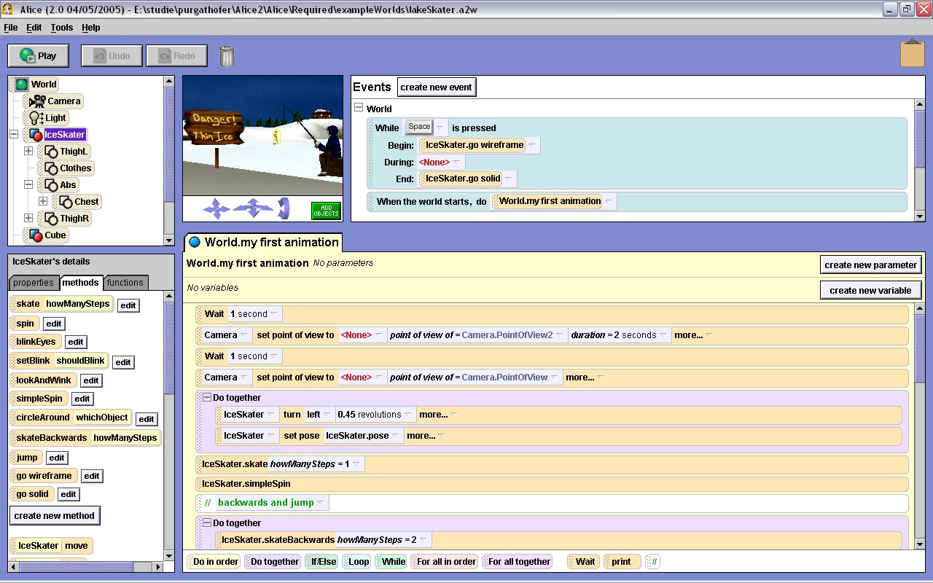
Overview
3D isn’t just 2D +1
  Many new issues
Mentioned somewhat in lecture 22 on EUD tools
  Alice 3D

Slide 4
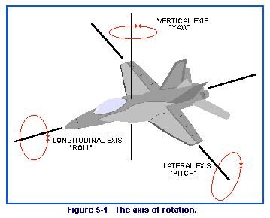
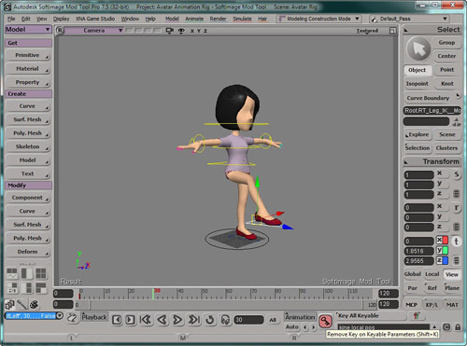
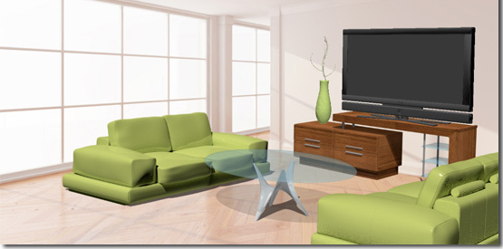
Why is 3D Harder?
Objects have six degrees of freedom (DoF)
  X, Y, Z
  Roll, pitch, yaw
Also camera position
  Occlusion and resolution issues
  Difficulty of orienting oneself
People are not very good at 3D manipulation or reasoning
  Mouse is basically 2D
Generally, dealing with complex, hierarchical objects
Full real-world simulation
  Look and behaviors

Slide 5
Why Hard, cont.
Rick Carey, Tony Fields, Andries van Dam, Dan Venolia. 1994. Why is 3-D interaction so hard and what can we really do about it? (panel). In Proceedings SIGGRAPH '94. ACM, pp. 492-493. http://doi.acm.org/10.1145/192161.192299
3D picking is hard – which object is selected?
  Occlusion, hierarchy, accuracy of pointing device
Designing widgets for 3D manipulation is hard
  Interfere with graphics
  Should they have shadows?
Harder to get interactive speeds for direct manipulation

Slide 6
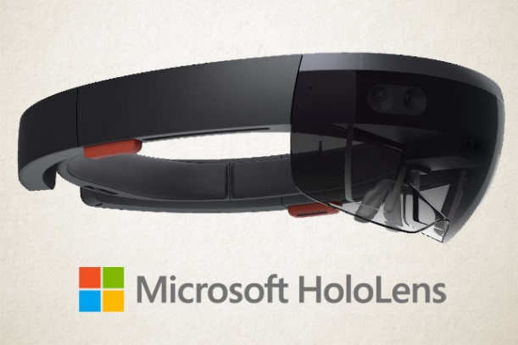
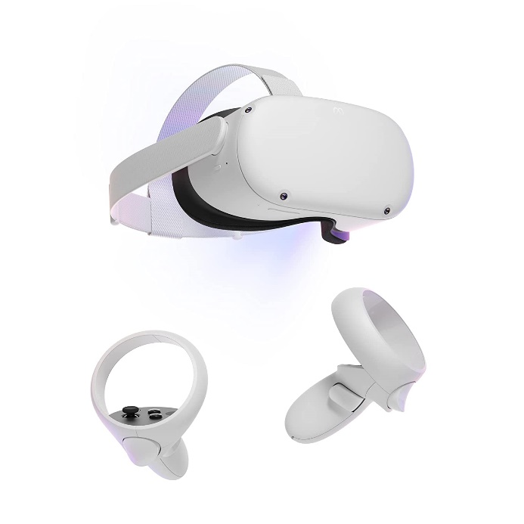

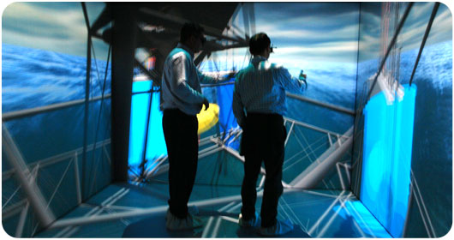

Where 3D displayed?
Desktops – just on a screen in the usual way
3D “Cave” or other large displays (ACM ref)
  Display on one or up to all walls and ceiling
Virtual Reality (VR) or Augmented Reality (AR) headsets
  AR – can see through the display, so
  pictures are superimposed on the view
Examples:
  Google Glass
  Meta Quest (formerly Oculus)
  Microsoft HoloLens
  3D displays
Credit: https://newatlas.com/vr/voxon-photonics-3d-hologram-volumetric-displays/

Slide 7
3D Control
Regular Mouse or touch – 2D
  Possibly with extra knobs or buttons
“Mouse in the air” tracked in 3D = “bat”; 6 DoF
  “bat” translates to fledermaus in German
  (mouse that flies through the air)
Fixed camera tracking object in 3D space
Moving the end of an articulated motorized arm
3D physical objects incorporating the above

Slide 8
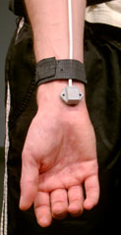
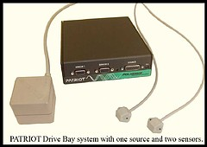
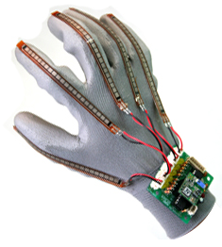
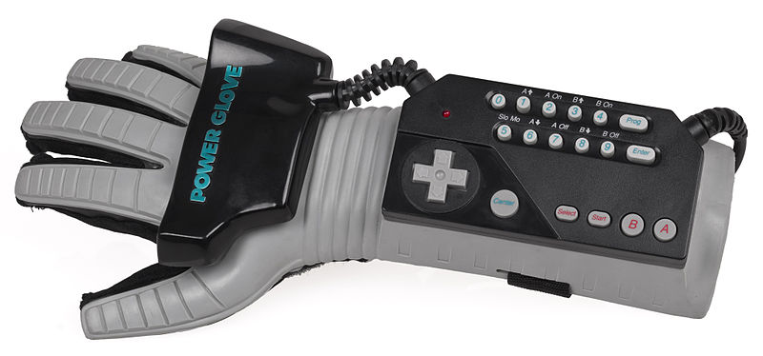
Types of 3D sensors
Earliest: Boxes with sets of knobs
for each dimension
Polhemus trackers (“bat”)
  Starting in 1969
  Magnetic cube on part to be tracked
  and nearby receiver
  6 DOF
  Limited sensing area
  Company still selling similar products
  Often attached to gloves, head-trackers, etc.
DataGlove
  Starting about 1982
  Measured finger bending =
  pose of hand
  Incorporated Polhemus tracker
  on the wrist
Nintendo “PowerGlove” – 1989
  Unsuccessful – only 2 games

Slide 9
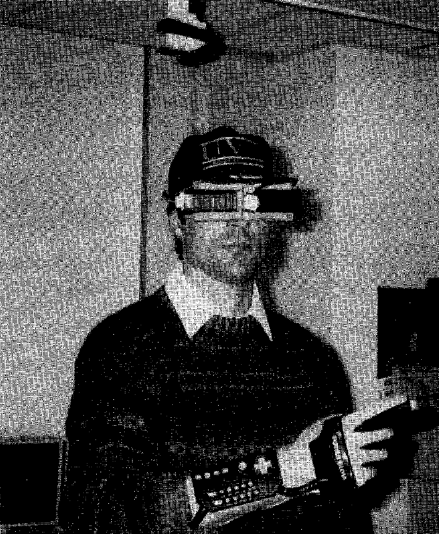
Virtual reality on five dollars a day
Randy Pausch. 1991. Virtual reality on five dollars a day. In Proceedings of the SIGCHI Conference on Human Factors in Computing Systems (CHI '91), ACM, pp. 265-270. http://dl.acm.org/citation.cfm?doid=108844.108913
Combined with inexpensive virtual reality headset

Slide 10

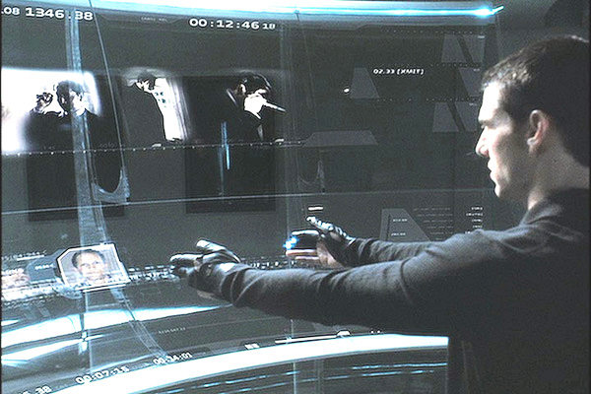
Minority Report, 2002
Using data gloves to interact with large 2-D displays in the air (or on a surface)
MIT Media Lab advised on science (John Underkoffler)

Slide 11
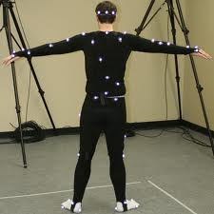

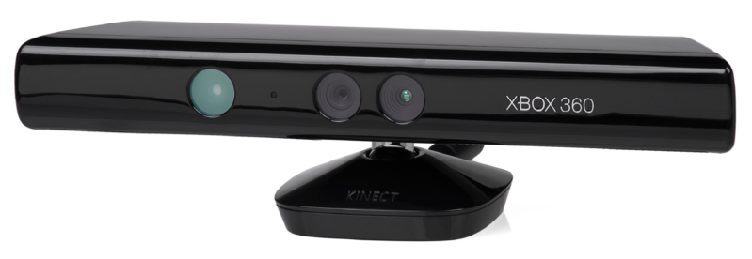

History of 3D sensors, cont.
Lots of motion capture research
and systems
  Motion capture rooms with cameras
  Used for many movies, etc.
    Example: Alita: Battle Angel
Kinect
  Introduced 2010
  Two cameras
Leap Motion
  2013
  Camera based – designed to look
  upwards

Slide 12
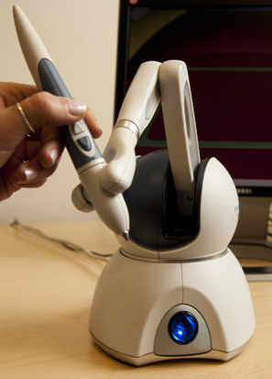

3D “arm” Controllers
Motors to measure 3D movements and provide force feedback
3D Systems Phantom Premium
  Medical Applications, etc.
  3D editing and drawing (video 0:40)
Falcon from HapticHouse

Slide 13
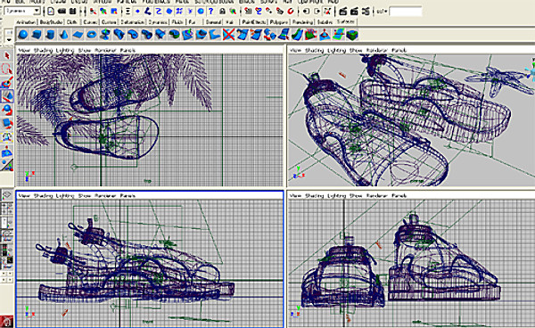
Mouse-Based 3D manipulation
Formerly: used 4-panel display
  Mouse works in conventional way in each panel
  Still tricky to manipulate
  Now, mostly replaced with real-time motion on a single view

Slide 14

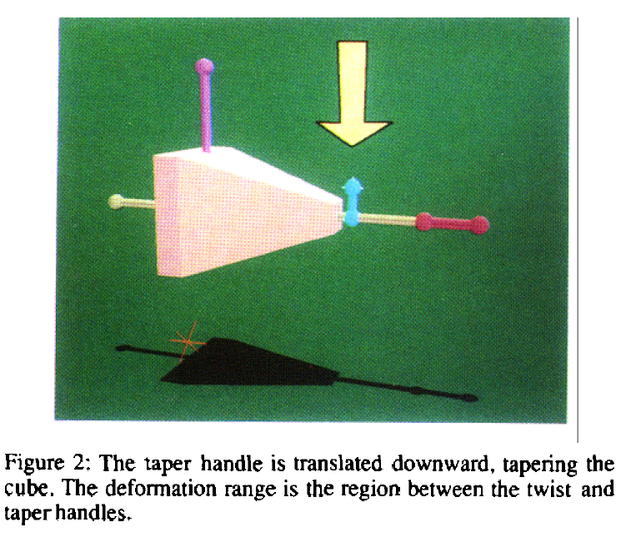
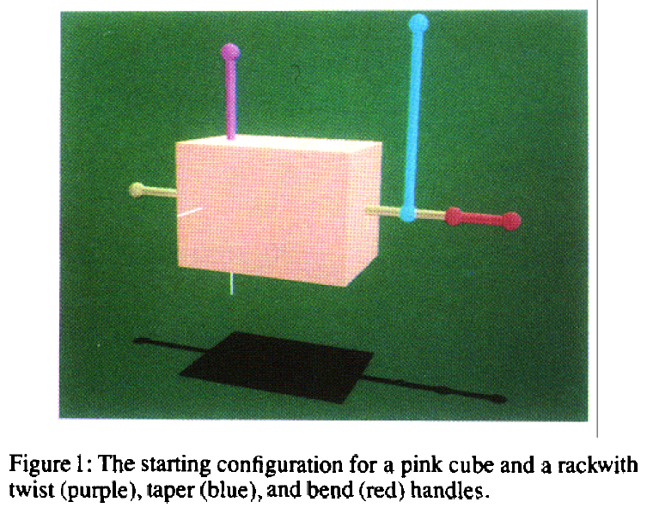
3D Handles
Extend idea of handles on 2D objects to 3D
Need handles for move, stretch, rotate, etc. in each dimension
  Many approaches for doing this. E.g.,
  Scott S. Snibbe, Kenneth P. Herndon, Daniel C. Robbins, D. Brookshire Conner, and Andries van Dam. 1992. Using deformations to explore 3D widget design. In Proceedings SIGGRAPH '92, ACM, pp. 351-352. http://doi.acm.org/10.1145/133994.134091

Slide 15
Why are games harder?
(Next few slides adapted from Erik Harpstead, 05-830)
3D
Rapidly shifting design requirements
Multi-platform development
Integration of many different forms of media (sound, music, art, modeling)
Highly interdisciplinary teams
The demand for novelty
Extremely complex tools and environments

Slide 16
Game Development
Three general methods:
  Roll your own engine
  Use a Framework
  Use an off-the-shelf engine

Slide 17

Rolling Your Own Engine
Surprisingly common
Special game mechanics require custom software architectures
Existing tools are too restrictive
for rapid design changes
Using other people’s tools is a
cop-out
Notes:
As much as Blow was talking about all these great opportunities for tools he makes his own engines
Braid was a great example of why he needed to, reversing time is not something usually included in an out of the box engine
On larger scale projects it is not uncommon for a team to have a toolbuilder who does nothing but build tools for other team members to integrate with eachother
Not so sure why the Witness needed it
Parallax, Anti-Chamber, Minecraft

Slide 18
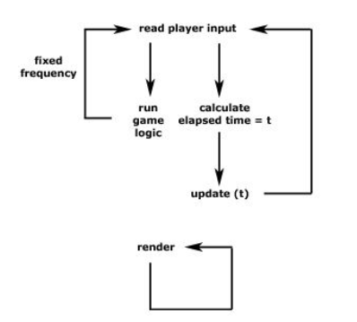
Using a Framework
Usually provide basic utilities and primitives
Commonly built around a state machine in a loop
Notes:
LibGDX
Starling
FlashPunk
Flixel
Citrus
XNA
Swift
Slick2D
pygame
LÖVE
Alegro

Slide 19
Using a Framework
Other Common Components:
  Rendering Library
  Physics Engine
  Input Abstraction
  Fast Math Libraries
  Object Pooling/Resource Management
  Audio Management
Notes:
Rendering Library almost always means OpenGL
Physics Engine (Box2D is very common for 2D games)
Input usually designed to handle controllers and such
Commonly have to use external tools for things like level design or animation

Slide 20
Using a Full Game Engine
Use some kind of interactive editor
Provide custom API or scripting language for defining game mechanics
More approachable by design and art members of a development team
Combines many tools into a single package
Examples: Unreal Engine, Unity
Others: (ref: https://www.incredibuild.com/blog/top-7-gaming-engines-you-should-consider for 2022)
  Amazon Lumberyard
  CryENGINE
  GameMaker: Studio (2d only, simple)
  Godot
  etc.
Notes:
Unity, UDK, Torque, Jmonkey
Unity does Entity/Component Model
UDK has Kismet

Slide 21
Game Tools
Slides by Mary Beth Kery from 05-830 in 2017

Slide 22
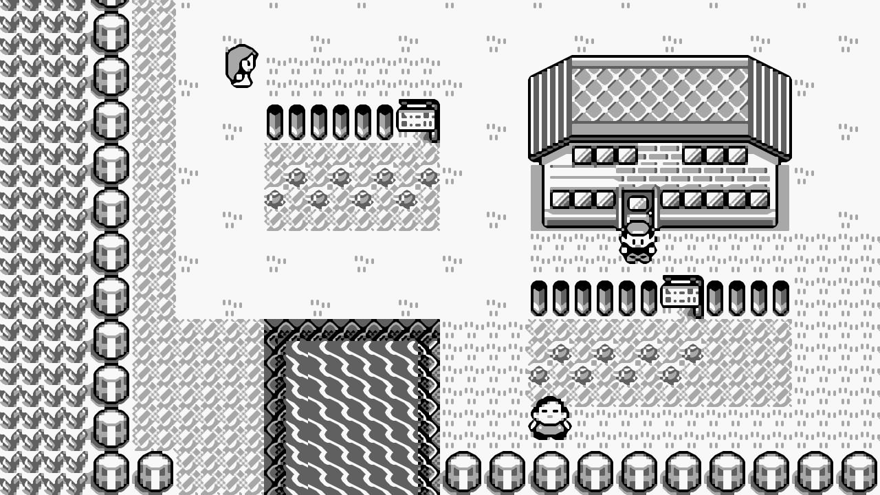
Game Tools
MARY BETH KERY - ADVANCED USER INTERFACES SPRING 2017

Slide 23
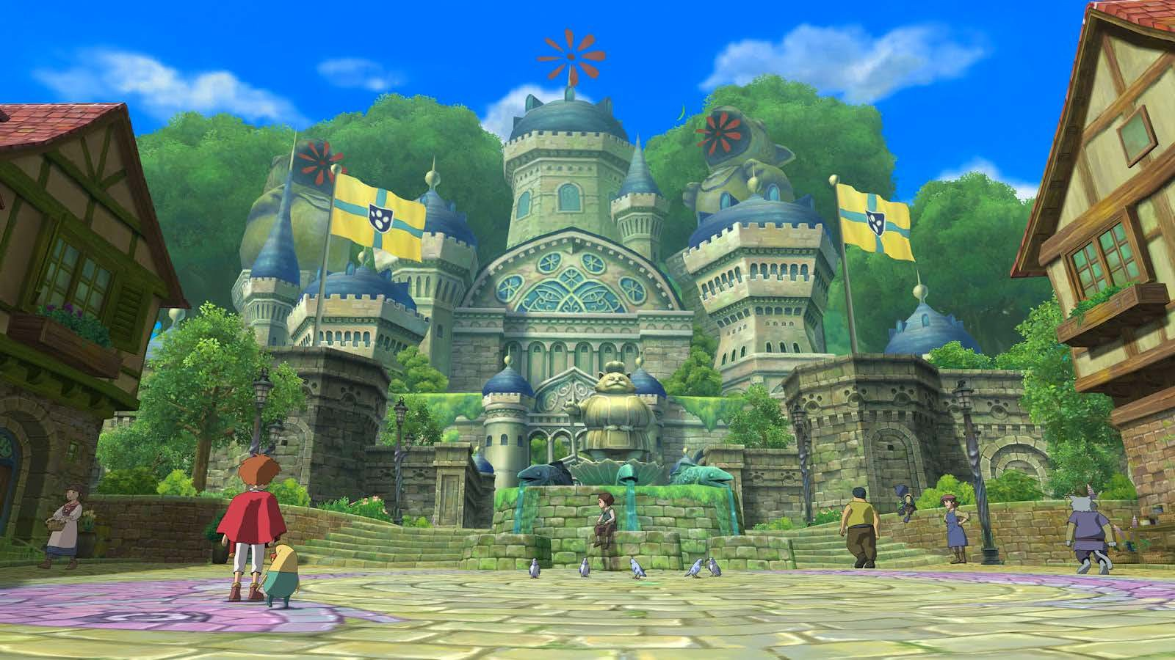




Slide 24
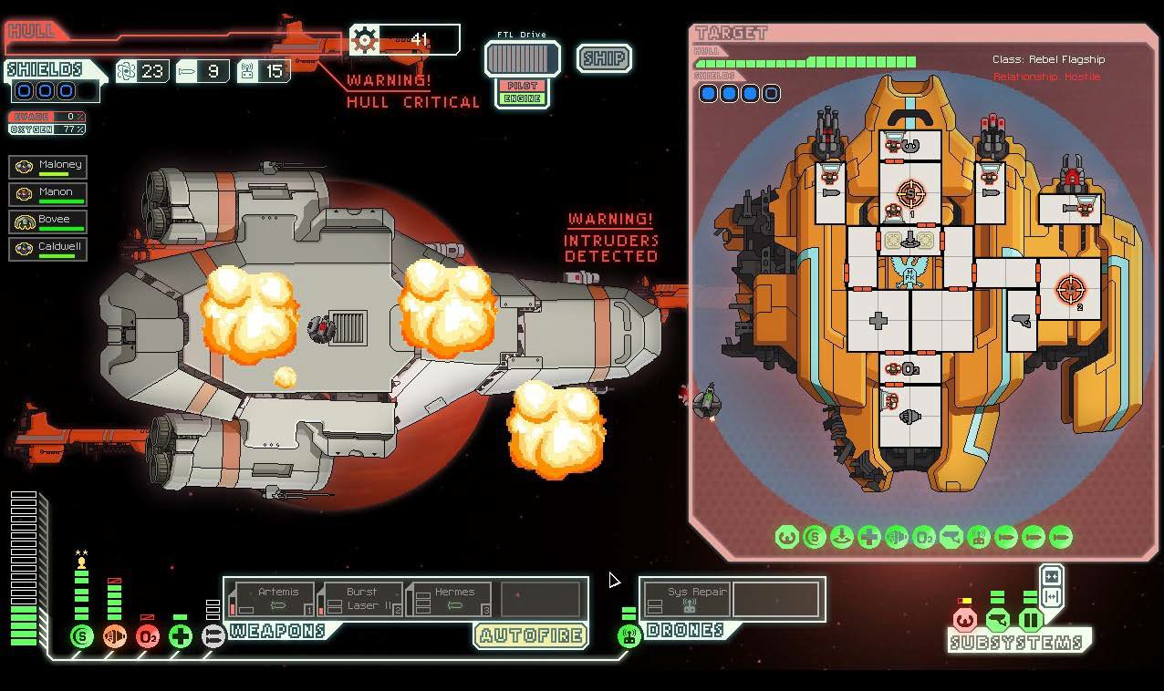
2 person team
3 years

Slide 25

ART
GAME DESIGN
ENGINEERING
PRODUCTION/BUSINESS
300 person team
10 years
Final Fantasy 15

Slide 26
TECHNICAL CHALLENGES OF VIDEO GAMES
1. Video games are real time complex simulations, and must be efficient.

Slide 27
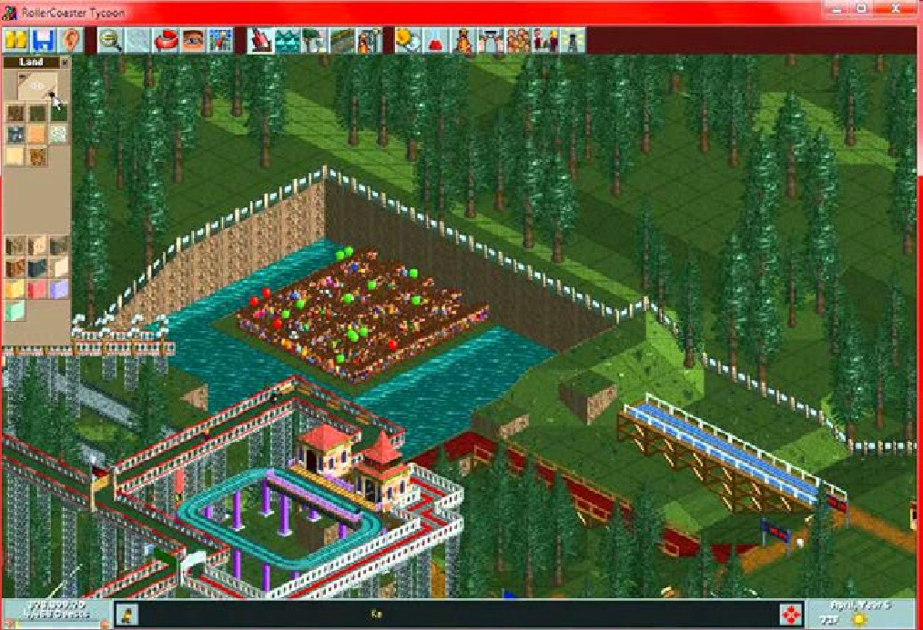
TECHNICAL CHALLENGES OF VIDEO GAMES
1. Video games are real time complex simulations, and must be efficient.
1999 Roller Coaster Tycoon written by one guy in x86 assembly language

Slide 28
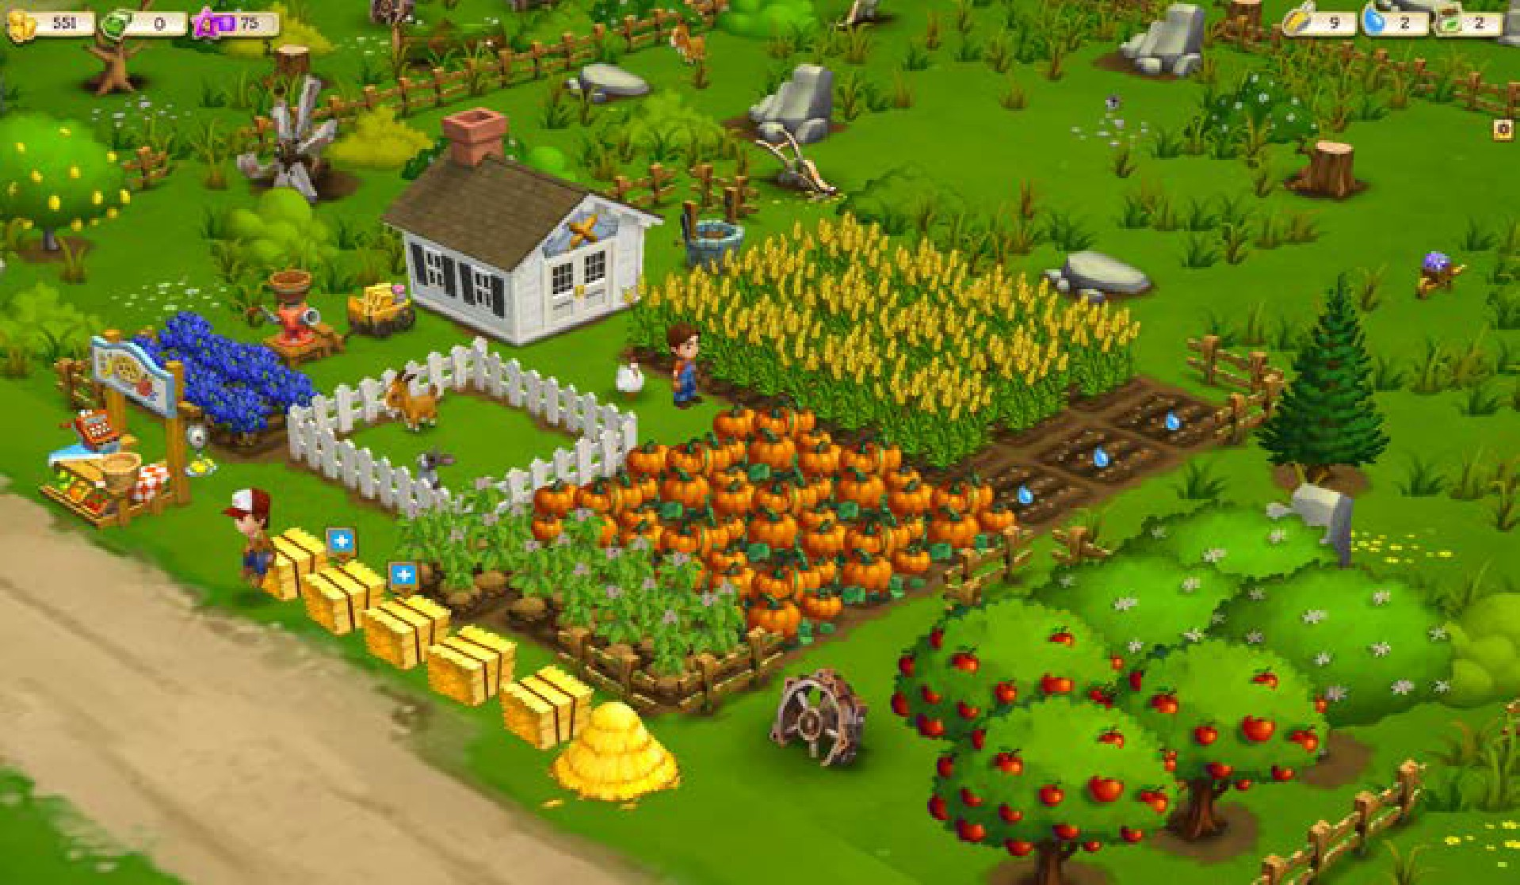
TECHNICAL CHALLENGES OF VIDEO GAMES
1. Video games are real time complex simulations, and must be efficient.
Today, more flexibility in language
Typically Object-Oriented
Use development tools like Visual Studio or IntelliJ

Slide 29
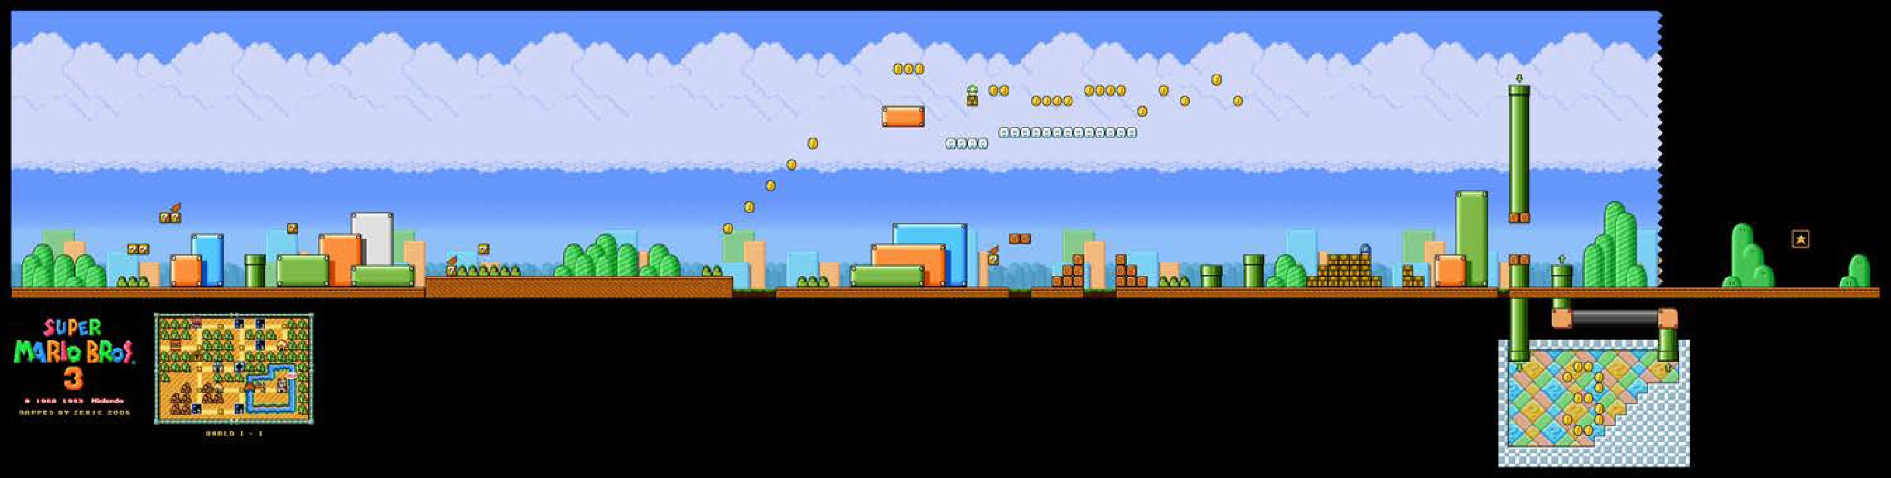
TECHNICAL CHALLENGES OF VIDEO GAMES
2. People have high expectations for interactive worlds with lots of content

Slide 30
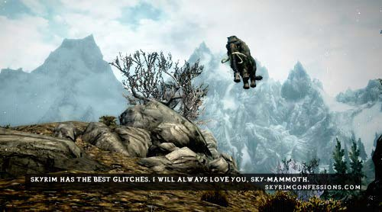
TECHNICAL CHALLENGES OF VIDEO GAMES
2. People have high expectations for interactive worlds with lots of content
Lots of content on tight deadlines.
Glitches and crashes are BAD.

Slide 31
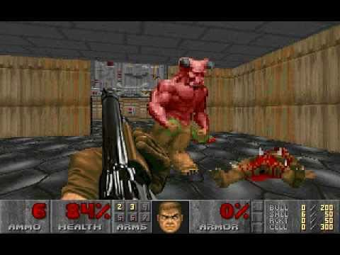
TECHNICAL CHALLENGES OF VIDEO GAMES
3. Real time 3D graphics simulations
Doom 1993
Levels, dungeons, and rooms were not only for game pacing, but to limit the number of objects to compute and render at a time.

Slide 32


TECHNICAL CHALLENGES OF VIDEO GAMES
3. Real time 3D graphics simulations
2016 graphics
Pixar - Piper
Final Fantasy 15

Slide 33
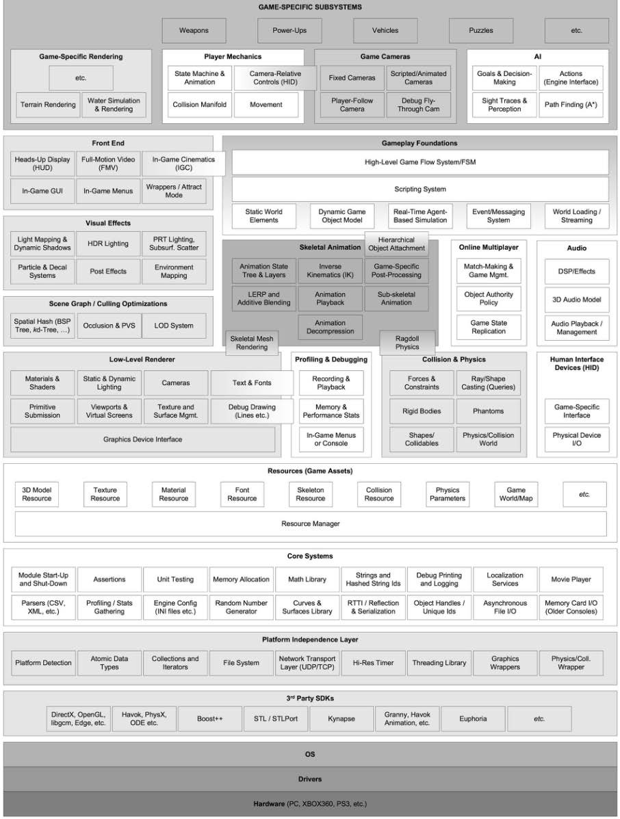
Game Engine modules
source:
Gregory, Jason. Game engine architecture. CRC Press, 2009.

Slide 34

Game Engines:
Tools that fit the pieces together

Slide 35
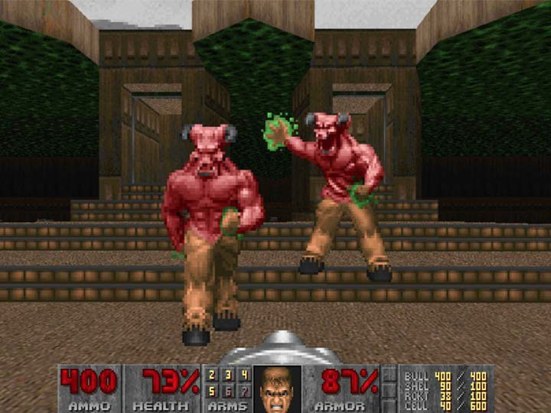
GAME ENGINES: HISTORY
1990s First-person shooters:
Doom by id Software

Slide 36

GAME ENGINES: HISTORY
Architecture separates core software from game-specific assets
ASSETS “ENGINE” SOFTWARE
Art assets
Game map/
environments
Rules of play
3D graphics rendering
Collision detection Audio system

Slide 37
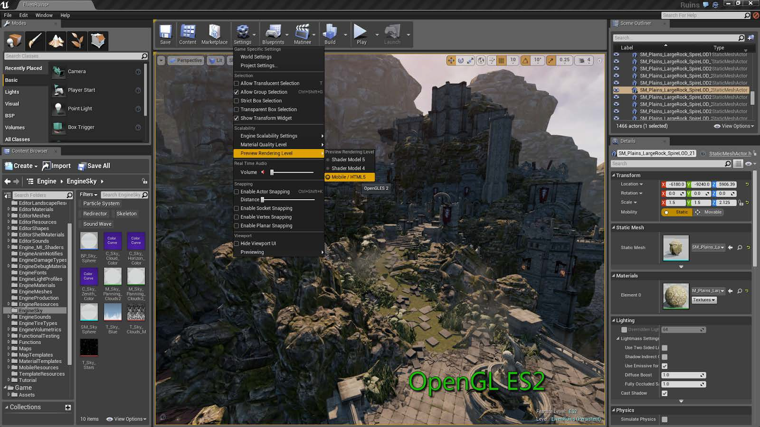
Unreal Engine: A full industry-grade development environment (advanced tool)

Slide 38
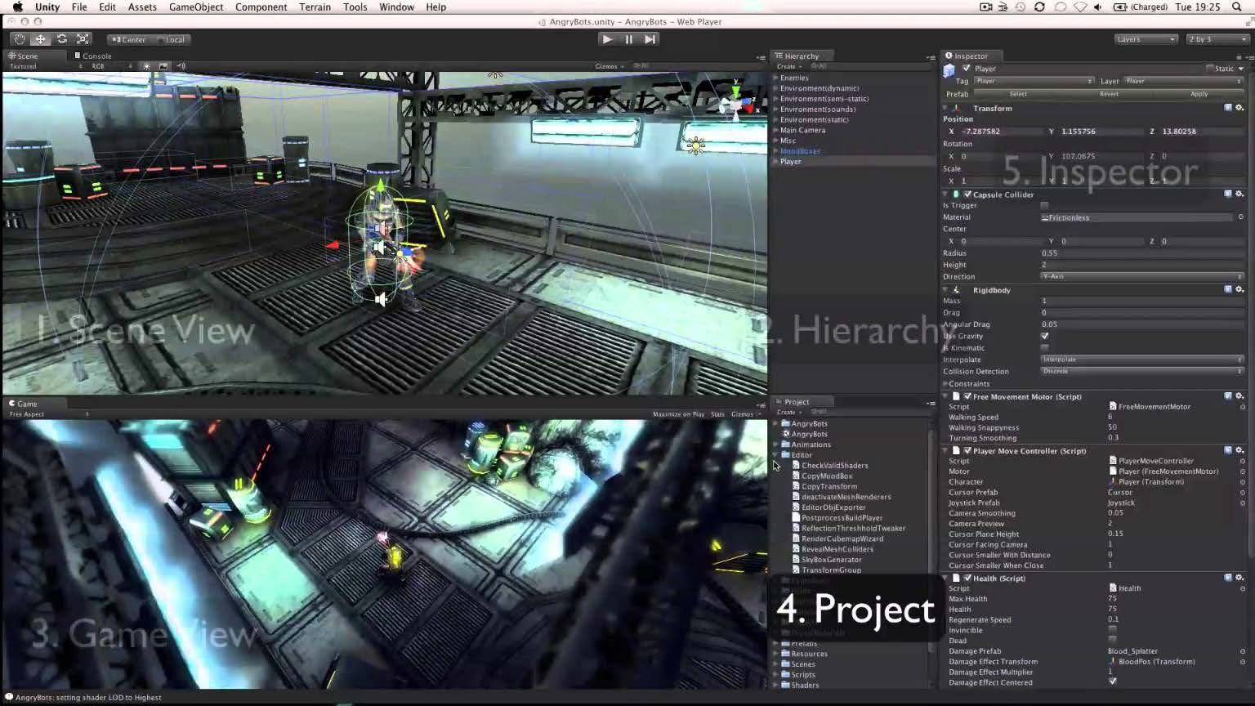
Unity: A full development environment (advanced tool)

Slide 39

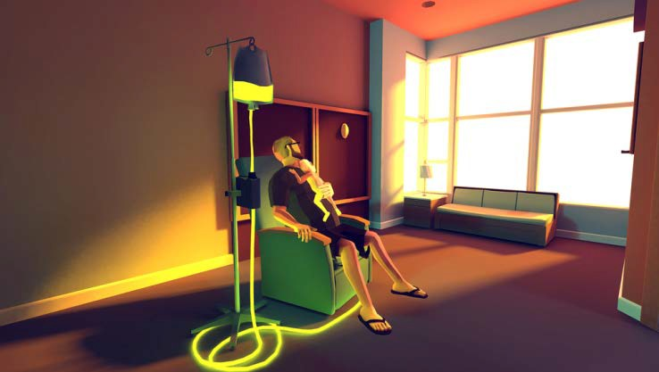

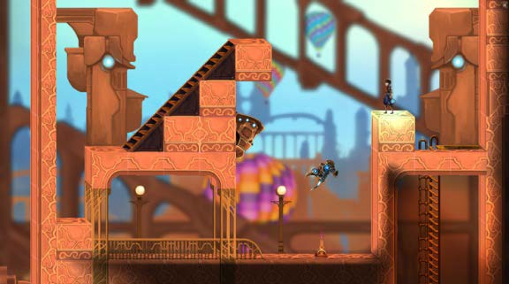
A game engine has a data driven architecture that can be used to make many games
That dragon cancer
Gardenarium
Clockwork

Slide 40

Art assets & animation
Graphics Physics engines Game loop

Slide 41
Art assets & animation
Graphics Physics engines Game loop

Slide 42
Art to game:
Workflow of artists with tools and the game engine

Slide 43
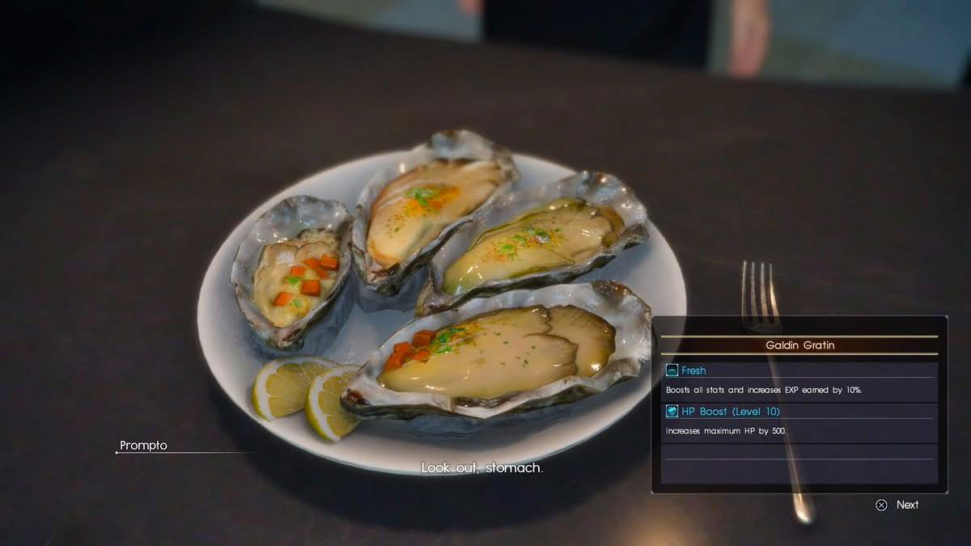

Slide 44

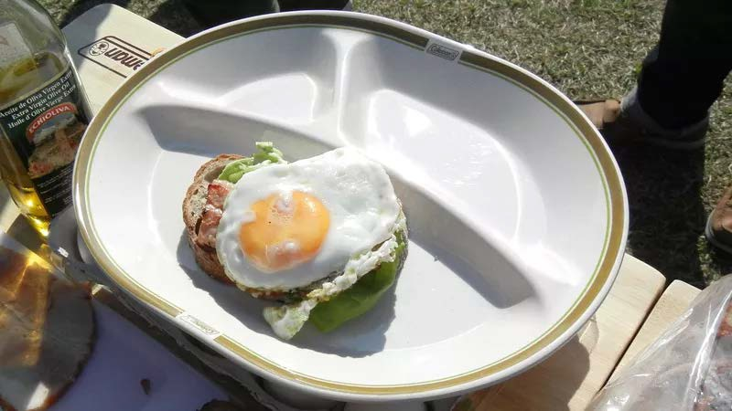
Photo or drawing
The Final Fantasy 15 team cooked food and then photographed it as reference material for 3D modelers and shaders.

Slide 45
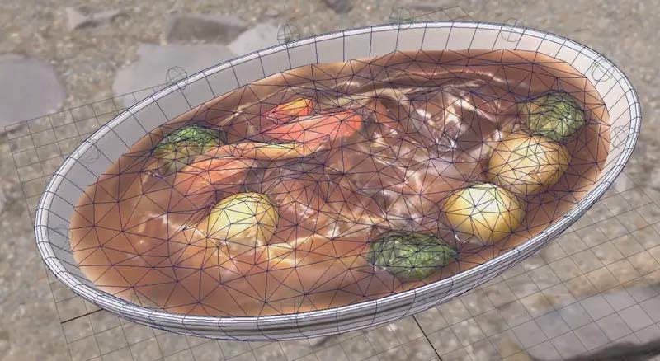
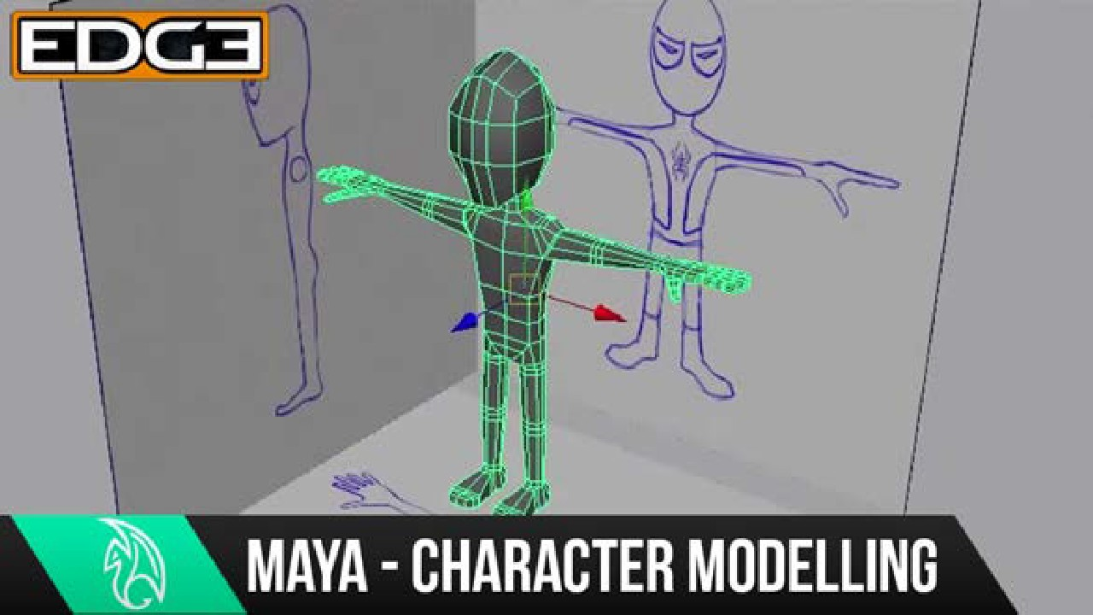
3D Scanning or image tracing
Modelers use reference drawings from different angles
The Final Fantasy 15 team scanned their food and photographed it

Slide 46



Modeling Software
model in progress
Final in-game model.

Slide 47
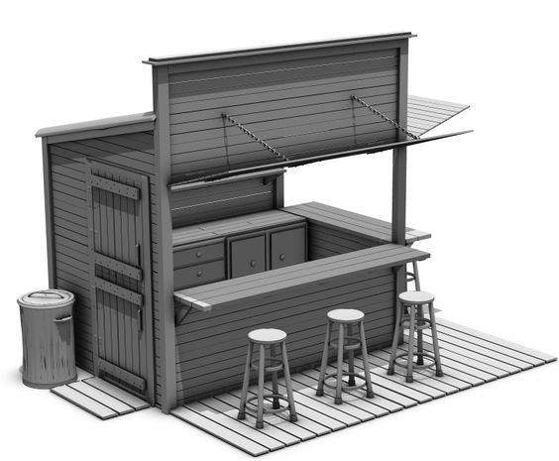
Textures and Shading
Final in-game model.

Slide 48
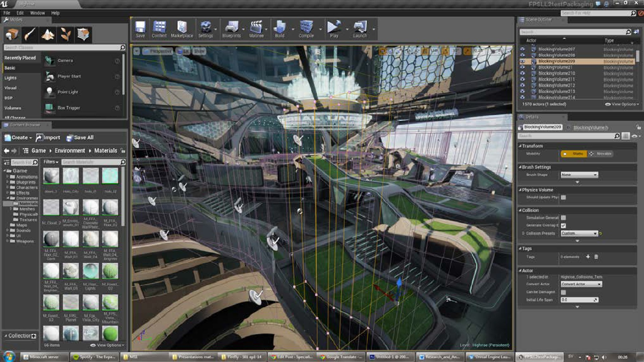
Back to the game
Unreal Engine place objects in scene with map editor

Slide 49
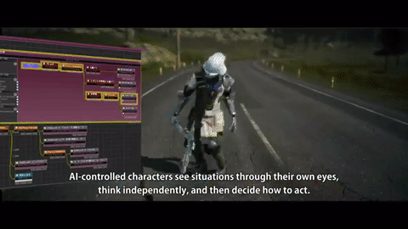
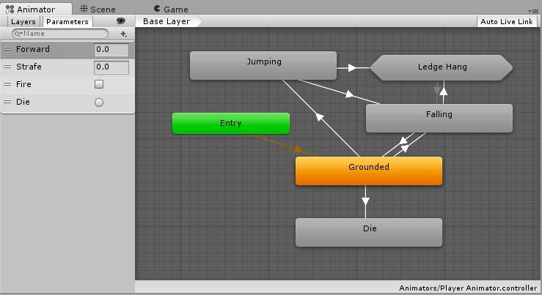
In the game engine
Visual programming languages allow animations, materials, and shaders to be written by artists

Slide 50
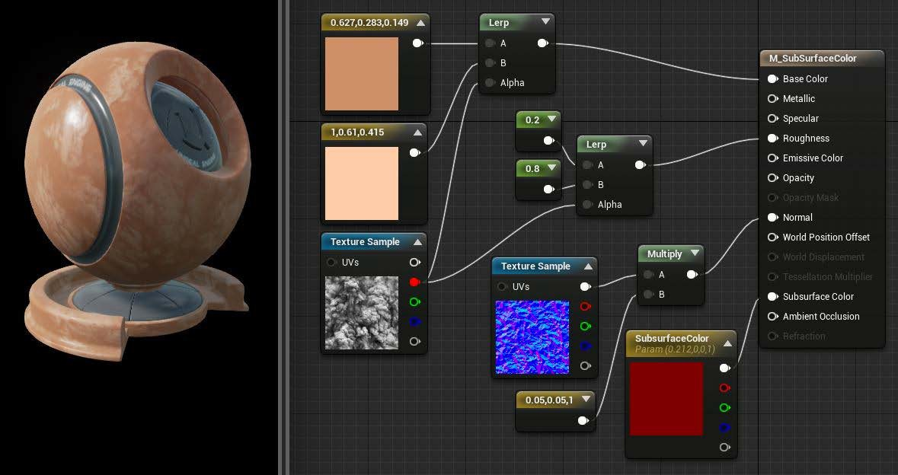
In the game engine
Visual programming languages allow animations, materials, and shaders to be written by artists

Slide 51

In the game engine
Visual programming languages allow animations, materials, and shaders to be written by artists

Slide 52
Art assets & animation
Graphics Physics engines Game loop

Slide 53
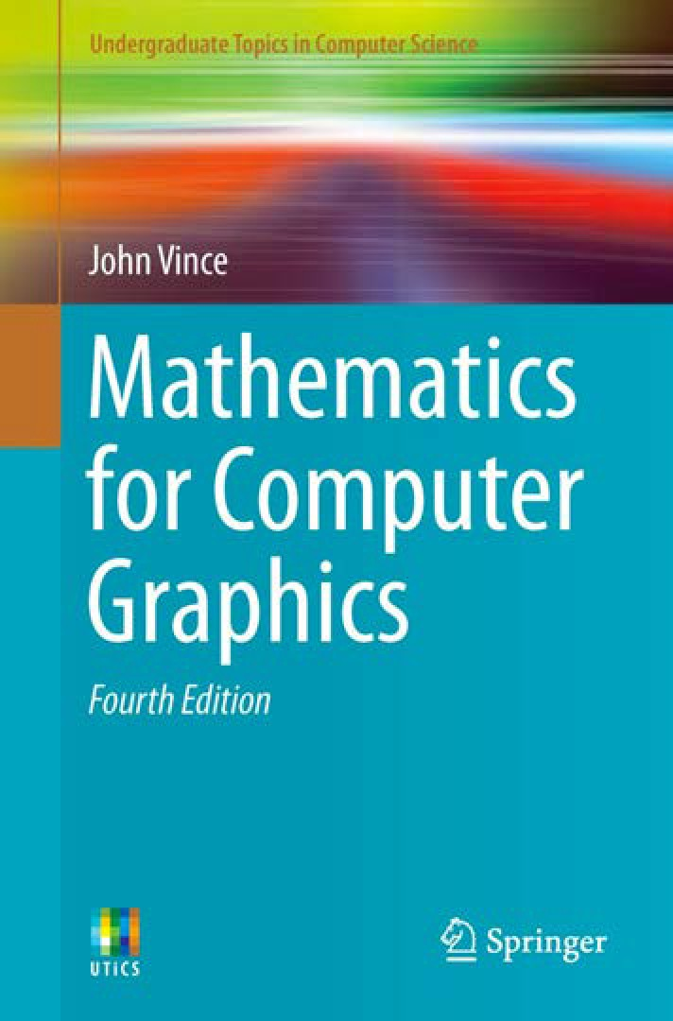

Shaders = VERY TECHNICAL

Slide 54


Technical Graphics Tools
Open GL has bindings in lots of different languages
Powerful, but not easy to learn.
Some language bindings are more learner-friendly than others

Slide 55
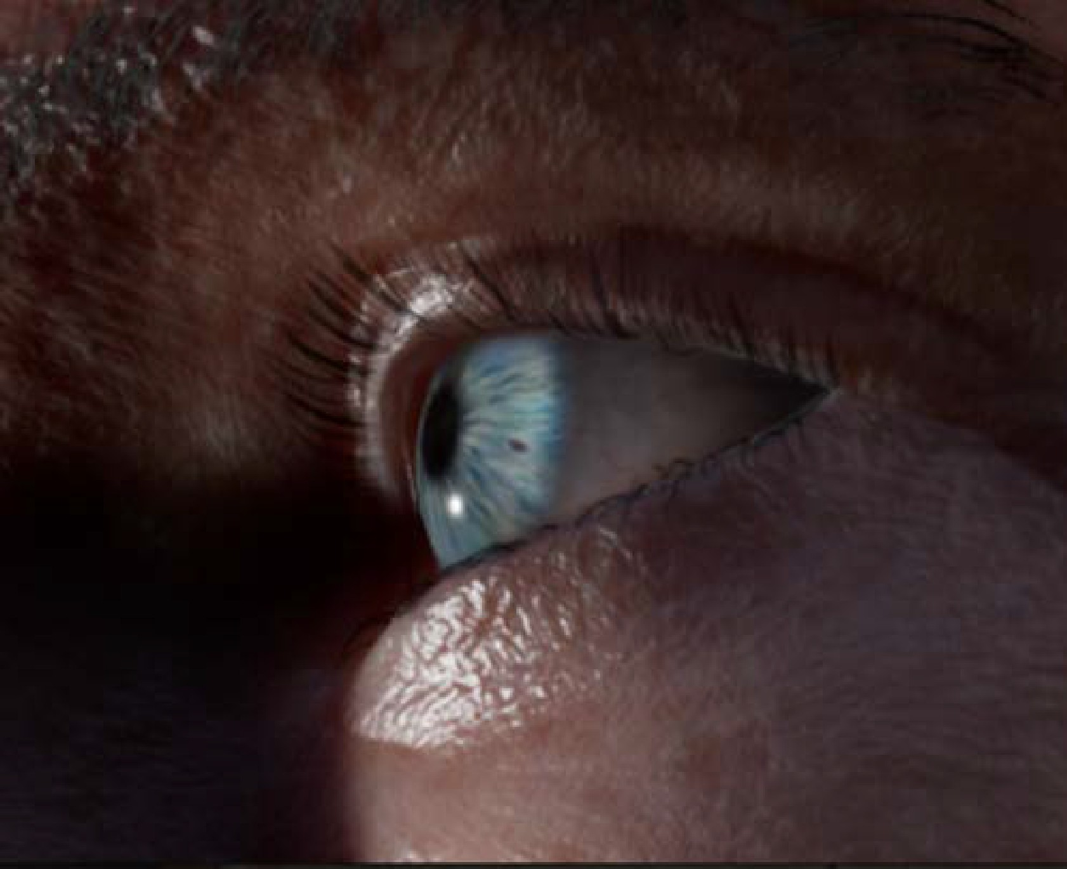
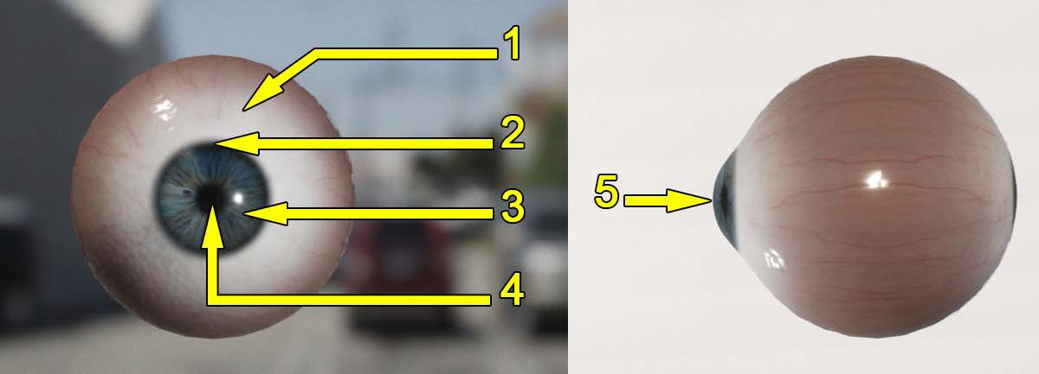
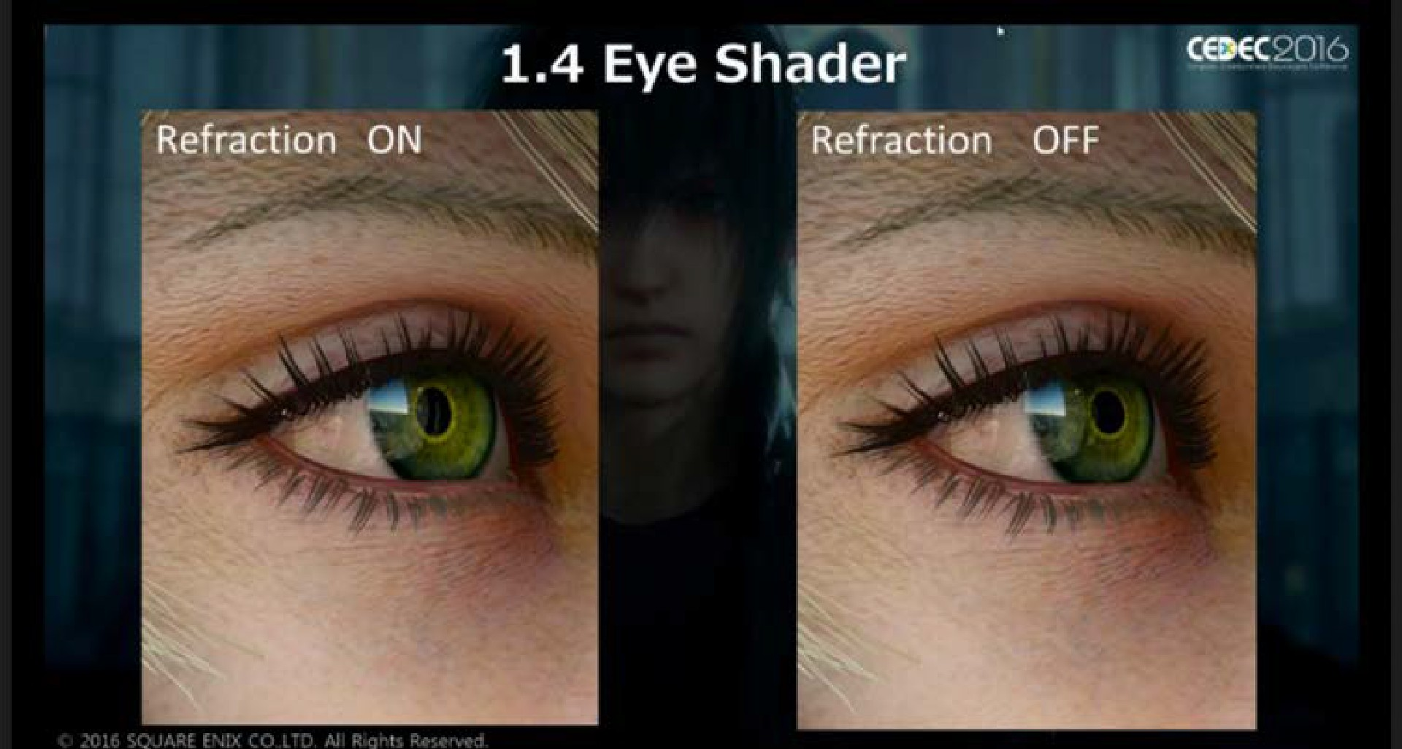
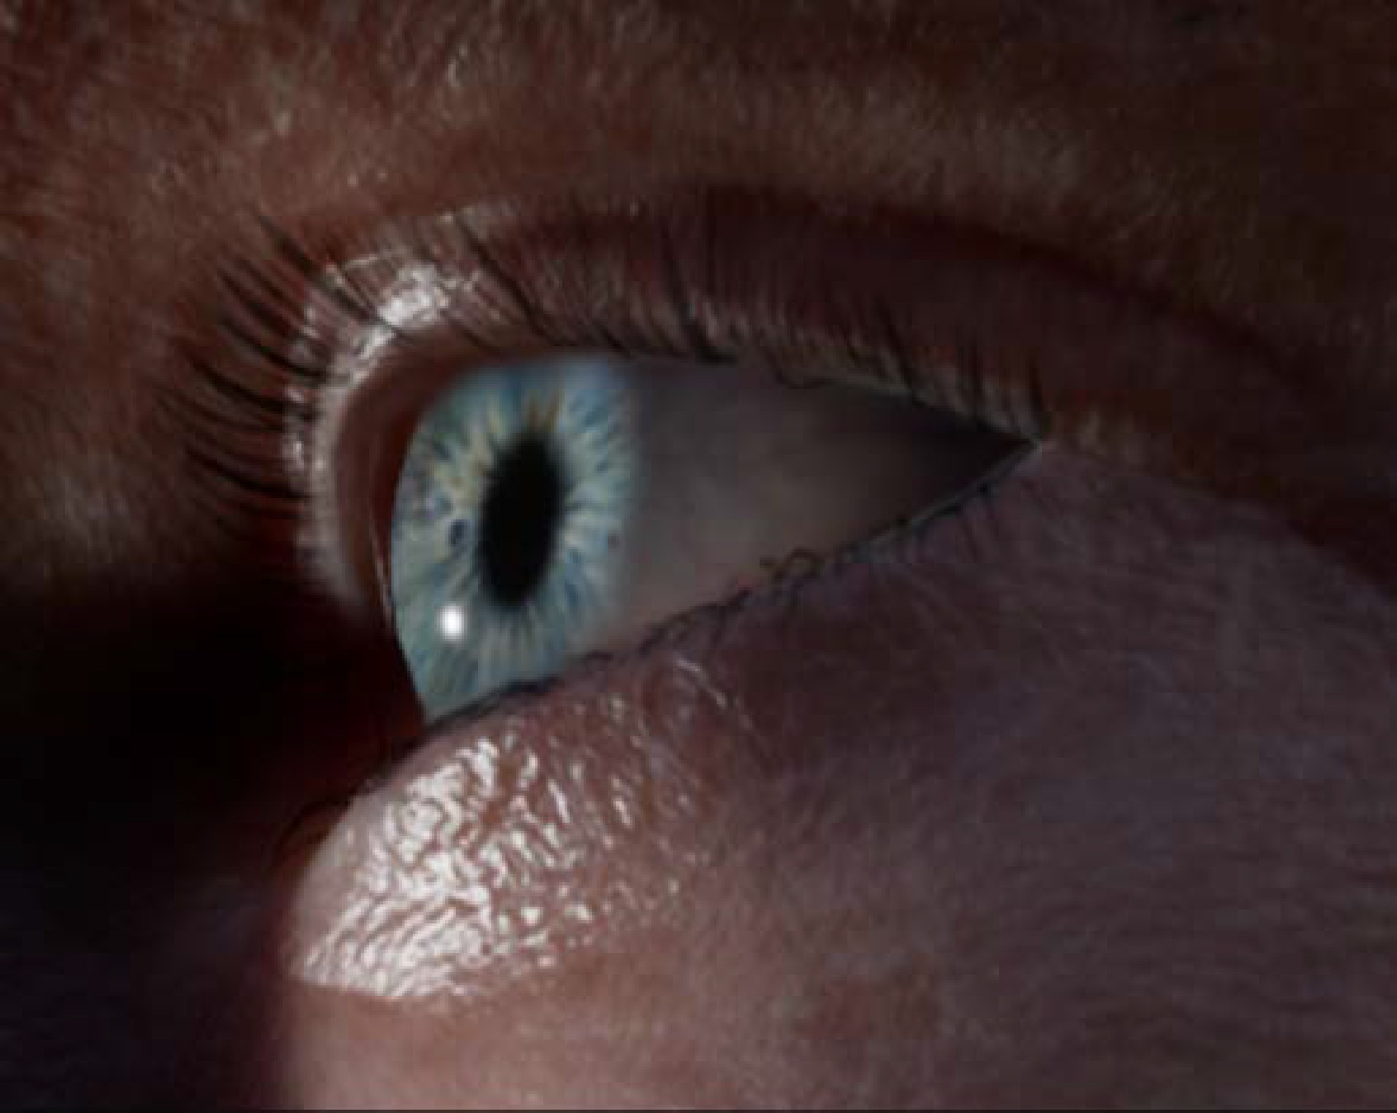
Technical Graphics – eyes
No refraction at cornea
Full refraction at cornea

Slide 56
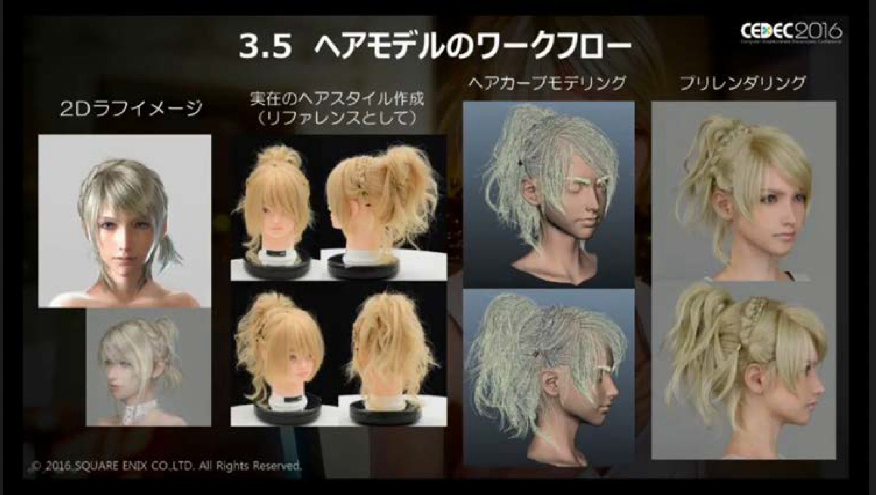
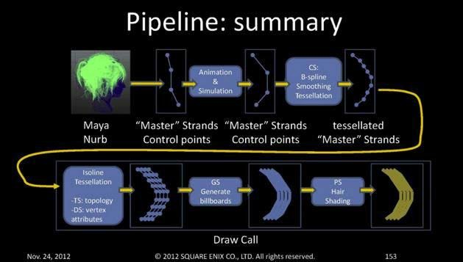
Technical Graphics – hair
Process of modeling and rendering character Lunafreya’s hair from Final Fantasy 15x

Slide 57

Graphics – Updating the Screen
Must be efficient!
The screen must be updated every frame, at 30fps to 60fps. Rendering and shaders are computationally expensive!

Slide 58

Graphics – Updating the Screen
Occlusion culling problem: don’t render hidden objects
Frustum culling: test if an object intersects with the frustum.
Portals: designers manually place simple primitives around chunks of the game world. The portals are invisible but cheap to test
intersection on.

Slide 59



Graphics – Updating the Screen
Occlusion culling problem: don’t render hidden objects
Frustum culling: test if an object intersects with the frustum.
Portals: designers manually place simple primitives around chunks of the game world. The portals are invisible but cheap to test
intersection on.

Slide 60
Graphics – Updating the Screen
PVS: Potential Visibility Set, precomputed. Very efficient for small environments. PVS is
submitted to the renderer and
items in the set are tested to make sure they are indeed visible Bad: storage costs

Slide 61
Art assets & animation
Graphics Physics engines Game loop

Slide 62

Physics
Unity or Unreal game engines have basic built-in libraries.

Slide 63


Physics engines
Calculate on-the-fly physics simulations, optimized for a game environment.
Soft-body physics, CryEngine Physics Engine
Hard-body physics, Havok Physics Engine

Slide 64

Physics engines
SDKs with visual debuggers that allow you to run physics simulations on your object to test your code

Slide 65


Dynamic animation
Euphoria by Natural Motion encodes lots of information about human muscles, bones, and nerves to dynamically create realistic character movement like falls.

Slide 66

Dynamic animation
Natural Motion editor with visual programming.

Slide 67
Art assets & animation
Graphics engines Physics engines Game loop

Slide 68


Game loop
update player health
update monster health physics engine render scene sound effects Heads-up-display

Slide 69

https://unity.com/
A leading game engine

Slide 70




Guest lecture in 05-830, Spring 2020
Lead developers at Unity
Video of the presentation
Generative Art — Made with Unity
A decade of evolving developer and designer workﬂows in a game engine
Adam Mechtley
Lead Developer DOTS Physics & Rigging
Damian Campeanu
Developer Editor & UI

Slide 71

Generative Art — Made with Unity
* Oversimpliﬁed version

Slide 72
More than just a game engine!
Run-Time
  Built-in libraries (input, animation, physics, UI, rendering, etc.)
  Compatible with much of .NET ecosystem
Editor
Services
  Analytics, live ops, etc.
Asset Store
Millions of users, hundreds of thousands active monthly

Slide 73
How do users make stuff with Unity?
Create GameObjects and add Components to produce behavior
Create new Components via C#
  Or imported from other programs like AutoDesk’s Maya
Create reusable Prefabs from GameObjects
Prefabs can be nested in each other with overrides

Slide 74


Slide 75

Components in Unity
All public members of a script are exposed in the GUI allowing non-programmer team members to control game settings
Built in Component types can also be accessed and edited this way
Properties can be changed in the GUI while the game is running to test changes
Notes:
This actually reminds me a lot of the GARNET model, where Behavior Scripts can be dynamically added and removed from objects at run time to edit the behavior of the game

Slide 76
How do users create UI with it?
Unity 1.0
Unity 2.5
Unity 2019.1
GUITexture, GUIText, GUILayer, TextMesh
Customize editor with IMGUI
First public release of UI Toolkit (formerly UIElements)
2007
2014
2005
2009
2019
Unity 2.0
Unity 4.6
IMGUI run-time
First release of uGUI

Slide 77


A simple UI framework for an ever-changing world
Generative Art — Made with Unity
Unity 1.0
Unity 2.5
Unity 2019.1
GUITexture, GUIText, GUILayer, TextMesh
Customize editor with IMGUI
First public release of UI Toolkit (formerly UIElements)
2007
2014
2005
2009
2019
Unity 2.0
Unity 4.6
IMGUI run-time
First release of uGUI

Slide 78

Design considerations
Unity needed a UI framework! (both run-time and editor)
Most Unity projects…
  ...were small web player experiences
  ...were created by small teams with few/broad role specializations
Most game UI…
  ...communicate frequently
  updating values
  ...overlays

Slide 79
IMGUI API
OnGUI() callback
  Event loop with Event.current
  Call order determines event handling priority
Library of static methods in GUI class for common functionality
  GUILayout variants to assist with Rect calculations
  Both run-time and editor-only variants for most types
GUIStyle class
GUISkin asset

Slide 80
IMGUI advantages and disadvantages
+ Gathering and responding to input is trivial
+ Fast for programmers to prototype with
+ Works well for property grids
+ Simple API organization
+ Predictable performance
But not very great performance
Limited designer workﬂows
No control over rendering pipeline
Only supports non-diegetic UI
Lots of manual work making new controls

Slide 81


A framework for to make UI feel more like the rest of Unity
Generative Art — Made with Unity
Unity 1.0
Unity 2.5
Unity 2019.1
GUITexture, GUIText, GUILayer, TextMesh
Customize editor with IMGUI
First public release of UI Toolkit (formerly UIElements)
2007
2014
2005
2009
2019
Unity 2.0
Unity 4.6
IMGUI run-time
First release of uGUI

Slide 82

Design considerations
Unity needed to empower designers to be productive more independently
Most Unity projects…
  ...were created by teams with clearer role specializations
  ...were run on mobile platforms where draw calls are expensive and display speciﬁcations vary wildly
Most game UI…
  ...contained in-story/spatial and non-in-story elements
  ...were richly animated with effects

Slide 83
uGUI API
UIBehaviour base class inherits MonoBehaviour
Selectable, Graphic, etc., sub-classes
Canvas and CanvasScalar control rendering of hierarchies of elements
  RectTransform (inherits Transform) use for layout
  Most components draw Sprite assets
  Set geometry, materials, etc. on child CanvasRenderer
StandaloneInputModule and EventSystem gather and delegate input events
  BaseRaycaster of some kind ﬁnds event handlers
  IPointerDownHandler, IPointerUpHandler, IDragHandler, etc.

Slide 84
uGUI advantages and disadvantages
+ Designer workﬂows that ﬁt with other Unity features (prefabs, animation, etc.)
+ Serializable event handlers
+ Automatic atlasing and scaling based on physical size, DPI, etc.
+ Diegetic UI
+ Common rendering pathway with everything else
Performance overhead from GameObjects and Components
Authoring data format hard to read and debug at a glance
No centralized styling
Canvases require specialized knowledge to optimize

Slide 85

A framework to make Unity feel more like the rest of the world
Generative Art — Made with Unity
Unity 1.0
Unity 2.5
Unity 2019.1
GUITexture, GUIText, GUILayer, TextMesh
Customize editor with IMGUI
First public release of UI Toolkit
(formerly UIElements)
2007
2014
2005
2009
2019
Unity 2.0
Unity 4.6
IMGUI run-time
First release of uGUI

Slide 86







Design considerations

Slide 87
UI Toolkit advantages and disadvantages
+ Great performance for most use cases
+ Powerful automatic layouting via Flexbox
+ Centralized styling using standard paradigms (CSS)
+ Visual authoring without writing code
+ One API for both Editor and Runtime
Name-based handles can easily break
Ineﬃcient when lots of things are changing at once
More complicated Event-based value bindings
More complicated bindings to Unity objects and gameplay

Slide 88

Final thoughts from Unity
Immediate-mode and retained-mode GUI each have strengths and disadvantages in different situations
As the rest of the world evolves, so, too, must your API
  Everything comes with a maintenance cost
Reasonableness of API design decisions is very contextual
  Aesthetic tastes of the historical
  moment
  Technical requirements of target
  hardware
  Tools ecosystem
Design inﬂuences users’
expressive capabilities
37

