Slide 1
Lecture 23:
Toolkit support for Assistive and Accessible Interfaces;
Web Accessibility
05-431/631 Software Structures for User Interfaces (SSUI)
Fall, 2022

Slide 2


Happy Thanksgiving!

Slide 3
Logistics
Happy Thanksgiving!
  No office hour tomorrow (Wednesday)
  No class Thursday
  No lab Friday
Form final project groups now
Final test information posted
  Date: start Tuesday, 12/13/2022 at 12:01am ET; Due Wednesday, 12/14/2022 at 11:59pm ET (all day Tuesday and Wednesday)
  Right after project reports due

Slide 4
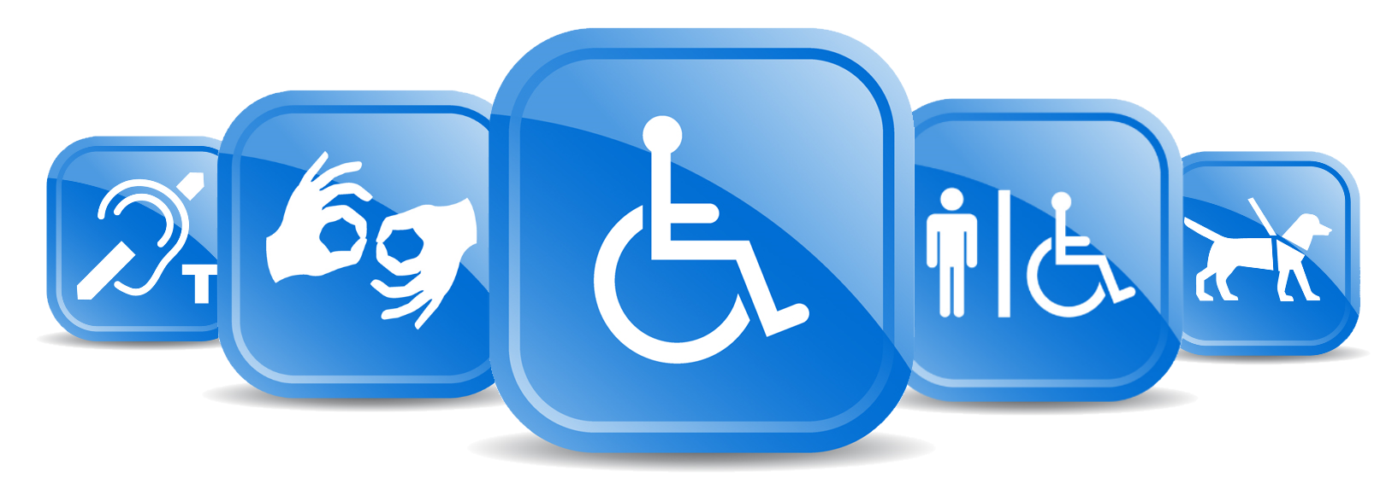
Disabilities
Worldwide, more than 1 billion people experience some form of disability [World Health Organization, 2011]
19% of the U.S. population is disabled [U.S. Census Bureau, 2012]
Slide courtesy of Merrie Morris (Microsoft Research, then Google Brain)

Slide 5
People With Disabilities
People with Disabilities may have trouble with conventional interaction techniques
Motor difficulties – difficulty with controlling mouse and keyboard
Blind / low vision – difficulty with graphical interfaces
Cognitive impairments and learning disabilities
  Less focus on this area
  Significant autism research, but mainly using computers in education or monitoring
Deaf, etc. less of an issue
  Still may benefit from computerized assistance, but usually can use conventional interaction techniques
  Captioning on videos, etc.

Slide 6
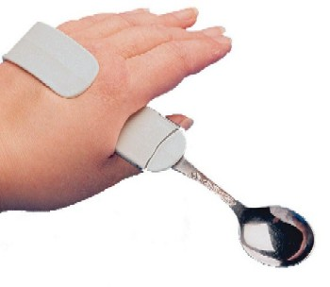
“Assistive Technology”
Wikipedia:
  “Any item, piece of equipment, or product system, whether acquired commercially, modified, or customized, that is used to increase, maintain, or improve functional capabilities of individuals with disabilities”
Includes fatter spoon handles, hearing aides, and screen readers
“Accessibility software”
  “Accessibility of a computer
  system to all people, regardless
  of disability or severity of impairment”

Slide 7
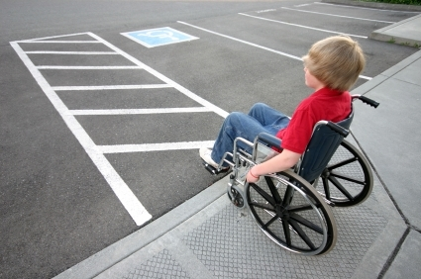
“Universal Design”
One design works for everybody
  Typical example: curb cuts
“Situational Impairments”
  Trying to type on Smartphone while walking
  Trying to enter numbers without looking at a screen (e.g., while driving)
Elderly
  Less accuracy, lower vision, cognitive difficulties

Slide 8
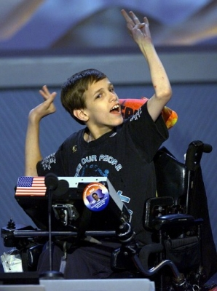
Kinds of Physical Disabilities
Cerebral Palsy
  Result of brain damage to motor control parts of brain, often prenatally or as an infant
  Doesn’t get worse
  Limited physical control
    58% have difficulties with communication
    Often cannot talk or control their hands
  Often, no affect on intelligence
    42% have problems with their vision
    23–56% have learning disabilities
  2.1 per 1,000 live births
  Wide range of abilities

Slide 9
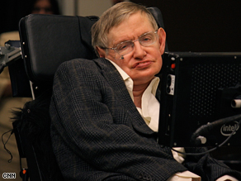
Kinds of Physical Disabilities, cont.
Amyotrophic lateral sclerosis (ALS), Lou Gehrig's disease
Affects about 30,000 Americans
  1.2-4.0 per 100,000 individuals in Caucasian populations
Muscle weakness and atrophy throughout the body due to the degeneration of the upper and lower motor neurons
Degenerative (gets worse)
Lose ability to speak and move
Eventually, may lose ability to eat
and even breath
Stephen Hawking, 1942-2018 (76)

Slide 10
Kinds of Physical Disabilities, cont.
Parkinson's disease
  Degenerative disorder of the central nervous system
  Usually affects older people, usually after age 60
  Shaking, rigidity, slowness of movement
  About one million people in the United States
Muscular Dystrophy (MD)
  About one in every 4,000 newborn boys
  Lose gross motor control while retaining fine motor control
  Lose strength
Many other physical disabilities and diseases
Just being elderly
  Reduced physical dexterity, eyesight, cognitive abilities, etc.

Slide 11
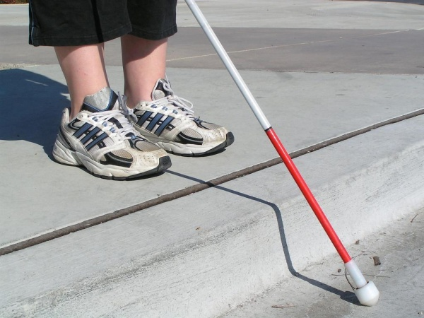

Blindness and Visual Disabilities
Estimate that globally the number
of people of all ages visually impaired is 285 million, of whom 39 million are blind.
  (cite)
Many levels
  No vision from birth
  Need magnification
  Color blindness

Slide 12




Example: CAPTCHAs
Hard for Computers/Easy for Humans
Require vision
Audio CAPTCHAs
PLAY
SUBMIT
Completely Automated Public Turing Test to Tell Computers and Humans Apart
Notes:
These we can imagine ourselves using, which is a good and bad thing. We often aren’t the user.
Nothing makes that quite as explicit as when we’re designing for someone with a disability.

Slide 13
CAPTCHAs
Hard for Computers/Easy for Humans
Require vision
Audio CAPTCHAs
PLAY
1
7
7
8
2
2
3
4
8
5
SUBMIT
Completely Automated Public Turing Test to Tell Computers and Humans Apart

Slide 14
Study of Existing CAPTCHAs
162 Participants
  89 Blind Web Users
  73 Sighted Web Users
10 Examples, 10 Sites
  Randomized Trials
Jeffrey P. Bigham and Anna C. Cavender. 2009. Evaluating existing audio CAPTCHAs and an interface optimized for non-visual use. In Proceedings of the SIGCHI Conference on Human Factors in Computing Systems (CHI '09). Association for Computing Machinery, New York, NY, USA, 1829–1838. DOI:https://doi.org/10.1145/1518701.1518983

Slide 15
Recommendations and Laws
Section 508 of the Rehabilitation Act mandates all federal agencies to purchase only accessible products and to provide information on the Web in a barrier-free manner
Accessibility guidelines exist for the major operating systems and platforms
[Zimmermann & Vanderheiden 2008]

Slide 16
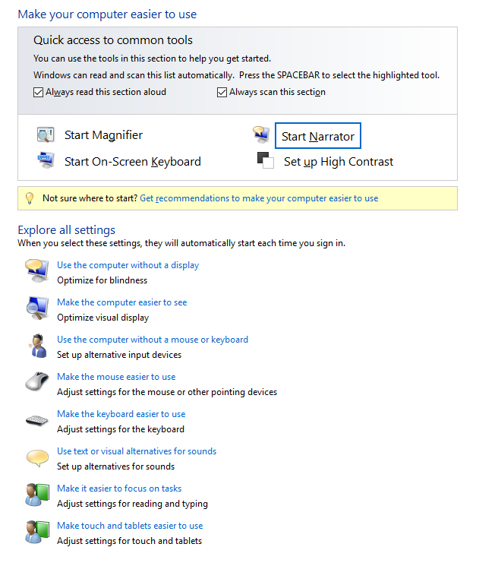

Assistive Technologies
Built into OSs
Windows has a whole
collection of adaptations
  Accessories/Ease of Access
  Magnifier – make whole screen or
  a portion bigger
    Can also just use larger fonts, lower
    resolution
    Change colors and contrast
  Narrator – read words on screen
  On-Screen keyboard
    Can be scanned
  Built-in speech recognition

Slide 17
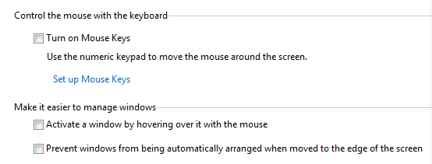
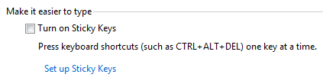
Assistive Technologies
Built into OSs, cont
Adaptations for mouse
  Make mouse easier to see
  Move mouse with the keyboard
Adaptations for keyboard
  Sticky Keys – so no need for chords
    Work like on Smartphones

Slide 18
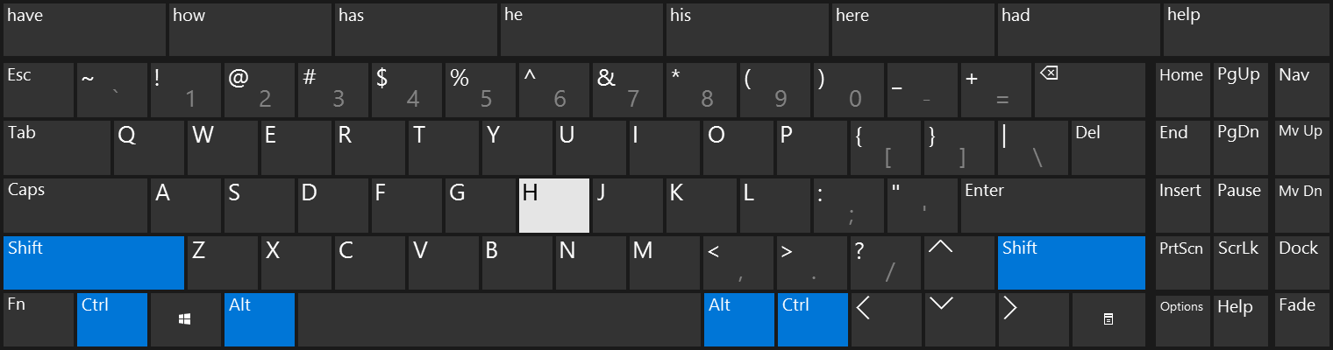
On Screen Keyboards
Built-in or add-on
  Usually add auto-complete and auto-predict
    Auto-predict: Predict next word based on previous words with no letters typed
Can point to on-screen keyboards with various mechanisms
  Example: head tracking (video 3:05)
Or use scanning keyboards
  Sip and puff to select (video 3:55)

Slide 19
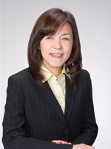
Screen Readers for the Blind
Reads the words on the screen
Keystroke to move to next area
Blind people can operate them amazingly quickly
JAWS – job access with speech
  Example: video 7:23
IBM Home Page Reader – by Chieko Asakawa from IBM Japan, visiting CMU

Slide 20
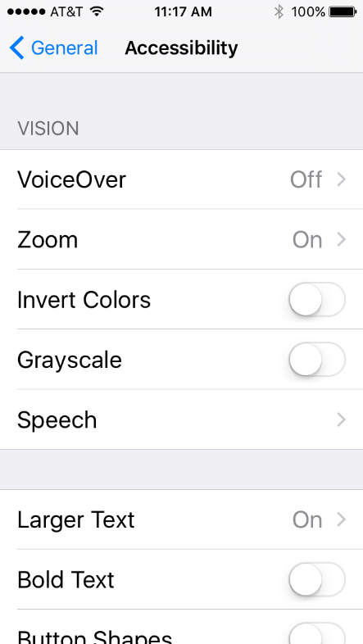
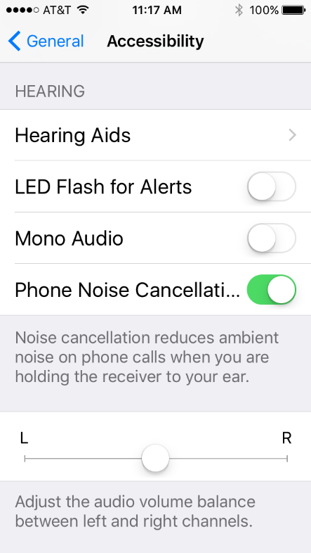
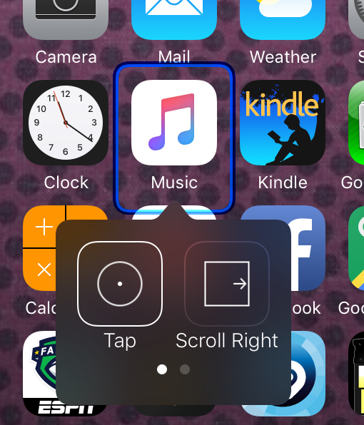
Assistive Technologies in iPhone
Many pages of accessibility settings
VoiceOver – reads what is on screen
Zoom – screen magnifier – 3 finger tap
Speech recognition for controlling device
Closed captions on videos
AssistiveTouch – so don’t need multiple fingers, don’t need to press Home button, etc.
Switch Control
– Scanning through items
with optional connection to
external switch
  How to set it up with
  BlueTooth (video 7:14)
  Can use head movement
  with built in camera (video 3:25)

Slide 21
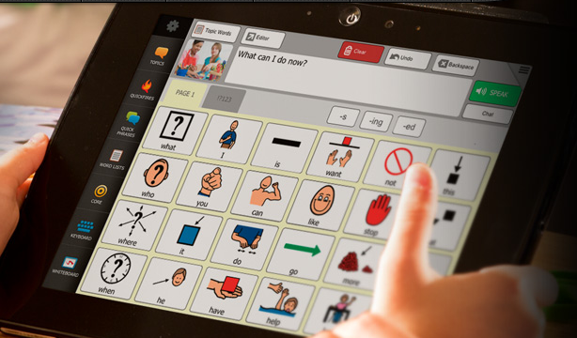
Augmentative and Alternative Communication (AAC) devices
Talk for people
Originally were cardboard
pictures that would point at
Now computerized
Custom devices or tablet applications
  DynaVox (now subsidiary of Tobii) (Example in use - video 3:41)
  MinSpeak by Semantic Compaction
    Both Pittsburgh companies!
Usually pictures since faster than typing
Pointing – head or eye tracking or scanning with switch (like keyboards)

Slide 22
Web Accessibility
http://www.w3.org/WAI/intro/accessibility.php
Original web was a real boon to handicapped
  All text, easily navigated, provided access to: “education, employment, government, commerce, health care, recreation, and more”
Then it got more complicated and inaccessible
Standards and requirements emerged to help
Includes:
  Using appropriate html standards, e.g., <h3>, not <b>
  “Alt” labels for pictures
  Appropriate tab order – see aa.com
  Easy distinguishing between content and navigation
    Link at top that goes directly to content for screen readers
  Clearly marked links to multi-media content, etc.
  … many more
But most web sites still have accessibility problems

Slide 23
Accessibility in Mobile UI
Assistive technology: assuming an immutable environment. “non-standard” users use assistive technology to access the system (e.g., stair lifts)
Regular Mobile Apps
Accessibility Tools
(e.g., screen readers, assistive touch tools)
Thanks to
Toby Li for these slides!
Notes:
3 main high-level design approaches to accessibility – most current GUI systems still take the assistive technology approach, but I think it’s very interesting to talk about those 3 totally different design approach

Slide 24
Accessibility in Mobile UI
Assistive technology: assuming an immutable environment. “non-standard” users use assistive technology to access the system (e.g., stair lifts)
Universal design/Design for all (Shneiderman 2000): “one size fit all” solution – the same system design should be usable by everyone (e.g., ramps instead of stairs)
Notes:
Ben Shneiderman. 2000. Universal usability. Commun. ACM 43, 5 (May 2000), 84–91. DOI:https://doi.org/10.1145/332833.332843

Slide 25
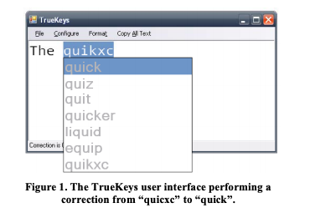
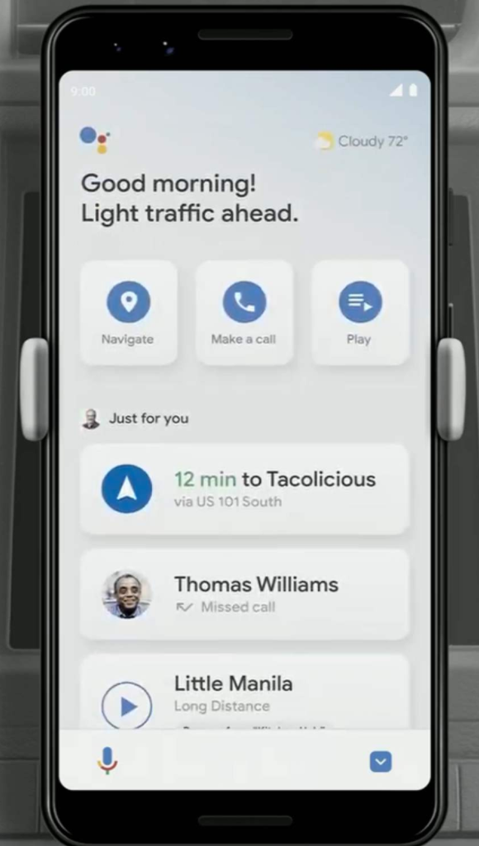
Accessibility in Mobile UI
Assistive technology: assuming an immutable environment. “non-standard” users use assistive technology to access the system (e.g., stair lifts)
Universal design/Design for all (Shneiderman 2000): “one size fit all” solution – the same system design should be usable by everyone (e.g., ramps instead of stairs)
Ability based design (Wobbrock 2011): the system identifies the user’s abilities and automatically adapt to them (e.g., soft keyboard that automatically corrects errors based on the perceived user motor impairments (Kane 2008), Android driving mode)
Notes:
Might be useful to use this example to mention that accessibility also includes handling situational impairments such as driving
Shaun K. Kane, Jacob O. Wobbrock, Mark Harniss, and Kurt L. Johnson. 2008. TrueKeys: identifying and correcting typing errors for people with motor impairments. IUI ‘08.
Jacob O. Wobbrock, Shaun K. Kane, Krzysztof Z. Gajos, Susumu Harada, and Jon Froehlich. 2011. Ability-Based Design: Concept, Principles and Examples. ACM Trans. Access. Comput. 3, 3, Article 9 (April 2011), 27 pages.
Users with accessible needs can +

Slide 26
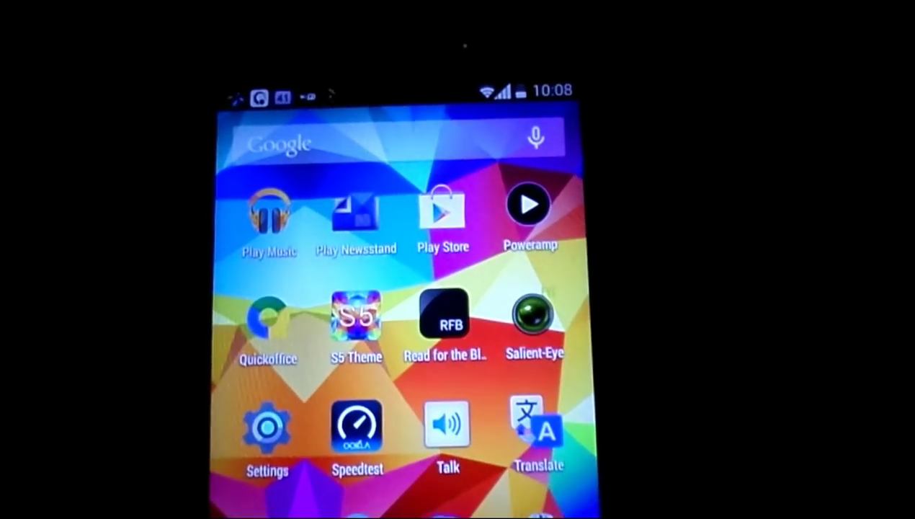
Accessibility in Mobile UI
Android Talkback + Touch Exploration
Notes:
The mechanism adds support for ”hover” on touch screens, read out the hovered content, and use “double tap” and “double tap and long press” to replace the regular clicks and long clicks

Slide 27
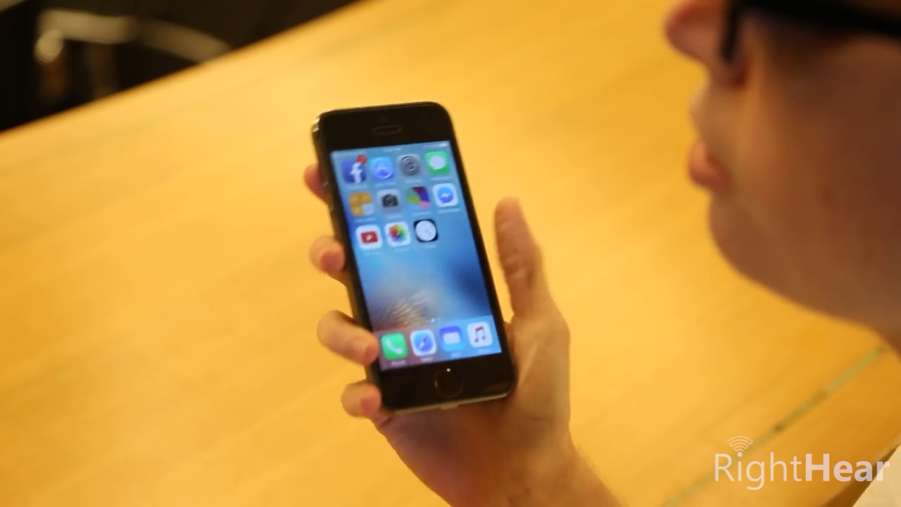
Accessibility in Mobile UI
Linear navigation – explore the screen one item at a time
Notes:
For some people it’s easier to do navigation where the user move through items on the screen in sequence.

Slide 28
Developing Accessible Apps - Android
That is, building your apps in a way that’s friendly to assistive tools and providing necessary meta-data of your GUI.
Alt-text: add content descriptions to all graphical widgets, the screen reader reads out the contentDescription field of all views. Set contentDescription to null for decorative elements so they are omitted by screen readers
Hierarchy: organize your widgets in clear hierarchy so it’s easier to navigate using assistive tools.
Set focus order for your widgets: so important ones are read out first in linear navigation.
Use built-in widgets (e.g., Button, Spinner) and event handler (e.g., onClick) instead of custom ones (e.g, onTouchDown + onTouchUp) whenever possible.
If you use gestures/voice input/sensory input (such as tilting the phone) in your interface, the same functionalities should also be available without using these modalities for users who can’t do them.

Slide 29
Developing Assistive Tools - Android
Android allows developers to build assistive tools by implementing an AccessibilityService
Listening to events: can listen to events in the foreground UI such as VIEW_CLICKED, TEXT_CHANGED, WINDOW_CHANGED, WINDOW_CONTENT_CHANGED etc.
For each event, the service can retrieve a hierarchical representation (similar to DOM tree) for all UI elements on the screen as well as their meta data (e.g., contentDescription, isClickable, isEditable, className)
For each event, the service can also interact with UI elements on the screen on the user’s behalf (e.g., CLICK, LONG_CLICK, SELECT, SET_TEXT).
Usually, for each event, an assistive tool represents the event and the current state of the UI in an alternative way (e.g., read out, show a simplified interface) so the user can understand, solicit the user’s intent on what to do in the current state in a way that corresponds to the user’s ability (e.g., voice, gaze, trackball), and perform the action on the original UI on the user’s behalf.
Android accessibility guide: https://developer.android.com/guide/topics/ui/accessibility

Slide 30
Apple iOS developer guidelines
https://developer.apple.com/design/human-interface-guidelines/foundations/accessibility/
Many categories of recommendations
  Simplicity, Perceivability, Support personalization, Don’t override the platform gestures, user built-in widgets
  Voiceover requires extra thought
    “hide” purely decorative content
    Tell VoiceOver when onscreen content or layout changes

Slide 31

Research
Lots of current work on accessibility
Annual 3-day conference: ASSETS’22
  The 24th International ACM SIGACCESS Conference on Computers and Accessibility
But most not about tools / toolkit support

Slide 32
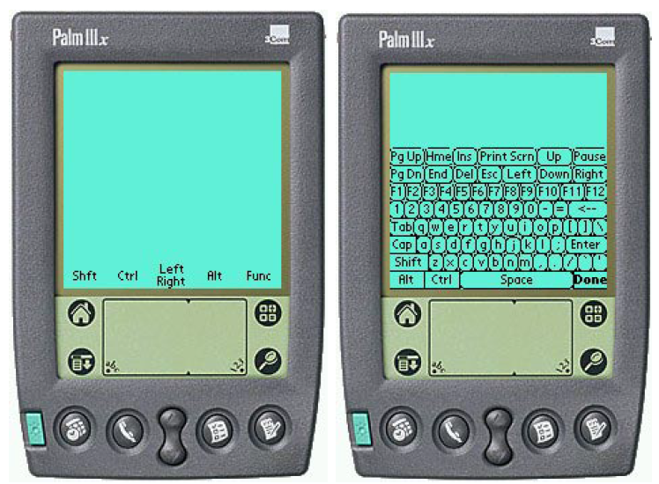
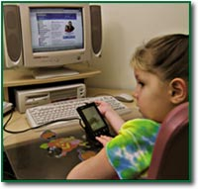
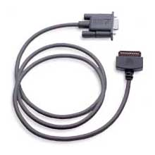
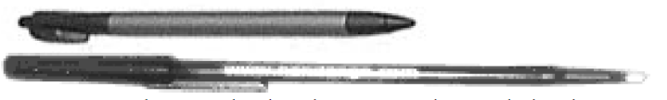
Research: RemoteCommander
Brad A. Myers, Jacob O. Wobbrock, Sunny Yang, Brian Yeung, Jeffrey Nichols, and Robert Miller. "Using Handhelds to Help People with Motor Impairments", Fifth International ACM SIGCAPH Conference on Assistive Technologies; ASSETS 2002. July 8-10, 2002. Edinburgh, Scotland. pp. 89-96. http://www.cs.cmu.edu/~pebbles/papers/pebbleshandicapped.pdf
We were researching using Palm Pilots to augment regular computers
Pebbles Remote Commander allows the Palm to be mouse and keyboard for a PC
  Found by a father of a 10-year old with Muscular Dystrophy (MD) and he wrote a testimonial
Found some long cables & special long and lightweight stylus

Slide 33
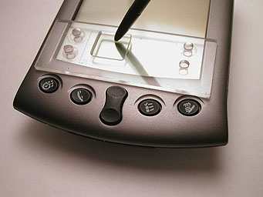
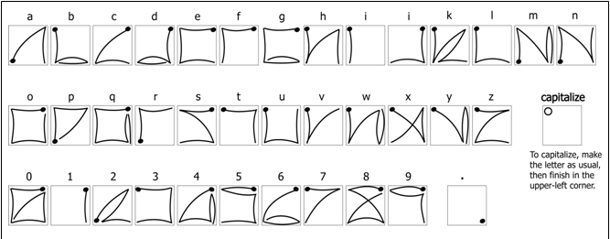
Research EdgeWrite
Led to the EdgeWrite project for text entry
Jacob O. Wobbrock, Brad A. Myers, and John A. Kembel. 2003. EdgeWrite: a stylus-based text entry method designed for high accuracy and stability of motion. In Proceedings of the 16th annual ACM symposium on User interface software and technology (UIST '03). ACM, pp. 61-70. http://dl.acm.org/citation.cfm?doid=964696.964703

Slide 34
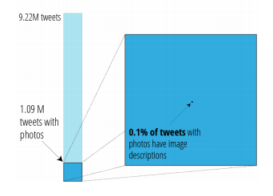
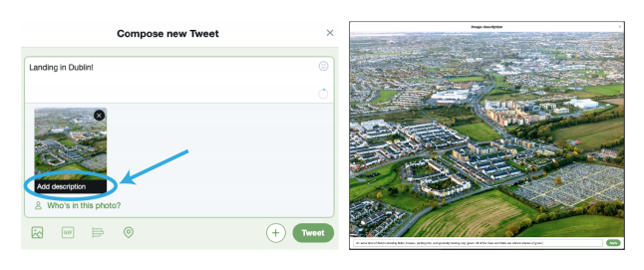
“It’s almost like they’re trying to hide it": How User-Provided Image Descriptions Have Failed to Make Twitter Accessible
Gleason, Bigham, et al. WWW 2019.

Slide 35
Other Resources
CMU courses
  Accessibility (S2015,F2017,S2022) by Jeff Bigham or Patrick Carrington
  Fall 2022: Divakaran Liginlal, 67-220 “Digital Accessibility - Ensuring Universal Access to the Information Society”
HCII Faculty
  Jeff Bigham
    E.g., crowdsourcing with iPhone for blind
  Patrick Carrington
    E.g., technology to help with wheelchairs
  etc.

