Slide 1
Lecture 22:
Simple User Interface Toolkits and End-User Programming for UIs; Low-Code / NoCode
05-431/631 Software Structures for User Interfaces (SSUI)
Fall, 2022

Slide 2
Logistics
HW6 due today
Fill in project ideas in Piazza
Propose to have final take-home test during exam week – ok?
  Vote for Tuesday+Wed of exam week

Slide 3
Overview
Approaches to help novice programmers to be able to create dynamic interfaces
  Static interfaces can just be drawn
Typically, also easier to program in general
  Most modern tools to make it easy to program focus on creating interactive software, like games, which have a UI
EUP = end-user programmers
Definition: Visual Programming = “Programming in which more than one dimension is used to convey semantics.” - [Myers, 1990]

Slide 4
New terms: Low-Code, No-Code
“Low-Code” – create app by “graphical user interfaces and configuration instead of traditional programming” – Wikipedia
  Term coined in 2014
  Often use visual programming
  Require some coding expertise
“No-Code” – theoretically no coding at all, but often the same as “low code”
  Aim to allow business people to create the whole app
  Often declarative “model-driven”, with fixed GUI

Slide 5
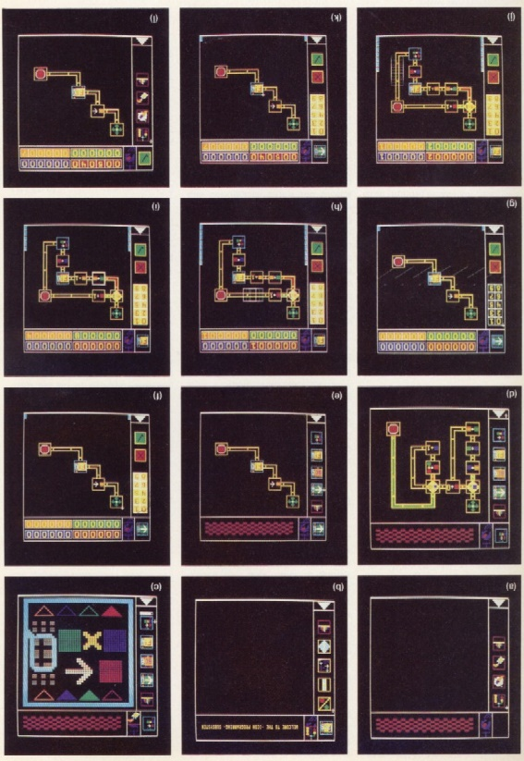
Older Approaches
Older visual language systems did not necessarily help with UIs
E.g., Pict from Ephraim Glinert, 1984 uses conventional flowcharts to program algorithms
Goal: easier to learn programming

Slide 6
Some Examples
LabVIEW (1991 - present)
  See also OutSystems (2001- present)
SUIT [Pausch, 1992]
Alice [Pausch, 1995]
HANDS [Pane, 2002]
Yahoo! Pipes (2007 – 2015)
Scratch (2003-present)
AppInventor (2009-present)
Lego Mindstorms (NXT) Robot kits

Slide 7
Historical trends
Action Graphics
FORMAL
ThingLab
Hi-Visual
LabView
PROGRAPH
PIGS
Pict
Rehearsal
SmallStar
Forms
Editing by Example
PICT
Lotus 1-2-3
SIL-ICON
VisiCalc
HiGraphs
Miro
StateMaster
AMBIT/G/L
Grail
GAL
Graphical Program Editor
Query by Example
Pygmalion
I/O Pairs
Cube
Cantata
SchemePaint
CODE 2.0
Iconicode
MViews
AVS
Mondrian
ChemTrains
Vampire
VIPR
SPE
LOFI/HIPI
FOXQ
VMQL
GXL
Euler View
Yahoo Pipes
Popfly
1960
1980
1990
2000
Techniques
Graphs
Flowcharts
Flowchart derivatives
FORMS
Demonstrational
Techniques
Graphs
Flowcharts
Flowchart derivatives
FORMS
Demonstrational
Data Flows
Spreadsheets
Matrices
Jigsaw Puzzles
Petri nets
Flowchart derivatives
Techniques/Goals
3D Rendering
Visual Hierarchy
Procedures
Control Structures
Programmable Graphics
Animations
Video Imagery Exploitation
General purpose, declarative language
Audio, video and image processing
Graphical models from behavioral models
Learning and Cognitive abilities in vision processes
Handling Scalability, typing, and imperative design
Collaborative Software Development
Techniques/Goals
Child Learning
Xquery by FORMS
Spreadsheet Analysis
Visual Model Query
Layouts
Specification and Interchange
Mashups
Web-based design
Programming for end-users (non-Professionals
From: Vishal Dwivedi,
05-830 in 2013

Slide 8

LABView
One of the most successful visual programming systems
Started about 1991 on Macintosh, still going
  http://www.ni.com/labview/
  J. Kodosky, J. MacCrisken and G. Rymar. “Visual programming using structured data flow,” Visual Languages, 1991., Proceedings. 1991 IEEE Workshop on, 8-11 Oct 1991, 1991. pp. 34-39.
Focused on scientists and lab equipment
Wiring diagram backend with front panel
  Drag and drop elements
  Data flow programming

Slide 9
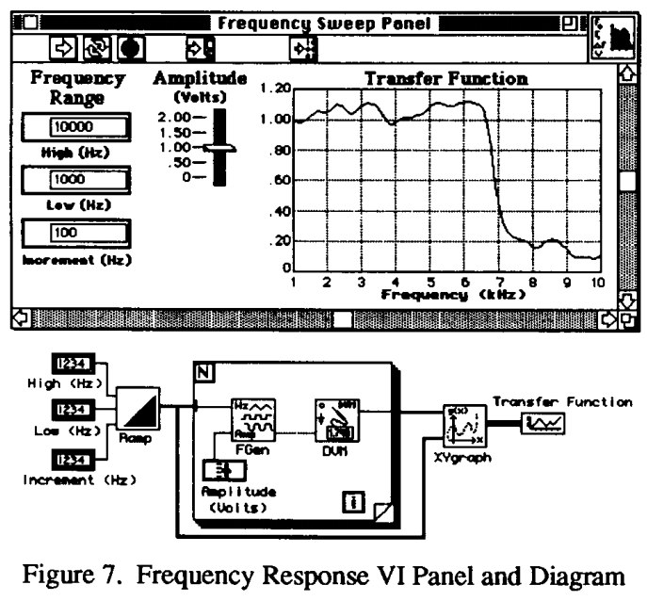
LabVIEW
[Kodosky, 91]
2-view approach
very influential

Slide 10
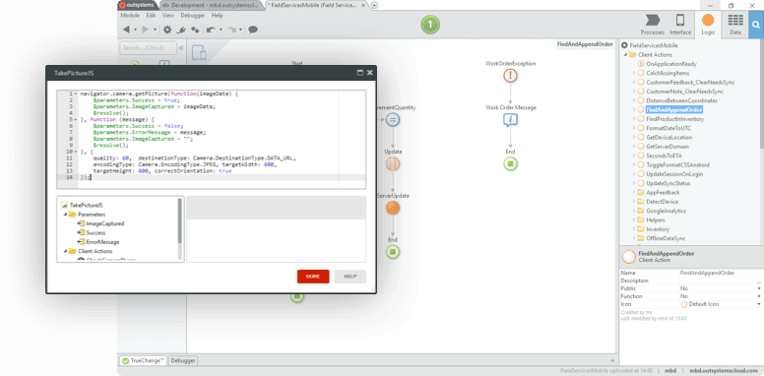
OutSystems
2001 – present
https://www.outsystems.com/ - see video
“low-code” platform
Drag and drop, visual programming
Focus on enterprise

Slide 11
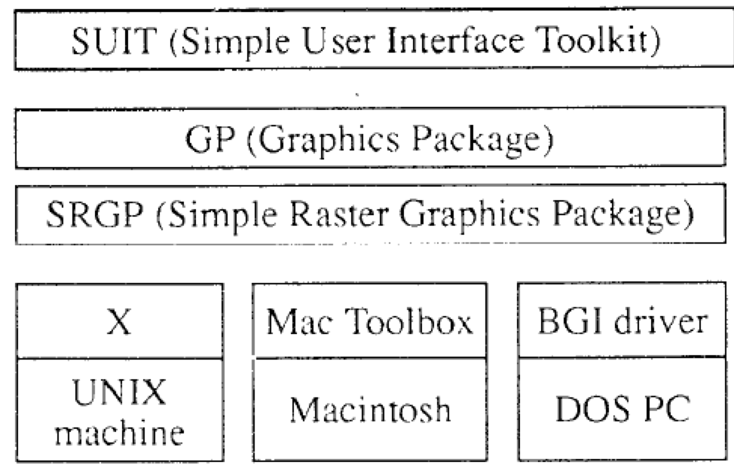
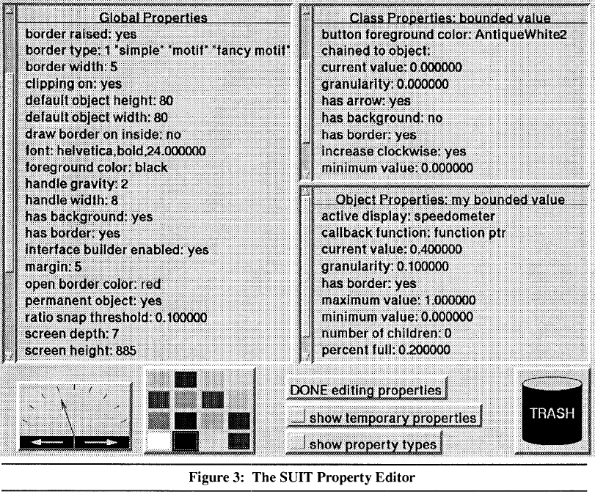
SUIT (1992)
Pausch, R., Conway, M., & DeLine, R. (1992). Lesson Learned
from SUIT, the Simple User Interface Toolkit. ACM Transactions on Information Systems, 10(4), 320-344.
Simple User Interface Toolkit
Implemented in C
  Portable across UNIX, Macintosh, and DOS
  Requires only basic C programming skills
Used in many courses at UVA
  Become productive in
  2½ hours, vs. weeks
Iterative user testing
Table of objects
  No inheritance – just global or local
  Property sheets
Uses CTRL-SHIFT to avoid run/build mode
Retained object model
Data-linkages (constraints) through drag-and-drop

Slide 12
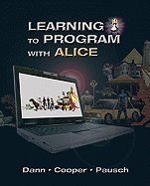
Alice
Randy Pausch, Tommy Burnette, A.C. Capehart, Matthew Conway, Dennis Cosgrove, Rob DeLine, Jim Durbin, Rich Gossweiler, Suichi Koga and Jeff White. “Alice: A Rapid Prototyping System for 3D Graphics,” IEEE Computer Graphics and Applications. 1995. 15(3). pp. 8-11. May.
Matthew Conway, Steve Audia, Tommy Burnette, Dennis Cosgrove, Kevin Christiansen, Rob Deline, Jim Durbin, Rich Gossweiler, Shuichi Koga, Chris Long, Beth Mallory, Steve Miale, Kristen Monkaitis, James Patten, Jeff Pierce, Joe Shochet, David Staack, Brian Stearns, Richard Stoakley, Chris Sturgill, John Viega, Jeff White, George Williams and Randy Pausch. “Alice: Lessons Learned from Building a 3D System For Novices,” Proceedings CHI'2000: Human Factors in Computing Systems, The Hague, The Netherlands, Apr 1-6, 2000. pp. 486-493. http://www.alice.org
Started as a 3D extension to SUIT
PhD dissertation of Matthew Conway (1998)
Grown to a large-scale system with books
  Wanda Dann, Steven Cooper and Randy Pausch.
  Learning to Program With Alice. Prentice-Hall.
  August, 2003.
Many more user studies of what students
found easy and difficult

Slide 13
Alice
Easy 3D with character-centered movement & rotation
  “Bunny.move (up, 1)”, “Turn Around Once” “Bunny.move(forward, 1, speed=4)”
  No matrices! No X, Y and Z
Camera control
  “Point Camera At”, “Get a Good Look At”
Easy parallelism with “do-together”
  ArmsOut = DoTogether(
  Bunny.Body.LeftArm.Turn(Left, 1/8),
  Bunny.Body.RightArm.Turn(Right, 1/8) )
Create scene (by direct manipulation), then script
All commands animated by default, so no sudden jumps, disappearing objects
Early user of Python, switched to Java
Lots of vocabulary fixes:
  Resize, not Scale; Move, not Translate; Speed, not Rate; FrontToBack, not Depth:

Slide 14
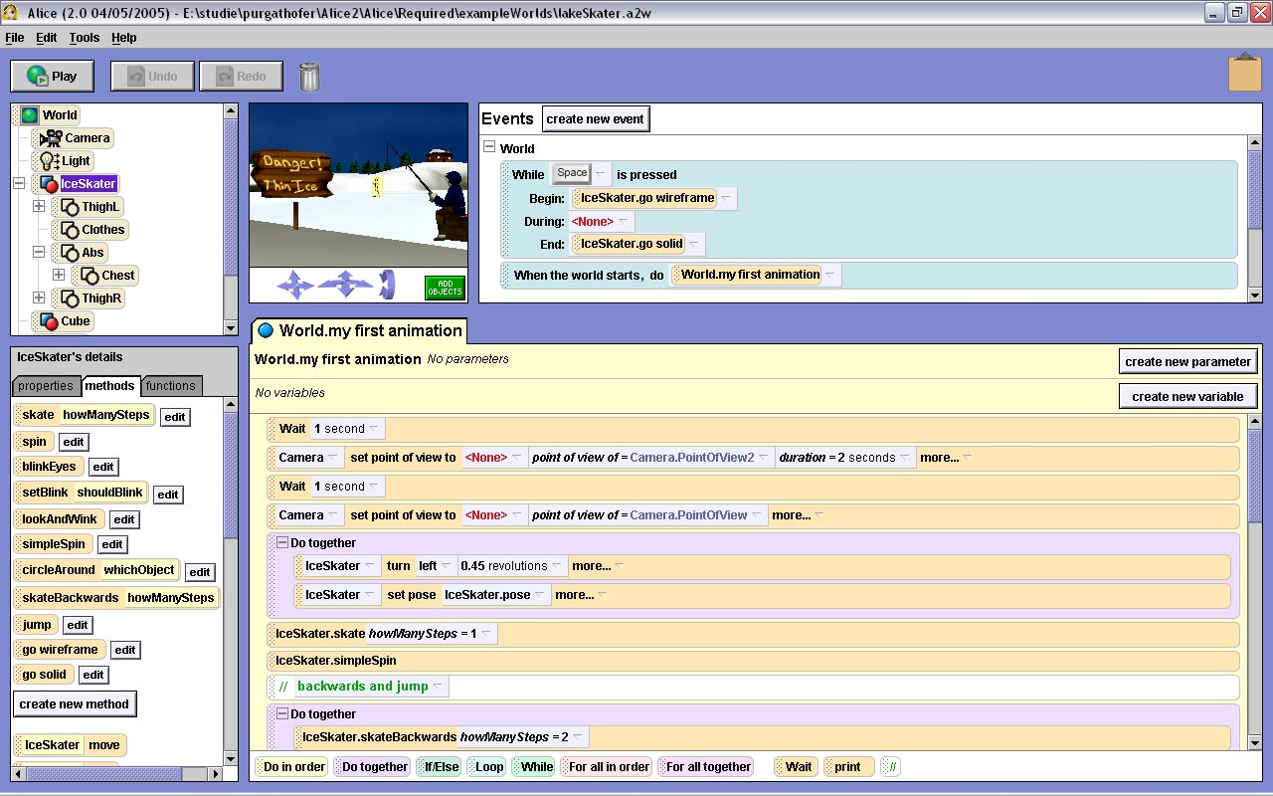
Alice, cont.
Later versions: Avoid syntax issues with drag-and-drop editing
Testing in classrooms showed significantly better learning and retention
Tutorial video
(from 2013)
6:44

Slide 15


HANDS
J.F. Pane, B.A. Myers and L.B. Miller. “Using HCI Techniques to Design a More Usable Programming System,” IEEE 2002 Symposia on Human Centric Computing Languages and Environments (HCC 2002), Arlington, VA, September 3-6, 2002. 198-206.
PhD 2002 of John Pane (now at Rand in Pgh)
Studies:
  How people naturally express
  programming concepts and algorithms
    1) Nine scenes from PacMan
    2) Transforming and calculating
    data in a spreadsheet
  Specific issue of language design
    3) Selecting specific objects from a group (“and”, “or”, “not”)
  Lots of interesting results

Slide 16
Examples of Results
Rule-based style
“If PacMan loses all his lives, its game over.”
Set operations instead of iterations
“When PacMan eats all of the dots, he goes to the next level.”
“And”, “Or”, “Not” don’t match computer interpretation
Most arithmetic used natural language style
“When PacMan eats a big dot, the score goes up 100.”
Operations suggest data as lists, not arrays
  People don’t make space before inserting
Objects normally moving
“If PacMan hits a wall, he stops.”
  so objects remember their own state

Slide 17
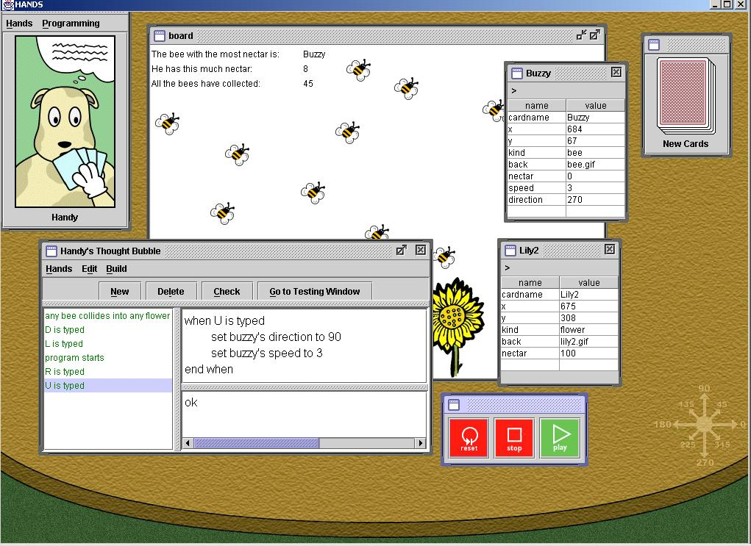
New Language and
System: HANDS
Properties:
  All data visible on cards
  Metaphor of agent (Handy
  the dog) operating on cards
  Natural language style for
  code
  Domain-specific operations, like movement in a direction
  All operations can operate on single items or sets of items
  Sets can be dynamically constructed and used
    “Set the speed of all bees to 0”
  Event handlers: “when U is typed”
See the video: YouTube (7:36)

Slide 18
Scratch
Mitchel Resnick, John Maloney, Andrés Monroy-Hernández, Natalie Rusk, Evelyn Eastmond, Karen Brennan, Amon Millner, Eric Rosenbaum, Jay Silver, Brian Silverman and Yasmin Kafai. “Scratch: Programming for All,” Comm. ACM. 2009. 52(11). pp. 60-67. See also: http://scratch.mit.edu/.
MIT has long history of helping kids program
  Logo (Seymour Papert, 1967)
  Lego Mindstorms
  ”Constructionist” movement in education
Scratch comes out of that program (MIT Media Lab) – started about 2003
  https://scratch.mit.edu/
  “Create stories, games, and animations
  Share with others around the world”

Slide 19
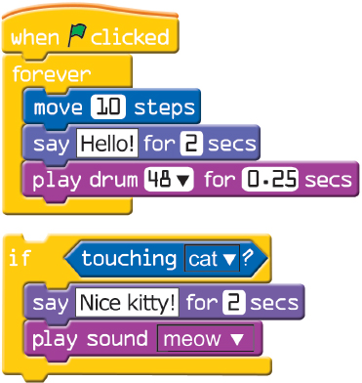
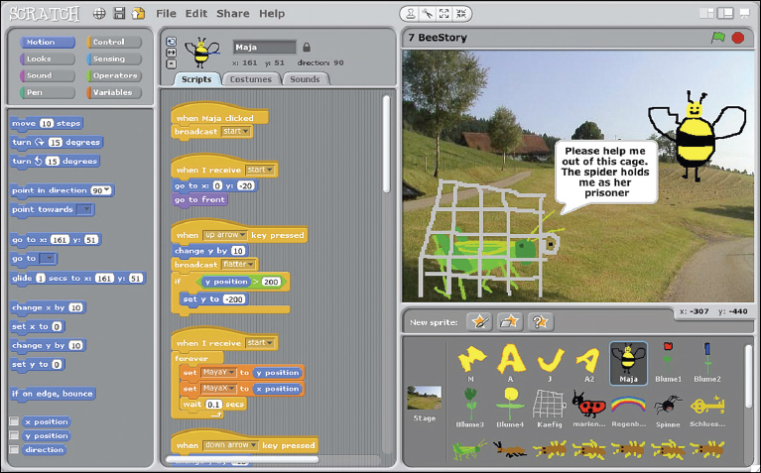
Scratch, cont.
Metaphor of puzzle pieces with properties
  Connectors shaped by type to eliminate type errors
  Control structures wrap around
Uses event handlers
for behaviors
https://vimeo.com/65583694, 1:37

Slide 20
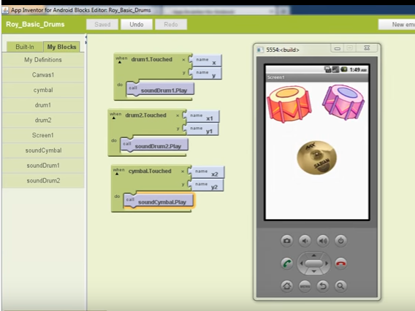
AppInventor
Ideas from Scratch to build real Apps for Android phones
  Briefly was a product from Google, while Hal Abelson was on sabbatical there (2009)
http://appinventor.mit.edu/
2 panel view, like
LabVIEW
  Drag in elements
  for UI
  Blocks view for
  code
  event handlers
  using “when”

Slide 21
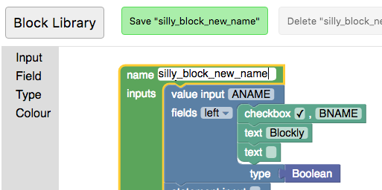
Many other “blocks” style languages
Blockly Developer Tools from Google from AppInventor
Used by Code.org, RoboBlockly, Wonder Workshop, etc.
Define own set of primitive blocks

Slide 22

IFTTT.com
Founded 2011
“If this then that”
  Condition-action rules (same as stimulus-response)
  Web-based conditions
  Often used with Internet of Things (IoT), “smart home” appliances
  New services added with Ruby programming
Single condition and action

Slide 23
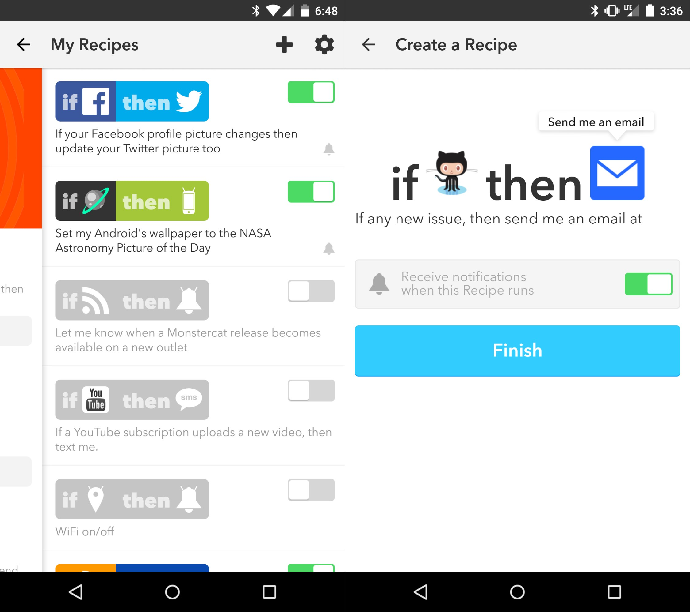
IFTTT

Slide 24


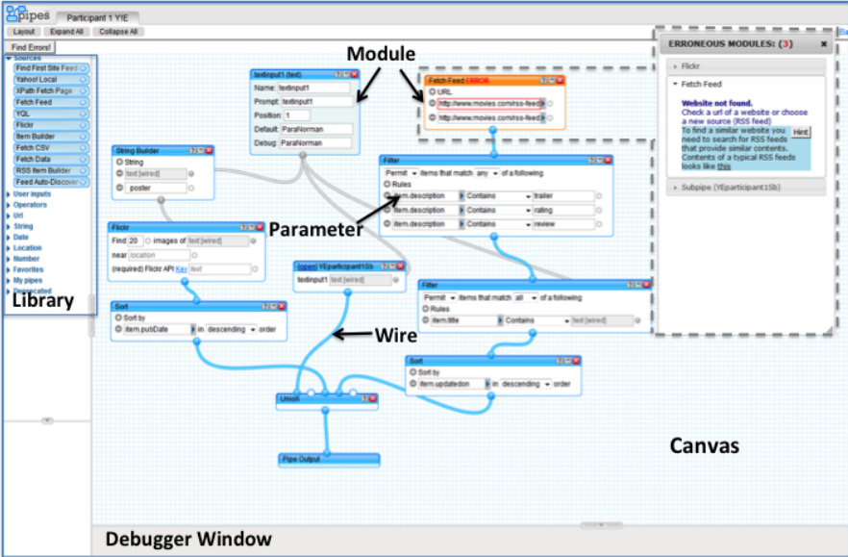
Yahoo! Pipes (2007 – 2015)
Was a web application to process data feeds on the web
  Originally focused on “RSS feeds”
Visual data flow architecture, like LabVIEW
Studies showed wasn’t easy for non-programmers to use
Sandeep K Kuttal, A. Sarma, and G. Rothermel, "Debugging Support for End-User Mashup Programming", in Proceedings of Computer and Human Interactions - CHI, Paris, France,pages 1609 - 1618, April 2013.[pdf]
  Issues with
  connections,
  parameters,
  debugging, etc.
Video (1:50) or
tutorial (5:15)

Slide 25
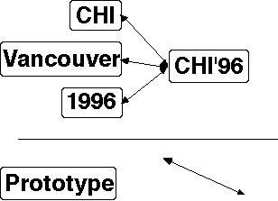
Another Approach: PBD
Programming by Demonstration (PBD)
  Also: Programming by Example (PBE)
Give examples of desired input and output
  Or of desired behavior
For example:
  Learns that size of boxes
  should match text from these
  examples
  Arrows stay attached
Like Machine Learning (ML)
but only a few examples
  E.g., gesture learning from 15 examples

Slide 26
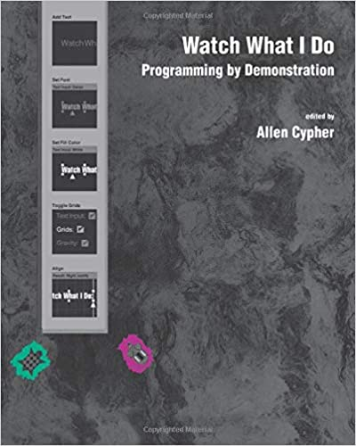
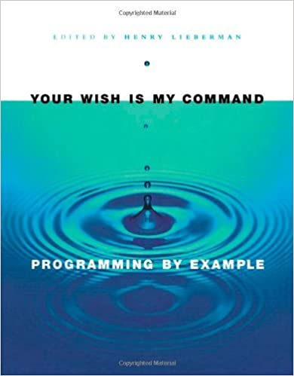
Demonstrational Interfaces
"Classic" Reference: Allen Cypher, ed. Watch What I Do, MIT Press. 1993.
Later book: Henry Lieberman, ed. Your Wish is My Command. 2001: Morgan Kaufmann.
My group has chapters in both

Slide 27
Motivation
Demonstrational techniques expand how much of the interface can be specified interactively.
And Interactive editors are much faster to use than programming with toolkits
  Frameworks improve productivity by factors of 3 to 5, interactive tools by factors of 10 to 50!
  It might take an hour to draw an interface interactively, compared to days to program it.
  Because they are faster, this promotes rapid prototyping
It is much more natural to specify the graphical parts of applications using a graphical editor.
Because they do not require programming skills, graphic designers can design the graphical parts of the interface.

Slide 28
Key Challenges
“Data description problem”
  What does the reference mean?
    Charlie Palmer Steak
    The least expensive steakhouse near me
    The closest one in Midtown East
    The one with 1,000 bonus points
    A promoted restaurant
    The second restaurant in the list
    ….
(Operator is usually easy – like “click”)
Control structures
  Conditionals and loops

Slide 29
Examples (of uses to create UIs)
(chronological order)

Slide 30
Peridot (1986-88)
Myers B. "Creating User Interfaces Using Programming-by-Example, Visual Programming, and Constraints," ACM Transactions on Programming Languages and Systems. vol. 12, no. 2, April, 1990. pp. 143-177. (Peridot)
Myers B., Creating User Interfaces by Demonstration, Academic Press, San Diego, 1988.
Myers B., "Creating Interaction Techniques by Demonstration," IEEE Computer Graphics and Applications, Vol. 7, No. 9, IEEE, September 1987, pp. 51 - 60.
First demonstrational tool, and it used by-example techniques to allow the creation of new widgets.
From the drawings, it infers:
  Graphical constraints among the objects, such as that the boxes should be the same size as the text.
  control structures such as iteration over all the items in a menu
  how the mouse affects the graphics, such as that the check mark should follow the mouse.
feedback: question and answer
video (8 min)

Slide 31
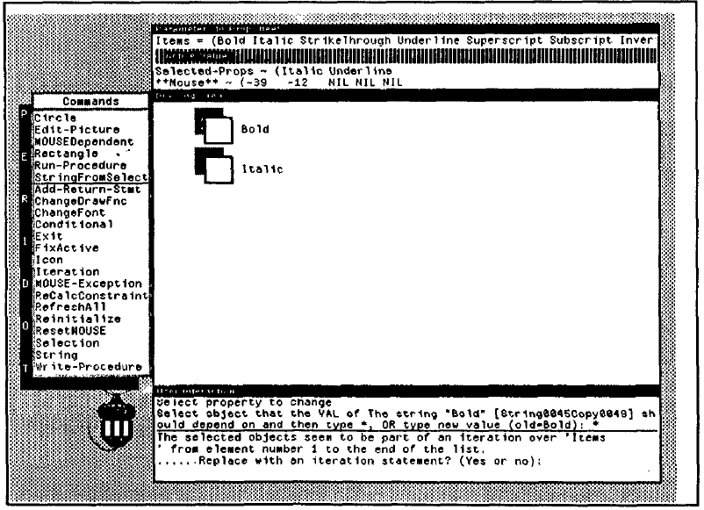
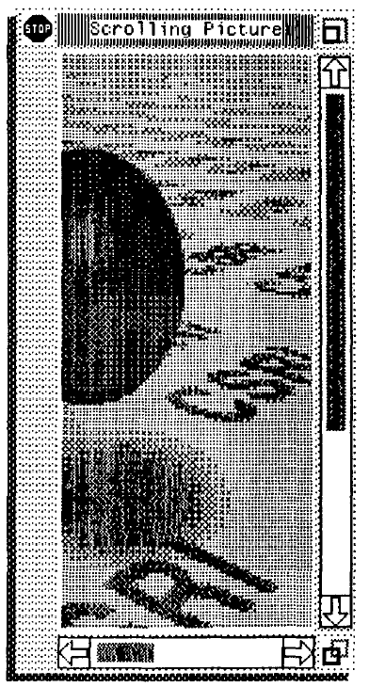
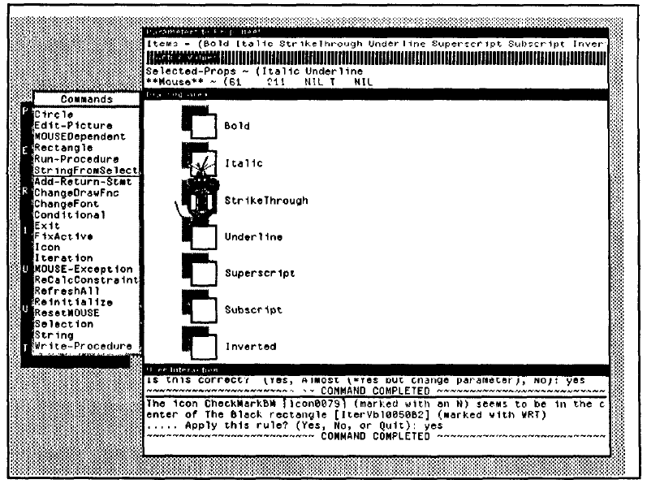
Peridot Pictures

Slide 32
Lapidary (1989-1993)
Myers B., Vander Zanden B. and Dannenberg R., "Creating Graphical Interactive Application Objects by Demonstration," Proceedings of the ACM Symposium on User Interface Software and Technology, UIST'89, Williamsburg, November 1989, pp. 95 - 104.
Brad Vander Zanden and Brad A. Myers. "Demonstrational and Constraint-Based Techniques for Pictorially Specifying Application Objects and Behaviors," ACM Transactions on Computer-Human Interaction. vol. 2, no. 4, Dec, 1995. pp. 308-356.
Extends Peridot to allow the creation of application-specific graphical objects, like nodes in a graphics editor.
Uses less inferencing and more dialog boxes
Is "real" and you get it as part of the Garnet distribution
Problems:
  can only demonstrate "syntactic" parts of application
  hard to set up correct constraints
video (12 min)

Slide 33
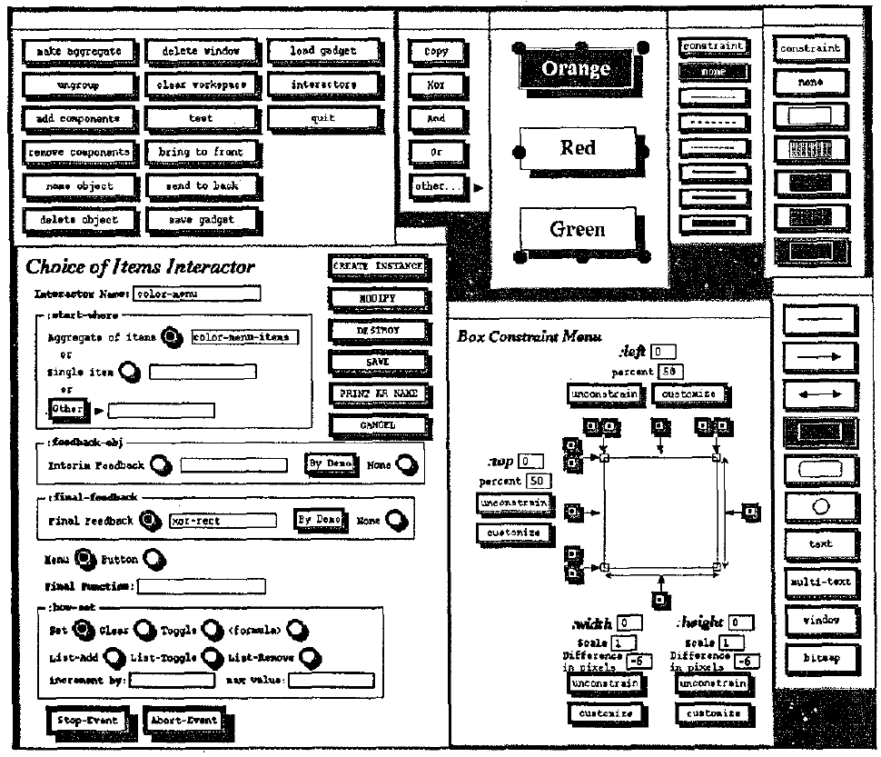
Lapidary dialog boxes

Slide 34
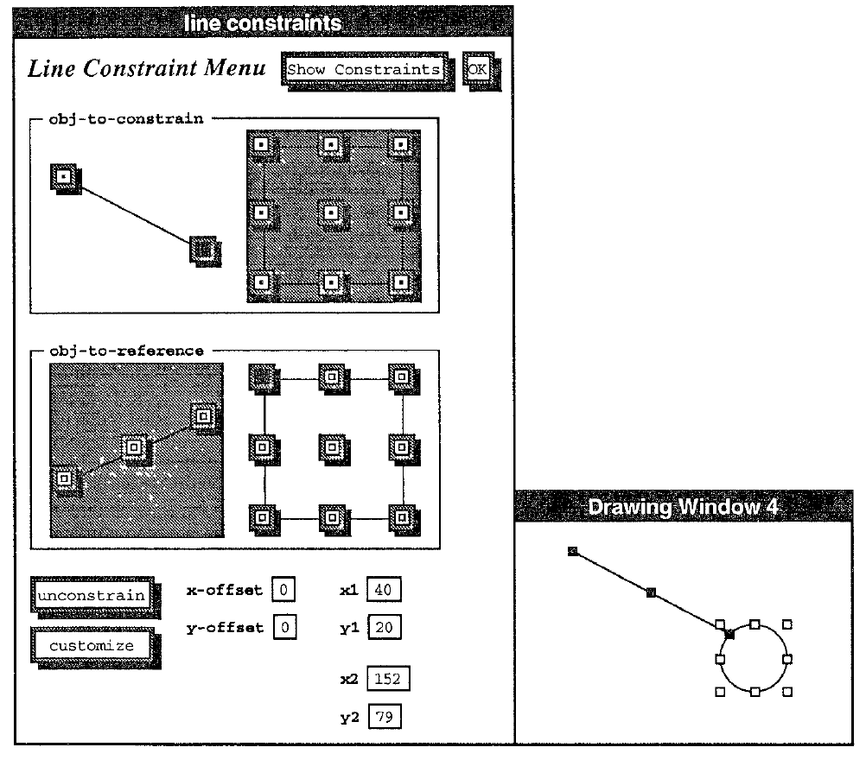
Lapidary, cont.

Slide 35
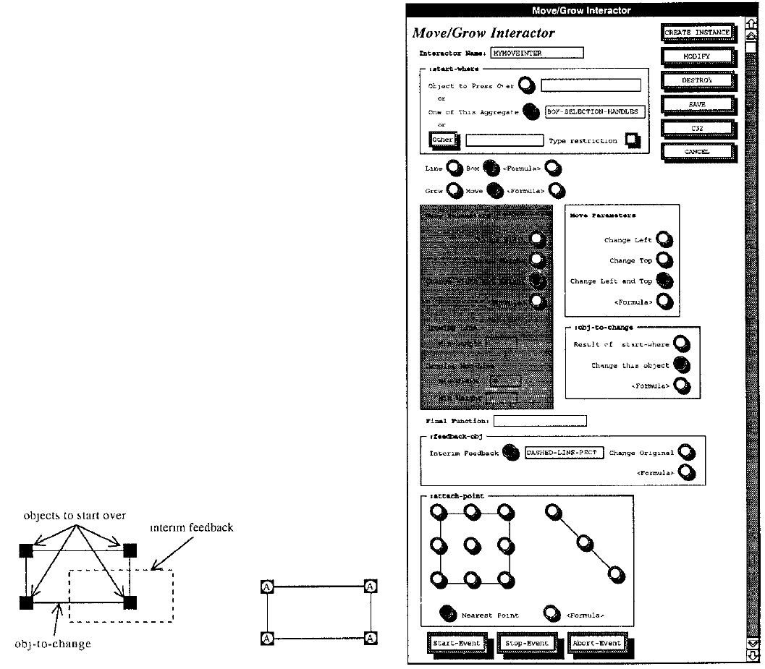
Lapidary, cont.

Slide 36
Marquise (1993-1994)
Myers B., McDaniel, R. and Kosbie, D.. "Marquise: Creating Complete User Interfaces by Demonstration," Proceedings CHI'94: Human Factors in Computing Systems. Amsterdam, The Netherlands, April 24-29, 1993. pp. 293-300.
Go back to doing more by demonstration, and just show the way that the interface should operate.
In particular, demonstrate when the behaviors should start and what the feedback looks like.
  mouse button does one of 10 things, depending on where press and global mode.
Demonstrate both behavior and conditions
Built-in support for palettes and modes.

Slide 37
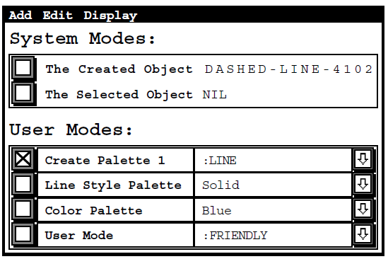

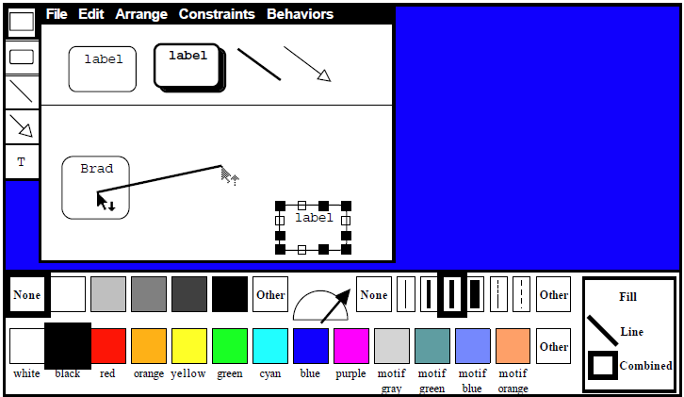
Marquise windows

Slide 38
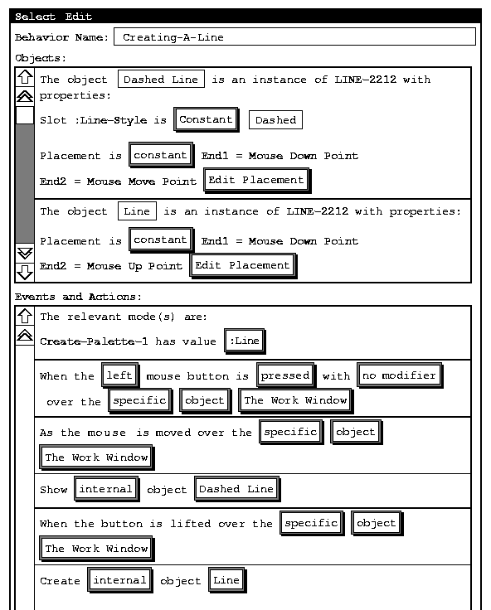
Marquise feedback window
video (12 min)

Slide 39
InferenceBear & Grizzly Bear (1994-1996)
Martin R. Frank, Piyawadee "Noi" Sukaviriya, James D. Foley. “Inference bear: designing interactive interfaces through before and after snapshots,” DIS’95. Ann Arbor, Michigan, pp. 167 – 175. pdf
Martin Frank, Model-Based User Interface Design by Demonstration and By Interview. PhD Thesis, Georgia Tech, 1996.
(Discussed his "Elements, Events & Transitions (EET) language in the event-language lecture)
User control through dialog boxes, edit using textual language: EET
Snapshots of before and after
Multiple examples
  More positive examples to cause generalization
  Negative examples to specify exceptions
Pictures – next slide

Slide 40
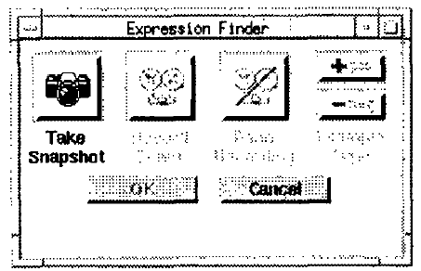
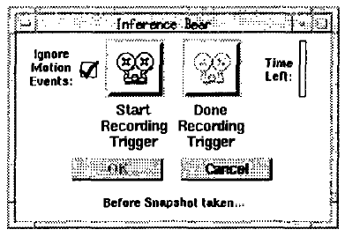
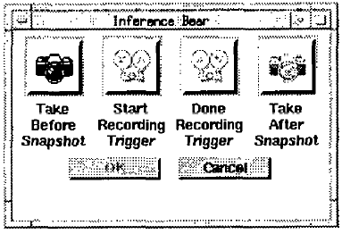
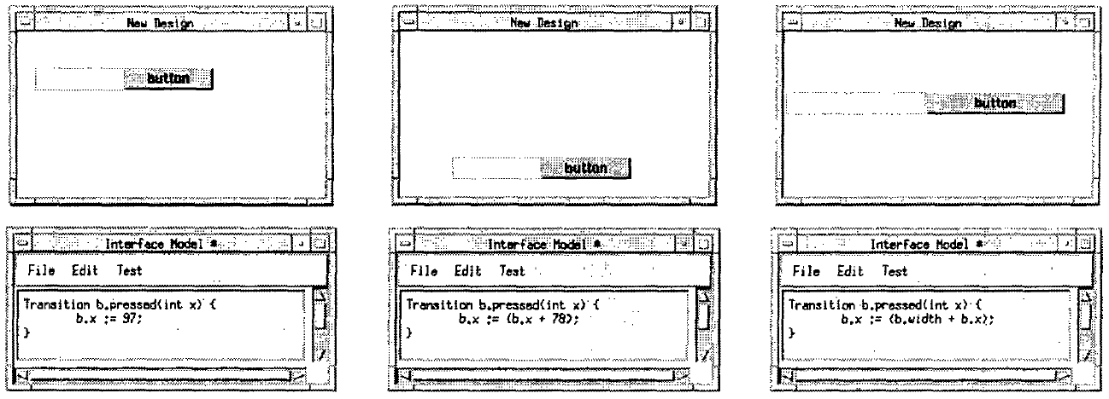
InferenceBear Pictures

Slide 41
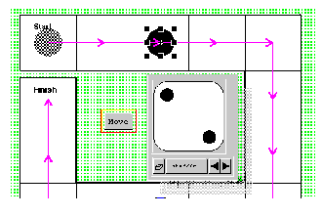
Gamut (1996 - 1999)
PhD thesis of Rich McDaniel.
Richard G. McDaniel and Brad A. Myers. "Building Applications Using Only Demonstration," IUI'98: 1998 International Conference On Intelligent User Interfaces, January 6-9, 1998, San Francisco, CA. pp. 109-116. pdf
Richard G. McDaniel and Brad A. Myers, "Getting More Out Of Programming-By-Demonstration." Proceedings CHI'99: Human Factors in Computing Systems. Pittsburgh, PA, May 15-20, 1999. pp. 442-449. ACM DL Reference
Domain: "board games" and
educational software
Goal: new interaction techniques
so can infer more complex behaviors
E.g., how a piece can move in
Monopoly / Chess
Reduce number of modes
New interaction techniques to
provide hints
  "Do Something!", "Stop That", Hint highlighting, Temporal Ghosts, Guide objects, Deck of Playing Cards, etc.
Better inferencing algorithms
video (4.5 min)

Slide 42
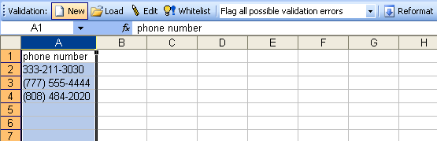
Topes (2004-2009)
Chris Scaffidi’s PhD thesis: 2009
  Christopher Scaffidi, Brad Myers, Mary Shaw, "Topes: Reusable Abstractions for Validating Data." ICSE'2008: 30th International Conference on Software Engineering, Leipzig, Germany, 10 - 18 May 2008. pp. 1-10. IEEE DL pdf
“topes” = user-level types for end-user programming (EUP)
Create parsers, data-transformations
  Infers topes from a list of examples
Patterns in text input
  Phone numbers, addresses, social security numbers, etc.

Slide 43
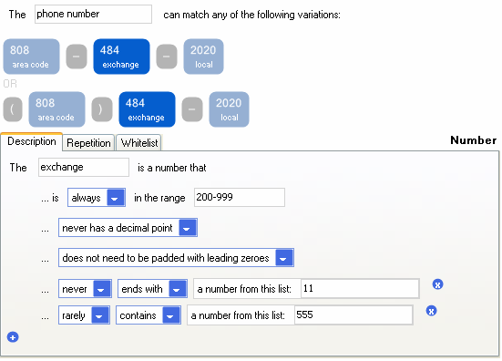
Topes, cont.
Inferred pattern

Slide 44
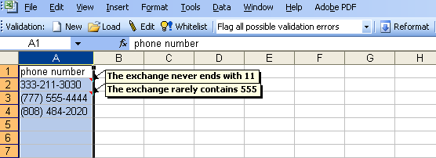
Topes, cont.
Validator – never vs. rarely

Slide 45
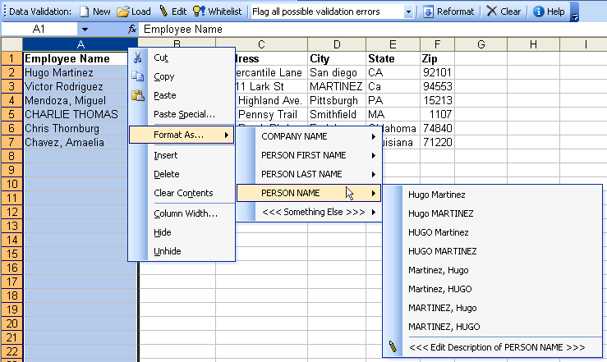
Topes, cont.
Converter

Slide 46
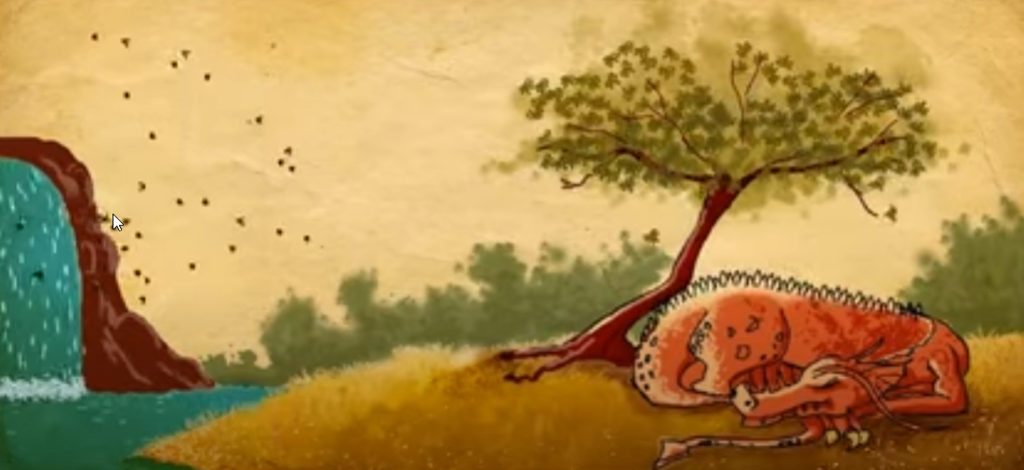
Draco, Skuid
Rubaiat Habib Kazi, Fanny Chevalier, Tovi Grossman, Shengdong Zhao, and George Fitzmaurice. 2014. Draco: bringing life to illustrations with kinetic textures. In Proceedings of the SIGCHI Conference on Human Factors in Computing Systems (CHI '14). 351-360. DOI: https://doi.org/10.1145/2556288.2556987
Sketch to show animations and movements
Augmented with dynamic animation effects
Commercialized by AutoDesk
Video (4:57)!

Slide 47
Toby Li’s Sugilite
Toby Li, Amos Azaria, and Brad Myers. "SUGILITE: Creating Multimodal Smartphone Automation by Demonstration", Proceedings CHI'2017: Human Factors in Computing Systems, Denver, CO, May 6-11, 2017. To appear. preprint pdf and video. Best paper Honorable Mention award.
Programming by example for Android
Scripts (macros) of common or repetitive tasks
Uses the Android accessibility API
Invoke using Speech or GUI
Generalizes based on other menu items seen
Currently, uses multiple examples only when script fails
  Can replace or add fork
Video (6:48)

Slide 48
Sugilite pictures

Slide 49
Commercial Systems using PBD
Excel Flashfill
Adobe Catalyst
  Create menus by giving examples of the items
  Scroll bars by indicating the parts (thumb, track, etc.)
  But discontinued ☹
Adobe XD
  Repeat grid
  Component behaviors based on “states”
What else?

Slide 50
General Disadvantages of PBD
People are actually not very good at coming up with concrete examples
  Examples tend to show the system the same thing over and over
  People can’t think of the edge cases and negative examples
People need to be able to edit the code, so need a representation they can understand

Slide 51
Open Issues with PBD
Sometimes examples are harder than specifying
  “and” vs. “or”
How intelligent is enough?
  Predictability
  AI problem
Techniques for feedback and editing
Combining inferencing with direct editing of the code
A “really” successful product using this technology

Slide 52
Some newer systems
Claim to be: “Low code” or “No code”
  Examples (all companies founded in 2012!):
    AirTable – based on a spreadsheet model
    Bubble.io – visual programming
    Zapier – move data between web applications (automate repetitive tasks)
      Like Yahoo! pipes!
Many others, e.g., see Wikipedia entry

Slide 53
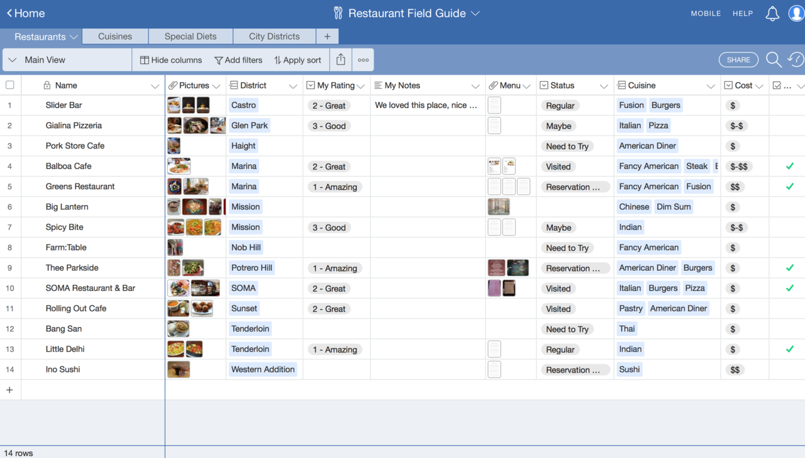
Airtable
Database + spreadsheet for business processes
LinkedIn Learning course (first part of intro)

Slide 54
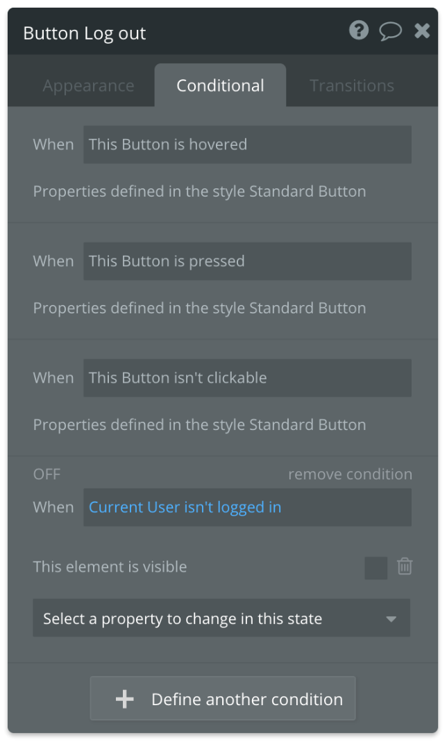
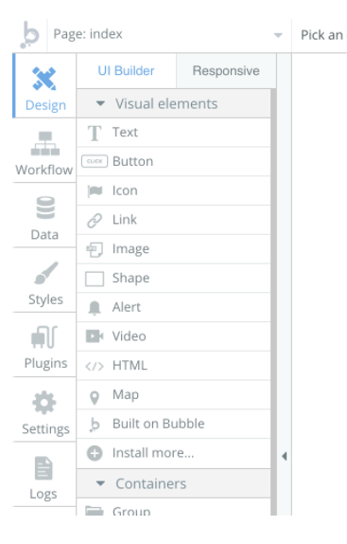
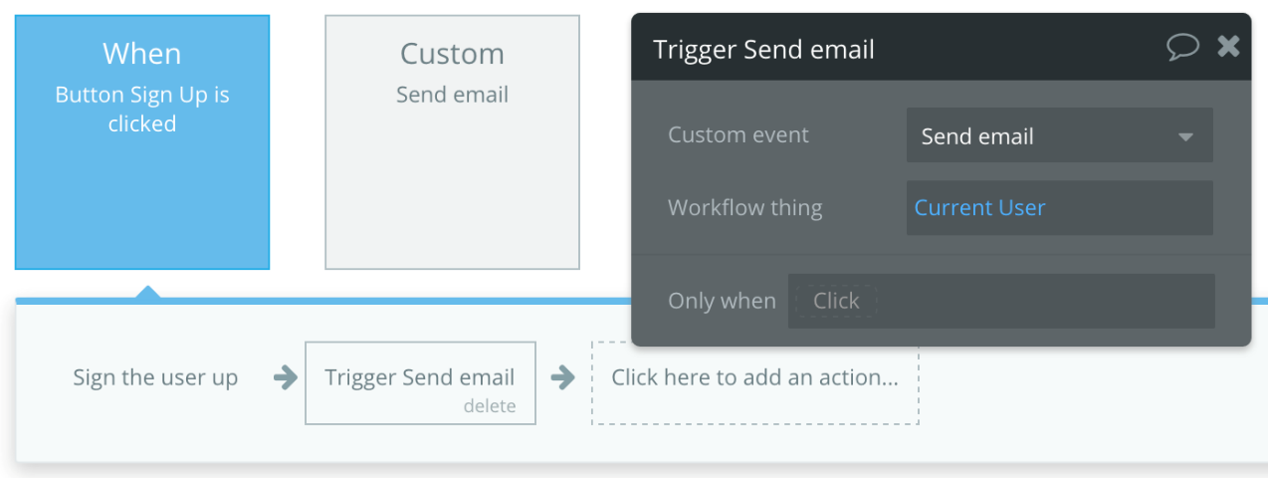
Bubble.io
Web apps: “No-Code”
  Connect to web services
  Lots of built-in functions in menus
LinkedIn course (intro: 3min)

Slide 55
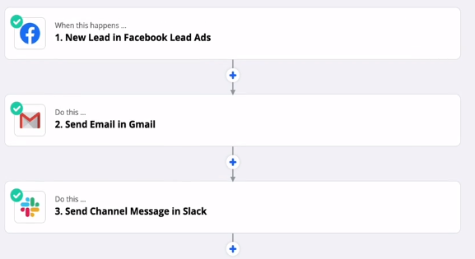
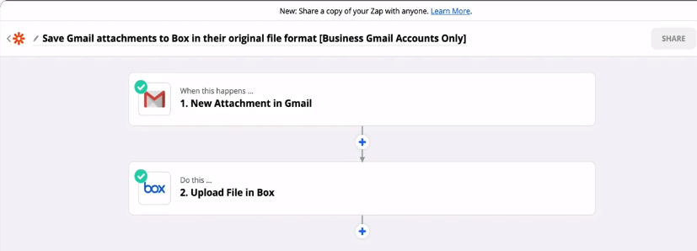
Zapier
“No code” for automating personal tasks
Connects to 4000 pre-selected applications
LinkedIn course (intro 1:53)

