Slide 1
Lecture 21: Software Engineering for UIs: How to create high-quality UIs in the context of Agile and other software development processes
05-431/631 Software Structures for User Interfaces (SSUI)
Fall, 2022

Slide 2
Logistics
HW6 due Thursday (not today)
Need to start on entering ideas for projects into Piazza
Need to do my office hours tomorrow virtually (using regular class zoom link – see Canvas)

Slide 3
How to organize development process
"Usability is not a quality that can be spread out to cover a poor design like a thick layer of peanut butter." [Nielsen]
“It’s the careful and user-centered approach to product strategy, features, structure, interactions, content, and aesthetics” -- cite
Like Software Engineering, is a process for developing software to help ensure high quality
Need process so have structure, planning, management
Must plan for and support usability considerations throughout design
Including right at the beginning
Not enough to discover usability problems at the end

Slide 4
Software Engineering
“Software engineering is the systematic application of engineering approaches to the development of software” -- Wikipedia
Aspects of development beyond coding
Aim to achieve quality metrics, including:
Reliability (Availability, Dependability, Robustness)
Usability
Efficiency
Of the development process
And of the resulting system
Both speed and size
Security
Maintainability

Slide 5
“Usability Engineering”
Parallel with “software engineering”
Make use of usability more like engineering:
“Engineering”
Measurable, process-oriented
Not just “art”
Term coined by John Bennett in the 1980’s
Nielsen book: 1993
ISO 13407 & 13529 standards discuss UE process

Slide 6
Some Important Components
Study the users and their tasks
Study the competition
Set usability goals
Participatory Design
Guidelines and Heuristic Evaluation
Evaluate your interface according to the guidelines.
Make prototypes of the system early and quickly
Empirical testing
Iterative design with usability analysis
Collect feedback from field use
(See also lecture 13 about evaluation of UIs)

Slide 7
Know the User
Study the intended users and the use of the product
Best if developers go and interview them personally
Difficult because
May want to hide the developers
Reluctance of salespeople
Reluctance of users
User Characteristics
Work experience, education level, age, previous computer experience
Time for learning, training
Available hardware (monitor size, acceptance of plugins, cell-phones vs. desktop)
Social context of use

Slide 8
“Early Focus on Users and Tasks”
(From Gould & Lewis article)
Not just “identifying,” “describing,” “stereotyping” users
Direct contact through interviews, discussions
HCI programs teach Contextual Inquiry method for this

Slide 9
“Personas”
Popularized by Alan Cooper
User archetype you can use to help guide decisions about design decisions
“fictional, yet realistic, description of a typical or target user”
Created after contextual inquiry or equivalent
Must be based on user research
Summarizes properties of a group of users
Focus on properties that are relevant to the design

Slide 10
“Personas”, cont.
Use: helps keep designers & implementers focused on user needs.
“personas support user-centered design throughout a project’s lifecycle by making characteristics of key user segments more salient” cite: https://www.nngroup.com/articles/persona/
Include: behavior patterns, goals, skills, attitudes, and environment, with a few fictional personal details to bring the persona to life
Have a small number for each product
One for each important group of users
Special new version for identifying gender issues: http://gendermag.org/

Slide 11
Persona Example
From: http://www.steptwo.com.au/papers/kmc_personas/
Bob is 52 years old and works as a mechanic with an organisation offering road service to customers when their car breaks down. He has worked in the job for the past 12 years and knows it well. Many of the younger mechanics ask Bob for advice when they meet up in the depot as he always knows the answer to tricky mechanical problems. Bob likes sharing his knowledge with the younger guys, as it makes him feel a valued part of the team.
Bob works rolling day and night shifts and spends his shifts attending breakdowns and lockouts (when customers lock their keys in the car). About 20% of the jobs he attends are complex and he occasionally needs to refer to his standard issue manuals. Bob tries to avoid using the manuals in front of customers as he thinks it gives the impression he doesn't know what he's doing.
Bob has seen many changes over the years with the company and has tried his best to move with the times. However he found it a bit daunting when a new computer was installed in his van several years ago, and now he has heard rumours that the computer is going to be upgraded to one with a bigger screen that's meant to be faster and better.
Bob's been told that he will be able to access the intranet on the new computer. He has heard about the intranet and saw once in an early version on his manager's computer. He wonders if he will be able to find out want's going on in the company more easily, especially as customers' seem to know more about the latest company news than he does when he turns up at a job. This can be embarrassing and has been a source of frustration for Bob throughout his time with the company.
Bob wonders if he will be able to cope with the new computer system. He doesn't mind asking his grandchildren for help when he wants to send an email to his brother overseas, but asking the guys at work for help is another story.

Slide 12
Task analysis
What tasks the users will do?
Involve users in this
Important to include exceptions and error conditions
Many different kinds and variations on Task Analyses
Nielsen’s
“Hierarchical Task Analysis”
Can also use Contextual Inquiries (CIs)
Need tasks to design CIs, usability analysis, scenarios

Slide 13
User-Centered Task Analysis
Based on what user will do
Not what system will do
Not a list of system features
High-level
Nothing about how to accomplish at user level
No discussion of web pages, buttons, filling in fields, etc.
Example, company YYY menu structure based on functions rather than tasks => Inefficient for every task!

Slide 14
Components of Task Analysis
Goals:
What are the actions this task is supposed to accomplish?
Remember: not how it will be done, just what
Thinkalouds reveal why
Information needs
What does the user need to know or view to do this task?
Includes what needs to be on the screen.
Both:
What does the system need to show?
What does the user need to know?

Slide 15
Task Analysis: Scenarios
Scenarios (stories) of typical uses:
Related to software engineering "use cases"
Specific example of how a user might use the system.
One scenario for each major class of users doing each kind of important task
Will want to make those tasks efficient and easy
What is important to optimize?
Will significantly affect the design
Try to include lots of exceptional cases
Shows how the interface will be used
One representation → Customer “Journey Maps”

Slide 16
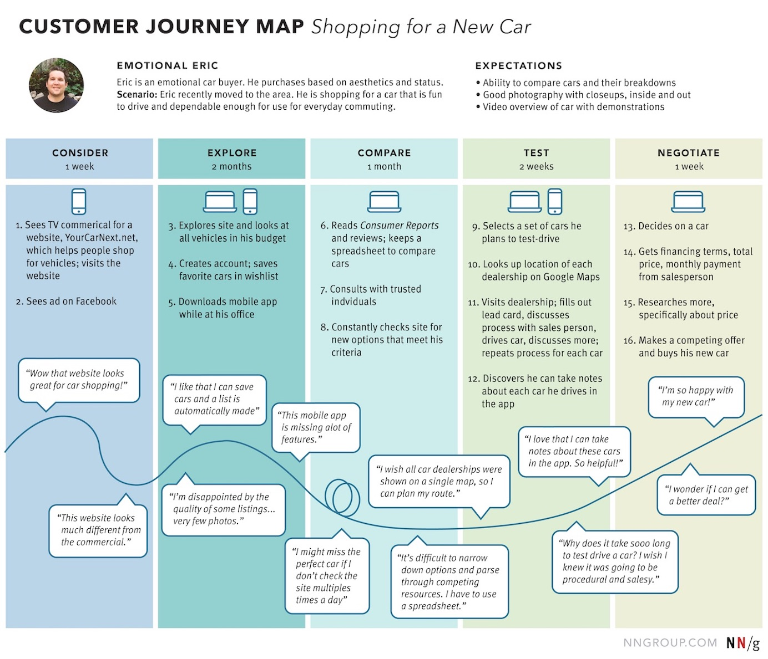
Example Journey Map
Source: https://www.nngroup.com/articles/analyze-customer-journey-map/

Slide 17
Functional analysis
What really needs to be done
Should be higher-level – not the UI to perform it
Not just the way users are doing it now
May be a more efficient or more appropriate way to achieve same task
Usually, companies are good at this
However, may include extra functions that are not useful

Slide 18
Competitive Analysis
“Know the competition”
For usability and function
Read trade-press reviews of products or web sites
Visit competitor’s web sites
Also, web sites for related products
Importance of various features, issues
Pictures, navigation, search, prices, shipping, metaphors

Slide 19
Goal Setting
What does it mean to be “easy to use”?
Some proposed definitions:
“I like it”
“I always do it that way”
“That is the way the xxx system does it”
“It is easy to implement”

Slide 20
Much better Goals:

Slide 21
Much better Goals:
Can be learned in less than 2 minutes
User will perform 2 error-free purchases per session
The error rate will be lower than 2 per 10 operations
Tasks will be performed in 30% of the time it takes using the competitor’s system
Users will have a high satisfaction with the system as measured by a survey.
Explicit, specific, measurable metrics.
Allows objective decision making.

Slide 22
Goals, cont.
Tradeoffs, so have to pick relevant metrics
Some measures:
Learnability: Time to learn how to do specific tasks (at a specific proficiency)
Efficiency: (Expert) Time to execute benchmark (typical) tasks. Throughput.
Errors: Error rate per task. Time spent on errors. Error severity.
Lots of measures from web analytics:
Abandonment rates, Completion rates, Clickthroughs, % completions, etc.
Subjective satisfaction: Questionnaire.
Notes:
MOVED TO LECTURE 5

Slide 23
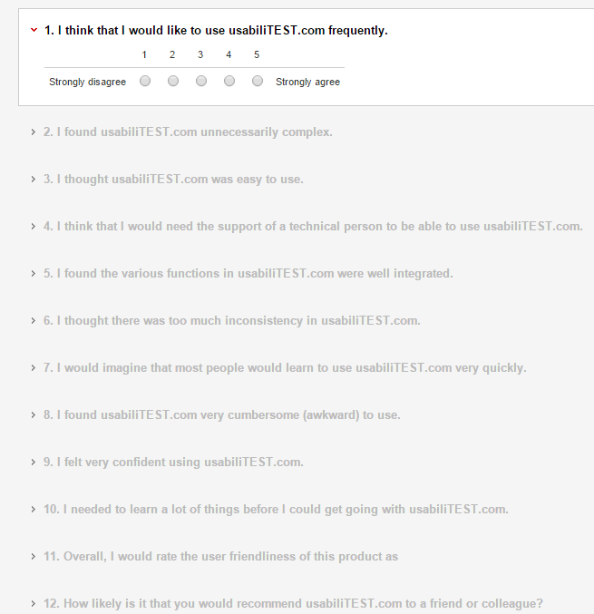
Example of validated survey
http://www.usabilitest.com/uxxc4jP

Slide 24
Goal Levels
Pick Levels for your system:
Minimum acceptable level
Desired (planned) level
Theoretical best level
Current level or competitor's level
Minimum Acceptable
Current
Best
Desired
0
1
2
5
Errors

Slide 25
Financial impact analysis
Prove It!
Demonstrates the importance of usability
# users * their salary per hour * # hours on system = cost of system per hour
$39,000, $613,000, $8,200,000
Estimate savings of reduced training, error time, need for support staff, etc.
Support calls can cost $30 - $100 per call
Tells how much time to spend on usability
Whole books on this topic:
Randolph G. Bias and Deborah J. Mayhew, Eds. Cost-Justifying Usability: An Update for the Internet Age, Second Edition. Morgan Kaufmann, 2005
Randolph G. Bias and Deborah J. Mayhew, Cost-Justifying Usability, Boston: Academic Press, 1994.

Slide 26
Participatory Design
Users involved during the design process through regular meetings
Not just at the beginning during Contextual Inquiry
Users are good at reacting to concrete designs and prototypes
But users are not necessarily good designers

Slide 27
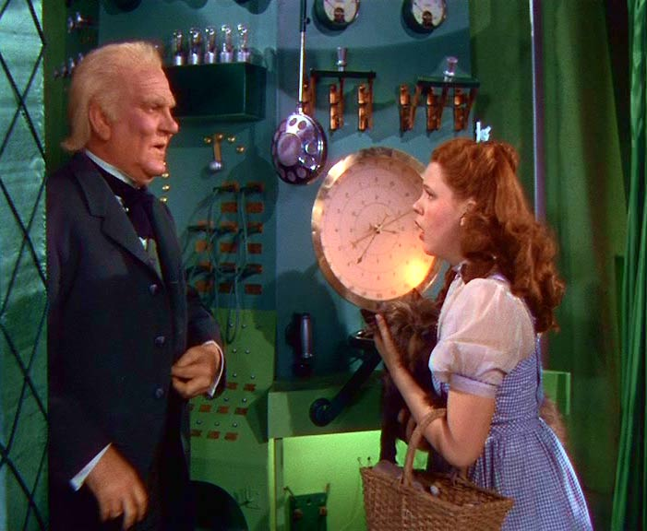
Prototyping
Try out designs with developers before implementing them
Quick and cheap to create (no “back end”)
Paper
“Low fidelity prototyping”
Often surprisingly effective
Experimenter plays the computer
Drawn on paper → drawn on computer
“Wizard of Oz”
Experimenter remote-controls the computer, as if it is real
“Pay no attention to that man behind the curtain”
Implemented Prototype (“Click through”)
Figma, Balsamiq, Axure, PowerPoint, Web tools (even for non-web UIs)
Real system
Need to test these with users!
Better if sketchier for early design
Use paper or “sketchy” tools, not real widgets
People focus on wrong issues: colors, alignment, labels
Rather than overall structure and fundamental design
Using a “design system” allows higher-fidelity testing earlier
Collection of widgets and other components of the UI in a library
Includes fonts, colors, icons, etc. to be used in this UI
Increasing fidelity

Slide 28
Use Guidelines and Heuristic Analysis
Designers evaluating the Interface
Based on their experience
Especially Consistency:
Most important characteristic of UI
Requires oversight
Not each department creating own section
May require overall design document, vocabulary guide, style guide, templates, etc.
Especially when using Agile design (covered later)

Slide 29
Empirical Testing
Critical to usable products
Designers must watch users
Web logs are not sufficient
Not necessarily difficult or expensive
Test low-fidelity prototypes, high-fidelity prototypes, final system
Notes:
**** STOPPED HERE *****

Slide 30
Iterative design
Redesign interface based on evaluation
New design may be worse or may break something
Keep track of reasons for design decisions
Called "Design Rationale"
So don't need to keep revisiting the same decisions
When future conditions suggest changing a decision will remember why made that way and what implications for change are.
Instead of arguing about a design feature, figure out what information would tell you which way to go
Experiment, marketing data, etc.

Slide 31
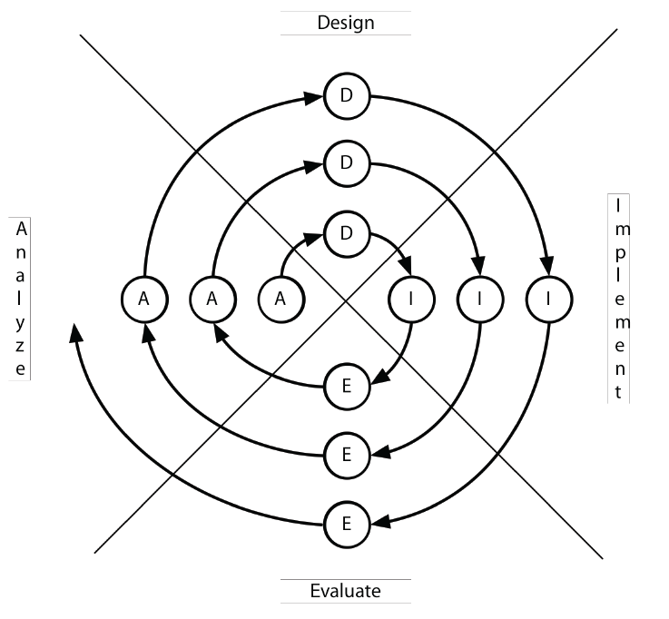
Iterative Design
Empirical testing with intention to fix the problems
Not just goals (“be easy to use”), but a process to achieve the goals
Successively higher-fidelity designs
Spiral model from (Boehm, 1988)

Slide 32
Measure Real Use
Follow-up after release
For the next version
From bug reports, trainers, initial experiences (for conventional applications)
From web logs, reports, customer support

Slide 33
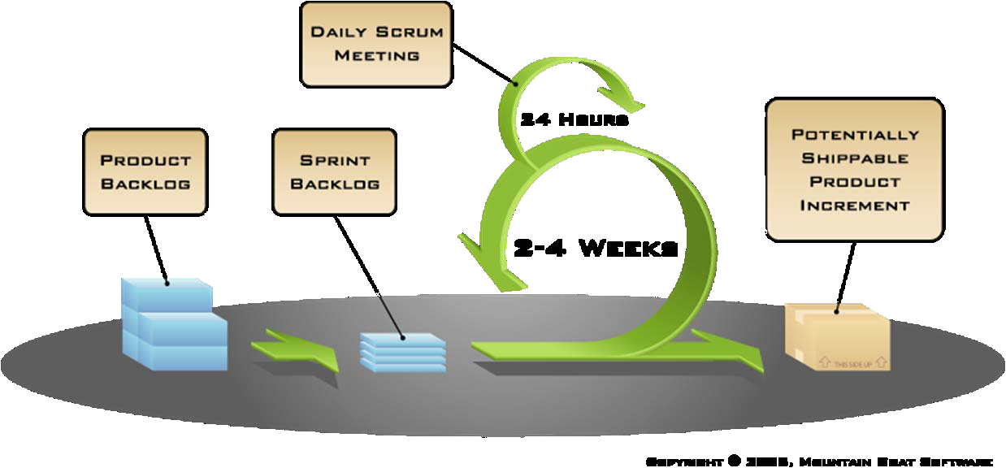
Agile Development
Agile has taken over the software-development world
“eXtreme Programming” (XP)
How does that interact with usability methods?
Agile = “development iterations, teamwork, collaboration, and process adaptability throughout the life-cycle of the project.” – Wikipedia
See “agile manifesto”: http://agilemanifesto.org/
“Scrum” is one of many agile methods.
Work is broken into 2 to 4 week “sprints”
Avoid “big design up front”

Slide 34
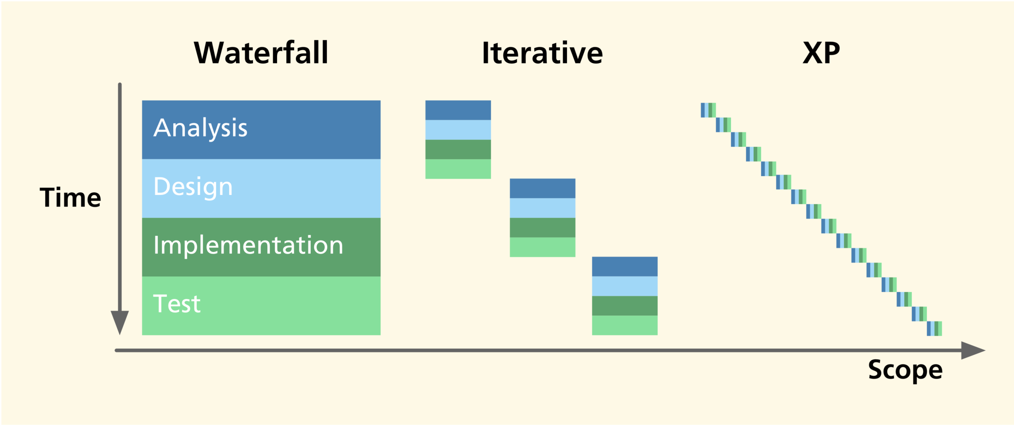
Waterfall, Iterative, XP
from Fig. 19-1 of [Hartson & Pyla, The UX Book, 2012]

Slide 35
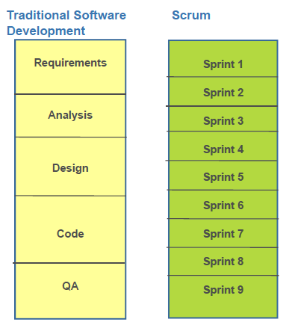
Scrum vs. traditional software development
Michael Budwig, http://doi.acm.org/10.1145/1520340.1520434

Slide 36
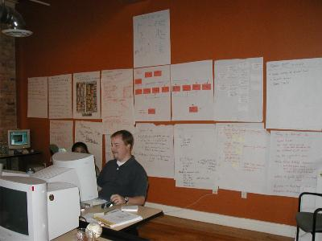
Shared Design and Implementation Space
“Radical co-location”
Lots of new research about remote work during pandemic
http://agileproductdesign.com/blog/emerging_best_agile_ux_practice.html

Slide 37
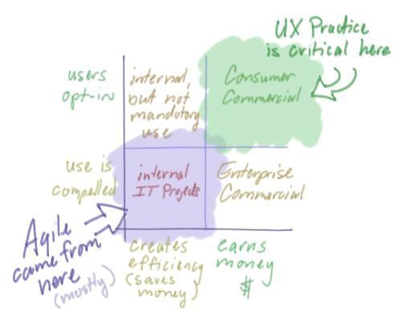
Issues with Agile UX
Created by programmers, not designers
UI might be patchwork of non-integrated pieces
Reducing documentation → not capturing design rationale
No mention of iteration on UI design
http://agileproductdesign.com/blog/emerging_best_agile_ux_practice.html

Slide 38
Report from PayPal
Courtesy: Michael Budwig, User Experience Manager, Customer Experience and Merchant Solutions, PayPal, “When user experience met agile: a case study”, SIGCHI’2009, pp. 3075-3084. http://doi.acm.org/10.1145/1520340.1520434
Separate UX team, worked 1 or 2 sprints ahead of developer teams
Design vision sprint every 3-6 months
Worked well
See also Fig. 19-7 of [Hartson & Pyla, The UX Book, 2012]
UX team
Sprint 0
Sprint 1
Sprint 2
Sprint 3
Sprint 4
Sprint 5
Sprint 6
Vision Sprint
Vision Sprint
Sprint 0
Sprint 1
Sprint 2
Sprint 3
Sprint 4
Sprint 5
Sprint 6
Dev Scrum team

Slide 39
Debate: UX Team Centralized or Distributed?
(Applies to all development processes)
Centralized UX team services all projects
Leverages resources, expertise
Can have UI people with various skills: design, testing, etc.
UI team has close colleagues
Manager of UI people better able to judge quality UI work
But doesn’t get to know products well
Distributed puts UX people into each project
More influence with project since always there
May not have appropriate skills
Team may not need UI person full-time
HCII Seminar talk by ANSYS – uses this organization
Cite with video: http://www.hcii.cmu.edu/news/seminar/event/2016/10/how-ux-techniques-promote-simulation-software-everyone
May work better for Agile – Nielsen http://www.useit.com/alertbox/agile-user-experience.html

Slide 40
Many More Resources for “Agile User-Centered Design”
https://www.nngroup.com/topic/agile/ - dozens of articles and videos
Don Norman: “The Changing Role of the Designer: Practical Human-Centered Design” June 5, 2020, 4 minute video
Rachel Krause, “Tracking Research Questions, Assumptions, and Facts in Agile”, December 15, 2019, article
Nielsen’s Alertbox: “Agile Is not Easy for UX: (How to) Deal with It”, September 24, 2017, article
Nielsen’s Alertbox: “How Iterative Testing Decreased Support Calls By 70% on Mozilla's Support Website”, August 2, 2015, article
Nielsen 2-minute video “Does Agile Destroy UX?”: article
Nielsen’s Alertbox: “Agile User Experience Projects”, Nov. 4, 2009, article & expensive 119-page report: http://www.nngroup.com/reports/agile/
“The Agile UX Development Lifecycle: Combining Formative Usability and Agile Methods,” 04 Jan 2017 http://scholarspace.manoa.hawaii.edu/handle/10125/41219
P. McInerney and F. Maurer, “UCD in agile projects,” Interactions, vol. 12, no. 6, pp. 19-23, 2005. http://dl.acm.org/citation.cfm?doid=1096554.1096556
Google “Agile User-Centered Design” returns many relevant resources

