Slide 1
Lecture 20:
Toolkit support for Gestural Input Techniques
05-431/631 Software Structures for User Interfaces (SSUI)
Fall, 2022

Slide 2
Logistics
Final Project information is posted

Slide 3
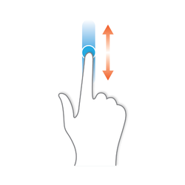
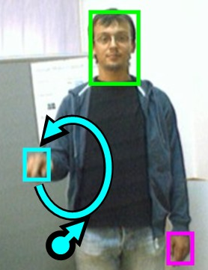
What is a “Gesture”
In HCI, an input to a computer where the path or other properties of the input is important to its recognition, not just the end points
  Regular drag-and-drop just cares about where starts and finishes, so generally does not count as a “gesture”
A recognizer is needed to interpret the path – so it may be interpreted incorrectly
Can be done with a mouse, a stylus or finger on touchscreen, or hands in the air in front of a camera
Can be one or multiple fingers; one or multiple strokes
On Smartphones, call “tap” a “gesture” to distinguish between tap, long-press, flick, drag, etc.
  Depends on properties of the action or of the other actions
    Location, but also speed, timing, etc.

Slide 4
Advantages of Gesture Recognition
Very fast to enter
Single gesture can give both parameters and command
  E.g., cross out gesture tells both what to do and to what
Large space of potential gestures
Can be “natural”
Can fit in easily with event-based programming
  Assuming gestures simply invoke a command
Can be integrated with the toolkit
  E.g., get events when a gesture starts / finished

Slide 5
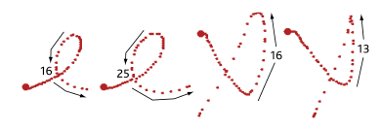
Disadvantages
No affordance – user has to know they can be done
No in-place information on what they look like
User may find it hard to remember which gesture does what operation (especially if lots)
System may recognize them incorrectly
Often cannot be entered correctly by users with disabilities, etc.
Can be unnatural if designed poorly
Hard to provide feedback of what is happening, especially if continuous
Implementation challenge: creating a good recognizer
Designer must decide if
rotation and size invariant

Slide 6
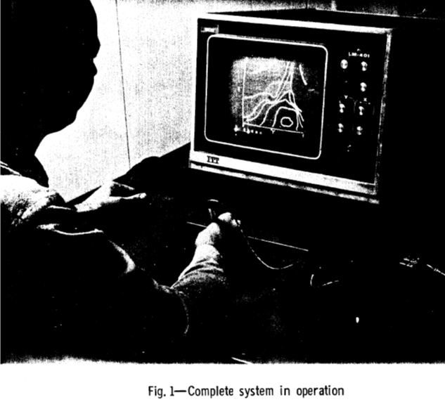
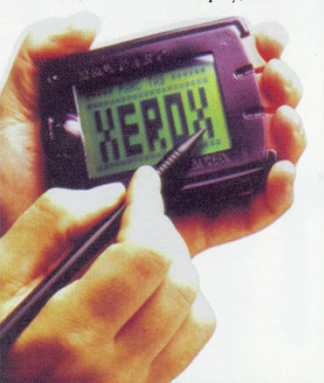
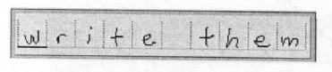
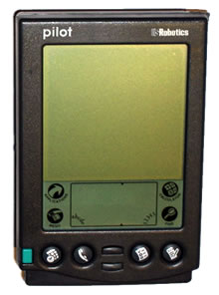
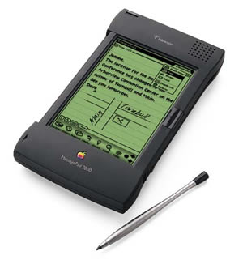
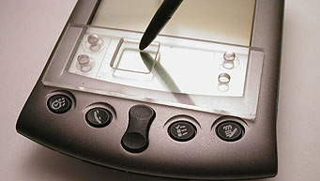
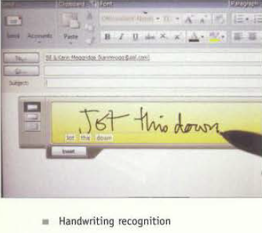
Gestures → Character →
Handwriting recognition
Text entry using hand-printing
and hand-writing
  Rand tablet (1964)
  PARC Tab QuickWriting (1989)
  Go PenPoint (1991)
  Apple Newton (1993)
  Palm Graffiti (1996)
  Windows TabletPC
  (2002)
  EdgeWrite (2003)

Slide 7
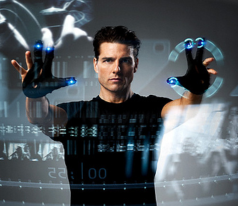
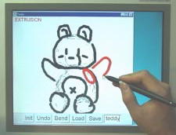
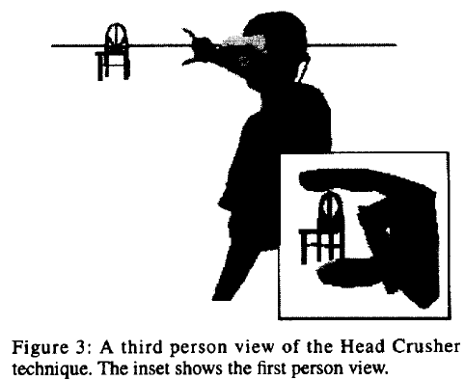
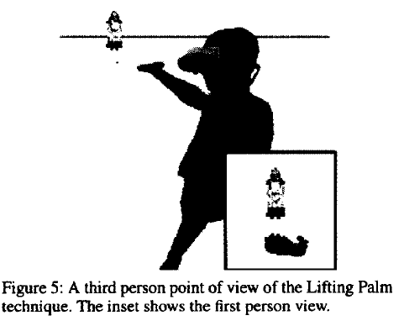
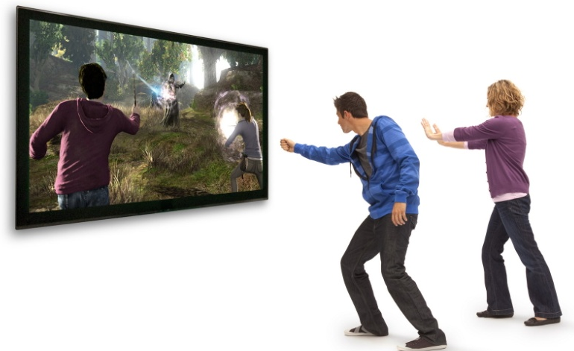
Gestures in 3D
Gestures for 3D manipulation
  Mainly pose and path of fingers with datagloves
  Also elaborate gestures in Teddy
  May depend on path and timing
  Wii controller gestures
  Kinect Body poses

Slide 8
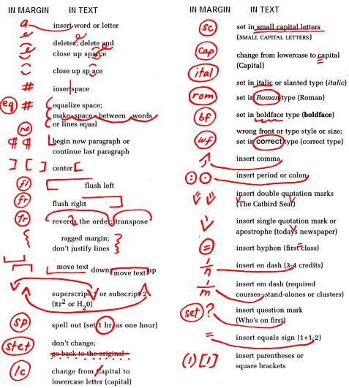
Gestures for Proofreading
Well-known proofreading symbols on paper
Many investigated using these gestures
COLEMAN, M. L. Text editing on a graphic display device using hand-drawn proofreader's symbols. In Pertinent Concepts in Computer Graphics, Proceedings of the Second University of Illinois Conference on Computer Graphics, M. Faiman and j. Nievergelt, Eds. University of Illinois Press, Urbana, Chicago, London, 1969, pp. 283-290.
RHYNE, J. R., AND WOLF, C. G. Gestural interfaces for information processing applications. Tech. Rep. RC12179, IBM T.J. Watson Research Center, Sept. 1986.

Slide 9
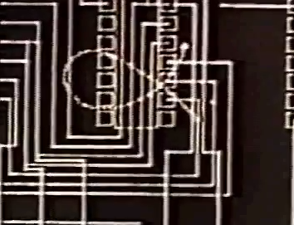
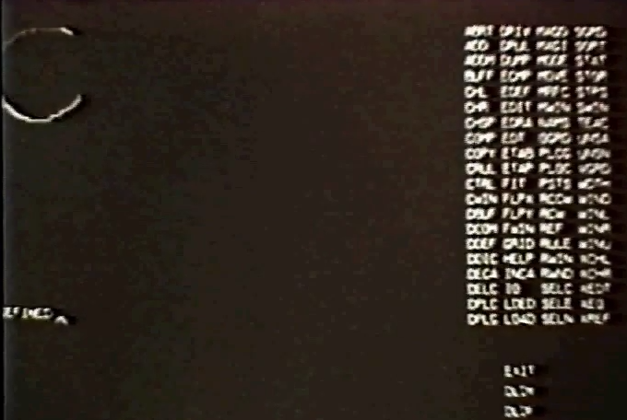
Trainable Gesture Recognizer
Applicon (circa 1970). An interactive trainable computer aided circuit design system using hand-drawn shapes to enter data and commands. Applicon. 16 mm film. Video (2:25 min excerpt)
  From Bill Buxton Lincoln Labs page. See the Wikipedia entry

Slide 10
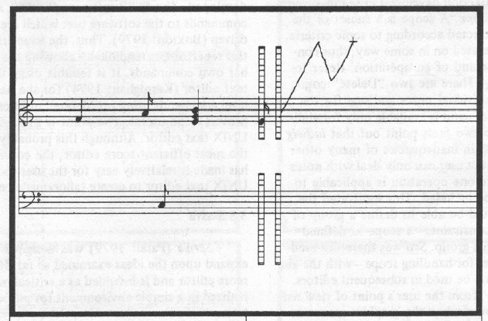
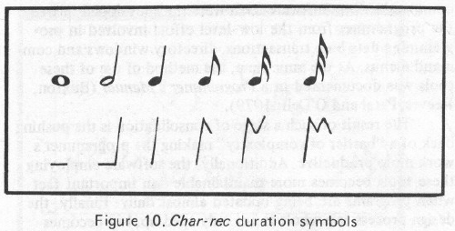
Early Gesture Recognition
Buxton, W., Sniderman, R., Reeves, W., Patel, S. & Baecker, R. (1979). The Evolution of the SSSP Score Editing Tools. Computer Music Journal 3(4), 14-25. [PDF] [video]
Can draw gestures for the desired notes to enter music
Start location determines pitch

Slide 11
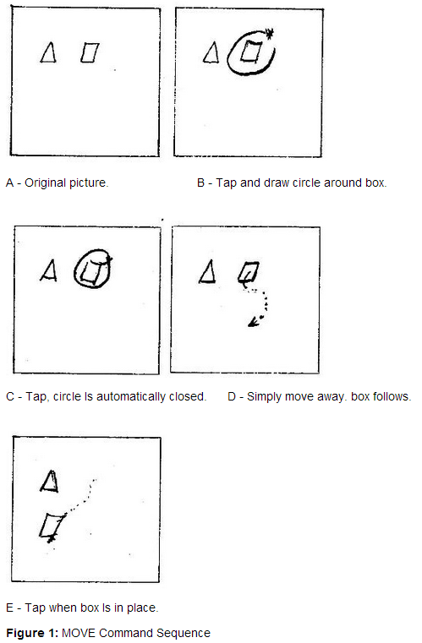
Early Graphical Editing Gestures
Buxton, W., Fiume, E., Hill, R., Lee, A. and Woo, C. Continuous Hand-Gesture Driven Input. Proceedings of Graphics Interface '83, Edmonton, May 1983, 191-195. http://billbuxton.com/gesture83.html [video]
Gestures for move and copy
Copy is same except make a “C” gesture along the path after circling and before moving

Slide 12
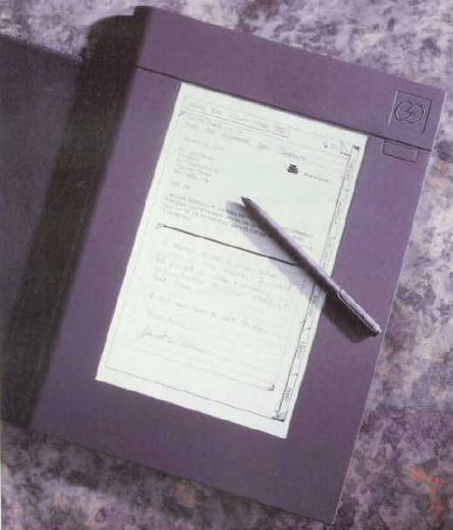
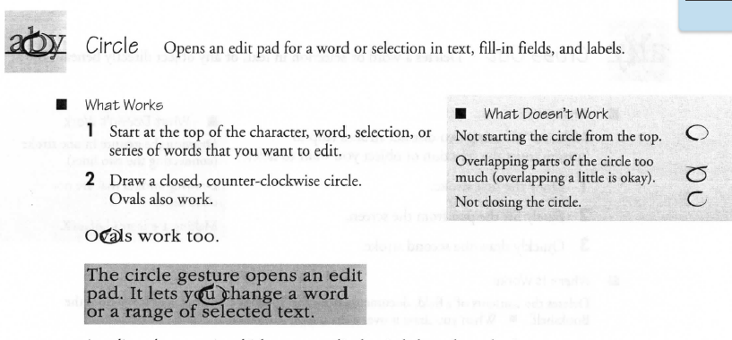
Go Corp’s “PenPoint” OS
Founded 1987, released in 1991
Many gestures for editing, navigation, etc.
  Flick to scroll and turn pages, circle, insert
  space, cross-out, insert word, get help, …
  Press and hold to start moving or selecting
Special-purpose recognizer for the built-in gestures
  http://research.microsoft.com/en-us/um/people/bibuxton/buxtoncollection/a/pdf/
  Go%20PenPoint%20Getting%20Started.pdf

Slide 13
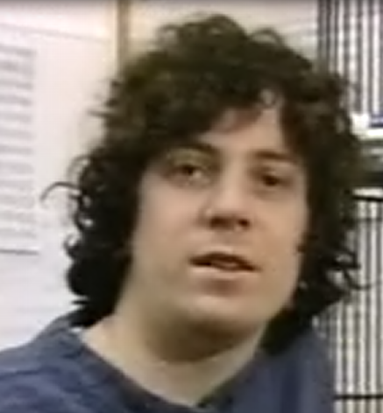
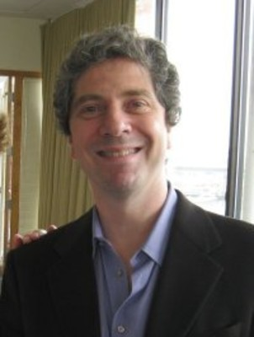
Dean Rubine’s System
Dean Rubine at CMU (PhD CSD, 1991) created novel gesture interaction techniques
Also, a novel “open-source” flexible algorithm, which researchers used for 16 years.
Paper: Dean Rubine. 1991. Specifying gestures by example. In Proceedings of the 18th annual conference on Computer graphics and interactive techniques (SIGGRAPH '91). ACM, 329-337. http://doi.acm.org/10.1145/122718.122753
Video: Dean Rubine. 1992. Combining gestures and direct manipulation. In Proceedings of the SIGCHI Conference on Human Factors in Computing Systems (CHI '92), ACM, actual video (10:20) or
(ACM Ref for description)
Powerful and influential system for single-stroke gesture recognition
1991
today

Slide 14
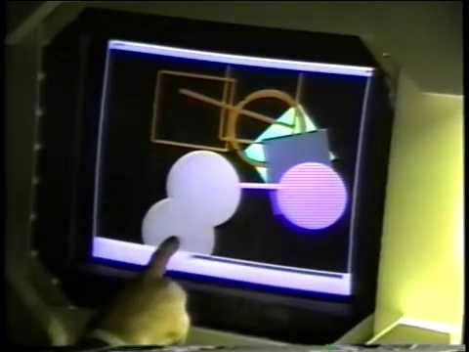
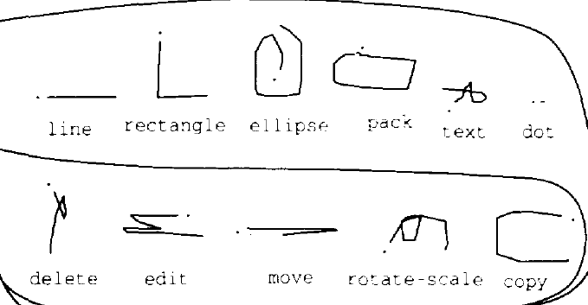
Rubine’s Gesture Innovations
“Eager recognition” – can recognize a gesture while mouse button is still down as soon as it is unambiguous
  Either wait for mouse pause, or immediately when unambiguous
  Allows user to continue with direct manipulation
  E.g., “L” gesture for rectangle,
  continue to drag for size
  “C” gesture for copy, “curlicue” for rotate and scale
Multi-finger gestures also
supported
  Two finger drag and resize
local video, up through 6:00, 7:00-end

Slide 15
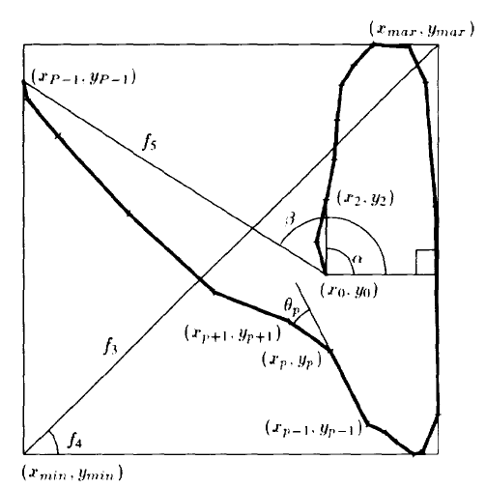
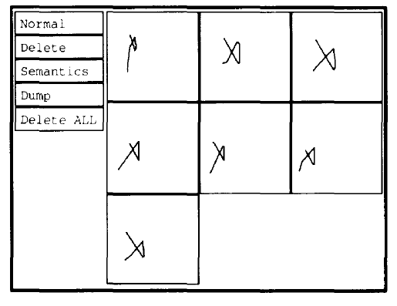
Rubine: Gesture recognition algorithm
Trained with a small number of examples (e.g., 15)
  Since done by a person, won’t be identical
  Examples should vary in whatever ways they will for the user
    E.g., different sizes? Different orientations?
Automatically looks for features of all gestures, that
differentiates them
  Uses a Machine Learning algorithm
    Statistical Single-Stroke Gesture Recognition
    Computes matrix inversions, discriminant
    values, and Mahalanobis distances
  Experimentally picked a set of 13
  features that seemed to work well
    E.g, “cosine and the sine of the initial angle of the
    gesture, the length and the angle of the bounding
    box diagonal, …”
Implemented in a system called GRANDMA
  local video, 6:00 through 7:00

Slide 16
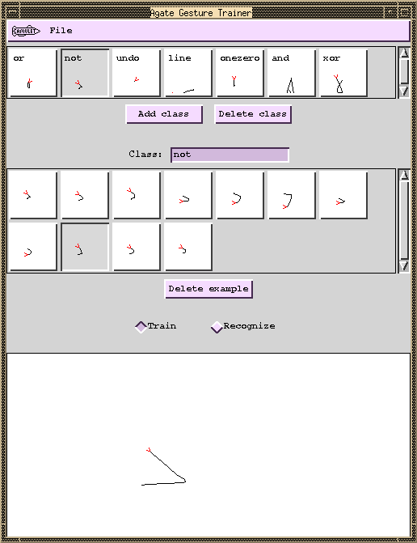
Uses of Rubine’s algorithm
Many subsequent projects re-implemented and built on his algorithm
  We implemented it twice, both called “AGATE”: A Gesture-recognizer And Trainer by Example
  Integrated with the standard “interactor” event handling model
  James A. Landay and Brad A. Myers. "Extending an Existing User Interface Toolkit to Support Gesture Recognition," Adjunct Proceedings of INTERCHI'93. Amsterdam, The Netherlands, April 24-29, 1993. pp. 91-92. (Garnet)
  Brad A. Myers, Richard G. McDaniel, Robert C. Miller, Alan Ferrency, Ellen Borison, Andrew Faulring, Andy Mickish, Patrick Doane, and Alex Klimovitski, The Amulet User Interface Development Environment. 8 minute video. Technical Video Program of the CHI‘1997 conference. ACM, YouTube (local copy) 8:27 total, gestures at 6:00-6:30

Slide 17
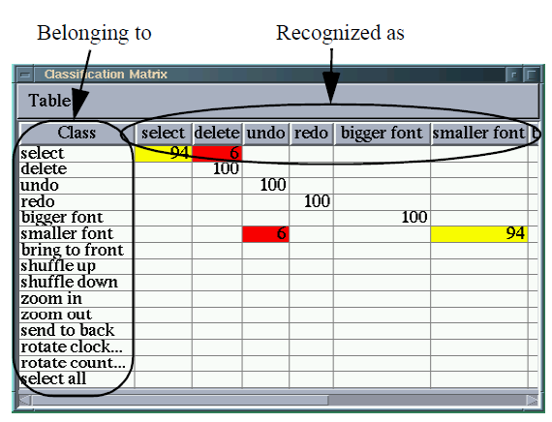
Improving the Gestures
Allan Christian Long Jr., Quill: a gesture design tool for pen-based user interfaces, PhD thesis, UC Berkeley, 2001, (307 pages), pdf
How to know if the gestures are too similar?
Chris Long took the Rubine recognizer and analyzes if gestures are too “confusable”
“Quill” tool
Similarity in recognition space
not necessarily the same as in
human perceptual visual space
  Now would be called “explainable AI”

Slide 18
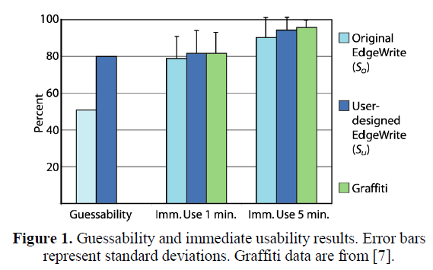

User Designed Gestures
Jacob O. Wobbrock, Htet Htet Aung, Brandon Rothrock and Brad A. Myers. "Maximizing the Guessability of Symbolic Input" (Short Talk). Extended Abstracts CHI'2005: Human Factors in Computing Systems. Portland, OR, April 2-7, 2005. pp. 1869-1872. pdf. http://doi.acm.org/10.1145/1056808.1057043
When creating the EdgeWrite gestures,
Jake Wobbrock wanted to know what
users thought the gestures should be:
  “Guessability of the EdgeWrite
  unistroke alphabet was improved
  by users from 51.0% to 80.1%”
Multiple phases
  Participants told the constraints
  Participants propose a set of gestures –
  tricky not to bias answers with prompts
  Get participants to resolve conflicts
    since likely to create indistinguishable gestures

Slide 19
iPhone Gestures
Quick flick down / up / left / right
  New behaviors starting in iOS7 in various apps (no affordance)
    Left and right in Messages, Safari
    Up and down in home screens
Swipe down from top
Swipe up from bottom
Press and hold (long press)
Press hard (“3D”) – now abandoned (same as long-press)
Two finger zoom
  Also in photos
Two finger zoom and rotate
  Google maps
Undo – shake
Tilt up – turn on
Double click and hold = zoom
Three finger tap – accessibility zoom
…

Slide 20
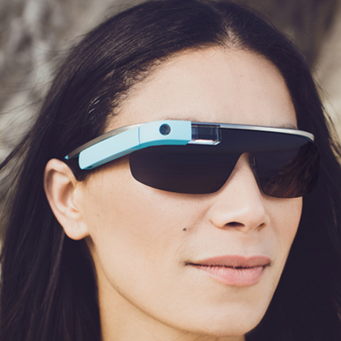
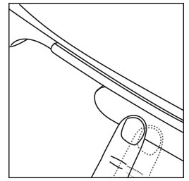
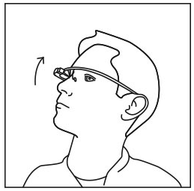
Google Glass Gestures
https://support.google.com/glass/answer/3064184?hl=en
Small touch pad on right side &
Motion sensor
Activate Glass: Tap the touchpad to
turn the display on
Swipe forward and back: affect content being shown
Select an item: Tap
Tilt head up / down:
display on / off

Slide 21
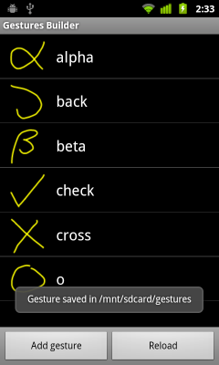
Android Gesture Builder
All Smartphones have libraries to support programming apps with gestures
  Often provided to the code by “events” like “mouse-down” → “swipe-left”
Android provides nice tool to
define gestures by example
  http://developer.android.com/training/gestures/index.html
  http://android-coding.blogspot.com/2011/09/gestures-
  builder-create-your-gestures.html
  http://android-developers.blogspot.com/2009/10/gestures-
  on-android-16.html

Slide 22
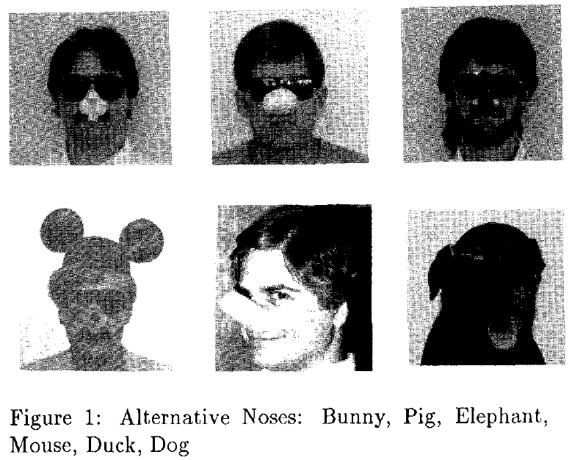
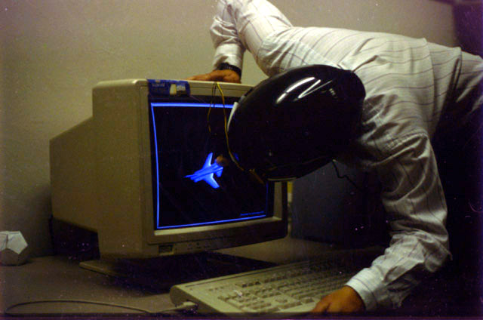
Funny
Tyson R. Henry, Scott E. Hudson, Andrey K. Yeatts, Brad A. Myers, and Steven Feiner. "A Nose Gesture Interface Device: Extending Virtual Realities," ACM Symposium on User Interface Software and Technology, Hilton Head, SC, Nov. 11-13, 1991. pp. 65-68. ACM DL or local copy and slides.

Slide 23
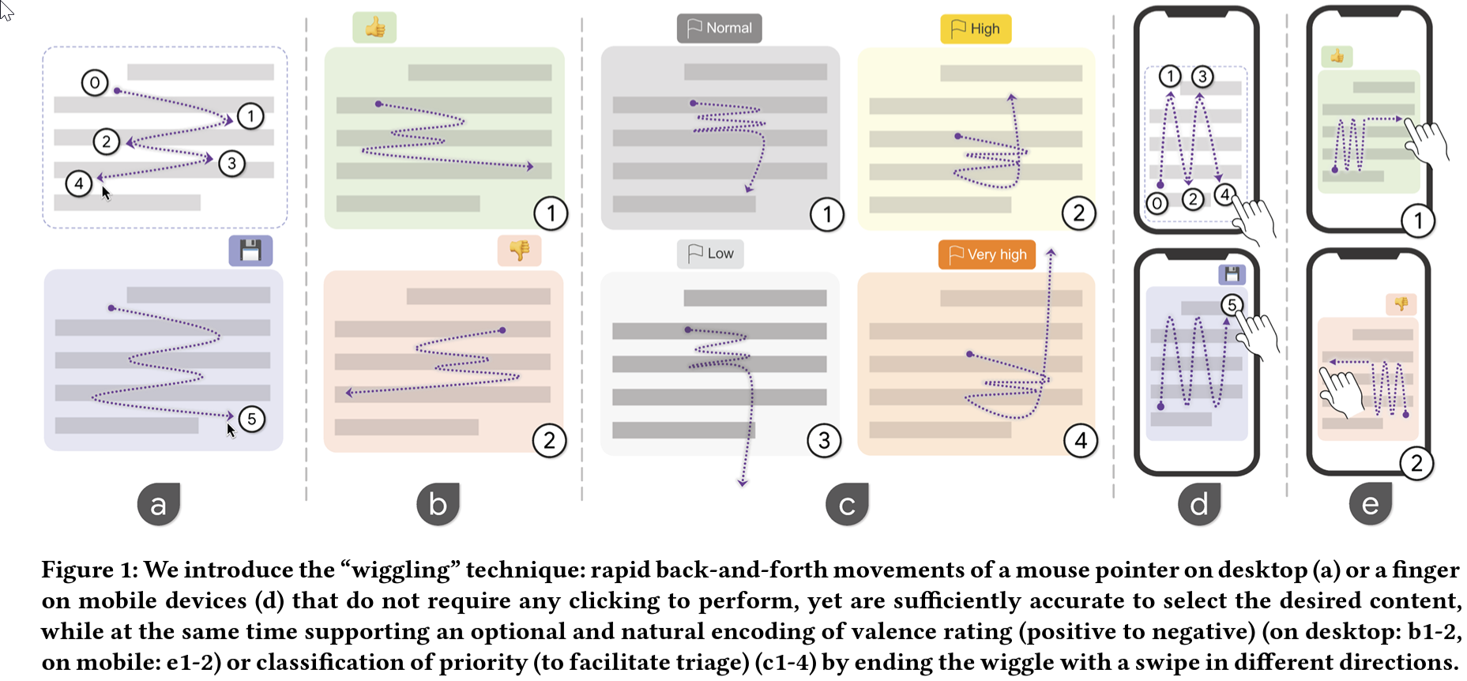
New! Michael Liu’s “Wiggling” Gesture
Michael Xieyang Liu, Andrew Kuznetsov, Yongsung Kim, Joseph Chee Chang, Aniket Kittur, Brad A. Myers. "Wigglite: Low-cost Information Collection and Triage,” UIST '2022: The 35th Annual ACM Symposium on User Interface Software and Technology, Bend, Oregon, October 29 - November 2, 2022, Article No. 32. Pages 1–16. https://doi.org/10.1145/3526113.3545661

Slide 24
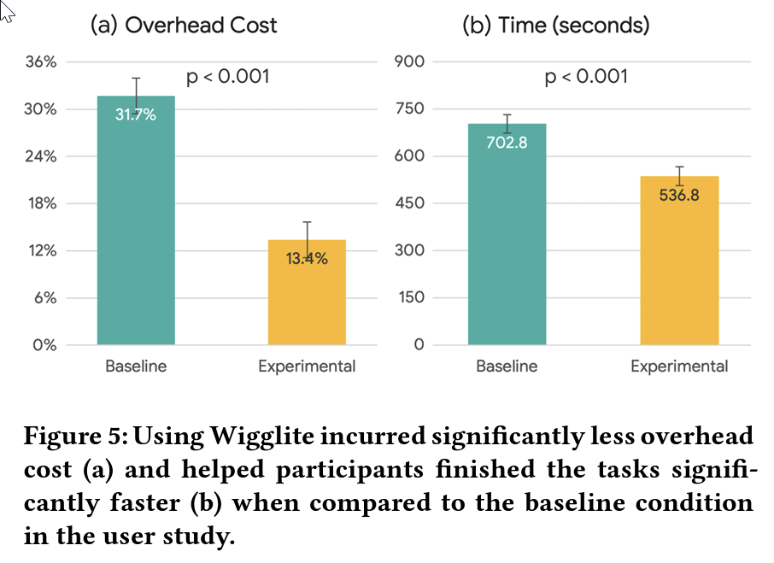
Wiggling
Custom detection algorithm
  Tried many others which didn’t work well:
    $1 [94] or the Protractor [62] recognizer
    ML image classification models such as MobileNets [42]
  Wanted eager recognition – after 5 back-and-forth movements
User evaluation –
low overhead,
high accuracy
Video of talk (15 min):
https://youtu.be/_MH81Zuyj64
  (Draft video)

Slide 25
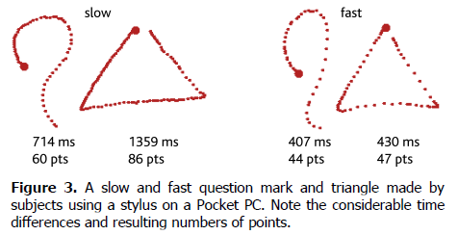
Wobbrock’s new recognizers
Jacob O. Wobbrock, Andrew D. Wilson, and Yang Li. 2007. Gestures without libraries, toolkits or training: a $1 recognizer for user interface prototypes. In Proceedings of the 20th annual ACM symposium on User interface software and technology (UIST '07). ACM, pp. 159-168. http://doi.acm.org/10.1145/1294211.1294238 or http://faculty.washington.edu/wobbrock/pubs/uist-07.1.pdf
More efficient and simpler than Rubine’s
Became the new standard that others use for research
Unistroke and multi-stroke versions
Match candidate points to remembered
templates
Default: rotation, size
and speed invariant

Slide 26
Design criteria
Be resilient to variations in sampling due to movement speed or sensing;
Support optional rotation, scale, and position invariance;
Require no advanced mathematical techniques (e.g., matrix inversions, derivatives, integrals);
Be easily written in few lines of code;
Thanks to Jake Wobbrock for these slides!

Slide 27
Design criteria (cont.)
Be fast enough for interactive purposes;
Allow developers and application end-users to “teach” it new gestures with only one example;
Return an N-best list with [0..1] scores that are independent of the number of input points;
Be conceptually straightforward for easy comprehension, inspection, modification, extension, debugging, etc.

Slide 28
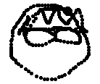
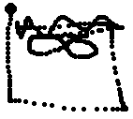


Live demo
~100 lines of JavaScript
  http://depts.washington.edu/acelab/proj/dollar/index.html
Notes:
Make the point about defining new types of arrows.
Make the point that a misrecognized candidate gesture can immediately be added as a template of the correct type.
Defining a previously undefined type and defining a new instance of an existing type are also the same process.
We can make an Andy Wilson gesture. And look! It knows what Andy Wilson looks like.

Slide 29
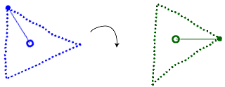
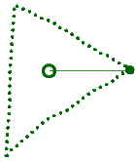
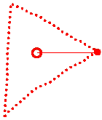
Four easy steps
(on next slides)
2. Rotate once to 0°
1. Resample
3. Scale, translate
4. Compare to templates

Slide 30
Step 1: Resample
Resample to N equidistant points
(Plamondon & Srihari 2000,
Tappert et al. 1990, Kristensson & Zhai 2004)
Removes clusters and gaps
Accommodates different sampling rates
Allows us to compare point C[k] to T_{i}[k]
Notes:
Allows us to compare point C[k] and T_{i}[k] and is not time dependent.

Slide 31
Step 1

Slide 32
Step 2: Rotate once to 0°
No closed-form solution for finding best angular alignment (Kara & Stahovich 2004)
Find angle from (x,y) to first point
  Call it the “indicative angle”
Rotate this to 0°
Approximates rotational alignment between C and T_{i}
0°
Notes:
There is no closed form solution for finding the best angular alignment between two sets of ordered points. There are complex methods based on moments, but these assume the points are unordered, and they fail in some cases. Plus, they aren’t consistent with our simple $1 approach.
So we will have to search over the space of possible angles to find the best alignment between a candidate and each template.
This is a refinement step.

Slide 33
Step 2

Slide 34
Step 3: Scale, translate
Scale to a square
  Non-uniform
  Aspect-invariant
Translate centroid to origin
Notes:
If you wanted to differentiate circles from ovals, you could do so by scaling the candidate uniformly along with the templates. Such exceptions can be made on a per-gesture basis.

Slide 35
Step 3

Slide 36
At this point…
… all templates T_{i} and any candidate C have been treated identically.
Now we must compare C to each T_{i}.
  To which T_{i} is C closest?

Slide 37
Step 4: Compare to templates
Compute score [0..1] for each
(C, T_{i})
  Score is based on average distance between corresponding points
  Score should be for best angular alignment for (C, T_{i})
    Requires search over angles
Notes:
The denominator is half the bounding box diagonal, which is a sort of limit to the average distance between points.

Slide 38
“Seed & search”
Find angle at which avg. point distance is minimized
Could use brute force
  +1° for 360°
Or use hill climbing CW/CCW
  ±1° for ±180°
  There can be local minima

Slide 39
Step 4

Slide 40
Limitations of $1
Depends on 2-D pairwise point comparisons
  Resilient to differences in sampling, rotation, scale, position, aspect, and velocity/acceleration
  But no ovals vs. circles, rectangles vs. squares
  (This can be added on a per-gesture basis)
  No differentiation based on speed
1-D gestures (lines) should not be scaled in 2-D
No features are used
  Gesture “classes” require different templates with the same name

Slide 41
arrow “class”
Notes:
Define these arrow gestures all as “arrow” to encompass an arrow class.
This is very direct and intuitive. But if you had a system meant to recognize many, many variations, it might require a handful of templates.

Slide 42

Evaluation

Slide 43
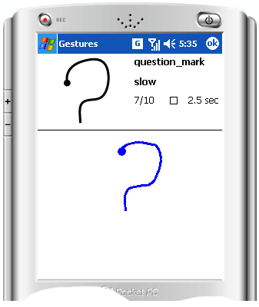
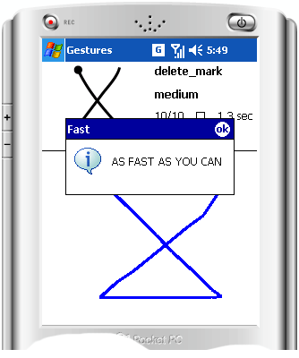
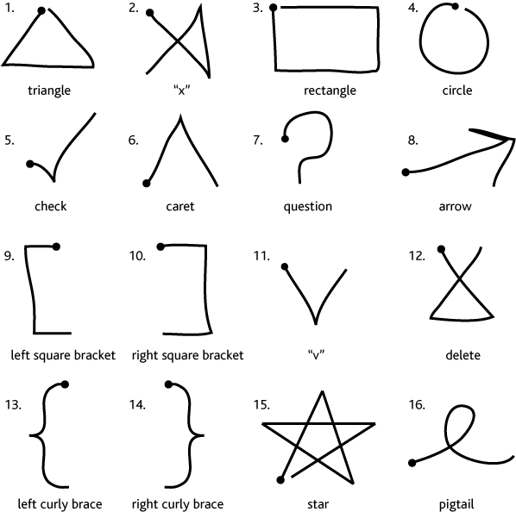
Method
Tested $1, Rubine, DTW
10 subjects
16 gestures
  10 × (slow, med, fast)
  4800 gestures total
  1-5 (disliked, liked)
Train on E=1-9, test on one random from 10-E. Repeat 100× for error rate.
1,248,000 total tests
3-factor within-subjects design (recognizer, speed, num. train)
Notes:
We extended Rubine and DTW to use $1’s rotation invariance scheme. Also, the gestures for Rubine and DTW were scaled to a standard square size and translated to the origin. They were not resampled, since these techniques do not use pairwise point comparisons. Rubine was properly trained after these adjustments to gestures were made.
Weakness: Subjects were only tested against their own gestures. This is acceptable if users are defining their own gestures at run-time, so it is a consistency test. We could have tested gestures from one subject using templates from other subjects. It just depends on the application.

Slide 44
Recognition errors
$1 0.98% errors
(1.21% without searching over angles)
DTW 0.85%
Rubine 7.17%
With 1 template:
  $1: 2.73%
  DTW: 2.14%
With 9 templates:
  $1: 0.45%
  DTW: 0.54%
DTW: 80× slower than $1
  Speedup possible, but complex
Rubine with 9 train: 4.70%
  (Rubine reported ~6.5%.)
χ²_{(2,N=780)}=867.33, p<.0001 (overall)
χ²_{(2,N=780)}=668.43, p<.0001 (vs. Rubine)
χ²_{(2,N=780)}=0.13, n.s. ($1 vs. DTW)
Notes:
DTW is quadratic in the number of sampled points, so it performs much more slowly than $1.

Slide 45
Wobbrock’s subsequent gesture work
AGATe: AGreement Analysis Toolkit - for calculating agreement in gesture-elicitation studies (CHI’2015)
GHoST: Gesture HeatmapS Toolkit - for visualizing variation in gesture articulation (ICMI ’2014)
GREAT: Gesture RElative Accuracy Toolkit - for measuring variation in gesture articulation (ICMI’2013)
GECKo: GEsture Clustering toolKit - for clustering gestures and calculating agreement (GI ‘2013)
$P: Point-cloud multistroke recognizer - for recognizing multistroke gestures as point-clouds (ICMI ‘2012)
$N: Multistroke recognizer - for recognizing multistroke gestures as strokes (GI ‘2012)
$1: Unistroke recognizer - for recognizing unistroke gestures as strokes (UIST’2007)

Slide 46
More References
From Bill Buxton, www.billbuxton.com
The first gesture-related stuff that I did was the single-stroke shorthand that I developed for entering music to the score editor. This was the stepping stone to Unistrokes and that to Grafitti.
  Buxton, W., Sniderman, R., Reeves, W., Patel, S. & Baecker, R. (1979). The Evolution of the SSSP Score Editing Tools.Computer Music Journal 3(4), 14-25. [PDF] [video]
The paper that you referred to as well as the accompanying video can be found here;
  Buxton, W., Fiume, E., Hill, R., Lee, A. & Woo, C. (1983). Continuous Hand-Gesture Driven Input. Proceedings of Graphics Interface '83, 9th Conference of the Canadian Man-Computer Communications Society, Edmonton, May 1983, 191-195. [video]
For a review of Marking and Gesture stuff, see the following two draft chapters of the yet-to-be-finished (!) input book:
  http://www.billbuxton.com/inputManuscript.html
  Marking Interfaces
  Gesture Driven Input
IMHO, the most useful thing that I have written that guides me, at least, in terms of gestures, is:
  Buxton, W. (1986). Chunking and Phrasing and the Design of Human-Computer Dialogues, Proceedings of the IFIP World Computer Congress, Dublin, Ireland, 475-480.
The two things that I always discuss when I speak about gestures are:
  Kreuger’s work & introduction of the pinch gesture, etc.: http://www.youtube.com/watch?v=d4DUIeXSEpk
  Richard Bolt’s work combining gesture and speech: http://www.youtube.com/watch?v=RyBEUyEtxQo
There is also some nice examples from Lincoln Lab:
  Applicon (circa 1970). An interactive trainable computer aided circuit design system using hand-drawn shapes to enter data and commands. Applicon. 16 mm film. 2:25 min excerpt
    The quick story is this – Applicon was a spin-off from Lincoln Labs, and the recognition stuff was born there. Fontaine Richardson, who was behind the work, was a key person at the lab. There was little published on this stuff, but it was the offspring of Sketchpad, and – I believe – the first commercial system to use these types of gestures – or gestures at all.
  http://www.billbuxton.com/Lincoln.html
  http://www.billbuxton.com/LincolnLab.pdf
An old summary which still has some relevance:
  Buxton, W. (1995). Touch, Gesture & Marking. Chapter 7 in R.M. Baecker, J. Grudin, W. Buxton and S. Greenberg, S. (Eds.)(1995). Readings in Human Computer Interaction: Toward the Year 2000 San Francisco: Morgan Kaufmann Publishers.

