Slide 1
Lectures 15 & 16: Connecting to the Backend – Web Services and Databases
05-431/631 Software Structures for User Interfaces (SSUI)
Fall, 2022

Slide 2

Logistics – 10/25 (15)
Please fill out the survey: https://www.surveymonkey.com/r/ssui2022midterm
Midterm review
Homework 4 due today
Homework 5 due 11/3/2022 (9 days)
No lab this Friday (10/28)
Tartan community day - no classes
I will be away next week
"Toward Scientific Evidence Standards in Empirical Computer Science”

Slide 3

Logistics – 10/26 (16)
Please fill out the survey (now have 8): https://www.surveymonkey.com/r/ssui2022midterm
Homework 4 deadline extended to be tomorrow (Friday at 3:05)
Bonus 5 points for people who turned it in on time
Homework 5 due 11/3/2022 (next week)
No lab tomorrow (10/28)
Tartan community day - no classes
I will be away next week
Happy Halloween!

Slide 4


Background
This is a front-end course
Pretty much all Web and Smartphone apps connect to a backend server
As do many desktop applications
Modern “Web Services” make creating integrated (“full stack”) apps quite easy
Homework 6 asks you to use 2 different kinds:
Web service for getting pictures
Unsplash – conventional REST interface; free for small tasks
No need for authentication, security, etc.
Networked database for storing user-specific data
We selected Google’s Firebase: NoSQL, object-oriented so easier to learn
Also handles person authentication in an easy way

Slide 5
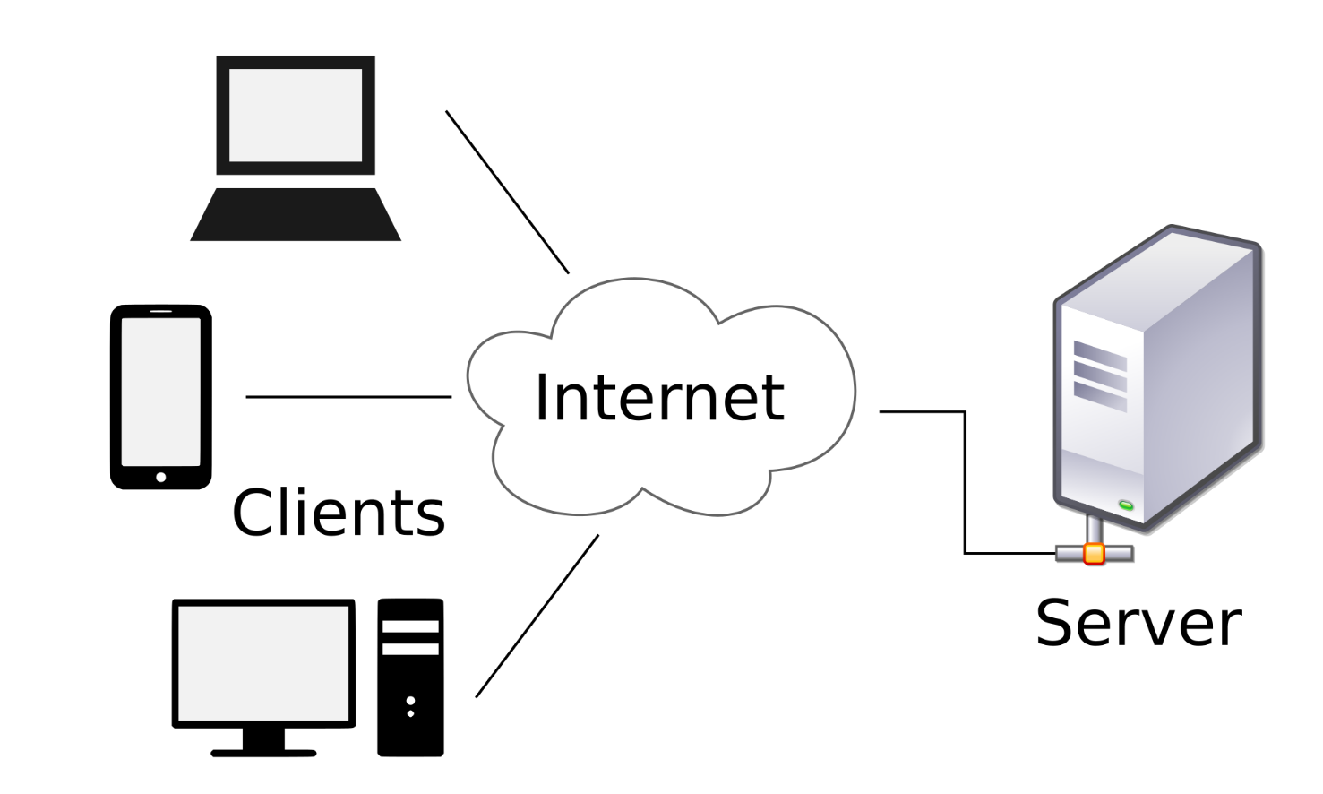
“Client Server Model”
Client = smaller computers, phones, devices (IoT)
Server = bigger computer, clusters
Does the bigger tasks, stores the bigger data
Manage sharing
Client-server model dates from the 1960s
Many protocols over the years

Slide 6
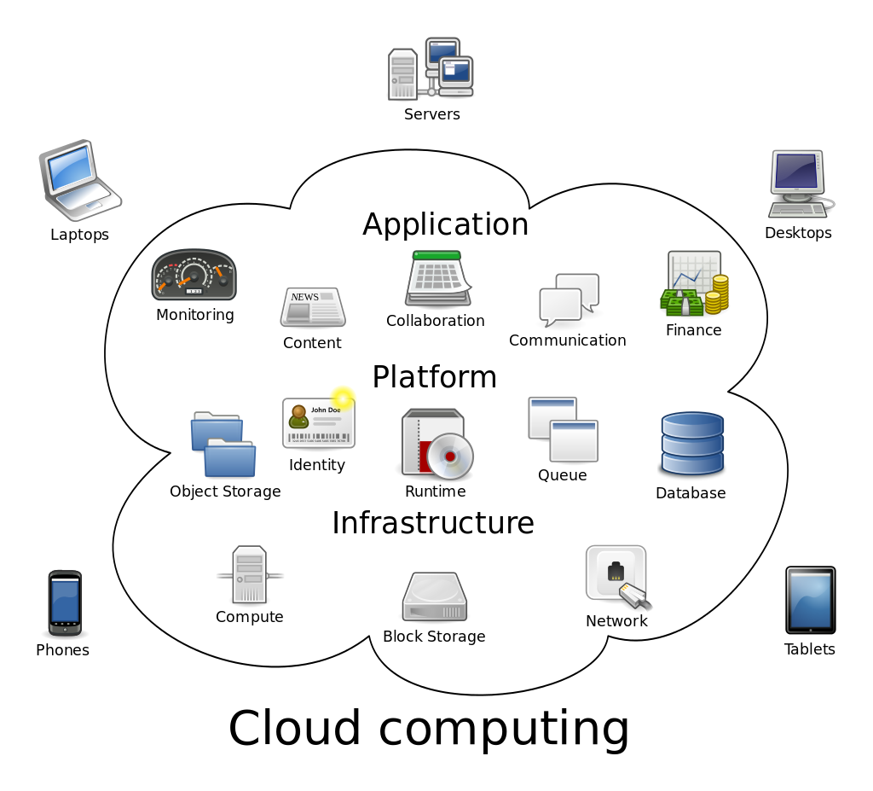
Cloud Computing
Amorphous cloud of networked elements
Don’t necessarily address a specific server
Not necessarily centrally managed
“Cloud Computing” term started to be used around 2000
(Reminder, WWW dates from 1990; “Internet” term from the 1980s, but ARPAnet from 1960s)

Slide 7
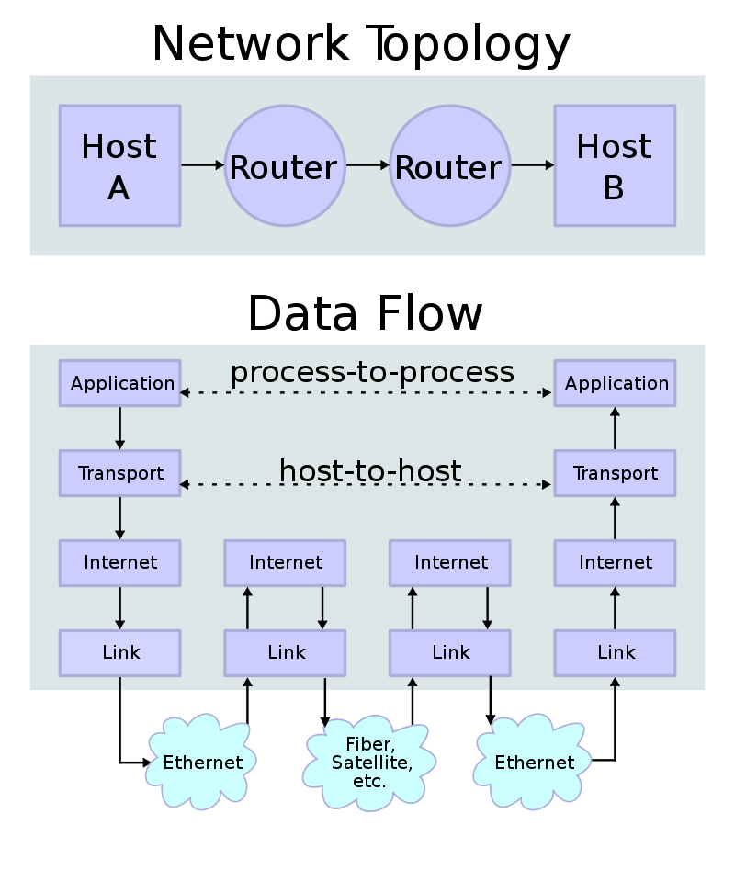
Important Protocols
(Assuming have not taken a networking class!)
“Protocol” – rules to allow communication
For Internet, are worldwide standards
Format of the messages
Multiple levels of protocols – build higher ones using lower-level ones
TCP/IP - Transmission Control Protocol and the Internet Protocol (IP) – how packets are sent around the internet
Handles naming of hosts (servers) – like cs.cmu.edu & IP numbers, like 128.2.42.95 (CMU)
Routing of packets with retry if one is lost (not for video) – may have many hops
Headers say where each packet is going
Examples: Simple Mail Transfer Protocol (SMTP), SSH, FTP, Telnet, http

Slide 8

Web protocols
Hypertext Transfer Protocol (HTTP) & newer HTTPS (secure)
All transfers in plain text
Others built on top of http
SOAP - Simple Object Access Protocol
Started around 1999 by Microsoft
Data encoded in XML
Had to describe the format of all messages using the on Web Services Description Language (WSDL)
Specifies what specific fields and values are allowed
Very complex and hard to use

Slide 9
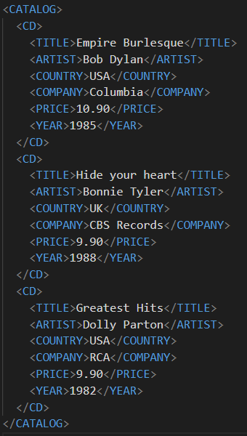
XML
Extensible Markup Language (XML)
Looks like html, but a little different
Yet another syntax
Used as communication and storage format
Arrays are implicit (like html)

Slide 10
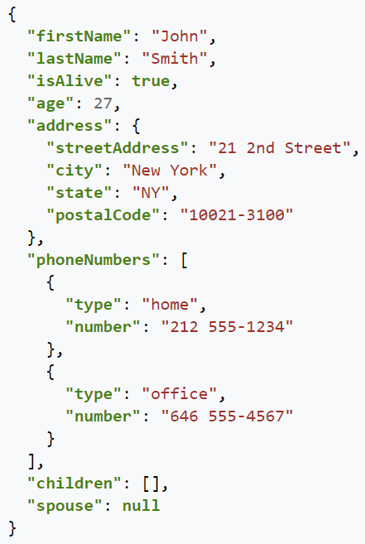
JSON
JavaScript Object Notation
Alternative to XML for saving and exchanging inurns formation
Files and web services
Yet another syntax!
Similar, but not identical to the other ones we have been using
Note that names must be quoted strings
Like JavaScript objects
Arrays using [ ]
Values can be JavaScript types or object or array
Parse the data with JSON.parse(data), to make a JavaScript object

Slide 11
REST
Representational state transfer (REST)
Created in 2000 by Roy Fielding in his PhD dissertation from UC Irvine
Very simple protocol, in contrast to SOAP
Also more efficient
Everyone uses this today
Encode commands and parameters in the URL
Simple commands: Post, Get, Put, Patch, Delete
Return values as HTML, XML, or JSON
Stateless so don’t have to worry about keeping track of things – all supplied in each message
No need to specify what will be in the messages
RESTful APIs (web services) follow this format

Slide 12
Web Services
Lots of available web services
Programmableweb.com lists over 24,000 public APIs
E.g., 476 APIs for “credit cards”
Lots more available internally for companies
Companies redoing their proprietary client-server or “mainframe” APIs to have web-services so easier to access on their own phone & web apps
Many companies are monetizing their data assets as web services
Sometimes just to “trusted partners”
E.g., PNC bank + Insurance company adjusters

Slide 13
Using a RESTful Web Service
Example: Unsplash for Developers
Free photos
Unsplash bought by Getty Images, but still free
Register as a developer
Note: DEMO mode is “50 requests per hour”
Accept the terms
Make an application
Scroll down to get your API Keys
We are using “Access Key” from Unsplash
Everyone should get their own – do not use mine!
Will need to put this into every message (since stateless)
How they make sure you are allowed to request pictures

Slide 14
Operations
Look like html requests
URL: https://api.unsplash.com/
Command (looks like a path), e.g: /search/photos
Then parameters and values for that command
First one separated by ?, then by &
Parameter order usually doesn’t matter
Always have client_id (Access Key) as the API key
Example query:
https://api.unsplash.com/search/photos/?client_id=YOUR_ACCESS_KEY&page=1&query=lion&per_page=10
Return is a JSON file (or error)
Pull out of it what you need
See https://jsonformatter.org/json-pretty-print to see what it looks like
Remember: stateless, so have to send the information each time
Get the second page of 10:
https://api.unsplash.com/search/photos/?client_id=YOUR_ACCESS_KEY&page=2&query=lion&per_page=10

Slide 15
More operations
Get an individual photo from its ID (ref):
Way more data than from search (1700 lines!)
https://api.unsplash.com/photos/ ZxNKxnR32Ng?client_id=YOUR_ACCESS_KEY

Slide 16
Sending/receiving the request
Sending the URL to a remote server and waiting for the results will take a noticeable time
So need to use asynchronous features of JavaScript
https://betterprogramming.pub/3-ways-to-write-asynchronous-code-in-javascript-b8d17e60df06
Support for multi-processing without threads
async
Defines a function as operating asynchronously
Have “await” in the function to wait for the operation to finish
await takes a “promise” – object that waits for the result (or fail)
await causes its containing function to wait for the promise to finish
See example
function resolveAfter2Seconds() {
return new Promise(resolve => {
setTimeout(() => {
resolve('resolved');
}, 2000);
});
}
async function asyncCall() {
console.log('calling');
const result = await resolveAfter2Seconds();
console.log(result);
// expected output: "resolved"
}
asyncCall();

Slide 17
Fetch API
https://developer.mozilla.org/en-US/docs/Web/API/Fetch_API
Performs an http request, handling the async and awaits
Call .then() on the result
Takes a function which is called on the return value of the previous promise
E.g., fetch() on unsplash will retrieve a JSON string, so can create a json object from it, and then reference its fields
Note that fetch returns a promise immediately, so have to call .then on the result

Slide 18
Fetch, cont.
Call .then on the result to get the response and its data: fetch('http://example.com/movies.json') .then(response => response.json()) .then(data => console.log(data));
Response is a “stream”; .json reads it all, returning another promise from which you can get the data as an object – see doc
data has fields for all of the json fields
E.g., for tempResults.json: data.total = 4589; data.total_pages = 459, data.results is an array with 10 elements
Use .map to create element for each item, can use urls.small as image
Wrap everything in try-catch in case of network errors

Slide 19
Example
fetch('https://api.unsplash.com/search/photos/?client_id=YOUR_CLIENT_ID&page=1&query=lion&per_page=10')
.then(response => response.json())
.then(data => console.log(data.total));
→ 4589
… data.results.length → 10
… data.results[0].urls.small → https://images.unsplash.com/photo-1546182990-dffeafbe841d?crop=entropy&cs=tinysrgb&fit=max&fm=jpg&ixid=MnwxNzg2NjV8MHwxfHNlYXJjaHwxfHxsaW9ufGVufDB8fHx8MTY2NjY1ODgyMA&ixlib=rb-4.0.3&q=80&w=400

Slide 20
Keeping the API Key safe
Your app uses the same access key for all users
Could theoretically just have it as a string in your JavaScript file
But big security hole
People can get it from your downloaded build
Lets people write code that uses your app’s access for free
One alternative, keep in “environment”: see stackoverflow
File called “.env” at top level, put in .env:
REACT_APP_UNSPLASH_API_KEY=xxxxxxxxxxxxxxxxxxxxxxxxxxxxxxxx
Then, your code can say:
const API_KEY = process.env.REACT_APP_UNSPLASH_API_KEY;
Make sure .env is in .gitignore
Doc = https://stackoverflow.com/a/57103663
Can also keep it in your Firebase database: https://dev.to/remi/firebase-set-and-access-environment-variables-1gh8

Slide 21
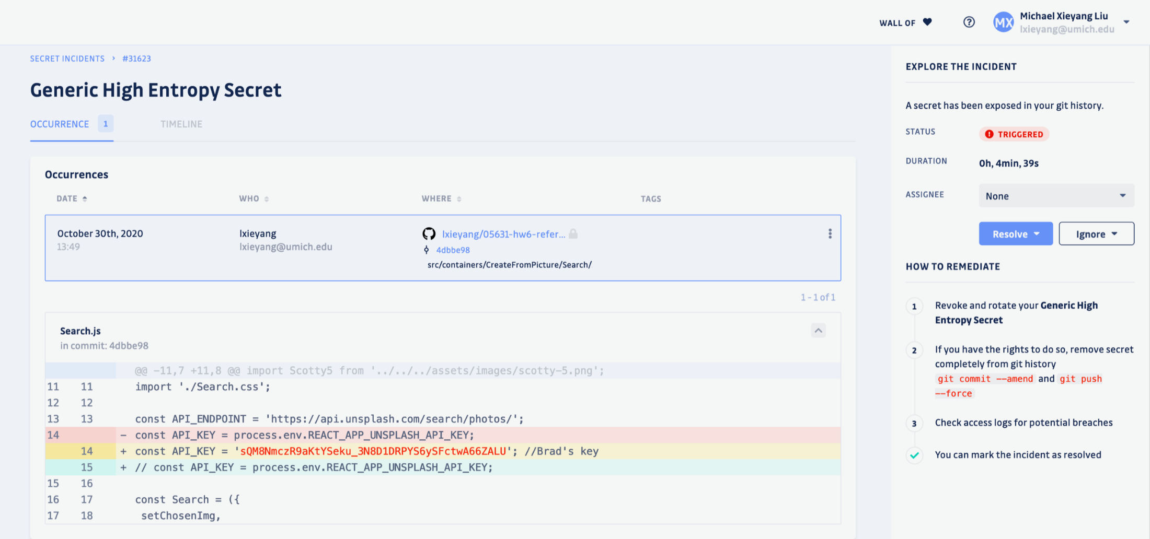
Warning from GitGuardian
“a secret has been exposed in the git history”:

Slide 22
Using a Library instead of Rest Calls
Most web services provide an SDK that helps construct the requests correctly and handle the results
The unsplash JS library
In this case, it is pretty easy to concatenate up the required request, so maybe the library isn’t needed?
But you are welcome to use it

Slide 23

Use Cloud Storage
Database on a server (instead of on the client)
Also handles user-login and authentication
User can switch machines and still get to their data
We will use Firebase database provided by Firebase (Google) https://firebase.google.com/

Slide 24

Getting Started with Firebase
Go to https://firebase.google.com/, hit “Get Started” (log in with your typical Google account). Then “Create a Project”. Give your project a name. I’ll use “ssui-hw6”. BTW, don’t use Google Analytics.
Once a project is created, go ahead and add an app (web). I’ll name it “ssui-hw6”,
No need for “hosting”
hit register.
Will use the code displayed in a minute

Slide 25
Getting Started, cont.
Docs for web: https://firebase.google.com/docs/web/setup?authuser=0
Step 3,
1. – use Node.js apps
Follow these instructions
No need to do npm init
npm install --save firebase
2. – use exactly what there – authentication and firestore
Make a src/firestore folder, new file index.js there
Put this code there at the top
3. – use the config information from other page in that file too

Slide 26
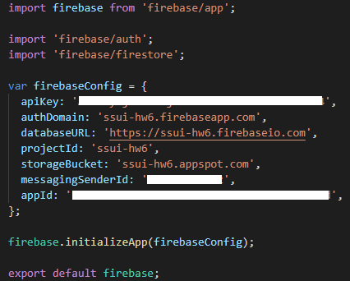
Finishing Setup
Resulting file will look like the following:

Slide 27
Authentication
“Continue to console”
Click on authentication
Set up sign in method
Select Google - third one
Slide to “enable”
Support email – login one is fine
Save
Should be configured!

Slide 28
In the code
Create auth page route to get to from login button
See: https://firebase.google.com/docs/auth/web/google-signin?authuser=0
Skip 2,3,4
Step 5
const handleLogIn = () => {
const provider = new firebase.auth.GoogleAuthProvider();
firebase
.auth()
.signInWithPopup(provider);
};
Now, set the user information:
See:https://firebase.google.com/docs/auth/web/start?authuser=0#set_an_authentication_state_observer_and_get_user_data
Put this code into app.js in componentDidMount()
To set the user state variable: this.setState({ user });
Also need the this.unsubscribeAuthListener(); in componentWillUnmount()
Now, in auth.js
Display login or logout based on whether user variable is set
Use to logout: firebase.auth().signOut();
user.displayName = user’s name
user.photoURL = picture for login button – can do in an <img src=‘xxx’ > in navbar

Slide 29
Database Functions
Go to console; Click on app
Cloud Firestore
Create Database
Start in Test mode
Location: default is fine
Enable
Now it is ready to go
Can come back to here to see what is in the database

Slide 30
Using Firestore
Good documentation: https://firebase.google.com/docs/firestore
A Firestore database is consisted of a series of “collections” and “documents”.
On-line debugging interface

Slide 31
In the Code
Should read the documentation first:
https://firebase.google.com/docs/firestore?authuser=0
Data model: https://firebase.google.com/docs/firestore/data-model?authuser=0
Also: Add and Manage Data & Read data
One collection: e.g., ShoppingCartItems
(Not supposed to have a bunch of collections)
Contains a set of items, each with the fields

Slide 32
Adding items
Disable add to cart buttons based on user not logged in
Add to cart function will use
Need user ID since per user: (assuming logged in) this.state.user.uid
Update to deal with new kind of image shirts
For adding data: Add a document: https://firebase.google.com/docs/firestore/manage-data/add-data?authuser=0#add_a_document
Use generated ID
let cartItemRef = firebase
.firestore()
.collection(“ShoppingCartItems”)
.doc(); cartItemRef.add(cartItem);

Slide 33
Query list of cart items for this user
Need a listener for cart change so will refresh automatically
Read data, listen to multiple items:
https://firebase.google.com/docs/firestore/query-data/listen?authuser=0#listen_to_multiple_documents_in_a_collection
Foreach: collect the information you need from each item, including id
Sort by created time so newest at top
Can use array sort after query – lodash.com useful
Simpler than orderBy in database – first time run, will generate an error, use the url of the error to create a database index (slow)

Slide 34
Updating and Removing items
Update doc: https://firebase.google.com/docs/firestore/manage-data/add-data?authuser=0#update-data
E.g., for quantity change
Delete data in doc: https://firebase.google.com/docs/firestore/manage-data/delete-data?authuser=0
Need the id
.doc(id).delete()

Slide 35
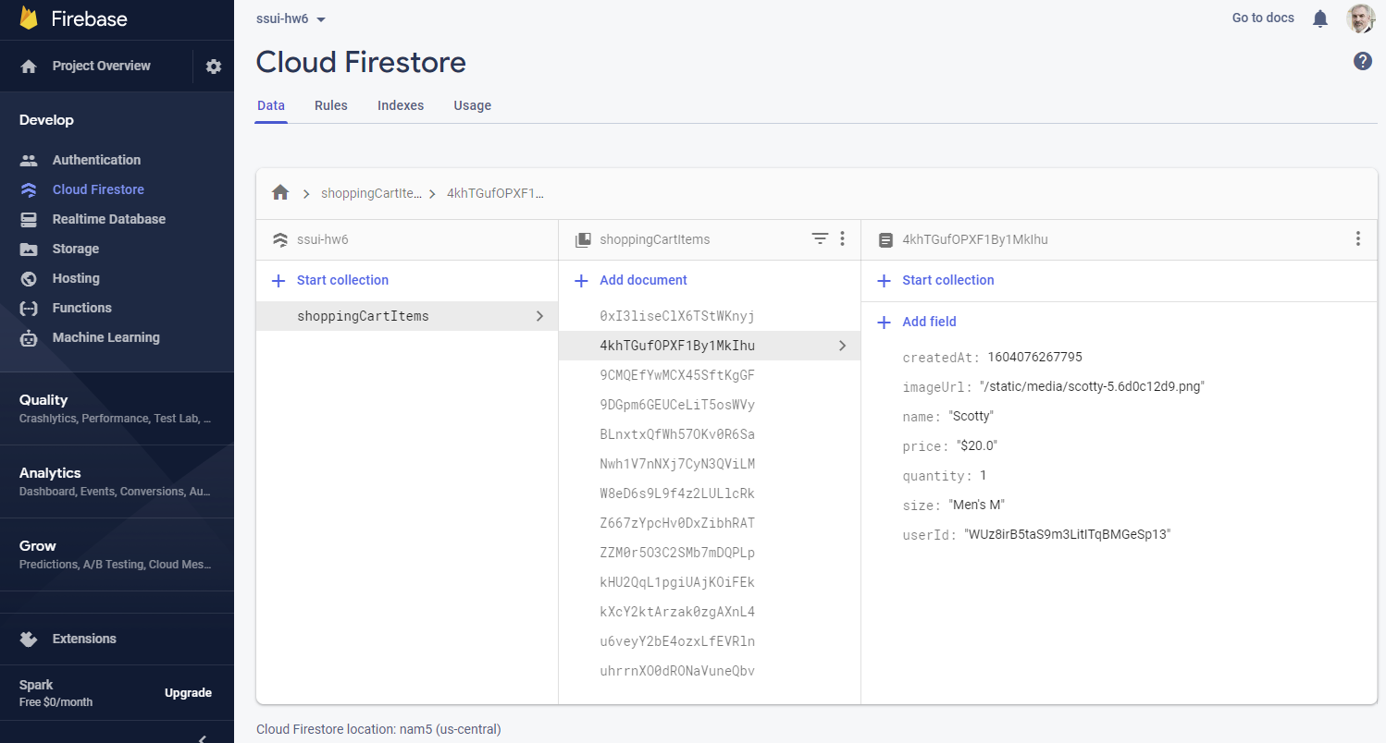
Debugging the Database
Can see items come and go from database
Highlights changed items with orange
Can also add/edit/remove items interactively
Available from Console / ssui-hw6 / “Cloud Firestore” (on left)

Slide 36
Creating your own backend
Doing Server-Side programming
Building and supplying your own web services
Sorry, not covered in this course
Resources: expressjs.com using node.js
Popular library to support responding to requests
Jeff Eppinger’s fall course: 17-437/17-637: Web Application Development

