Slide 1
Lecture 13:
Evaluation of APIs and UI Tools, API Usability, Cognitive Dimensions.
05-431/631 Software Structures for User Interfaces (SSUI)
Fall, 2022

Slide 2
Logistics
Homework 3 due today
Homework 4 starts today
  Due in 2 weeks, on October 25
    Sorry it goes across fall break
  People found this homework difficult in the past
Midterm starts tomorrow, Wednesday 3:05 – Friday 3:05
  You have 48 hours!
  No late turn-ins for the midterm
  Will be in Canvas in the “quizzes” section
  Note: not this lecture (midterm covers lectures 1-12)
  You should still come to class on Thursday!

Slide 3
How Can UI Tools be Evaluated?
Same as any other software
Software Engineering Quality Metrics
  Power (expressiveness, extensibility and evolvability)
  Performance (speed, memory)
  Robustness
  Complexity
  Defects (bugginess), …
Same as other GUIs
  Tool users (programmers) are people too
    Effectiveness
    Errors
    Satisfaction
    Learnability
    Memorability
    …

Slide 4
API Design Decisions
Jeffrey Stylos and Brad Myers, "Mapping the Space of API Design Decisions," 2007 IEEE Symposium on Visual Languages and Human-Centric Computing, VL/HCC'07. Sept 23-27, 2007, Coeur d'Alene, Idaho. pp. 50-57. pdf

Slide 5
API Design Decisions, cont.

Slide 6
UI Evaluation of UI Software Tools:
Some Usability Methods
Contextual Inquiry
Contextual Analysis
Paper prototypes
Think-aloud protocols
Heuristic Evaluation
Affinity diagrams
Personas
Wizard of Oz
Task analysis
A/B testing
Cognitive Walkthrough
Cognitive Dimensions
KLM and GOMS (CogTool)
Video prototyping
Body storming
Expert interviews
Questionnaires
Surveys
Interaction Relabeling
Log analysis
Storyboards
Focus groups
Card sorting
Diary studies
Improvisation
Use cases
Scenarios
“Speed Dating”
Journey Maps
…

Slide 7
Dangers of Not Applying Human Centered Approaches
Tools may prove to be not useful
  Useful = solves an important problem
    Happens frequently
    Difficult to solve otherwise
    Developers believe academic tools solve unimportant problems
    [How do practitioners perceive Software Engineering Research? http://catenary.wordpress.com/2011/05/19/how-dopractitioners-perceive-software-engineering-research/]
  Tools may not actually solve the problem
    Example: a study suggested that Tarantula tool identifying potentially faulty statements for debugging was not helpful
      Changed the task, but telling if the identified statement was actually faulty not easier than finding the bug
      Parnin, C. and Orso, A. 2011. Are Automated Debugging Techniques Actually Helping Developers International Symposium on Software Testing and Analyisis (2011), 199–209.
}
HCI questions

Slide 8
Dangers of Not Applying
Human Centered Approaches
Tools may show no measurable impact
  Desired advantage overwhelmed by problems with other parts
  Example: Emerson Murphy-Hill found that refactoring tools are under-utilized and programmers do not configure them due to usability issues
    Emerson Murphy-Hill, Chris Parnin, Andrew P. Black. How we refactor, and how we know it. In ICSE '09: Proceedings of the 2009 IEEE 31st International Conference on Software Engineering (2009), pp. 287-297.

Slide 9
Study of API Usability
Duala-Ekoko, E., Robillard, M.P., 2012. Asking and answering questions about unfamiliar APIs: An exploratory study. In: Proceedings of the 34th International Conference on Software Engineering. ICSE ’12, pp. 266–276. http://dl.acm.org/citation.cfm?id=2337223.2337255
Think-aloud protocols, screen captures and interviews
20 participants working on two programming tasks on different APIs
5 hardest problems:
  Which keywords best describe a functionality provided by the API?
  How is the type X related to the type Y?
  Does the API provide a helper-type for manipulating objects of a given type?
  How do I create an object of a given type without a public constructor?
  How do I determine the outcome of a method call?

Slide 10
Coordination / Dependencies
“Discovering Relevant Dependencies” among the classes
A. J. Ko, Brad A. Myers, and Htet Htet Aung. "Six Learning Barriers in End-User Programming Systems." VL/HCC'04: IEEE Symposium on Visual Languages and Human-Centric Computing, Rome, Italy, September 26-29, 2004. pp. 199-206. pdf. (Winner, Most Influential Paper Award for important influences on VL/HCC research or commerce over the last 10+/-1 years in 2013.)
  Design - I don’t know what I want the computer to do...
  Selection - I think I know what I want the computer to do, but I don’t know what to use
  Coordination - I think I know what things to use, but I don't know how to make them work together
  Use - I think I know what to use, but I don't know how to use it
  Understanding - I thought I knew how to use this, but it didn’t do what I expected
  Information - I think I know why it didn’t do what I expected, but I don’t know how to check

Slide 11
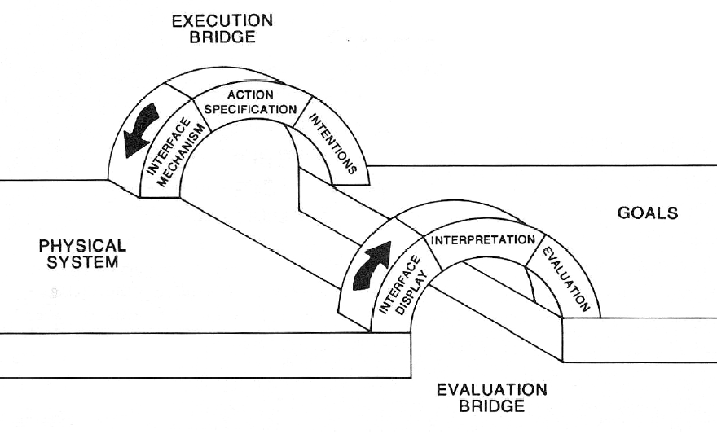
Don Norman’s “Gulfs”
Donald A. Norman and Stephen W. Draper. 1986. User Centered System Design; New Perspectives on Human-Computer Interaction. L. Erlbaum Assoc. Inc., Hillsdale, NJ, USA.
“Gulf of Evaluation”
“Gulf of Execution”
7 stages:
  Form goal
  Form intention
  Specify action
  Execute action
  Perceive state
  Interpret state
  Evaluate outcome

Slide 12
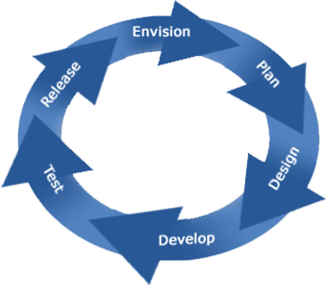
Product Lifecycle
Exploratory Studies
  Contextual Inquiries
  Interviews
  Surveys
  Lab Studies
  Corpus data mining
Field Studies
  Logs & error reports
Evaluative Studies
  Expert analyses
  Usability Evaluation
  Formal Lab studies
Design Practices
  “Natural programming”
  Graphic & Interaction Design
  Prototyping
  Wizard of Oz

Slide 13
Design and Development
Use CIs, other field studies and surveys to find problems to solve
  Ko, A.J., Myers, B.A., and Aung, H.H. “Six Learning Barriers in End-User Programming Systems,” in IEEE VL/HCC’2004. pp. 199-206.
  Ko, A.J. and DeLine, R. “A Field Study of Information Needs in Collocated Software Development Teams,” in ICSE'2007.
  Thomas D. LaToza and Brad Myers. "Developers Ask Reachability Questions", ICSE'2010: 32nd International Conference on Software Engineering, Cape Town, South Africa, 2-8 May 2010. pp. 185-194. pdf
  Also interviews and surveys, etc.: Myers, B., Park, S.Y., Nakano, Y., Mueller, G., and Ko, A. “How Designers Design and Program Interactive Behaviors,” in IEEE VL/HCC‘2008. pp. 185-188.
Iterative design and usability testing of versions
Summative testing at end

Slide 14


“Natural Programming” Elicitation Method
Technique developed by my group to discover developer’s “natural” expressions
  Mental models of tasks, vocabulary, etc.
A form of participatory design
Blank paper tests
Must prompt for the tasks in a way that doesn’t bias the answers
Examples:
  PacMan before and after
    Mostly rule-based (if-then)
  API designs
    Architecture, names used, which methods are on
    which classes

Slide 15
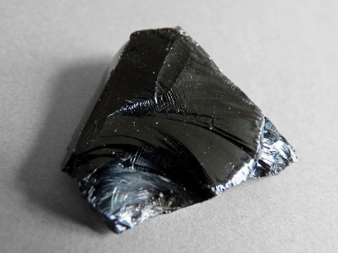
Example of use of Natural Programming
Obsidian is a domain specific language
(DSL) for blockchains [Coblenz, et al, 2019]
  Object-oriented Blockchain State Interaction and
  Development Implementation And Notation
Combining state transition language (“TypeStates”) with resources (“linear types”) all checked statically
11 different NatProg studies on how to present these complex concepts

Slide 16


Evaluation Methods
Does my tool work?
Does it solve the developer’s problems?
“If the user can’t use it, it doesn’t work!”
  ̶̶ Susan Dray

Slide 17
Expert Analyses
Usability experts evaluating designs to look for problems
  Heuristic Analysis – [Nielsen] set of guidelines
  Cognitive Dimensions – [Green] another set
  Cognitive Walkthroughs – evaluate a task
Can be inexpensive and quick
However, experienced evaluators are better
  22% vs. 41% vs. 60% of errors found [Nielsen]
Disadvantage: “just” opinions, open to arguments
[Nielsen] Jakob Nielsen. Usability Engineering. Boston, Academic Press. 1993.
[Green] T.R.G. Green and M. Petre. “Usability Analysis of Visual Programming Environments: A 'Cognitive Dimensions' Framework,” Journal of Visual Languages and Computing. 1996. vol. 7, no. 2. pp. 131-174.

Slide 18
Heuristic Evaluation Method
Named by Jakob Nielsen
Expert evaluates the user interface using guidelines
“Discount” usability engineering method
  One case study found factor of 48 in cost/benefit:
    Cost of inspection: $10,500. Benefit: $500,000 [Nielsen]

Slide 19
10 Basic Principles
From Nielsen’s web page: http://www.useit.com/papers/heuristic/heuristic_list.html
Visibility of system status
Match between system and the real world
User control and freedom
Consistency and standards
Error prevention
Recognition rather than recall
Flexibility and efficiency of use
Aesthetic and minimalist design
Help users recognize, diagnose, and recover from errors
Help and Documentation
Slightly different from list in Nielsen’s text

Slide 20
Cognitive Dimensions
12 different dimensions (or factors) that individually and collectively have an impact on the way that developers work with an API and on the way that developers expect the API to work. (from Clarke’04)
  Abstraction level. The minimum and maximum levels of abstraction exposed by the API
  Learning style. The learning requirements posed by the API, and the learning styles available to a targeted developer.
  Working framework. The size of the conceptual chunk (developer working set) needed to work effectively.
  Work-step unit. How much of a programming task must/can be completed in a single step.
  Progressive evaluation. To what extent partially completed code can be executed to obtain feedback on code behavior.
  Premature commitment. The amount of decisions that developers have to make when writing code for a given scenario and the consequences of those decisions.
  Penetrability. How the API facilitates exploration, analysis, and understanding of its components, and how targeted developers go about retrieving what is needed.
  Elaboration. The extent to which the API must be adapted to meet the needs of targeted developers.
  Viscosity. The barriers to change inherent in the API, and how much effort a targeted developer needs to expend to make a change.
  Consistency. How much of the rest of an API can be inferred once part of it is learned.
  Role expressiveness. How apparent the relationship is between each component exposed by an API and the program as a whole.
  Domain correspondence. How clearly the API components map to the domain and any special tricks that the developer needs to be aware of to accomplish some functionality.

Slide 21
Example: Consistency
Issues in html/CSS/JavaScript?

Slide 22

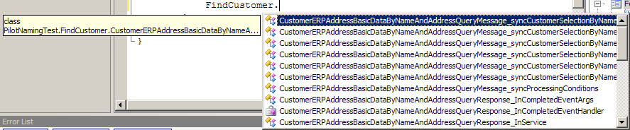
Our Use of Expert Analyses
Study APIs for Enterprise Service-Oriented Architectures - eSOA (“Web Services”)
  Cite: Jack Beaton, Sae Young Jeong, Yingyu Xie, Jeffrey Stylos, Brad A. Myers. "Usability Challenges for Enterprise Service-Oriented Architecture APIs,“ VL/HCC'08. Sept 15-18, 2008, Herrsching am Ammersee, Germany. pp. 193-196.
HEs and Usability Evaluations
Naming problems:
  Too long
  Not understandable
  Differences in middle are frequently missed
CustomerAddressBasicDataByNameAndAddressRequestMessageCustomerSelectionCommonName
CustomerAddressBasicDataByNameAndAddressResponseMessageCustomerSelectionCommonName

Slide 23
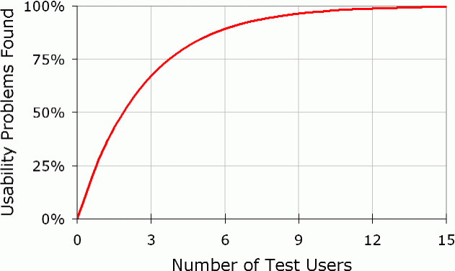
Usability Evaluations with users
Different from formal A vs. B “user studies”
  Understand usability issues
  Should be done early and often
    Doesn’t have to be “finished” to let people try it
“Think aloud” protocols
  “Single most valuable usability engineering method”
  -- [Nielsen]
  Users verbalize what they
  are thinking
    Motivations, why doing things,
    what confused about
  Don’t need many users
Notes:
More on WHY
Especially when doesn’t go the direction you want.

Slide 24
Why Usability Analysis
Improve the user interface prior to:
  Deployment
  A vs. B testing (as a “pilot” test)
Demonstrate that users can use the system
  Show that novel features of the UI are understandable

Slide 25
Formal A vs. B “User Studies”
Formal A vs. B lab user studies are “gold standard” for academic papers – to show something is better
But many issues in the study design
Issues:
  Vast differences in programmer productivity
    10X often cited (cites: Sackman, 1968, Curtis 1981, Mills 1983, DeMarco and Lister 1985, Curtis et al. 1986, Card 1987, Boehm and Papaccio 1988, Valett and McGarry 1989, Boehm et al 2000)
  Difficulty of controlling for prior knowledge
  Usually really care about expert performance, which is difficult to measure in a user test
  “Confounding” factors which were not controlled and are not relevant to study, but affect results
  Tasks or instructions are mis-understood
    Use prototypes & pilot studies to find these
Statistical significance doesn’t mean real savings
Be sure to collect qualitative data too
  Strategies people are using
  Why users did it that way
  Especially when unexpected results

Slide 26
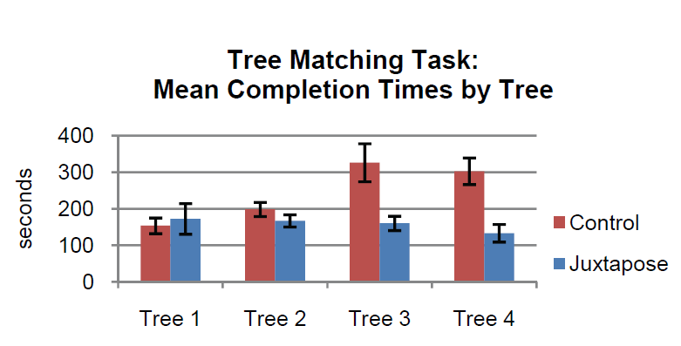
Examples of UI Tests
Many tool papers have user tests
  Especially at CHI conference
    E.g.: Ellis, J. B., Wahid, S., Danis, C., and Kellogg, W. A. 2007. Task and social visualization in software development: evaluation of a prototype. CHI '07. http://doi.acm.org/10.1145/1240624.1240716
      8 participants, 3 tasks, within subjects: Bugzilla vs. SHO, observational
  Backlash? at UIST conference
    Olsen, 2007: “Evaluating user interface systems research”
    But: Hartmann, Björn,Loren Yu, Abel Allison, Yeonsoo Yang, and Scott Klemmer. "Design As Exploration: Creating Interface Alternatives through
    Parallel Authoring and Runtime Tuning“, UIST 2008 –
    Best Student Paper Award
      18 participants, within subjects,
      full interface vs. features removed,
      “(one-tailed, paired Student’s
      t-test; p < 0.01)”

Slide 27
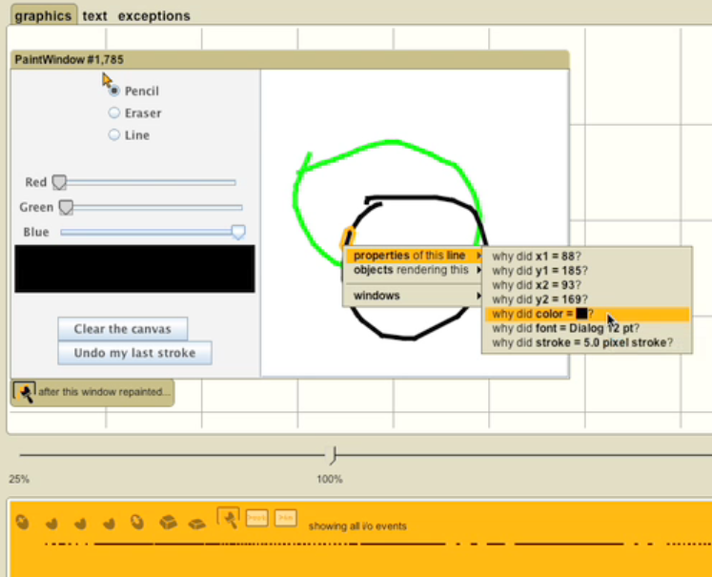
Our use of A vs. B Study: Whyline
PhD work of A.J. Ko
Allow users to directly ask “Why” and “Why not”

Slide 28
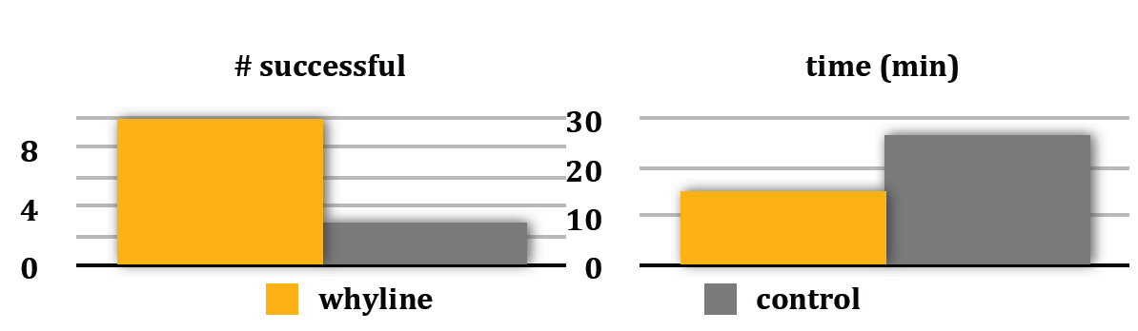
Whyline User Studies
Initial study:
  Whyline with novices outperformed experts with Eclipse
  Factor of 2.5 times faster
Formal study:
  Compared to Whyline with key features removed (rather than Eclipse)
  Tasks: 2 real bug reports from real open source system (ArgoUML)
  Whyline was over 3 times as successful, in ½ of the time

Slide 29
Steven Clarke’s “Personas”
Classified types of programmers he felt were relevant to UI tests of Microsoft products (Clarke, 2004) (Stylos & Clarke 2007)
Capture different work styles, not experience or proficiency
Systematic - work from the top down, attempting to understand the system as a whole before focusing on an individual component. Program defensively, making few assumptions about code or APIs and mistrusting even the guarantees an API makes, preferring to do additional testing in their own environment. Prefer full control, as in C, C++
Opportunistic - work from the bottom up on their current task and do not want to worry about the low-level details. Want to get their code working and quickly as possible without having to understand any more of the underlying APIs than they have to. They are the most common persona and prefer simple and easy to use languages that offer high levels of productivity at the expense of control, such as Visual Basic.
Pragmatic - less defensive and learn as they go, starting working from the bottom up with a specific task. However, when this approach fails, they revert to the top-down approach used by systematic programmers. Willing to trade off control for simplicity but prefer to be aware of and in control of this trade off. Prefer Java and C#.

Slide 30
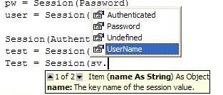
Usability Evaluations of APIs
PhD work of Jeff Stylos (extending Steven Clarke’s work)
Which programming patterns are most usable?
  Default constructors
  Factory pattern
  Object design
  E-SOA APIs
Measures: learnability, errors, preferences
Expert and novice programmers
Fix by:
  Changing APIs
  Changing documentation
  Better tools in IDEs
    E.g., use of Code completion
    (“IntelliSence”) for exploration

Slide 31
Required Constructors
Compared create-set-call (default constructor)
  var foo = new FooClass();
  foo.Bar = barValue;
  foo.Use();
vs. required constructors:
  var foo = new FooClass(barValue);
  foo.Use();
All participants assumed there would be a default constructor
Required constructors interfered with learning
  Want to experiment with what kind of object to use first
Did not ensure valid objects – passed in null
Preferred to not use temporary variables

Slide 32
“Factory” Pattern
(Ellis, Stylos, Myers 2007)
Covered in Lecture 9, slide 5
Instead of “normal” creation: Widget w = new Widget();
Objects must be created by another class:
AbstractFactory f = AbstractFactory.getDefault();
Widget w = f.createWidget();
Used frequently in Java (>61) and .Net (>13) and SAP
Lab study with expert Java programmers
  Five programming and debugging tasks
  Within subject and between subject measures
Results:
  When asked to design on “blank paper”, no one designed a factory
  Time to develop using factories took 2.1 to 5.3 times longer compared to regular constructors (20:05 v 9:31, 7:10 v 1:20)
  All subjects had difficulties getting using factories in APIs
Implications: avoid the factory pattern!

Slide 33
Summary
CIs and Iterative Design to help design and develop better tools
User testing is still the “gold standard” for user interface tools
HE and CD are useful for evaluations

