Slide 1
Lectures 11 and 12: React for JavaScript
05-431/631 Software Structures for User Interfaces (SSUI)
Fall, 2022

Slide 2
Logistics (lecture 11)
No longer need to create GitHub Pages version for homeworks.
No office hours tomorrow (Wednesday, Oct. 5)
Starting to cover React today, since HW4 spans mid-fall break, when there are no lectures or labs
Midterm quiz
Take home, open book, open internet
Will start at 3:05 on Wednesday 10/12/2022, due 24 hours later on Thursday, 10/13/2022 at 3:05 (before class)
Updated: Wednesday 10/12/2022, due 48 hours later on Friday, 10/14/2022 at 3:05 but still come to class on Thursday
Will include topics through lecture 12 (formerly 13), and homeworks 1 to 3

Slide 3
Logistics (lecture 12)
These slides were updated
Reload slides from schedule, lecture 11
HW3 due Tuesday
Bug in supplied floodfill js file
See Piazza
Or download new version: https://github.com/CMU-SSUI-Fall2022/HW3/blob/main/floodfill.js
Request for midterm to be Thursday after class until Friday:
4:25 (after class) on Thursday, 10/13/2022, due 24 hours later, on Friday, 10/14/2022 at 4:25
Any objections?

Slide 4
What is React
https://reactjs.org/
“A JavaScript library for building user interfaces”
Created by Facebook and actively used and supported by them
Goal: be more declarative, like original html and CSS
As opposed to imperative like JavaScript
React handles updating and redrawing as data changes
Still need input handlers
New way to write html with computed parameters = JSX
Build reusable, encapsulated components
E.g., header and footer
React can also be used “native” to make Android and iOS apps

Slide 5
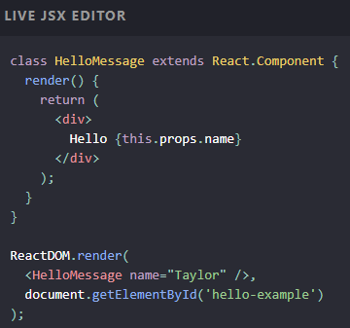
Key Concepts
JSX – yet another syntax for html
Almost like regular html, but some differences
Yet another syntax for comments: {\* comment *\}
Compute elements based on props
Computed and returned by render() methods
CSS classes called className
States – dynamic data
Note: totally different from state-transition-diagrams
Store values as JS objects
DOM updated when state’s values change

Slide 6
Getting Started
Download node.js and npm: https://nodejs.org/en/
Now can bring up a console and type npm or npx
Follow these instructions for getting started with React
https://create-react-app.dev/docs/getting-started#quick-start
cd into the code folder (expert hint: use drag-and-drop – see below)
C:\Users\bm1x\Documents> cd C:\Users\bm1x\Documents\UICOURSE\05-631fall22\HW 4-solution
C:\Users\bm1x\Documents\UICOURSE\05-631fall22\HW 4-solution> npx create-react-app my-app C:\Users\bm1x\Documents\UICOURSE\05-631fall22\HW 4-solution> cd my-app
C:\Users\bm1x\Documents\UICOURSE\05-631fall22\HW 4-solution> npm start
Will open new tab in browser running the app.
Can edit App.js and changes will be shown immediately on save
Stop with ^C in cmd window, or close tab, or close cmd window

Slide 7
Extra resources for getting started
https://reactjs.org/docs/create-a-new-react-app.html
https://docs.npmjs.com/downloading-and-installing-node-js-and-npm
W3Schools intro on how to get started with React dev: https://www.w3schools.com/react/react_getstarted.asp
Thanks to Michael Liu and Clara Cook and Alex Cabrera also for help with these slides!

Slide 8
Learning React
Can’t cover it all in two lectures & two labs
Lots of great material out there to learn from
Lots of Stack Overflow answers that cover most problems
eCommerce websites are exactly its target application
HW4 write up includes an example app from Michael Liu that is similar to HW4: SSUI-Star-Wars
How to deploy React+Router app to Netlify from GitHub: https://dev.to/easybuoy/deploying-react-app-from-github-to-netlify-3a9j

Slide 9
JavaScript features heavily used by React
Might want to review these features!
export and import
React uses lots of files and need to control namespaces
spread and rest operator: . . .
Flatten an array or object in place
const oldArray = [4,5]; const newArray = [...oldArray, 1, 2, 3]; newArray = [4,5,1,2,3] instead of [ [4,5], 1,2,3]
const newObject = {...oldObject, newProp: 'Jason'} function sortNumbers(...args) { } //args is an array of the parameters
Destructuring – assign variables using same name let {name, loc} = func(); // returns object with name: and loc: fields

Slide 10
Useful JavaScript array functions
ar1.map(fn) – returns a new array of calling fn on each element of ar1 const doubleNumArray = numbers.map(num => num * 2);
ar2.filter(fn) – returns a new array containing the elements of ar2 that when passed to fn return true const longwords = words.filter(word => word.length > 6);

Slide 11
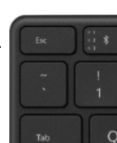
Backquote (“backtick”) operator
(Covered in Lab)
Called “template literals”, ref: https://developer.mozilla.org/en-US/docs/Web/JavaScript/Reference/Template_literals
Creates a string, where elements in ${} are evaluated
document.title = `You clicked ${count} times`;
Same as: "You clicked " + count + " times";
Can also include newlines: `string text line 1 string text line 2` is the same as: 'string text line 1\n' + 'string text line 2'
Notes:
DELETE THIS – covered in lab

Slide 12
React is Client Side
Compiled into pure JavaScript
But uses lots of libraries
npm to manage everything for you
https://www.npmjs.com/
Originally: Node Package Manager
Command line interface
Requires using a server on your machine
Automatically recompiles when edit code
Start with React create-react-app

Slide 13
JSX
React’s version of html
Describe the desired code in-line, without needing strings
Compute parts based on variables, lists, etc. by putting it in {}
Note, not strings
Usually in a return() or an assignment
return(
<div>
<h1>Hello, world!</h1>
<h2>It is {new Date().toLocaleTimeString()}.</h2>
</div>
);
const element = (
<div>
<h1>Hello, world!</h1>
<h2>It is {new Date().toLocaleTimeString()}.</h2>
</div>
);

Slide 14
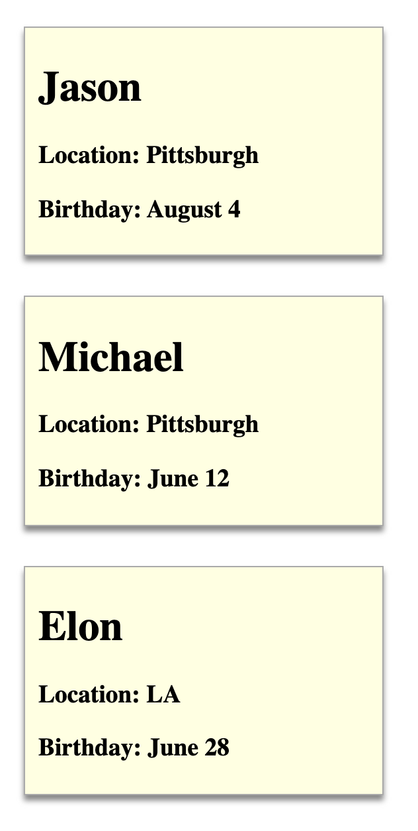
React Components
Elements of the web page
Styled with regular CSS
Defined using jsx
Use “className” for CSS classes
const Person = (props) => {
const {name, location, birthday} = props
return (
<div className="person">
<h1>{name}</h1>
<h3>Location: {location}</h3>
<h3>Birthday: {birthday}</h3>
</div>
)
}
ReactDOM.render(<Person name={"Jason"} location={"Pittsburgh"} birthday={"August 4"}/>, document.querySelector('#p1'))
ReactDOM.render(<Person name={"Michael"} location={"Pittsburgh"} birthday={"June 12"}/>, document.querySelector('#p2'))
ReactDOM.render(<Person name={"Elon"} location={"LA"} birthday={"June 28"}/>, document.querySelector('#p3'))
<div id="p1"></div>
<div id="p2"></div>
<div id="p3"></div>
.person {
margin: 10px;
border: 1px solid #aaa;
background-color: lightyellow;
padding: 5px 10px;
width: 250px;
box-shadow: 0 4px 4px #888;
margin: 30px 20px;
}
Notes:
This is the function version

Slide 15
Structure of our React apps
index.html just contains <div id="root"></div>
index.js connects the app component to it:
ReactDOM.render(
<React.StrictMode>
<App />
</React.StrictMode>,
document.getElementById('root')
);
Always need a “render” method at each level
Takes function that returns contents (App) and where to put it (‘root’)
App.js – contains the content of the app by importing all the components

Slide 16
Create components
React components: custom HTML elements that can be used to construct a web app
Create your elements
One React app typically only has ONE root component. In our case, it’s the App component.
Nest all the other components in the root (App) component => a tree of components
Can use <div> like usual <div className="App"> xxx <img src xxx /> <p> xxx </p> </div>
Each component needs to return/render some JSX code - it defines which HTML code React should render to the DOM in the end
Instead of constructor, React classes have a render() method
Notes:
Class style
JSX part
Render method – only in classes – functions RETURN the JSX, classes use Render method

Slide 17
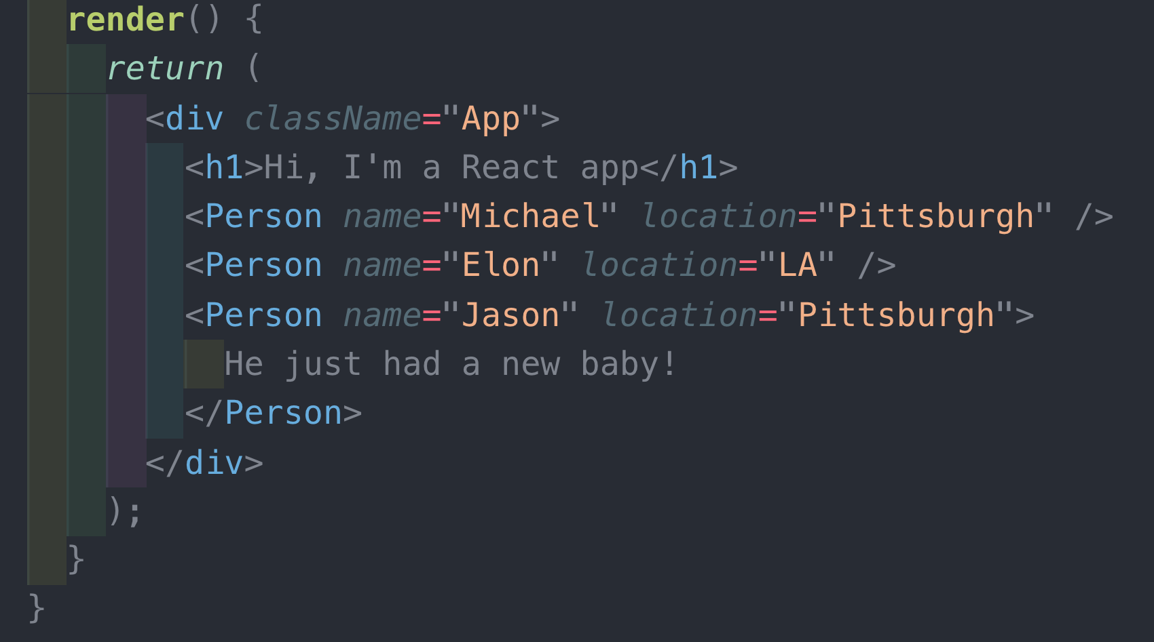
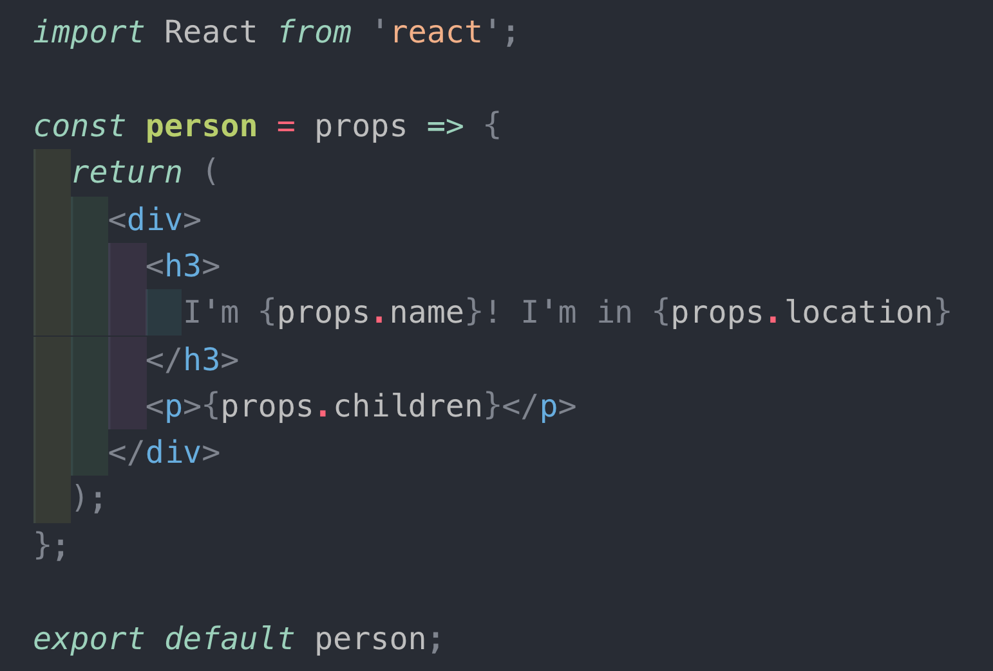
Dynamic Contents: Props and State
Props – variable that holds attributes to be used
Passed down hierarchy – parent to child
Notes:
Both styles
Left = class
Right = function

Slide 18
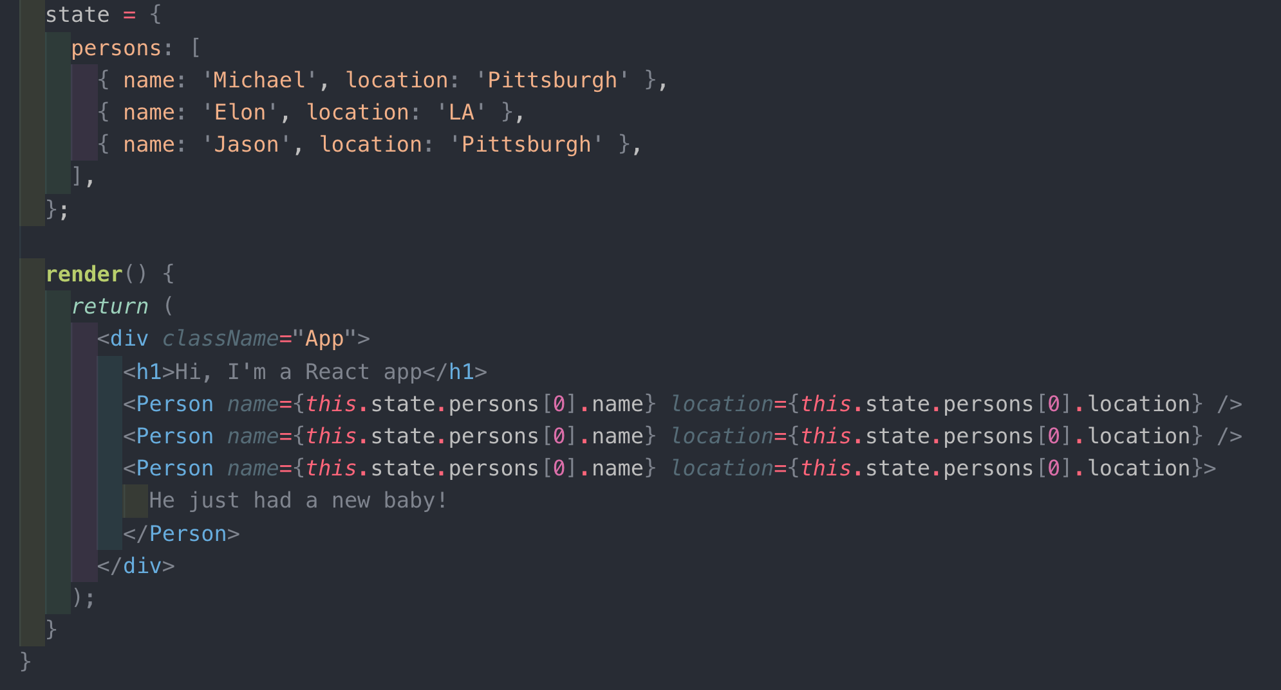
Dynamic Contents: Props and State
State: Variables that change, causing redisplay
Note: not MVC model with listener pattern
Shared variables instead
Both props and state are JavaScript objects
attribute-value pairs
Notes:
Props – how to move state around

Slide 19
this.setState or useState
Use this.setState to change state if using classes
Cannot update state directly
Challenging when state is data structure
Or const [count, setCount] = useState(0); if using hooks (see below)
So React knows to calculate what to redisplay
Minimize the number of states
Calculate props (attributes) based on state
Notes:
Very imperative

Slide 20
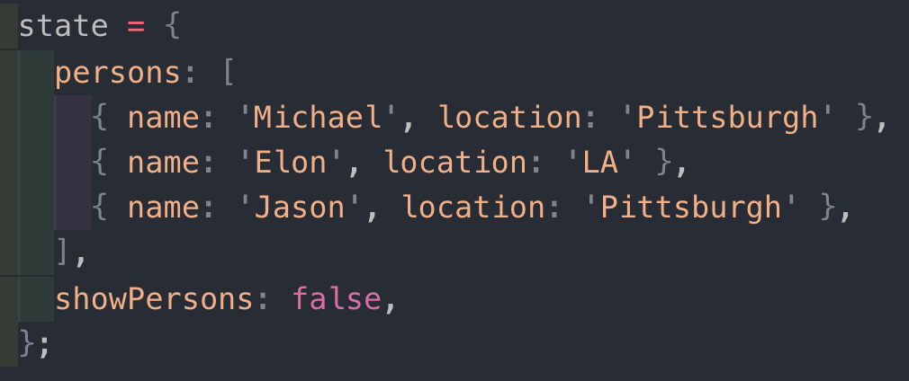
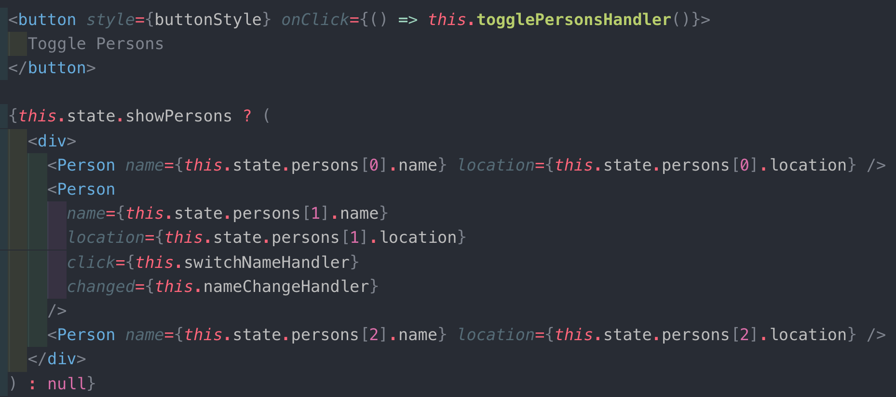
Conditional rendering
Can use ternary to compute contents, typically based on state
null causes nothing to be displayed
Can just compute contents
True means it will get rendered
Same as ternary but…
&& instead of ?
Null need not be specified

Slide 21
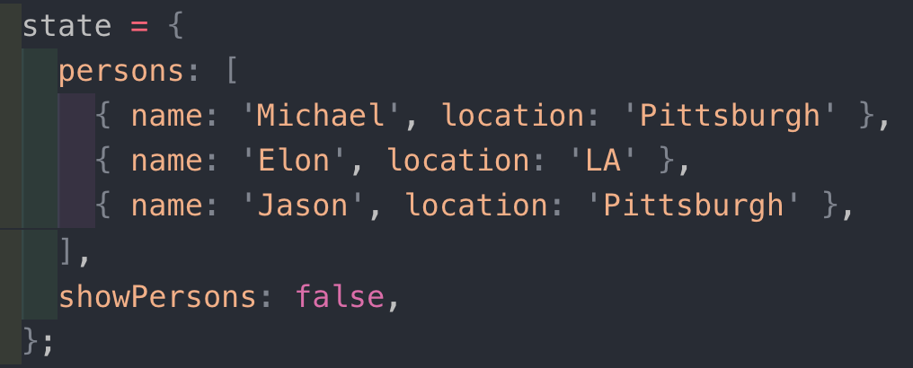
Rendering Lists
Use map() to return jsx from data list
Don’t forget the “key” attribute -- needed for efficient redisplay
Must be unique within the list
Should be “stable” wrt the element
React uses it to compute what has changed

Slide 22
Two ways to use React
Two ways to use React
Tutorials and other materials online do not distinguish them
Confusing mix of approaches
No clear names for them
Object-based or function-based
Function-based is newer – relies on “hooks”
Both are considered acceptable in general
Alex will cover these more tomorrow as well

Slide 23
Object Based
Create a new class that provides a render method (instead of a constructor)
Pass this class as a parameter to ReactDOM.render()
Also pass the place in the DOM to display it.

Slide 24
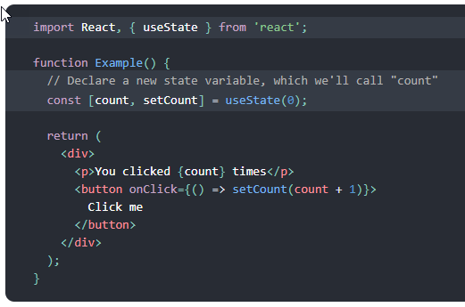
Function Based
Create a new function instead of a new class
Make use of “hooks” to connect into DOM

Slide 25
React Hooks
https://reactjs.org/docs/hooks-intro.html
Added in React 16.8 released February 2019
Replaces need to define new classes
“Hooks are functions that let you “hook into” React state and lifecycle features from function components.”
Simpler way to assign and access state variables
State hook and Effects Hook
Historical note: “hooks” date at least back to the 1970s
E.g., Emacs hooks – functions you can assign that will be run just before or after some important event happens

Slide 26
State Hook
useState is the state hook
Takes initial value of state
Returns: current value of state, and function to update it
count, setCount can be any pair of names
Values are remembered across executions
Notes:
If this was a class, then just say this.state.count

Slide 27
State Hook, cont.
Must be defined in top-level functions
Initial value can be a single value or object
If multiple useState() they must be in the same order everywhere
Can use any names
Be sure to put uses in {}so evaluated

Slide 28
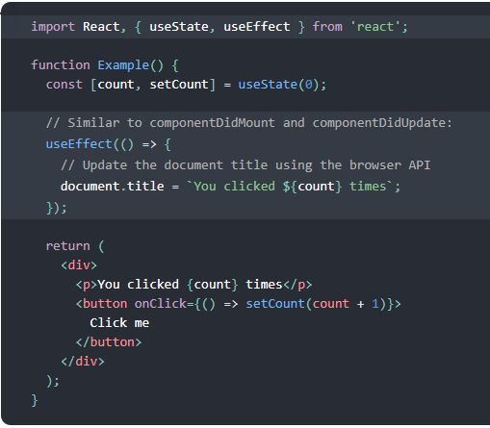
Effect Hook
Takes a function that will be called at a specific time
By default, after every render (including the first time)
Can perform side effects – updating external things
Can use state and other variables since inside the top-level function.
The function parameter can return another function to be used as cleanup
When the component “unmounts” (goes to another page)
Notes:
“effect” is the wrong word
Run after rendered, that are expensive or slow

Slide 29
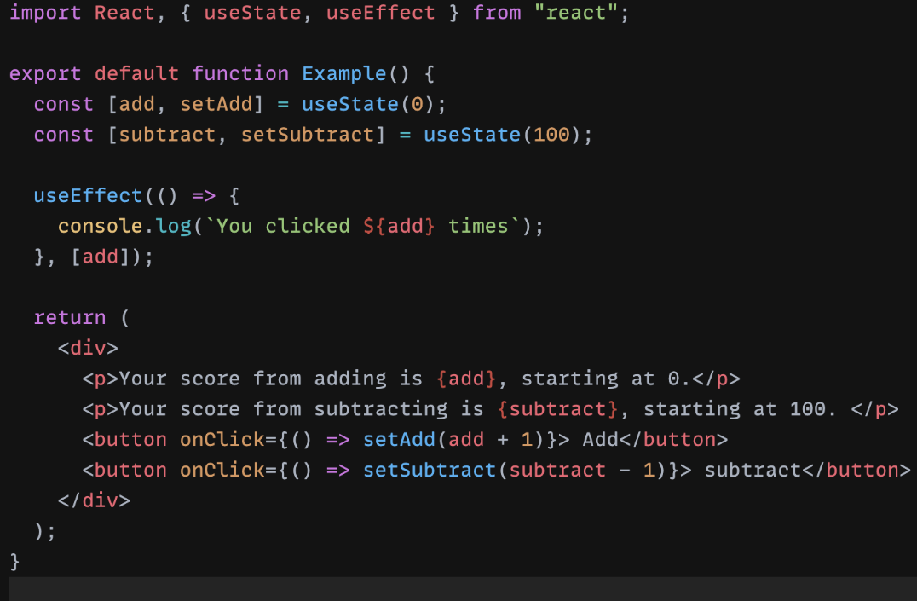
Effect Hook (another example)
useEffect() can take dependencies
Dependencies placed at in brackets at the end of function
Dependencies say that only when the specified variables change, will the app remount
Augment our current example, so that we have 2 state variables:
Only when add is updated, does it print to console

Slide 30
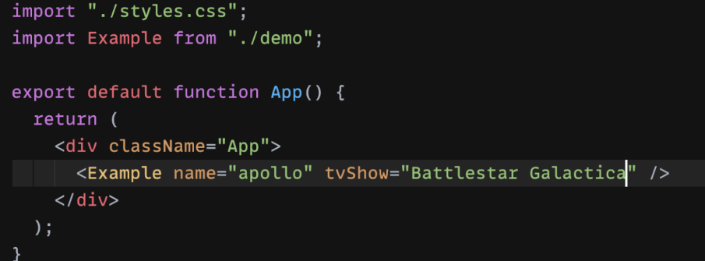
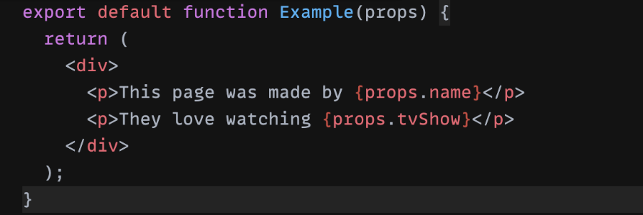
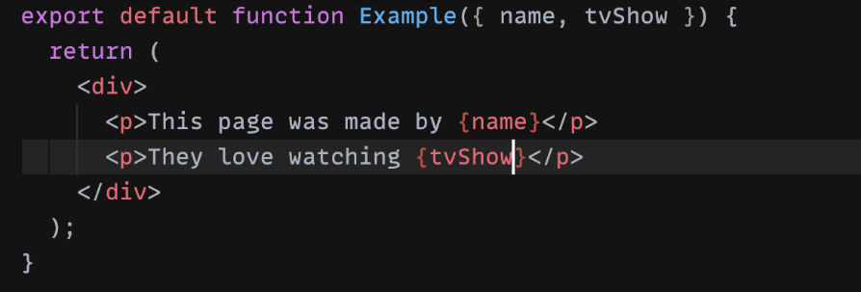
Props parameter
Props can be passed in 2 ways
Still will be passed in same way as class components [picture A]
Direct use of props (notice you no longer need “this” anymore) [picture B]
”this” is considered inherent
Object that contains parameters passed as props [picture C]
Separated by commas
A
B
C

Slide 31
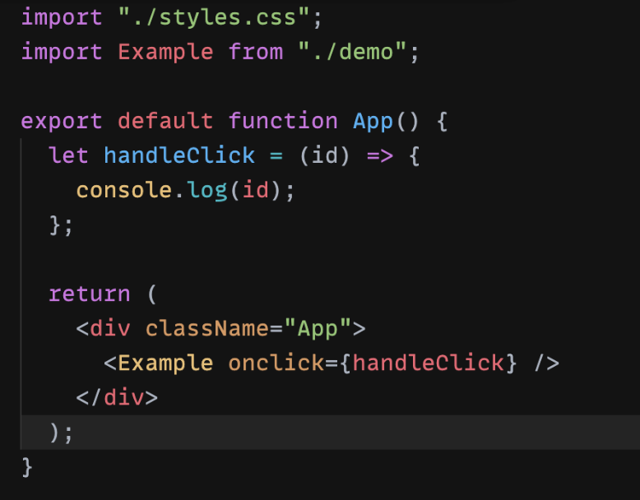
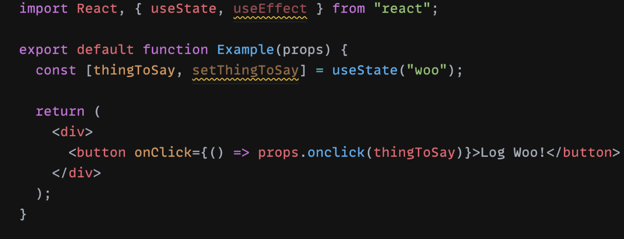
Passing function as props
This is the same example as the class component
Constructor not necessary
Automatic Binding (why “this” is not necessary either)
Child component does not need “this” either
Notes:
This is important
Parent component with sub-component

Slide 32
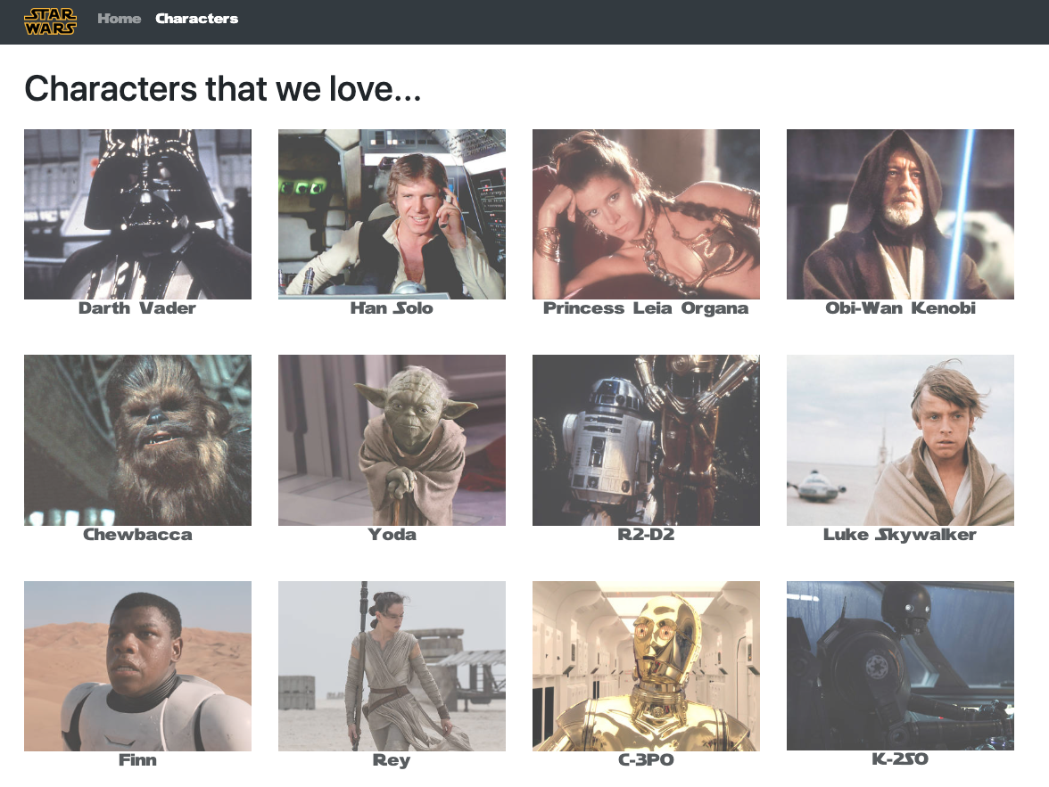
Michael Liu’s sample app
https://lxieyang.github.io/ssui-simple-react-app.
https://lxieyang.github.io/ssui-simple-react-app
Updated to React v18 – nothing important is new (yet!) -ref
Basic code structure
Component Reuse
Lists
Uses Router
Styling using ReactStrap
But doesn’t use states
Notes:
** redux – people don’t use this much any more
- use “context” instead
Can use ReactStrap - OK

Slide 33
Extra Packages You Can Use
React Router
Provides for multiple pages with unique URLs
Can pass parameters from one page to another so don’t need localStorage
Useful for which shirt clicked on
https://reactrouter.com/en/main
ReactStrap
Helpful formatting and layout mechanisms so you don’t need to make them from scratch
Based on Bootstrap but updated for React
https://reactstrap.github.io/
(But no others for homework 4!)

Slide 34
React Router
https://reactrouter.com/en/main
Support multiple pages with same header/footer
react-router-dom – allows switch among different content
const app = () => {
return (
<div className="App">
<NavBar />
<div className="MainContent">
<Switch>
<Route exact path={appRoutes.home}>
<HomePage />
</Route>
<Route exact path={appRoutes.characters}>
<CharactersPage />
</Route>
<Route exact path={appRoutes.character}>
<CharacterPage />
</Route>
<Redirect to={appRoutes.home} />
</Switch>
</div>
<Footer />
</div>
);
}; export default app;
Notes:
Move to end

Slide 35
ReactStrap
https://reactstrap.github.io/
Containers for layout
<Container> … </Container>
Row
Col
Simple parameterizations to make Responsive to window sizes: <Col lg={4} md={6} sm={12}>
Navbar – ref
Contains <NavItem>
Automatic collapse into a hamburger icon
… and many others

