Slide 1
Lecture 10: UI Implementation Concepts: Callbacks, Resources, Widget Hierarchies, Geometry Management
05-431/631 Software Structures for User Interfaces (SSUI)
Fall, 2022

Slide 2
Widgets as objects
Many features of programming languages were added to support UI Toolkits
Even Object-Oriented itself – from Smalltalk – (previous lecture)
In Unix: Motif and Tk each widget is at least one window
Since windows already have mechanisms for mouse enter/leave, etc.
But high overhead
In most other toolkits, widgets are not windows
Decorative lines, labels and boxes also are "widgets“

Slide 3
Intrinsics
How the widgets are implemented
Original Mac toolbox (1984) - call GetNewMBar to create a menu, and then SetMenuBar to fill its items, followed by DrawMenuBar to actually display it
When “C” was the key language, people still wanted OO
C++ (1982) had limitations and wasn’t available for free
Unix Motif -- made a "fake" object system out of C, called Xt intrinsics
Same in Andrew toolkit
Tk -- Tcl language, and descendants
Amulet – we created a new Prototype-instance object system, constraints, Opal graphics model, Interactors input model, command objects
Java (1996) – OO to fix some flaws in C++
Make more reliable, also to be better for UIs
Raw html – some widgets built-in
<input …>
Buttons, menus, checkboxes, radio buttons, text input fields, …
JavaScript object model
Very dynamic
Became more like Java with introduction of Class in 2015

Slide 4
“Resources”
Starting from original Macintosh as “resource fork” – for language independence (& better memory management)
All natural language strings and their positions in a separate file
Every parameter of widgets in Motif
Passed as a parameter to the create routine, set afterwards, or read from a configuration file
Called "options" by Tk
Each resource has a default value defined by the class
In an X file = appl.widget1.resource: value appl.widget1.widget2.resource: value *.resource: value
Many now use XML variants
XAML language from Microsoft for .Net resources
Extensible Application Markup Language

Slide 5
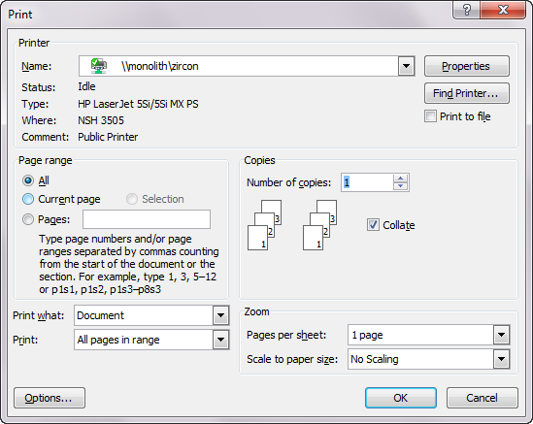
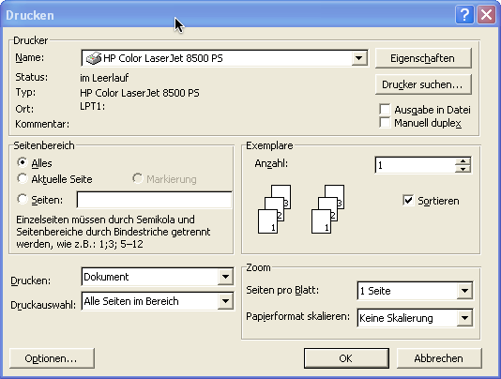
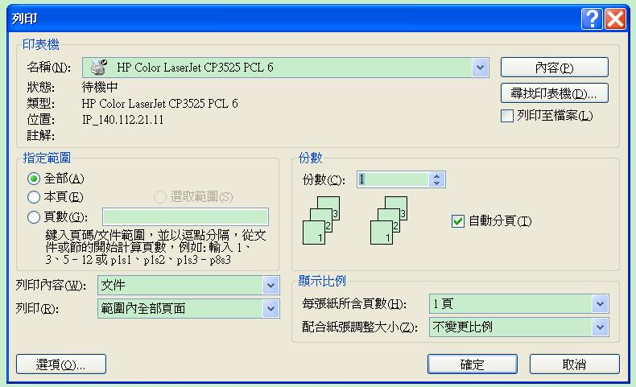
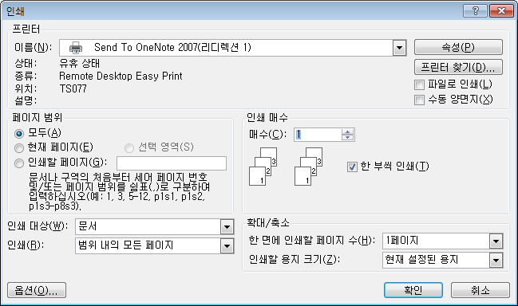
Dialog Box Layouts: Print

Slide 6
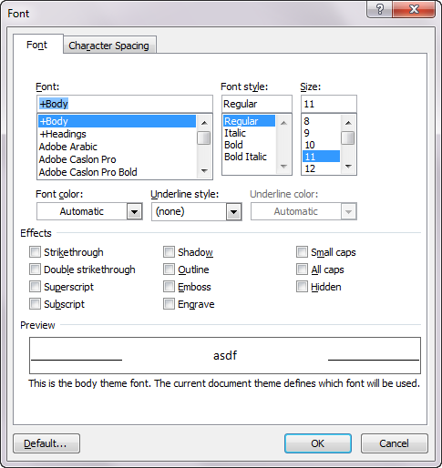
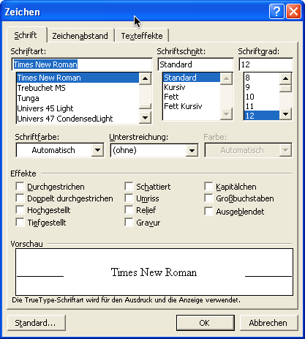
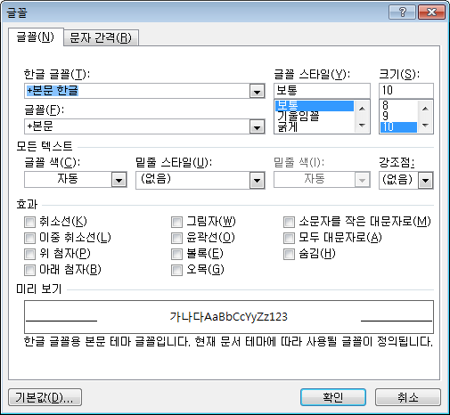
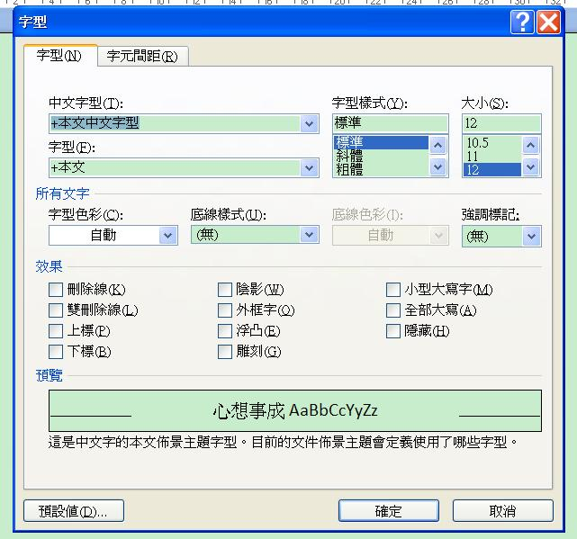
Dialog Box Layouts: Fonts

Slide 7
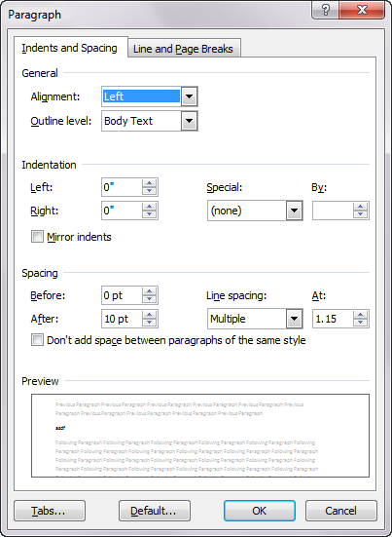
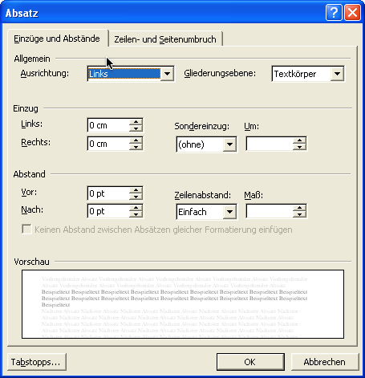
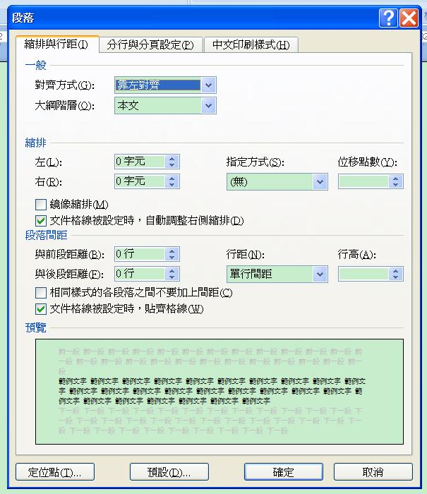
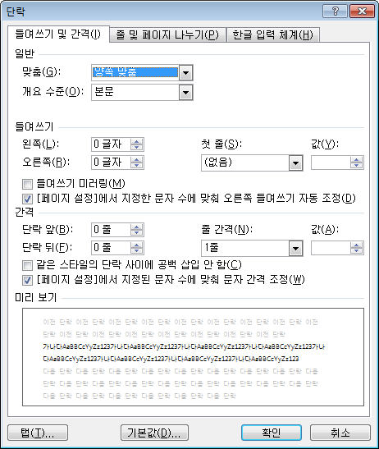
Dialog Box Layouts: Paragraph

Slide 8
Resources, cont.
Advantages
Easier to change languages
UI designer can do layout and wording
Can give appropriate names to the IDs
Easier for interactive editors to save to separate resource file
Disadvantages
Not always a good separation
E.g., when need whole new commands
Right-to-left languages require code to be different
Code is harder to write
Have to keep looking up the IDs to use
Code is harder to debug and understand
Names don’t appear in the code, so hard to search for

Slide 9
Callbacks
In JavaScript – event handler functions
In Motif, associate C procedures with widgets
Many different callbacks for the same widget
create, start, abort, finish, destroy, ...
Registered (set) at widget creation time, invoked at run time
Are "resources"
There are also "actions" which are internal to the widget and called by events
In VB, “event handlers”
Button: click, focus-in/out, change, etc.
In Amulet, invoke Command Objects on "interactors" or widget finish, and call-back is the DO method.

Slide 10
HTML call-back model
Form controls (buttons, text field) have various events or “actions”
Built-in actions like “submit”
Attach script code to run when used <button type="submit" formaction "myfunction">
ReactJS – like regular JavaScript
Has “state” variables that are shared (“reactive”)
AngularJS supports “data bindings”
Like Amulet constraints
Connects JavaScript variable to html element
<p ng-bind="firstname"></p>
Can be two-way

Slide 11
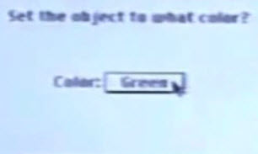
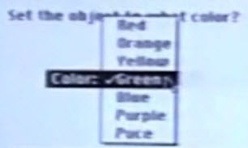
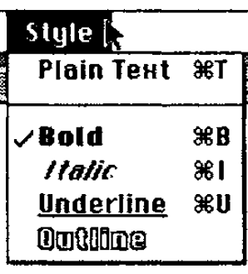
Widget Hierarchies
Inheritance to give the right methods to widgets
Menu in option button should look and work the same as a pull-down menu
Not used in JavaScript
Functions down the parent or class hierarchy
Java swing hierarchy:
https://docs.oracle.com/javase/10/docs/api/index.html?javax/swing/package-tree.html
(similar for Java v.18, but reorganized)
6002 interfaces, classes, subclasses; up to 8 levels deep!
68 different classes and interfaces with the word “menu” as part of the name
Rarely use the simple one (2 with the name “menu”)
Separate hierarchies for internal look-and-feel classes
Visible when debugging

Slide 12
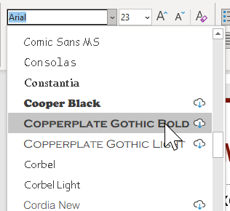
Geometry Management
Simplest – fixed values for location and size of each widget
Some widgets have dynamically-determined content
E.g., fonts menu, width=widest font name
Doesn’t work for changing languages; changing window size
Widgets don't set their own location.
Widgets put into special group objects called "geometry managers" that perform the layout by setting the component's positions and size
Each widget negotiates with parent for more room when resize

Slide 13
JavaScript Layout
Html/CSS placements:
Default – flows with text – next position or next line
Also, fixed location, percent of the way across page, offset relative to previous item
CSS Layouts
CSS framework (library), like Bootstrap
CSS float property – move to sides
CSS grid container – rows and columns
CSS flexbox container – deals with changing window size

Slide 14
Independent Constraints
Programmer defines a set of constraints
Mathematical relationships among the objects that compute the position, size, etc.
E.g.: width of menu = width of its widest item width of ribbon = width of window – 4 OK-Cancel buttons are centered at the bottom of the window
Idea dates back to Sketchpad research system – 1963!
Covered in depth in Lectures 16-18

Slide 15
Amulet geometry management
Combination of arbitrary constraints and containers
Group can have the Am_LAYOUT slot set with a constraint that depends on other slots
Sets positions of parts by side effect
Default layout routines: Horizontal and Vertical layout, for lists or tables.
Rest done by arbitrary constraints

Slide 16
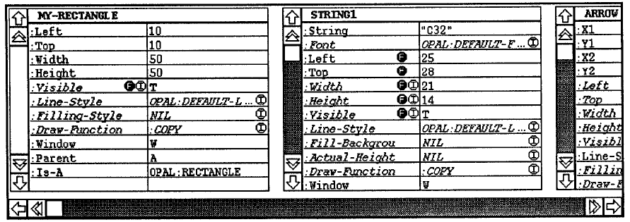
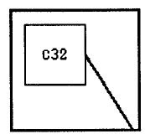
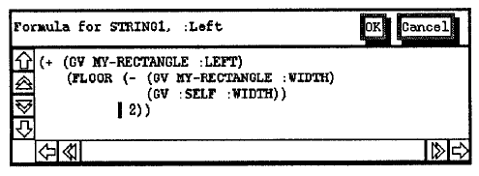
Our old research on layout: C32
Brad A. Myers. "Graphical Techniques in a Spreadsheet for Specifying User Interfaces," Proceedings SIGCHI'91: Human Factors in Computing Systems. New Orleans, LA. April 28-May 2, 1991. pp. 243-249. ACM ref. See also YouTube video or video

Slide 17
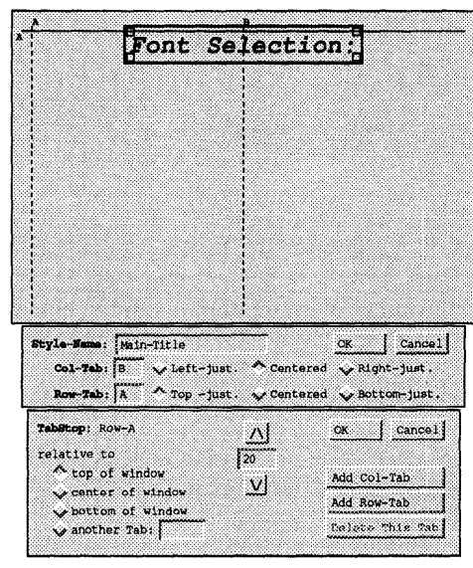
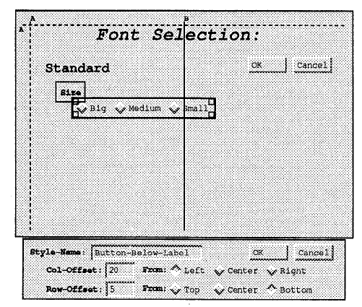
Our old research on layout: Gilt
Osamu Hashimoto and Brad A. Myers. "Graphical Styles For Building User Interfaces by Demonstration," ACM Symposium on User Interface Software and Technology: UIST'92, Monterey, CA, Nov. 16-18, 1992. pp. 117-124. pdf.
YouTube video. (9:01)

Slide 18
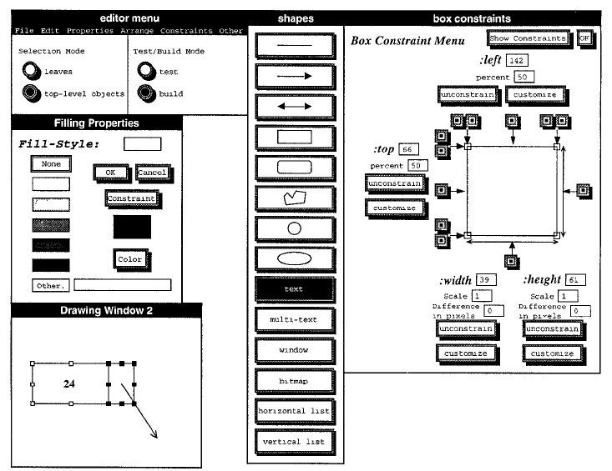
Our old research on layout: Lapidary
Brad Vander Zanden and Brad A. Myers. "Demonstrational and Constraint-Based Techniques for Pictorially Specifying Application Objects and Behaviors," ACM Transactions on Computer-Human Interaction. Vol. 2, no. 4, Dec, 1995. pp. 308-356.

Slide 19
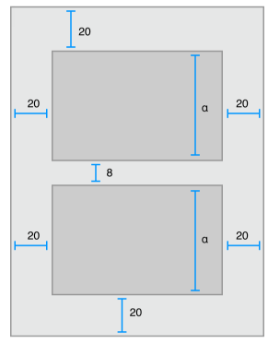
iOS
Can manually place elements of UI
“Auto Layout”
Constraint-based layout system
Helps with adaptive UI
Can set up constraints in the interface builder or programmatically
cite

Slide 20
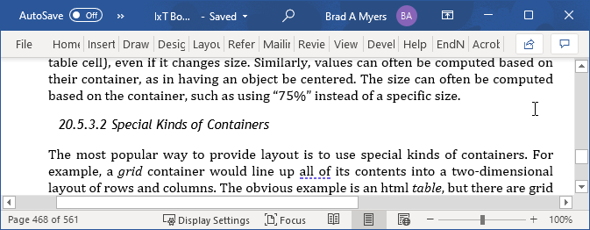
Special Containers
Put widgets in a container that will place them appropriately
Simple: Horizontal row or vertical column
OK for menus, but little else
Grid (table) – doesn’t cover much
Java GridBagLayout – more general but too hard to use
Doesn’t support multiple-pass calculations
E.g., items centered in a menu depend on menu width which depends on widest item
Allowed size might be different than desired size
E.g., Microsoft ribbon changes the widgets based on allowed size

Slide 21
Motif Geometry Management
Motif (the “winning” X toolkit)
RowColumn - add widgets and it lays them out
Treats all children the same, so not for ScrollBars
Form - generic constrained layout
Put extra resources on the children widgets
"For details, see the Motif Reference Manual, because the complete behavior of Form is quite complicated."
Each edge can be constrained
at a position or offset from an edge of the Form
at an offset from an edge of another widget
percent of the way across the Form (edge, not center)
a percent calculated based on the initial position
If wrong, widgets are on top of each other

Slide 22
Java Widget Layout
“Using Layout Managers”
BorderLayout – layout around the edges, center gets extra space
BoxLayout – vertical or horizontal columns
CardLayout – overlapping JPanels
FlowLayout – fills row, then goes to next row
GridLayout -- components in a grid of cells. Resizes children to fill cell
GridBagLayout – “one of the most flexible — and complex — layout managers the Java platform provides…. uses a grid of rows and columns, allowing specified components to span multiple rows or columns
Funny GridBagLayout video “Totally Gridbag” by Matt Quail (July 2004) https://www.youtube.com/watch?v=UuLaxbFKAcc (2:42)
GroupLayout – new, designed for use by IBs
SpringLayout -- also new for IBs, constraints for layouts
Funny video

Slide 23
Android
Similar to Java Swing
Layout: Different kinds of containers that lay out children
Linear, grid, etc.
Attach layouts to “view”s

Slide 24
Spacer model
History: TeX layout model
Typesetting system designed and mostly written by Donald Knuth starting in 1978
Boxes (of text) connected by “glue”
\vspace also between characters, etc.
Can control the “stretchiness” of the glue

Slide 25
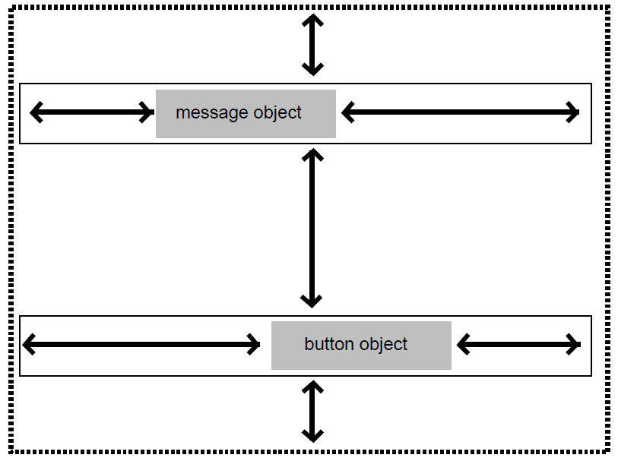
History: Interviews layout model
“Interviews” – one of the first C++ toolkits
Linton, M.A., Vlissides, J.M., and Calder, P.R., “Composing user interfaces with InterViews.” IEEE Computer, Feb, 1989. 22(2): pp. 8-22.
Adopted the TeX boxes and glue metaphor
hbox tiles its components horizontally
hglue
vbox tiles them vertically
Vglue
Controls have a “natural” size
Different glues and controls have different stretchiness

Slide 26
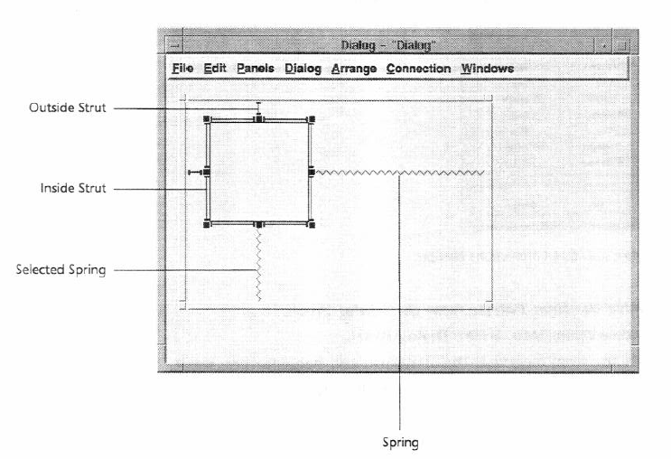
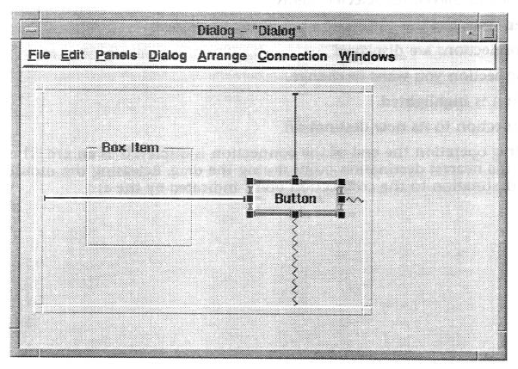
“Struts and Springs” layout
For stretchy or rigid constraints
Graphical interface layouts
NeXTStep (1989), MacOS & Galaxy (~1992)
Notes:
Also : http://doi.acm.org/10.1145/98188.98201
Interactive specification of flexible user interface displays
Scott E. Hudson & Shamim P. Mohamed

