Slide 1
Lecture 8a:
Input 2: Declarative input models; “Interactor” (Behavior) Objects in Garnet and Amulet
05-431/631 Software Structures for User Interfaces (SSUI)
Fall, 2022

Slide 2
Overview of the “Interactor” Input Model
Try to provide more support so input handling isn't so difficult
Make easy things simple and complex things possible
Based on the "Model-View-Controller" architecture from Smalltalk
    (Lecture 9)
True separation of graphics (view) and input handling (controller)
Also uses idea from [Foley&Wallace 1974] of identifying types of input handlers:
  move
  grow
  rotate
  text edit
  gesture
  select (pick)
  [James D. Foley and Victor L. Wallace. “The Art of Natural Graphic Man-Machine Conversation,” Proceedings of the IEEE. Apr, 1974. vol. 62, no. 4. pp. 462-471.]
Notes:
Stopped here

Slide 3
Innovations
Identifying primitive "Interactor" objects and correct parameterizations so most direct manipulation UIs can be constructed by re-using built-in objects.
  Better name might be “Behavior” objects
Only a few kinds of behaviors, and standard parameters
Real separation between input and output handling
Handles all input
  insides of widgets
  and for application programs
+ First successful separation of View from Controller in Smalltalk MVC
+ Integration of gestures with conventional interaction.
+ Easier to code because substantial re-use
+ Built-in support for multi-window dragging

Slide 4
General idea
Attach Interactor objects to a set of graphical objects to handle their input.
Graphical objects don't handle input
  No "event methods" in objects
Instead, define invisible "Interactor" objects and attach them to graphics
Interactors can operate on multiple objects
Strategy: pick the right type of Interactor, attach to the objects to be affected, fill in necessary slots of interactor
Widgets use interactors internally
Can have multiple interactors on an object (e.g., different mouse buttons)
Interactors directly set slots of objects using a standard protocol
  constraints can be used to map those slots into behaviors:
Details of input events and event processing is hidden
Used first in Garnet, refined in Amulet.

Slide 5
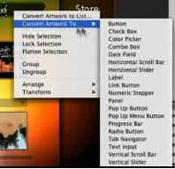
Flash Catalyst
Previous product from Adobe
  Only in CS 5.5
Also had behaviors
that can be attached
to graphics and
parameterized

Slide 6
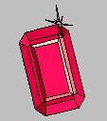

Aside: Garnet and Amulet
Garnet: (link)
  1987 to 1994
  Common Lisp and X11 or Macintosh
  Generating an Amalgam of Real-time, Novel Editors and Toolkits
Amulet:
  1994 to 1997
  C++ and X11, Windows or Macintosh
  Automatic Manufacture of Usable and Learnable Editors and Toolkits
  Full Amulet Manual:
    http://www.cs.cmu.edu/afs/cs/project/amulet/amulet3/manual/Amulet_ManualTOC.doc.html
    Tutorial
    Interactors and Command Objects
Novel object, graphics, constraint, input, output, undo, command, and animation models
Were widely used for a while

Slide 7
Garnet, Amulet Design Overview
Invented our own object system
  Prototype-instance instead of class-instance
  Syntax: prototype.Create(“name”)
Uses obj.set ( instance-variable, value )
Uses what is now called method cascading or fluent interface
  .set and other methods return the original object, so can be chained together
  Obj.set(Am_X, 4).set(Am_Y, 6).add_part…
C++ didn’t have name spaces, so started all Amulet words with Am_ …

Slide 8
Types of Interactors
Am_Choice_Interactor : select one or more of a set of objects
Am_Move_Grow_Interactor : move or grow objects with the mouse
Am_New_Points_Interactor: to create new objects by entering points while getting feedback "rubber band" objects
Am_Text_Edit_Interactor : mouse and keyboard edit of text
Am_Gesture_Interactor: interpret freehand gestures

Slide 9
Affected Graphical Objects
Set of objects to operate on:
  To be active, Interactor must be attached to an object which is (recursively) attached to the screen
  Equivalent to visibility of graphical objects
  Unlike graphical objects which can only be added as parts of windows or groups, interactors can be added as parts of any object:
  rect.Add_Part(my_inter);
  Default: operates on the object attached to
  But also common to operate on any member of a group.
  Controlled by the Am_Start_Where_Test slot, which should contain a method

Slide 10
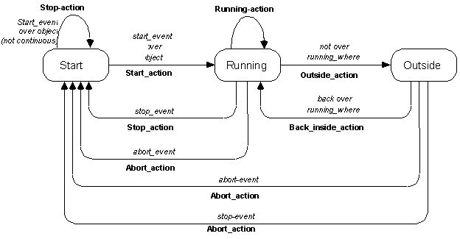
Standard Behavior
(“state diagrams” covered in lecture 9)

Slide 11
Other standard parameters
Multiple groups
  interactor can span multiple windows
start, stop and abort events
  single key, mousebutton, "any" mousebutton, modifiers, (shift, meta...), double click, click vs. drag, etc.
active?
priority levels

Slide 12
Parameters for specific types of Interactors
For buttons (Choice Interactors)
  how many objects to select: set, toggle, list-toggle
For move-grow:
  interim feedback object (while the mouse moves)
    if missing then object itself is modified
  gridding
  move or grow
flip if change sides
minimum size

Slide 13
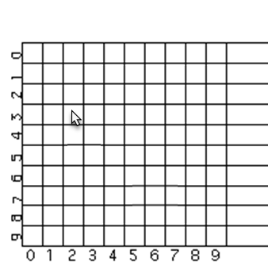
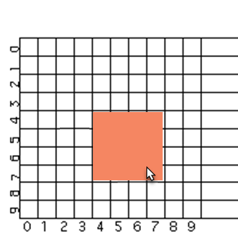
Gridding
Surprisingly complicated
  E.g., grid of 4 – where is first point?
    (X+2 mod 4)*4 = 4
  Should width be a multiple of 4 or right side?
    Width = right side at 7
    Right side = 8
Origin of grid – with window or container?

Slide 14
Flip if change sides
What happens when move towards upper left?
  Pegs at minimum size?
    Most window managers do this
    Might be zero – shape disappears?
  Object flips over?
    PowerPoint does this
    Text becomes upside down and/or backwards
TEXT
BOX
IN PPT
TEXT
BOX
IN PPT
Test
Me

Slide 15
Parameters for New_Point
interim feedback object (while the mouse moves)
gridding
minimum size
abort if too small
  Avoid creating tiny or invisible objects

Slide 16
Simple Example
To make an object movable with the mouse:
Am_Object rect = Am_Rectangle.Create() .Set(Am_LEFT, 40) .Set(Am_TOP, 50) .Set(Am_FILL_STYLE, Am_Red) .Add_Part(Am_Move_Grow_Interactor.Create());

Slide 17
Advanced Feature: Priorities
If two interactors want to run, priorities used to determine which
Am_PRIORITY slot contains a number. Default = 1
When running, 100 added to it
Inspector interactors use 300.0
If multiple with same priority, runs the one attached closer to the leaf

Slide 18
Lecture 8b:
Output 2:
Basic 2D Computer Graphics
05-431/631 Software Structures for User Interfaces (SSUI)
Fall, 2022

Slide 19
DOM is an Example of: Structured Graphics
Saves a list of all the graphical objects
  Edit the screen by editing the saved list
Also called "display list" or "retained object model"
Provided by many toolkits and graphics packages early vector displays
  CORE (~1977), GKS (1985), PHIGS (1988)
  Optional in InterViews, CLIM, etc.
  Required in Amulet, Garnet, Rendezvous, etc.
Also SVG that is part of DOM

Slide 20
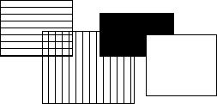
Structured Graphics, cont.
Advantages:
  Simpler to program with: don't call "draw" and "erase"
    Just add and remove objects
  Automatic refresh of windows when uncovered, etc.
  Automatic redisplay of objects when change and also of other overlapping objects
Before
After

Slide 21
Structured Graphics Can Support
Ability to support:
  high-level behaviors like move, grow, cut/copy/paste, etc.
  high-level widgets like selection handles
  constraints among objects
  automatic layout
  grouping: "Groups" in Garnet
  automatic printing
  external scripting, ...
  accessibility

Slide 22
Structured Graphics Disadvantages
Disadvantages:
  Significant space penalties
    objects take up to 1000 bytes each
    imagine a scene with 40,000 dots (200x200 fat bits)
  Time penalties
    Redisplay doesn't take advantage of special properties of data:
      regularity
      non-overlapping
    Reason for special parameters in lists in React (see future lecture!)

Slide 23
Basic Idea: Graphical objects retained in a hierarchy
Primitives: text, rectangles, circles, …
Groups
  Also called “aggregates”, “collections”, …
  In HTML: <div>, <ux>, …
  SVG: “Group”
  The size of a group includes all of its “children” objects.
    Also called “components”
    Bounding box of group
  Group is “parent”, elements are “children”
Foo

Slide 24
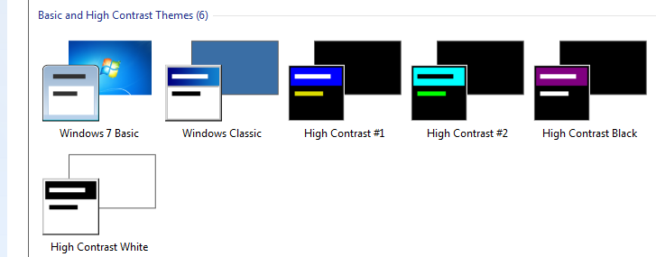
Design Issues: Hierarchies & Inheritance
How many hierarchies for OO graphics systems?
  Inheritance (class-instance or prototype-instance)
  Components / Groups
  Style hierarchies, like from CSS classes or Windows themes
Where do properties come from?
  Color, size, shape
    From aggregate or inheritance hierarchy?
  Issue: changing type of object – rectangle → polygon
  Windows widget
  properties
    Size, color scheme,
    transparency, …

Slide 25
Redisplay Algorithms
Redisplay everything each time
  Most appropriate for small numbers of objects, and if drawing is really quick compared to computation
  Used on the Macintosh and many others
  Used by Amulet
  I don’t know what browsers do

Slide 26
Redisplay only the affected areas of the screen
Requires computing what areas are affected
Garnet:
  keep track of objects that change any "interesting" slot
  compute the bounding box of all these changed objects in their old and new locations
  assert this as the clipping region (must not self-intersect; Garnet uses 2 regions)
  erase the area
  go through objects from top-to-bottom, back to front draw those which overlap the bounding box
  goes through all top level aggregates, and any children of the aggregates that intersect (recursively)
Other techniques: quad trees

Slide 27
Overview of Redisplay Algorithm
Simplest algorithm: draw all objects from back to front
More sophisticated: Can clip to boundary of changed objects
  1st pass – collect all the objects which have changed
    Combine into one or more clipping rectangles
  2nd pass – go through all objects from back to
  front and redraw them
    Will be clipped to affected regions
    Optimization – only do components if group intersects changed area
  Issue: complexities determining bounding boxes due to anti-aliasing, miter for polygons, etc.
Foo

Slide 28
Object-Oriented Techniques
Motivation
  Became popular along with GUIs, Direct Manipulation
  Icons, graphics seem like objects:
    have internal state, persistance
  OO was originally developed (SmallTalk) and became popular (C++) mostly due to GUIs.
  C++ became popular with Windows programming

Slide 29
Object Oriented
As a UI technique:
  Same as GUI, Direct Manipulation = icons, graphical objects, widgets
Here, as a programming paradigm (often in a language)
A form of "data abstraction"
"Classes" describe the basic structure of the data
Also, the methods that can be called
Usually no direct access to the data, only the methods

Slide 30
OO
Create "instances" of the classes
  local copy of data
  may also be class data -- all instances share the same value
  shares all methods
"Inheritance": create a new class "like" the superclass
  by default has all the same methods and data
  can add new data and methods and re-program inherited methods
Example: graphical_object.draw ... circle.draw

Slide 31
OO
New style of programming; thinking about the problem
  Many books about how to do it right.
  OO design; getting the classes and protocols right
    So subclasses don't have extra, wasted data space
    Methods make sense to all sub-classes
    So external classes don't need to know inside description.
  Also OO databases, etc.
Implementation:
  object in memory, starts with pointer to table of methods, etc.
  lots of tricks and extra declarations in C++, Java etc. to avoid overhead of lookups at run-time ("virtual", "pure virtual")

Slide 32
Multiple inheritance
Class has multiple parent classes
Combine all the methods and data of all
Special rules for when conflict (same method, same name of data with different types, etc.)
Example: circle inherits from graphical-object and moveable-object
Complex so often not used even when available
  “Diamond problem”
Amulet uses constraints to provide flexible copying of
values instead
Java, etc. use “interfaces”
  No inheritance of implementations, but ability to have arbitrary “mix-ins”
  No confusion about which superclass to inherit from

Slide 33
Prototype-Instance model
Instead of the class-instance model
All objects are instances
Can use any object as a prototype for other objects
  Inherits all slots it doesn't override (= instance variables, member variables, fields, attributes).
  Methods are just a value in a slot
  Dynamic changing of methods
Easy to implement using structures.
Usually, changing prototype data also changes all instances that do not override it.
Now used by JavaScript
  Older uses: ActionScript (Flash), SELF, NewtonScript,

Slide 34
Prototype-Instance model
Adding and removing of slots dynamically to any instance
Simpler model, easy to implement
More dynamic
But much less efficient
  Can't usually compile slot accesses into structure access; may need a search
  No type checking on slots
  Methods looked up at run-time
  Space for names of slots, extra pointers, etc.

Slide 35
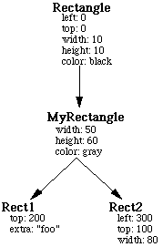
Prototype-Instance model
Available, but not frequently used in
JavaScript

Slide 36
JavaScript class and superclass, and dynamic setting
class x extends y {
constructor (a,b) { //class constructor
super(a); // call constructor of y (required)
this.b = b;
//other set up stuff
}
doSomething(a) { //overrides this method
super(a); // call y’s version of doSomething
// local stuff
}
Dynamic creating of new field:
  let myx = new x(4, 5);
  myx.newthing = 6; //creates and sets a new field in myx
  …
  let p = myx.newthing + 12; //somewhere else can use it

