Slide 1
Lecture 5: What is "User Interface Software", Overview of UI Software and Tools
05-431/631 Software Structures for User Interfaces (SSUI)
Fall, 2022

Slide 2
Logistics
Homework 1 due today!
Late policy: https://www.cs.cmu.edu/~bam/uicourse/05631fall2022/homeworks.html#latepolicy
Homework 2 is posted, due in 2 weeks: 9/27/2022
https://www.cs.cmu.edu/~bam/uicourse/05631fall2022/HW2/index.html

Slide 3
What does UI Software encompass?
“User Interface Software”
All the software that implements the user interface
“User Interface” = The part of an application that a person (user) can see or interact with (look + feel)
Often distinguished from the “functionality” (back-end) implementation
Some ambiguity if a tool is specifically for “UI” part
User Interface Software Tools
Ways to help programmers create user interface software
Tools used by UI Designers and UI Builders

Slide 4
Names
Tools = UI Frameworks, Toolkits, Development Kits = SDK, Libraries
UI APIs = Application Programming Interfaces (APIs)
Old names = User Interface Management Systems (UIMS), User Interface Development Environments (UIDE)
Micro-Service Architecture for web UIs
Also interactive tools: Resource Editors, Interface Builders, Prototypers, UI Builders

Slide 5
Examples of UI Software Tools
We created a list in 2017 = https://docs.google.com/document/d/1qeBkQaoIBmwK9Z7LmWP4L_4GKgddzNn7YmvSQuPukGo
Over 100!
Lots of new ones that should be added
APIs for UI development:
JavaScript/Web: ReactJS, Vue, AngularJS
Apple Cocoa, Carbon
Microsoft Foundation Classes, .Net, wx-Python
Java AWT, Swing, Android UI classes
Interactive tools
Visual Basic .Net
Adobe Flash, Adobe Catalyst
Prototypers like Axure, Balsamiq, Adobe XD
Research systems:
Garnet
Amulet
ConstraintJS
InterState

Slide 6
Why is This Important?
Virtually all UIs are created using such Tools
Previous research has influenced today’s tools
Enormous impact!
New tools are created all the time
E.g., Flutter for Dart language and mobile
Some are easier to use than others!
Principles and architectures for good designs
Avoid “reinventing the wheel”
What are the “best practices” for these tools
Modern UIs and Tools for web, phones, wearables, Smart TVs, etc. all use similar designs
Speech and conversational interfaces are different
Research topic in ACM UIST, CHI
Also ICSE, SPLASH, PLATEAU, CHASE, many others

Slide 7
Analogy with OS or Compilers
In CS curriculums, often teach Operating Systems, Compilers, Networking
Even though most people will just use these
Useful to know the key principles
Lasts longer than the specifics of one current tool
Some people will need to know how to build the next generation of tools
The algorithms, architectures, design patterns, and principles are useful in other situations as well

Slide 8
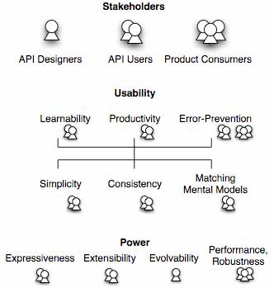
Stakeholders
Many groups of people
Need unambiguous names
Too many “users”
Tool Designers
Tool Users (are programmers)
Users of products created with the tools = consumers or end-users
Source: Jeffrey Stylos and Brad Myers, "Mapping the Space of API Design Decisions," 2007 IEEE Symposium on Visual Languages and Human-Centric Computing, VL/HCC'07. Sept 23-27, 2007, Coeur d'Alene, Idaho. pp. 50-57. pdf

Slide 9
Who Are Developers?
Programming tools are not just used by highly-trained professional programmers
End-User Programmers = People whose primary job is not programming
In 2012 in USA at work: — [Scaffidi, Shaw and Myers 2005]
3 million professional programmers
6 million scientists & engineers
13 million will describe themselves as programmers
55 million will use spreadsheets or databases at work
90 million computer users at work in US
All these may be the tool users!

Slide 10


UI Runtime Pipeline
Hardware Sensor
Device Driver
OS
Toolkit
input
Syntactic feedback /
View/controller
Application Code
output
Screen Driver
Device Driver
OS
Drawing Package
Toolkit

Slide 11

UI Runtime Pipeline w/ Browser
Browser
Html / canvas spec
Hardware Sensor
Device Driver
OS
Toolkit
Toolkits
input
Application Code
output
Toolkits
Screen Driver
Device Driver
OS
Drawing Package
Toolkit
Html / canvas spec

Slide 12
UI Tools stack
Interactive Tools (Builders, Prototypers) | Automatic Tools
UI Framework (Architecture, Objects)
UI Toolkit (library, programming interface)
OS / Windows Interface / Browser (Input and Output)
Device Drivers & Hardware
}
Optional

Slide 13
From the bottom: Windows & OS
Window System + Operating System
Microsoft Windows, MacOS, Android, iOS, etc.
Unix & older OS’s separated OS, Windows
SunOS: X Windows or NeWS or SunTools
Or the equivalent provided by the browser’s “OS”
Low level input events – keycodes, mouse position, values from accelerometers
Low level graphics primitives
Draw Circle, Draw Line, set pixel color
Called “Imaging Model”
Clipped to window boundaries

Slide 14
UI Toolkits
(Specific meaning, one part of the tool set)
A library of UI widgets that application programs can use
Only a programming interface
Provides higher-level “widgets”
Also called “controls”
Scroll bars, buttons, text input fields
Examples:
Html “input”
Java Swing, SWT, AWT
Win32, Macintosh “toolbox”

Slide 15
UI Frameworks
Higher-level programming architecture
Generally all-encompassing – controls all of the ways apps are built
Supports common design patterns
Listener pattern, data bindings, etc.
Significantly affects design of applications
Often object-oriented
“Foundation Classes”
Often cross-platform (iOS + Android)
React native, Flutter, Microsoft’s Xamarin, Titanium, …
Electron (https://electronjs.org/): cross-platform toolkit for desktop apps
Sometimes hard to distinguish from “toolkits”
(So we usually won’t!)
Note: React says it is a “library” and not a “framework”, but provides React.Component and other classes from which developers should inherit
Other Examples:
Historical: Apple MacApp (invented in 1986), my Amulet
Current: Unity, AngularJS

Slide 16
Historical Notes
OO
Early toolkits and Frameworks invented their own object systems
Before C++ was widely used
Look and Feel
Early UI Toolkits and Frameworks tried not to enforce a look-and-feel
Microsoft DOS
Unix and “X window system” (1986) originally
“…the system must provide hooks (mechanism) rather than religion (policy).” [Scheifler, 1986]
“intrinsics” layer of the toolkit
How widgets would be built
Gave up on this approach as early as 1989
Windows, Mac, iOS, Android – quite constrained look and feel
Web – still pretty open, but built-in widgets (html “input”) standardized

Slide 17
APIs
Application Programming Interface (API)
“the collection of software utilized without change to create other software”
Covers both UI Toolkits and UI Frameworks
Plus all the other libraries programmers need to use

Slide 18
Interactive Tools
Not a programming interface
Supports designers who might not be programmers
Select widgets and place them
Layout, possibly with constraints
Specify properties of widgets
Two categories:
GUI Tools – create representations used by the real code
Often built into IDEs
Prototypers – just to work out look and feel, and must be re-implemented
Examples:
Adobe Dreamweaver for web pages
Resource editors & builders: Eclipse, Xcode IB, Android studio, Microsoft Visual Basic IDE
Prototypers: Figma, Balsamiq, Axure, etc.

Slide 19
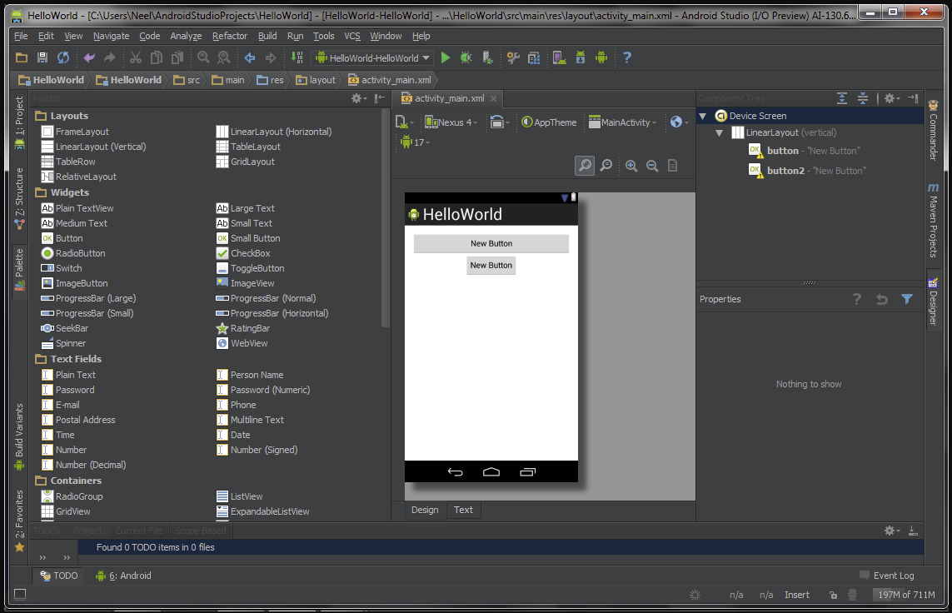
Android Studio Builder
https://stacktips.com/tutorials/android/android-studio-features/attachment/android-studio-viewing-layout_builder

Slide 20
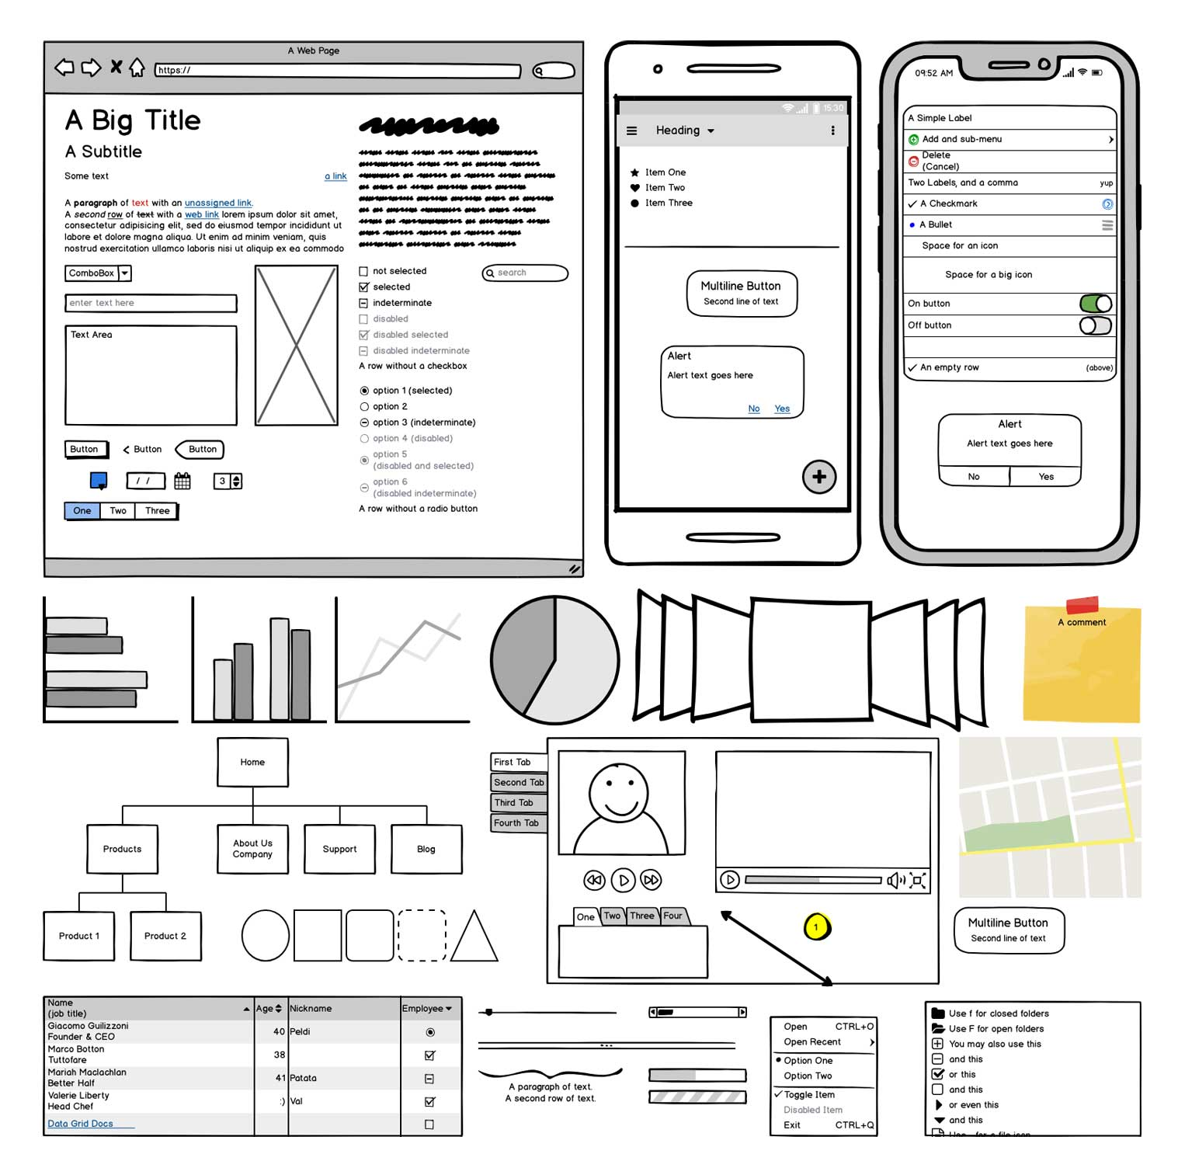
Balsamiq
https://balsamiq.com/wireframes/

Slide 21
Automatic Tools
Take a high-level specification of the UI
Use algorithms to decide on such features as which specific widgets to use, the layout of where the widgets should go, and properties of the widgets
Often AI-based
Sometimes called “model-based design”
Many research examples; few commercial successes
Html “decides” on layout but not AI based, so doesn’t really “count”

Slide 22
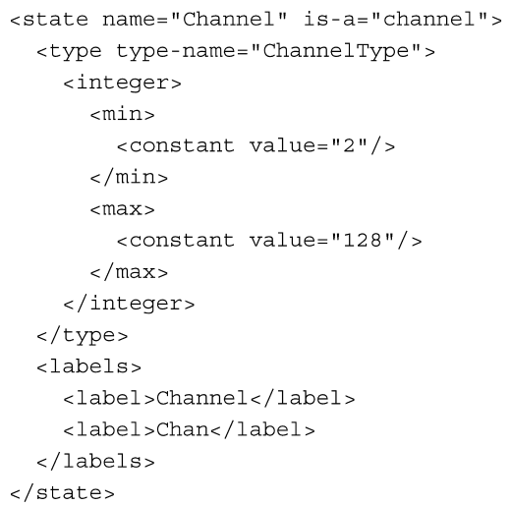
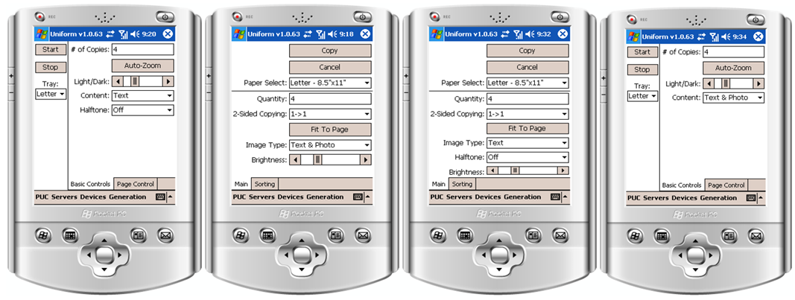
Research Example
Jeff Nichols’ PhD system PUC took high-level spec in XML of a consumer electronics device and created personalized UI on a portable device
Jeffrey Nichols and Brad A. Myers. "Creating a Lightweight User Interface Description Language: An Overview and Analysis of the Personal Universal Controller Project". ACM Transactions on Computer-Human Interaction,. Vol. 16, no. 4, (November 2009). pp. 1-37. ACM DL

