Slide 1
Lecture 21: Interactive Tools: Prototypers (HyperCard, Director, Visual Basic, Balsamiq), Interface Builders, and Sketching Tools
05-431/631 Software Structures for User Interfaces (SSUI)
Fall, 2021

Slide 2
Logistics
HW6 due next Thursday, 11/18/2021, but need to work on arranging the final projects in parallel
Initial project ideas are due TOMORROW
Lots of ideas here: https://www.cs.cmu.edu/~bam/uicourse/05631fall2021/FinalProject/index.html
Enter proposals into Piazza before Friday, 11/12/2021 at 3:05pm (in parallel with working on HW6)
Try to form groups around the projects on Piazza
We will finalize groups on Thursday, 11/16 in class, so you can get started right away (when finished with HW6)

Slide 3
Interactive Tools (review from Lecture 8)
Not a programming interface
Supports designers who might not be programmers
Select widgets and place them
Layout, possibly with constraints
Specify properties of widgets
Two categories:
GUI Tools – create representations used by the real code
Often built into IDEs
Prototypers – just to work out look and feel, and must be re-implemented
Examples:
Adobe Dreamweaver for web pages
Resource editors & builders: Eclipse, Xcode IB, Android studio, Microsoft Visual Basic IDE
Prototypers: Balsamiq, Axure, etc.

Slide 4
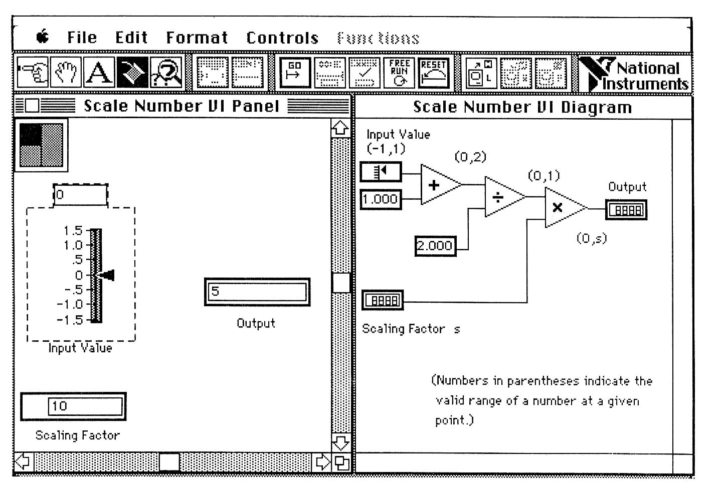
Definition, cont.
Tools that use graphical techniques to specify UI
Usually focus on graphical parts of UI
Not same as “visual” or “graphical programming”
Use graphics for the code

Slide 5
Interface Builders (IB)
Also called Interface Development Tools (IDTs) or GUI Builders or “Resource Editors” or “Form Editors”
First = ResEdit on original Macintosh (1984)
Lay out widgets to make dialog boxes, menus.
Have a palette or menu of kinds of widgets
Select widget, place with mouse in a window
Set some properties
Design menus, palettes, dialog boxes, controls
Put in “graphics” pane for main application window
Easy to use, but limited
Connect call-backs with each widget
Generates C code directly or intermediate language
Sometimes connected to an interpreter so can execute call-backs.
If not, some call-backs can be simulated, e.g., transition to another window; pop-up error

Slide 6
Interface Builders, cont.
Layout mechanisms
See lectures 10 (Geometry Management) and 17 (Constraints)
Usually a complication
X's row and columns stuff
Galaxy's struts and springs
Java’s Layout Managers
“Resources” (lecture 10)
store information in special files rather than in source code
positions, colors, text labels, etc.
allow for easier modification for users, internationalization, etc.
IBs Usually don't support:
Error checking of values, e.g. for text input fields
Graying of widgets depending on values and other widgets
Default values of widgets
Dynamic changing of widgets (e.g., add more items)
Dynamic changing layers (groups) of widgets (visibility) depending on values and other widgets
Any dynamically created graphical objects.

Slide 7
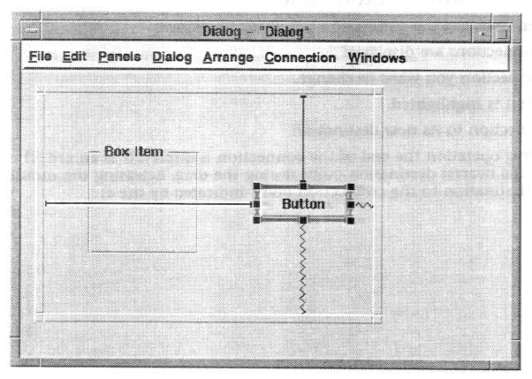
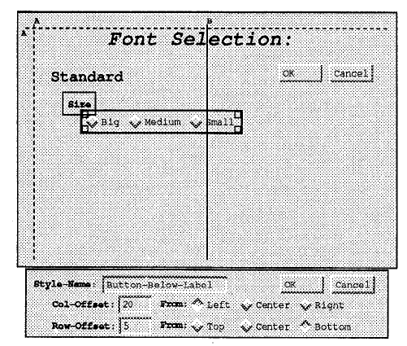
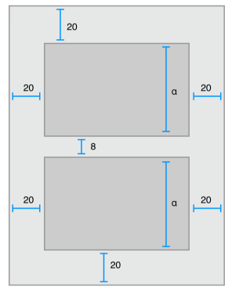
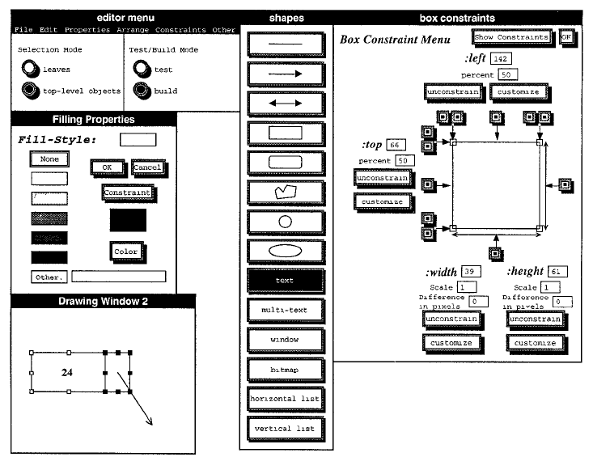
Examples from previous lectures
Struts and springs
Gilt’s graphical tabs
iOS Auto Layout
Lapidary constraints

Slide 8
Interface Builders, cont.
Examples:
See “Card” systems, e.g., Menulay (1983-research system)
NeXT Interface Builder (NeXT) - 1988 popularized the name
By Jean-Marie Hullot who had an IB in Lisp at INRIA in France
Started in 1984, finished in 1986, used a Macintosh
Key innovation – binding between UI and source code
Visual Basic
First released in 1991 on Windows 3.0
Originally for End-User Development (lecture 23) but gave up in 2002
Resource editors in programming environments
Used to be lots of IB products
Used to be many commercial tools are in this category; over 100
See my old list (1997): http://www.cs.cmu.edu/~bam/toolnames.html
Most went out of business
Microsoft, MetroWorks, etc. include “resource editors” for “free”

Slide 9
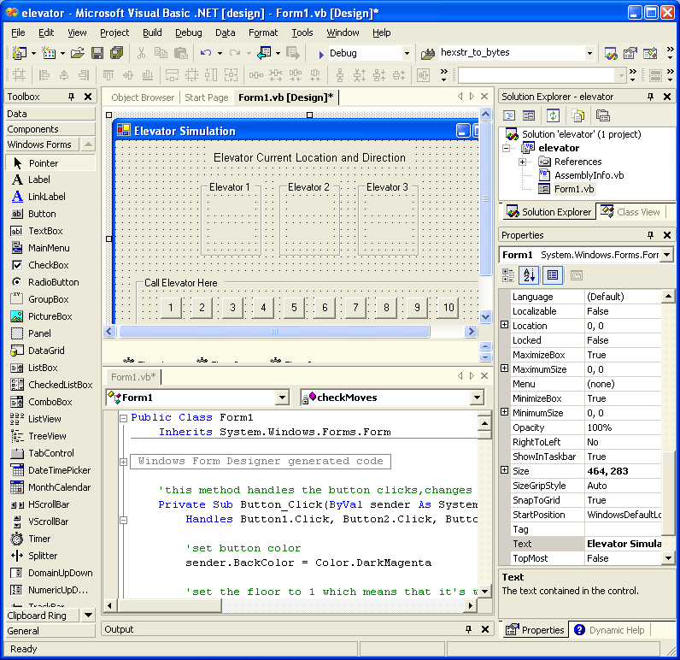
VB Screen

Slide 10
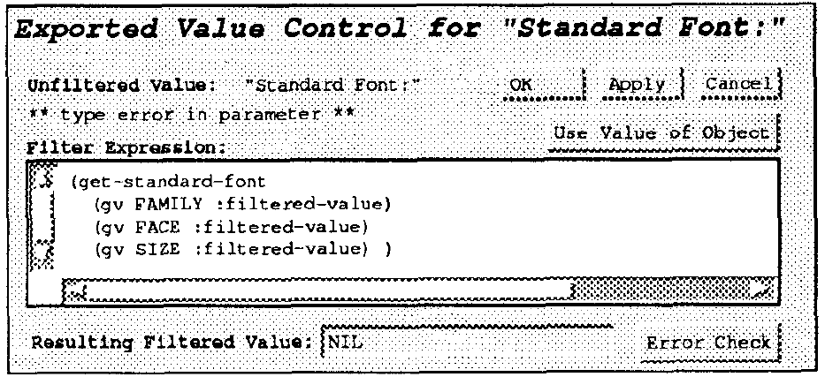
Some Research in IB
Garnet’s GILT interface builder:
Eliminating Call-backs (UIST’91)
http://doi.acm.org/10.1145/120782.120805 or video (5min) or video of both (9 min)
Handles error checking, data transformations, connections of widgets to each other

Slide 11
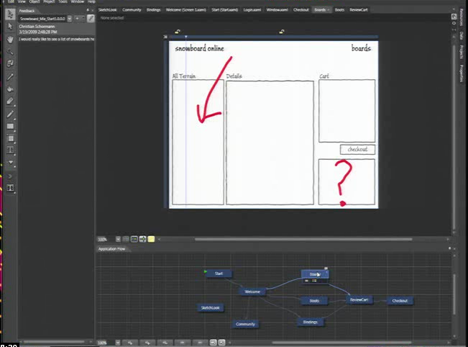
Microsoft’s Expression Blend
Microsoft Silverlight Blend’s SketchFlow
http://channel9.msdn.com/Events/MIX/MIX09/C01F (1 hour video)
2006-2012
Behaviors, etc. as well
Landay says this has “sketching” (see 3/19/09 blog)
Now discontinued
Some features put into Visual Studio

Slide 12
Prototyping Tools
Just show what looks like
Storyboard of screens
“Wireframing tools”, “Click-through prototypes”
Note: differentiate from term "rapid prototyping“
Some support for behavior: typically changing screens
Like a movie of the interaction
Goal: see some of interface very quickly (hours)
Often no possibility of migrating to real application
May not use "real" widgets
"Low Fidelity" Techniques

Slide 13
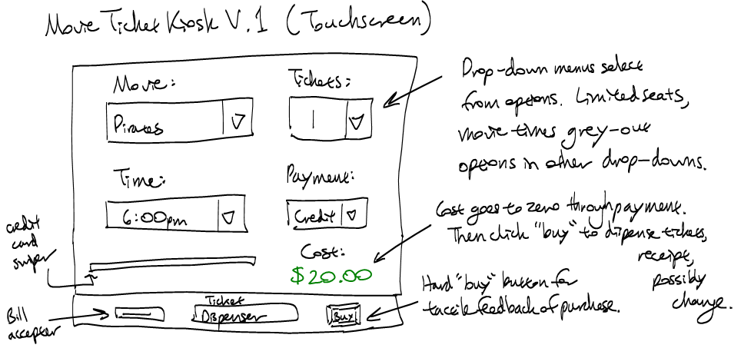
Low Fidelity Prototyping
Just use paper and/or overheads
No tools
Experimenter "plays computer"
Ask the user "what would you do now“
Experimenter shows the computer's expected response
Very cheap and easy and gets surprisingly good results
Find out if users understand organization, how to find desired operations, if understand menu names, etc.
Easy to change between sessions
Can make a movie of the paper using a regular video camera
To demonstrate/explain the interface

Slide 14
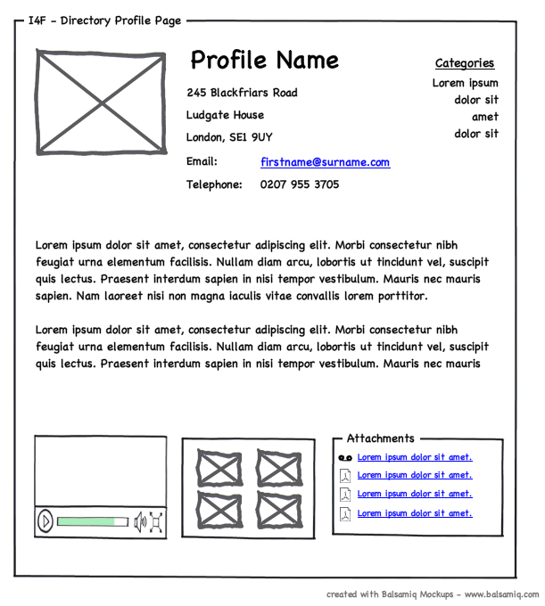
Low Fidelity Examples
“Wireframes” since often just draw the outlines

Slide 15
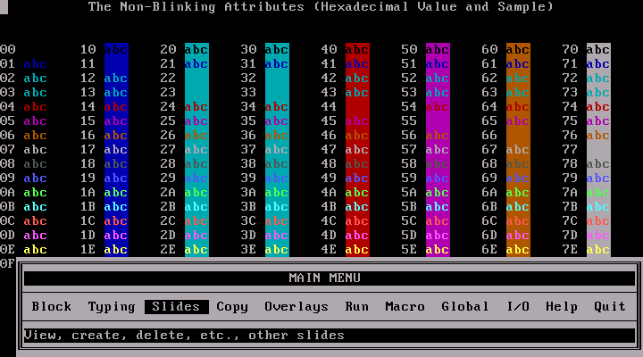
Early Prototypers
For Character Screens
24x80 DOS, often no mouse (like terminal / console)
Especially for forms-based applications
Examples: Dan Bricklin’s Demo-It (Windows v2.0 ~1987), Protoscreens for PCs from Bailey&Bailey (~1990)
Specify characters for each position of screen, or a "character graphics"
Can specify fields that are editable text
Can specify that clicking on an area cause changing to a new screen.
Also menus

Slide 16
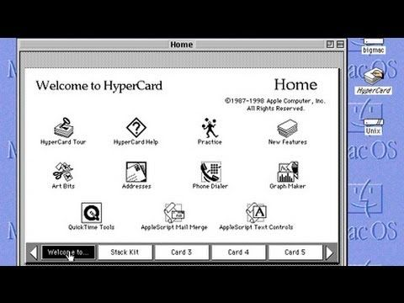
Card Programs as Prototypers
Card Programs
Examples:
HyperCard (1987) and SuperCard for Mac
OWL's GUIDE for PCs (gone?)
Toolbook (formerly from Asymetrix then Click2Learn, then SumTotal Systems, Inc. http://www.toolbook.com , now EOL)
Sequence of cards
Click-through prototypes
Paint program (not "draw")
Draw pictures on each card
May be multiple layers

Slide 17
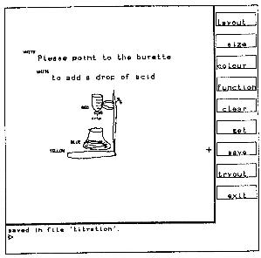
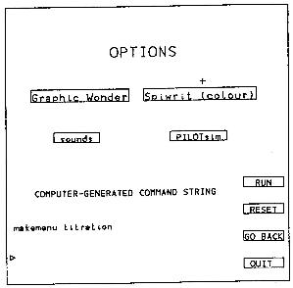
Early Research Card Systems
Menulay
Buxton, Siggraph’83 pp. 31-38
http://www.billbuxton.com/menulay.pdf
http://www.youtube.com/watch?v=Kt0oAg0haU0
vector screens, widgets, sounds, text, output C code and tables
All actions (including transitions) required C programming

Slide 18
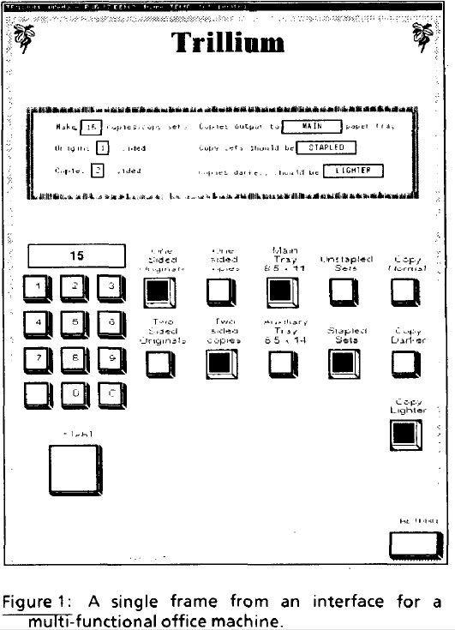
Early Research Card Systems, cont.
Trillium
Henderson, CHI’86
http://doi.acm.org/10.1145/22339.22375
Xerox copier interfaces
Interpreted Lisp
Transitions defined using the interface

Slide 19
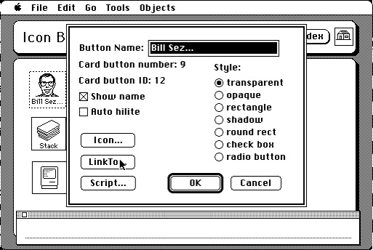
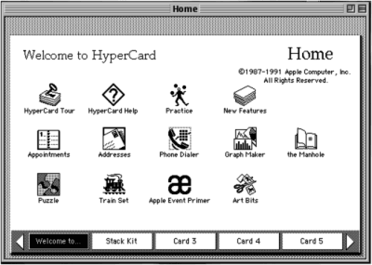
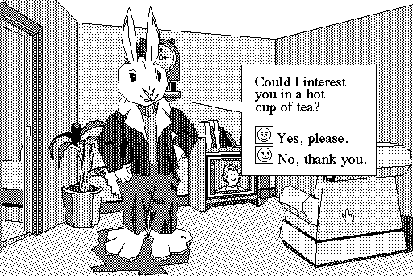
HyperCard
1987 – 2004

Slide 20
HyperCard, details
Goal: programming for everyone
Buttons can transition to another card
Fancy transitions
Single window
Buttons can start running a script ("HyperTalk")
Script can move objects, change cards, animate, compute, etc.
Code management: who changes what; finding the script
Not good for dynamically created graphics
Complete control of individual pixels
Graphic designers have complete control
Design new widgets
Can be "real" application if sufficient power/speed
Used for original Myst game, etc.
See also Lecture 19 on EUP

Slide 21
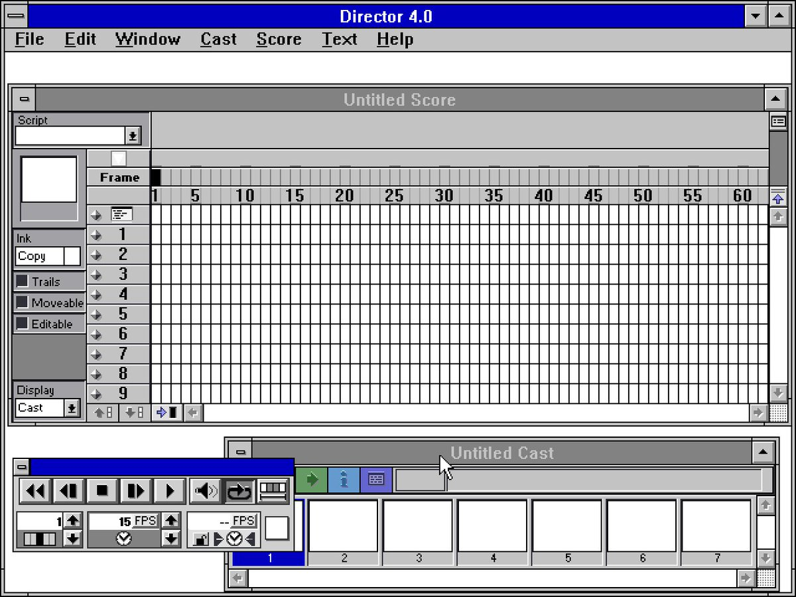
Animation Programs
Example: MacroMedia’s Director (1987) – now Adobe
Replaced (pretty much) by Adobe Flash, now html
Discontinued January 27, 2017
Also control individual pixels
Individual paintings can be specified as animation element
E.g., characters
Each can be instantiated, moved, etc.
Good control over timing, synchronization
Scripting language
Can program that when a mouse button is clicked in an area, start an animation or transition
Scripting language even more primitive than HyperTalk
Good for "Future Scenarios“ when want good fidelity with real look
Not for final (real) interface unless Multi-media

Slide 22
Commercial Prototypers
Search for “Prototyping tools” or “Wireframing Tools”
Here are some lists:
2021: https://www.uxbooth.com/articles/10-best-prototyping-tools-for-ux-designers-in-2021/
2018: https://medium.theuxblog.com/11-best-prototyping-tools-for-ui-ux-designers-how-to-choose-the-right-one-c5dc69720c47

Slide 23
Examples:
Adobe XD
New, free and quite powerful
Axure (downloaded)
InVision
Sketch (Mac only)
On-line tools
Figma – good collaboration features (also downloadable)
Balsamiq (http://www.balsamiq.com/)
Just in Mind
Protopie https://www.protopie.io/
….many others!

Slide 24
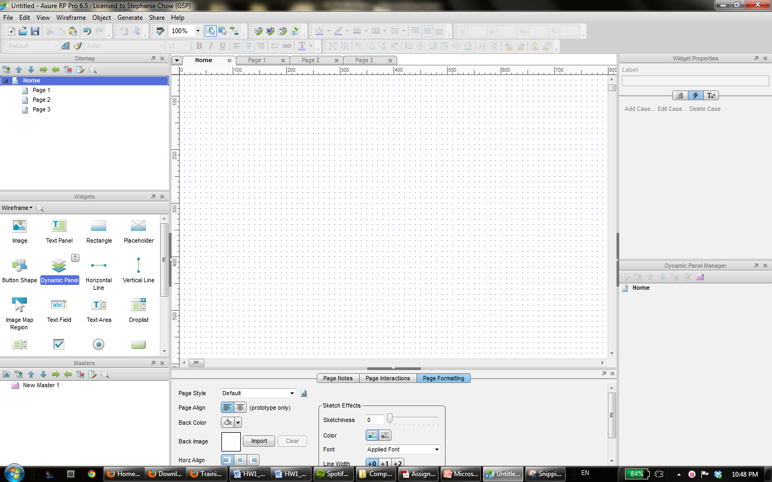
Axure
Drag and drop widgets onto your page

Slide 25

Adobe XD
Pull in components from palette
Lots of provided elements
Mimic any screen
Supports “design systems” if have company-specific requirements
Create “art boards” for each screen
Can keep track of previous versions, or options
“Repeat Grid”
Very clever feature for lists, etc.
Can pull out as many as desired
Drag-and-drop lists of text/images, etc. onto grid

Slide 26
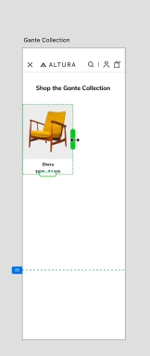
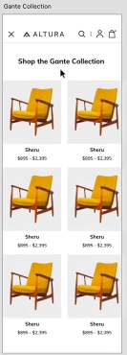
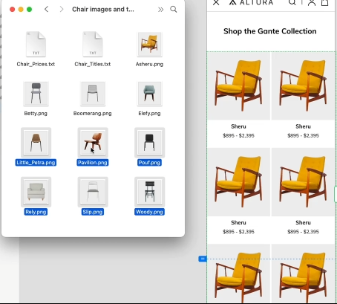
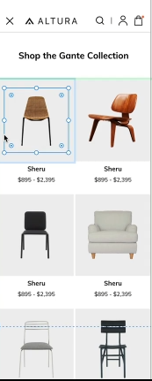
Adobe XD Repeat Grid
Source: https://www.adobe.com/products/xd/learn/get-started.html

Slide 27
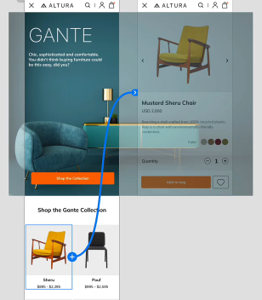
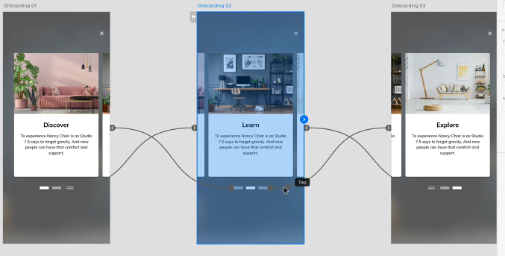
Adobe XD Interactions
Click-throughs by wiring click points to other “art boards”
Can trigger on tap or other events
Transition effects including animations, timing
Or wire to “previous artboard” or other
“Auto-animate” – copy and paste, edit new one
E.g., position, size, opacity, color…
Trigger on click, etc.

Slide 28




Adobe XD “Components”
(Also available in Axure, but not simpler tools like Balsamiq)
Create elements with internal behaviors that can reuse in multiple places
E.g., login/logout vs. cart on multiple web pages
E.g., can create custom button – change color, etc.
Prototype (“main”) and instances
Edit main and others change accordingly
Can override properties in instances will be retained

Slide 29
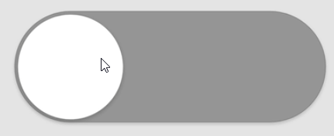
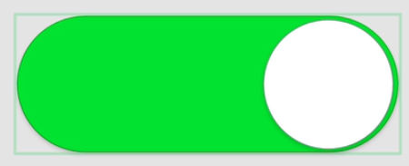

Adobe XD Component “states”
Can define different states for a component
E.g., hover state, toggle state, user-defined
Different property values in different states
Triggers can cause state change
Can animate between states
Reusable in all instances
Source: https://www.adobe.com/products/xd/learn/prototype/component-states/component-states-common-use-cases.html

Slide 30
Research in Informal Prototyping Tools
Sketching tools
Use before interface builders
Designed to help support the ideation phase
Menulay (saw earlier)
James Landay’s SILK tool
Infer formal widgets and widget groupings from sketches
Convert to real widgets
Sketch storyboards for transitions

Slide 31
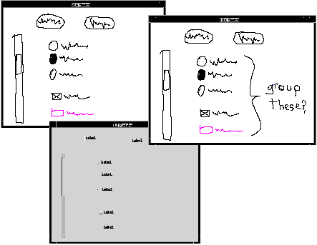
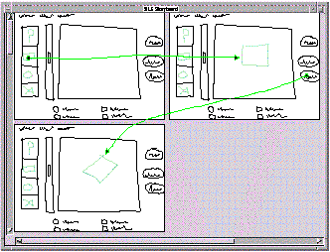
Research in Informal Tools
Silk main paper: http://doi.acm.org/10.1145/223904.223910
Video from CHI’96 (8:22 min)

Slide 32
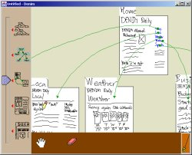
Landay’s later tool: Denim
Denim and its video

