Slide 1
Lecture 20: Toolkits for building speech/conversational/chatbot User Interfaces, and Visualizations
05-431/631 Software Structures for User Interfaces (SSUI)
Fall, 2021

Slide 2
Logistics
Changed lecture order because speech or viz might be a topic for final projects

Slide 3
Based on: Toolkits for Creating Conversational Interfaces by Toby Jia-Jun Li http://toby.li/ 04/20/2020

Slide 4
Conversational Interfaces
Intelligent personal assistants Alexa, Siri, Google Assistant, Cortana…
Voice command support for specific task domains e.g., Talking to your car
Automated phone systems for customer service
Chatbots for tech support or fun
Notes:
We also have chatbots for fun, who can engage in social conversation, or “chit-chat” with users

Slide 5
History
Turing Test (1950)
Notes:
Supporting natural language interactions between users and computers have been historically one of the most important topic in computer science an AI research. “the turing test”, proposed by Alan Turing in 1950, is considered an ultimate goal for artificial intelligence. If the evaluator cannot reliably tell the machine from the human (Turing originally suggested that the machine would convince a human 30% of the time after five minutes of conversation[3]), the machine is said to have passed the test.

Slide 6
History
Let computers facilitate formulative thinking as they now facilitate the solution of formulated problems
Enable men and computers to cooperate in making decisions and controlling complex situations without inflexible dependence on predetermined programs.
“Man-Computer Symbiosis (1960): Cooperative interaction between men and electronic computers”
J. C. R. Licklider
Notes:
Besides turing test, the natural language interaction plays an important role in another foundational visionary work in computer science and human-computer interaction. The idea of “man-computer-symbiosis” proposed by Licklider in 1960.
1. let computers facilitate formulative thinking as they now facilitate the solution of formulated problems
2. enable men and computers to cooperate in making decisions and controlling complex situations without inflexible dependence on predetermined programs.
In Licklider’s vision, in the anticipated symbiotic partnership, men will set the goals, formulate the hypotheses, determine the criteria, and perform the evaluations. Computing machines will do the routinizable work that must be done to prepare the way for insights and decisions in technical and scientific thinking
The basic dissimilarity between human languages and computer languages may be the most serious obstacle to true symbiosis.

Slide 7
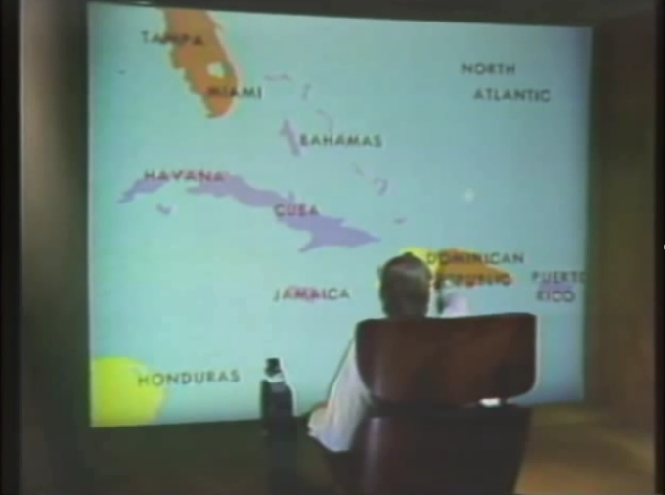
Lots of research and commercial attempts
Influential early multi-modal system: Put That There (1980)
Bolt, Richard A. “Put-that-there”: Voice and gesture at the graphics interface. SIGGRAPH Computer Graphics. Vol. 14. No. 3. ACM, 1980.
https://youtu.be/sC5Zg0fU2e8 (5:30)

Slide 8
Advantages of conversational interfaces
Hands-free: can handle situations where direct manipulation is not possible or convenient (e.g., far away, driving, users with accessibility needs)
Screen size independence: can operate on devices with small screens (e.g., wearable) and no screen.
Intuitive to use: well-designed conversational interfaces should have low learning barriers to users.
Efficient: takes less time and effort for *some tasks* that require a lot of text entry, or navigating complex menus.
Can be inefficient and hard-to-use in some situations too! E.g., when the prompts are too verbose, when the affordances are unclear (discoverability), or when the error handling mechanism is lacking.
Notes:
There are several important advantages of conversational interfaces compare with conventional graphical interfaces:
allows hands-free use, so users can use them in situations where direct manipulation is not possible or convinient. such as when your hands are occupied doing other things, when you are away from the device, or for users with vision or motor impairments
it also works on devices with small screens and no screen, such as smartwatches, smart speaker etc.
when well implemented, conversational interfaces should be intuitive to use. the goal is to enable users to talk naturally to the device, without having to learn much about “how does this work”.
it’s also efficient in some situations. this is especially true for tasks that require navigating multiple levels of GUI menus. (starbucks example), or in Adobe Photoshop, if i want to apply a specific filter, that requires many clicks to find the filter in the menu and set the parameters too.
There are also some potential pitfalls — first, most people can “read” an interface much faster than hearing the prompt of a voice interface. Users also cannot easily skim through or skip some parts of voice prompts. So for voice interfaces like Alexa, when the prompt is too long, that will be very frustrating to the users.
Also, it’s harder for users to discover all the affordances in a voice interface. Unlike graphical interfaces, where the users can see all the widgets, and in most cases, know how to interact with them to invoke the underlying functionalities. The users of conversational interfaces often don’t know what functionalities the interface provide, and what commands to use to trigger them. There was a prior study of Alexa users, many of them just tried a bunch of commands at the beginning, figured out a small subset of things that work reliability well such as setting alarms and playing musics, and stick with them. Although many new functionalities have been added to Alexa in the years, they are not aware of them till when, for example, they see their other friends using them.
Another challenge is error handling, many of the existing systems don’t have good mechanisms for error recovery. When the user says something they don’t understand, they usually just say “I don’t understand” or perform a generic fallback action, such as doing a web search without providing any help to the user for repairing the error,

Slide 9
Two classes of conversational systems
Task-oriented conversational agents
Purpose: help the user perform some specific tasks
Social chatbots (“chit-chat” bots)
Purpose: maintain realistic conversations with humans
Notes:
There are two classes of conversational systems, ….., we will mostly focus on task-oriented conversational agents today

Slide 10
Practical architectures for task-oriented dialog systems
RavenClaw (Bohus and Rudnicky, 2003)
Bohus, Dan, and Alexander I. Rudnicky. "RavenClaw: Dialog management using hierarchical task decomposition and an expectation agenda." Eighth European Conference on Speech Communication and Technology. 2003.
Notes:
This is a typical architecture for task oriented dialog system > This figure is from a system called RavenClaw, which was developed here at CMU. But most current task oriented dialog systems use a similar architecture .

Slide 11
Practical architectures for task-oriented dialog systems
Finite-state
The developer manually defines all the conversation states in the system, and the transitions between the states.
Frame-based
frame (“intent”): the user’s intention for one conversation turn (e.g., book_flight)
slot: the information that the system needs to know to fulfill an intent (e.g., departure_date, destination_city)
slot values: the values that each slot can take
Notes:
For the dialog management part, there are two main types of practical architectures. There are a few more less-practical ones for task-oriented systems, I’ll talk about those later if we had time.
Finite-state
Frame-based - the most popular one at this moment. it’s organized around a collection of frames, also known as intents. Each represents the user’s intention for one conversation turn
Slot: each intent can have some slots, those are information needed for the system to fulfill an intent. For example…
Slot value: each slot may have a set of possible slot values: the values that each slot can take -> for example, destination city can take a city from a list of all the cities, the departutre_date can take a date value.

Slide 12
User: I want to book a flight for 2 to Munich.
bookFlight
bookHotel
bookCar
confirm Booking
Notes:
Let me explain the slot-filling process using a simplified travel booking bot as an example. Suppose we have a bot whose supported intents are shown above. The user says “I want to book a flight for 2 to Munich”.

Slide 13
User: I want to book a flight for 2 to Munich.
bookFlight
Intent recognition
bookHotel
bookCar
confirm Booking
Intent: bookFlight Slots: departureCity, arrivalCity, personCount, date
Notes:
An intent recognizer will first recognize this user’s intent as “bookFlight”, which has four slots

Slide 14
User: I want to book a flight for 2 to Munich.
bookFlight
Entity extraction / slot filling
bookHotel
bookCar
confirm Booking
Intent: bookFlight Slots: departureCity, arrivalCity, personCount, date
Notes:
And then an entity extractor can extract the arrivalCity and the number of people mentioned in the utterance and fill them into the corresponding slots

Slide 15
User: I want to book a flight for 2 to Munich.
Bot: What city are you flying from?
User: Pittsburgh.
bookFlight
bookHotel
bookCar
confirm Booking
Intent: bookFlight Slots: departureCity, arrivalCity, personCount, date
Notes:
There are two more slots, “departureCity” and “date” whose values need to be provided for this intent. So the bot will use the developer-defined prompts for these two slots to ask users.

Slide 16
User: I want to book a flight for 2 to Munich.
Bot: What city are you flying from?
User: Pittsburgh.
bookFlight
bookHotel
bookCar
confirm Booking
Intent: bookFlight Slots: departureCity, arrivalCity, personCount, date

Slide 17
User: I want to book a flight for 2 to Munich.
Bot: What city are you flying from?
User: Pittsburgh.
Bot: What’s the departure date for the flight?
User: Tomorrow.
bookFlight
bookHotel
bookCar
confirm Booking
Intent: bookFlight Slots: departureCity, arrivalCity, personCount, date
Notes:
Now we can see that all the required slots for the “bookFlight” intent has been filled.

Slide 18
User: I want to book a flight for 2 to Munich.
Bot: What city are you flying from?
User: Pittsburgh.
Bot: What’s the departure date for the flight?
User: Tomorrow.
Bot: Do you want to also book a hotel or a car?
User: I’d like to get a place to stay too.
bookFlight
bookHotel
bookCar
confirm Booking
Intent: bookHotel Slots: …..
Notes:
Then the bot needs to decide which next intent to go to. It asks the user a question, and detects the next intent “bookHotel” from the user response. This is a simplified example where we ignored many details. But it should give you an idea of how the slot-filling approach works.

Slide 19
Existing tools for building slot-filling bots
Notes:
There are many popular toolkits for building slot-filling bots, such as Google DialogFlow, wit.ai by Facebook, Microsoft Bot Framework, and Amazon Lex. Those tools are mostly similar, this is the general workflow of using those tools.

Slide 20
Dialogflow
One of the more popular toolkits
https://cloud.google.com/dialogflow/docs
Can easily connect to other Google components (e.g., speech recognition, speech synthesis, knowledge graph…)
Notes:
Let me use DialogFlow as an example, it’s one of the more popular toolkits developed by Google. Its major advantage is that it can easily connect to other Google services in a pipeline, such as speech recognition, speech synthesis, knowledge graph, entity recognition, back-end cloud database….
Dialogflow itself solves these parts in a conversational system. Speech recognition and speech synthesis are largely solved problem, which we can use as black boxes in most use cases.

Slide 21
Other architectures for dialog systems
Rule-based (if (contains (or “hi” “hello”)) (output “hello”)) (if (and (= detect_comm_type SELF_DISCLOSURE) (= detect_emotion SAD)) (output “I'm sorry to hear [$USER_DISCLOSURE]”))
Corpus-based: use a very large corpus of human-human or human-machine conversations
Information retrieval (IR) based approach: find the best-matched prior utterance for the user’s input in the corpus, and use the prior response for that utterance
Sequence-to-sequence dialog generation: model conversation as a sequence transduction problem -> generate a response from a user input (and probably with some other contexts encoded in)
Notes:
Here are some other architectures for dialog systems:
Rule-based systems operate on rules specified by developers —> used by early systems like ELIZA.
Q: what are some challenges and disadvantages of rule-based approach?
Q: what are some advantages of of corpus-based approach?
effort-consuming to build, hard to scale-up, don’t handle corner cases well.
Corpus-based: dialog systems that operate based on very large corpus of conversation log. The corpus can be extracted from existing sources, such as the corpus of billions of conversation turns from Twitter. There is also a movie dialog corpus made by researchers from Cornell that contain more than 200k conversational turns from 600 movies.
Q: what are some challenges and disadvantages of corpus-based approach?
Q: what are some advantages of of corpus-based approach?

Slide 22
Example: 05-830 project (Spring’20)
Use DialogFlow to create a GUI Builder
Thanks to Hongyi Zhang, Mengxin Cao, Ron Chew
1-month project

Slide 23
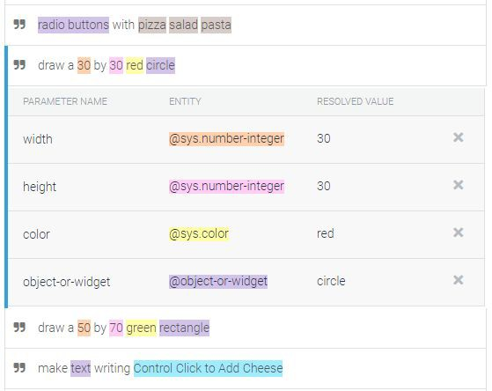
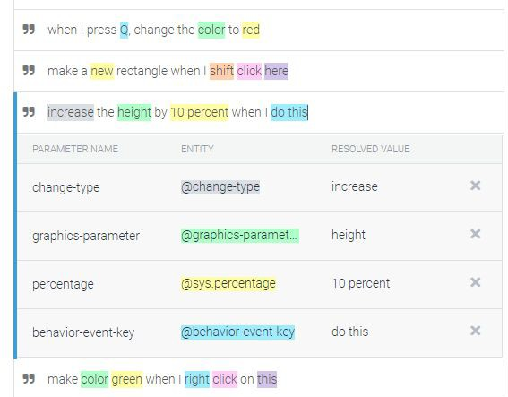
Conversation Design in DialogFlow
Two intents: Initialization, Interaction
Capability vs Complexity: What things do we need to specify via voice, or could we use a demonstration?

Slide 24
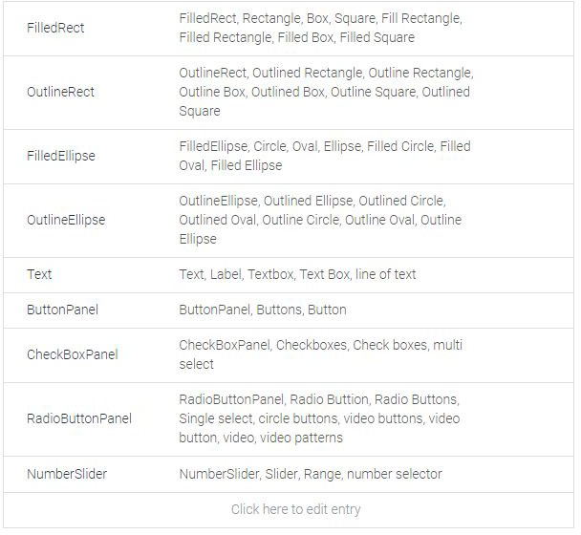
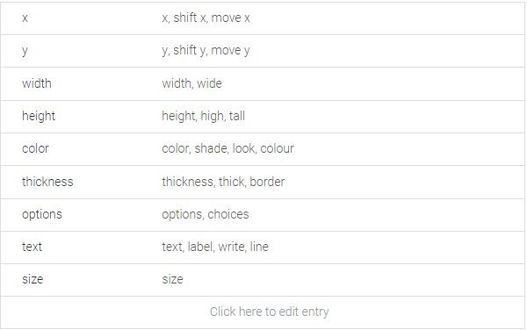
Conversation Design in DialogFlow
Everyone has a diﬀerent word for everything…
Provide synonyms

Slide 25
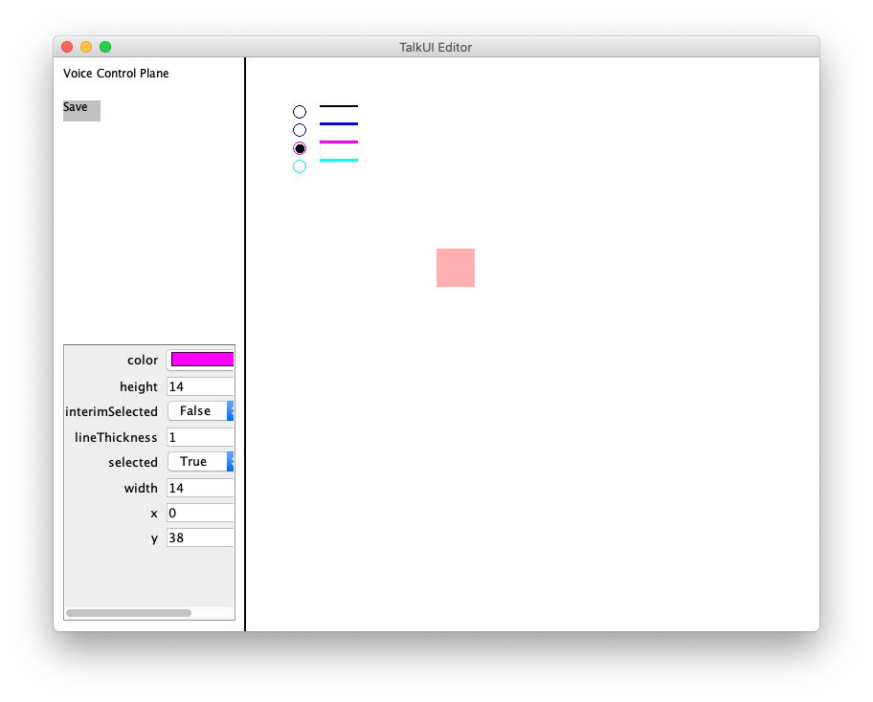
Interface Design
Features
Continuous voice monitoring
Voice control to interact with graphical objects
Dialog feedback in both audio and text
Property sheet that supports direct manipulation
Export existing canvas as a static picture
Property sheet of active object

Slide 26
Issues Encountered
DialogFlow Issues
Interface Issues
Speech-to-text is pretty crappy
Hardware heterogeneity
Background noise interference
Errors in text recognized from audio
Timeout for slow interaction
Property sheet not updated properly when integrated with our toolkit
Generic speech recognition service vs Google Assistant
Compounded by audio recording quality in Java
Cannot have too many parameters in one intent, but graphics need many
Possible Solution: multiple intents, but diﬃcult to manage
Current limitations
Doesn’t give response in ideally real time
Doesn’t properly deal with errors from user input and system internals
One way conversation, doesn’t support constraints and “natural” placement

Slide 27
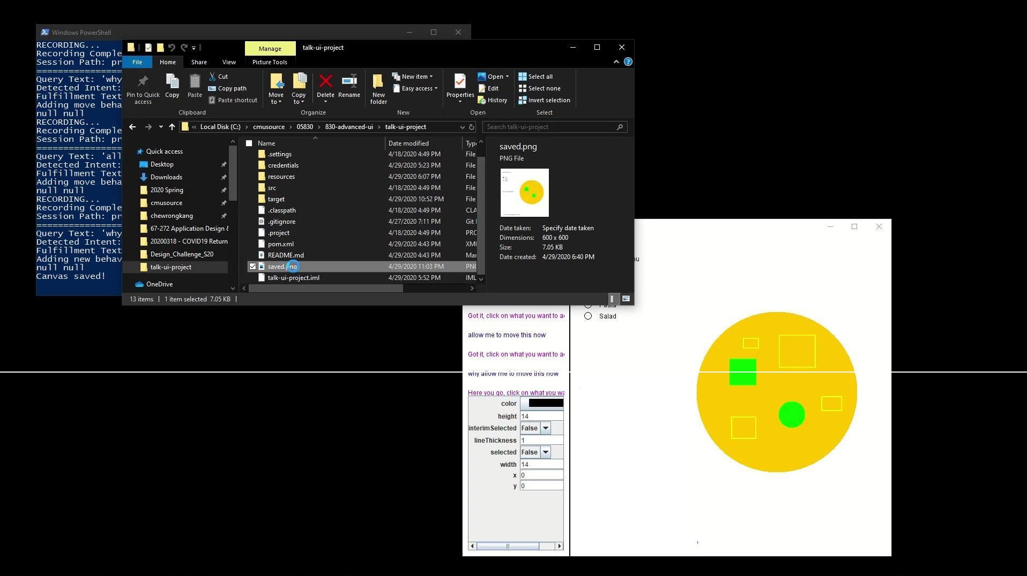
Video demo of result
Local video (4:28)

Slide 28

Based on: Toolkits for Visualization and UIs in Data Science by Dominik Moritz, April 8, 2020 https://dig.cmu.edu

Slide 29
Origins
Four major influences act on data analysis today:
The formal theories of statistics.
Accelerating developments in computers and display devices.
The challenge, in many fields, of more and ever larger bodies of data.
The emphasis on quantification in an ever wider variety of disciplines.
Data Analysis & Statistics. Turkey and Wilk. 1965.
Effective Data Visualization. Heer. 2015.

Slide 30
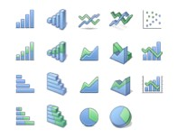
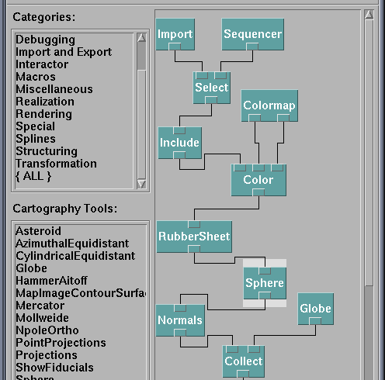
How do people create visualizations?
Chart Typology
Pick from a stock of templates
Easy-to-use but limited expressiveness Prohibits novel designs, new data types
Component Architecture
Permits more combinatorial possibilities Novel views require new operators, which requires software engineering

Slide 31
Drawing Visualizations with Imperative Programs
Graphics APIs: Processing, OpenGL, Java2D, JavaScript/html SVG and Canvas
Program by giving explicit steps. e.g.:
"Put a red bar here and a blue bar there."
"Draw a line and some text."
Specification and execution are intertwined.
"You have unlimited power on this canvas. You can literally move mountains." — Bob Ross
Value
A B

Slide 32
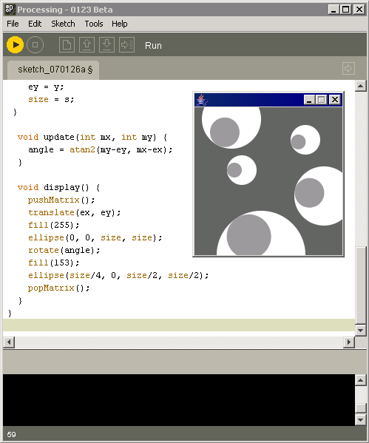
Example: processing. org

Slide 33

Component Architectures
Component Architectures on top of the graphics APIs
Examples: Prefuse, Flare, Improvise, VTK
Dataflow architecture – wire together nodes
Data
Visual Form
Task
Raw Data
Data Tables
Visual Structures
Interactive View
Data Transformations
Visual Encodings
View Transformations

Slide 34
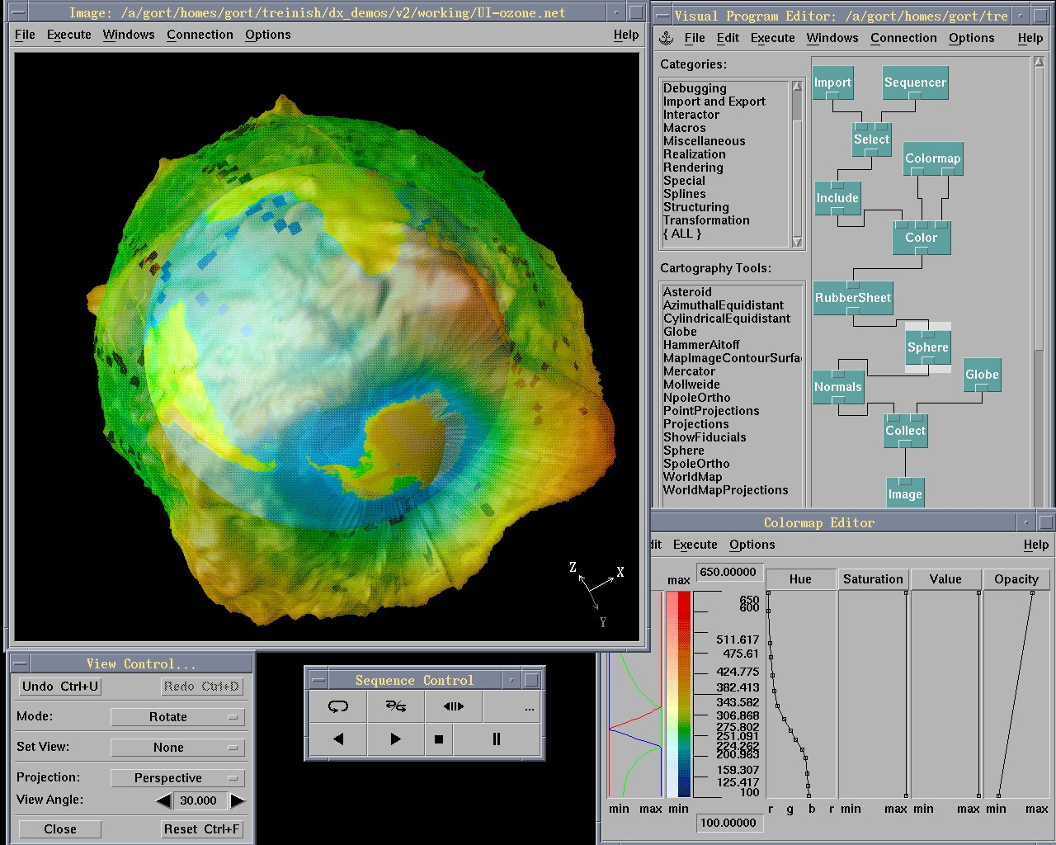

Slide 35
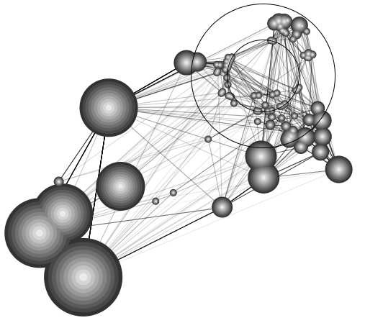
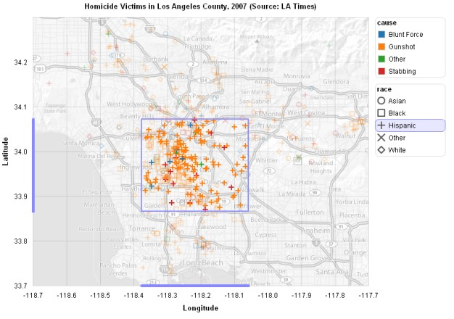
Prefuse & Flare
Operator-based toolkits for visualization design
Vis = (Input Data -> Visual Objects) + Operators
Prefuse (http://prefuse.org)
Flare (http://flare.prefuse.org)

Slide 36
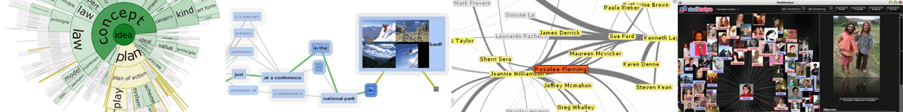
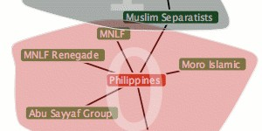
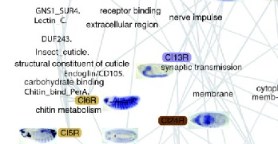
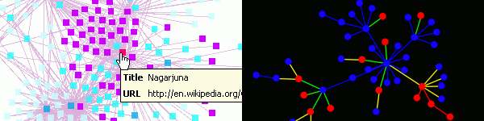
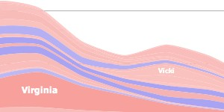
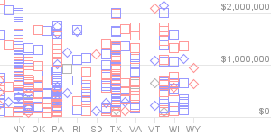
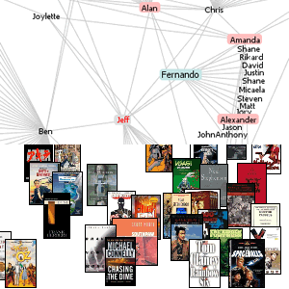
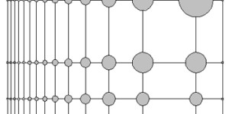
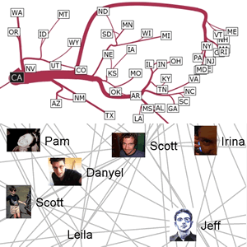
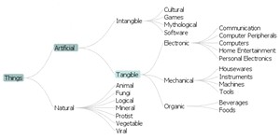
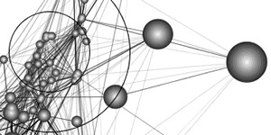
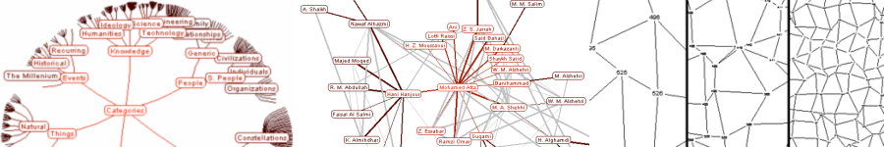
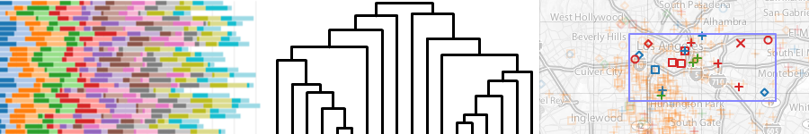

Panopoly of visualizations

Slide 37
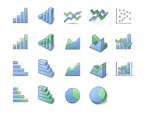
Other extreme: Chart Typologies
Excel, Many Eyes, Google Charts, Tableau

Slide 38
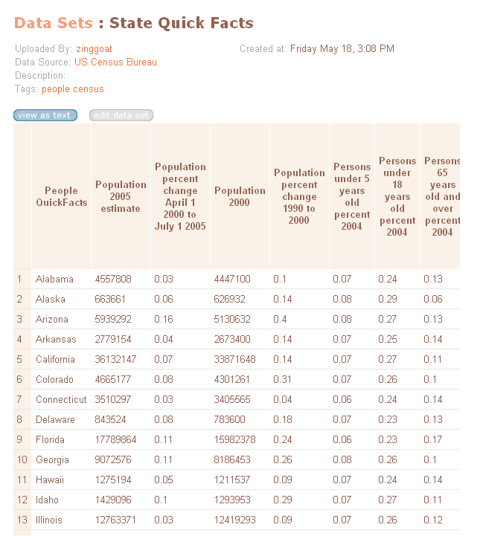
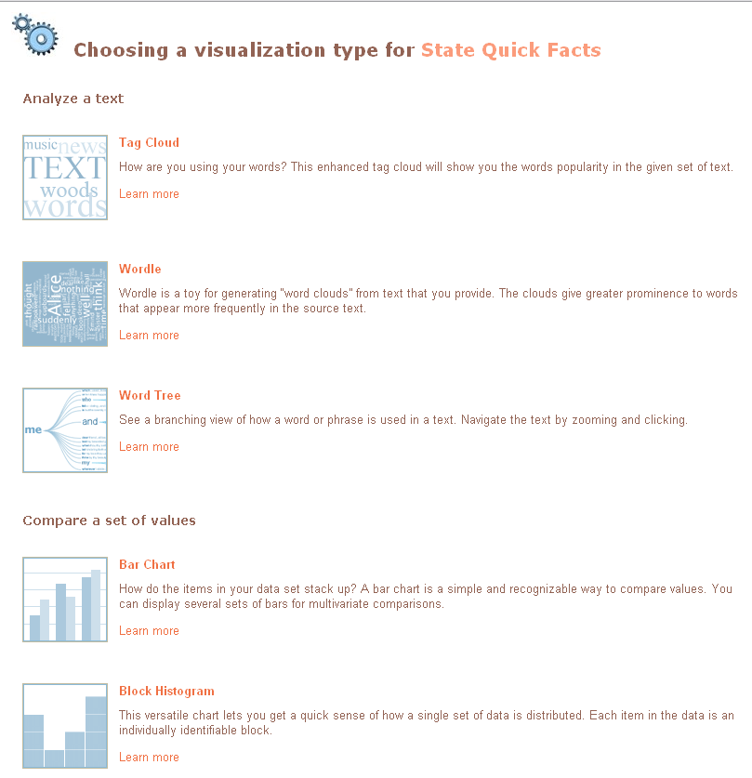
Select from Menus…

Slide 39
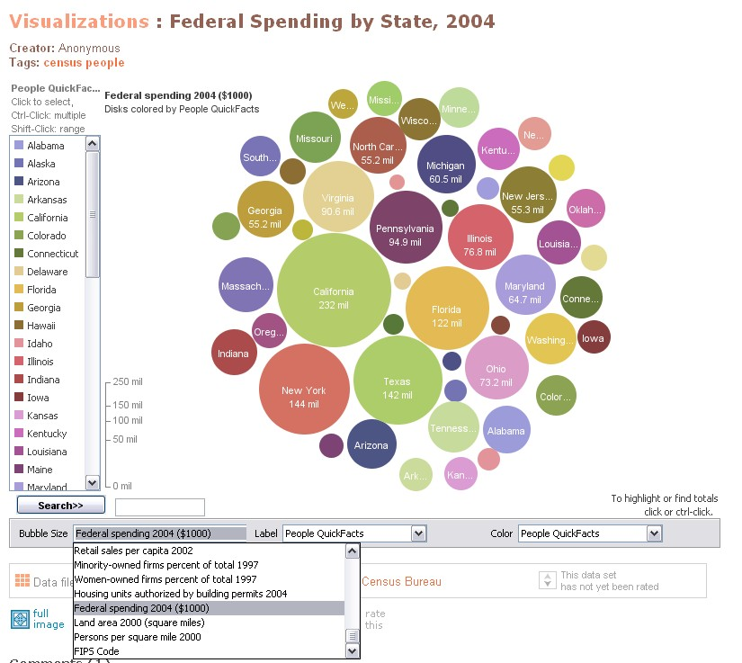
Results:
Inflexible
Can tinker after generated

Slide 40
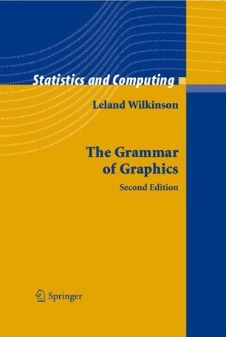
Visual Analysis Grammars
Examples: VizQL, ggplot2
Specialized programming language
Declarative – what to produce, not how (like html)

Slide 41
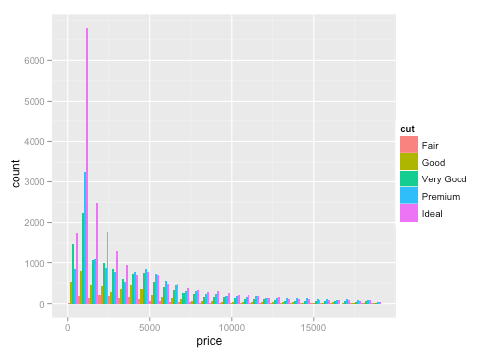
Grammar examples
ggplot(diamonds, aes(x=price, fill=cut)) + geom_bar(position="dodge")

Slide 42
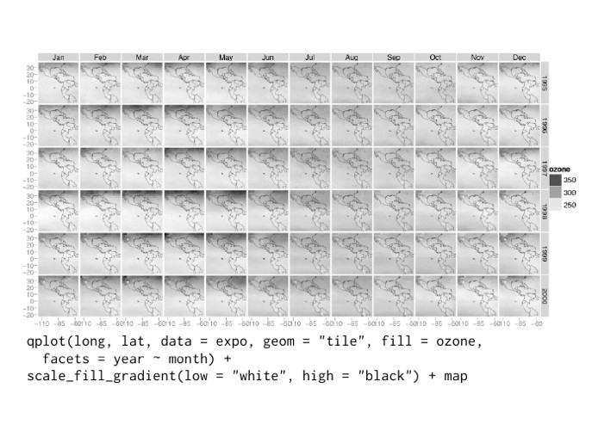

Slide 43
Chart Typologies
Excel, Many Eyes, Google Charts
Visual Analysis Grammars
VizQL, ggplot2
Visualization Grammars
Protovis, D3.js
Component Architectures
Prefuse, Flare, Improvise, VTK
Graphics APIs
Processing, OpenGL, Java2D
Ease-of-Use
Expressiveness

Slide 44
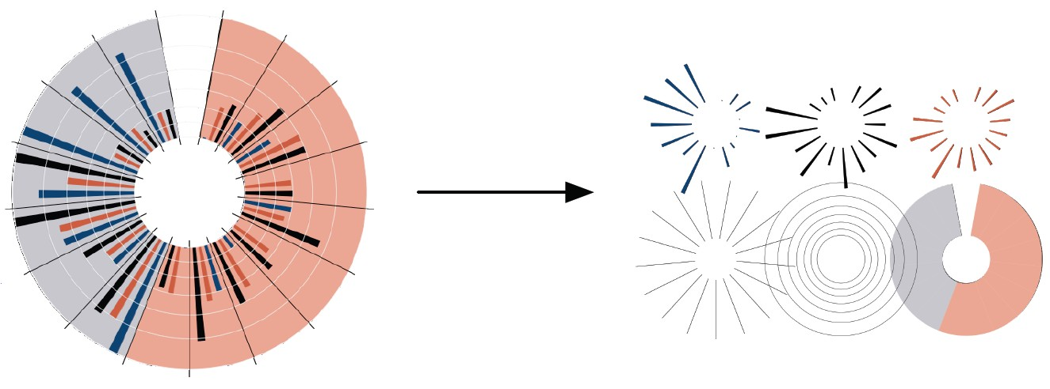
Protovis: A Grammar for Visualization
A graphic is a composition of data-representative marks.
Jeffrey Heer, Mike Bostock & Vadim Ogievetsky

Slide 45
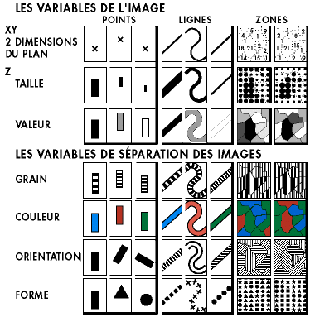
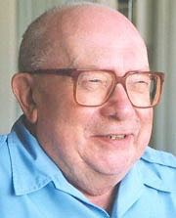
Visualization Grammar
Data Transforms Scales
Input data to visualize
Grouping, stats, projection, layout Map data values to visual values
Jacques Bertin
Sémiologie Graphique, 1967

Slide 46
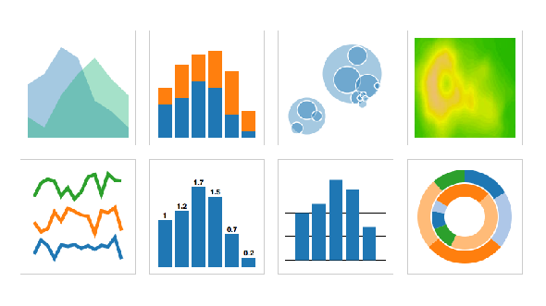








Visualization Grammar
Input data to visualize
Grouping, stats, projection, layout Map data values to visual values
Axes & legends visualize scales Data-representative graphics
Data Transforms Scales Guides Marks
Area | Rect | Symbol | Image
Line | Text | Rule | Arc

Slide 47
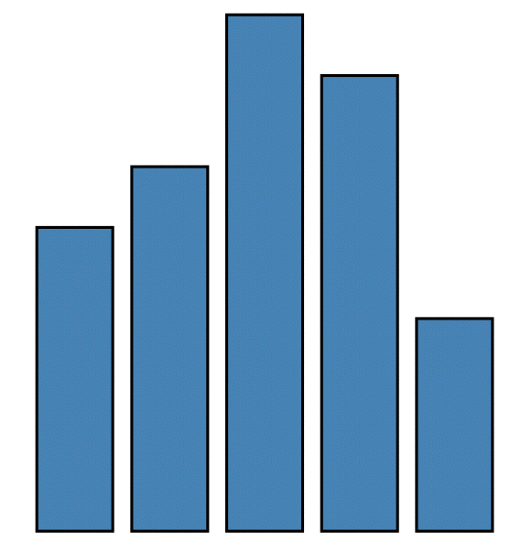
Properties of a “Mark”
RECT λ : D → R
data | 1 | 1.2 | 1.7 | 1.5 | 0.7
visible | true
left | 1 * 25
bottom | 0
width | 20
height | 1.2 * 80
fillStyle | blue
strokeStyle | black
lineWidth | 1.5
... | ...
var vis = new pv.Panel();
vis.add(pv.Bar)
.data([1, 1.2, 1.7, 1.5, 0.7])
.visible(true)
.left((d) => this.index * 25);
.bottom(0)
.width(20)
.height((d) => d * 80)
.fillStyle(“blue”)
.strokeStyle(“black”)
.lineWidth(1.5);
vis.render();

Slide 48
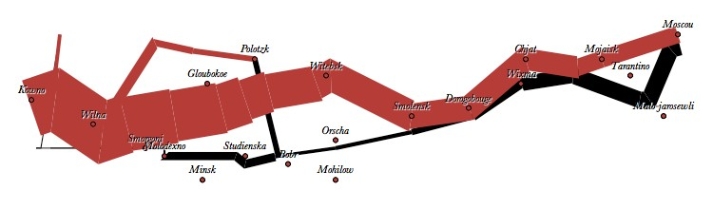

Minard 1869: Napoleon’s March, in ProtoViz
var army = pv.nest(napoleon.army, "dir", "group“); var vis = new pv.Panel();
vis.add(pv.Rule).data([0,-10,-20,-30])
.top((d) => 300 - 2*d - 0.5).left(200).right(150)
.lineWidth(1).strokeStyle("#ccc")
.anchor("right").add(pv.Label)
.font("italic 10px Georgia")
.text((d) => d+"°").textBaseline("center");
var lines = vis.add(pv.Panel).data(army);
lines.add(pv.Line)
.data(() => army[this.idx])
.left(lon).top(lat).size((d) => d.size/8000)
.strokeStyle(() => color[army[paneIndex][0].dir]);
vis.add(pv.Line).data(napoleon.temp)
.left(lon).top(tmp) .strokeStyle("#0")
.add(pv.Label)
.top((d) => 5 + tmp(d))
.text((d) => d.temp+"° "+d.date.substr(0,6))
vis.add(pv.Label).data(napoleon.cities)
.left(lon).top(lat)
.text((d) => d.city).font("italic 10px Georgia")
.textAlign("center").textBaseline("middle");

Slide 49
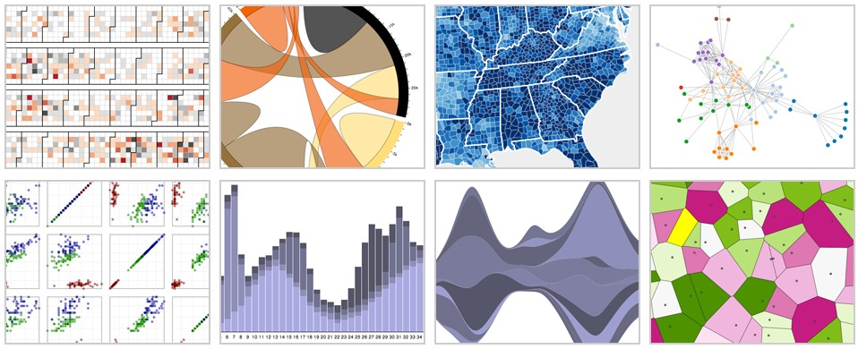
d3.js: Data-Driven Documents
Mike Bostock, Dominik Moritz, Vadim Ogievetsky, Jeff Heer, etc.

Slide 50
Protovis vs. D3
Protovis Specialized mark types
+ Streamlined design
Limits expressiveness
More overhead (slower)
Harder to debug
Self-contained model
Specify a scene (nouns)
+ Quick for static vis
Delayed evaluation
Animation, interaction are more cumbersome
D3 Bind data to DOM
Exposes SVG/CSS/…
+ Exposes SVG/CSS/…
+ Less overhead (faster)
+ Debug in browser
+ Use with other tools
Transform a scene (verbs)
More complex model
+ Immediate evaluation
+ Dynamic data, anim, and interaction natural

Slide 51
D3 Selections
The core abstraction in D3 is a selection.
// Add and configure an SVG element
var svg = d3.append(“svg”)
.attr(“width”, 500)
.attr(“height”, 300);
// Select & update existing rectangles contained in the SVG element
svg.selectAll(“rect”)
.attr(“width”, 100)
.style(“fill”, “steelblue”);
// add new SVG to page body
// set SVG width to 500px
// set SVG height to 300px
// select all SVG rectangles
// set rect widths to 100px
// set rect fill colors

Slide 52
Data Binding
Selections can bind data and DOM elements.
var values = [ {…}, {…}, {…}, … ]; // input data as JS objects
// Select SVG rectangles and bind them to data values.
var bars = svg.selectAll(“rect.bars”).data(values);
// What if the DOM elements don’t exist yet? The enter set represents data
// values that do not yet have matching DOM elements.
bars.enter().append(“rect”).attr(“class”, “bars”);
// What if data values are removed? The exit set is a selection of existing
// DOM elements who no longer have matching data values.
bars.exit().remove();

Slide 53
D3 Modules
Data Parsing / Formatting (JSON, CSV, …) Shape Helpers (arcs, curves, areas, symbols, …) Scale Transforms (linear, log, ordinal, …)
Color Spaces (RGB, HSL, LAB, …)
Animated Transitions (tweening, easing, …) Geographic Mapping (projections, clipping, …) Layout Algorithms (stack, pie, force, trees, …) Interactive Behaviors (brush, zoom, drag, …)

