Slide 1
Lecture 19:
Connecting to the Backend –
Web Services and Databases
05-431/631 Software Structures for User Interfaces (SSUI)
Fall, 2021

Slide 2
Logistics
Homework 5 due Saturday – extended deadline
Start on Homework 6 – last homework!
  Today will cover how to do hw6
  Deadline extended too!
Clara will run review session on Sunday at 1:00pm in NSH 3001 and Zoom (same room)
  See Canvas announcement
Will be news about final projects next week

Slide 3


Background
This is a front-end course
Pretty much all Web and Smartphone apps connect to a backend server
  As do many desktop applications
Modern “Web Services” make creating integrated (“full stack”) apps quite easy
Homework 6 asks you to use 2 different kinds:
  Web service for getting pictures
    Unsplash – conventional REST interface; free for small tasks
    No need for authentication, security, etc.
  Networked database for storing user-specific data
    We selected Google’s Firebase: NoSQL, object-oriented so easier to learn
    Also handles person authentication in an easy way

Slide 4
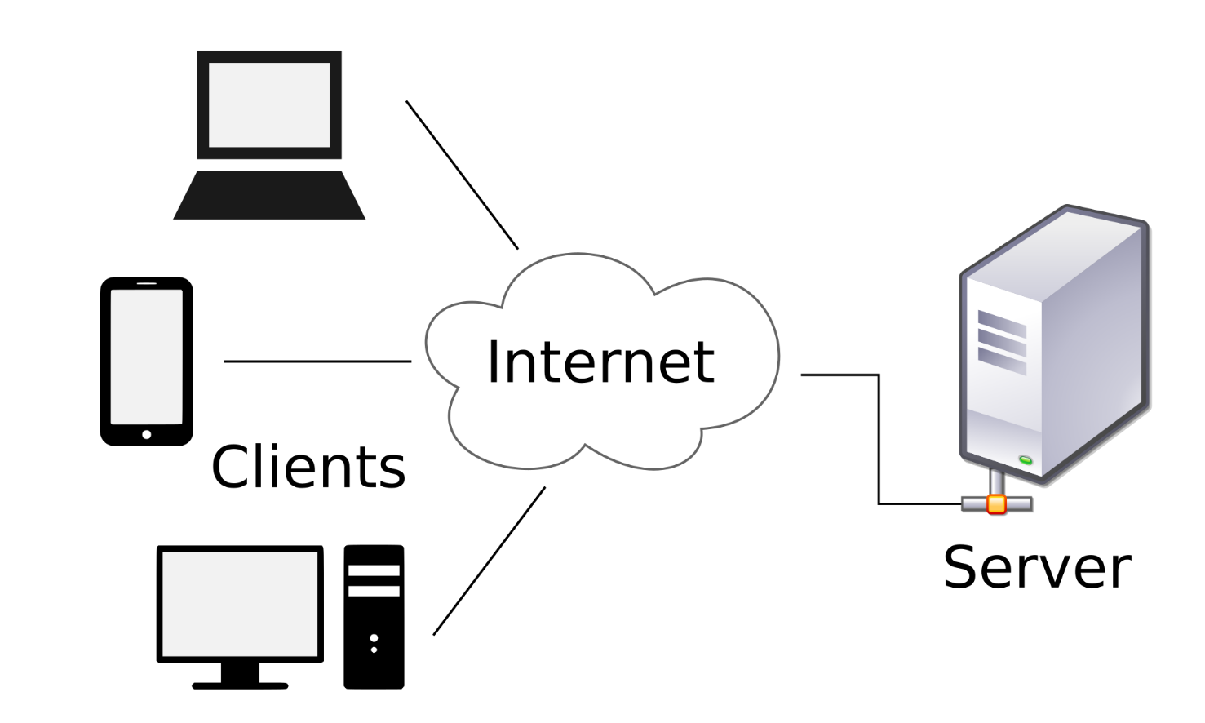
“Client Server Model”
Client = smaller computers, phones, devices (IoT)
Server = bigger computer, clusters
  Does the bigger tasks, stores the bigger data
  Manage sharing
Client-server model
dates from the
1960s
Many protocols
over the years

Slide 5
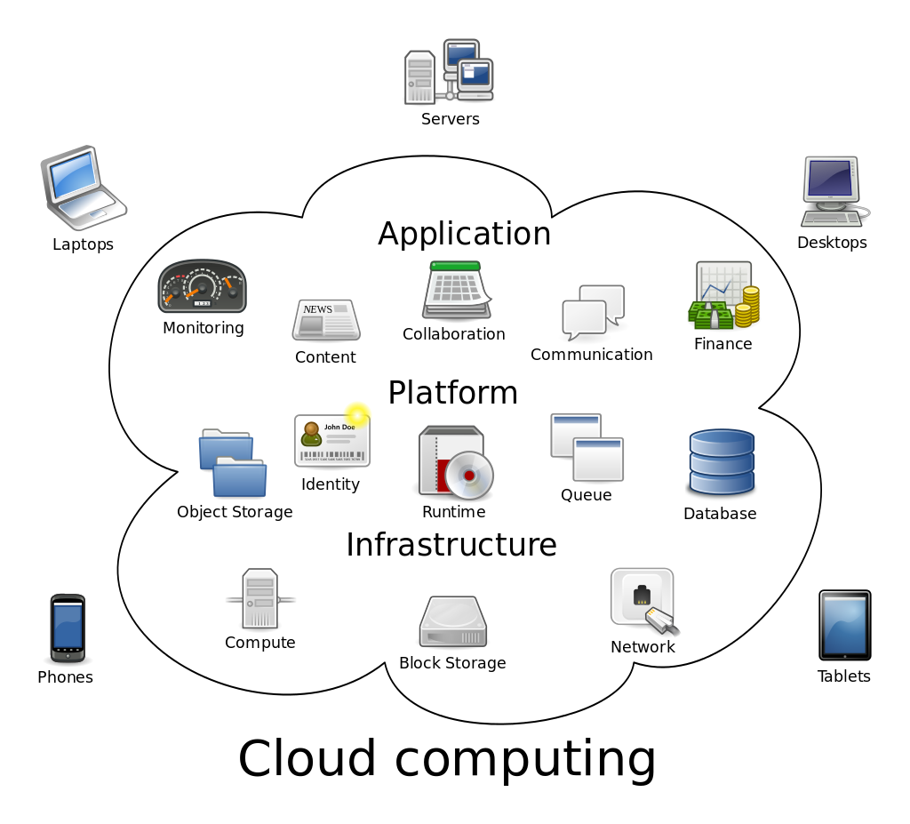
Cloud Computing
Amorphous cloud of networked elements
Don’t necessarily address a specific server
Not necessarily centrally managed
“Cloud Computing” term started to be used
around 2000
(Reminder, WWW
dates from 1990;
“Internet” term from the
1980s, but ARPAnet
from 1960s)

Slide 6
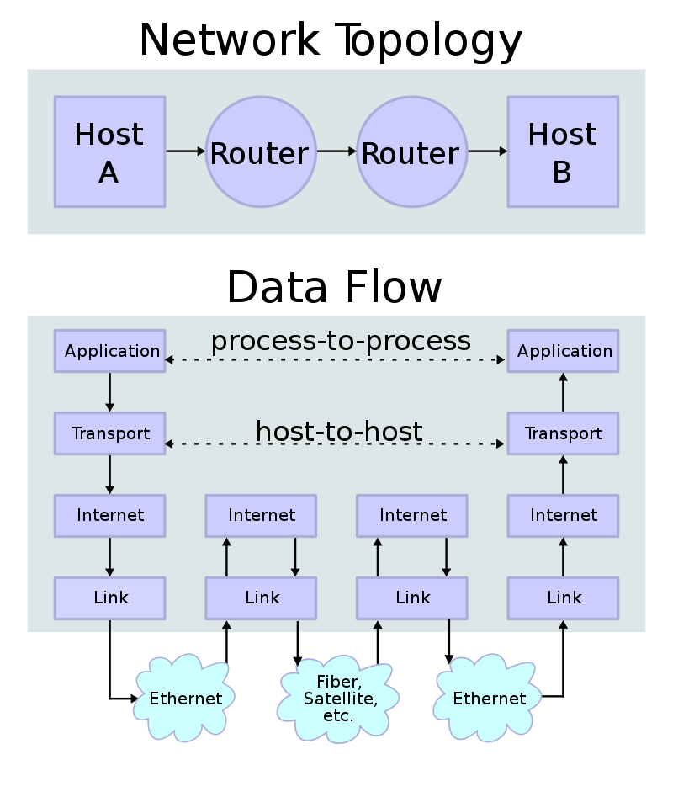
Important Protocols
(Assuming have not taken a
networking class!)
“Protocol” – rules to allow
communication
  For Internet, are worldwide standards
  Format of the messages
Multiple levels of protocols – build
higher ones using lower-level ones
TCP/IP - Transmission Control Protocol
and the Internet Protocol (IP) – how
packets are sent around the internet
  Handles naming of hosts (servers) – like cs.cmu.edu & IP numbers, like 128.2.42.95 (CMU)
  Routing of packets with retry if one is lost (not for video) – may have many hops
Headers say where each packet is going
Examples: Simple Mail Transfer Protocol (SMTP), SSH, FTP, Telnet, http

Slide 7

Web protocols
Hypertext Transfer Protocol (HTTP) & newer
HTTPS (secure)
  All transfers in plain text
Others built on top of http
SOAP - Simple Object Access Protocol
  Started around 1999 by Microsoft
  Data encoded in XML
  Had to describe the format of all messages using the on Web Services Description Language (WSDL)
    Specifies what specific fields and values are allowed
  Very complex and hard to use

Slide 8
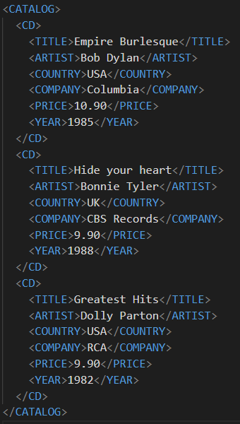
XML
Extensible Markup Language (XML)
Looks like html, but a little different
  Yet another syntax
Used as communication and storage format
Arrays are implicit (like html)

Slide 9
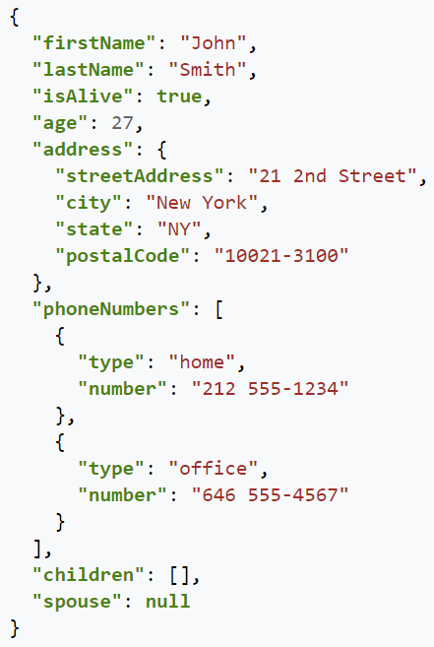
JSON
JavaScript Object Notation
Alternative to XML for saving and exchanging inurns formation
  Files and web services
Yet another syntax!
Similar, but not identical to
the other ones we have been using
Note that names must be quoted strings
Like JavaScript objects
Arrays using [ ]
Values can be JavaScript types or object or array
See SSUI-hw6/tempResults.json

Slide 10
REST
Representational state transfer (REST)
Created in 2000 by Roy Fielding in his PhD dissertation from UC Irvine
Very simple protocol, in contrast to SOAP
  Also more efficient
  Everyone uses this today
Encode commands and parameters in the URL
Simple commands: Post, Get, Put, Patch, Delete
Return values as HTML, XML, or JSON
Stateless so don’t have to worry about keeping track of thing – all supplied in each message
No need to specify what will be in the messages
RESTful APIs (web services) follow this format

Slide 11
Web Services
Lots of available web services
  Programmableweb.com lists over 24,000 public APIs
    E.g., 476 APIs for “credit cards” (down 3 from last year)
  Lots more available internally for companies
Companies redoing their proprietary client-server or “mainframe” APIs to have web-services so easier to access on their own phone & web apps
Many companies are monetizing their data assets as web services
  Sometimes just to “trusted partners”
  E.g., PNC bank + Insurance company adjusters

Slide 12
Using a RESTful Web Service
Example: Unsplash for Developers
Register as a developer
Note: DEMO mode is “50 requests per hour”
Accept the terms
Make an application
Scroll down to get your API Keys
  We are using “Access Key” from Unsplash
    Everyone should get their own – do not use mine!
  Will need to put this into every message (since stateless)
  How they make sure you are allowed to request pictures

Slide 13
Operations
Look like html requests
URL: https://api.unsplash.com/
Command (looks like a path), e.g: /search/photos
Then parameters and values for that command
  First one separated by ?, then by &
  Parameter order usually doesn’t matter
  Always have client_id (Access Key) as the API key
Example query:
https://api.unsplash.com/search/photos/?client_id=YOUR_ACCESS_KEY&page=1&query=lion&per_page=10
Return is a JSON file (or error)
  Pull out of it what you need
Remember: stateless, so have to send the information each time

Slide 14
Keeping the API Key safe
Your app uses the same access key for all users
Could theoretically just have it as a string in your JavaScript file
  But big security hole
  People can get it from your downloaded build
    Lets people write code that uses your app’s access for free
One alternative, keep in “environment”: see stackoverflow
  File called “.env” at top level, put in .env:
  REACT_APP_UNSPLASH_API_KEY=xxxxxxxxxxxxxxxxxxxxxxxxxxxxxxxx
  Then, your code can say:
const API_KEY = process.env.REACT_APP_UNSPLASH_API_KEY;
  Make sure .env is in .gitignore
  Doc = https://stackoverflow.com/a/57103663
Can also keep it in your Firebase database:
https://dev.to/remi/firebase-set-and-access-environment-variables-1gh8

Slide 15
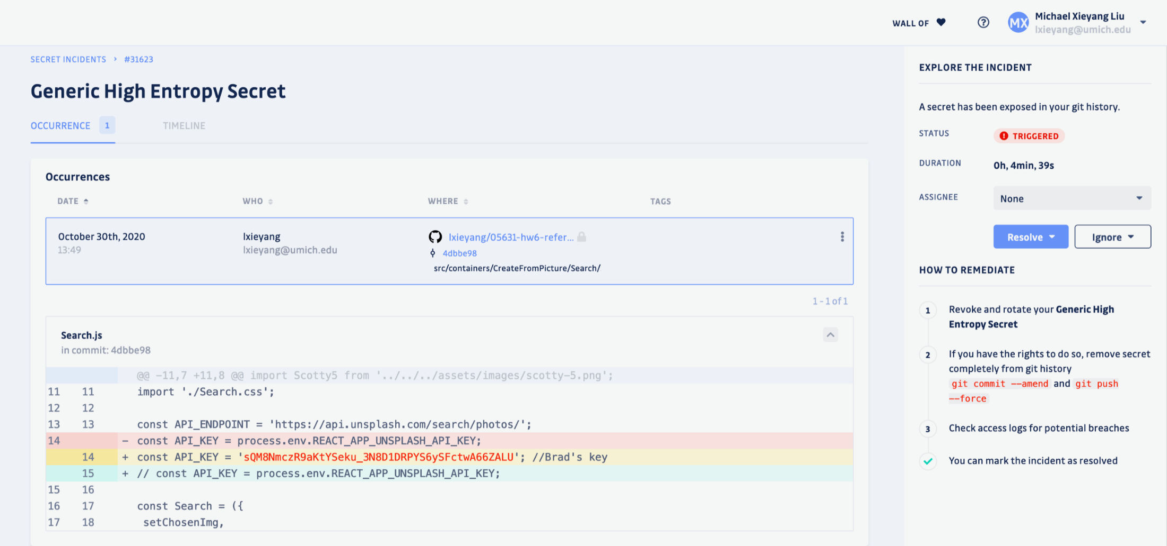
Warning from GitGuardian
“a secret has been exposed in the git history”:

Slide 16
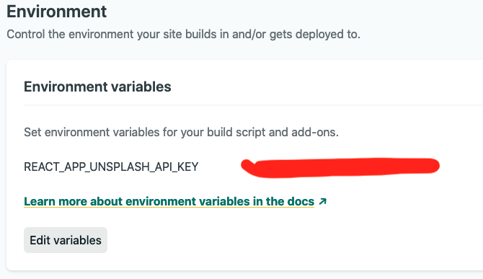
Environment variables
To set it up for netlify, under "Site settings" -> "Build & deploy" => "Environment" -> "Environment variables"

Slide 17
Sending/receiving the request
Sending the URL to a remote server and waiting for the results will take a noticeable time
  So need to use asynchronous features of JavaScript
  async, await, then
Built-in call: fetch(apiCall)returns a promise (so can avoid needing explicit async) – see documentation
  Call .then on the result to get the response and its data:
  fetch('http://example.com/movies.json')
  .then(response => response.json())
  .then(data => console.log(data));
Response is a “stream”; .json reads it all, returning another promise from which you can get the data as an object – see doc
  data has fields for all of the json fields
    E.g., for tempResults.json: data.total = 2390; data.total_pages = 239, data.results is an array with 10 elements
    Use .map to create element for each item, can use urls.small as image
Wrap everything in try-catch if network errors

Slide 18
Using a Library instead of Rest Calls
Most web services provide an SDK that helps construct the requests correctly and handle the results
  The unsplash JS library
  In this case, it is pretty easy to concatenate up the required request, so maybe the library isn’t needed?
  But you are welcome to use it

Slide 19

Use Cloud Storage
Database on a server (instead of on the client)
  Also handles user-login and authentication
  User can switch machines and still get to their data
We will use Firebase database provided by Firebase (Google) https://firebase.google.com/

Slide 20

Getting Started with Firebase
Go to https://firebase.google.com/, hit “Get Started” (log in with your typical Google account). Then “Create a Project”. Give your project a name. I’ll use “ssui-hw6”. BTW, don’t use Google Analytics.
Once a project is created, go ahead and add an app (web). I’ll name it “ssui-hw6”,
  No need for “hosting”
  hit register.
Will use the code displayed in a minute

Slide 21
Getting Started, cont.
Docs for web: https://firebase.google.com/docs/web/setup?authuser=0
Step 3,
  1. – use Node.js apps
    Follow these instructions
    No need to do npm init
  npm install --save firebase
  2. – use exactly what there – authentication and firestore
    Make a src/firestore folder, new file index.js there
    Put this code there at the top
  3. – use the config information from other page in that file too

Slide 22
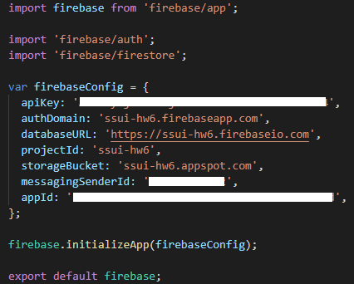
Finishing Setup
Resulting file will look like the following:

Slide 23
Authentication
“Continue to console”
Click on authentication
  Set up sign in method
  Select Google - third one
    Slide to “enable”
    Support email – login one is fine
    Save
Need to add “Authorized Domains”
  Need to add netlify as trusted domain
    Need the full name of the domain you are using in netlify: xxxx.netlify.app
Should be configured!

Slide 24
In the code
Create auth page route to get to from login button
  See: https://firebase.google.com/docs/auth/web/google-signin?authuser=0
  Skip 2,3,4
  Step 5
const handleLogIn = () => {
const provider = new firebase.auth.GoogleAuthProvider();
firebase
.auth()
.signInWithPopup(provider);
};
Now, set the user information:
  See:https://firebase.google.com/docs/auth/web/start?authuser=0#set_an_authentication_state_observer_and_get_user_data
  Put this code into app.js in componentDidMount()
  To set the user state variable: this.setState({ user });
Also need the this.unsubscribeAuthListener(); in componentWillUnmount()
Now, in auth.js
  Display login or logout based on whether user variable is set
    Use to logout: firebase.auth().signOut();
  user.displayName = user’s name
  user.photoURL = picture for login button – can do in an <img src=‘xxx’ > in navbar

Slide 25
Database Functions
Go to console; Click on app
Cloud Firestore
  Create Database
    Start in Test mode
    Location: default is fine
    Enable
Now it is ready to go
Can come back to here to see what is in the database

Slide 26
Using Firestore
Good documentation: https://firebase.google.com/docs/firestore
A Firestore database is consisted of a series of “collections” and “documents”.
  On-line debugging interface

Slide 27
In the Code
Should read the documentation first:
  https://firebase.google.com/docs/firestore?authuser=0
  Data model: https://firebase.google.com/docs/firestore/data-model?authuser=0
  Also: Add and Manage Data & Read data
One collection: e.g., ShoppingCartItems
  (Not supposed to have a bunch of collections)
  Contains a set of items, each with the fields

Slide 28
Adding items
Disable add to cart buttons based on user not logged in
Add to cart function will use
  Need user ID since per user: (assuming logged in) this.state.user.uid
  Update to deal with new kind of image shirts
For adding data: Add a document: https://firebase.google.com/docs/firestore/manage-data/add-data?authuser=0#add_a_document
  Use generated ID
let cartItemRef = firebase
.firestore()
.collection(“ShoppingCartItems”)
.doc();
cartItemRef.add(cartItem);

Slide 29
Query list of cart items for this user
Need a listener for cart change so will refresh automatically
Read data, listen to multiple items:
  https://firebase.google.com/docs/firestore/query-data/listen?authuser=0#listen_to_multiple_documents_in_a_collection
Foreach: collect the information you need from each item, including id
  Sort by created time so newest at top
    Can use array sort after query – lodash.com useful
    Simpler than orderBy in database – first time run, will generate an error, use the url of the error to create a database index (slow)

Slide 30
Updating and Removing items
Update doc: https://firebase.google.com/docs/firestore/manage-data/add-data?authuser=0#update-data
  E.g., for quantity change
Delete data in doc: https://firebase.google.com/docs/firestore/manage-data/delete-data?authuser=0
  Need the id
  .doc(id).delete()

Slide 31
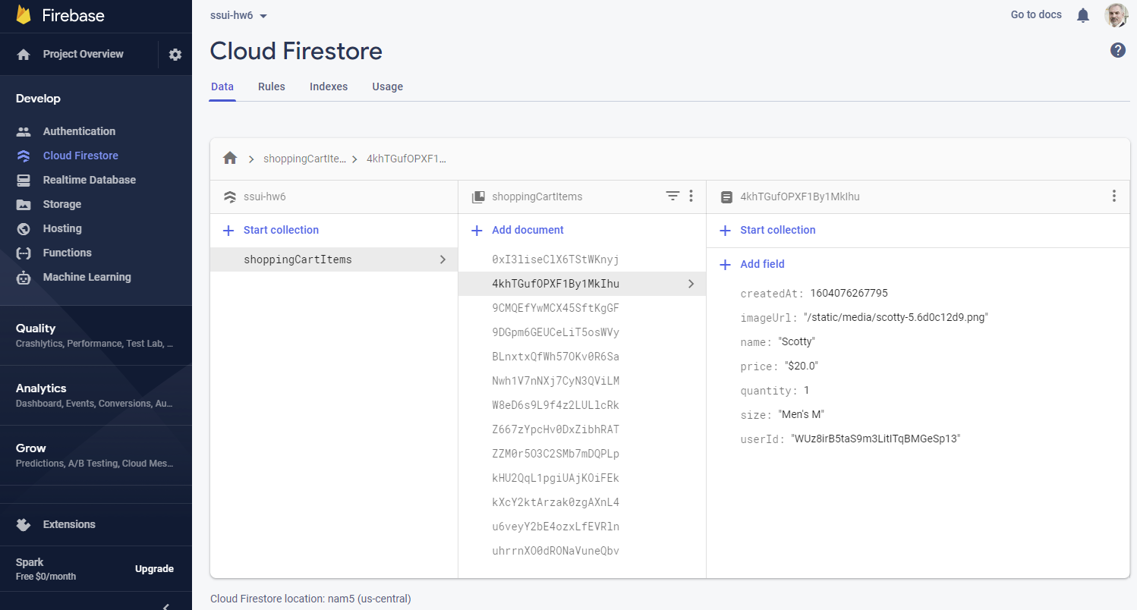
Debugging the Database
Can see items come and go from database
  Highlights changed items with orange
  Can also add/edit/remove items interactively
Available from Console / ssui-hw6 / “Cloud Firestore” (on left)

Slide 32
Creating your own backend
Doing Server-Side programming
Building and supplying your own web services
Sorry, not covered in this course
Resources: expressjs.com using node.js
  Popular library to support responding to requests
Jeff Eppinger’s fall course:
17-437/17-637: Web Application Development

