Slide 1
Lecture 17:
Constraints and Data Bindings, 1
05-431/631 Software Structures for User Interfaces (SSUI)
Fall, 2021

Slide 2

Happy Halloween!
Take some candies! ☺
  But don’t eat them here ☹

Slide 3
Logistics
Last lecture audio didn’t work at all ☹ – sorry!
  Let me know if you need it fixed.
Try narrow format for slides, so don’t have to worry about the video window

Slide 4
Constraints
Relationships defined once and maintained by the system
Useful for keeping parts of the graphics together.
Also for passing values around
Typically expressed as arithmetic or code relationships among variables.
  Variables are often the properties of objects (left, color)
Types:
  "Dataflow" constraints; Choices:
    Single-Output vs. Multi-output
    Types: One-way, Multi-way, Simultaneous equations, Incremental, Special purpose
    Cycles: supported or not
  Others: AI systems, scheduling systems, etc.

Slide 5
Historical Note: “Active Values”
Old Lisp systems had active values
  Attach procedures to be called when changed
Similar to today’s “Listeners” or “Observer pattern”
Like the “inverse” of constraints
  Procedures are attached to values which change instead of values where needed
  Push vs. Pull
Inefficient because all downstream values are re-evaluated, possibly many times
  E.g., when x and y values change

Slide 6
Important Historical
Constraint Systems
Alan Borning’s ThingLab (1979)
Spreadsheets (~1979)
Peridot (1987) (Myers)
Garnet & Amulet (1989, 1994) (Myers)
  Graphics and “data bindings”
DeltaBlue (1990) (Freemen-Benson)
  SkyBlue (1994) (Michael Sannella)
subarctic (Hudson) (1991)
Gleicher’s (1993)
…

Slide 7
Some Constraint Systems Today
Apple constraints for “Auto Layout”
Toolkit and windows “layout managers”/”geometry managers” (lecture 10)
“data bindings”
  Adobe Flex, AngularJS
Google’s AngularJS (before v2)
Most AutoDesk (CAD) products, e.g., Fusion 360 for 2D & geometric
Ember. http://emberjs.com/
  MVC, “Computed Values” of properties
KnockoutJS. http://knockoutjs.com/
  “Declarative Bindings”, “Dependency Tracking”
Research: Stephen Oney’s ConstraintJS https://from.so/ (2012)

Slide 8
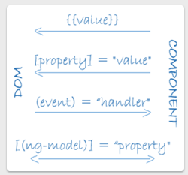
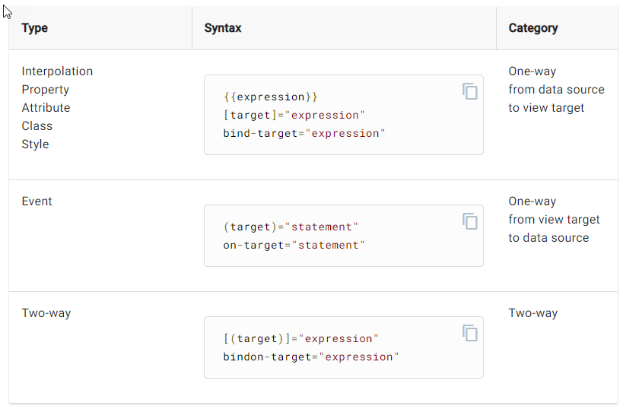
Angular Data Bindings
Tie DOM properties to other values
Can be one-way or two-way
  Use [] to bind from source to view.
  Use () to bind from view to source.
  Use [()] to bind
  in a two way
  sequence of
  view to source
  to view.
https://angular.io/guide/architecture-components#data-binding
https://angular.io/guide/binding-syntax

Slide 9
One Way Constraints
Simplest form of constraints
D = F(I1, I2, ... In)
Often called formulas since like spreadsheets
Can be other dependencies on D
CurrentSliderVal = mouse.X - scrollbar.left scrollbar.left = window.left + 200
scrollbar.visible = window.has_focus

Slide 10
Data flow graph
Nodes for variables (values) grouped into objects
Lines for data flow for the constraints
  Reverse direction of lines for “dependencies”
  E.g., A = B+5
    B’s value flows to A
    A’s value depends on B
Often need back-pointers too to clean up when change
A = 15
B = 10
A = 15
B = 10

Slide 11
One Way Constraints
CurrentSliderVal = mouse.X - scrollbar.left scrollbar.left = window.left + 200
scrollbar.visible = window.has_focus
CurrentSliderVal = f1() =17
scrollbar
…
Window
…
mouse
left = f3() = 250
left = 50
X = 267
top = 835
top = 5
Y = 840
visible = f2() = true
has_focus = true

Slide 12
One Way Constraints, cont.
Not just for numbers: mycolor = x.color
Implementations:
  1. Just re-evaluate all required equations every time a value is requested
    least storage, least overhead
    Equations may be re-evaluated many times when not changed. (e.g, scrollbar.left when mouse moves)
    cycles:
    file_position = F1(scrollbar.Val)
    scrollbar.Val = F2(file_position)
    Objects may jitter – change X and then change Y
    Cannot detect when values change (to optimize redraw)
2. More efficient algorithms next lecture

Slide 13
Garnet / Amulet
Constraint Solving
Default: one-way, data flow constraints with variables in the dependencies, support for cycles, and multiple changes before solving
  Efficient enough for ubiquitous use
  Garnet text button widget contained 43 constraints internally, and the Lapidary graphical interface builder contained 16,700 constraints
Also can bring in alternative solvers
  Brad Vander Zanden’s multi-way solver
  [Vander Zanden 1996]
  “Animation Constraints” [Myers 1996]
Snippets of video for Garnet and Amulet constraints

Slide 14
Garnet / Amulet Default Algorithm
D=f()=?
p = obj1
Variables in the dependencies
  Example: D = p^.left + A
  Important innovation in Garnet we
  invented, now ubiquitous
  Supports feedback objects
    outlineRect.left = selectedObject^.left …
    circle1.object_over = rect34
    circle1.left = self.object_over.right + 10
  Supports loops: D = Max(components^)
  Only evaluates needed part of conditionals
  width = if otherpart.value > tolerance
  then expensive computation
  else otherpart.width
  Requires the dependencies be dynamically determined
A = 15
obj1
obj2
left = 12
left = 22
top = 5
top = 15

Slide 15
Garnet / Amulet Default Algorithm
D=f()=27
p = obj1
Variables in the dependencies
  Example: D = p^.left + A
  Important innovation in Garnet we
  invented, now ubiquitous
  Supports feedback objects
    outlineRect.left = selectedObject^.left …
    circle1.object_over = rect34
    circle1.left = self.object_over.right + 10
  Supports loops: D = Max(components^)
  Only evaluates needed part of conditionals
  width = if otherpart.value > tolerance
  then expensive computation
  else otherpart.width
  Requires the dependencies be dynamically determined
A = 15
obj1
obj2
left = 12
left = 22
top = 5
top = 15

Slide 16
Garnet / Amulet Default Algorithm
D=f()=37
p = obj2
Variables in the dependencies
  Example: D = p^.left + A
  Important innovation in Garnet we
  invented, now ubiquitous
  Supports feedback objects
    outlineRect.left = selectedObject^.left …
    circle1.object_over = rect34
    circle1.left = self.object_over.right + 10
  Supports loops: D = Max(components^)
  Only evaluates needed part of conditionals
  width = if otherpart.value > tolerance
  then expensive computation
  else otherpart.width
  Requires the dependencies be dynamically determined
A = 15
obj1
obj2
left = 12
left = 22
top = 5
top = 15

Slide 17
Examples of Expressing Constraints
Garnet:
(create-instance NIL opal:line
(:points '(340 318 365 358))
(:grow-p T)
(:x1 (o-formula (first (gvl :points))))
(:y1 (o-formula (second (gvl :points))))
(:x2 (o-formula (third (gvl :points))))
(:y2 (o-formula (fourth (gvl :points)))))
Amulet:
Am_Define_Formula (int, height_of_layout) {
int h = (int)Am_Height_Of_Parts(self) + 2 * ((int)self.Get(Am_TOP_OFFSET));
return h < 75 ? 75 : h;
}
am_empty_dialog = Am_Window.Create("empty_dialog_window")
.Set (Am_LEFT_OFFSET, 5) // used in width_of_layout
.Set (Am_TOP_OFFSET, 5) // used in height_of_layout
.Set (Am_WIDTH, width_of_layout)
.Set (Am_HEIGHT, height_of_layout)
...

Slide 18
Other One-Way Variations
Multiple outputs
  (D1, D2, ... Dm) = F(I1, I2, ... In)
Side-effects in the formulas
  useful for creating objects
  when happen?
  what if create new objects with new constraints
  cycles cannot be detected
Constant formula elimination
  To decrease the size used by constraints

Slide 19
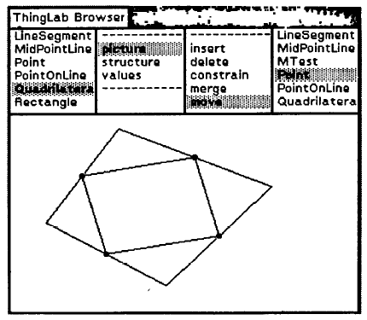
Two-Way (Multi-way) Constraints
From ThingLab (~1979)
  Alan Borning. “Defining Constraints Graphically,” Human Factors in Computing Systems. Boston, MA, Apr, 1986. pp. 137-143. Proceedings SIGCHI'86.
Constraints are expressions with multiple variables
Any may be modified to get the right values
Example: A.right = A.left + A.width - 1
Often requires programmer
to provide methods for
solving the constraint in
each direction:
A.left = A.right - A.width + 1
A.width = A.right - A.left + 1
Useful if mouse expressed
as a constraint

Slide 20
Two-Way implementations
Requires a planning step to decide which way to solve
  Many systems compute plans and save them around since usually change same variable repeatedly
In general, have a graph of dependencies, find a path through the graph
How control which direction is solved?
CurrentSliderVal = mouseX - scrollbar.left
  "Constraint hierarchies" = priorities
    constants, interaction use "stay" constraints with high priority
  Dynamically add and remove constraints
Brad Vander Zanden's "QuickPlan" solver
  Handles multi-output, multi-way cyclic constraints in O(n²) time instead of exponential like previous algorithms

Slide 21
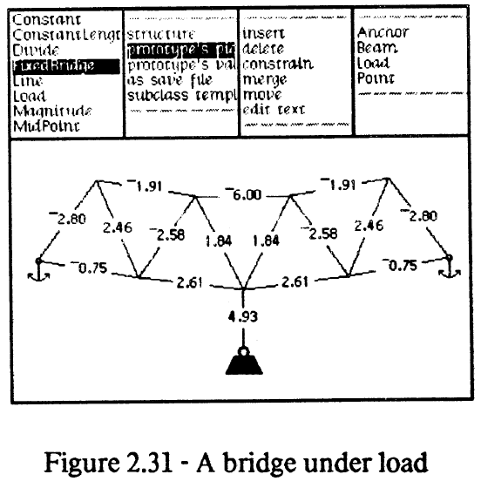
Simultaneous Equations
Required for parallel, perpendicular lines; tangency, etc.
Also for aggregate's size
Numerical (relaxation)
or symbolic techniques
  Thinglab bridge (1979)
  (cite)

Slide 22
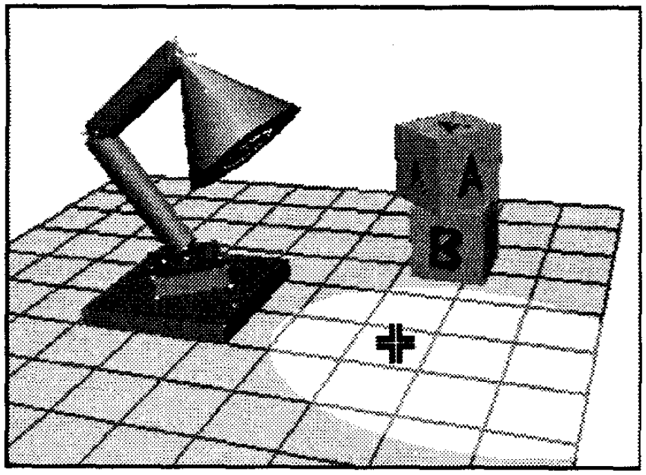
Incremental
Michael Gleicher's PhD thesis, 1994
Only express forward computations
Tries to get reverse by incrementally changing the forward computation in the right direction using
derivatives.
Supports interactions
otherwise not possible
Produces smooth
animations

Slide 23
Animation Constraints in Amulet
Implemented using Amulet's constraint mechanism
When slot set with a new value, restores old value, and animates from old to new value
Usually, linear interpolation
For colors, through either HSV or RGB space
For visibility, various special effects between TRUE and FALSE
Demo

